Slide 1
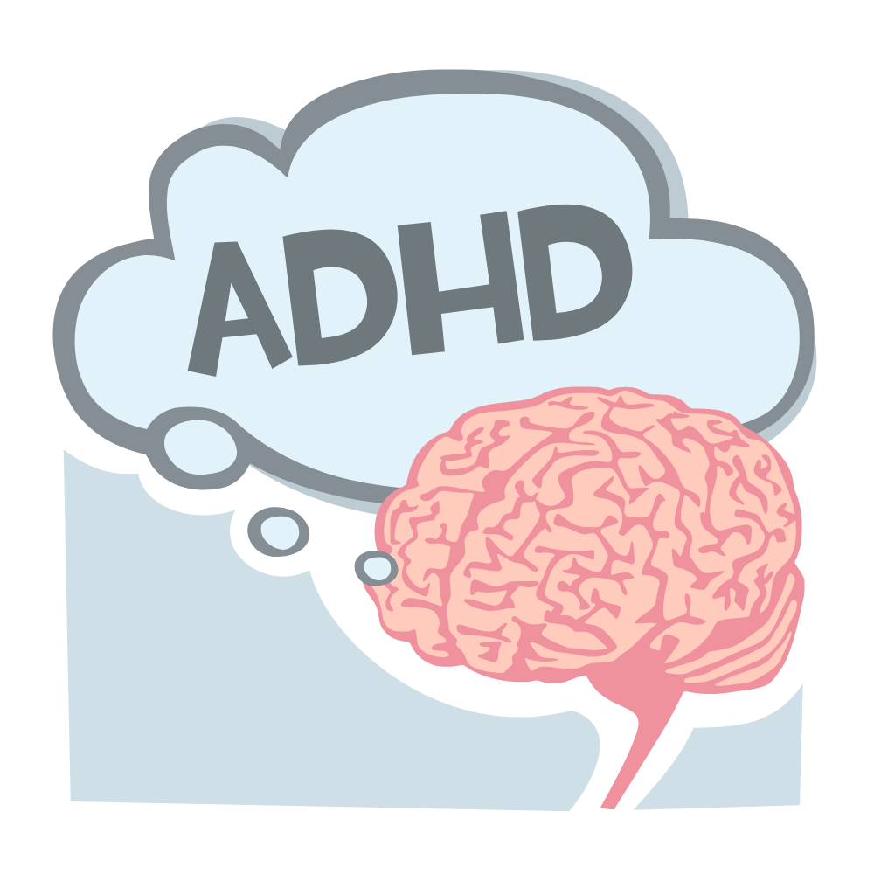
Maximizing Teaching for Student Success
Mary Dixson, PhD
Professor of Instruction
The University of Texas at San Antonio

Slide 2
What we'll discuss
What is it and who is affected
How it changes learning
How we increase student success

Slide 3
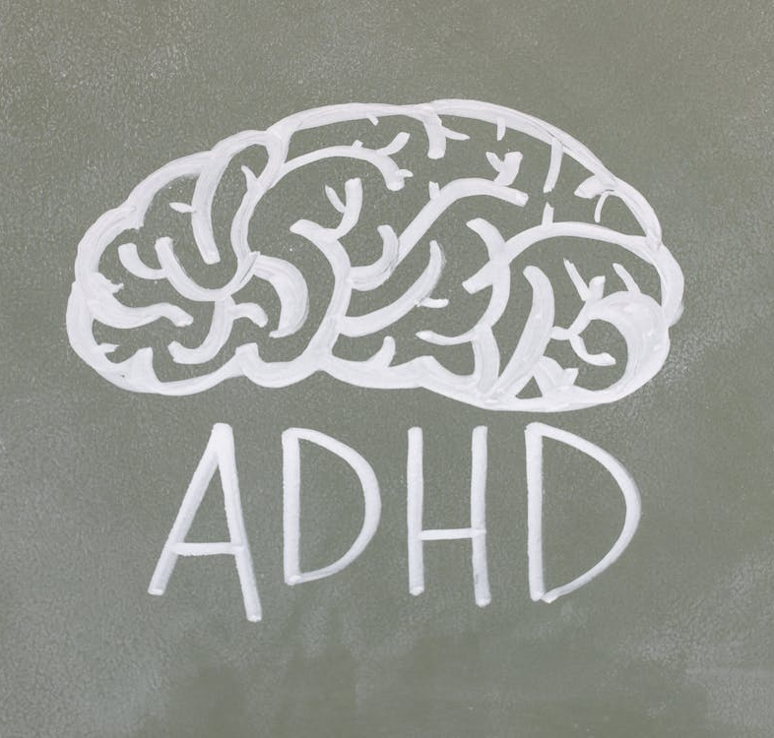
What Is

Slide 4
Attention Deficit... Hey Donuts!
This Photo by Unknown author is licensed under CC BY-NC.

Slide 5
Attention Deficit Hyperactivity Disorder

Slide 6
Physical Differences

Slide 7
Different Brains
Lower level of dopamine transporters
Different folds in the brain
Less tissue in prefrontal & temporal lobes
Reduction in total brain volumes
Notes:
https://www.sciencenewsforstudents.org/article/brain-signals-attention-disorder
Proal, E., Reiss, P. T., Klein, R. G., Mannuzza, S., Gotimer, K., Ramos-Olazagasti, M. A., Lerch, J. P., He, Y., Zijdenbos, A., Kelly, C., Milham, M. P., & Castellanos, F. X. (2011). Brain gray matter deficits at 33-year follow-up in adults with attention-deficit/hyperactivity disorder established in childhood. Archives of general psychiatry, 68(11), 1122–1134. https://doi.org/10.1001/archgenpsychiatry.2011.117

Slide 8
Affected Regions
Control attention
Regulate emotion
Control Motivation
Notes:
https://www.sciencenewsforstudents.org/article/brain-signals-attention-disorder
Proal, E., Reiss, P. T., Klein, R. G., Mannuzza, S., Gotimer, K., Ramos-Olazagasti, M. A., Lerch, J. P., He, Y., Zijdenbos, A., Kelly, C., Milham, M. P., & Castellanos, F. X. (2011). Brain gray matter deficits at 33-year follow-up in adults with attention-deficit/hyperactivity disorder established in childhood. Archives of general psychiatry, 68(11), 1122–1134. https://doi.org/10.1001/archgenpsychiatry.2011.117

Slide 9
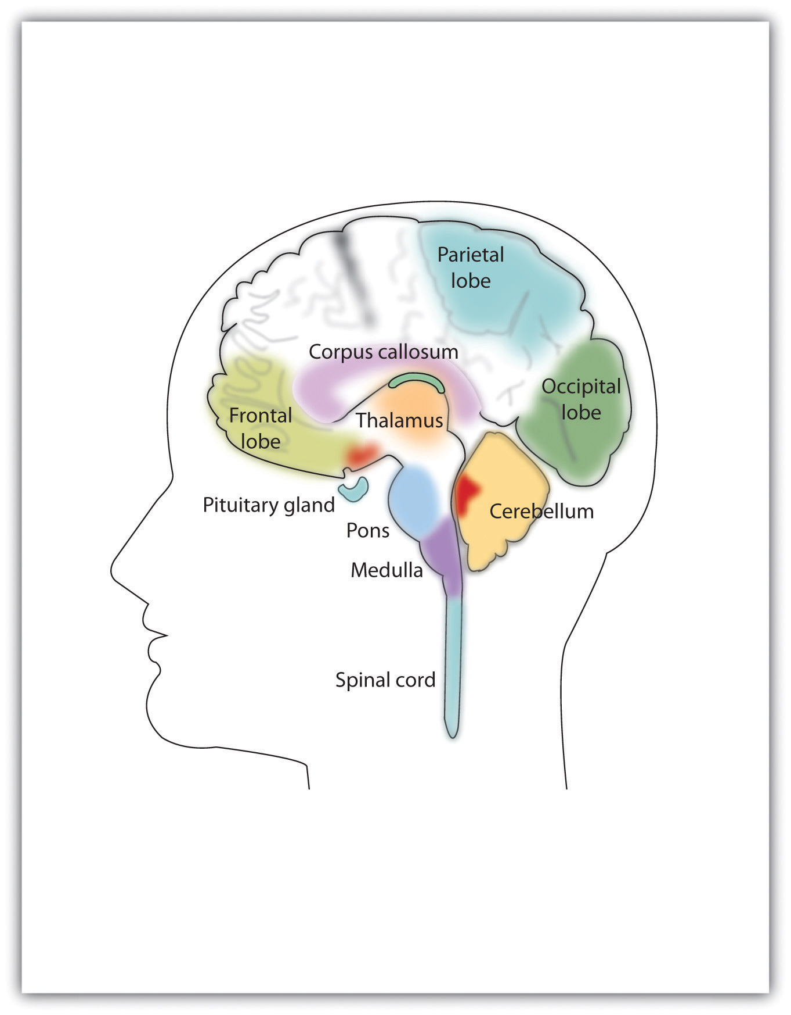
ADHD Affects
Brain structure
Brain function
Brain development
This Photo by Unknown author is licensed under CC BY-SA-NC.

Slide 10
9-14% of Kids Aged 3-17
This Photo by Unknown author is licensed under CC BY.
Notes:
Benjamin Zablotsky, Ph.D., and Josephine M. Alford, M.S. (2020) Racial and Ethnic Differences in the Prevalence of Attention-deficit/Hyperactivity Disorder and Learning Disabilities Among U.S. Children Aged 3–17 Years. NCHS Data Brief No. 358, March 2020

Slide 11
Diagnosis Rates Differ by
Race
Parental education
Poverty level
This Photo by Unknown author is licensed under CC BY-SA-NC.
Notes:
Benjamin Zablotsky, Ph.D., and Josephine M. Alford, M.S. (2020) Racial and Ethnic Differences in the Prevalence of Attention-deficit/Hyperactivity Disorder and Learning Disabilities Among U.S. Children Aged 3–17 Years. NCHS Data Brief No. 358, March 2020

Slide 12
3-10 year-olds
11-17 year-olds
19.7%
21.6%
18.1%
14.2%
12.8%
10.1%
10.1%
10.1%
Total
Non-Hispanic White
Non-Hispanic Black
Hispanic
Zablotsky and Alford 2020
Notes:
Benjamin Zablotsky, Ph.D., and Josephine M. Alford, M.S. (2020) Racial and Ethnic Differences in the Prevalence of Attention-deficit/Hyperactivity Disorder and Learning Disabilities Among U.S. Children Aged 3–17 Years. NCHS Data Brief No. 358, March 2020

Slide 13
How it changes learning
This Photo by Unknown author is licensed under CC BY-ND.

Slide 14
Poor Executive Functions
Self-Control
Self-Monitor
Emotional Control
Flexibility
Task Initiation& Completion
Organization
Working Memory
Planning & Time Management

Slide 15
Challenges
Remembering assignments
Memorizing facts
Complex math
Self-esteem
Time management
Sitting still
Notes:
https://www.additudemag.com/college-students-and-adhd-improving-outcomes/#:~:text=College%20students%20with%20ADHD%20face,often%20lead%20to%20adverse%20outcomes.

Slide 16
Comorbidities
Dysgraphia - Writing
Dyscalculia - Math
Dyslexia - Reading
Anxiety – Mental Health

Slide 17
Medications

Slide 18
ADHD in College

Slide 19
College is a perfect storm
This Photo by Unknown author is licensed under CC BY-SA.

Slide 20
executive function required
parental involvement
This Photo by Unknown author is licensed under CC BY-SA.

Slide 21
ADHD Students
Significantly lower GPAs
Use Fewer Study Skills Strategies
Less confident
This Photo by Unknown author is licensed under CC BY.
Notes:
DuPaul GJ, Gormley MJ, Anastopoulos AD, Weyandt LL, Labban J, Sass AJ, Busch CZ, Franklin MK, Postler KB. Academic Trajectories of College Students with and without ADHD: Predictors of Four-Year Outcomes. J Clin Child Adolesc Psychol. 2021 Feb 2:1-16. doi: 10.1080/15374416.2020.1867990. Epub ahead of print. PMID: 33529049. https://pubmed.ncbi.nlm.nih.gov/33529049/

Slide 22
ADHD Students
Need multiple readings
Difficulty on timed items
Work harder for same grade
This Photo by Unknown author is licensed under CC BY.
Notes:
DuPaul GJ, Gormley MJ, Anastopoulos AD, Weyandt LL, Labban J, Sass AJ, Busch CZ, Franklin MK, Postler KB. Academic Trajectories of College Students with and without ADHD: Predictors of Four-Year Outcomes. J Clin Child Adolesc Psychol. 2021 Feb 2:1-16. doi: 10.1080/15374416.2020.1867990. Epub ahead of print. PMID: 33529049. https://pubmed.ncbi.nlm.nih.gov/33529049/

Slide 23
What are some things in our classes that might be hard for ADHD students
This Photo by Unknown author is licensed under CC BY.

Slide 24
My List
Timed Exams
Deadlines
Textbook readings
Groupwork
Memorizing
Long lectures

Slide 25
Teaching
This Photo by Unknown author is licensed under CC BY.

Slide 26
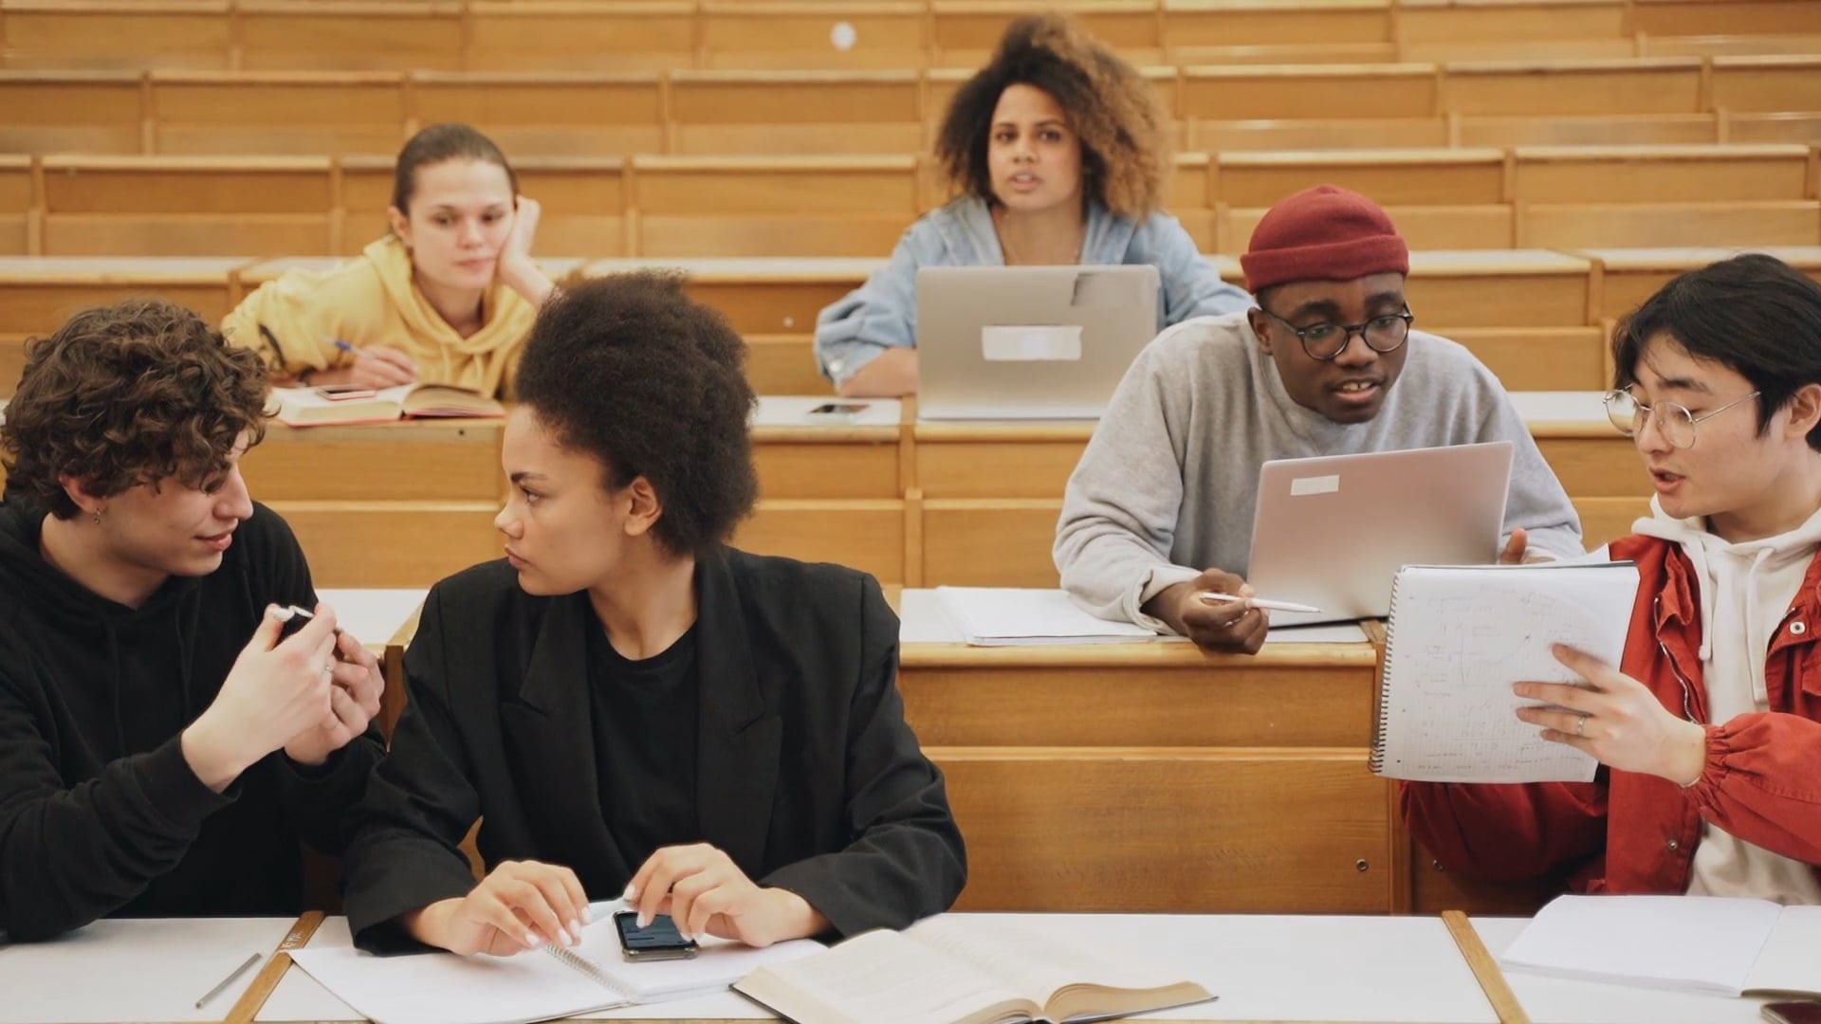
Accommodations

Slide 27
Required Under Americans with Disabilities Act (ADA)

Slide 28
Common Accommodations
Breaks and Extended Time for Exams
Reduced-distraction sites for exams
Laptop, spellchecker, calculator
Note-taking accommodations
Notes:
https://www.additudemag.com/college-accommodations-for-adhd-faq/

Slide 29
Accommodated students achieve higher grades
Notes:
DuPaul GJ, Gormley MJ, Anastopoulos AD, Weyandt LL, Labban J, Sass AJ, Busch CZ, Franklin MK, Postler KB. Academic Trajectories of College Students with and without ADHD: Predictors of Four-Year Outcomes. J Clin Child Adolesc Psychol. 2021 Feb 2:1-16. doi: 10.1080/15374416.2020.1867990. Epub ahead of print. PMID: 33529049. https://pubmed.ncbi.nlm.nih.gov/33529049/

Slide 30
Accommodations Aren't Enough
This Photo by Unknown author is licensed under CC BY-NC-ND.

Slide 31
This Photo by Unknown author is licensed under CC BY.
This Photo by Unknown author is licensed under CC BY.
In Class
Out of Class

Slide 32
In Class
This Photo by Unknown author is licensed under CC BY.

Slide 33
Lecture
This Photo by Unknown author is licensed under CC BY.

Slide 34
Chunk Lectures
Add movement
Add activities
Review guided notes

Slide 35
Use Active Learning
Application Exercises
Connect Material to Assignments
Engage Problem Solving
Explore Relevance

Slide 36
Out of Class
This Photo by Unknown author is licensed under CC BY.

Slide 37
Assignments
This Photo by Unknown author is licensed under CC BY-SA.

Slide 38
Stack Assignments
Multiple Stages
Bite Size Chunks
Cadence of Accountability

Slide 39
Study Skills Support

Slide 40
Send Due Date Reminders

Slide 41
Connect to Resources
This Photo by Unknown author is licensed under CC BY.

Slide 42
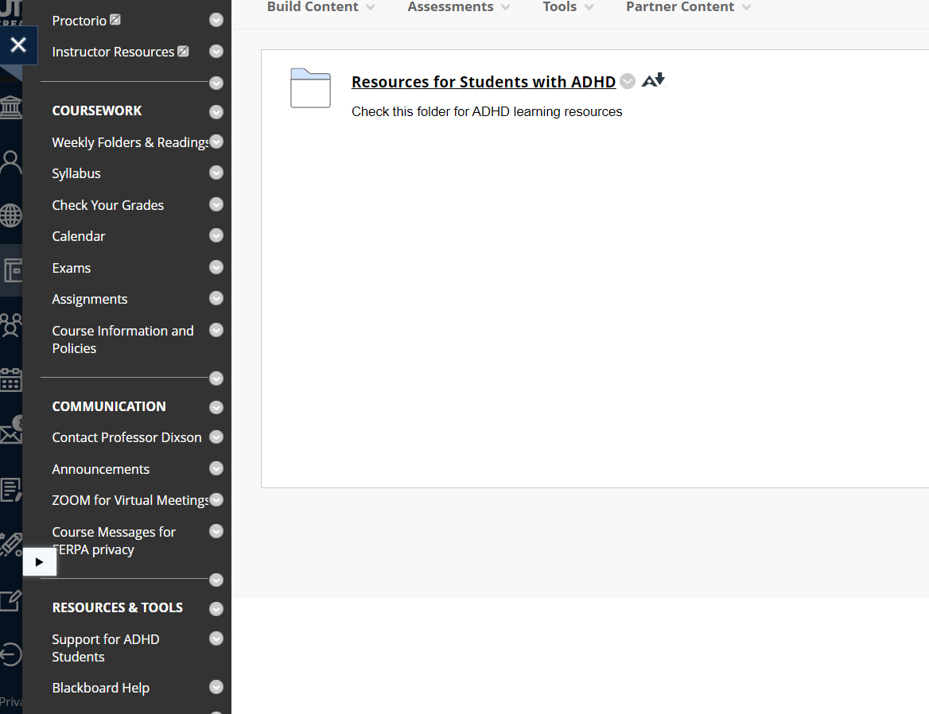

Slide 43
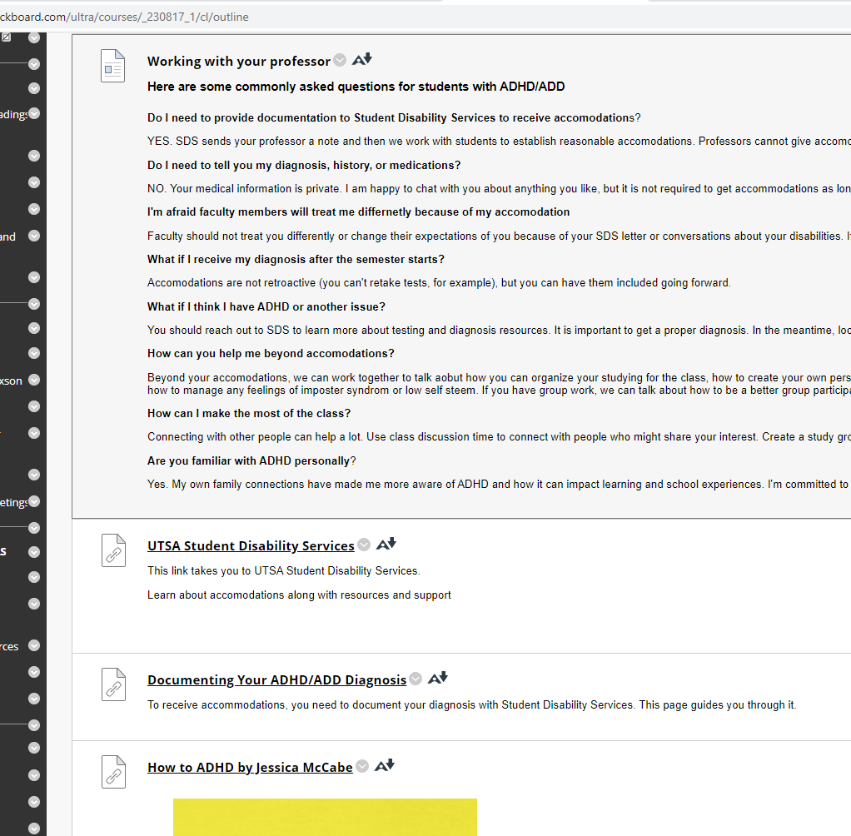
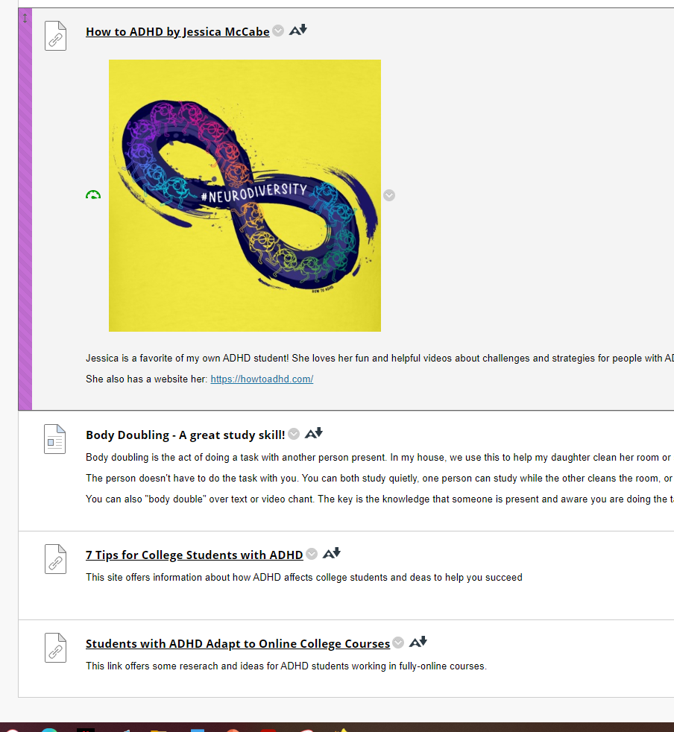

Slide 44
https://marydixson.godaddysites.com/adhd-resources

Slide 45
Remove Shame and Fear
This Photo by Unknown author is licensed under CC BY.

Slide 46
Use of Mental Health Resources
Management of depression and anxiety
Increase self esteem
This Photo by Unknown author is licensed under CC BY.

Slide 47
What we'll discuss
What is it and who is affected
How it changes learning
How we increase student success

Slide 48
Sources
https://www.addrc.org/adhd-numbers-facts-statistics-and-you/
Benjamin Zablotsky, Ph.D., and Josephine M. Alford, M.S. (2020) Racial and Ethnic Differences in the Prevalence of Attention-deficit/Hyperactivity Disorder and Learning Disabilities Among U.S. Children Aged 3–17 Years. NCHS Data Brief No. 358, March 2020
Kimberly Holland and Elsbeth Riley | Illustrations by Tony Bueno Medically Reviewed by George T. Krucik, MD, MBA on September 4, 2014
https://www.sciencenewsforstudents.org/article/brain-signals-attention-disorder
Proal, E., Reiss, P. T., Klein, R. G., Mannuzza, S., Gotimer, K., Ramos-Olazagasti, M. A., Lerch, J. P., He, Y., Zijdenbos, A., Kelly, C., Milham, M. P., & Castellanos, F. X. (2011). Brain gray matter deficits at 33-year follow-up in adults with attention-deficit/hyperactivity disorder established in childhood. Archives of general psychiatry, 68(11), 1122–1134. https://doi.org/10.1001/archgenpsychiatry.2011.117
DuPaul GJ, Gormley MJ, Anastopoulos AD, Weyandt LL, Labban J, Sass AJ, Busch CZ, Franklin MK, Postler KB. Academic Trajectories of College Students with and without ADHD: Predictors of Four-Year Outcomes. J Clin Child Adolesc Psychol. 2021 Feb 2:1-16. doi: 10.1080/15374416.2020.1867990. Epub ahead of print. PMID: 33529049. https://pubmed.ncbi.nlm.nih.gov/33529049/
https://www.additudemag.com/college-accommodations-for-adhd-faq/
DuPaul GJ, Gormley MJ, Anastopoulos AD, Weyandt LL, Labban J, Sass AJ, Busch CZ, Franklin MK, Postler KB. Academic Trajectories of College Students with and without ADHD: Predictors of Four-Year Outcomes. J Clin Child Adolesc Psychol. 2021 Feb 2:1-16. doi: 10.1080/15374416.2020.1867990. Epub ahead of print. PMID: 33529049. https://pubmed.ncbi.nlm.nih.gov/33529049/
Green AL, Rabiner DL. What do we really know about ADHD in college students? Neurotherapeutics. 2012 Jul;9(3):559-68. doi: 10.1007/s13311-012-0127-8. PMID: 22678459; PMCID: PMC3441934.

