Slide 1
Ways to Protect Soil and Water on Farms
By Anne Skinner
Cowan Museum of History and Science

Slide 2
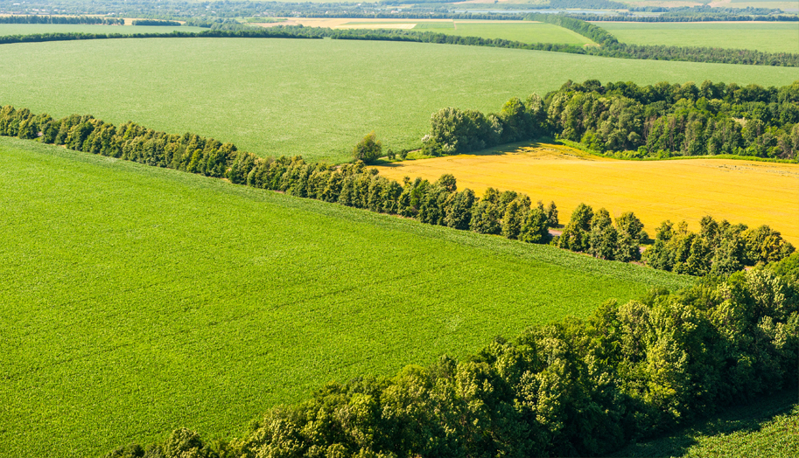
Use windbreaks – a line of trees at the edge of a field that slows down the wind, so it won’t blow away soil.
https://www.qcsupply.com/blog/product-tips-and-how-tos/guide-to-planting-a-windbreak.html

Slide 3
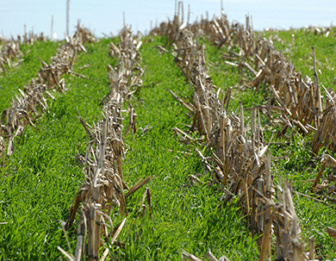
Plant cover crops instead of leaving the ground bare after harvest.
https://www.extension.iastate.edu/news/cover-crops-reduce-loss-nitrogen-and-phosphorus-waterways

Slide 4
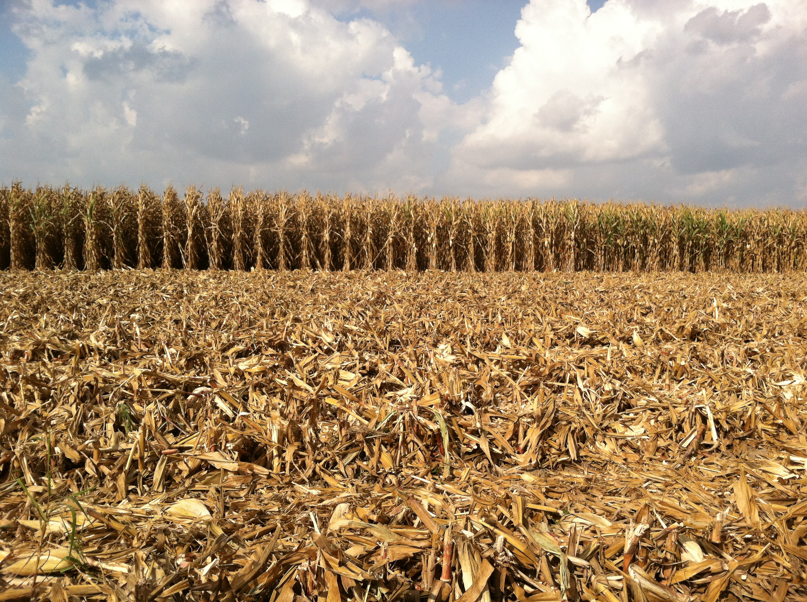
Leave parts of crops we don’t use, like corn stalks, on the ground to protect the soil after harvest.
https://www.no-tillfarmer.com/articles/4304-webinar-managing-crop-residue-decomposition-turning-trash-into-a-treasure?v=preview

Slide 5
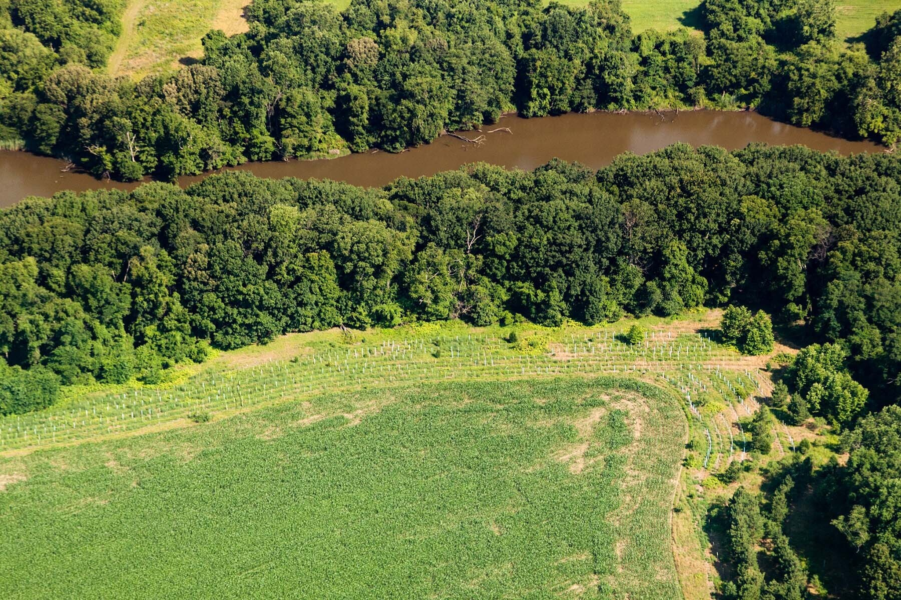
Leave some trees, shrubs, and other plants next to streams to stop soil from washing into the water when it rains.
https://www.chesapeakebay.net/images/issues/06.17_buffers_issues_image.jpg

Slide 6
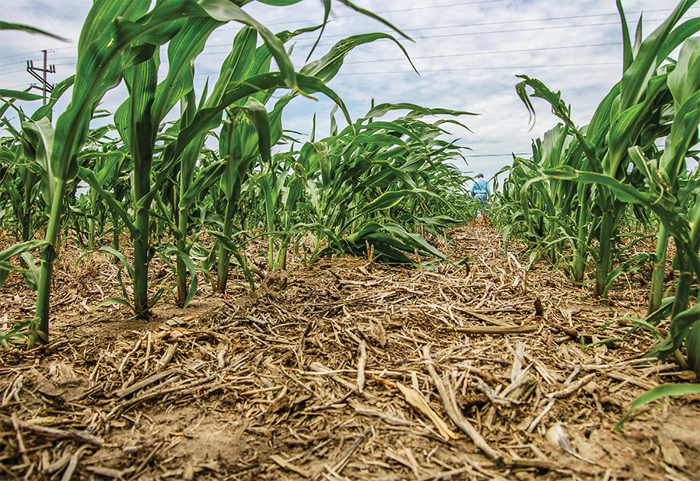
Plow or till soil less so it doesn’t form a hard crust or ruin the soil’s structure.
https://www.no-tillfarmer.com/articles/489-no-till-movement-in-us-continues-to-grow?v=preview

Slide 7
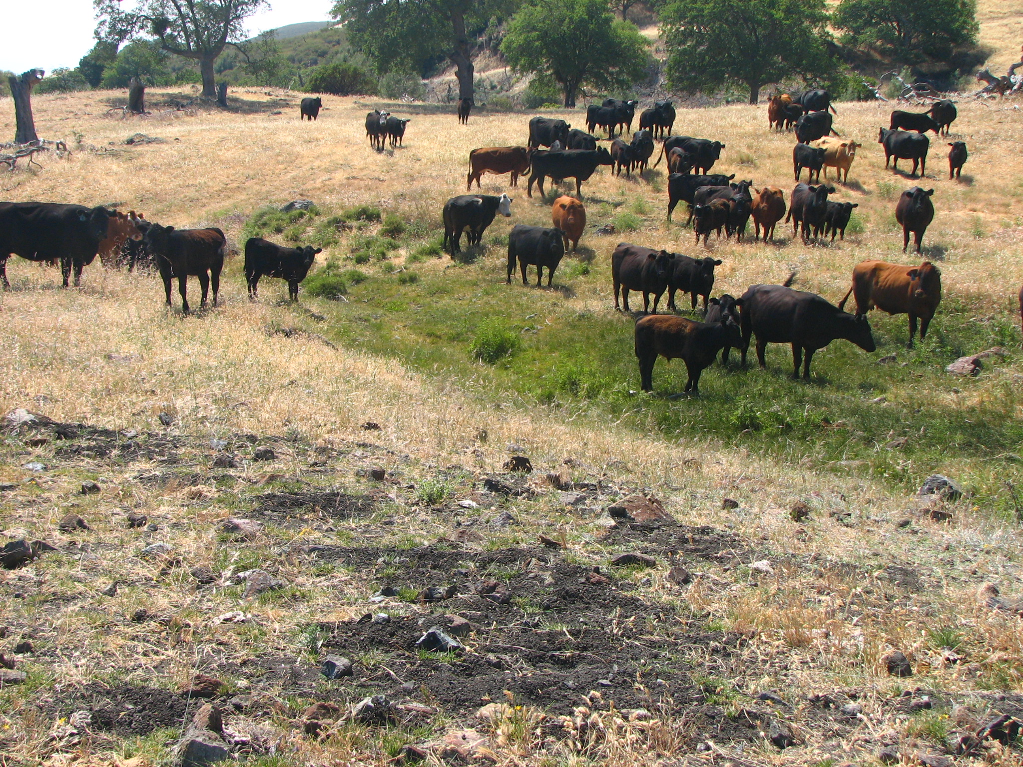
Don’t let cows eat all the grass and leave the ground bare.
https://lpfw.org/our-work/ending-resource-abuse/overgrazing/

Slide 8
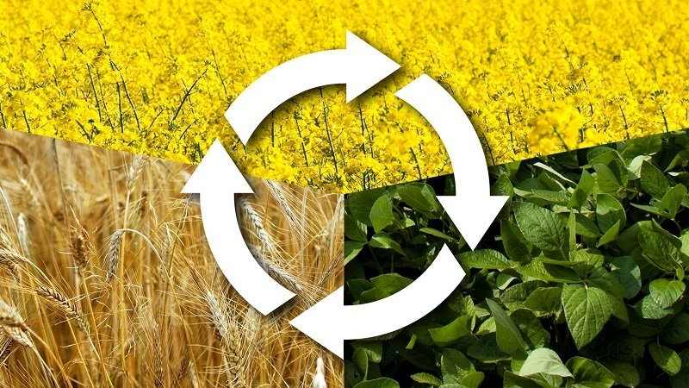
Rotate crops. For example, grow corn one season, then soybeans, and then wheat. Corn takes nitrogen out of the soil. Soybeans put nitrogen back in. Nitrogen is a nutrient that helps plants grow.
https://toptillers.com/crop-rotation/

Slide 9
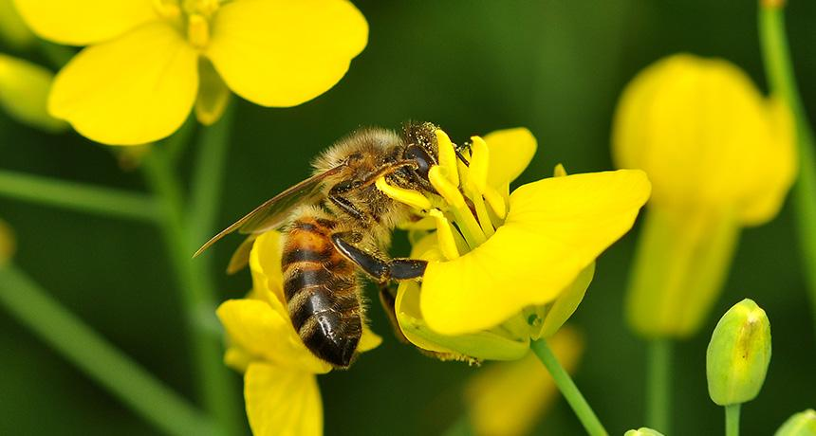
Protect insects like bees that pollinate flowers by avoiding or using less chemicals that harm them. Some pesticides kill pollinators and microbes (tiny living things) that make soil healthy.
https://www.sciencenewsforstudents.org/article/pesticides-offer-bees-risky-allure

