Slide 1
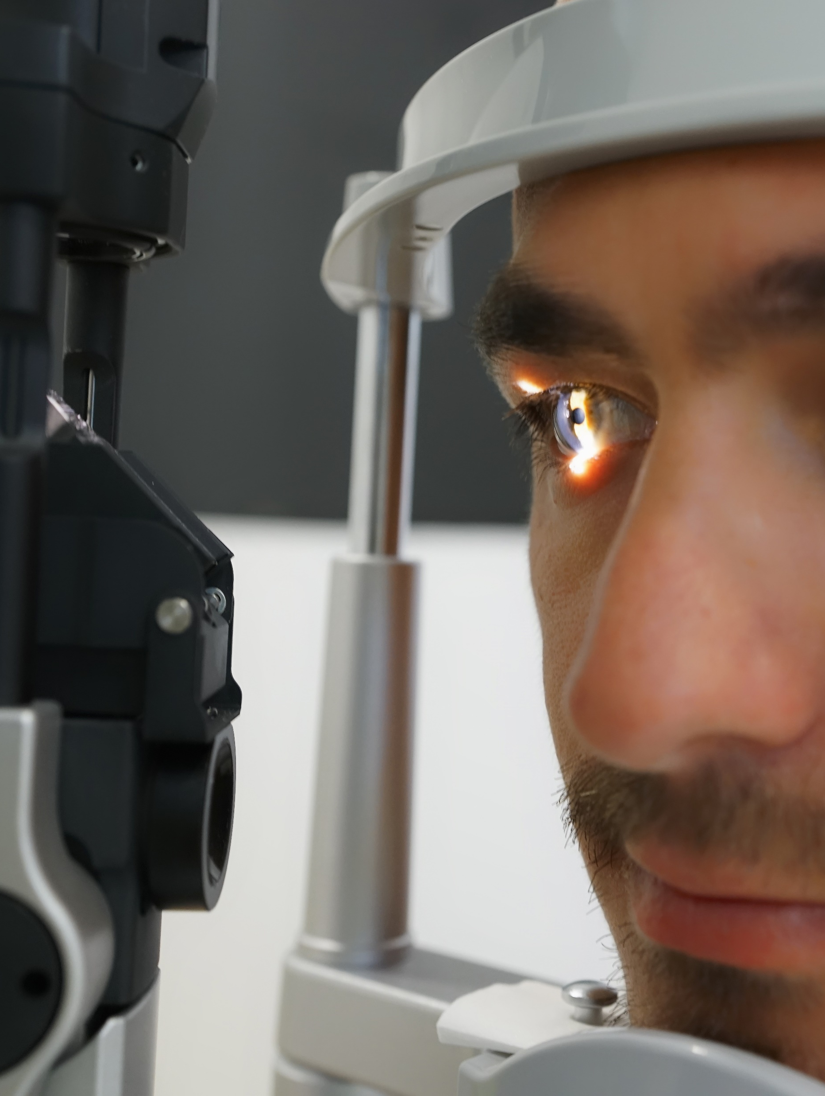
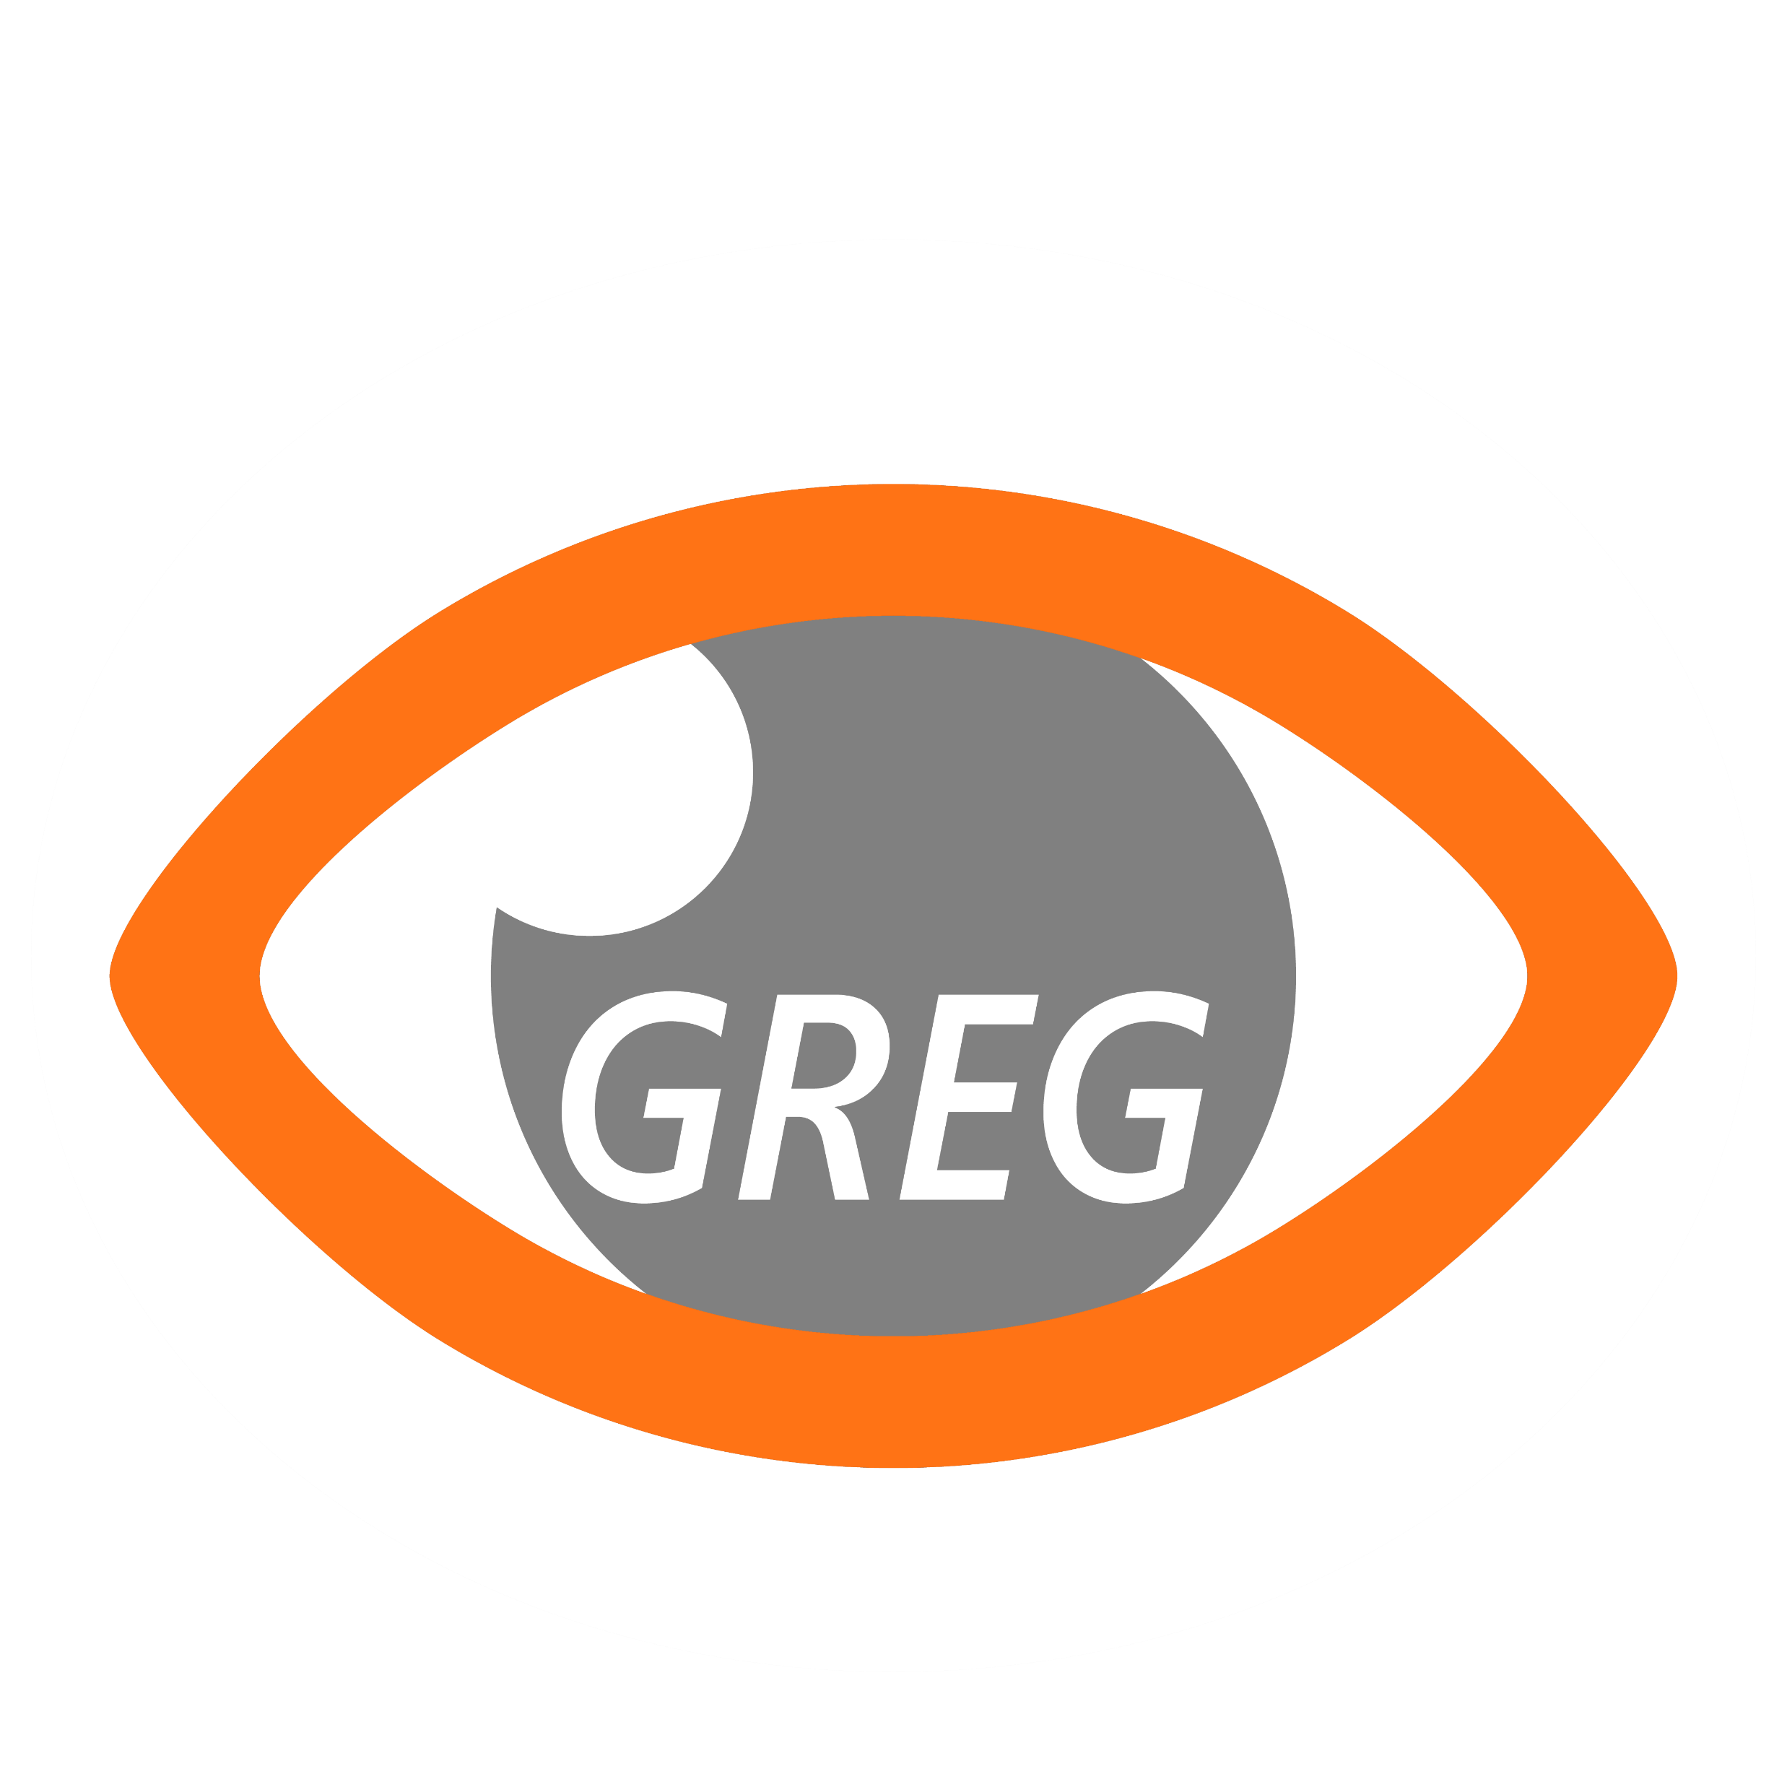
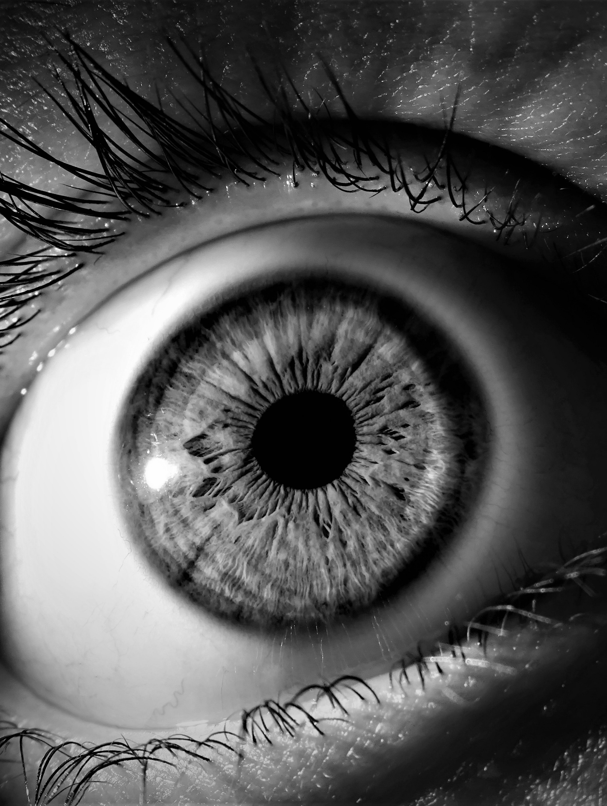
Scanning CONfoCal Ophthalmoscopy foR DIAbetic Eye Screening
(CONCORDIA)
Prof. Peter Scanlon

Slide 2
RELEVANT FINANCIAL DISCLOSURES
1
GREG have received:
  Unrestricted grants from CenterVue, Optos and Zeiss for the CONCORDIA study which is studying the effectiveness and cost-effectiveness of these devices in diabetic retinopathy screening.
  Unrestricted research grants from Bayer for real world studies in DMO and AMD
2
In the last 3 years I have received, conference registration fees and travel expenses from Boehringer and Bayer, and speaker fees from Topcon and Bayer.
3
The Gloucestershire Research and Education Group have gratefully received financial support from Bayer, Novartis, Allergan and the Diabetic Retinopathy Network (DR-NET) to provide training to students from low income countries.
4
PHS is Clinical Professional Advisor for the English NHS Diabetic Eye Screening Programme.

Slide 3
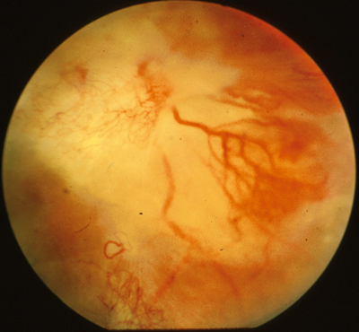
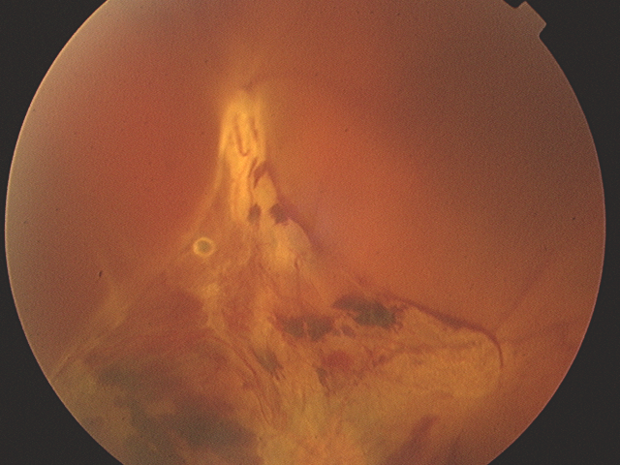
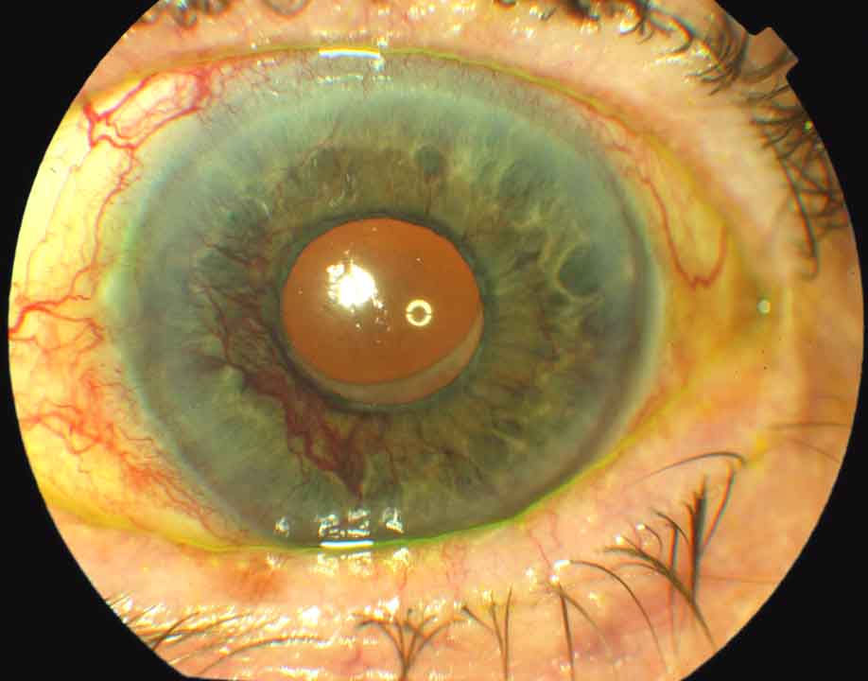
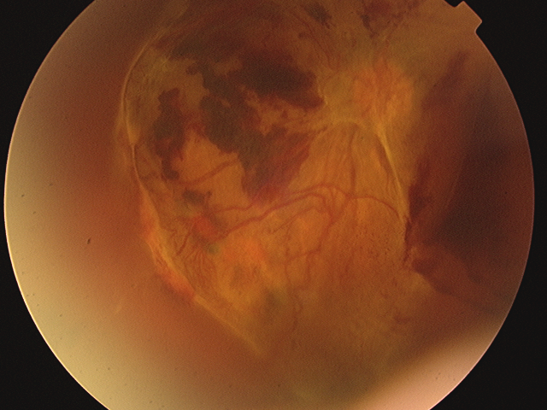
BETWEEN 1921 - 1976 THERE WAS NO TREATMENT FOR DIABETIC RETINOPATHY
Advanced presentations
Neovascular glaucoma
Treated with Pred Forte 1% + Atropine 1% Eye drops
Many blind painful eyes were removed!

Slide 4
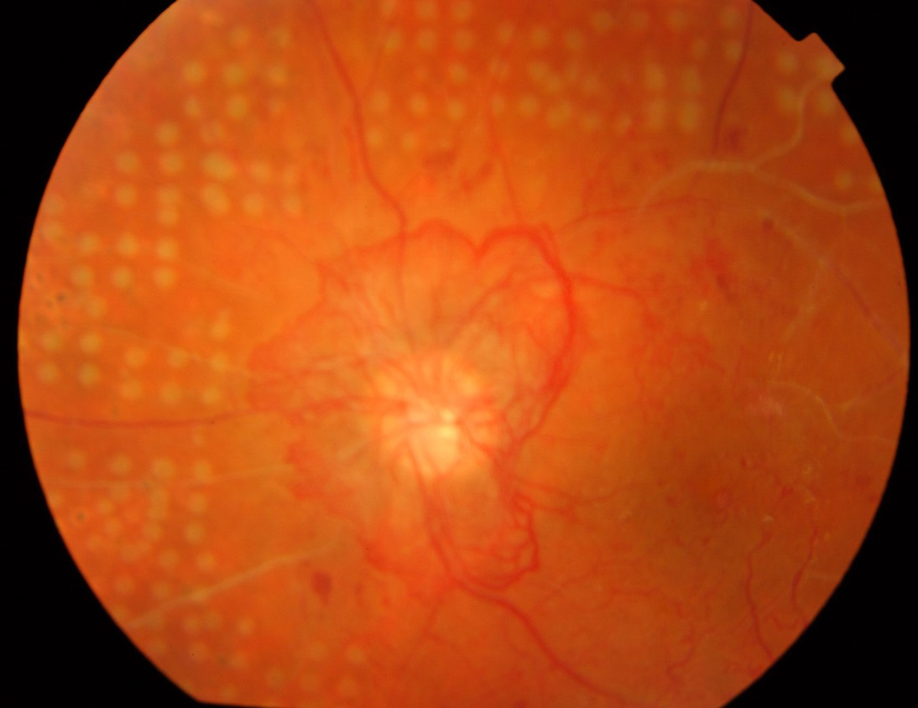
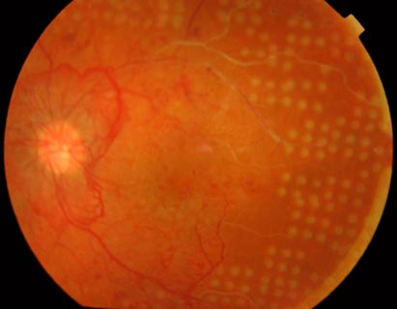
THE EFFECTS OF PHOTOCOAGULATION THERAPY (1976)
Preliminary Report on the Effects of Photocoagulation Therapy
The Diabetic Retinopathy Study Research Group
Department of Pathology, Institute of Ophthalmology, London
American Journal of Ophthalmology, Volume 81, Number 4. Published April 1976.
DRS high-risk characteristics chance of severe visual loss within 2 years 25.6% - 36.9%...
Halved with laser treatment
Treated left eye

Slide 5
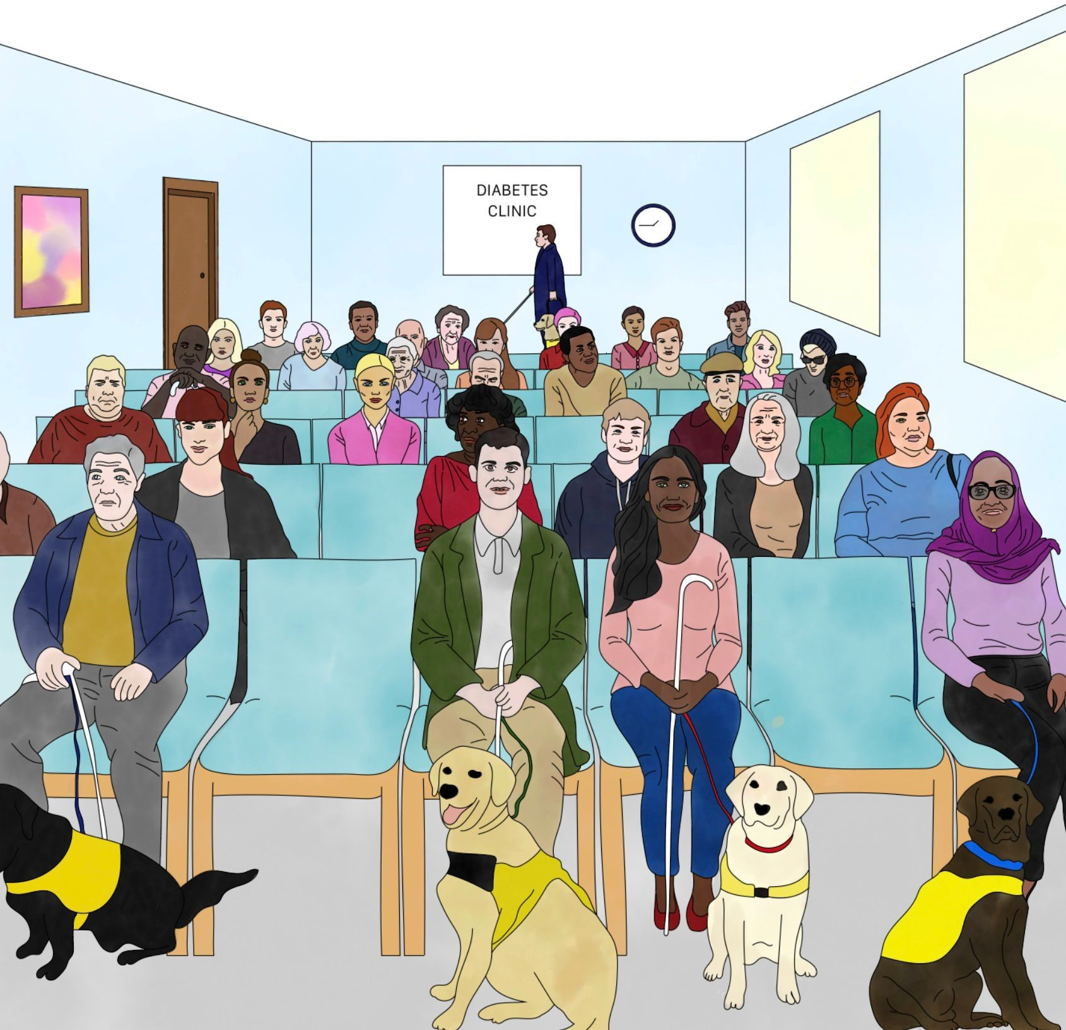
SOON AFTER I QUALIFIED (1980)

Slide 6
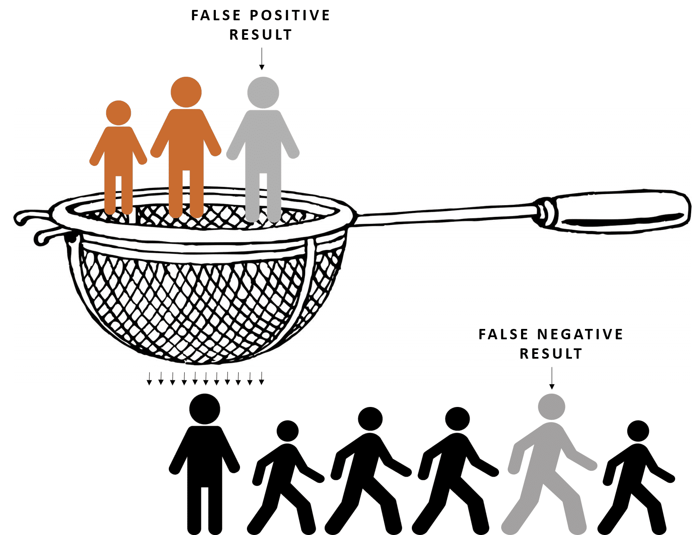
1977 Qualified
THE BEGINNING OF DIABETIC EYE SCREENING (DES)
Screening is not a diagnostic test
Sensitivity – how many one picks up is
never 100%
  a test is good if it is 90% sensitive
  this means 1 in 10 are missed
Specificity – how many one refers unnecessarily
is never 0%
  a test is good if it is 90% specific
  this means 1 in 10 are referred unnecessarily

Slide 7
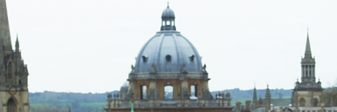
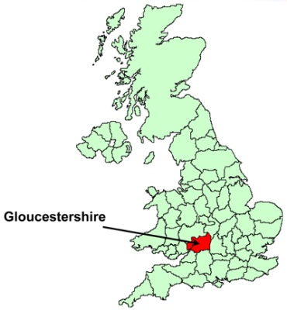
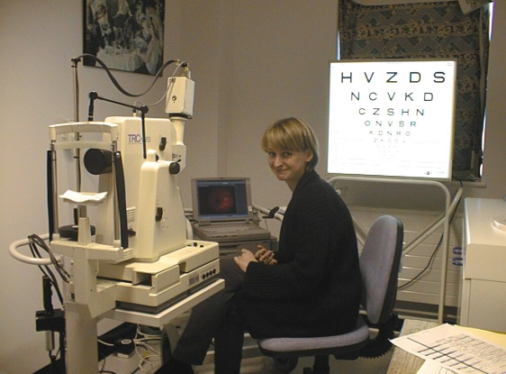
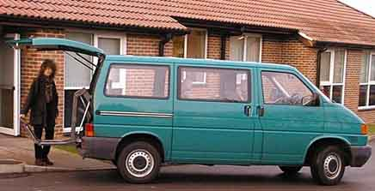
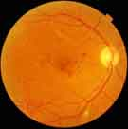
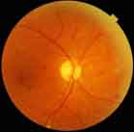
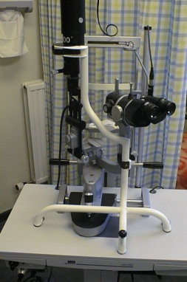
OUR HISTORY: 1998-2000
Gloucestershire Diabetic Eye Study
3611 randomly selected study patients
Non-mydriatic followed by mydriatic photography
1549 Examinations in General Practice with direct and indirect
ophthalmoscopy with slit lamp biomicroscopy
136 visits to 34 of the 85 Gloucestershire practices
Completed September 2000
Scanlon, P. H., Malhotra, R., Thomas, G., et al.
The effectiveness of screening for diabetic retinopathy by digital
imaging photography and technician ophthalmoscopy.
Diabetic Medicine. 2003; 20 (6), 467-474.
Scanlon PH, Malhotra R, Greenwood RH, et al.
Comparison of two reference standards in validating two field mydriatic digital
photography as a method of screening for diabetic retinopathy.
Br J Ophthalmol.

Slide 8
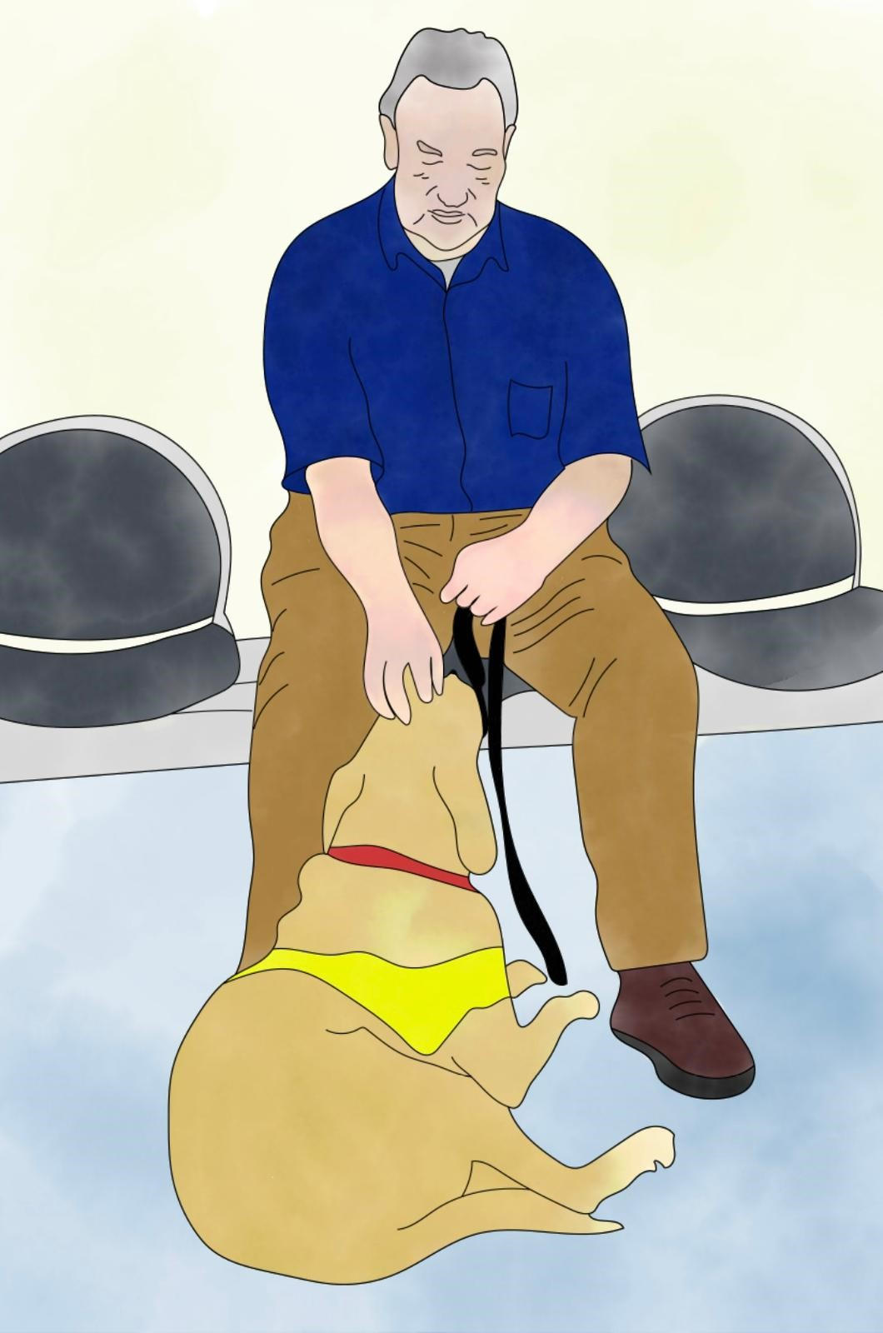
OUR HISTORY: 2002
1 Field Digital Imaging Offered To All People With Diabetes In Scotland
Organisation of Screening Services for Diabetic Retinopathy Screening
Authors: K. Facey, E. Cummins, K. Macpherson, A. Morris, L. Reay and J. Slattery
Health Technology Board for Scotland, Glasgow. Published in 2002.
Jim Slattery came to Gloucestershire to analyse all of my results from non-mydriatic photography.
Recommendation:
A National Screening Programme in Scotland based on
1-field staged mydriatic photography.
Aiming to prevent

Slide 9
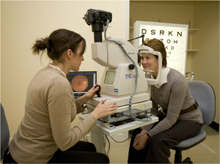


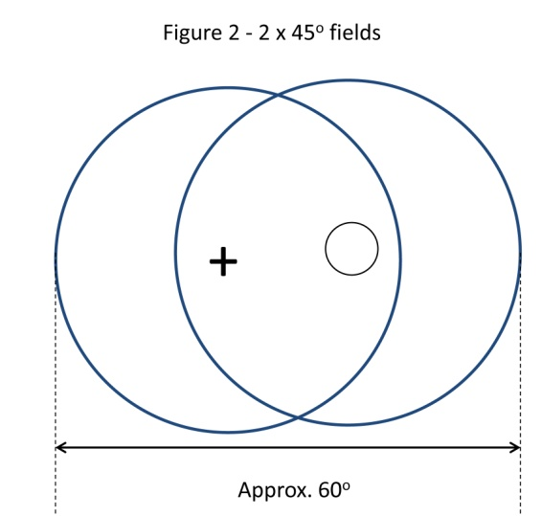
OUR HISTORY: National Service Framework (NSF) 2003
2 Field Digital Imaging Offered To All People With Diabetes In England

Slide 10
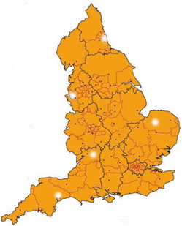
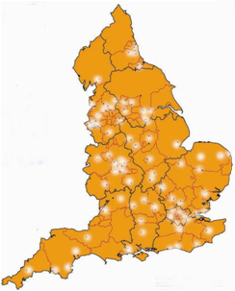
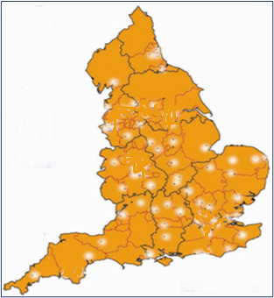
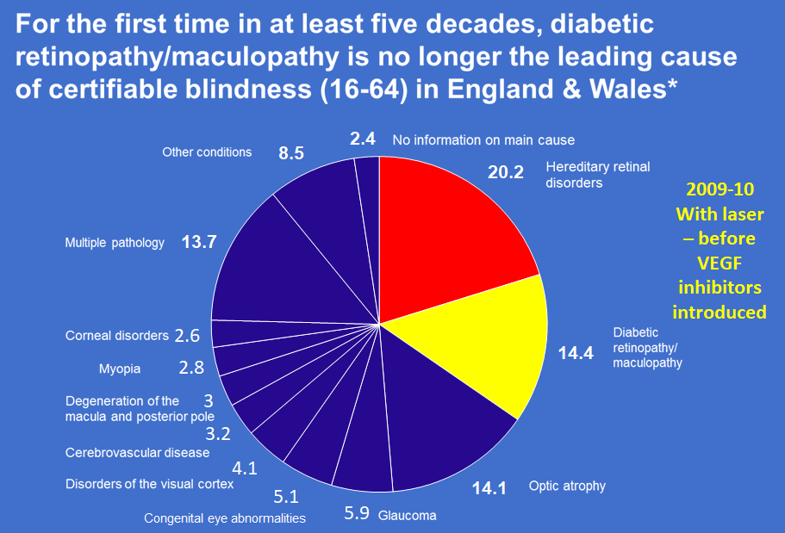
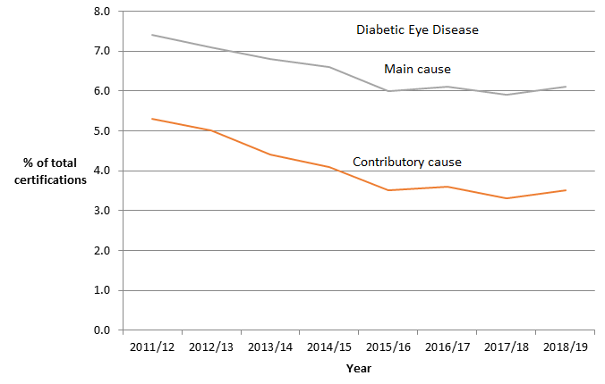
OUR HISTORY: 2002-2022
Roll out and Reductions in Blindness
2002
8 reasonable quality services
2017-18
65 centres
3.2 million with diabetes
2.7 million offered
2.23 million actually screened
2021-22
57 centres
2.2 million actually screened
Liew, G., et al. (2014). "A comparison of the causes of blindness certifications in England and Wales in working age adults (16-64 years), 1999-2000 with 2009-2010.“ BMJ Open 4(2): e004015.
Scanlon, P. H. (2021). The contribution of the English NHS Diabetic Eye Screening Programme to reductions in diabetes-related blindness, comparisons within Europe, and future challenges. Acta diabetologica 2021;58(4):521-530.

Slide 11
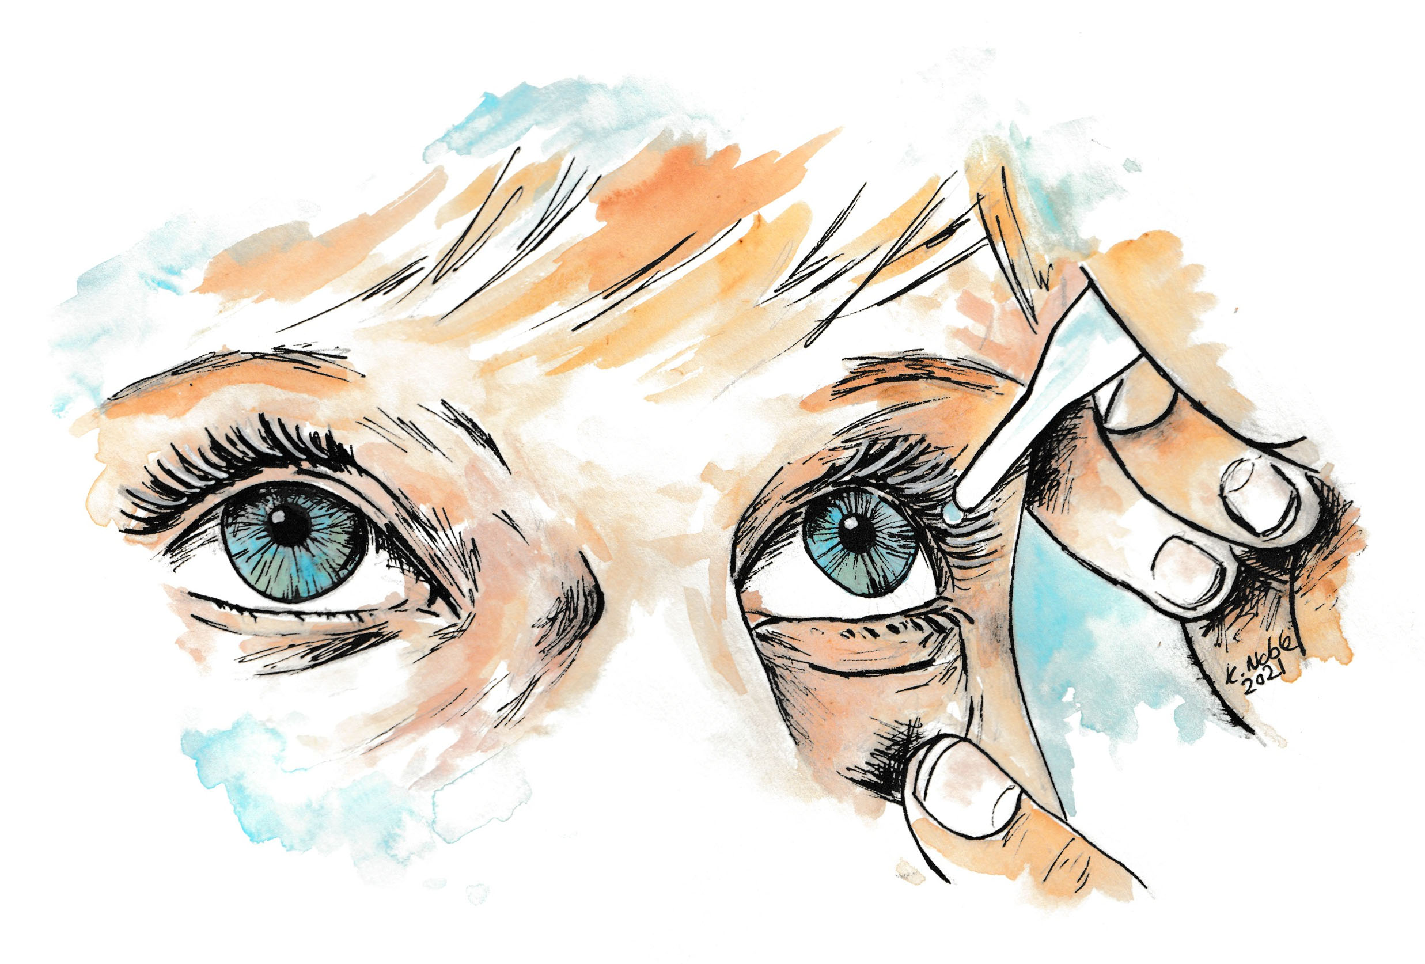
1977 Qualified
RESEARCH ON THE USE OF MYDRIATIC EYE DROPS IN DIABETIC EYE SCREENING

Slide 12
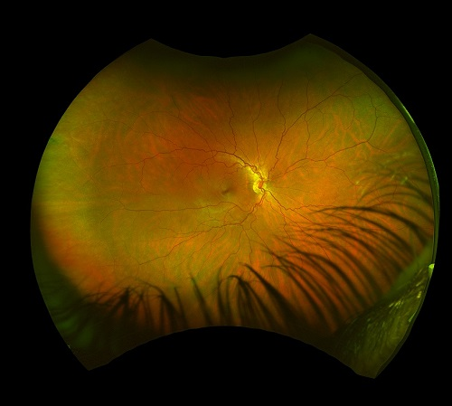
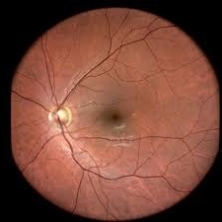
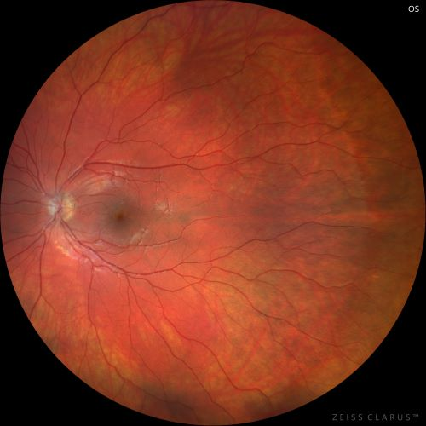
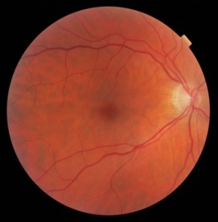
CAMERA MANUFACTURERS
Manufacturer | Model | Max FoV, center of eye (degrees) | Equivalent fundus camera FOV (degrees) | Max mosaic FOV, center of eye (degrees)
Digital camera | (typical) | 67-90 | 45-60
NDESP equivalent | 2-field protocol | 90 (horiz) | 60 (horiz)
OPTOS | Daytona (plus) Monaco California Silverstone | 200 | 135 | 220
Zeiss | Clarus 500 Clarus 700 | 133 | 90 | 200
Centervue | EIDON | 90 | 60 | 135
45 degree
90 degree external Zeiss Clarus
60 degree EIDON
135 degree external Optos

Slide 13
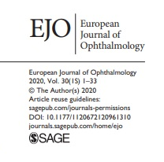
THE USE OF DILATING EYE DROPS IN SCOTLAND
Use of Dilating Drops in the Scottish Diabetic Eye Screening Programme
Authors: C. Styles, N. Lee, M. Black, K. Ah-See.
Diabetic Retinopathy Screening, Scotland, United Kingdom.
Abstract: 30th Meeting of the European Association for the Study of Diabetes Eye Complications Study Group (EASDec)
Barcelona, Spain, Virtual Meeting, 5th-6th November 2020.
Study design: Retrospective Audit
Purpose:
  Scotland has had a staged approach to mydriasis in the DRS programme since the national programme started in 2006.
  A single macula centred image is taken initially using a non-mydriatic fundus camera.
  If the image is inadequate for grading, only then are dilating drops used and a repeat image taken.
  This audit looks at the requirement for dilating drops in the retinopathy screening service by age in 2018-2019 and compares this with uptake rates.
Methods:
  Data was obtained from Vector.
  The use of dilating drops for obtaining an image and age was recorded.
  Percentages of dilating drops use where then calculated for each age group. Uptake rates over the age ranges were also calculated.

Slide 14
THE USE OF DILATING EYE DROPS IN SCOTLAND
Results:
Dilating drops:
  In 2018-2019, 211,518 people had fundus photography in the DRS programmes.
  The overall use of dilating drops was 30% but varied greatly with age group.
    The highest rate of dilating drops use (62%) was in the 85 years old and over.
    The need for dilating drops only went above 50% in the 75-84 year olds.
    Before then there is an increasing requirement for dilating drop use for adequate imaging with age ranging from 1.3% in the 12-14 year old group to 32.8% in 2019.
  The overall photographic technical failure rate (where adequate imaging was not possible even with dilating drops) in Scotland for 2018-2019 was 2.7%.
Uptake:
  The highest uptake rate was 83.4% in the 65-74 year olds (dilation drop use of 33%) and the lowest was 60.2% in the 35-44 age group (dilation drop use 8.9%).
  The overall uptake rate did not correlate with use of dilating drops.
Conclusions:
  The use of staged mydriasis is an efficient, effective method of screening for DR.
  It does not directly correlate with uptake rate so factors other than being able to drive to an appointment appear to have greater influence on attendance behaivours.

Slide 15
INNOVATE UK 2019 - AIDED
Detection of DR in Ultra-Wide-Field (UWF) Retinal Images
Competition: Digital health technology catalyst round 4: collaborative R&D
Project title: Retina UWF - AI Detection of Diabetic Retinopathy in UWF Retinal Images
Funding: £216,125 to GREG (Research), plus Optos and Zeiss Clarus cameras
Non-Mydriatic
The initial project entitled ‘AI Detection of Diabetic Retinopathy in Ultra-Wide-Field Retinal Images’ (AIDED) was funded by Innovate UK and is a collaboration between Gloucestershire Hospitals NHS Foundation Trust, RetinaScan Ltd, and the University of Surrey.
This project provided funding for the capture of retinal images on 500 patients (1000 eyes) using an Optos California and a Zeiss Clarus.
Approval was given to this project (IRAS project ID 275896) and capture of the retinal images commenced on 11th August 2020.
Additional funding was secured to extend the AIDED study to capture images from another 1000 patients.
90 degree external Zeiss Clarus
Non-Mydriatic
135 degree external Optos

Slide 16
CONCORDIA STUDY
Scanning CONfoCal Ophthalmoscopy foR DIAbetic Eye Screening
The CONCORDIA study investigates whether wide angle retinal cameras can be used without pupil dilation in DES, and whether they are accurate, safe, and cost-effective compared to the standard two-field mydriatic fundus photography used in the NHS DESP.
It is structured in three work packages:
Work Package 1 (WP1): Secondary Analysis of AIDED data
  Uses anonymised data from the AIDED study to evaluate the diagnostic performance of two UWF devices, the Optos California and Zeiss Clarus.
  It compares non-mydriatic images from the UWF devices against the 2 standard 45° mydriatic fundus photographs.
Work Package 2 (WP2): Clinical Trial with Eidon cSLO
  Assesses the Centervue Eidon cSLO in screening.
  It uses a staged mydriasis approach, where images are taken without dilation first, and the patient is dilated only if the images are ungradable, or when the pupil size is less than 3mm.
  It compares non-dilated and, when needed, dilated Eidon images to the 2 standard 45° mydriatic reference images.
Work Package 3 (WP3): Health Economics Analysis
  Assesses the cost-effectiveness of a staged mydriasis approach.

Slide 17
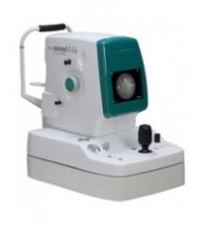
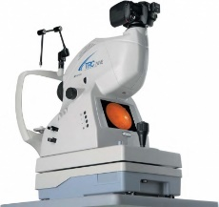
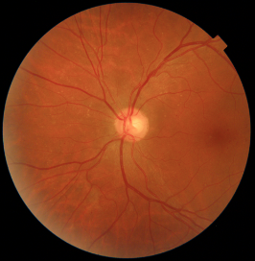
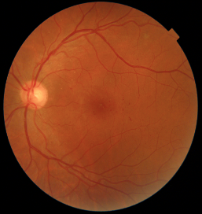
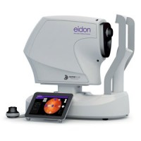
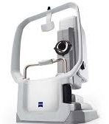
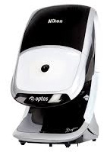
CONCORDIA STUDY
Scanning (Confocal) Ophthalmoscopes
vs. Digital Cameras
2 x 45 degree fields
Manufacturer | Model | Field of view | Light | Minimum pupil size (mm)
Digital cameras | 2-45º protocol | 60º | White light flash | 3.5
Centrevue | Eidon | 60º | White light LED scan | 2.5
Zeiss | Clarus | 90º | Red, green and blue LED scan | 2.5
Optos | California | 135º | Red and Green laser scan | 2
60 degree EIDON
90 degree external Zeiss Clarus
135 degree external Optos

Slide 18
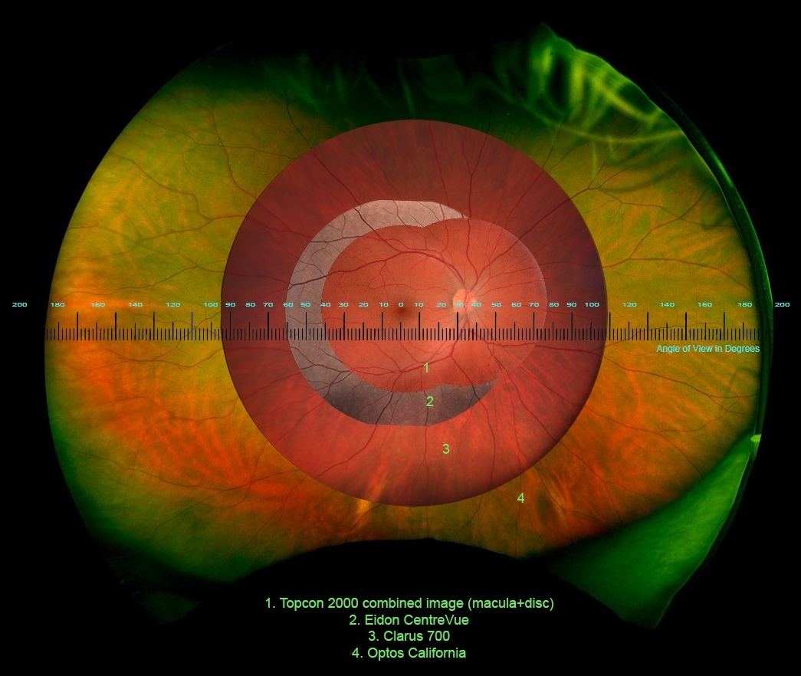
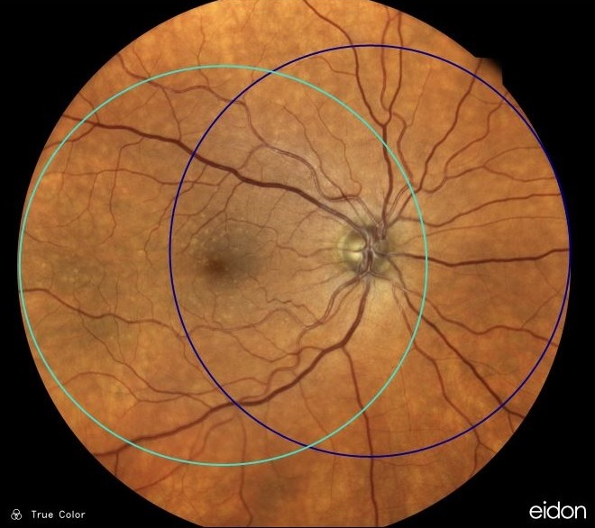
CONCORDIA STUDY
Comparing the Optos, Clarus and Eidon using staged mydriasis to 2 X 45 mydriatic degree digital photography
Work package 2. Centervue Eidon, Field of View 60 degrees, minimum pupil diameter claimed 2.5 mm
White light LED, confocal, wavelength 440 – 650 nm. Resolution claimed 15 μm

Slide 19
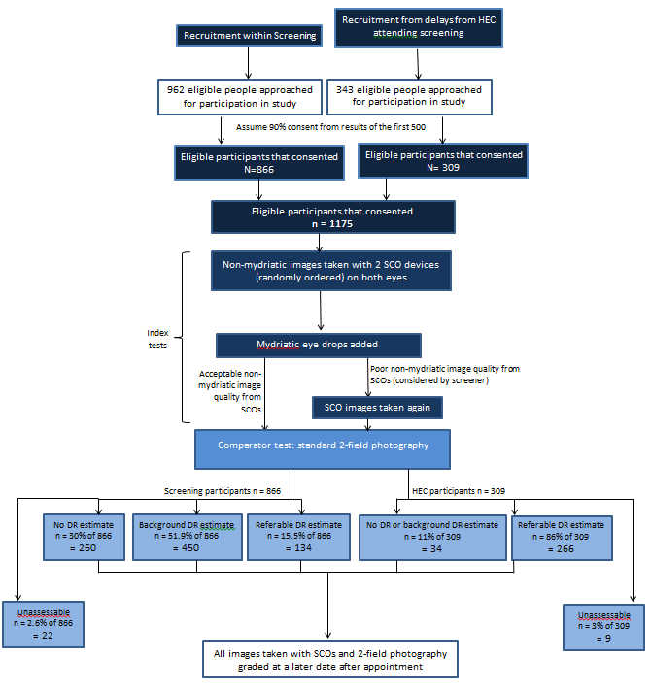
CONCORDIA STUDY: Work Package 1
Target 1,500 patients; Recruited 1,573
Mydriatic reference standard
2 x 45 degree fields
Non-Mydriatic
90 degree external Zeiss Clarus
Non-Mydriatic
135 degree external Optos
135 degree external Optos

Slide 20
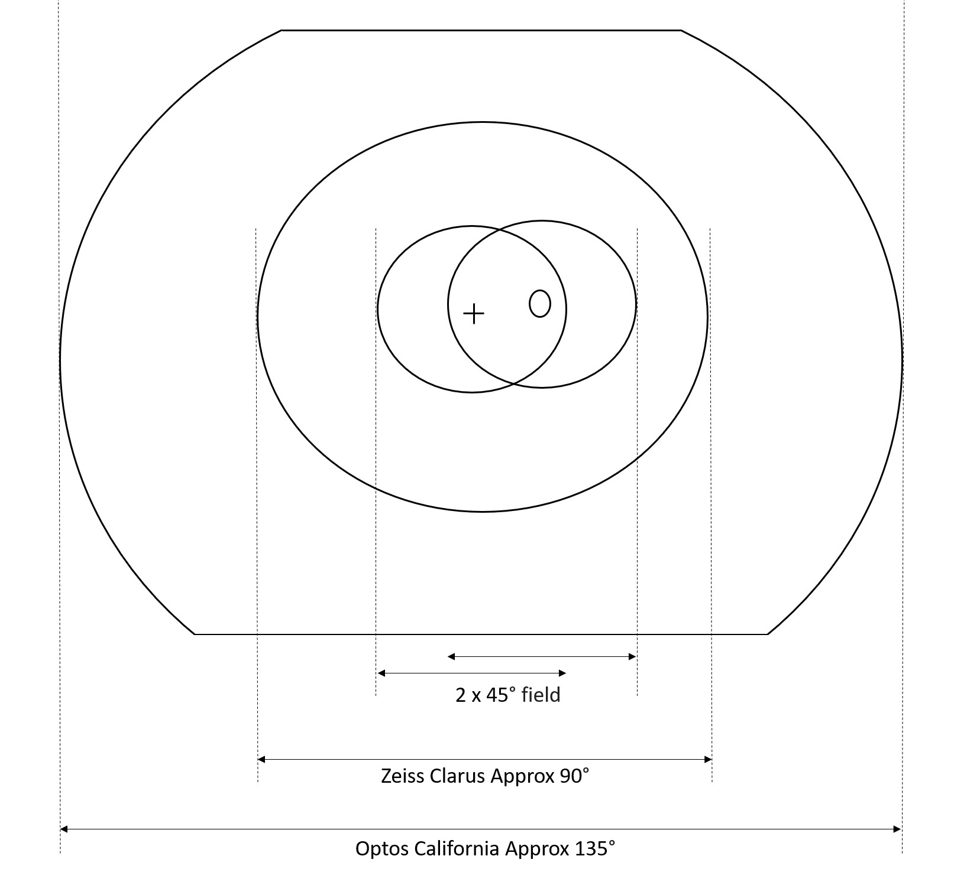
CONCORDIA STUDY: Work Package 1
Results
WORK PACKAGE 1: Zeiss Clarus
Out of 2,995 photos taken pre-dilation using Clarus, 3.3% with 95% CI (2.7% - 4.0%) were unassessable according to the grader.
The sensitivity and specificity for any retinopathy were 94.2% with 95% CI (92.9% - 95.3%) and 87.3% with 95% CI (85.4% - 89.0%) respectively.
The sensitivity and specificity for referable retinopathy were 86.0% with 95% CI (82.9% - 88.8%) and 92.8% with 95% CI (91.7% - 93.8%) respectively.
WORK PACKAGE 1: Optos California
Out of 2,993 photos taken pre-dilation using Optos, 5.1% with 95% CI (4.3% - 6.0%)
were unassessable according to the grader.
The sensitivity and specificity for any retinopathy were 91.9% with 95% CI
(90.5% - 93.2%) and 78.1% with 95% CI (75.7% - 80.3%) respectively.
The sensitivity and specificity for referable retinopathy were 77.6% with 95% CI
(73.9% - 80.9%) and 95.4% with 95% CI (94.5% - 96.2%) respectively.
Reference: Scanlon PH, Gruszka-Goh M, Javed U, et al. The Scanning CONfoCal Ophthalmoscopy foR DIAbetic eye screening (CONCORDIA) study paper 1.
Eye (London, England) 2024. DOI: 10.1038/s41433-024-03360-2.

Slide 21
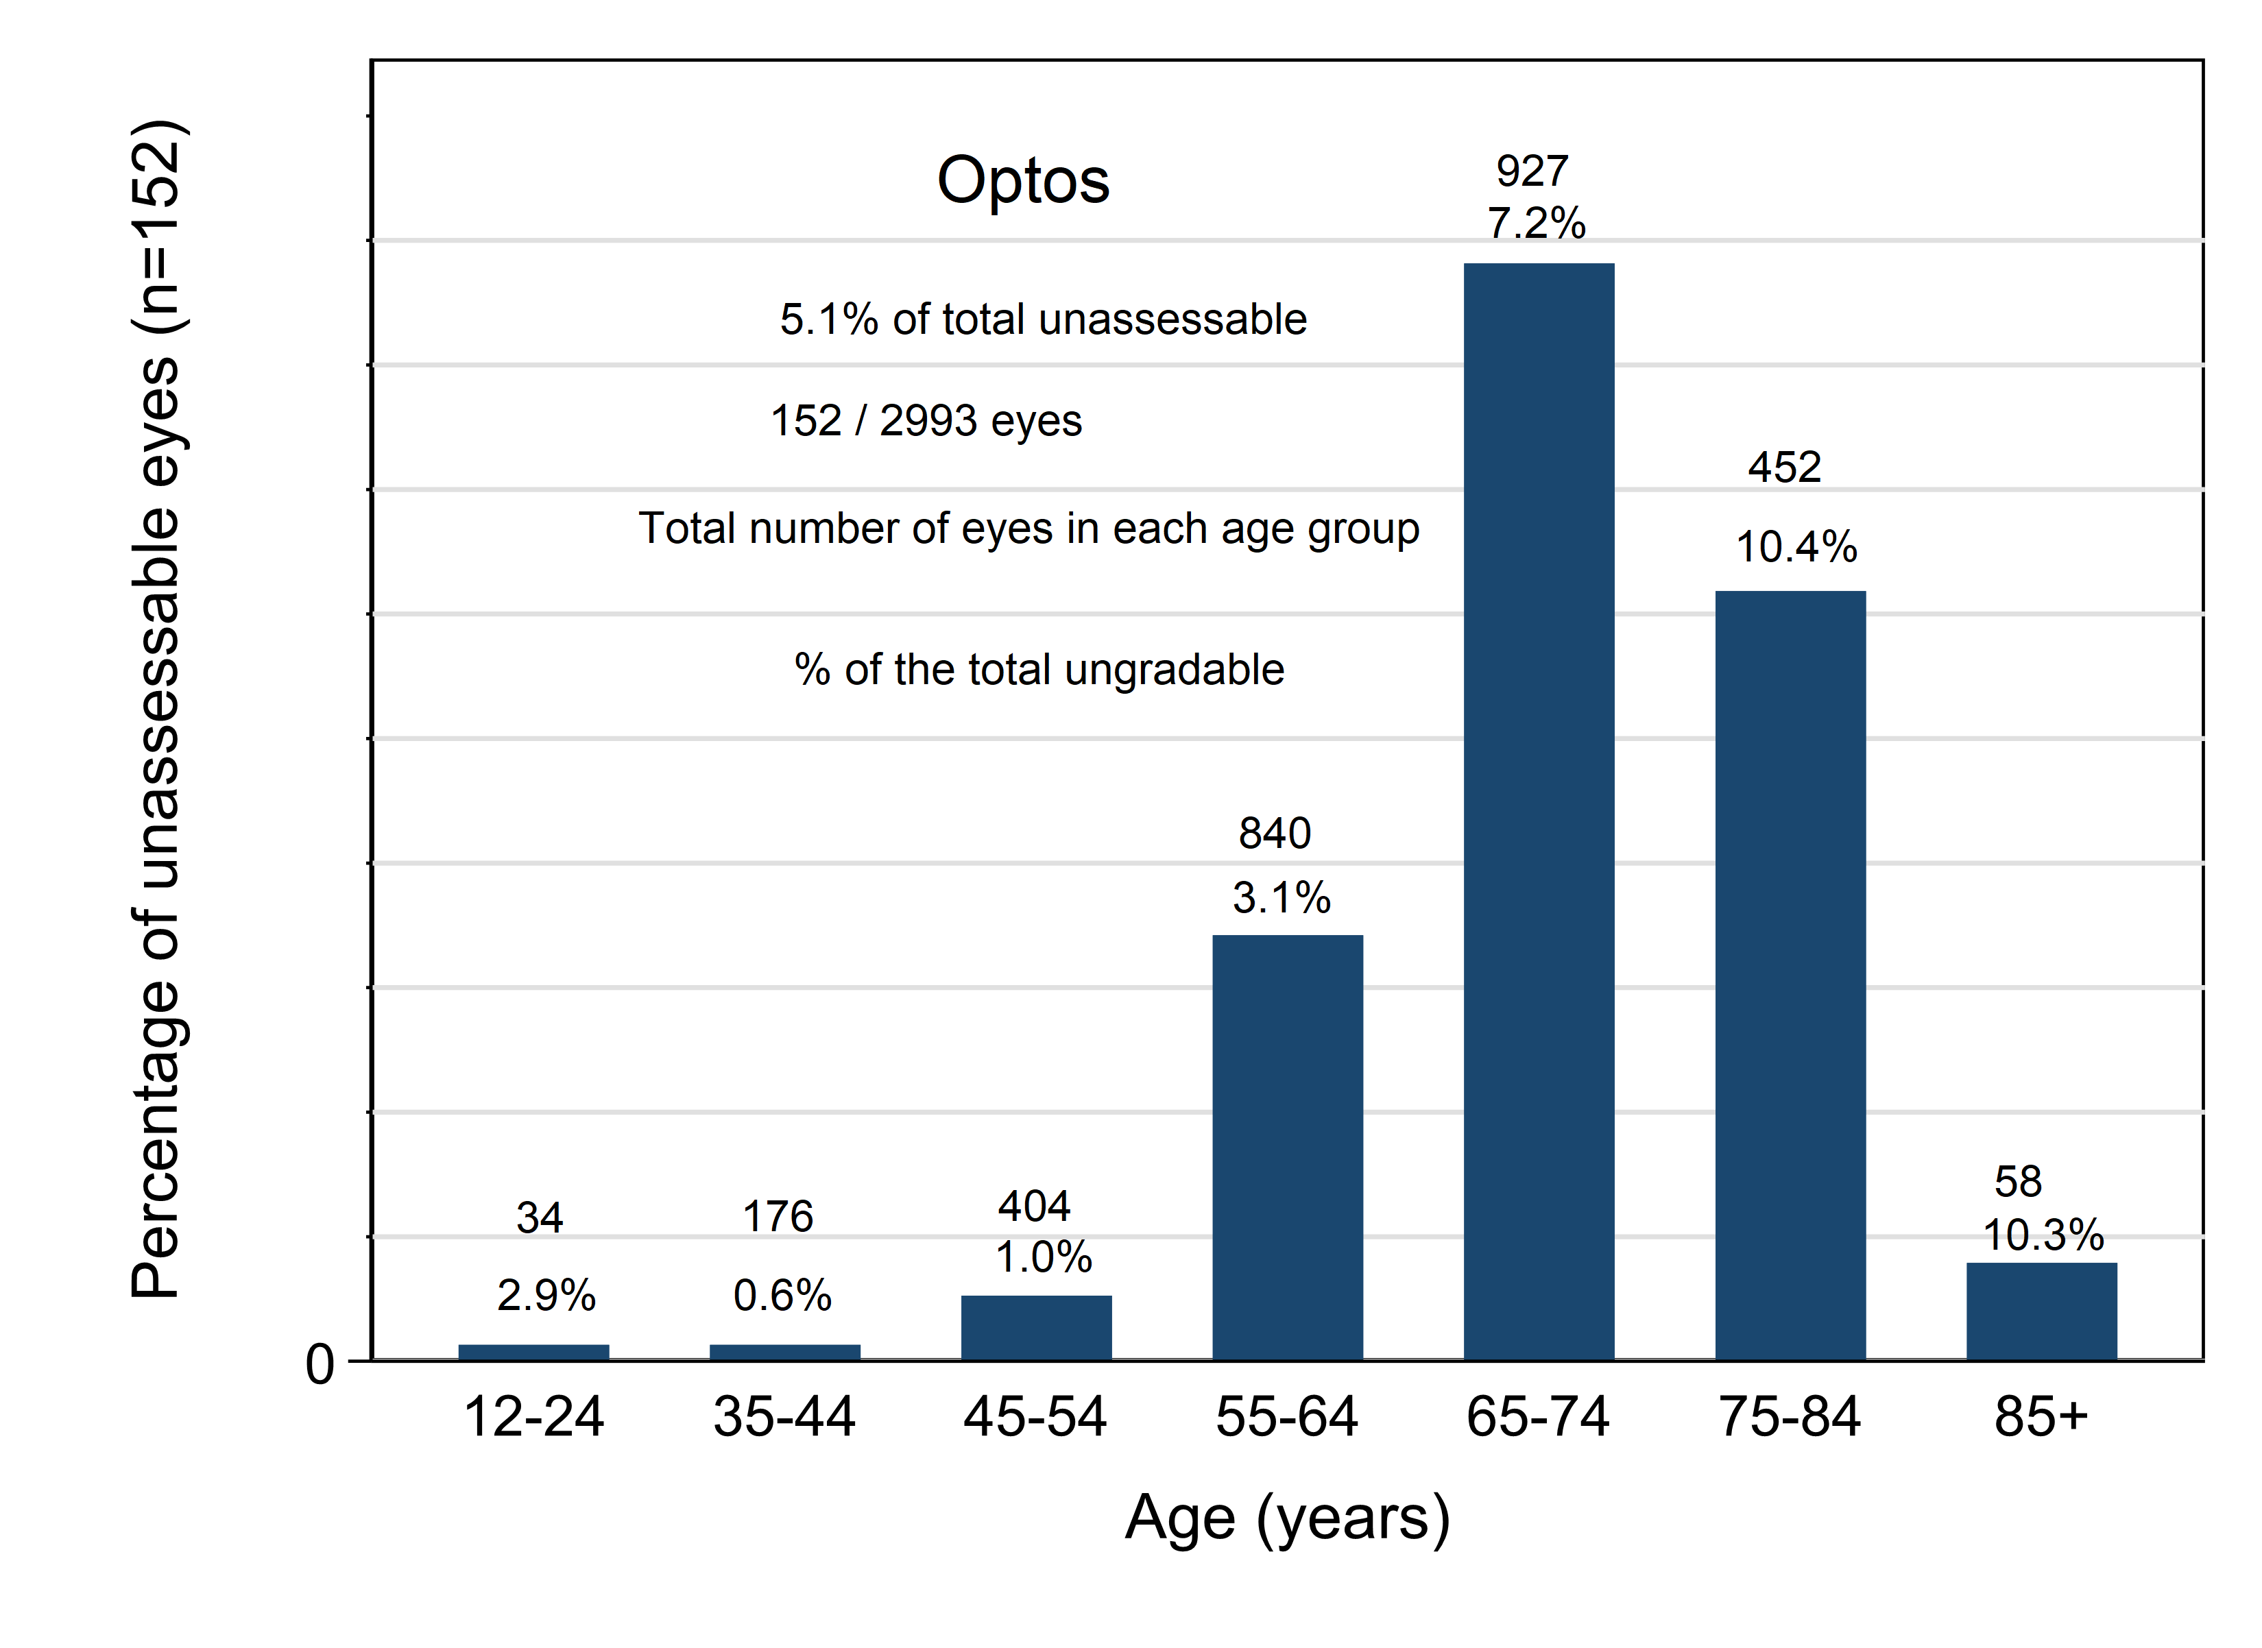
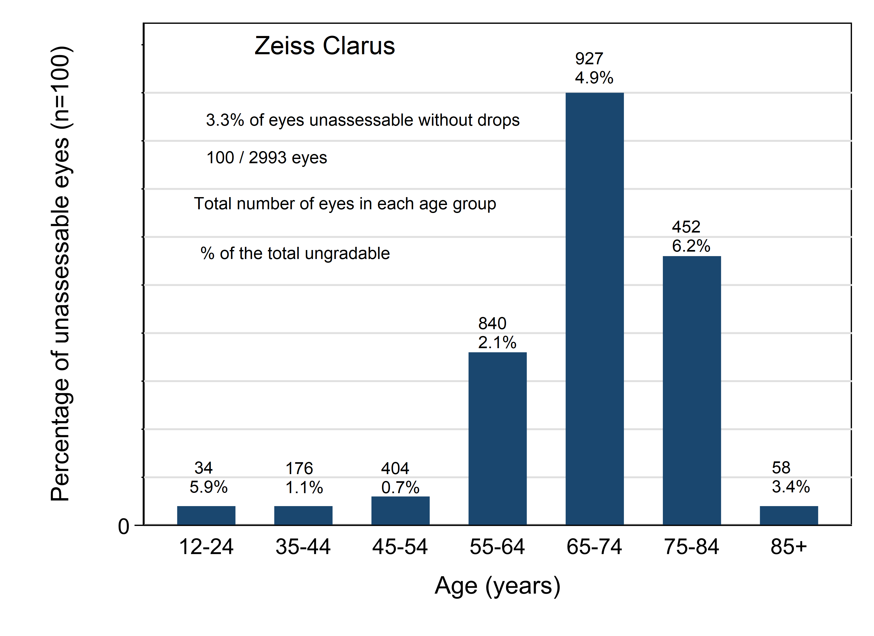
CONCORDIA STUDY: Work Package 1
Optos and Zeiss Clarus Comparisons
UNGRADABLE NON-MYDRIATIC PHOTOGRAPHY NUMBER AND PERCENTAGE FOR THE OPTOS AND CLARUS IN RELATION TO AGE
Optos
Zeiss Clarus

Slide 22

CONCORDIA STUDY: Work Package 2
Target 1,000 patients; Recruited 1,050
Mydriatic reference standard
2 x 45 degree fields
Non-Mydriatic
60 degree EIDON

Slide 23
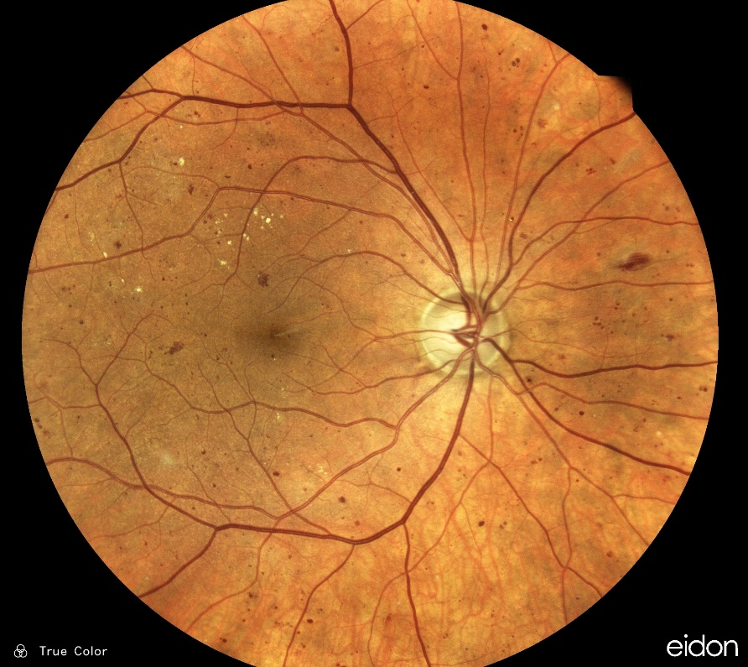
CONCORDIA STUDY: Work Package 2
Objectives and Recruitment
OBJECTIVES OF WORK PACKAGE 2:
The CONCORDIA work package 2 study is a clinical trial to obtain the sensitivity and specificity of the Eidon device against 2-field digital imaging in the central two 45-degree field area for the detection of any retinopathy and referable retinopathy in diabetic eye screening in the English NHS DESP.
1,000 patients. Staged mydriasis.
WORK PACKAGE 2 RECRUITMENT:
1,050 patients were recruited as trial participants.
34 individuals were withdrawn for the following reasons:
  Imaging protocol deviation /camera error - 18
  Patient withdrew consent and left before the imaging was complete – 9
  IT network error – 1
  Recruitment / administrative error e.g., patient study ID not allocated – 6
The final sample consisted of 1,016 individuals (2,031 eyes).
Ethnicity
White Caucasian | 384 (93.2%) | 563 (93.2%) | 947 (93.2%)
Asian or Asian British | 12 (2.9%) | 24 (4.0%) | 36 (3.5%)
Black or Black British | 5 (1.2%) | 10 (1.7%) | 15 (1.5%)
Mixed - Multiple Ethnic Groups | 10 (2.4%) | 6 (1.0%) | 16 (1.6%)
Data Not Available | 1 (0.2%) | 1 (0.2%) | 2 (0.2%)

Slide 24
CONCORDIA STUDY: Work Package 2
Results for Referable DR for the Eidon Camera
SENSITIVITY AND SPECIFICITY:
As the reference standard was 2-field mydriatic digital photography, we could only estimate the sensitivity and specificity of the staged mydriatic approach using the Eidon on 1,009 patients (1,971 eyes) who were considered gradable on the 2 x 45-degree mydriatic digital photography and staged mydriasis Eidon.
RESULTS:
Results for referable retinopathy for the Eidon camera compared
to 2-field digital photography.
  The sensitivity and specificity for referable retinopathy were
  92.7% with 95% CI (89.9%- 94.9%) and 85.4% with 95% CI
  (83.5%- 87.1%) respectively.
  Positive predictive value was 66.2% with 95% CI (62.4% - 69.8%)
  and negative predictive value 97.4% with 95% CI (96.4%- 98.2%).
Figure 3. ROC curve for referable Diabetic Retinopathy

Slide 25
CONCORDIA STUDY: Work Package 2
Results for any DR for the Eidon Camera and MAs count
RESULTS:
Results for any retinopathy for the Eidon camera compared
to 2-field digital photography.
  The sensitivity and specificity for any retinopathy were 97.5%
  with 95% CI (96.4% - 98.4%) and 82.3% with 95% CI
  (79.6% - 84.7%) respectively.
  Positive predictive value was 87.1% with 95% CI (85.1% - 88.9%)
  and negative predictive value 96.4% with 95% CI (94.8% - 97.6%).
Microaneurysm counts for the Eidon camera compared to 2-field
digital photography.
  The microaneurysm (MA) count was defined as non-inferior,
  when the number of MAs detected within 1DD of the centre of
  the fovea on images photographed using Eidon was equal to or
  higher than on the images taken using two 45-degree field digital
  cameras.
  For pre-dilation images taken with Eidon, in 93.7% of cases SCO
  was non-inferior in a detection of MA counts within 1DD of the
  centre of the fovea to the mydriatic digital photography used as
  a diabetic screening standard.
Figure 2. ROC curve for any Diabetic Retinopathy

Slide 26
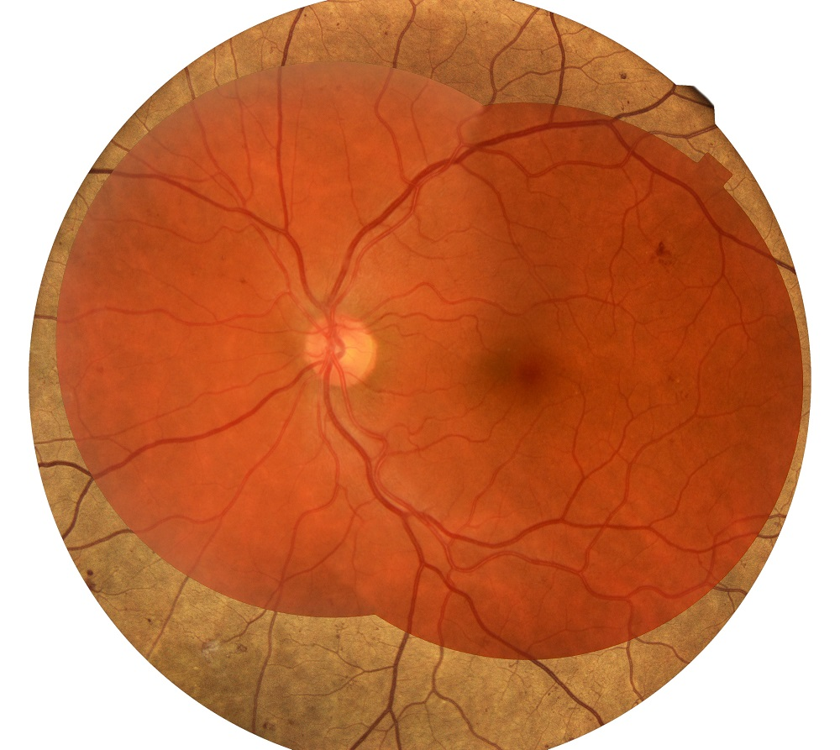
CONCORDIA STUDY: Work Package 2
Results for any DR for the Eidon Camera and MAs count
WORK PACKAGE 2 RESULTS:
Out of 2,029 photos taken pre-dilation using Eidon, 4.2% with 95% CI (3.4% - 5.2%) were
unassessable according to the grader.
The sensitivity and specificity for any retinopathy were 97.5% with 95% CI (96.4% - 98.4%)
and 82.3% with 95% CI (79.6% - 84.7%) respectively.
The sensitivity and specificity for referable retinopathy were 92.7% with 95% CI (89.9%- 94.9%)
and 85.4% with 95% CI (83.6%- 87.2%) respectively.
Reference: Scanlon PH, Gruszka-Goh M, Javed U, et al. The scanning CONfoCal Ophthalmoscopy foR DIAbetic eye screening (CONCORDIA) study paper 2.
Eye (London, England) 2024. DOI: 10.1038/s41433-024-03361-1.

Slide 27
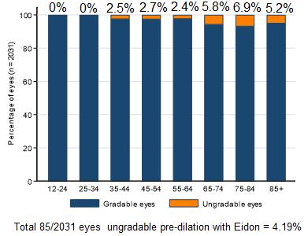
CONCORDIA STUDY: Work Package 2
Eidon Ungradable Findings
UNGRADABLE NON-MYDRIATIC PHOTOGRAPHY NUMBER AND PERCENTAGE FOR THE EIDON IN RELATION TO AGE
Gradable and Ungradable Eyes in Relation to Age
Ungradable Eyes in Relation to Age
Before dilation:
The total number of eyes that were ungradable with the Eidon was 85 out of the 2031 (4.2%)
After dilation:
The total number of eyes that were ungradable with the Eidon was 34 out of the 2031 (1.7%)
The total number of eyes that were ungradable with the 2-field digital photography reference standard was 34 out of the 2031 (1.67%)

Slide 28
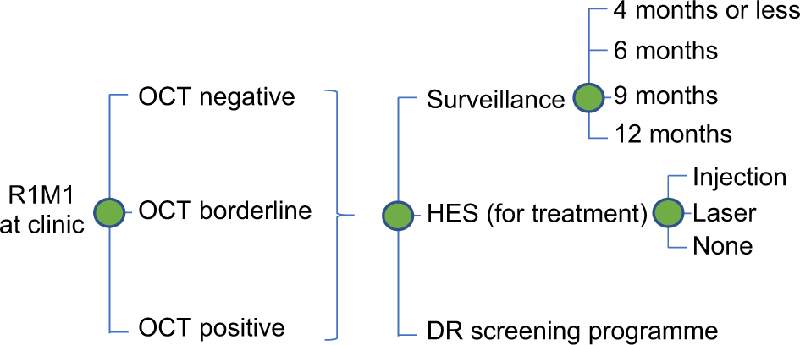
CONCORDIA STUDY: Work Package 3
Health Economic Analysis
OBJECTIVES OF WORK PACKAGE 3:
Assess the cost-effectiveness of two Scanning Confocal Opthalmoscopes (SCOs) in the non-mydriatic mode against 2-field, mydriatic, digital imaging in the central two 45-degree field area (standard current practice);
Assess the cost-effectiveness of a third non-mydriatic mode SCO (CentreVue Eidon one-field 60-degree image per eye with a white light LED source), when compared to current practice; and
Assess the cost-utility of the current National English screening programme for diabetic retinopathy (DR) after incorporating non-mydriatic SCO screening.
Figure 1. Model structure capturing the natural history of diabetic retinopathy (red boxes denote referable retinopathy).
Figure 2. Model structure capturing the clinical pathways associated with digital surveillance clinics.

Slide 29
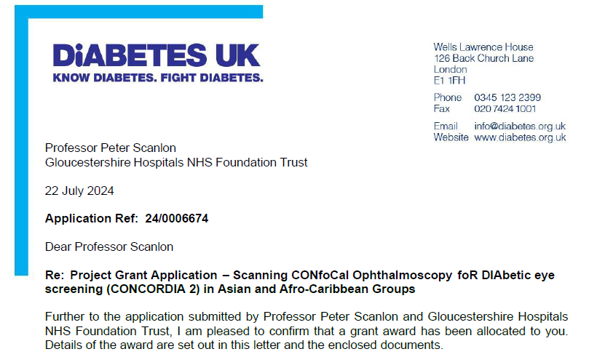
1977 Qualified
FUTURE RESEARCH
Successful Application: Diabetes UK Grant

Slide 30

CONCORDIA 2 STUDY
DUK Application
Title: Scanning CONfoCal Ophthalmoscopy foR DIAbetic eye screening (CONCORDIA 2) in Asian and Afro-Caribbean Groups
About: An extension using the EIDON camera in North Central London for an Asian and Afro-Caribbean population
Recruitment:
  A total of 1,800 patients will need to be recruited:
    900 from Asian descent and
    900 from Afro-Caribbean descent.
  The participants will be recruited from people with
  diabetes of Asian and Afro-Caribbean descent
  attending appointments in the North East London
  DESP in Leyton Green. 34.6% (6759) of the total
  population with diabetes (19,481) in Leyton Green
  are of Asian descent and 21.2% (4,139) of
  Afro-Caribbean descent.
Funding: Applied for £156,525.

Slide 31
THANK YOU FOR LISTENING.
Name: Peter Scanlon
E-mail: p.scanlon@nhs.net

