Slide 1
AGM 2025
Friday 19th September 2025
Holiday Inn Hotel
Birmingham

Slide 2
Agenda
Minutes of last AGM – available on website
Co-chairs report
Council election results
BARS and the future
President’s Report
AOB
Date and venue for the next AGM

Slide 3




Membership and Socials
Membership – 800+ (394 active)
Social media
Facebook - 686
Instagram - 223
LinkedIn – 589
Future NHS – 125
No longer on X
Notes:
Increase from 208 to 384 on LinkedIn

Slide 4
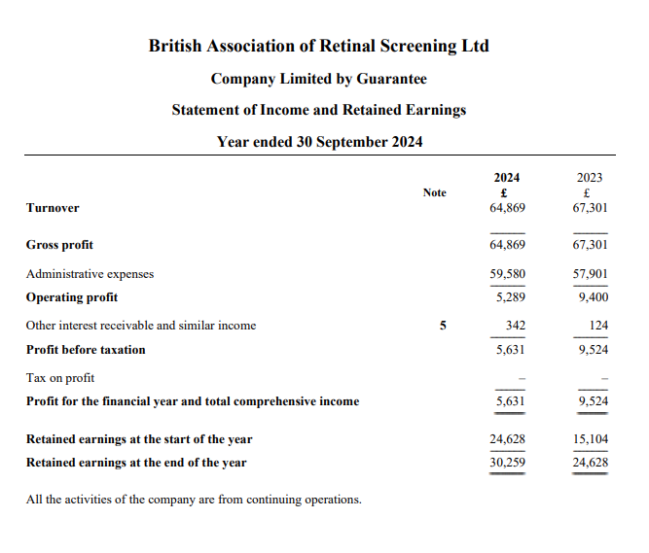
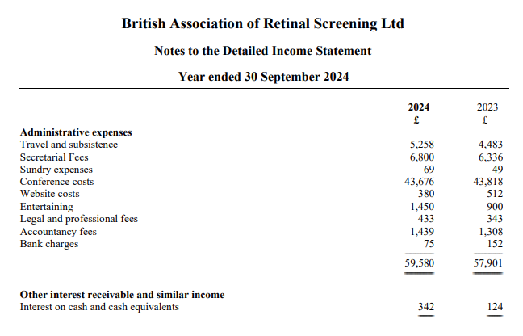
Financial statements for the year to 30th Sept 2024

Slide 5
Co-Chairs report contd
Over the past year we have:
Published 3 editions of the BARS Chronicle
30 students started, and 16 have completed the BARS Administration certificate.
Continued to work on our NHS Futures platform
Trialling new 1 day conference format
Worked with the Together Type 1 team

Slide 6

Matthew Baines
Dominique Zamarian

Slide 7

Marzena Zoladz
Ananditha Gopan
Lisa Richardson
Karen Rigby
Ali Askari
Simon White

Slide 8
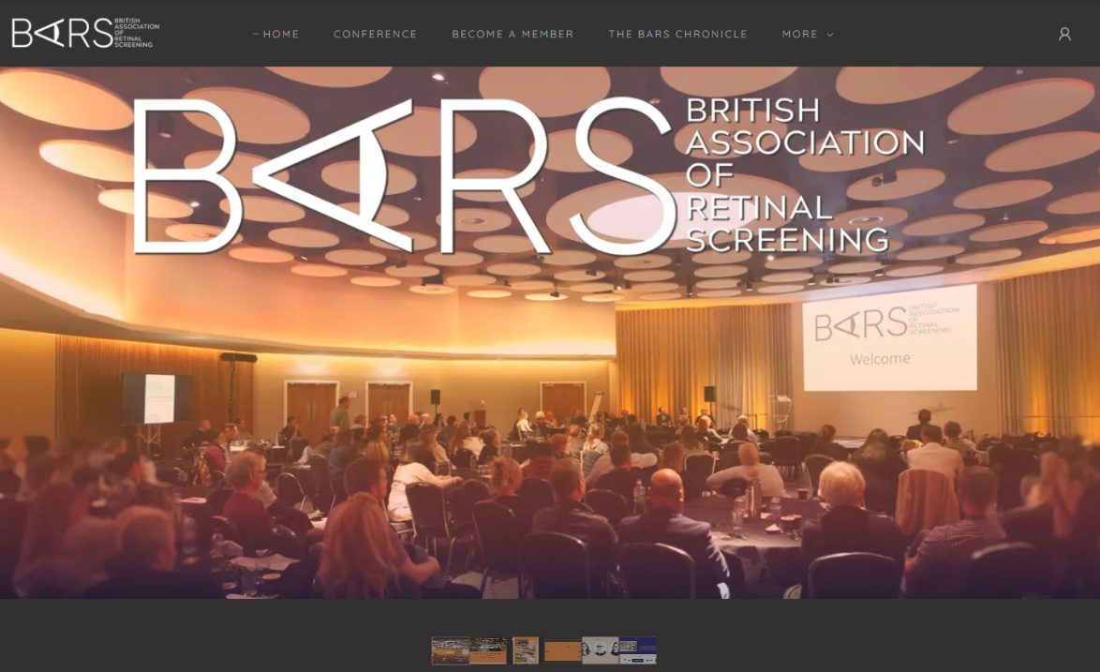

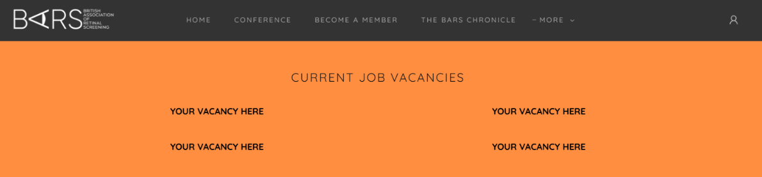
BARS and the future
Exciting news – new website
Remember to log in once a year
Revise the BARS Administration certificate

Slide 9
BARS and the future
Challenging year
Brand new, wonderful BARS Council
We need to think about the future/ new opportunities
Sustainability where budgets are getting tighter
Continue with the chronicle/educational events/ admin certificate/brand new website
Proposal to merge with the RSM conference next year- April 24th, 2026
Continue the BARS poster competition!

Slide 10
AOB
Date of next AGM April 24th, 2026

