Slide 1


Beyond Diabetic Retinopathy: Spotting the Unusual in Retinal Screening
Mr Yu Jeat Chong FRCOphth
Consultant Ophthalmologist in Medical Retina and Uveitis
Birmingham and Midland Eye Centre
Honorary Senior Clinical Research Fellow, University of Birmingham

Slide 2
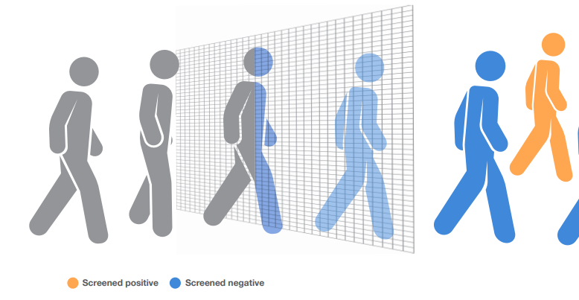
Screening is a like a sieve
Notes:
https://iris.who.int/bitstream/handle/10665/330829/9789289054782-eng.pdf

Slide 3
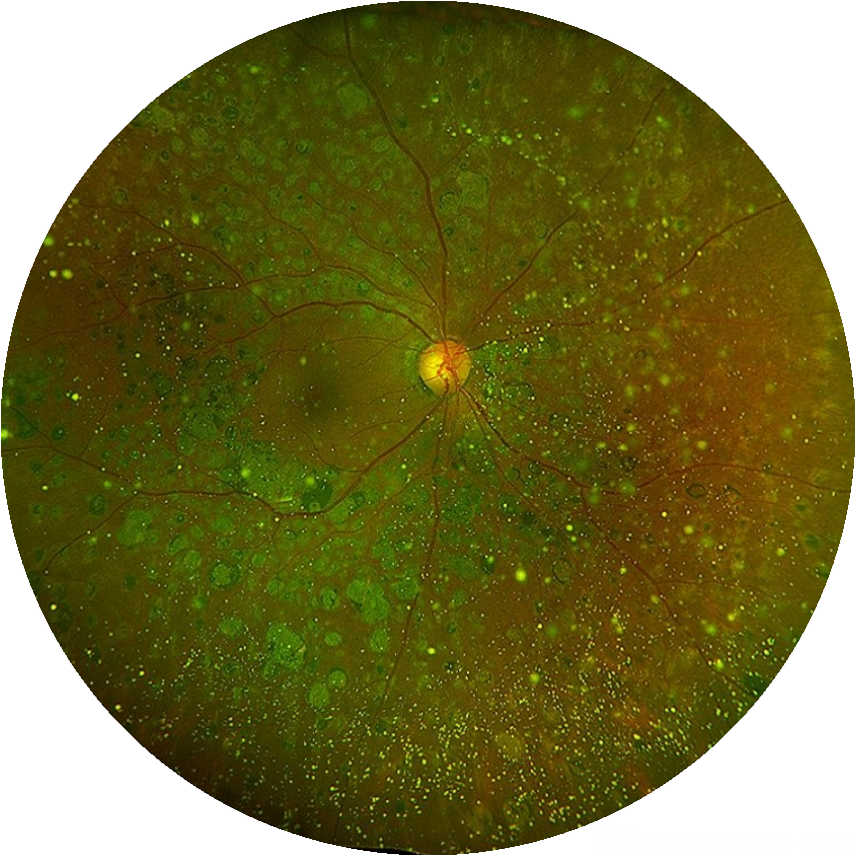
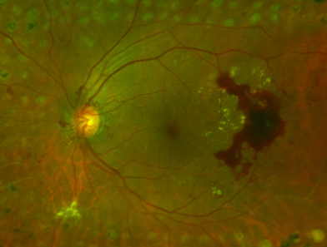
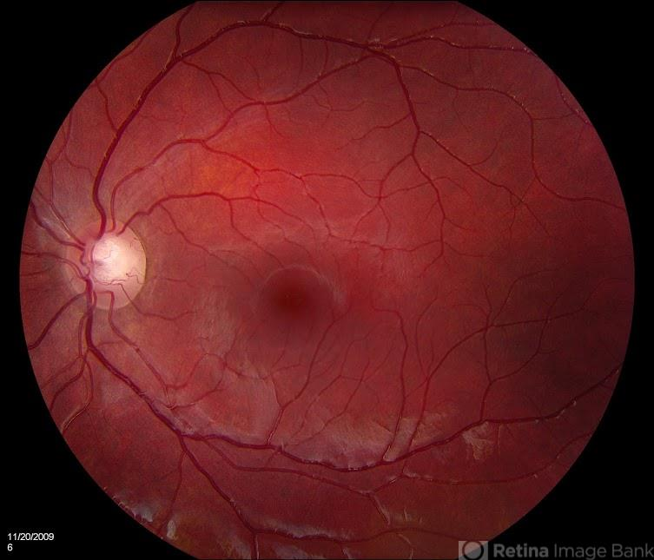
Find those probably with disease versus those without

Slide 4
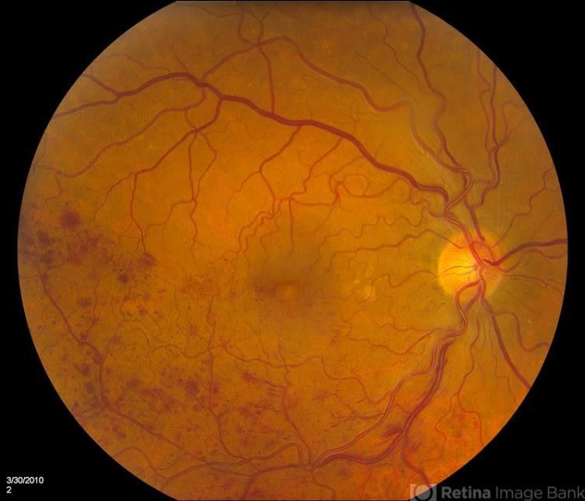
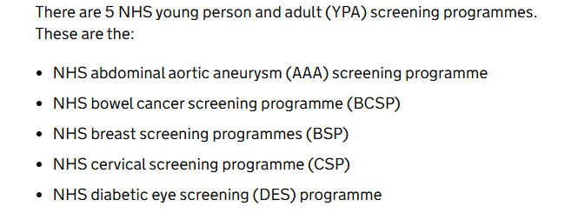
DES is unique!
Other NHS screening programme have a clear target condition
You often capture other important retinal disease
Sometimes first person to notice them!
Notes:
All NHS screening programmes have a clear target condition — and for diabetic eye screening that’s diabetic retinopathy. But uniquely, because we look directly at the retina, we often pick up other important pathology. That makes DES not just a sieve for DR, but also a safety net for other sight-threatening eye diseases. You often capture other important retinal diseases (they just come along “for free”).
Sometimes, you’re the first person to notice them.

Slide 5
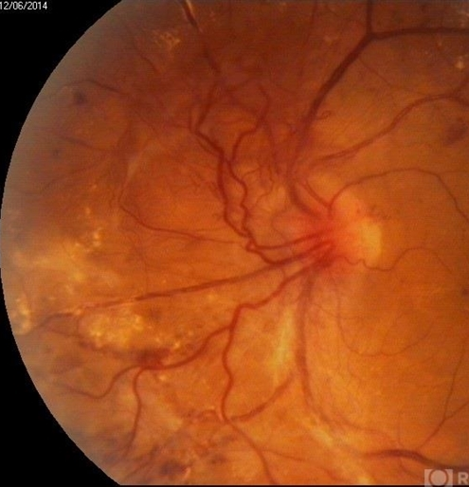
What is diabetic retinopathy?
Microvascular complication of diabetes:
  Affects 30-40% of people with diabetes
Key risk factors:
  Diabetes duration
  Poor glycaemic control
  Hypertension
Major challenge
  Low disease awareness
  Poor systemic risk factor management

Slide 6
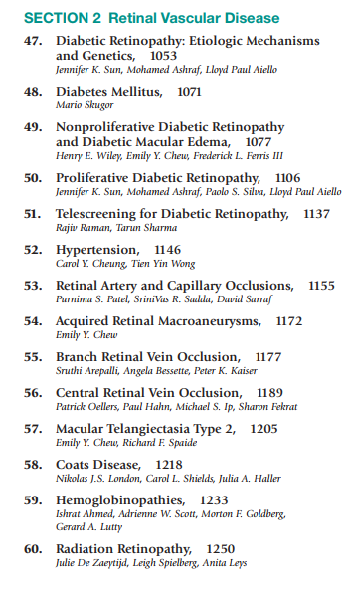
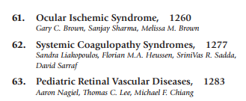
Not the only vascular disease of the eye
Notes:
Ryan’s Retina Index

Slide 7
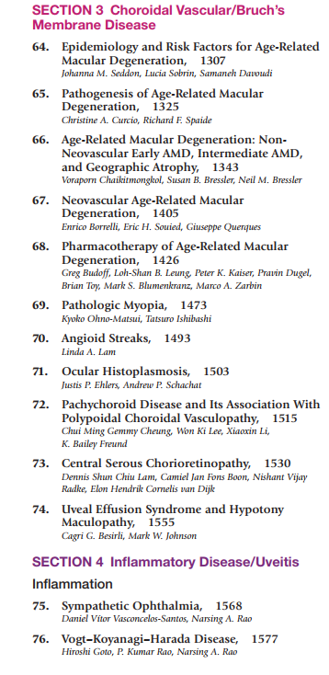
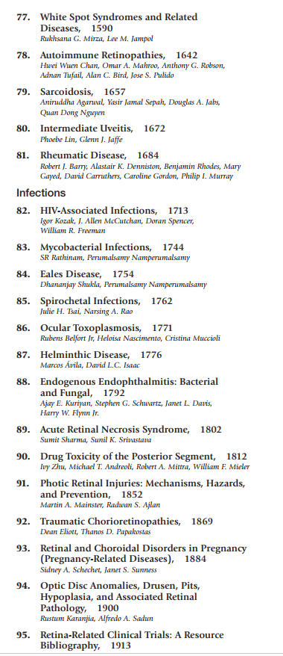
And certainly not the only category of disease in the retina!

Slide 8
The problem is that….
Even medical retina specialist struggle to remember all of these

Slide 9
The Big 3 Retinal Vascular Disease
Neovascular age-related macular degeneration
  Number of cases: 196 million cases globally, projected to be 288 million by 2040
  Up to 10% of AMD cases have neovascular complications
Diabetic retinopathy
  Number of cases: 103 million cases globally, projected to be 161 million by 2045
Vein occlusions
  Number of cases: 17 million cases globally
Notes:
Campochiaro PA. Retinal and Choroidal Vascular Diseases: Past, Present, and Future: The 2021 Proctor Lecture. Invest Ophthalmol Vis Sci. 2021 Nov 1;62(14):26. doi: 10.1167/iovs.62.14.26. PMID: 34817536; PMCID: PMC8637787.

Slide 10
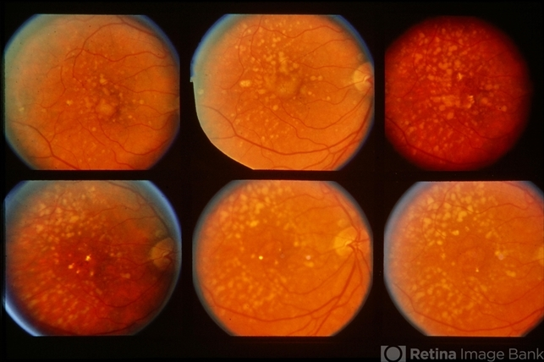
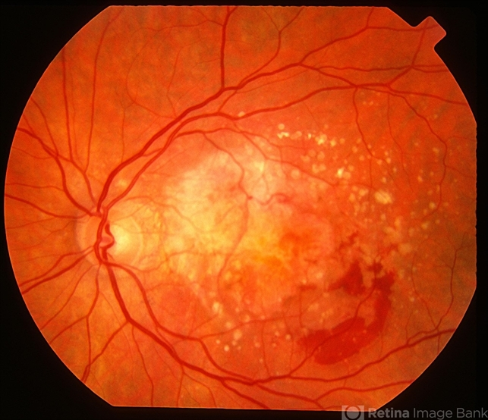
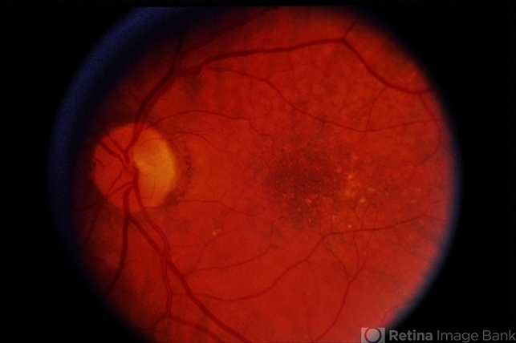
Age-related macular degeneration

Slide 11
AMD is a disease of older people
Age-related macular in persons more than age 55
Drusen in younger patients eg: 20-40s, is never normal
  Consider diagnosis like Malattia Leventinese
  Genetic disease like loss of function complement factor H variant
  Could it be inflammatory?

Slide 12
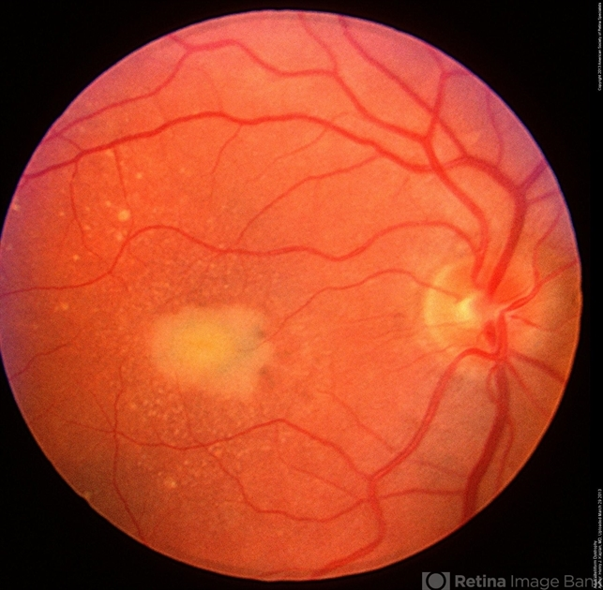
Adult onset vitelliform macular dystrophy
“A peculiar central macular dystrophy” first described in 1974 by J. Donald Gass
Tend to occur in persons aged 30-50, but can be older

Slide 13
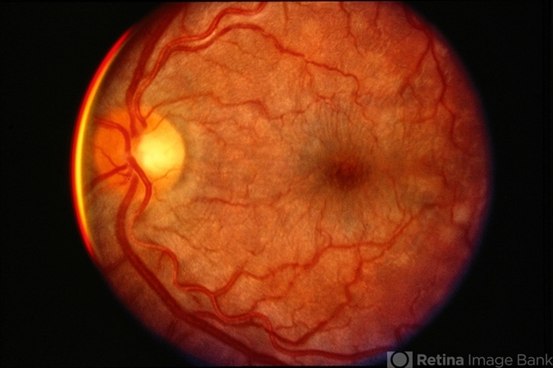
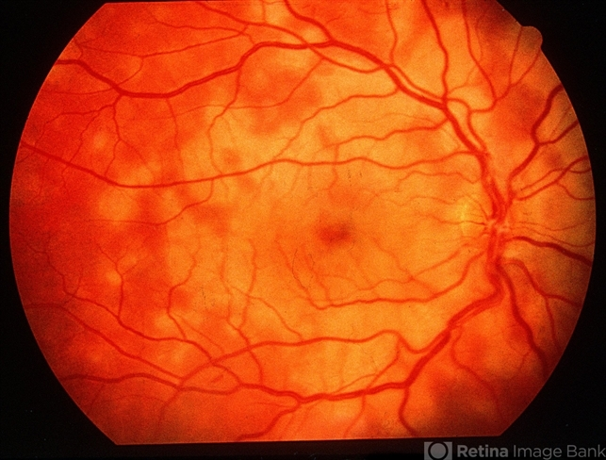
White dot syndrome
Notes:
MEWDS Multiple evanescent white dot syndrome. Acute inflammatory disorder, usually unilateral, multiple small white spots at level of outer retina: blurred vision, photopsia, flu like illness
AMPPE-Acute posterior multifocal placoid pigment epitheliopathy: multiple, plaque-like, creamy lesions that affect young heatlhy men and women. Rapid vision loss, cases are usually bilateral, second eye occurs after first. Flu like symptoms . Rarely associated with central nervous system vasculitis

Slide 14
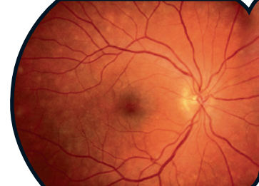
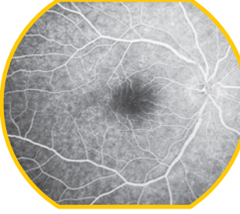
White dot syndrome difficult to differentiate on CFP alone….
Notes:
Yanuzzi retinal atlas 2nd edition

Slide 15
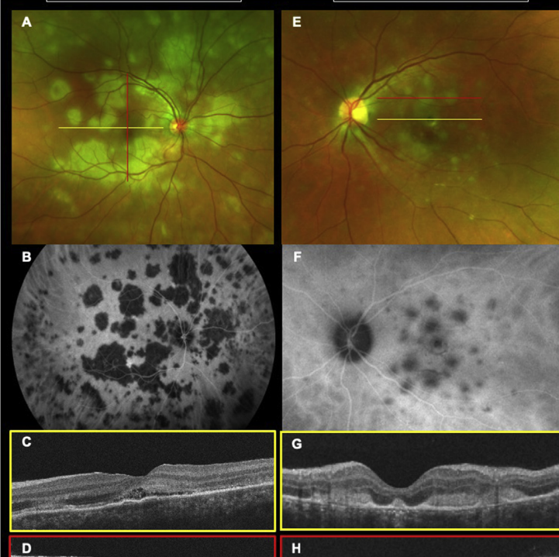
We have other imaging to help us in hospital
Notes:
AMPPE
MFC
Pichi, F., Invernizzi, A., Tucker, W.R. and Munk, M.R., 2020. Optical coherence tomography diagnostic signs in posterior uveitis. Progress in retinal and eye research, 75, p.100797.

Slide 16
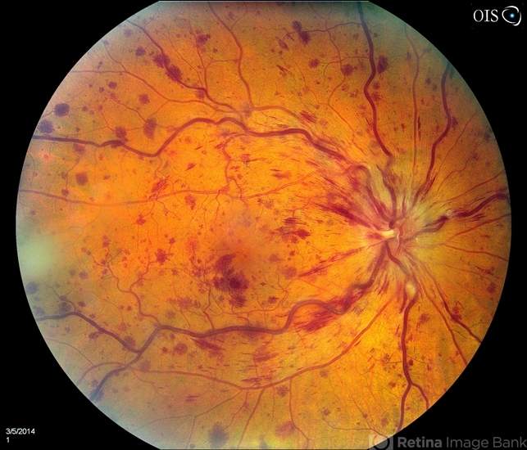
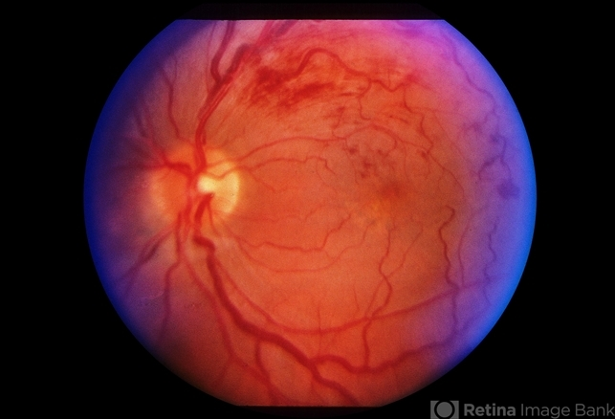
Vein occlusions

Slide 17
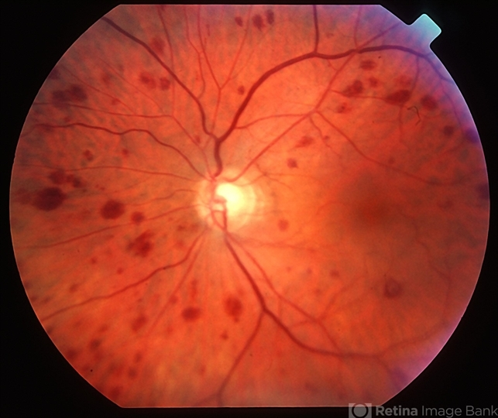
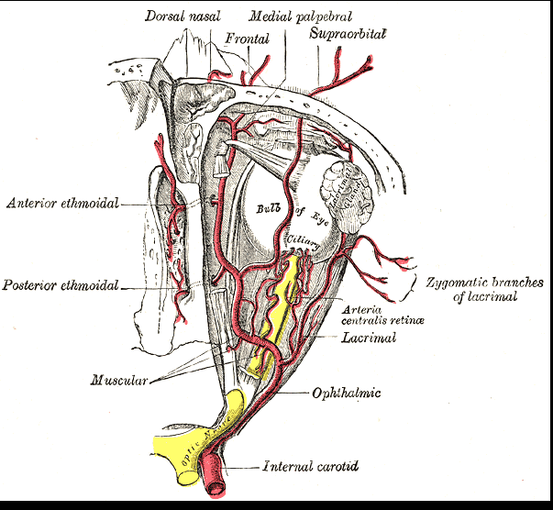
Beware the asymmetrical haemorrhages
Notes:
Ocular ischaemic syndrome
Retina Imagebank
Wikipedia

Slide 18
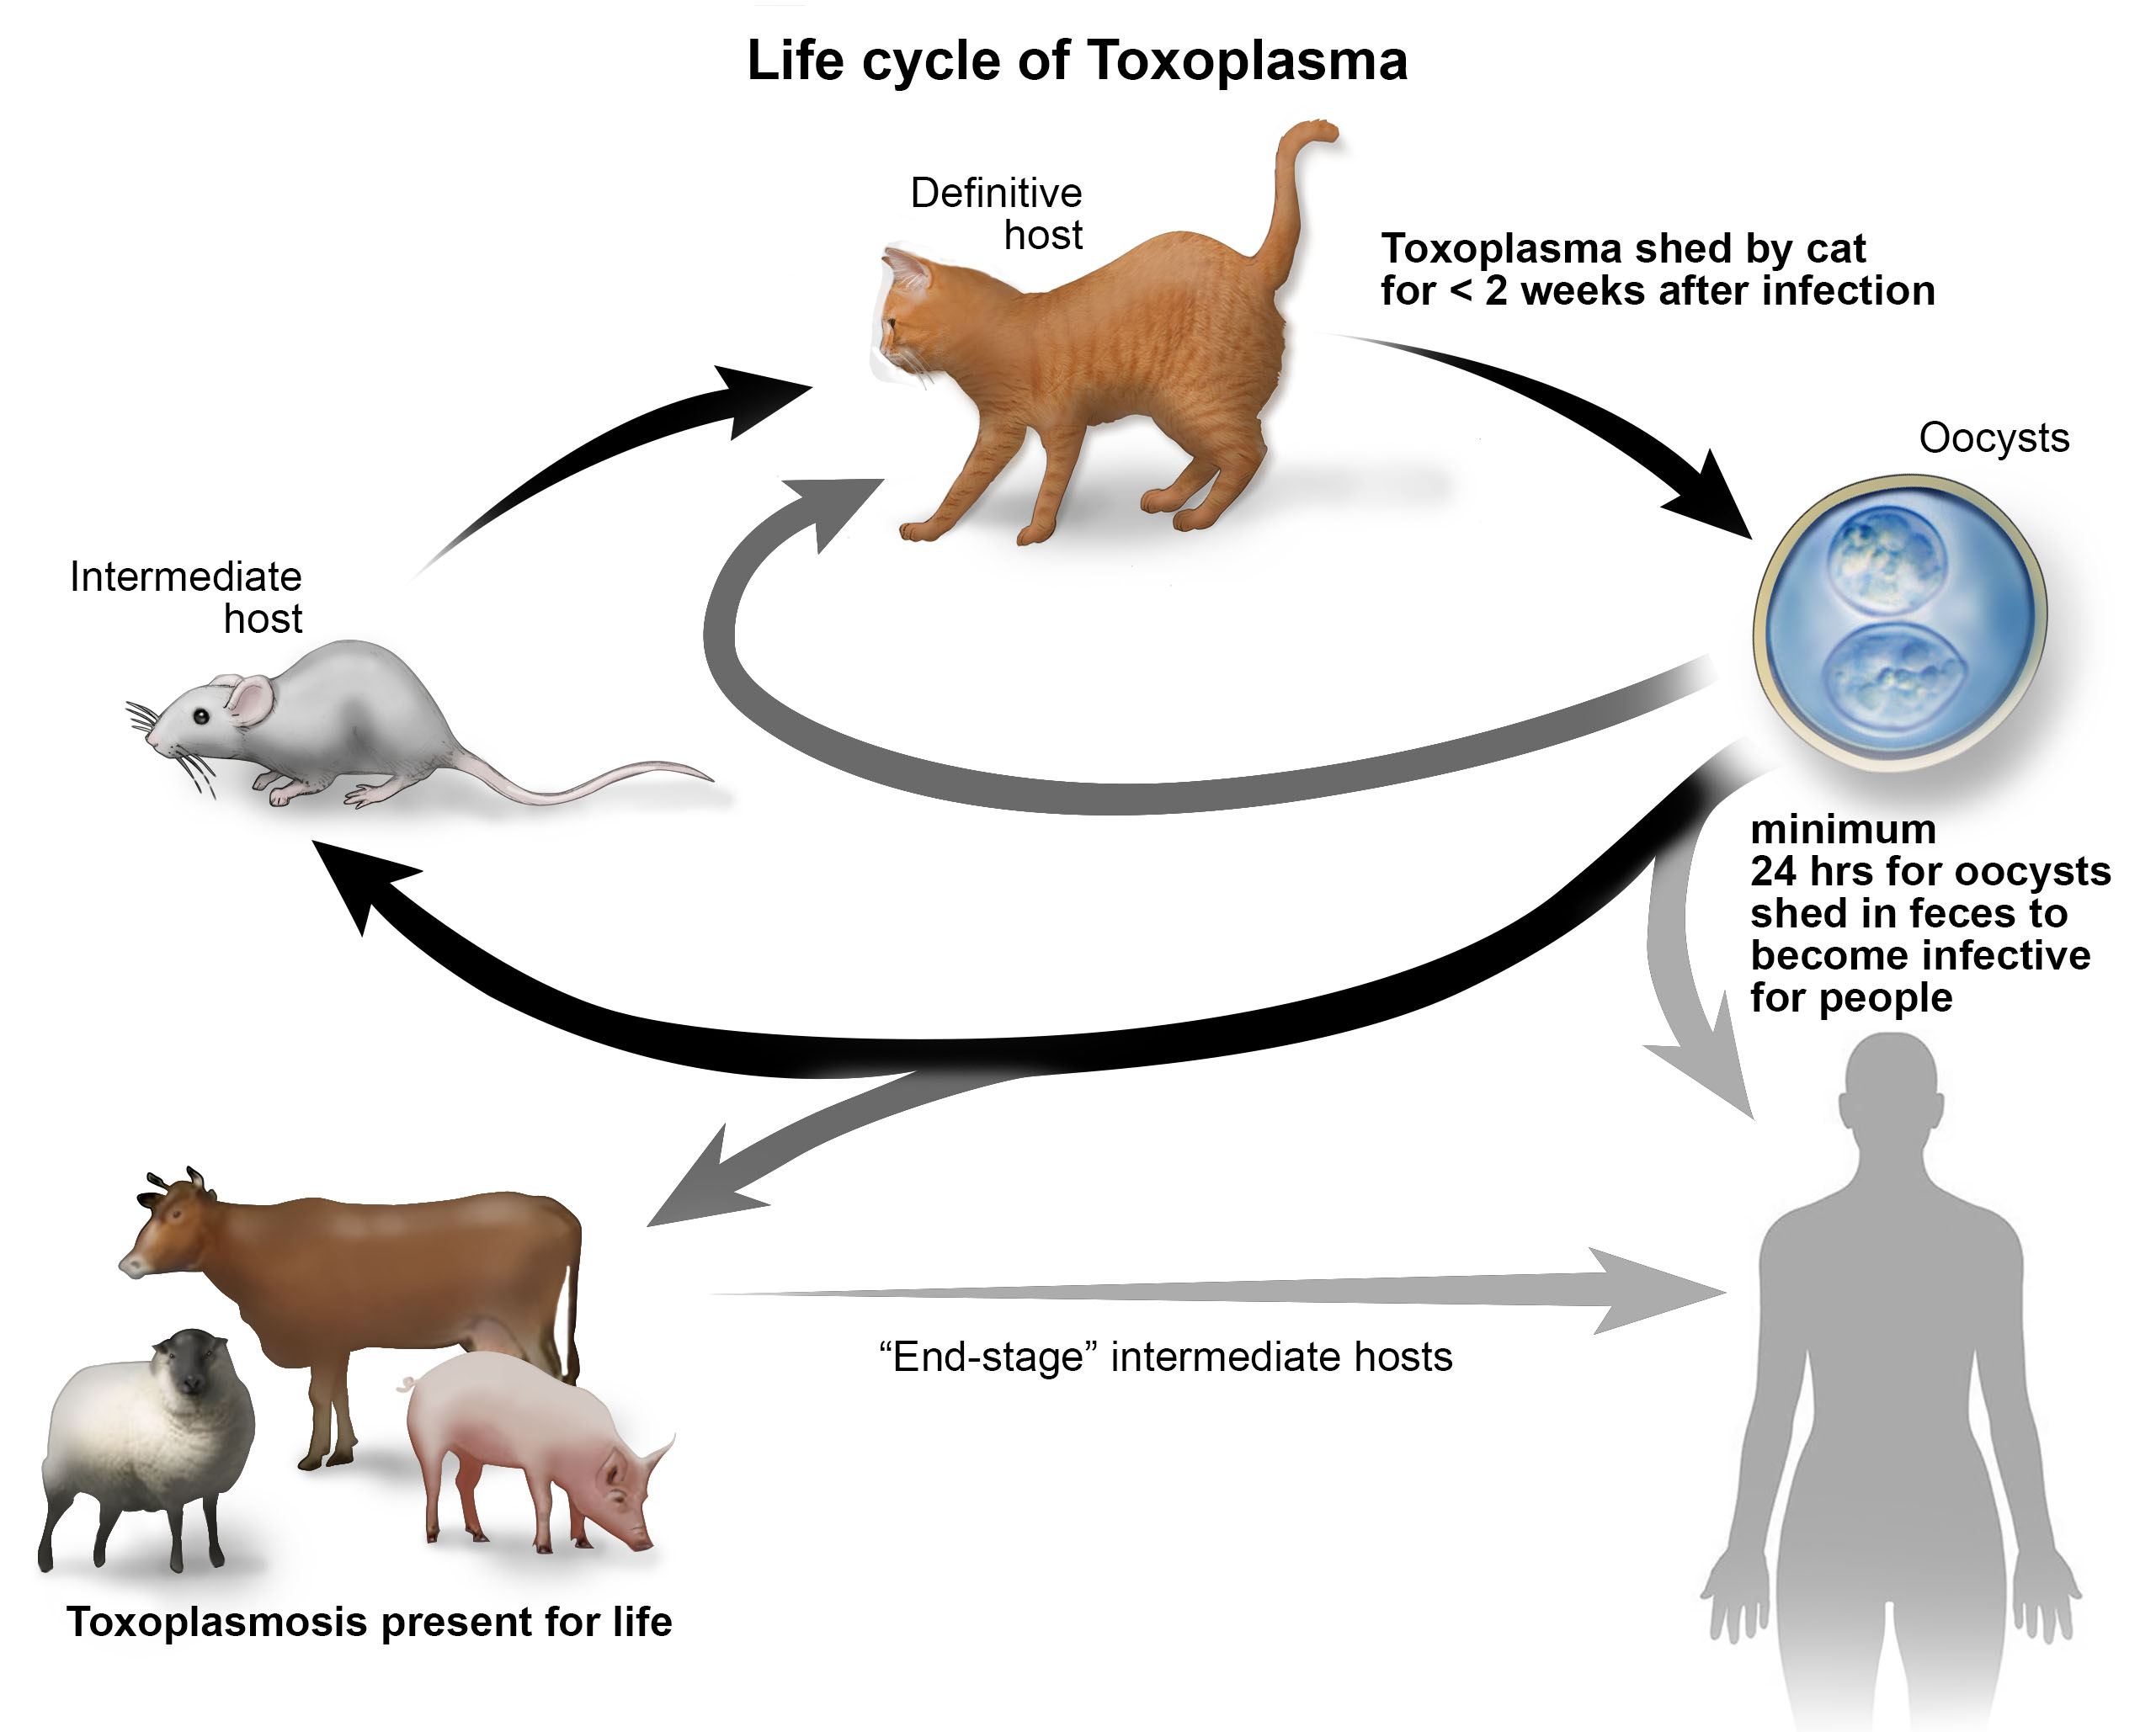
What about other incidental findings?
Common things are common
Toxoplasmosis is the most common cause of infectious uveitis
Notes:
https://www.vet.cornell.edu/departments-centers-and-institutes/cornell-feline-health-center/health-information/feline-health-topics/toxoplasmosis-cats

Slide 19
Other ways of transmission
Foodborne
  Contaminated/ undercooked meat ( pork, lamb, venison)
  Shellfish ( oysters, clams, mussels)
  Food contaminated by knives, utensils, cutting boards, other food in contact with raw meat/ shellfish
  Drinking water contaminated with Toxoplasma
  Unpasteurized goat’s milk
Doesn’t pass from person to person
  Except from mother-to-child
Notes:
Kalogeropoulos D, Sakkas H, Mohammed B, Vartholomatos G, Malamos K, Sreekantam S, Kanavaros P, Kalogeropoulos C. Ocular toxoplasmosis: a review of the current diagnostic and therapeutic approaches. Int Ophthalmol. 2022 Jan;42(1):295-321. doi: 10.1007/s10792-021-01994-9. Epub 2021 Aug 9. PMID: 34370174; PMCID: PMC8351587.

Slide 20
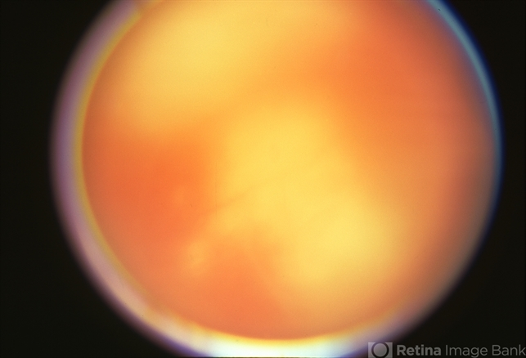
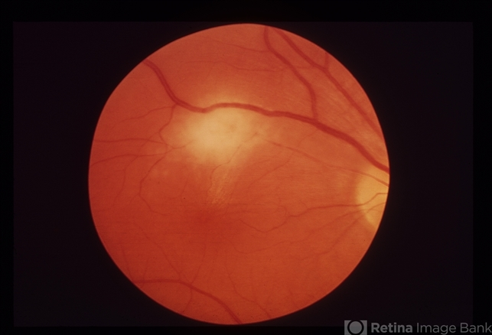
Headlight in the fog

Slide 21
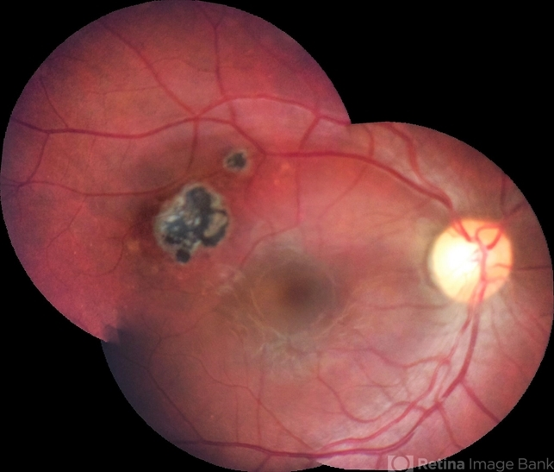
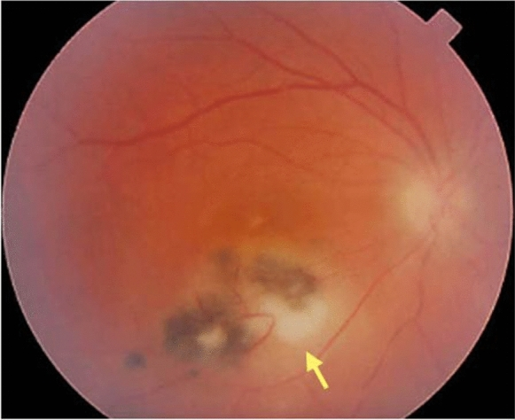
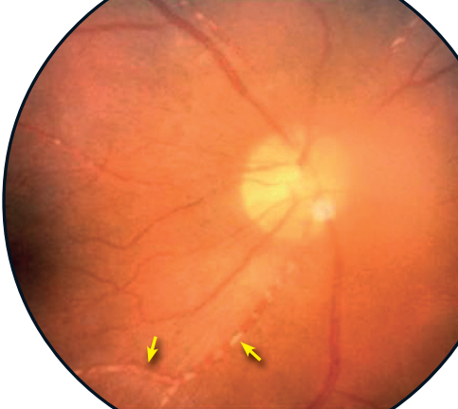
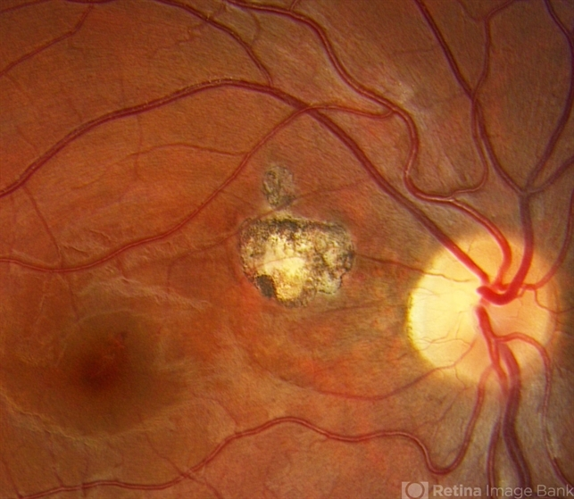
The toxoplasmosis you would see
Kyrieleis Plaque
Notes:
Last image is Kyreileis plaque

Slide 22
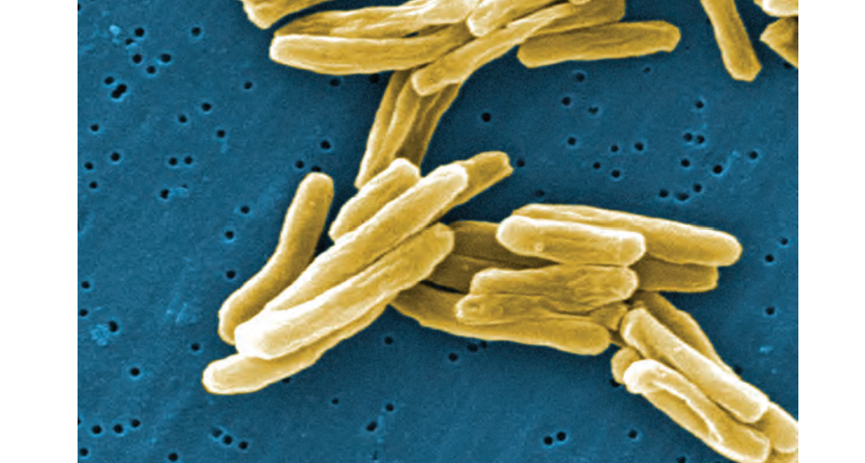
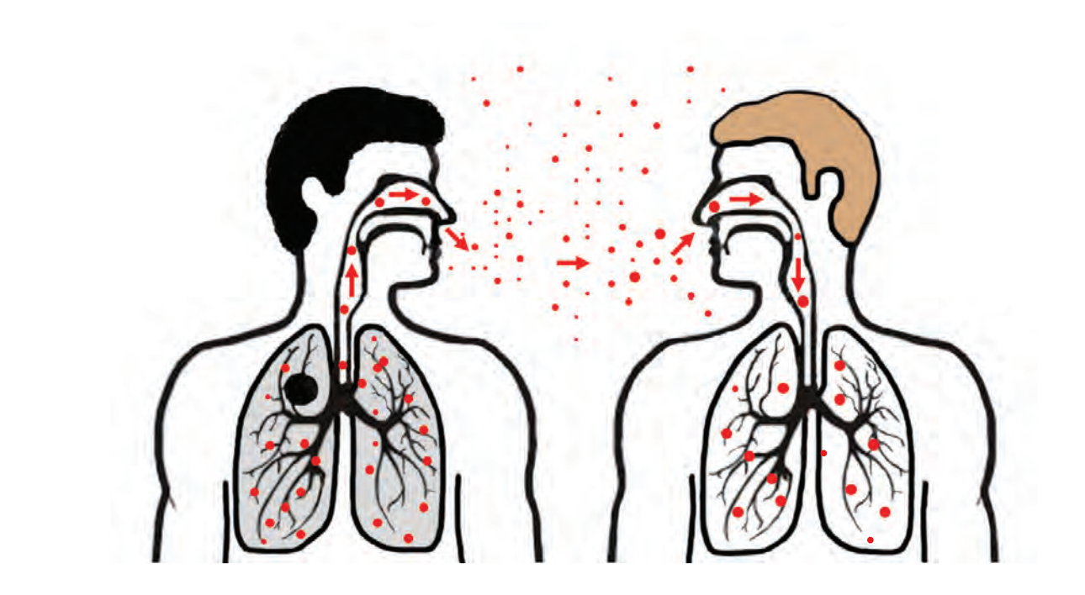
Tuberculosis
Up to one third of world’s population estimated to be infected with latent TB
10.6 million people per year fell ill with TB in 2022
Airborne disease caused by the bacterium Mycobacteria tuberculosis
Known as the ‘great mimic’ as can affect virtually any organ in the body
Notes:
https://www.who.int/publications/i/item/9789241550239 ( Latent TB data)
https://www.who.int/news-room/fact-sheets/detail/tuberculosis ( TB factsheets)
https://www.gov.uk/government/news/tuberculosis-tb-cases-continue-to-rise-in-england-in-2023 ( TB in the UK )
https://www.cdc.gov/tb/education/corecurr/pdf/chapter2.pdf ( TB diagrams)
https://bmjopenrespres.bmj.com/content/9/1/e001225
Tubercular Retinal Vasculitis Ling Chen JAMA ( Occlusive vasculitis)
https://www.aao.org/education/topic-detail/ocular-tuberculosis-tb--asia-pacific-2 ( OTB images)
Vasconcelos-Santos, D.V., Rao, P.K., Davies, J.B., Sohn, E.H. and Rao, N.A., 2010. Clinical features of tuberculous serpiginouslike choroiditis in contrast to classic serpiginous choroiditis. Archives of ophthalmology, 128(7), pp.853-858.

Slide 23
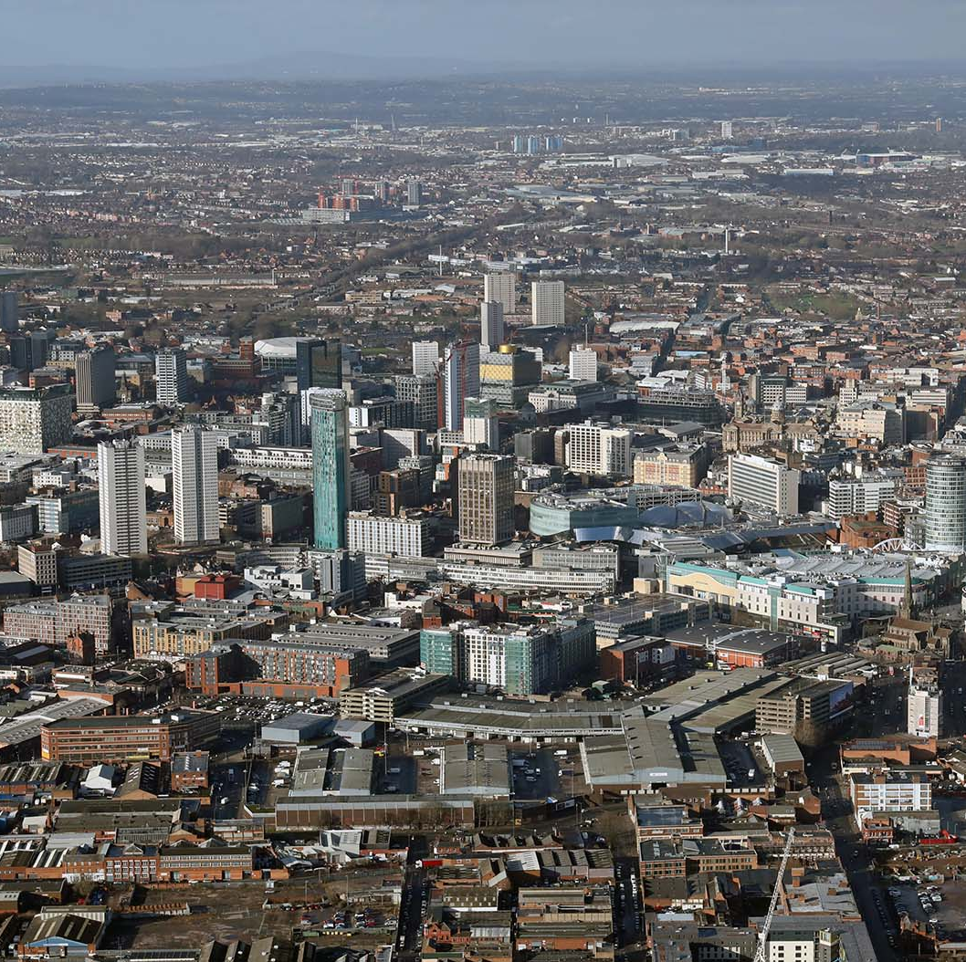
How are we doing with TB in the UK?
Remains a low incidence country
Active TB is on the rise
  TB notifications have risen to close to 5000 cases a year
More common in large areas like London and Birmingham
  And in areas with higher level of deprivation

Slide 24
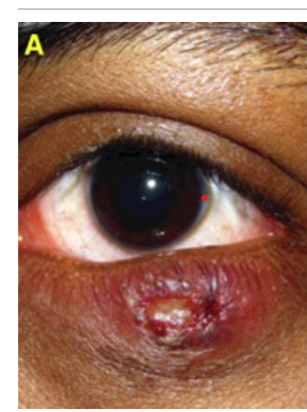
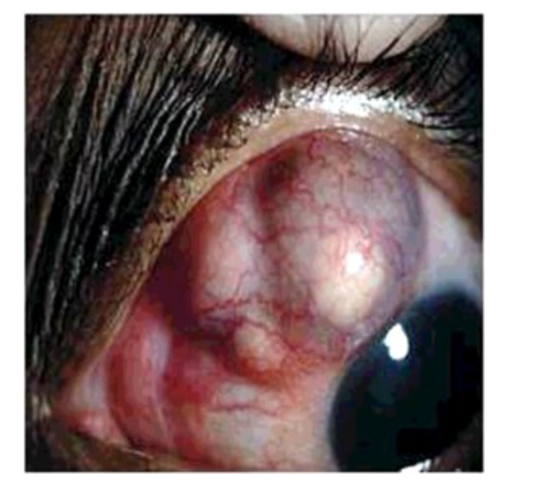
Ocular manifestations of TB
External eye disease
Intraocular disease

Slide 25
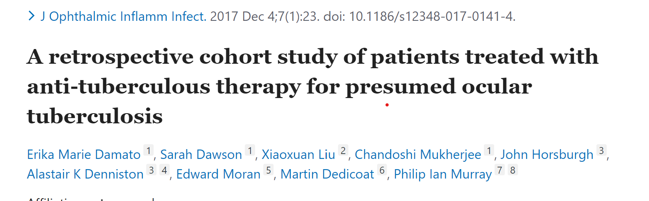
BMEC Experience
In cohort of 41 ocular TB patients between 2010 to 2014
  Only 1 patient presented with nodular scleritis
  2 patients presented with symptoms other than intraocular inflammation

Slide 26
Typical features of OTB
Classic presentation tends to be posterior uveitis
  Peripheral occlusive vasculitis
  Choroidal granuloma
  Serpiginous choroiditis

Slide 27
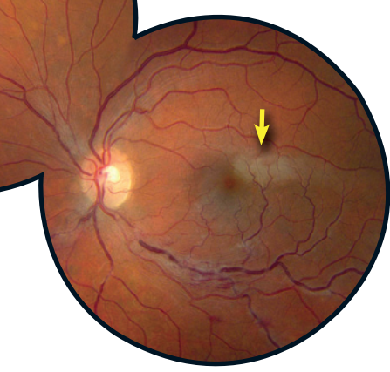
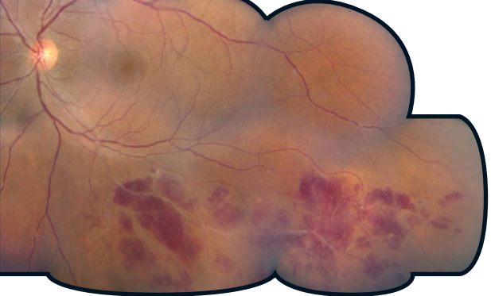
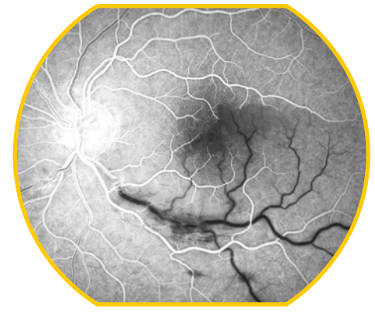
Occlusive vasculitis
Notes:
Grayish whitening in the superior temporal juxtafoveal area

Slide 28
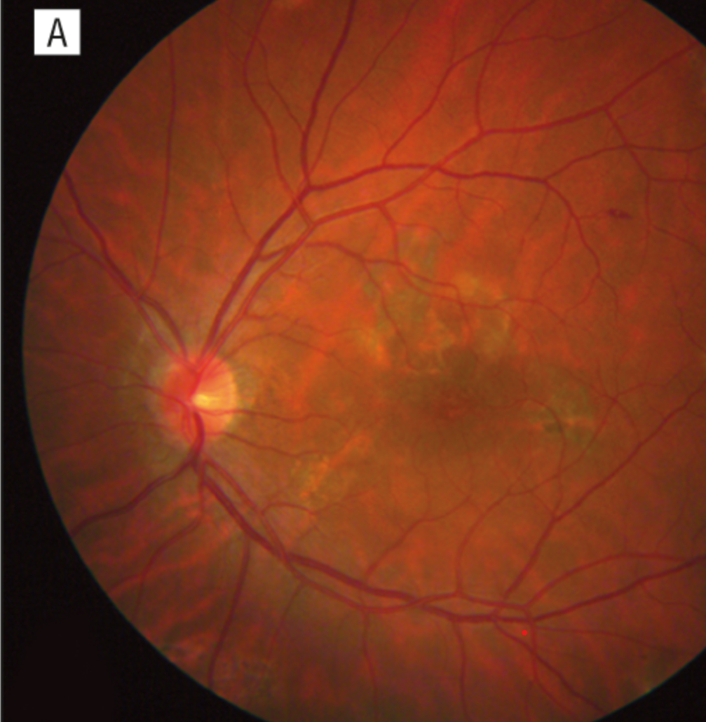
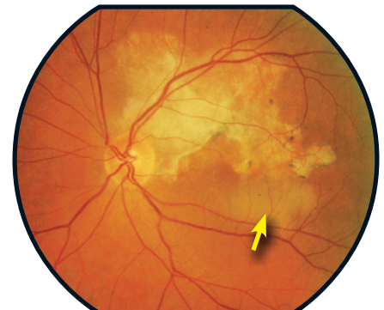
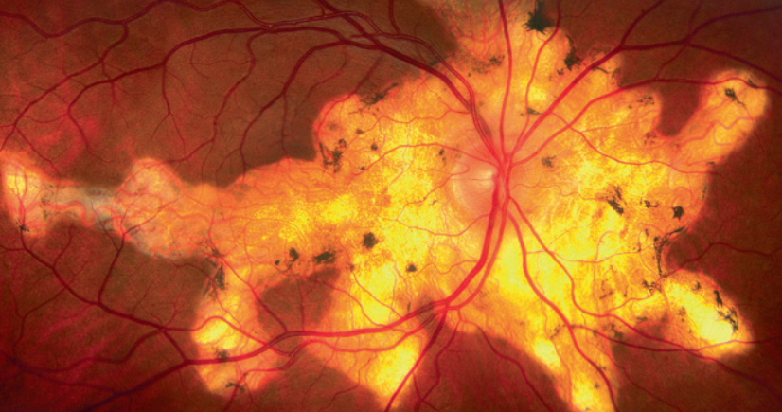
Serpiginous OTB
Notes:
1st image:Classic serpiginous start at the optic disc and spread in a contiguous, centrifugal manner
2nd image serpiginous changes with atrophy and fibrosis, fluffy white lesion is area of activity

Slide 29
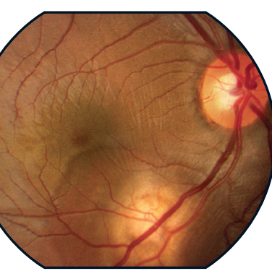
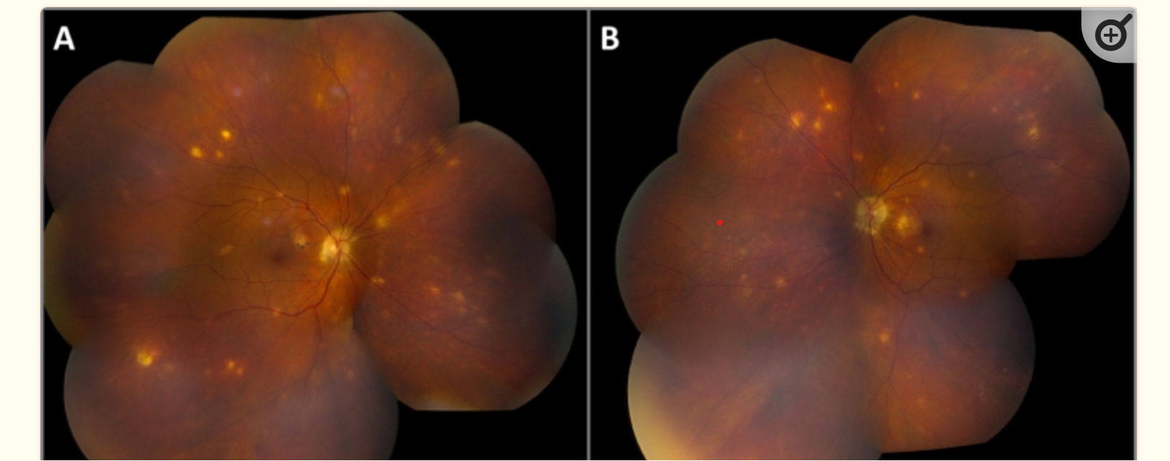
Choroidal granuloma
Can be solitary as a single elevated mass
Or multiple representing tubercles
Notes:
Can be solitary as a single elevated mass
Or multiple representing tubercles

Slide 30
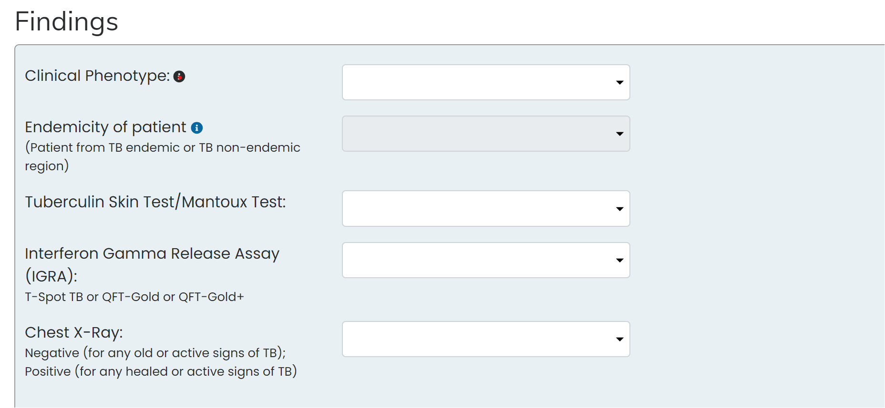
It is difficult for us to tell without other tests!
Notes:
COTS calculator

Slide 31
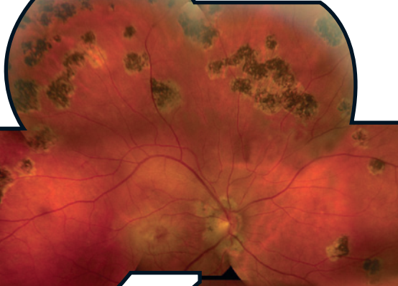
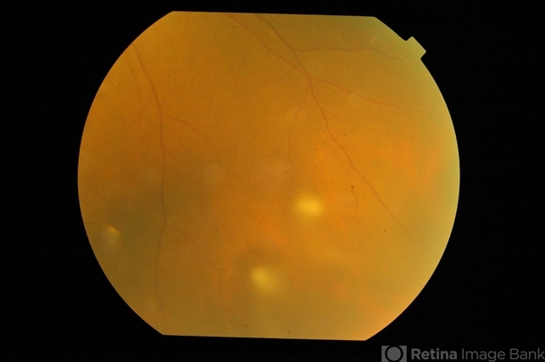
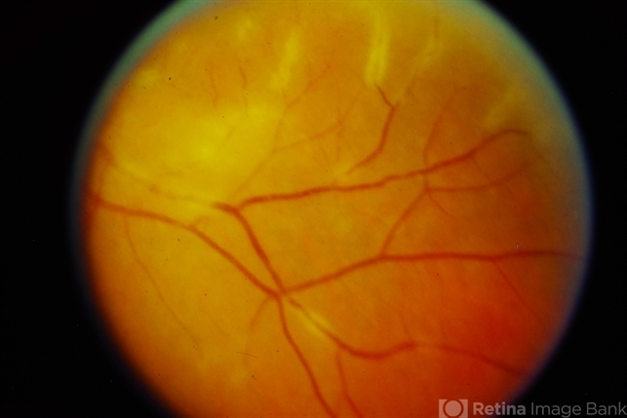
How about sarcoidosis?
Notes:
Can affect any part of the eye like TB, anterior , intermediate, posterior
Vitreous snowballs

Slide 32
Another common condition
Myopia
  Global prevalence of childhood myopia is growing
  Affecting approximately 1/3 of children and adolescents
  Global incidence of myopia will exceed 740 million cases
Notes:
Liang, J., 2025. Trend and Projection of Myopia in Children and Adolescents from 1990 to 2050: A Comprehensive Systematic Review and Meta-analysis”. Br J Ophthalmol, 362, p.109.

Slide 33
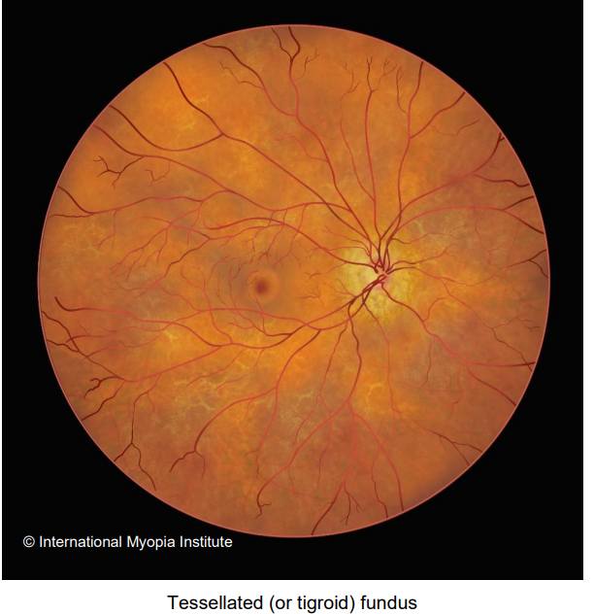

Tessellated fundus

Slide 34


Patchy and macular atrophy

Slide 35


Lacquer cracks

Slide 36


Neovascularisation in myopia

Slide 37

Don’t forget…

Slide 38
Useful references
Retina Image Bank (ASCRS)- Free Images
  https://imagebank.asrs.org/home?path=%2F
Ayton, L., 2017. The Retinal Atlas–Second Edition K Bailey Freund, David Sarraf, William F Mieler, Lawrence A Yannuzzi Elsevier 2016
International Myopia Institute
  https://myopiainstitute.org/

