Slide 1

What might the impact of the changes be?
Professor Tunde Peto
Professor of Clinical Ophthalmology QUB
Chair of Network of Ophthalmic Reading Centres UK
Clinical Lead for Diabetic Eye Screening in NI and Clinical Lead for Diabetic Eye, Medical Retina Consultant at the Belfast Health and Social Care Trust

Slide 2
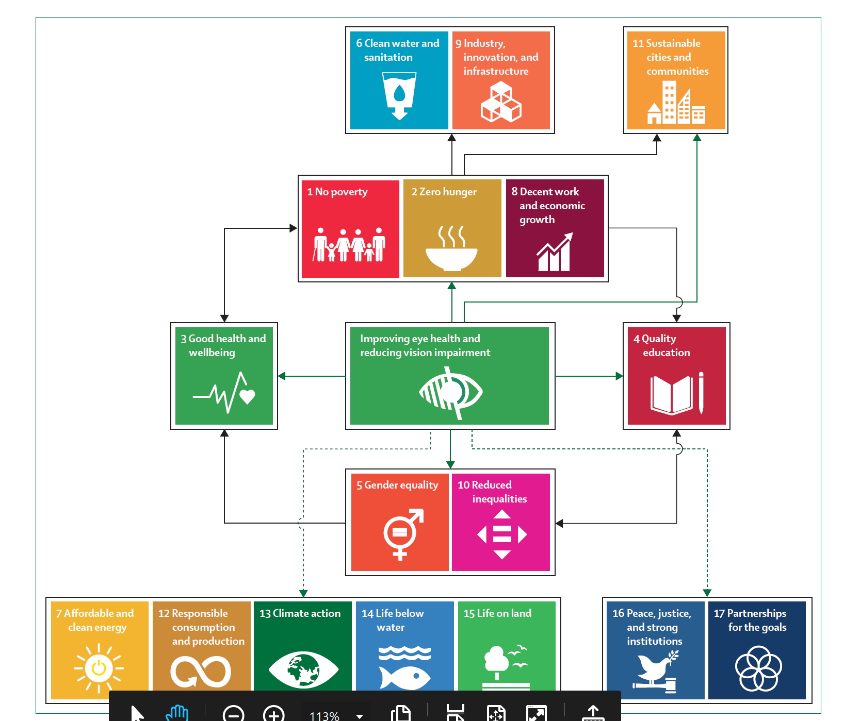
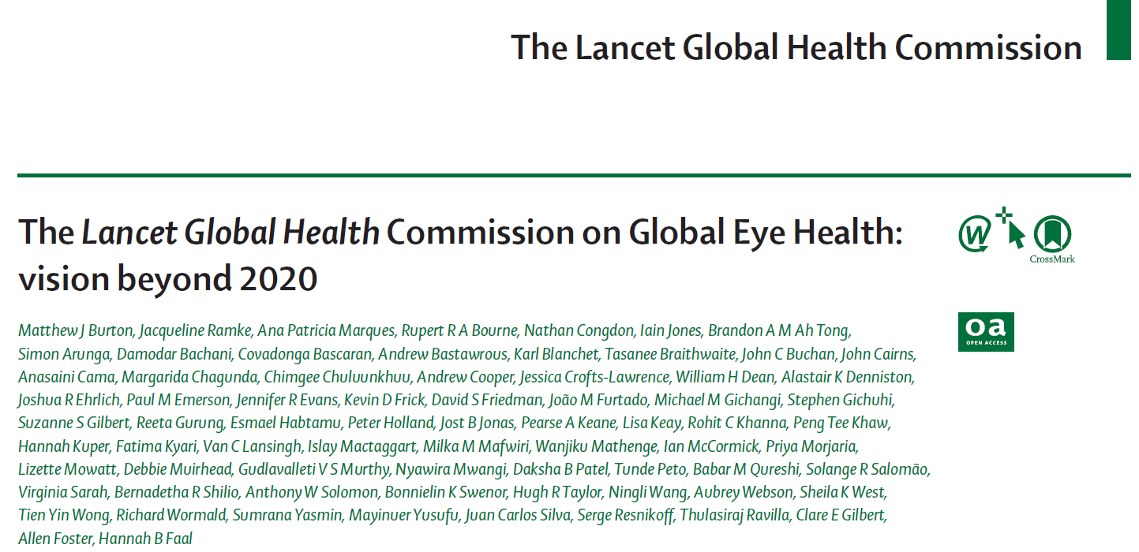
Eye-health contributes to Sustainable
Development Goals

Slide 3
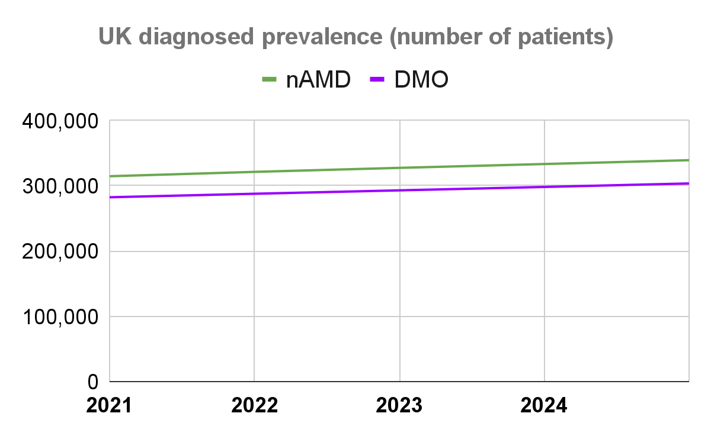
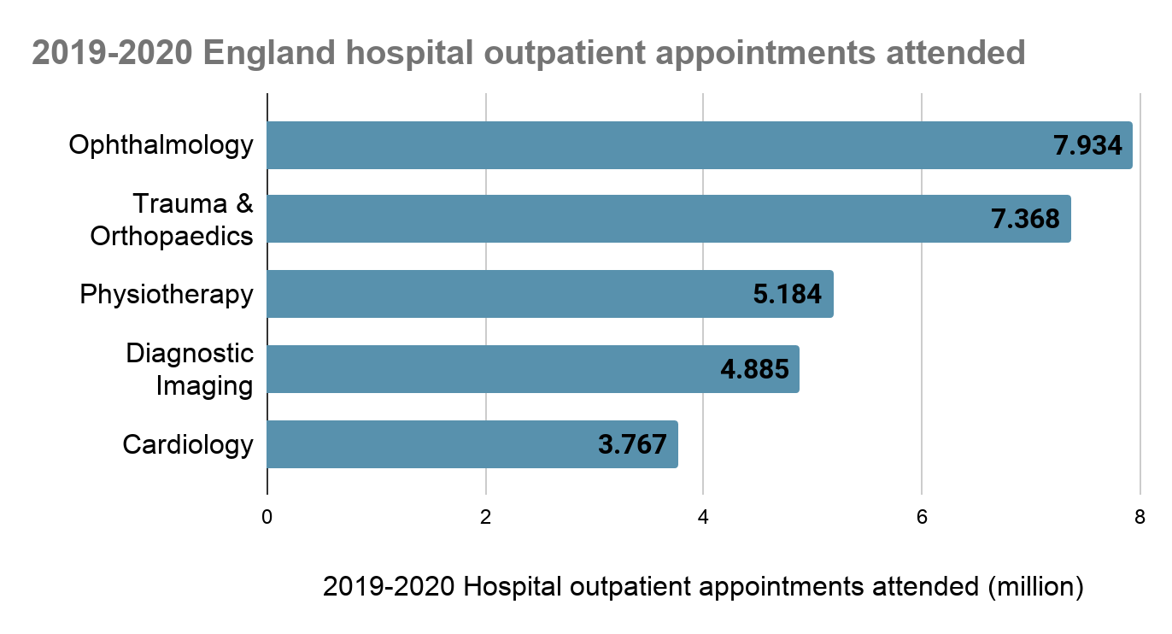
Ophthalmology is the busiest specialty in the UK
Due to an ageing population and growing non-communicable disease eye-related services will only get busier
National level data are crucial to change pathways
Ophthalmology represents approximately 10% of all hospital outpatient appointments in 2021-22
Source: MORSE 2021 epi update & NHS digital, publicly available data.

Slide 4
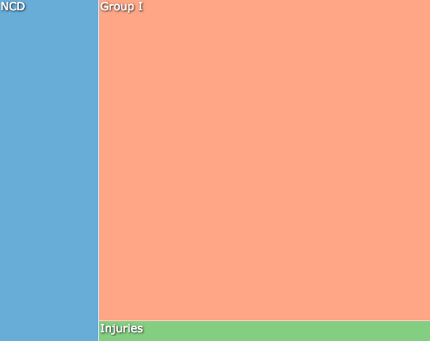
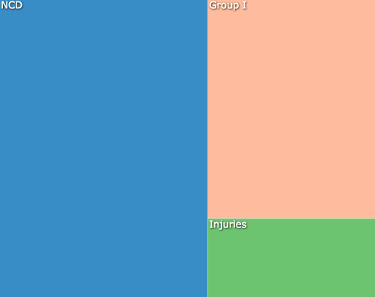

Why is understanding population health important for DESP? - the epidemiological transition
Nigeria
India
Germany
~70% disease burden due to infectious, child and maternal health conditions (“Group 1”)
~30% disease burden due to NCDs and injuries
~30% disease burden due to infectious, child and maternal health conditions (“Group 1”)
~70% disease burden due to NCDs and injuries
~5% disease burden due to infectious, child and maternal health conditions (“Group 1”)
~95% disease burden due to NCDs and injuries
Set up and change programmes relevant to the stage!
gbdcompare

Slide 5
We need appropriate grading and OCT
Diabetic Eye Disease
Anterior segment disease
Retinopathy
Cataract
Rubeosis/Rubeotic glaucoma
Maculopathy
VR surgery
DMO requiring treatment
No treatment required/
available

Slide 6
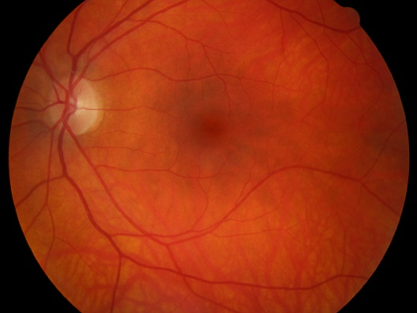
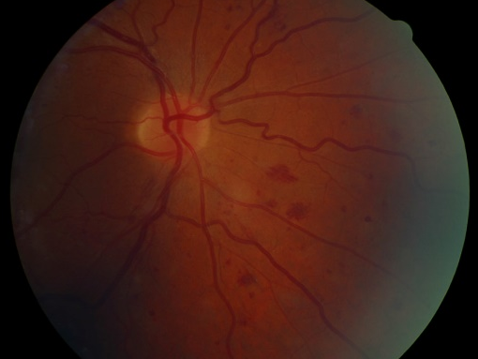
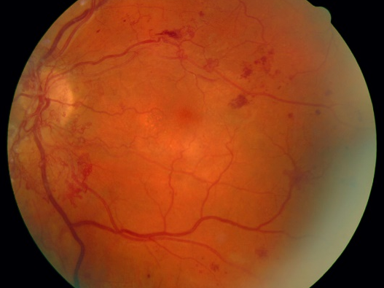
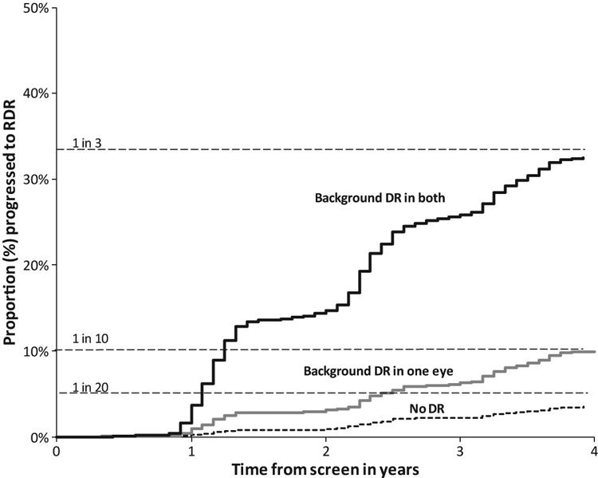
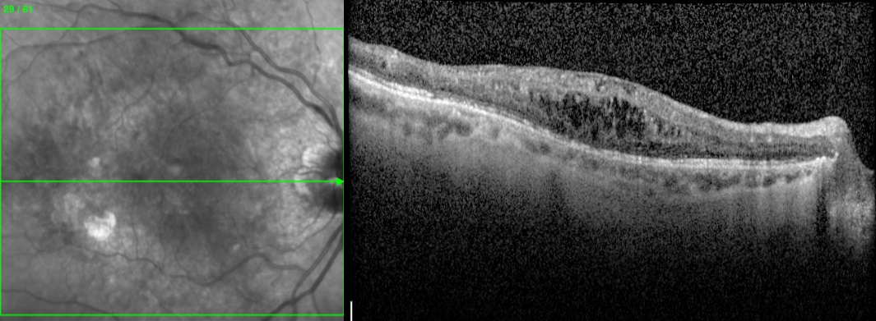
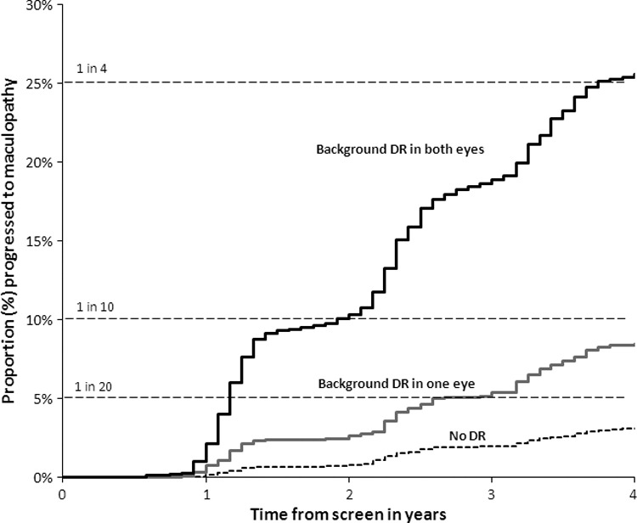
We have reliable data on the progression to proliferative disease and DMO
Scanlon PH, Stratton IM, Histed M, Chave SJ, Aldington SJ. Acta Ophthalmol. 2013 Aug;91(5):e335-9.

Slide 7
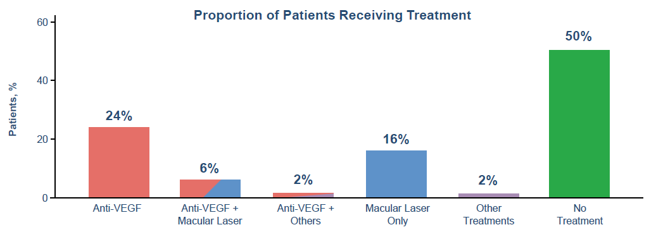
Half of Patients Did Not Receive Treatment Following DME Diagnosis
Anti-VEGF was most the common treatment
Median (Q1, Q3) time from diagnosis to anti-VEGF treatment was 24 (0, 410) days
DME, diabetic macular edema; Q1, first quartile; Q3, third quartile; VEGF, vascular endothelial growth factor.

Slide 8
Implications
Appropriate patients in the updated pathways
We need to concentrate on evaluating all equipment so they are fit for purpose
We need training for administrators, failsafe officers, screeners/graders/optoms, orthoptics, doctors, diabetologists…
Patient buy-in will be important

Slide 9
So what matters to people?
They want to see so they can contribute to society and enjoy their life to the fullest:
Our role is to enable this!

Slide 10
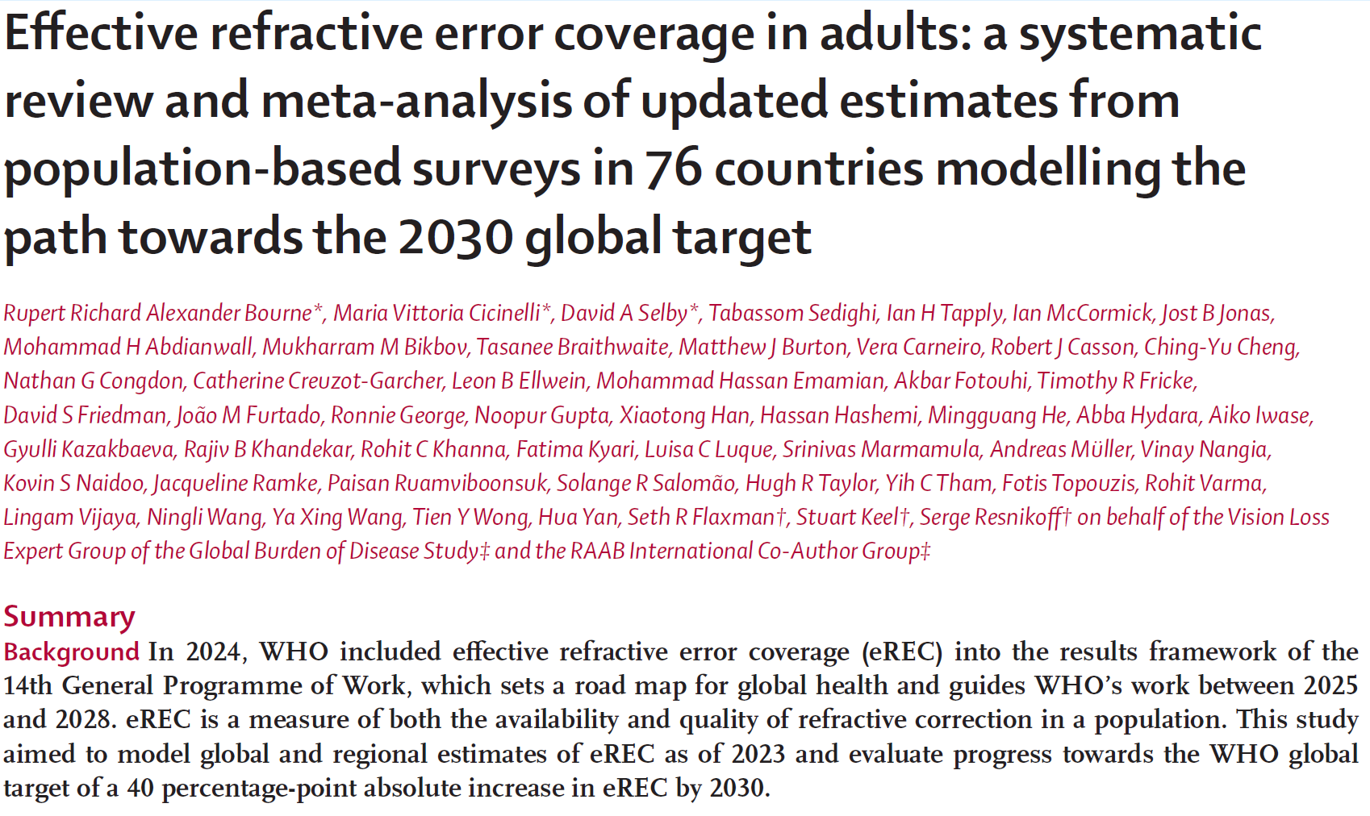
In July 2021: UN Resolution on Vision

Slide 11
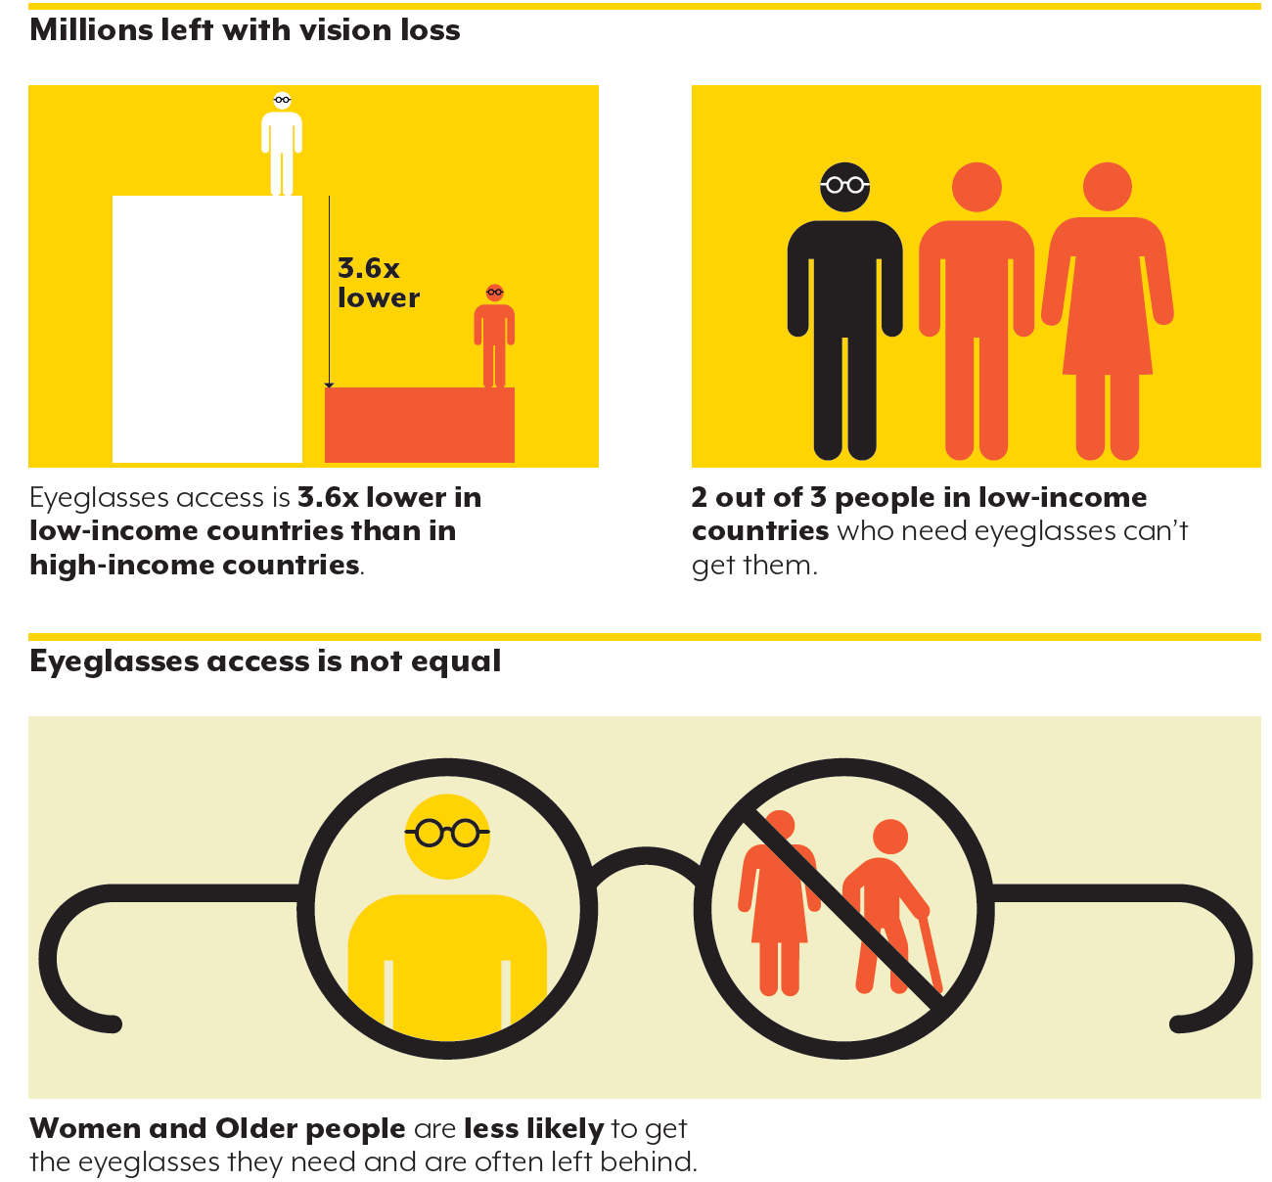
We analysed 237 studies from 76 countries including 815 273 participants for establishing the baseline need for effective refractive coverage

Slide 12
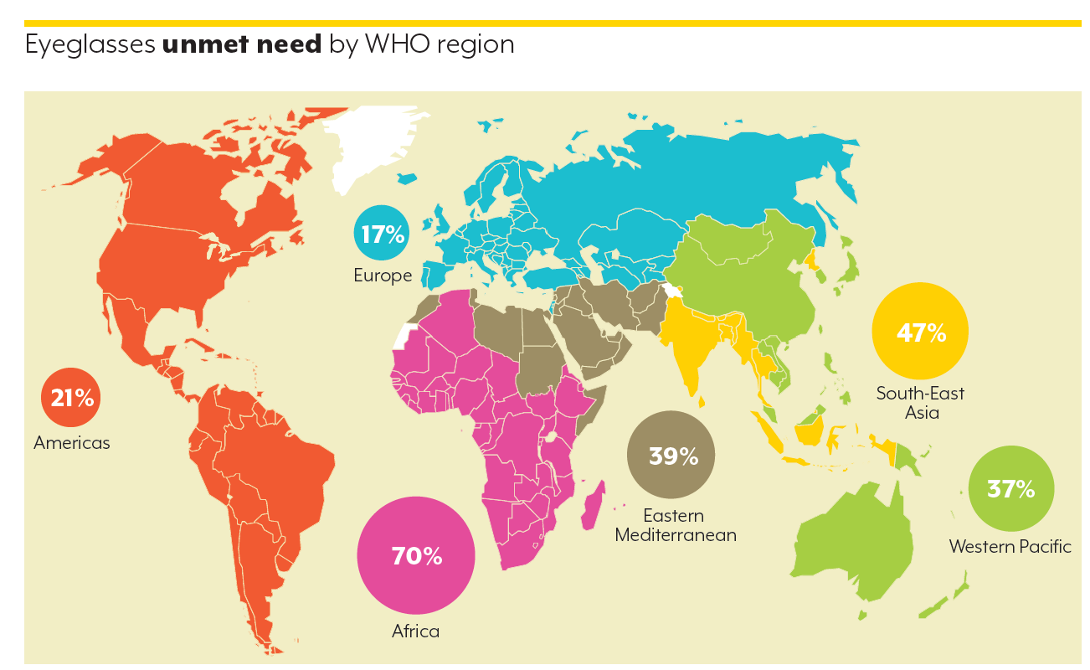
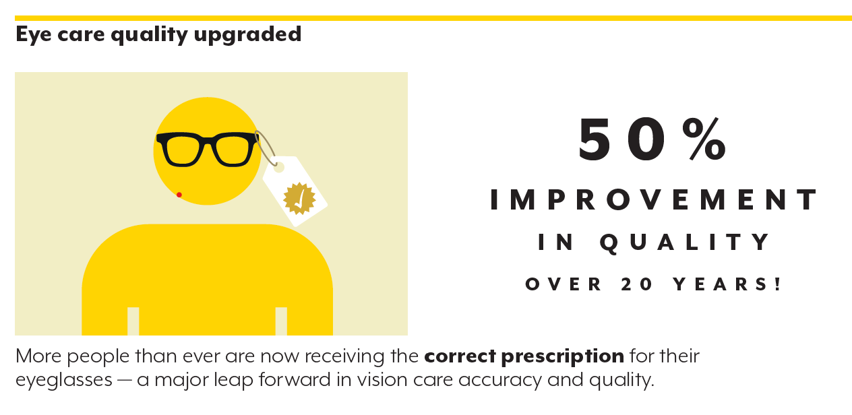
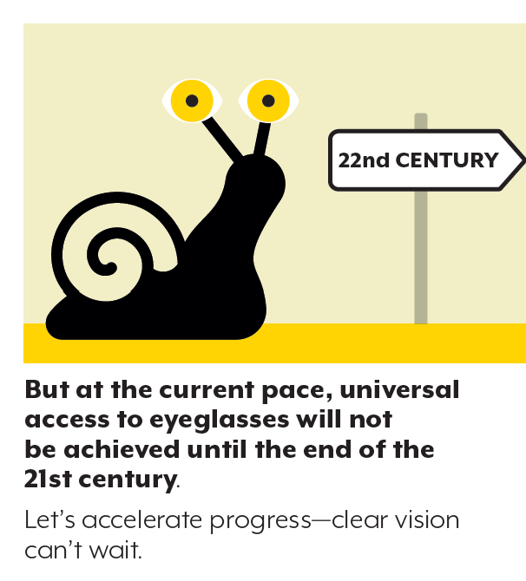
On any trips, eyeglasses are the most important reason why people attend

