Slide 1

Best practice for evaluating AI for screening prior to live implementation
Alicja R Rudnicka
E: arudnick@citystgeorges.ac.uk

Slide 2
Aims of today
Present findings from recent evaluation of AI-enabled systems for the detection of diabetic retinopathy (DR)
ARIAS role/position in DES pathway
Outline next steps from evaluation to implementation
‘AI is to be steered not feared’

Slide 3
54 potentially eligible ARIAS identified for DR detection from retinal images with Class IIa CE mark
32 ARIAS did not have CE certification
May 2022 Invitations sent to 22 vendors that met project criteria - Class IIa CE ARIAS for DR detection (7 CE mark uncertain) requesting expressions of interest in study participation by 30th June 2022
15th June reminders sent to 4 vendors - no further responses received
9th October 2022 reminders sent to 9 vendors. One vendor responded & withdrew as unable to run ARIAS offline. No other responses received from 8 vendors
30th June 2022 18 vendors replied with expression of interest in participating in the study
23rd July 2022 follow up email sent provided additional information and ARIAS outcomes sought, NHS DESP imaging and grading protocols as approved by the National Screening Committee, confirmation of CE mark, ability to run offline, type of DR grading, runtime processing.
21st October 2022 email sent to 9 vendors with Anonymous Q&A, specifications of ARIAS output data formats for evaluation and information on how to package the ARIAS software for offline processing
4 vendors withdrew*
20th September 2022 9 vendors responded positively raising several questions before confirming continued participation in the study
December 2022 5 vendors confirmed participation in the study
December 2022 - July 23 3 new vendors expressed interest in the study were guided through enrolment
In total 8 vendors proceeded with the clinical evaluation
9th October 2022 - “Holding email” sent to 9 vendors stating that all questions and answers (Q&A) would be shared anonymously with this vendor group
*Reasons given for withdrawal: not confident their ARIAS would perform well on our data, not able to deliver ARIAS within 6-month time window, Algorithm does not produce diabetic retinopathy specific outcomes

Slide 4
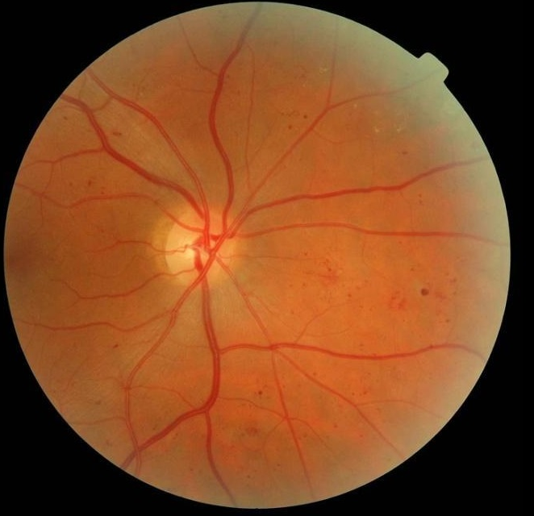
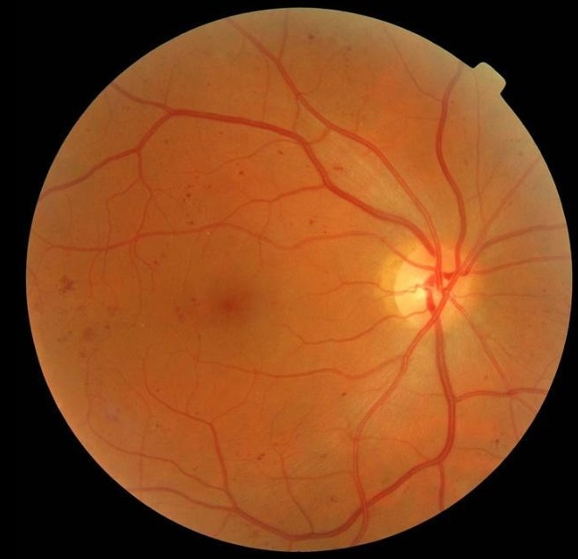
Methods: data curation / creation safe network for ARIAS processing
NEL ~200K episodes (1.2 million images)
1st January 2021 – 31st December 2022
Wide age range, ethnic diversity (35% White, 40% S. Asian, 20% Black) & full spectrum eye disease & DR
Images have NOT been used to develop or train any ARIAS
8/25 vendors invited participated
Test data→confirm ARIAS outputs
Vendors algorithm unable to access human DR grades or other meta data
Images graded, data stored
along with demographic information for all episodes within clinical screening database infrastructure
Pseudo anonymized images (1.2 million) extracted to restricted access computer facility for processing of images by ARIAS offline
Post-ARIAS-processing outputs linked with demographic screening data
CURATED DATA SET

Slide 5
North East London evaluation dataset (1st Jan 2021 to 31st Dec 2022)
Characteristics | White n = 64,023 | Black n =34,058 | South Asian n = 78,415 | Other/Unknown n = 24,942 | Total n = 201,438
Age (IQR) | 64.2 (14.9) | 61.3 (13.7) | 57.6 (13.5) | 59.4 (13.7) | 60.5 (14.3)
Female n (% ) | 28,031 (43.8) | 18,204 (53.4) | 37,058 (47.3) | 11,777 (47.2) | 95,070 (47.2)
Type of Diabetes n(%)
Type 1 | 4827 (7.5) | 1023 (3.0) | 1287 (1.6) | 785 (3.1) | 7922 (3.9)
Type 2 | 57,275 (89.5) | 31,999 (94.0) | 75,513 (96.3) | 23,385 (93.8) | 188,172 (93.4)
Level of DR
R0M0 (no DR) | 43,909 (68.6) | 21,432 (62.9) | 49,867 (63.6) | 16,461 (66.0) | 131,669 (65.4)
R1M0 | 12,118(18.9) | 6560(19.3) | 16,160 (20.6) | 4830 (19.4) | 39,668 (19.7)
R1M1 | 4197 (6.6) | 3859 (11.3) | 8318 (10.6) | 2246 (9.0) | 18,620 (9.2)
R2M1 R2M0 | 1090 (1.7) | 676 (2.0) | 1589 (2.0) | 526 (2.2) | 3881 (1.9)
R3M1 R3M0 (severe DR) | 677 (1.0) | 374 (1.1) | 672 (0.8) | 255 (1.0) | 1978 (1.0)
Ungradable | 2032 (3.2) | 1157 (3.4) | 1809 (2.3) | 624 (2.5) | 5622 (2.8)
24,479 referable DR
Data are mean or count (column percent ), DR = Diabetic retinopathy
n = number of encounters
Notes:
85% do not have referable DR -

Slide 6
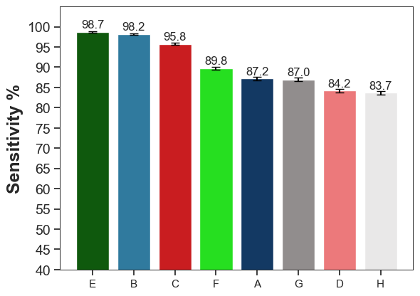
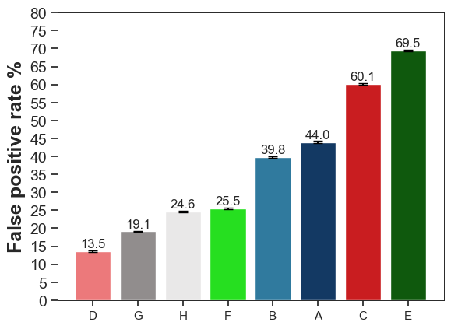
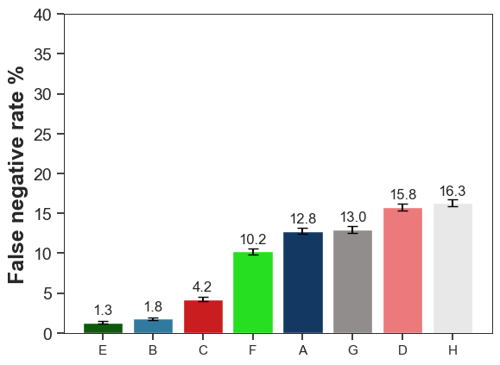
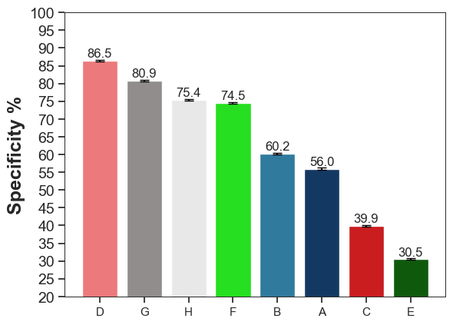
Primary outcome: Referable DR (yes/no): Final Human Grade in Worst Eye
YES
NO
ARIAS test +
ARIAS test -
Vendors: A-G

Slide 7
Final Human grade at the end of grading pathway
● R3 proliferative
■ R2 pre-proliferative
R1M1 Mild non-proliferative
with maculopathy
Sensitivity (detection rates)
R1M0
○ R0M0
False positive rates
% screen positive
(ARIAS⁺)
74% | 65% | 48% | 34% | 50% | 28% | 33% | 23%

Slide 8
● R3 proliferative
■ R2 pre-proliferative
R1M1
R3/R2/M1
R1M0
⬆ Any DR
R0M0
ADDING IN VISUAL ACUITY 6/12 or worse
% screen positive
(ARIAS⁺ or VA≤6/12)
77% | 70% | 54% | 44% | 56% | 39% | 42% | 35%

Slide 9
Round symbols are numerical values for sensitivity and the error bars are 95% confidence intervals. Different colours represent different groups of the population e.g. age, ethnicity
Sensitivity (%)
(Detection rate %)
Primary grader classified as referable DR, or
Tested positive with ARIAS
Blue dashed line is in line with the lower 95% confidence limit for the overall result for primary graders
Horizontal axes labels the primary grader (PG) and ARIAS vendor (A to G)

Slide 10
Final grade from human pathway = R2
Ethnic group | % classified referable by primary grader (95% CI)
 | R2M0/1
Overall | 95.4 (94.7,96.1)
White | 94.8 (93.3,96.0)
Black | 95.9 (94.1,97.2)
South Asian | 95.4 (94.3,96.4)
Other/missing | 96.2 (94.2,97.7)
 | R3M0/1
Overall | 95.8 (94.8,96.6)
White | 94.1 (92.0,95.7)
Black | 97.6 (95.5,98.9)
South Asian | 96.1 (94.4,97.5)
Other/missing | 96.5 (93.4,98.4)
 | R3AM0/1
Overall | 95.2 (93.8,96.3)
White | 93.2 (90.2,95.5)
Black | 97.1 (94.1,98.8)
South Asian | 95.4 (93.1,97.1)
Other/missing | 96.1 (91.7,98.6)
Final grade from human pathway = R3
Final grade from human pathway = R3A

Slide 11
Final grade from human pathway = R2
Age group | % classified referable by primary grader (95% CI)
 | R2M0/1
<30 | 94.7 (88.0,98.3)
30 to <45 | 96.4 (94.5,97.8)
45 to <60 | 96.3 (95.2,97.1)
60 to <75 | 94.6 (93.3,95.8)
+75 | 92.7 (89.3,95.3)
 | R3M0/1
<30 | 100.0 (92.5,100.0)
30 to <45 | 97.8 (94.9,99.3)
45 to <60 | 96.3 (94.2,97.8)
60 to <75 | 93.3 (90.4,95.5)
+75 | 88.5 (79.9,94.3)
 | R3AM0/1
<30 | 100.0 (92.5,100.0)
30 to <45 | 97.8 (94.9,99.3)
45 to <60 | 96.3 (94.2,97.8)
60 to <75 | 93.3 (90.4,95.5)
+75 | 88.5 (79.9,94.3)
Final grade from human pathway = R3
Final grade from human pathway = R3A

Slide 12
Final human grade Referable DR + good acuity
Final human grade in worst eye | ARIAS test negative %
R1M1 + good acuity n =14,764 | A | B | C | D | E | F | G | H
% Referred urgent DR | 0.01 | 0.00 | 0.01 | 0.01 | 0.00 | 0.01 | 0.01 | 0.01
% Referred to Ophthalmology | 0.30 | 0.03 | 0.12 | 0.34 | 0.04 | 0.23 | 0.26 | 0.31
R2M0/1 + good acuity n = 3083
% Referred urgent DR | - | - | - | - | - | - | -
% Referred to Ophthalmology | 0.23 | 0.03 | 0.06 | 0.10 | - | 0.06 | 0.03 | 0.32
R3M0/1 + good acuity n = 1040
% Referred urgent DR | 0.58 | 0.48 | 1.15 | 1.54 | 0.38 | 2.21 | 1.54 | 1.92
% Referred to Ophthalmology | - | - | 0.10 | - | - | 0.10 | - | -
TOTAL n =18,887
% Referred urgent DR | 0.04 | 0.03 | 0.07 | 0.10 | 0.02 | 0.13 | 0.09 | 0.16
% Referred to Ophthalmology | 0.30 | 0.03 | 0.13 | 0.35 | 0.04 | 0.23 | 0.26 | 0.34
Figures exclude those that were pregnant
2015 - Scanlon PH HTA:19(74)pp52 - estimate misclassification by human graders:
“True referable STDR” in both eyes with (without) maculopathy 2% (4%) missed by humans
(% missed are higher if true STDR in one eye only)
Notes:
79% of R1M1, 80% of R2 and 53% of R3 have good acuity

Slide 13
Final human grade Ungradable + good acuity
Final human grade in worst eye | ARIAS test negative %
Ungradable + good acuity n =1526 | A | B | C | D | E | F | G | H
% Referred urgent DR | 0 | 0 | 0 | 0 | 0 | 0 | 0 | 0
% Referred to Ophthalmology | 1.83 | 0 | 1.38 | 3.01 | 0.98 | 2.29 | 2.42 | 2.23
Figures exclude those that were pregnant

Slide 14
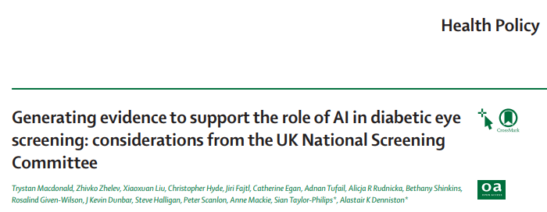
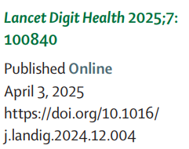
Existing NHS DESP pathway
Retinal image capture
Retinal image capture
AI image processing
Primary Grader
90% ARIAS test negative
100% ARIAS test positive +10% ARIAS test negative
90% No disease
10% No disease
Disease present+severity
Re-screen
12-24 month
(no DR or mild DR)
2° grader assigns ‘no referable DR’
Re-screen
12-24 month
(no DR or mild DR)
Secondary Grader
1° & 2° agree over grade, no referable DR
Secondary Grader
ARIAS test negative & 2° grader assigns referable DR
1° & 2°
disagree over DR grade
3° grader assigns
no referable DR
3° grader assigns
no referable DR
Tertiary Grader
2° grader assigns referable DR
Tertiary Grader
1° & 2° grader agree referable DR
3° grader assigns
referable DR
3° grader assigns
referable DR
Referral outcome grader
Refer to hospital eye service / re-screen <1yr
Referral outcome grader
Refer to hospital eye service / re-screen <1yr

Slide 15
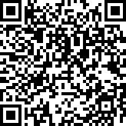
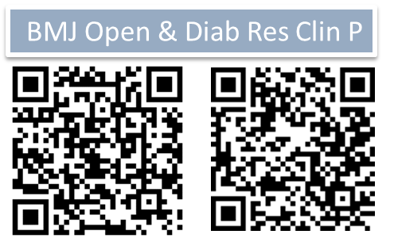
Conclusions
Framework for AI evaluation in real-life live screening programme
Independent, head-to-head, real-world evaluation
Transferable to other healthcare settings
  Curation of large diverse population dataset
  Adequately powered dataset reflecting target population where device is to operate
  Evaluate under a consistent computational environment
  Safeguard patient privacy and protect the curated data
  Assessed algorithmic bias
  Equity in statistical power by subgroups
Clear transparent pathway for future (quicker) ARIAS evaluation
Successful relationship built with vendors & NHS IT
ARIAS provides solution
  Safe triage picks up high risk cases as well as humans
  Increase grading capacity → reduce need for need human grading by up to 77%!
  Protects ongoing service provision
NEJM AI

Slide 16
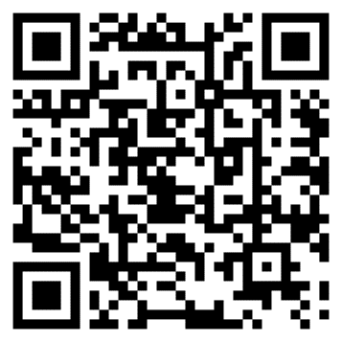
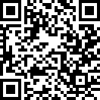
What’s next?
Multicentre prospective real-world implementation of ARIAS
Target population – live evaluation + prospective surveillance
Prospective Integration within current pathways is possible, scope scaling up
Multivendor - confirm all ARIAS could be integrated into DES digital framework
PPIE – will be key to ensure continued engagement with service (front facing material, staff training)
Health economic analyses
  Multivendor with annual and biennial pathways
Agreement from NSC & NHS England (permissive recommendation)
  Require support from NHS Digital and NHS DESP
  Successful relationship built with vendors NHS IT
BMJ Open & Diab Res Clin P

Slide 17









THE TEAM!
City St George’s University of London
Royce Shakespeare
Charlotte Wahlich
Kathryn Willis
Umar Chaudhry
Lakshmi Chandrasekaran
Christopher G Owen
Alicja R Rudnicka
Homerton Healthcare NHS Foundation Trust
Ryan Chambers
Louis Bolter
John Anderson
Kingston University
Jiri Fajtl
Roshan Welikala
Sarah Barman
Moorfields Eye Hospital, NHS Foundation Trust
Abraham Olvera-Barrios
Cathy Egan
Adnan Tufail
Guy’s and St Thomas’ Hospital
Samantha Mann
Laura Webster
Clare Connor
Artificial Intelligence and Automated Retinal Image Analysis Systems ARIAS Research Group
Alastair Denniston
Kevin Dunbar (NHSE)
Roz Given-Wilson (NSC RMG)
Fiona Martin (Patient)
George Onisiforou Ellen Coughlan
Brhmie Balaram

