Slide 1
OCT in Diabetic Eye Screening Implementation, Benefits, Challenges, Lessons Learnt
Ali Askari, NCL DESP Programme Manager
BARS Conference – Birmingham 19th September 2025

Slide 2
About NCL DESP
Catchment: North Central London (5 boroughs)
Programme Size: 105,000
Uptake: 88.2%
Number of Locations: 8
5 currently with OCT, Expanding to 8
Historically provided by North Middlesex University Hospital (NMUH)
NMUH is now Part of Royal Free London NHS Foundation Trust

Slide 3
OCT at NCL DESP - History
2019: CQUIN recommendation by NHSE
2020- 2025: Funded by CCG / ICB at an agreed tariff
2020: Started from August 2020 –with 3 Heidelberg-Spectralis OCT
2020- June 2025: Circa 20,200 OCT scans performed
Benefit: Approximately 78% reduction of referrals to HES
April 2025: Procured 5 extra Canon RX OCT
From April 2025: OCT is commissioned and funded by NHSE

Slide 4
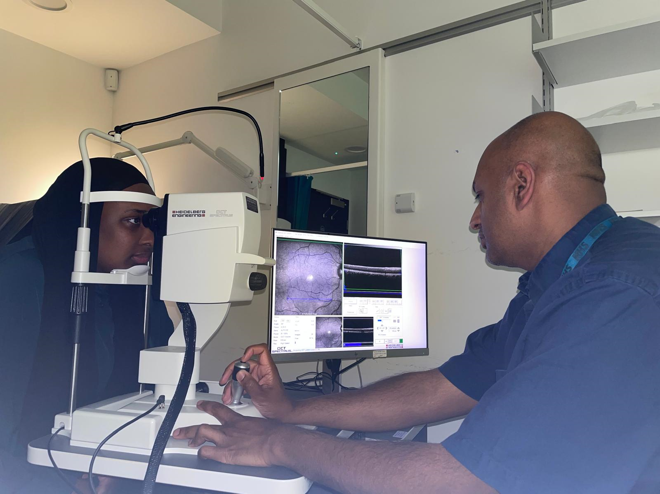
OCT Image capture

Slide 5
NCL DESP - OCT - From August 2020 to July 2025
Year | 20-21 | 21-22 | 22-23 | 23-24 | 24-25 | 25-26 | Total
Total OCT Scan | 1,098 | 2,734 | 3,356 | 4,888 | 5,911 | 2,184 | 20,171
Three level hierarchy grading in place
100% of Primary grading is SECONDARY graded
16.5% of OCT Scans need TERTIARY grading
Year on year increase in the volume of OCT scans
HES can confidently discharge patients back to DESP – Clinical criteria agreed

Slide 6
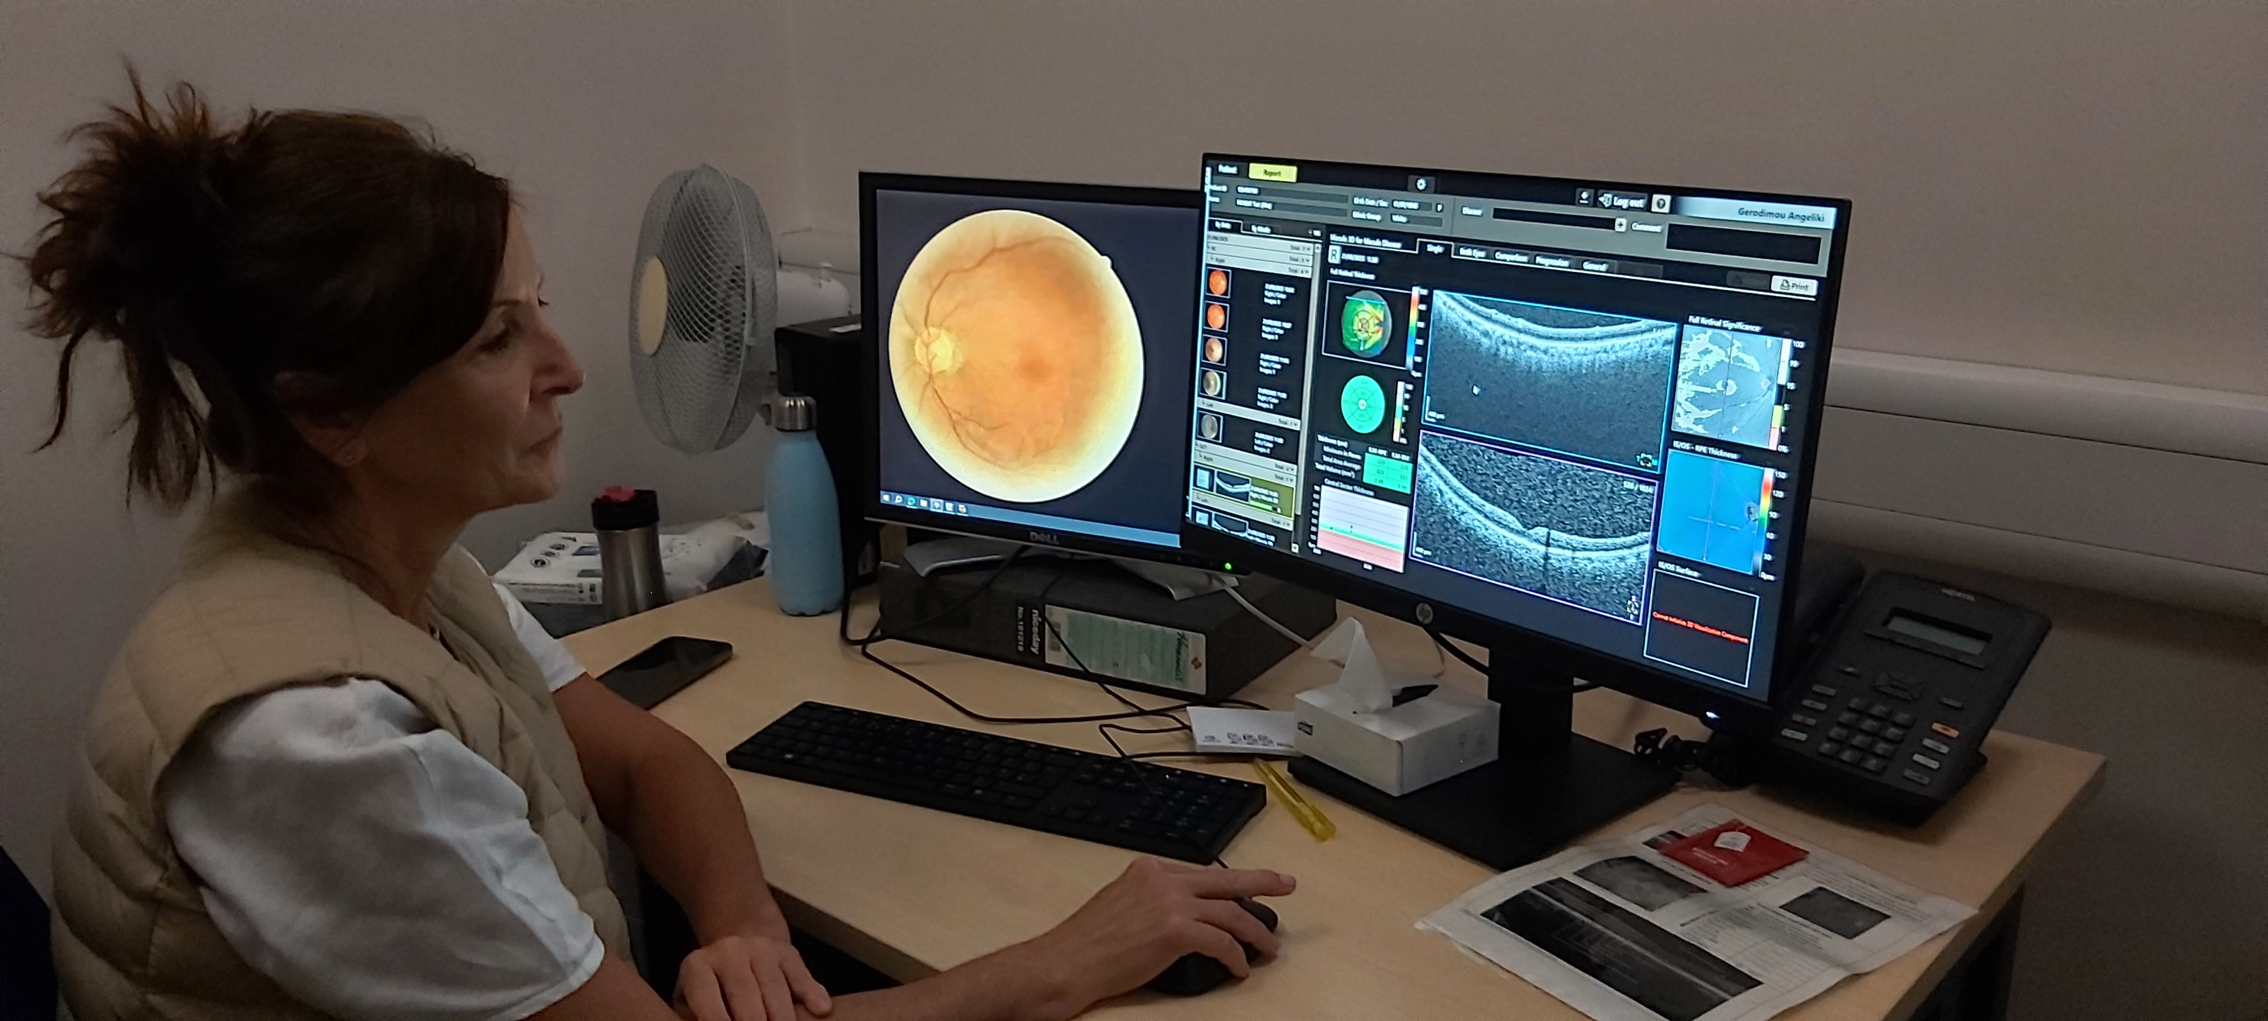
OCT Grading in action

Slide 7
NCL DESP - OCT Outcome
August 2020 to July 2025
Discharged back to RDS | OCT Recall | DR-Urgent Referral to HES | Discharged back to RDS | OCT Recall | DR-Urgent Referral to HES | DR-Routine Referral to HES | Non-DR-Urgent Referal to HES | Non-DR - Routine Referral to HES | Referred back to SLB | Refered back to DS
14.5% | 62.3% | 3.9% | 14.5% | 62.3% | 3.9% | 17.4% | 0.4% | 0.6% | 0.6% | 0.4%
Total Refered from OCT to HES | 22.30%
Total Recall to DESP OCT | 62.30%
Discharged Back to Origin (RDS/DS/) | 15.40%
OCT Outcome and benefits:
78% reduction of referrals to HES

Slide 8
Screening & Grading consideration
Workforce
Improved skillset opportunities for screener/ graders
Training
Time
Grading of OCT take longer
Will be part of HSD
Hence improved job satisfaction
In the meantime: Continuous internal & external training process and introduction of competency framework
Workaround: Better not to grade OCT scans from home and use the centre for grading which provides higher speed verses home broadband speed.
It is hoped that commissioners will consider this when setting the tariff

Slide 9
Screening challenges
Wide filed imaging (7 field)
R2 & R3S: Image acquisition and grading can be time consuming – estimated 2 x the time of RDS
OCT Integration with OptoMize
Communication with patients in clinic
Why they need to be screened in shorter frequency
OCT Triaging
RAG triaging to grade urgent patients quicker
Using different types of OCT software (Canon Viewer & Heyex 2) and how this integrates with each other and OptoMize
Would there be a time when widefield imaging will come to DESP?
No link between OCT Viewers and OptoMize
Patient information needs to be manually entered.
If referable disease: Ability to explain what happens next

Slide 10
IT Challenges
Extremely important:
Full engagement with the IT Team from outset:
Have a clear IT design template showing detail set up at each location.
different part of the IT team - Regular meetings with all involved in IT
Fixed locations using the IT infrastructure of the location (e.g. Hospitals or GP practices):
Managing the OCT PC/Laptop (Security patches and upgrades)
OCT PC:
setting up of OCT PC /
Networking and Fire walls and connectivity
Security is now a major consideration / hence continuous IT issues at satellite locations
IT is busy…… Involve them early ….. Suppliers are busy too
Security patches & updates. Whose responsibility?
Issues with Image/NOT image the PCs
Realisation that the PC is part of the medical device hence complications needing internet isolation and DMZ networking

Slide 11
IT Challenges…Cont
Better & realistic documentation by OCT suppliers
DESP equipment/Camera approval team: Examine ease of connectivity as part of approving process
DESP Management: Take ownership and pull everyone together.
Understand DESP multi-location set up with server at one point
Multiple locations / OCT machines are far away from the server
Band width …. 1Gb capacity? Is it realistic?
Suppliers assume one can log in with their organisation’s log-in details which may not be the case.
Windows accounts and windows file shares is not a given
DO NOT wait for others to do it for you

Slide 12
Administration challenges
How to overcome?
Challenges | Solutions
Patients discharged from HES- Unaware of having been discharged | Close communication with HES, regular meeting to discuss issues including clear communication with patients
Hard to reach patients: Patients frequently moving between different areas of London or spending majority of time abroad High concentration of international students in NCL DNA / PNA | All OCT Pts received phone call one day before appointment. All receive two text message reminders -7 & 3 days before Dedicated senior admin officer manages the DS OCT pathway Providing out of hour service for working age patients (Evenings and Saturday Clinics)

Slide 13
Administration challenges
How to overcome?
Challenges | Solutions
Uncontactable patients | Improved patient information access on SPINE portal and Hospital PAS systems at NMUH and RFH Ability to access Health Information Exchange (HIE) to senior member of the team
Managing out of area patients, who are registered with NCL GPs | Collaboration with Diabetes Care Navigation groups in ICBs Coordination with other programmes
Inconvenience of increased Patients' appointments | Call all DS/OCT patient to agree an appointment date. & explain where needed, importance of attendance and reasons for more frequently appointments Screeners input when screening patients HES input when discharging

Slide 14
Conclusion
Thanks to the National team
Introduction of OCT was an amazing move in line with GIRFT and improved health economy
OCT episode takes nearly 2 times that of RDS
70%-80% reduction of referrals to HES is expected
Set up good and positive relationship with IT department
Keep up the good work and move on…. ☺

Slide 15
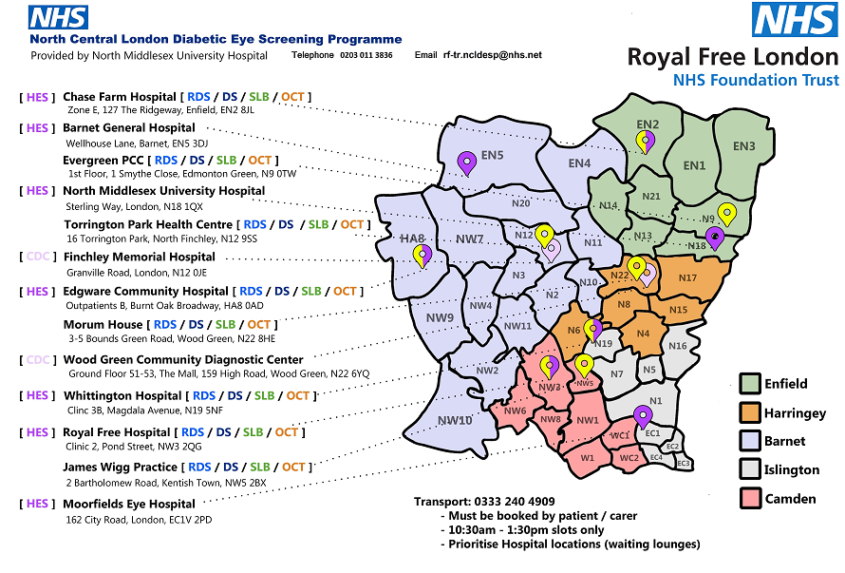
New NCL DESP map
Including HES locations

Slide 16

Thank you

