Slide 1
Diabetic Eye Screening National Programme Update Sept 2025
Presented by: Kate Jordan, Shahj Ahmed, Patrick Rankin, Nicola Hawdon

Slide 2

Welcome to the National DES Update Session
OCT Implementation
Guidance & GLP1s
Health Inequalities
Introduction & Overview

Slide 3



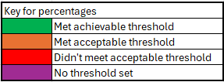
Summary of Q4 2024/25 Pathway Standard data
As of 31/03/2025
Eligible population of 4,186,919
PS1.2 - Suspended 14.93%
PS1.3 - Excluded 1.90%
Routine Digital Screening Pathway (RDS)
KPI DE2/PS10 - Result letters sent within 3 weeks
98.8%
PS2 – Newly diagnosed seen within 89 days
94.09%
KPI DE1/PS7 - Uptake
2,467,354 screened
81.48%
PS11.1 - Urgent referrals made within 2 weeks of screening
98.45%
3,482,485 individuals
KPI DE4/PS8 –
Persistent DNA
8.95%
PS11.2 - Routine referrals made within 3 weeks of screening
99.48%
844,260 individuals selected for 24mth recall between 01/04/2024-31/03/2025. 34.22% of those screened (includes estimated data for 3 services)
NB: each standard has a specific denominator, so the percentages are not from the total within the circle
Notes:
Things to note:
Not included the old PS1.1 – RDS invited and PS3 – RDS Timely 12mth recall, as these figures are skewed by the introduction of 24mth recall (we need the new PPR dataset and amended standards to monitor these)
Uptake is slightly down from the Q2 data (82.26% to 81.48%) – We anticipated that uptake would reduce following the implementation of 24mth recall. Those moving onto the 24mth recall pathway needed to be good attenders to be selected (2 consecutive R0M0 outcomes). This means there is a higher proportion of those that DNA remaining in the 12mth recall cohort.
It appears that a higher proportion of those being screened are being selected for 24mth recall within the Q4 data (34.22%) when compared to Q2 (24.5%).
This is due to the denominator (individuals being screened) being less during those 6 months, as those who were selected for 24mth recall between 01/10/2023-31/03/2024 did not need an invitation between 01/04/2024-31/03/2025.
There is a larger total of individuals who were selected for 24mth recall within the Q4 data (844,260) when compared to Q2 (646,266).
This is due to there being approx. 400,000 new patients added to the SCL each 12 month period. Within the first 6 months of selecting individuals for 24mth recall (01/10/2023-31/03/2024), only 50% of individuals with 2 consecutive R0M0 outcomes were chosen. Since then, of the 200,000 new patients who were registered and attended with a R0M0 outcome within that first 6 months, have then attended for their 2nd annual screen, and were selected for 24mth recall along with the remaining 50% between 01/10/2024-31/03/2025.

Slide 4

What we said we would do in 2025/2026
Implementation of Phase 3 of 24-month screening intervals & Data alignment
Audit and Impact assessment of OCT & R2 grading refinement into the programme
Future of GP2DRS…
Worked with the IT providers to implement the new data & reporting requirements and ensure that the data and reporting updates are working as expected
Worked closely with the National Diabetes Audit to align our data extracts and look at improving our linkage to outcomes
Complete the DES standards review in Q4 once we have had a full year of the new standards and publish updated thresholds
On track with the full guidance review for DES to be completed during 2025/2026 – ensuring all programme guidance is fit for purpose and aligns with the pathway changes that have taken place
Updated audit schedule to consider OCT & R2 grading refinement. New governance pack developed and deployed
Develop and publish QA assurance framework and governance pack.
Work closely with digital screening colleagues, data analytic teams and wider stakeholders to develop a cohorting solution beyond March 2026
Full review of SNOMED codes, including ethnicity codes to ensure the information extracted provides the best care opportunities for people offered screening
Scope alternative sources of data for extraction e.g. detained settings
Reducing Health Inequalities & workforce development
Continuous development, improvement & maintenance of the programme
Review impact of OCT on accessibility and health inequalities through OCT stocktake
OCT module to be developed and included in the Health Screener Diploma
Work with the Health Inequalities Team to develop a project plan and actions from the insights work looking at barriers to attendance for people aged 20 to 40
Refresh of the workforce survey to look at the effect of OCT implementation and R2 grading refinement and potential implication of AI introduction
Work with stakeholders to introduce the NHS App functionality and GP connect – aligning with the digital screening strategy
Act on the UKNSC review of DES AI research – UKNSC recommendati9on due January 2026.
Pilot a Research Impact Needs Assessment (RINA) approach to understand what the priority research areas are.
Work with the diabetes policy team and the eye care transformation teams to align priorities

Slide 5
DES: OCT Implementation Stocktake (mid point review)
September 2025
Shahjalal Ahmed
Senior QA Advisor
Notes:
Introduce myself.
Pleased to be here – first BARS in about 10yrs.
Like many of you my professional screening ‘passport’ has a range of stamps on it, going back 20yrs+ (ouch!).
All the ‘glamorous’ locations: London, EoE, the SW and I now live in the NE.
I have worn ‘hats’ covering DES, AAA, Breast, ANNB and Imms.
For those of you that I haven’t regularly worked with, we may have liaised on the cohorting incident, last year.
(Show of hands – how long have you 'been in the game'?)
I’m going to talk to you for a few minutes about the OCT implementation stocktake.
Whilst I am here presenting this, the survey was led by my colleagues Holly Wilson-Guy and Catherine Donaldson with input from my other SQAS colleagues also.

Slide 6
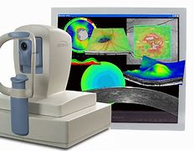
Context
The introduction of OCT to the digital surveillance pathway began in October 2024. The ‘target’ for completion is October 2025.
Safely monitoring more cases of diabetic retinopathy in screening, using capacity gains resulting from extending RDS intervals, is expected to reduce the capacity burden on HES.
Implementing this change has been a significant undertaking. The services and regional commissioning teams have worked incredibly hard to make progress and, in some cases, complete the implementation.
Notes:
It’s not a race.
Each service is faced with a somewhat unique journey, and the destination might look different compared to that of other services.

Slide 7
Purpose
The purpose of the survey was to take stock of progress, nationally, at the mid-way point of OCT implementation and to identify:
key challenges
barriers
benefits realised so far
The plan is to repeat the survey, post October 2025, to continue to chart progress, identify issues and evidence benefits.

Slide 8
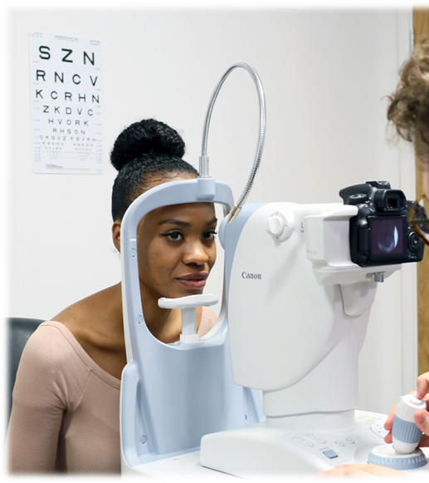
Results

Slide 9
Implementation status
51/55 services (93%) took part in the survey, representing all regions. The responses have been collated and anonymised. The results are a snapshot of the progress of implementation at that time (Jun-Sep 2025)
20/51 (39%) services stated that they had a pre-existing OCT function, introduced between 2010 and 2024.
34/51 (67%) services stated that they had now begun delivering DS with OCT, for the first time.
Of the 17 services that had not yet begun providing DS with OCT, the start date varied from Jul to Oct 2025.
3 services did not have a planned start date.

Slide 10
Timeline for OCT go live (since Oct 2024)
Notes:
This graph shows ‘progress on a page’.
Services with pre-existing OCT are not included.
And it shows consistent progress and a promising trajectory.

Slide 11




Delivery models and infrastructure
Services were asked to describe their ‘live’ DS with OCT function. For example, number of OCT machines, venues, staffing, infrastructure.
IT / Digital Infrastructure
Integration: A few services have direct links to hospital servers for seamless image access. Some services stated that Screening laptops have the 'sync' facility to ensure continuity of service should internet connectivity be disrupted.
Issues: Some services report delays in server setup and software installation, or poor internet access at venues.
Staffing
Screeners: Most services have trained screeners or are actively training them.
Graders:
Senior graders often handle OCT interpretation.
Some services have multiple levels of graders (primary, secondary, tertiary).
Training courses mentioned include GREG OCT Interpretation, Gloucester OCT in DS, and University Certificate in OCT interpretation.
Clinical leads and optometrists: Often involved in oversight and interpretation.
Venues
Typical setup: OCTs are placed in static screening locations, hospitals, or community health centres.
Shared arrangements: Some services share OCTs with Hospital Eye Services (HES).
Mobile units: Several services include mobile OCT machines for outreach (e.g., HMP, mental health settings).
Expansion plans: Multiple services are awaiting bid approval, installation of additional machines or reviewing sites for expansion.
Number of OCT Machines
Range: From 1 to 25 machines across services.
Common counts: The majority of Providers (60%) report having 3 or 4 machines at the time of their survey response, with over 90% having between 2 and 9.
Notes:
Looking at delivery models and infrastructure – services were asked to describe their live OCT function.
4 components are highlighted.

Slide 12
Access and equity (1)
Services were asked how they were assured that the DS with OCT function will meet the needs of their population in relation to access and equity, by October 2025. Across the next few slides are the themes and summarised responses:
Service Delivery and Location Planning | Many services are placing OCT machines in main population centres, areas of high deprivation, or aligned with HES sites. Mobile OCT units are sometimes being used to reach rural or hard-to-reach populations. Some services are using heat mapping and Health Equity Assessments to guide placement.
Equity and Accessibility Measures | Services are ensuring disabled access, public transport links, and weekend clinics. Some are implementing diagnostic hub models to reduce travel between appointments. Others are conducting audits and patient surveys to improve accessibility.
Equipment | Many services have several OCT machines in place or on order. Some are replacing end-of-life equipment or expanding to new sites. A few Providers note they are constrained by limited funding or space, only able to deploy 1–2 machines (on average, half of the required number for those providers).
Staffing Capacity | Several services are upskilling existing graders to provide OCT grading capacity or recruiting new staff to meet demand. Some are limited by staffing shortages, especially when graders are absent. A few services are already operating with adequate capacity.
Monitoring & Evaluation | Several services are using audits, patient surveys, postcode analyses, and feedback tools to monitor equity. Some are planning service audits to guide future OCT deployment. Ongoing capacity planning is used to ensure services meet population needs
Notes:
Services were asked about access and equity.
This highlights the range of needs across services and the strategies and tools that have been effective.
It highlights the fact that services are at different points on their journey.
And that on arrival there is often more work still to be done.

Slide 13
Access and equity (2)
Most services felt assured that, at this point in the implementation, their service was either already meeting the needs of the population in relation to access and equity or would be by October 2025. Several providers were actively working to improve access and equity.
“Service audit (OCT DNA audit) planned for May / June. following discussions with commissioners. Postcode analysis being considered. This will help guide now many more OCT scanners we need (figures provisional).”
“As we have OCT in all of our screening venues, we consider that we have fully adhered to access and equity requirements.”
“We used heat mapping, and HE tools to ensure our demographic is being catered for. We increased the provision of OCT from 5 community locations to 15 static community locations and have 2 mobile OCT machines which can be deployed anywhere. These mobile OCT machines will serve HMPs and Mental Health inpatient units. Patients have far more choice of OCT locations to attend and our OCT venues are predominately closer than their HES is.”
“Health Equity Impact Assessment completed. No patient will travel more than 10 miles to an OCT clinic.
“Venues aligned to HES sites. Cover a good geographical area”
“Assured (with some limitations) that with the additional OCTs added to the current offering extra capacity will be offered to allow additional coverage. The service is also planning to add more equipment as capital is available to further increase the community offering and build on the current position”
“The Sites Chosen are all in main population centres within areas of high deprivation, we are providing OCT from Main Health Centres, all with Ramp, Lift access where required at present the sites chosen should cover circa 70% of the screening population, further expansion required to get to 90% coverage”
Notes:
From a service part way through their journey - Top left.
And from a service closer to the end of their journey - Right middle.
Again, this highlights the fact that services are at different points in their implementation journey.
All progress represents success and is a result of motivation, hard work and dogged perseverance.

Slide 14
Benefits of DS with OCT
Services with (a) pre-existing OCT and (b) new implementers, were asked what benefits they had identified:
20/51 services had previously provided OCT in some capacity, and an additional 11 had implemented it long enough to identify benefits.
Services could list as many benefits as they identified
8 themes emerged.
Notes:
Essentially, services feel that they are safely monitoring more diabetic retinopathy in screening.
Which means that people are referred at the point that HES will treat them.
And that this benefits people and the health system overall.

Slide 15
Challenges & Barriers
Services were asked to describe any key challenges or barriers that were experienced whilst planning and implementing DS with OCT.
From 45 responses, 6 themes were identified:
IT and Connectivity Issues: Challenges with internet access, digital infrastructure, and software compatibility, often delaying implementation and limiting venue options.
Funding Constraints: Funding for equipment, IT upgrades, staffing, and ongoing operational costs. Variation in funding and resources across programmes, leading to unequal access and service delivery.
National Guidance and Support: Delays and gaps in national guidance and limited support from central teams and suppliers.
Staffing and Training: Shortages of trained staff, time-consuming training requirements, and difficulties upskilling teams to operate and grade OCT scans.
Operational Barriers: Challenges with information governance, procurement, venue suitability and logistical barriers (e.g., image storage, equipment suitability, prison access).
Service User Engagement: Confusion among patients regarding new pathways, reluctance to travel, and need for improved communication about service changes.
Notes:
Quite a broad range of challenges.
Mostly anticipated but some learning to take forward.

Slide 16
Disbenefits
Services were asked if they had identified any disbenefits of DS with OCT?
9/13 of services that responded to the question mentioned noticing lower uptake in DS with OCT compared with RDS. 5/9 felt that having additional OCT machines/venues would improve uptake.
4/13 services noted the (longer) time to take and (5/13) grade OCT images.
4/13 services noted IT connectivity issues and mentioned that a strong internet connection was vital. In some cases, this has limited the potential venues for OCT clinics.
Notes:
So the disbenefits cross over with the challenges and barriers.
And highlights , in particular, the ongoing challenge of maximising uptake and coverage.

Slide 17
Key quotes
“Connectivity with HES is a bonus as they are able to view OCT scans taken by DES and make clinically sound decisions from our scans. This allows patients to be placed immediately into treatment clinics saving extra appointments for both the patient and the HES.”
“Has involved significant clinical lead supervision and input which is ongoing. However, this is satisfying work in seeing the interest from screeners/ graders and the fruits of labour in their skills being developed.”
“While full equity is challenging due to resource limits, strategically locating OCT machines and ongoing collaboration with clinical and IT teams has helped us maximise the benefit of the service within existing constraints.”
“Introducing extra images for R2L cases has helped us detect more R3A cases earlier, which supports better patient outcomes.”
Quotes from OCT Stock take survey June-Sept 25
Notes:
The survey revealed lots of rich and important insights and every response was informative.
So, I’ll read a couple of quotes.
Top left.
Top right.

Slide 18
“This has been one of
the best things which will help DESP
as well as ophthalmology departments both in
short term and long term. Since starting
OCT, we have managed to reduce
unnecessary M1 referrals to
HES by around 80%”
Quotes from OCT Stock take survey June-Sept 25
Notes:
And a final quote which succinctly and eloquently summarises the outcomes which were hoped for.

Slide 19
Additional insights
The learning for the national portfolio team, from the additional comments and feedback, will be used to inform future projects and programme change. Themes included:
Timely changes to national guidance
Support requirements from the national team to services
Consider the number of required programme changes ongoing simultaneously
Operational planning challenges
Notes:
An enormous amount of work has and continues to be done.
You are not alone.
Keep calm and carry on.
We (Royal) are listening.

Slide 20

What next – the future?
https://www.mentimeter.com/app/presentation/al66vkjigsfz99sm8k7naq4xxpkdp25r/edit?source=share-modal
https://www.menti.com/alz7evqjbn6m
Code: 4819 2450
Notes:
Finally, before I pass over to Paddy, we would like to use Menti to get your thoughts on what next - the future of DES screening.
Thank you for listening.

Slide 21
https://www.menti.com/alz7evqjbn6m
https://www.menti.com/alz7evqjbn6m
Code: 4819 2450

Slide 22

Guidance Review and Updates
Overview
Guidance needs updating:
numerous organisational changes
programme changes in last 2 years
evolution of NHS and terminology used
more platforms used to publish guidance
70 pieces of individual guidance for DES services
some haven't been updated since before 2012
out of date, contradictory, incorrect or unclear
chosen for review based on use and requirement for update with DES priorities
ongoing process over next 12 months at least

Slide 23

GLP-1/GIP receptor agonists
Updated early worsening guidance
Repeated requests for additional imaging and monitoring before and during initiation
Updated interim guidance on futures NHS
Awaiting a wider review and evidence for additional imaging
Evidence is not conclusive at this stage regarding these drugs
No additional screening or surveillance should not be offered by DES programmes for people with diabetes being initiated on or monitored whilst on a GLP-1/GIP RA treatment.
This includes all other possible interventions that could lead to early worsening
Except hybrid closed loops on 24-month interval screening can have 1 scan after 12 months

Slide 24
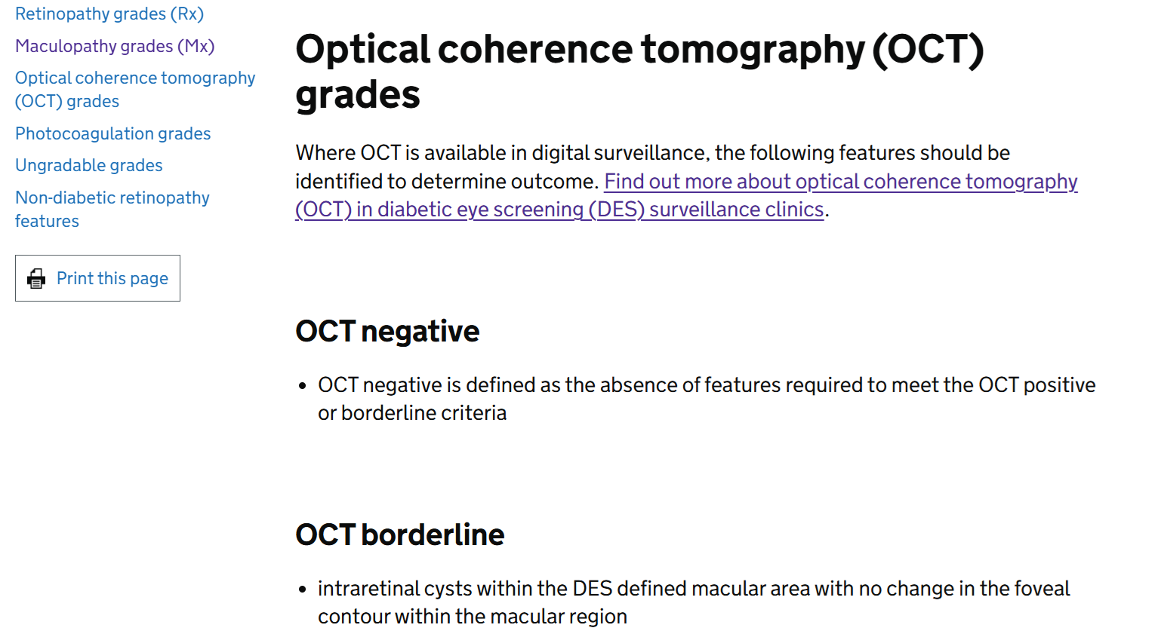
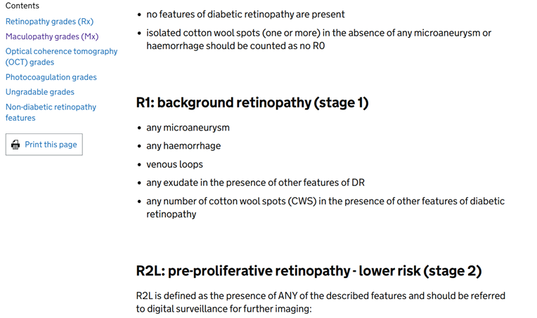
Features based grading forms
now features based grading guidance as form embedded in software
includes R2L/H and OCT grades

Slide 25

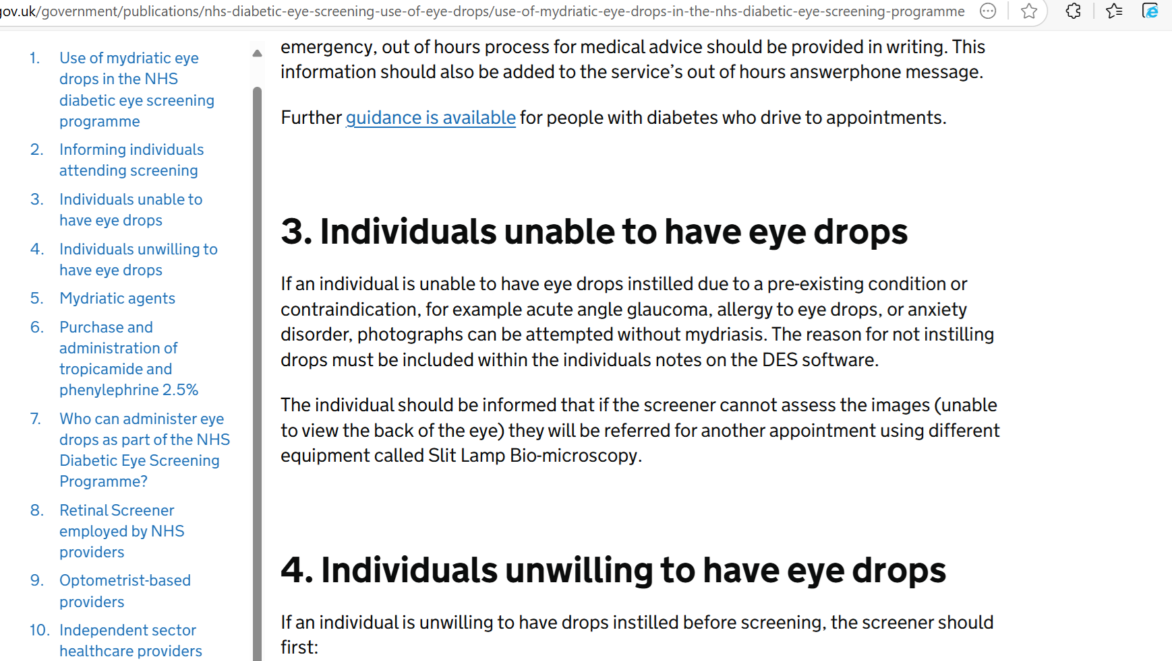
Use of Mydriatic Drops
Easier to understand
Provision of written information for service users
Confirmed ongoing legal basis for instillation of drops
Use of drops is being reviewed as part of wider research
2 years before any change
Still drops for all service users unless unable to have drops

Slide 26
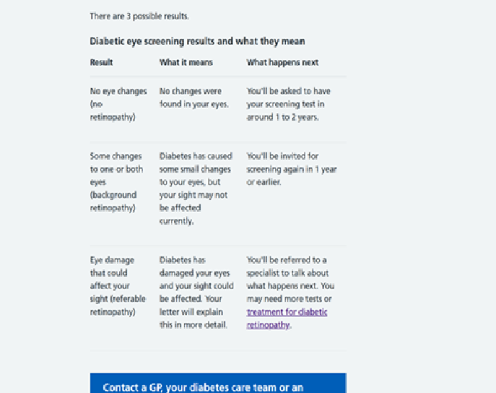
NHS.UK Diabetic eye screening further information link
feedback from local programmes and service users
removed stage 1-2-3 from website
associated with cancer diagnosis
adding more anxiety to process
will be removed from other guidance in due course
ongoing letter review project

Slide 27
Awaiting sign-off & publication
Digital surveillance service user leaflet/QR code
includes including terminology of closer monitoring as people didn’t understand digital surveillance
describe what DR and maculopathy are
outlines what OCT is and importance of attending OCT appointment
removed the treatment section as not needed
DES audit schedule
GOV.uk to be updated to reflect changes in programme
link to governance pack on futures
Removed camera audit and grading & opthamology outcomes
Added transferred patients, rejected referrals, discharged at 1st HES appointment and discharges from HES-DS (OCT pathway)

Slide 28
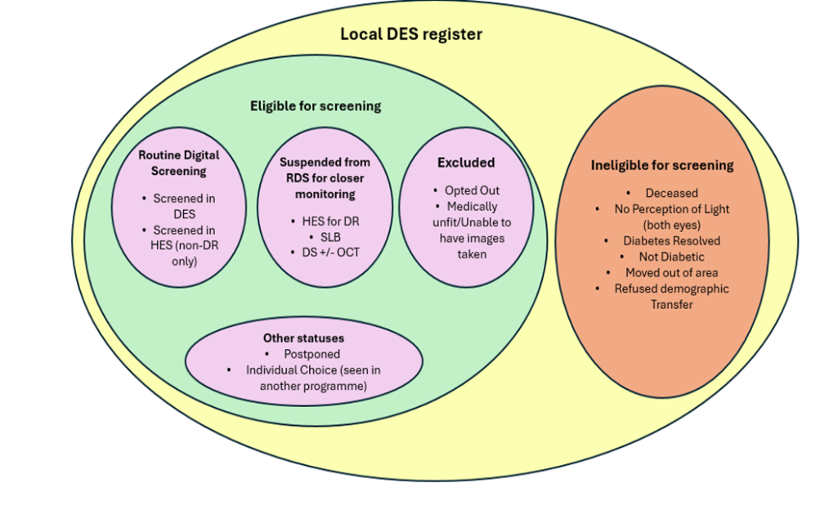
In progress.....
Cohort management
7 guidance docs into 1
1 guidance to rule them all
Updated bubble diagram
SCL reconciliation/missing patients/individual choice
Medically unfit/record retention/GLP/gender reassignment
Aggressive individuals/rarer diabetes/in remission
Opting out is easier
Inadequate images and image quality
Very confusing and language was incorrect
Suggested different pathway outcomes (SLB)
OCT in Digitial Surveillance Clinics
HSD module for OCT graders and training
OCT 1°/2° and arbitration grading in DS
Minimum content for referral letters
Recurrent DNA's in DS

Slide 29



Engaging with 20-40 year olds from deprived backgrounds to attend their DES appointment
Nicola Hawdon, Equalities Manager, National Vaccination and Screening Programme

Slide 30
Insight Research 20-40 year olds living in deprived areas
Rationale:
Diabetic retinopathy can affect people with diabetes and DES is the most effective tool for managing and reducing the risk of sight loss due to diabetes.​
Up-take rates are lower amongst people aged 20-40 years, yet they are more likely to be diagnosed with sight-threatening retinopathy when they do present.​
People from deprived areas and minority ethnic groups have the highest rates of non-attendance – 20-24% of the total T1D & T2D population (all ages) live in the most deprived areas.​
This is compounded by increasing rates of T2D amongst young people, which is more aggressive and has a higher prevalence amongst deprived communities and minority ethnic groups
Study:
To identify the key barriers and enablers to DES that people aged 20-40yrs living with type 1 and 2 diabetes (T1D and T2D) living in deprived areas/from C2DE backgrounds.
70 indepth interviews/focus groups – incl 12 DES Providers - + 50 surveys
6x recommendations – Engagement/Awareness/Education strongest

Slide 31
Audience Context 20-40 year olds living in deprived areas
Life stage/age
Vulnerability
(financial/jobs/
single parent/
kids)
Managing Diabetes (T1/T2)
Workplace and employment
Digitally savvy
Notes:
RATIONALE:
Diabetic retinopathy can affect people with diabetes and Diabetic Eye Screening (DES) is the most effective tool for managing and reducing the risk of sight loss due to diabetes.
Up-take rates are lower amongst people aged 20-40 years, yet they are more likely to be diagnosed with sight-threatening retinopathy when they do present.
People from deprived areas and minority ethnic groups have the highest rates of non-attendance – 20-24% of the total T1D & T2D population (all ages) live in the most deprived areas.
This is compounded by increasing rates of T2D amongst young people, which is more aggressive and has a higher prevalence amongst deprived communities and minority ethnic groups
RESEARCH PROJECT BACKGROUND:
To identify the key barriers and enablers that people aged 20-40yrs living with type 1 and 2 diabetes (T1D and T2D) living in deprived areas/from C2DE backgrounds encounter in relation to attending their DES appointment and accessing NHS DES services in England
To support DES service providers as they continue to encourage more people aged 20-40 to attend screening in line with their service specification

Slide 32







Specific factors impacting DES attendance
Motivation
Experience of attendance
Acceptance of diagnosis/
denial
Attendance
Attitude and understanding
Service factors
Logistics
Competing priorities
Process of booking
Understanding role of DES
Overlay of vulnerability and complexity of lives around lapsers and non attenders

Slide 33
Fear acts as both a motivator and a barrier Threat of losing eyesight is a huge concern
Fear motivator
Fear barrier
“Knowledge is power”
”Ignorance is bliss”
Discovering signs of damage
Disrupting sense of security
Tempting Fate
Exposure of poor Diabetes control/ guilt
Nervous about eye drop process
Fear also underpins other factors: even when other barriers are peeled away, fear can still act as barrier to attendance

Slide 34
Audience Typologies
Committed attenders:
mindset: ‘knowledge is power’
Likely to lapse:
mindset ‘other things on my mind’
*Resistant: mindset:
‘ignorance is bliss’
Health anxious
Committed and conscientious
Competing priorities
Overwhelmed
Fearful
Denial
Reformed non attenders
Lapsing attenders
* Likely to be Persistent-Non Attenders & need DES the most

Slide 35
Awareness
DES providers are mindful of this audience’s barriers and report a range of challenges experienced at a service level
Specific engagement/awareness issues:
Admin-intensive cohort to track down, especially student population + relatively small proportion of overall caseload
Their lack of understanding of DES and low motivation to attend
Limited opportunities to tailor communications to suit 20-40 years olds
Notes:
Accessing quality, updated data about audience: identifying and communicating with cohort specifically is challenging; data collection inconsistent across providers
An admin-intensive cohort to track down, especially student population; 20-40s relatively small proportion of overall caseload
Identify lack of understanding of DES and low motivation likely to be an issue for cohort alongside logistical barriers relating to lifestage
Limited opportunities to tailor communications to suit 20-40 years olds
Booking systems: frequently not adapted for online / mobile use
Challenges offering tailored appointment times – lack of flexibility within booking systems
Lack of OOHs availability: staffing, venues, equipment
Lack of resource / capacity / funding overall
Systems issues: invited to DES before definitive diagnosis - therefore don’t engage or don’t understand why invited

Slide 36
Awareness: some initiatives & ideas
Engagement officers and outreach opportunities - range of events e.g. wellbeing events, employer events, community events - join up with Local Council Outreach Teams
Better connection with local Diabetes Teams/GPs re raising awareness & marketing incl leaflets for newly diagnosed
Keep DES on the public agenda - thru better support from Communications & Inequality Teams with patient-facing marketing esp around diabetes – offer case studies/human stories, joint diabetes awareness campaigns & diabetes prevention week/month campaign + ongoing PHE Healthy Living Campaigns
Connect with local partners/leaders – within specific communities & local Diabetes branches & other diabetic support groups
Outreach events – via community contacts – faith communities health programmes (mosques, churches, temples etc); MECC events
Connect with other NHS services – eg pharmacies & community nurses
Health Equity Audits - support tool re population overview, data & Action Plan

Slide 37
AWARENESS: Your feedback & Ideas
https://www.mentimeter.com/app/presentation/al66vkjigsfz99sm8k7naq4xxpkdp25r/edit?source=share-modal
https://www.menti.com/alz7evqjbn6m
Code: 4819 2450
Notes:
Plain slide with subhead and bullets

Slide 38
https://www.menti.com/alz7evqjbn6m
Code: 4819 2450

Slide 39
For more information
Please find links to:-
Final Insight Report*
Provider Briefing Pack* - to further support you and colleagues when engaging with 20-40 year olds living in deprived areas (and beyond)
*https://future.nhs.uk/vaccsandscreening/view?objectID=65096912
Notes:
Accessing quality, updated data about audience: identifying and communicating with cohort specifically is challenging; data collection inconsistent across providers
An admin-intensive cohort to track down, especially student population; 20-40s relatively small proportion of overall caseload
Identify lack of understanding of DES and low motivation likely to be an issue for cohort alongside logistical barriers relating to lifestage
Limited opportunities to tailor communications to suit 20-40 years olds
Booking systems: frequently not adapted for online / mobile use
Challenges offering tailored appointment times – lack of flexibility within booking systems
Lack of OOHs availability: staffing, venues, equipment
Lack of resource / capacity / funding overall
Systems issues: invited to DES before definitive diagnosis - therefore don’t engage or don’t understand why invited

