Slide 1
Clinical implementation of OCT in DESP and arising challenges
Susanne Althauser NCL DESP Clinical Lead
BARS Conference – Birmingham 19th September 2025

Slide 2
Background-OCT in NCL DESP
OCT introduced in 2020 (Heidelberg Spectralis)
London OCT protocol (until 10/ 2024)
OCT in house training started
OCT now on all screening sites
Continuous expansion and development of screener grader training in OCT
Opportunity for screeners to participate on external OCT training course

Slide 3
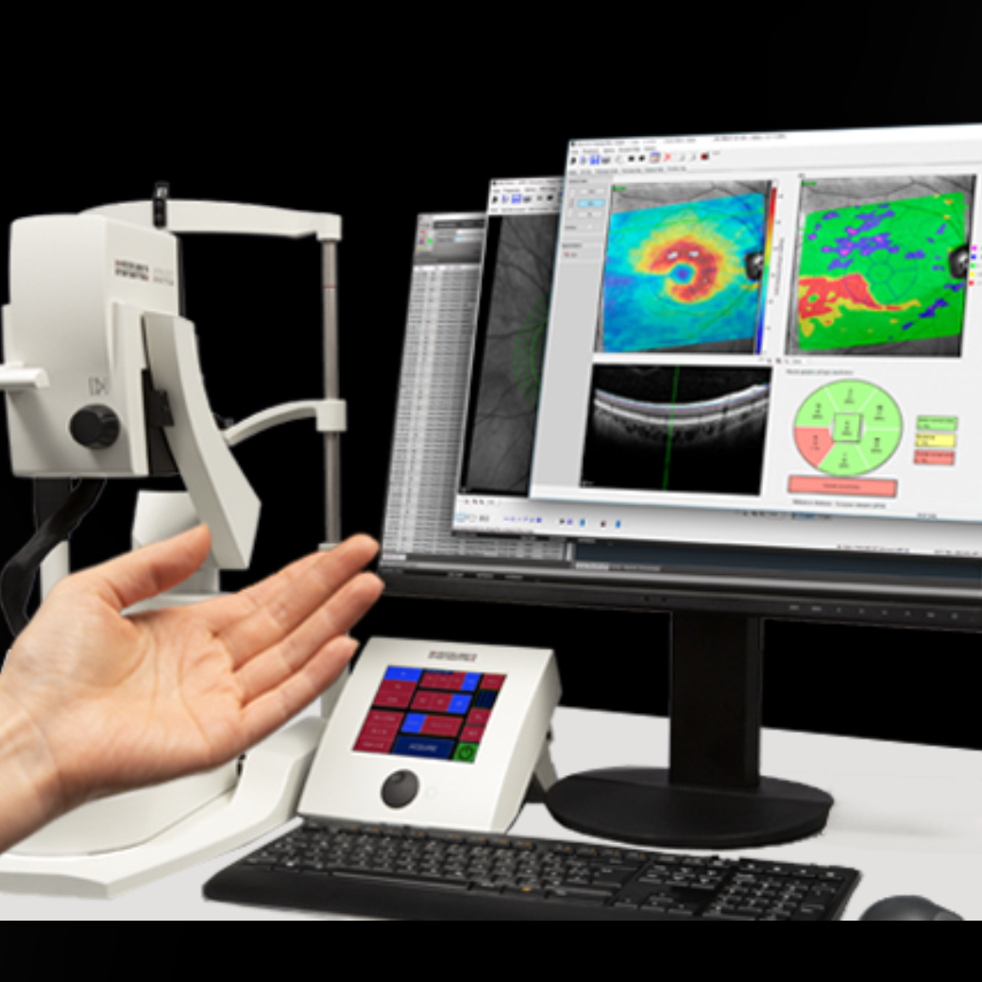
OCT arrives……
Now what?

Slide 4
Develop the workforce- OCT Training
Think about your workforce
Do you have a Model of combined screener/grader
Do you have separate screener and graders

Slide 5
NCL DESP workforce- OCT Training
Divided into:
Image acquisition
Grading of Images

Slide 6
OCT Training Image acquisition in NCL-DESP
Whom and how to train……
Train all screeners
Increases Flexibility
Initial stress on Resources
Training time
Trainers
Training material
From OCT provider
Developed own Training material
Practical training
Provider training
Individual F2F training with senior screener
Sign off process
Examples……

Slide 7
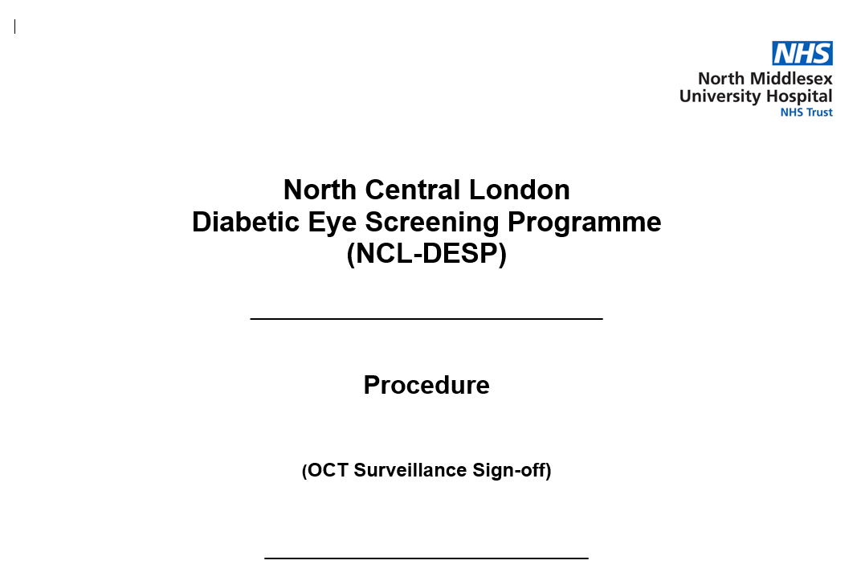
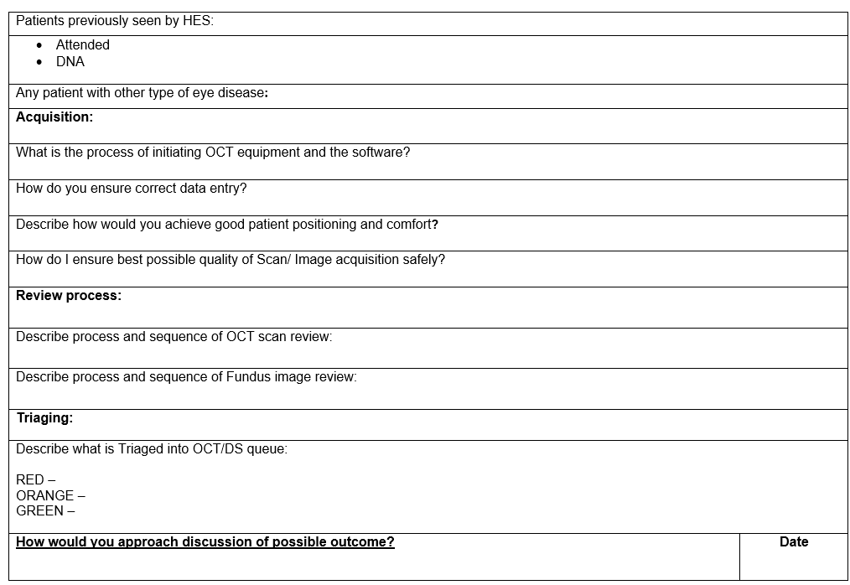
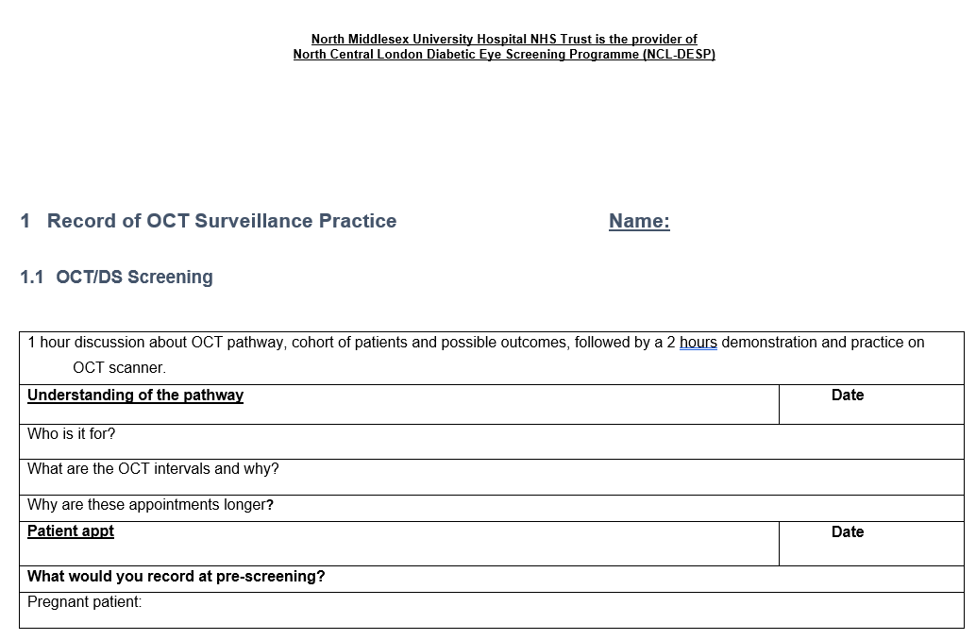
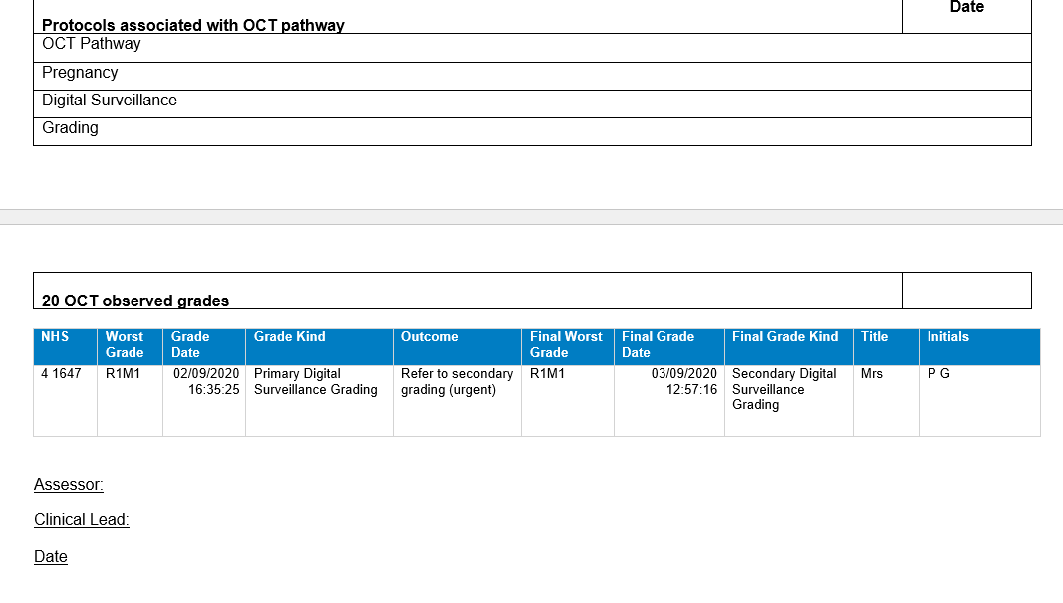

Slide 8

OCT Training- Image acquisition- Challenges
Multiple OCT devices/systems
Data entry
Validating images
Images in technical difficult patient
Myopia
Opacities (cataracts, cornea, vitreous opacities)
Tremor
Posture
Ensure correct demographic info
Gradable/ungradable
Spectralis
Canon

Slide 9
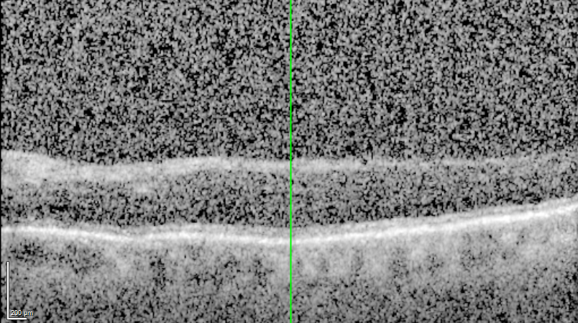
OCT examples Myopia Cataract..

Slide 10
OCT Training- Grading in NCL DESP
Grading
Train all graders in OCT
Increased Flexibility
…..But
Training takes time-costs

Slide 11
OCT Teaching & Training NCL DESP
Combined approach
Developed own training programme
Enrolling everybody in a certified course – ongoing
Individual Training
F2F training with senior OCT grader with input from clinical lead and “sign off”
Image library with examples-ongoing
Video teaching sessions-available on training platform-ongoing
2-3 times per month lunch time case discussions with clinical lead
Supportive measures
Grading hierarchy: Primary, Secondary, Tertiary/Arbitration
Allows primary graders to start safely on grading as all grades go to secondary and if disagreement to arbitration
Summary Grading Matrix for graders -Example

Slide 12
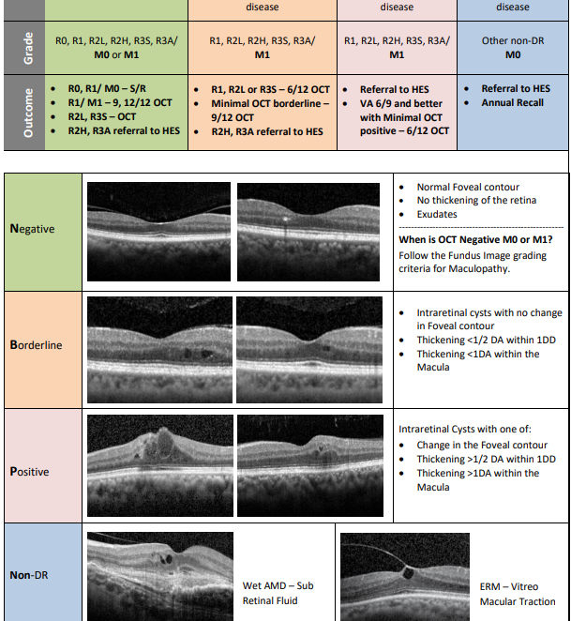
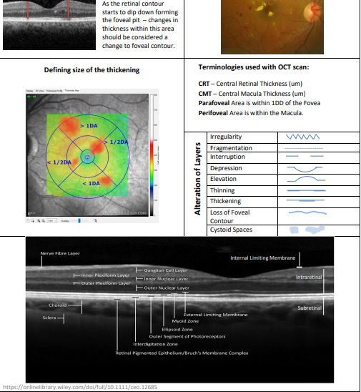
Grading Matrix

Slide 13
Challenges of implementing OCT Training
Time & Manpower & Costs
Continuous effort to upskill the workforce
Training takes graders out of clinical work
In house training by senior OCT graders/Clinical lead, puts further pressure on workforce
Costs of external training

Slide 14
Running an OCT service
Challenges in the OCT pathway

Slide 15
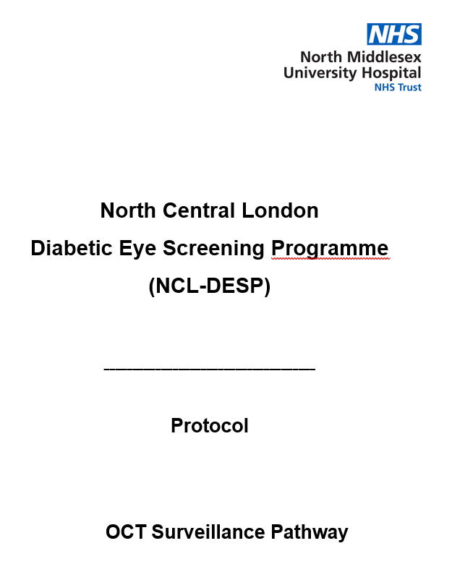
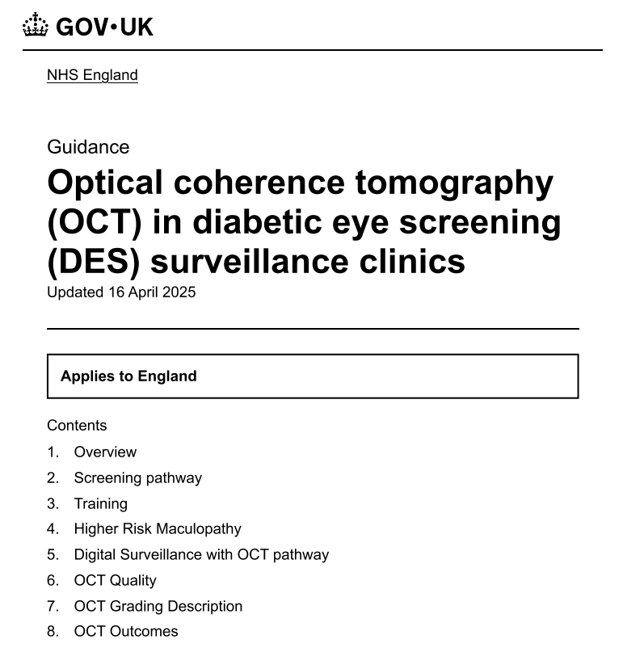

Local Protocols and National Guidelines
Continuous adjusting of local protocols
The London Protocol 2017

Slide 16

Local Protocols and National Guidelines Practice in NCL-DESP
Local protocols for referral into HES-our agreements
R1M1 OCT positive -when to refer and when to keep in DS OCT
Change in foveal contour:
HES would not start any treatment $if VA 6/6$ and minimal foveal thickening -KEEP DS OCT
Thickening of 1 > DA within macula with VA 6/6
HES would not use focal laser in these cases -KEEP DS OCT
R2LM1 OCT borderline or negative
HES would just monitor KEEP DS OCT

Slide 17
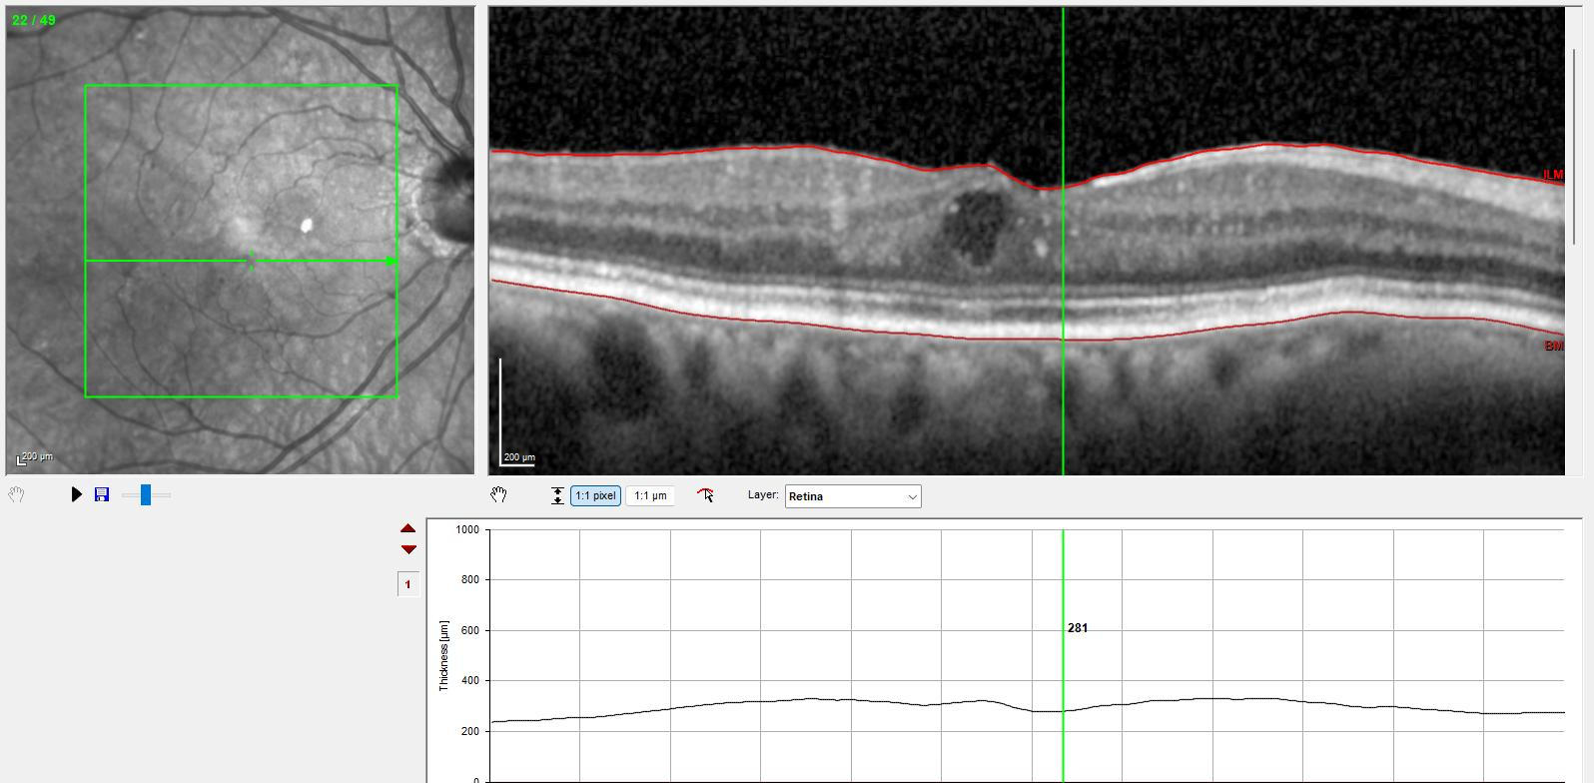
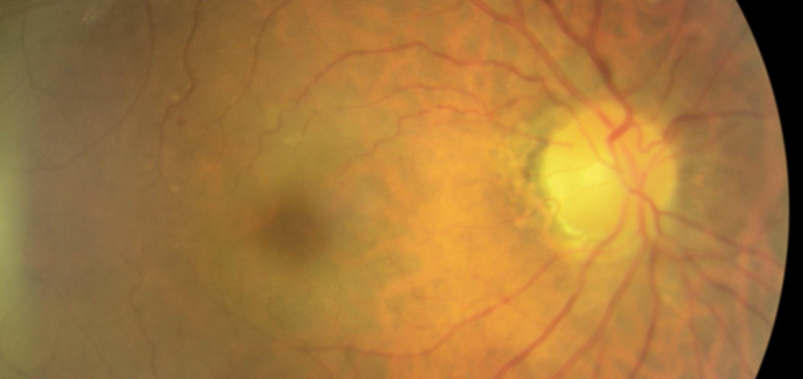
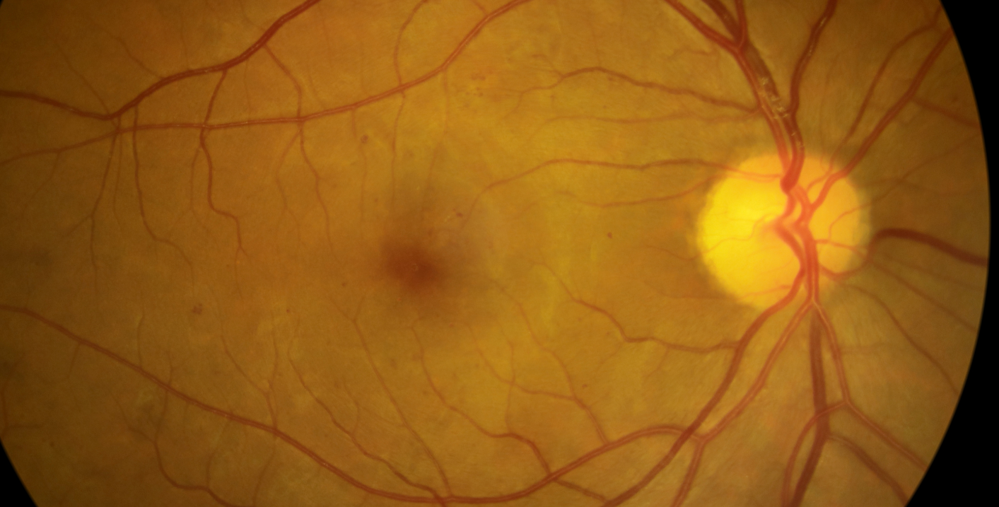
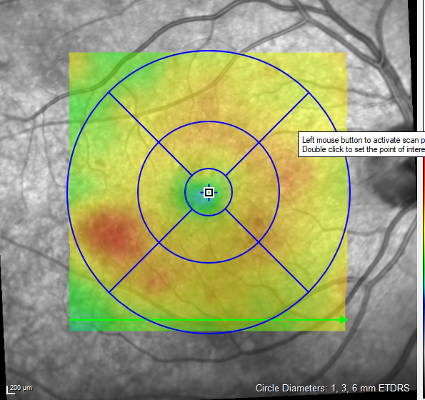
R1M1 OCT positive VA 6/6 refer to HES?
Case 1
Case 2

Slide 18
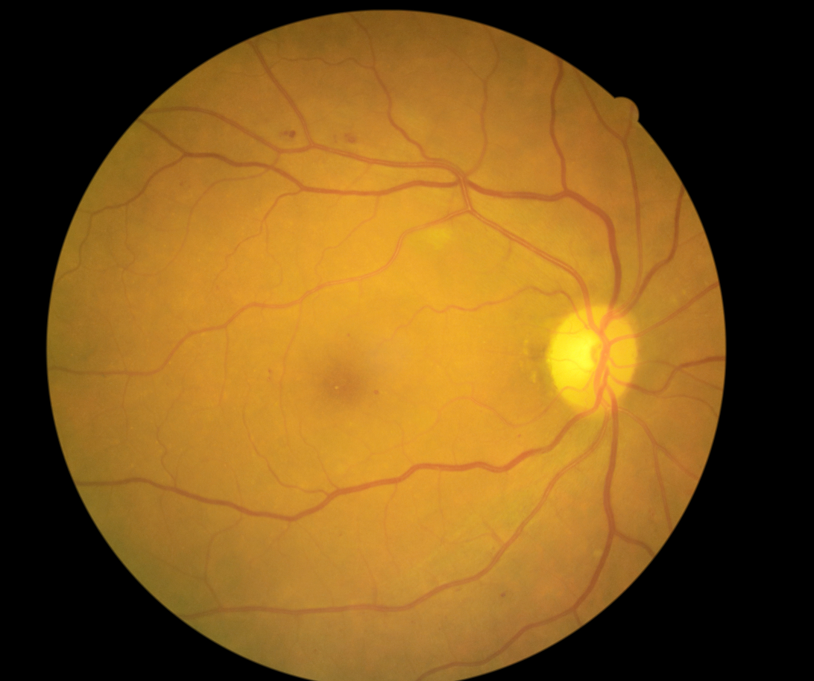
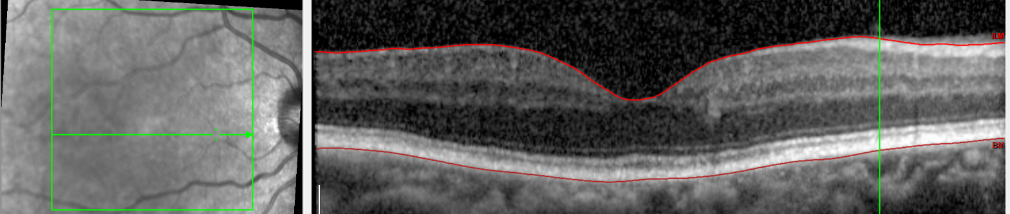
R2M1 OCT borderline
VA 6/6

Slide 19
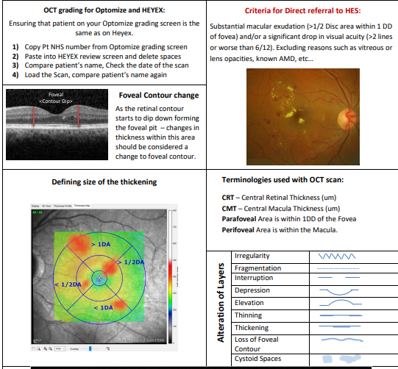
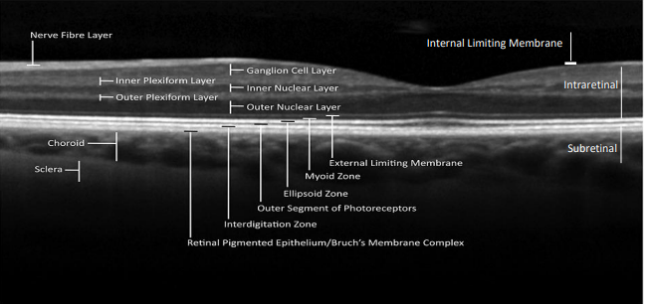

Slide 20
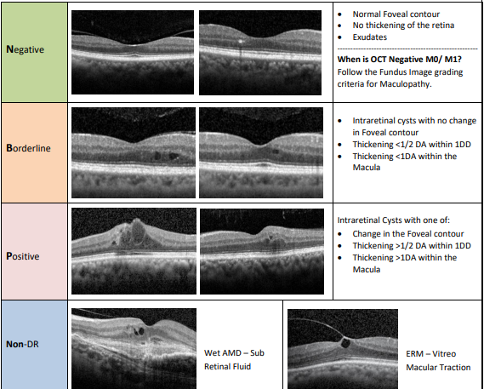

Slide 21
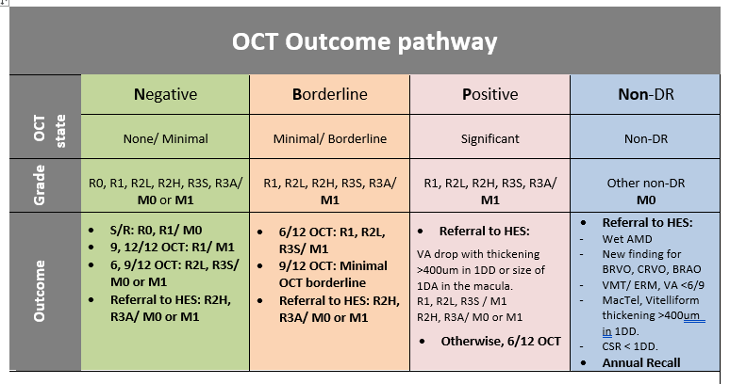

Slide 22

Maintaining standards in the workforce
Intergrader review of OCT graders
Continuous development of the workforce
Audits-QI
Local set up by programmes
Standards sensitivity and specificity?
Courses, in house training, on-line training
Examples of some of our audits:
M1 audit of referrals into HES
R2 audit progressing to R3a
New software update has an OCT intergrader function

Slide 23

Challenges in the OCT pathway Pressure on work force
OCT grading takes longer, more if arbitration grading is implemented
time per OCT grade = 2,5 x RDS grade
OCT IT support -no hyperlinks
DNA rate in the OCT pathway is high
Some reasons:
Patients don’t understand why early recall
Too many appointments
Solutions
train screeners to explain why potential recall and to explain some findings on images
Time and potential risks for grading on wrong patient

Slide 24
Challenges in the OCT pathway Cost Pressure
Revenue for OCT grades might not match the time spent by the programme
More complex grades (more disease) result in more tertiary grades - increase grading time

Slide 25
OCT.........
Will increase M1 grades
OCT guidelines for borderline OCT
Example
Can help with R3a lesions
ILM puncturing vascular lesion
Example

Slide 26
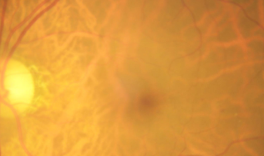
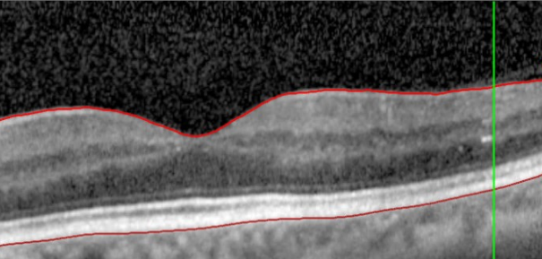
R1M1- on photo M0 on OCT borderline

Slide 27
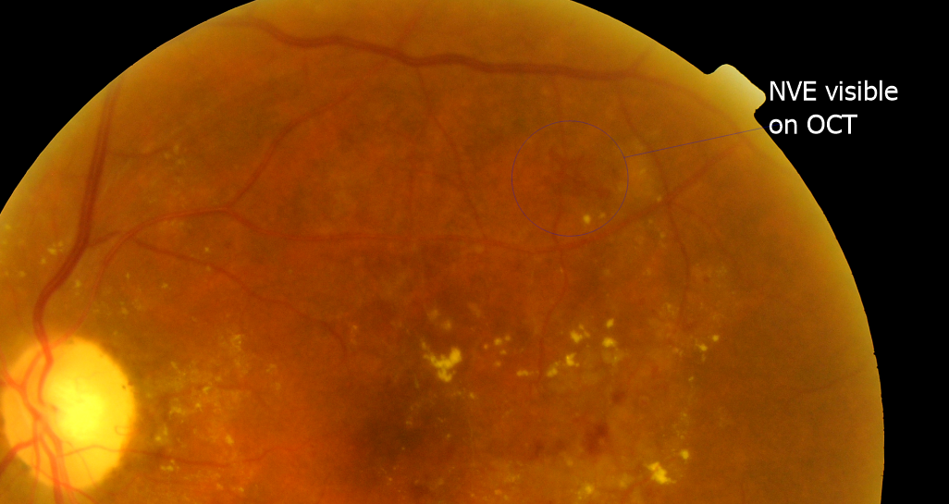
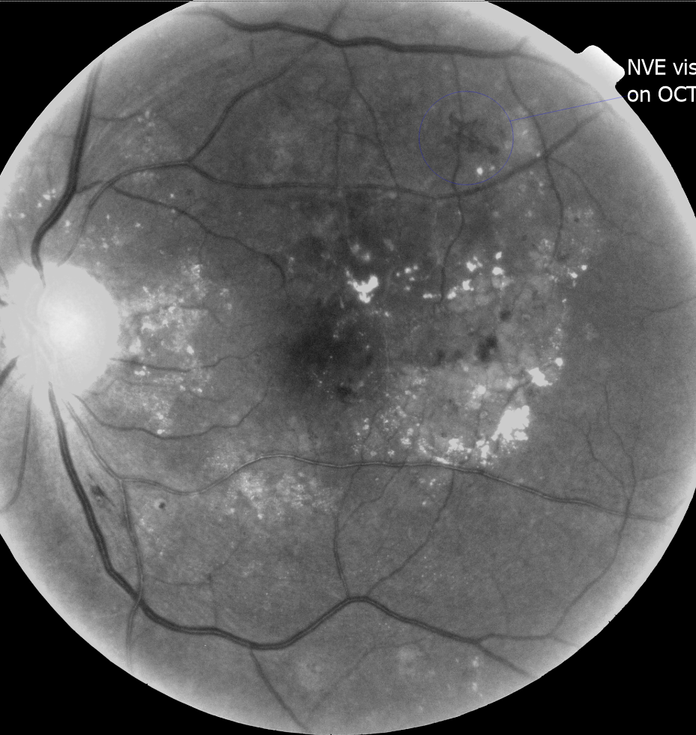
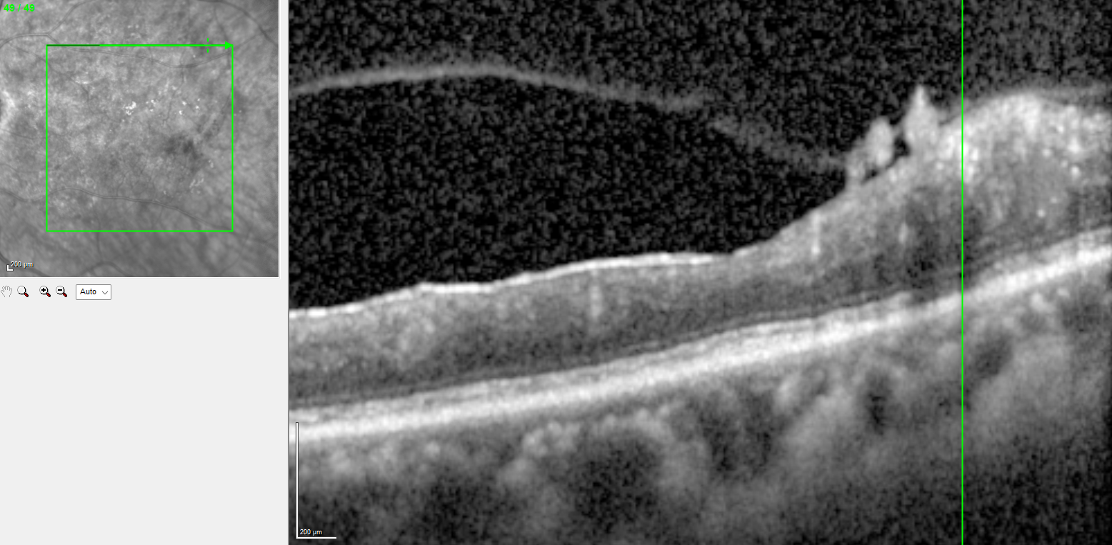
R3a on OCT

Slide 28
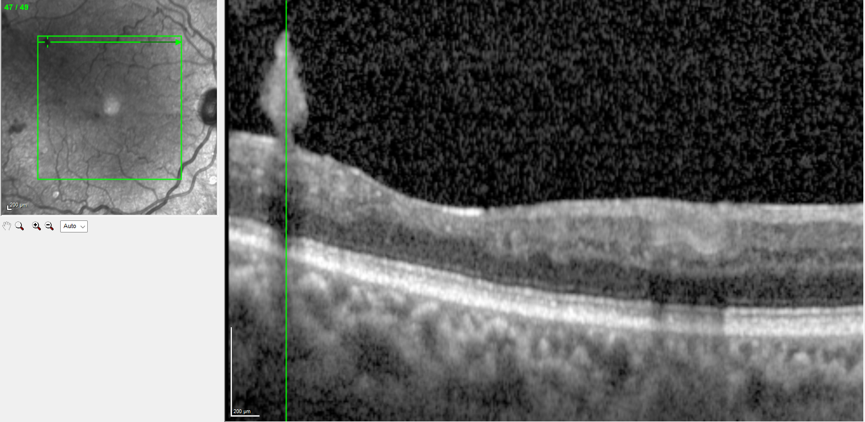
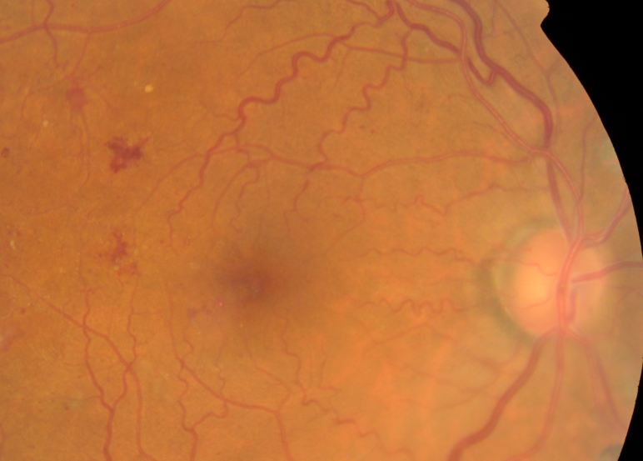
R3a on OCT

Slide 29
Wish list.......
Simplify access to OCT viewer platforms
Enable hyper links in screening software (OptoMize…..) to open grades in OCT viewing software
Will reduce error of grading incorrect OCT
Will facilitate much quicker access
Test & Training
Can OCT be included?
Standardized national audits to compare OCT implementation and pathways

Slide 30
Summary- Clinical implementation of OCT in DESP and arising challenges
OCT Workforce training
Screener
Graders
Impact of training on the workforce
Maintaining standards
Challenges of an ongoing OCT Service

Slide 31
Thank you
Special Thanks to Iveta Olejkova, Simon Daniel-Tong and Zine Elhousseini for developing the grading matrix, teaching material and teaching videos

