Slide 1
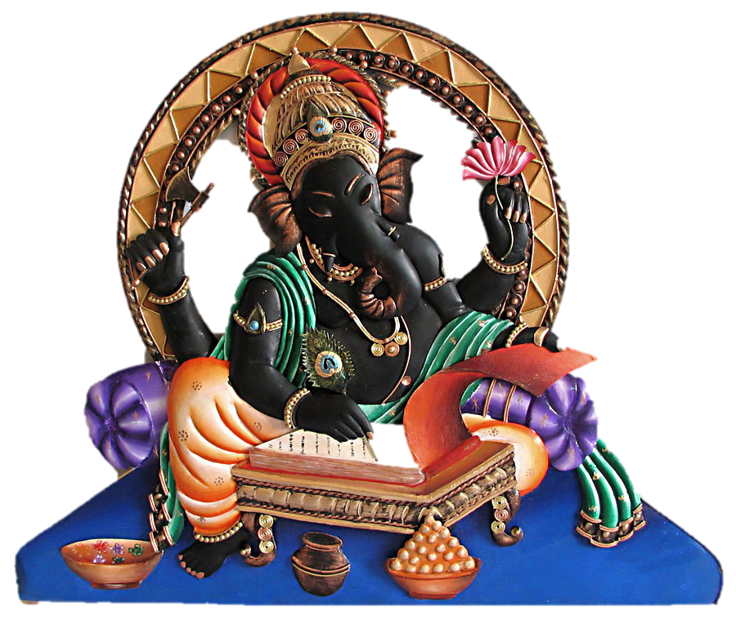
OPEN HOUSE AND REGISTRATION
Hindu School of Kentucky
Sunday August 28th, 2022

Slide 2
The Hindu School of Kentucky
Formally founded - 2000 by small group of parent volunteers
Affiliated with and operating under auspices of Hindu Temple of Kentucky
Steady growth over past 20 years with highest Enrollment of 140 students.
Six Classes according to grades from ages 3 – 15+ years
Hindu school went virtual in April 2020 due to COVID - 19 restrictions
Class for upcoming year 2022 -2023 will be IN-PERSON
Mode of Instruction (Virtual or In-Person) may vary based on JCPS and temple guidelines
Notes:
CS

Slide 3
Mission: Educate children and youth of our community, on the culture, values and heritage of Hinduism.
Vision: To use basic tenets of Hinduism to empower children and youth to be proud of their identity, promote cultural and spiritual wisdom and inspire them to become positive contributors of the global community.
Notes:
CS

Slide 4
Objectives:
To provide a fun, secure learning environment to educate children on Hindu religion through stories, quizzes, bhajans, shlokas, yoga, theater production and practical lessons.
To instill Hindu values and develop discipline, embrace identity, build character & self-esteem.
To develop awareness of Hindu culture and traditions by celebrating our Hindu festivals while encouraging students to become involved in temple activities.
To provide students the opportunity for peer interaction and to create friendships.
Notes:
CS

Slide 5
Integrated Learning Curriculum
Hindu School Book
Hindu Culture, Beliefs & Traditions, Philosophy
Hindu Epics and Morals
Values & Heritage
Significance of Hindu Festivals and Rituals
Meditation, Yoga, Sanskrit
Interactive Quizzes, Videos, Games, Plays
Hindu Festivals and Customs
Story Time, Music, Fancy dress, Sathvic Cooking
Interactive Learning
Curriculum
Age Approp. Learning
Hands-on Experience
Prema – Storytelling, bhajans
Sathya & Vinaya - Story time Dashavataar, Ramayana
Karuna - Bhagavatham, Why do We, Significance of Rituals
Dharma & Seva - Life lessons from Mahabharata, Hindu Way of Life
Shloka Competition
Annual Function
Mela, Picnics, Movie Matinee, Mother’s day, Field Trips, Seva Day
Saraswathi Puja & Diwali
Notes:
CS

Slide 6
Class Guidelines
In person attendance is required for all students residing LVL
Virtual options will be offered to our out of town students. We will support our remote students in a hybrid class at same time as in person classes
Virtual attendance will be allowed to local students only under special circumstances for up to 2 classes/semester
Regular attendance is strongly recommended and promotes better learning and student engagement
Student attendance is used for consideration during competition, events and promoted

Slide 7
Teaching Staff
Class | Symbolism | Grades | Teacher | TA/Co-lead
Prema | Love | PK1 & PK2 | Renu Mehta | Sudha Kukkala
Satya | Truth | K, 1 | Muralee Achyuth | Pushpa Adelli
Vinaya | Good Conduct | 2, 3 | Vidya Ram | Ramya Venugoal Sravani Narra Ivirtual)
Karuna | Compassion | 4, 5 | Vindhya Katta | Sreedevi
Dharma | Righteous | 6, 7 | Jothi Ravishankar | TBD
Seva | Service | 8 + | Jyoti Mahesh | Harish Chandan
Teaching Assistants: Need Volunteers
Notes:
JM

Slide 8
Class Timing & ScheduleTeaching Staff
Timing: All classes will be conducted at the same time at Hindu Temple of KY
All classes: 10:30-11:45 (60-75 mins depending on age)
Typical Schedule (depending of class). Lower classes will be more activity based to hold class attention
10 mins - Yoga/Pranayam
25 mins - Invocation/Shlokas
25 mins - Theory/Activity/Discussion/Kids time
10 mins - Bhajans and Arthi
5 mins - Attendance & Dismiss
MAKE SURE STUDENTS ARE IN CLASS ON TIME TO GET ATTENDANCE
Notes:
JM

Slide 9
Support Staff
HSKY Administrators: Anuya Kulkarni
Haripriya Kanuparthy
Website Administrator: Akshata Revankar
Teaching Assistants: Need Volunteers
Communications/PR: Need Volunteer
Events /Volunteer Coordinator: Need Voluntee
Notes:
JM

Slide 10
Important Info
Registration Start date: Aug 21st
Registration End Date: Sep 25th (with Regular Fee)
Registration Fee: $100/1st Child
$75/2nd or more children from same household
Late fee: $125/1st Child
$100/2nd or more children from same household
Shloka Book*: $10 – new registrants
First Day of Class: Sep 11th
HSKY Website: www.hskylou.org
* Shloka Books will be handed over by respective teachers
Notes:
JM

Slide 11
HINDU SCHOOL OF KENTUCKY
REGISTRATION LINK 2022-2023
https://app.easytithe.com/App/Form/d1bf298e-d049-4a58-a0d4-d328151ddce8
PLEASE SUBMIT ANY INQUIRIES REGARDING HINDU SCHOOL TO
TEACHERSHSKY@GMAIL.COM
Notes:
JM

Slide 12
HARI OM

