Slide 1




Hebrews 10: 24 & 25
And let us consider one another in order to stir up love and good works, not forsaking the assembling of ourselves together, as is the manner of some, but exhorting one another, and so much the more as you see the Day approaching.
Please Silence
Your Devices
Contact Us
(270) 683-4204
westsideowensboroky@gmail.com
Church Of Christ at
Westside Owensboro
Westside church of Christ
Owensboro KY

Slide 2
Westside Church of Christ
Sunday Bible Class:
9:30 AM
Sunday Worship:
10:30 AM
Sunday Worship:
5:00 PM
Wednesday Bible Class:
6:30 PM
Remember in your prayers:
Wanda Bradberry
Richard Hill
Don & Alice Ward

Slide 4
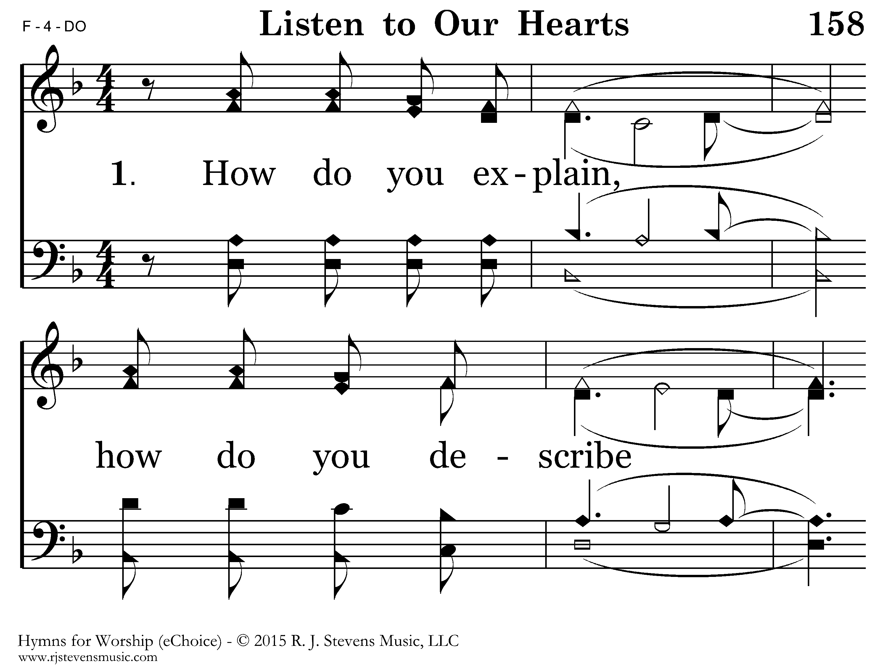

Slide 5
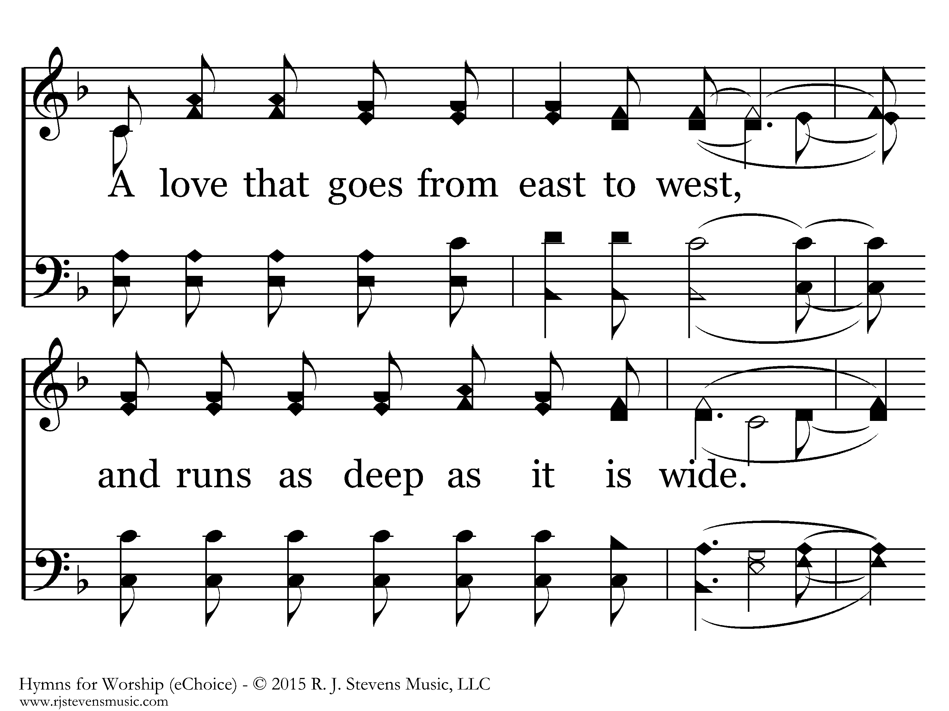

Slide 6
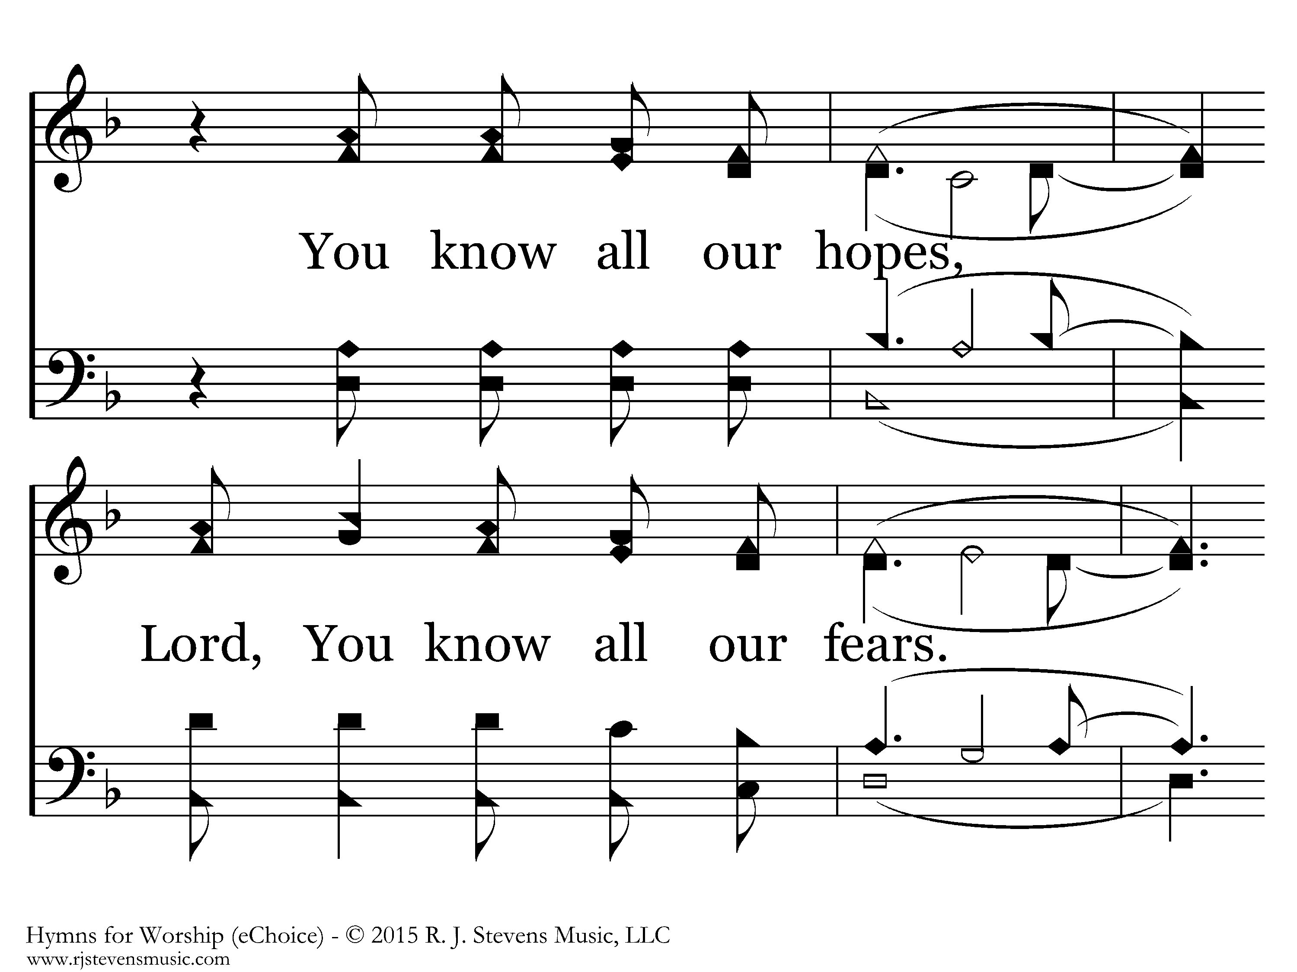

Slide 7
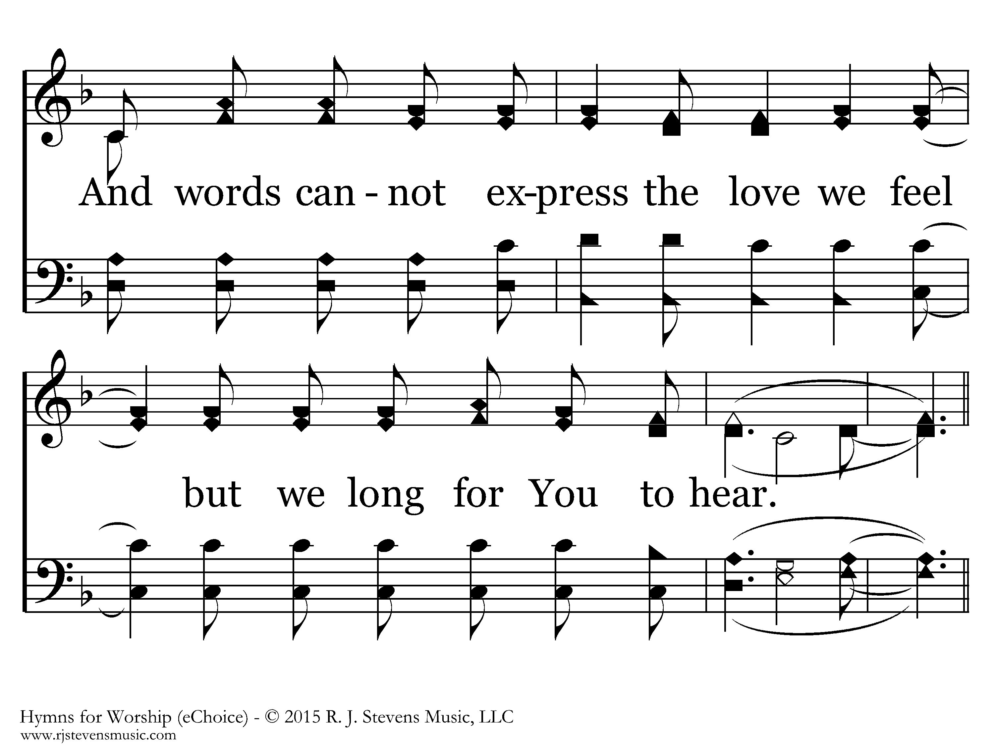

Slide 8
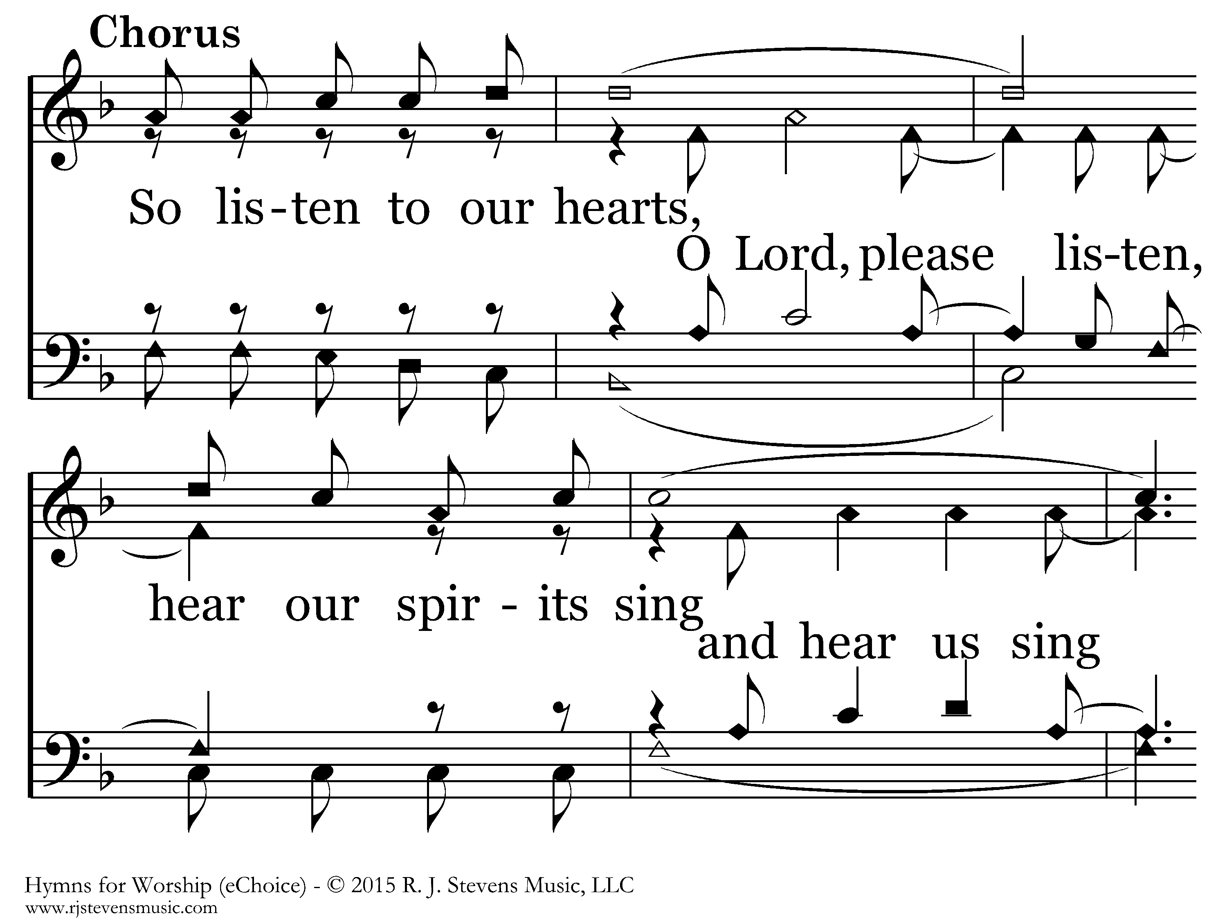

Slide 9
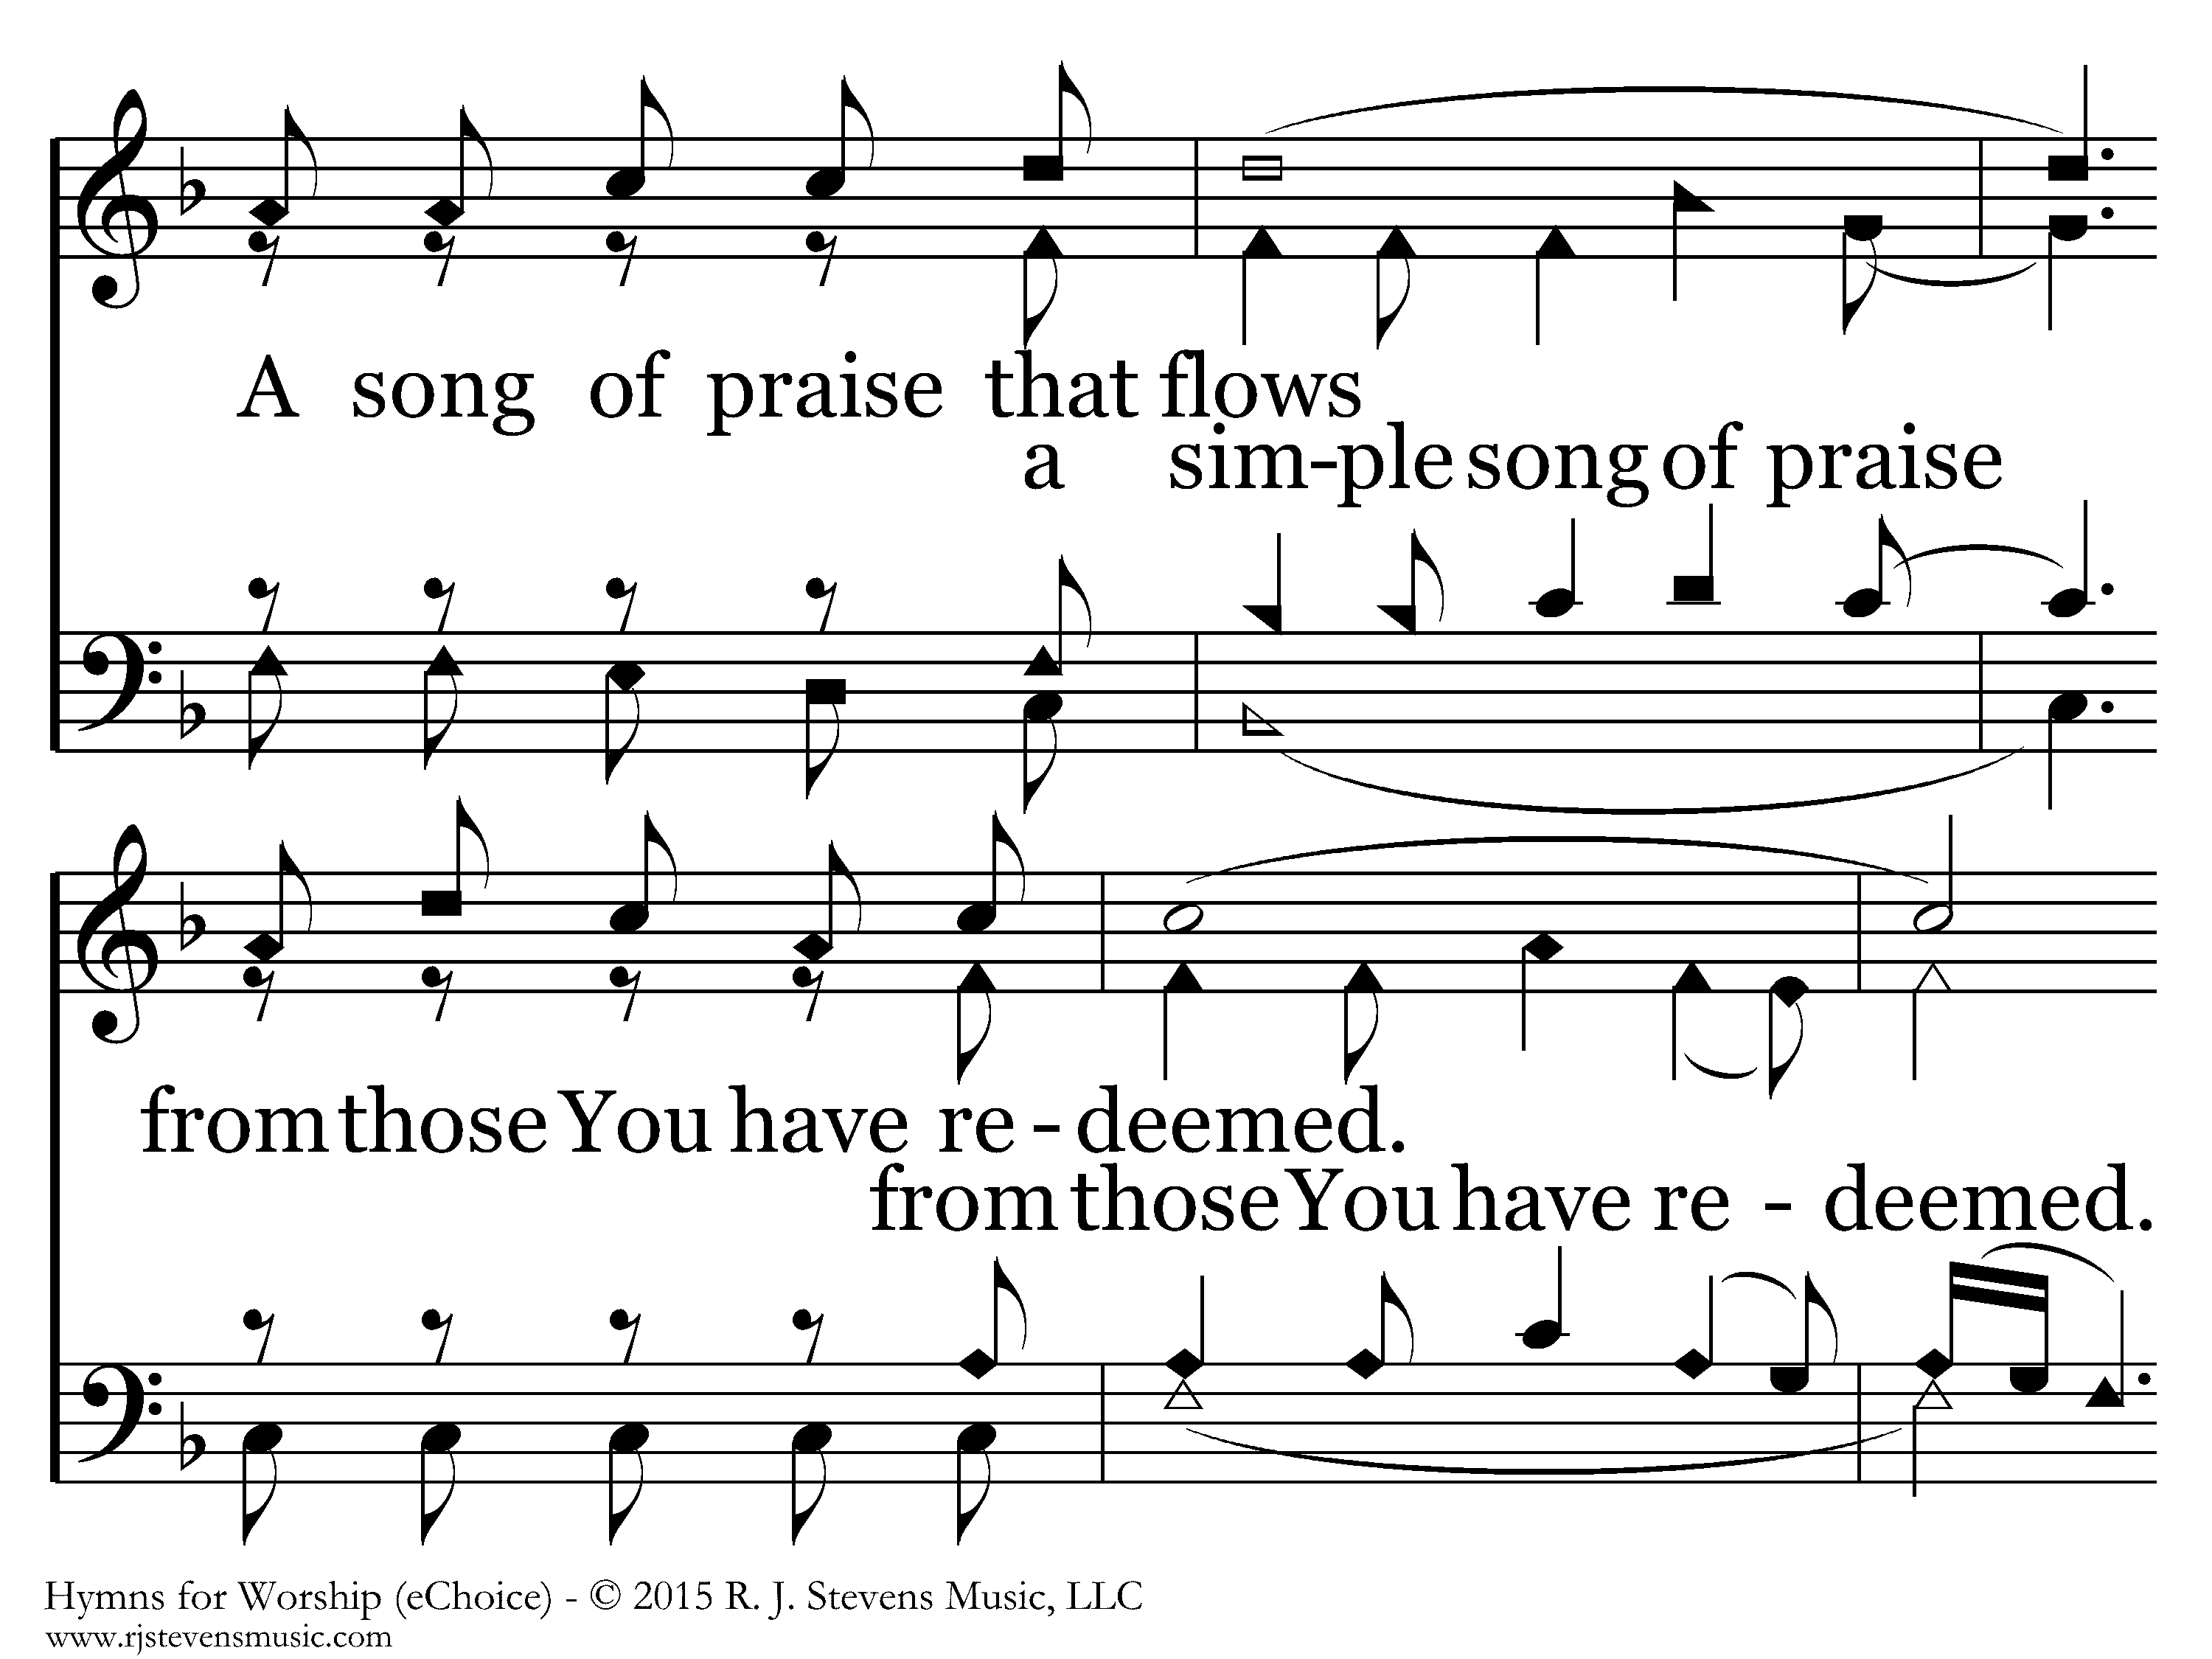

Slide 10
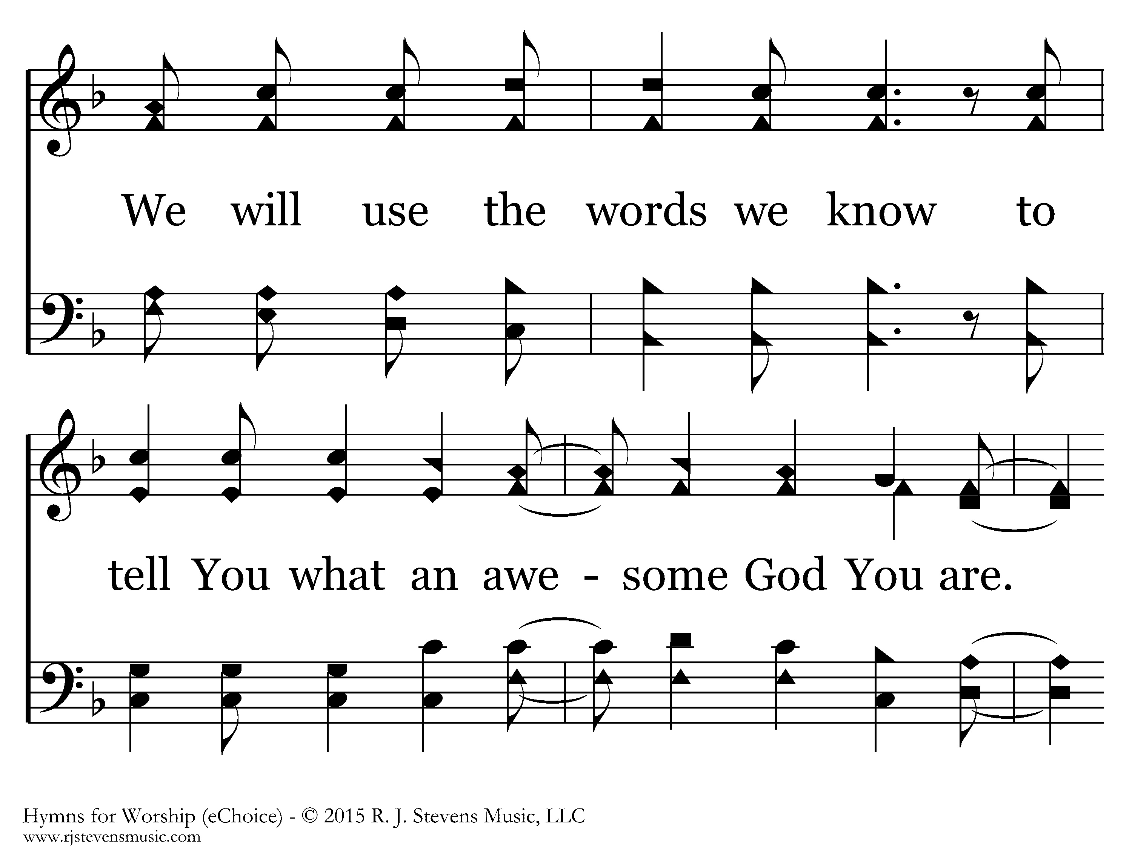

Slide 11
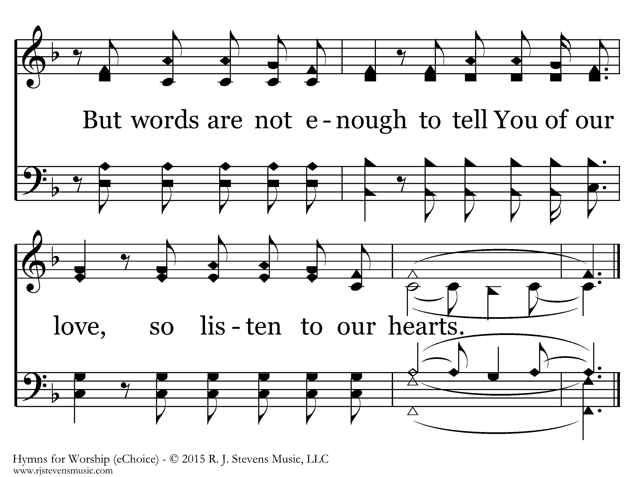

Slide 12
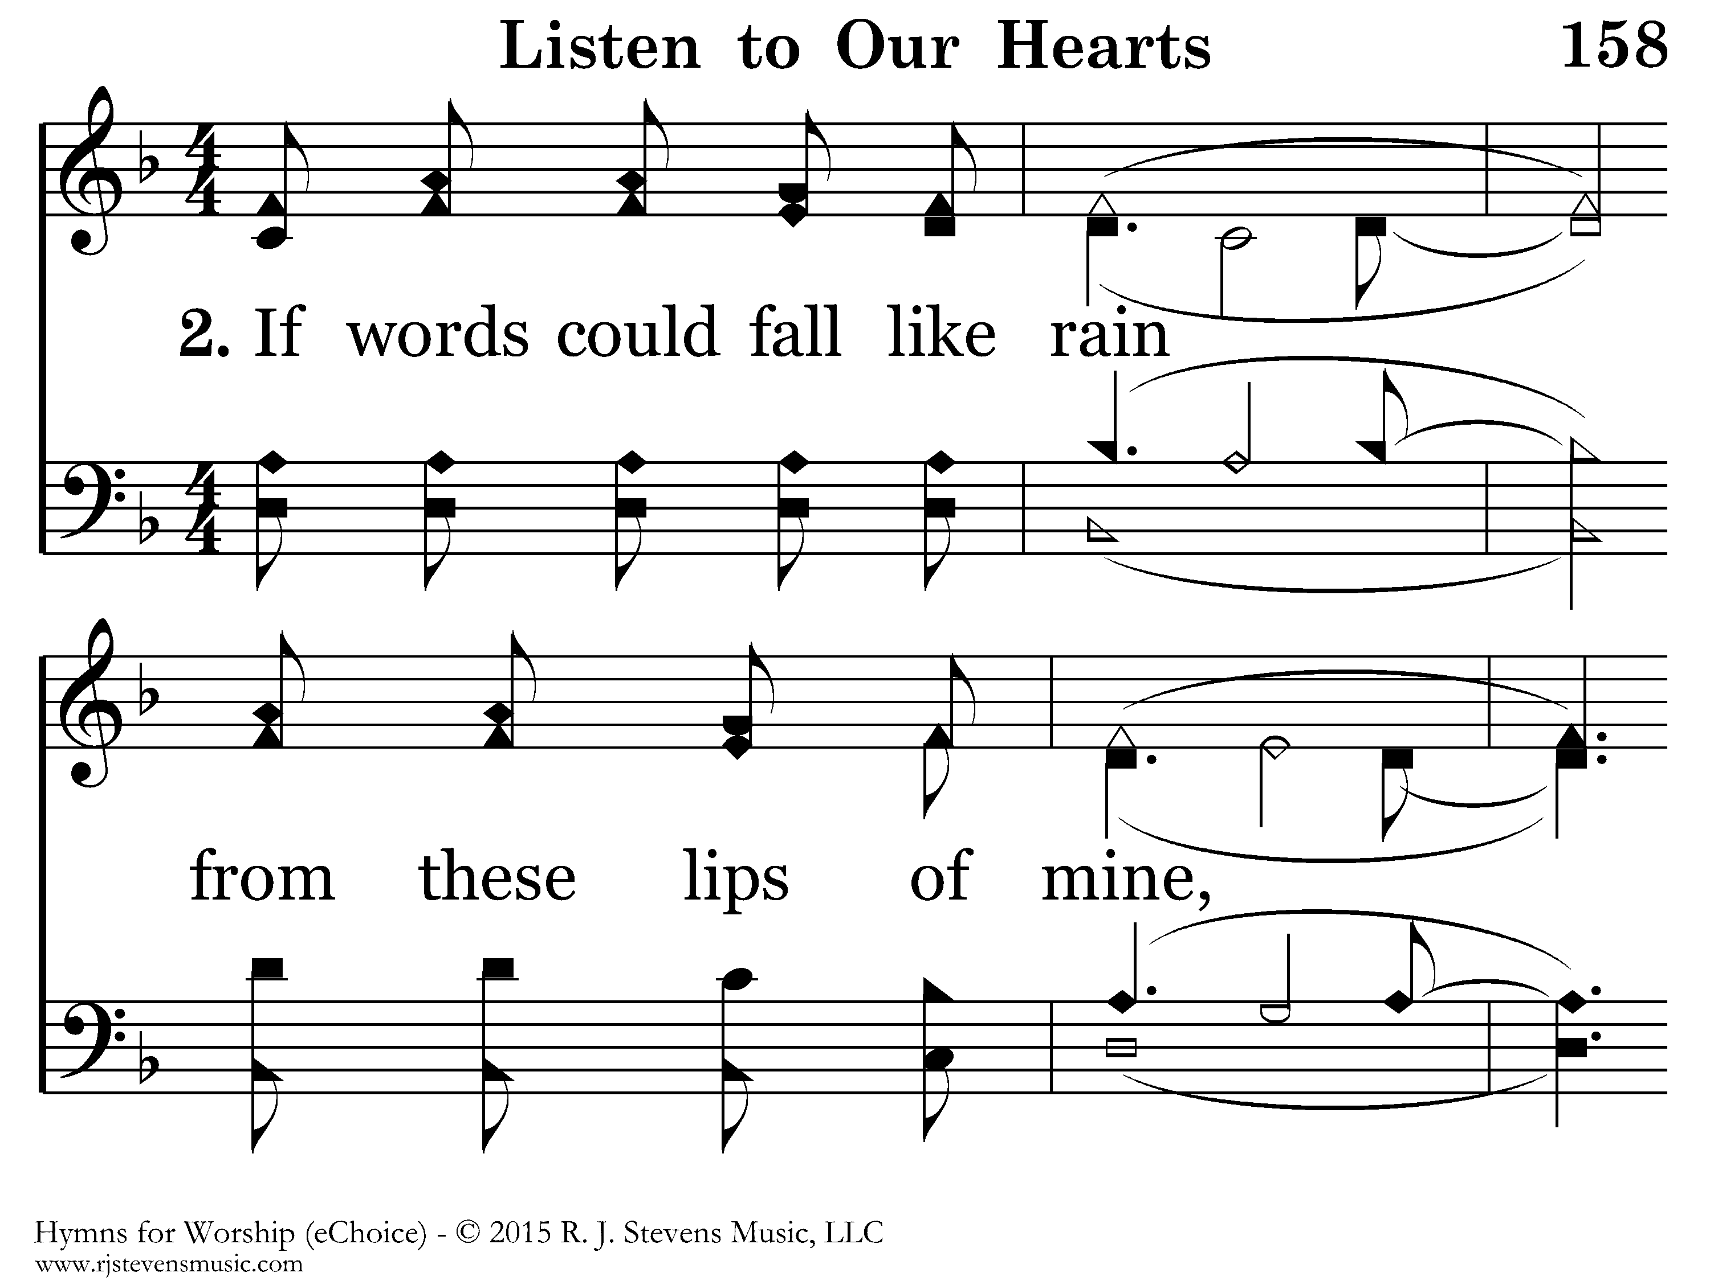

Slide 13
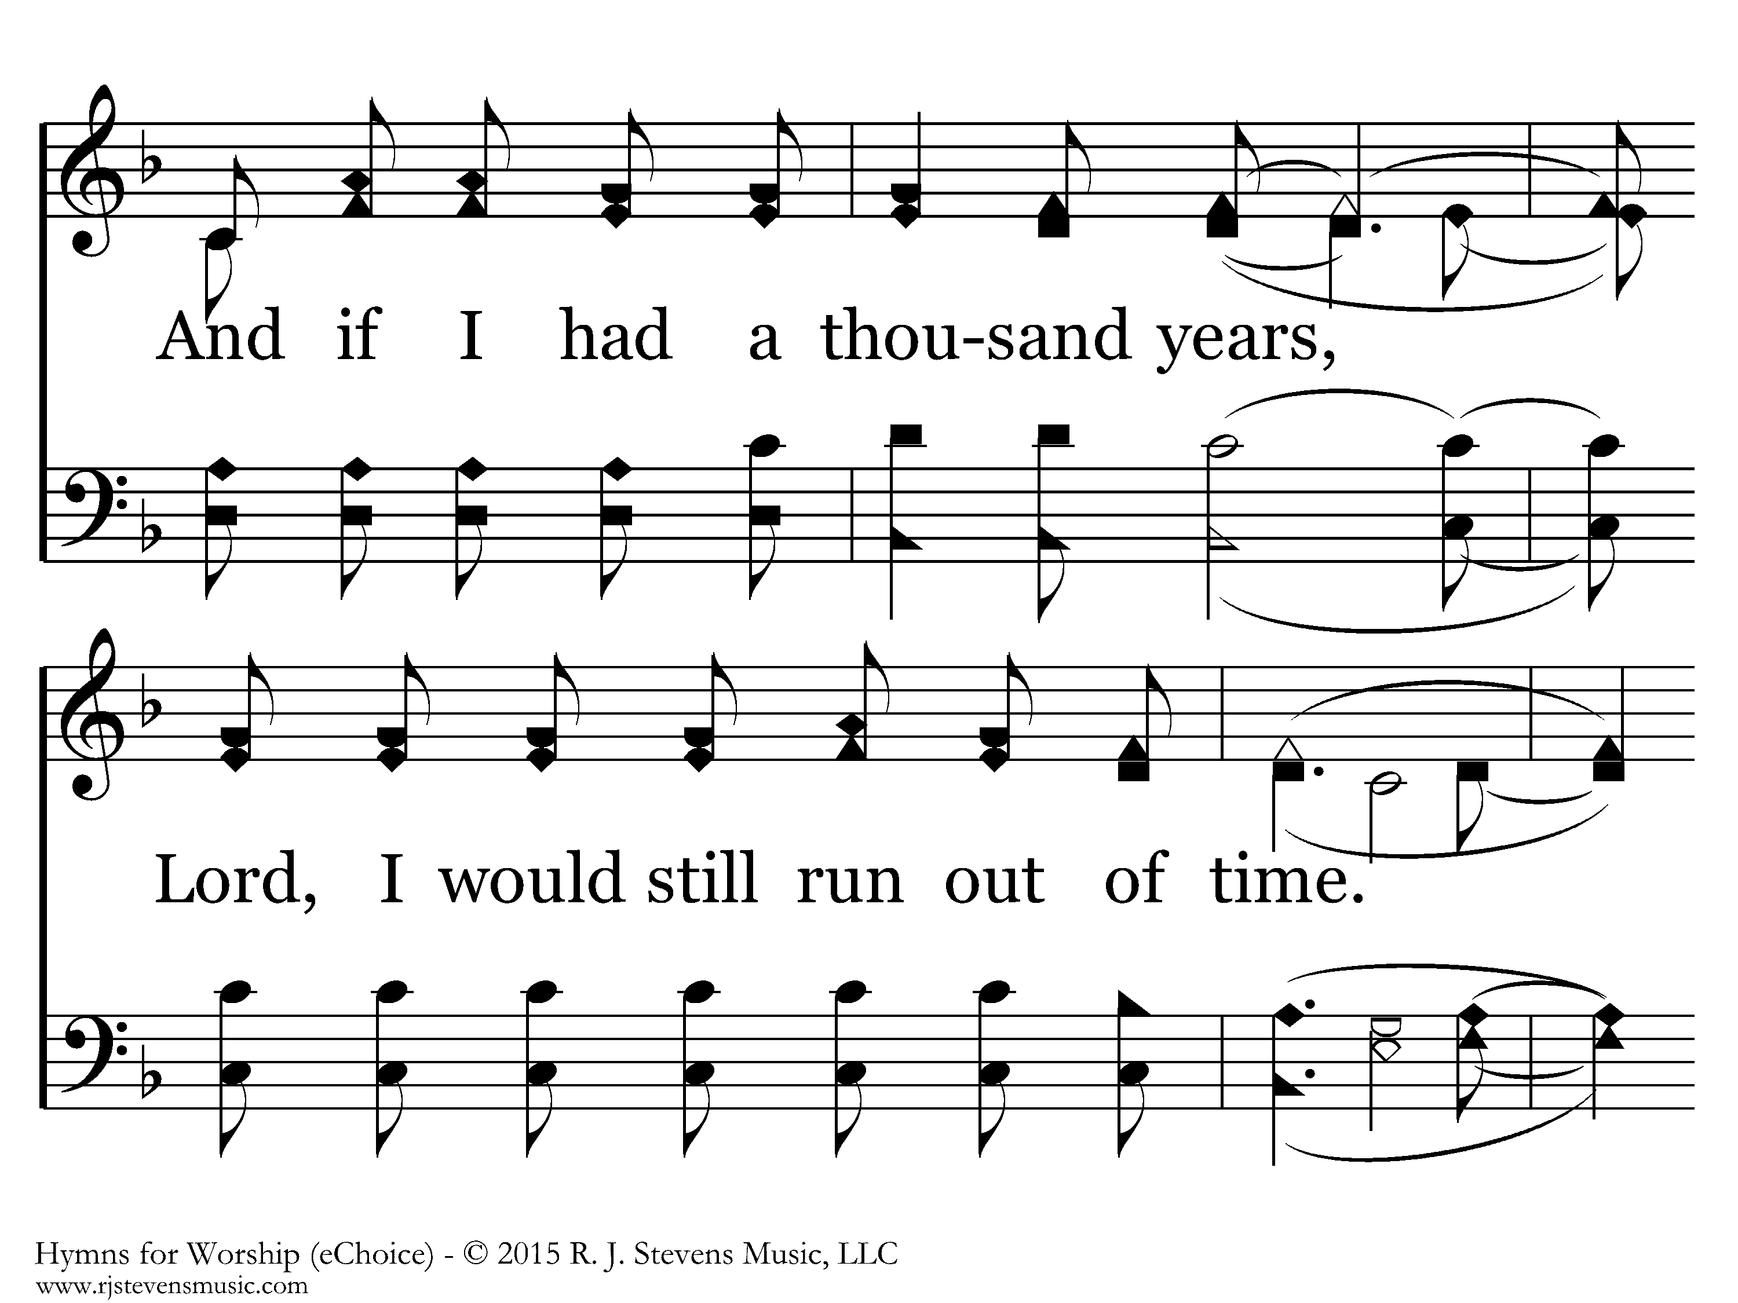

Slide 14
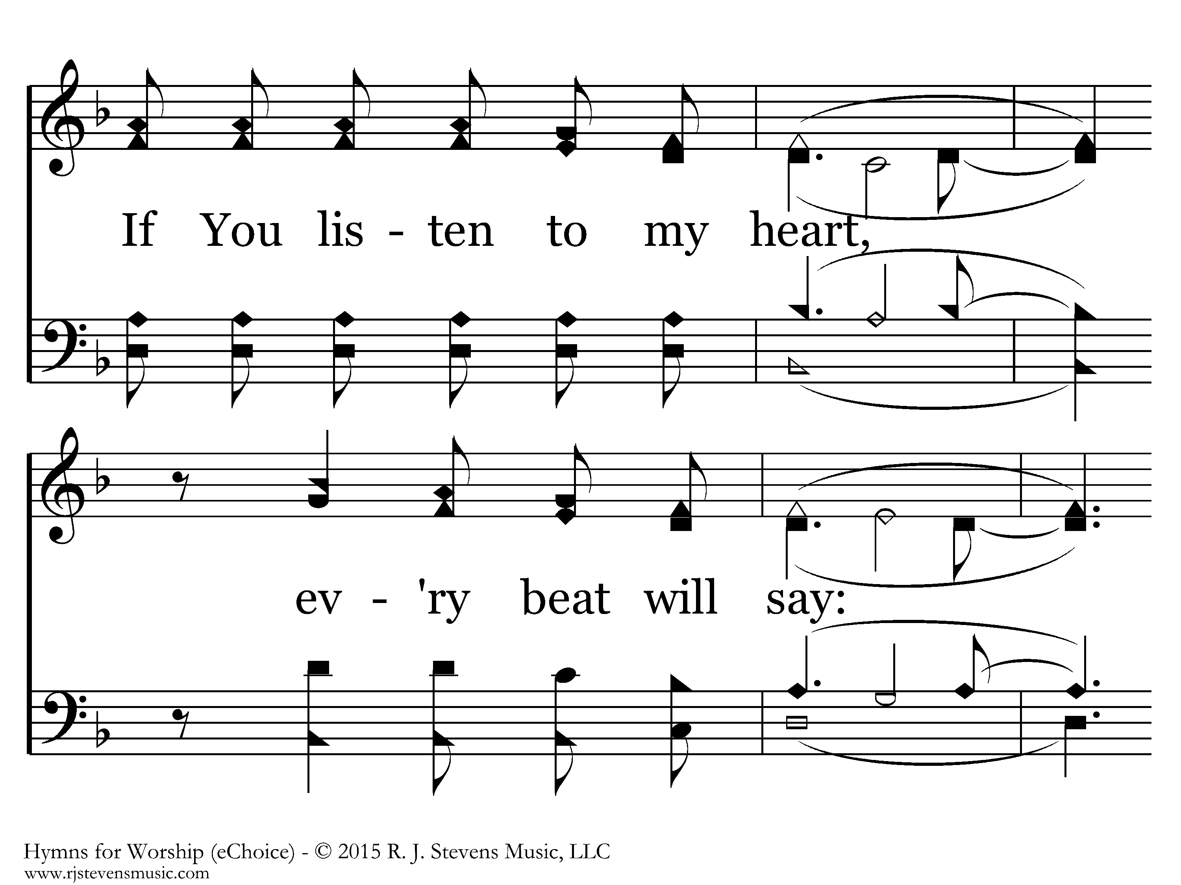

Slide 15
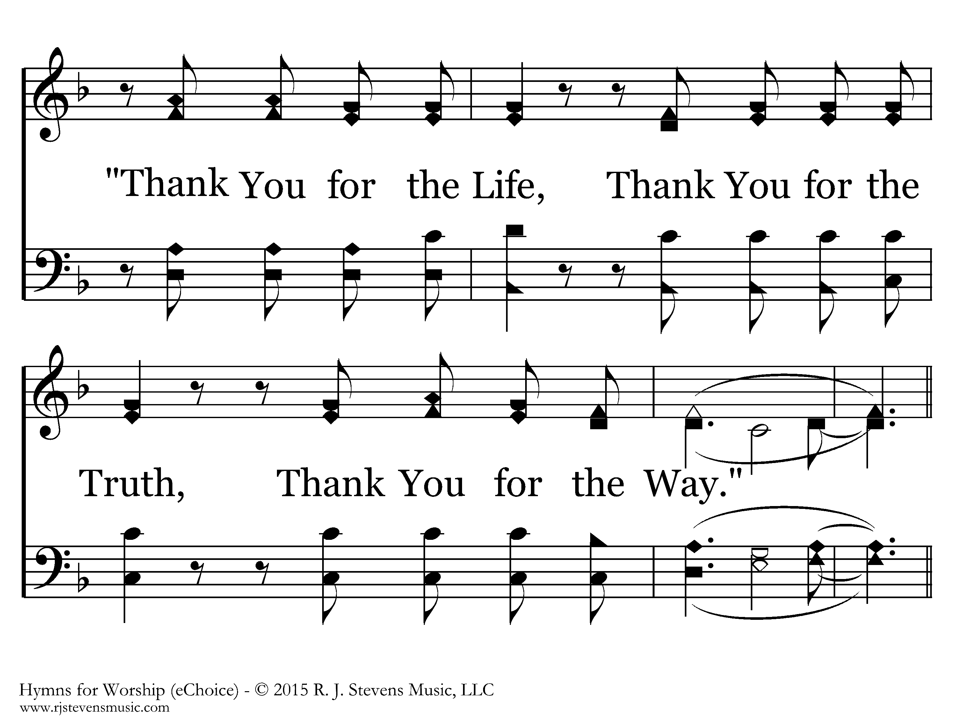

Slide 25
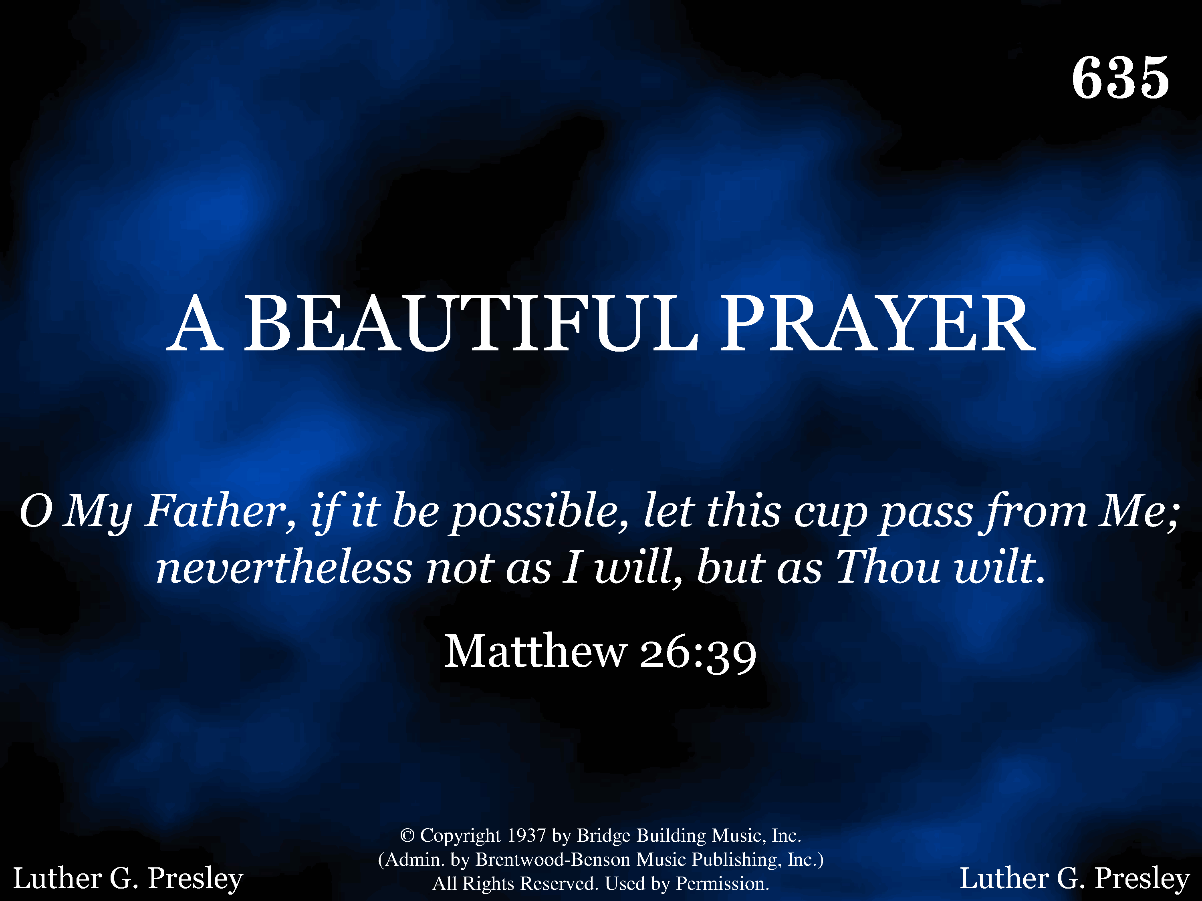
635 - A Beautiful Prayer - Title

Slide 26
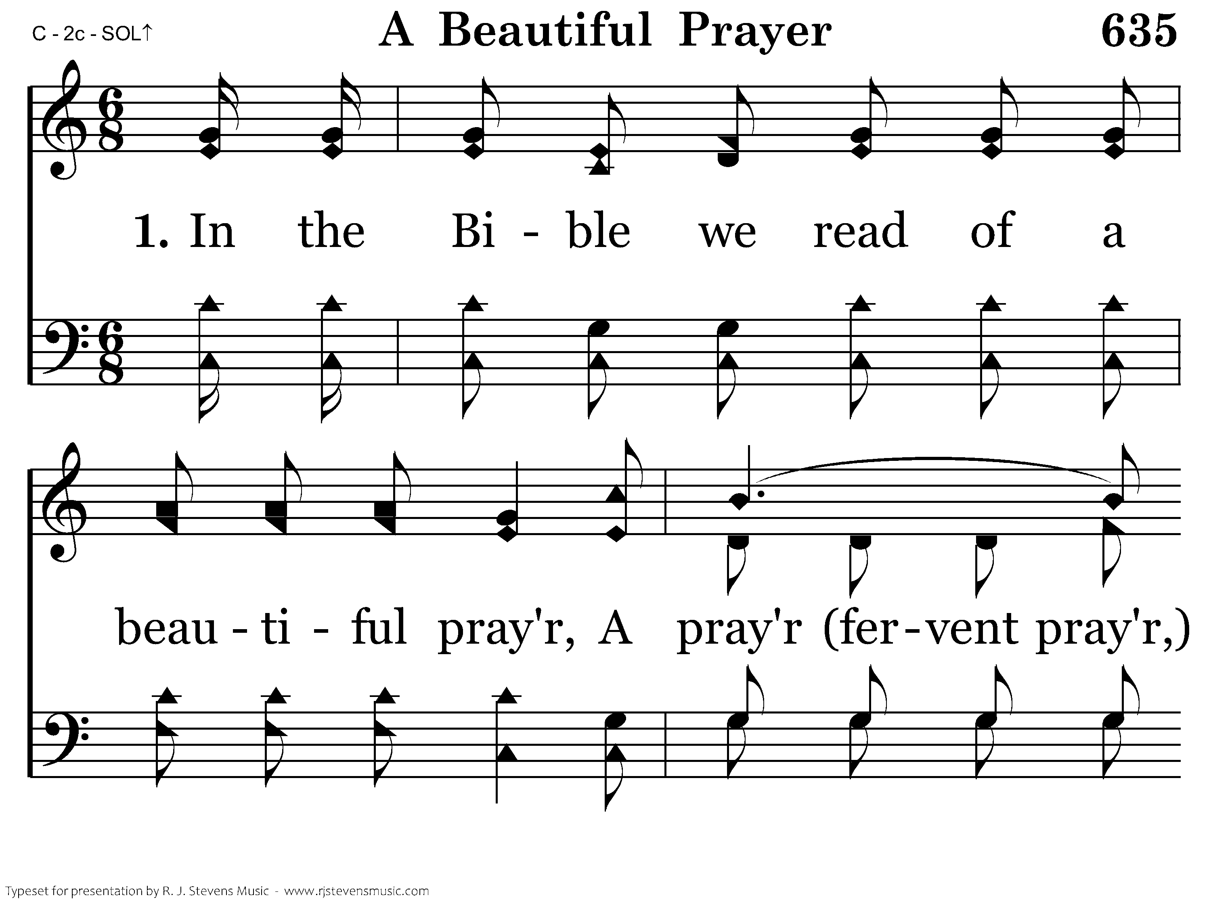
635 - A Beautiful Prayer - 1.1

Slide 27
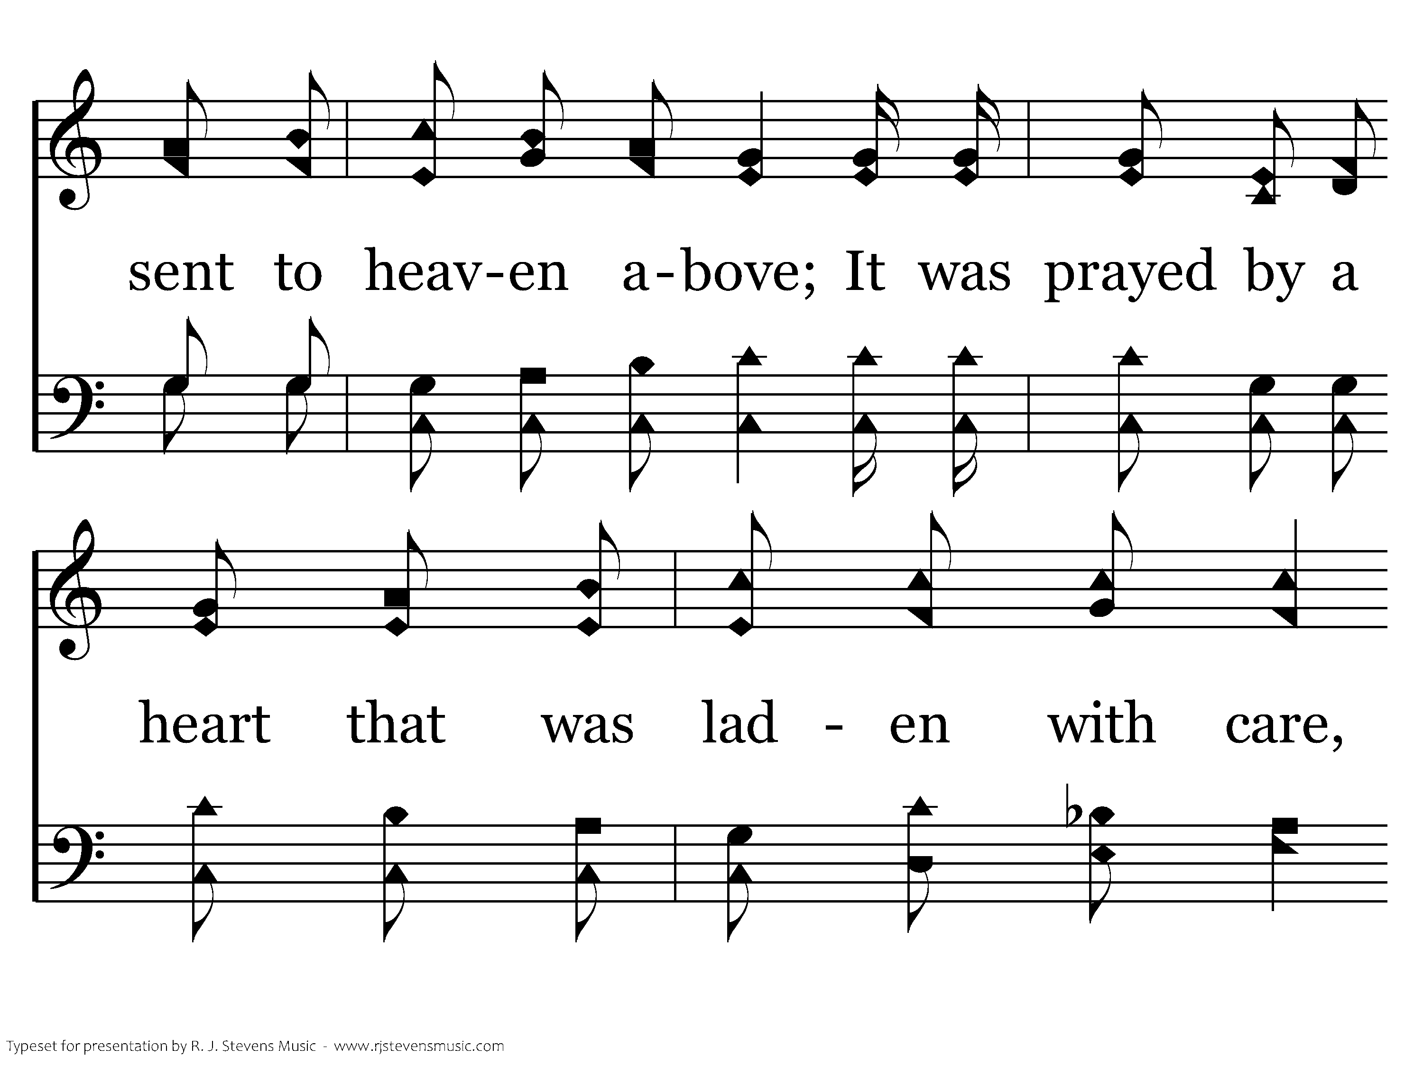
635 - A Beautiful Prayer - 1.2

Slide 28
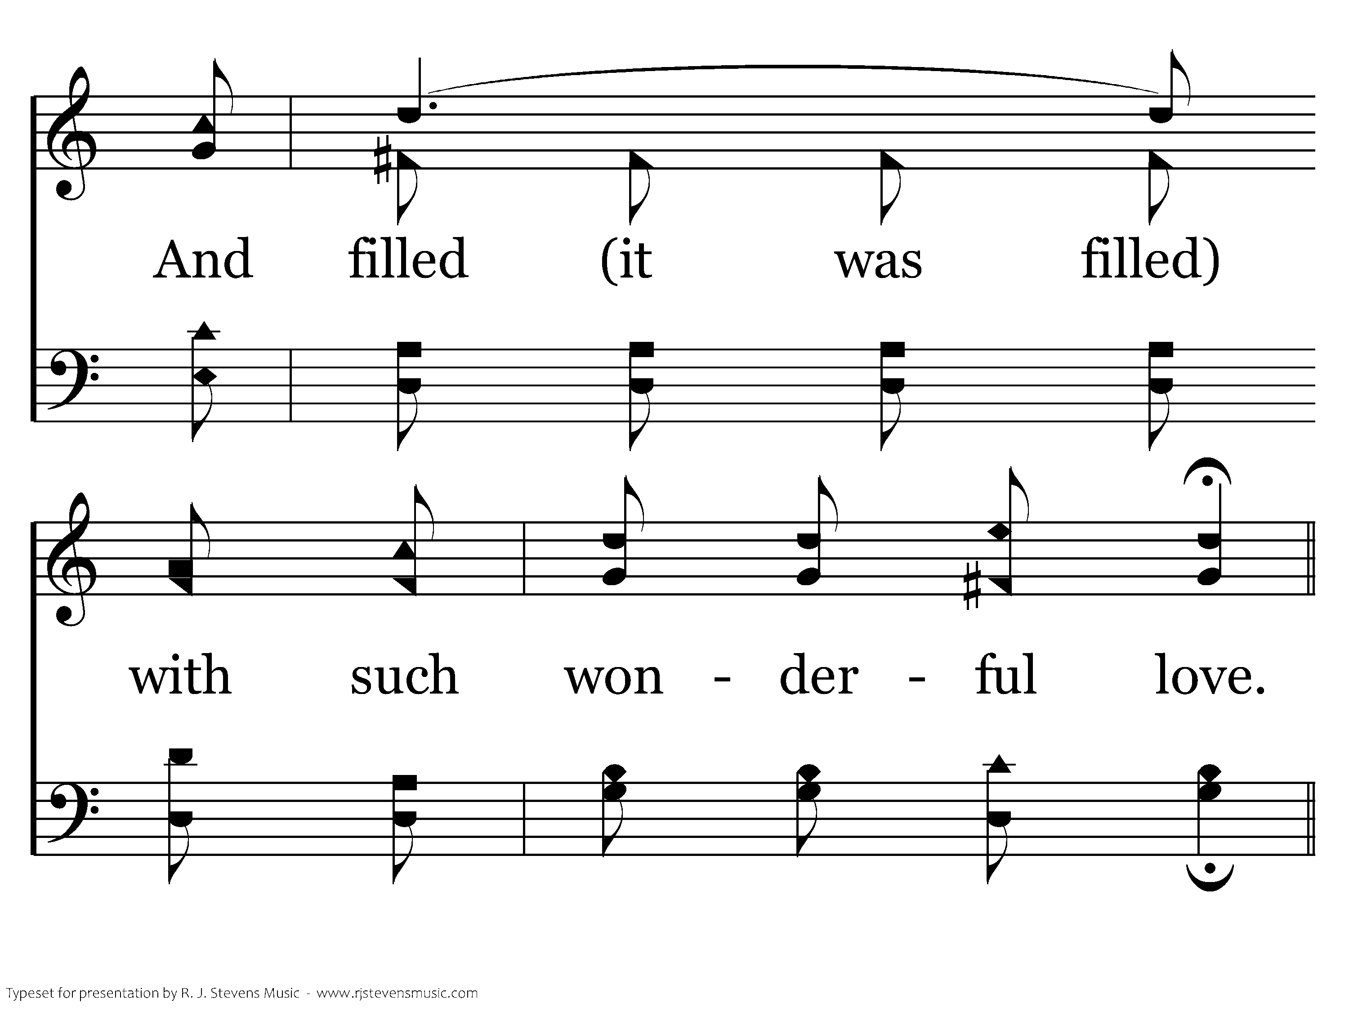
635 - A Beautiful Prayer - 1.3

Slide 29
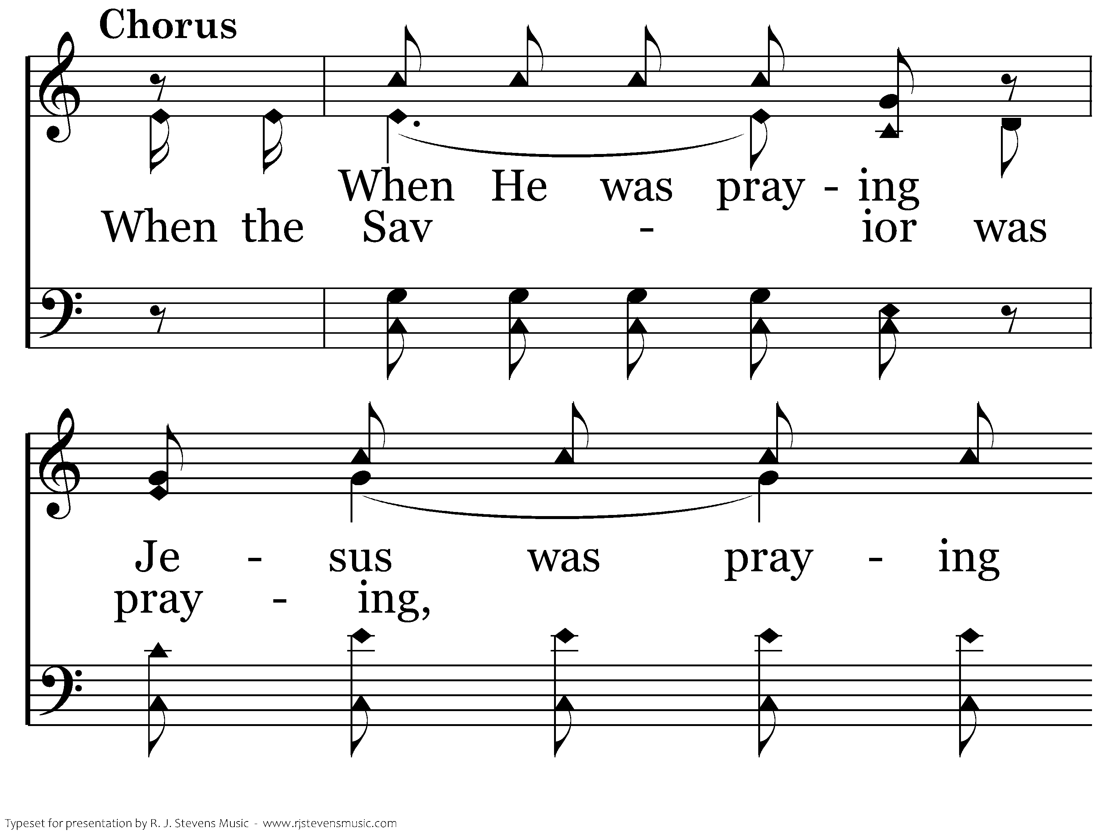
635 - A Beautiful Prayer - C.1

Slide 30
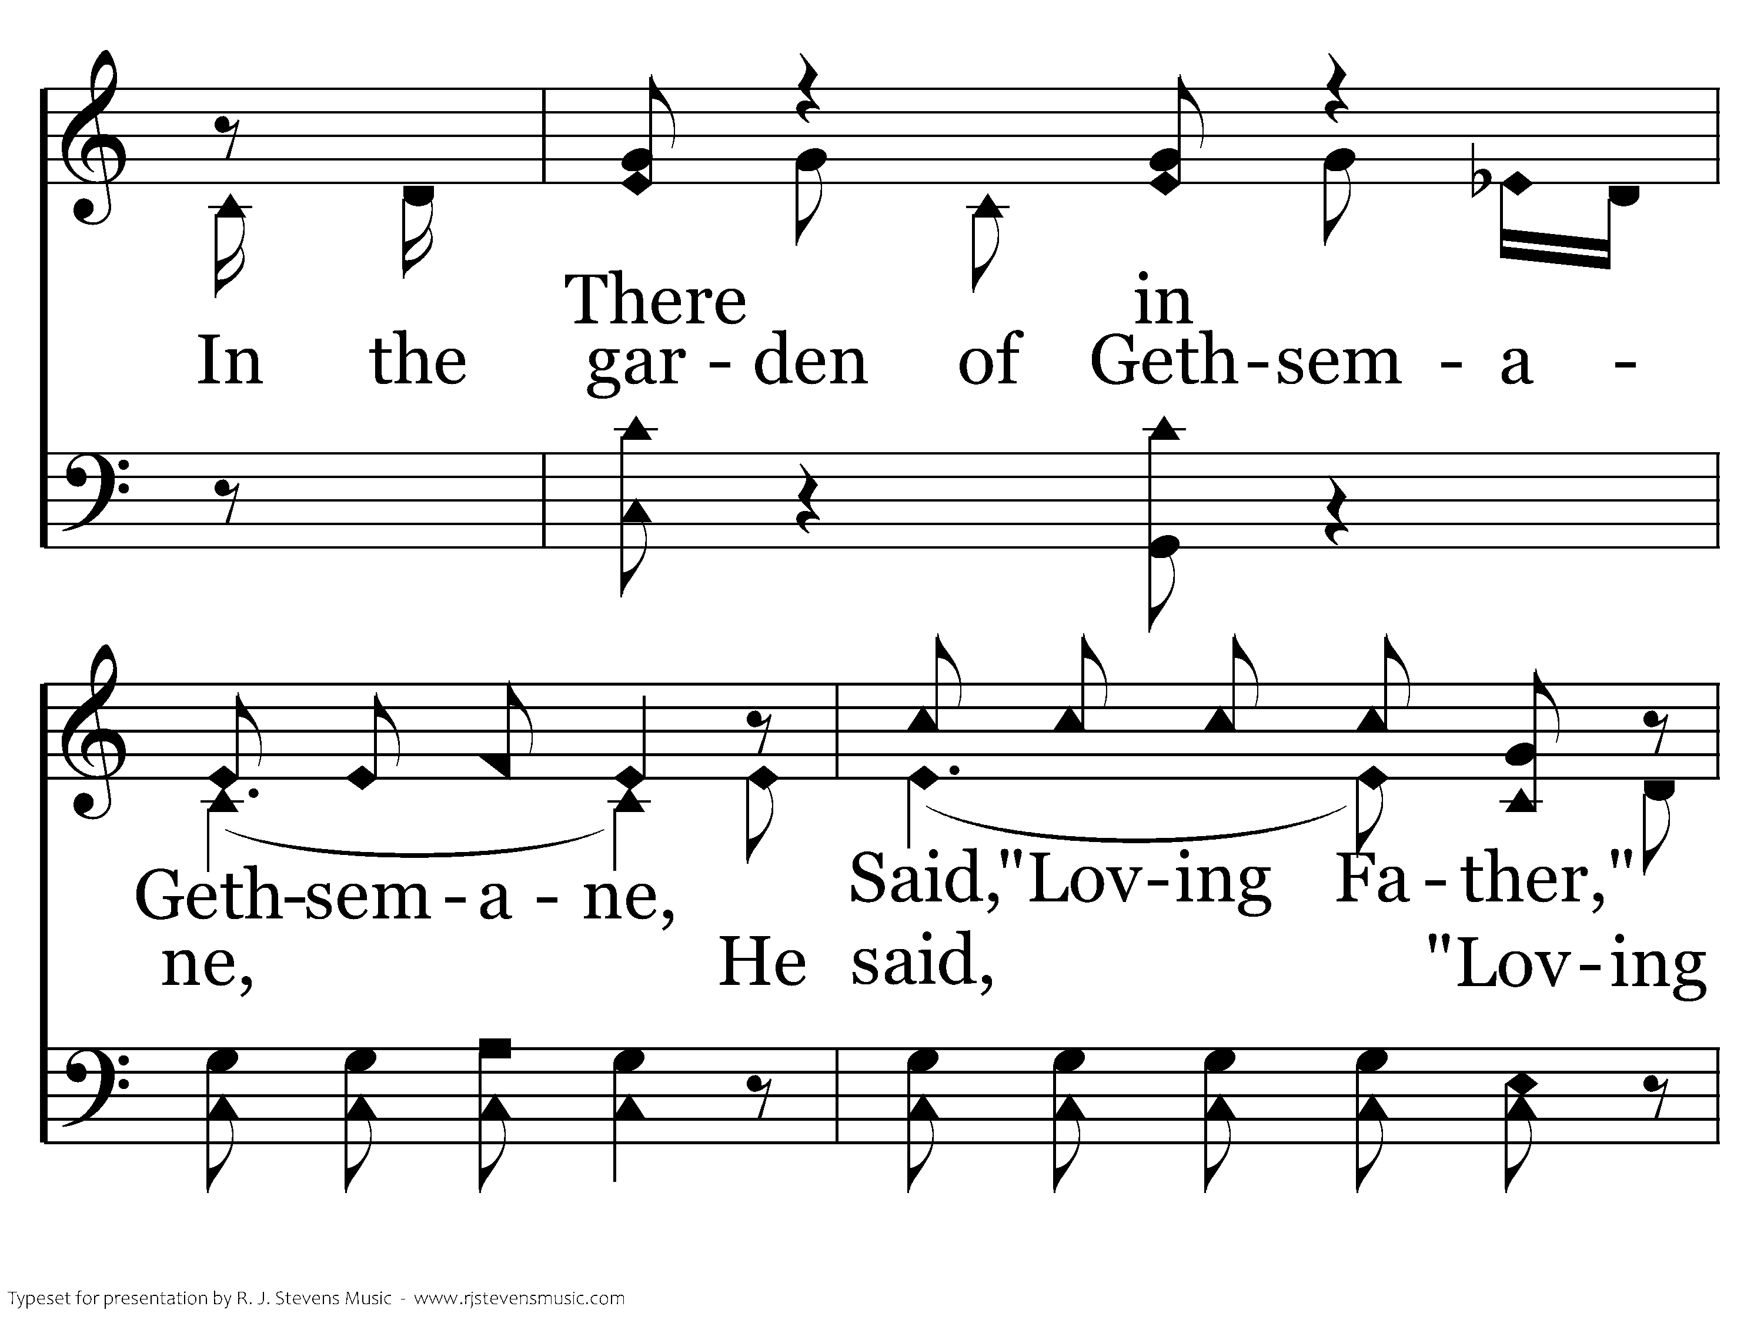
635 - A Beautiful Prayer - C.2

Slide 31
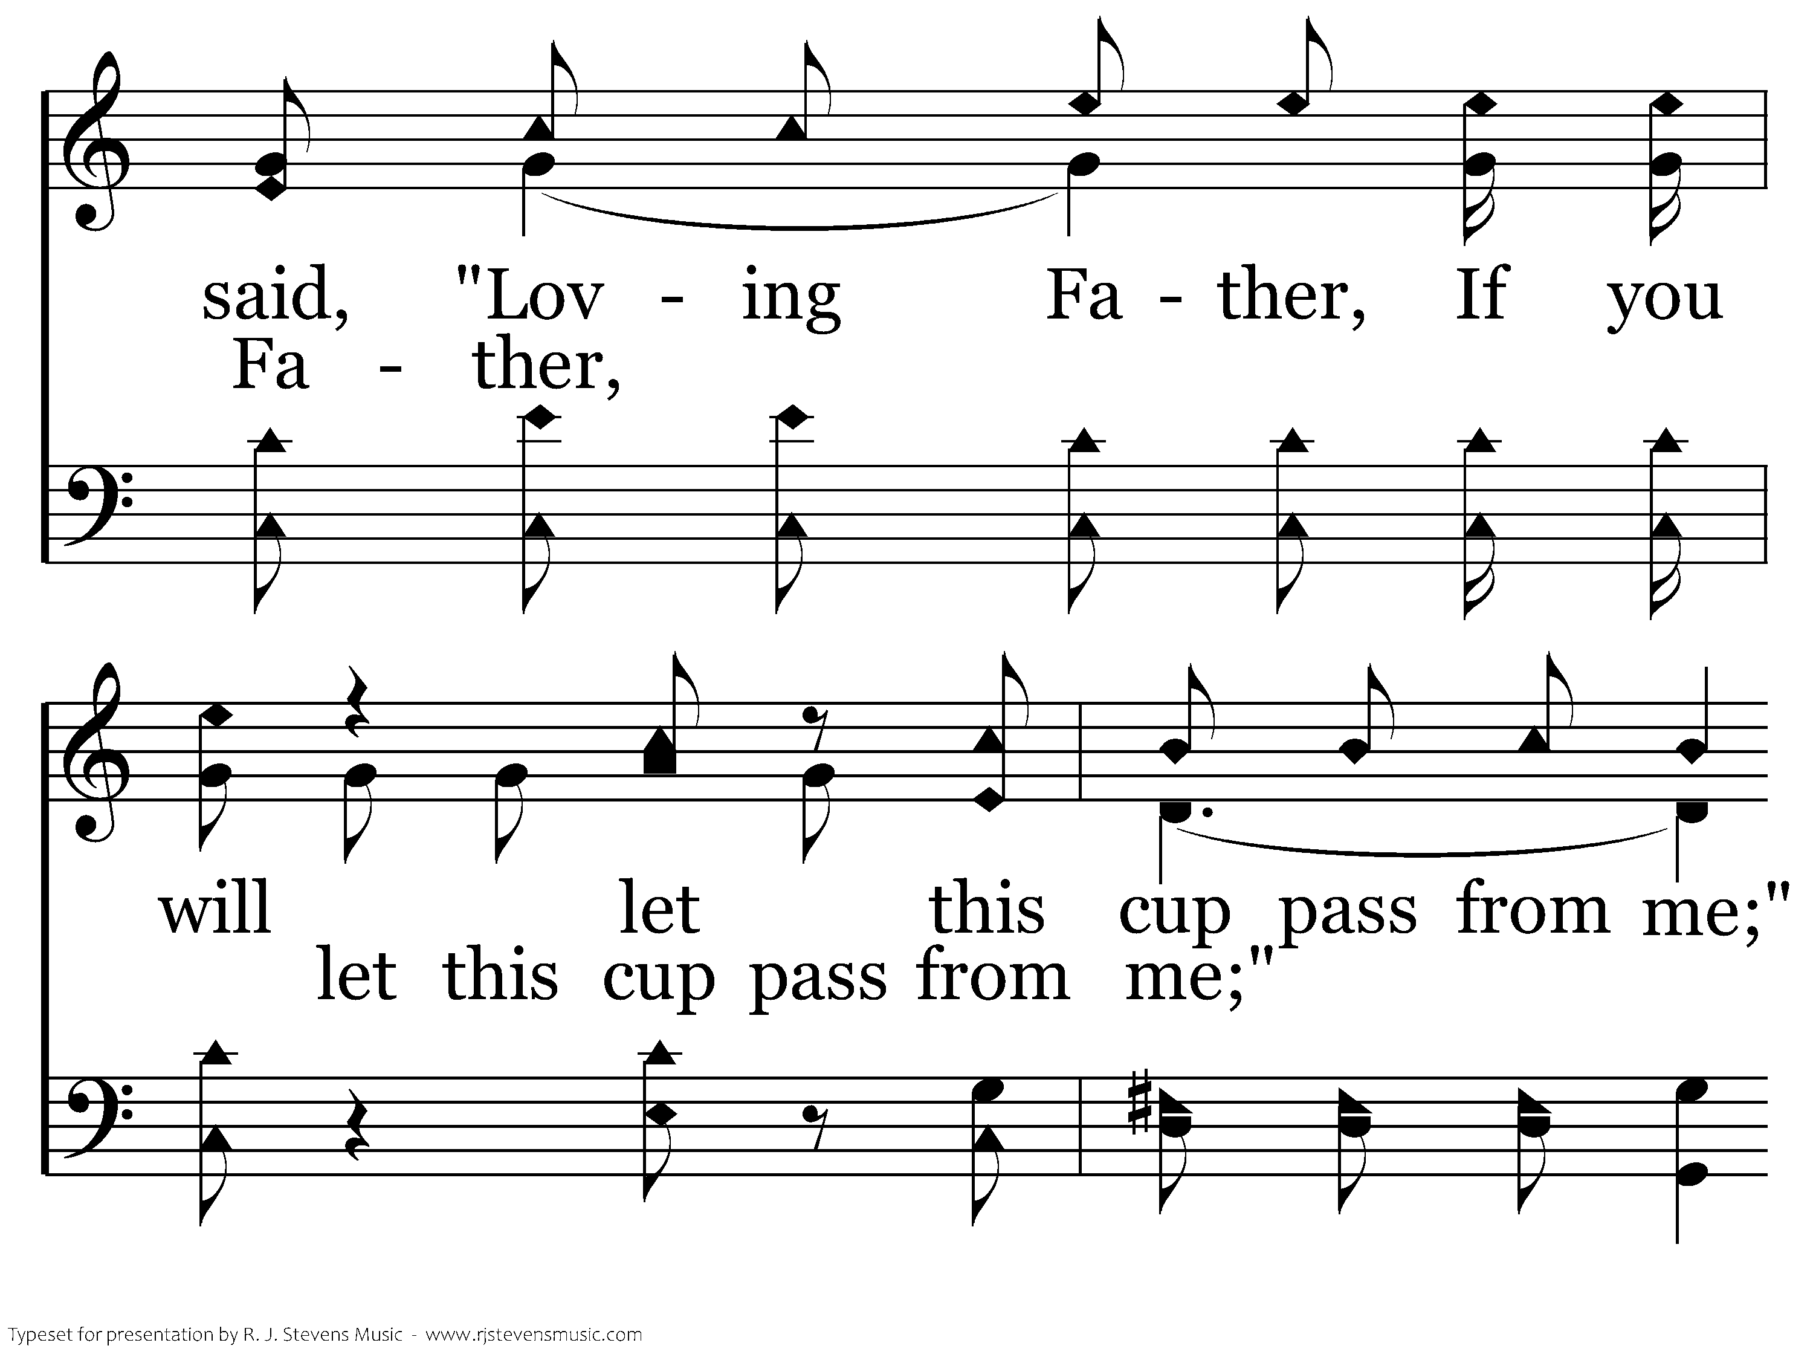
635 - A Beautiful Prayer - C.3

Slide 32
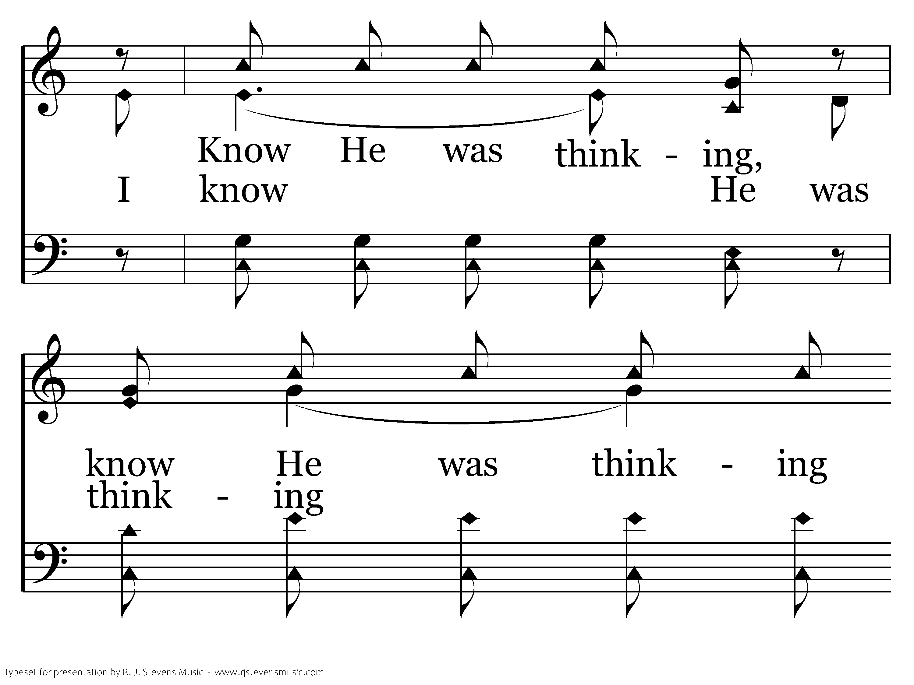
635 - A Beautiful Prayer - C.4

Slide 33
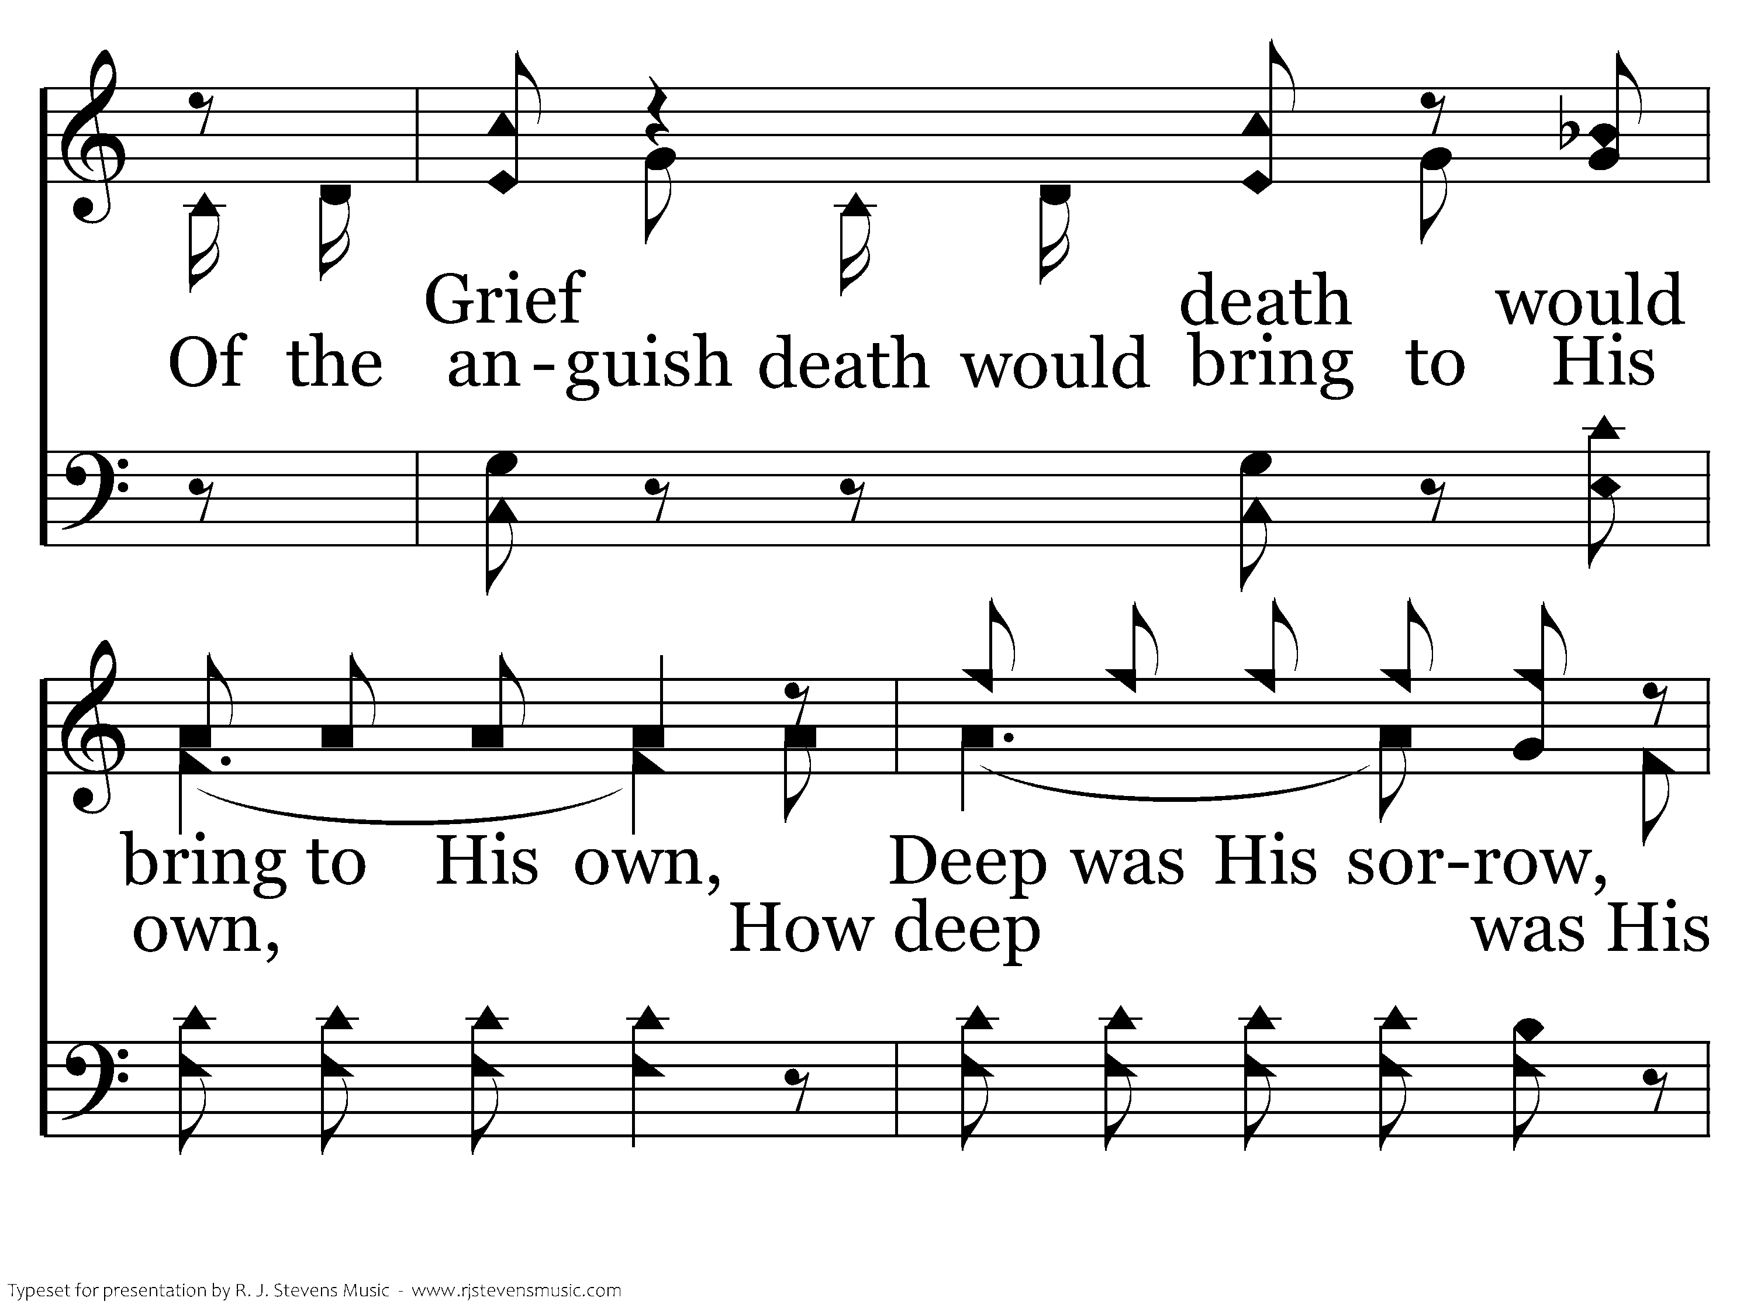
635 - A Beautiful Prayer - C.5

Slide 34
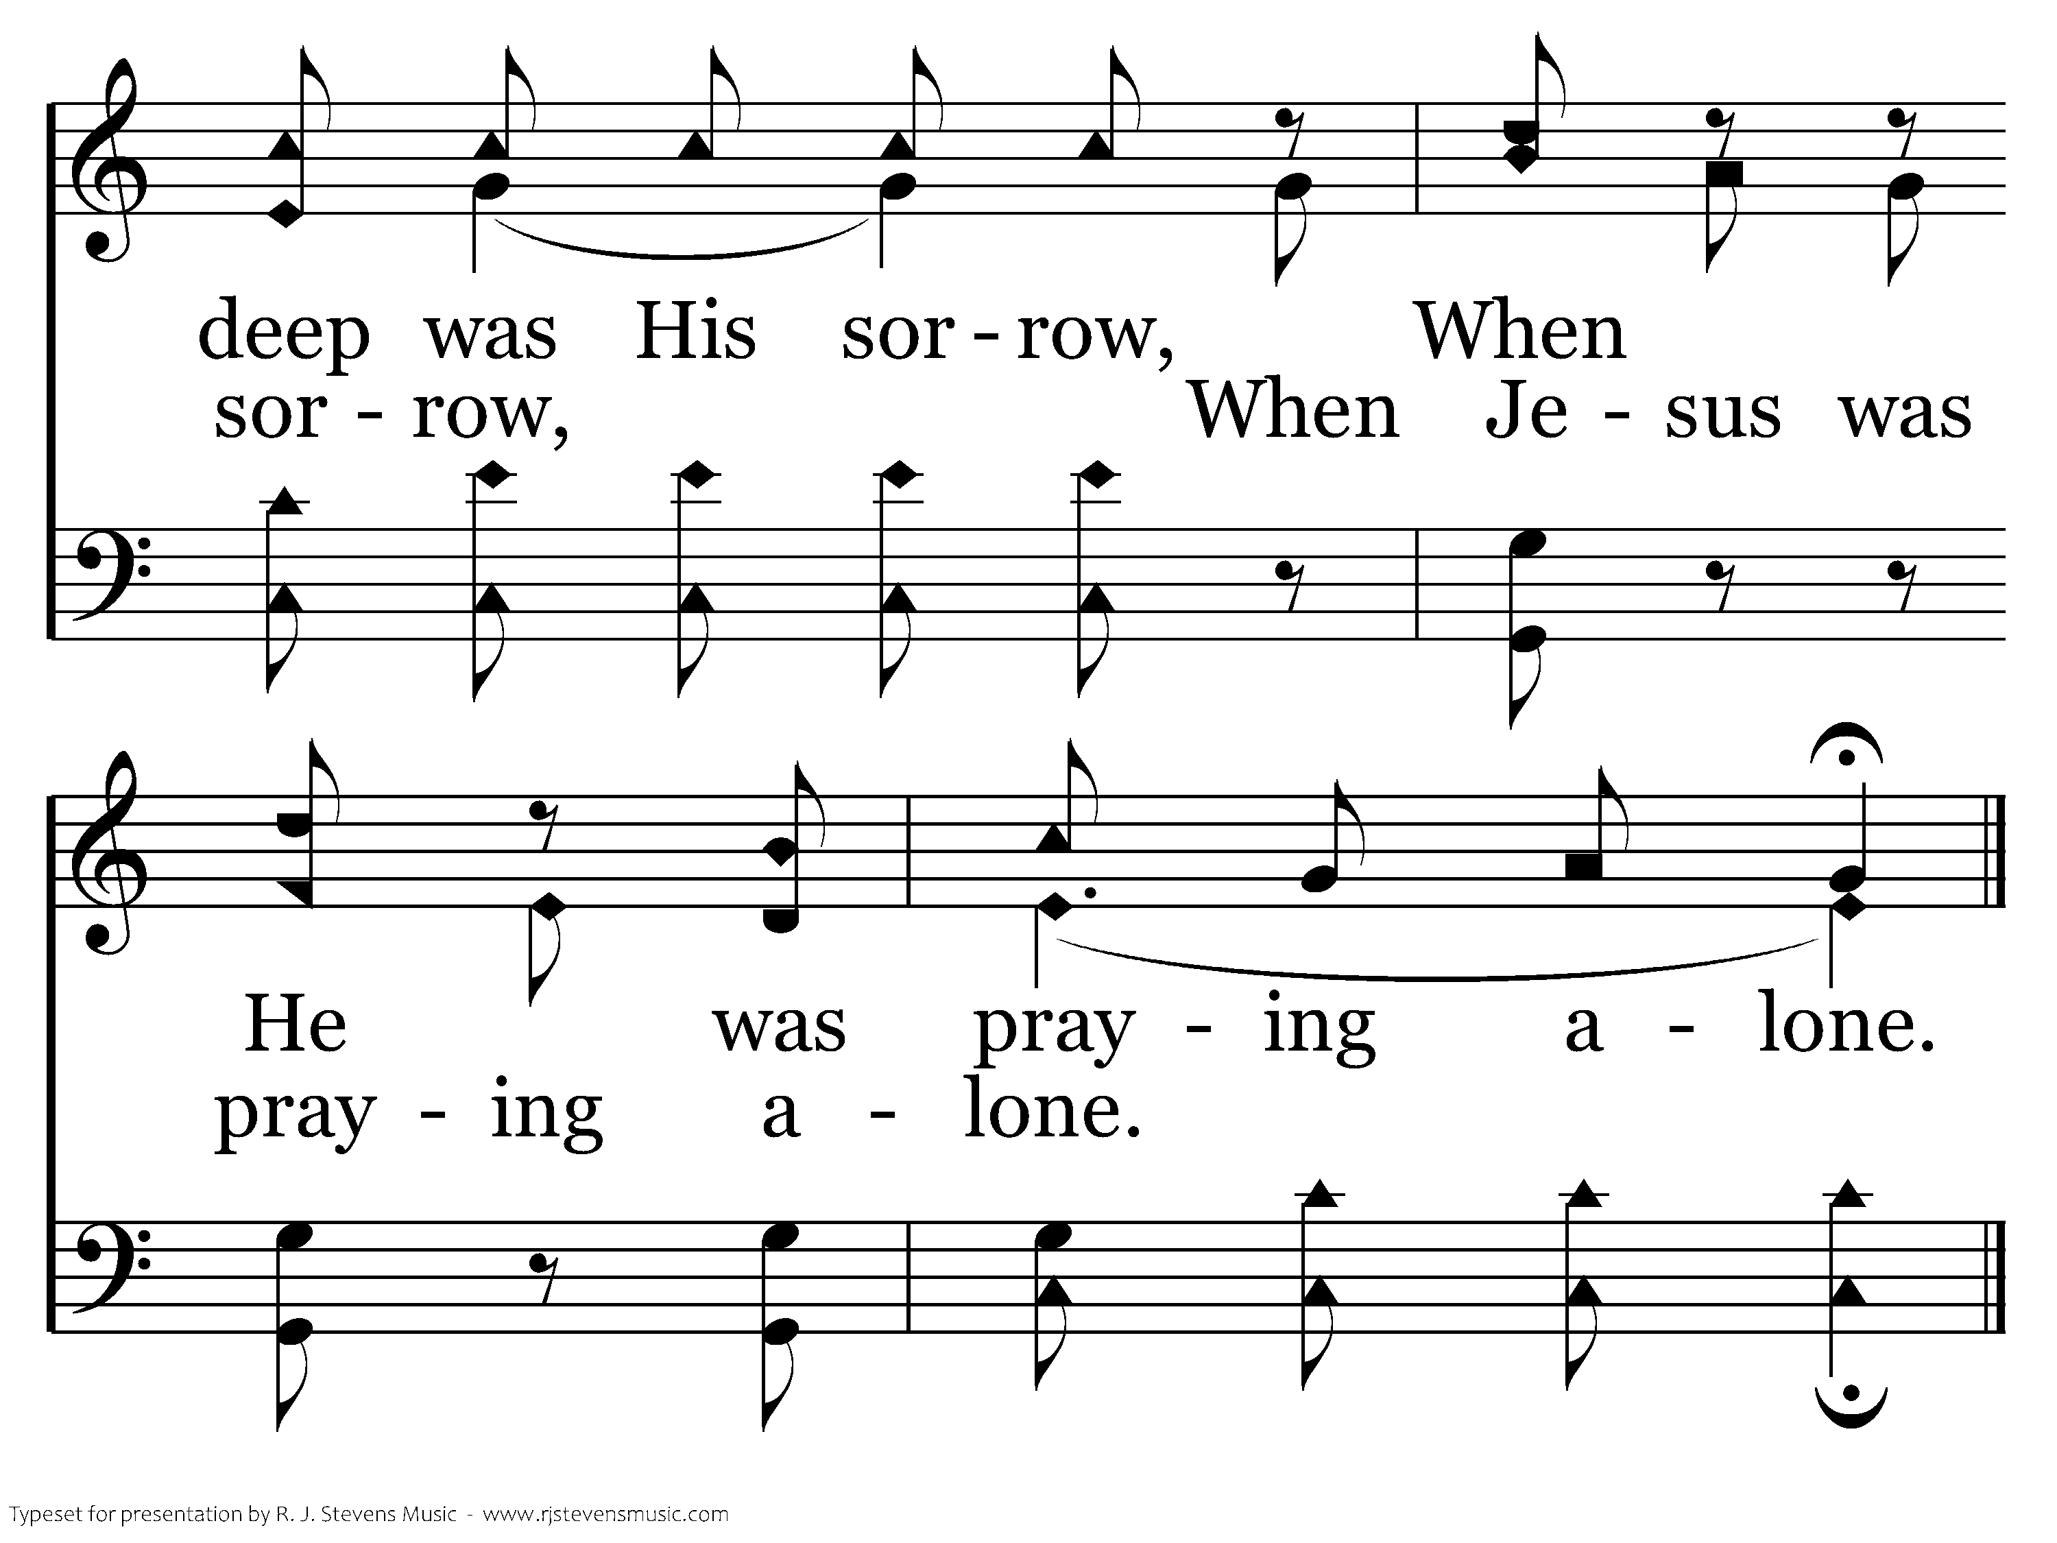
635 - A Beautiful Prayer - C.6
End of Verse 1

Slide 35
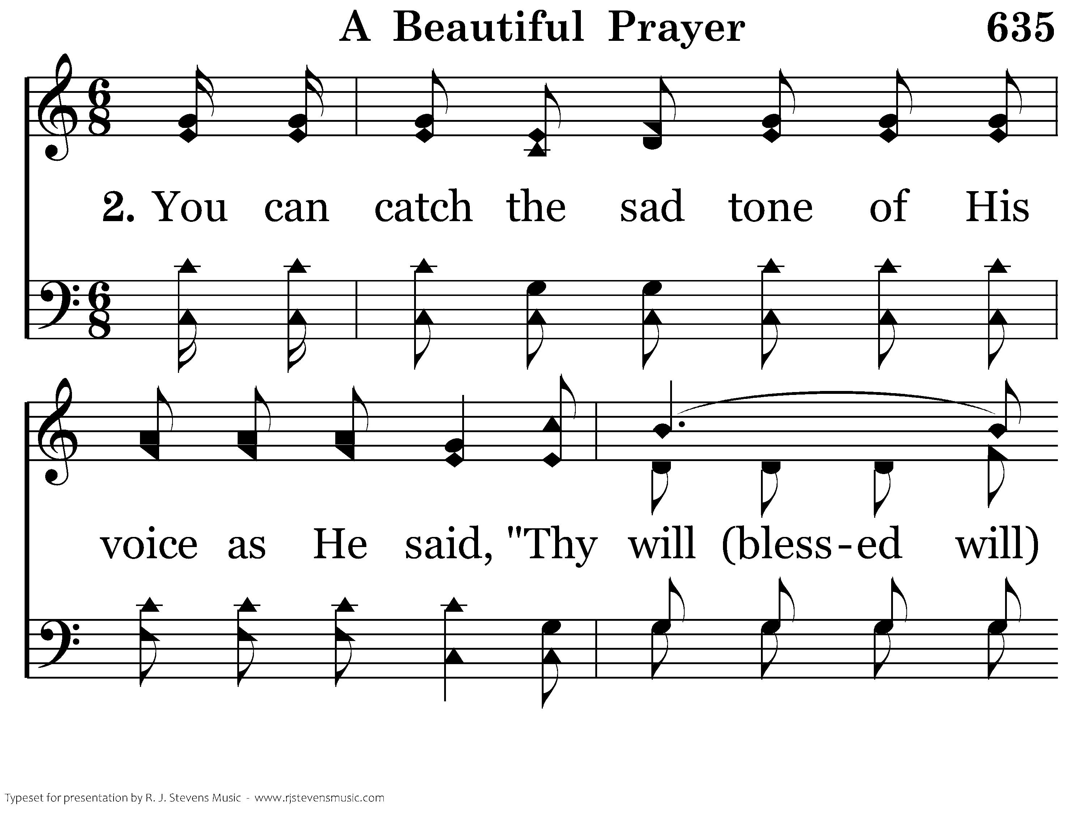
635 - A Beautiful Prayer - 2.1

Slide 36
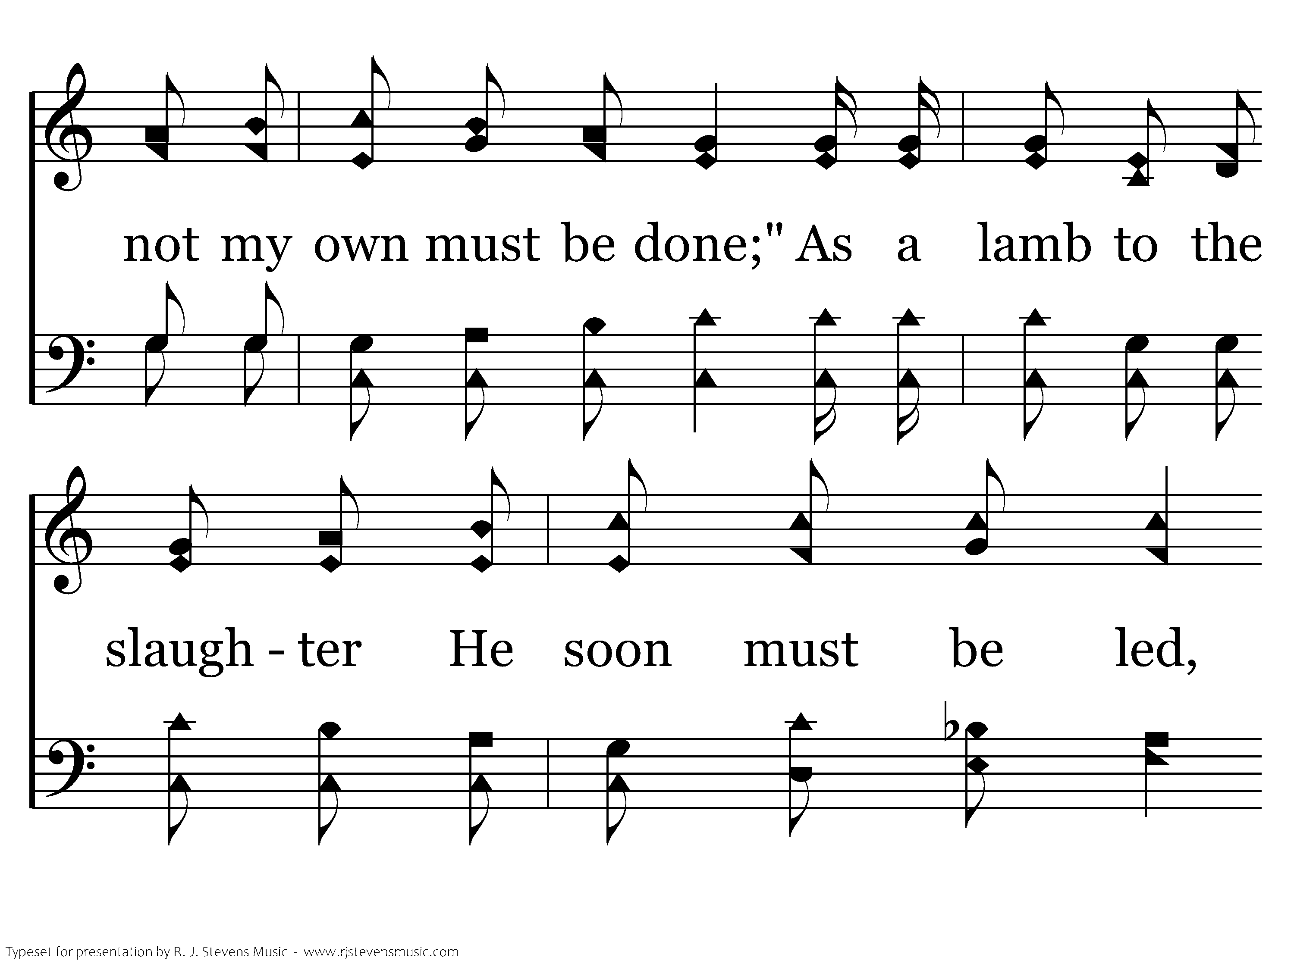
635 - A Beautiful Prayer - 2.2

Slide 37
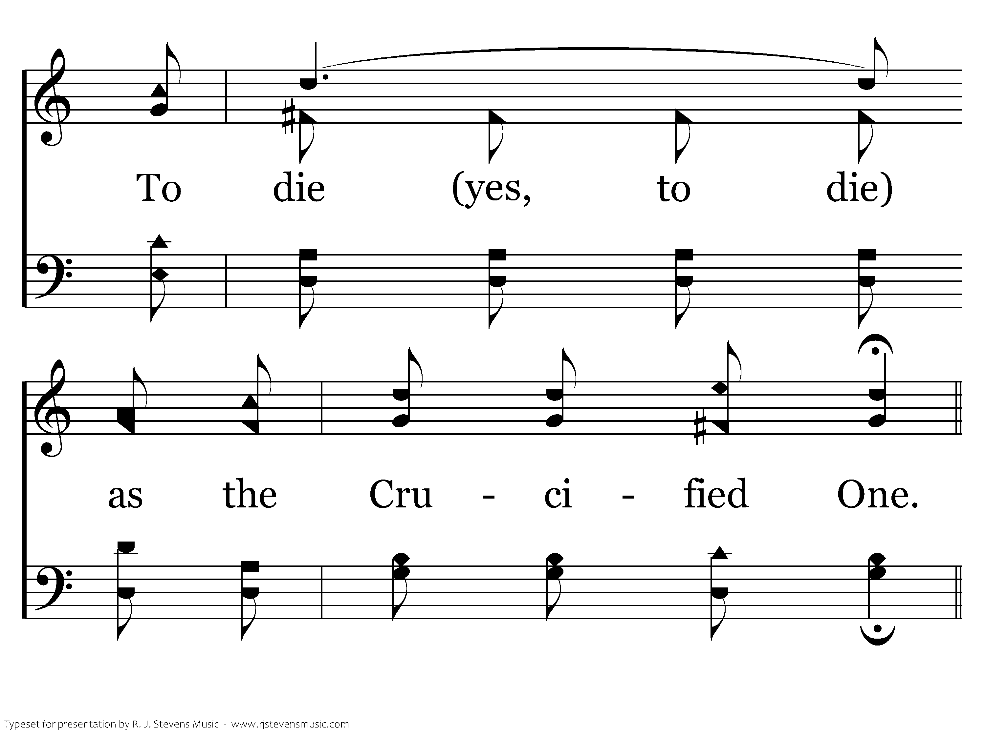
635 - A Beautiful Prayer - 2.3

Slide 38
635 - A Beautiful Prayer - C.1

Slide 39
635 - A Beautiful Prayer - C.2

Slide 40
635 - A Beautiful Prayer - C.3

Slide 41
635 - A Beautiful Prayer - C.4

Slide 42
635 - A Beautiful Prayer - C.5

Slide 43
635 - A Beautiful Prayer - C.6
End of Verse 2

Slide 44
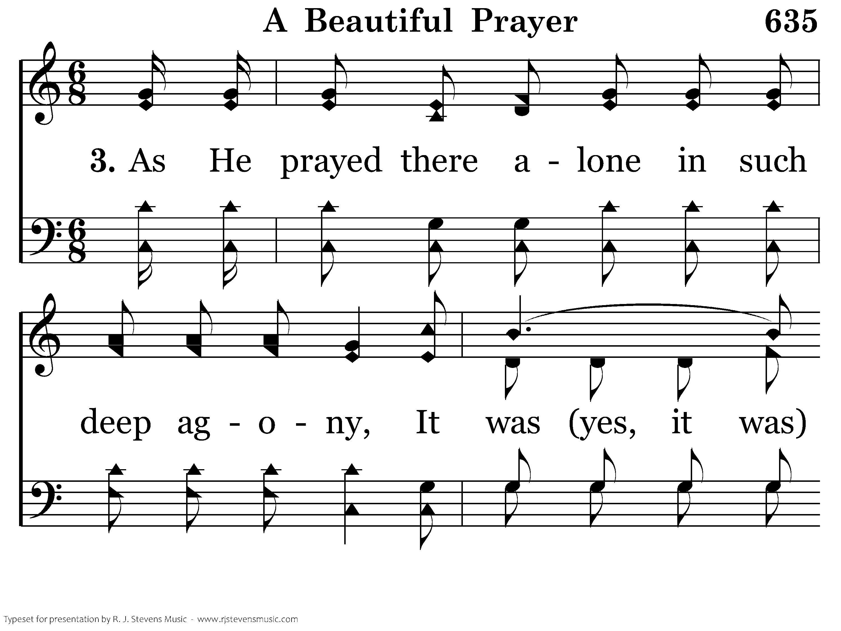
635 - A Beautiful Prayer - 3.1

Slide 45
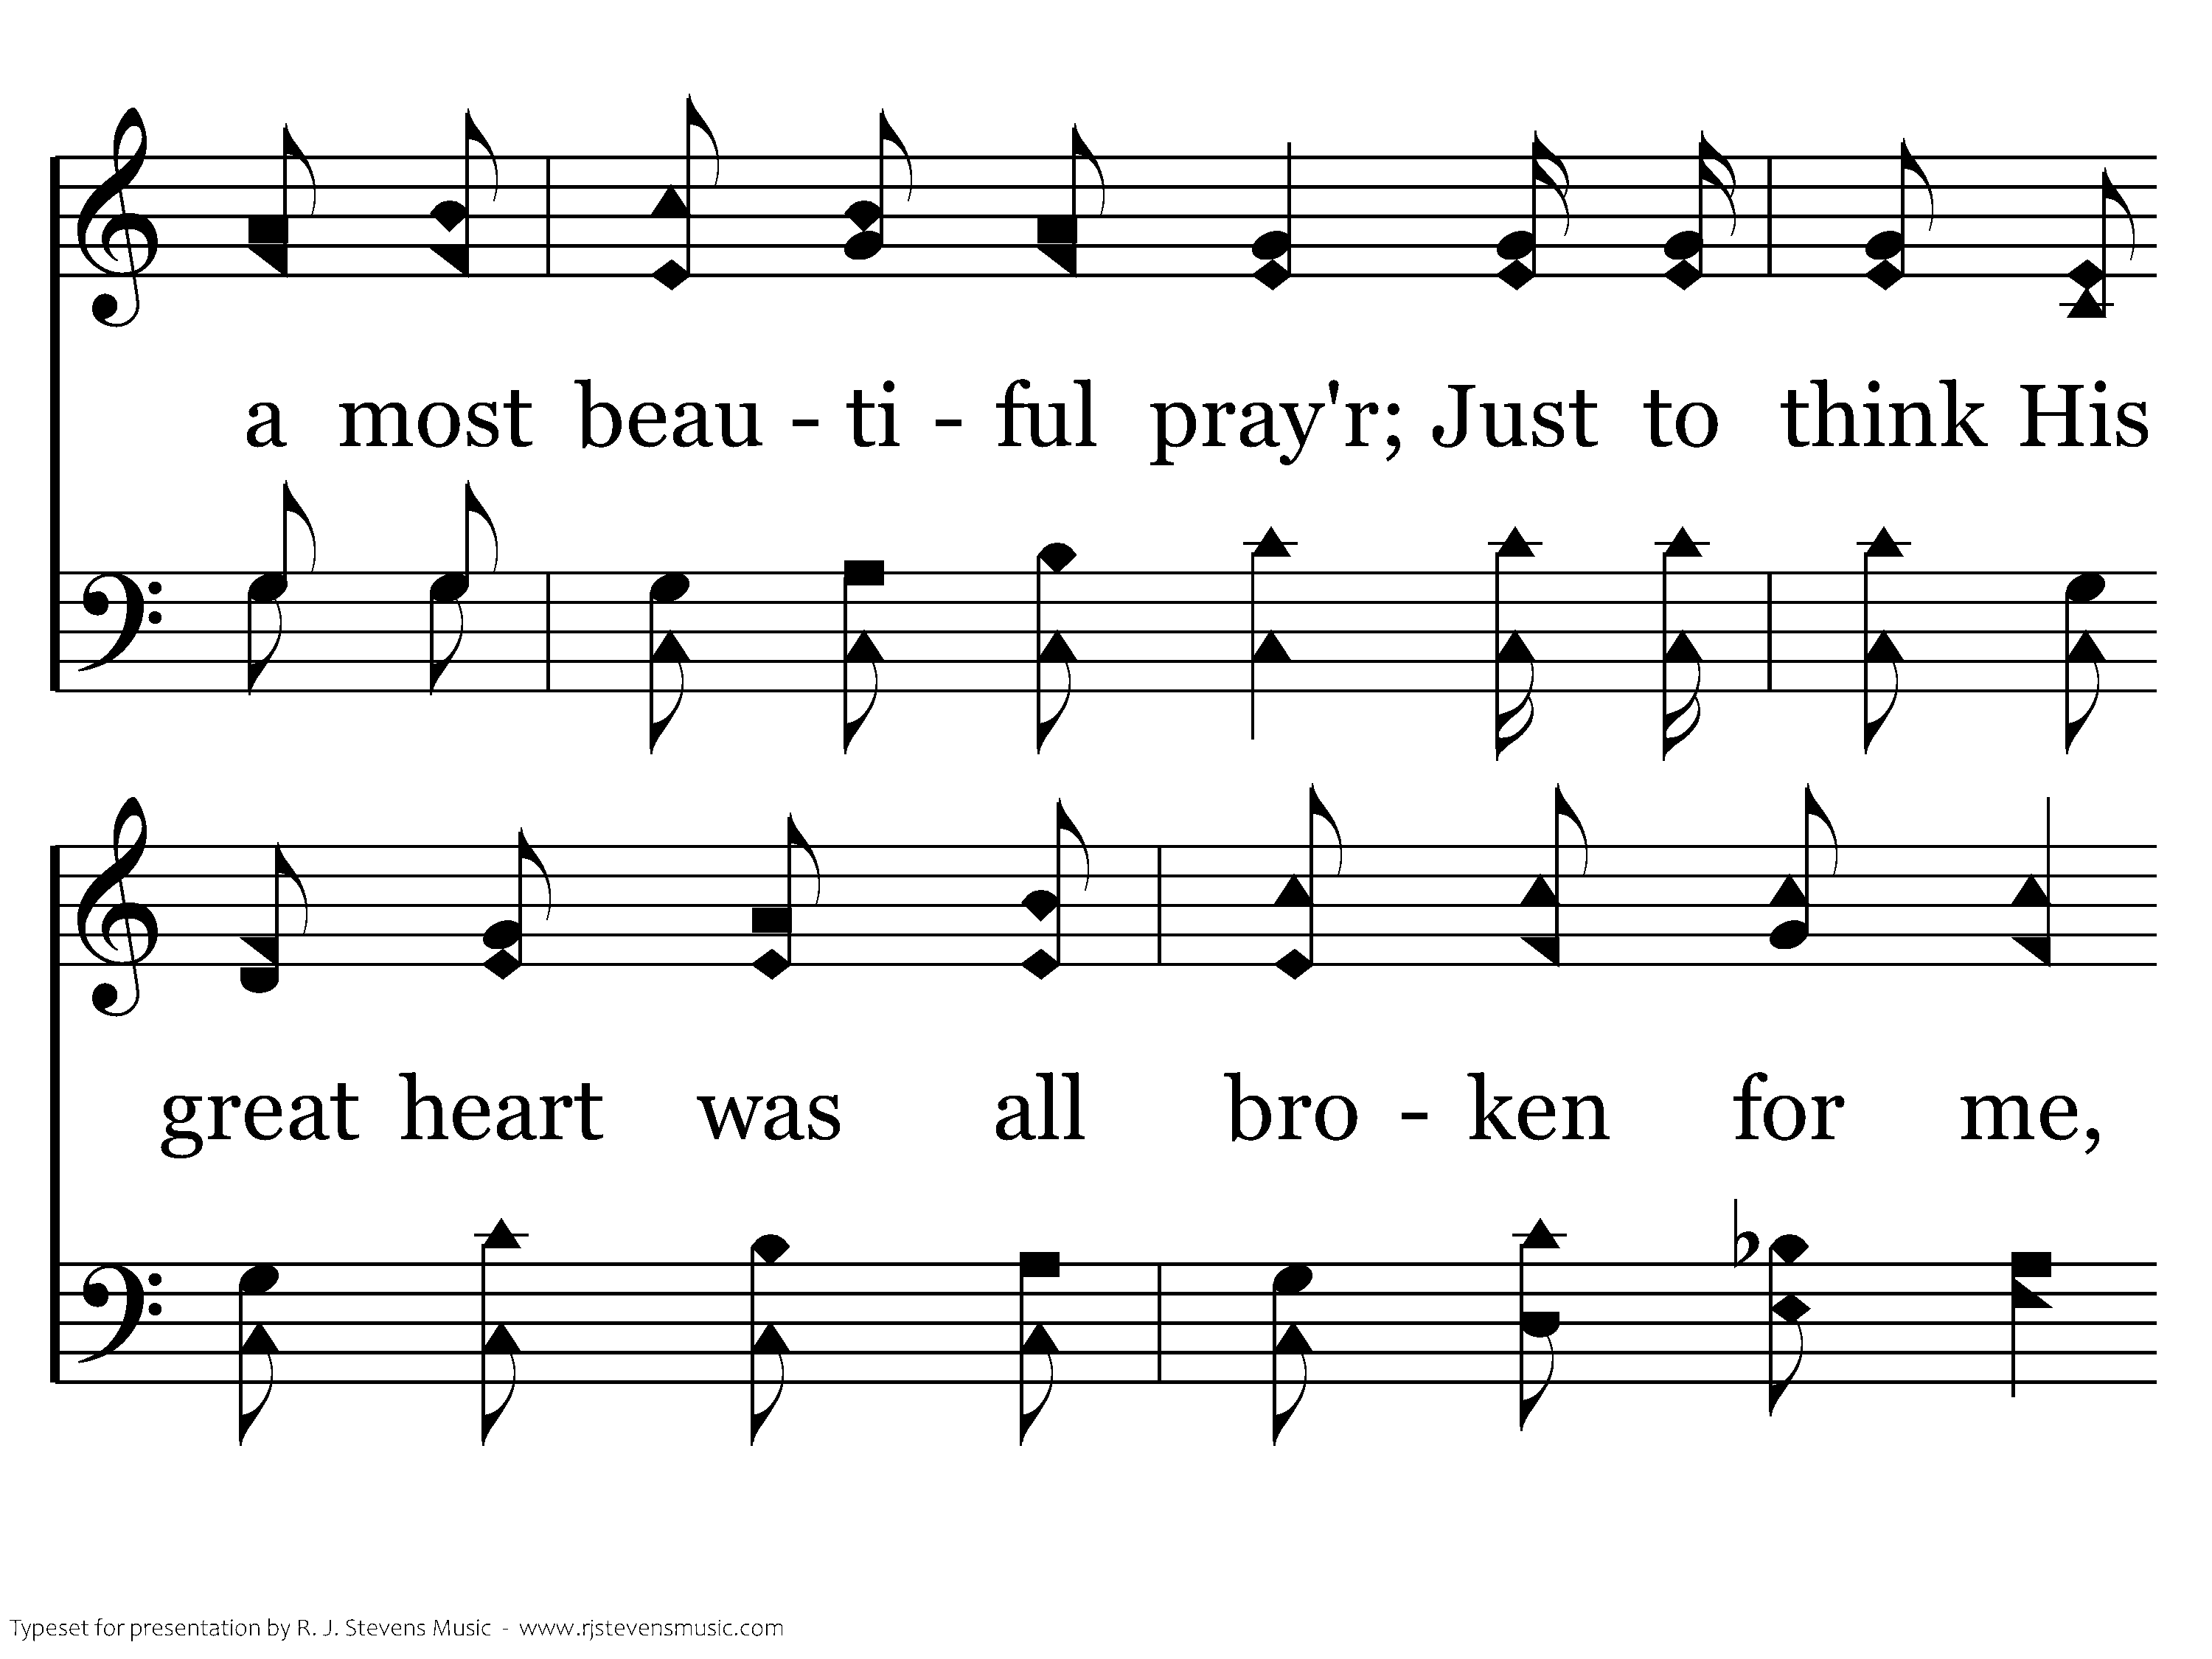
635 - A Beautiful Prayer - 3.2

Slide 46
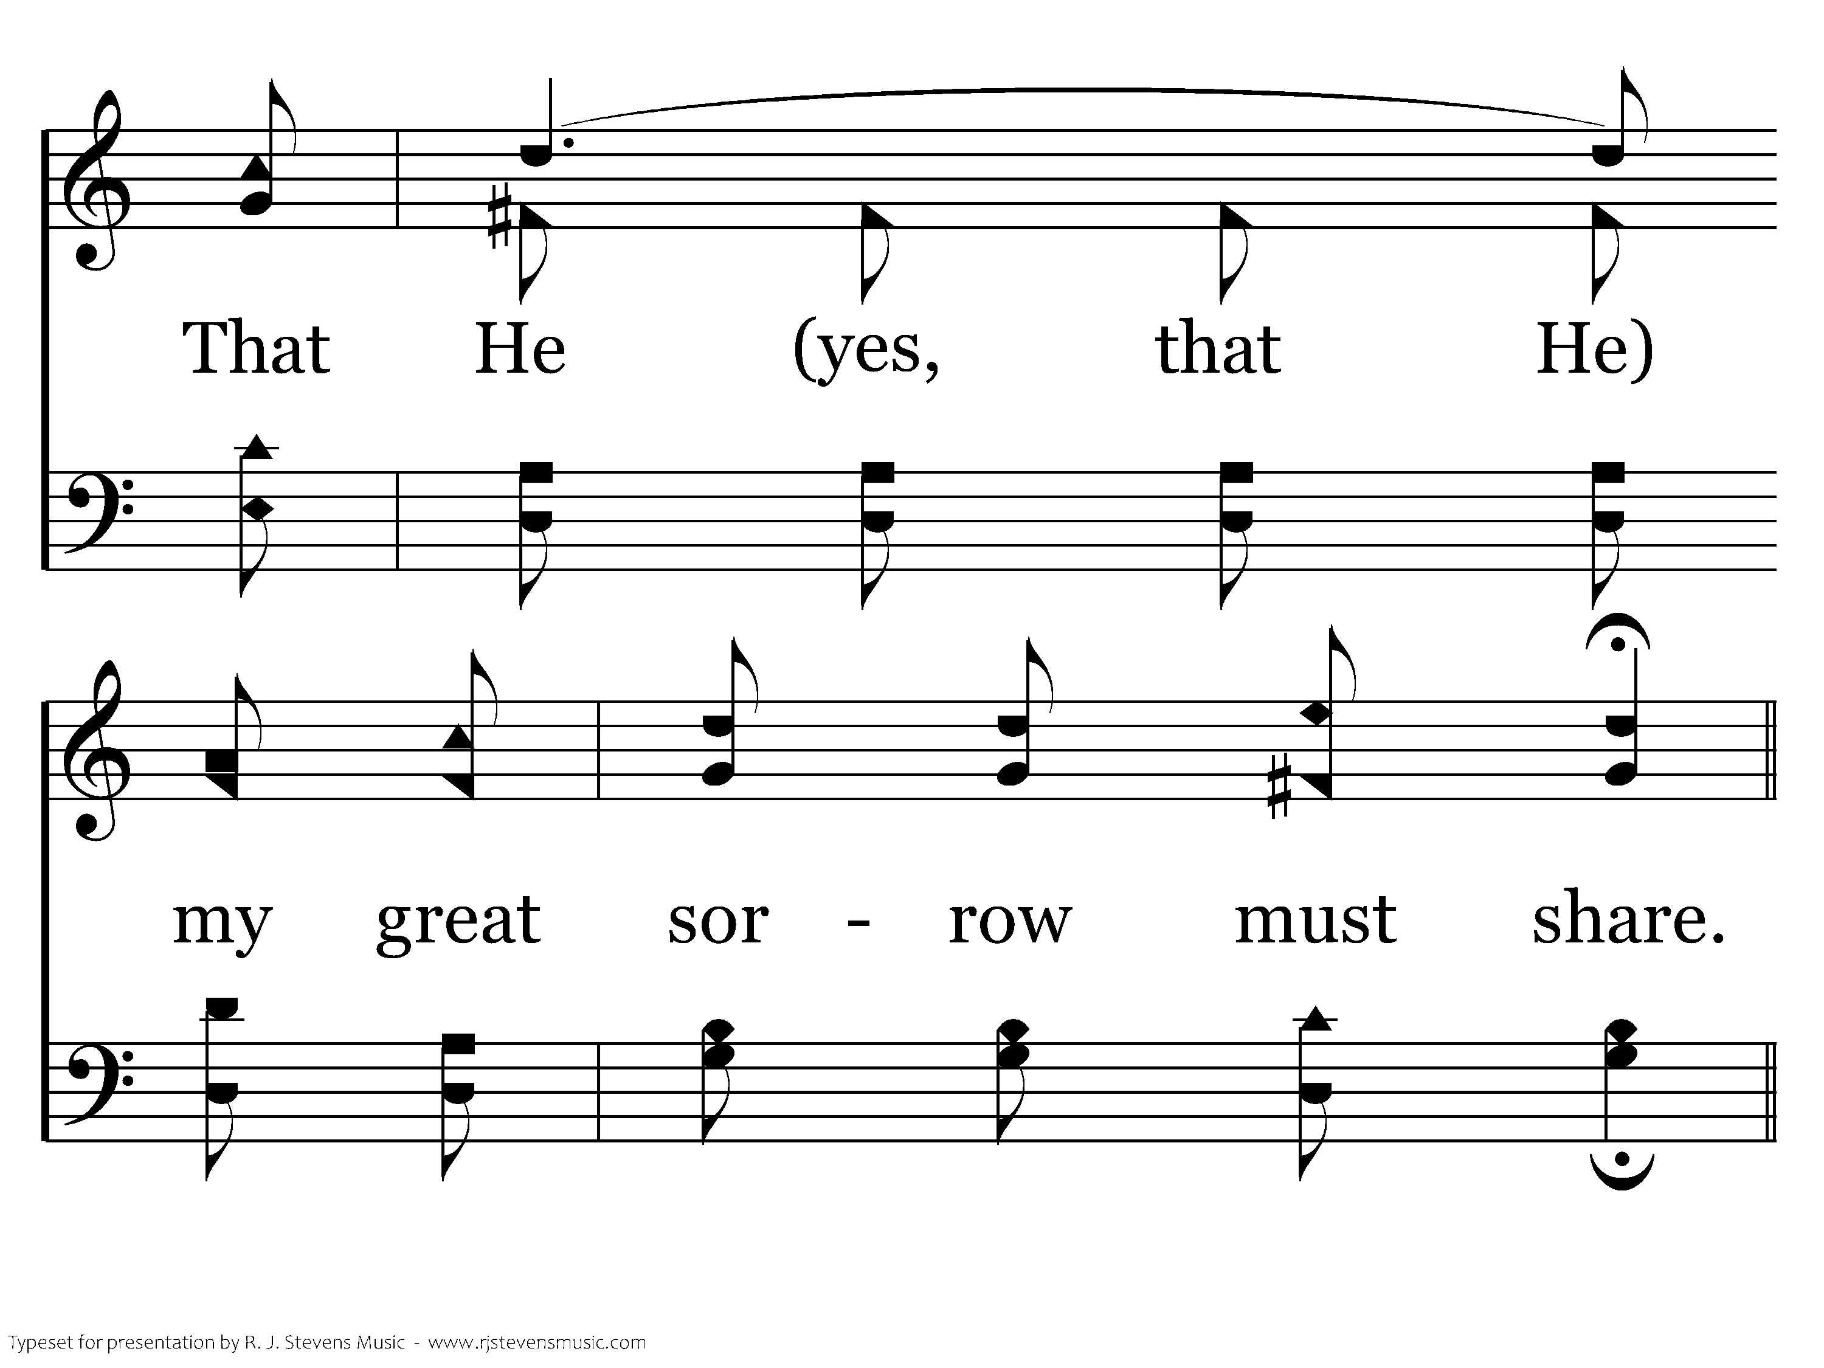
635 - A Beautiful Prayer - 3.3

Slide 47
635 - A Beautiful Prayer - C.1

Slide 48
635 - A Beautiful Prayer - C.2

Slide 49
635 - A Beautiful Prayer - C.3

Slide 50
635 - A Beautiful Prayer - C.4

Slide 51
635 - A Beautiful Prayer - C.5

Slide 52
635 - A Beautiful Prayer - C.6
End of Song

Slide 54
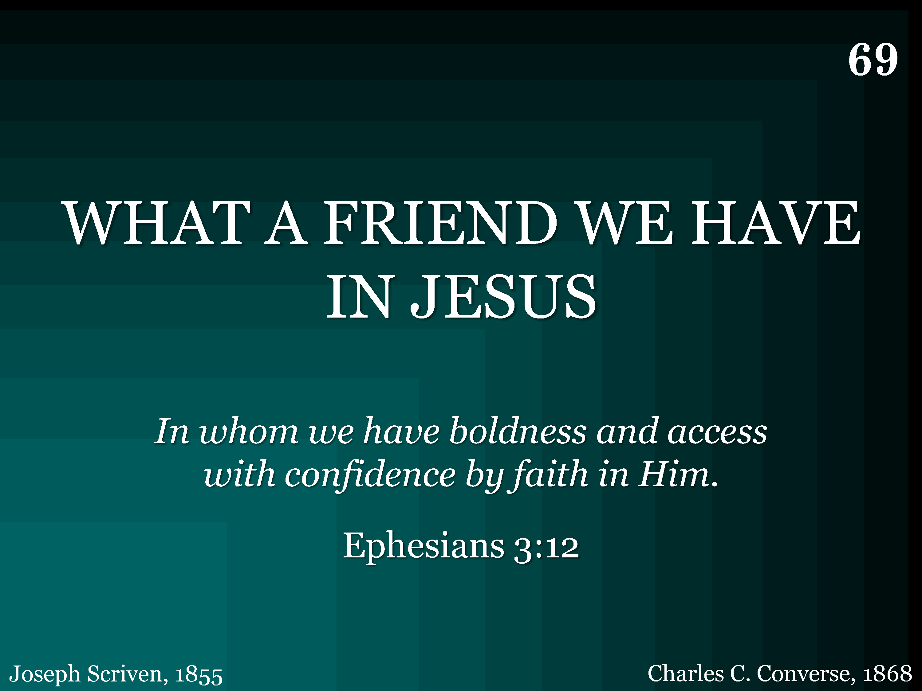
069 - What A Friend We Have In Jesus - Title

Slide 55
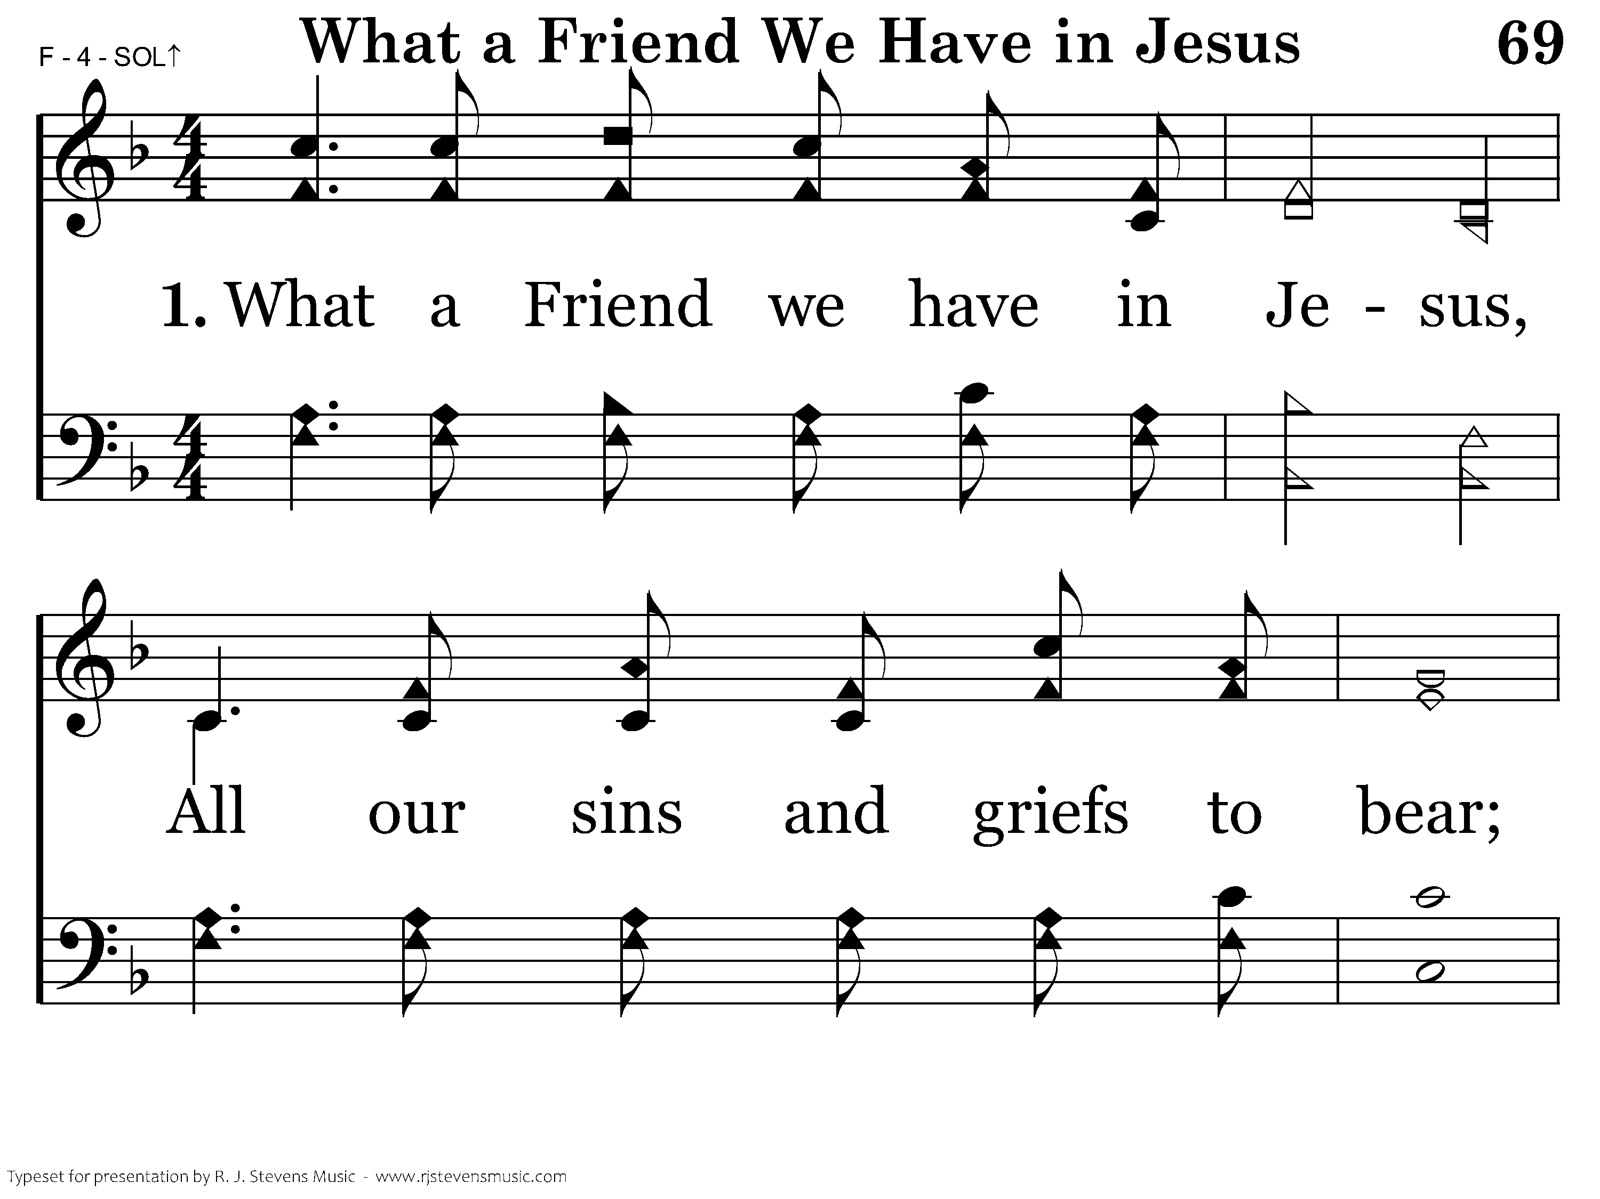
069 - What A Friend We Have In Jesus - 1.1

Slide 56
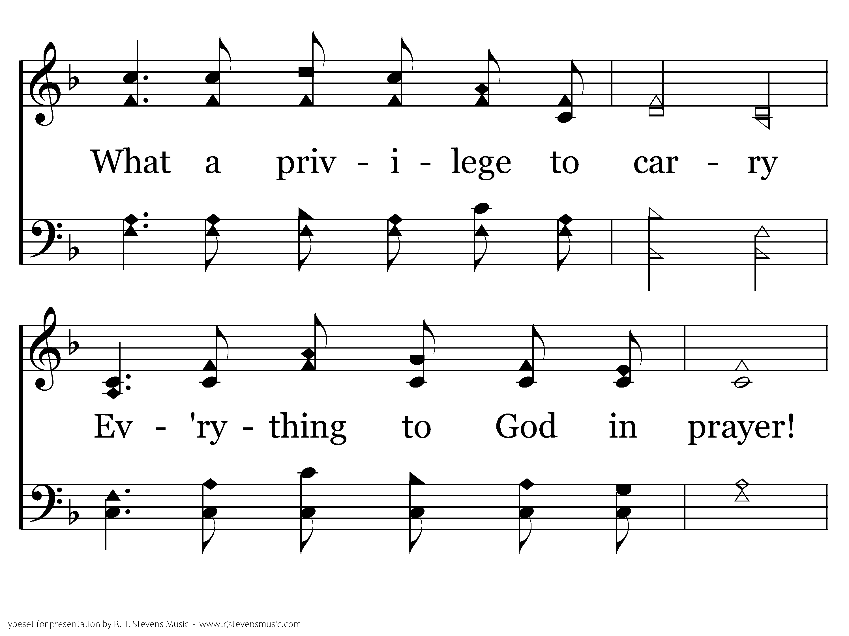
069 - What A Friend We Have In Jesus - 1.2

Slide 57
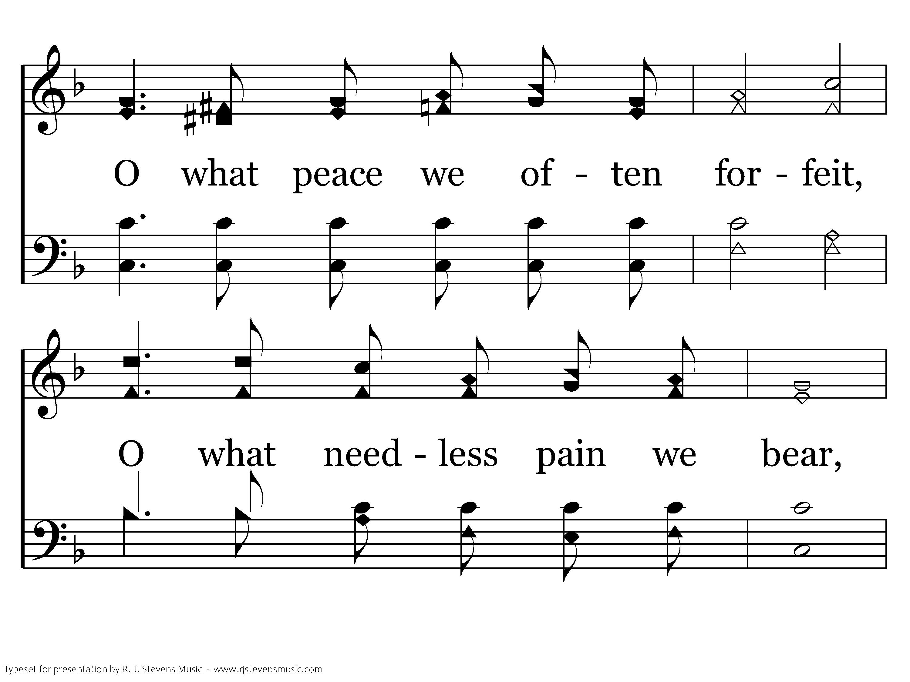
069 - What A Friend We Have In Jesus - 1.3

Slide 58
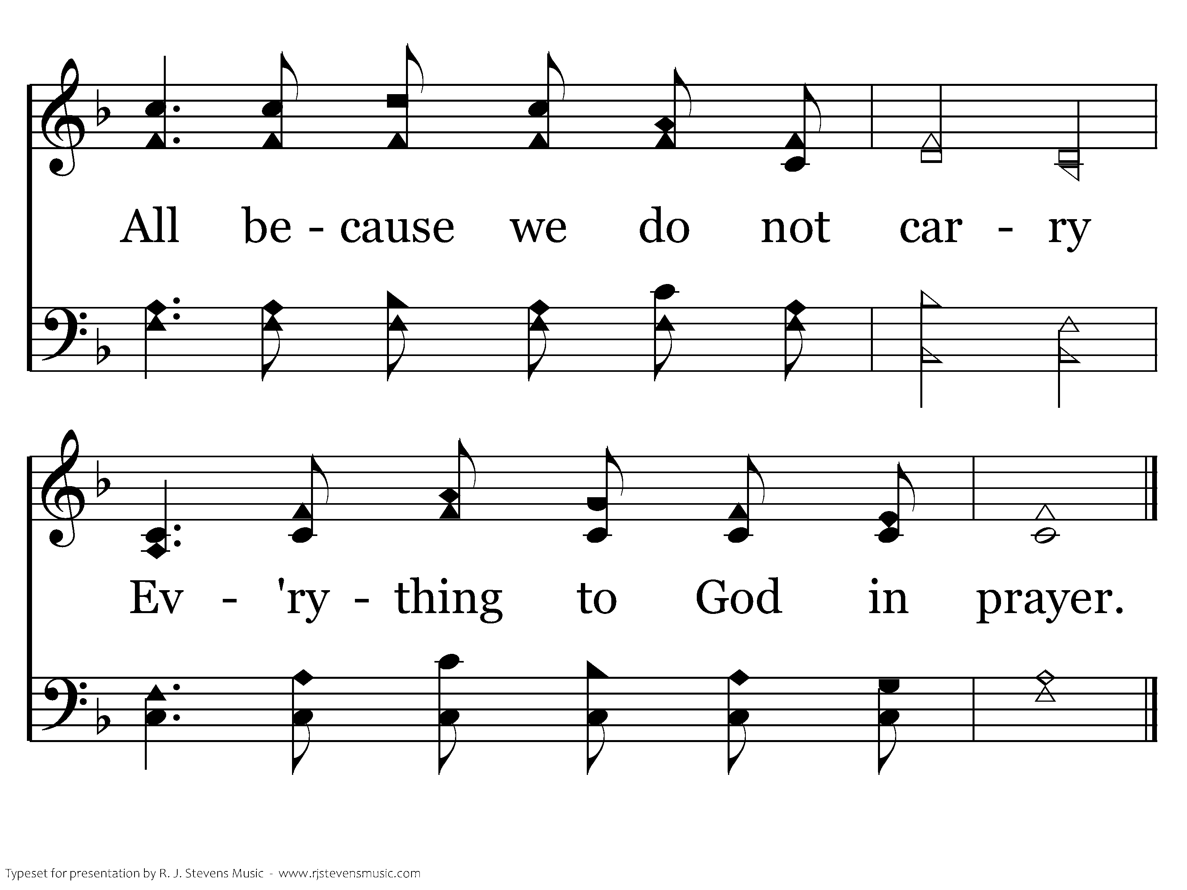
069 - What A Friend We Have In Jesus - 1.4
End of Verse 1

Slide 59
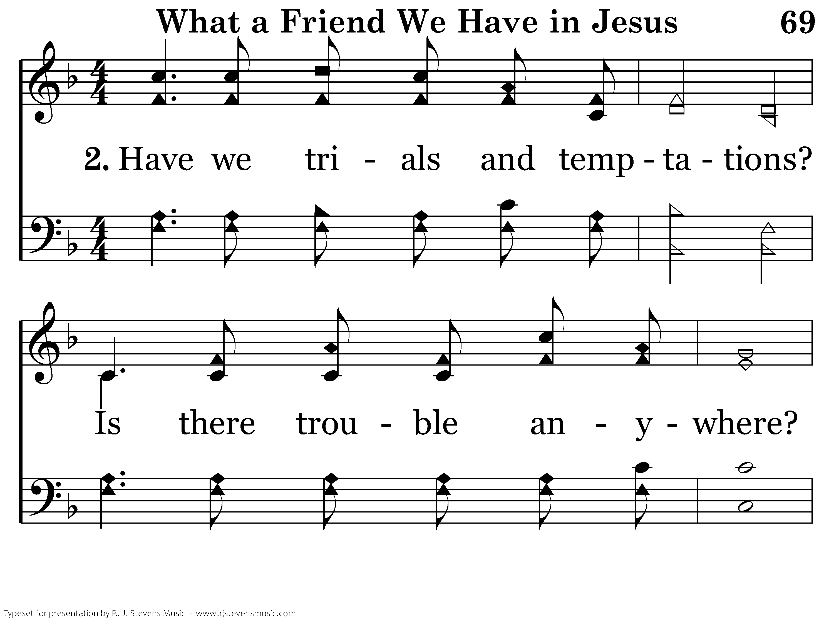
069 - What A Friend We Have In Jesus - 2.1

Slide 60
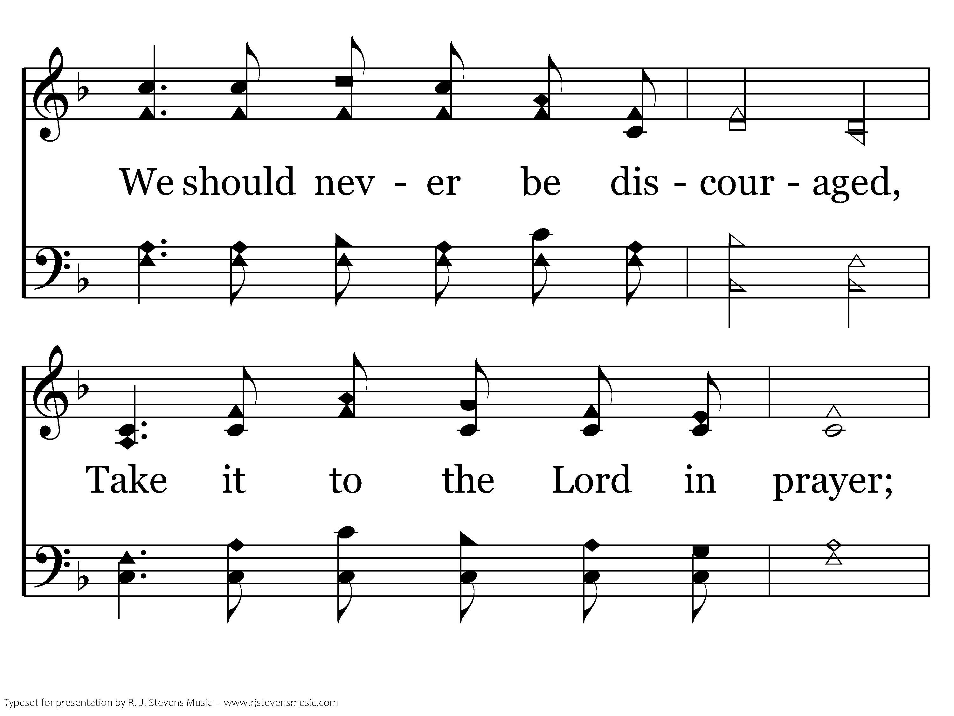
069 - What A Friend We Have In Jesus - 2.2

Slide 61
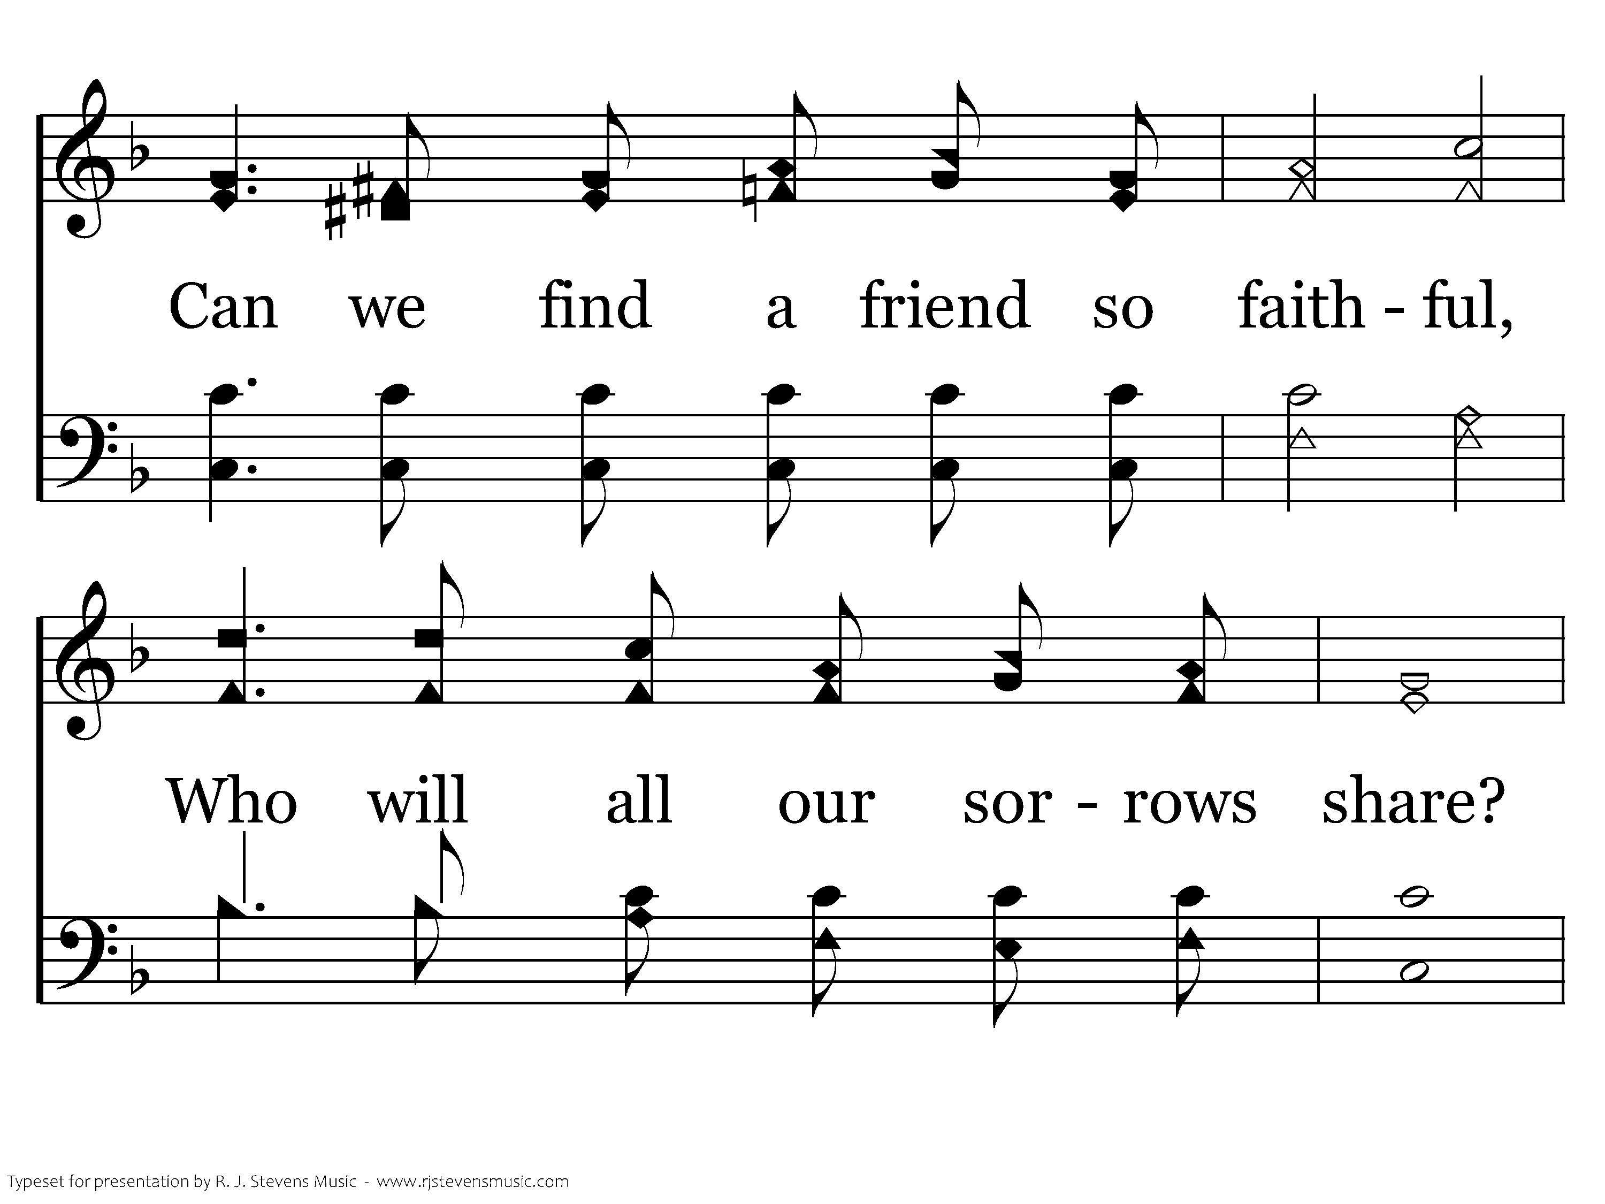
069 - What A Friend We Have In Jesus - 2.3

Slide 62
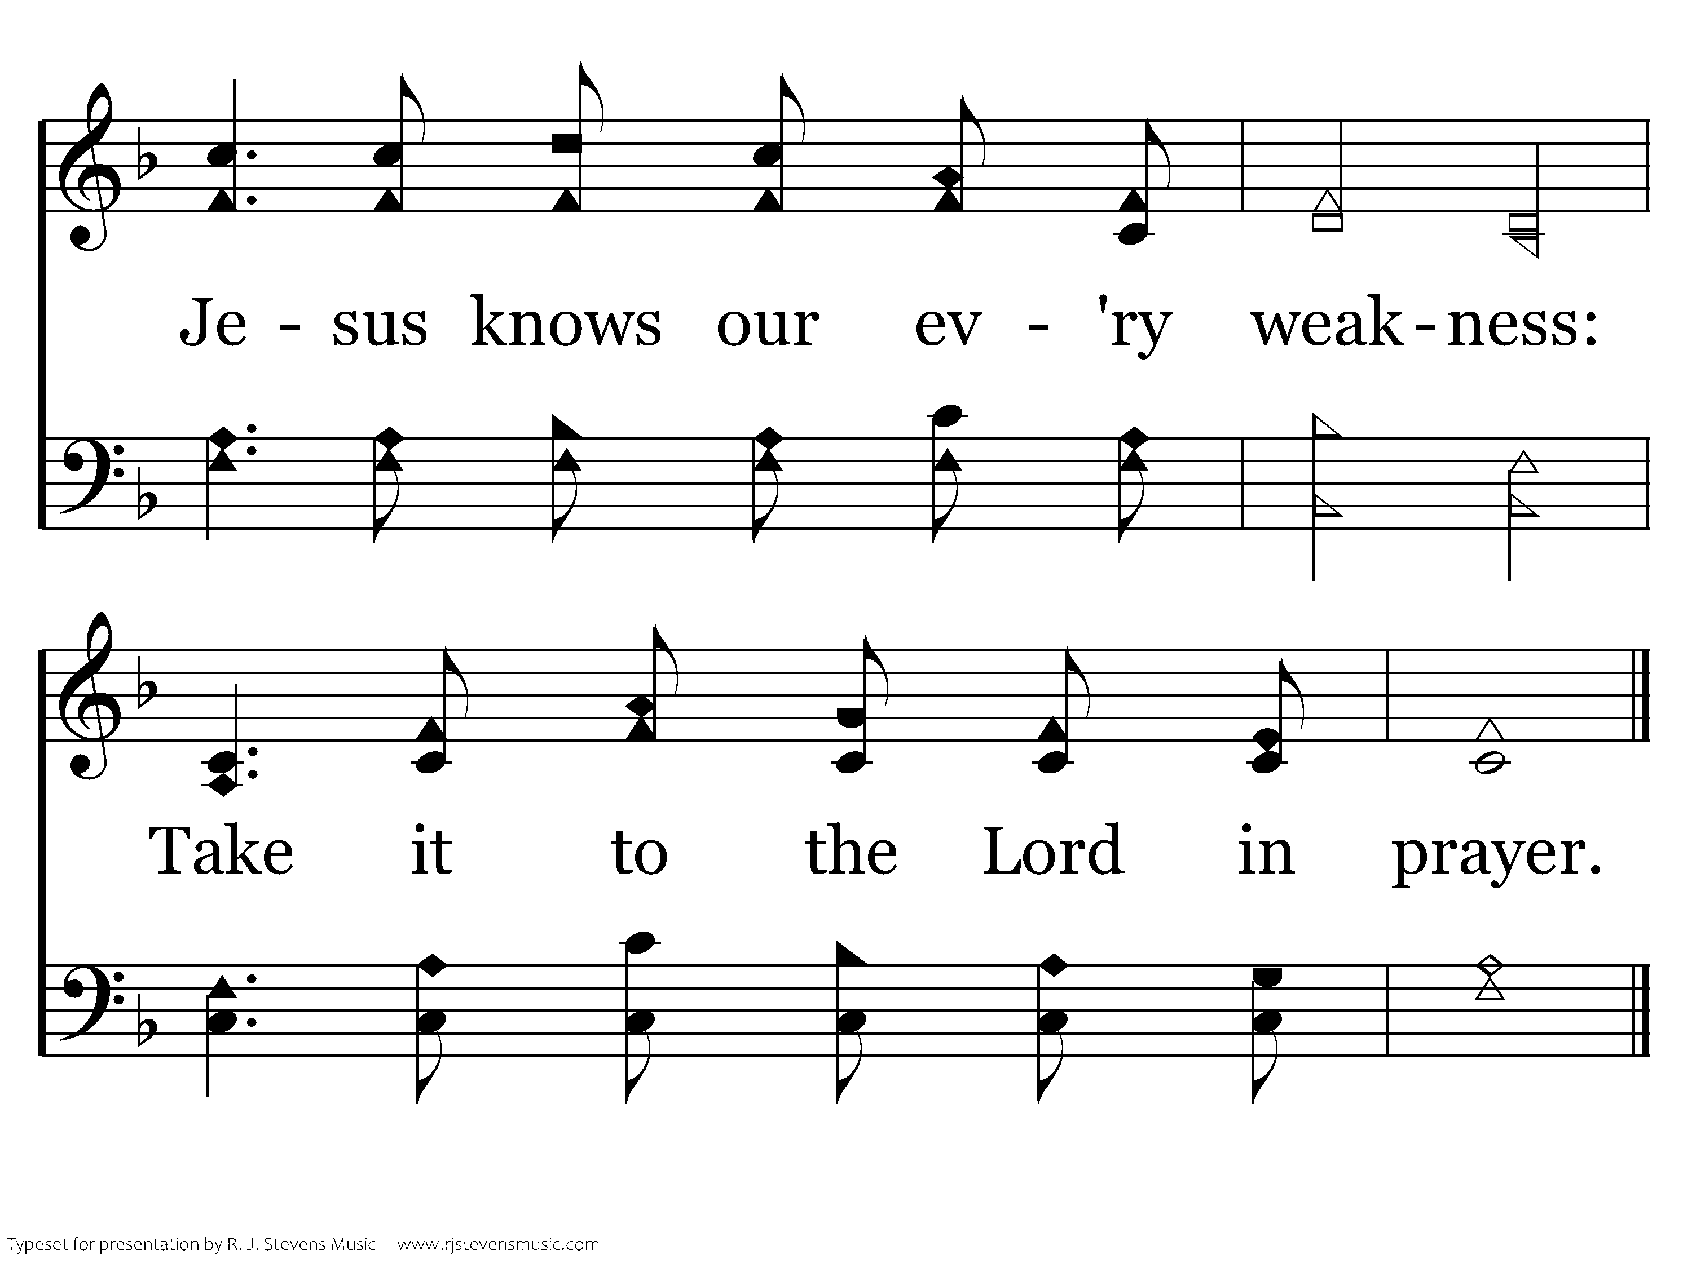
069 - What A Friend We Have In Jesus - 2.4
End of Verse 2

Slide 63
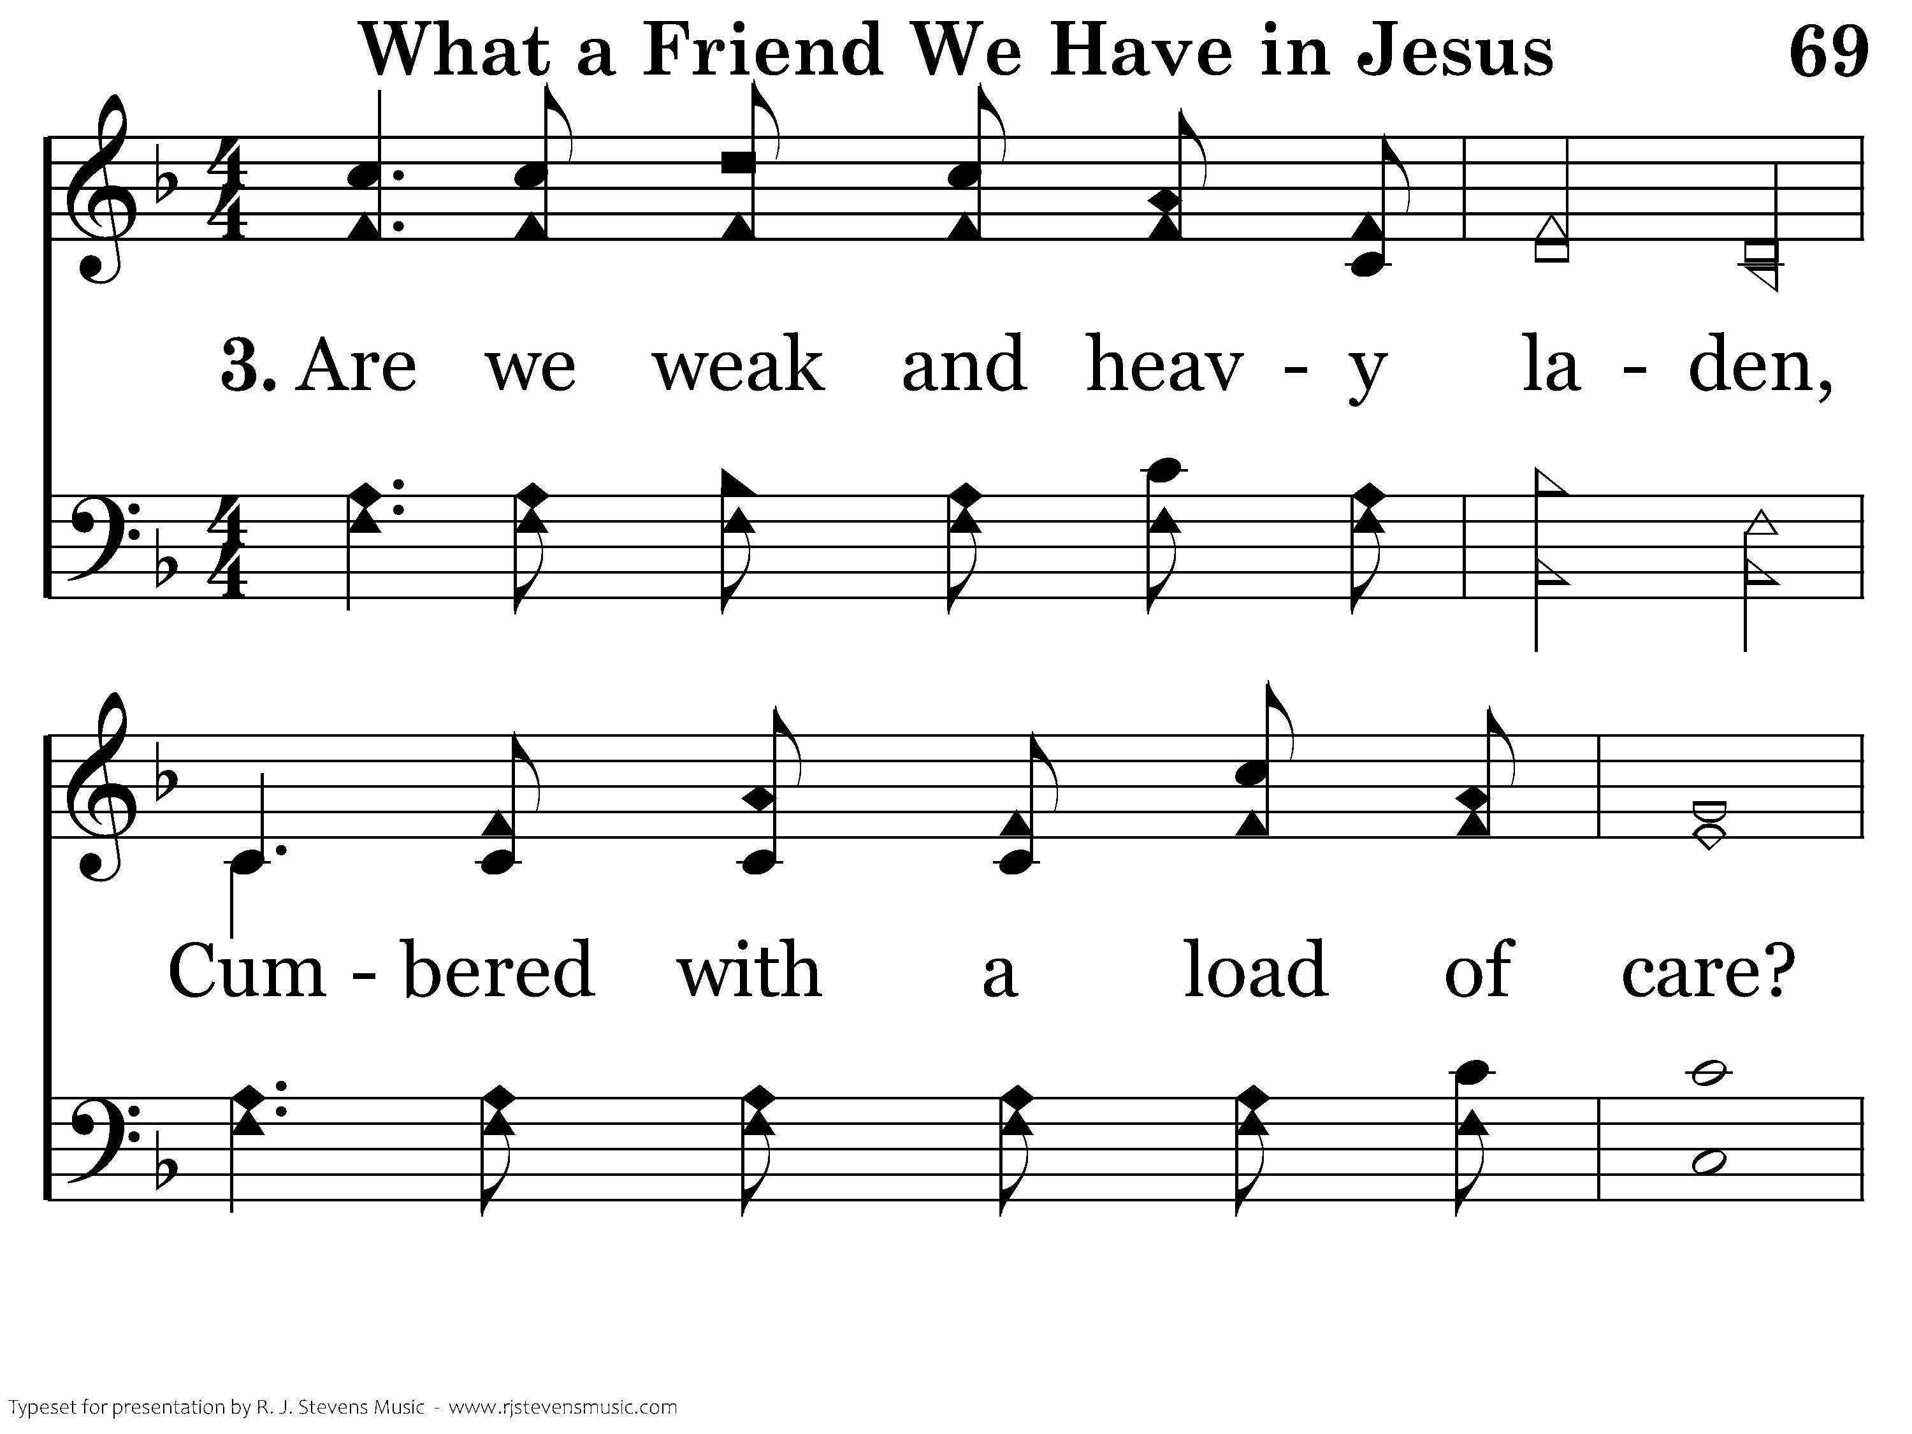
069 - What A Friend We Have In Jesus - 3.1

Slide 64
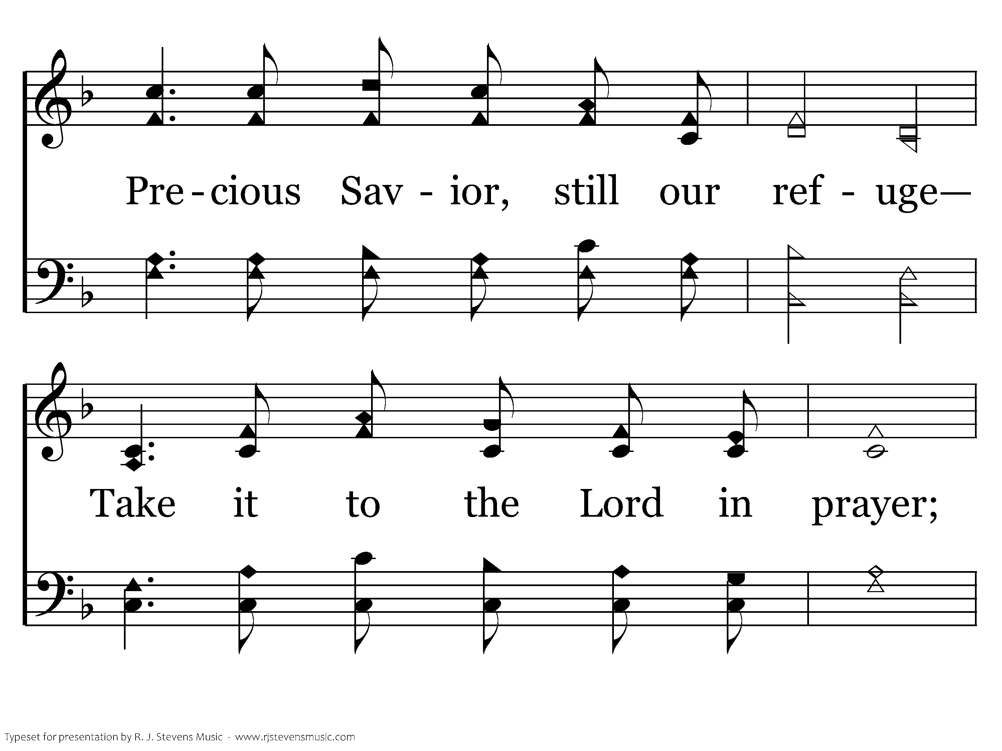
069 - What A Friend We Have In Jesus - 3.2

Slide 65
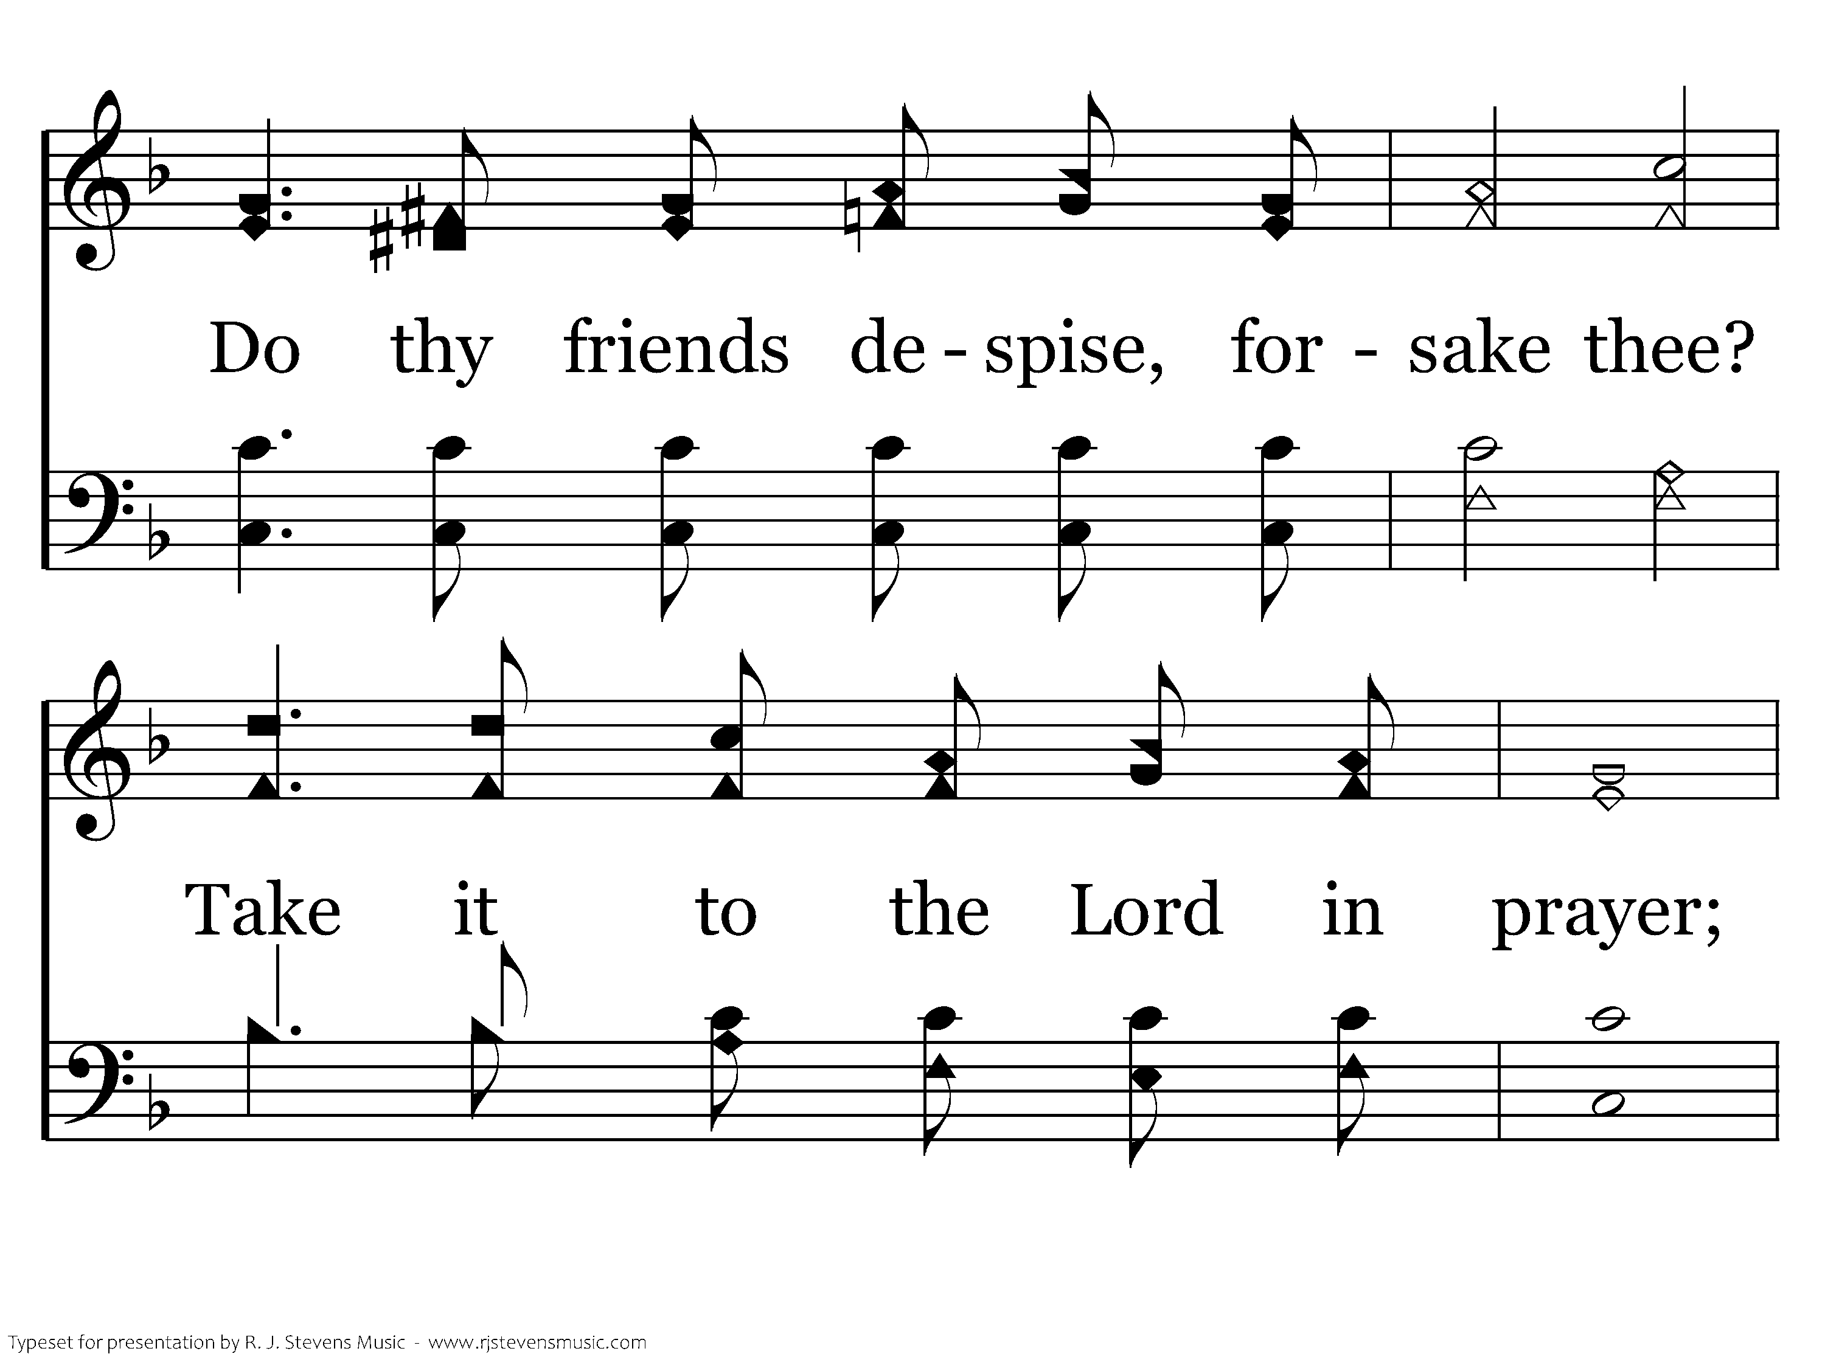
069 - What A Friend We Have In Jesus - 3.3

Slide 66
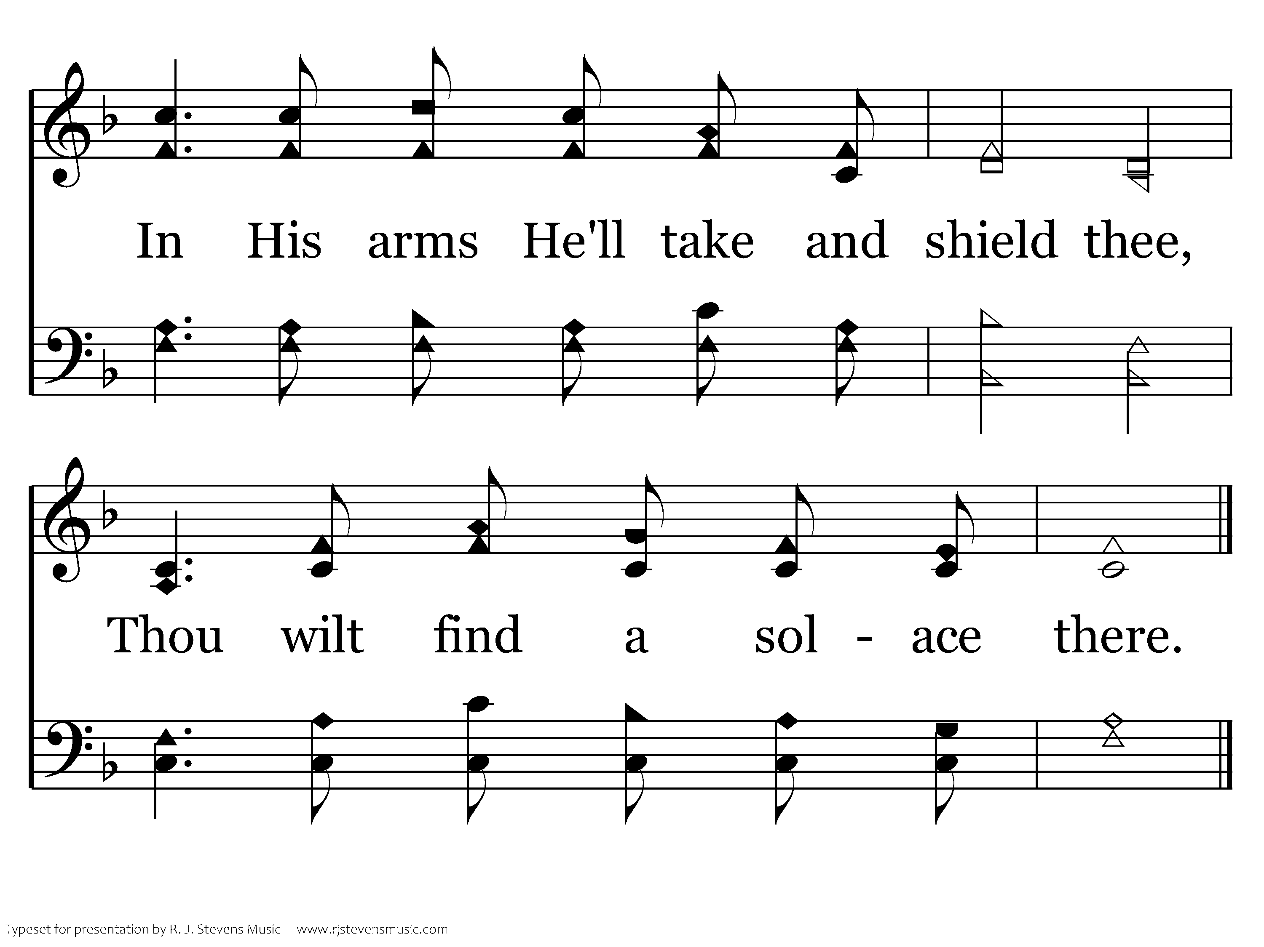
069 - What A Friend We Have In Jesus - 3.4
End of Song

Slide 68

Jesus Prayed

Slide 69

Jesus Prayed Often
Hebrews 5:7 offered up prayers and supplication
Luke 3:21 at His baptism
Matthew 14:23 by Himself to pray
Mark 1:35 early in the morning
Luke 11:1-4 teach us to pray

Slide 70
Jesus’ Prayer
Luke 11:1-4 model prayer
John 17 prayer for unity
  1-5
  6-19,24-26
  20-23
Matthew 26:39,42 prayer in the Garden

Slide 72
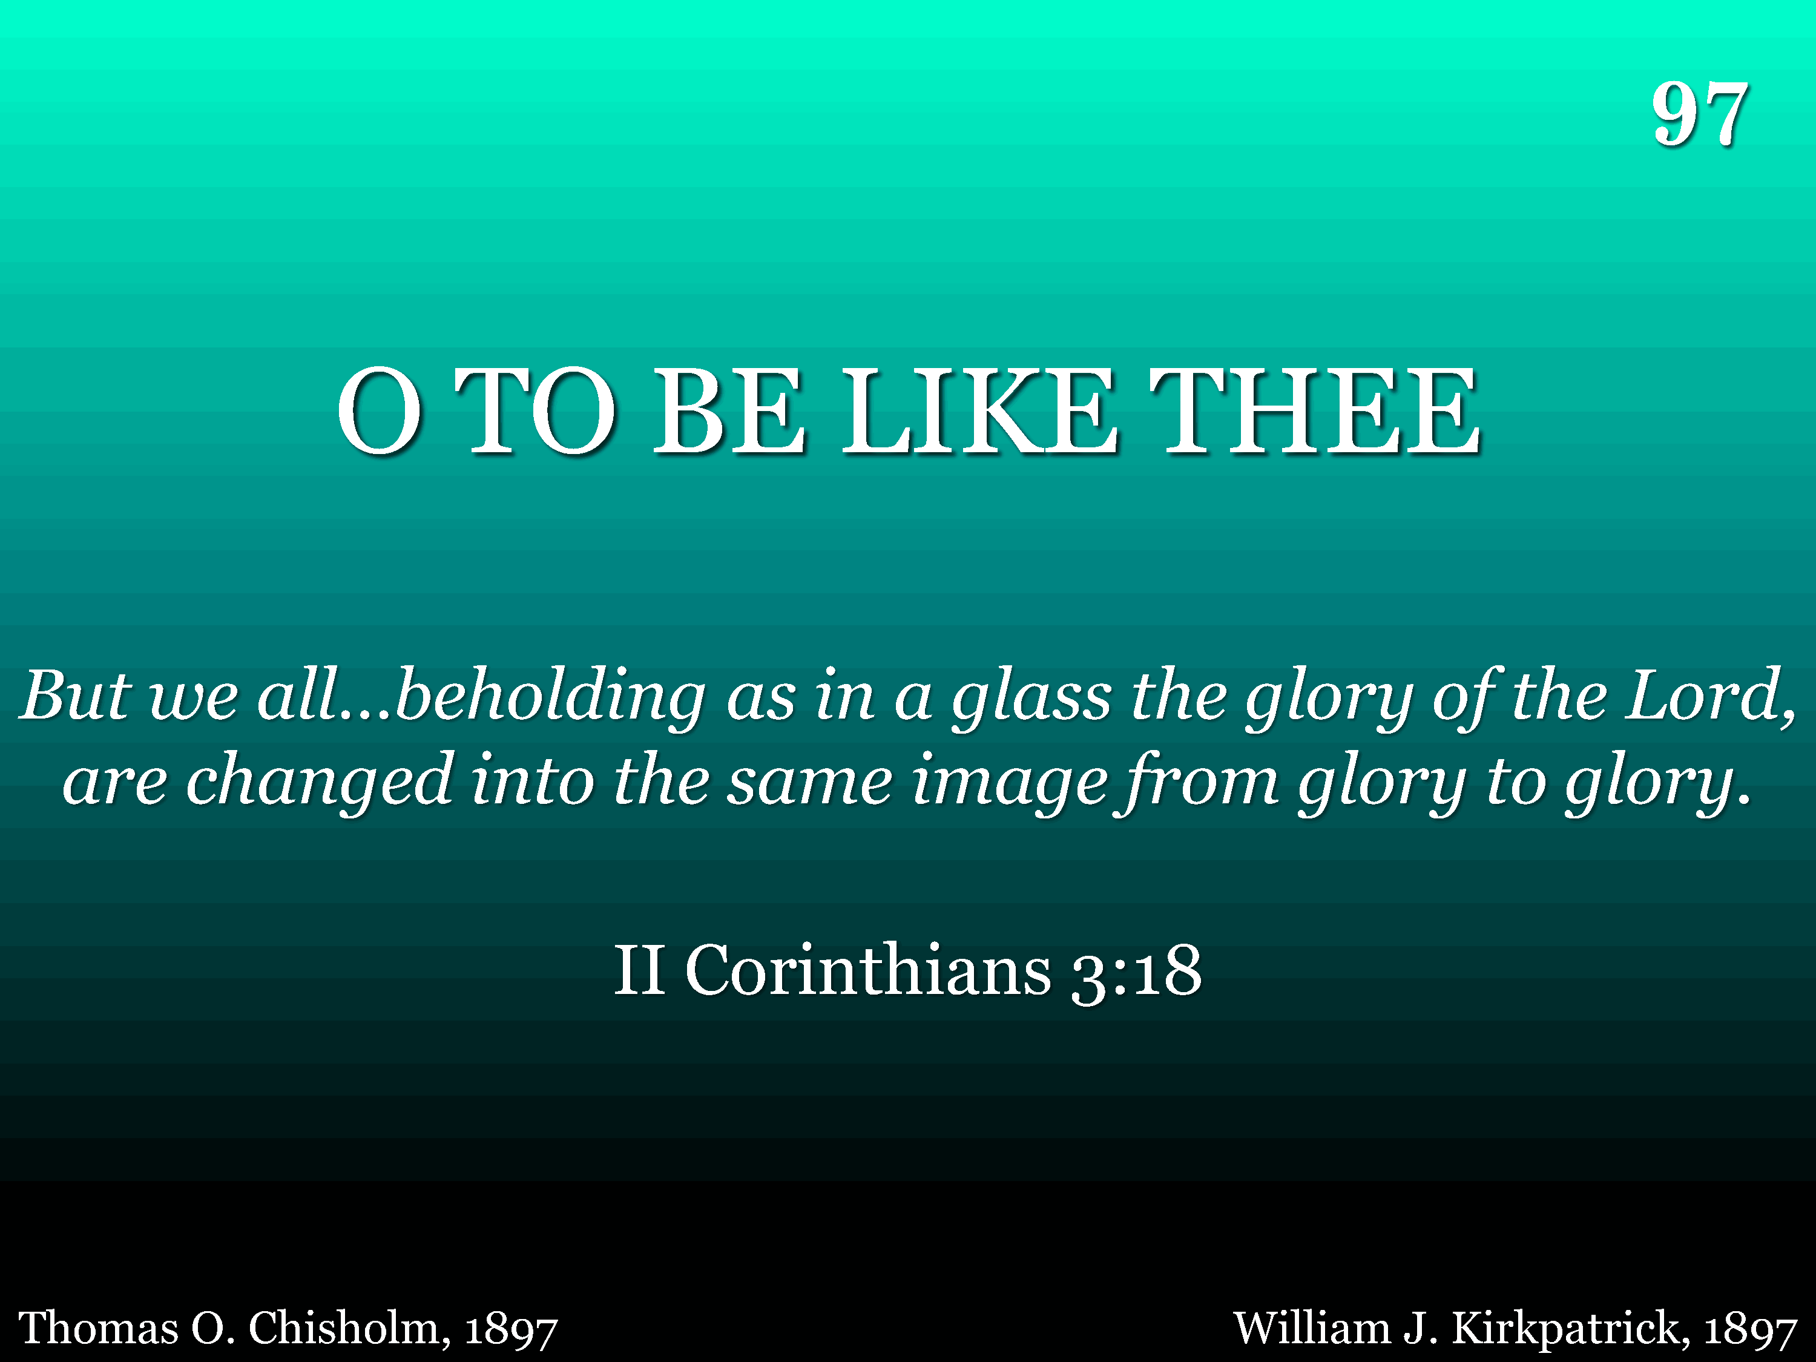
097 - O To Be Like Thee - Title

Slide 73
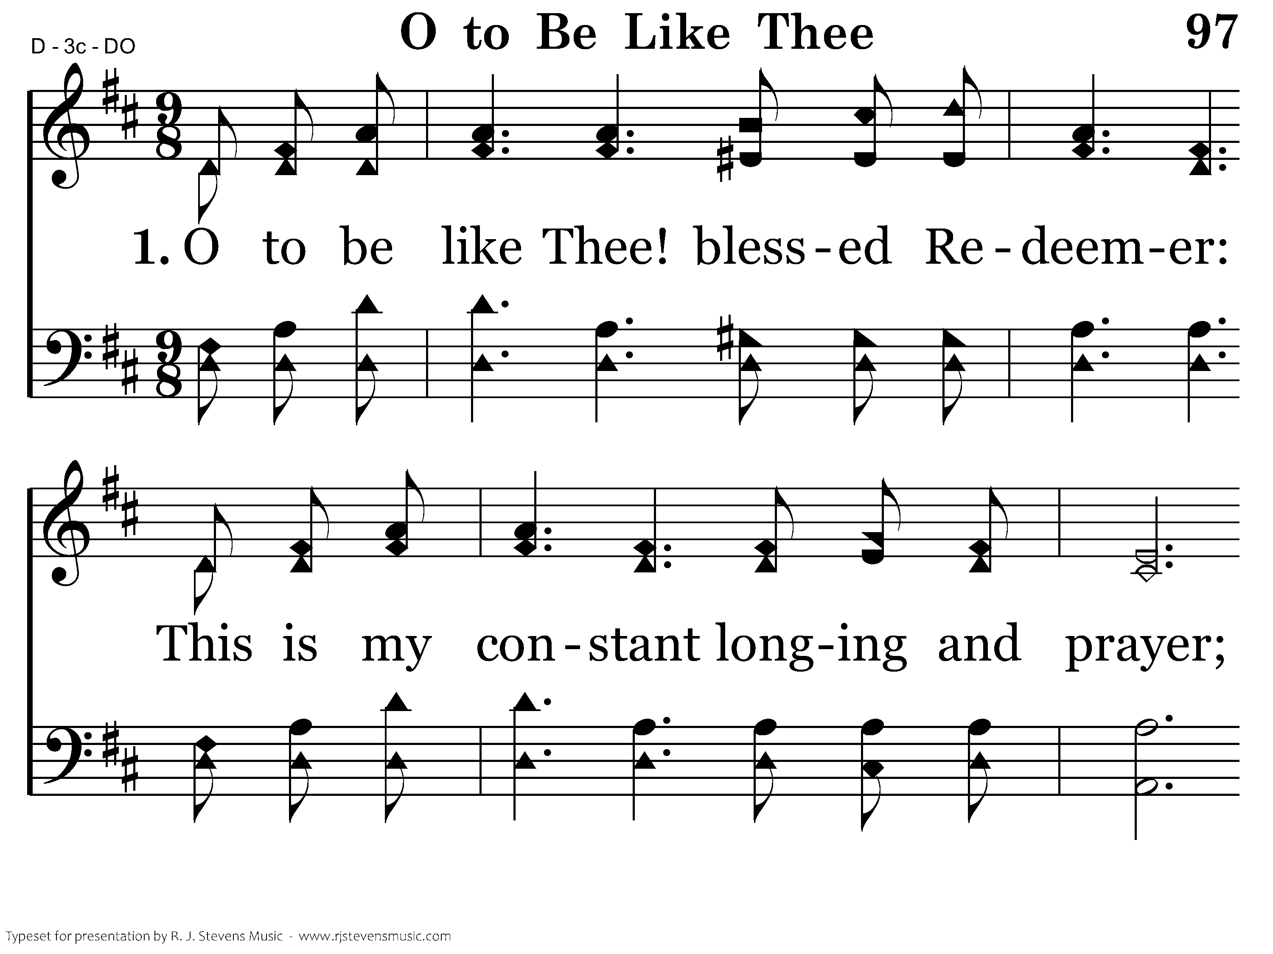
097 - O To Be Like Thee - 1.1

Slide 74
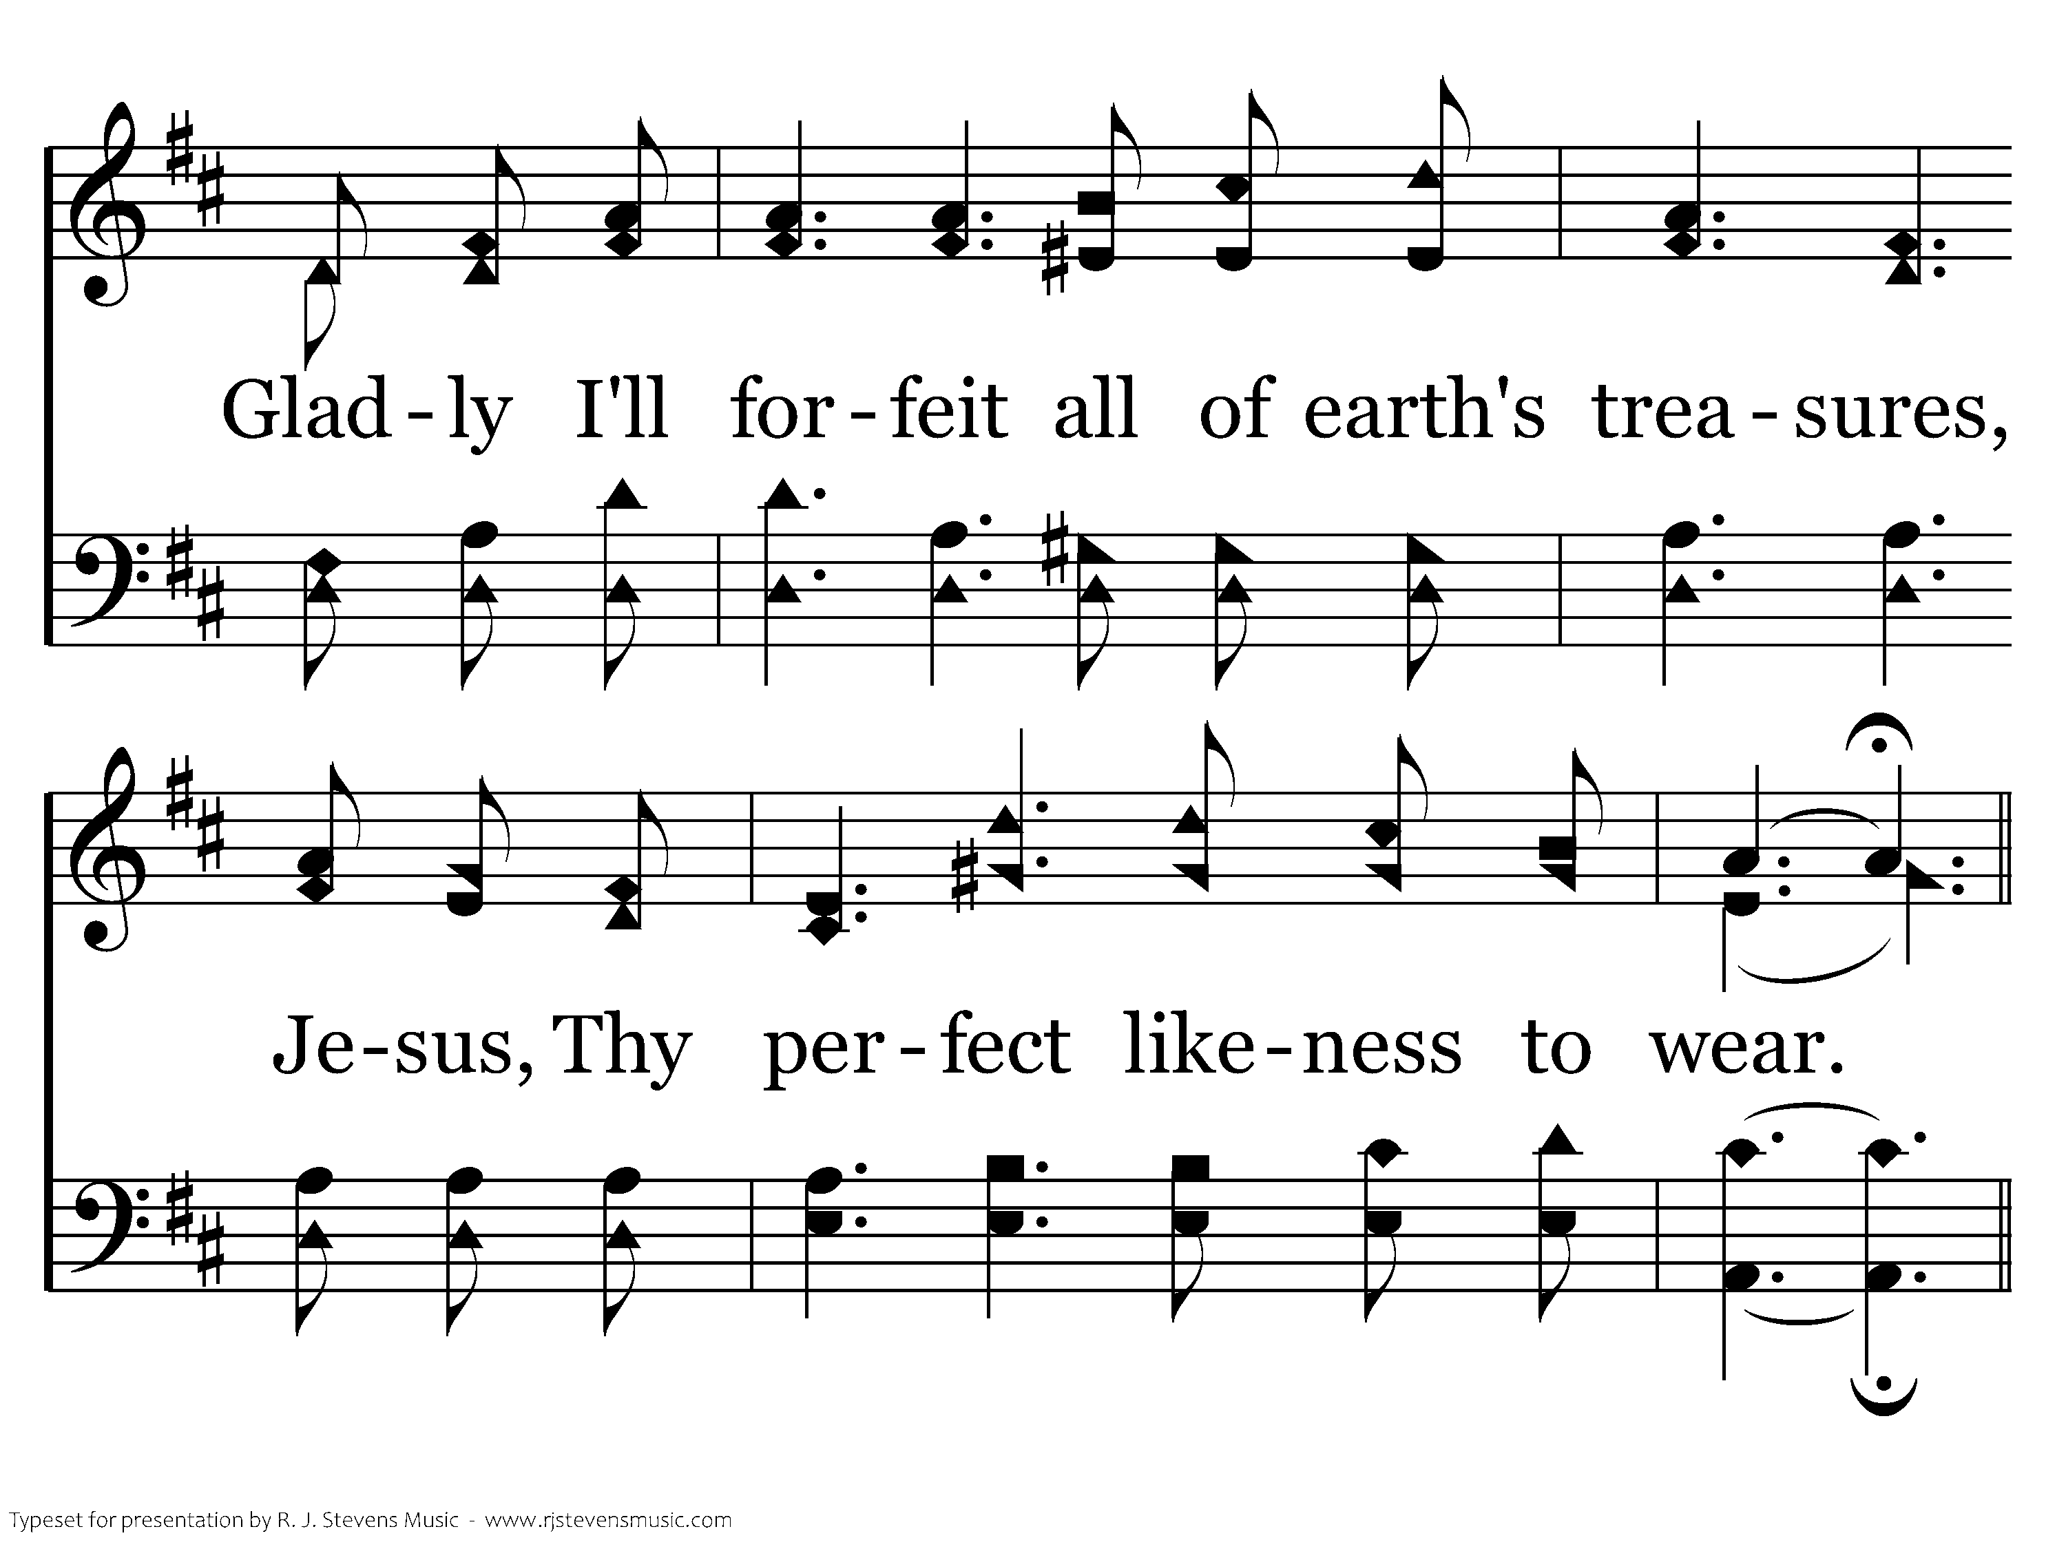
097 - O To Be Like Thee - 1.2

Slide 75
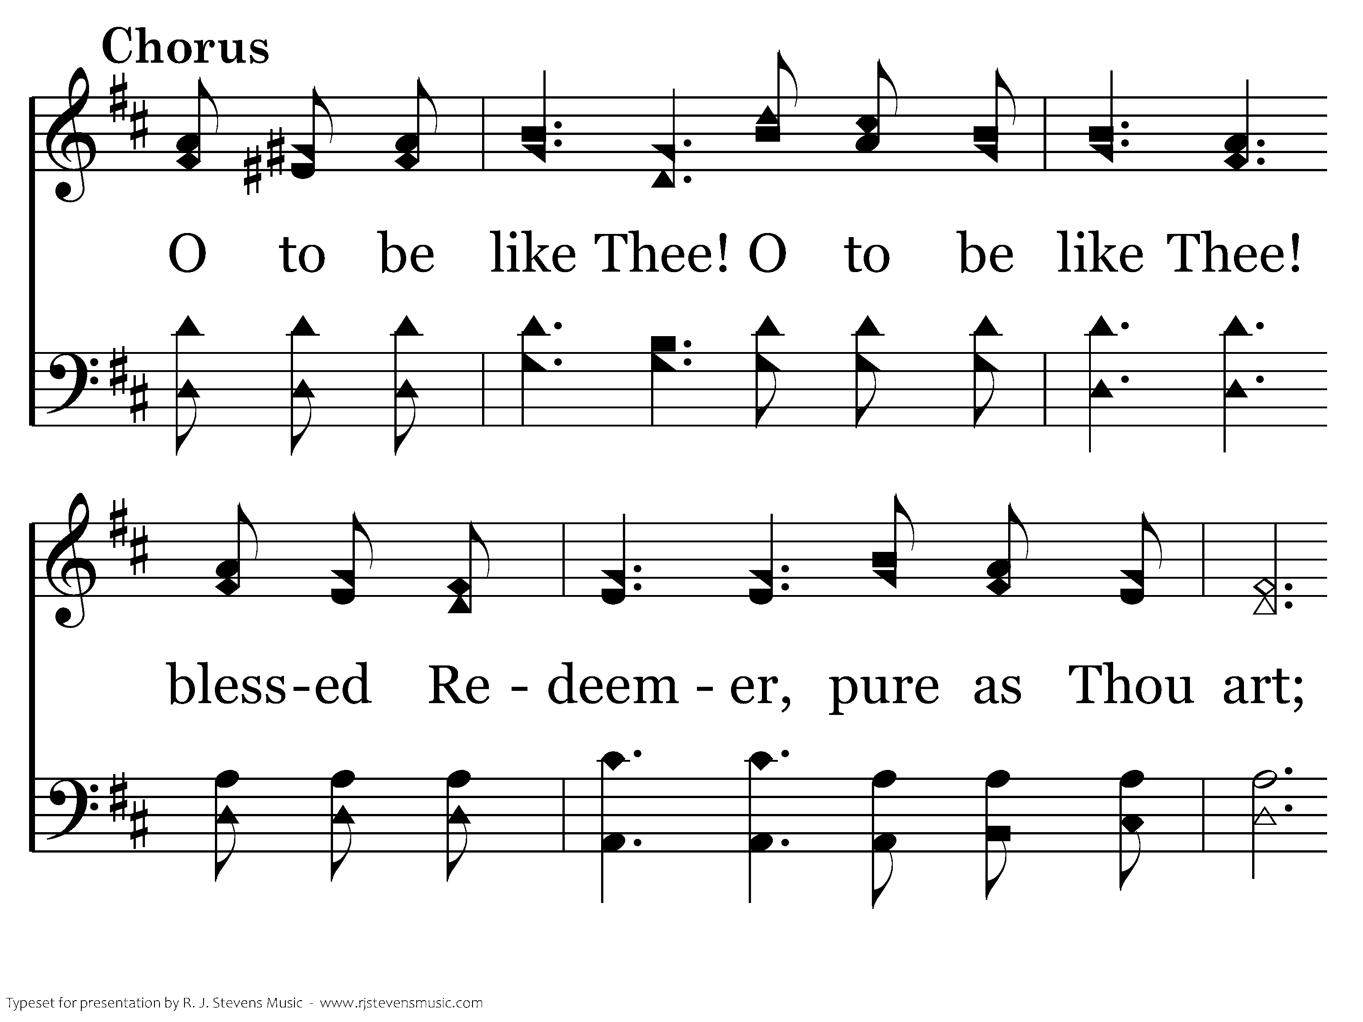
097 - O To Be Like Thee - C.1

Slide 76
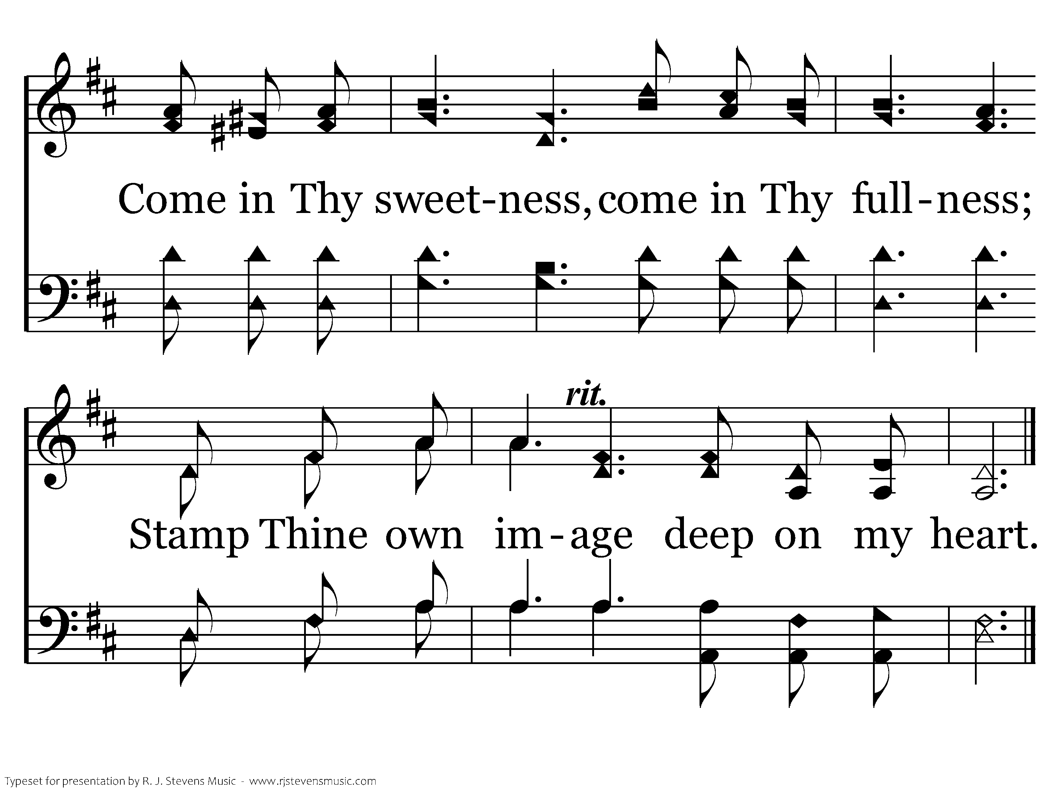
097 - O To Be Like Thee - C.2
End of Verse 1

Slide 77
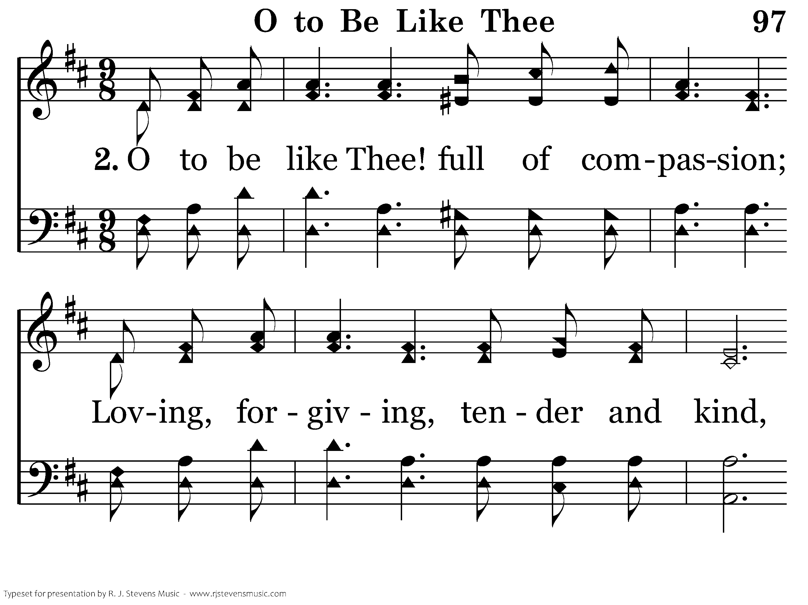
097 - O To Be Like Thee - 2.1

Slide 78
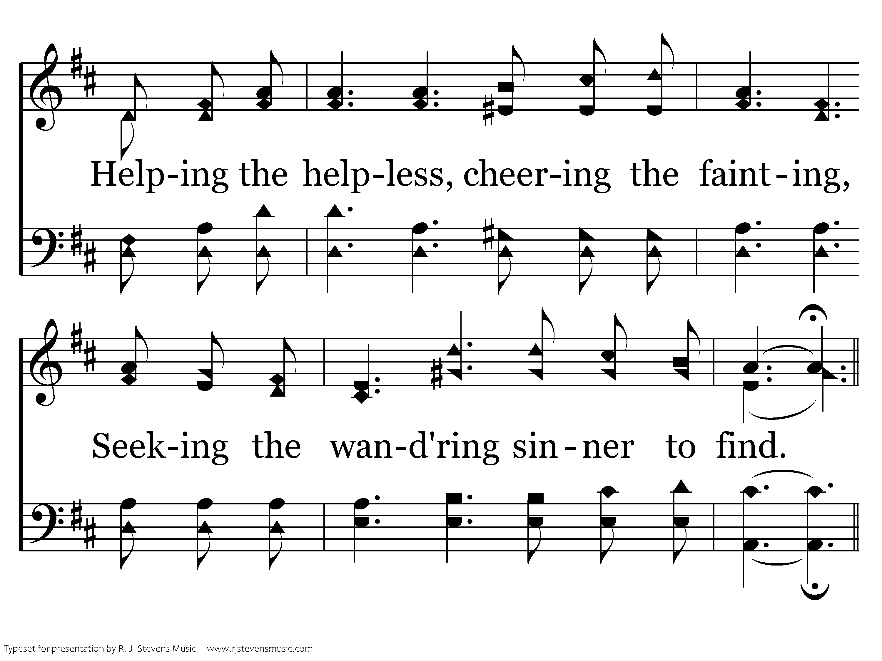
097 - O To Be Like Thee - 2.2

Slide 79
097 - O To Be Like Thee - C.1

Slide 80
097 - O To Be Like Thee - C.2
End of Verse 2

Slide 81
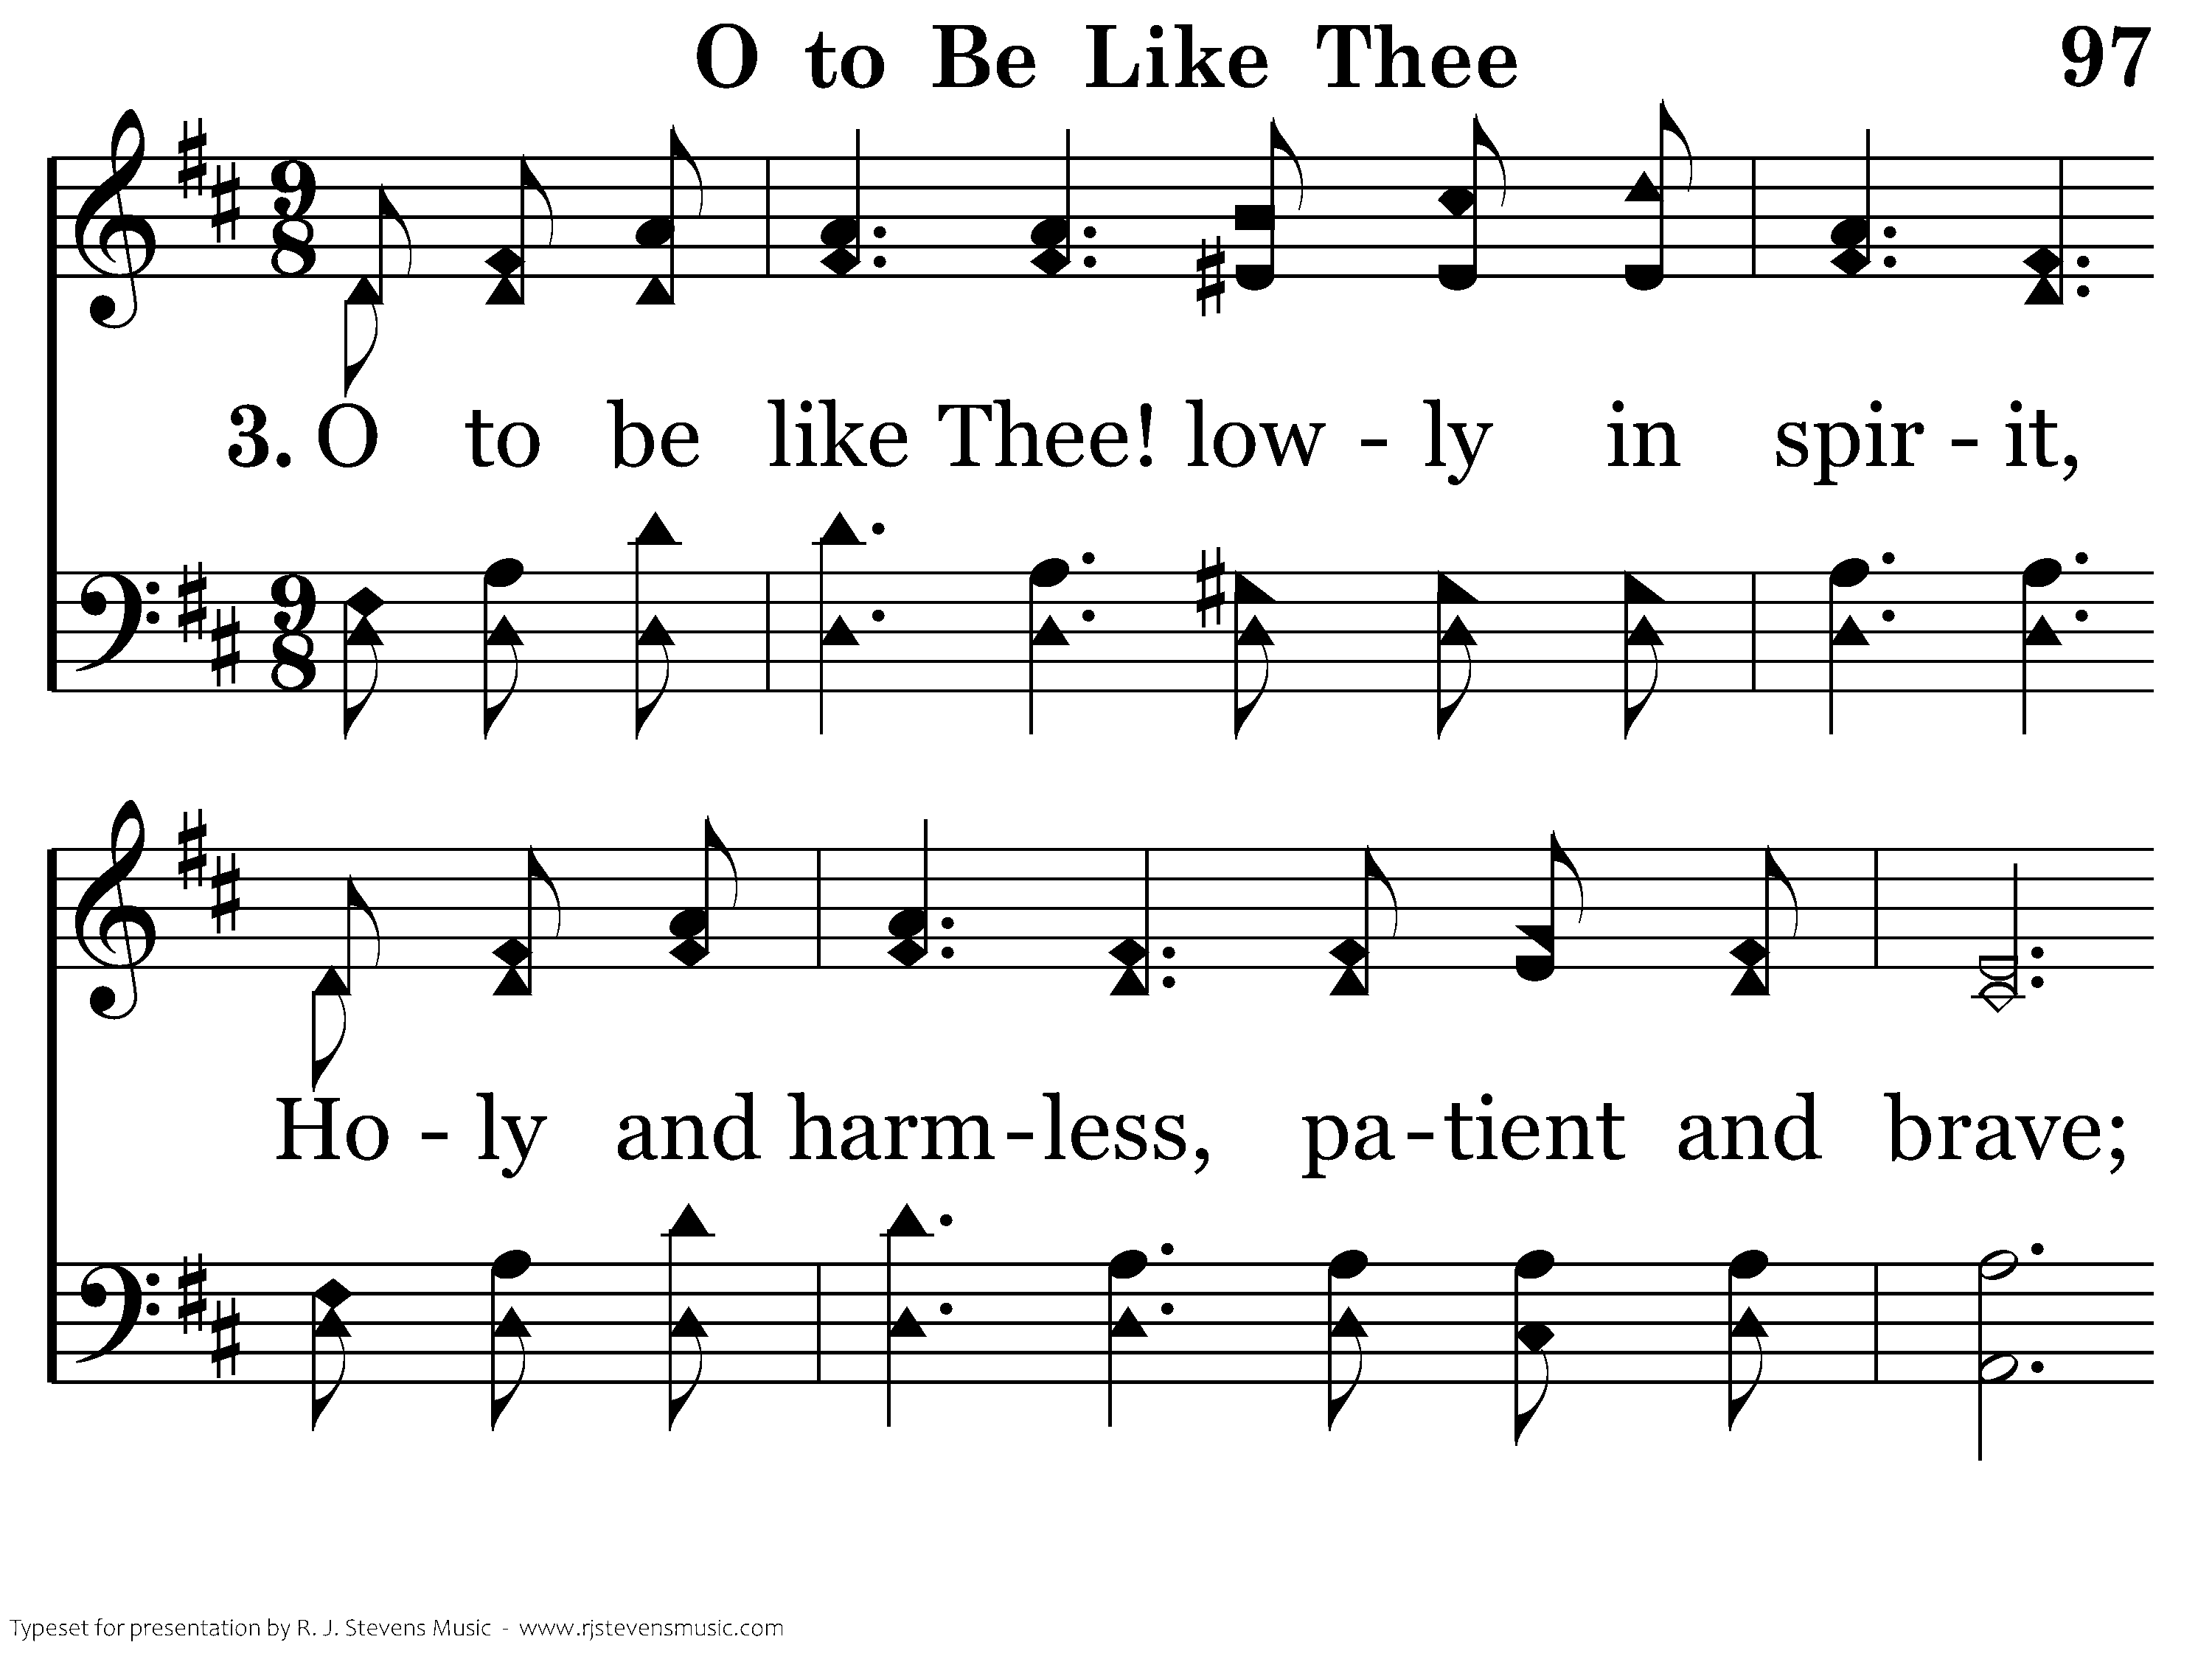
097 - O To Be Like Thee - 3.1

Slide 82
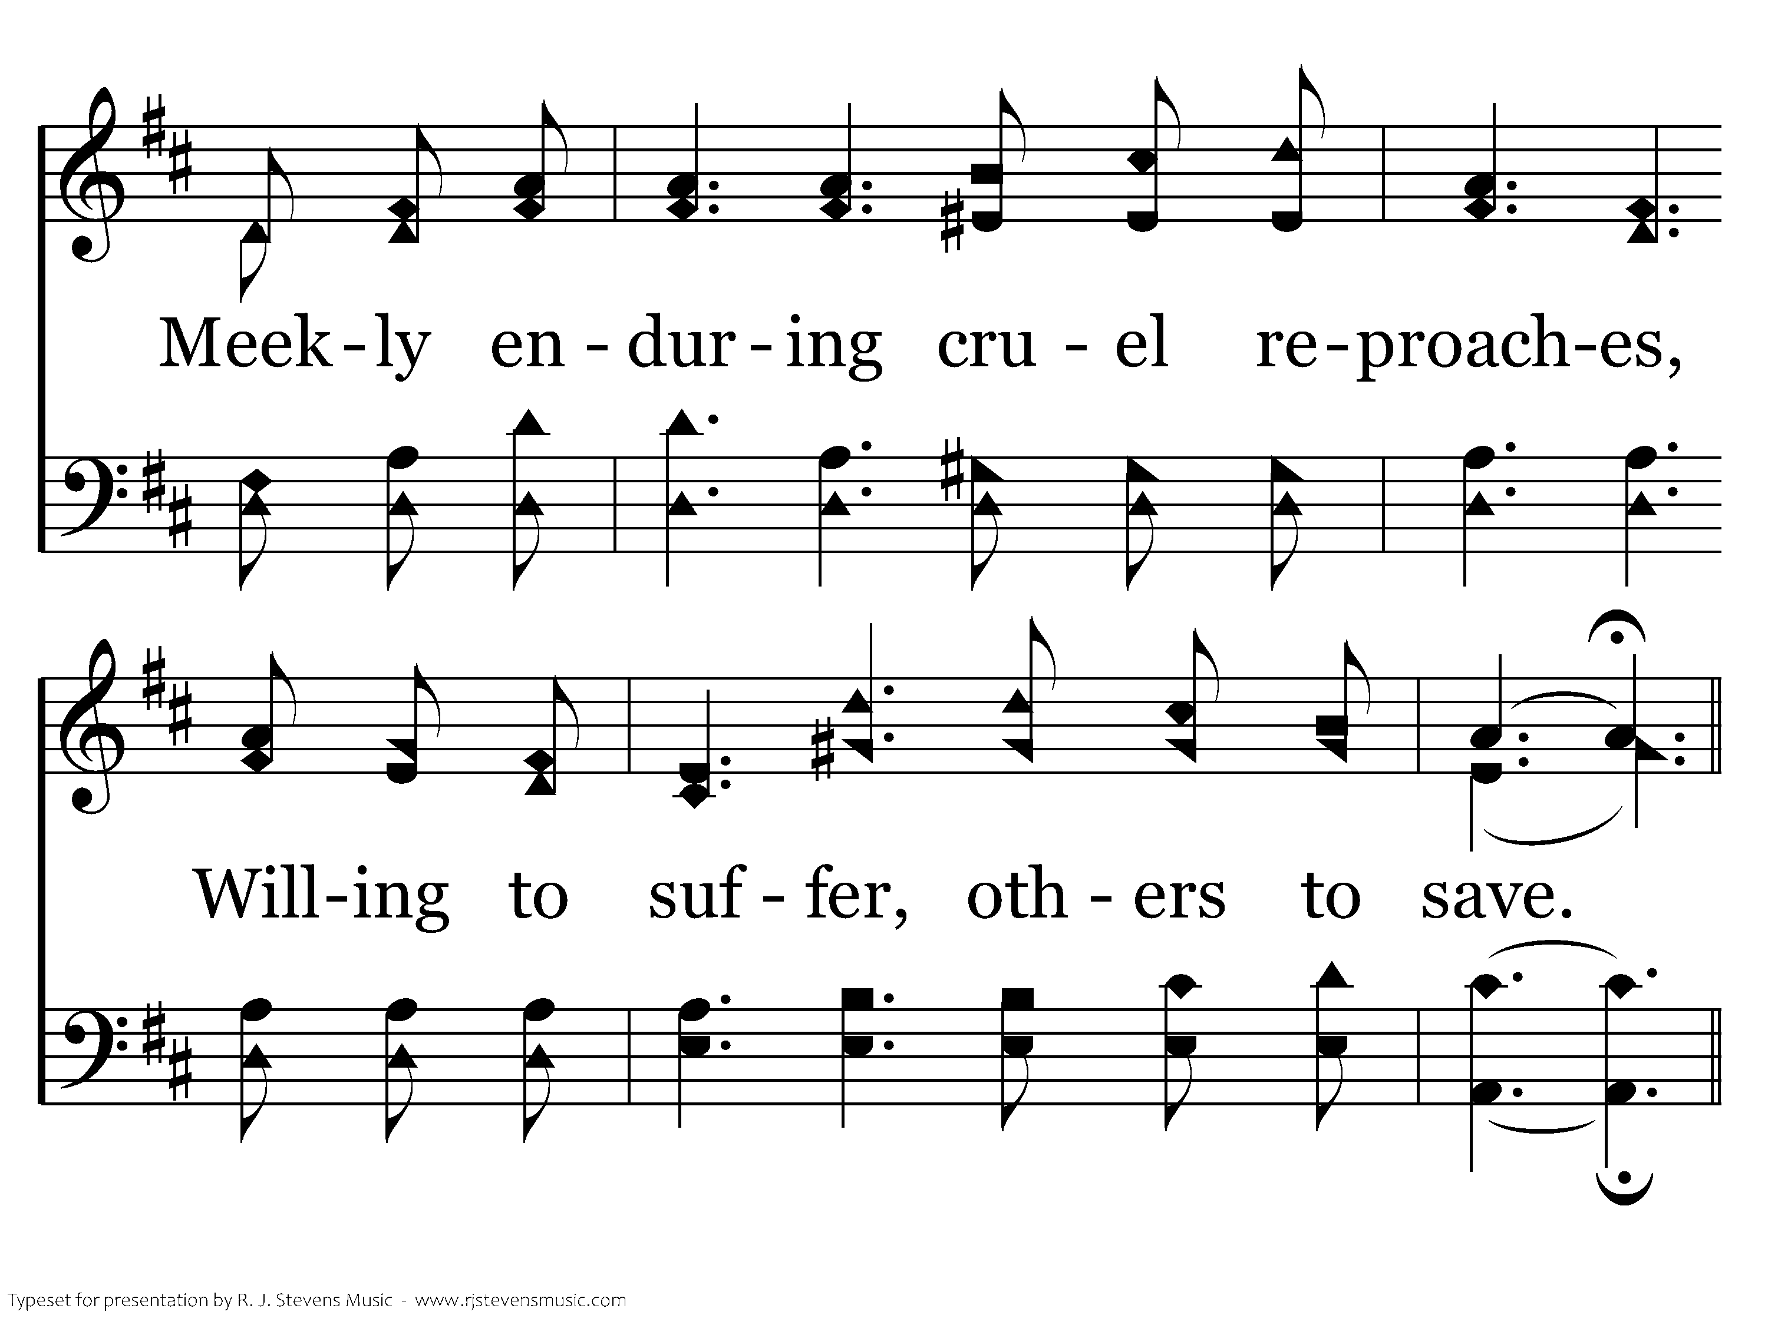
097 - O To Be Like Thee - 3.2

Slide 83
097 - O To Be Like Thee - C.1

Slide 84
097 - O To Be Like Thee - C.2
End of Verse 3

Slide 85

097 - O To Be Like Thee - 4.1

Slide 86

097 - O To Be Like Thee - 4.2

Slide 87
097 - O To Be Like Thee - C.1

Slide 88
097 - O To Be Like Thee - C.2
End of Song

Slide 90

1043 - Thank You, Lord! - Title

Slide 91

1043 - Thank You, Lord! - 1.1

Slide 92

1043 - Thank You, Lord! - 1.2

Slide 93

1043 - Thank You, Lord! - 1.3

Slide 94

1043 - Thank You, Lord! - C.1

Slide 95

1043 - Thank You, Lord! - C.2

Slide 96

1043 - Thank You, Lord! - C.3

Slide 97

1043 - Thank You, Lord! - C.4
End of Verse 1

Slide 98

1043 - Thank You, Lord! - 2.1

Slide 99

1043 - Thank You, Lord! - 2.2

Slide 100

1043 - Thank You, Lord! - 2.3

Slide 101
1043 - Thank You, Lord! - C.1

Slide 102
1043 - Thank You, Lord! - C.2

Slide 103
1043 - Thank You, Lord! - C.3

Slide 104
1043 - Thank You, Lord! - C.4
End of Song

