Slide 1





Hebrews 10: 24 & 25
And let us consider one another in order to stir up love and good works, not forsaking the assembling of ourselves together, as is the manner of some, but exhorting one another, and so much the more as you see the Day approaching.
Please Silence
Your Devices
Contact Us
(270) 683-4204
westsideowensboroky@gmail.com
Church Of Christ at
Westside Owensboro
Westside church of Christ
Owensboro KY

Slide 2

Westside Church of Christ
Sunday Bible Class:
9:30 AM
Sunday Worship:
10:30 AM
Sunday Worship:
5:00 PM
Wednesday Bible Class:
6:30 PM
Remember in your prayers:
Wanda Bradberry
Richard Hill
Don & Alice Ward

Slide 4

047 - God Is So Good - Title

Slide 5
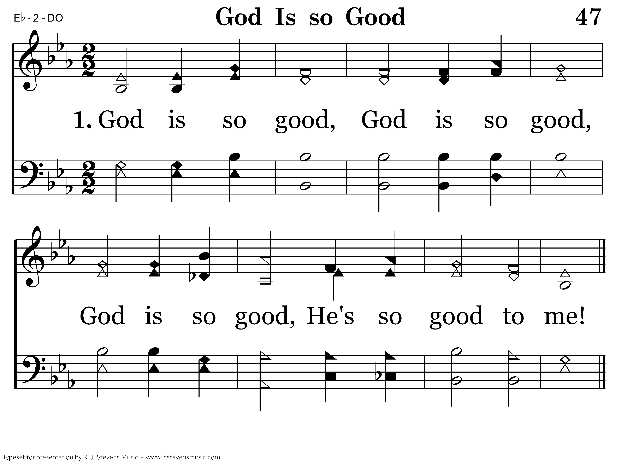
047 - God Is So Good - 1.1
End of Verse 1

Slide 6
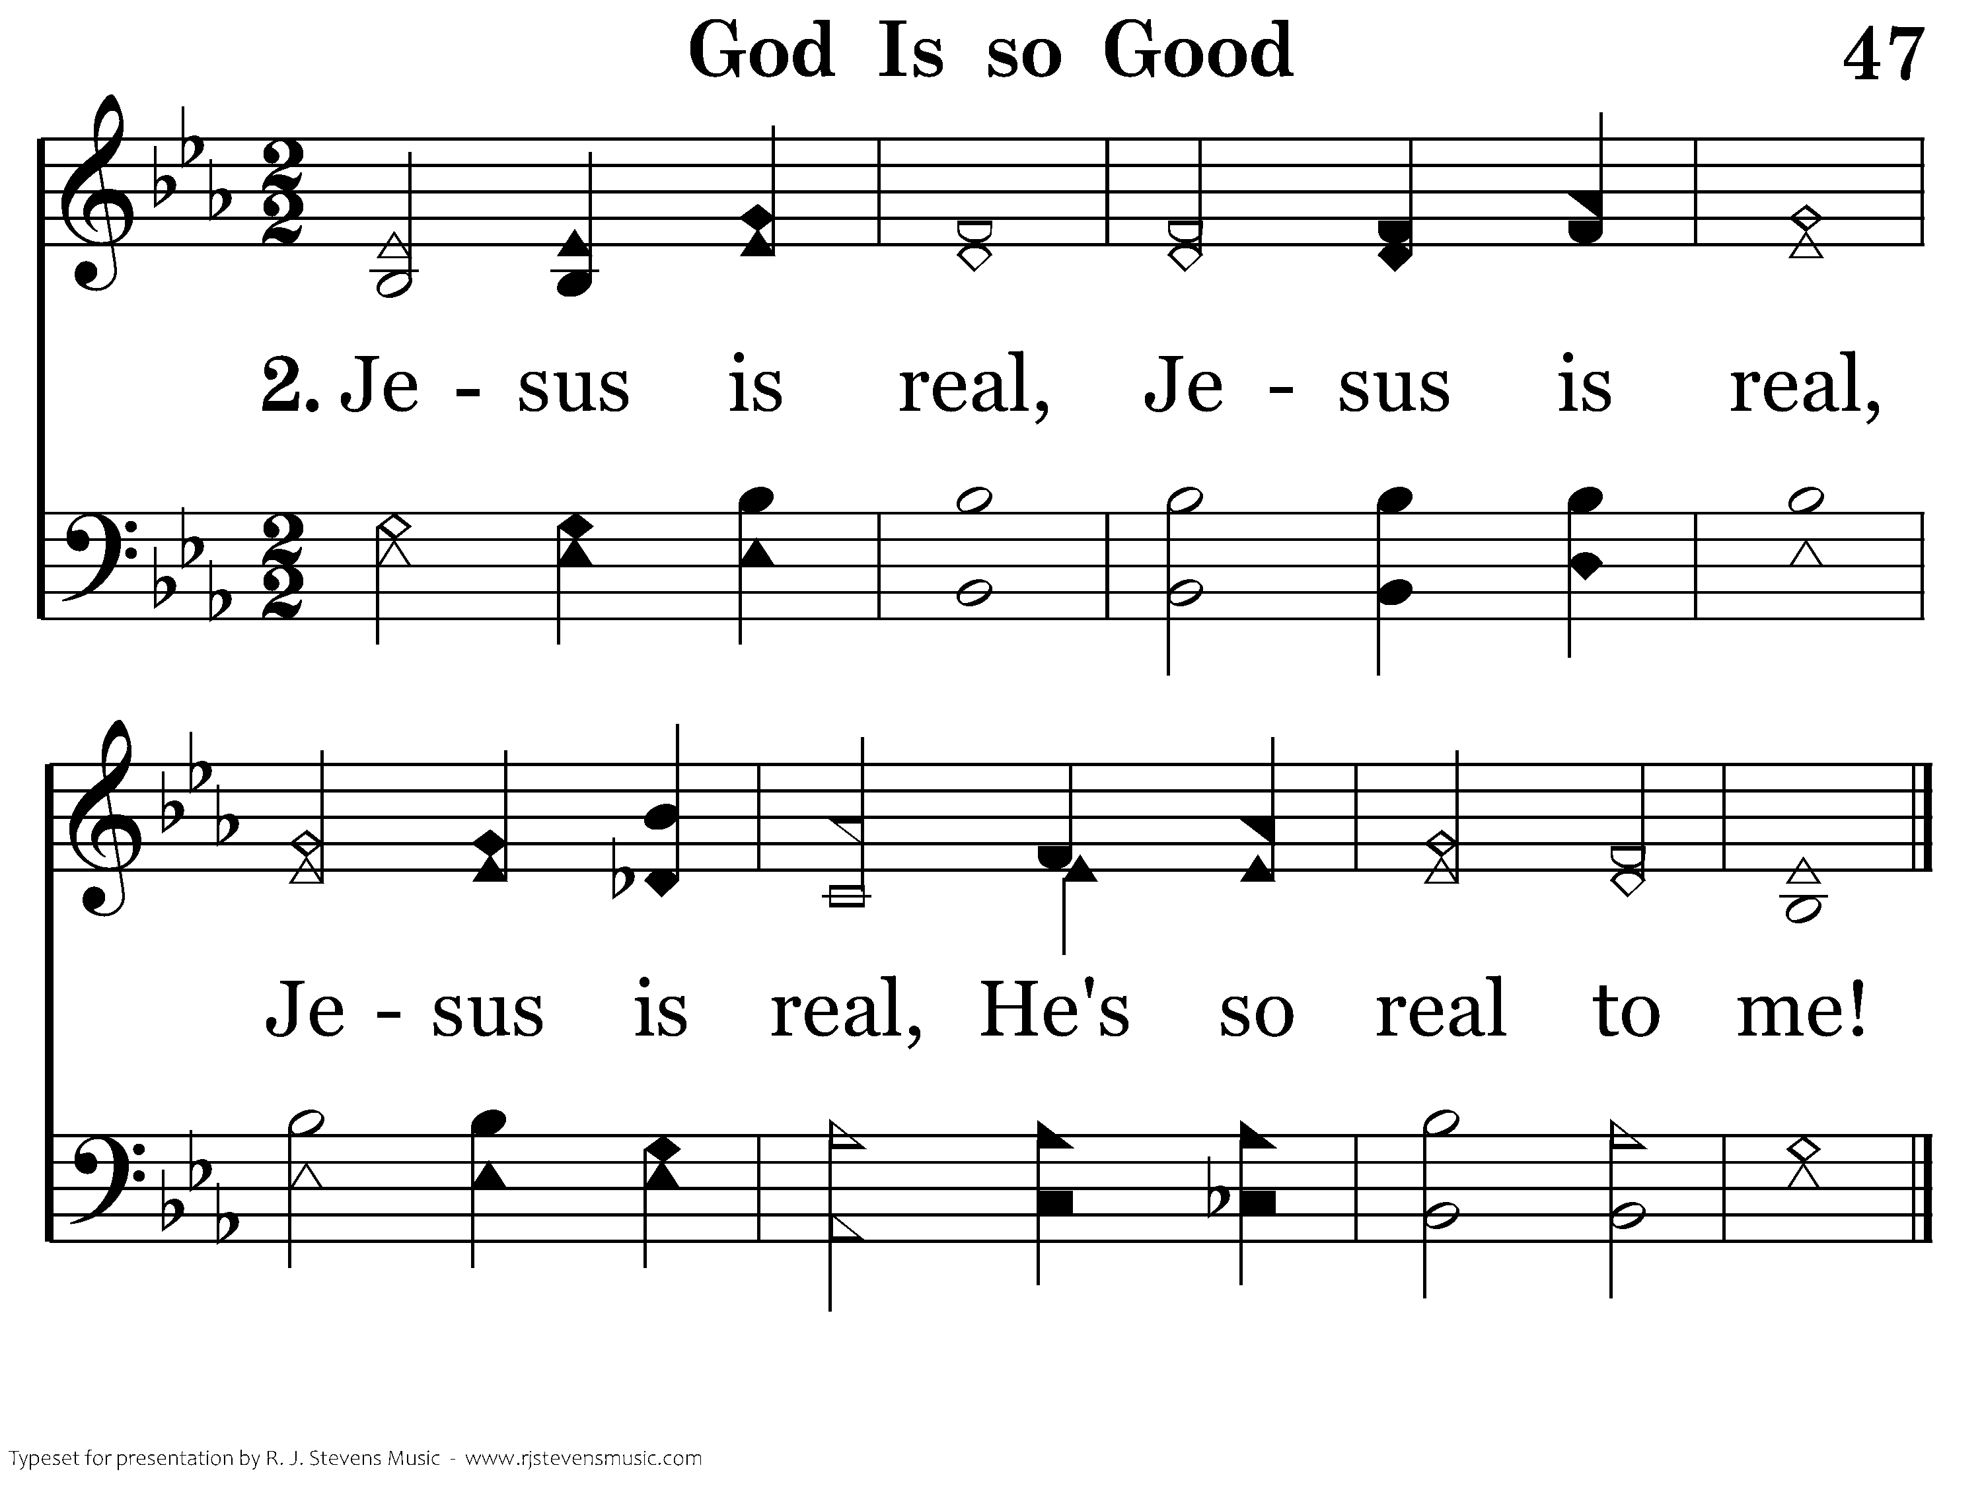
047 - God Is So Good - 2.1
End of Verse 2

Slide 7
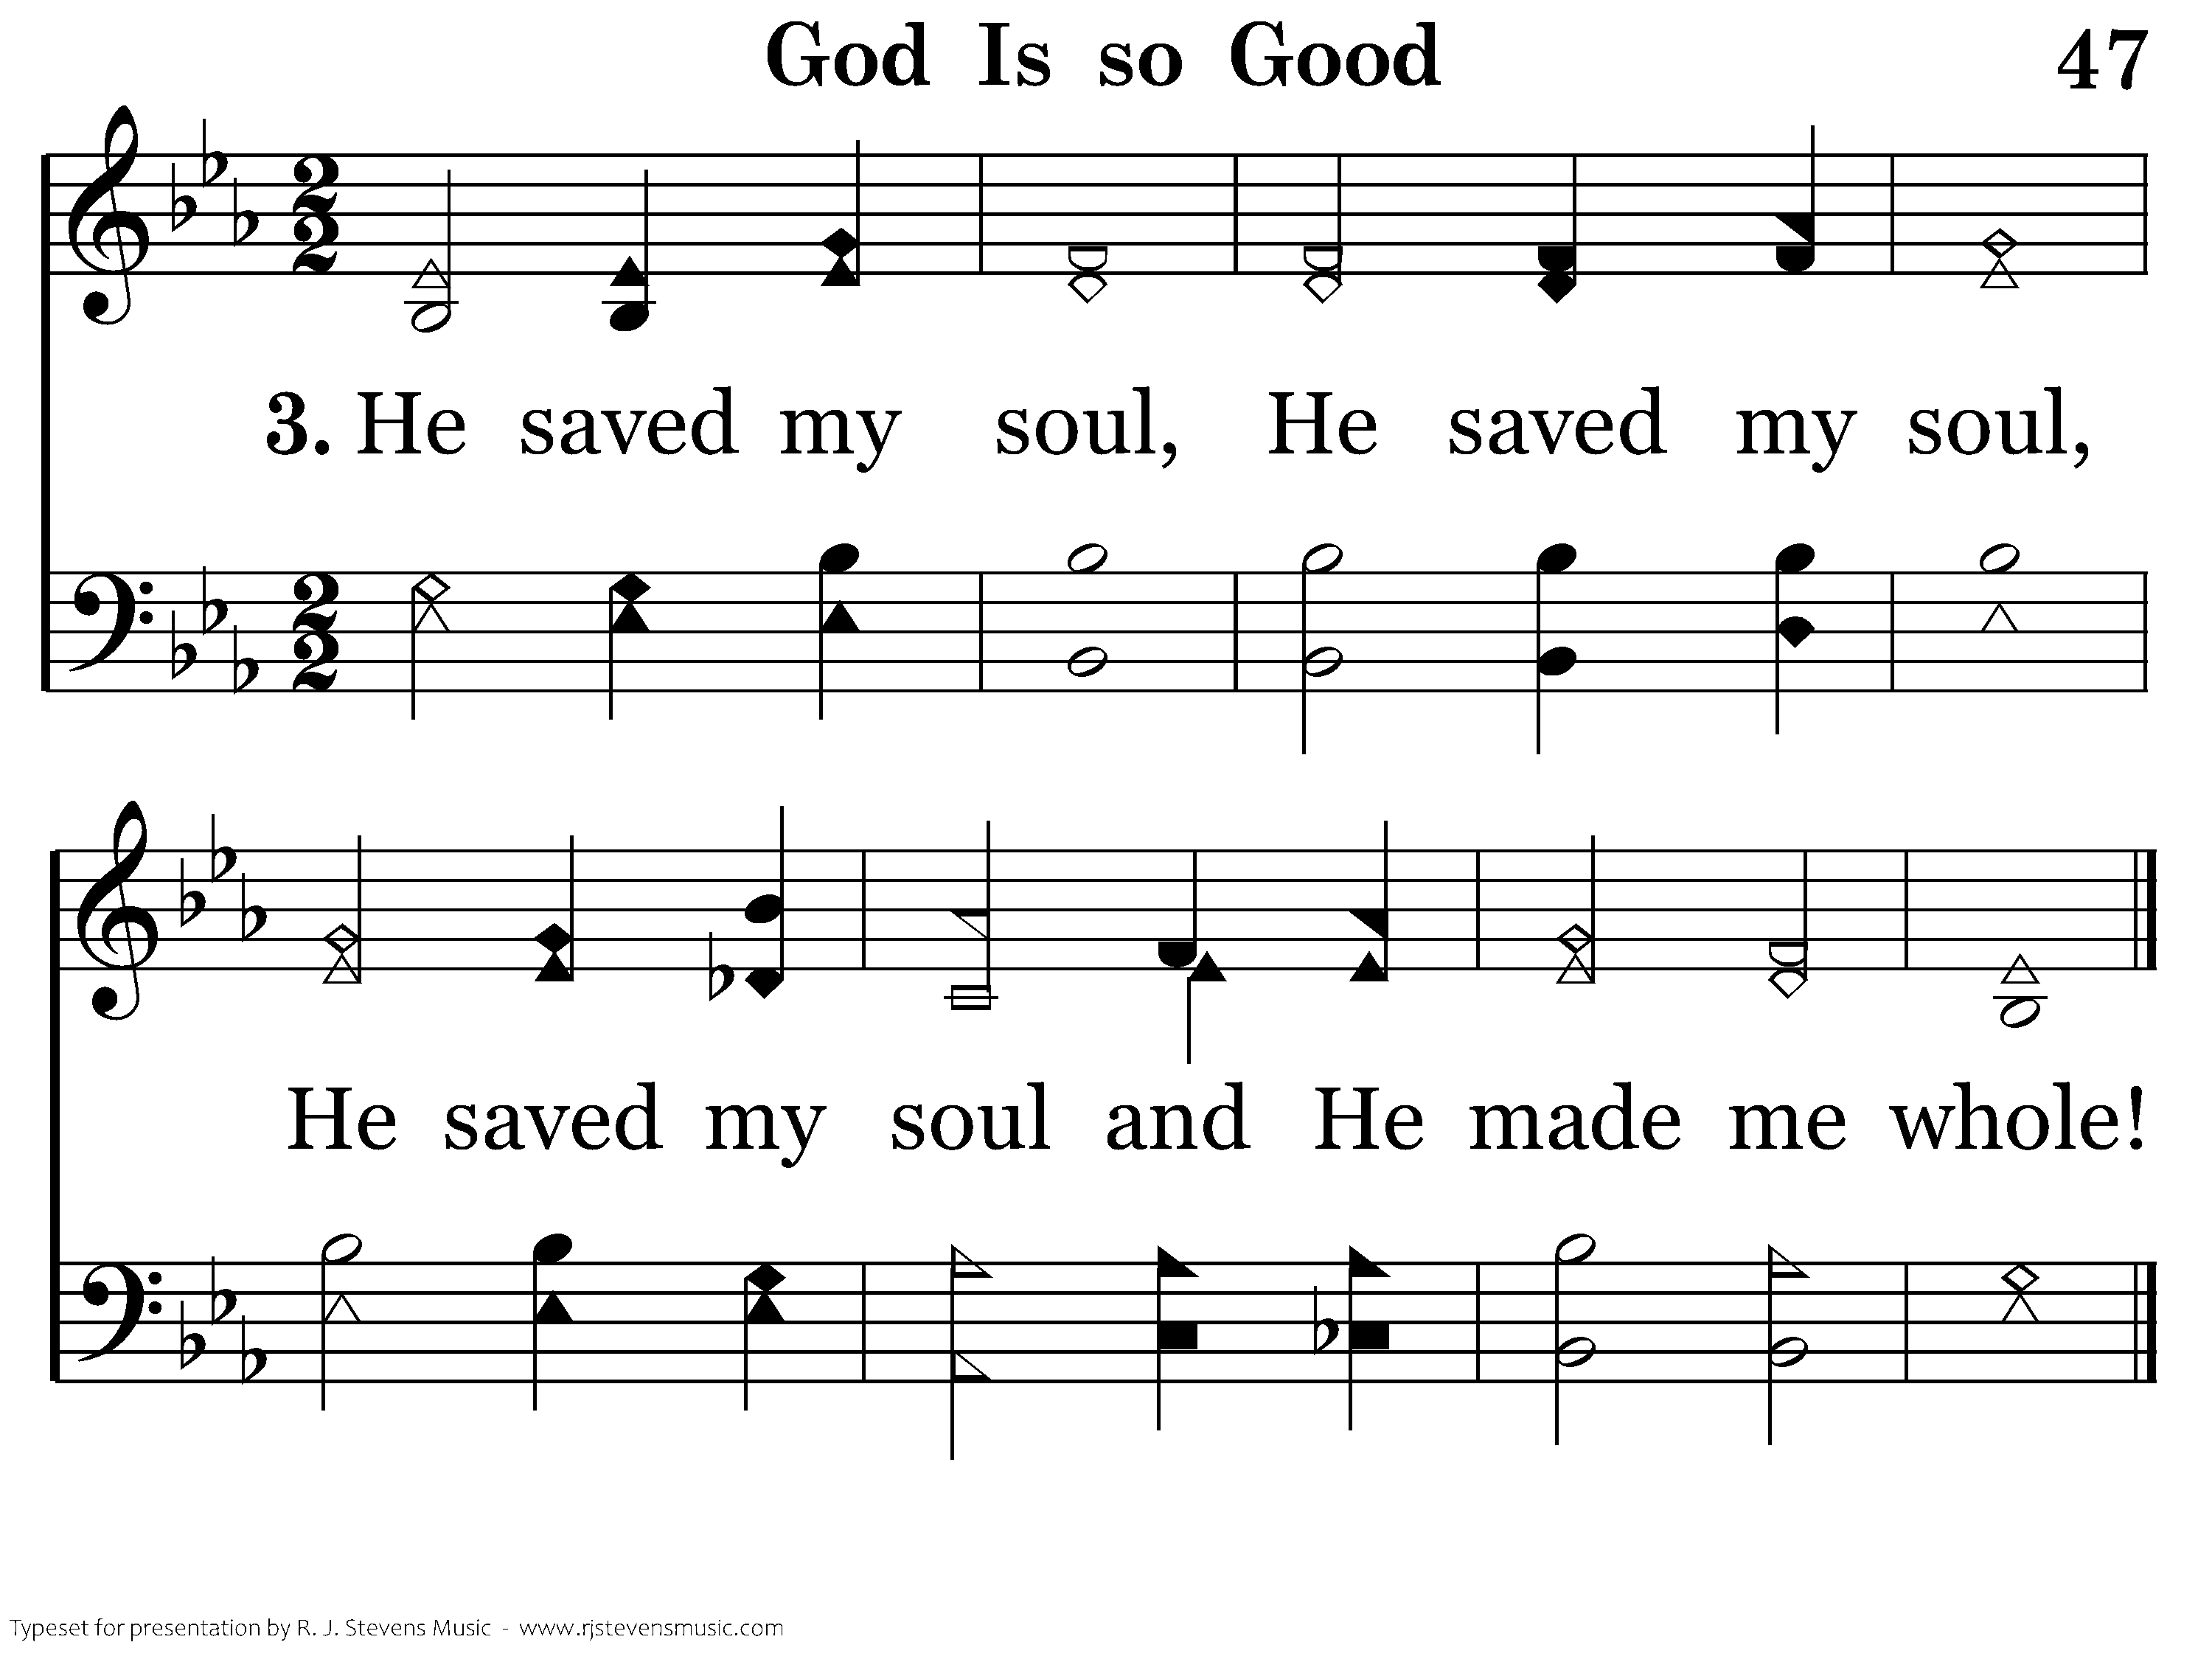
047 - God Is So Good - 3.1
End of Verse 3

Slide 8
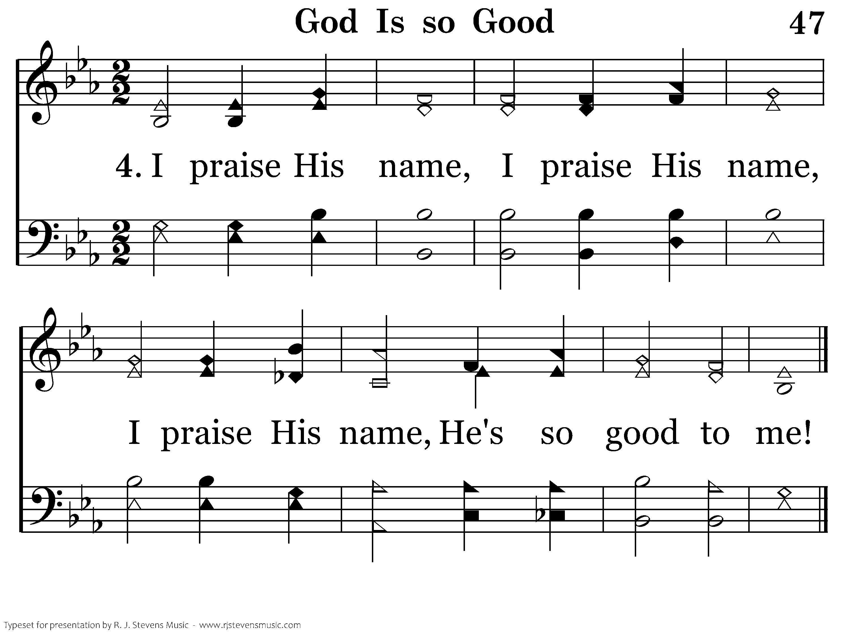
047 - God Is So Good - 4.1
End of Song

Slide 10
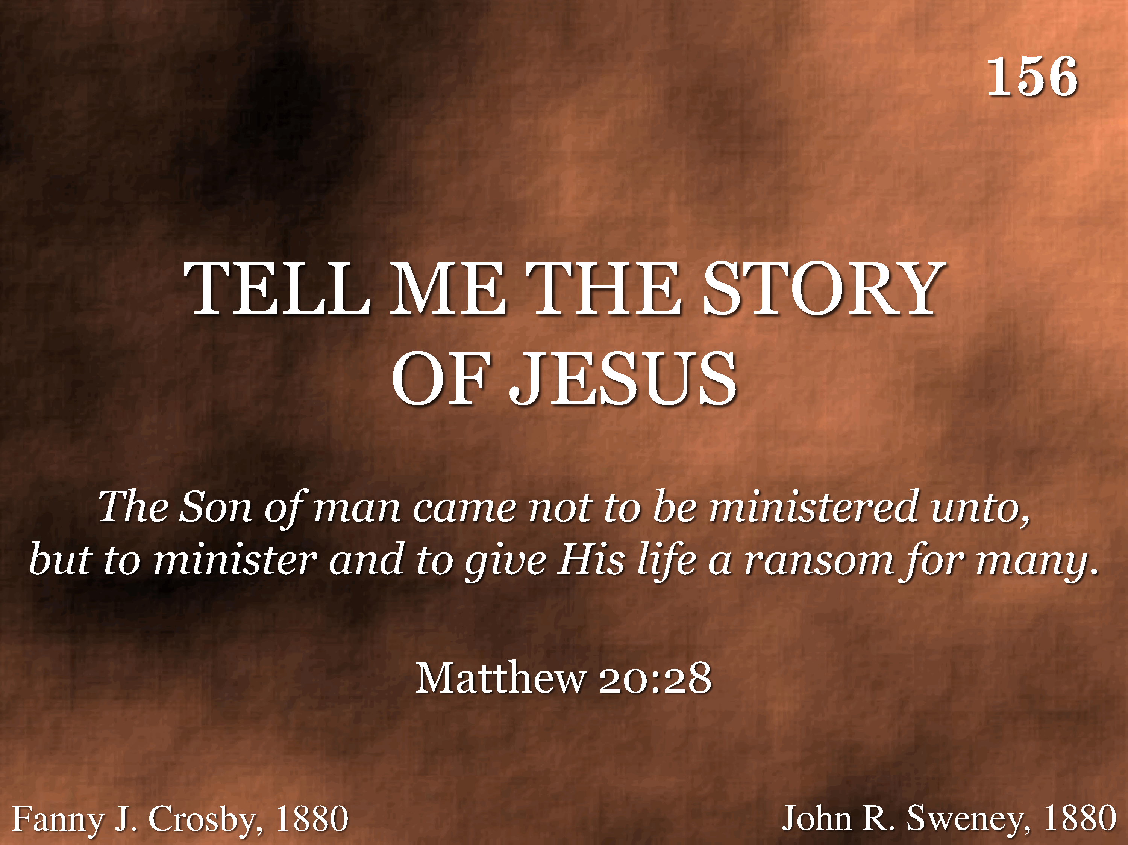
156 - Tell Me The Story Of Jesus - Title

Slide 11
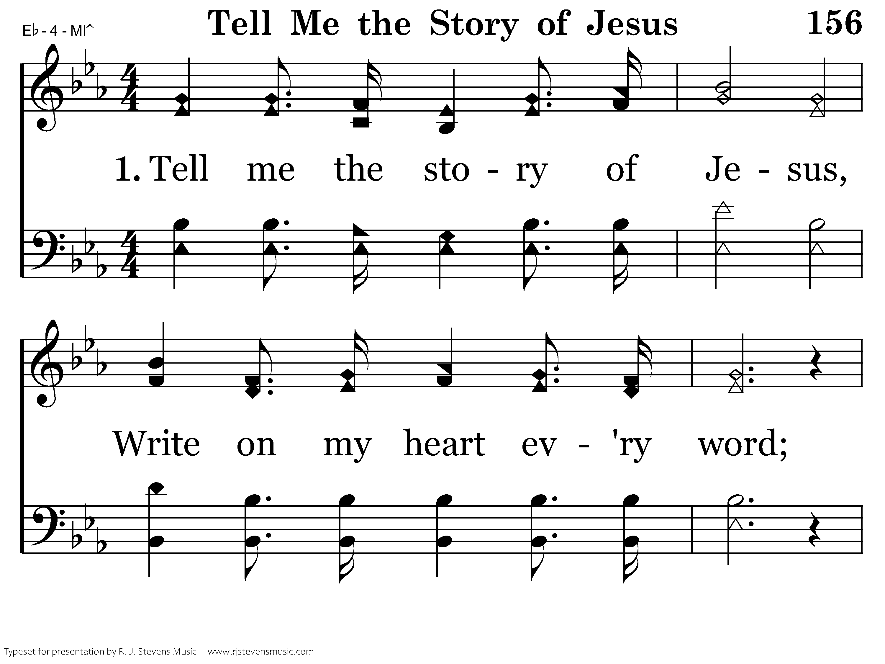
156 - Tell Me The Story Of Jesus - 1.1

Slide 12
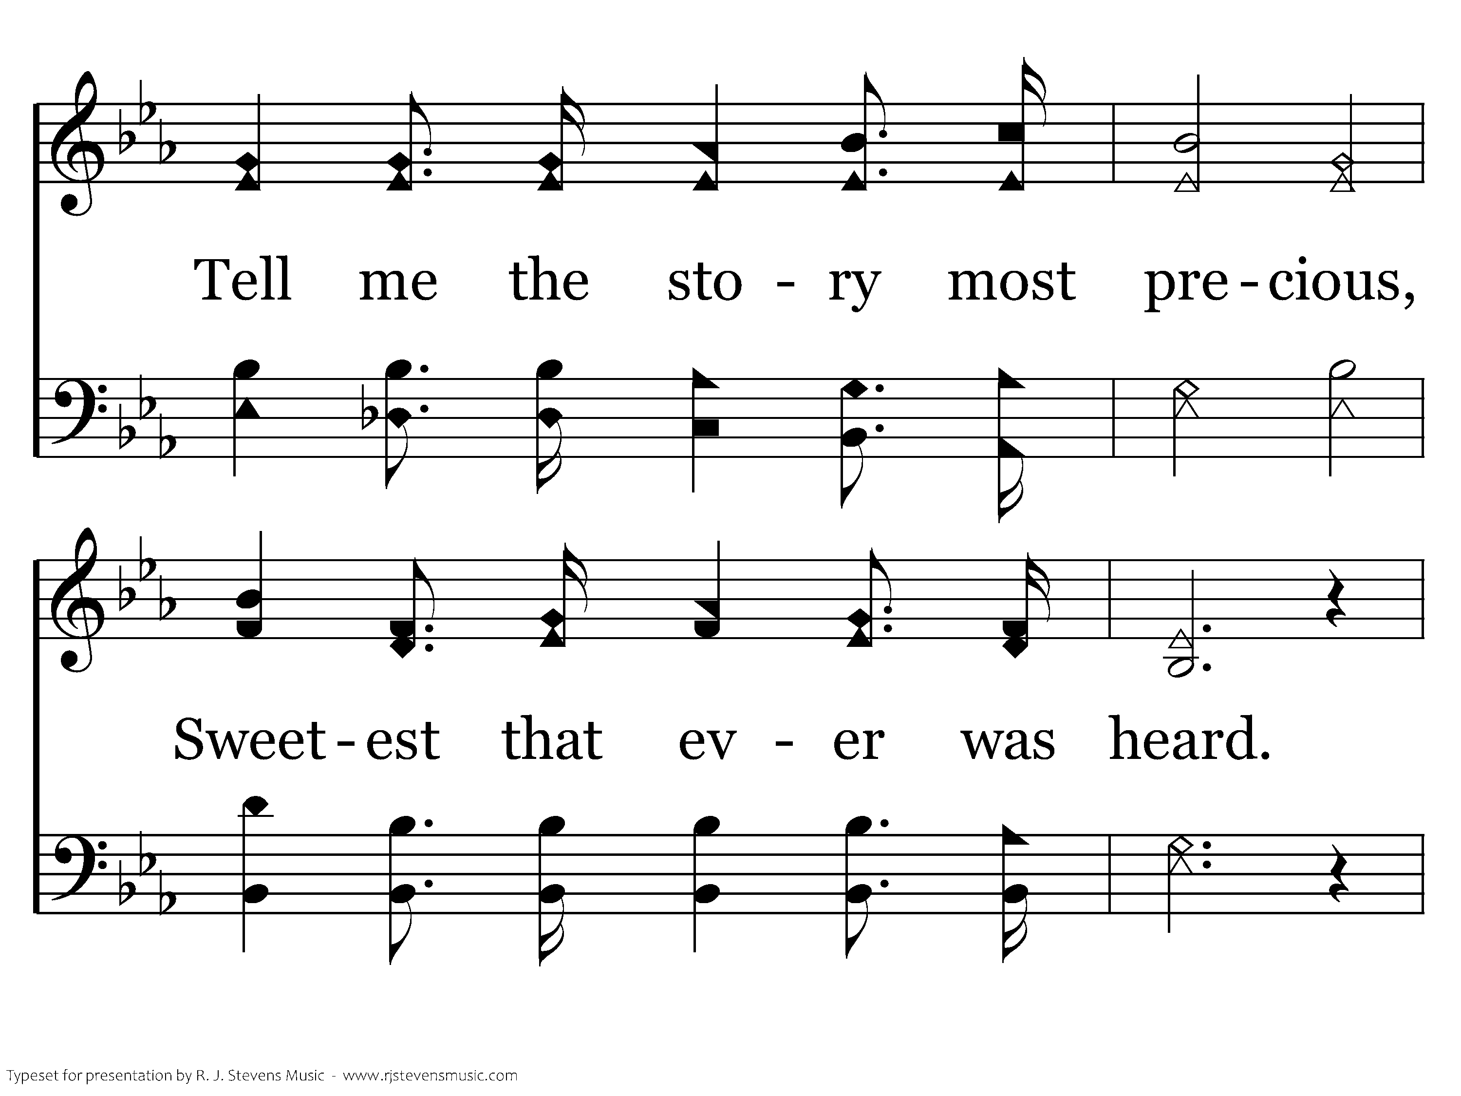
156 - Tell Me The Story Of Jesus - 1.2

Slide 13
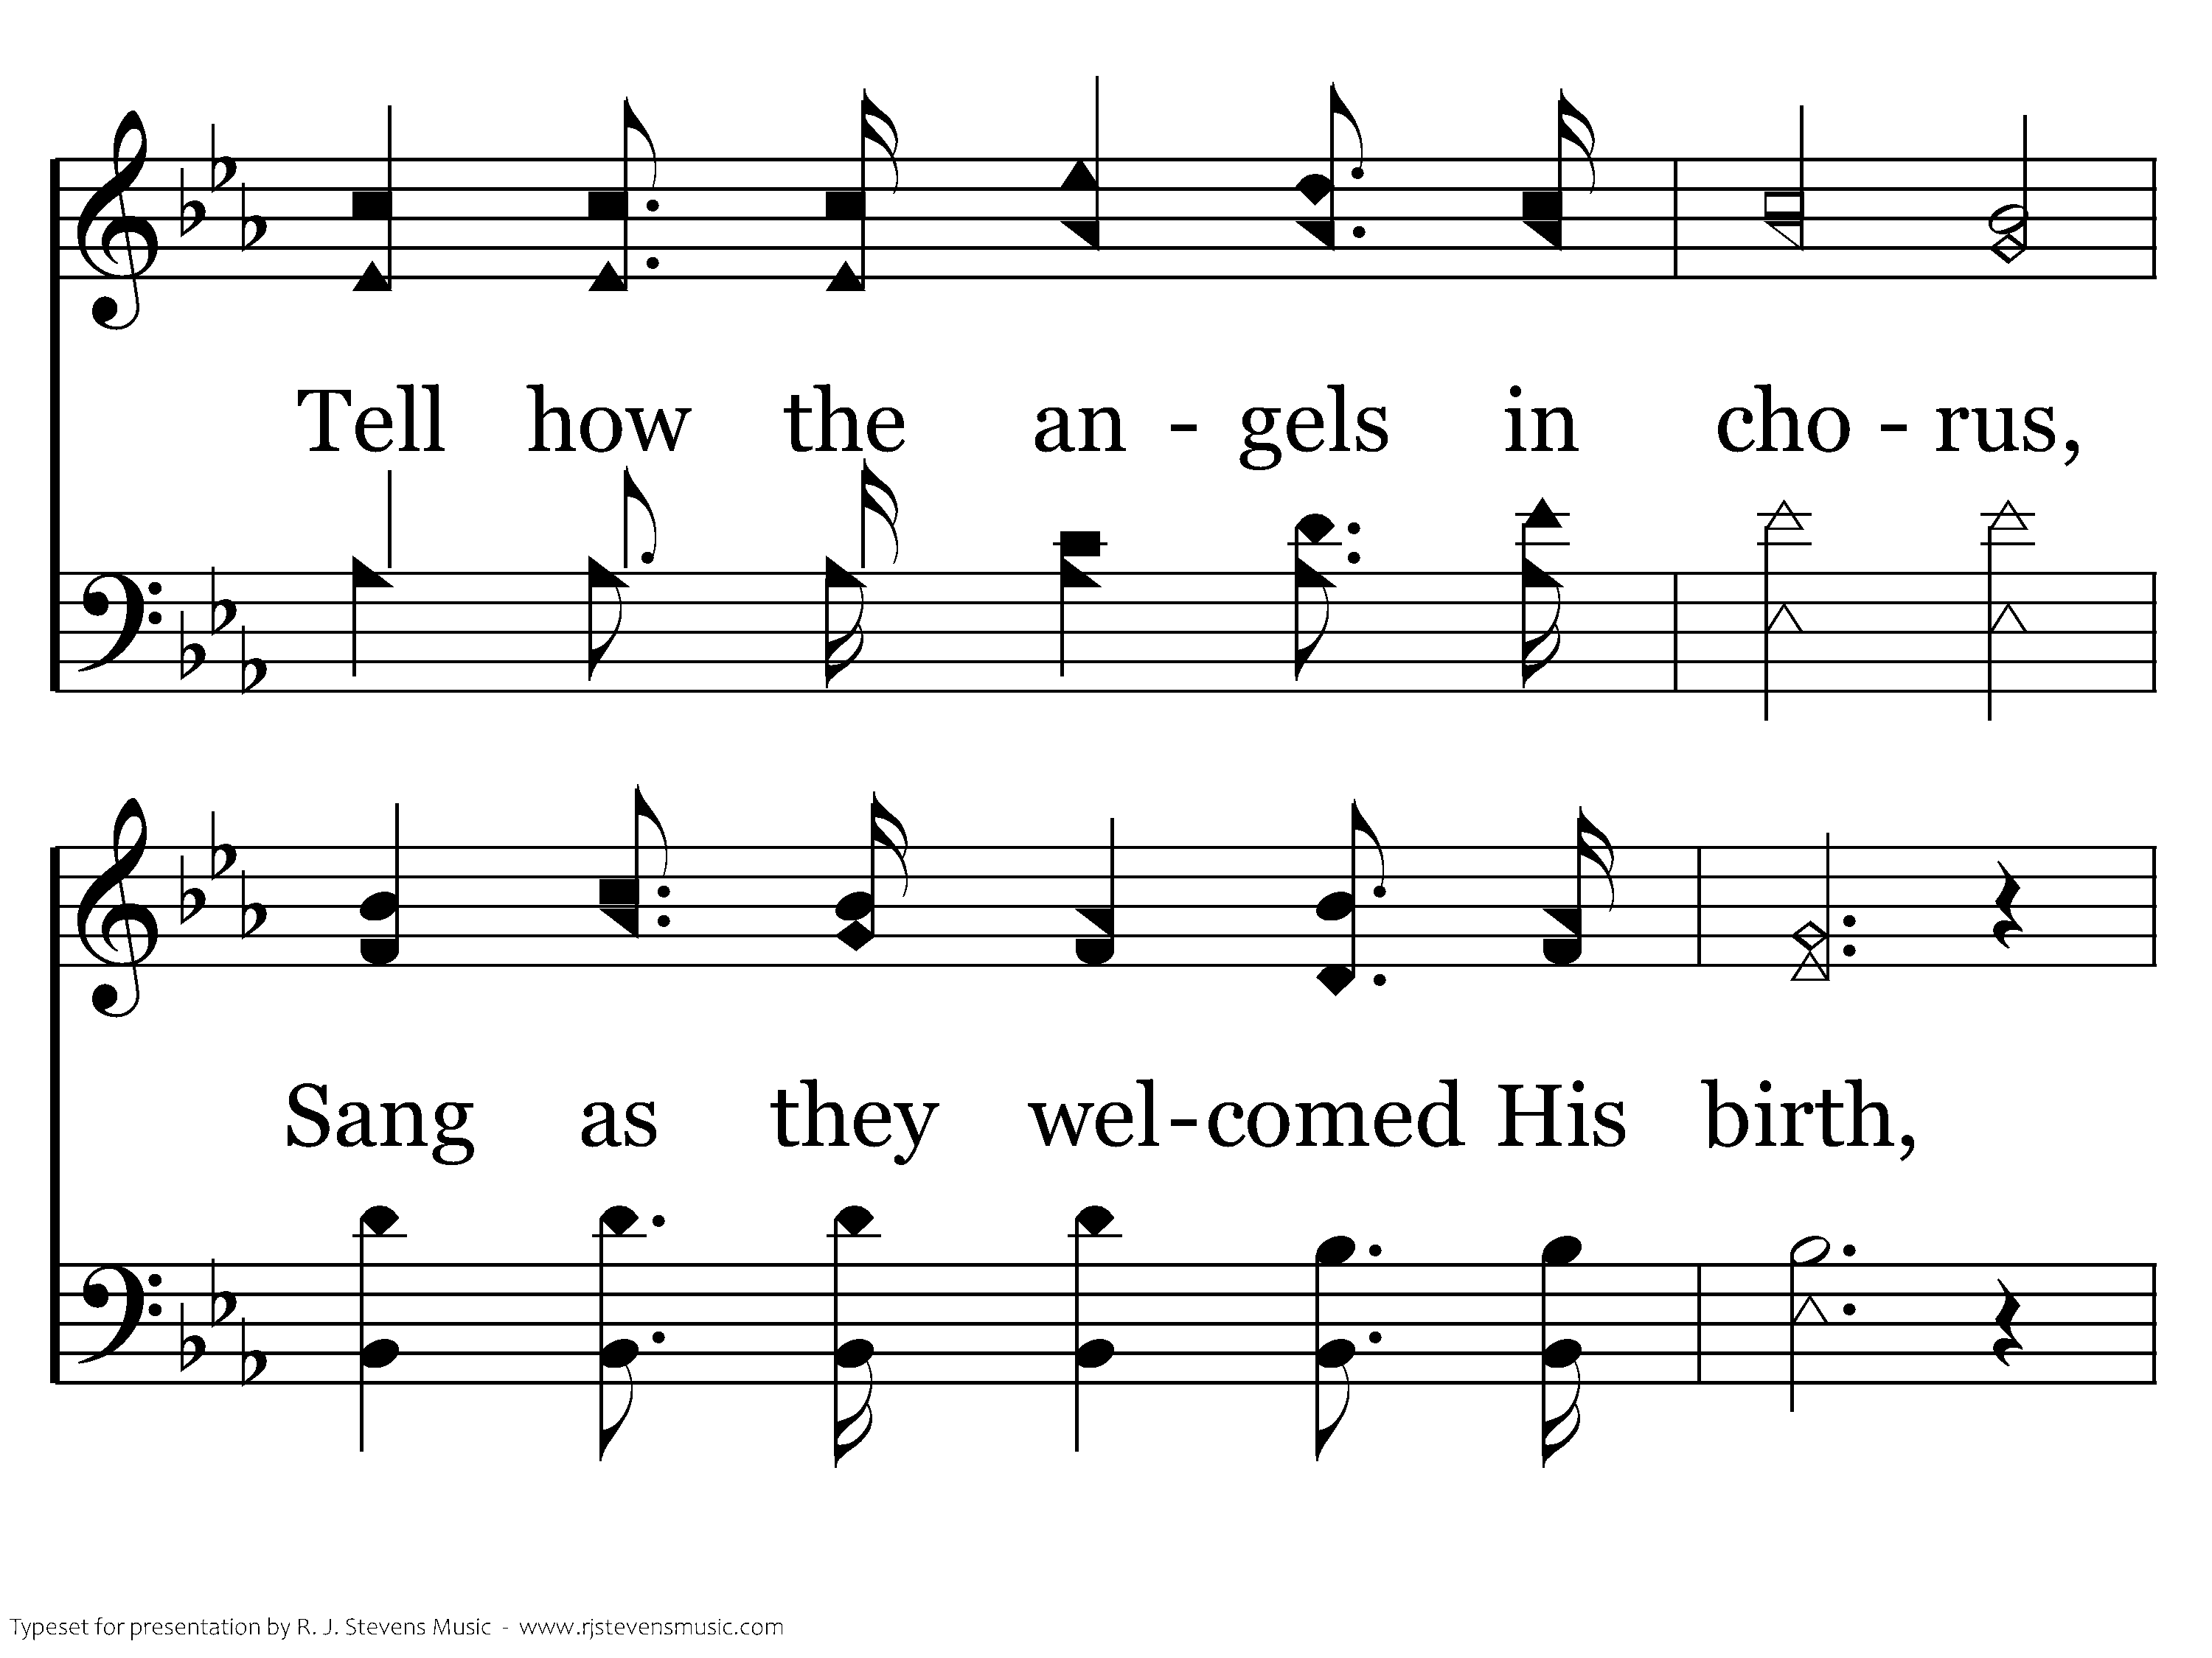
156 - Tell Me The Story Of Jesus - 1.3

Slide 14
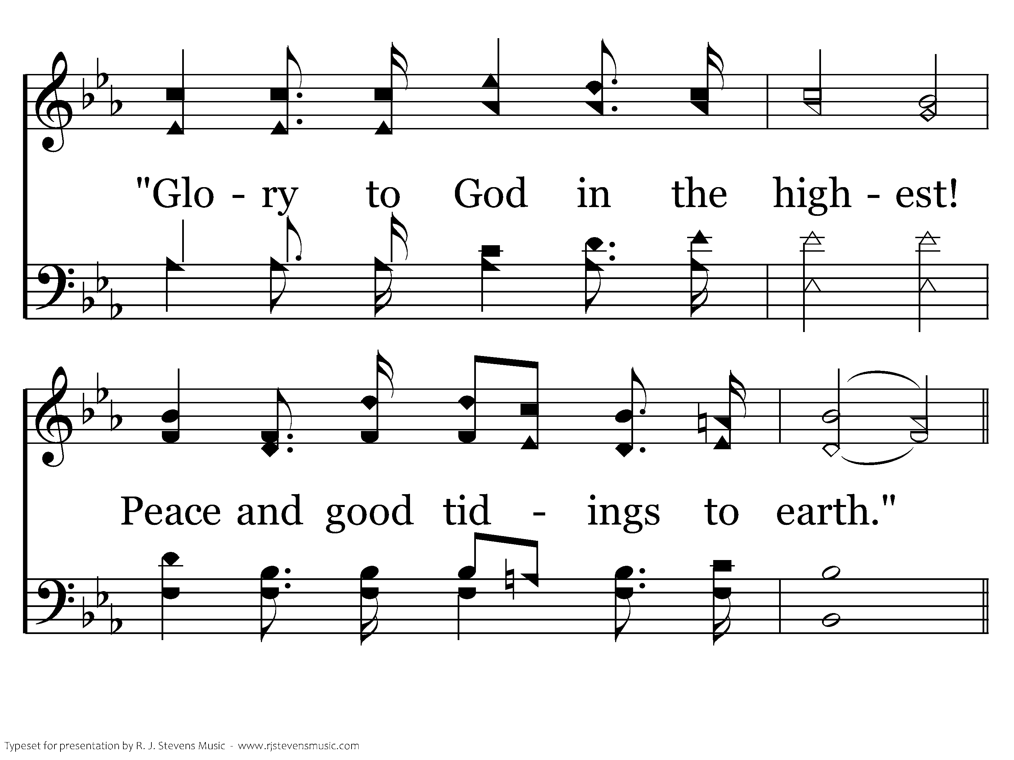
156 - Tell Me The Story Of Jesus - 1.4

Slide 15
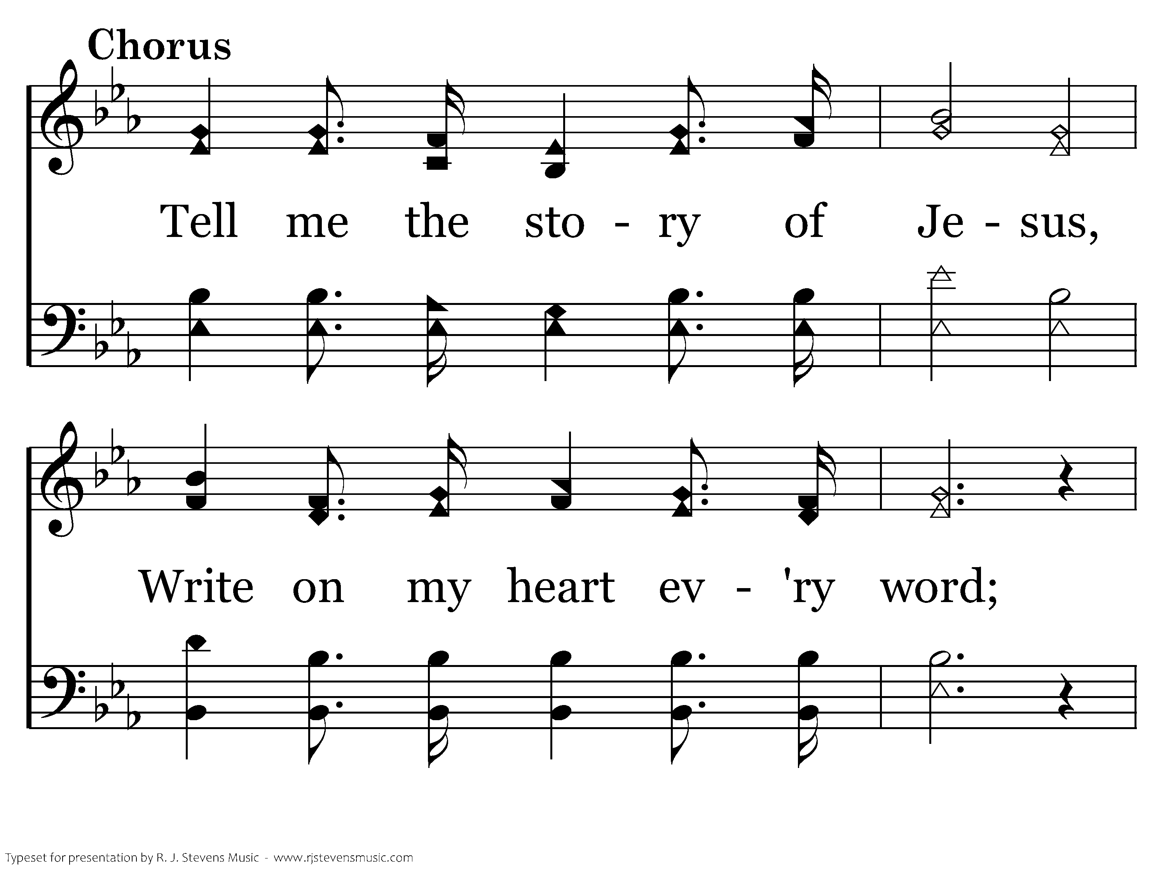
156 - Tell Me The Story Of Jesus - C.1

Slide 16
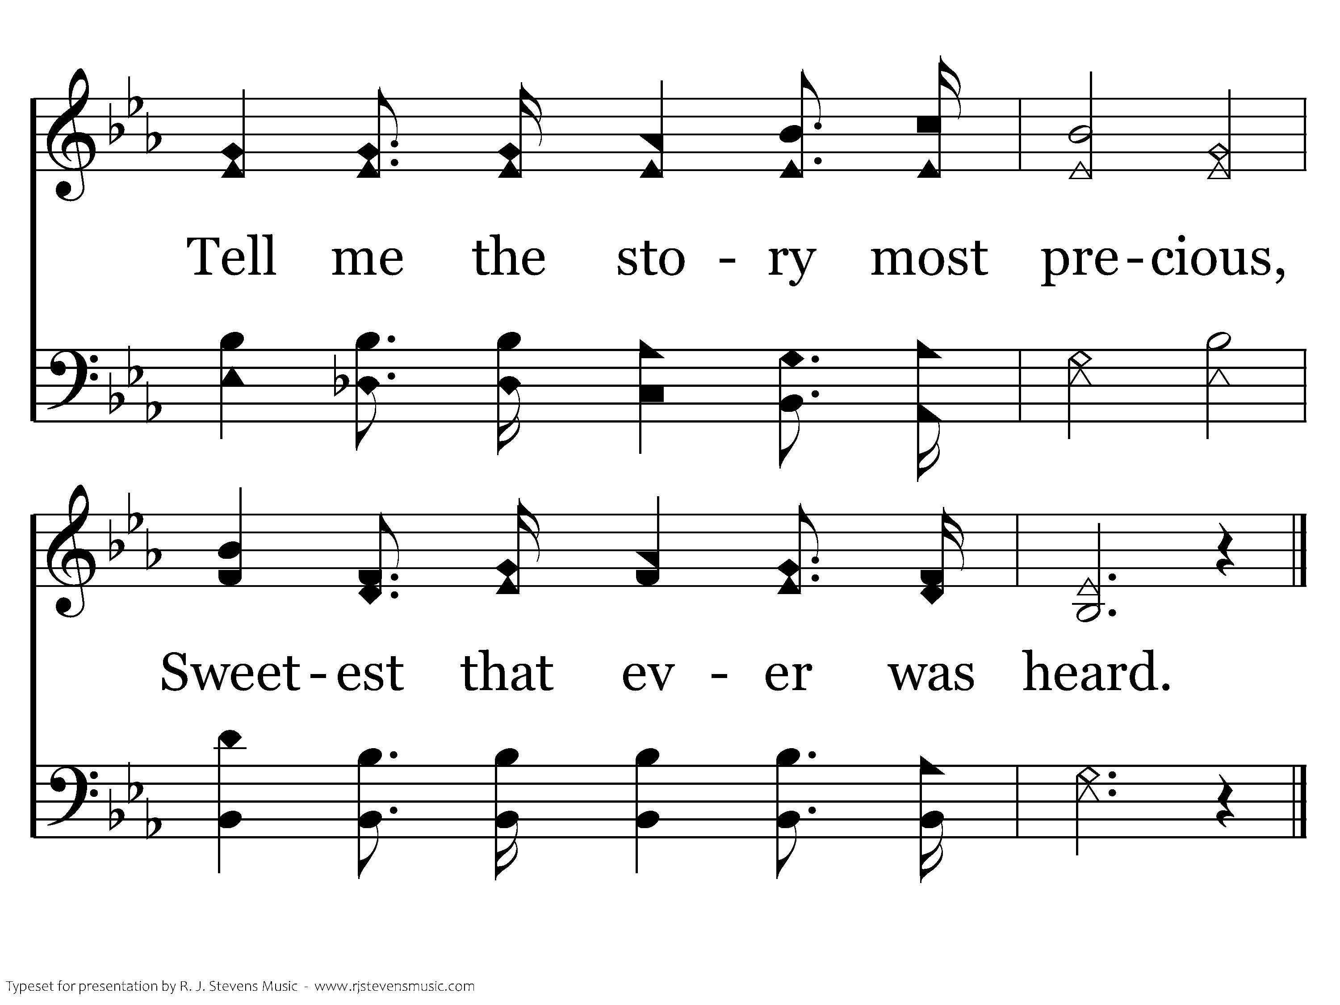
156 - Tell Me The Story Of Jesus - C.2
End of Verse 1

Slide 17
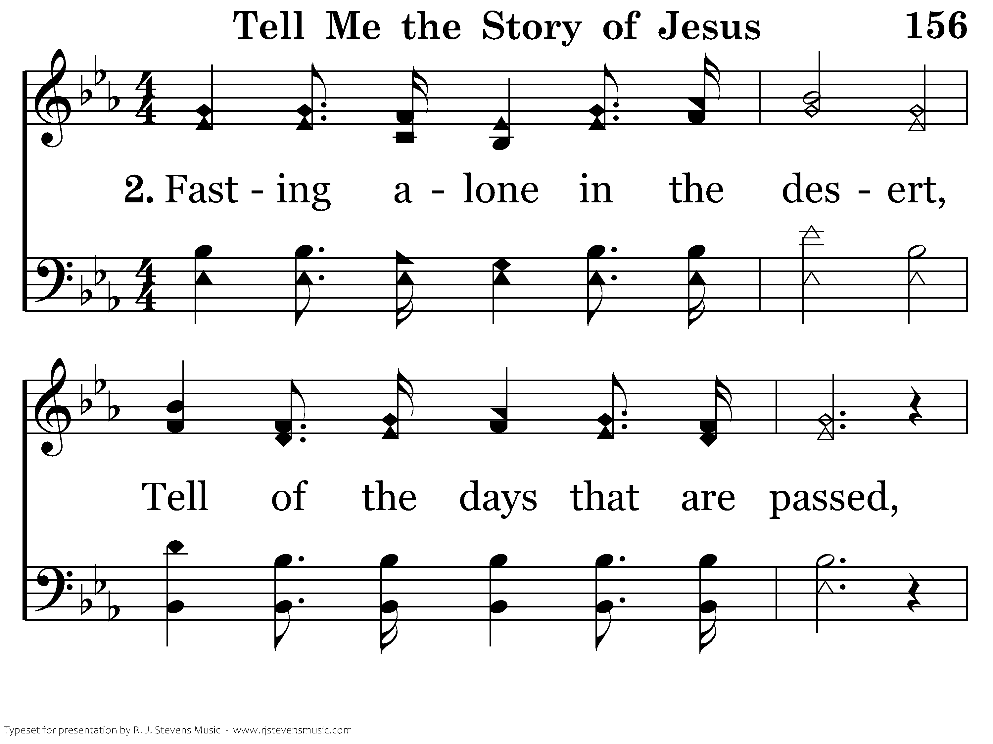
156 - Tell Me The Story Of Jesus - 2.1

Slide 18
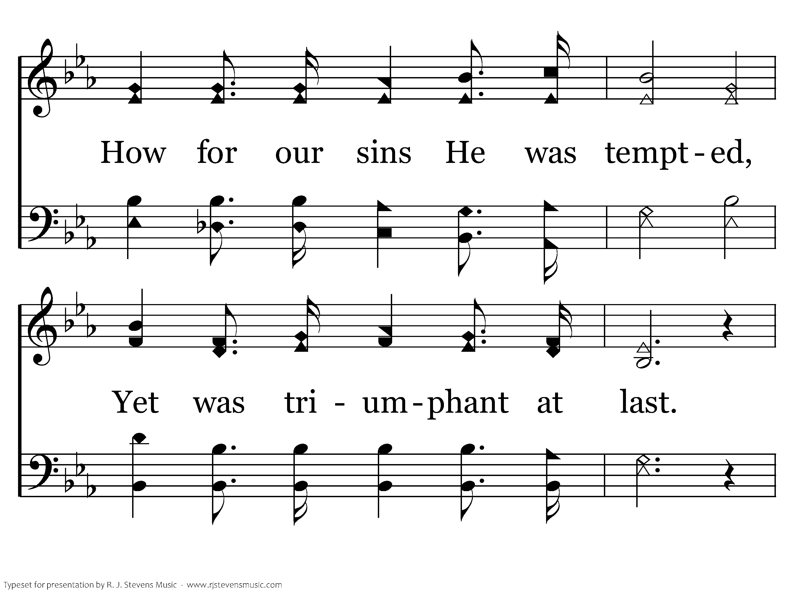
156 - Tell Me The Story Of Jesus - 2.2

Slide 19
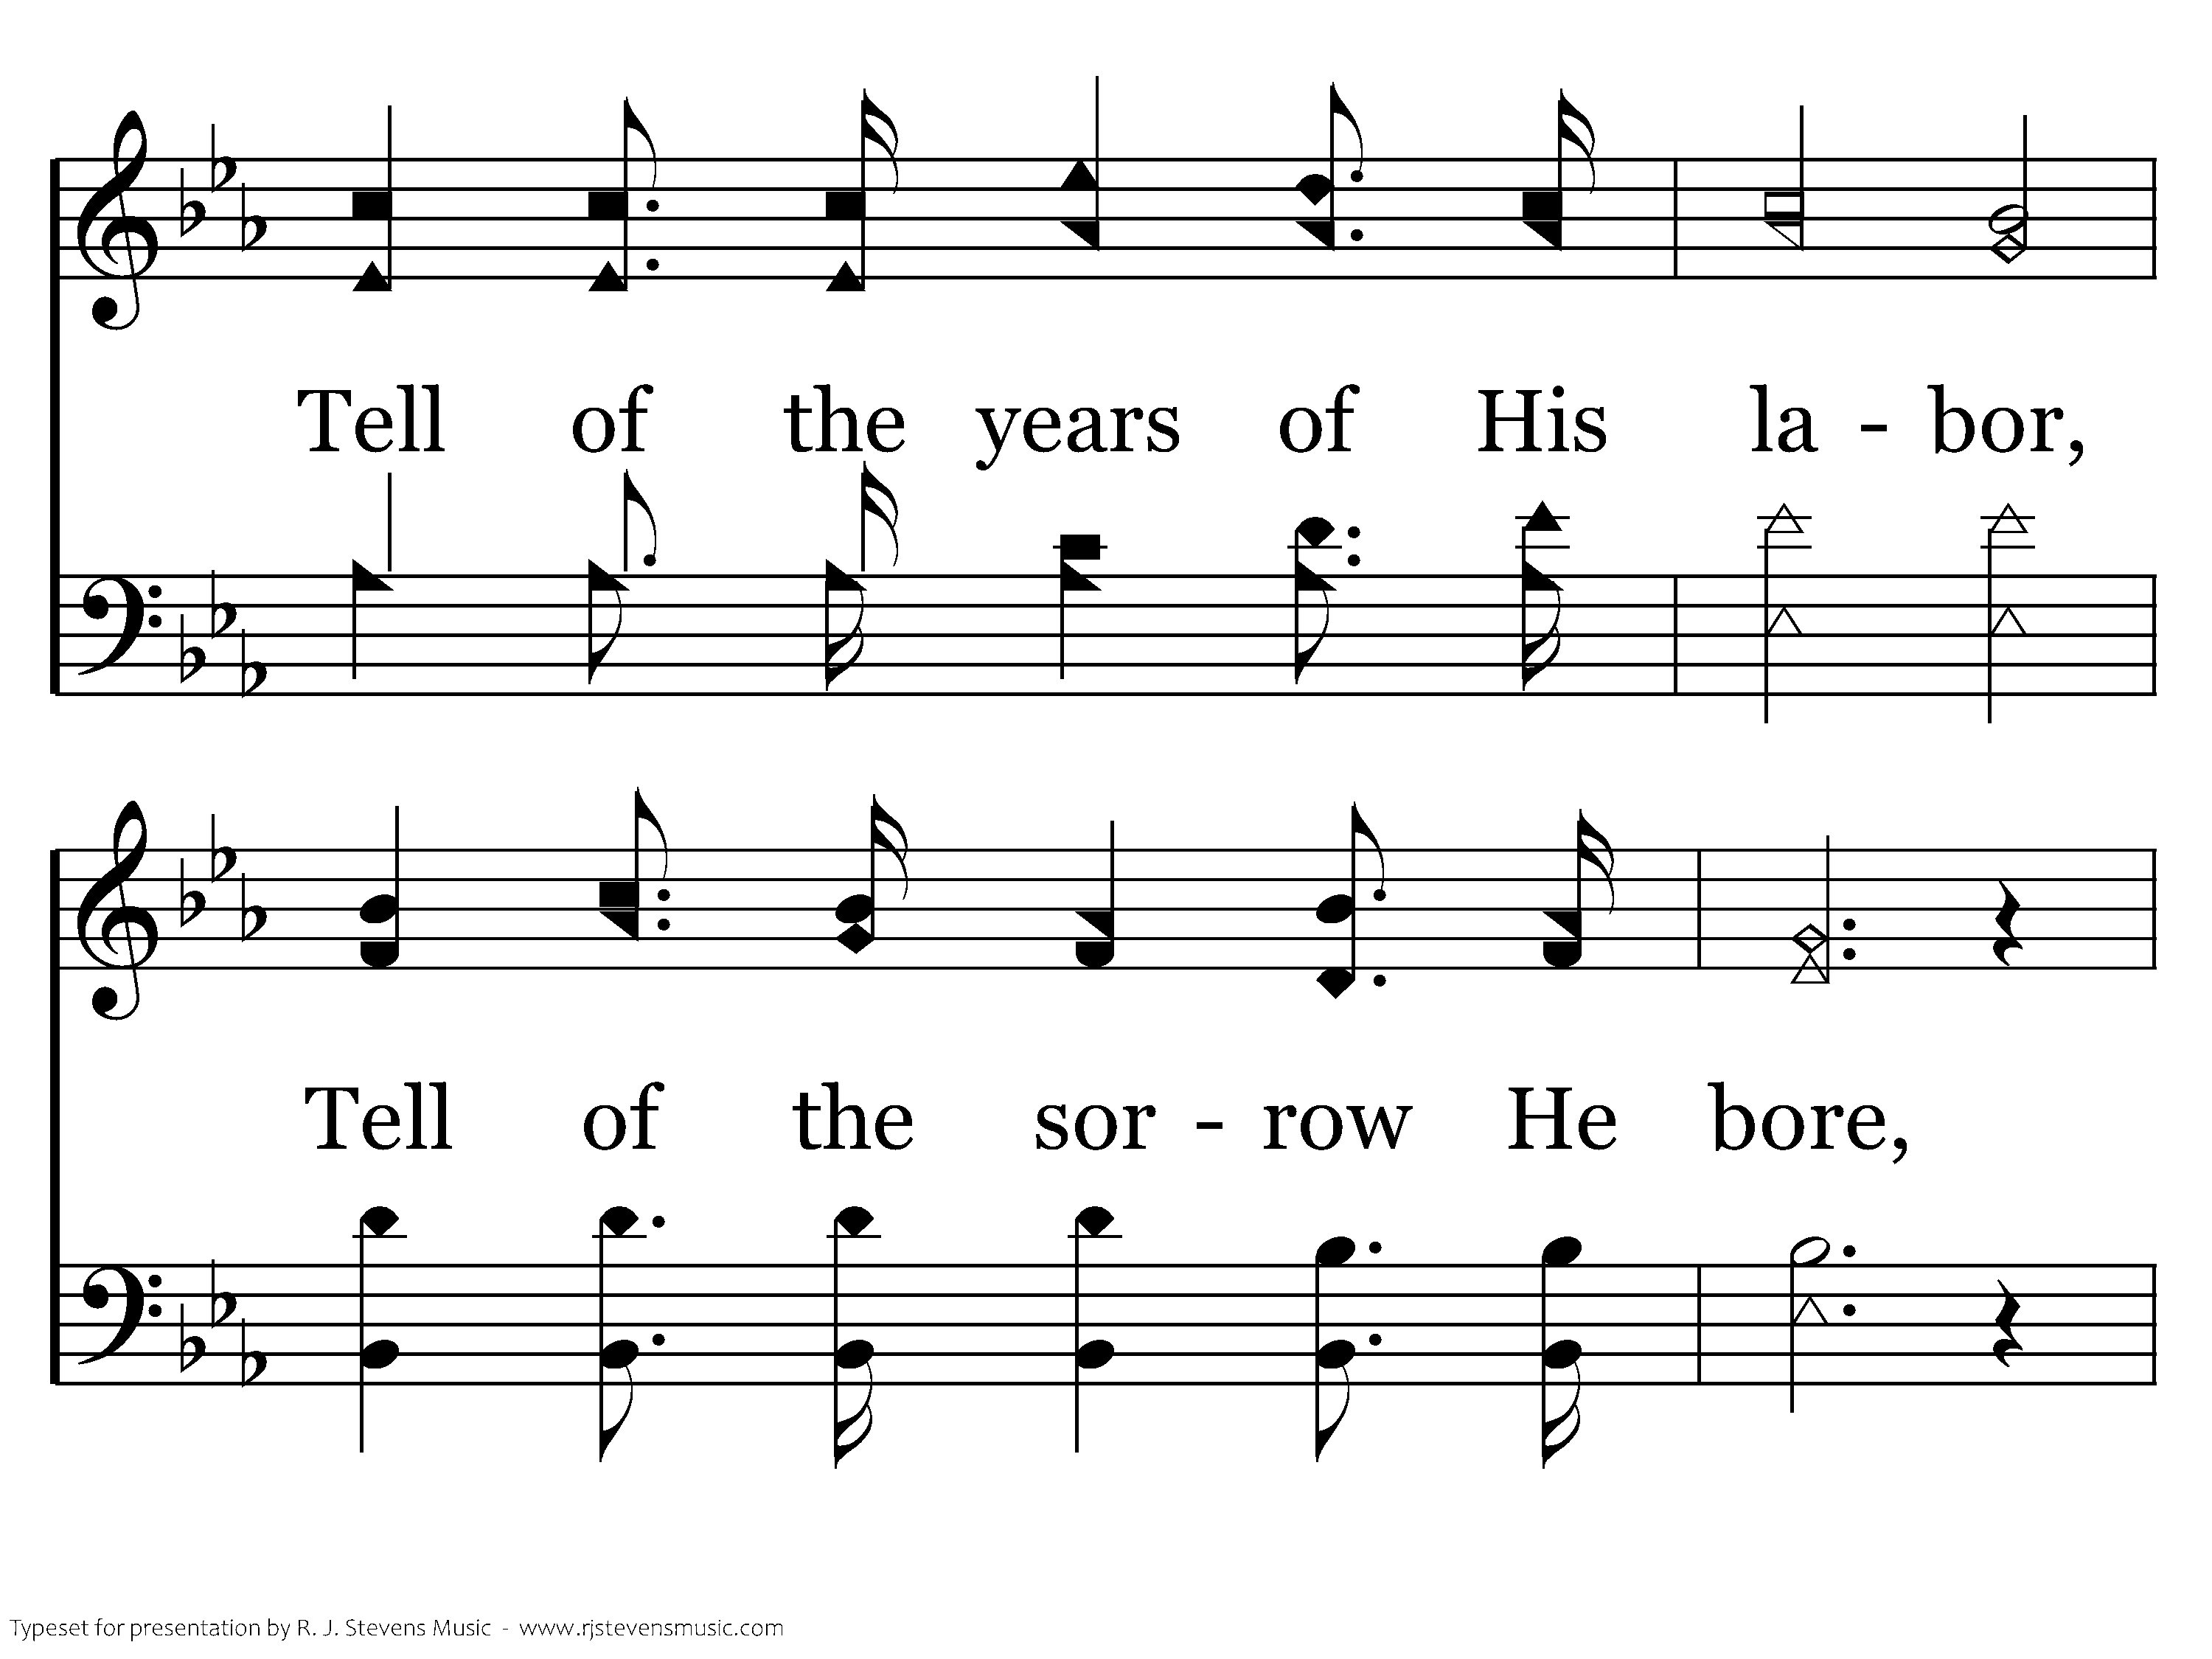
156 - Tell Me The Story Of Jesus - 2.3

Slide 20
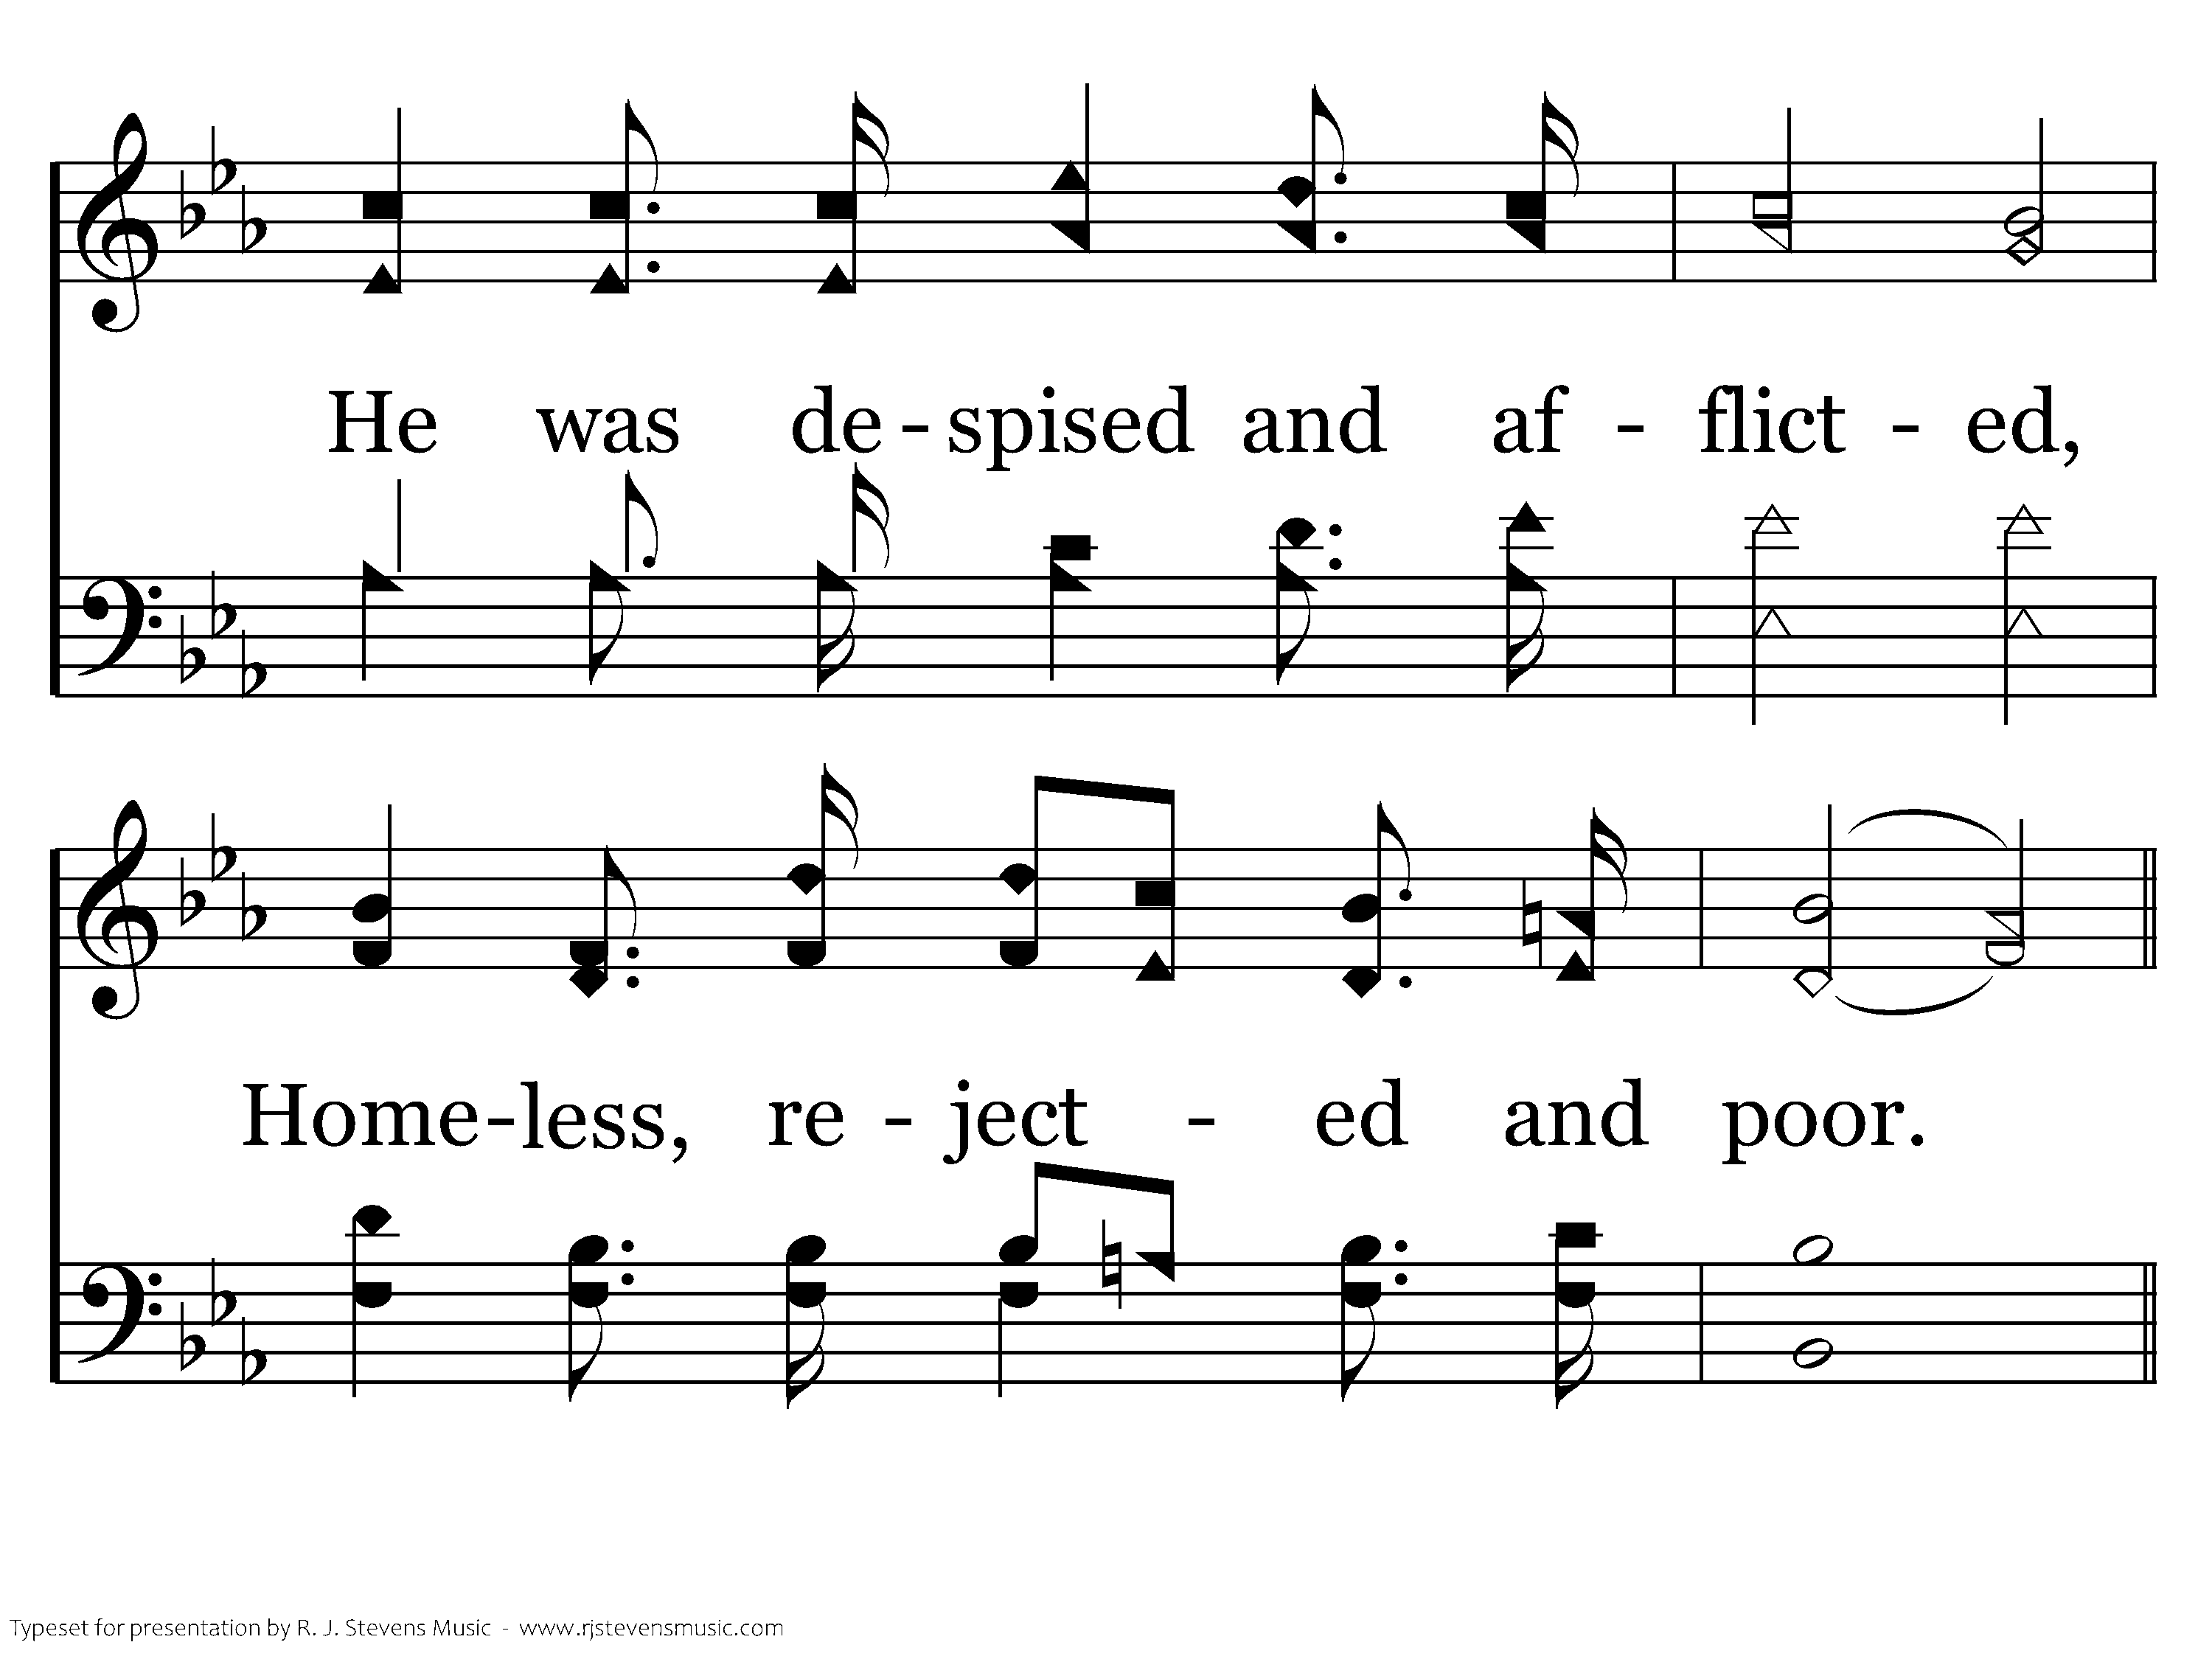
156 - Tell Me The Story Of Jesus - 2.4

Slide 21
156 - Tell Me The Story Of Jesus - C.1

Slide 22
156 - Tell Me The Story Of Jesus - C.2
End of Verse 2

Slide 23
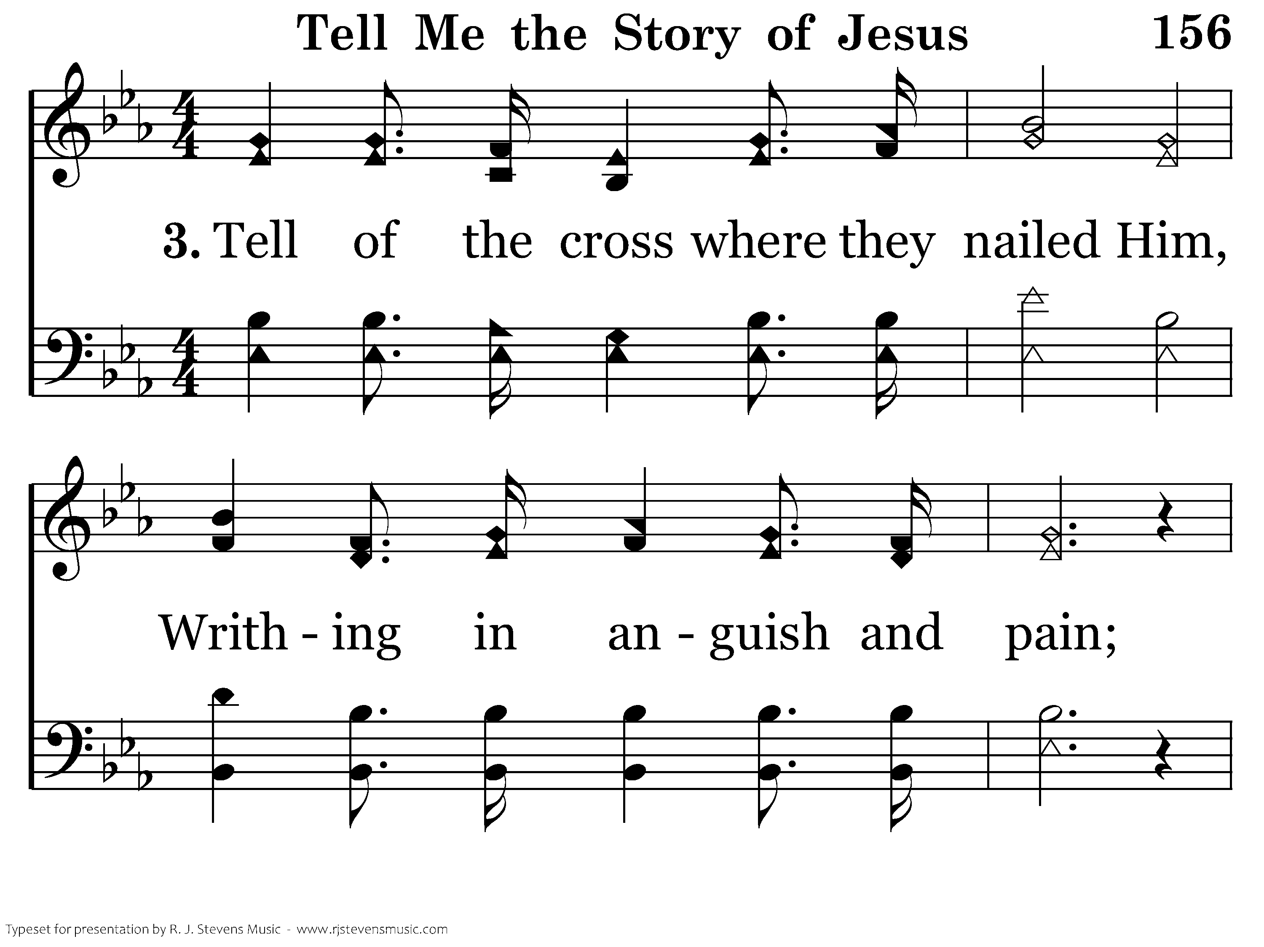
156 - Tell Me The Story Of Jesus - 3.1

Slide 24
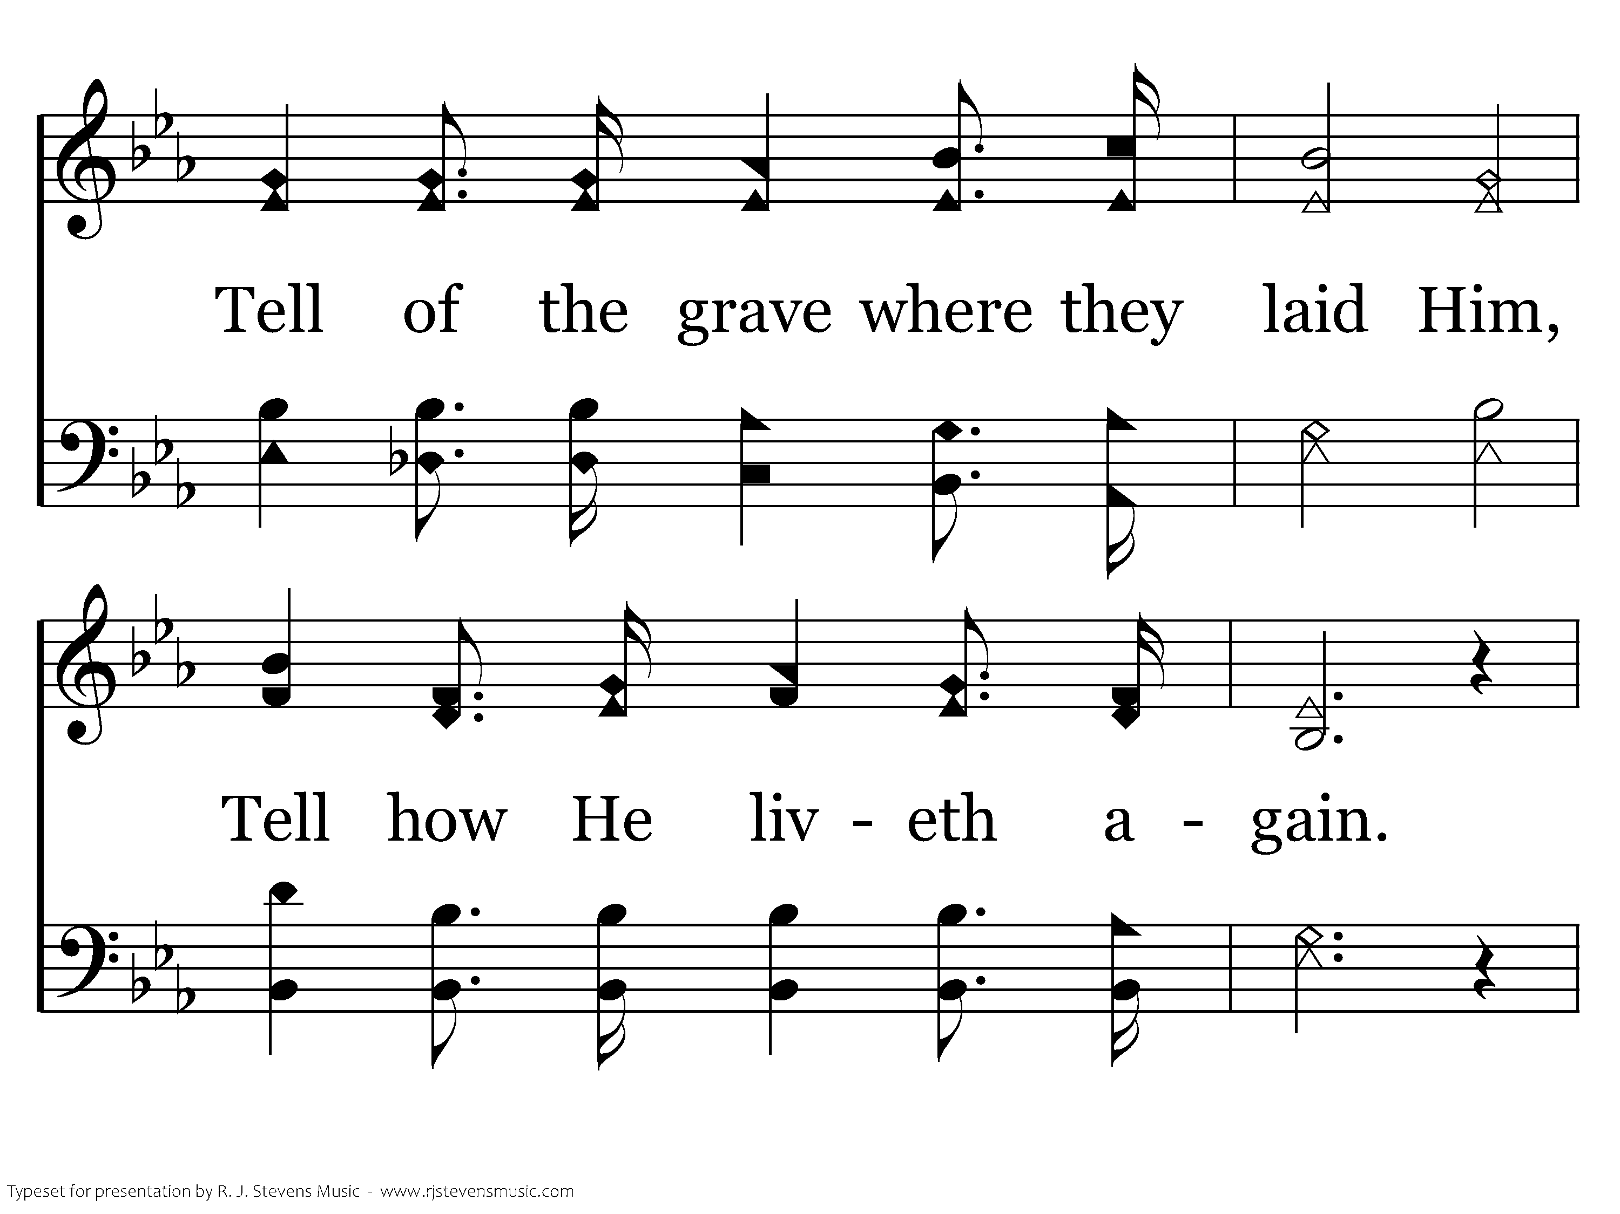
156 - Tell Me The Story Of Jesus - 3.2

Slide 25
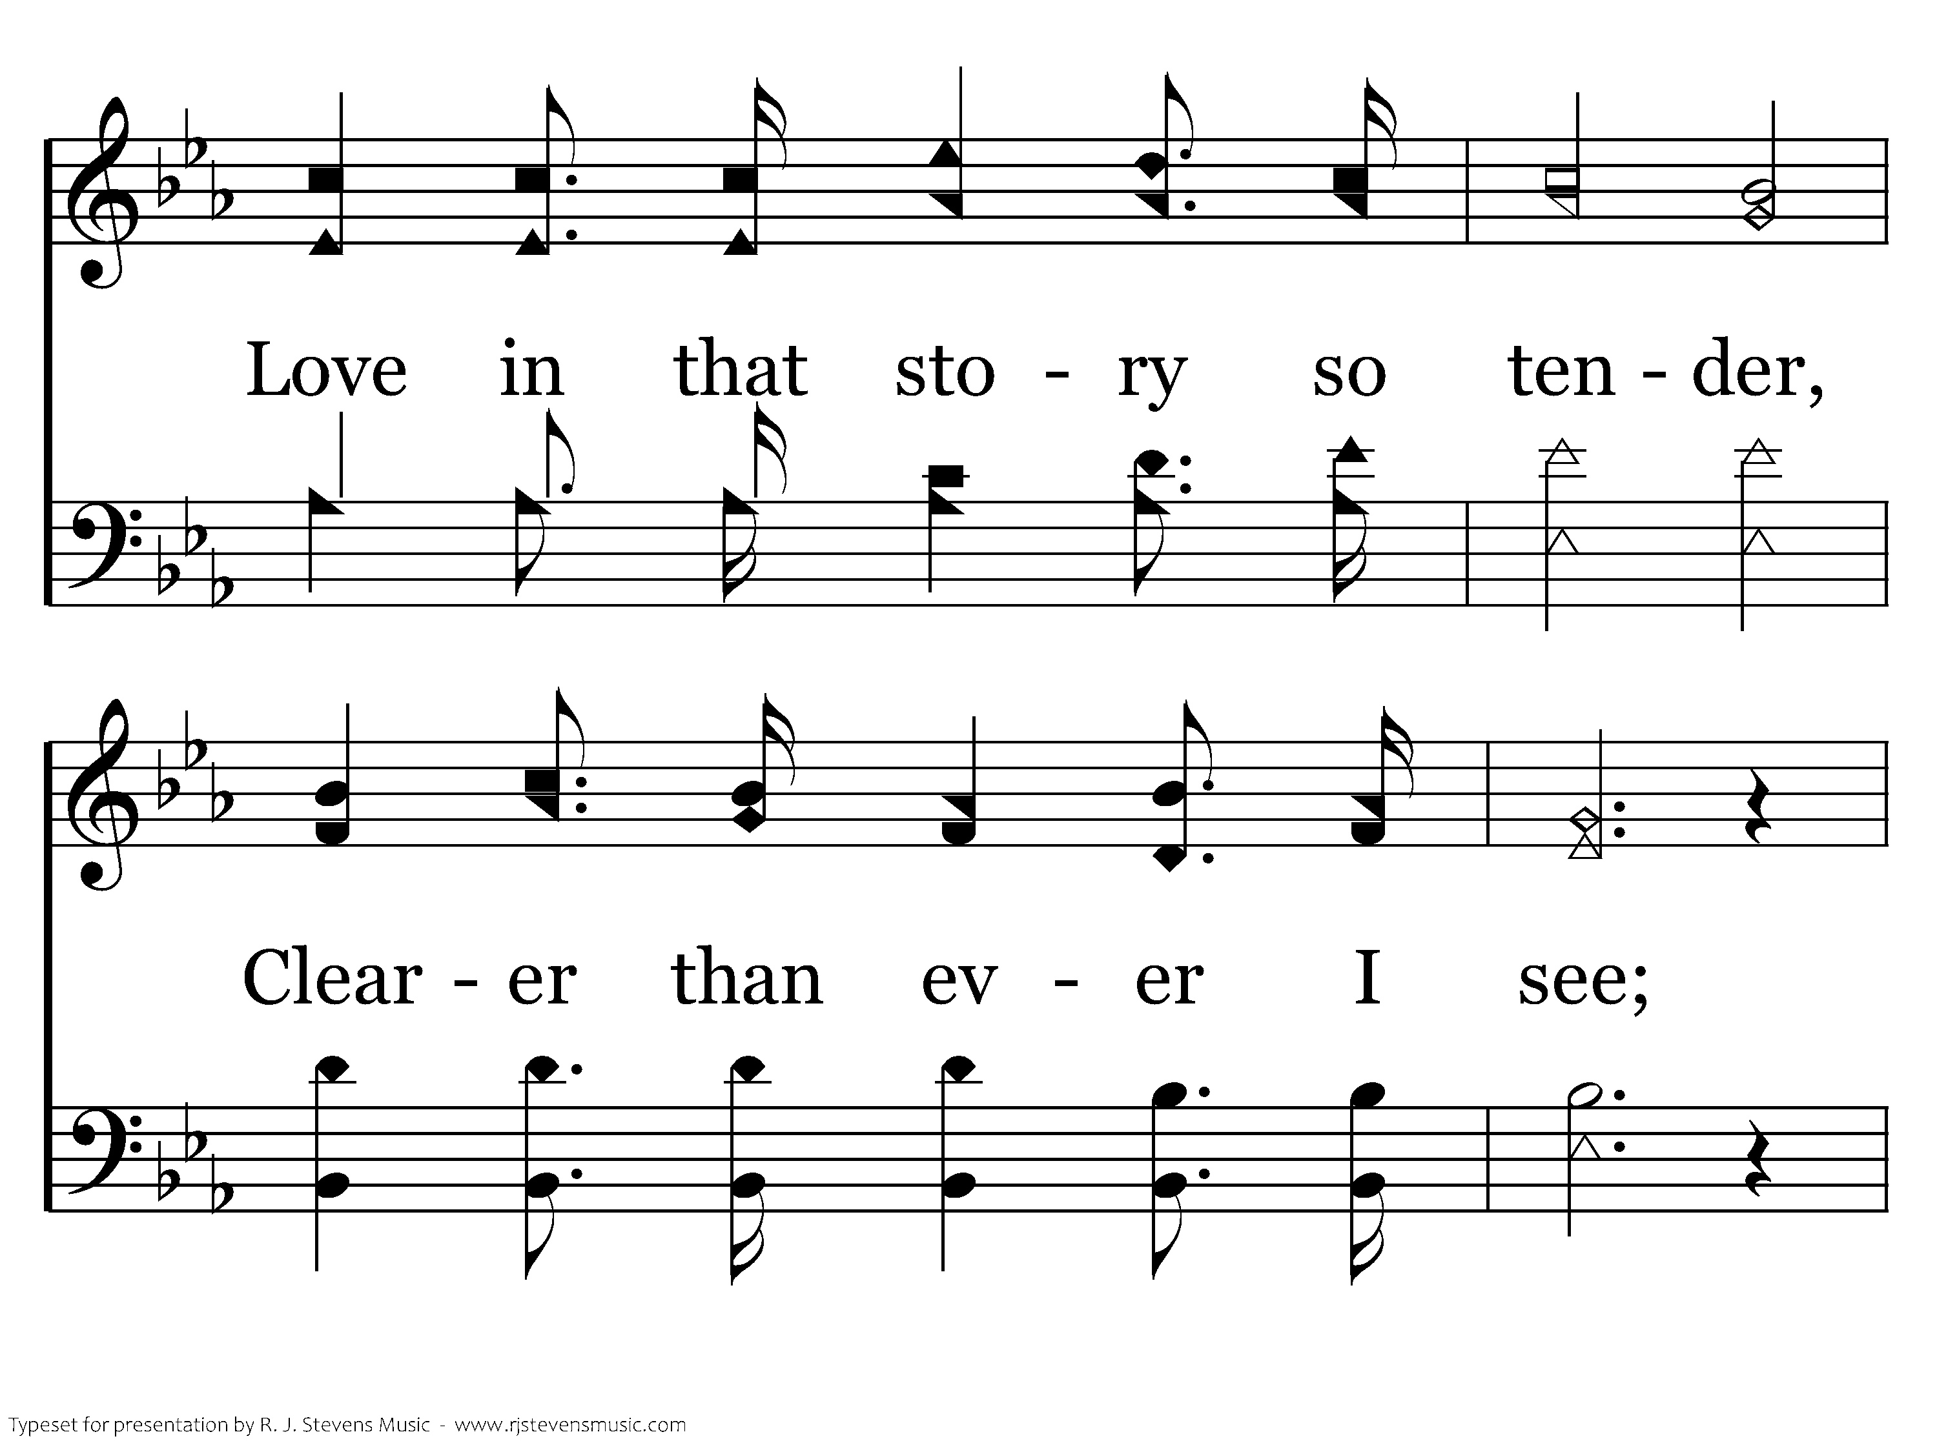
156 - Tell Me The Story Of Jesus - 3.3

Slide 26
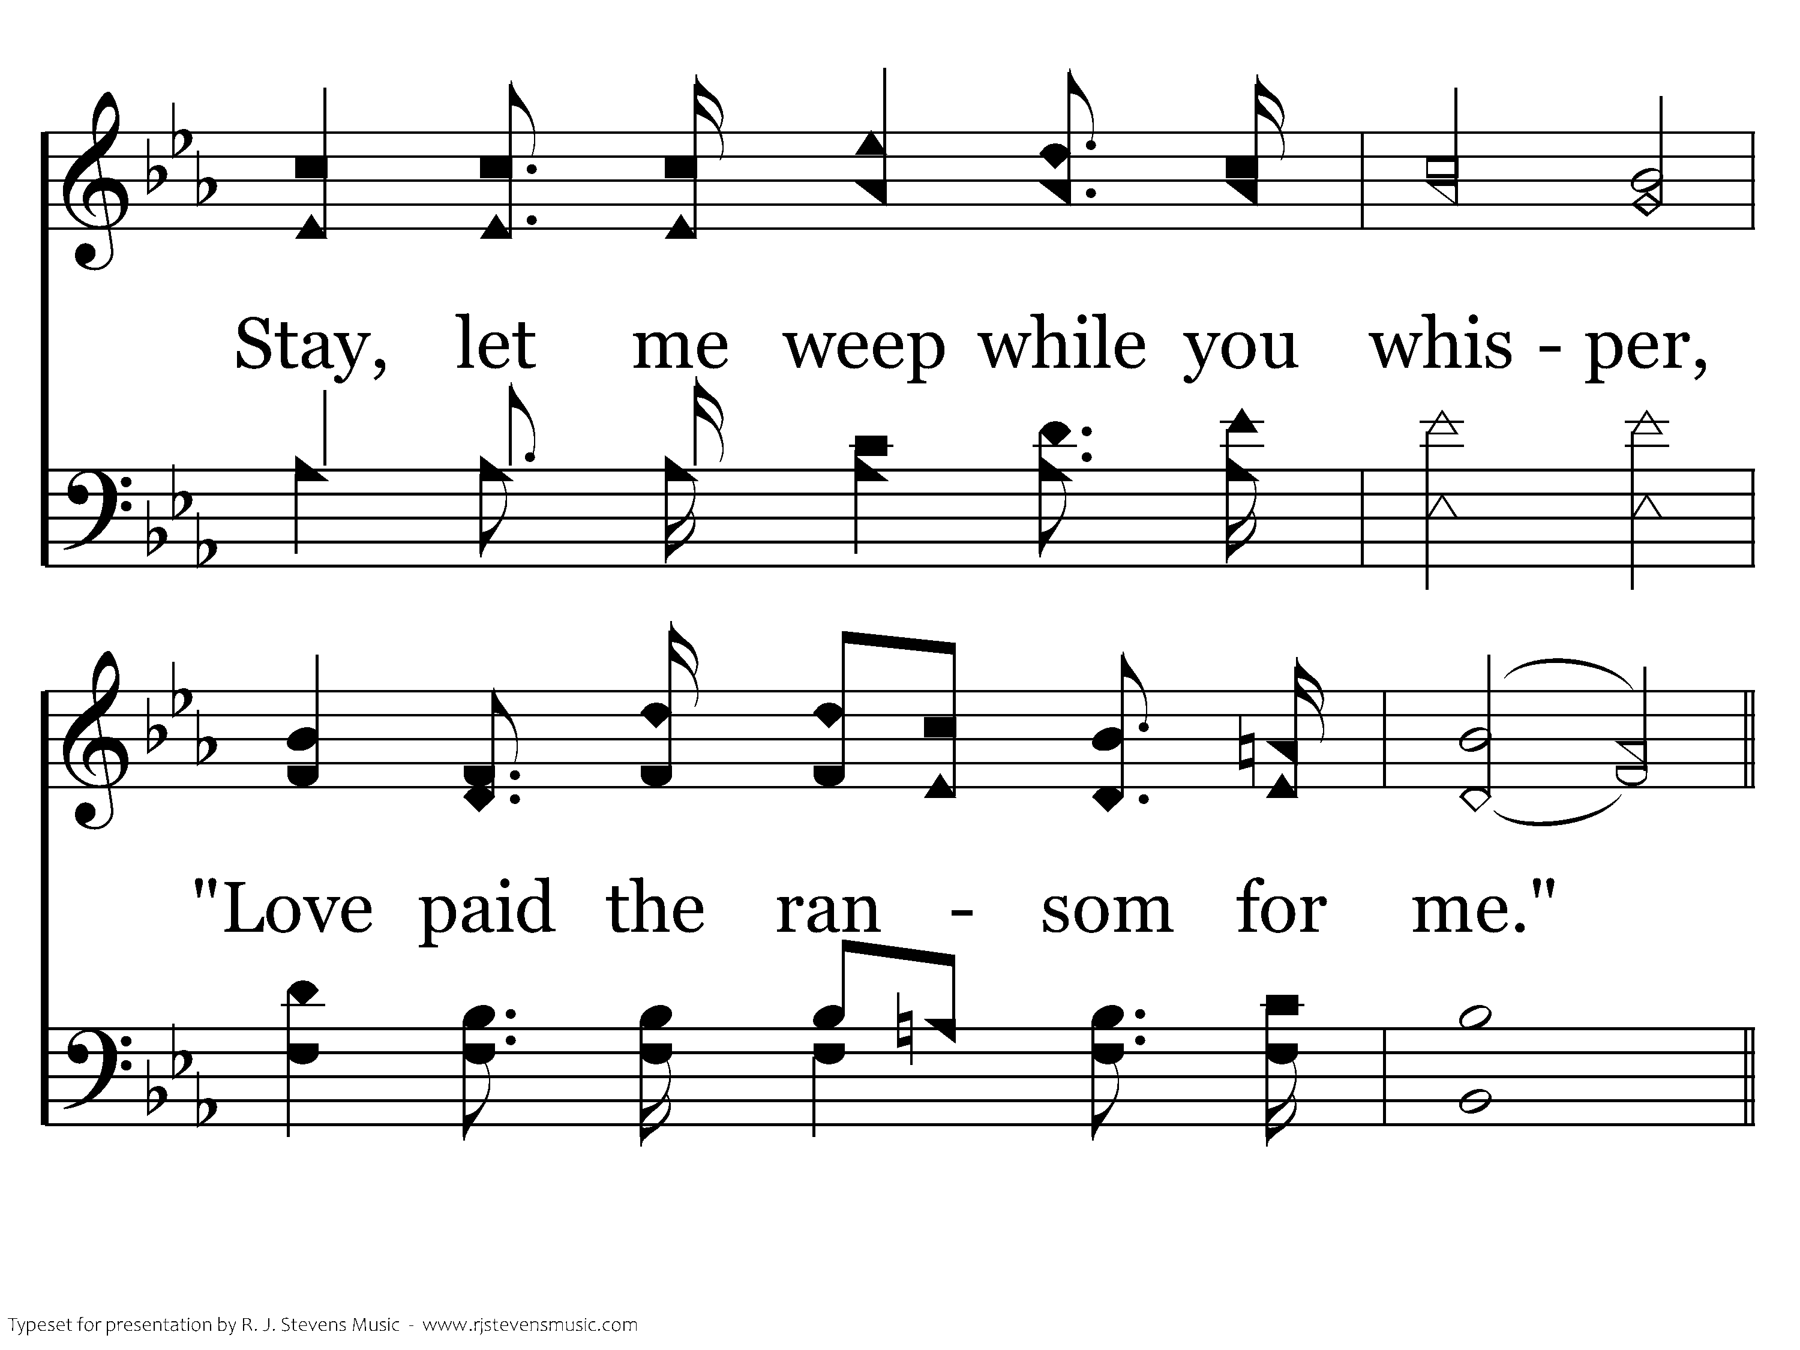
156 - Tell Me The Story Of Jesus - 3.4

Slide 27
156 - Tell Me The Story Of Jesus - C.1

Slide 28
156 - Tell Me The Story Of Jesus - C.2
End of Song

Slide 30
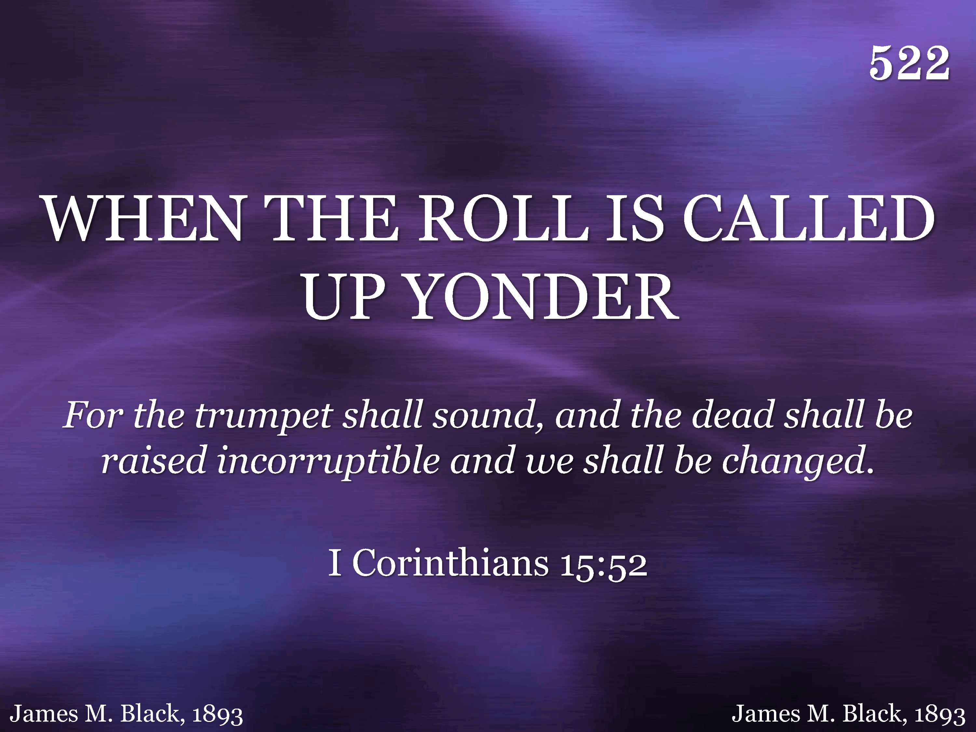
522 - When The Roll Is Called Up Yonder - Title

Slide 31
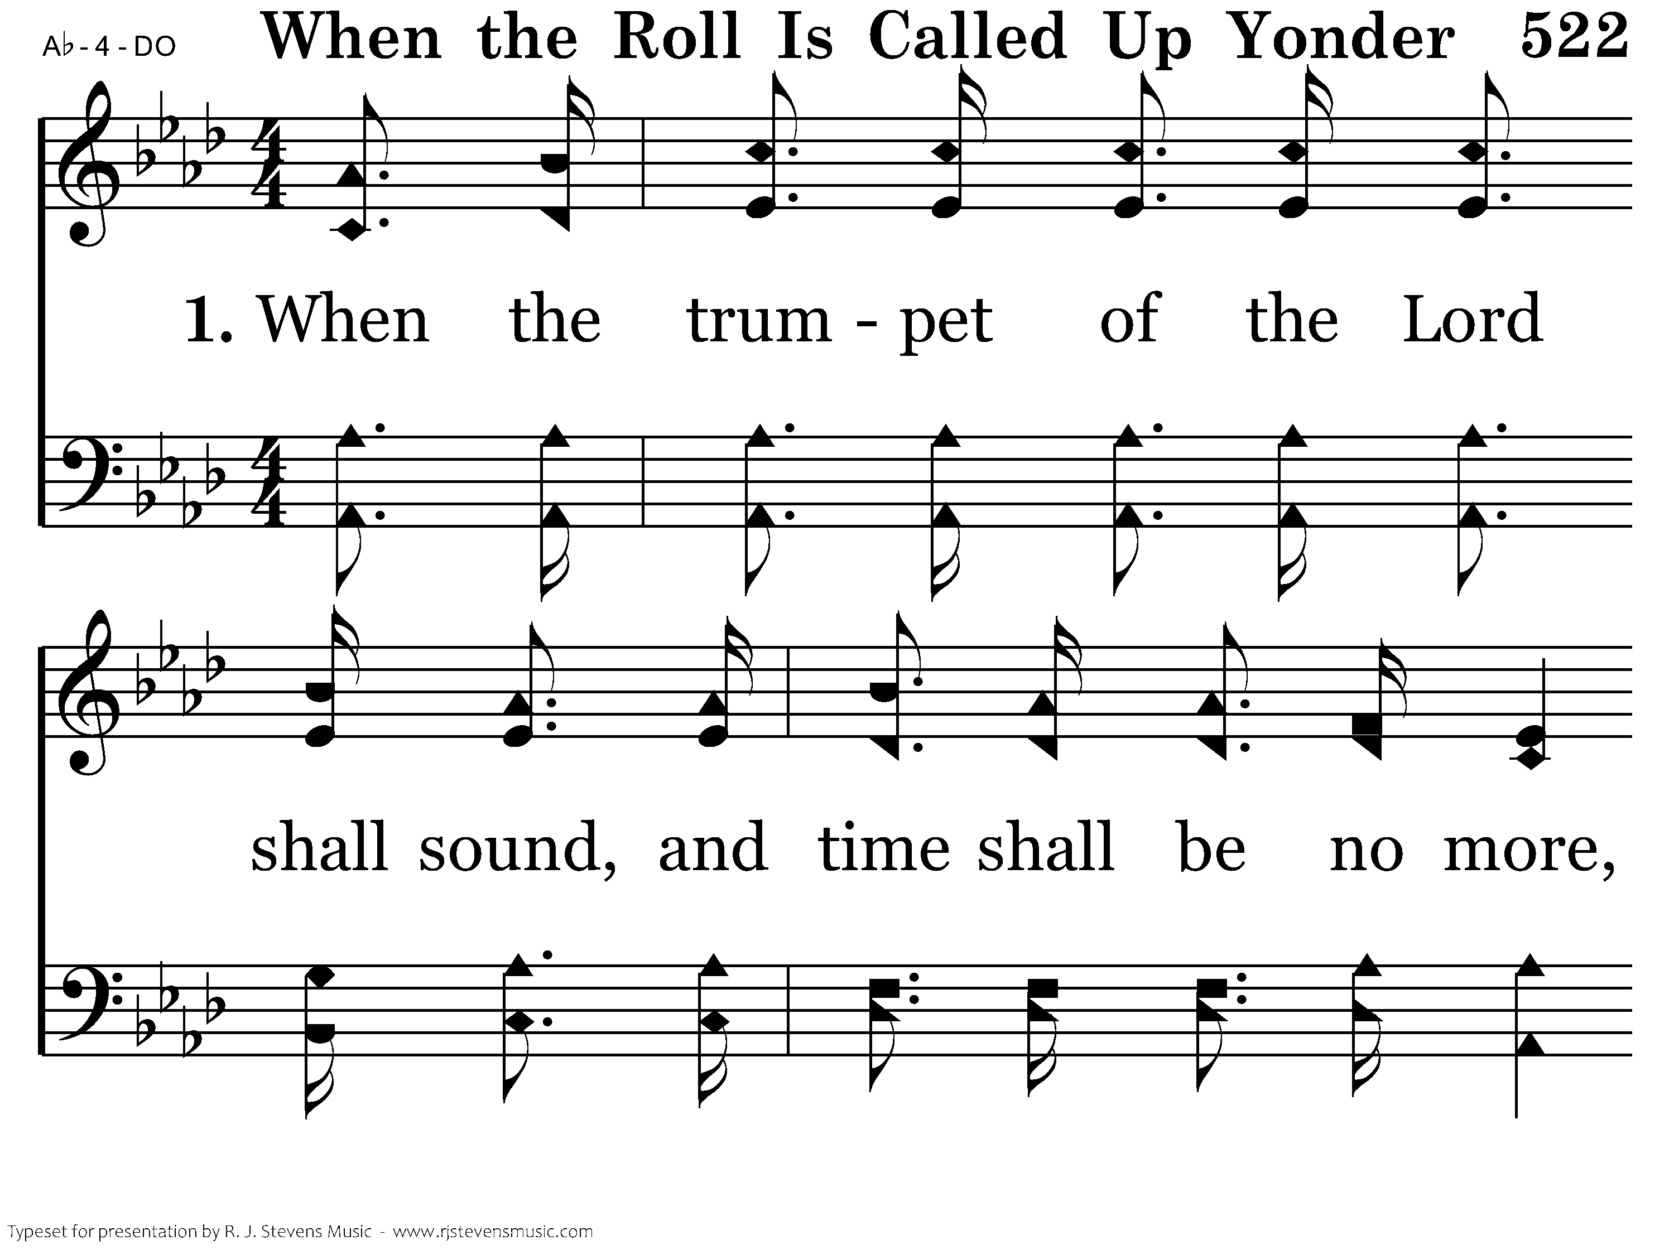
522 - When The Roll Is Called Up Yonder - 1.1

Slide 32
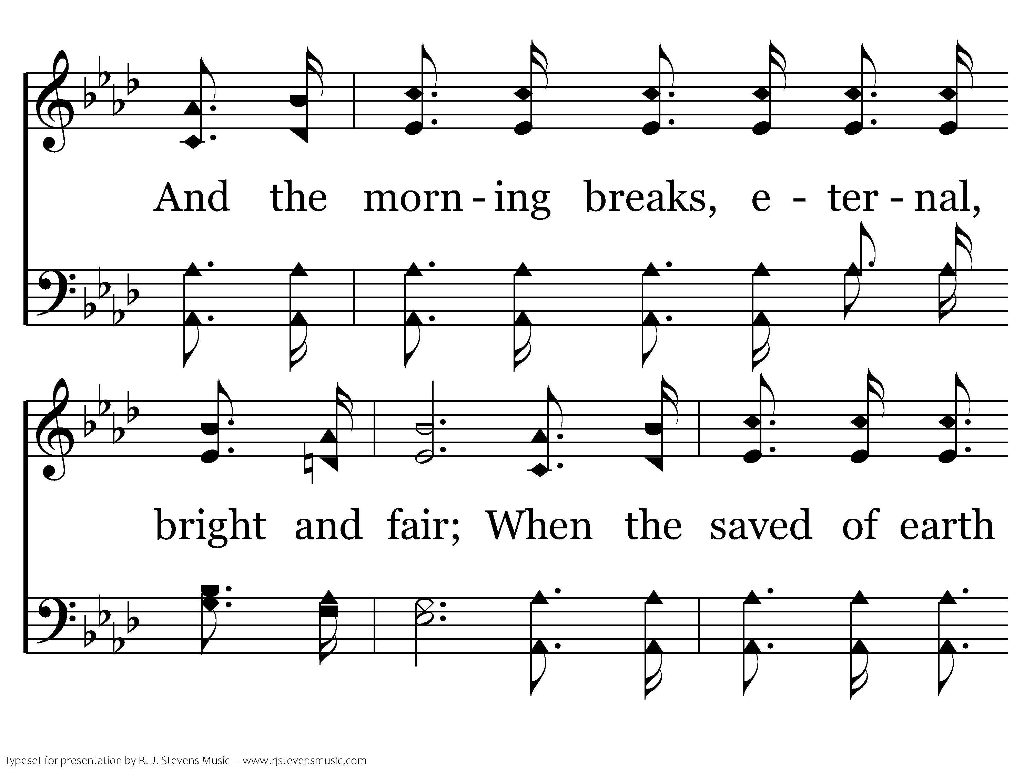
522 - When The Roll Is Called Up Yonder - 1.2

Slide 33
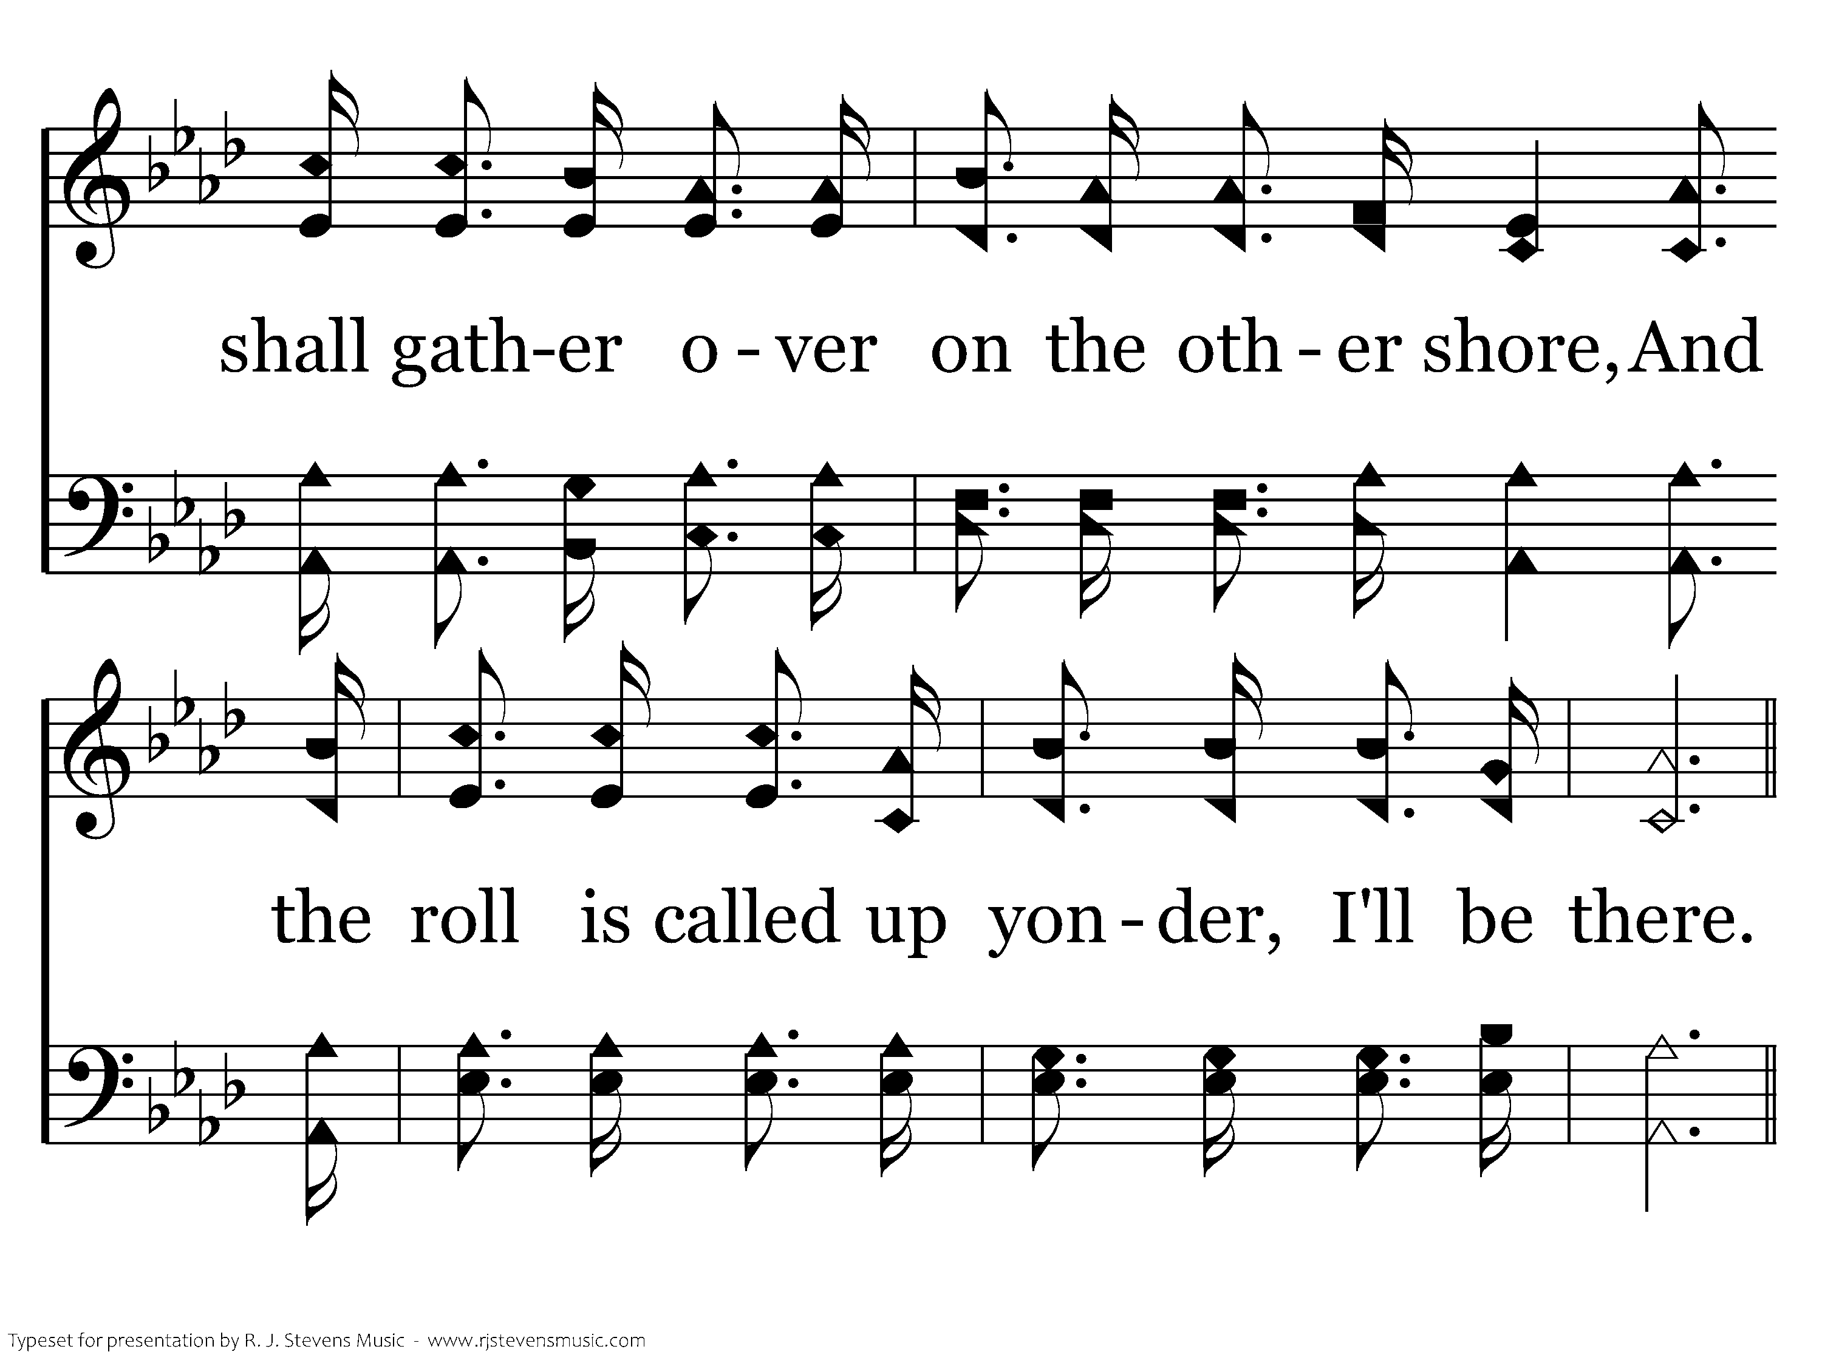
522 - When The Roll Is Called Up Yonder - 1.3

Slide 34
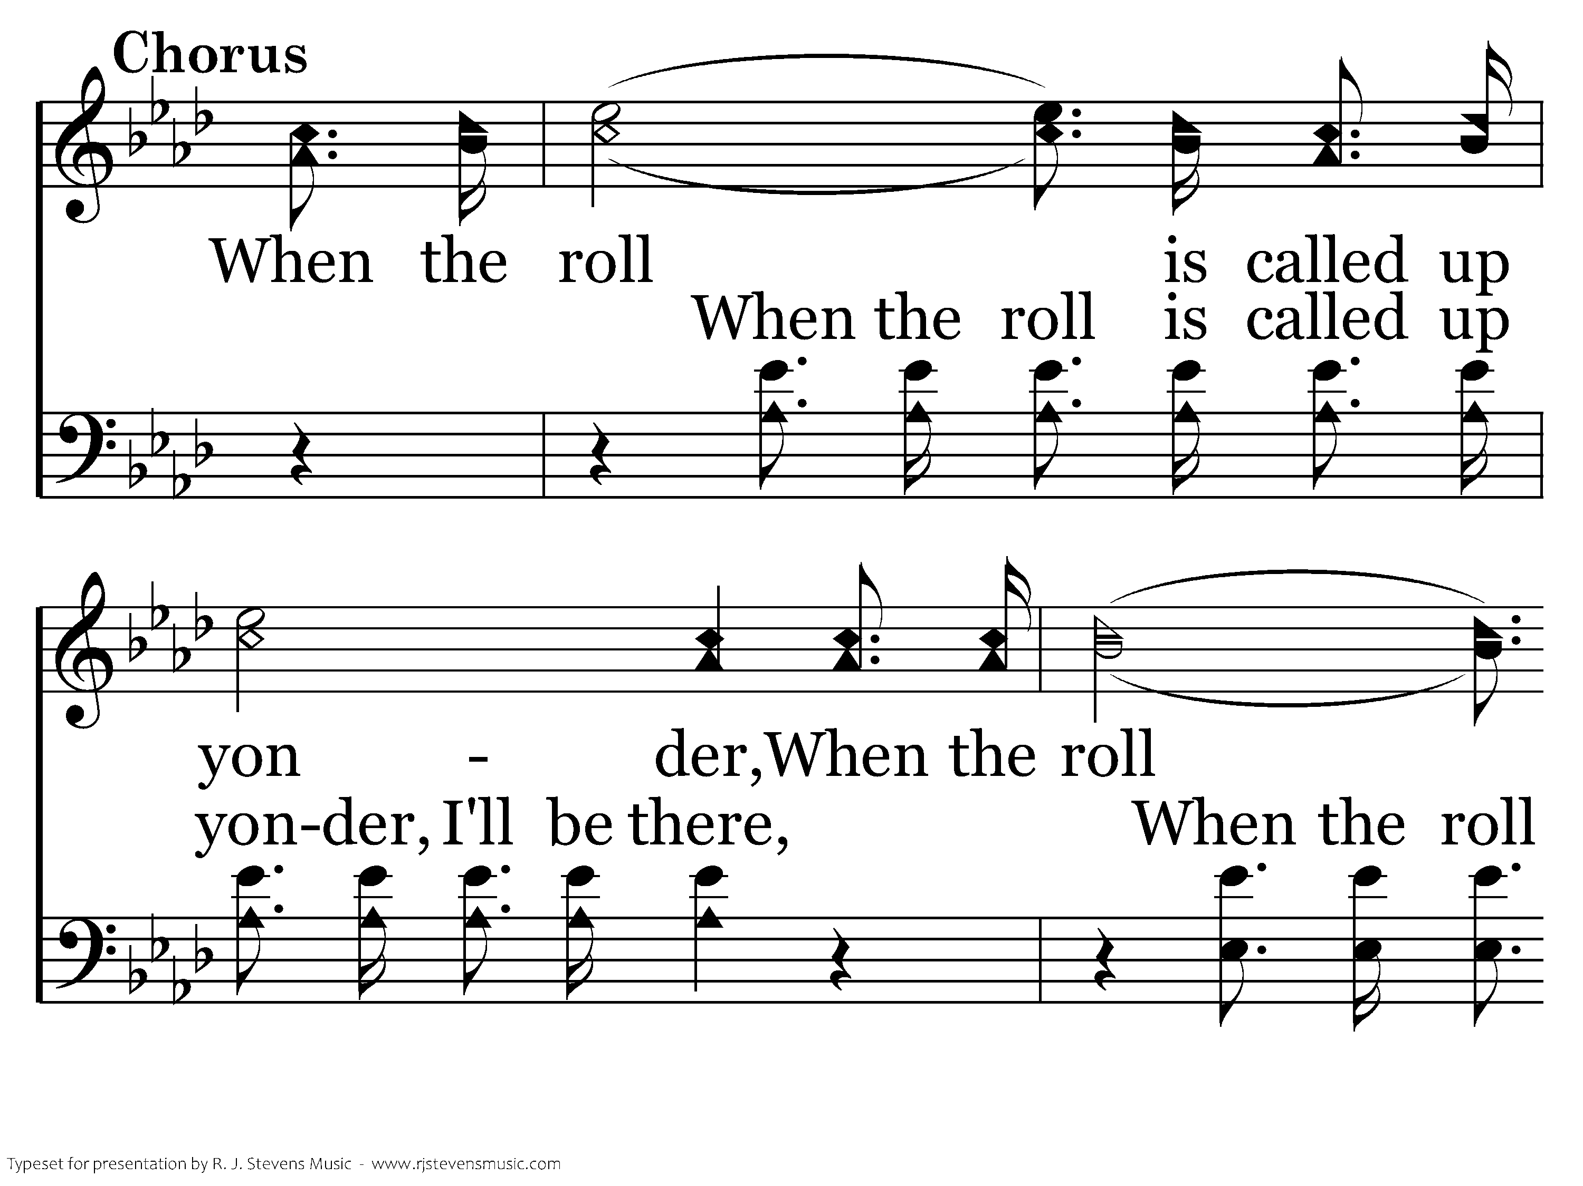
522 - When The Roll Is Called Up Yonder - C.1

Slide 35
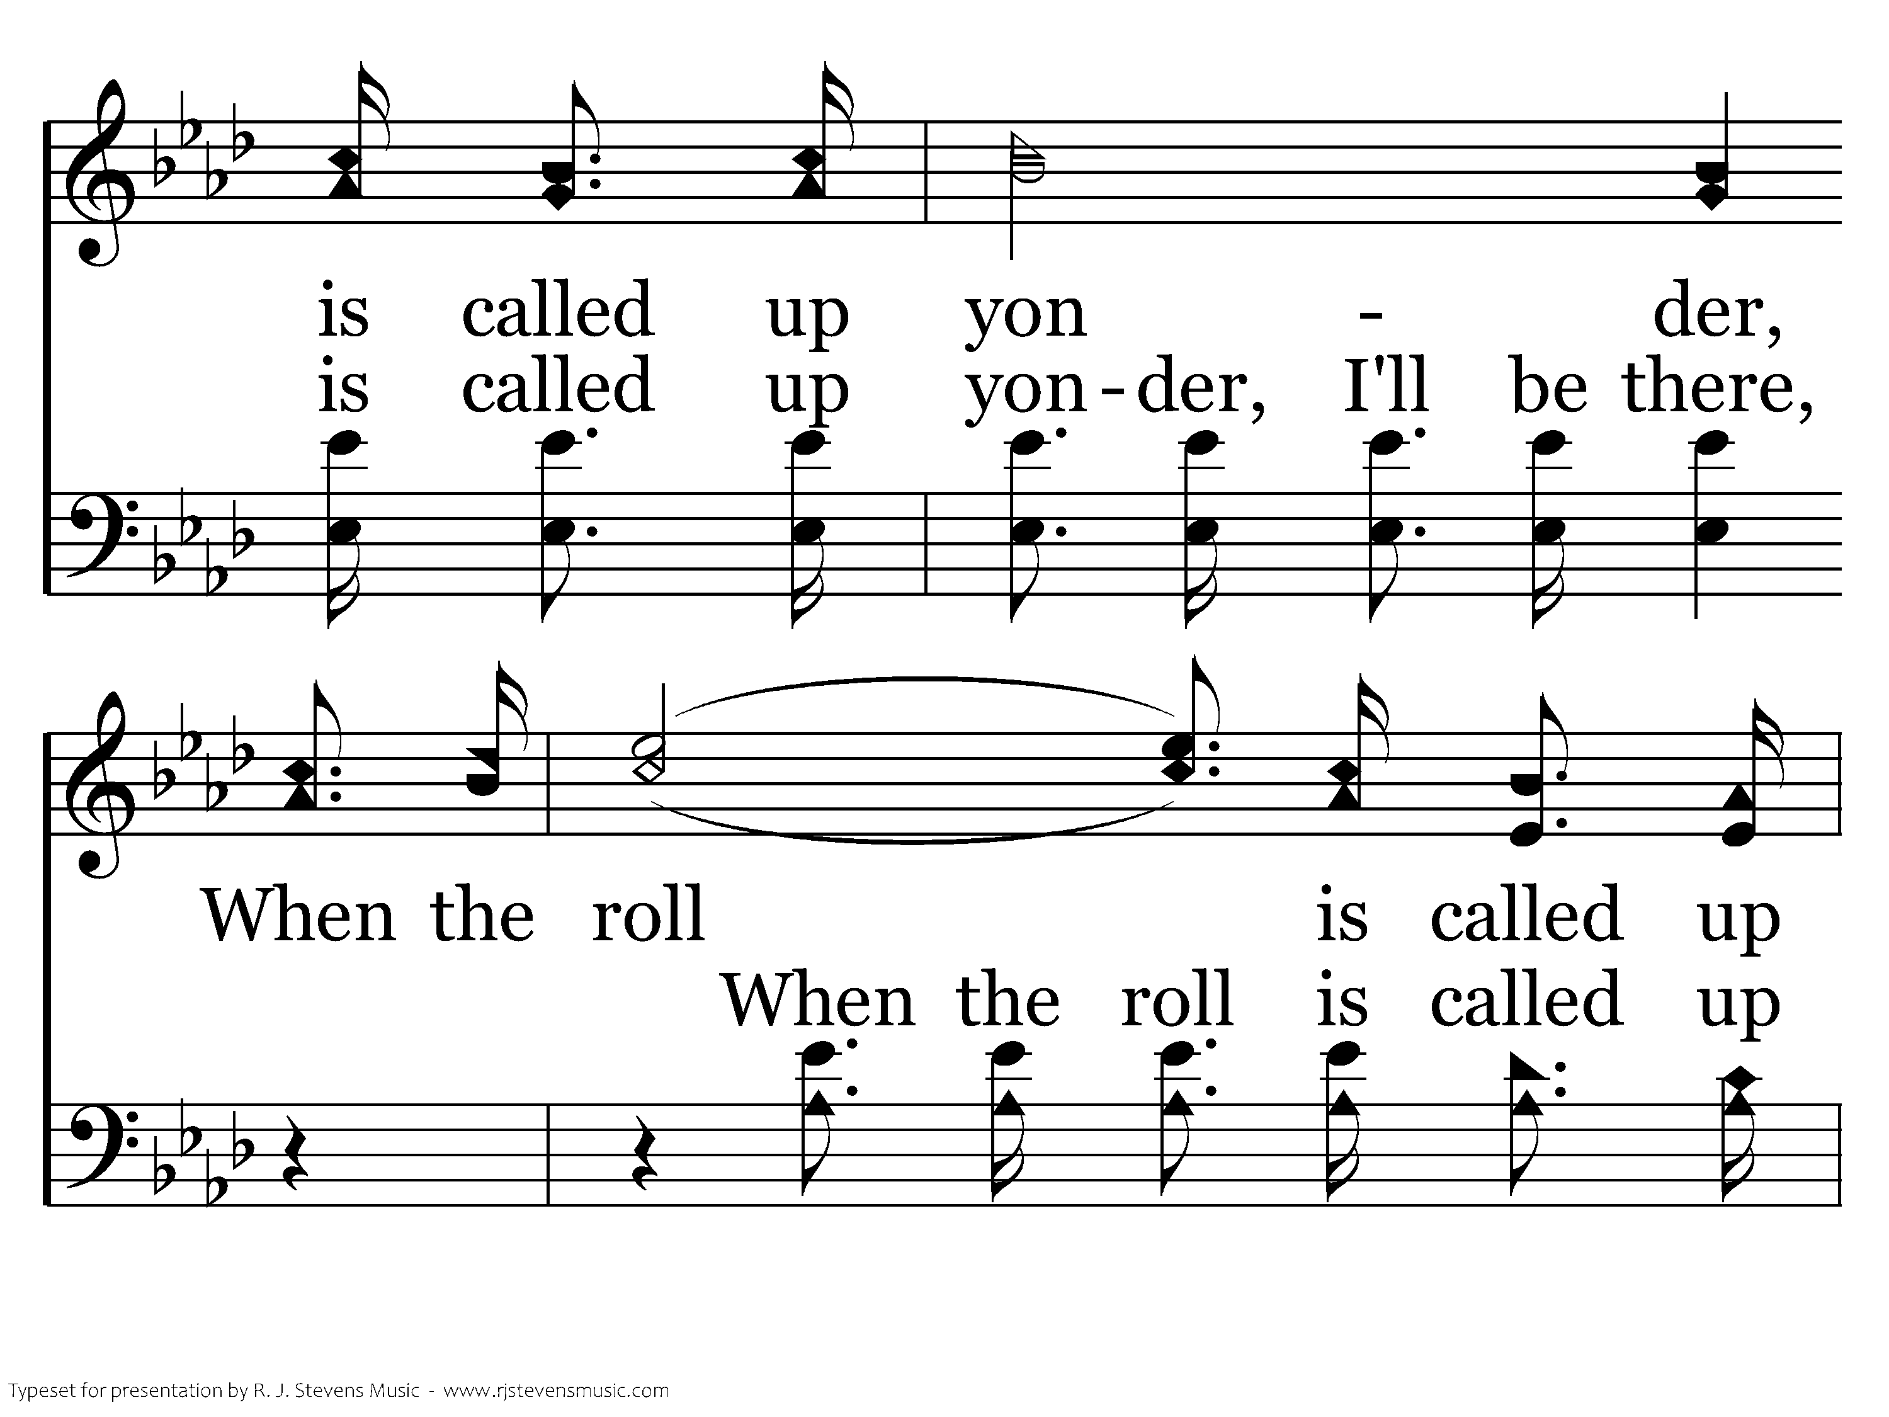
522 - When The Roll Is Called Up Yonder - C.2

Slide 36
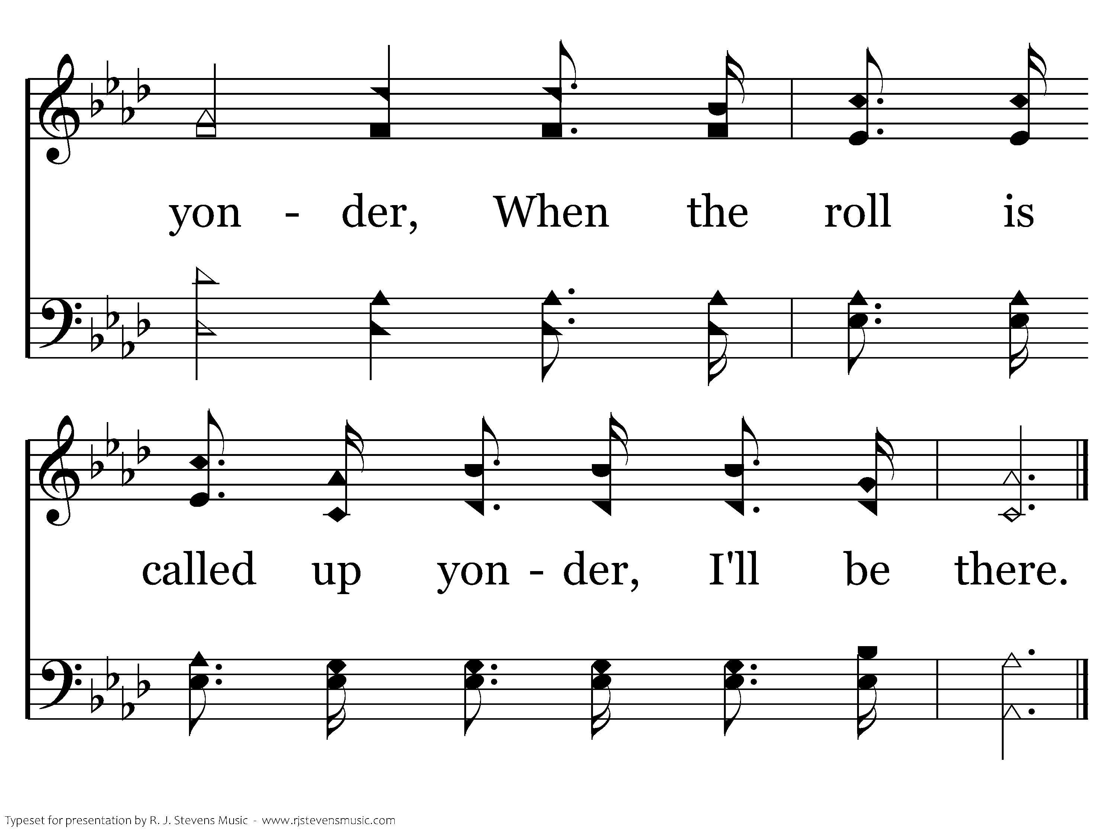
522 - When The Roll Is Called Up Yonder - C.3
End of Verse 1

Slide 37
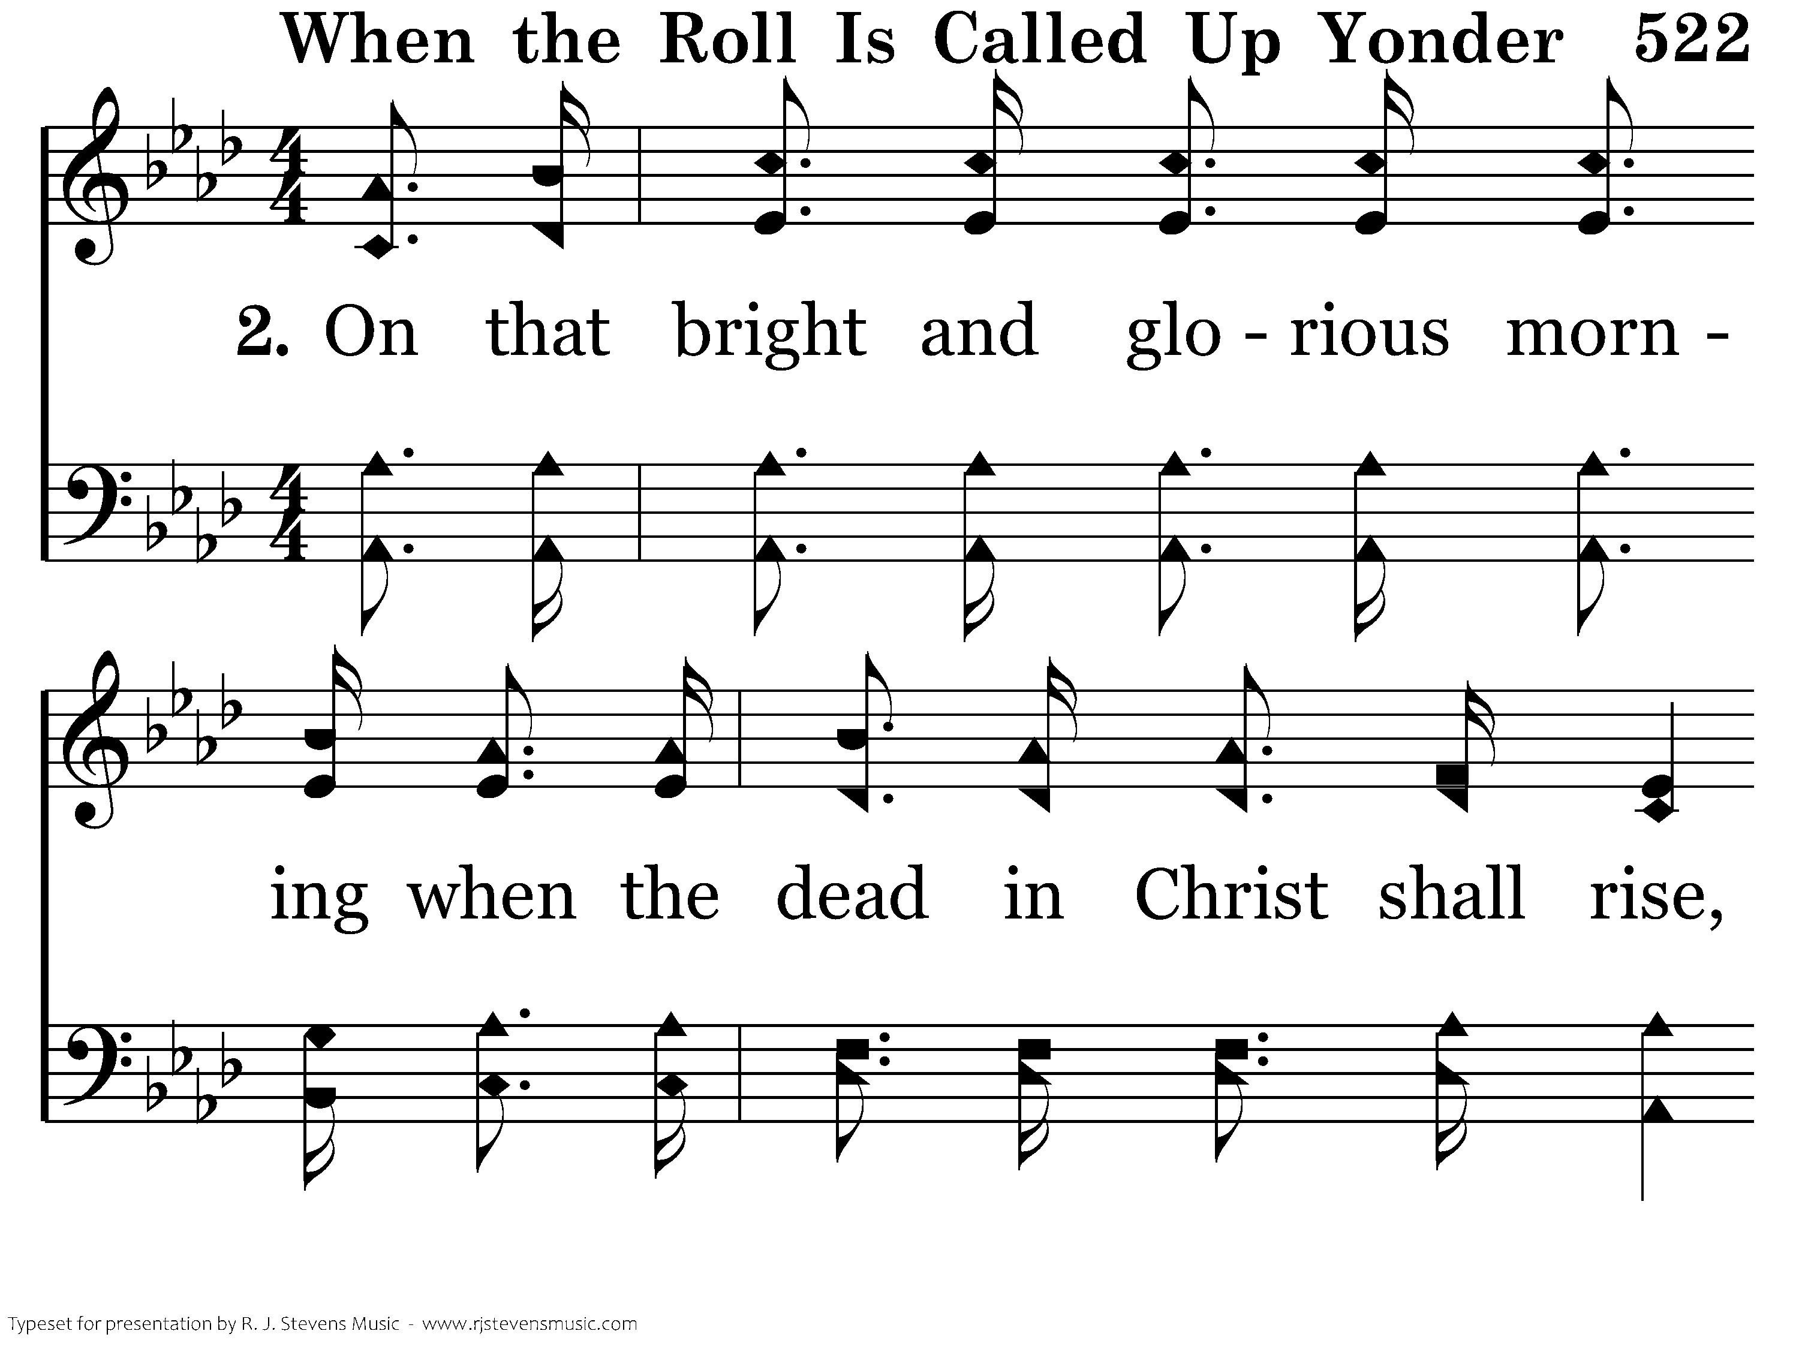
522 - When The Roll Is Called Up Yonder - 2.1

Slide 38
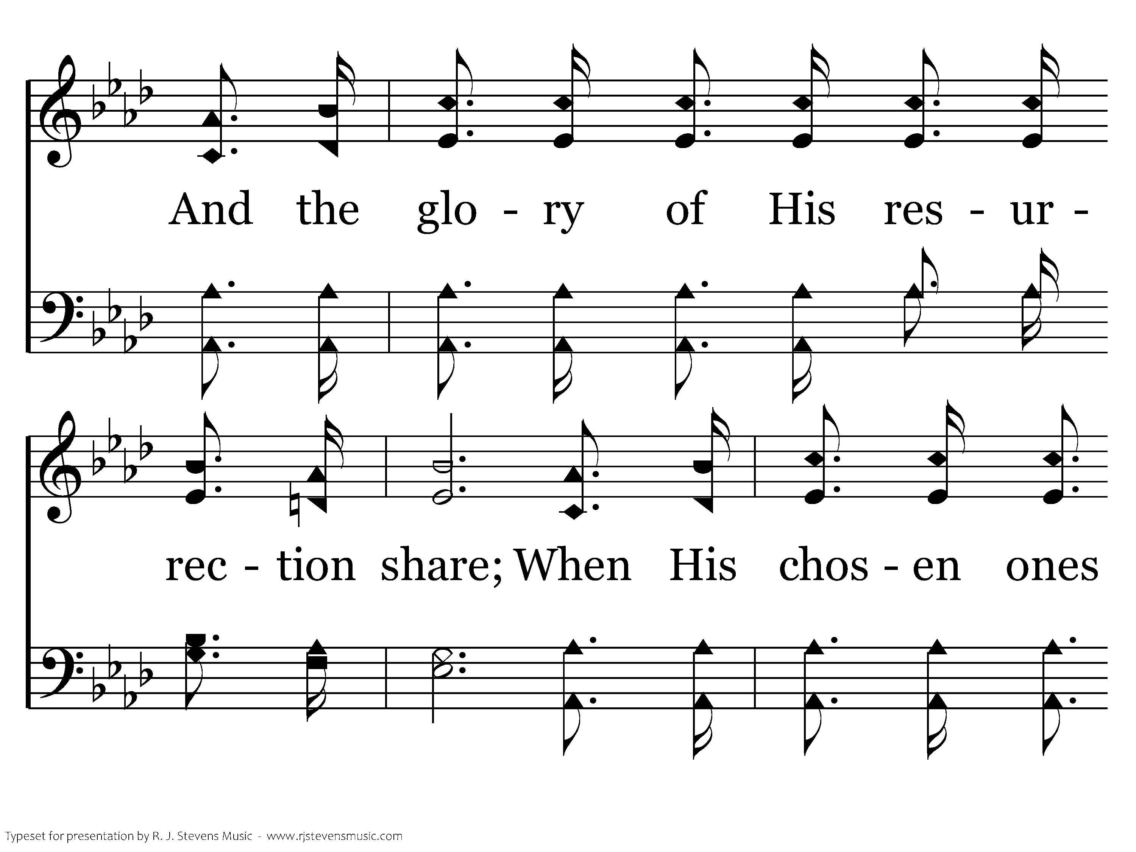
522 - When The Roll Is Called Up Yonder - 2.2

Slide 39
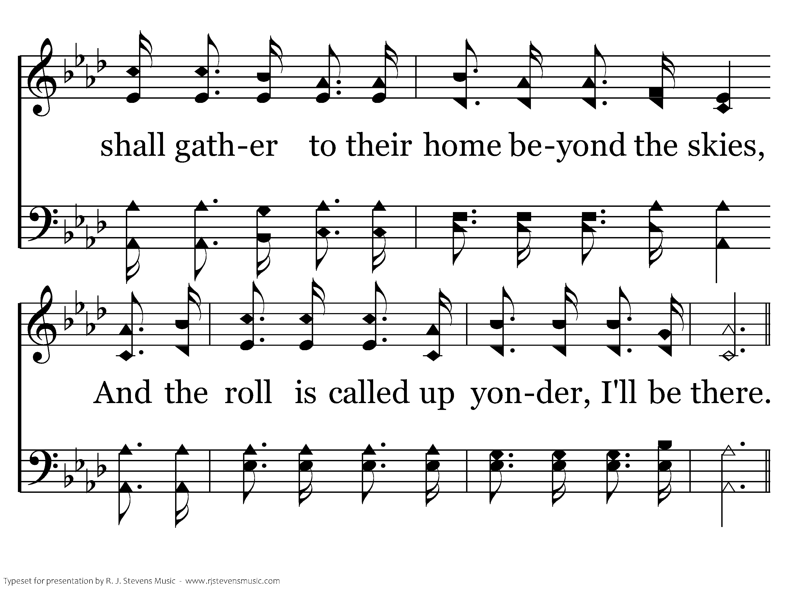
522 - When The Roll Is Called Up Yonder - 2.3

Slide 40
522 - When The Roll Is Called Up Yonder - C.1

Slide 41
522 - When The Roll Is Called Up Yonder - C.2

Slide 42
522 - When The Roll Is Called Up Yonder - C.3
End of Verse 2

Slide 43
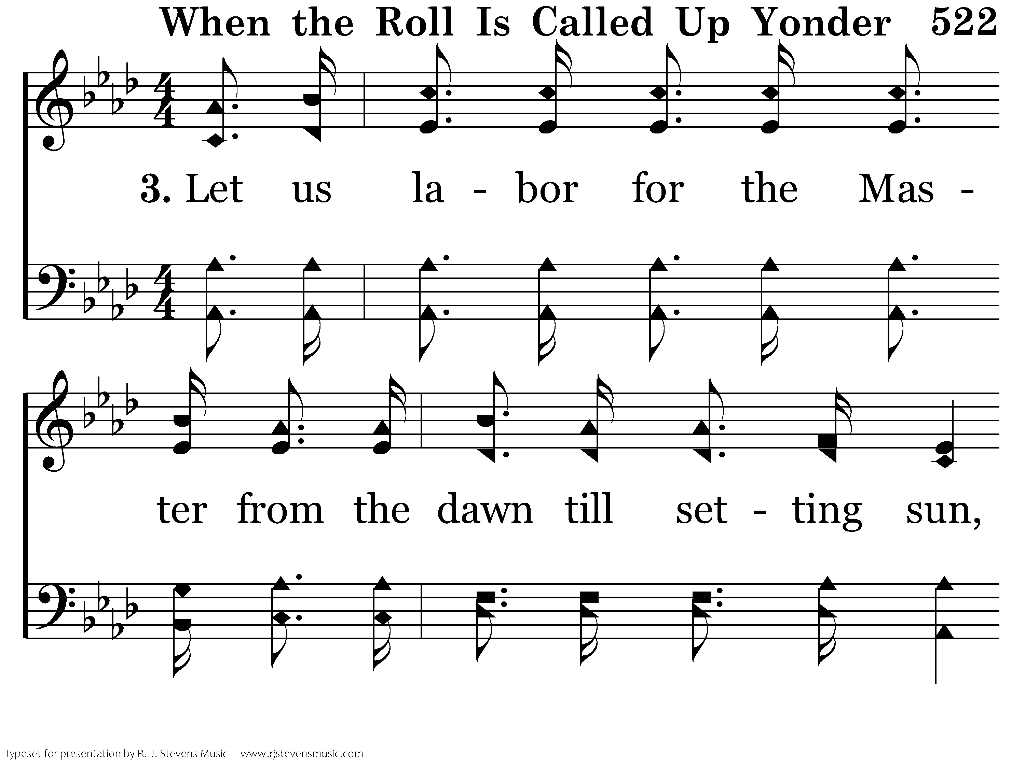
522 - When The Roll Is Called Up Yonder - 3.1

Slide 44
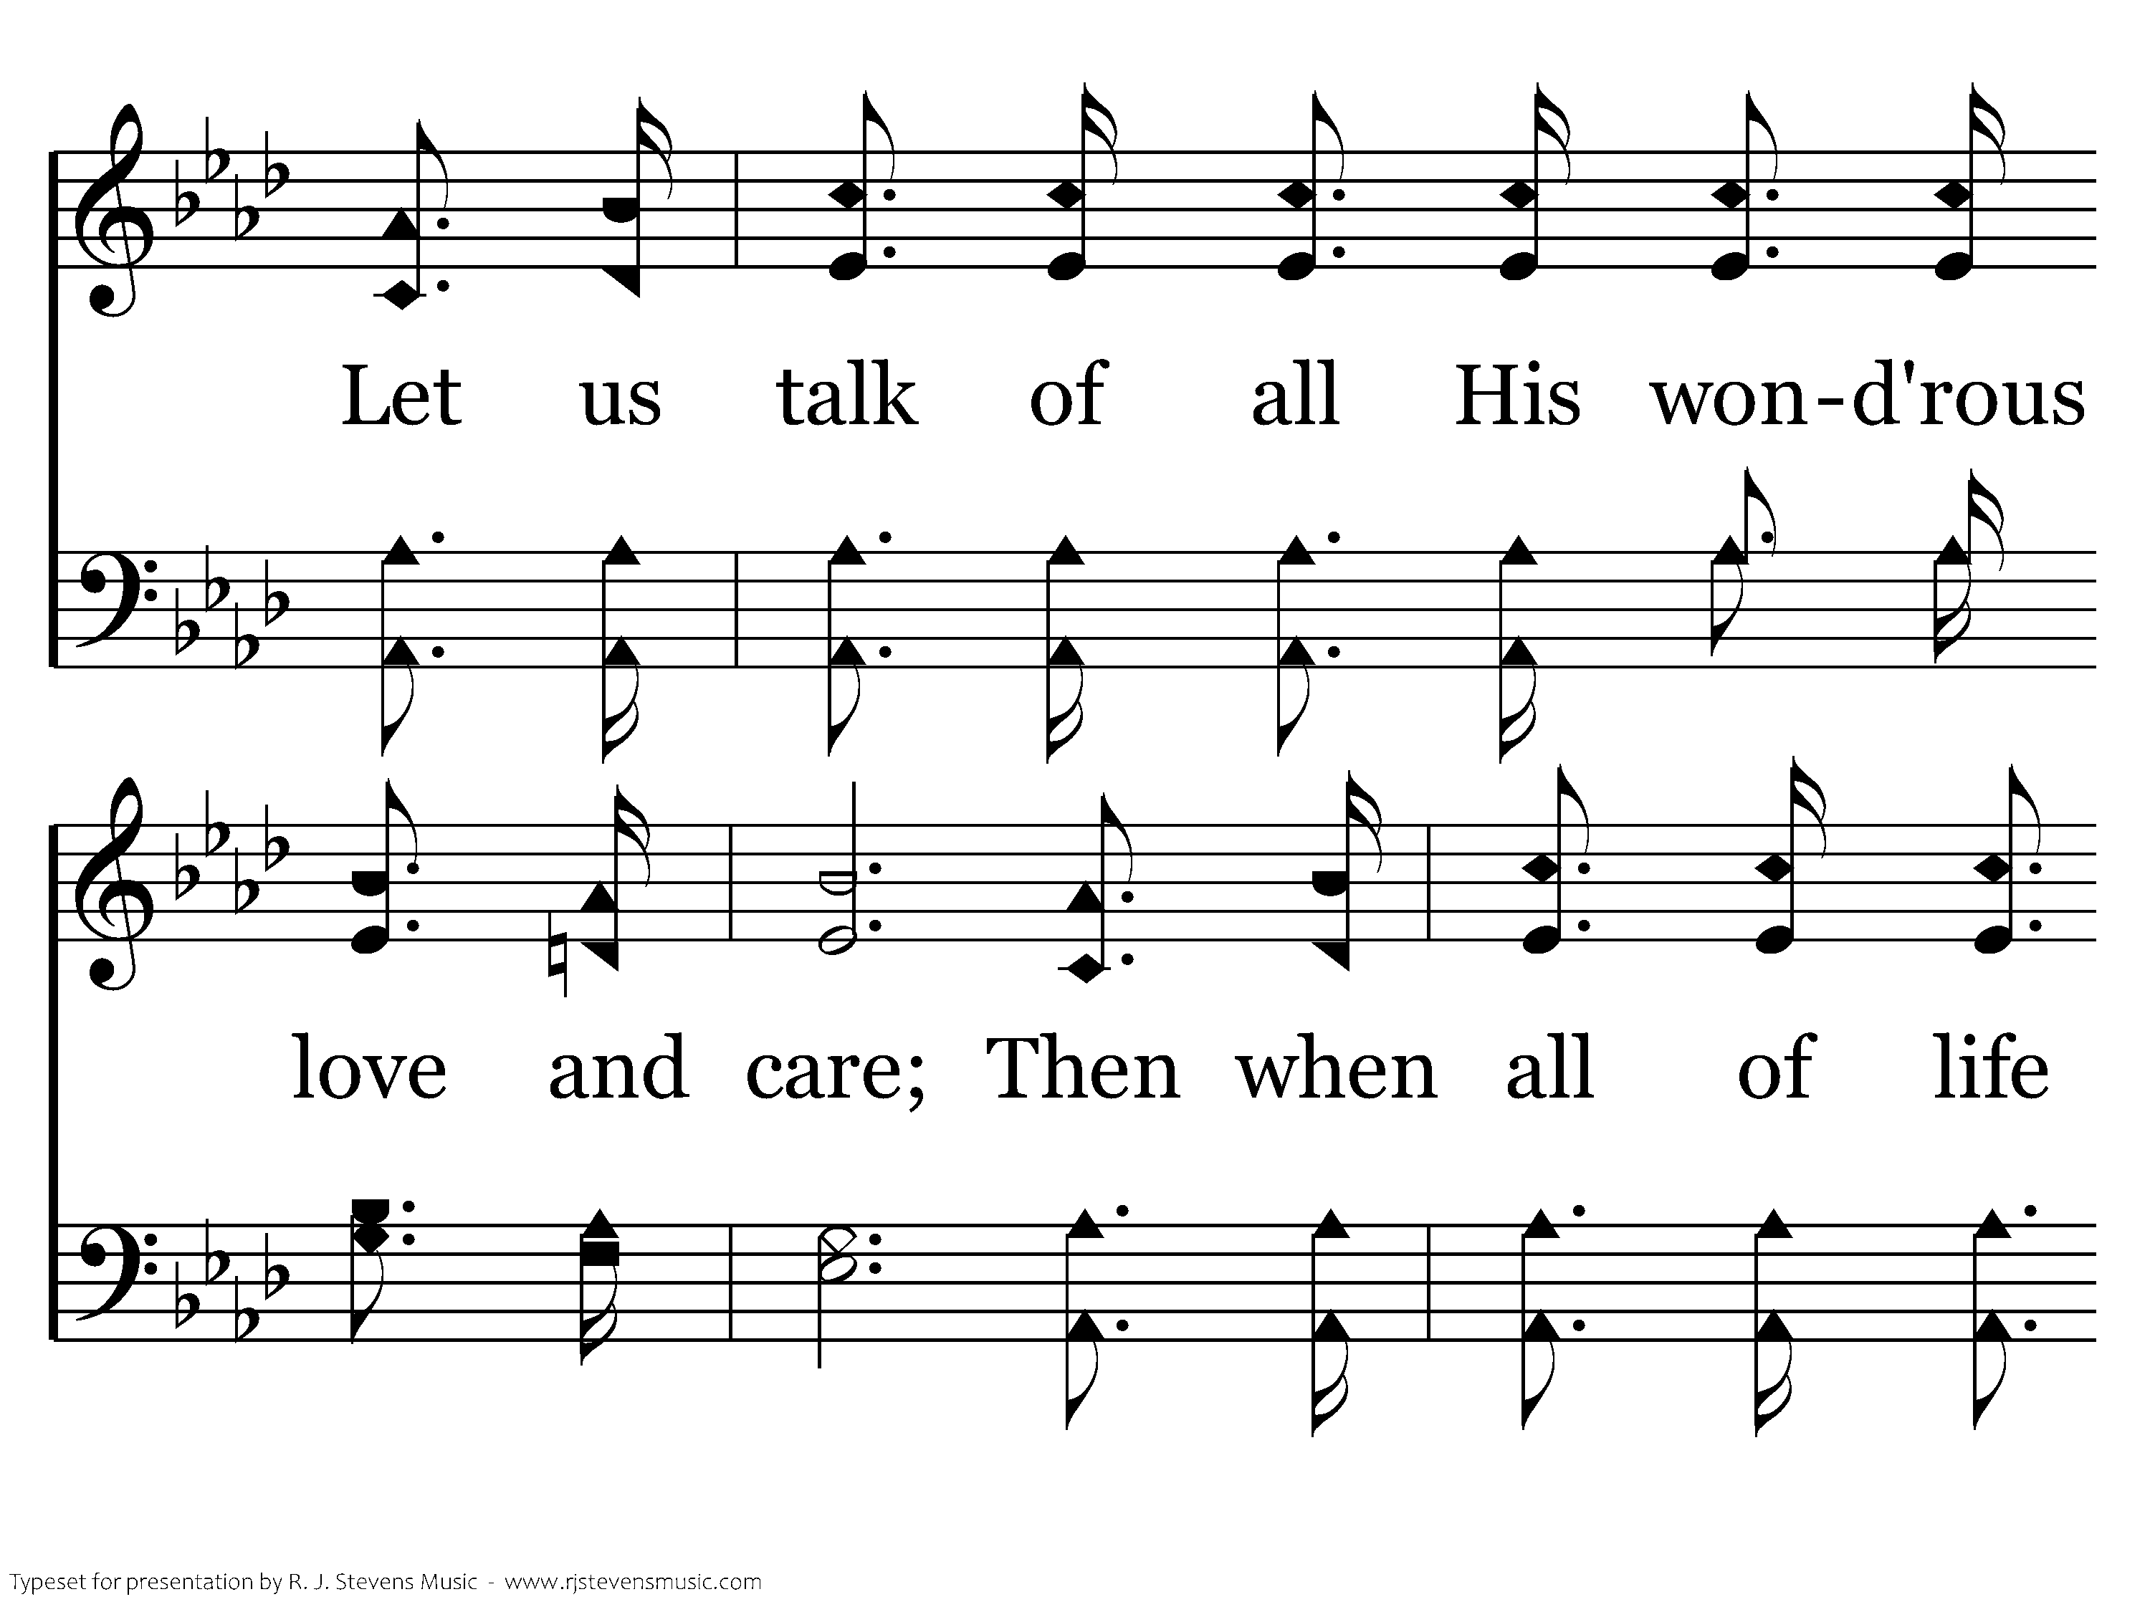
522 - When The Roll Is Called Up Yonder - 3.2

Slide 45
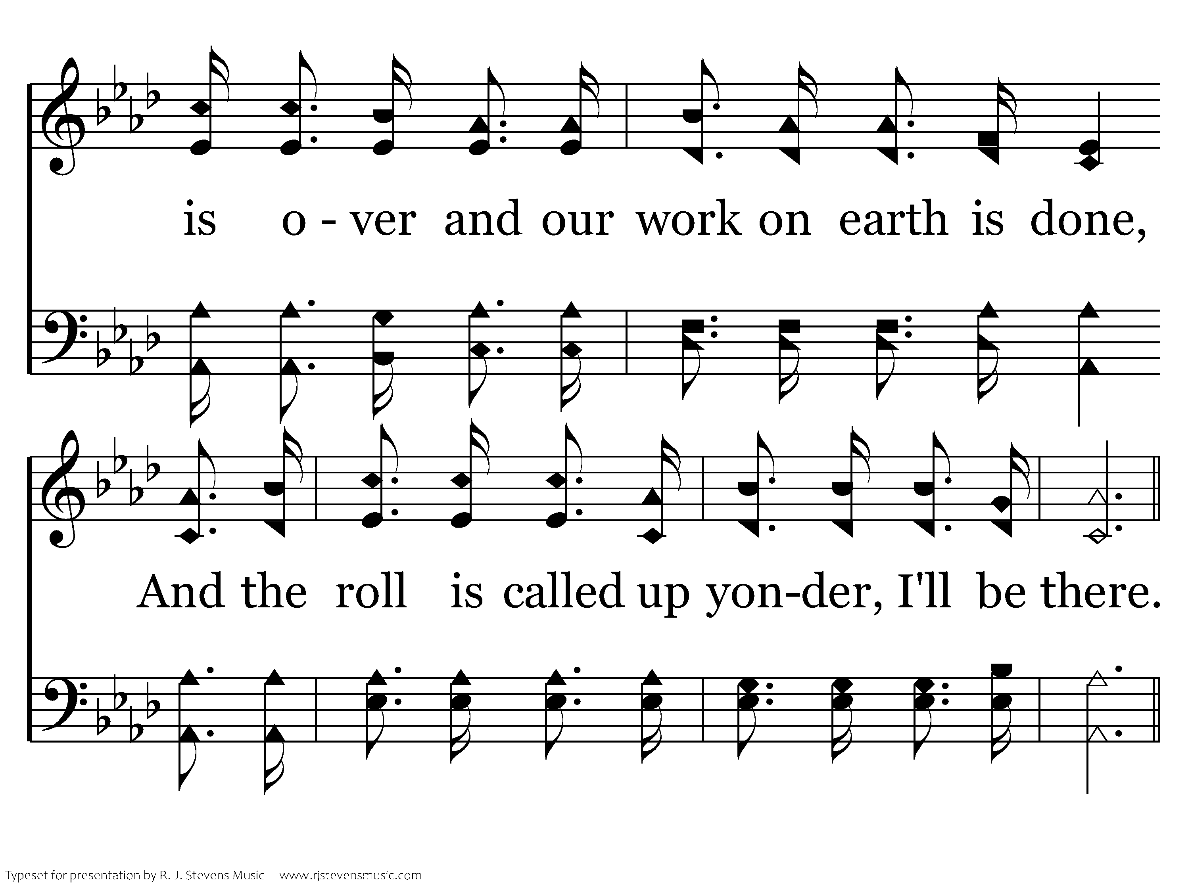
522 - When The Roll Is Called Up Yonder - 3.3

Slide 46
522 - When The Roll Is Called Up Yonder - C.1

Slide 47
522 - When The Roll Is Called Up Yonder - C.2

Slide 48
522 - When The Roll Is Called Up Yonder - C.3
End of Song

Slide 50

Who Am I?

Slide 51

Creation of God
Genesis 1:26-27 created in His image
Genesis 9:3-6 more than animals
  Matthew 6:26 more value than they
Mark 12:17 render to God what is Gods
Matthew 18:10-14 rejoices over that one

Slide 52
Servant
2 Timothy 2:24 the Lord’s bond-servant
Romans 1:1 Paul a bondservant of God
1 Corinthians 3:5 servants

Slide 53
A Friend
James 2:23 called Gods friend
Exodus 33:11 as one speaks to a friend
John 15:15 I have called you friends

Slide 54
Children of God
Galatians 3:26 you are sons of God
Galatians 4:7 no longer a slave, but a save
2 Corinthians 6:18 sons and daughter to Me
Mark 3:34 brothers and sister of Christ
Hebrews 2:11 not ashamed to call them
Romans 8:16-17 heirs of God and fellow heirs with Christ

Slide 56
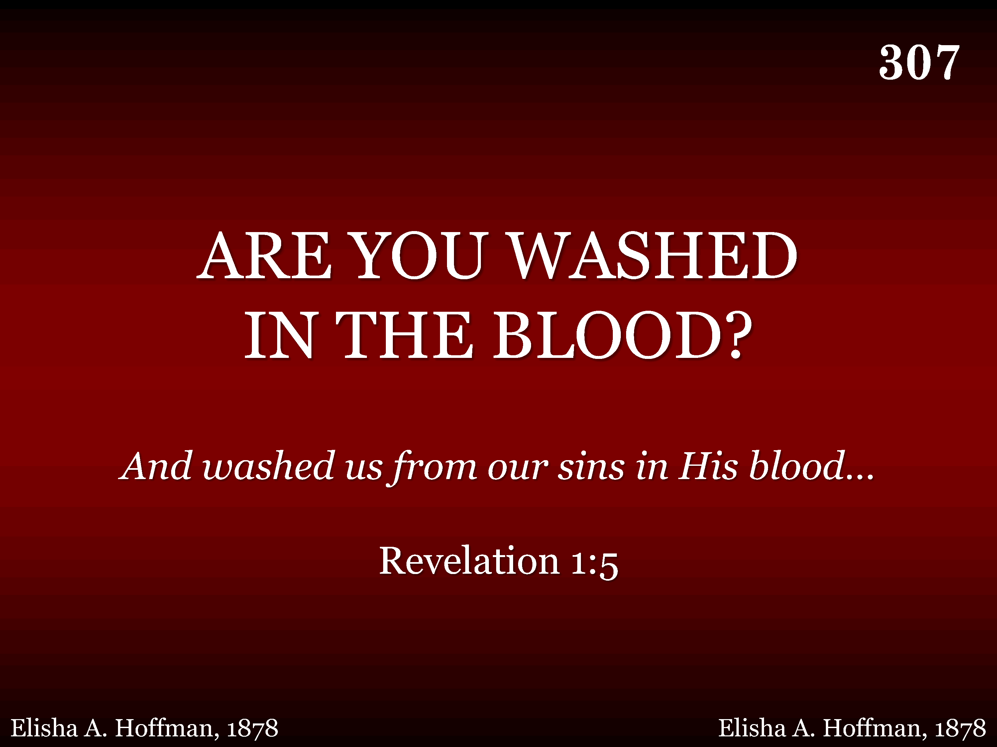
307 - Are You Washed In The Blood - Title

Slide 57
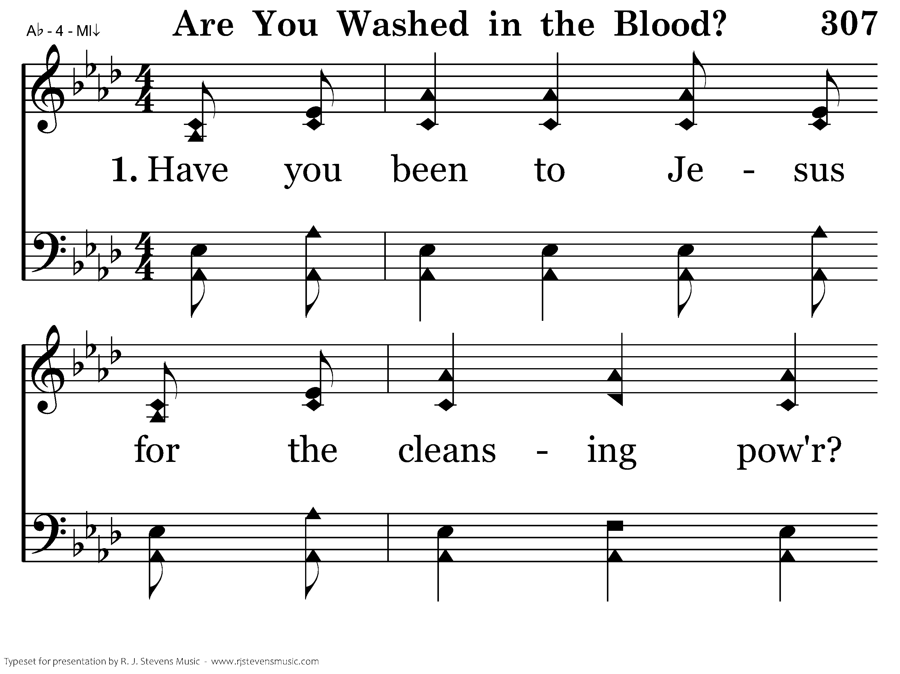
307 - Are You Washed In The Blood - 1.1

Slide 58
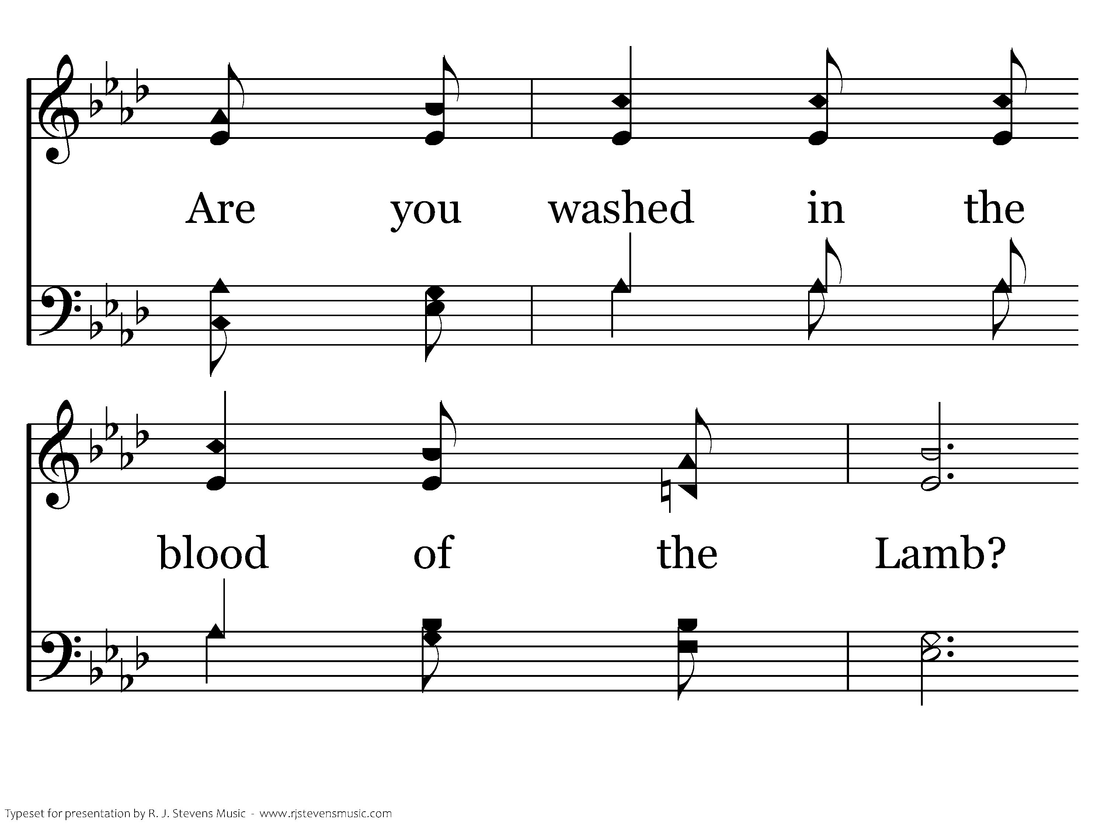
307 - Are You Washed In The Blood - 1.2

Slide 59
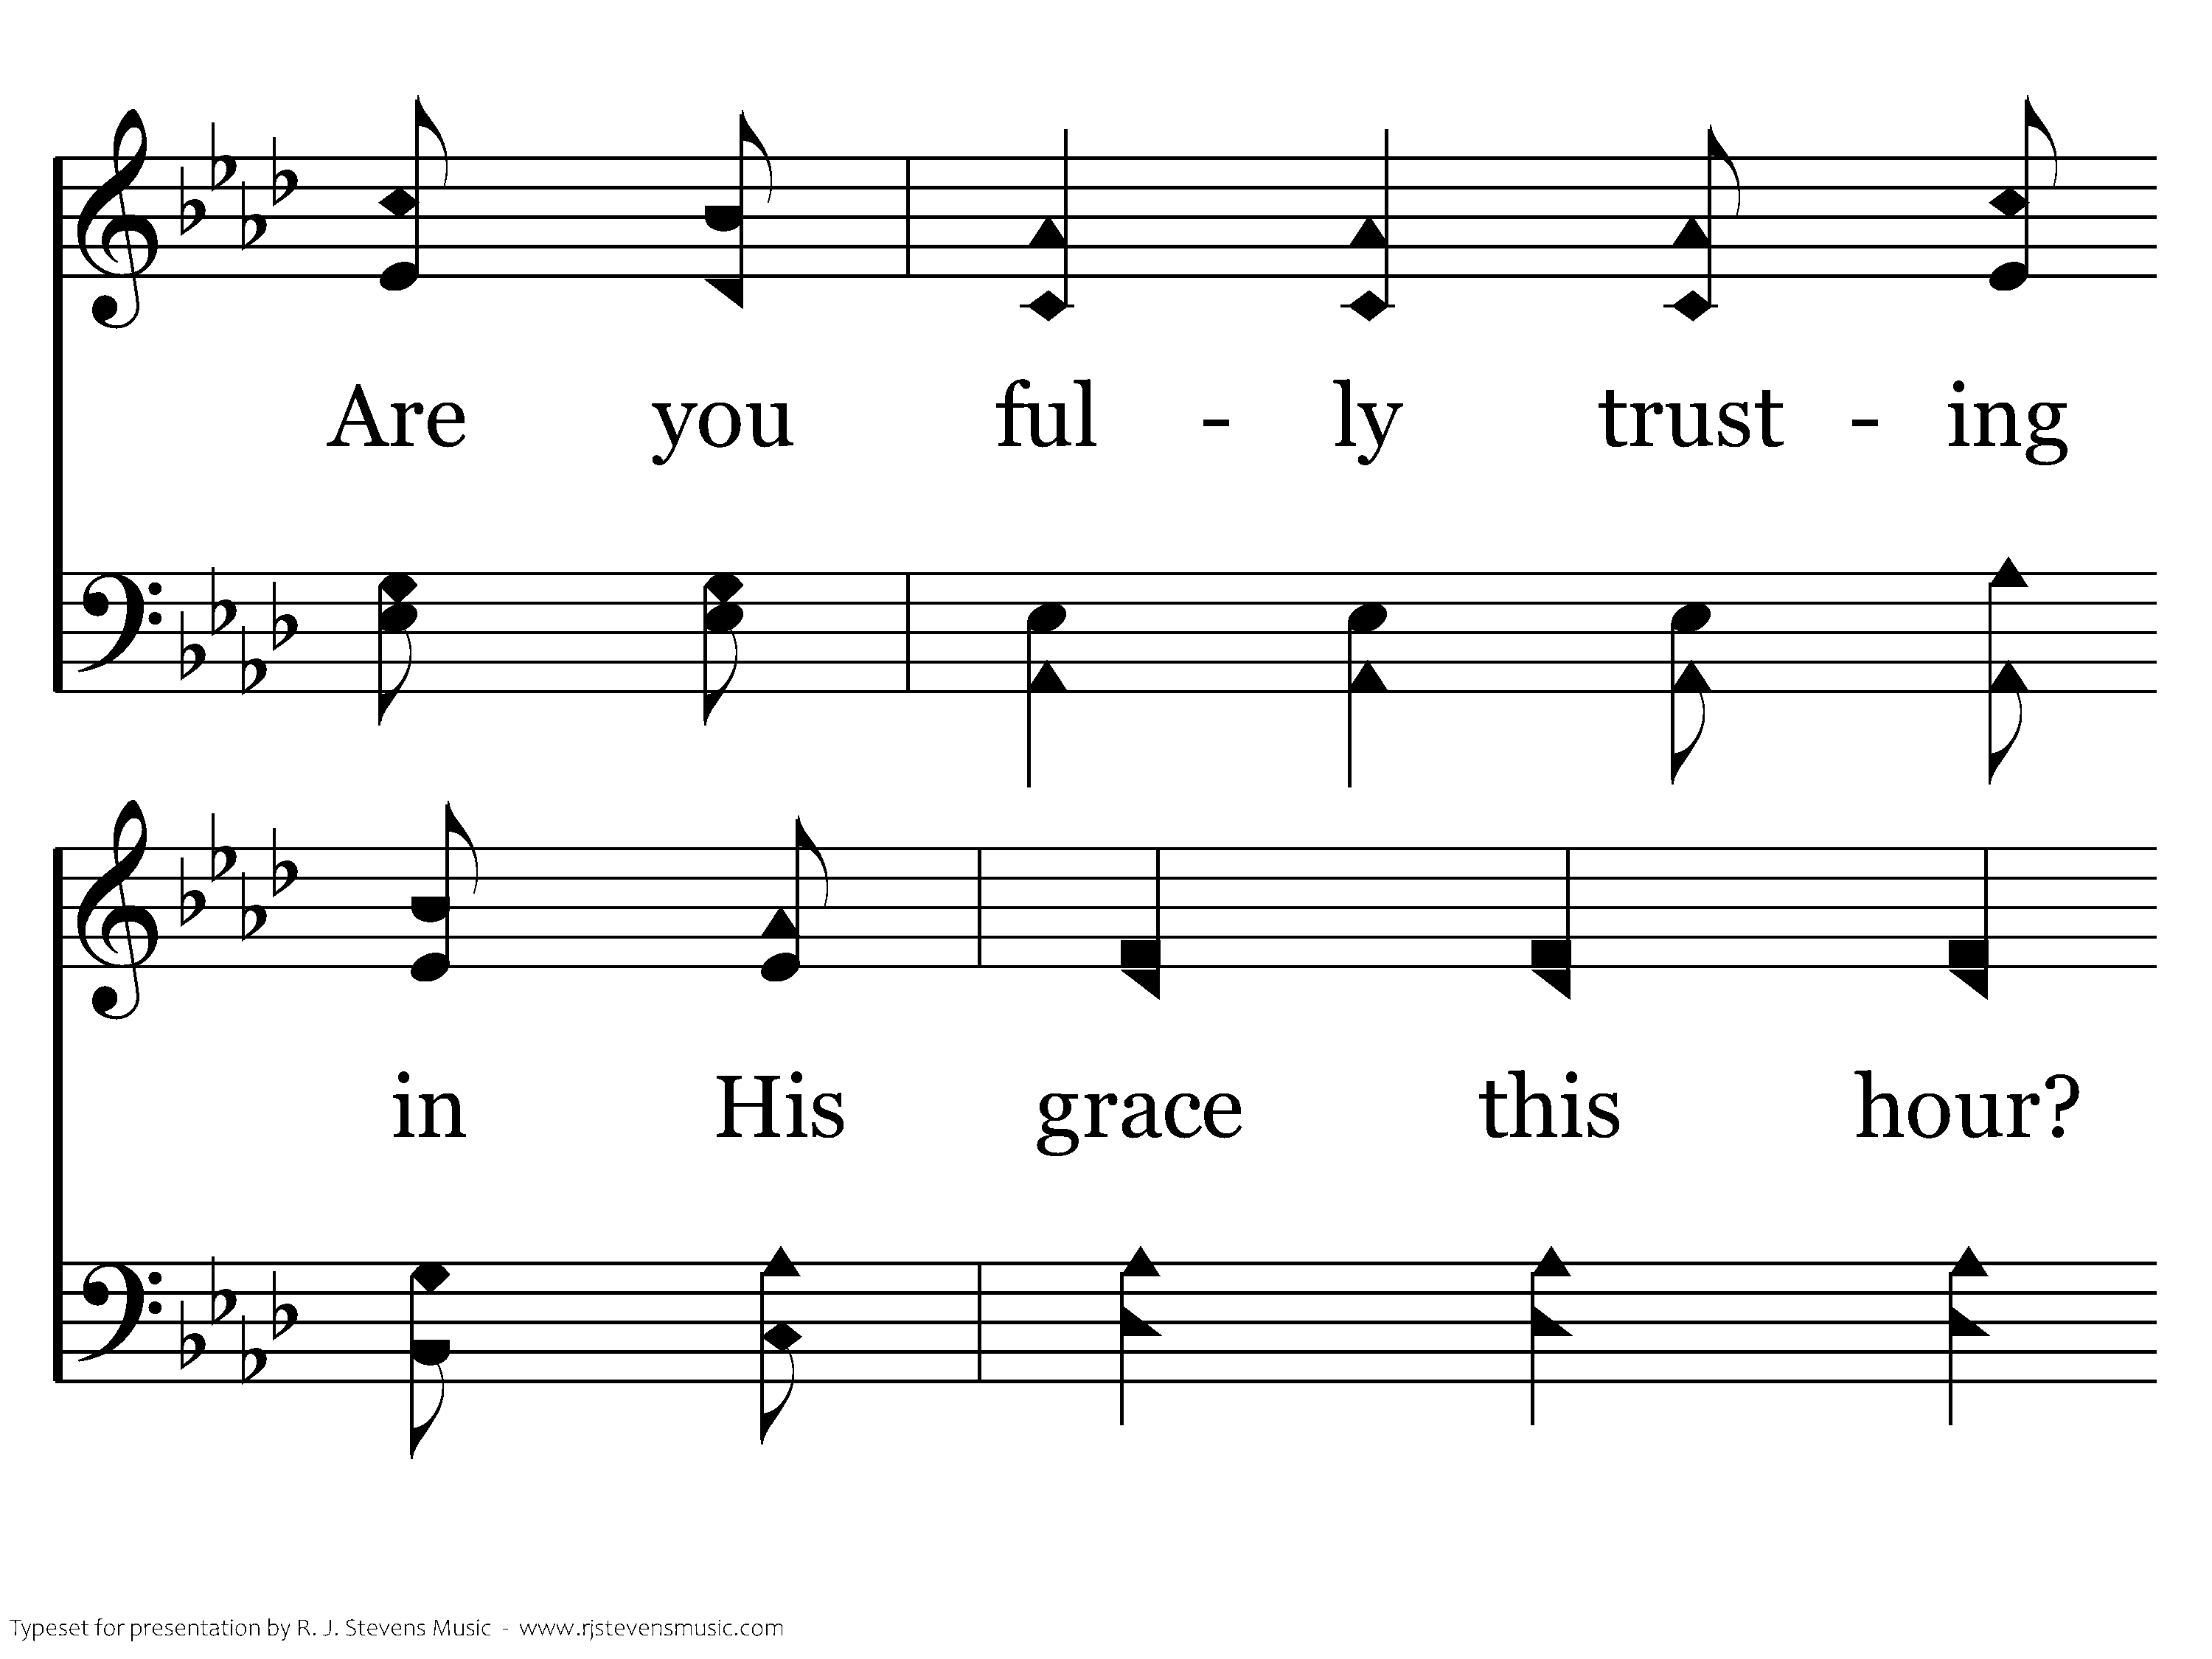
307 - Are You Washed In The Blood - 1.3

Slide 60
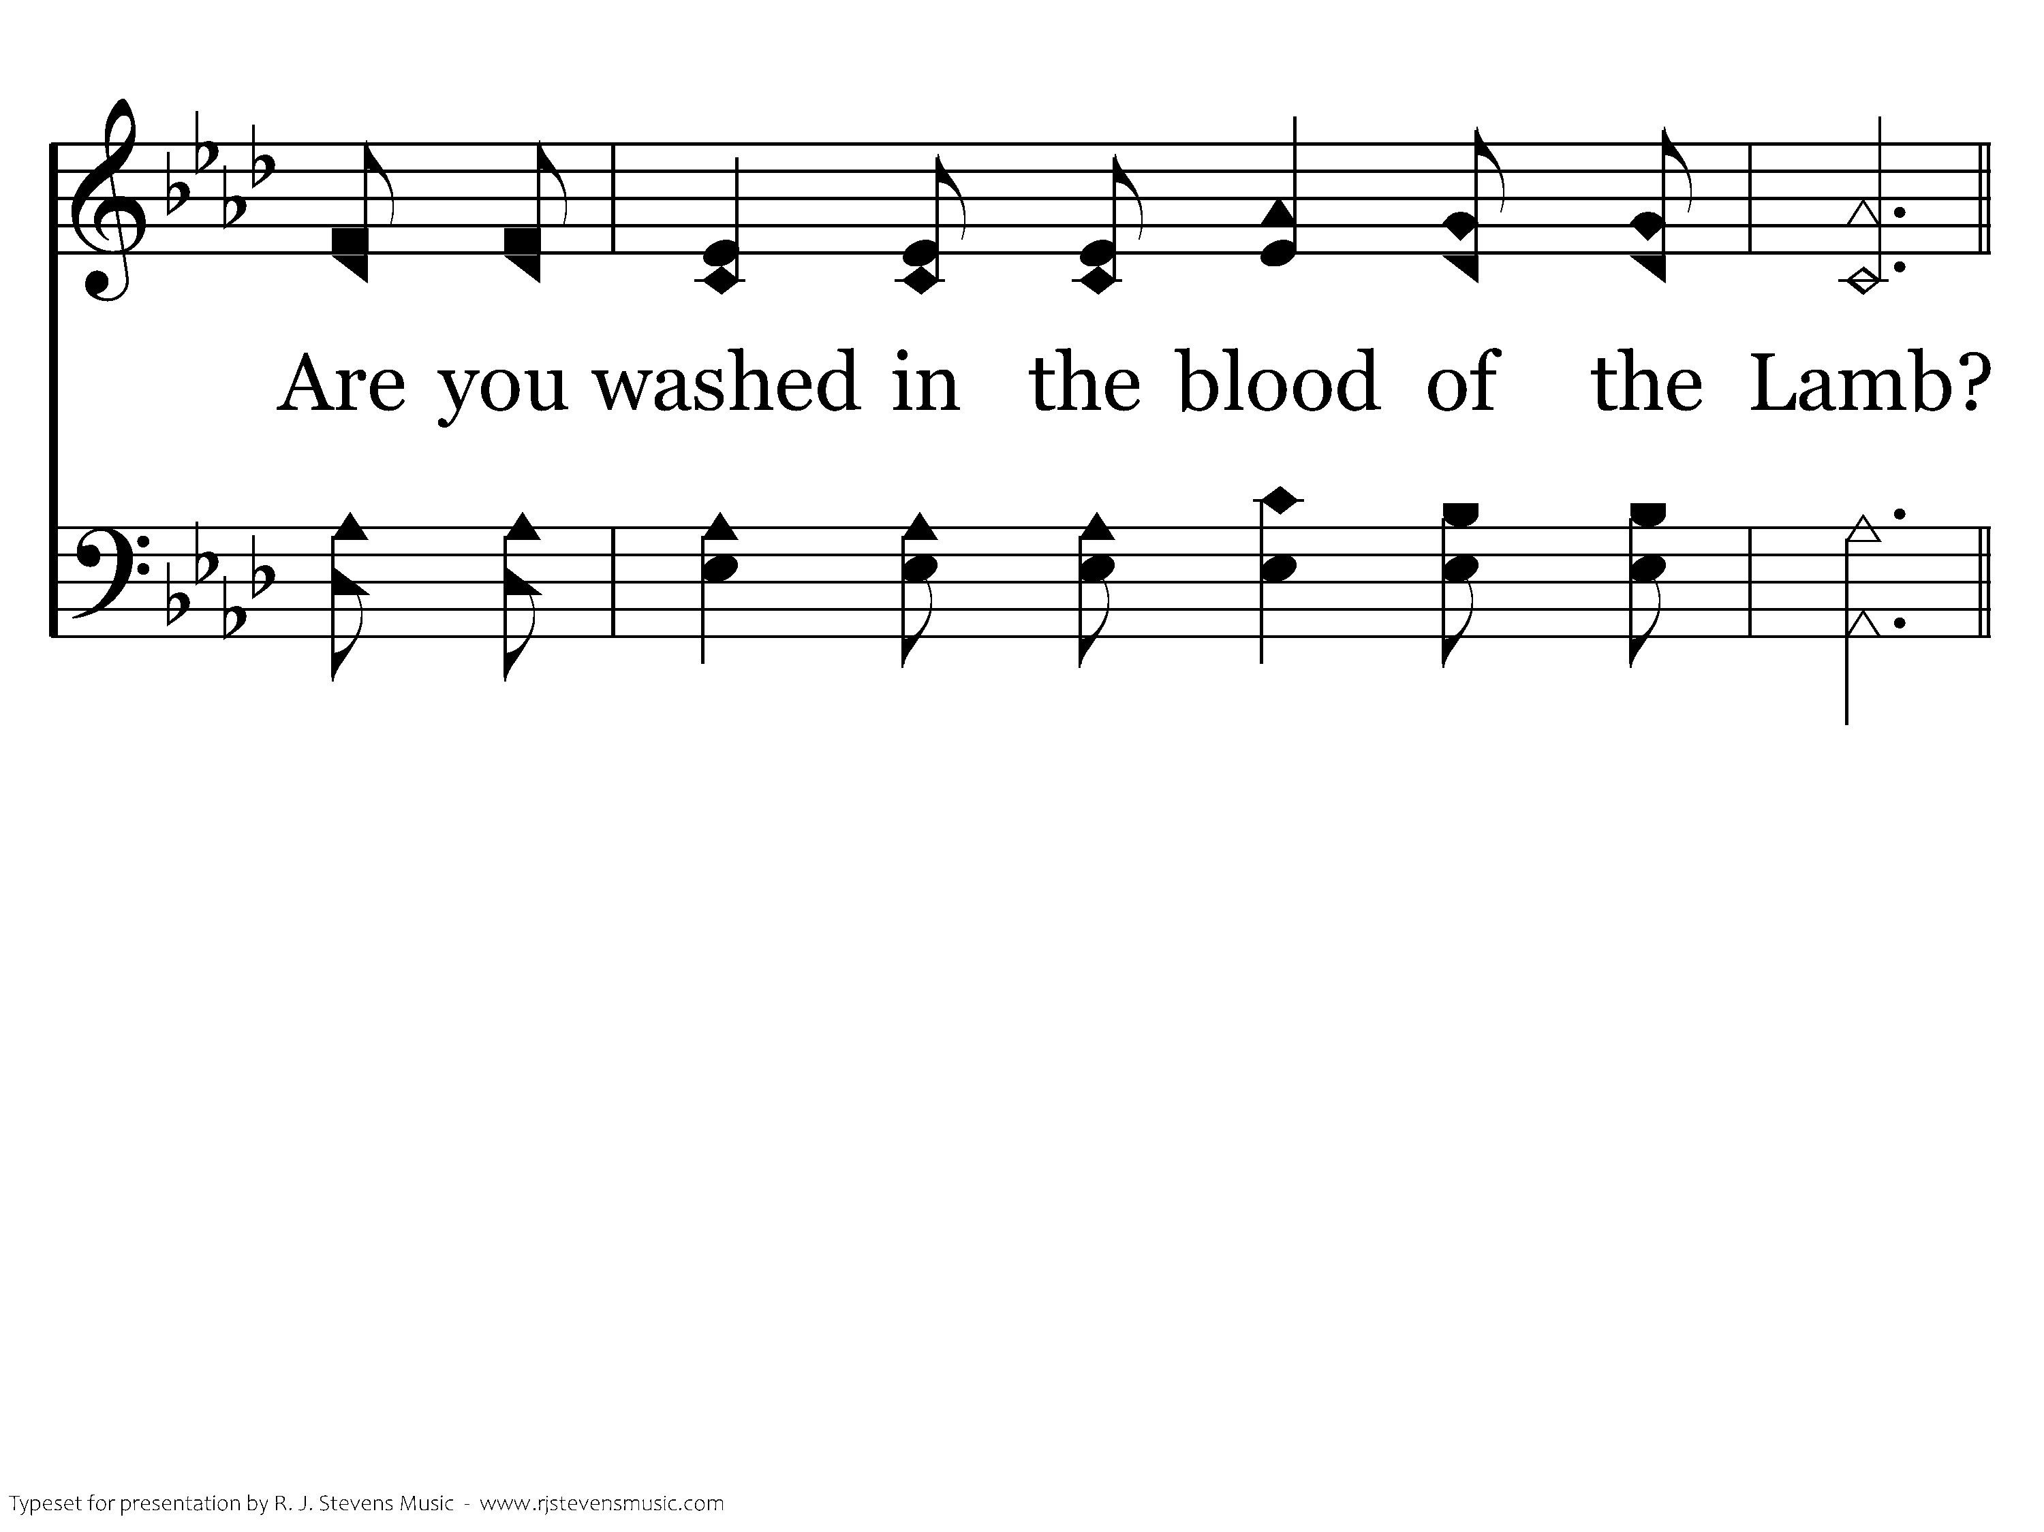
307 - Are You Washed In The Blood - 1.4

Slide 61
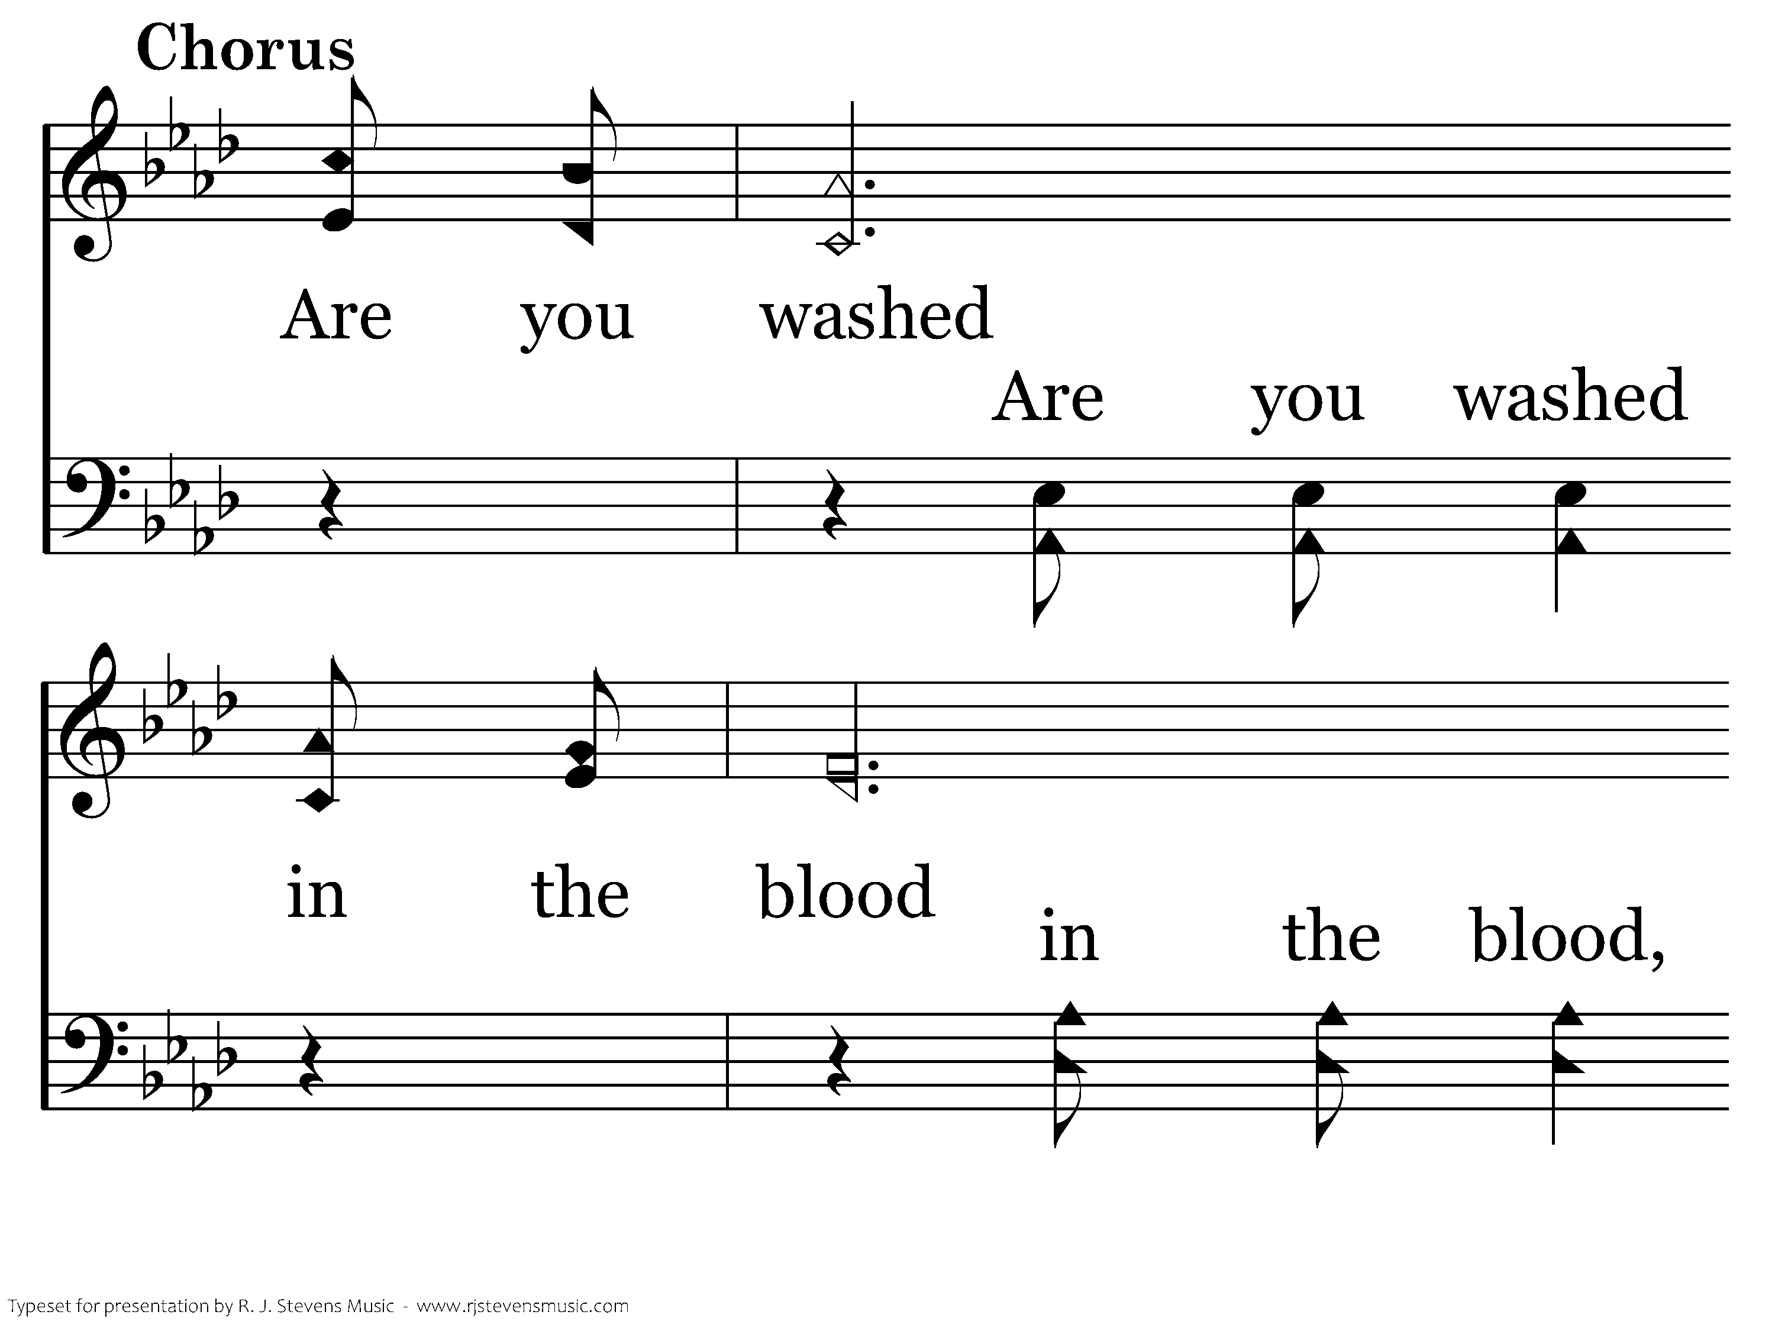
307 - Are You Washed In The Blood - C.1

Slide 62
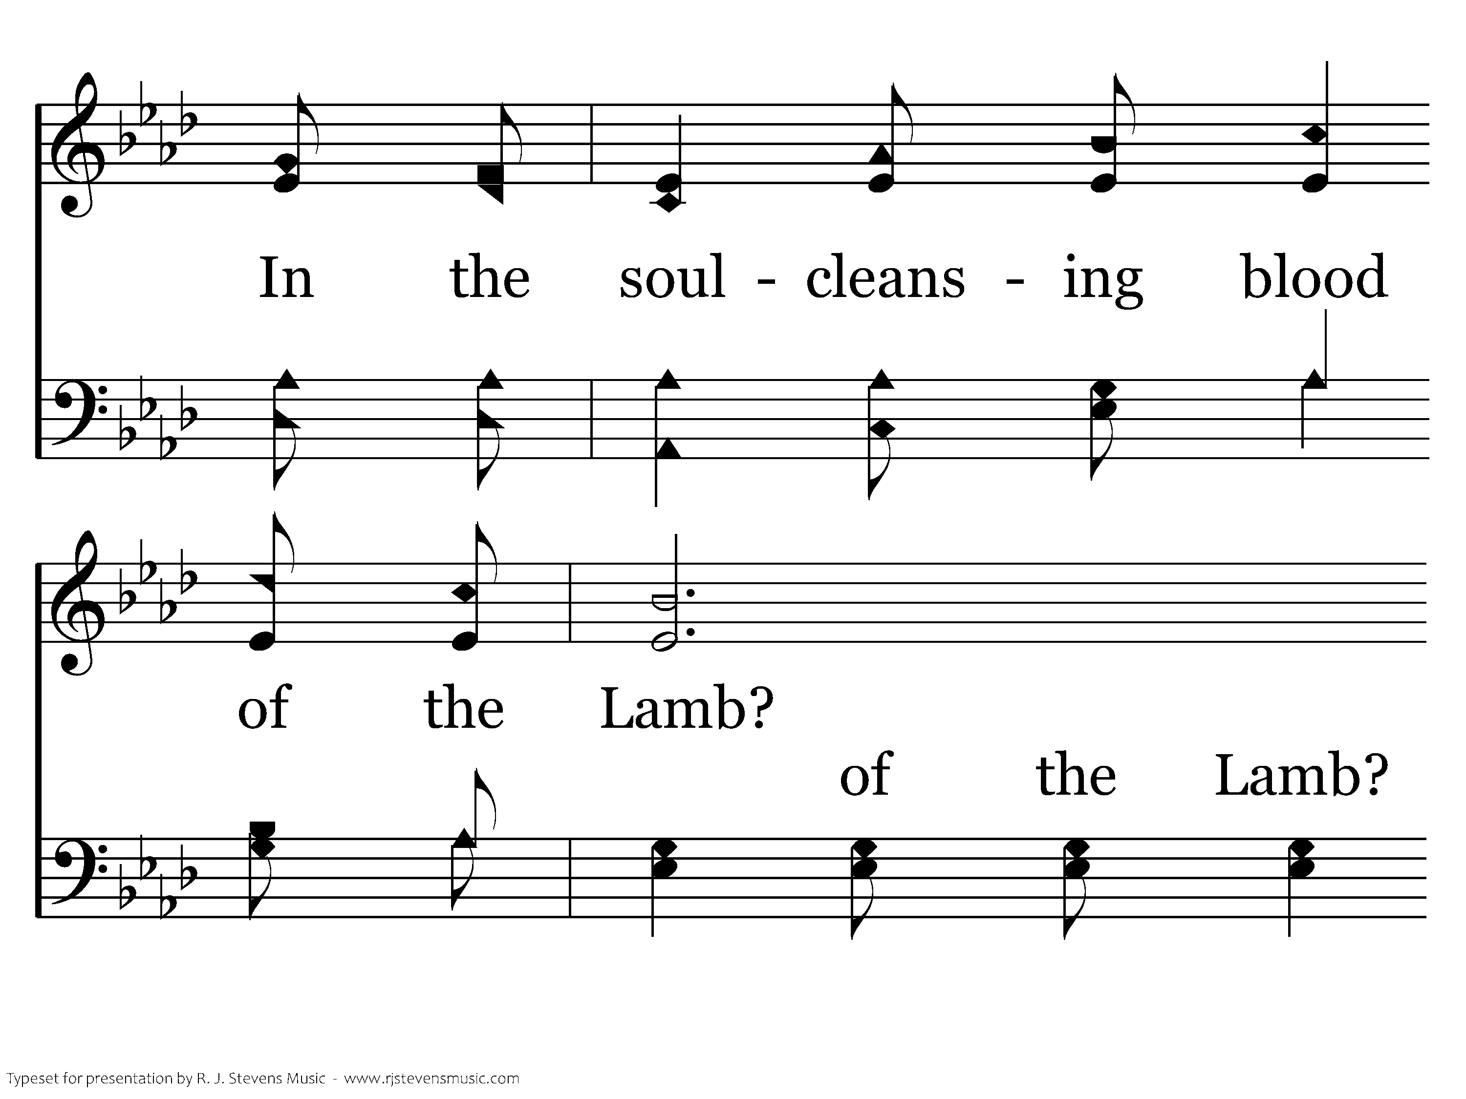
307 - Are You Washed In The Blood - C.2

Slide 63
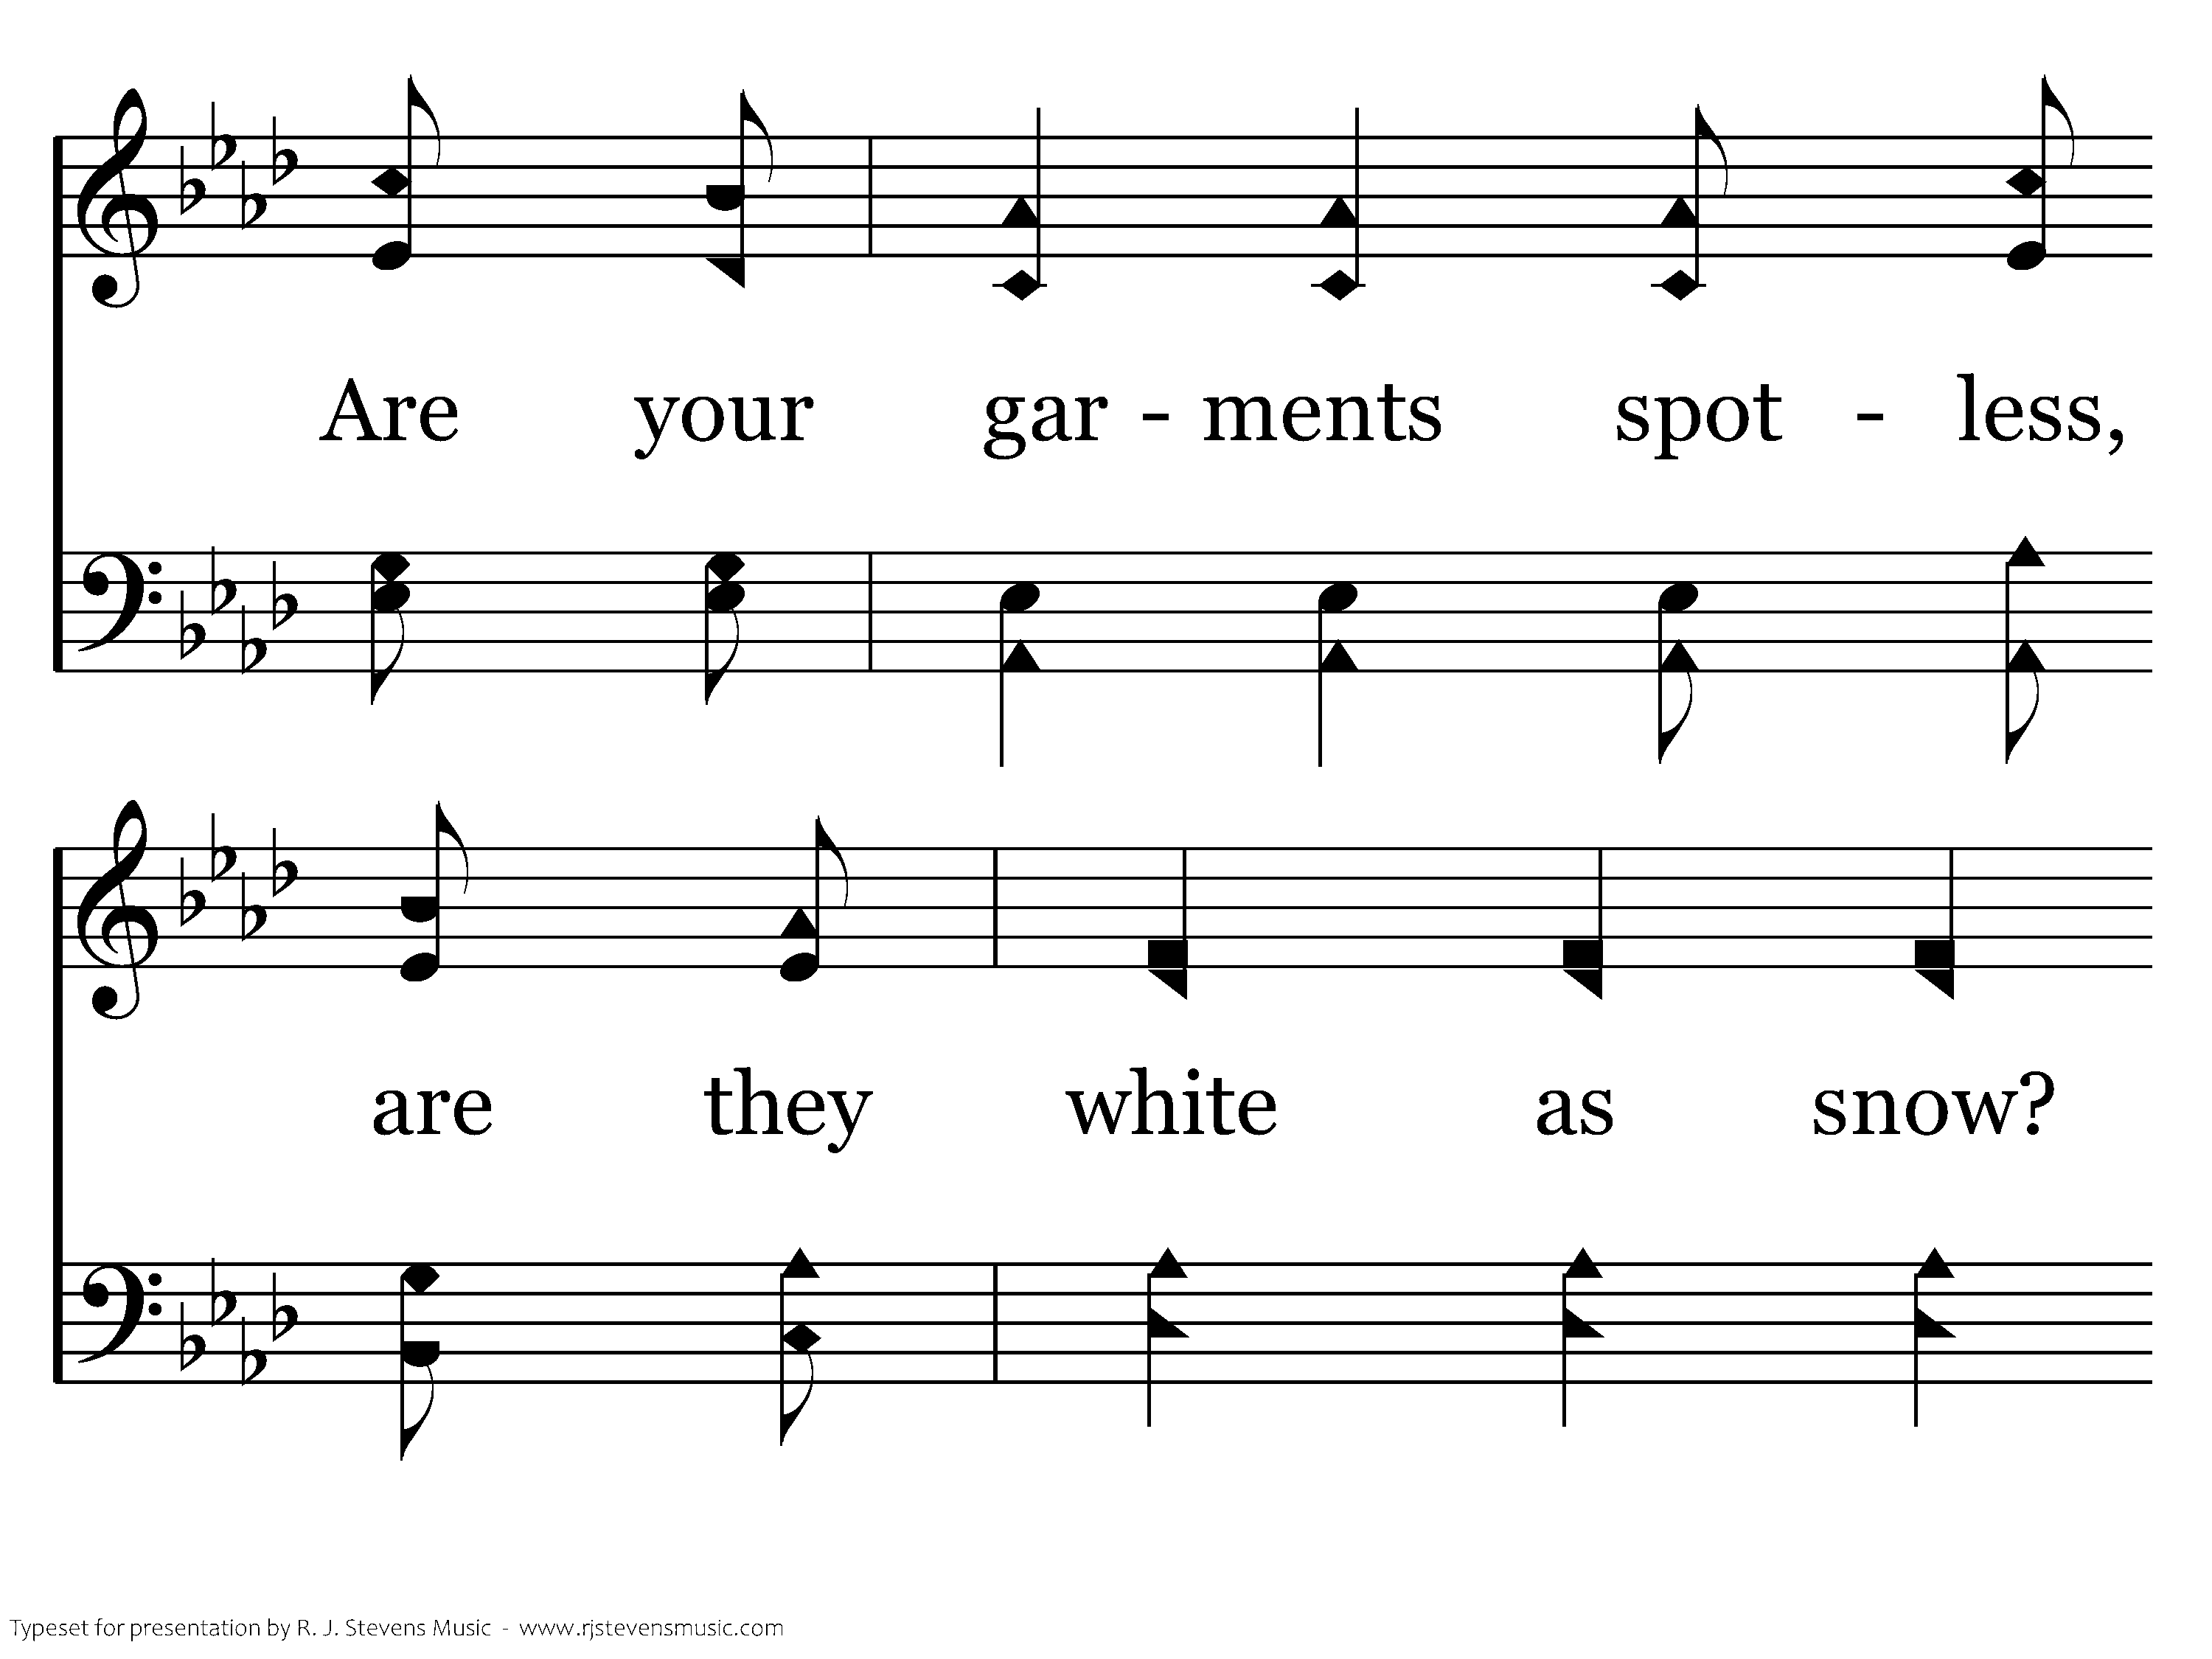
307 - Are You Washed In The Blood - C.3

Slide 64
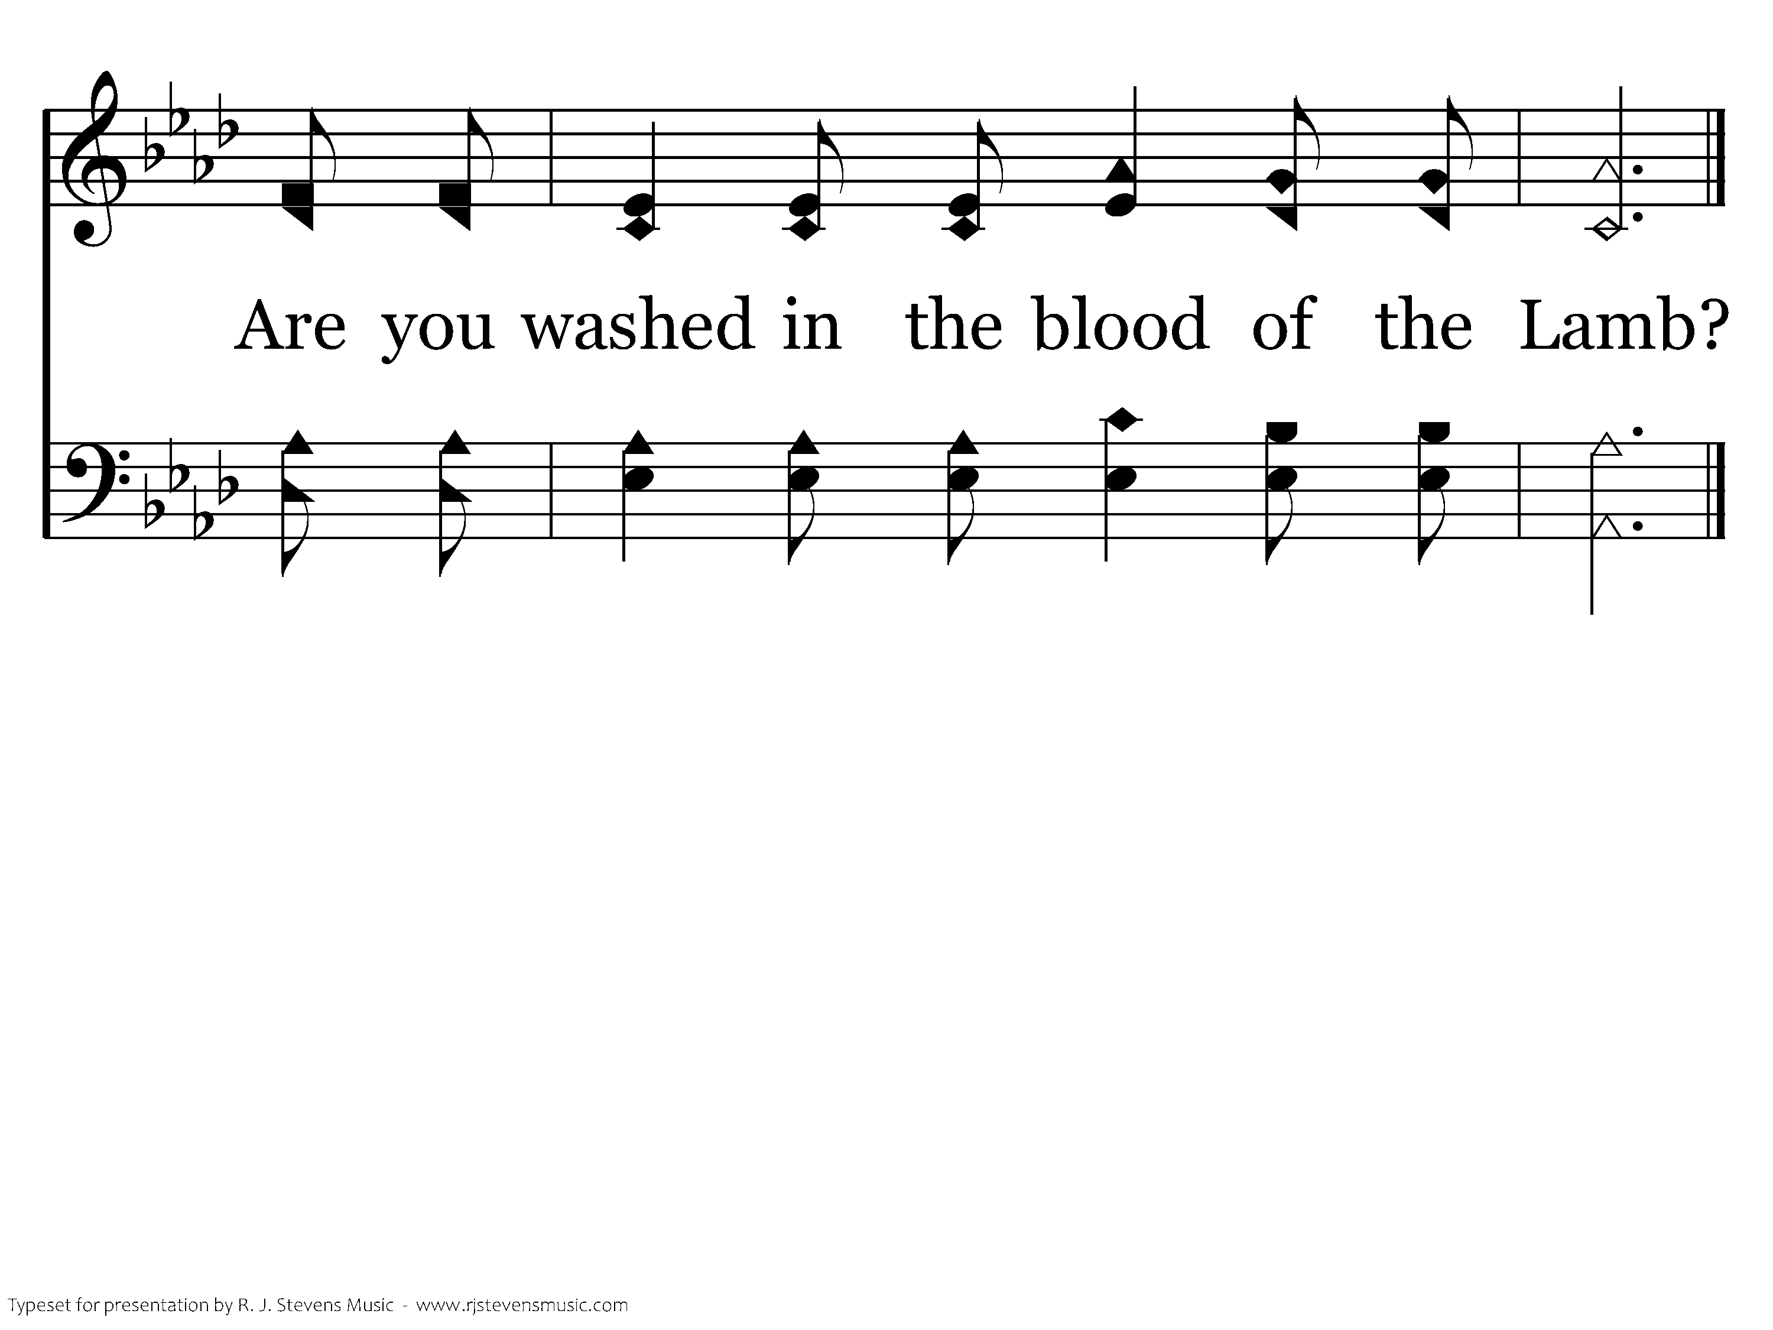
307 - Are You Washed In The Blood - C.4
End of Verse 1

Slide 65
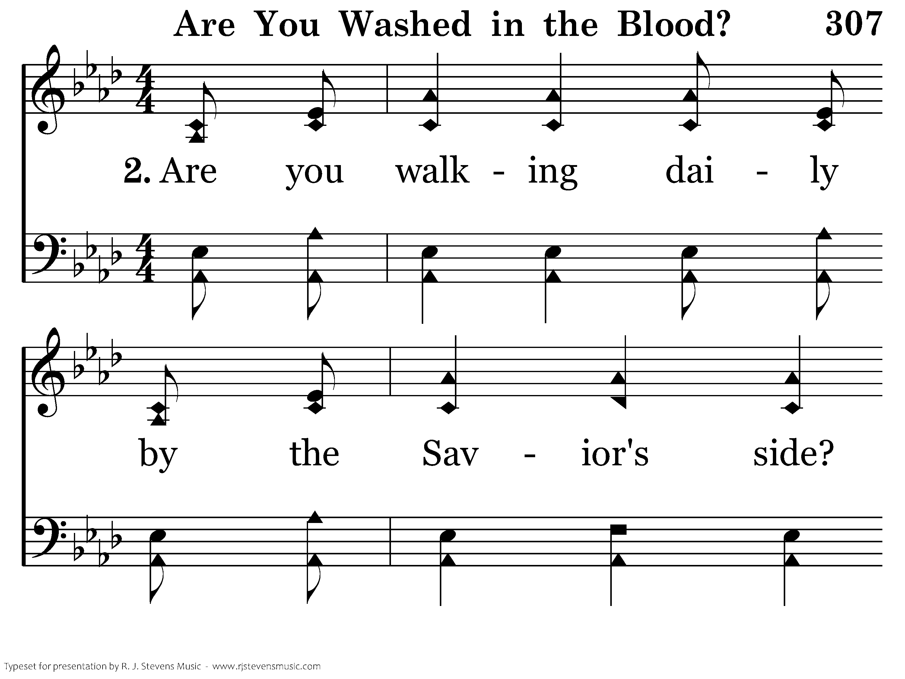
307 - Are You Washed In The Blood - 2.1

Slide 66
307 - Are You Washed In The Blood - 2.2

Slide 67
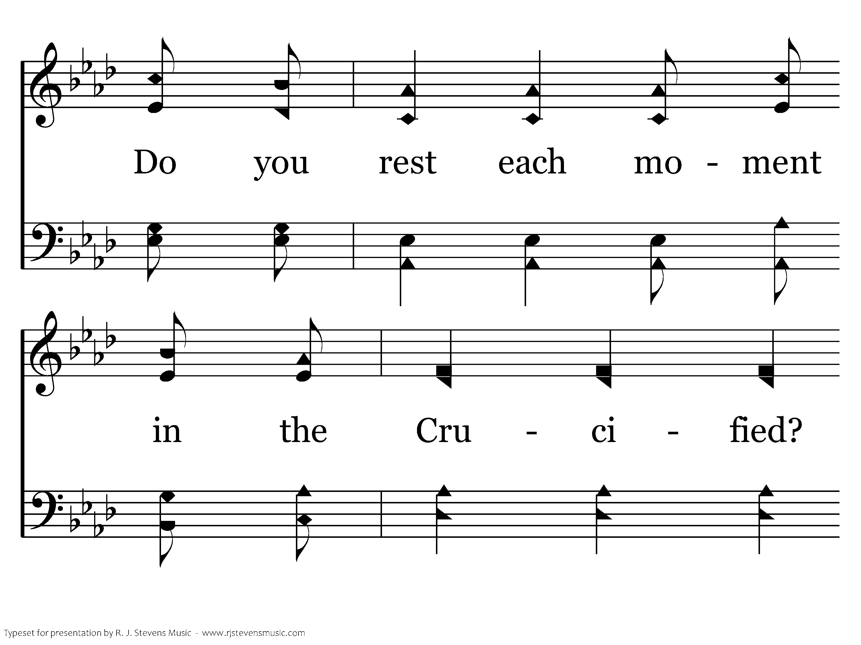
307 - Are You Washed In The Blood - 2.3

Slide 68
307 - Are You Washed In The Blood - 2.4

Slide 69
307 - Are You Washed In The Blood - C.1

Slide 70
307 - Are You Washed In The Blood - C.2

Slide 71
307 - Are You Washed In The Blood - C.3

Slide 72
307 - Are You Washed In The Blood - C.4
End of Verse 2

Slide 73
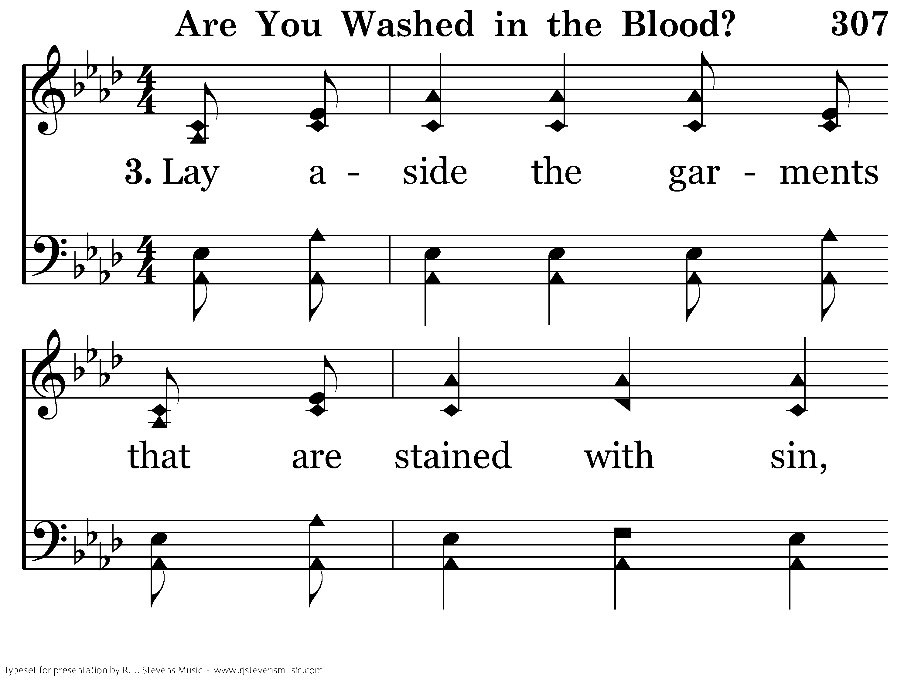
307 - Are You Washed In The Blood - 3.1

Slide 74
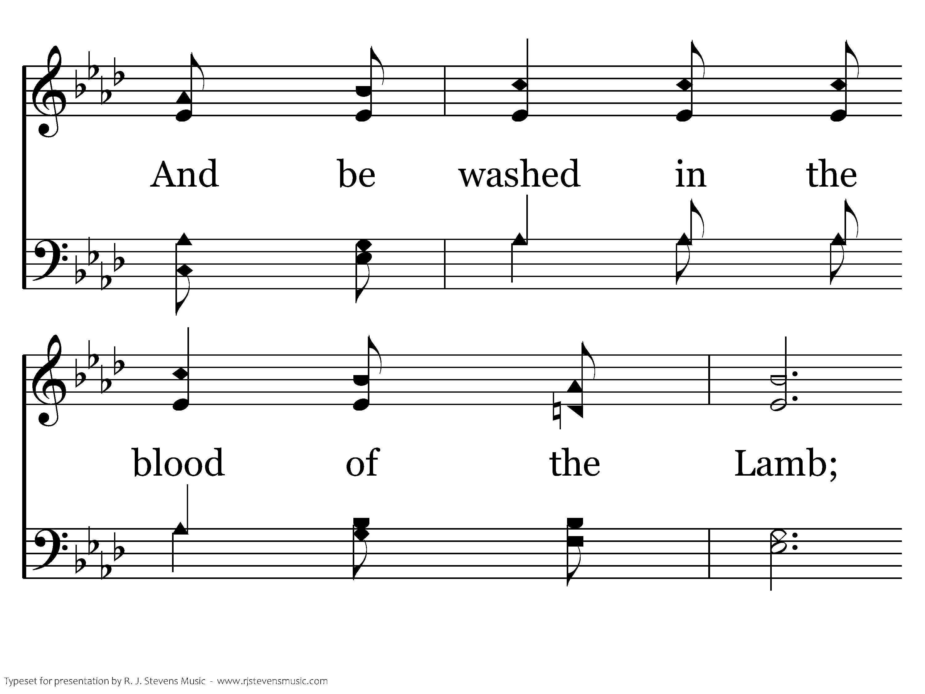
307 - Are You Washed In The Blood - 3.2

Slide 75
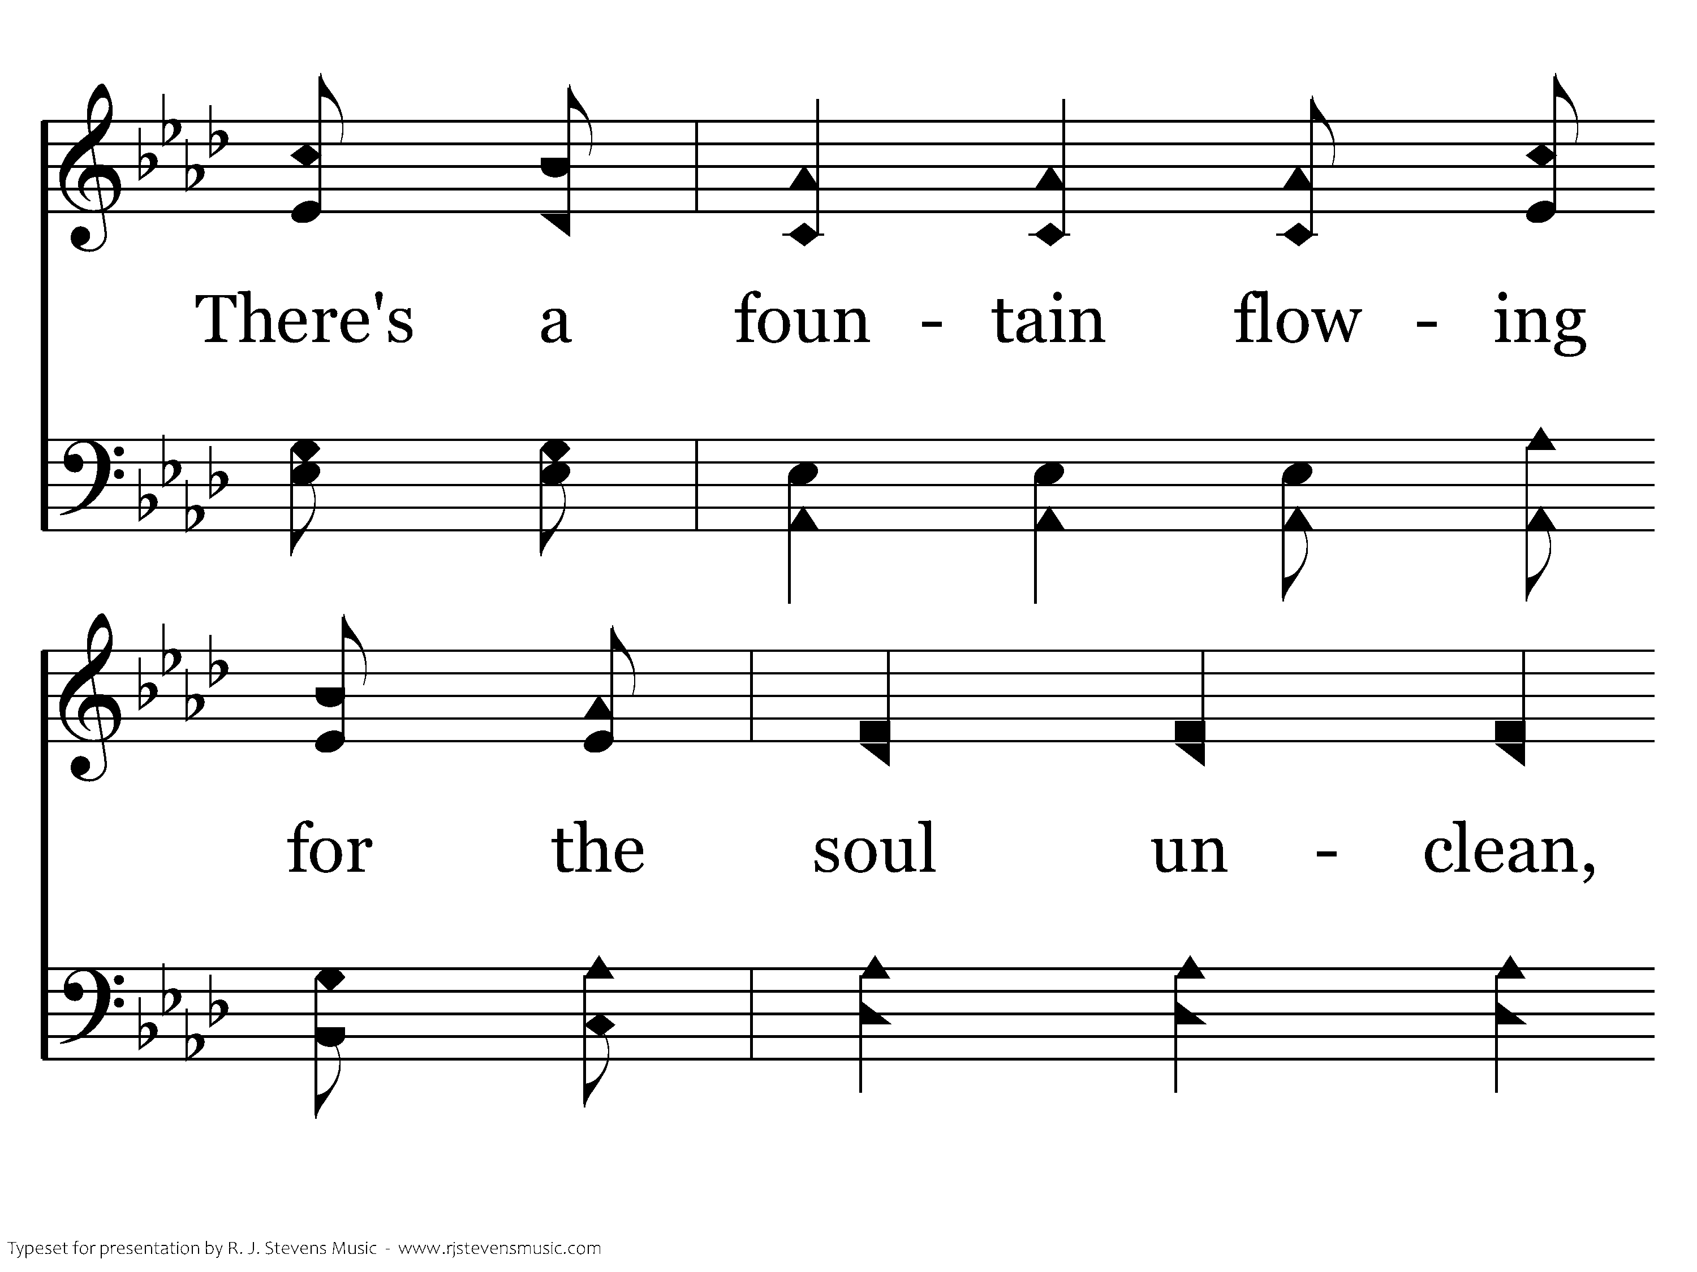
307 - Are You Washed In The Blood - 3.3

Slide 76
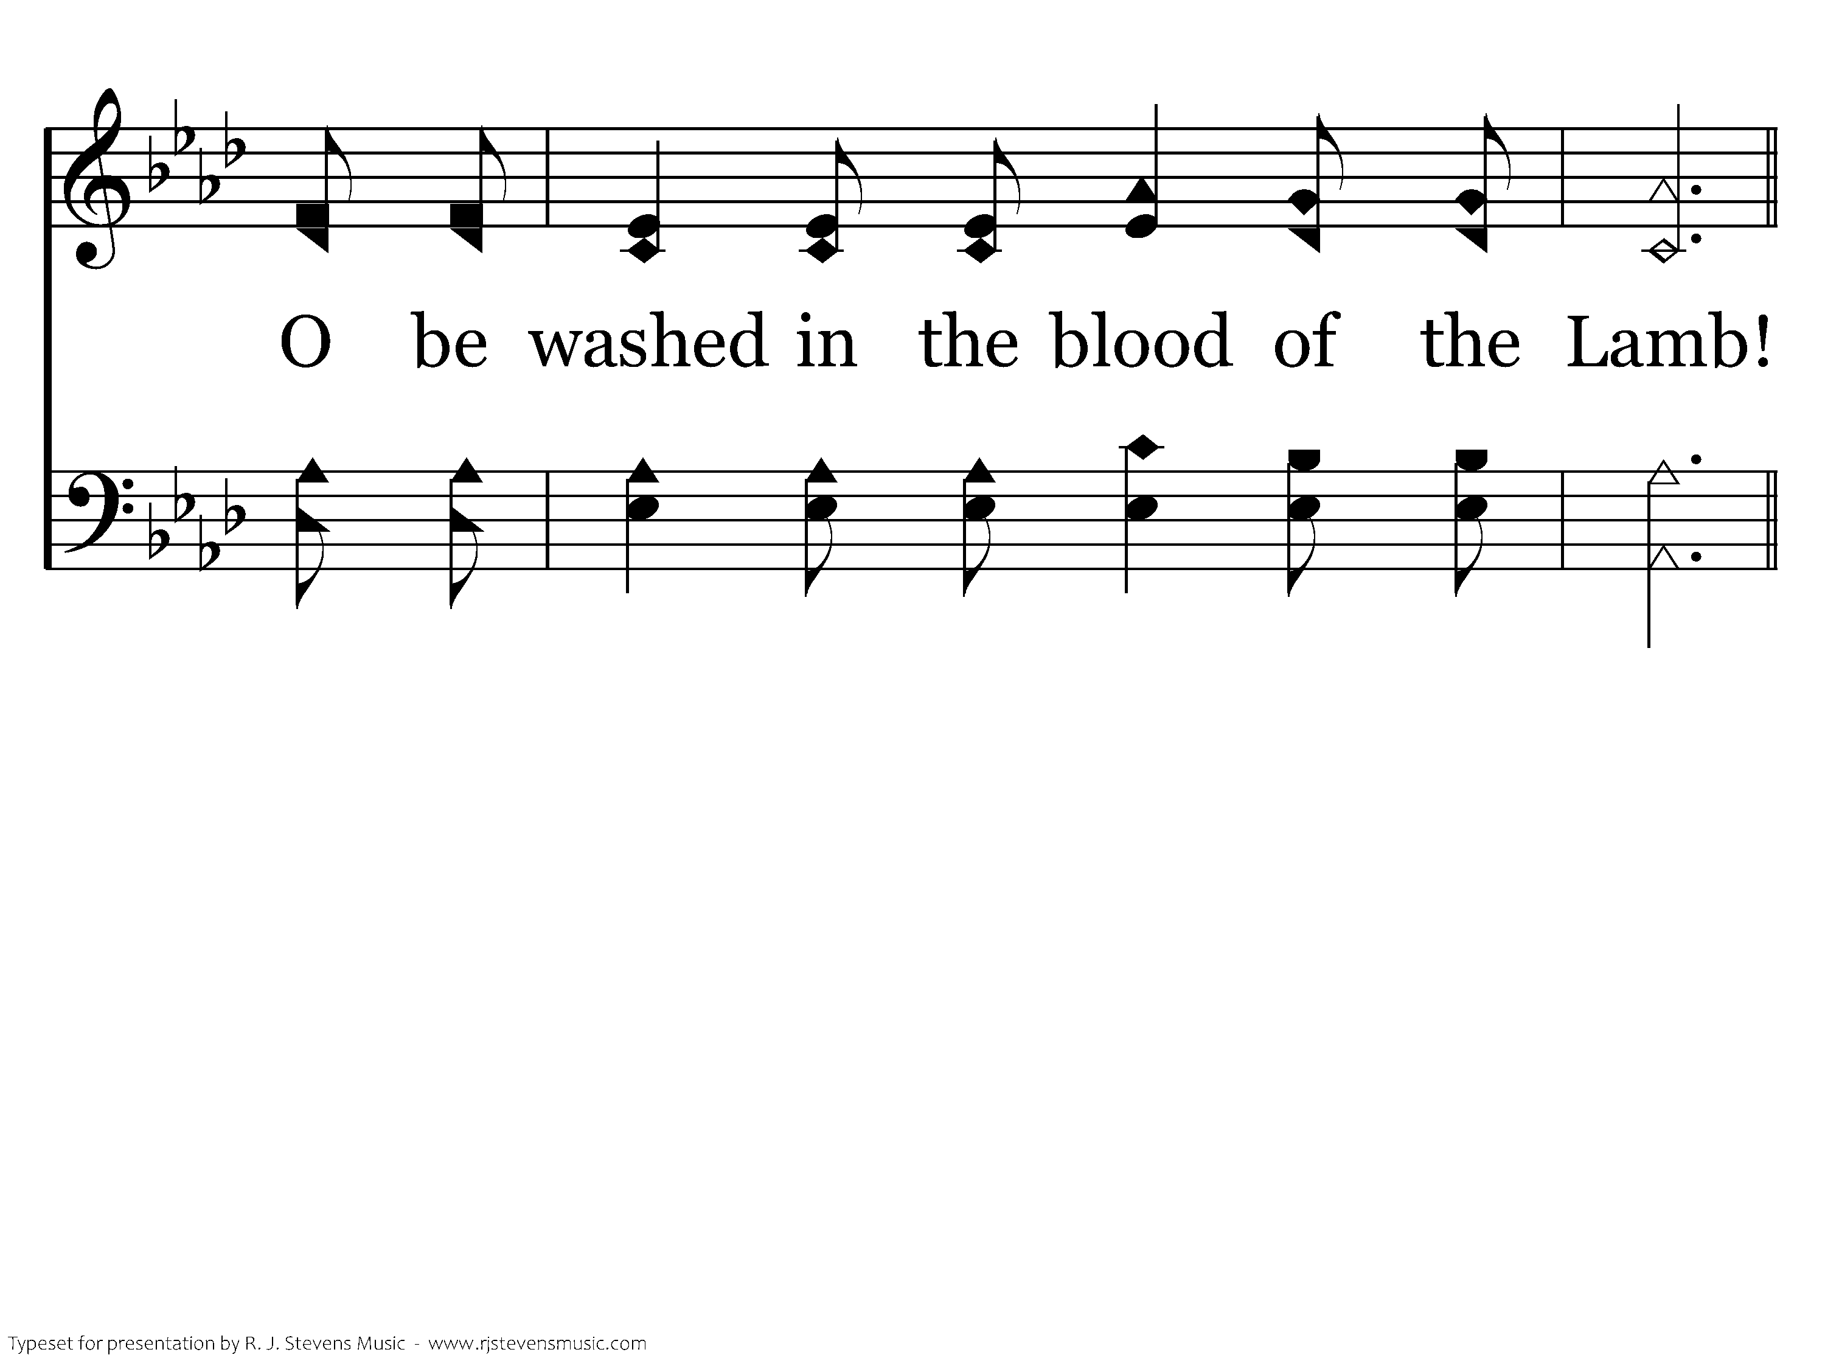
307 - Are You Washed In The Blood - 3.4

Slide 77
307 - Are You Washed In The Blood - C.1

Slide 78
307 - Are You Washed In The Blood - C.2

Slide 79
307 - Are You Washed In The Blood - C.3

Slide 80
307 - Are You Washed In The Blood - C.4
End of Song

Slide 82

660 - I Will Sing Of The Mercies - Title

Slide 83
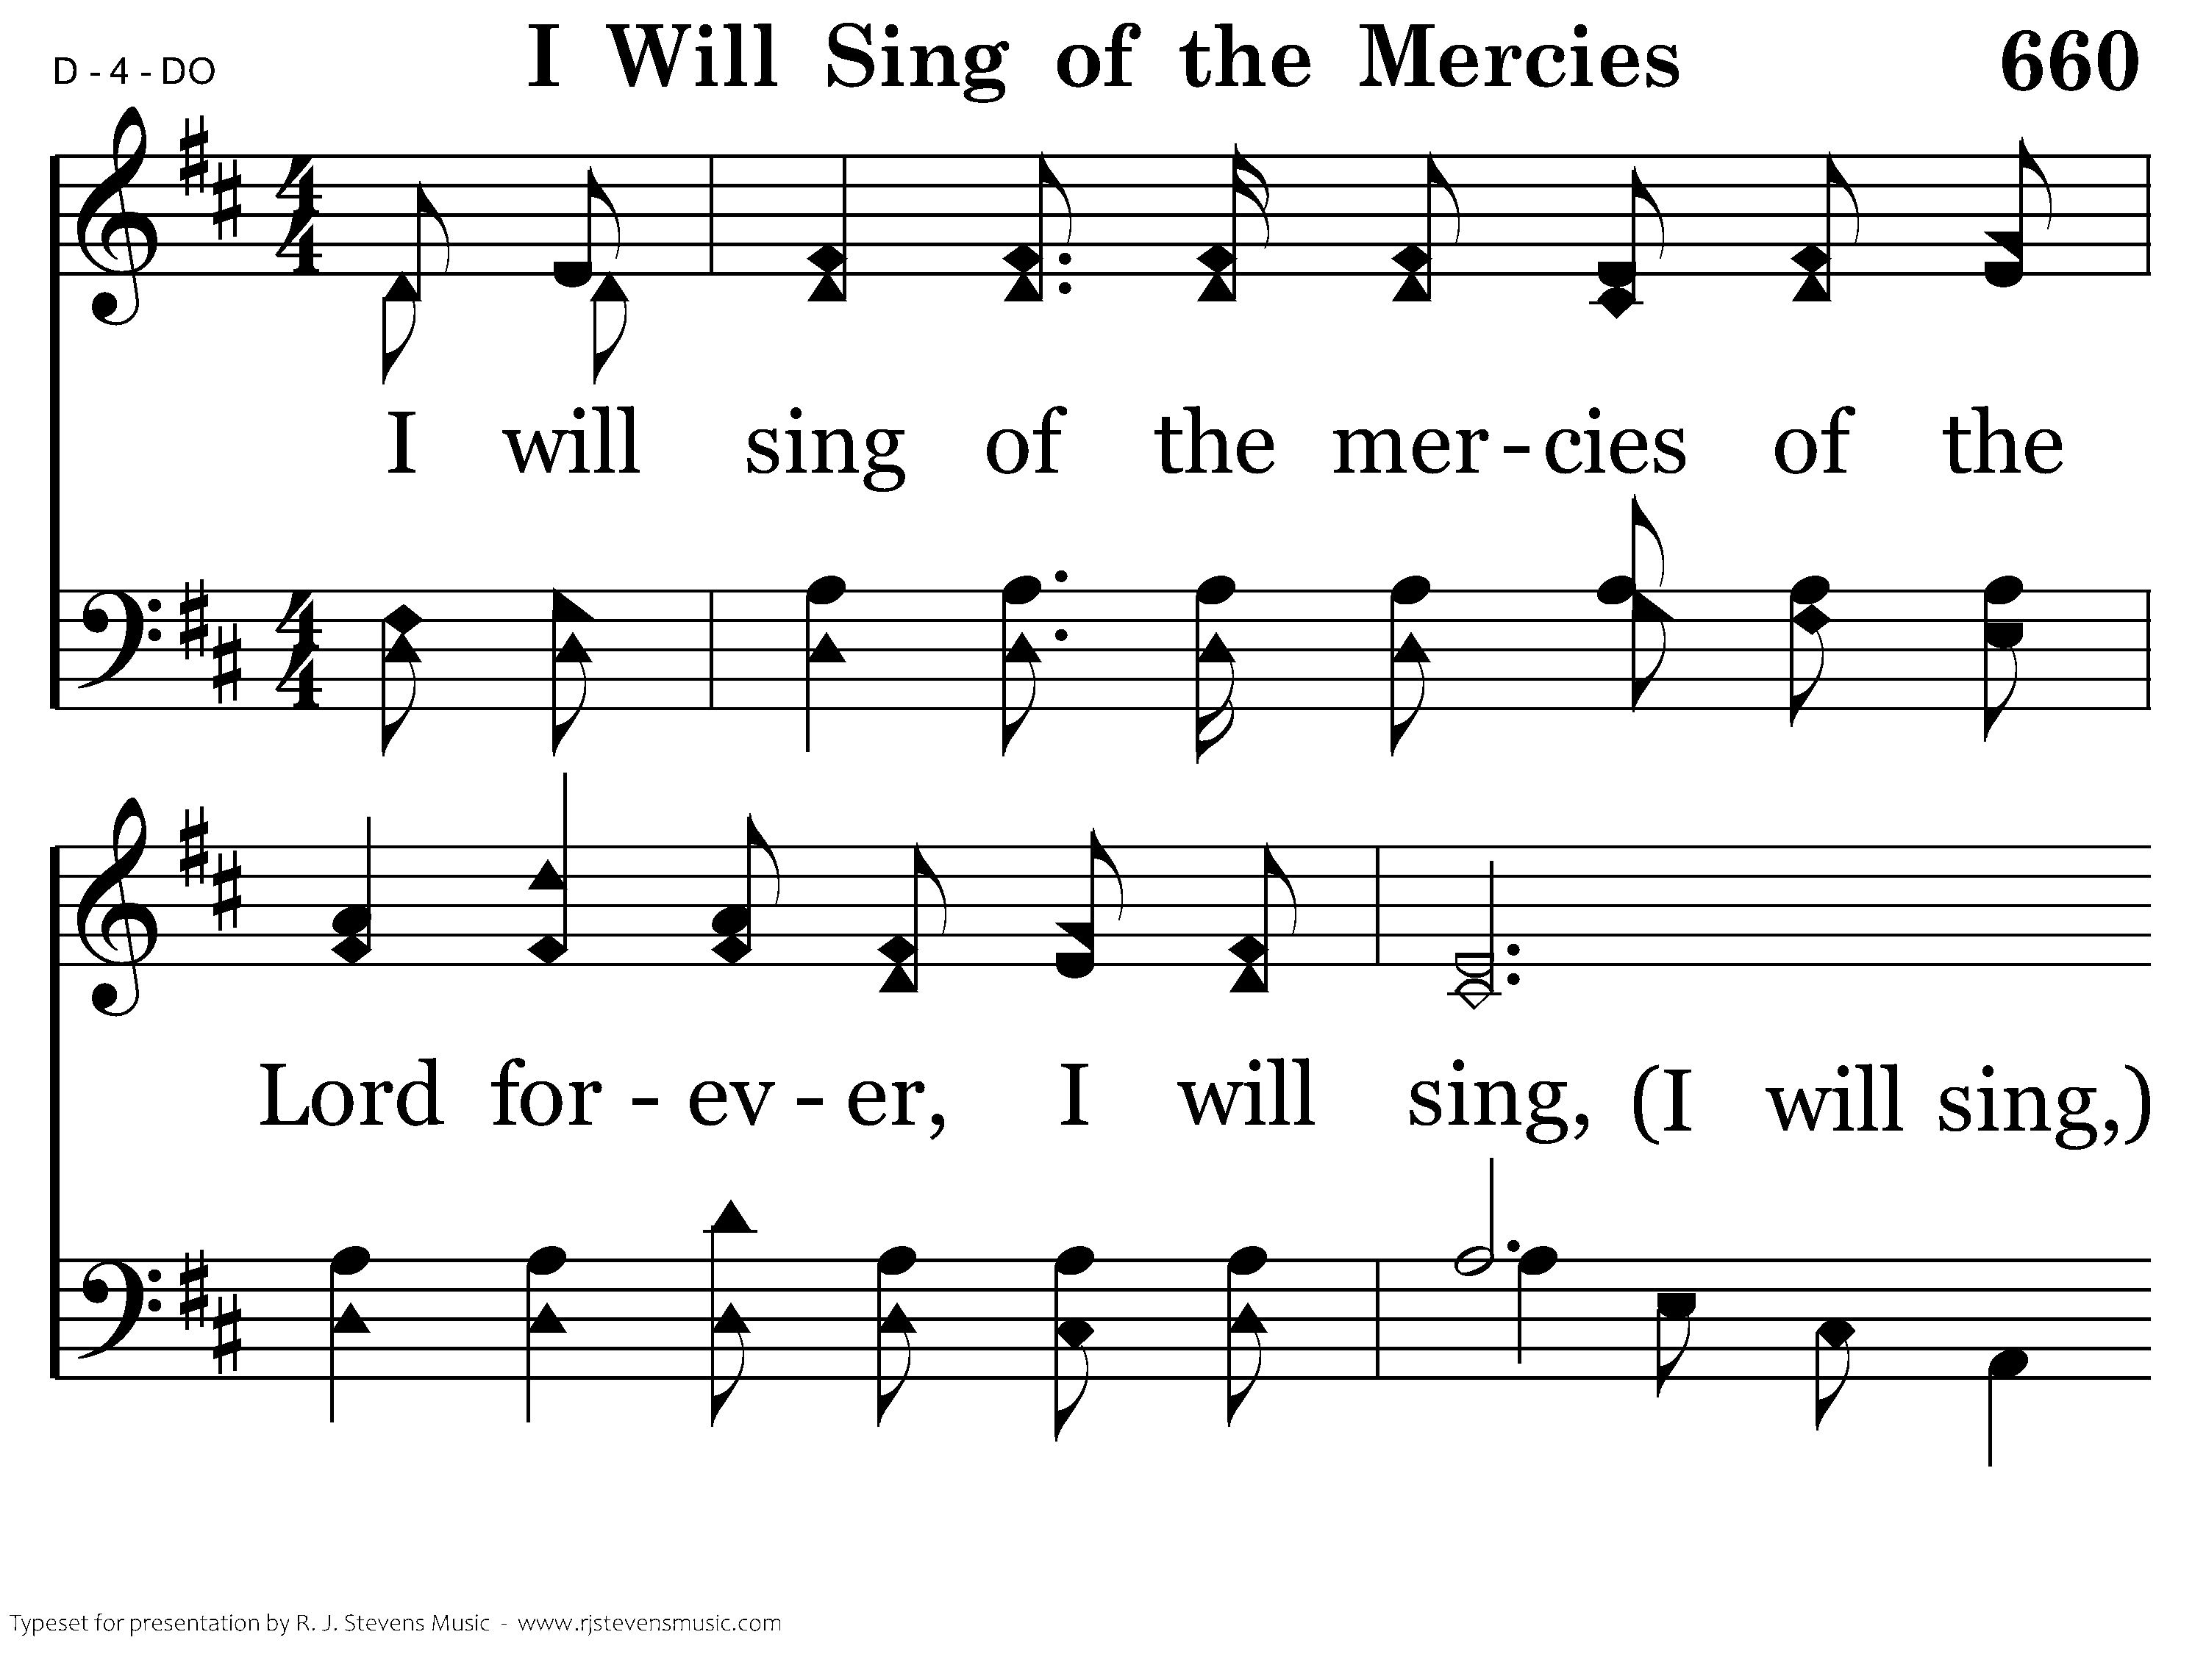
660 - I Will Sing Of The Mercies - 1.1

Slide 84
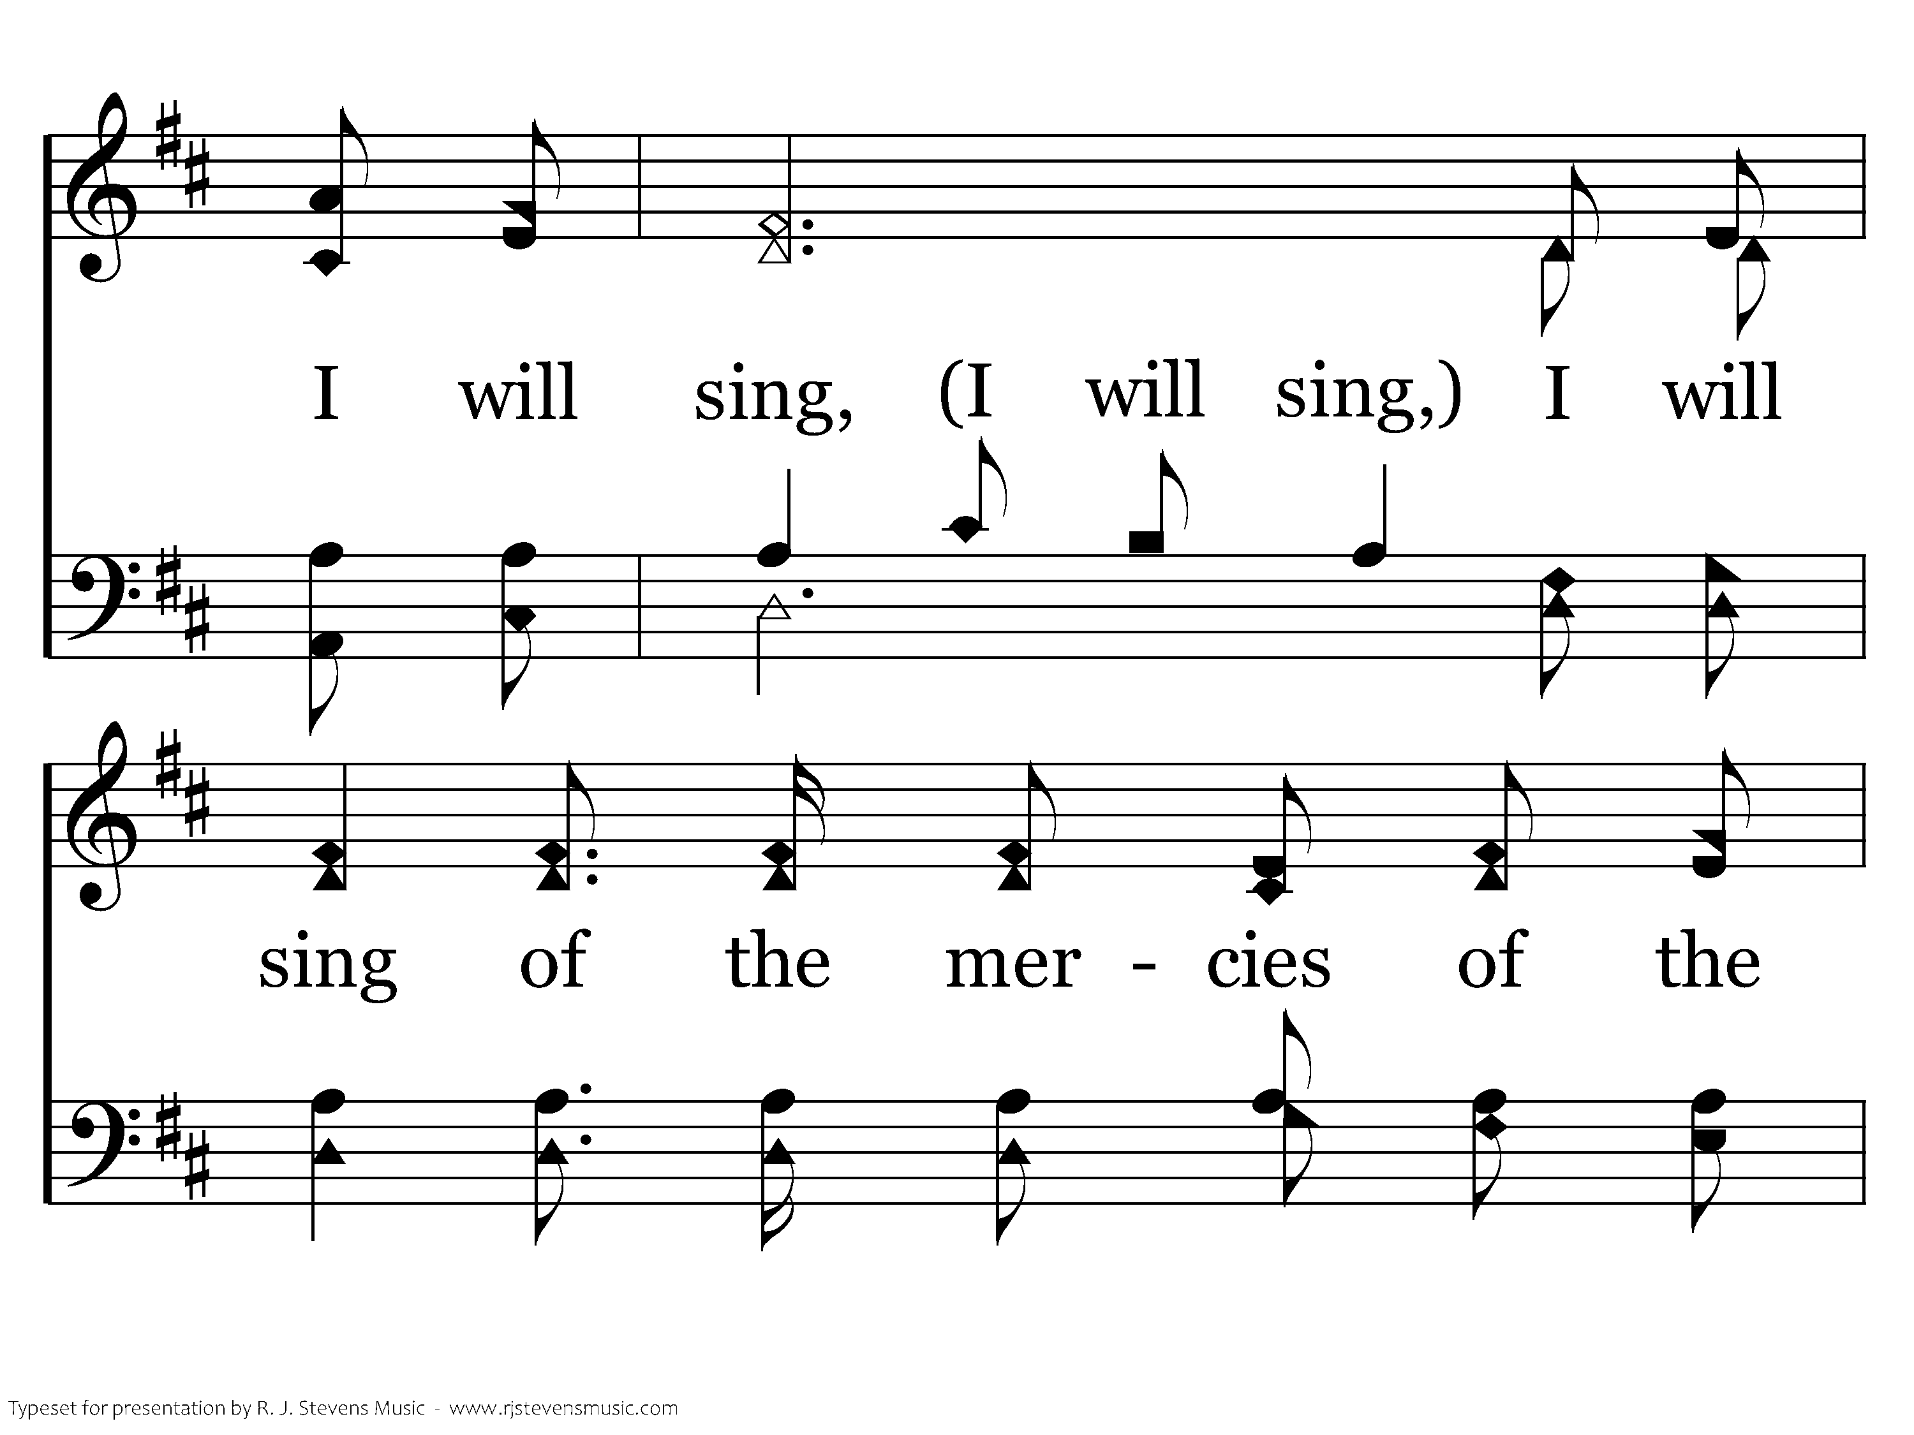
660 - I Will Sing Of The Mercies - 1.2

Slide 85
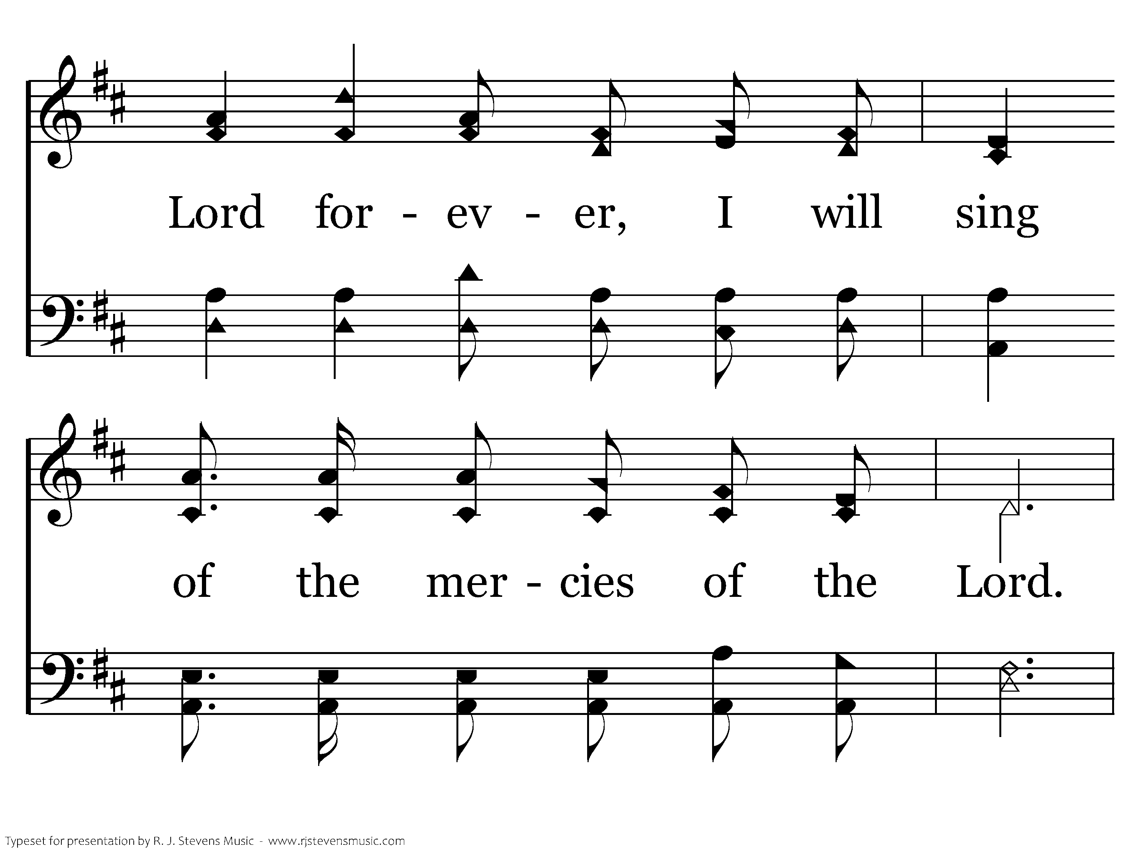
660 - I Will Sing Of The Mercies - 1.3

Slide 86

660 - I Will Sing Of The Mercies - 1.4

Slide 87

660 - I Will Sing Of The Mercies - 1.5

Slide 88

660 - I Will Sing Of The Mercies - 1.6

Slide 89

660 - I Will Sing Of The Mercies - 1.7

Slide 90

660 - I Will Sing Of The Mercies - 1.8

Slide 91

660 - I Will Sing Of The Mercies - 1.9
End of Song

