Slide 1
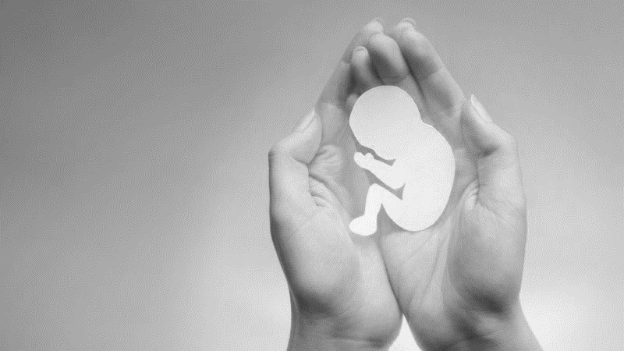
Life in the Womb
“Abortion”

Slide 2
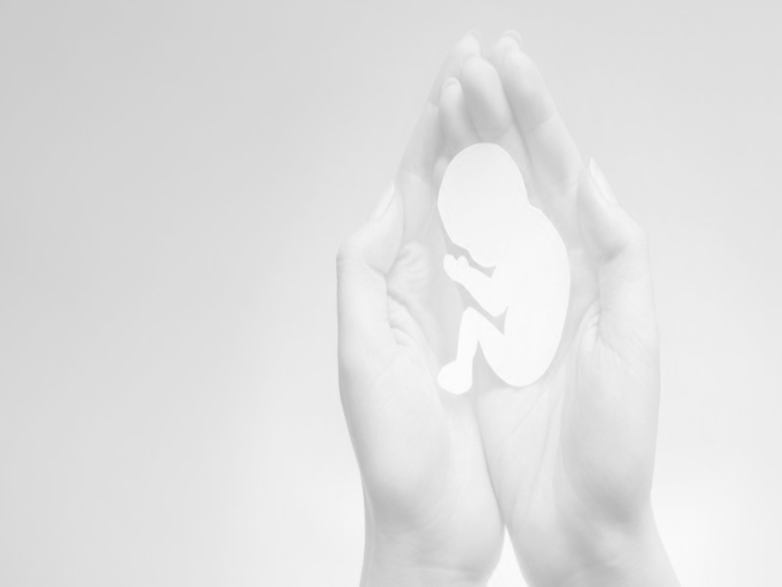
Children Are a Gift from God
Psalm 127:3 children are a heritage from the Lord
Psalm 127:4-5 blessed is the man who fills his quiver
  Psalm 128

Slide 3
God Knew Us in
Our Mother’s Womb
Jeremiah 1:4-5 I knew you
  Isaiah 49:1
Psalm 139:13-16 You formed my inward parts
Job 10:8-12 your hand fashioned and made me
  Job 31:15

Slide 4
Life in the Womb
Luke 1:41-44 baby leaped for joy
  Luke 2:12 baby (brephos)
Genesis 25:22 children struggled together
  Genesis 25:22 children (ben)

Slide 5
The Helpless
Proverbs 6:16-19 hands that shed innocent blood
Psalm 82:3-4 rescue the weak
Proverbs 24:10-12 does not He who weighs the heart perceive it
Exodus 1:15-21 Shiphrah and Puah

