Slide 1
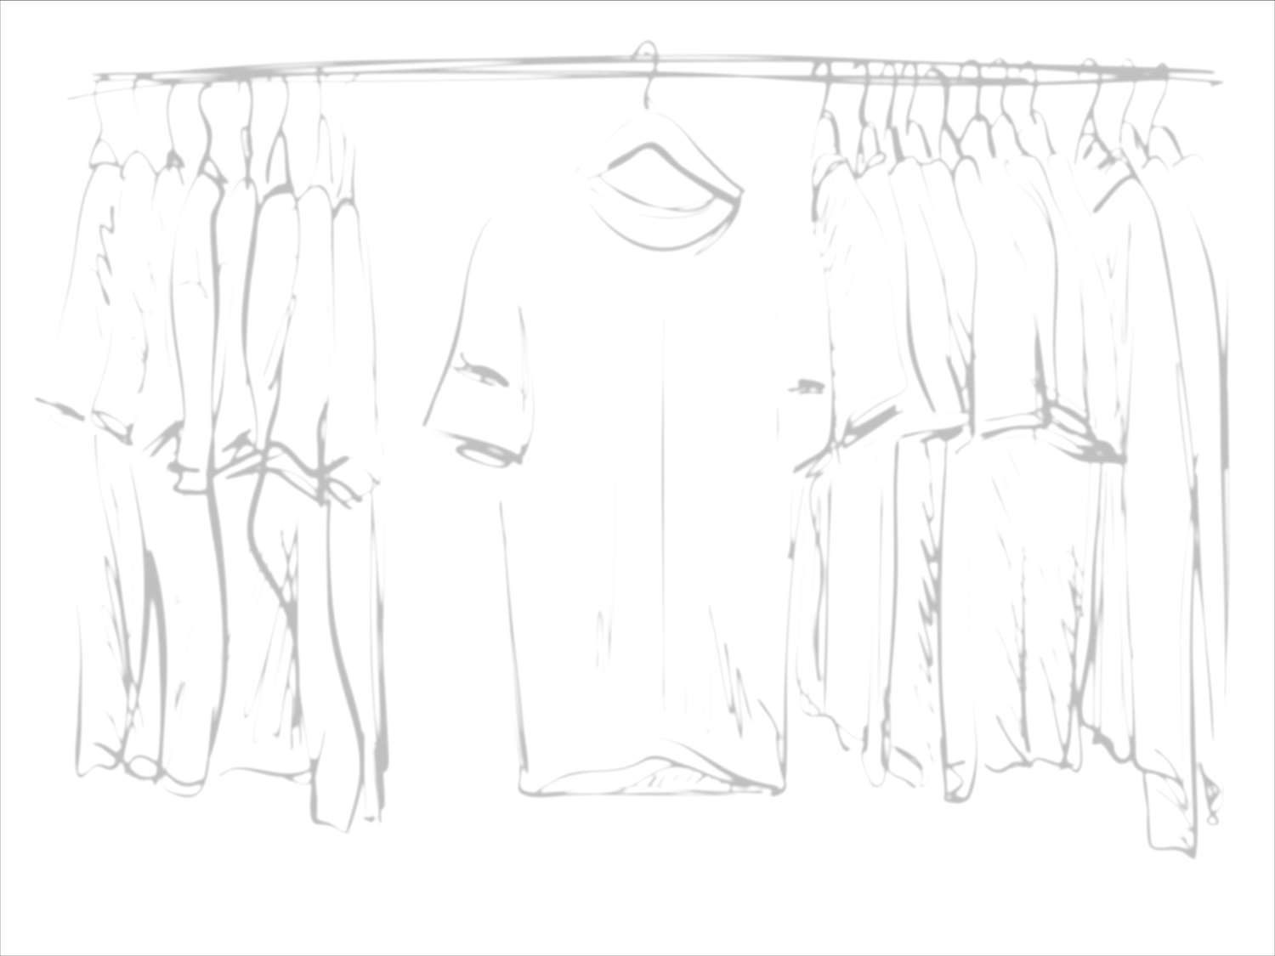
Modesty
What The Word of God
Has Revealed on

Slide 2
1 Timothy 2:8-10
Holy hands
  Men
Likewise
Claim to godliness
  Women
2 Peter 1:3 life and godliness

Slide 3
Important Words To Look At
“modest apparel” is derived from kosmios,
  1 Timothy 3:2, 1 Peter 3:3-4
“shamefacedness” from aidos,
  Jeremiah 6:15, 8:12, 2 Thessalonians 3:14-15, Micah 1:11
“sobriety” from sophrosune.
  1 Timothy 2:15

Slide 4
Since the Beginning
Genesis 2:25 not ashamed
Hebrews 13:4 the marriage bed is undefiled
1 Corinthians 7:1-7 so that Satan will not tempt
Genesis 3:7-10 afraid to be seen naked

Slide 5
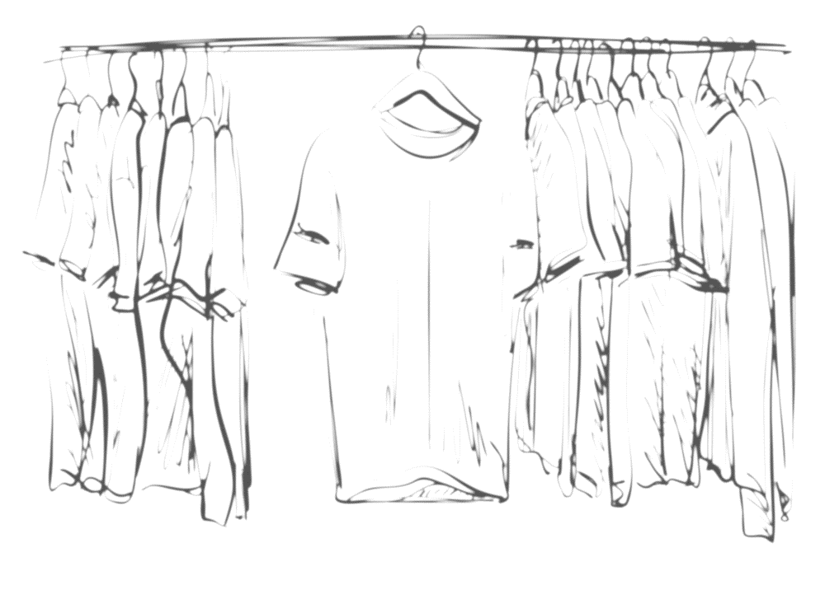
Nakedness or Covered
Genesis 3:7,10 aprons, coverings, loin coverings, loin cloths
Genesis 3:21 God made tunics
Exodus 28:40-43 linen trousers waist to the thighs (under the outer garments)
  Exodus 20:25-26 not go up steps

Slide 6
Nakedness or Covered
Isiah 47:2-3 uncover the thigh… your nakedness shall be uncovered
2 Samuel 10:4 cut the garments in the middle
  Isaiah 20:1-4
Proverbs 5:15-20 let them be only your own
  Ezekiel 16:7-8
Proverbs 11:22 beautiful woman without discetion

