Slide 1
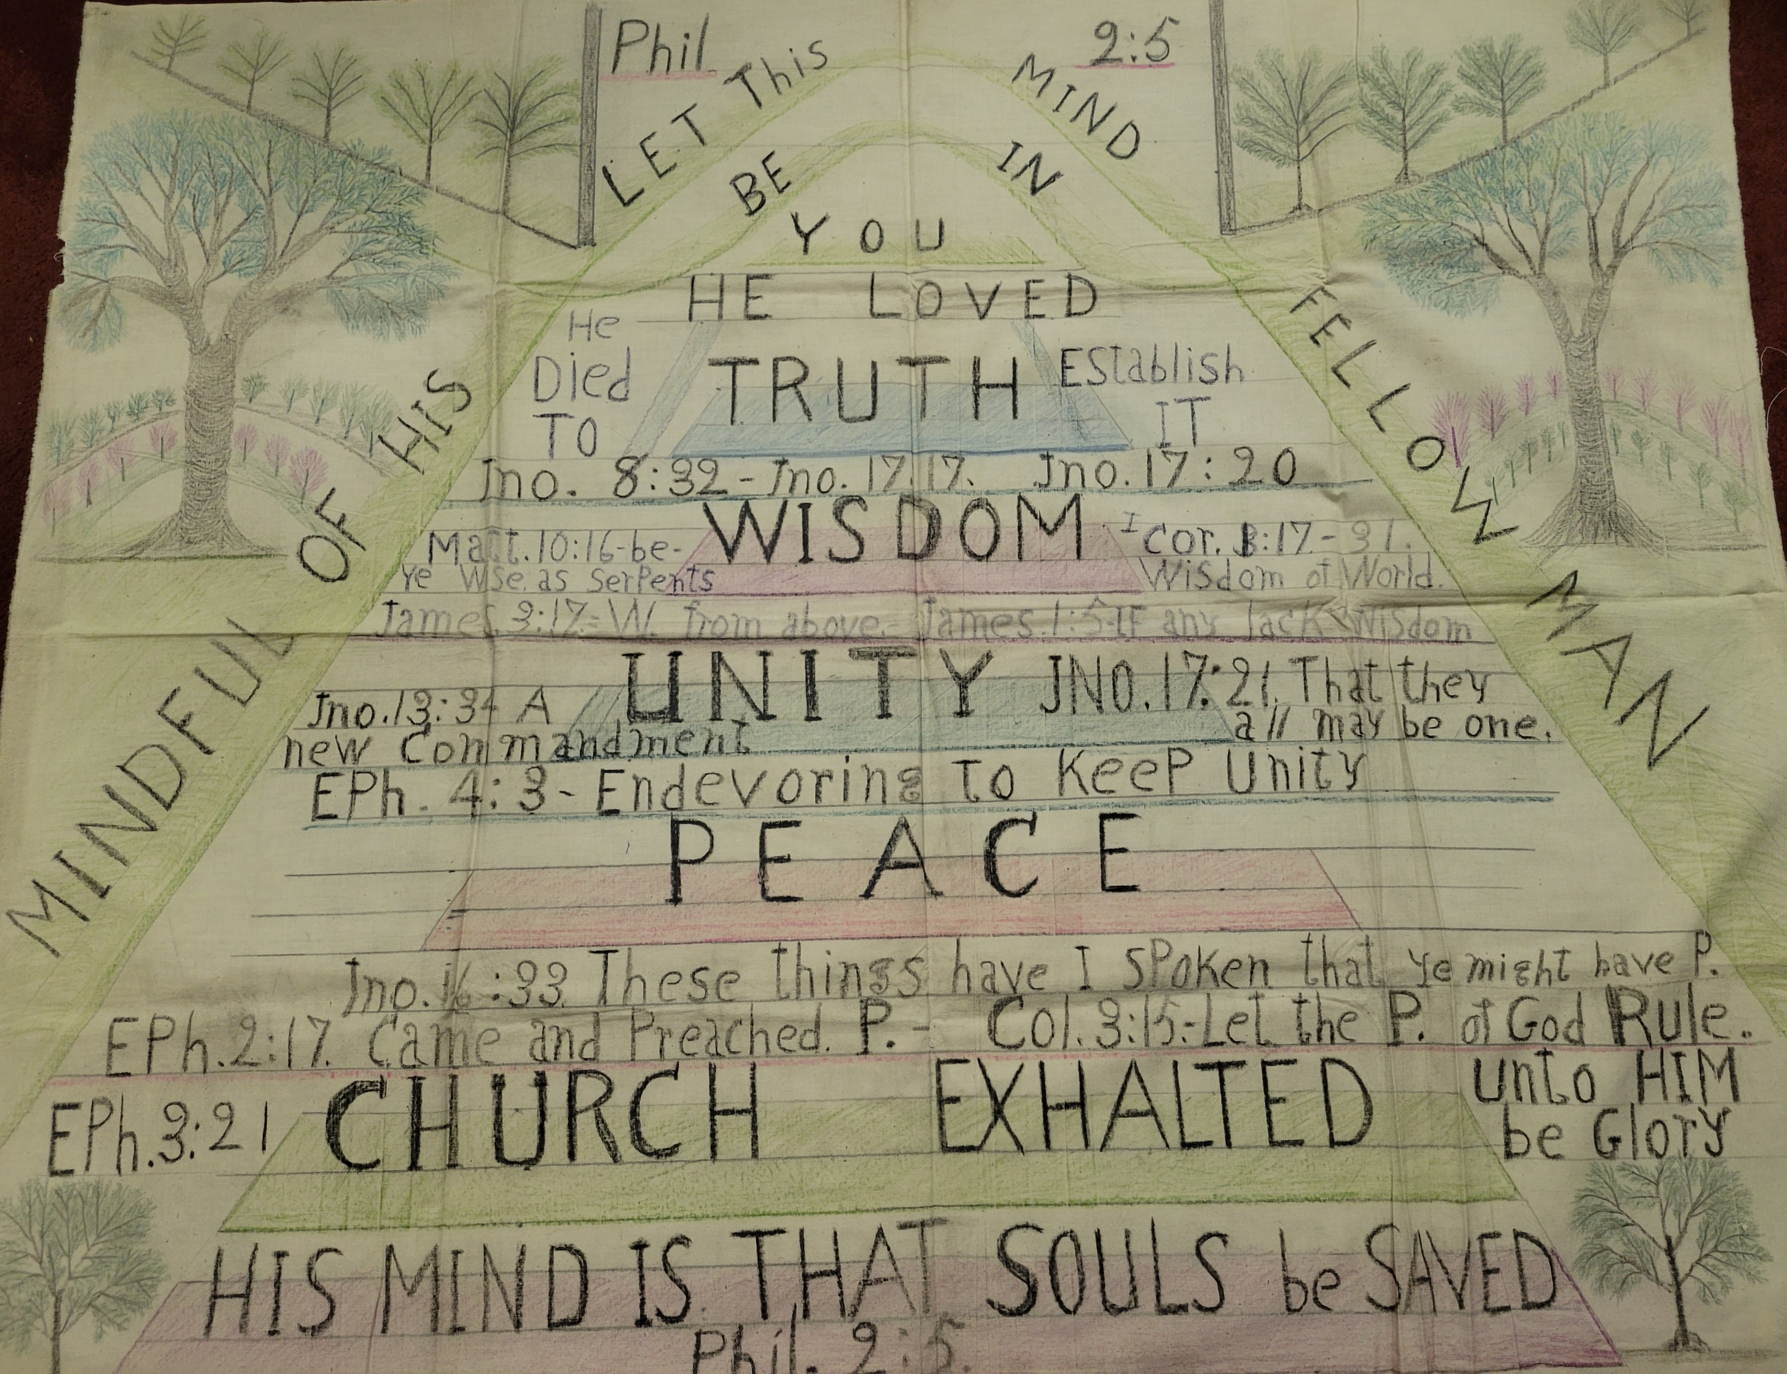

Slide 2

Mind Like Christ
Philippians 2:5

Slide 3
Truth
John 8:31-32 the truth will set you free
John 17:17-20 sanctify them in the truth

Slide 4
Wisdom
Matthew 10:16 wise as serpents
1 Corinthians 1:18-31 wisdom of God vs. wisdom of the world
James 1:5 any who lack wisdom should ask of God
James 3:17 wisdom from above

Slide 5
Peace
John 16:33 in Christ we may have peace
Ephesians 2:17 preached peace
Colossians 3:15 peace of Christ rule in you hearts

Slide 6
Unity
John 13:34 new commandment … love one another
Ephesians 4:1-6 unity of the Spirit
John 17:21 all be one

Slide 7
Church Exalted
Ephesians 3:21 to Him be glory in the church

