Slide 1
Not A Mistake nor an Accident

Slide 2
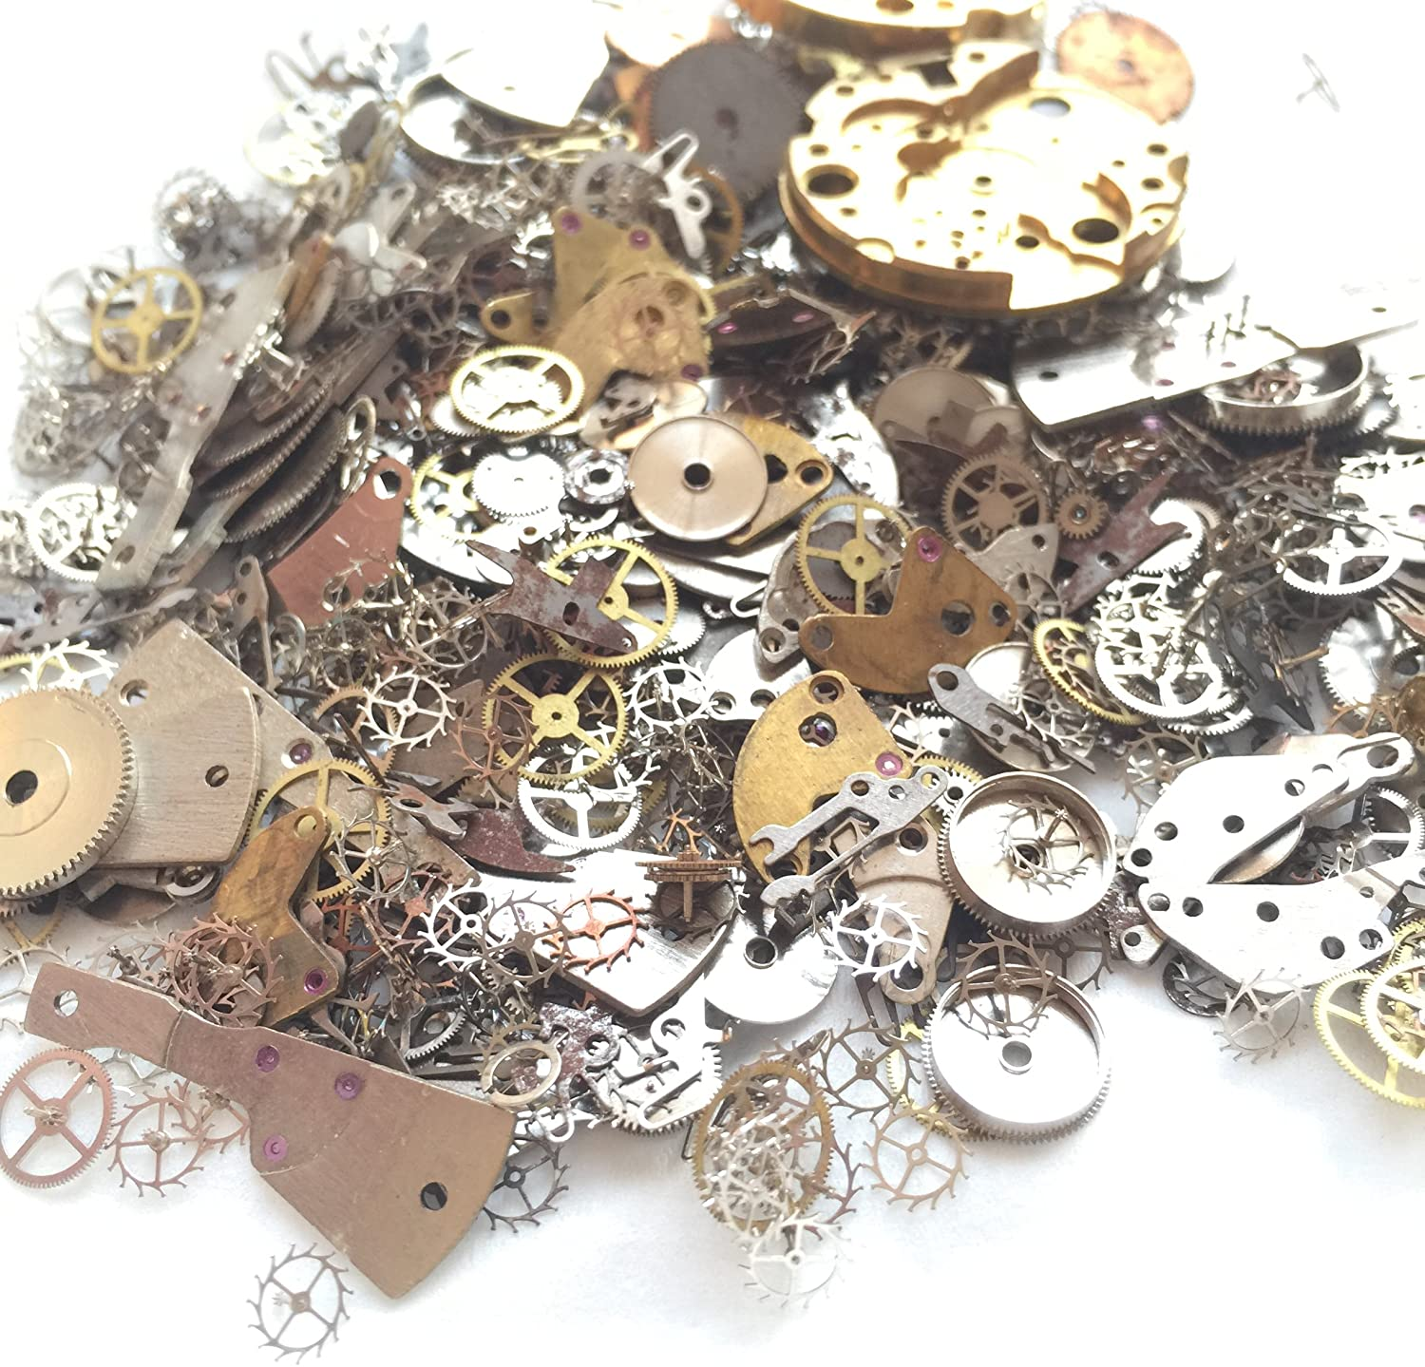
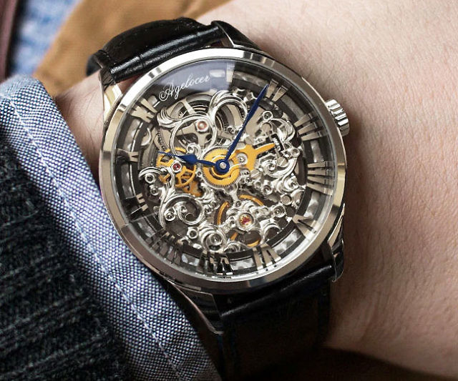

Slide 3
Genesis 1
It Was Good

Slide 4
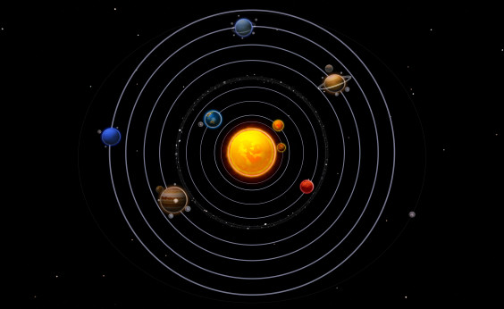

Slide 5
Genesis 1
It Was Good

Slide 6
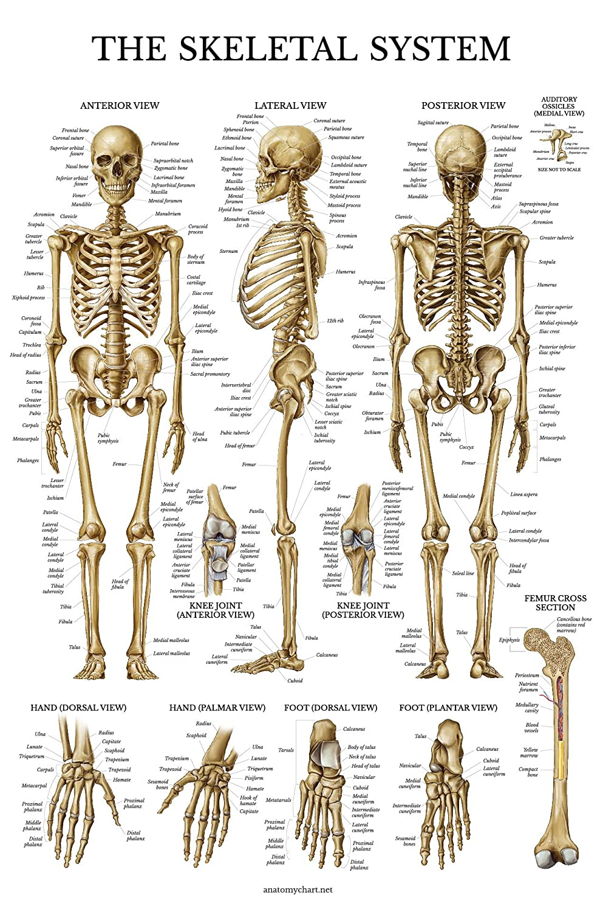

Slide 8
Genesis 1
It Was Good

