Slide 1
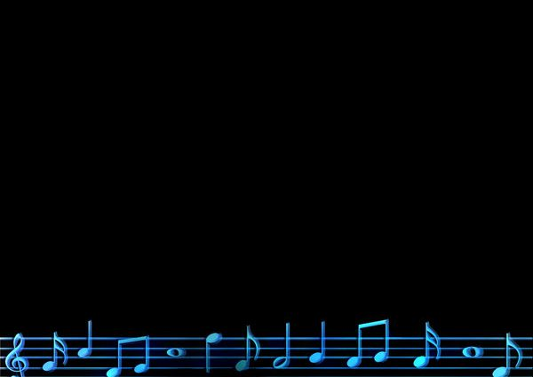
Singing

Slide 2
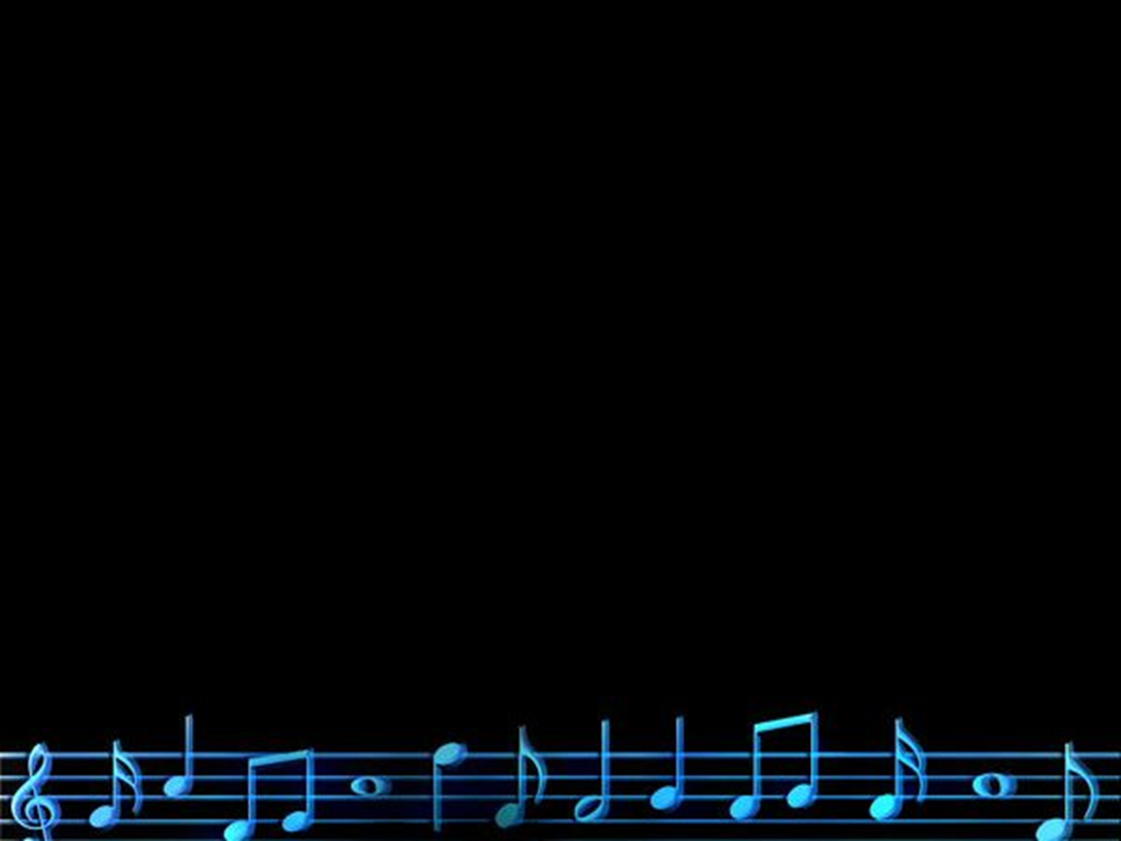
Instruments In The NT
1 Cor. 14:7-8 trumpet… battle
Matt. 6:2 sound the trumpet before you
Matt. 24:31 send His angels with a great sound of a trumpet (1 Cor. 15:52)
Heb. 12:19 sound of a trumpet (Rev. 1:10, Rev. 4:1, Rev. 8:13, Rev. 9:14)
Instruments
Rom. 6:13 instruments of righteousness

Slide 3
Music In The NT
Matt. 26:30 sung
Mark 14:26 sung
Acts 16:25 singing
Rom. 15:9 sing
1 Cor. 14:15 sing
Eph. 5:19 songs, singing
Col. 3:16 songs, singing
Heb. 2:12 sing
James 5:13 sing

Slide 4
How Are We To Sing?
Eph. 5:19 melody in our hearts
Col. 3:16 grace in your hearts
1 Cor. 14:15 sing with understanding and in spirit

Slide 5
Why We Sing
James 5:13 we are happy
Col. 3:16, Eph. 5:19 teach and admonish one another
Rom. 15:9 sing to His name
Heb. 2:12 I will sing praise to you

