Slide 1

Combatting Financial Fraud: Enhancing Payment Security
Stephen M. Flores, CTP
Senior Vice President, Director of Strategic Client Relations

Slide 2
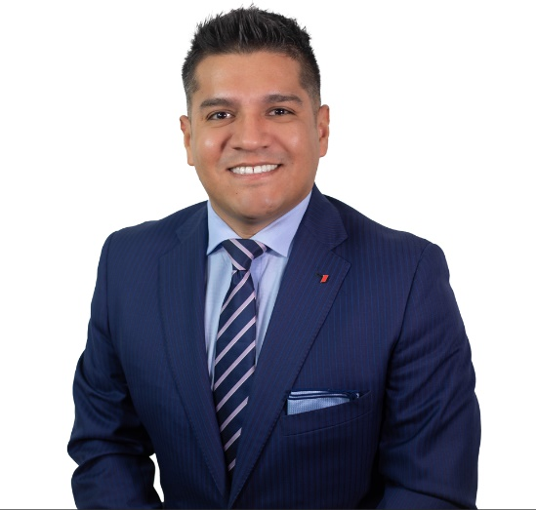
Stephen M. Flores, CTP
Over 16 years of experience in Treasury Management, Commercial Banking and Public Funds.
In his current role at First Financial Bank, Stephen leads strategic client relations efforts for top-tiered commercial, treasury management, and public fund relationships across the state of Texas. He is responsible for developing and executing dynamic sales strategies, collaborating closely with executive leadership, and driving cross-functional collaboration to deliver integrated solutions to clients.
Stephen holds a Bachelor of Business Administration (BBA) with a concentration in Finance from Texas A&M University – Corpus Christi. He is also a graduate of the Southwestern Graduate School of Banking at SMU (SWGSB). Additionally, he is certified as a Certified Treasury Professional (CTP) and is a Certified Corporate Financial Planning & Analysis Professional (FP&A) Candidate.

Slide 3
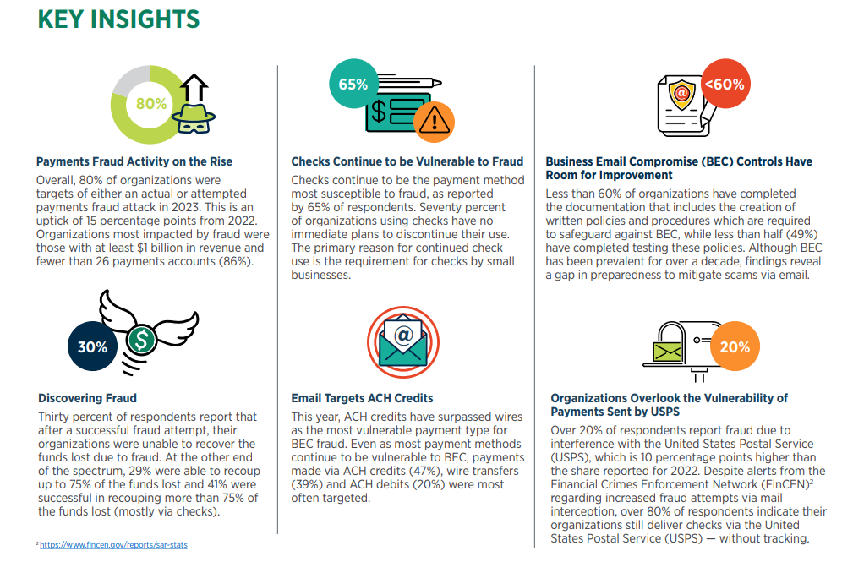

Slide 4

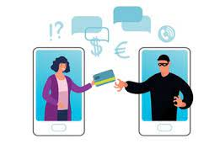


It Starts with You

Slide 5
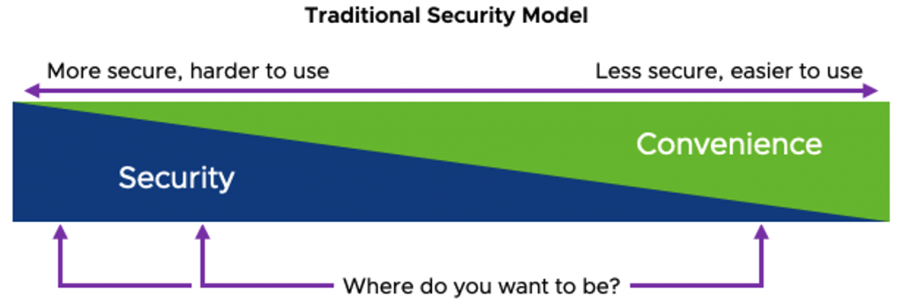
Security Vs Convenience

Slide 6
Best Practices
/
Avoid clicking on links and attachments in email, even in messages that appear to be sent from someone you have heard from previously. And as the phishing examples above demonstrate, many of today’s phishing scams use elements from hacked databases to make their lures more convincing.
Urgency should be a giant red flag. Most phishing scams invoke a temporal element that warns of negative consequences should you fail to respond or act quickly. Take a deep breath and relax. If you’re unsure whether the message is legitimate, visit the site or service in question manually (ideally, using a browser bookmark so as to avoid potential typosquatting sites).
Don’t re-use passwords. If you’re the kind of person who likes to use the same password across multiple sites, then you consider using a password manager. Some of the more popular password managers include Dashlane, Keepass, LastPass and Roboform.
Phone-based phishing uses hacked databases, too. A great many scams are perpetrated over the phone, leveraging personal and financial information gleaned from past data breaches to make them sound more believable. Remember, When in Doubt: Hang Up, Look Up, & Call Back.

Slide 7
Detecting BEC Fraud
Check
Check for correct email addresses
…@.co vs. …@.com
…@greatsuccesss.com vs. …@greatsuccess.com
…@abc-company vs. …@abc_company.com
Check for requests for secrecy or urgency
Be suspicious of “only use Reply” or “only call me at this number”
Check for consistency with earlier payments
Check prior vendor invoices for domain, timing, frequency, beneficiary, …

Slide 8
Indicators of Fraud – Text or Email
The use of the word “Kindly”
Ask for payment in USD, i.e. 1,500USD.
Vendor is insistent on a certain payment method
Payment instruction is to an out of state bank or location
A branch address in wiring instructions is a red flag!
Payment instructions are to a person’s account versus a company

Slide 9
Email Fraud- ACH Request
Good Morning Jennifer,
Here are the information as requested to set up ACH payment,
Vendor Name - Acme Construction Services
Address - 4100 Blvd, Fort Worth, TX, 76137
Contact Name - Maria Gonzalez
Telephone - (817) 813-2372
Financial Institution Information
Bank Name - Bank Of America
Address - 8001 Villa Park Drive ,Henrico , VA, 23228
Account Name - Acme Construction Services
ACH Routing Number - 063100277
Account Number- 898126952985
Account Type - Checking
Kindly notify me when it's set up.
Thanks,
Maria Gonzalez
Accounting

Slide 10
Email Fraud- ACH Request
Good Morning Jennifer,
Here are the information as requested to set up ACH payment,
Vendor Name - Acme Construction Services
Address - 4100 Blvd, Fort Worth, TX, 76137
Contact Name - Maria Gonzalez
Telephone - (817) 813-2372
Financial Institution Information
Bank Name - Bank Of America
Address - 8001 Villa Park Drive ,Henrico , VA, 23228
Account Name - Acme Construction Services
ACH Routing Number - 063100277
Account Number- 898126952985
Account Type - Checking
Kindly notify me when it's set up.
Thanks,
Maria Gonzalez
Accounting

Slide 11
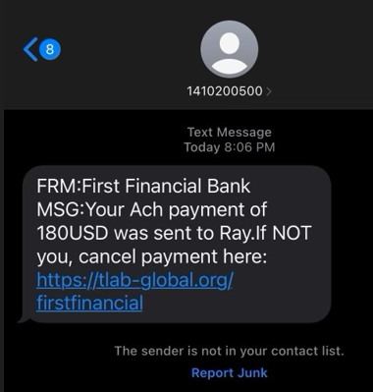
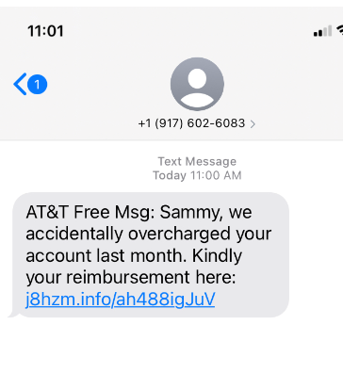
Text Message Fraud – Short Codes

Slide 12
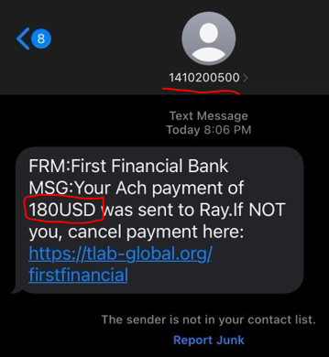
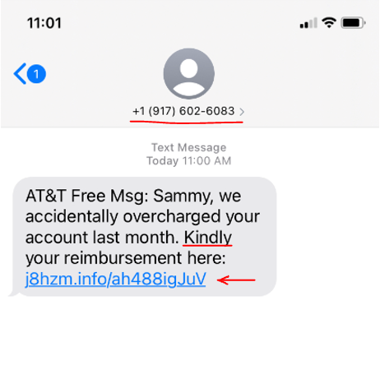
Text Message Fraud – Short Codes

Slide 13

Why is this Important?

Slide 14
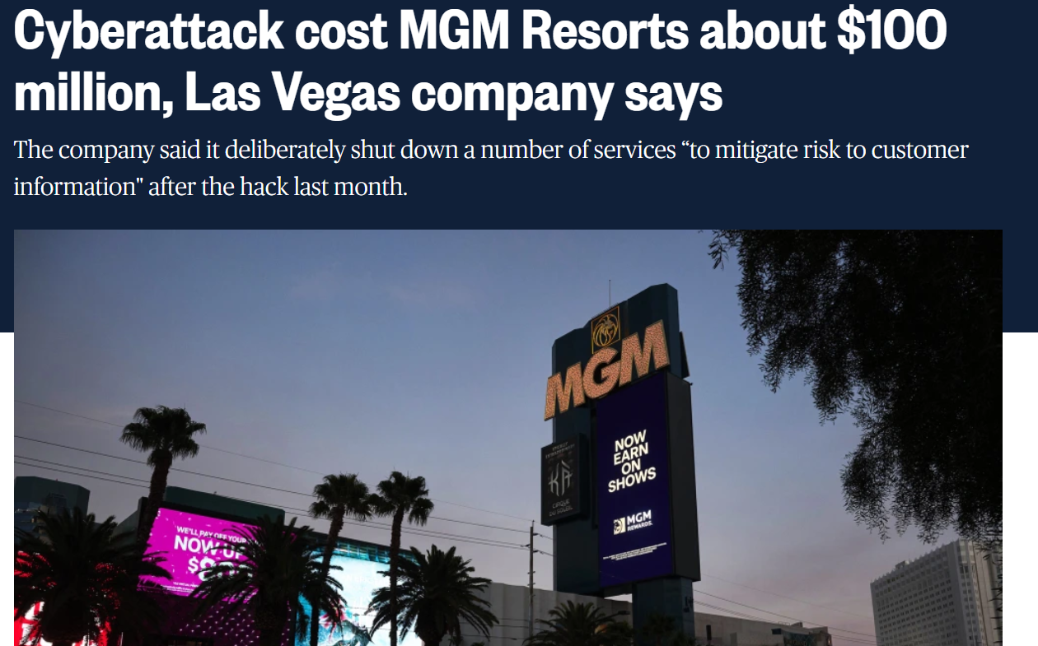
What Happens in Vegas Didn’t Stay in Vegas
The hackers reportedly found an MGM employee’s information on LinkedIn, then called the company’s IT help desk and pretended to be that employee to reset their account credentials. The cybercriminals claiming credit for the attack, a group called “Scattered Spider,” have used similar social engineering tactics in the past to infiltrate firms via phone calls (a technique sometimes called vishing, short for “voice-call phishing”).

Slide 15
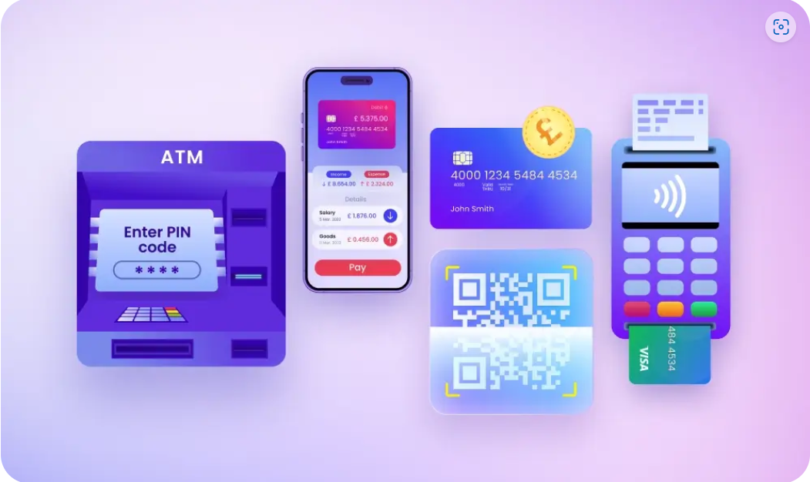
Next Steps- Protecting Your Payments

Slide 16
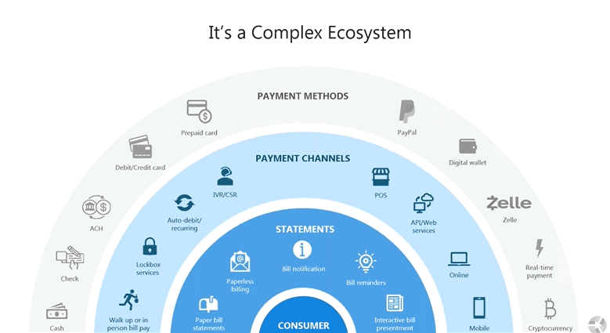
Payment EcoSystem

Slide 17
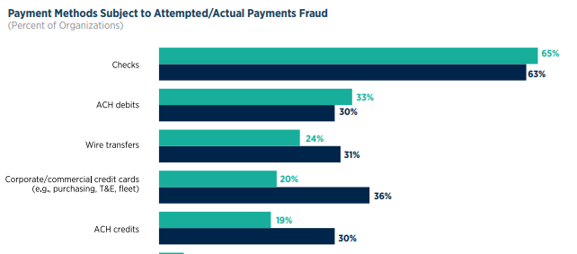
Which Payment is the Leader in Fraud?

Slide 18

Secret to Stopping Check Fraud Before it Starts…

Slide 19

Stop using Checks.

Slide 20


Slide 21
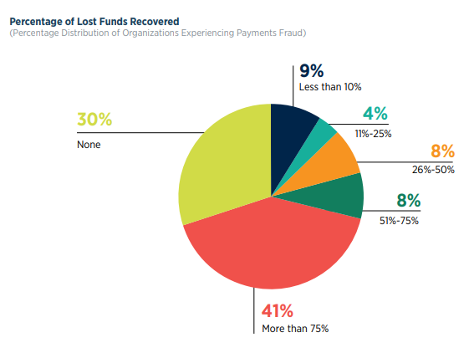
Fun Facts of Life- Payment Fraud

Slide 22
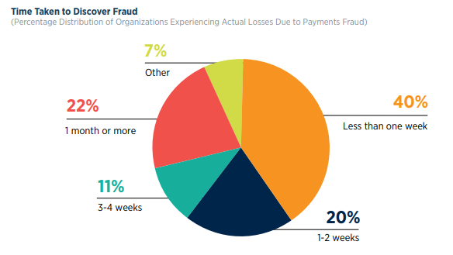
Every Second Counts

Slide 23
Don’t Forget to Keep the House Protected
Reconcile DAILY! Business accounts do not have the same protection as consumers. An item is generally settled 1 business day after it clears the account.
Setup more than one Administrator of users; use dual admin when possible.
Implement dual control (enter/approve) on all online features that allow for money transfer (bill pay, ACH, and Wires).
Use tokens for transaction origination online; encourage callbacks and PINs for verbal authentication.
Consider multiple layers of approvals for large transactions
Do not allow for International Wires if not needed
Separation of duties such as check writing versus exception management
Do not accept emails to change account information unless account information has been verified separately through outbound phone call, fax, or face to face.

Slide 24

Partner with your Bank

Slide 25
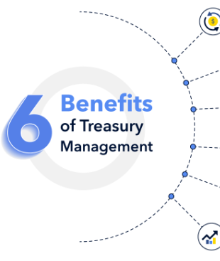
Start Using Treasury Management TODAY!

Slide 26
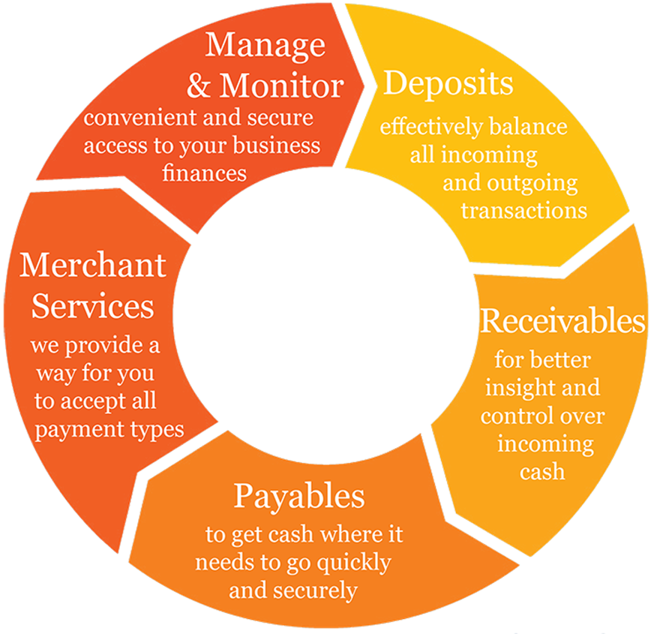
What is Treasury Management?

Slide 27

Treasury Management Solutions
Business Online Banking & Mobile
Tokenization
Positive Pay and ACH Filter
ACH & Wire Origination
Purchase/ Corporate Card
Merchant Services
Remote Deposit Capture

Slide 28

Business Online Banking & Mobile
Access to timely information
• Previous day balances and account transactions
• Pending transactions and available balances
• Electronic statement delivery
• Report delivery such as EDI/Addenda information
• Export of data for reconciliation
• Cleared check images
• Various types of Alerts

Slide 29
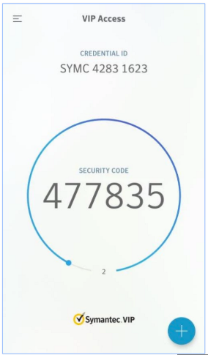
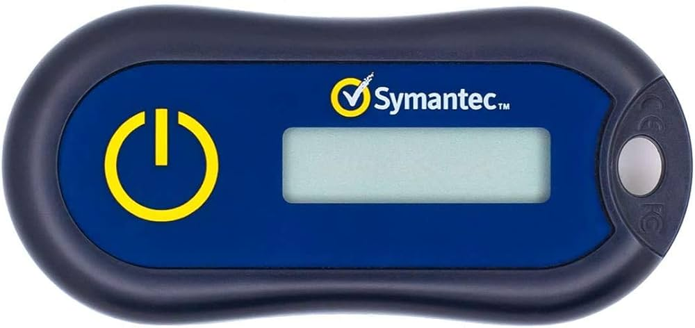
Secure Token

Slide 30

Positive Pay- Check
A data matching tool that helps identify anomalies for decisioning within a return time frame:
Identifies potential fraud
Helps with reconciliation
Allows for management of outstanding checks
Allows for separation of duties
Could replace stop payments on small dollar checks
Helps with escheated checks

Slide 31
Positive Pay- Easy as 1…2…3…
How it works:
Customer submits issued check information (in file or by hand)
  Check number
  Amount
  Payee
Bank matches paid items against issued items in the database.
If the check number, amount, and payee match, the item is automatically paid. Otherwise, an exceptions is created:
  Paid not issued
  Payee mismatch
  Void check or stale dated check
  Incorrect check number and/or dollar amount
  Duplicate check

Slide 32
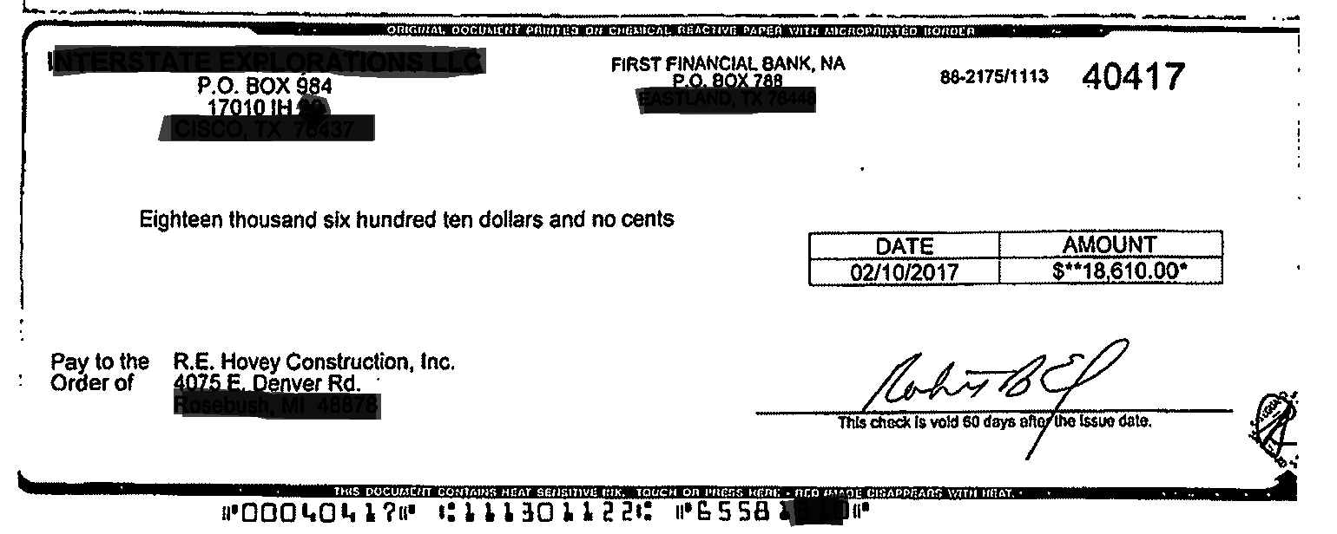
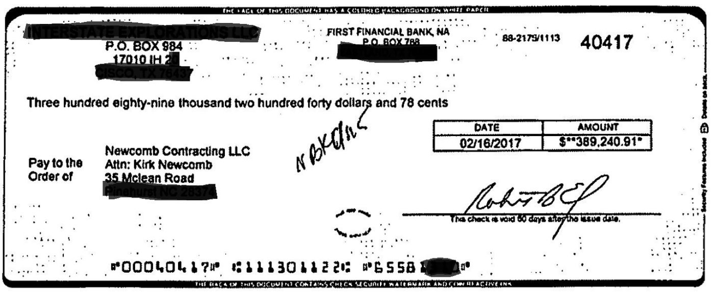
Can you detect the real vs. fake Check?
Here’s the Why
Notes:
The first check is the real check. It was mailed to a supplier in Michigan. The second check was negotiated at a Bank of America in North Carolina. The first check was likely stolen from the mail.
Can you sustain this kind of loss? Let’s talk about Positive Pay.

Slide 33

Positive Pay- ACH Block and Filter
Received ACH Transactions -
Fraud can also happen electronically. Businesses need to protect themselves from unauthorized debits.
ACH Block – can be used when an account does NOT have any ACH debit activity nor is it expected to in the future. Auto returned. Usually a free product.
ACH Filter – allows for preapproved ACH debits to clear while creating Exceptions for unapproved debits that occur.
  Preapprove by Sending Company ID
  ACH type
  Maximum amount
  Debit vs. Credit

Slide 34
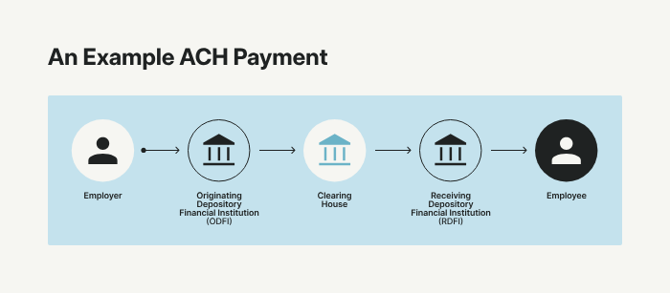
Alternative Solutions- Sending Payments
ACH Origination-
  Same day or future dated
  Credits or debits
  One time or recurring
  Usually sent in a batch
  Underwrite limit
Wire Origination-
  Generally, same day
  Generally used for larger single payments needing guarantee
  Fully available when received
  Can be setup as drawdown or reverse wires (received request)
  Larger transaction cost for origination

Slide 35
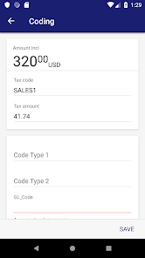
Alternative Solution- Sending Payments
  Purchase/ Corporate Card
    Multiple card options to select from
    Improve float time/ cash flow up to 45 days
    Reduce amount of fraud exposure
    Limit and or restrict where the card can be used
    Use for purchasing equipment, gas, travel, hotels etc.
    Improve how you manage your expense management/ receipts
    Increase/decrease limits in real-time

Slide 36
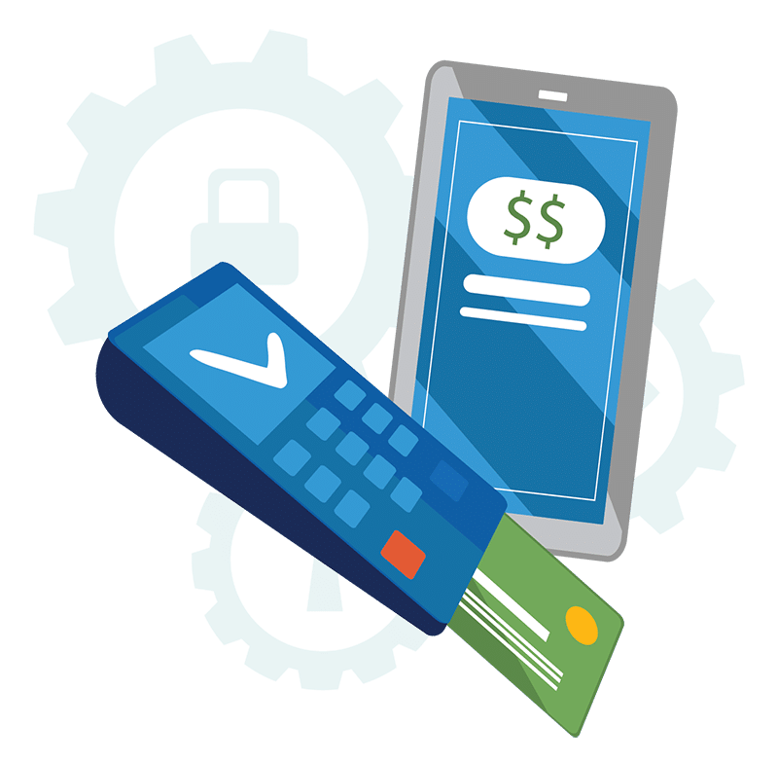
Alternative Solutions- Accepting Payments
Payment Processing offerings for virtually any need. Acceptance of Visa, MasterCard, Discover, and American Express.
Product offerings include:
  Apps, physical terminal, virtual terminal, POS, Gateway (shopping cart)
  Year round and seasonal (case by case)
  Signature or PIN based transactions
  Next business day funding if processing through and banking at FFIN
Must follow MC/Visa Association Rules
Subject to processor underwriting

Slide 37
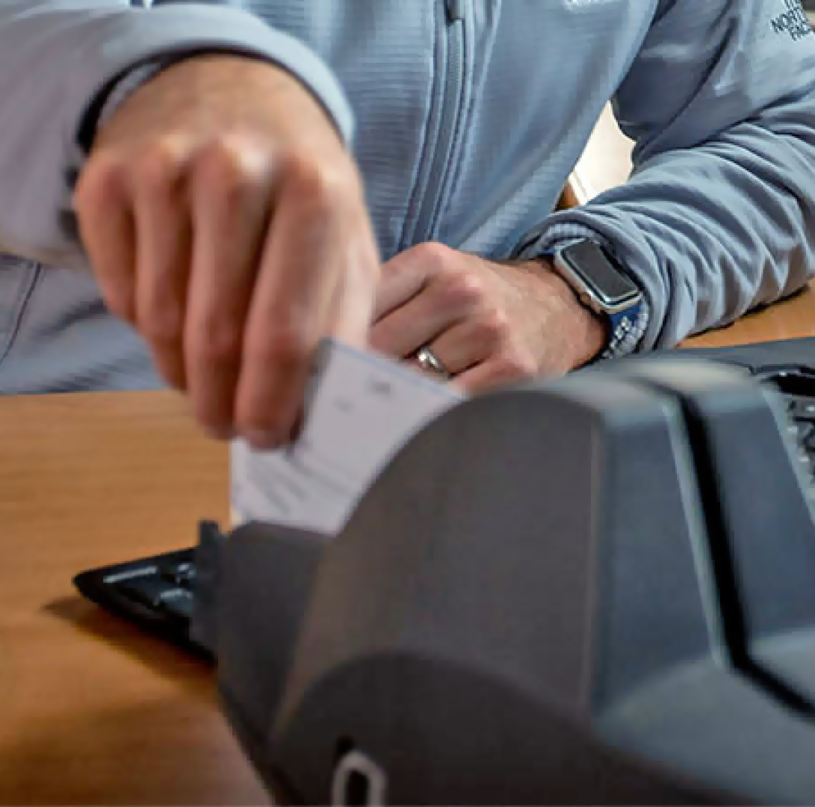
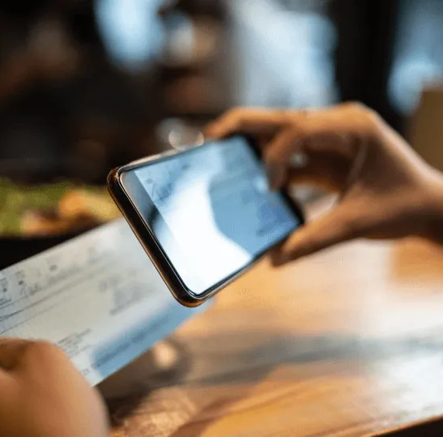
Alternative Solutions- Depositing Payments
RDC is a quick and easy way to make check deposits using a compatible check scanning device.
Provides for virtual banking by reducing or eliminating trips to the bank
Image archive – no copies laying around
Extended cutoff times for same business day deposits
Destroy checks after deposit (varies per bank)
Report options

Slide 38
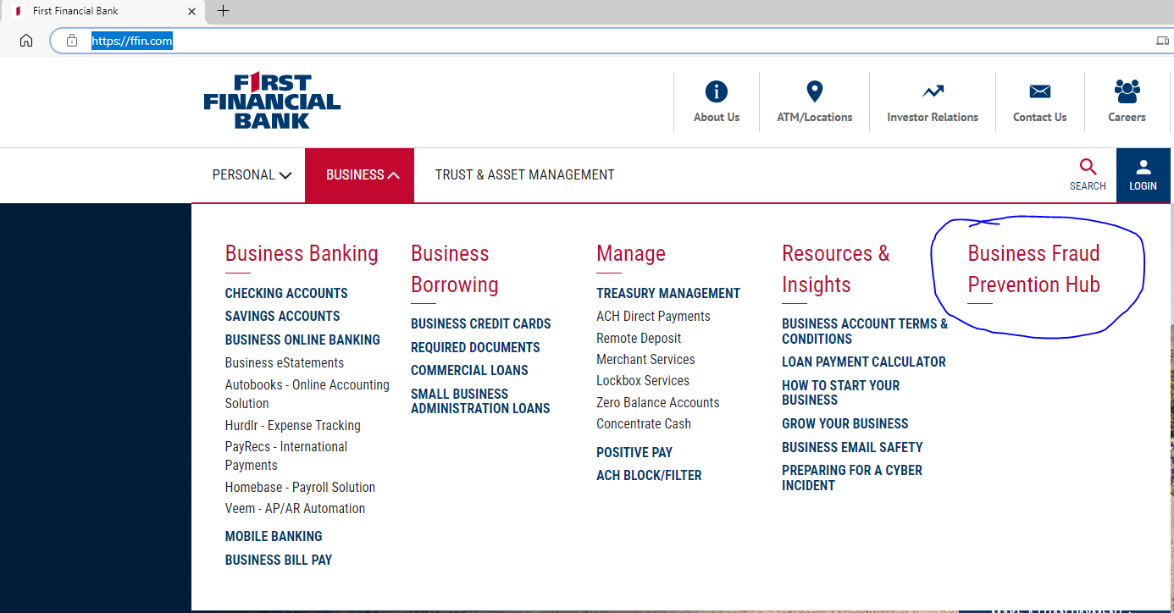
For more information, visit the First Financial Business Fraud Prevention Hub

Slide 39


