Slide 1
Sovereign citizens
2024 Urban Recorders Alliance (URA) Conference
September 12, 2024
Presented by: Dian Diaz, Chief Operating Officer

Slide 2

URA CONFERENCE
Session Objectives
The purpose of this session is to discuss the Sovereign Citizen Movement (SCM) and the best practices for managing the customers and the flow of paper documents in your office.
Please feel free to ask questions. They do not have to be held until the end of the session.

Slide 3
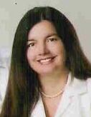
URA CONFERENCE
Who am I?
Dian Diaz, Chief Operating Officer for the Broward County Florida Clerk of Courts.
34+ years of service with the Broward Clerk of Courts in roles ranging from Administrative Assistant, Budget Manager, Administrative Aide, Operational Quality Specialist, Operations Director, Administration Chief Deputy, and Chief Director of Court Services.

Slide 4
URA CONFERENCE
SCM Origins and Ideology
The sovereign citizen movement is a large anti-government extremist movement whose adherents believe that they can ignore laws, regulations, court orders and taxes because they have divorced themselves from what they claim is an illegitimate, tyrannical government. Though "sovereign citizen” is the most common term movement members use to refer to themselves, they may also use a variety of other self-descriptions, including American state national, state citizen, constitutionalist, free man/woman upon the land, Moorish national, and many others.
Source: Anti-Defamation League. The Sovereign Citizen Movement in the United States. Published December 21, 2023. Retrieved June 11, 2024 from https://www.adl.org/resources/backgrounder/sovereign-citizen-movement-united-states.

Slide 5
URA CONFERENCE
SCM Indicators
Sovereign citizens often produce documents that contain peculiar or out-of-place language. In some cases, they speak their own language or will write only in certain colors, such as in red crayon.
References to the Bible, The Constitution of the United States, U.S. Supreme Court decisions, or treaties with foreign governments.
Personal names spelled in all capital letters or interspersed with colons (e.g., JOHN SMITH or Smith: John).
Signatures followed by the words “under duress,” “Sovereign Living Soul” (SLS), or a copyright symbol (©).
Personal seals, stamps, or thumb prints in red ink.
The words “accepted for value”.
They also carry fraudulent drivers’ licenses to indicate their view that law enforcement does not have the authority to stop their vehicle or may write “No Liability Accepted” above their signature on a driver’s license to signify that they do not accept it as a legitimate identification document.
Source: U.S. Department of Justice, Federal Bureau of Investigation, Domestic Terrorism Operations Unit and Domestic Terrorism Analysis Unit, Sovereign Citizen Danger to Law Enforcement (Washington, DC, 2010).

Slide 6
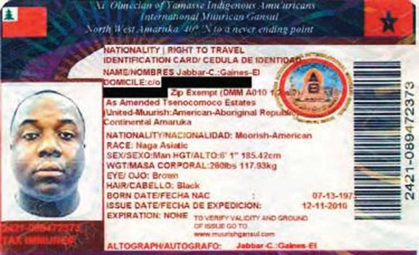
URA CONFERENCE
How far will they go?
Sovereigns will go as far as to creating their own documentation for birth, travel, and currency.
Driving vs. Traveling https://www.youtube.com/watch?v=daiBqcrjOVg

Slide 7
URA CONFERENCE
Sovereigns Often Have Lengthy Criminal Histories
  Abdono Haul – 49 years old with a combined twenty-five felony, misdemeanor and traffic cases in Broward County from 1997 to 2024.
    Accessory After the Fact x 2
    Resisting w/o Violence x 2
    Lewd/Lasc Battery Person 12+
    Possess Cannabis/20 Grams or less
    Carrying Concealed Firearm x 2
    Failure to Register as a Sexual Offender
    Broward Magistrate Judge’s Interaction with Mr. Haul https://www.youtube.com/watch?v=YyE_0YwiUAU

Slide 8
URA CONFERENCE
Sovereigns Consume Disproportionate Amount of Court’s Time
David Hall - 59 years old with a combined nineteen felony, misdemeanor, and traffic cases in Broward County from 2001 to 2018.
  Arson in the First Degree
  Felony Driving While License Suspended x 4
  Felony Unlawful Filing False Documents
  Driving Under the Influence (Habitual Offender)
  Operating w/o a Valid License
Broward Magistrate Judge’s Interaction with Mr. Hall (2.00) https://www.youtube.com/watch?v=307ajh95Q8g

Slide 9
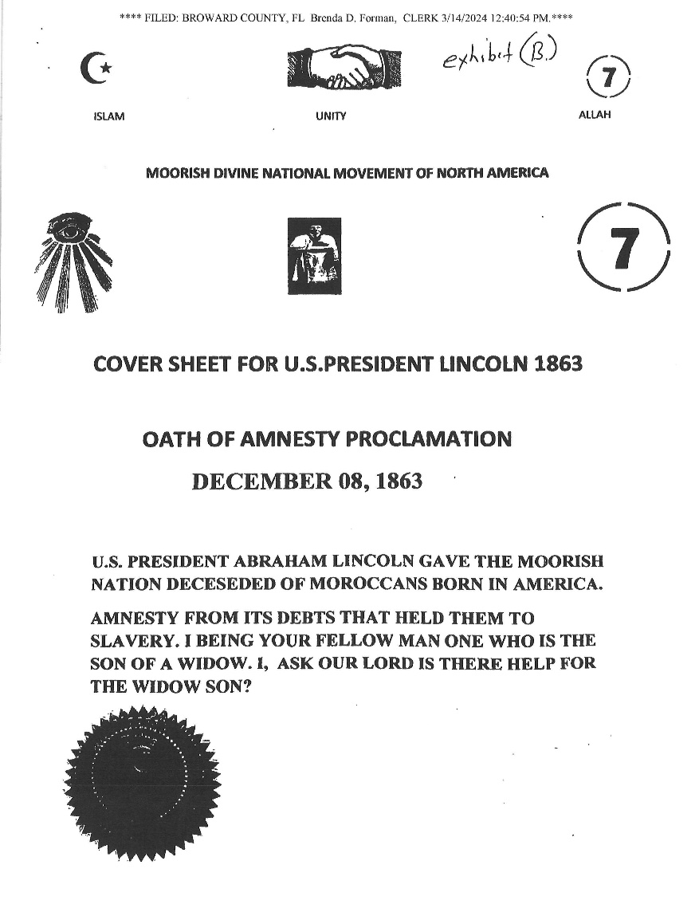
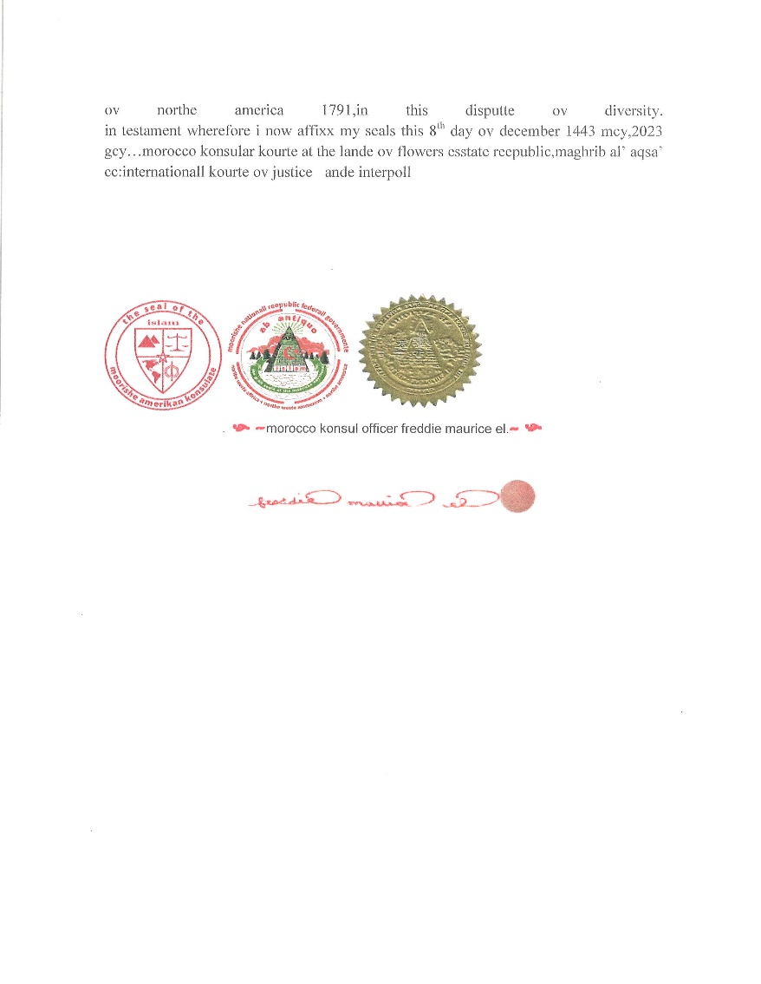
URA CONFERENCE

Slide 10
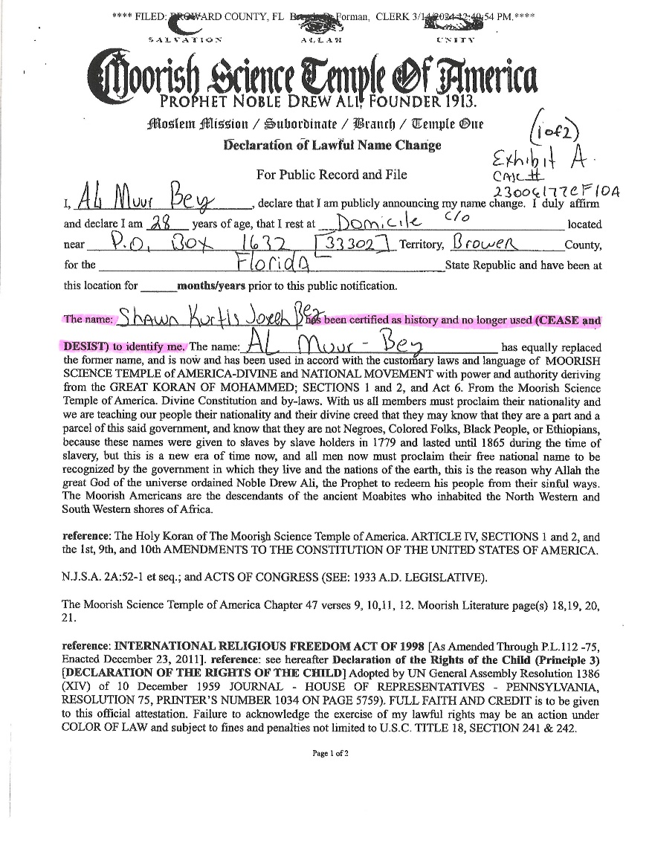
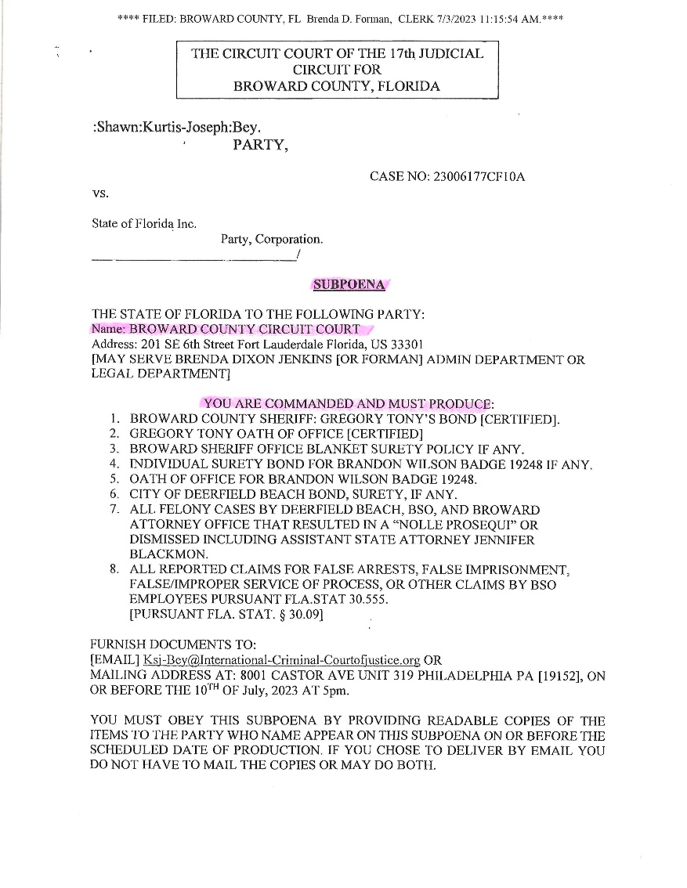
URA CONFERENCE

Slide 11
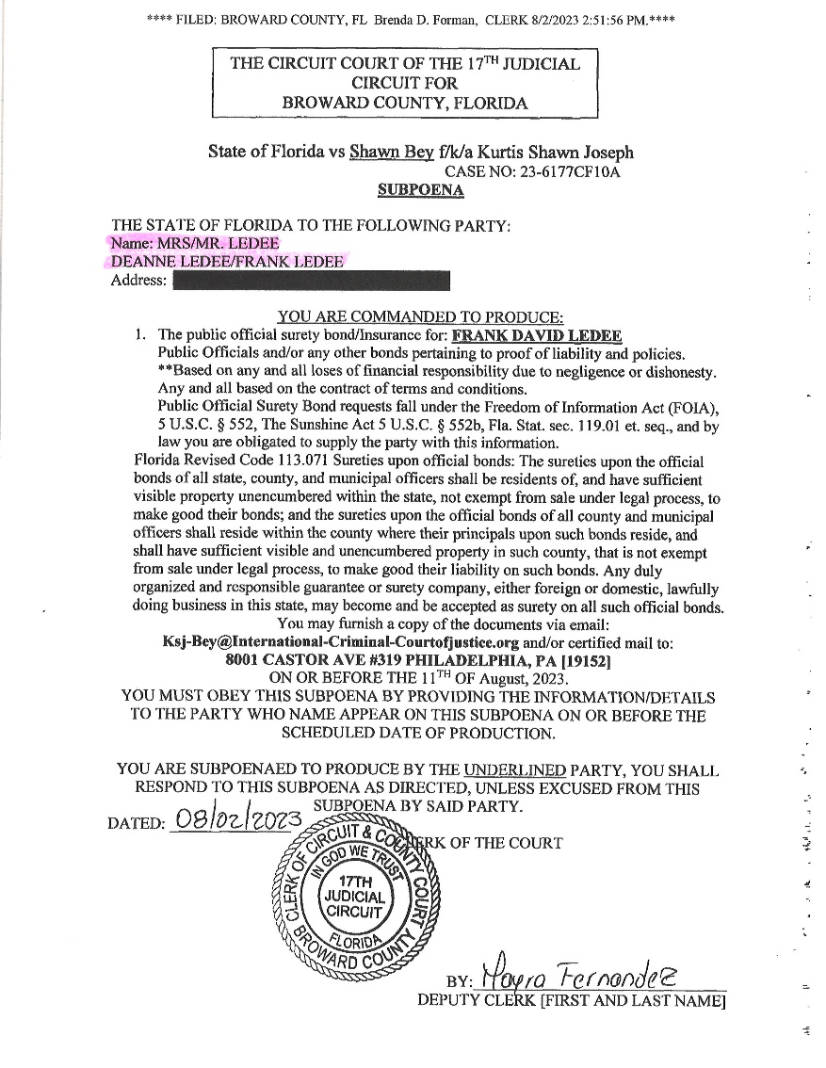
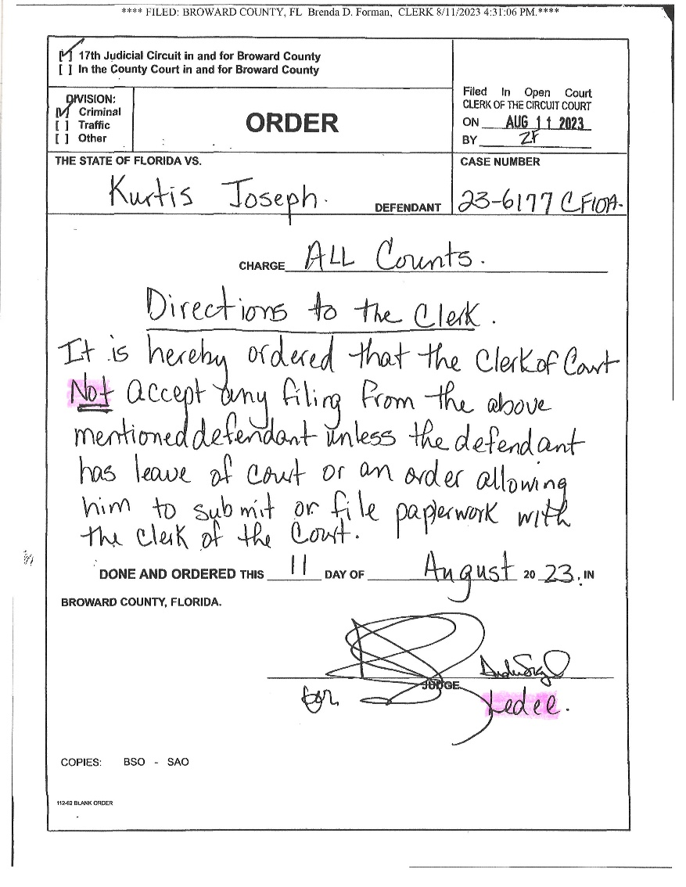
URA CONFERENCE

Slide 12
URA CONFERENCE
What can you do?
Be prepared.
Have a primary Subject Matter Expert (SME)in the office. (The SME should have a back-up.)
Provides a single point of contact for the Clerk, customers, and government agencies.
Singular resource gatherer and training provider.
Individual that can knowledgably testify on behalf of the Clerk if necessary.

Slide 13
URA CONFERENCE
Managing In-Person Interactions
Many times the underlying matter that has prompted the contact (divorce, civil or criminal case, property foreclosure, debt collection, traffic ticket, zoning issues, etc.), may create severe anger and other emotions. Under the right (or wrong) circumstances, this can create a potentially dangerous situation. Therefore, you should act to defuse the situation as best as possible.
Do not argue or debate the validity of the documents, requests, or their beliefs. You will not change their minds and it will likely only aggravate the situation.
Treat them with the same courtesy and respect you would every other customer. Be calm, professional and polite but firm. Be willing to listen, within reason, no matter how challenging they make it on you.
Patience is a virtue and is very important in defusing any situation. Law enforcement should be called if there is any concern for personal safety.
Source: https://ncjtc-static.fvtc.edu/resources/RS00011086.pdf

Slide 14
URA CONFERENCE
Managing In-Person Interactions
If you refer the person(s) to another office or agency please alert that office or agency so they can be prepared. Remember…My Sovereign Citizen is your Sovereign Citizen.
Avoid legal conversations and arguments. If you question whether a document should be accepted for filing you can advise the person that the documents need to be reviewed by legal counsel before filing. Be honest: simply state that you are not familiar with the documents or whether you can accept them but will consult with legal counsel. If proof of filing is demanded you can consider using a stamp or making a notation that simply says “received” and advising the person they will be informed if filed. Legal counsel can then assist in creating a response or actually send a response where filings are rejected.
Do not refer to them or the documentation as related to the Sovereign Citizen movement.
Be consistent! Orange County Comptroller SC Interaction

Slide 15
URA CONFERENCE
Document Acceptance
Accepting Documents: For documents that meet the requirements to be filed on a case or in the Official Record accept them as you would any other document.
The Recording and Filing requirements are subjective to each Clerk’s office based on interpretation of statutes and rules.
An exception to this suggestion exists for the Common Law Grand Jury Affidavit and Writs of Mandamus. Always refuse.

Slide 16
URA CONFERENCE
Document Refusal
For recording utilize a form like the Non-Recordable Document.
For case files utilize a letter template explaining generally the reason for not accepting the document. (Optional)
Avoid providing specific details on how to make the document acceptable. (Legal Advice)
Questions?

Slide 17
URA CONFERENCE
Contact Information
Dian Diaz
ddiaz@browardclerk.org
954-831-6504

Slide 18


Slide 19
URA CONFERENCE
Notes

