Slide 1
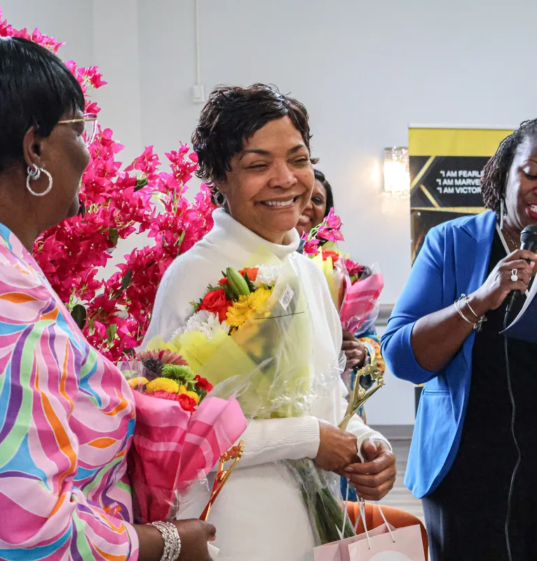

Fruitful family ministries (ffm) event sponsorship opportunities
WWW.FRUITFULFAMILY101.C0M

Slide 2

About fruitful family ministries
Who We Are
Fruitful Family Ministries (FFM) is a 501(c)(3) organization that was founded by Milo and Alicia Briscoe in 2020 with a mission to transform families through biblical teachings and practical guidance. They focus on helping individuals activate their true selves, deepen their relationship with God, and embrace their kingdom purpose. Through events, mentoring, and spiritual coaching, FFM strive to bring lasting impact to families and communities.
Our Vision
Our Mission
The vision for Fruitful Family is to see lives renewed and transformed through practical teachings, based on biblical principles to be in alignment with God.
The mission for Fruitful Family is to encourage people to live a fruitful life through meditation, declaration, revelation, and application of the word of God.

Slide 3
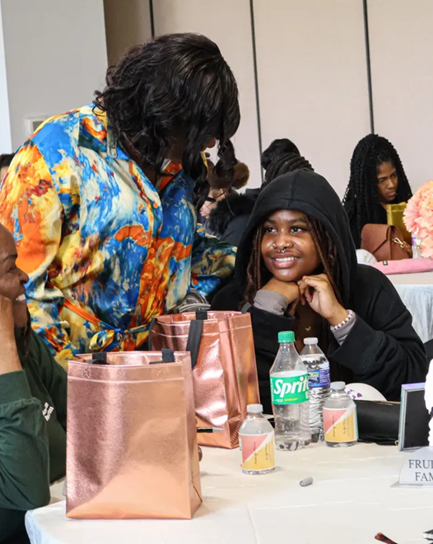
Welcome, Partners!
Sponsoring Fruitful Family Ministries (FFM) events allows you to position your company in the community, establish relationships, and learn about challenges and priorities from individuals within the community. These events are specifically designed to provide tools and resources to attendees that promote individual and family growth, harmony, and sustainability.
Don’t wait—secure an opportunity today that will give you exposure to these valuable in-person events!

Slide 4
Who attends and why support
Typical FFM Event Attendees
Reasons to Become a Sponsor
  Mothers, Sisters, Daughters
  Husbands, Fathers, Sons
  Median Age: 40
  Business Professionals
  Educators, Pastors
  Families
Introduce, demonstrate, or sell products and services, new or existing.
Gather qualified leads for post-exhibition company follow-up.
Give your customers an opportunity to meet you.
Solicit feedback from customers.
Connect with other businesses.

Slide 5
Fruitful family ministries events
EVENT NAME | AUDIENCE | DATE | LOCATION
Women Celebrating Women: Woman of Worth | Women of all ages | March 8, 2025 | Maryland
SML 2025: Change is Inevitable; Growth is Optional | Men and women who are either Single, Married, or living Life after Marriage | October 4, 2025 | Maryland
Fruitful Women | Women of all ages | March 2026 | TBD
SML 2026 | Men and women who are either Single, Married, or living Life after Marriage | October 2026 | TBD

Slide 6
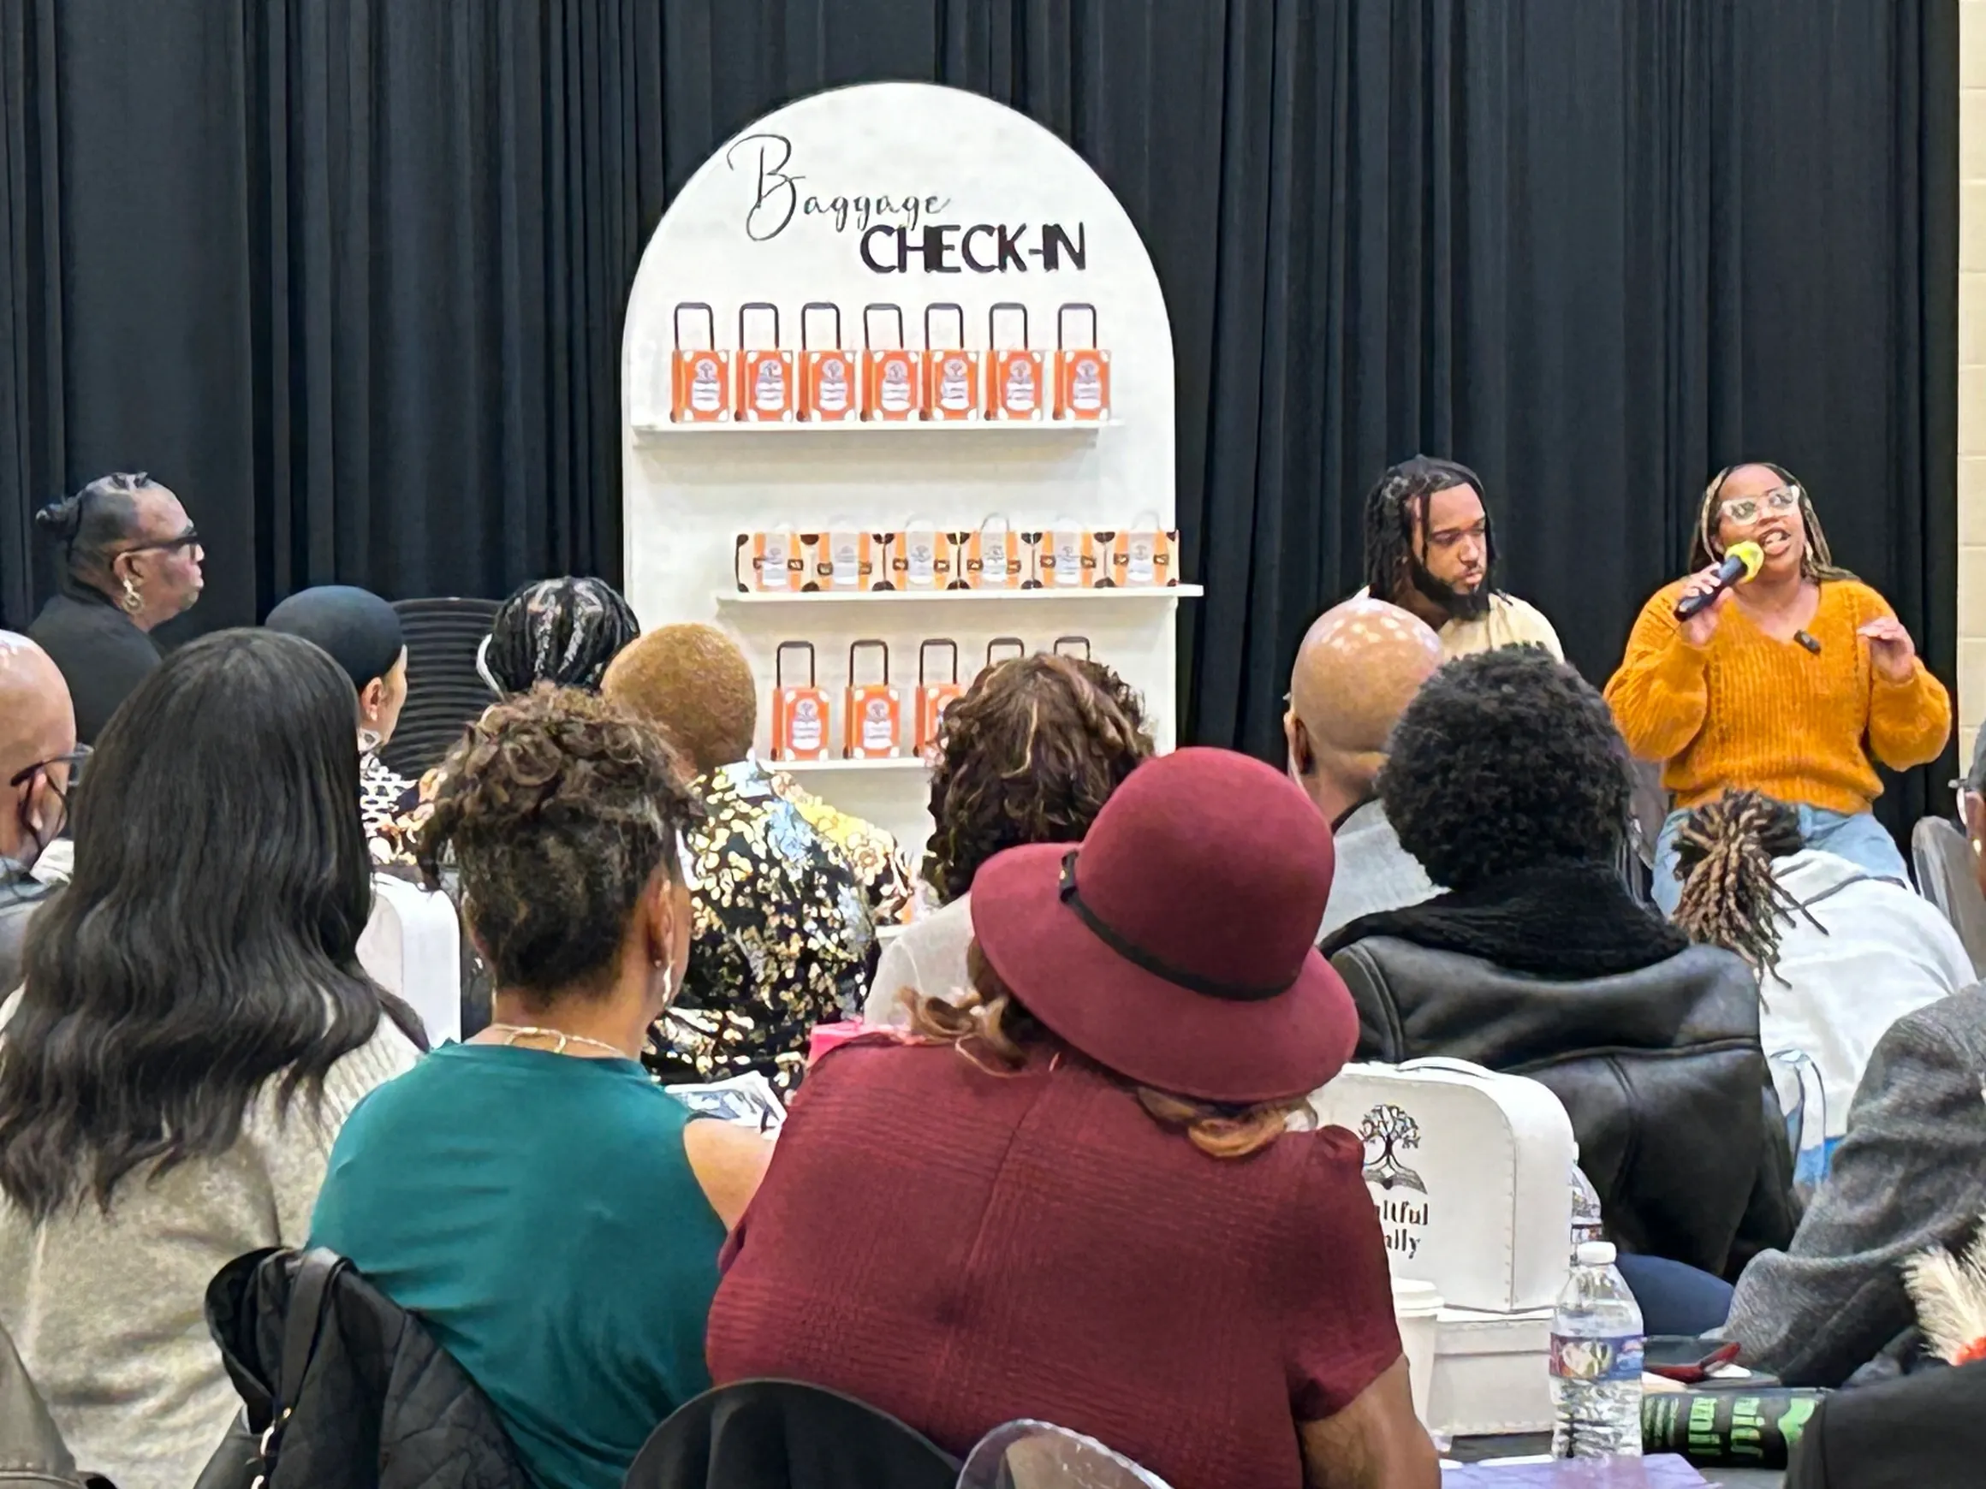
Sponsorship opportunities
The sponsorship allows you to be a part of one or multiple Fruitful Family events. These events reach members of the community who are family oriented and committed to growth and change. Fruitful Women’s events cater towards women empowerment and Single, Married, Life After Marriage events are geared towards both men and women with a strong desire to become the best versions of themselves while also healing the entire family.

Slide 7
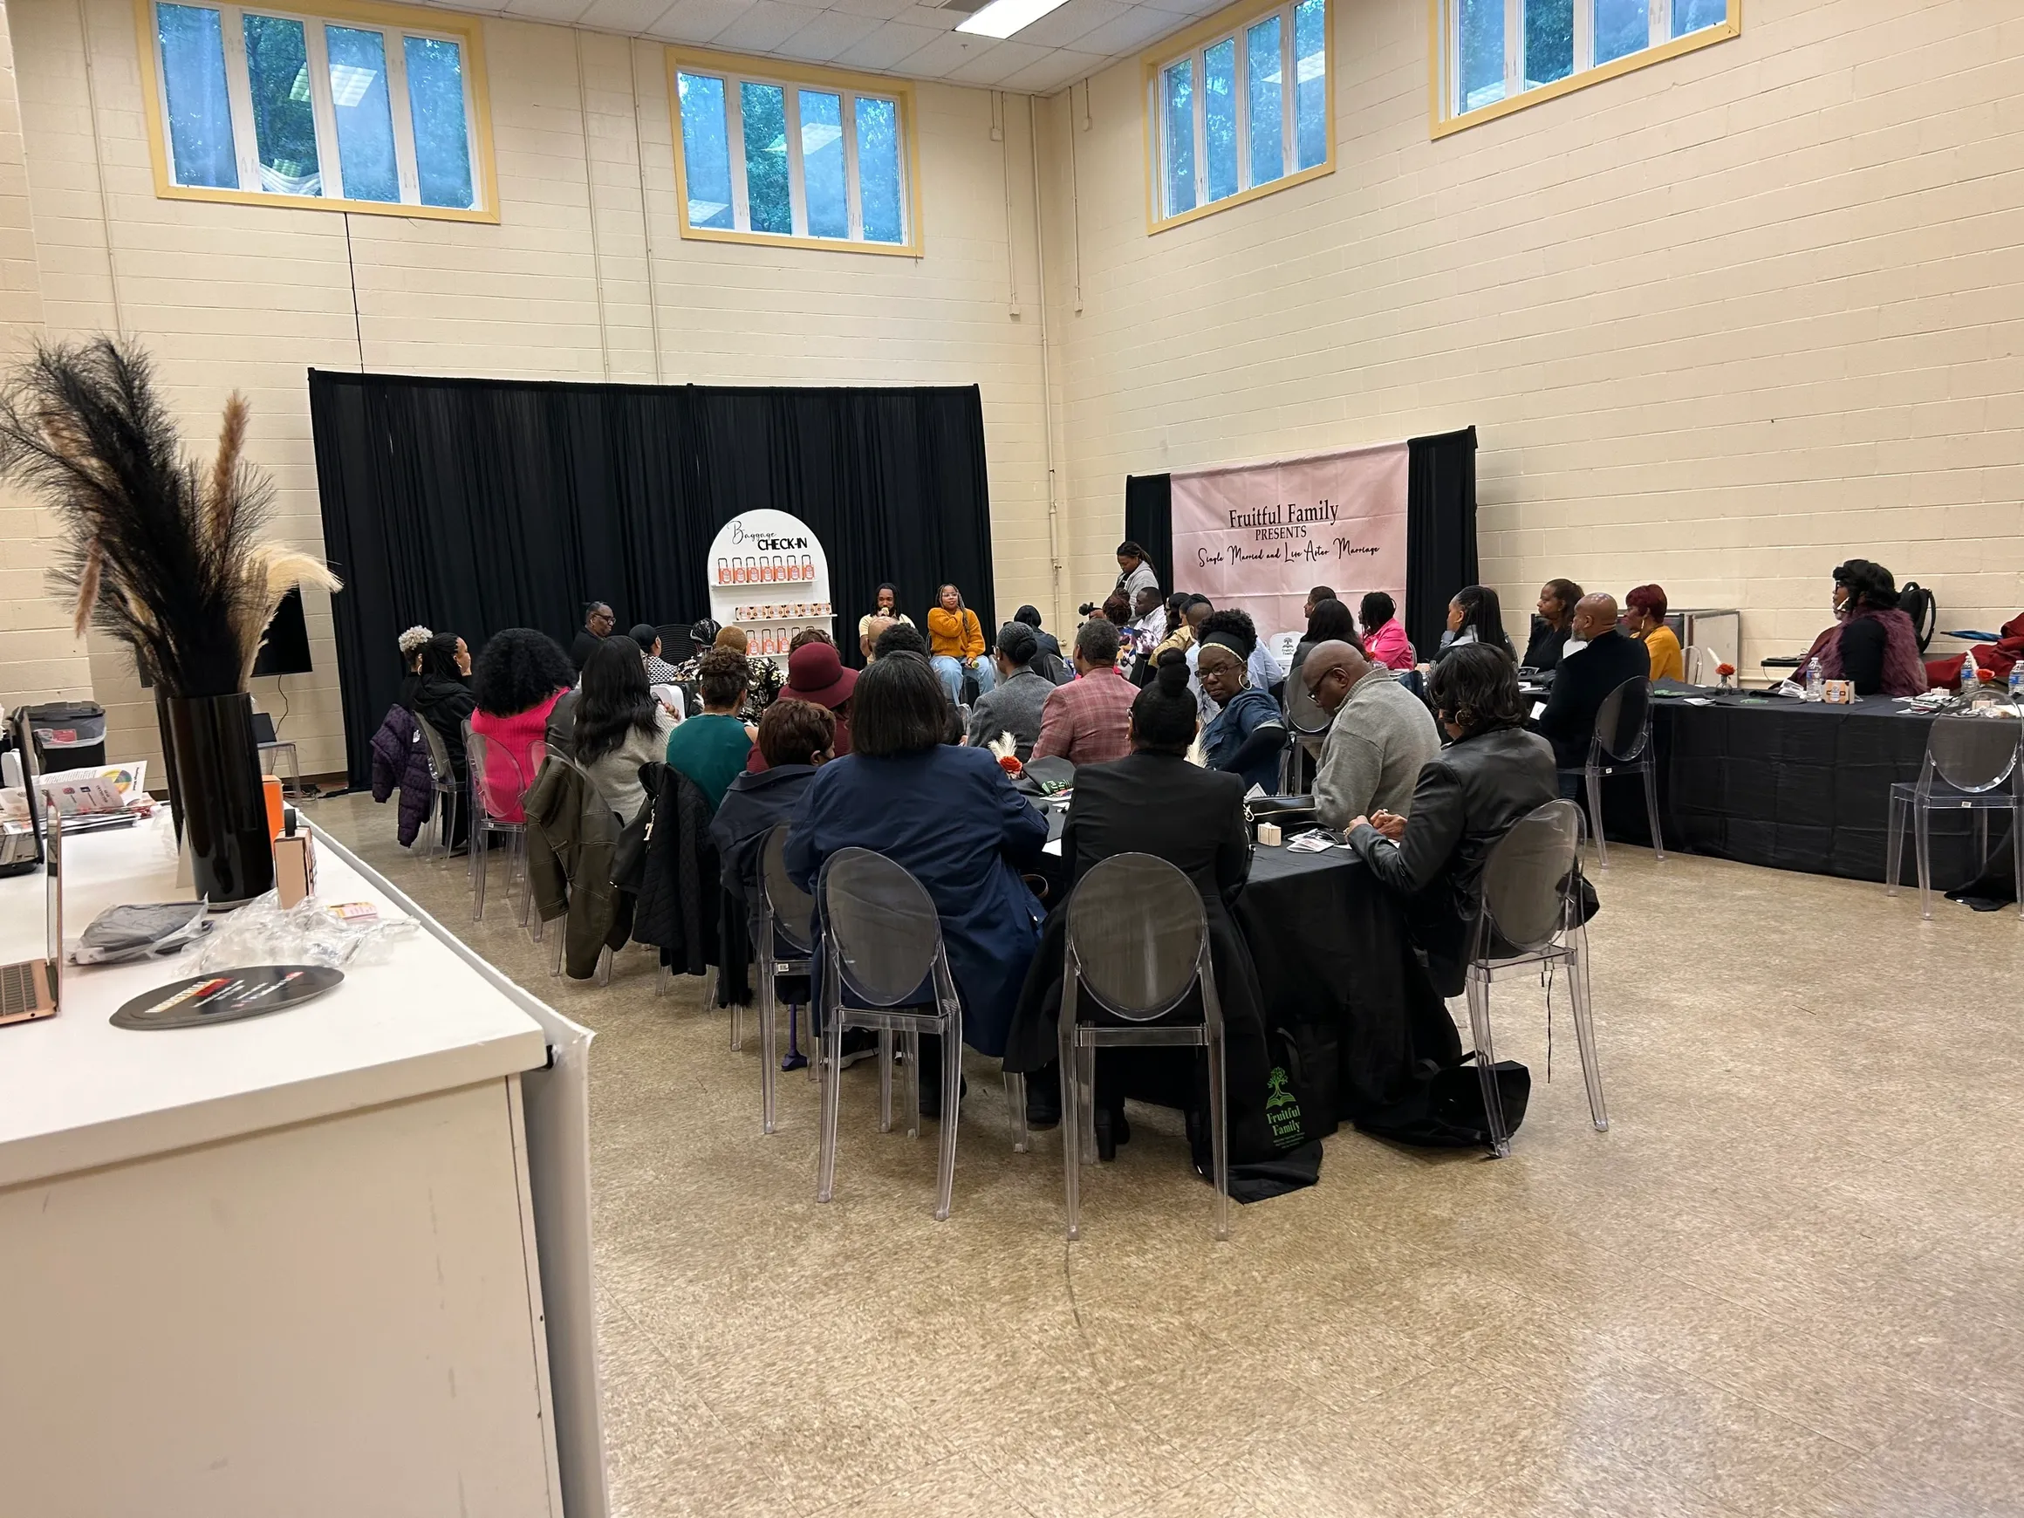
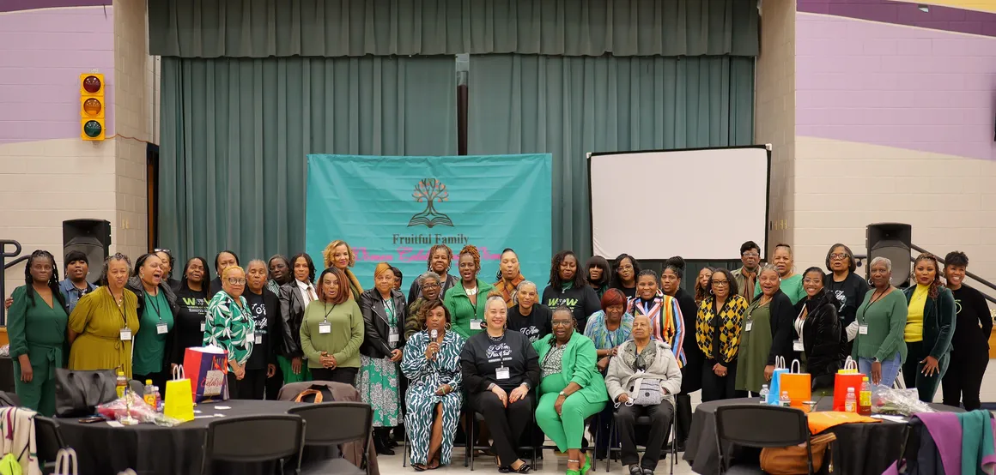
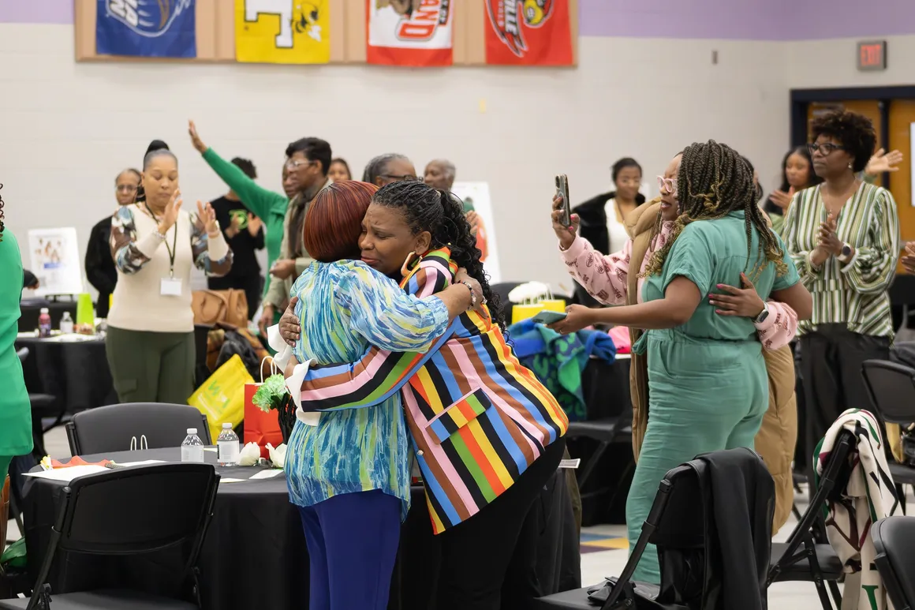
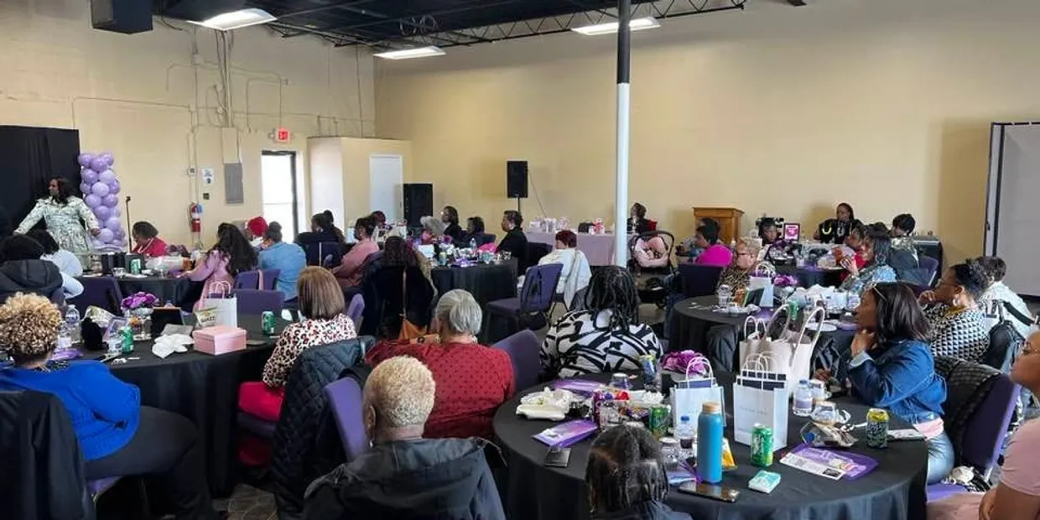
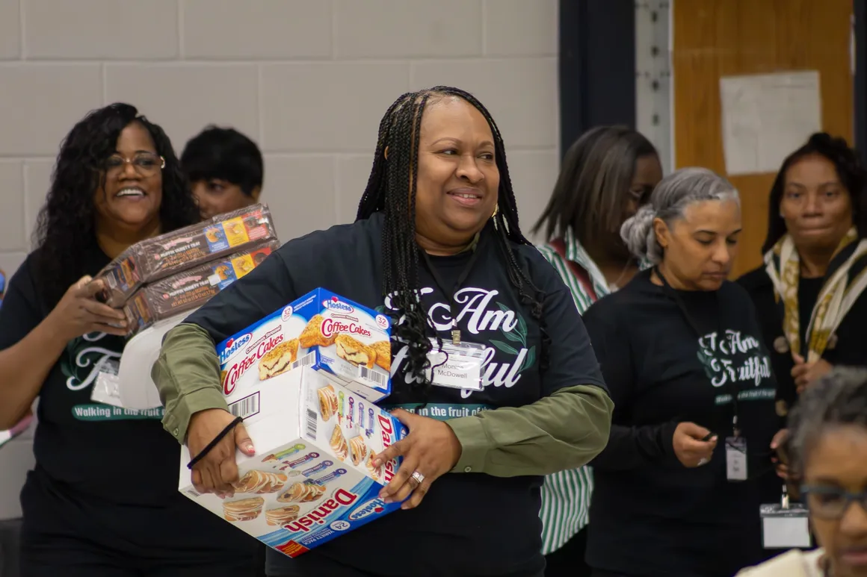

Slide 8
Sponsorship levels
BENEFITS | GOLD $5,000 | SILVER $1,000 | BRONZE $500
Vendor Table | Yes | Yes | Yes
Acknowledgement in Program | Full Page Ad | Quarter Page Ad | Name Recognition
Recognition on FFM website | Yes, with link to your website | Yes, with contact information | Name recognition
Complimentary Ticket(s) | VIP table | 5 tickets w/preferred seating | 2 tickets
Additional Benefits | Advertisement in swag bag | Advertisement in swag bag | None

Slide 9
IN KIND SPONSORSHIP OPPORTUNITIES
What We Are Seeking
Sponsorship Benefits
We are seeking in-kind donations in the following areas:
  Food
  Promotional Items
  Giveaways
  A/V Support
  Decorations
For your generosity Fruitful Family will:
One complimentary ticket to an event of choice
Name recognition in program
Advertisement in swag bag

Slide 10
HOW TO BECOME A SPONSOR
For Monetary Sponsorships
Complete the 2025 Sponsorship Form
  Method of Payments (Monetary):
    CashApp:
    Gift Cards
    Check/Money Orders made payable to: Fruitful Family
    Invoice (if requested)
    Credit Cards
Email completed form to fruitfulfamily101@gmail.com
Mail checks/money orders/gift cards to: Fruitful Family Ministries, 10768 Pam Drive, Waldorf, MD 20603
Fruitful Family will send a follow up email with details on how to retrieve sponsorship benefits.
For In-Kind Donations
Complete the 2025 Sponsorship Form
Email completed form to fruitfulfamily101@gmail.com
Fruitful Family will reach out to you directly to make arrangements for receiving your in-kind donation
Fruitful Family will send a follow up email with details on how to retrieve sponsorship benefits.

Slide 11

THANK YOU!
If you have any questions, please reach out to Fruitful Family Ministries:
Phone: 202-746-3991 (Alicia Briscoe)
Email: fruitfulfamily101@gmail.com
www.fruitfulfamily101.com

