Slide 1
Best Practices in Early Childhood Mental Health Intervention
Identifying and Integrating Interventions for Young Children of Addicted Parents Conference: Presented by the Collaborative for Children of Addicted Parents
Nov 1, 2019

Slide 2
Welcome and Introductions

Slide 3
Objectives
Participants will be able to give 3 examples of specific practices that are key in IECMH practice.
Participants will be able to offer an explanation of the importance of Reflective Practice/Consultation in the field of IECMH practice.

Slide 4
IECMH Principles
Young children exist in the context of their caregiving relationships and within the cultural context of their family
Experiences during pregnancy and in the first three years lay the foundation for all future development
Relationships are critical: best way to support babies and young children is to support their parents/families to build/strengthen nurturing relationships with them
There can be both ghosts and angels in the nursery that will impact the emerging attachment relationship (Alliance for the Advancement of IMH, 2019)

Slide 5
Best Practice Standards
Provide support to the dyad through a combination of services: Linkages to concrete resources, crisis intervention, developmental guidance, supportive counseling, and child/parent psychotherapy
Receive reflective supervision/consultation to step back and consider the impact of the work on the child, caregivers and clinician

Slide 6
Evidence-Based Practices
Dyadic in nature
Relationship-Based Interventions
Strengthen Parental Capacity to Support Attachment
Trauma-Informed
Culturally Sensitive

Slide 7
Child Parent Psychotherapy
Therapy for young children from birth through age five and their parents/caregivers
Supports family strengths and relationships
Helps families heal and grow after stressful experiences
Respects family and cultural influences http://childparentpsychotherapy.com/about/

Slide 8
CPP Indications…
Children have experienced scary or painful events
Children show difficult behavior
Children have a change in placement or caregivers
Caregivers have physical health or mental health difficulties
Caregivers want improved parent-child relationships http://childparentpsychotherapy.com/about/

Slide 9
CPP Therapeutic Objectives
Return to normal development, coping, or reciprocity in relationships
Increased capacity to respond to threats realistically
Maintain regular levels of arousal
Establish trust in body sensations
Normalize the traumatic responses and place the experience in perspective

Slide 10
CPP: Conceptual Premises
Importance of Attachment
Dyadic in Nature
Cultural Influences
Interpersonal Violence is a Stressor
Importance of Relationship
Speak the Unspeakable

Slide 11
Case Example

Slide 12
Teaching Family Model
A behavioral approach to treatment which is evidenced-based and teaches skills to assist youth with behavioral health challenges
The program is used in residential programs, schools and is taught to parents to manage children in their homes
Once the teaching procedures are understood, skills can be developed or individualized.

Slide 13
Goals within the TFM
Teach youth and caregivers new skills
Understand how a behavior is learned so we can teach new behavior.
Bring about positive, socially acceptable behavior, by teaching skills
Decrease inappropriate behavior
We don’t use punishment.
We apply positive and negative consequences following behavior by explaining behavior and child oriented rationales
We try to ensure the skills are generalizable.

Slide 14
Communicate to Parents the Elements of Good Relationships
Show affection through voice tone, appropriate touch, praise, valuing statements.
Provide empathy.
Show concern when needed.
Be the child’s advocate by ensuring their needs are met and feelings acknowledged.
Help child solve problems.
Spend time with the child.
Show respect.

Slide 15
Teaching Interactions
Effective Praise
Preventative Teaching
Corrective Teaching
Intensive Teaching
Counseling

Slide 16
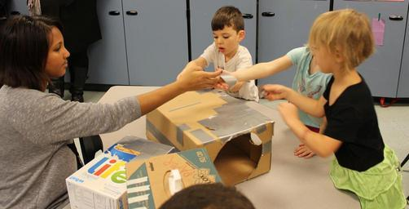
Case Example

Slide 17
Questions and Contact Info
Stacey Cornett, LISW-S, LCSW, IMH-E® (IV-Clinical Mentor)
scornett@tchcincy.org
513 272 2800

Slide 18
Thank you!

