Slide 1
Addressing Inequities in Pierce County's COVID-19 Response and Recovery
The Black Collective
Anthony L-T Chen, MD, MPH, Director of Health
Tacoma-Pierce County Health Department
May 16, 2020

Slide 2
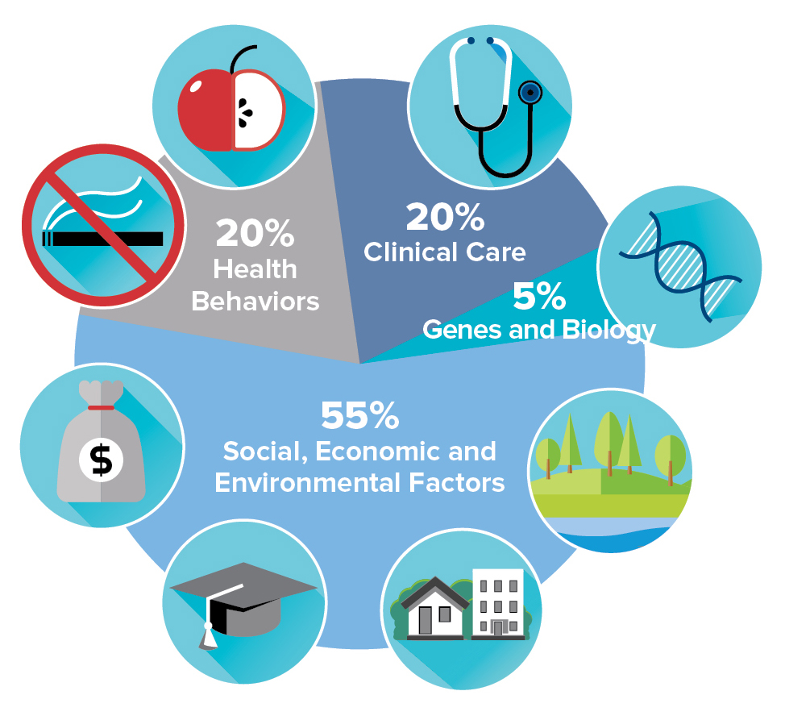
Racial Inequities Exist
2015 Health Equity Assessment
Social, economic, and environmental conditions shape health most.
Geographic and demographic health inequities exist.
2019 disparities in health outcomes
17 of 20 health indicators showed significant disparities.
American Indian/Alaskan Native-NH and Black-NH residents experience the most.
White-NH experience the least.

Slide 3
Infant Mortality Rates Highest Among Black and American Indian Babies

Slide 4
COVID-19 in Pierce County
1,765 COVID-19 cases.
66 deaths.
Estimated 1027 recovered (58% of total cases).
Stable number of cases since late April.
90% of deaths among people ages 60 and older.

Slide 5
COVID-19 Rates by Race

Slide 6
Comparisons to White Residents
Notes:
A

Slide 7
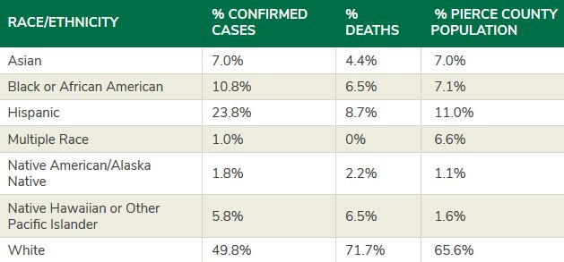
Why does COVID-19 affect some groups more than others?
Racism and racial discrimination.
Socioeconomic status:
  Unsafe at home.
  Unsafe at work.
Underlying health conditions.

Slide 8
Native Hawaiian and Other Pacific Islanders
Face the worst local COVID-19 health effects.
  4% are healthcare workers.
  15% are associated with congregate care.
  Average age is 43 years.
  About 25% live in 98444.
  High average number of contacts.

Slide 9
COVID-19 Trends by Race

Slide 10
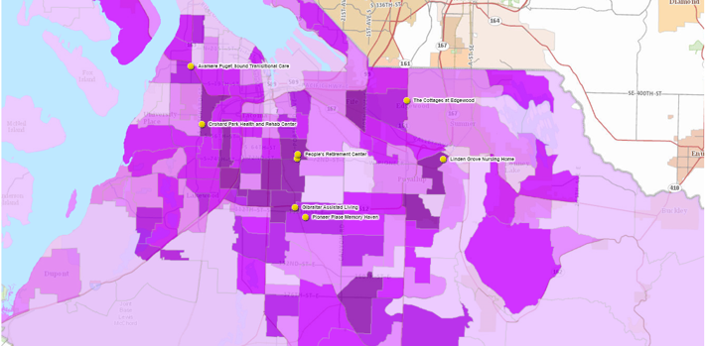
COVID-19 Cases in Pierce County

Slide 11
Other COVID-19 Data Considerations
Women have higher COVID-19 rates than men.
Highest rate by age group is among those 50-59 years old.
Almost all deaths have underlying conditions.
Data limitations: race data availability is decreasing.

Slide 12
What You Can Do
Champion policy, system and environmental changes to improve underlying conditions.
Join Tacoma-Pierce County Equity Action Network.
Mobilize your community networks.
"Health interventions that are adapted for local contexts and community characteristics are more effective than standard approaches."
- The Journal of Clinical Psychology, 2011

Slide 13
Thank You!
Questions?
Anthony Chen
achen@tpchd.org
Learn more:
www.tpchd.org/coronavirus
Sign up for alerts:
www.tpchd.org/notify

