Slide 1
Smart City Infrastructure Framework
By Jonathan L. Tan
President
GZZ Cleantech Consulting
June 2016

Slide 2
Smart City Framework
I. Smart City Drivers
Smart City Definition
Smart City Elements
II. Smart City Infrastructure Frameworks
III. Technology Ecosystem
Stakeholders
ICT Essentials
OGD
ICT for Building Automation
Smart Water
Smart Energy
Smart Transportation
Smart Education
Smart Healthcare
Smart City Services
IV. Smart City Applications
V. Smart City Systems Infrastructure
Top SC Vendors

Slide 3
Smart City Drivers
North America Focal Points for Economic Development
South America Refurbish under invested infrastructure
Europe Responding to Environmental Sustainability
Africa Future Smart Cities in later 21st Century
Asia Massive Urban Growth – India and China
Technology and Data Analytics enable and accelerate
urban sustainability and resilience

Slide 4
Smart City
Infrastructure Frameworks Physical Infrastructures
ICT, Buildings, Airports, Highways, Bridges, Roadways, Power Generation, Power
Delivery, Water Resource Management, Water Treatment, Water Distribution, Waste Management, IoT, Integrated and Interoperable Data Systems
Environment/Living Entities
Citizens, visitors, fauna, flora, air, water ecosystems (wetlands, lakes, oceans, rivers)
Flow of interactions and information
between physical and living entities
ICT, Mobile devices, Web based applications and data analytics, data management, asset management systems , M2M, M2H, H2H, H2M2H, Data Analytics

Slide 5
Foundational Infrastructures for a Smart City
Smart City Definition

Slide 6
A “SMART CITY” should be described as one that: dramatically increases the pace at which it improves its sustainability and resilience by fundamentally improving how it engages society, how it applies collaborative leadership methods, how it works across disciplines and city systems, and how it uses data and integrated technologies, to facilitate better city services, like transportation, energy, water, waste, health, education, fire and police to improve the quality of life to those in and involved with the city (residents, businesses, visitors). Dave Welsh, Microsoft
A smart city uses information and communication technologies (ICT) to enhance quality, performance and interactivity of urban services, to reduce costs and resource consumption and to improve contact between citizens and government. Wikipedia

Slide 7
Smart City Elements
1. Ecosystem – A smart city ecosystem includes economic, environmental, social and citizen engagement. All of these aspects of the ecosystem must be connected, interoperable and enhance the quality of life for all stakeholders. To construct the smart city elements (ICT, integrated data systems, data analytics) no one supplier can provide everything required to make a city “smart”. So a vendor ecosystem is critical as well. Assembling the best local and world-wide companies to optimize technology and open government data to achieve a city’s resiliency and sustainability goals is key for leaders to understand.
2. Critical Infrastructures – Transportation, Energy, Water, Waste, Education, Health, Communication and Data infrastructures are all pieces of a smart city that must be intelligent, meaning there are IoT devices, mobile devices connecting all these assets with people getting the right information to the right people at the right time to be deemed “smart”. These connected infrastructures enable and accelerate a city’s ability to be truly resilient and sustainable.
3. Interoperability of Data Systems – 5% of all data is utilized and leveraged to value. This means there is a huge opportunity to take all the data a city generates and leverage it by creating systems of systems that are integrated and made publicly available to create interoperability, which optimizes and maximizes the value of that data. This innovation will enable environmental and economic sustainability, resilience, socially responsibility, quality of life and a healthier more better educated stakeholders within a city.

Slide 8
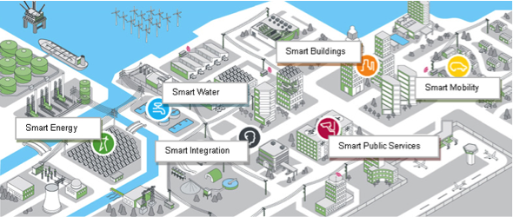
Smart Cities’ foundation are critical human infrastructures, energy, water,
Transportation, ICT networks, data integration, buildings and mobile devices

Slide 9
Foundational Infrastructures for a Smart City
Stakeholders

Slide 10
The Different Stakeholders in a Smart City (a complex interaction of systems of systems)
People or citizens: People are one of the major customers of a city since most are residents; many may pay taxes to the city; and others experience the city as a visitor.
Industry or enterprises: Industries or enterprises which have or plan to have activities in a city are essential for the city. It is an important to attract and industries or enterprises who play an essential part in the economy and functions of the city.
City authorities: are usually the administrators that regulate operation of a city (effective leadership of city authorities remains a challenge in some parts of the world).
Infrastructure operators: The operators are the direct providers of city services. They are stakeholders to which the city's performances are closely related. They may be under contract to, regulated or steered by, city authorities.
Product, service and solution providers: Although product, service and solution providers are not always the direct providers of community services, they provide machines, components, systems, services and solutions which are necessary for infrastructure operators to provide city services.
Financial institutions and investors: As the construction and operation of a city tend to involve large scale, long-span projects, the role of financial institutions and investors is essential.
Others: may include advisers, analysts, and press – all of whom have a bearing on the thinking process of the city.

Slide 11
Foundational Infrastructures for a Smart City
ICT Network

Slide 12
Five ICT Essentials for Smart Cities
Essential #1 Deployment of Broadband Networks
Essential #2 Use of Smart Devices and Agents
Essential #3 Developing Smart Urban Spaces
Essential #4 Developing Web-based Applications, e-Services and leveraging Data Analytics
Essential #5 Opening up Government Data (OGD)
Benefits of OGD
1. Improving government accountability, transparency, responsiveness and democratic control
2. Promoting citizens self-empowerment, social participation and engagement
3. Building the next generation of empowered civil servants
4. Fostering innovation, efficiency and effectiveness in government services
5. Creating value for the wider economy
Without a comprehensive ICT network, your city is not smart

Slide 13
United States’ democracy is “of the people, by the people and for the people.”
This definition implies government should be open and transparent in how it makes its decisions. Furthermore, those decisions should be logical and explainable to constituents. Decisions must be data-driven. Data used in decision making should be open to inspection by any constituent or member of the public who, in turn, could suggest alternate interpretations and solutions.
“Open Data” is a relatively new concept in transparency: open data is freely available or accessible, without license, and machine-readable, among other characteristics :
• “Freely available and accessible” means the data can be easily obtained, preferably on a website or in another place on the Internet without onerous restrictions such as login-passwords or other security measures. These terms also mean without discrimination as to the user or reason for use.
• “Without license” means the data can be re-used and re-published without obtaining a license or other legal contract. Some restrictions, such as attribution6 and immutability, are allowed.
• “Machine readable” is another way of saying usable without technological hindrances. Data contained in a portable-document-format (PDF) is not machine readable – it is not easy for a computer to read and use the data. Machine readability is extraordinarily important so that the dataset can be used in applications such as mapping points on a handheld device such as a smart phone or tablet.

Slide 14
OGD Value
It is already possible to point to a large number of areas where open government data is creating value. Some of these areas include:
Transparency and democratic control
Participation
Self-empowerment
Improved or new private products and services
Innovation
Improved efficiency of government services
Improved effectiveness of government services
Impact measurement of policies
New knowledge from combined data sources and patterns in large data volumes

Slide 15
OGD Benefits
More citizens will engage with government to make policy and support government services such as public safety
Citizen advocacy groups and researchers will analyze government data producing new and better insights into difficult problems such as crime and homelessness
New businesses will start using the government open data, combined with information from other sources, to produce new services and products such as smart phone applications
Existing government services could be significantly improved as operational data becomes available to improve business processes and shorten delivery times.

Slide 16
Cultural Obstacles to OGD
Open data movements face a wide variety of obstacles, almost all of them internal to governments. Chris Martin, researcher at the University of Leeds, has chronicled a number of these obstacles, including:
• The risk-averse culture of governments
• Opening data is an extra activity, rather than day-to-day responsibility of employees, and therefore will not occur in a consistent manner;
• Governments lack a coherent vision for funding and promoting open data
• Government officials feel there is little demand or value in the data within their custody
• Government will lose revenue by opening data,while,conversely, the private sector will focus on exploiting the financial value while ignoring the social and environmental value of the data
• Many citizens and advocacy groups are concerned about protecting the privacy of individuals
• Fear that opening the data will result in criticism for incomplete or inaccurate datasets

Slide 17
Executive Support Needed for OGD
Given the obstacles and culture of government, all successful open data initiatives to date have required strong and explicit support from the chief executive of the government entity involved in the effort. Examples include:
President Barack Obama’s Executive Order and data.gov (more on slide 19)
US Treasury is participating in the White House National Action Plan for Open Government's U.S. Extractive Industries Transparency Initiative https://www.treasury.gov/open/Documents/m10-06.pdf
New York City Council law 11 of 2012, which basically says “all data which can be opened, will be opened”, with the support of Mayor Michael Bloomberg, and the resulting open data program of the City’s Department of Information Technology and Telecommunications
Chicago Mayor Rahm Emanuel’s Executive Order 2012-2 on Open Data http://www.cityofchicago.org/city/en/narr/foia/open_data_executiveorder.html
And a number of other examples from Oakland and San Francisco, California, Louisville, Kentucky and other places Executive support is critical to open data movements because every government and its bureaucracy resist change. Governments are, inherently, conservative, always striving to maintain the status quo. Government officials constantly feel their programs are underfunded and already burdened with work. Since this conservatism is inherently a part of government, it takes extraordinary effort to overcome the inertia through senior leadership.

Slide 18
Businesses
At the same time the open data movement is occurring in government, private businesses are producing and consuming vast amounts of data.
And the technologies to generate and process data are improving. The techniques developed and used by private companies to process data can also be applied to government datasets.
Governmental data can often be combined with privately collected data to develop new insights and new economic activity.
These insights, in turn, can better inform government policy and services. Some of these related developments are:
• Generation of data from consumers and businesses who use the Internet
• Generation of data from use of social media
• Generation of data by traditional bricks-and-mortar businesses
• Data analytics
• Use of data from other sources by agencies such as the National Security Agency
Smart City Infrastructure frameworks

Slide 19
Since his first full day in office, President Obama has prioritized making government more open and accountable and has taken substantial steps to increase citizen participation, collaboration, and transparency in government.
Data.gov, the central site for U.S. Government data, is an important part of the Administration’s overall effort to open government.
Open Data in the United States
A large number of cities, counties, and states have open data sites.
Cities.Data.gov
Counties.Data.gov
States.Data.gov
U.S. States
40
U.S. Cities and Counties
46
International Countries
52
International Regions
164
https://www.data.gov/open-gov/

Slide 20
Open Government Partnership
OGP was launched in 2011 to provide an international platform for domestic reformers committed to making their governments more open, accountable, and responsive to citizens. Since then, OGP has grown from 8 countries to the 69 participating countries indicated on the map below. In all of these countries, government and civil society are working together to develop and implement ambitious open government reforms.
http://www.opengovpartnership.org/

Slide 21
The Transparency and Accountability Initiative (T/A Initiative) is a donor collaborative working to expand the impact and scale of transparency and accountability interventions.
The Transparency and Accountability field is one of the fastest growing public movements of recent years. It brings together a wide range of organizations and projects aimed at promoting greater openness on the part of governments, companies and other institutions so that the public can hold them to account.
We aim to seize on this momentum by supporting policy change and encouraging all those working in this field to learn from their successes and failures so that they can have greater impact in the future.
http://www.transparency-initiative.org/

Slide 22
ALL IN: WHICH LOCAL GOVERNMENTS HAVE FORMAL OPEN DATA POLICIES?
According to 2014 surveys from the Center for Digital Government, open government, transparency and open data rank high on the priority lists of public-sector CIOs — No. 1 for cities and No. 7 for counties. Toward that end, many jurisdictions have established open data portals over the past few years. The cities and counties below have formalized their commitment with an official open data policy.
Amherst, N.Y.
Austin, Texas
Bloomington, Ill.
Boston
Chattanooga, Tenn.
Chicago
Cincinnati
Cook County, Ill.
Hartford, Conn.
Honolulu
Houston
Howard County, Md.
Jackson, Miss.
Kansas City, Mo.
Lexington-Fayette County, Ky.
Los Angeles
Louisville/Jefferson County, Ky.
Madison, Wis.
Memphis, Tenn.
Minneapolis
Montgomery County, Md.
Nashville and Davidson County, Tenn.
New York City
Oakland, Calif.
Philadelphia
Pittsburgh
Portland, Ore.
Providence, R.I.
Raleigh, N.C.
Sacramento, Calif.
Salt Lake City
San Francisco
San Mateo County, Calif.
South Bend, Ind.
Tulsa, Okla.
Washington, D.C.
West Sacramento, Calif.
Williamsville, N.Y.
Source: Sunlight Foundation

Slide 23
How Helsinki Became the Most Successful Open-Data City in the World
Helsinki has always had a top-notch statistics bureau. Now, it's bringing that data online, and making it regional.
OLLI SULOPUISTO
@Citiscope
Apr 29, 2014
1 Comment
HELSINKI, Finland — If there's something you'd like to know about Helsinki, someone in the city administration most likely has the answer. For more than a century, this city has funded its own statistics bureaus to keep data on the population, businesses, building permits, and most other things you can think of. Today, that information is stored and freely available on the internet by an appropriately named agency, City of Helsinki Urban Facts.
http://www.citylab.com/tech/2014/04/how-helsinki-mashed-open-data-regionalism/8994/

Slide 24
New York City Open Data
City Record Online
The newly-expanded City Record Online (CROL) is a fully searchable database for all the notices contained in the City Record newspaper – including schedules for public hearings, land-sales, and contract awards. All this data is now also available for download on the Open Data Portal, increasing New Yorkers access to important government information. Click here to view the City Record Online data set.
https://nycopendata.socrata.com/
---------------------------------------------------------------------------------------------------------------
League of Cities – City Open Data Policies
http://www.nlc.org/Documents/Find%20City%20Solutions/City-Solutions-and-Applied-Research/CSAR%20Open%20Data%20Report%20FINAL.pdf
7 Open City Apps
http://mashable.com/2012/11/07/open-data-city-apps/#Y9r8J3VcTqqI

Slide 25
Understanding Open Protocol for Building Automation
First, choose products that use an open protocol, meaning one that is used by many different vendors. This will give you more choices going forward than if you choose a proprietary protocol (one controlled by a single company).
Second, choose products with a protocol that is widely used, at least in your area. This is important because some protocols are global while others are restricted to specific regions. For example, Clipsal C-Bus is popular in Australia, and M-Bus is used mostly in Europe.
Third, rely on a partner—a major vendor or a systems integrator—who can consult with you and guide you through the choices.
Fourth, ask questions. You don’t need to be an expert on protocols to choose a building automation system, you just need to be able to ask the right questions. Such as:
How many vendors support this protocol?
Will it work with the equipment I already have?
Will it be easy to add new devices later?
What are the plusses and minuses of choosing products with this protocol?
Buildings are the biggest users of energy and water
Smart buildings make cities smart

Slide 26
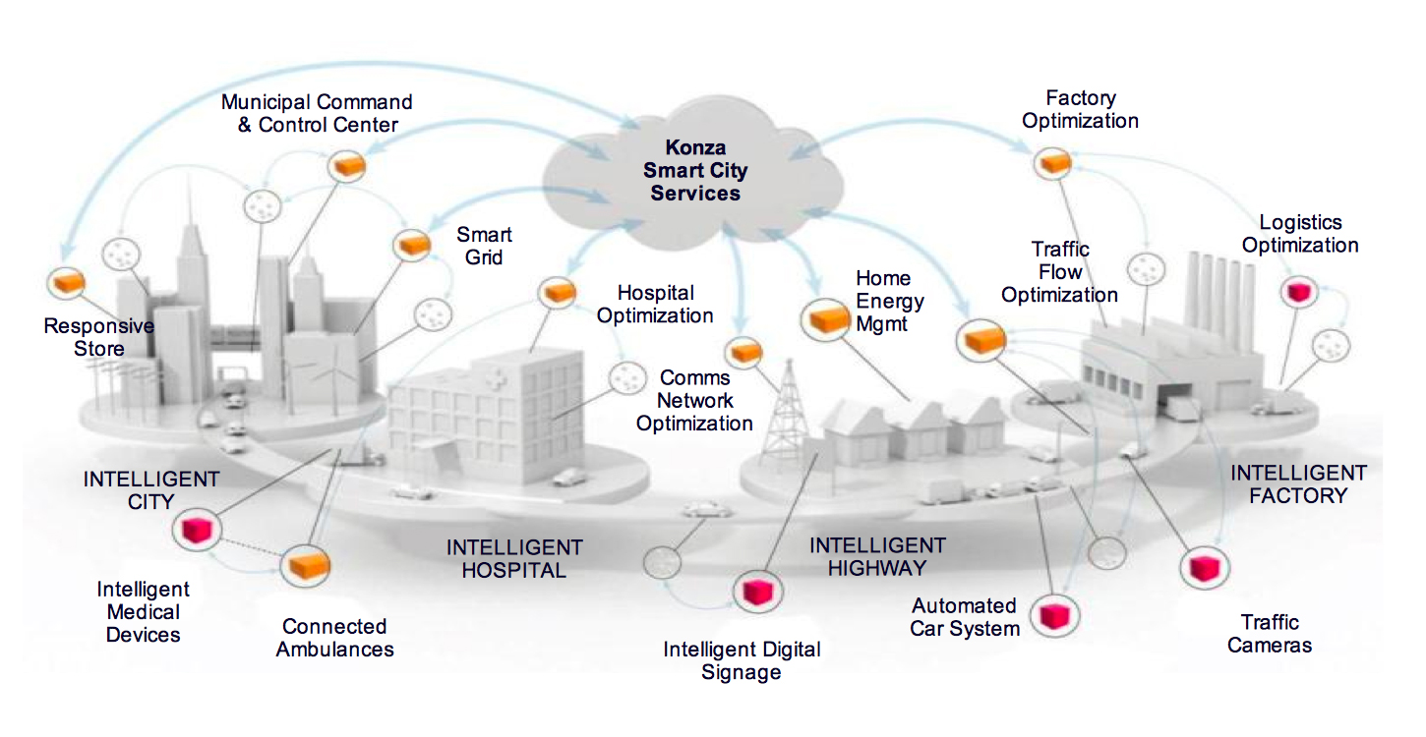
Konza, Kenya will be a smart city, with an integrated urban information and communication technology (ICT) network that supports delivery of connected urban services and allows for efficient management of those services on a large scale. Specifically, a smart city framework will integrate the following four key city services:
Infrastructure services (transportation, utilities, public safety, environment)
Citizen services (access and participation)
City services (city information, planning and development)
Business services (supportive services for local commerce)

Slide 27
Foundational Infrastructures for a Smart City
Smart Water

Slide 28
Smart Water Applications
Potable Water Monitoring & Diagnostics Monitor the quality of tap water in cities.
Water Leakages Detection of liquid presence outside tanks and pressure variations along pipes.
CSO Runoff
Monitoring and managing combined storm and sewer water run off
Flood Control
Predictive modeling software lets officials operate and manage the city as events unfold, like sudden rainstorms and hurricanes, all in real time
Chemical Leakage Detection in Rivers Detect leakages and wastes of factories in rivers.
Swimming pool remote measurement Control remotely the swimming pool conditions.
Pollution levels in the sea Control real time leakages and wastes in the sea.
River Floods Monitoring of water level variations in rivers, dams and reservoirs

Slide 29
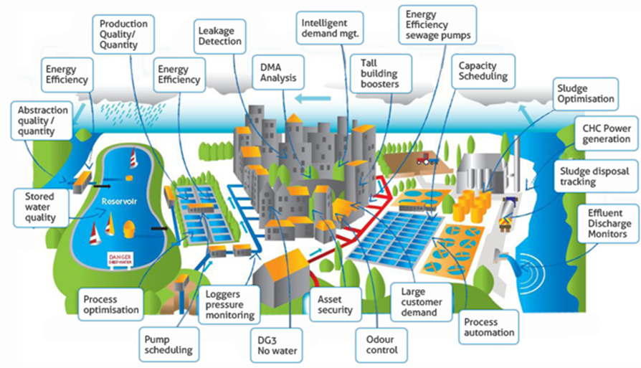

Slide 30
Foundational Infrastructures for a Smart City
Smart Energy

Slide 31
Smart Energy Applications
Smart Buildings
Energy Efficiency, rooftop solar integration, building automation systems (ICT)
Smart Grid Energy consumption monitoring and load management. Renewables Integration. Microgrid (PV/EV/ES) deployment for resiliency modeling
Energy and Water Use Energy and water supply consumption monitoring to obtain advice on how to save cost and resources. Also the nexus of energy and water to make more efficient water and waste water systems.
Tank level Monitoring of water, oil and gas levels in storage tanks and cisterns.
Photovoltaic Installations Monitoring and optimization of performance in solar energy plants.
Water Flow Measurement of water pressure in water transportation systems.
Silos Stock Calculation Measurement of emptiness level and weight of the goods.

Slide 32
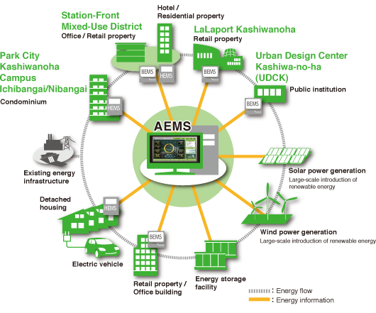
Area Energy Management System *AEMS

Slide 33
Foundational Infrastructures for a Smart City
Smart Transportation

Slide 34
Smart Transportation Applications
EV Integration
EV Charging station availability, location, EV fleet management
Smart Lighting Energy savings and also environmental monitoring (temperature, air quality), security features
Leveraging City Cameras
Traffic management by time and by lane and coordinated with street lights to ease traffic flow
Smart Highways
Notifications of traffic and alternate routes, communications of accidents, construction, hazards
Smart Parking
Sensors allow for navigation to open parking throughout the city
Smart Airports
By enabling the exchange of real-time information, deep cross-silo collaboration, and airport-wide process integration, smart airports significantly improve operational efficiencies, passenger services, and advanced security capabilities.
Smart Public Transport (Trains, Buses, Bike-Sharing, Ride Sharing, Walking/Hiking)
Public transport operators and authorities embark on bold, overarching plans, called Integrated Mobility Plans (IMPs), to coordinate and optimize traffic.

Slide 35
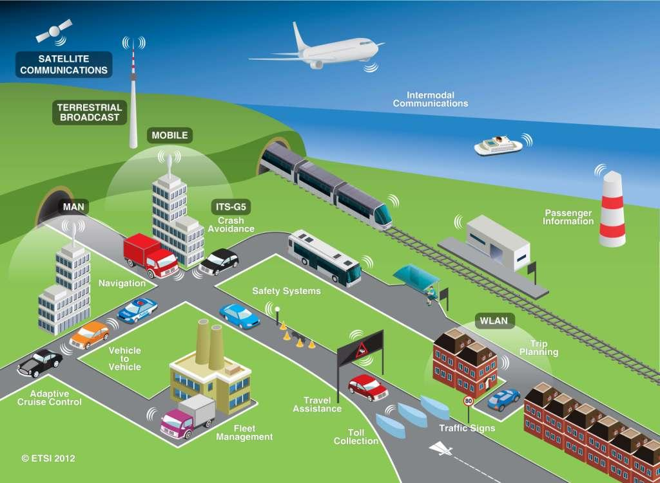

Slide 36
Foundational Infrastructures for a Smart City
Smart Education

Slide 37
Smart Education
From IBM Smarter Cities
One resource the world has no shortage of is data. Schools and universities have always recorded and stored data as they tracked grades, attendance, test scores and demographics. With the increasing availability of technology in the instructional process, educational institutions now collect, in real time, data about what their students learn and how they progress. Using big time analytics, everything from attendance to a campus building's energy usage has a place in identifying targets for improvement and sharing of resources to enhance learning, spot troubling trends earlier, and instill a sense of common purpose in working toward goals.
“Our use of analytics is enabling teachers to easily access information, whereas heretofore it would take a good bit of time. Now they can really concentrate on the teaching piece and on getting the student engaged.”
J. Alvin Wilbanks, Gwinnett County Public School system

Slide 38
IBI Group Smart Education
At the building level, the kinds of intelligent systems developed can help schools, colleges and universities better manage their energy systems, security, communication, and transportation.
At a higher level, intelligent systems can help connect departments and campuses; they can enable virtual and online learning, and engage social media. At the very highest level, they can partner with contemporary education thinking to actually change the way that children learn.
Technology is changing the way that we deliver education. Migration from text books to dynamic learning content delivered through computers and mobile smart devices allows for more student focused delivery of education; at their pace, with relevant content and learning approaches. It also allows schools to stay up to date with current and timely information, and to leverage teaching resources across schools, campuses, districts and across the world.

Slide 39
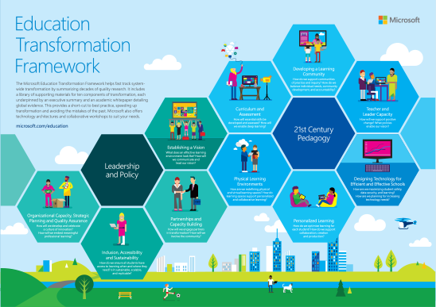
Microsoft helps educators transform the classroom to create lifelong learners. Once you a technology plan in place, transform teaching and learning within the school. Find resources you need to inspire students, empower teachers, and inform IT staff.

Slide 40
Foundational Infrastructures for a Smart City
Smart Health Systems

Slide 41
Smart Healthcare
Healthcare analytics turns data into clinical and business insights in real time for point-of-care decisions and productivity. Forward-thinking organizations are connecting their healthcare data, systems and processes to facilitate secure communications and information sharing. IBM Smarter Cities
Hospitals are under enormous pressure to keep their costs down and improve the bottom line. They’re looking for ways to achieve greater operating efficiency to reduce costs. And new revenue opportunities are also needed to boost income. Patient satisfaction is also important, helping ensure that their beds stay full. Solution: The “smart” bedside terminal can address most of these challenges. This all-in-one device connects and integrates the hospital information network, clinical services, patient entertainment, and communication systems, enabling better and more efficient access at the point of care. Intel Smart Cities

Slide 42
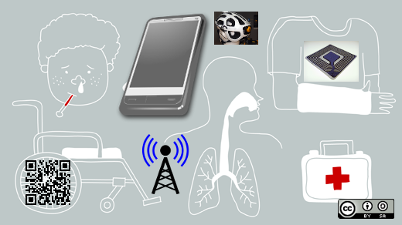
Smart
Ubiquitous
Healthcare
Electronic medical records help decrease the amount of unnecessary medication and number of tests, accelerate the care process cycle, reduce administrative costs, and improve physician productivity.
Clinician and patient portals can provide greater visibility into patient records, improve collaboration among providers, accommodate increased patient volumes, and reduce coding errors for fewer denied claims.
Health information exchange solutions help reduce duplicate tests and preventable adverse events, enhance referrals and access to records from other institutions, support effective time management, and enable more efficient billing.
Health analytics can support early detection and improved diagnoses, help reduce the cost of patient care, save money on drug costs, and provide greater insight into business performance.
Advanced clinical decision support helps reduce preventable adverse effects and duplicate lab or radiology orders, frees physicians' time for more personalized care, and enables more effective time management with proactive alerts, guidelines and communications.

Slide 43
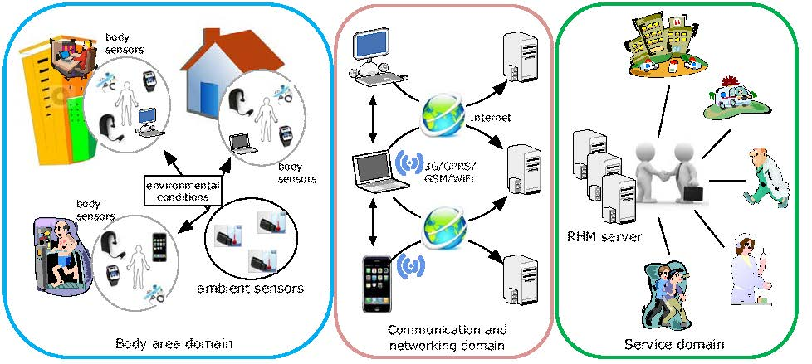
ICT enables connections between patients via body sensors and patient care providers presently on-call to provide just-in-time care.

Slide 44
Foundational Infrastructures for a Smart City
Smart City Services

Slide 45
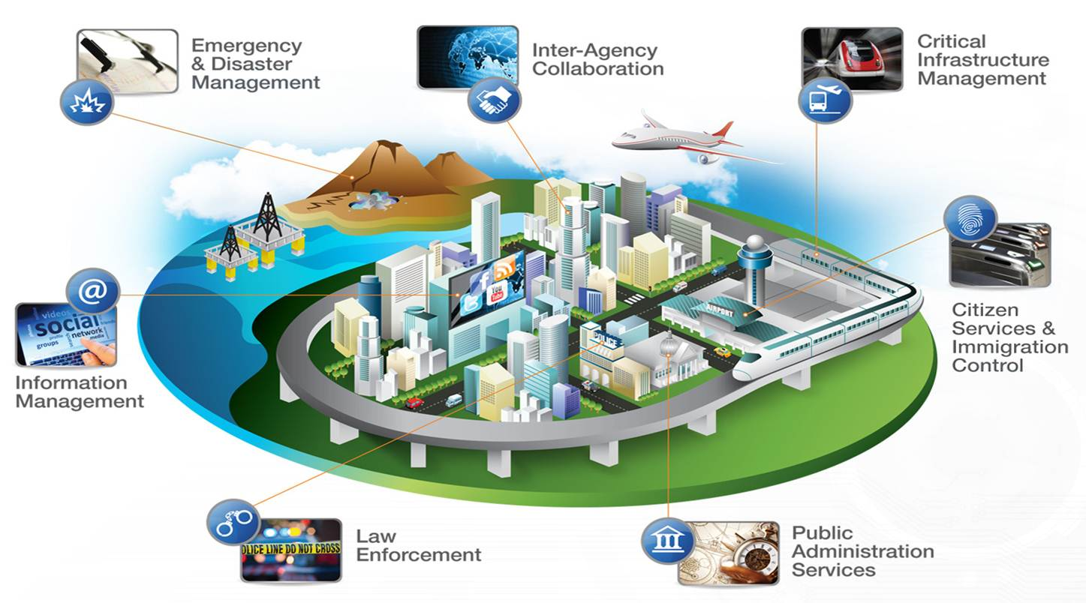
Smart City Services leverage ICT and open sourced data integration and analytics to help local governments modernize their IT infrastructures and works within the constraints of existing budgets and legacy IT assets which includes integrated and extensible data center platforms and ERP suites
Provides industry-standard servers, storage, software, and applications (Source: Oracle Smart Cities)
Benefits
Provides IT infrastructure modernization
Enables efficiency and transparency
Transforms constituent services

Slide 46
Foundational Infrastructures for a Smart City
Current Smart City Applications

Slide 47
Current Smart City Applications
Smart Parking Monitoring of parking spaces availability in the city.
Structural health Monitoring of vibrations and material conditions in buildings, bridges and historical monuments.
Noise Urban Maps Sound monitoring in bar areas and centric zones in real time.
Smartphone Detection Detect iPhone and Android devices and in general any device which works with WiFi or Bluetooth interfaces.
Eletromagnetic Field Levels Measurement of the energy radiated by cell stations and and WiFi routers.
Traffic Congestion Monitoring of vehicles and pedestrian levels to optimize driving and walking routes.
Smart Lighting Intelligent and weather adaptive lighting in street lights.
Waste Management Detection of rubbish levels in containers to optimize the trash collection routes.
Smart Roads Intelligent Highways with warning messages and diversions according to climate conditions and unexpected events like accidents or traffic jams.

Slide 48
Top 10 Smart City Vendors:
IBM
Cisco
Schneider Electric
Siemens
Microsoft
Hitachi
Huawei
Ericsson
Toshiba
Oracle
https://www.navigantresearch.com/research/navigant-research-leaderboard-report-smart-city-suppliers

Slide 49
CISCO believes the IoT could generate $4.6 trillion over the next ten years for the public sector, and $14.4 trillion for the private sector.
How Open Data Is Transforming City Life, Forbes Magazine
http://www.forbes.com/sites/techonomy/2014/09/12/how-open-data-is-transforming-city-life/

Slide 50
Smart City Infrastructure Framework
Jonathan L. Tan
President
GZZ Cleantech Consulting

