Slide 1

Welcome to
Protect Point Loma

Slide 2
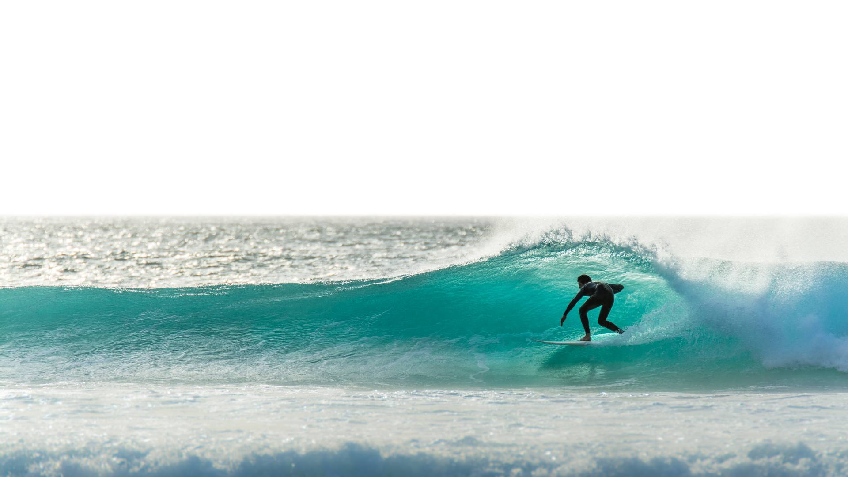
Protect Point Loma
We are a 501C-4
Our EIN No. 33-3510409
State Charity Reg. #CT0298575
Federal Tax Exempt Form 1024A Submitted 3/18/25

Slide 3

Website
www.ProtectPointLoma.com

Slide 4
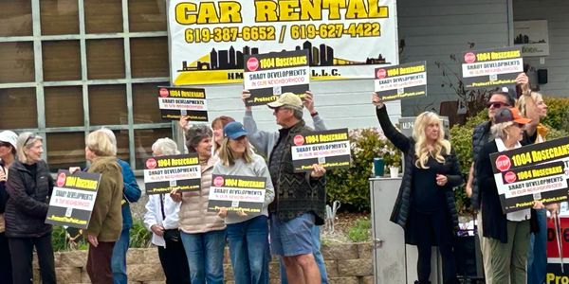
Peaceful Protest

Slide 5
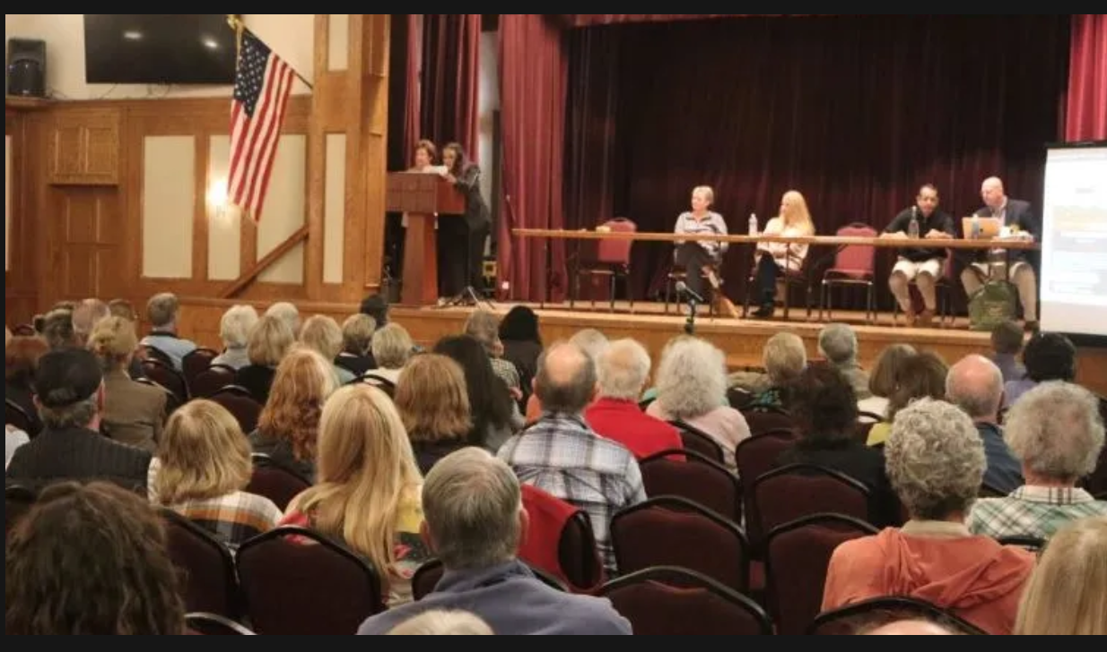
Selecting visul aids
Town Hall Meetings
Enhancing your presentation

Slide 6
Attorney
DeLano & DeLano
Current Litigation/Potential Suits
Liveable San Diego v. City of SD & DSD
Case No. 37-2023-00014923-CU-TT-CTL
  San Diego sued for allowing developers to forego parking requirements, build higher, and construct backyard apartments
4591 Pescadero Ave. PRJ-1131969 & PRJ-1106002
  12 ADU’s on a lot zoned for single family residences in the Coastal Zone
Midway Rising – Save Our Access v. City of SD
  Opposed to raising the Midway Height limit. As was the case the first go around, the new lawsuit challenges the city's environmental review and the expected impacts that raising the height limits will have on the environment as well as the residents.
-

Slide 7
Navigating The Problems…
Complete Communities Housing Solutions
What Complete Communities really means…
Ministerial review - no community input, no environmental studies, no traffic studies, developer incentives $$$ to build, no height limits, no setbacks, no zoning rules, no parking as long as you include a small portion for low income housing (412 sq. ft. for $2,500 - $3,000 per month)
What they told us Complete Communities Housing Solutions was…
“Furthers the City of Villages Smart Growth Strategy focusing mixed-use villages connected to transit.”
Live, work, and play in your community.
Emphasizes increased use of transit, bicycle and pedestrian commute trips to reduce vehicle miles travelled (Transit Priority Area/Sustainable Development Area)

Slide 8
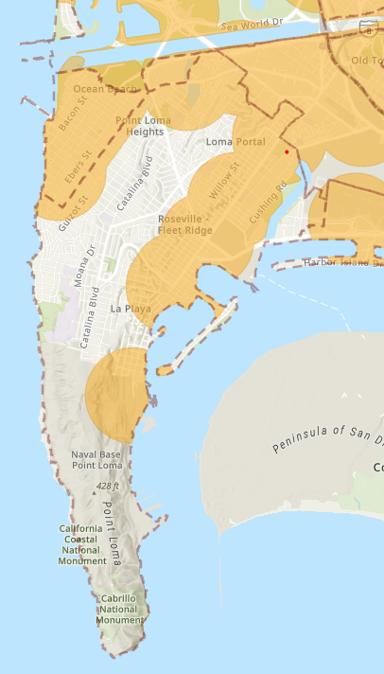
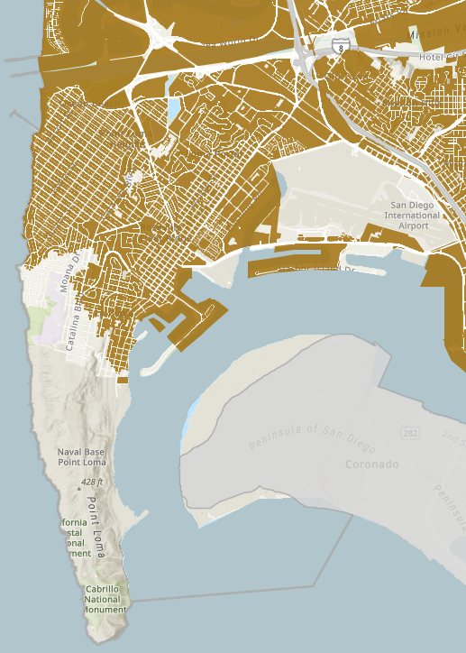
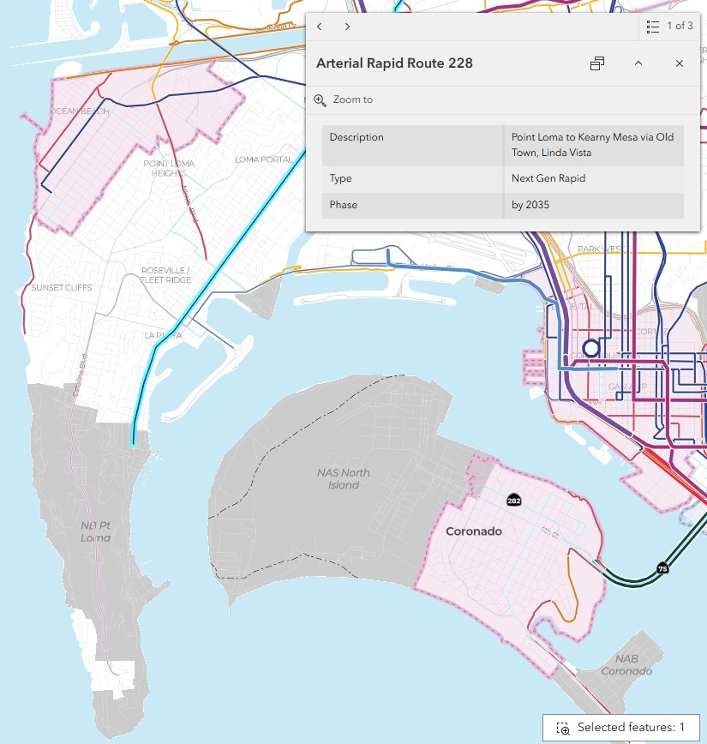
Transit Priority Area Changed to Sustainable Development Area
In 2023 the City of San Diego changed our Transit Priority Areas (TPA) to Sustainable Development Areas (SDA). This opened up 5,200 additional acres to be developed in areas like Point Loma under CCHS rules.
TPA/SDA creation on Point Loma is based entirely on a Rapid Bus Routes that do not exist.

Slide 9
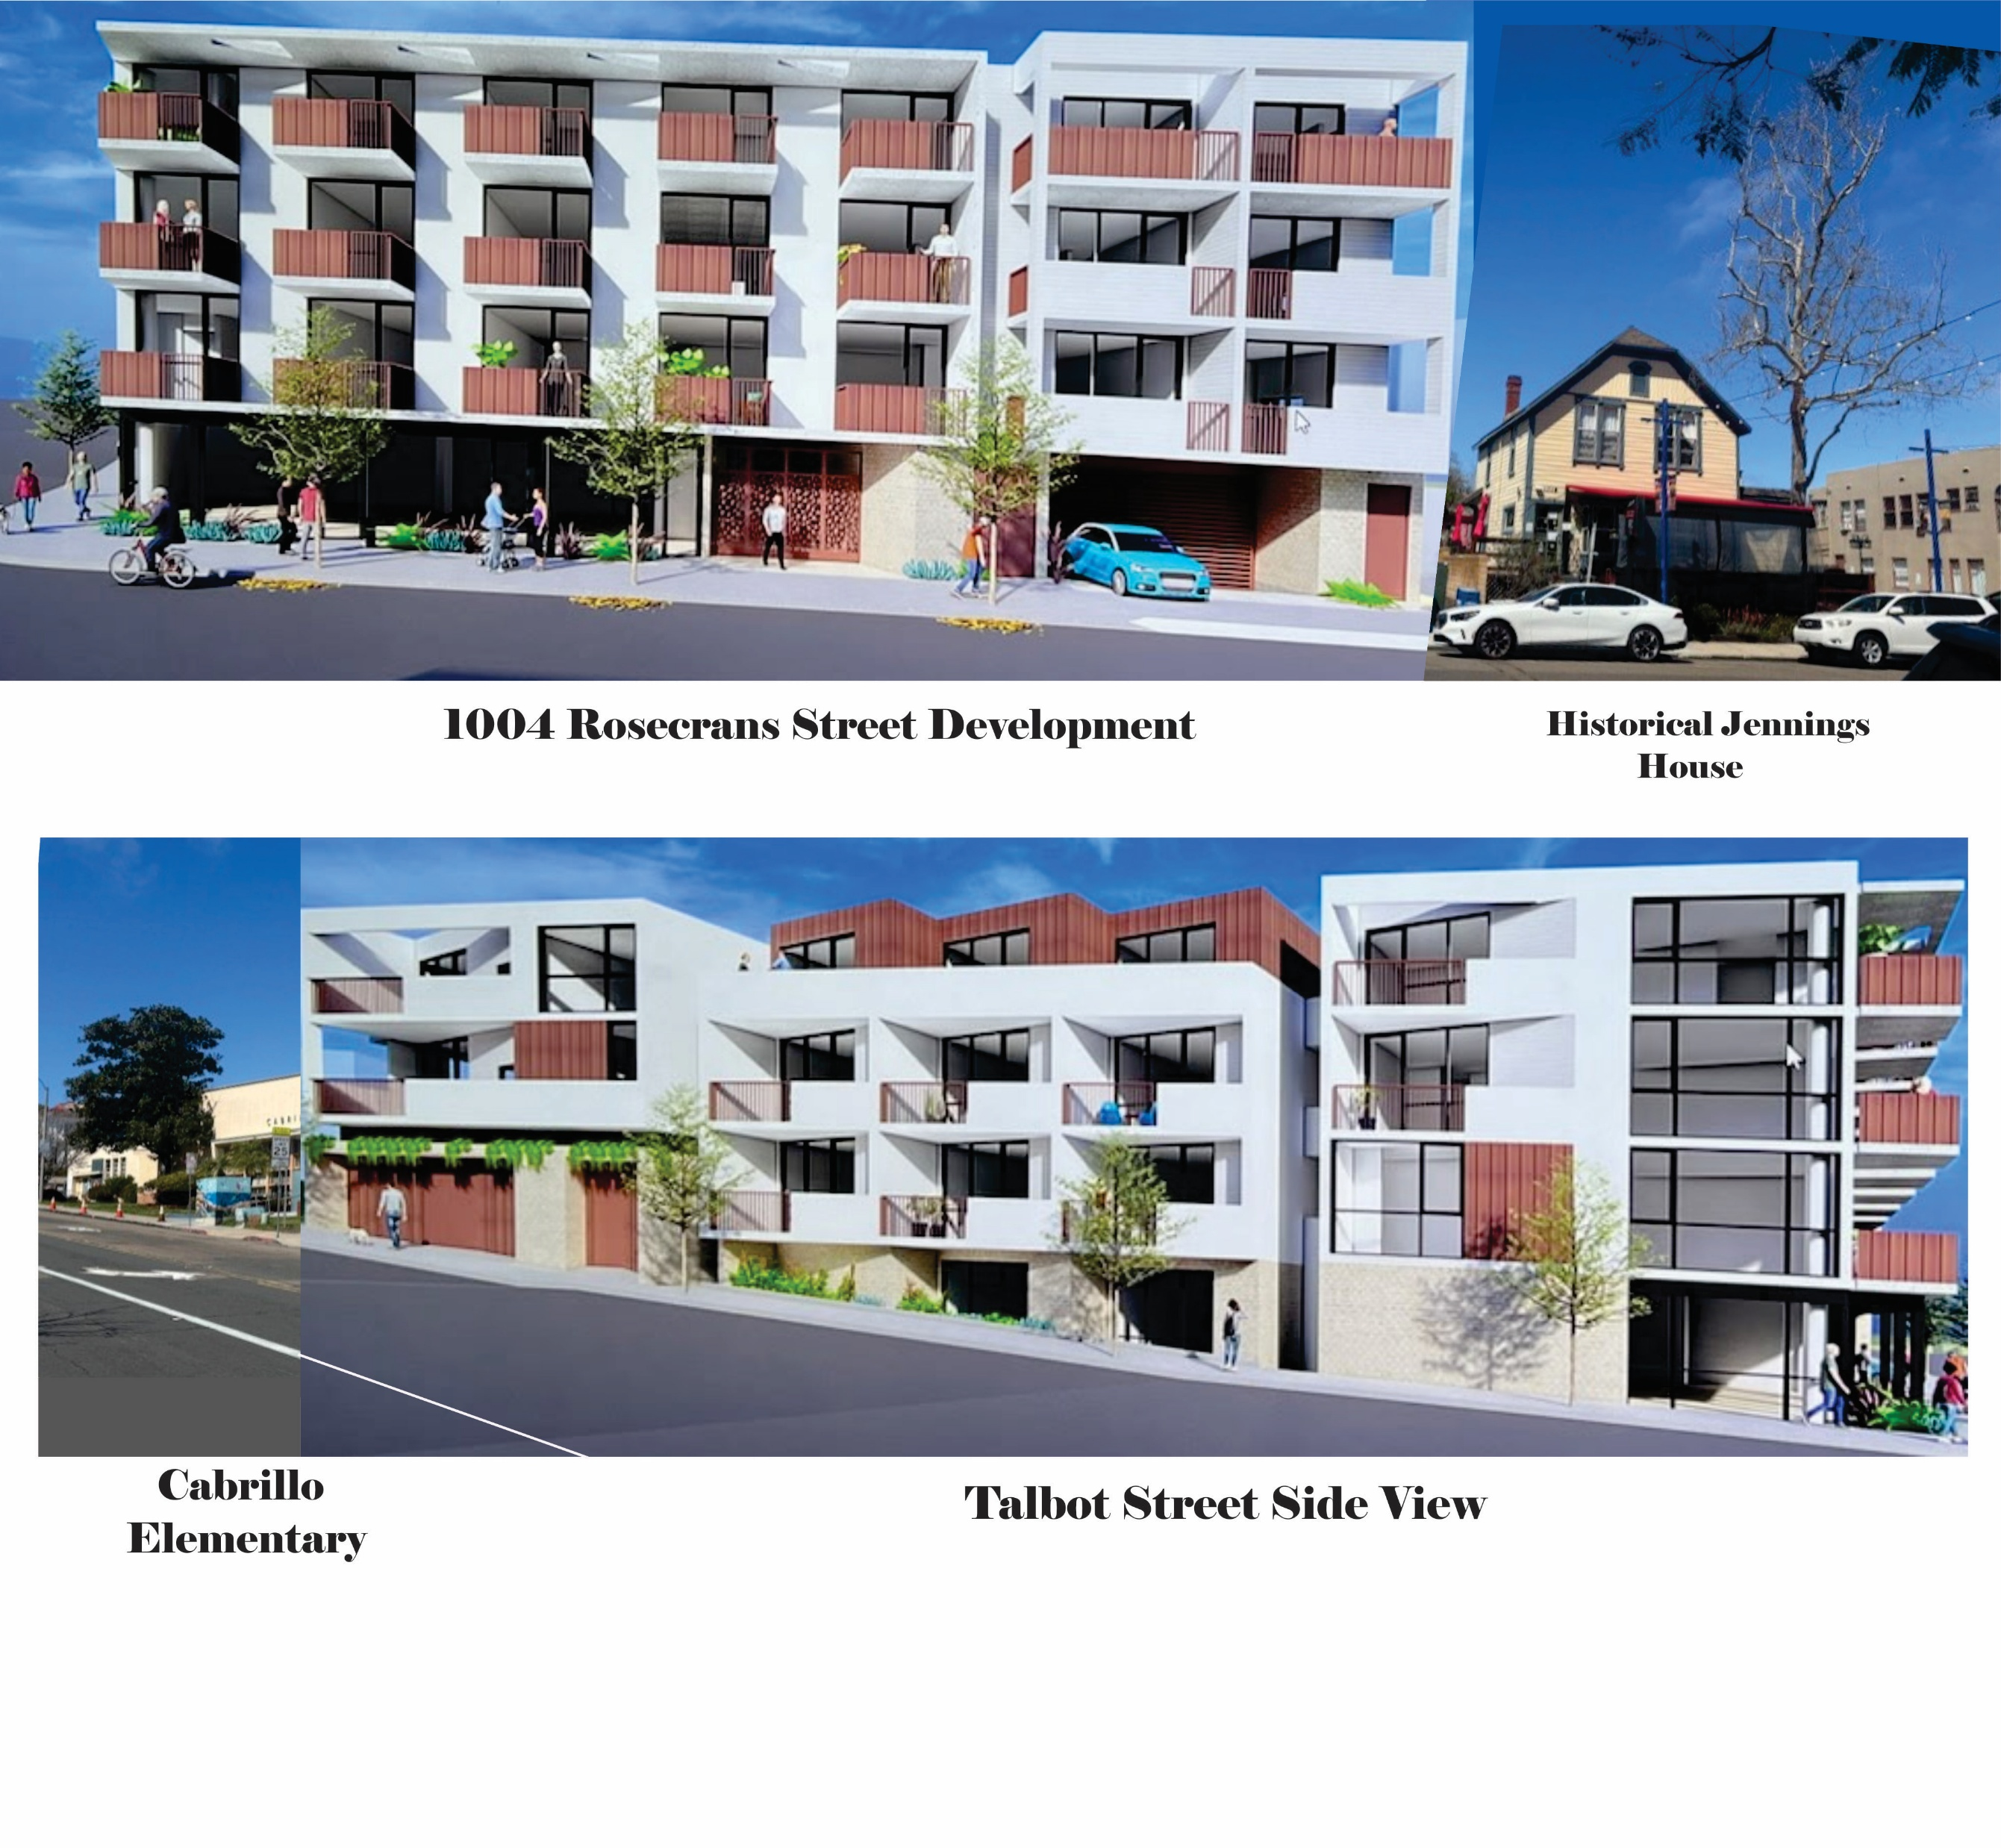
Rendering…
1004 Rosecrans Street
Point Loma
(Corner of Rosecrans/Talbot)

Slide 10
Why 1004 Rosecrans is in the Wrong Place
-Exceeds Coastal Overlay Height Limit of 30’
-No Setbacks – overshadows Historic Jennings House and Cabrillo Elementary
-No parking forcing all street parking
-Location was gas station with leaky tanks with contaminated soil
-Traffic congestion (Rosecrans is two lanes at this location and only ingress egress for Navy Submarine Base which is in a Very High Fire Hazard Severity Zone)
-Evacuation issues not addressed
-Noise, safety and health issues
-Next Gen Rapid Transit is not scheduled until 2035 and cannot be accomplished in this area.
-The list goes on!

Slide 11
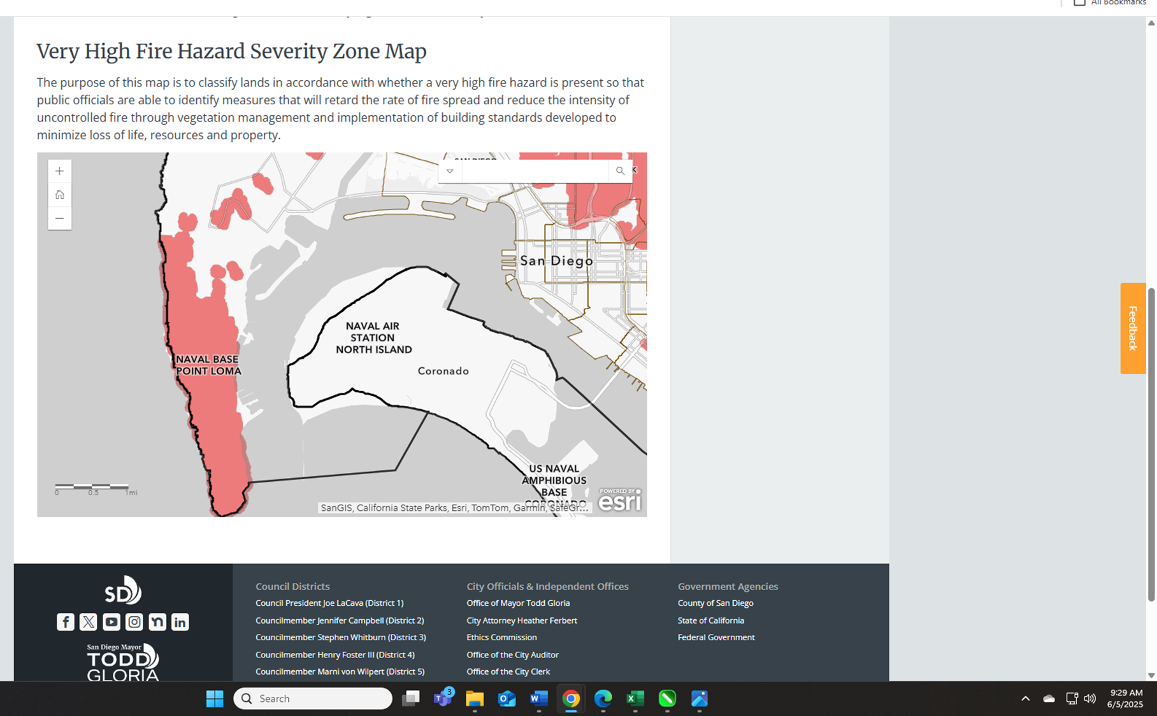
Evacuation Problems. Rosecrans is the major ingress & egress from the Navy Submarine base located in a Very High Fire Hazard Severity Zone! 12,000 – 22,000 people occupy the base daily. If there is a fire, we are in trouble.

Slide 12
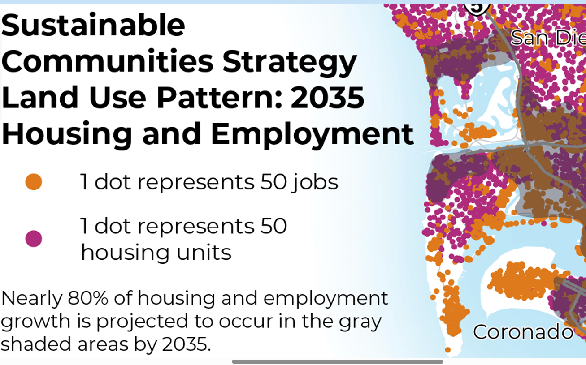
Sustainable Communities Strategy. The City is claiming Point Loma will have 150-300 jobs in this area by 2035 and housing as far down as the Navy Sub Base… Big plans for increased housing (purple dot)… 80% will be out of our area.

Slide 13
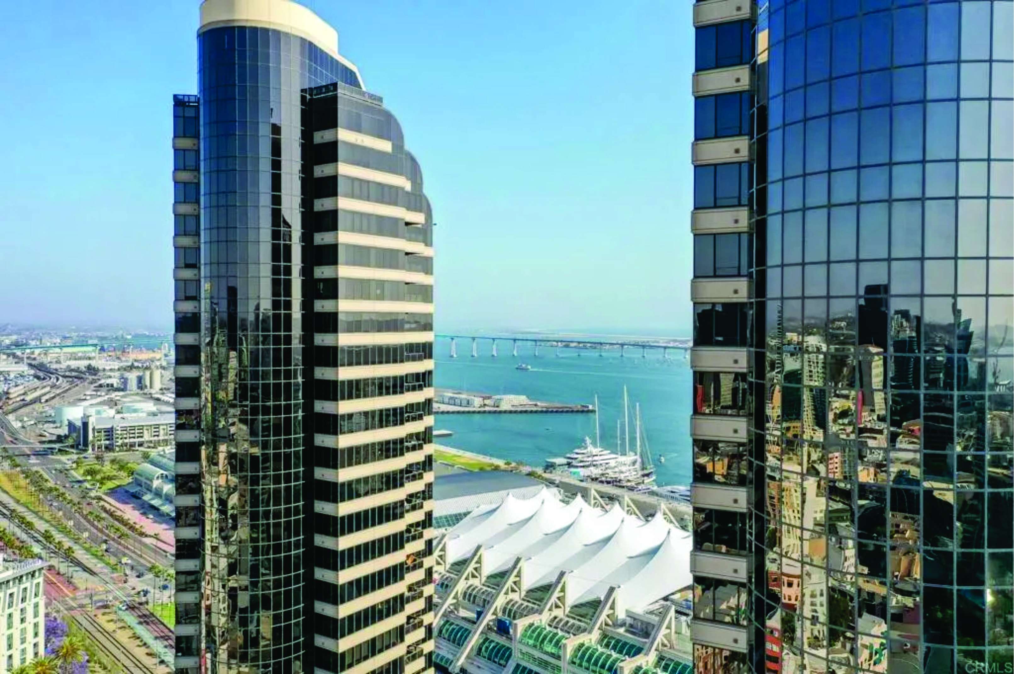
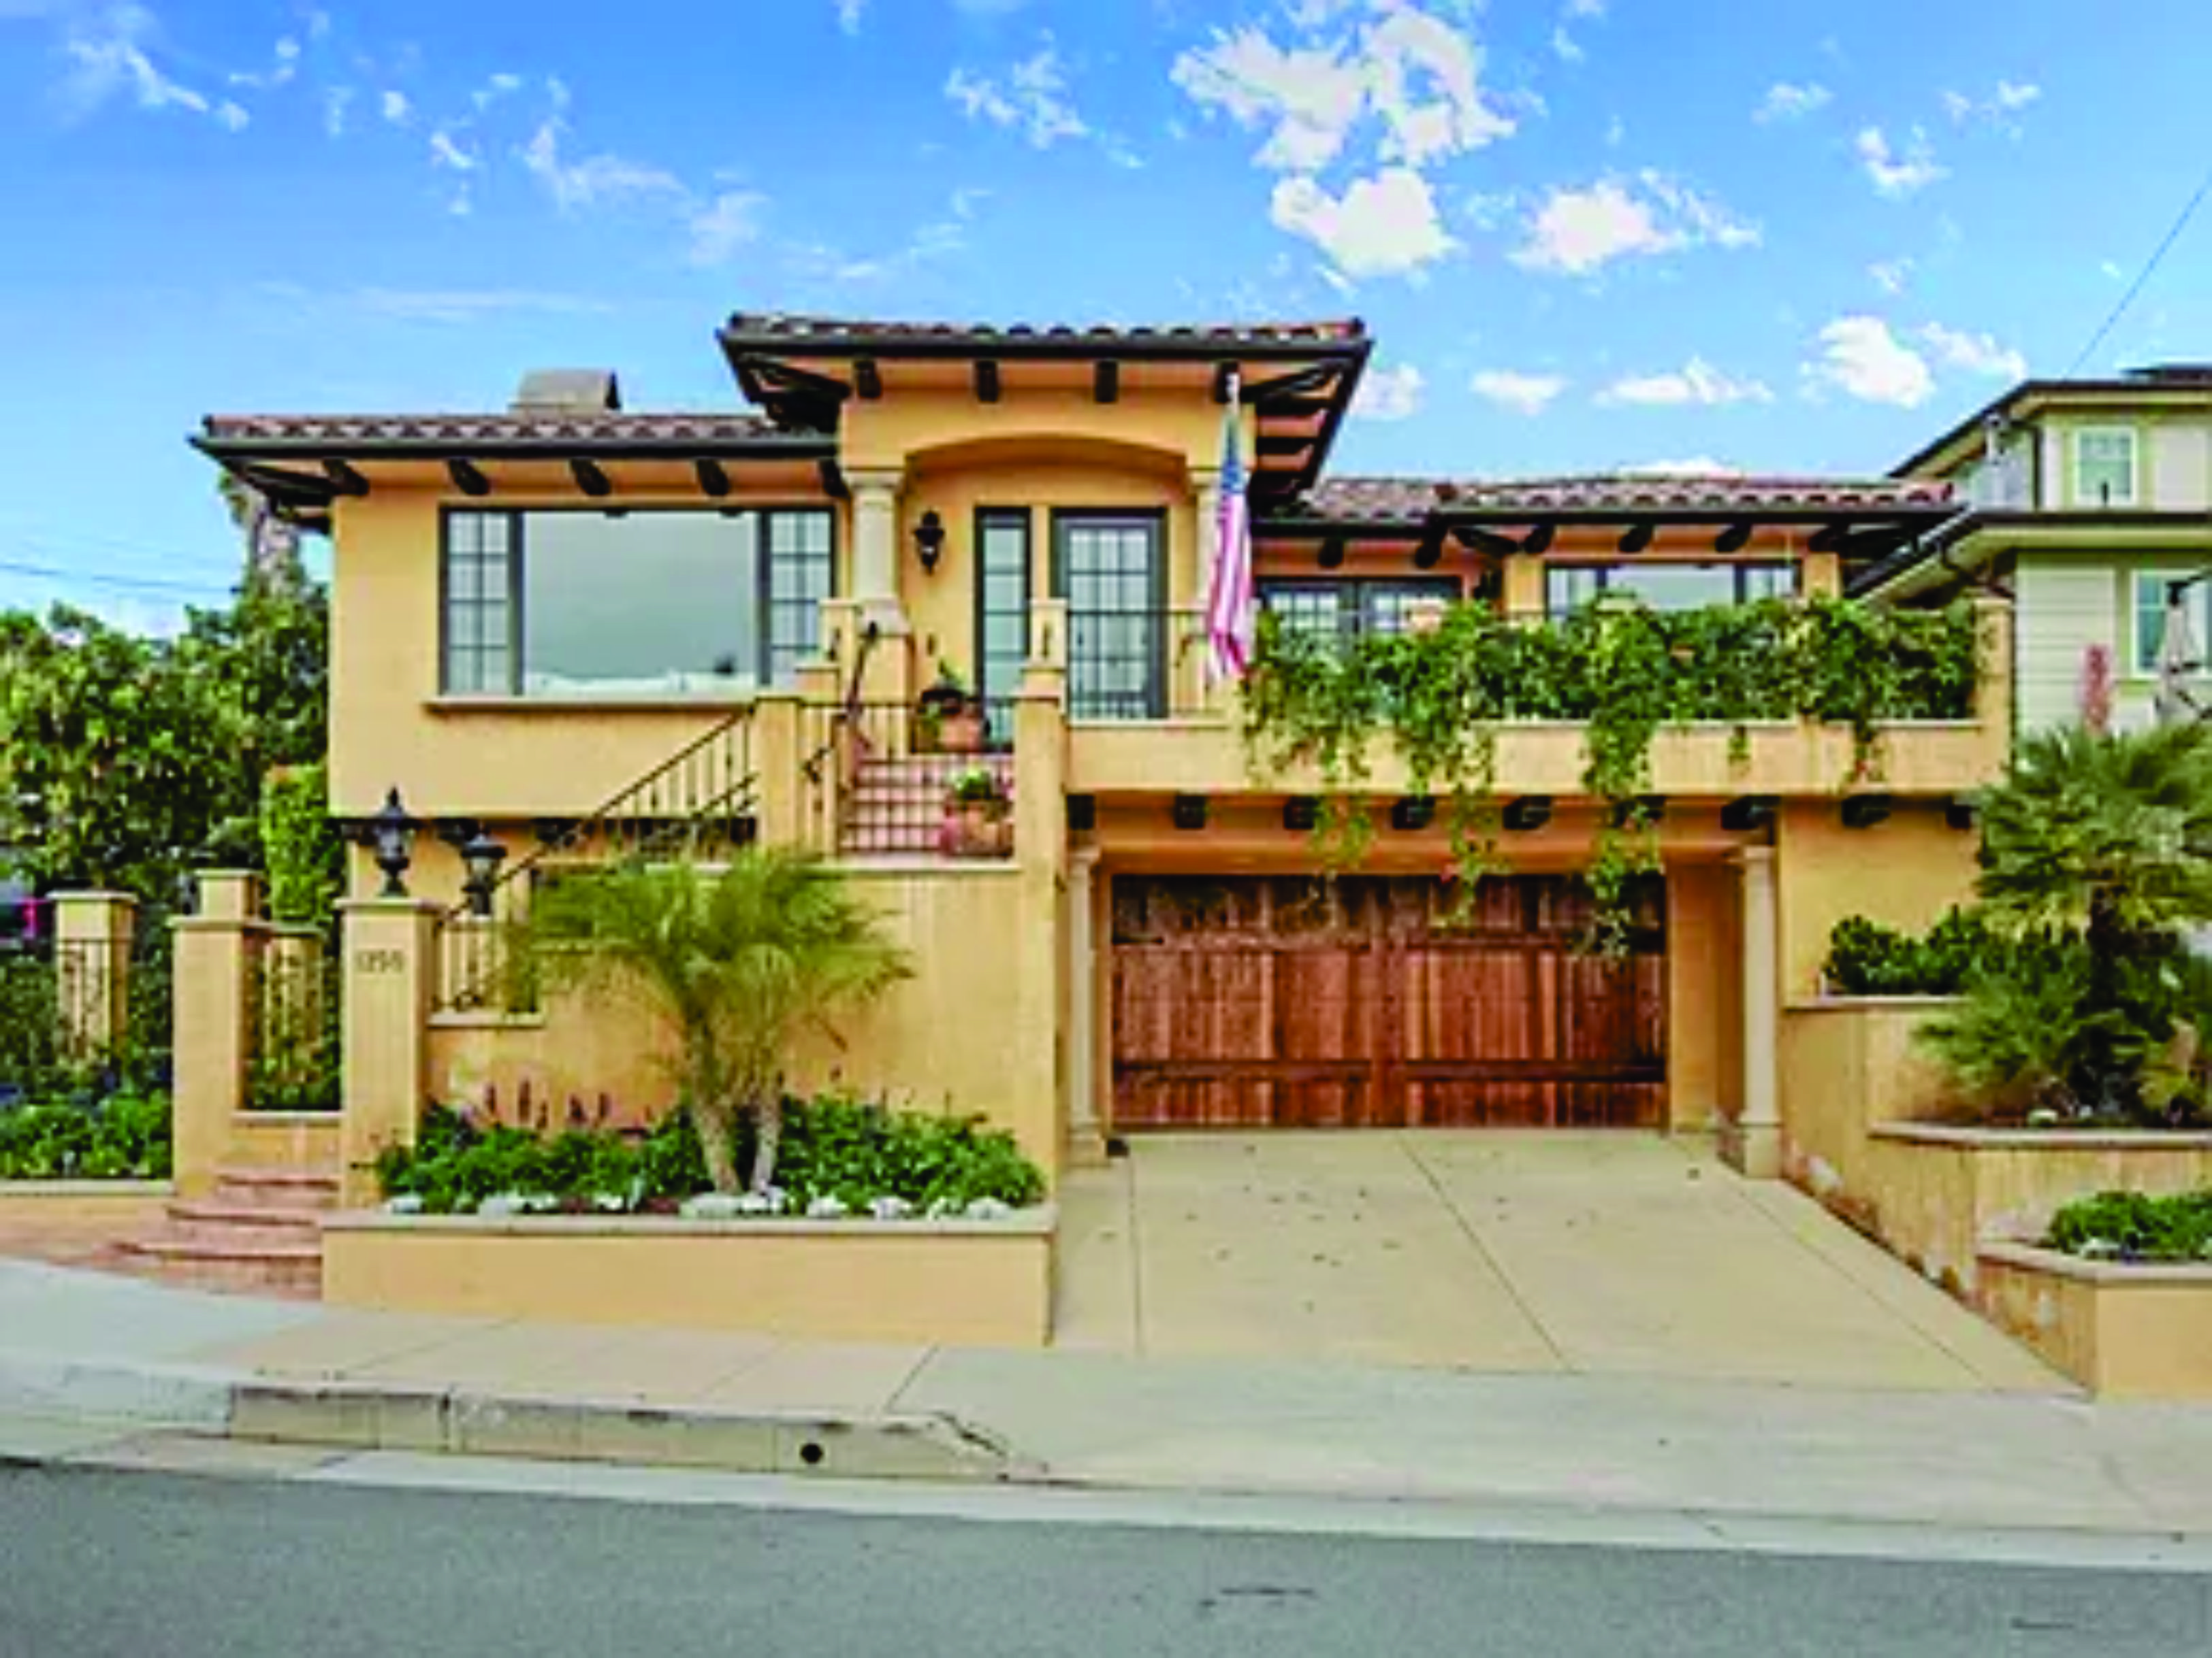
Why is the City pushing for High Density?
High rise apartments generate approx. 9x the tax revenue per acre than single family homes.

Slide 14
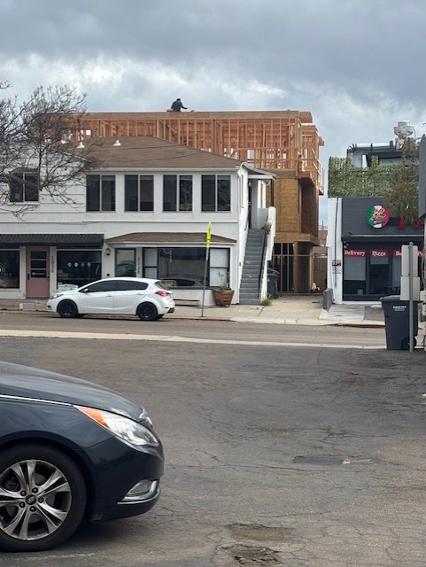
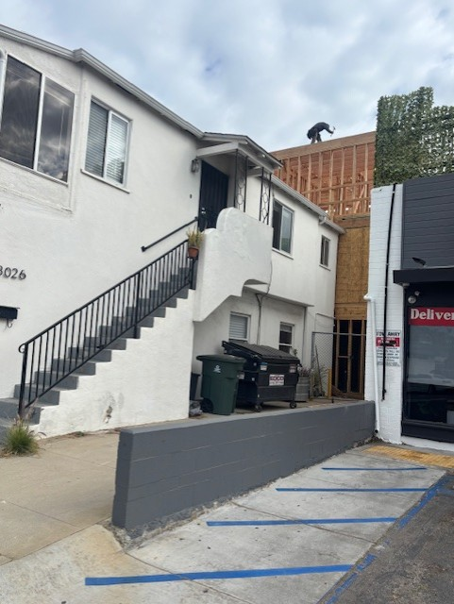
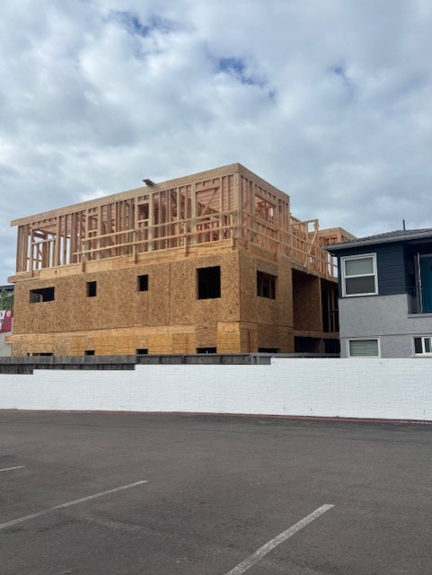
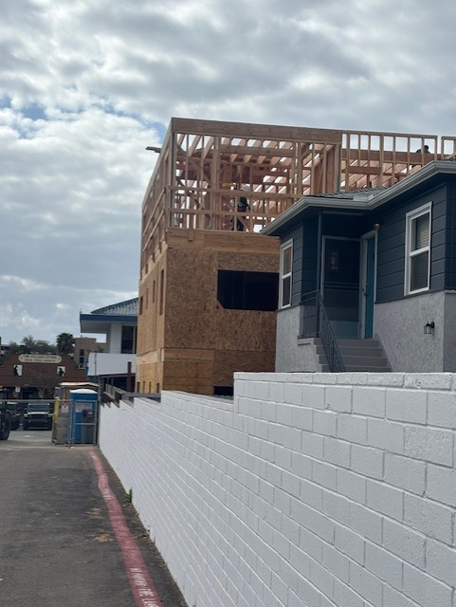
3024 Canon St. 12 ADU’s with another 12 going in front. No parking provided. This is coming to ALL Point Loma neighborhoods with bonus incentives if you add a small portion to low income. 24 units with no parking required.

Slide 15
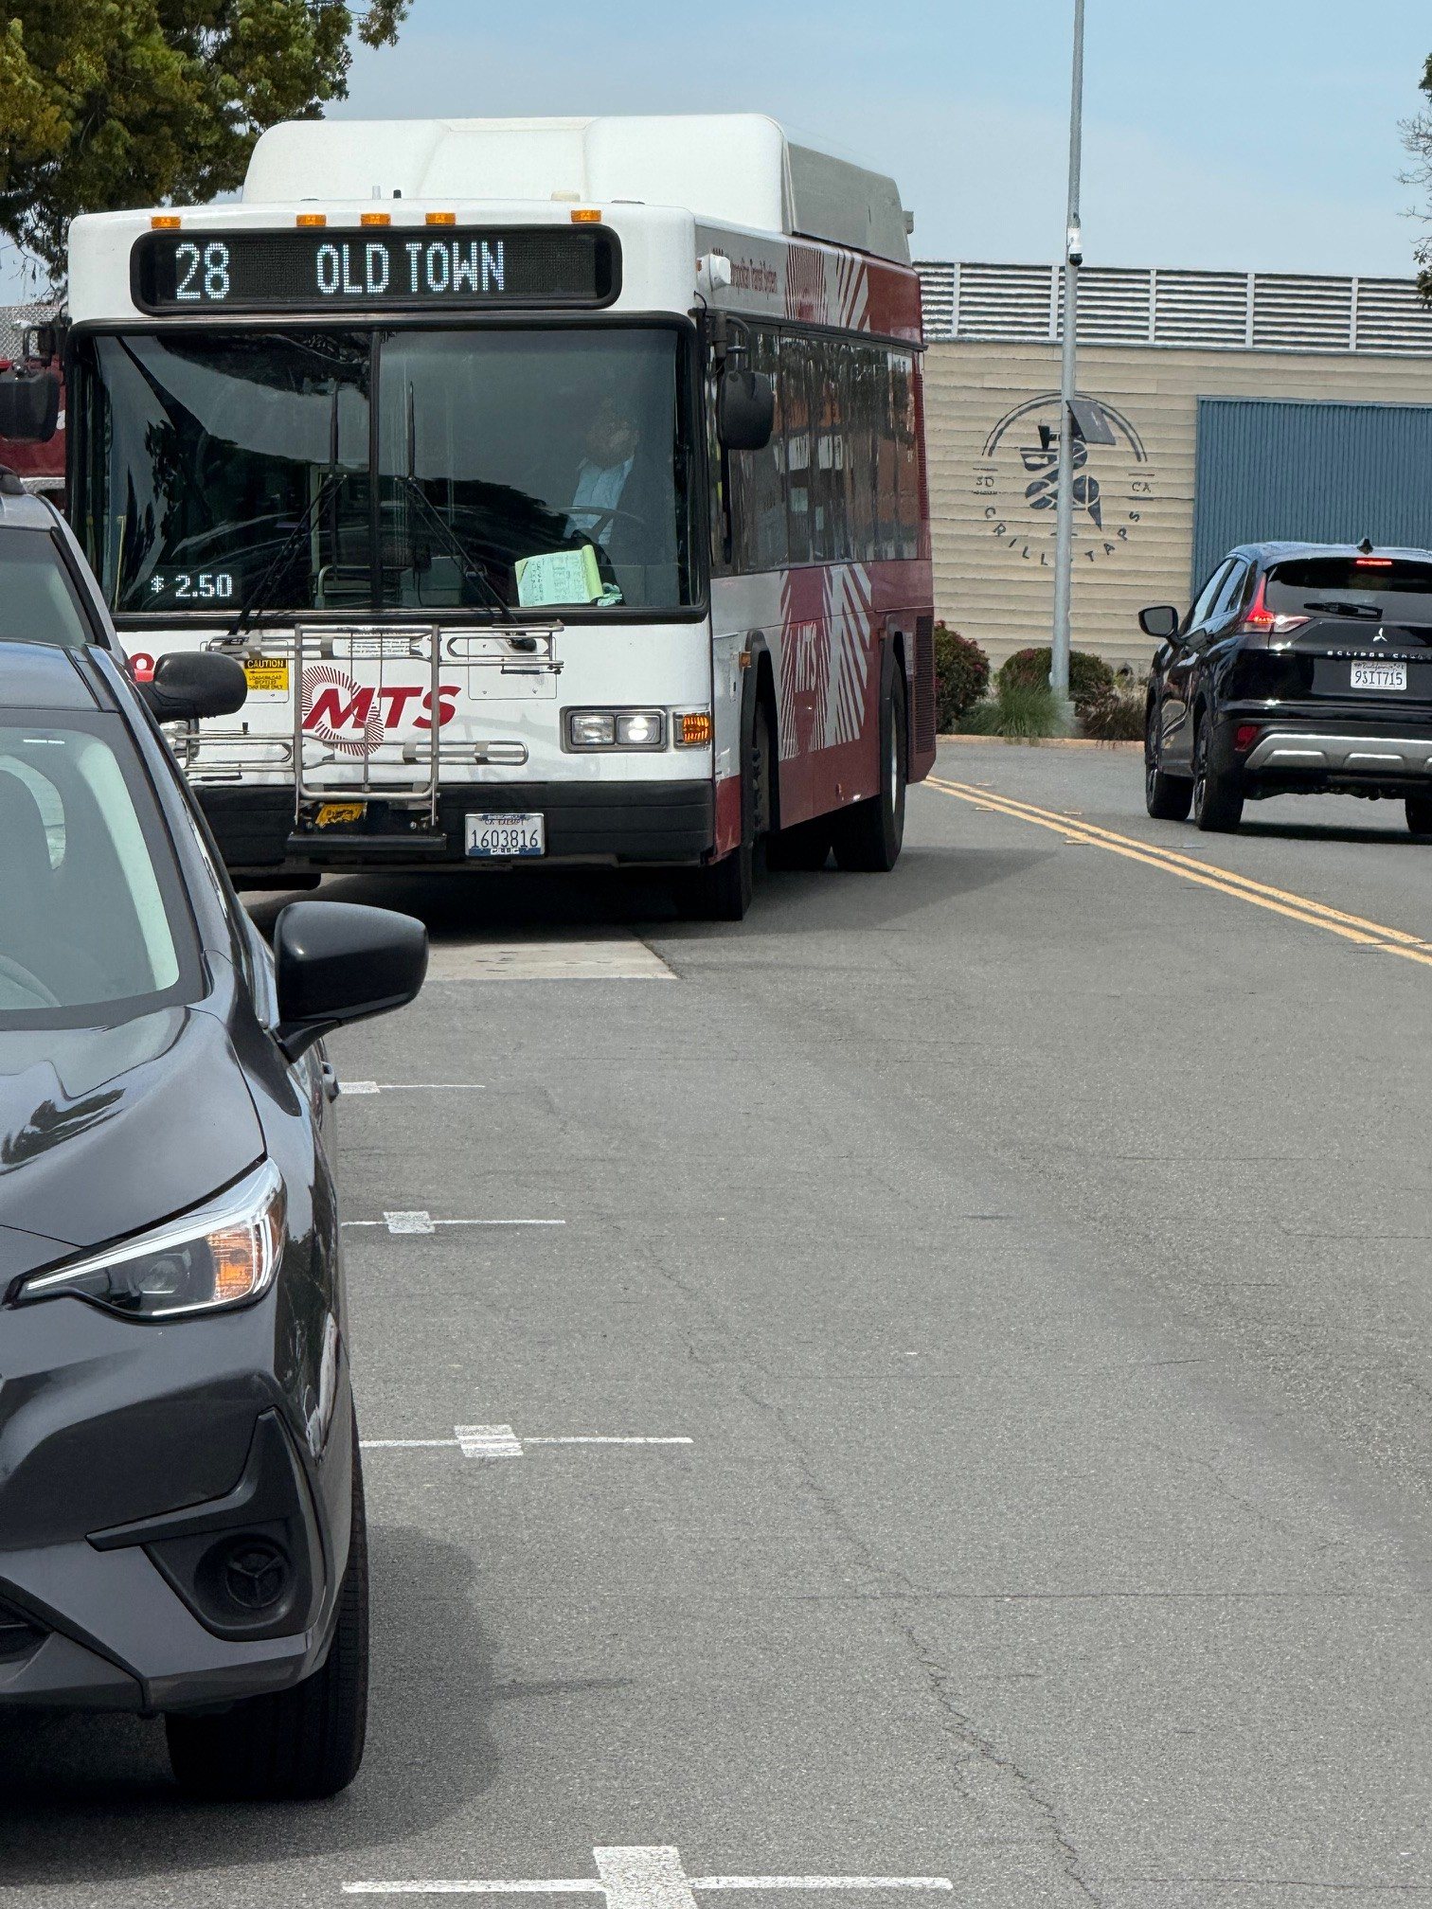
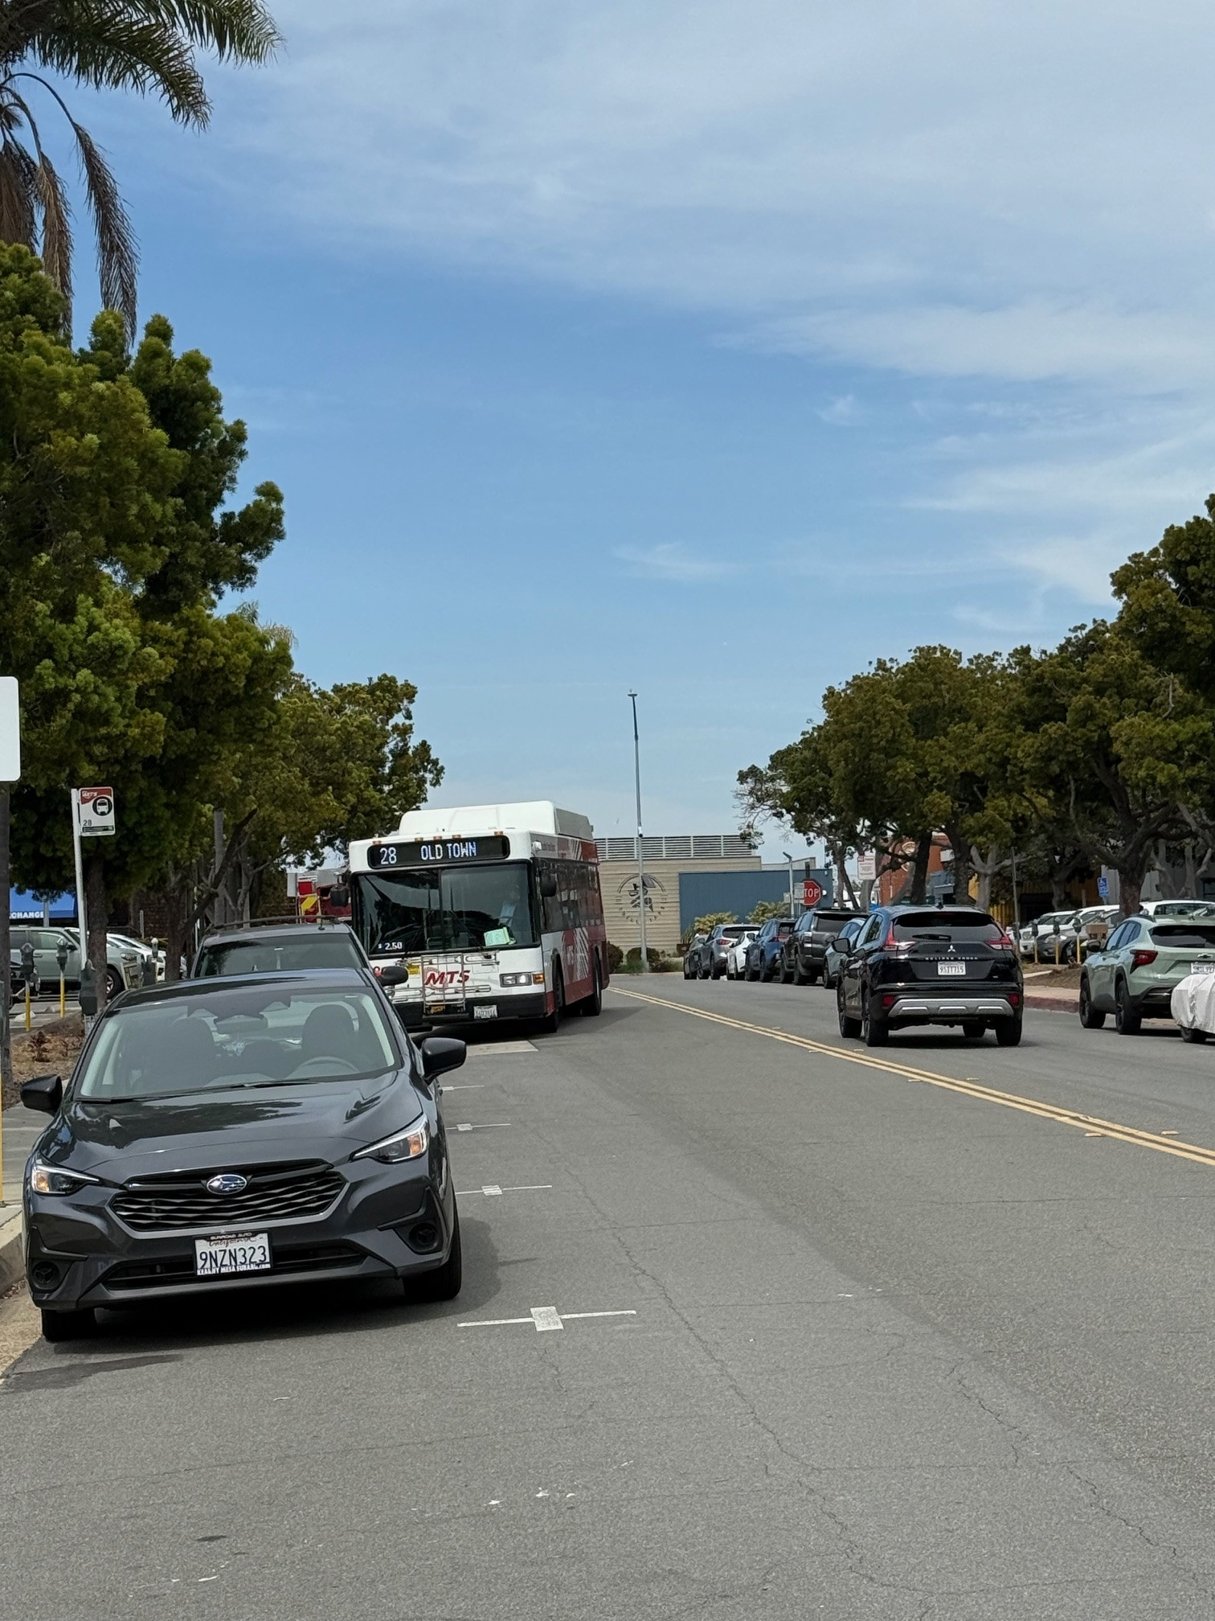
Route 28 Shelter Island and Anchorage. This is our “Next Gen Rapid Route” “planned” for 2035 with 30-60 minute intervals. Build now with no parking and hope the new build will ride the bus. In the meantime, more cars, not less, more greenhouse gasses, not less, more congestion, not less, more health and safety issues, not less, more evacuation problems, not less… With MTS & City deficit, & low ridership/ low priority/ no road room, this may never be feasible.

Slide 16
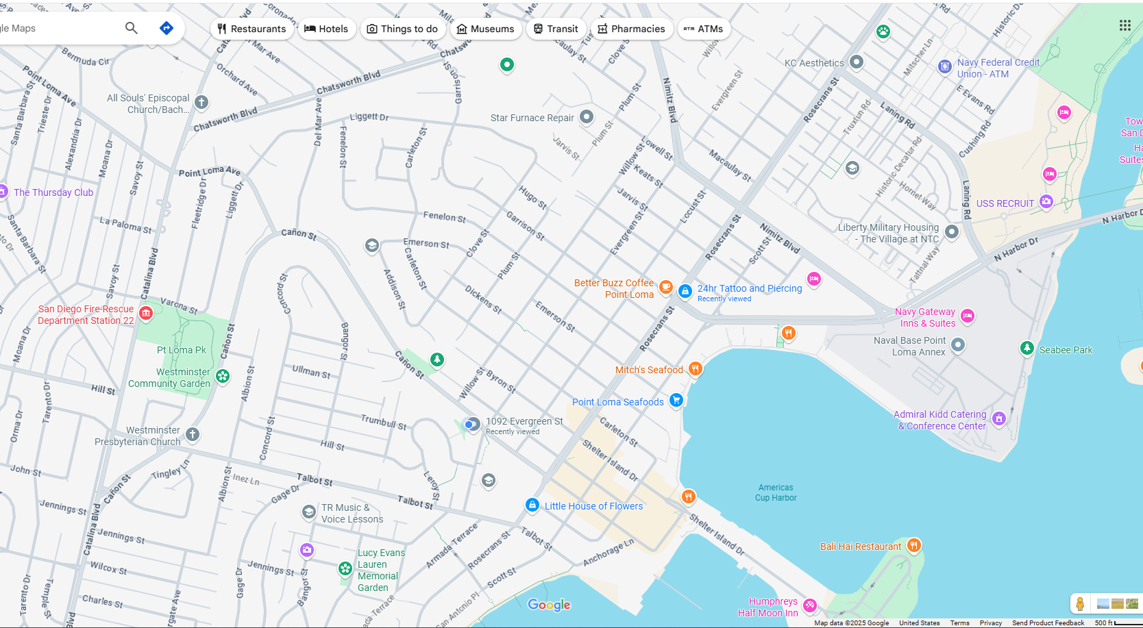
Next Gen Rapid Transit Bus Route 2035
Rosecrans and Shelter Island. Do not understand how this qualifies in this area by any stretch.

Slide 17
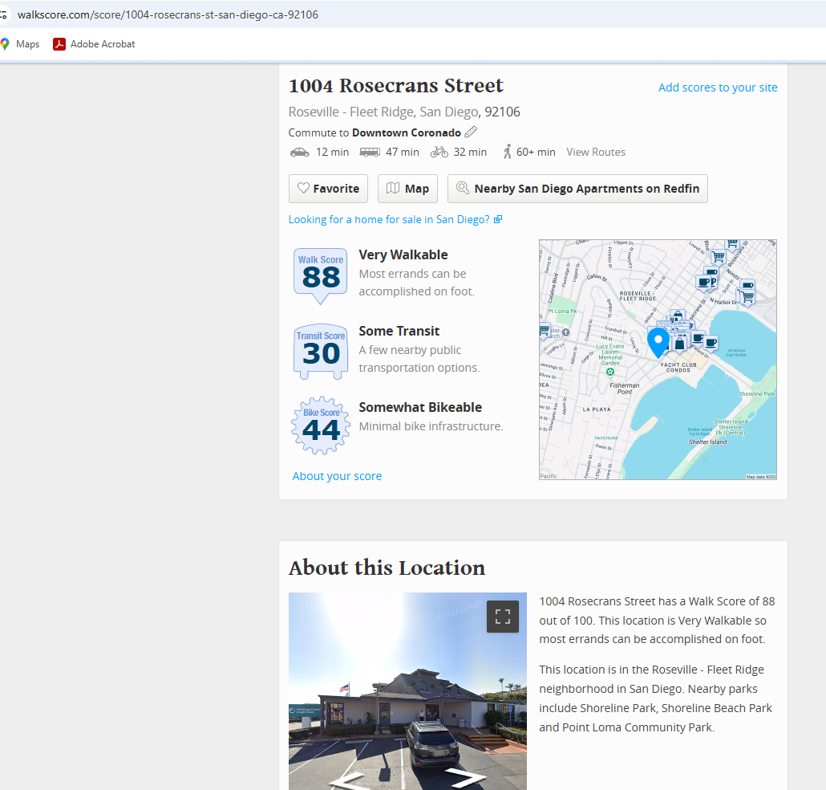
Walk, Bike, Transit Score…. Pharmacy 1.7 miles away, Grocery 1 mile away, Hospital 5.8 miles away, Downtown San Diego 6.3 miles away

Slide 18
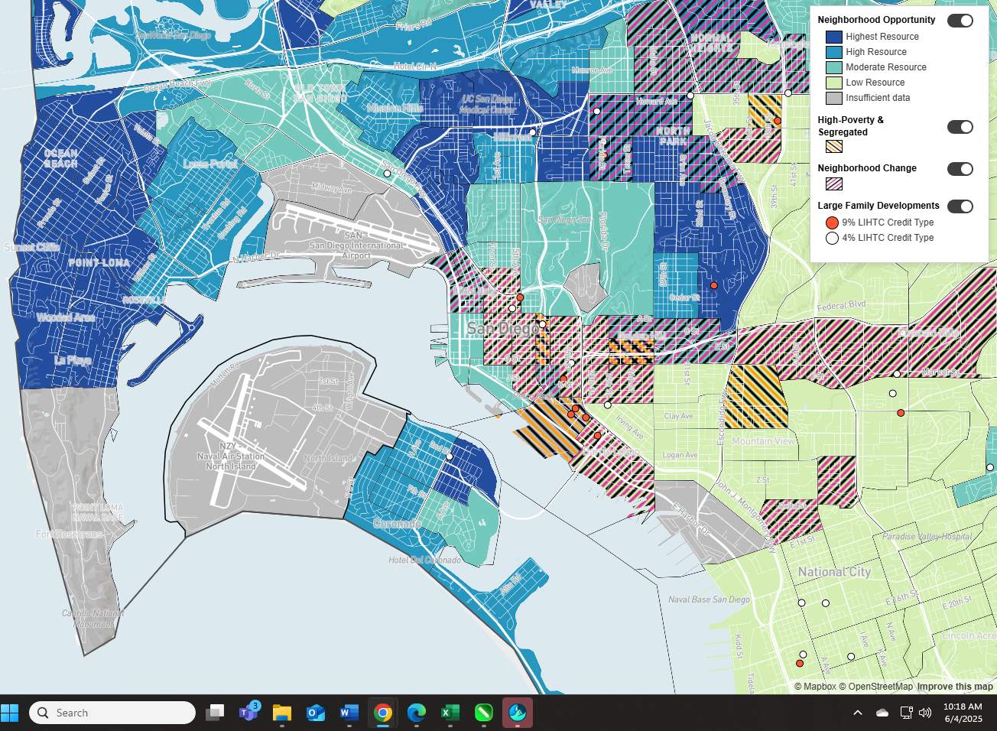
Neighborhood Opportunity Map… Point Loma ranks high on the list for development!

Slide 19
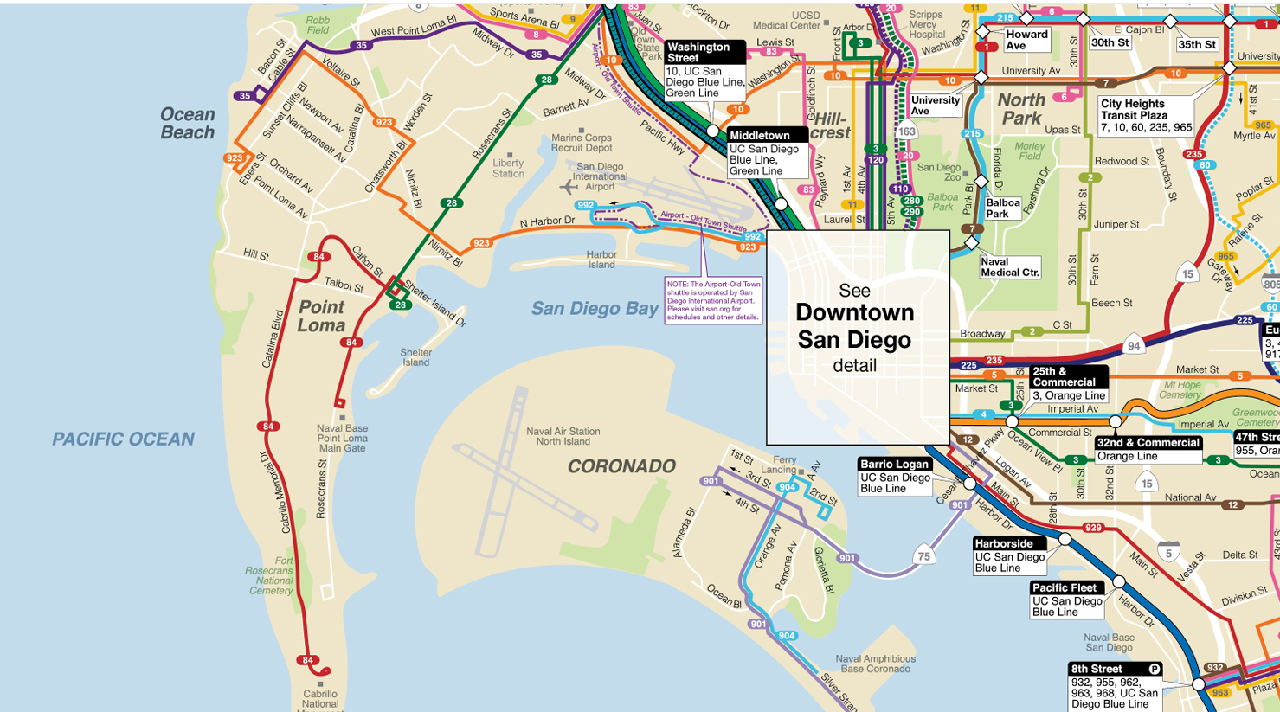
San Diego Bus Line Route… Route 28 down Rosecrans runs every 30-60 minutes. Route 84 every 60 minutes to loop to Cabrillo Monument on a very small mini-bus.

Slide 20
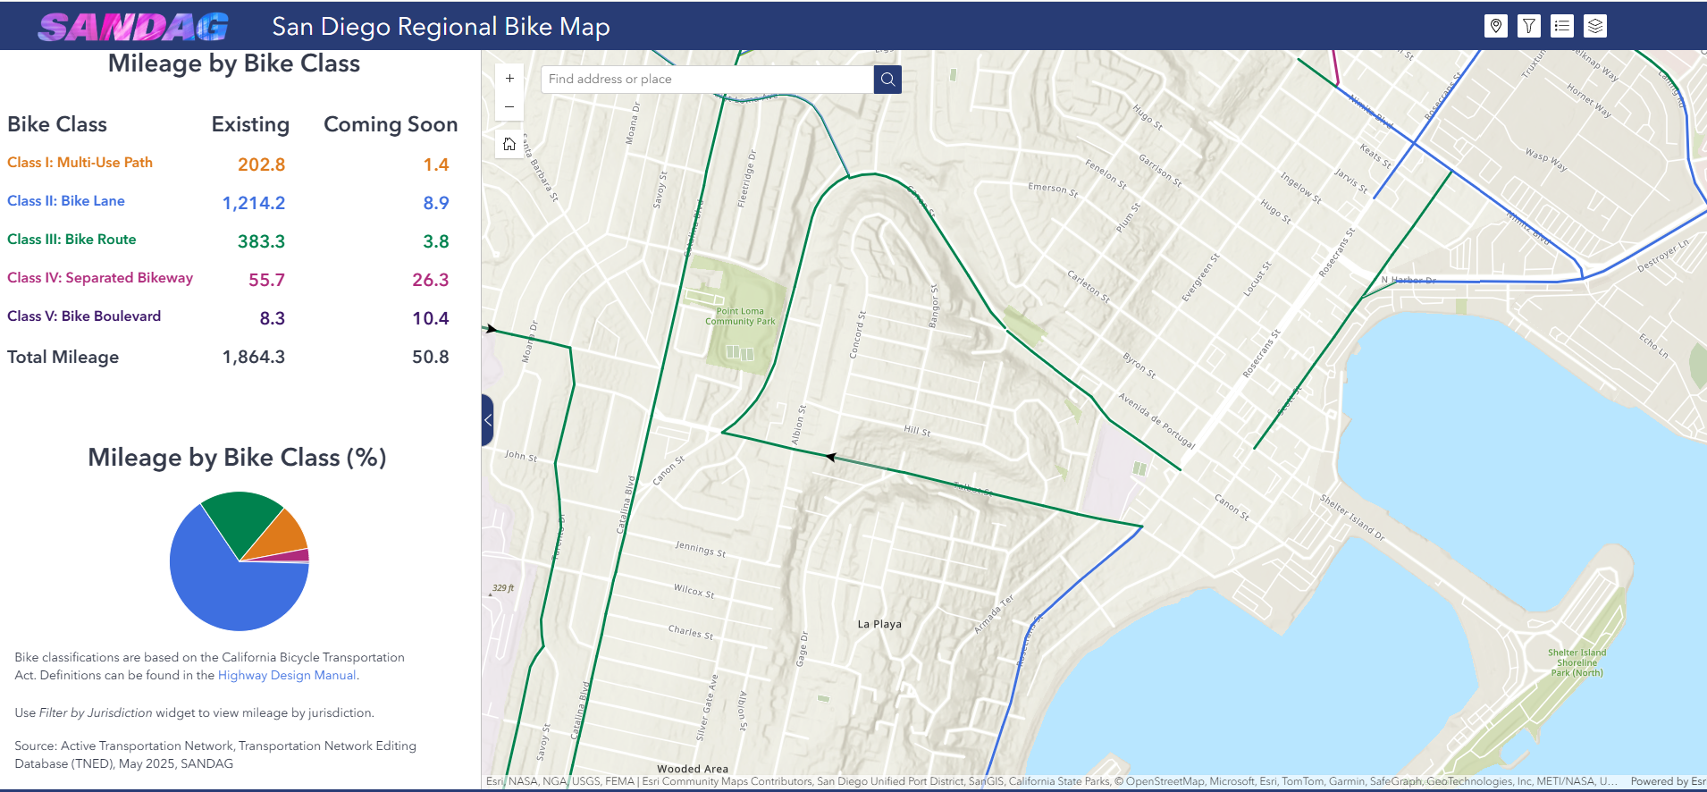
San Diego Regional Bike Map - Point Loma is zone 4 and the route is not complete, sharing the lane with cars, now and in the future. Major safety issues.

Slide 21
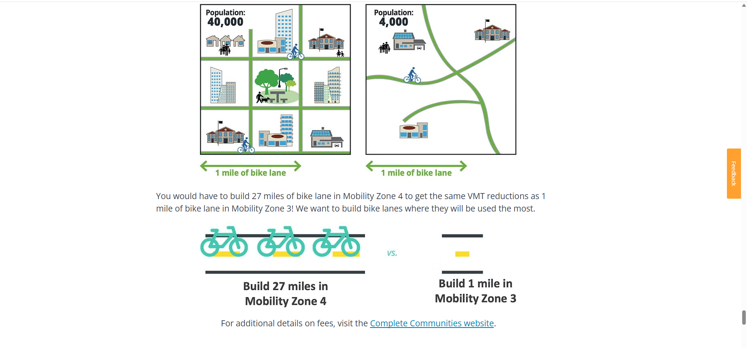
27 miles of bike lane in zone 4 to get same Vehicle Miles Traveled (VMT) as 1 mile in zone 3 = No bike lanes for Point Loma, no bikeable transit.

Slide 22
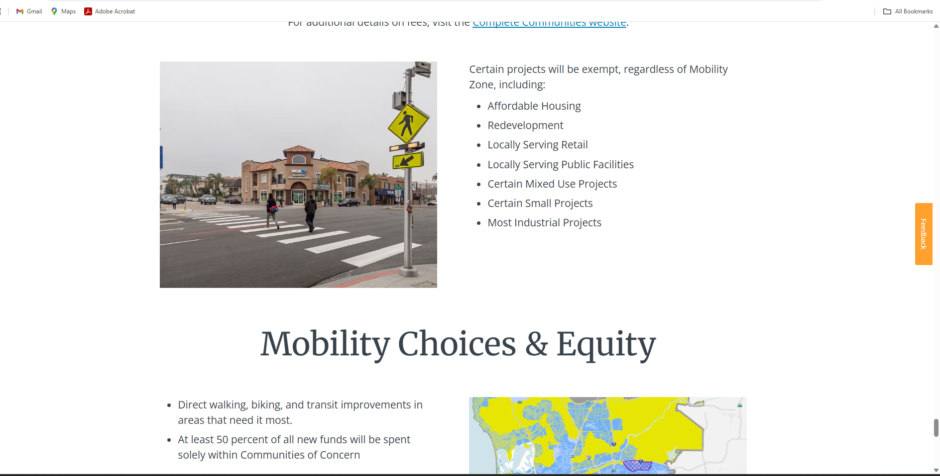
We are fighting projects that are exempt from zoning and regulatory rules…

Slide 23
California Senate Bill 79 (SB79)…
-This bill was designed to promote housing infill and upzoning near major transit stops.
-It has passed the California State Senate and is set to be heard on the Assembly floor for amendment or passage.
-Once passed it goes to Governor Newsom to be signed into law.
-Problem: This law allows for “planned” rapid routes to be included – all of Point Loma.
-Solution: Get rid of the verbiage “planned” with “existing” - Get Point Loma out of the Sustainable Development Area label.

Slide 24
How much is it going to cost?
These are very rough estimates and each case is very different, with some being higher or lower than these estimates
-Preparation and filing of litigation (normally within approximately 30 days of the decision approving the project): $2,000 to 5,000.
-Initial steps in case, including responding to any demurrer or motion to strike at the outset of the litigation, and attendance at the initial mandatory settlement conference (normally within the first month or two of filing of the case): $3,000 to 10,000
-Administrative Record Preparation (normally within two to four months of filing of the case):
$10,000 to 20,000
-Motion practice, possibly including a request for a temporary restraining order and/or motion for a
preliminary injunction (could occur at any time):$10,000 to 25,000
-Writ Work/Trial, preparation of briefing, and appearance at any writ hearing (i.e., trial) (roughly around a year after the case is filed):$25,000 to 50,000
Potential Total $40,000 to 100,000+

Slide 25
How do we Win this Fight?
Legal Battle, Donations, Perseverance and our community speaking as one!

Slide 26
Social Media - You Can Help…..
Facebook – NextDoor - Instagram
Help us keep your neighbors and community informed.
Cut and paste from our Website
Ask to help…. It will take all of us!

Slide 27
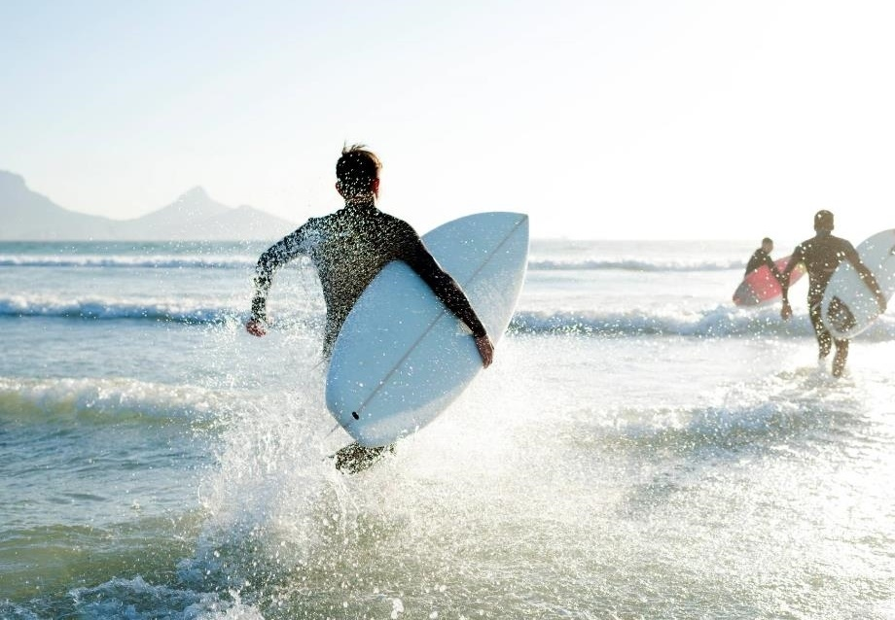
Thank you
Protect Point Loma
It will take our village voices!

