Slide 1

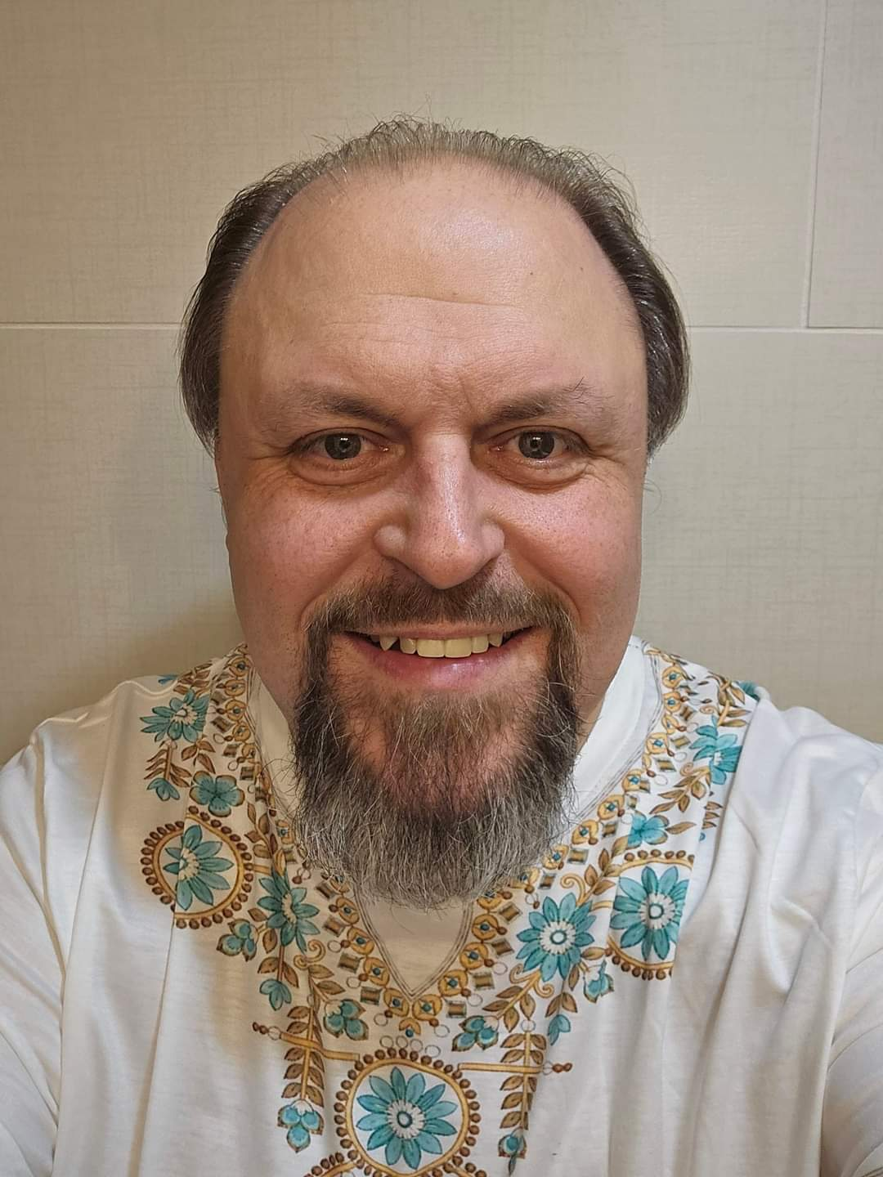
Empowering Federal Executives to Lead with Intelligence, Influence, and Integrity
Senior Executive Coach / Founder
Richard Pater

Slide 2
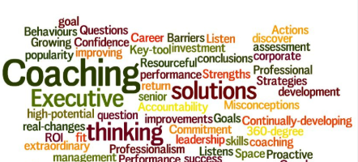

Executive Summary
Lead4Success is a leadership development consulting firm focused on coaching senior federal executives to thrive in hybrid environments. Our coaching integrates emotional intelligence, employee engagement, and biblical ethics to develop resilient leaders who inspire high-performing teams.
Notes:
Speaker Notes:
Today’s session introduces our consulting model designed to support federal leadership transformation. We'll cover our philosophy, services, and real-world benefits of coaching with a spiritual and emotional intelligence lens.

Slide 3
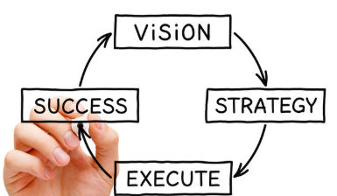
Vision Statement
To transform federal leadership by developing emotionally intelligent, spiritually grounded, and engagement-focused executives who lead with integrity in hybrid work environments.
Notes:
Speaker Notes:
Our vision speaks to our commitment to federal leaders becoming both high-impact professionals and relationally intelligent role models for their teams.

Slide 4

Mission Statement
To provide executive coaching and development solutions to federal leaders that elevate engagement, emotional intelligence, and ethical leadership across hybrid workplaces.
Notes:
Speaker Notes:
Our mission explains how we deliver our vision—through coaching services, workshops, and assessments that are values-aligned and results-driven.

Slide 5

The Why: The Federal Leadership Challenge
- 68% of federal employees report low trust in senior leadership (OPM, 2022)
- Burnout and disengagement have increased post-pandemic
- Leadership under pressure to implement Return-to-Office (RTO) with minimal disruption
Notes:
Speaker Notes:
Federal leaders are under unique pressure due to policy shifts, workforce hybridization, and performance demands. Coaching helps navigate these complexities while preserving team morale.

Slide 6

The Hybrid Work Paradigm
Hybrid work brings:
- Flexibility and autonomy
- Communication breakdowns
- Trust and accountability challenges
Notes:
Speaker Notes:
Hybrid work environments require stronger emotional intelligence, clearer communication, and consistent leadership visibility. Coaching enhances a leader’s capability to manage these realities effectively.

Slide 7

Coaching for the Federal Executive
Why coaching?
- Federal SES & GS-15s face complex, mission-critical challenges.
- Coaching builds resilience, agility, and ethical clarity.
- Personalized support in navigating leadership in hybrid settings.
Notes:
Speaker Notes:
This slide clarifies why tailored coaching is necessary—federal leaders need personal transformation to lead organizational transformation.

Slide 8
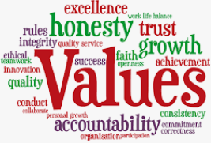
Our Unique Value Proposition
We deliver:
- Custom coaching programs for federal executives
- Biblical, ethical, and scientific leadership frameworks
- Outcomes tied to engagement and performance metrics
Notes:
Speaker Notes:
What makes us different is our integration of ethics, EI, and government context. We’re not just another consulting firm—we’re purpose-driven.

Slide 9

Our Coaching Philosophy
- We believe coaching is a partnership built on trust
- Rooted in servant leadership and emotional intelligence
- Designed for action, accountability, and growth
Notes:
Speaker Notes:
Our philosophy is biblically inspired and scientifically backed. We serve leaders who serve others.

Slide 10
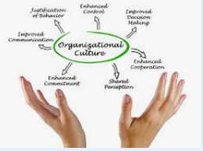
Core Services Overview
- 1:1 Executive Coaching
- Leadership Development Workshops
- Group Coaching & Team Alignment
- Organizational Culture Assessments
Notes:
Speaker Notes:
Each service addresses a layer of leadership development: individual, team, and organizational culture.

Slide 11
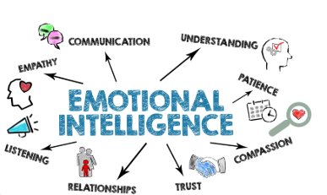
Emotional Intelligence in Leadership
Key EI Competencies:
- Self-awareness
- Self-regulation
- Empathy
- Social skills
Notes:
Speaker Notes:
Emotional intelligence is foundational for leading hybrid teams. It creates connection, clarity, and credibility.

Slide 12

The Engagement Imperative
- Engaged employees are 21% more productive (Gallup, 2021)
- Coaching increases emotional connection to the mission
- Leaders set the tone for engagement in hybrid teams
Notes:
Speaker Notes:
Coaching leaders is the first step in boosting engagement for entire teams.

Slide 13
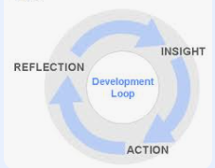
Coaching Process Framework
1. Intake & Leadership Assessment
2. Discovery & Clarifying Goals
3. Coaching Sessions & Action Plans
4. Feedback Loops & Accountability
Notes:
Speaker Notes:
This process provides structure and flow to each coaching engagement, ensuring consistency and results.

Slide 14
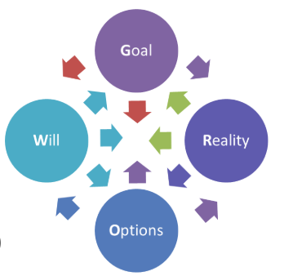
Coaching Models We Use
- GROW Model
- Strengths-Based Coaching
- Emotional Intelligence Framework
- Values-Based Leadership Model
Notes:
Speaker Notes:
Each model serves a specific leadership need—from strategic thinking to self-awareness and resilience.

Slide 15
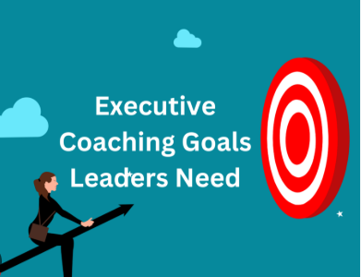
Sample Coaching Goals
- Improve cross-agency collaboration
- Manage remote and hybrid teams
- Increase trust and reduce team conflict
- Lead change with clarity
Notes:
Speaker Notes:
These goals reflect real needs federal executives bring into coaching conversations.

Slide 16

Custom Tools and Diagnostics
- EQ-i 2.0 (Emotional Intelligence Assessment)
- Engagement Pulse Surveys
- 360° Leadership Feedback Tools
Notes:
Speaker Notes:
Diagnostics provide objective data to guide coaching strategies and measure growth.

Slide 17
Federal Case Scenario Example
Scenario: SES leader facing team disengagement post-RTO
Coaching Result:
- Increased empathy and listening skills
- 25% rise in engagement scores
- Improved collaboration in hybrid teams
Notes:
Speaker Notes:
This is a representative success story showcasing the tangible outcomes of coaching.

Slide 18
Evidence of Impact
- 80% of coached leaders report improved performance (ICF, 2023)
- Coaching contributes to 70% improvement in team dynamics
- Data-backed improvements in trust and engagement
Notes:
Speaker Notes:
Quantifiable success metrics are crucial for federal agency investment and accountability.

Slide 19

Testimonials or Pilot Results
"The coaching helped me rebuild trust after a rough transition to hybrid work. I became more empathetic and present."
- SES Leader, Dept. of Veterans Affairs
"We now use EI insights across our leadership team. Engagement is up, and morale is stronger than ever."
- Coaching Program Pilot Participant
Notes:
Speaker Notes:
Stories bring data to life. These testimonials underscore our transformational impact.

Slide 20

Organizational Benefits
- Stronger team cohesion
- Higher morale and reduced attrition
- Greater clarity in mission execution
- Cultural transformation in federal agencies
Notes:
Speaker Notes:
Our coaching outcomes ripple through the organization—creating sustainable leadership capacity.

Slide 21

Coaching Packages & Pricing
Options:
- Executive Essentials: 6 sessions
- Leadership Accelerator: 12 sessions + tools
- Strategic Partner: Full-year, embedded coach
Notes:
Speaker Notes:
Flexible options accommodate diverse agency budgets, with value-based pricing.

Slide 22

Partnership Opportunities
- Agency-wide leadership development
- SES and GS-15 coaching initiatives
- Collaboration with HR/RMO and learning divisions
Notes:
Speaker Notes:
We aim to be long-term strategic partners—not just vendors—working across government systems.

Slide 23

Getting Started: Onboarding Process
Steps:
1. Schedule Discovery Call – 920-949-1521
www.lead4success.us
2. Customize Engagement Plan
3. Begin Coaching or Workshops
Notes:
Speaker Notes:
Simple, consultative onboarding that allows rapid alignment with agency needs.

Slide 24
Meet the Founder
- Richard Pater, Senior Executive Coach / Founder
- 20+ years in federal leadership and organizational development
- Supported over 100 leaders through employee engagement, change management, lean six sigma efficiency, and cultural and business operations transformation, leadership development
Guest Speaker
Author
Notes:
Speaker Notes:
Clients want to know who they are working with. Trust begins with transparency and expertise.

Slide 25
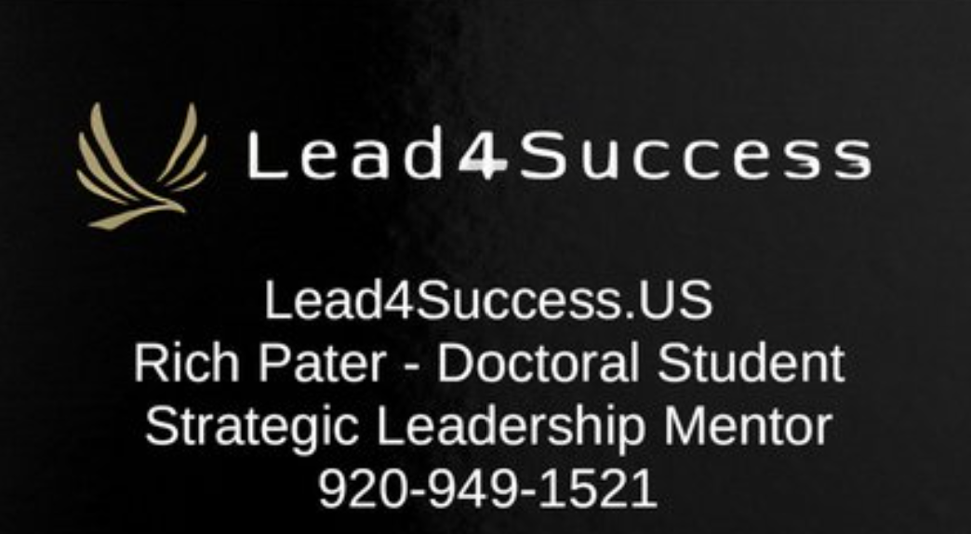

Together we can…
Website - Expert Change Management Services
www.Lead4Success.US

Slide 26
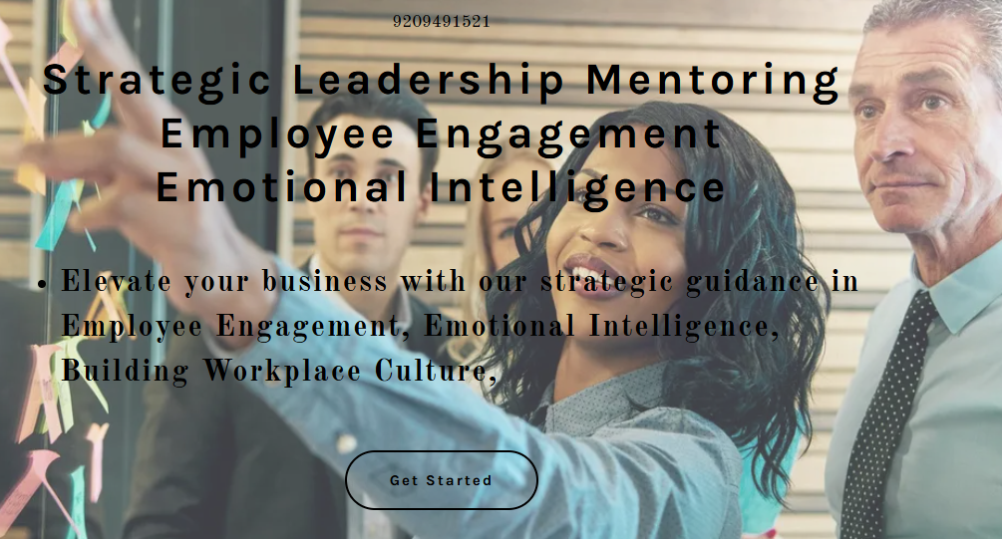
Appendix

