Slide 1
Master Plan Task Group:
Master Plan Gap Analysis and
Update Recommendations
2022

Slide 2
Master Plan Task Group
Members
  Steven Bolotin – Planning Board
  Evelyn Strawn – Advisory & Finance Committee
  Kathryn Holmes – Comm of Precinct Chairs
  Kathy Castagna - Citizen at Large
  Glenn MacGregor - Citizen at Large
  Lorenzo Pizarro – Citizen at Large
  Darice Wareham - Citizen at Large
  Donald Williams - Citizen at Large

Slide 3
Gap Analysis
Where we are vs. Where we want to be
Successes and Areas for Improvement
Challenges to reaching goals

Slide 4
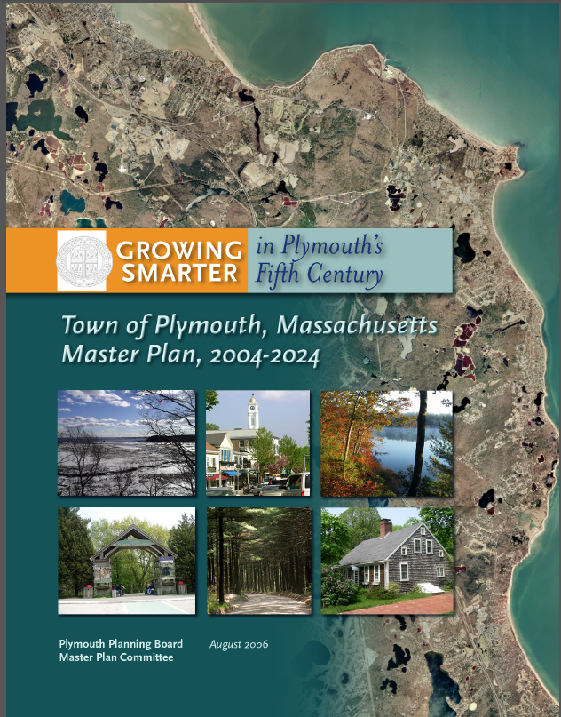
2006 Plymouth Master Plan
Last Major update approaching 20 years ago

Slide 5
Task Group Process
Held 16 Meetings
Reviewed 22 Planning Documents
Interviewed 17 Public & Private Sector Stakeholders
Individually, Members Spoke to Boards, Committees and resident Groups Throughout Town

Slide 6
Master Plan Components MGL 41 § 81D
  Master Plan is the Basis for Long-term Decision Making Regarding the Physical Development of the Town
  Identifies Goals and Policies of the Town for Future Growth and Development
  Goals and Policies are Developed by the Community Through an Interactive Public Process

Slide 7
What Did We Learn?

Slide 8
Master Plan Components MGL 41 § 81D
  Goals and Policies Statement
  Land Use Plan
  Housing Analysis
  Economic Development
  Natural and Cultural Resources
  Open Space and Recreation
  Services and Facilities
  Circulation Guidance
  Implementation Program

Slide 9
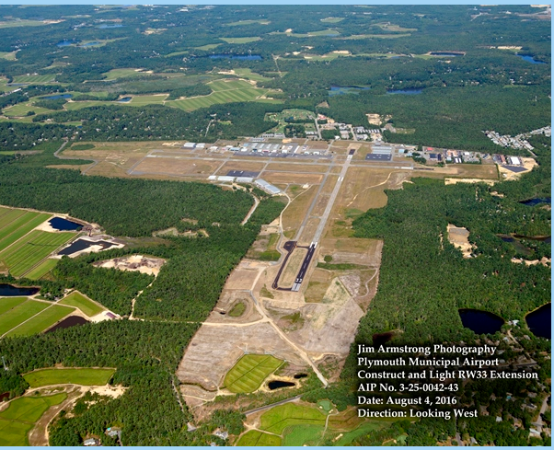
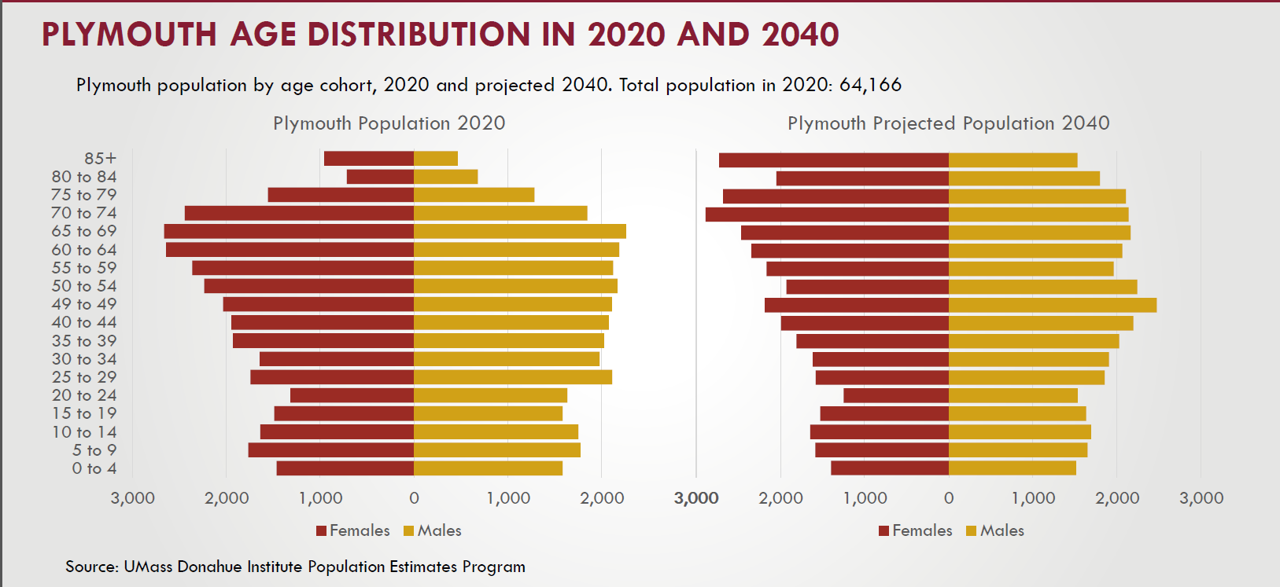
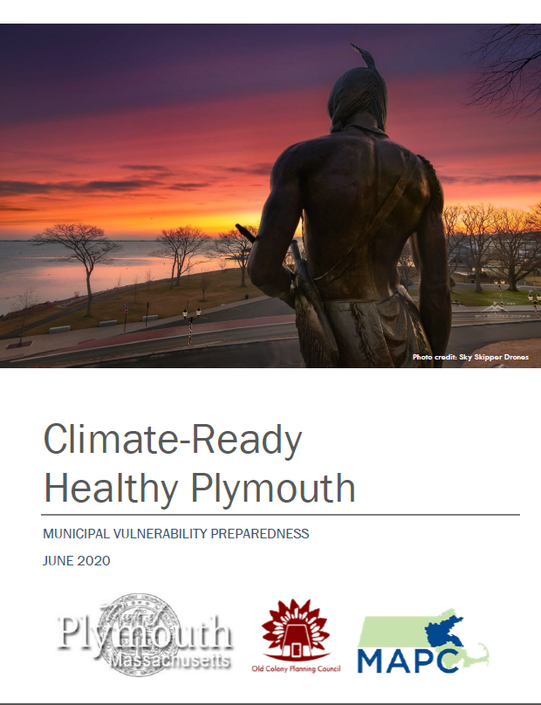
Possible New Categories/Priorities
  Climate Change and Resiliency
  Water Resource Protection, Usage & Conservation
  Public Health & Safety
  Regionalization
  Airport Area Usage
  Changing Demographics

Slide 10
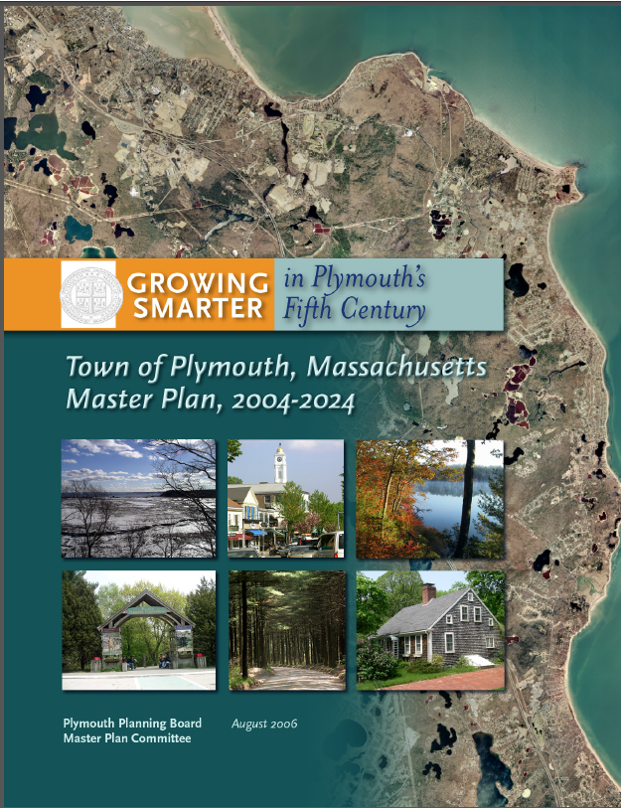
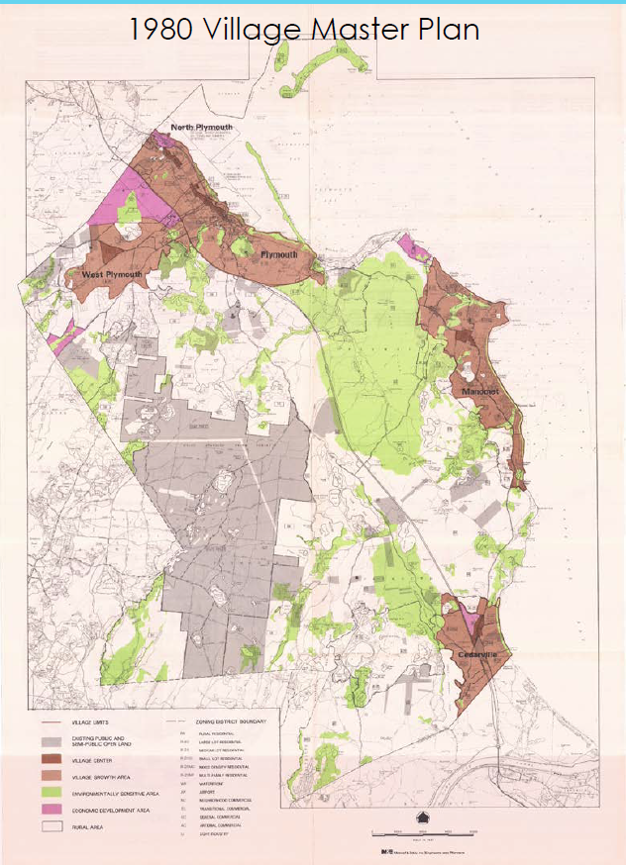
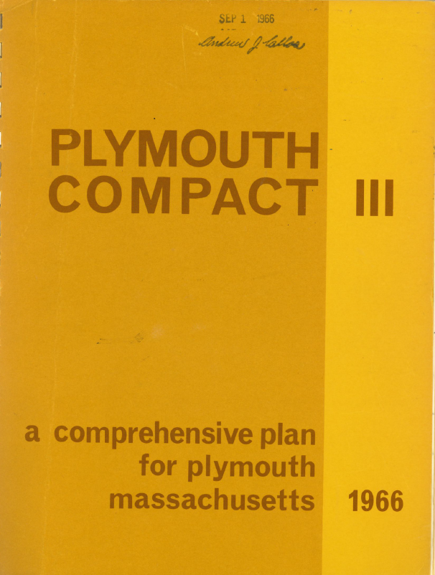
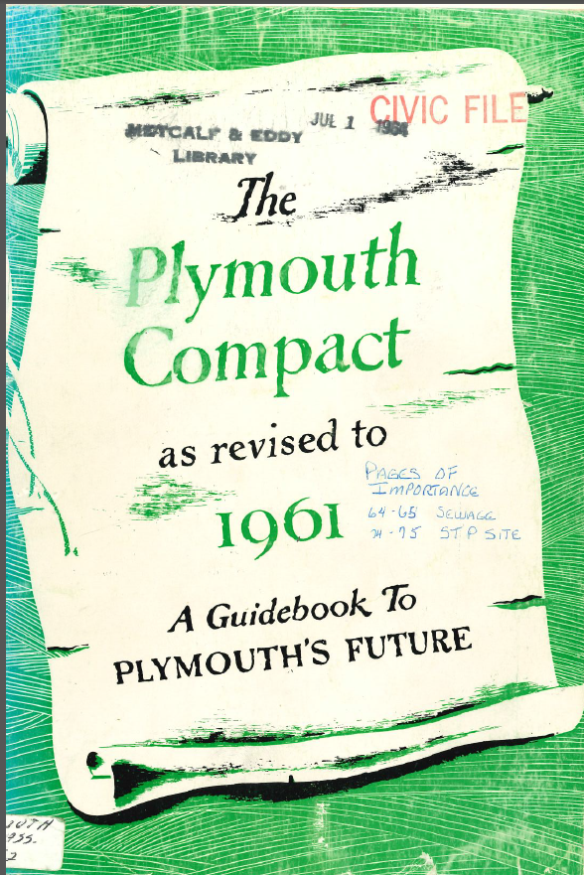

Plymouth Master Planning
  A Guidebook to Plymouth’s Future in 1949
    Updated in 1961 & 1966
  1980 Plymouth’s First Formal Master Plan (Village Centers Plan)
    Updated in 2004 – Plymouth’s Current Master Plan

Slide 11
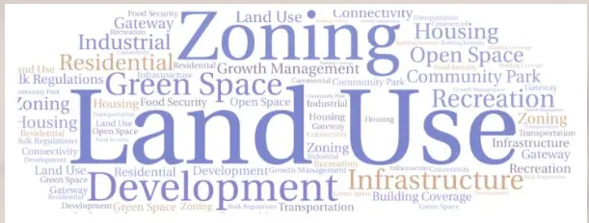
Community Concerns
Growth Management
  Village Centers Concept Development
  Open Space Preservation
Economic Development
  Tax Rate Control
  Public Facilities Needs and Priorities

Slide 12
Updating the Master Plan Process

Slide 13
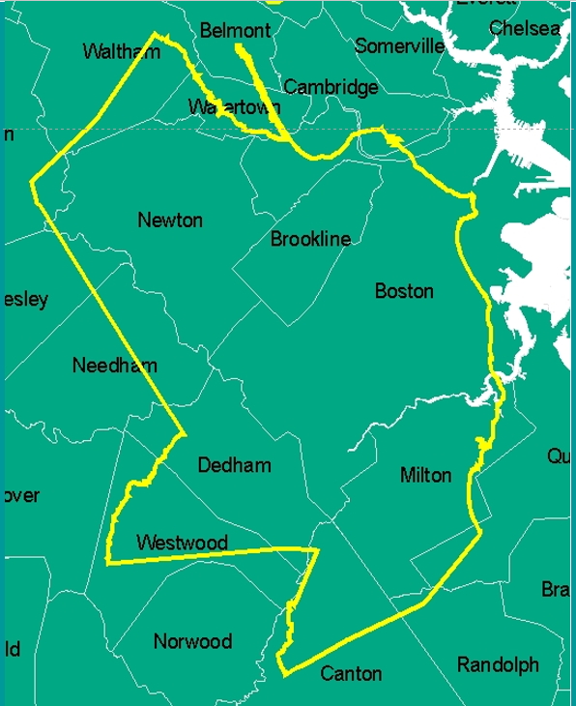
Major Concerns
By virtue of its size, population, geography, and history, Plymouth is a truly unique community, and therefore faces different challenges than other communities.
By creating a Master Plan that focuses on segmented categories, we are not meeting one of its critical requirements; that it be internally consistent.

Slide 14
Focus on Community Goals
What do the residents need to sustain our community?
What do the residents want to enjoy our community?
How do we make those things happen?

