Slide 1
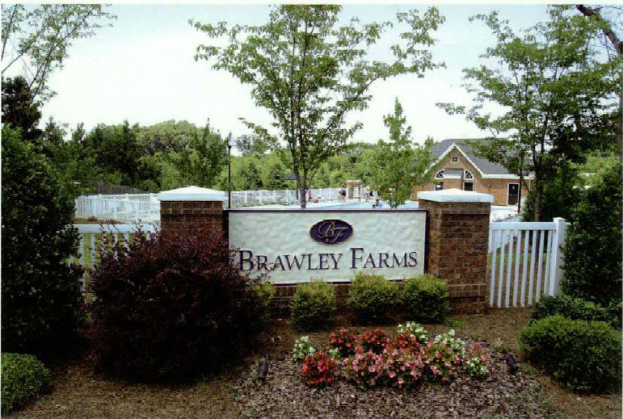
BRAWLEY FARMS HOA
Town Hall Meeting
January 30, 2013
6:30 PM

Slide 2
Brawley Farms HOA Board
Lakisha Allen
  President
Alicia Thompson
  Vice President
Rashida Gittens-
  Member-at-Large
Deborah Miller
  Member at Large

Slide 3

www.brawleyfarmshoa.com has become a primary resource used by the HOA Board to improve neighborhood communication
www.brawleyfarmshoa.com

Slide 4
Accomplishments
Gained control over the landscaping(from erosion in Bristol to the high weeds and wetland in Crossley, removed several graffiti markings, pressured city and bond company to remove drain covers, getting property owners to maintain condo areas
Developed relationship with the City of Charlotte
Reopened the pool after being inoperable 2 seasons
Newly created HOA website for consistent communication
Board response always within 72 hours
Board Directors live in the Community
Provide club-house rental
Awarded a grant for $22965.25 from City of Charlotte

Slide 5
Cont’d Accomplishment
Cleared unsafe neighborhood playground in Brawley
Cleaned and manicured playground in Bristol
Held 2 Annual Meetings since 2011, previous meeting was in 2009
Openly discuss budget at meetings
Promoted and held workshops to discuss matching grant initiative
Installed picnic area on common grounds of clubhouse
Improved safety at the clubhouse with fencing and security
Pool passes with ID’s to increase security
Under Board Direction and persistence, city will assume Crossley and Brawley
Reconstructed monuments after vehicle accidents
Community Walks
Created a sense of Community and Togetherness.

Slide 6
More Accomplishments
Installed street lights in areas of low visibility for homes and for students at bus stops
Install speed signs
Deeded 7 acres of land
Offered amnesty to get neighborhood back on track
Installed lighting at neighborhood monuments
Registered all 3 neighborhoods with Neighborhood Watch while providing frequent statistics and updates
Fixed non-working irrigation
Fostered relationship with builders
Improvements made to clubhouse

Slide 7
2012 Events
Feb 11th Teen Valentine Party
March 28th Neighbor Hood Matching Grant workshop
Pool Grand Opening
Fourth of July Celebration
Community Clean up July 7th
Neighborhood Watch Meeting July 18th with CMPD
National Night Out
Back to School Jam
Halloween Trunk or Treat
Annual Meeting Oct 22nd

Slide 8
Neighborhood Matching grant
Duke Energy Lights -12 qty | 4662.56
Pool/common area fencing | 12210.42
Common Area Equipment | 5800.00
Neighborhood Watch Signs | 292.27
TOTAL | 22,965.25

Slide 9
2013 Pool Repairs
Pool Cover
Full Flo Valve (whole)
Replace the valves on all three filters and rebuild plumbing. *
Sand Change (1xTR140C Large Filter)

Slide 10
2013 Goals
Improve Community Involvement
Improve Policy and Procedures( CCR’s)
Strategically design a way to create a surplus for 2014 budget & on

