Slide 1
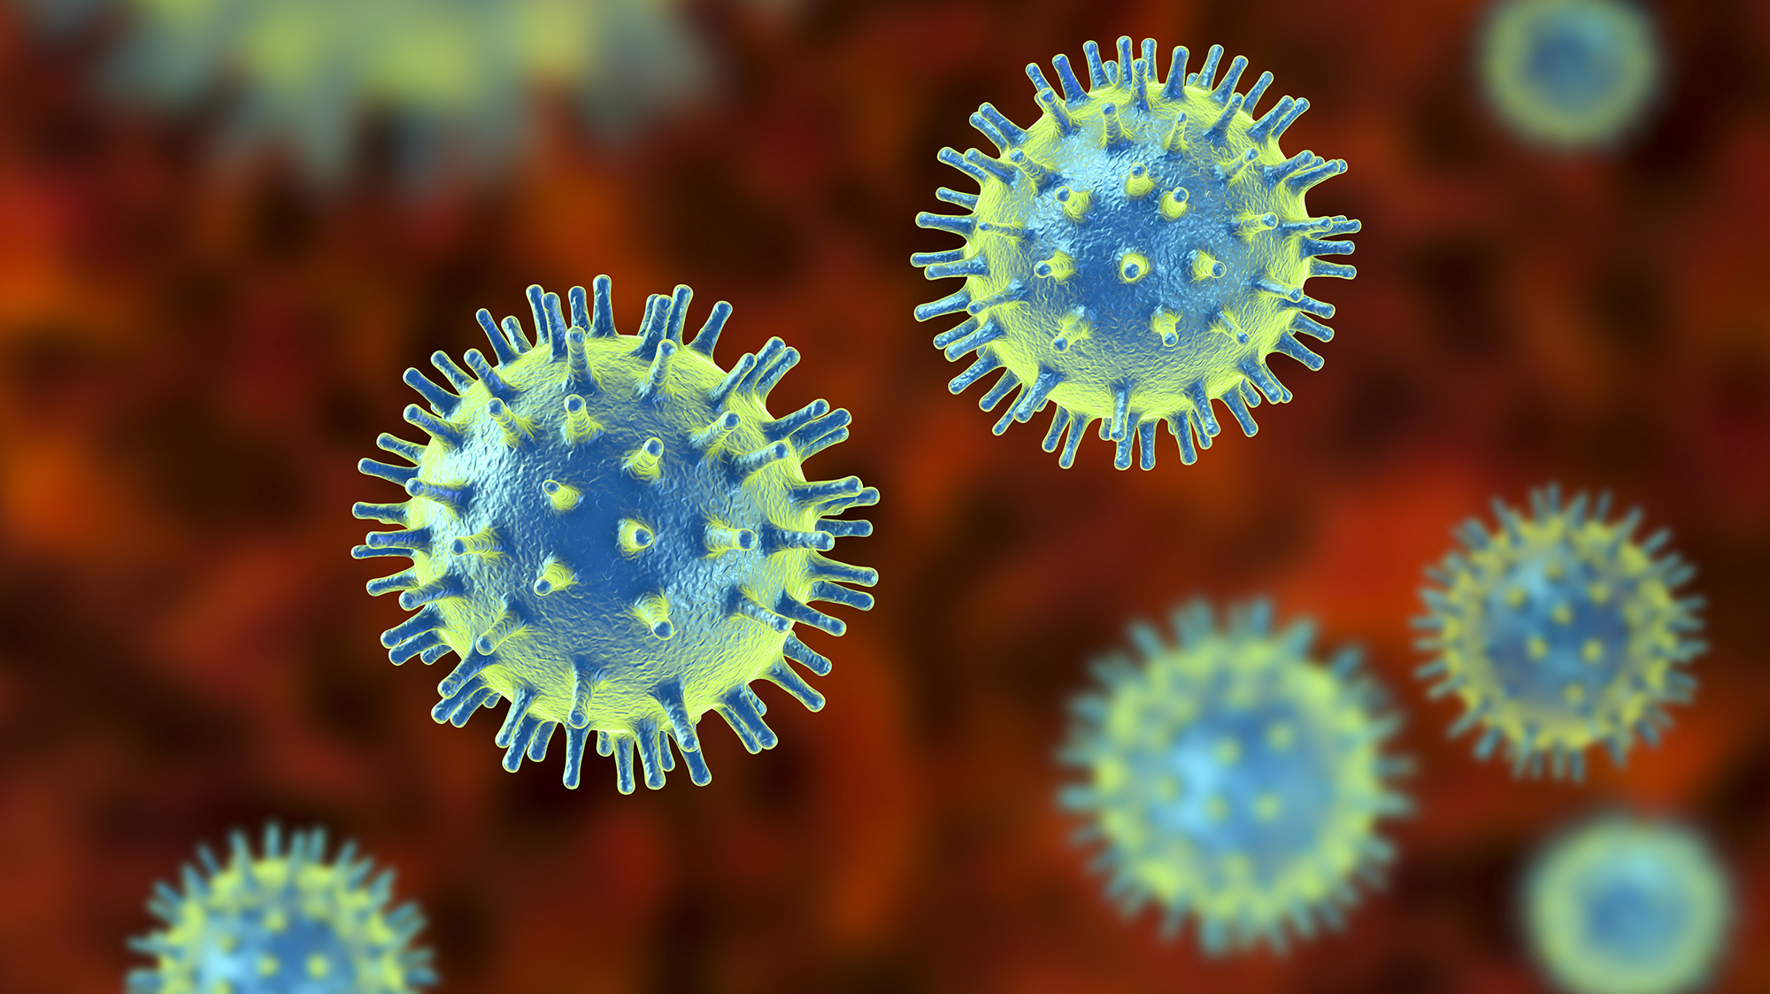
RABIES

Slide 2
PATHOPHYSIOLOGY
Mode of infection:
By saliva usually through the bites or licks of an infected animal on abrasions or on intact mucous membranes
Pathogen:
Rabdovirus
Humans are usually infected from dogs/fox & bats

Slide 3
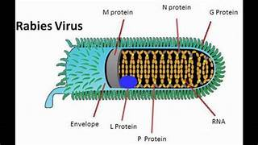
Street rabies virus Isolated freshly from affected animal Infectives by several routes Not to be used in vaccine | Fixed rabies virus Serial passage intracerebrally in rabbits Infective by intracerebral route only To be used in vaccine

Slide 4
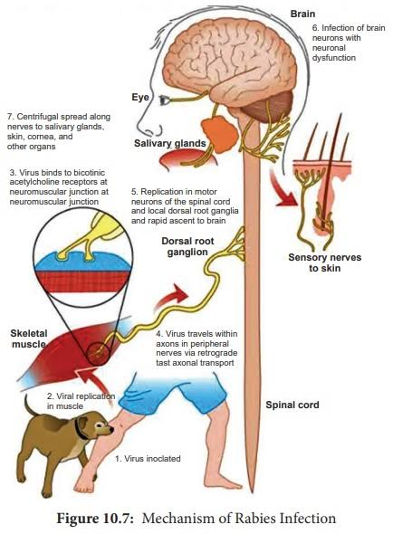

Slide 5
CLINICAL FEATURES
Types
Furious rabies
(Classical variety)
Dumb rabies
(paralytic variety)
Prodromal period
2-10 days
Paresthesia at wound site
Malaise,nausea,vomiting along with fever

Slide 6
Paralytic rabies:
Ascending type of flaccid paralysis
seizures
hydrophobia
Autonomic dysfunctiom
hallucinations
aerophobia
Bizzare behaviour
Furious rabies
Coma followed by death

Slide 7
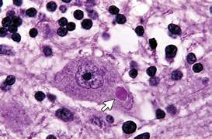
Diagnosis
Examination: It shows hyperreflexia, spasticity and features of sympathetic overactivity.
Antemortem diagnosis:
Skin biopsy
Nape of the neck=5-6mm
Saliva, corneal impressions
RTPCR
Immunofluorescence
Cultivation: cell lines, yolk sac
Antibodies:6th day of illness
Rabies fluorescence inhibition testing
(RFFIT)
Postmortem diagnosis:
Brain biopsy, salivary glands
Negri bodies demonstrated in hippocampus

Slide 8
MANAGEMENT
Established disease: Once the CNS disease is established, treatment is symptomatic, as death is virtually inevitable. Only a few patients with established rabies survive.
Intensive care: The patient should be isolated in a quiet, darkened room. Patients who received some postexposure prophylaxis should be given intensive care facilities.nutritional support. Only palliative treatment can be given once symptoms have appeared.
Heavy sedation: The patient should be heavily sedated with diazepam/ morphine, supplemented by chlorpromazine if needed. Sedation should be done liberally in patients who are excitable. Nutrition and fluids should be given intravenously or through a gastrostomy.

Slide 9
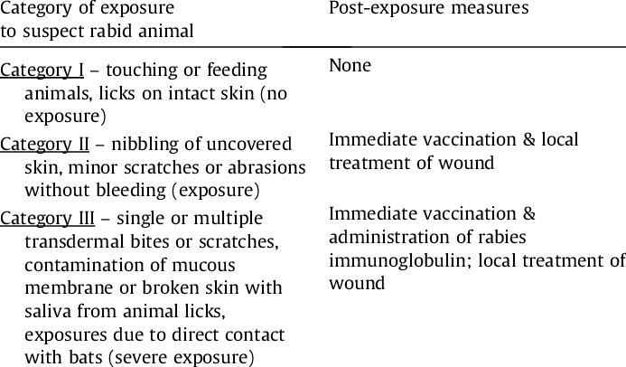

Slide 10
Wound toilet:
Irrigation
Excision of wound
Rabies immunoglobulin:
CATEGORY III exposure
20IU/kg body weight
Infiltrated around the wound
Vaccines:
Inactivated fixed rabies virus
Human diploid cell vaccine
Purifies chick embryo cell vaccine

Slide 11
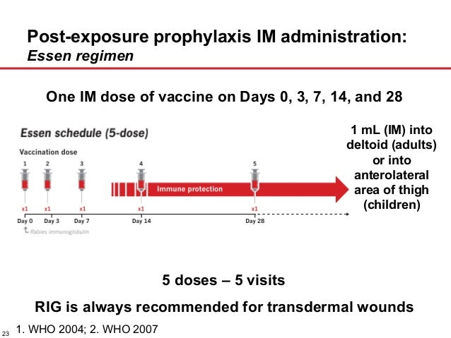
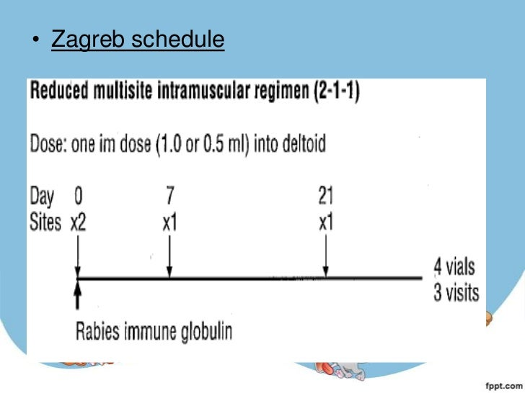

Slide 12
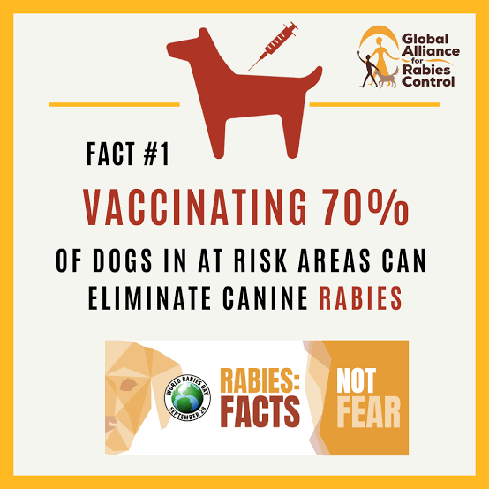
PRE-EXPOSURE PROPHYLAXIS
Preexposure prophylaxis High-risk individuals:
Preexposure prophylaxis is indicated to individuals with a high-risk of contracting rabies. These include laboratory workers, animal handlers.
Method: –
Three doses on days 0, 7 and 28 (1.0 mL) of human diploid (HDCV) or chick embryo cell vaccine given by deep subcutaneous or intramuscular route. – A reinforcing dose after 12 months and additional reinforcing doses are given every 3–5 years.

Slide 13
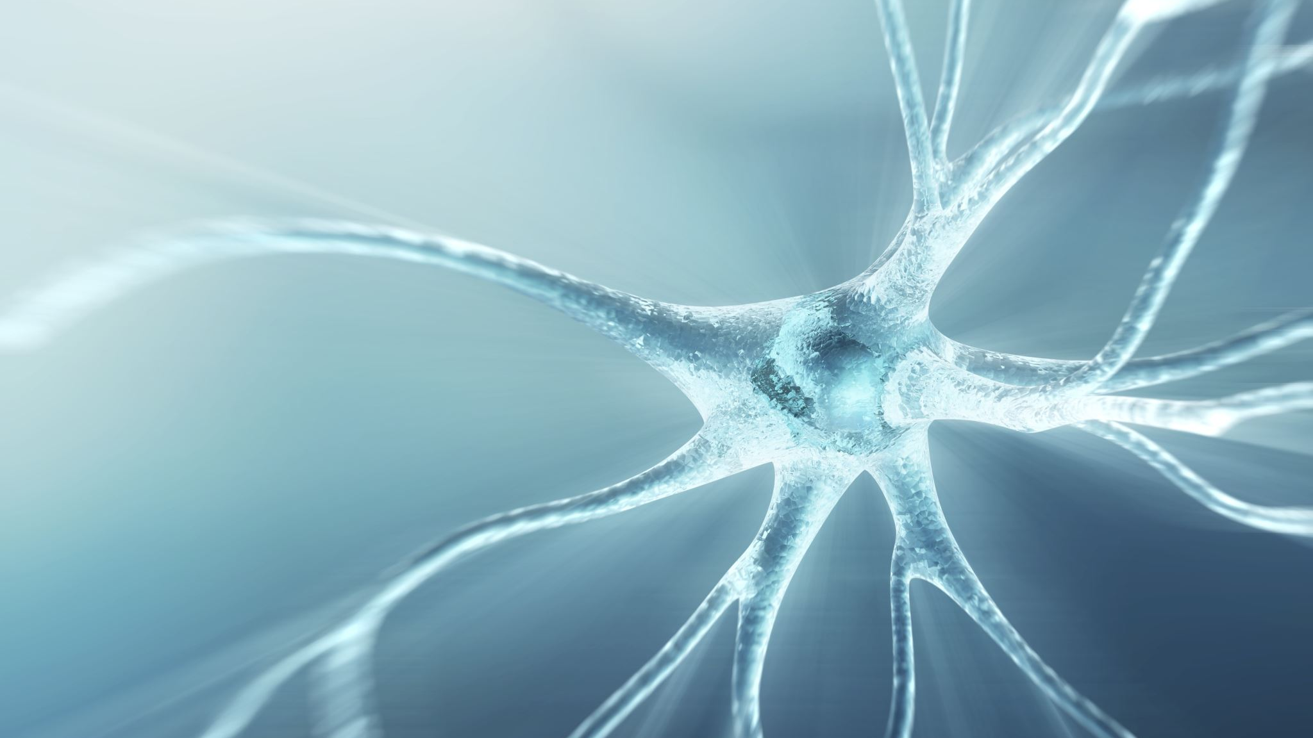
LEPTOSPIROSIS

Slide 14
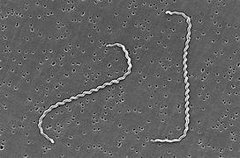
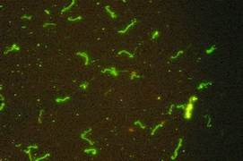
Leptospira interrogans
Gram negative organisms
23 sero groups
6-20 microns
Dark field microscopy
Umbrella shaped/shepherd crook appearance
EMJH,Sterwart’s, morthoff,fletcher
Dinger’s ring

Slide 15
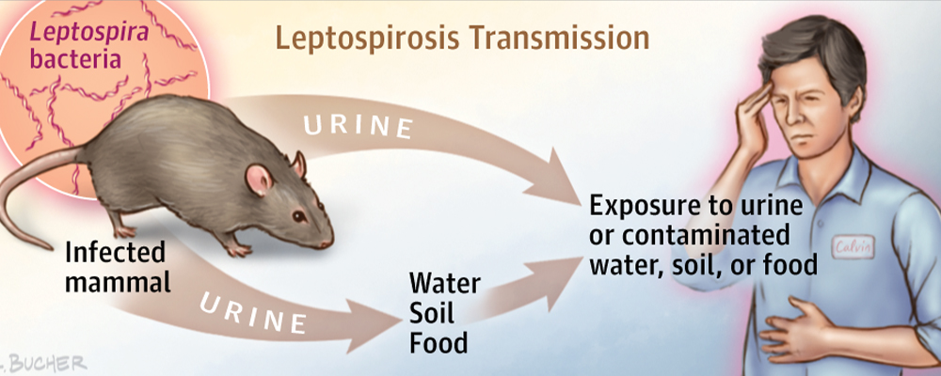
PATHOPHYSIOLOGY
Other reservoirs:
Dogs , horse, cows
Occupational risk:
Rice field , sewer workers , mine workers, veterinarians

Slide 16
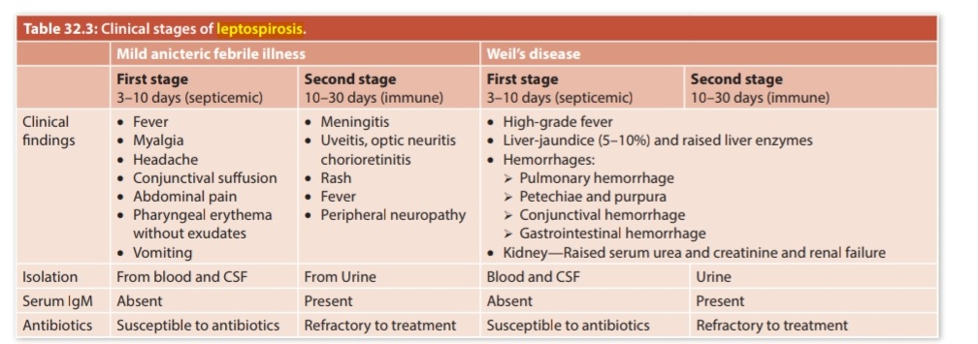

Slide 17
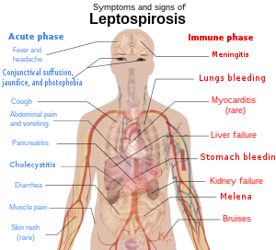
CLINICAL FEATURES
Incubation period:5-14 days
Fever , headache
Conjunctival suffusion, photophobia
Cough
Abdominal pain and vomiting
Pancreatitis
Diarrhea
myalgia
Skin rash

Slide 18
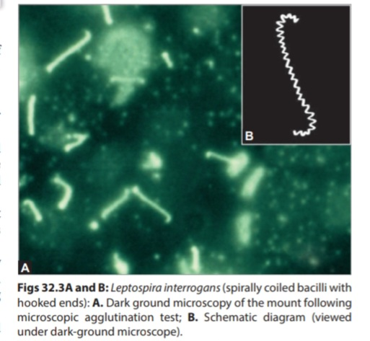
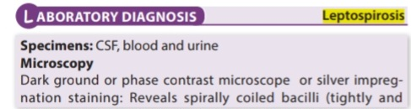
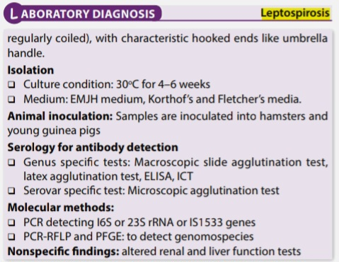
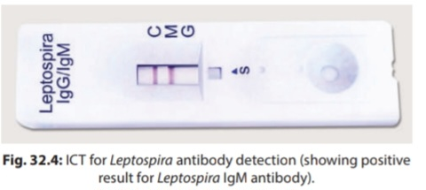

Slide 19
MANAGEMENT
Antibiotic therapy: Leptospirosis is highly susceptible to a broad range of antibiotics. Early antibiotic therapy may prevent the development of major organ system failure or lessen its severity, but it should be given whatever the stage of the infection.
Mild disease: Oral treatment with following for 7 days effective when started within 4 days of onset of symptoms. – Doxycycline (100 mg orally twice daily) or – Ampicillin (750 mg four times daily) – Amoxicillin (500 mg four times daily) – Azithromycin
Severe leptospirosis should be treated – Intravenous penicillin (1.5 million units intravenous 6 hourly) or – Ceftriaxone 1 g twice a day IV – Cefotaxime 1 g IV four times a day.
Prevention: whole cell vaccine : SPIROLEPT
Sc,2 doses

Slide 20
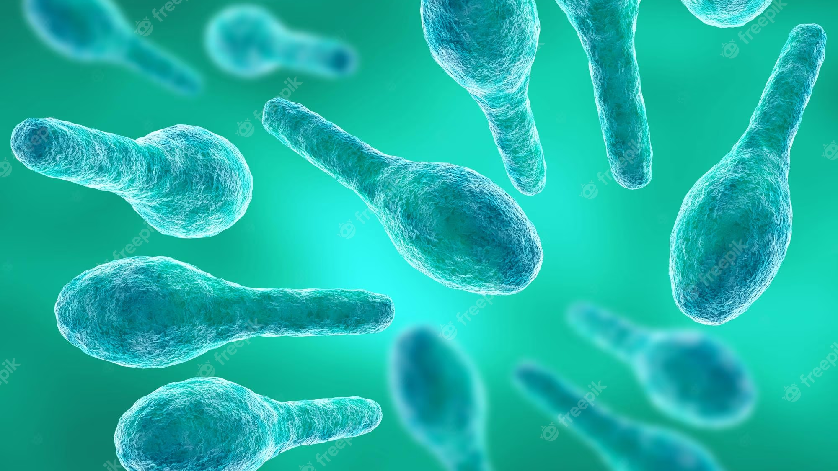
TETANUS

Slide 21
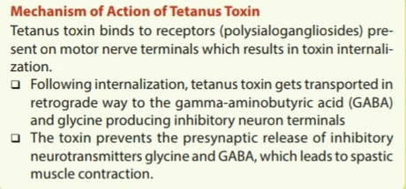
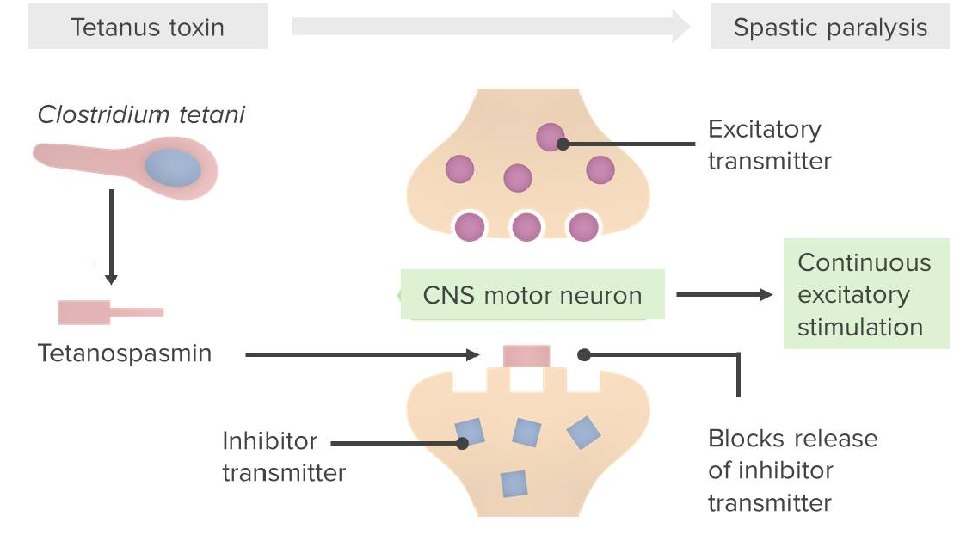

Slide 22
CLINICAL FEATURES
Lockjaw: General malaise is rapidly followed by the most important symptom namely trismus. It is due to spasm of masseter muscle
Severe disease: If the disease is severe, painful, violent, exhausting, reflex spasms (convulsions) develop, usually within 24–72 hours of the initial symptoms and lasts for a few seconds to 3–4 minutes.
Risus sardonicus: When the tonic rigidity involves the muscles of the face, neck and trunk.
Opisthotonus: Varying degree of rigidity develops in the muscles at the neck and trunk. The back is usually slightly arched and the abdominal wall appears board-like

Slide 23
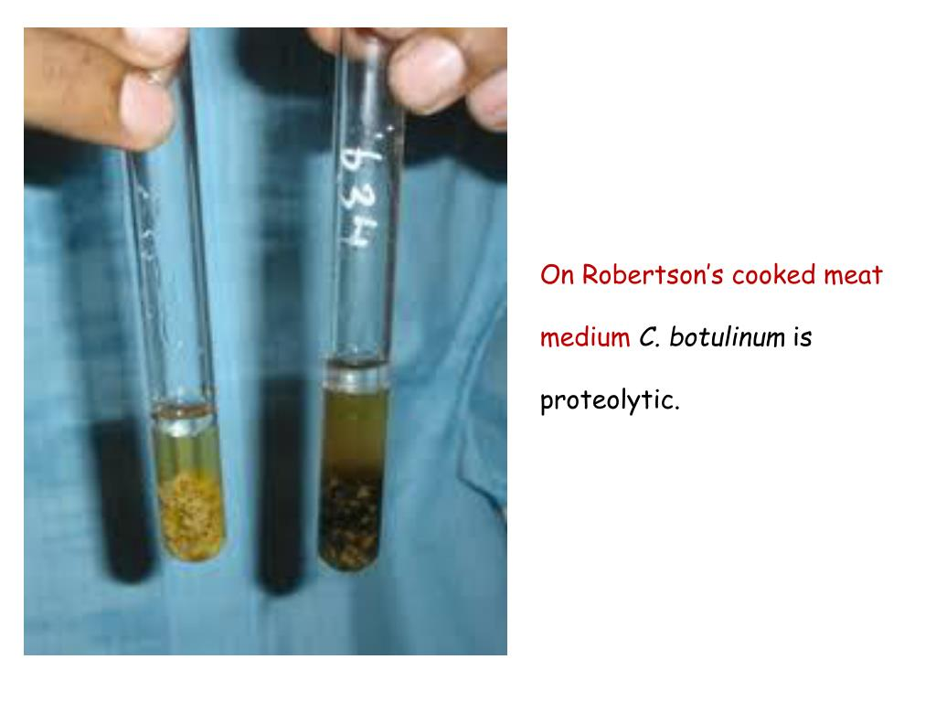
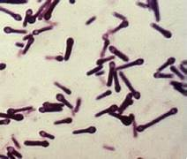
Investigations/Diagnosis
Diagnosis is usually made on clinical grounds.
Clostridium tetani: Rarely possible to isolate from wounds (original locus of entry).It is gram positive bacilli with terminal round spores-Drum stick appearance
Culture:Blood agar with polymyxin B
Robertson’s cooked meat broth

Slide 24
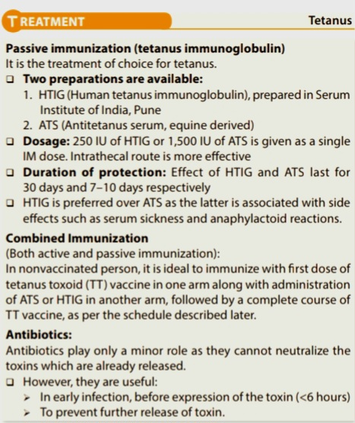
Management/Treatment of Tetanus
Prevent further toxin production: Debridement of wound and antibiotics.Metronidazole is the drug of choice.
General supportive medical and nursing care. Patient is isolated in a quiet, well ventilated and darkened room. Maintain hydration and nutrition and treat secondary infections.
Control of spasm: Nurse in a quiet room, avoid unnecessary stimuli. Benzodiazepines/IV diazepam are used to control spasms and sedate the patient. If spasms continue, paralyze patient and ventilate.

Slide 25
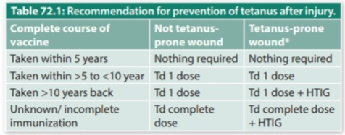
Prevention
Active immunization:
TT(Tetanus toxoid): can be monovalent or combined
DPT, Td, Pentavalent vaccine
Primary immunization in children:6,10,14-pentavalent
Two booster doses of DPT at 16-24 weeks and 5 years
Two additional doses of Td at 10 and 16 years

Slide 26


COMING SOON.
ROLL NUMBER-
91 & 92

