Slide 1
CARDIAC
ARRYTHMIAS

Slide 2
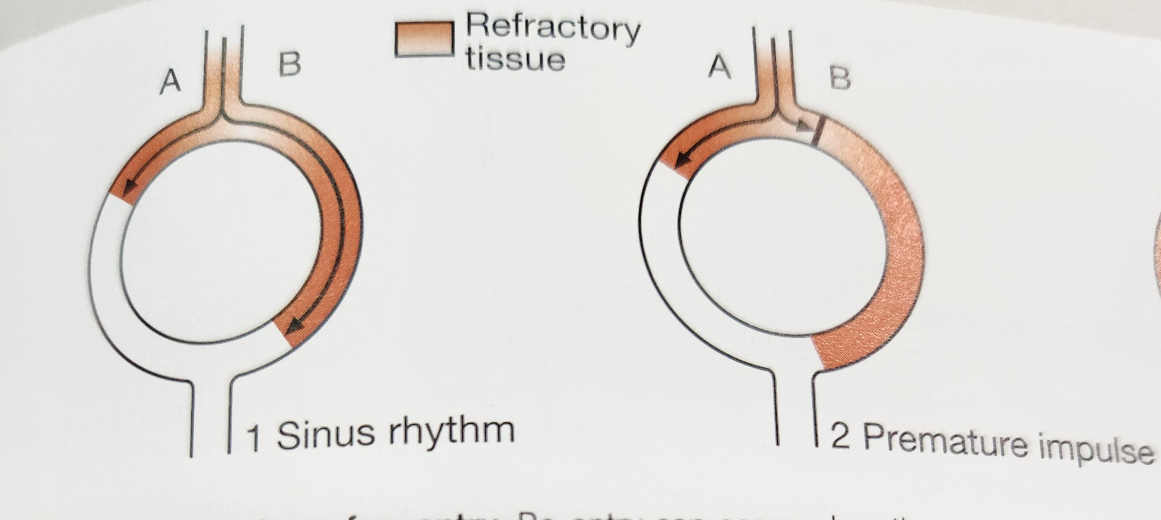
MECHANISMS
Increased automaticity
Re-Entry

Slide 3
CLASSIFICATION
TACHYARRYTHMIAS
NARROW COMPLEX TACHYCARDIAS
WIDE COMPLEX TACHYCARDIAS
BRADYARRYTHMIAS
IRREGULAR
REGULAR
VENTRICULAR FIBRILLATION
VENTRICULAR FLUTTER
WPW SYNDROME
TORSADES DE POINTES

Slide 4
IRREGULAR
WITH P WAVES
MAT
WITHOUT P WAVES
ATRIAL FIBRILLATION
ATRIAL FLUTTER
REGULAR
SVT
SINUS TACHYCARDRIA

Slide 5
SINUS ARRYTHMIA
During inspiration

Slide 6
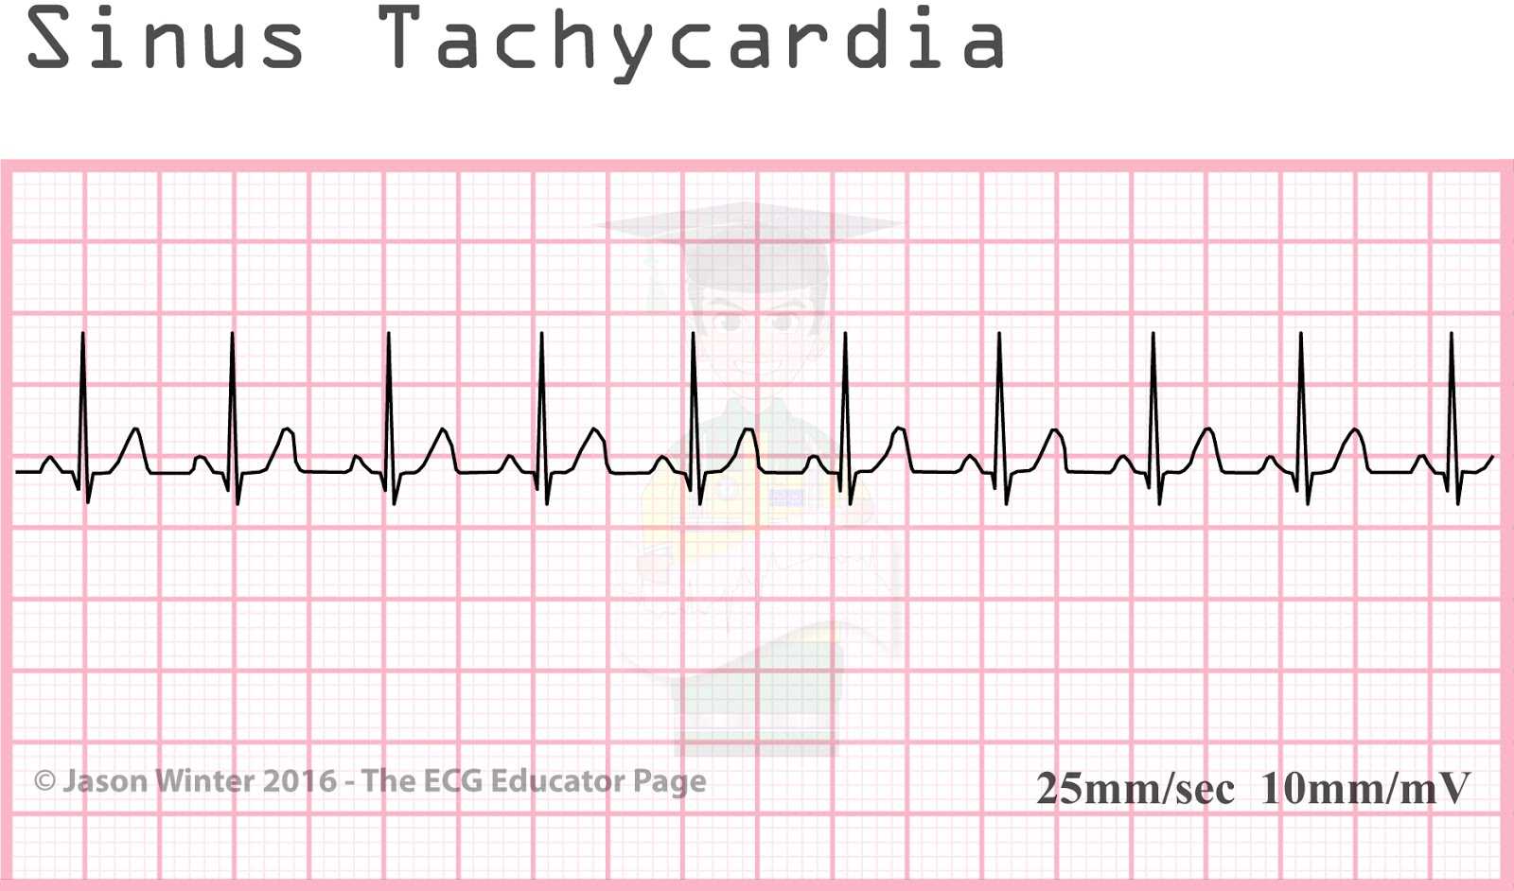
SINUS TACHYCARDIA
P-Pain
H-Hypovolemia
A- Anxiety
T- Temperature
H- Hypoxia
A-Anaemia
D-Dehydration , Drugs
E- Exercise, Emotions
S-Systemic problems: hyperthyroidism, pheochromocytoma

Slide 7
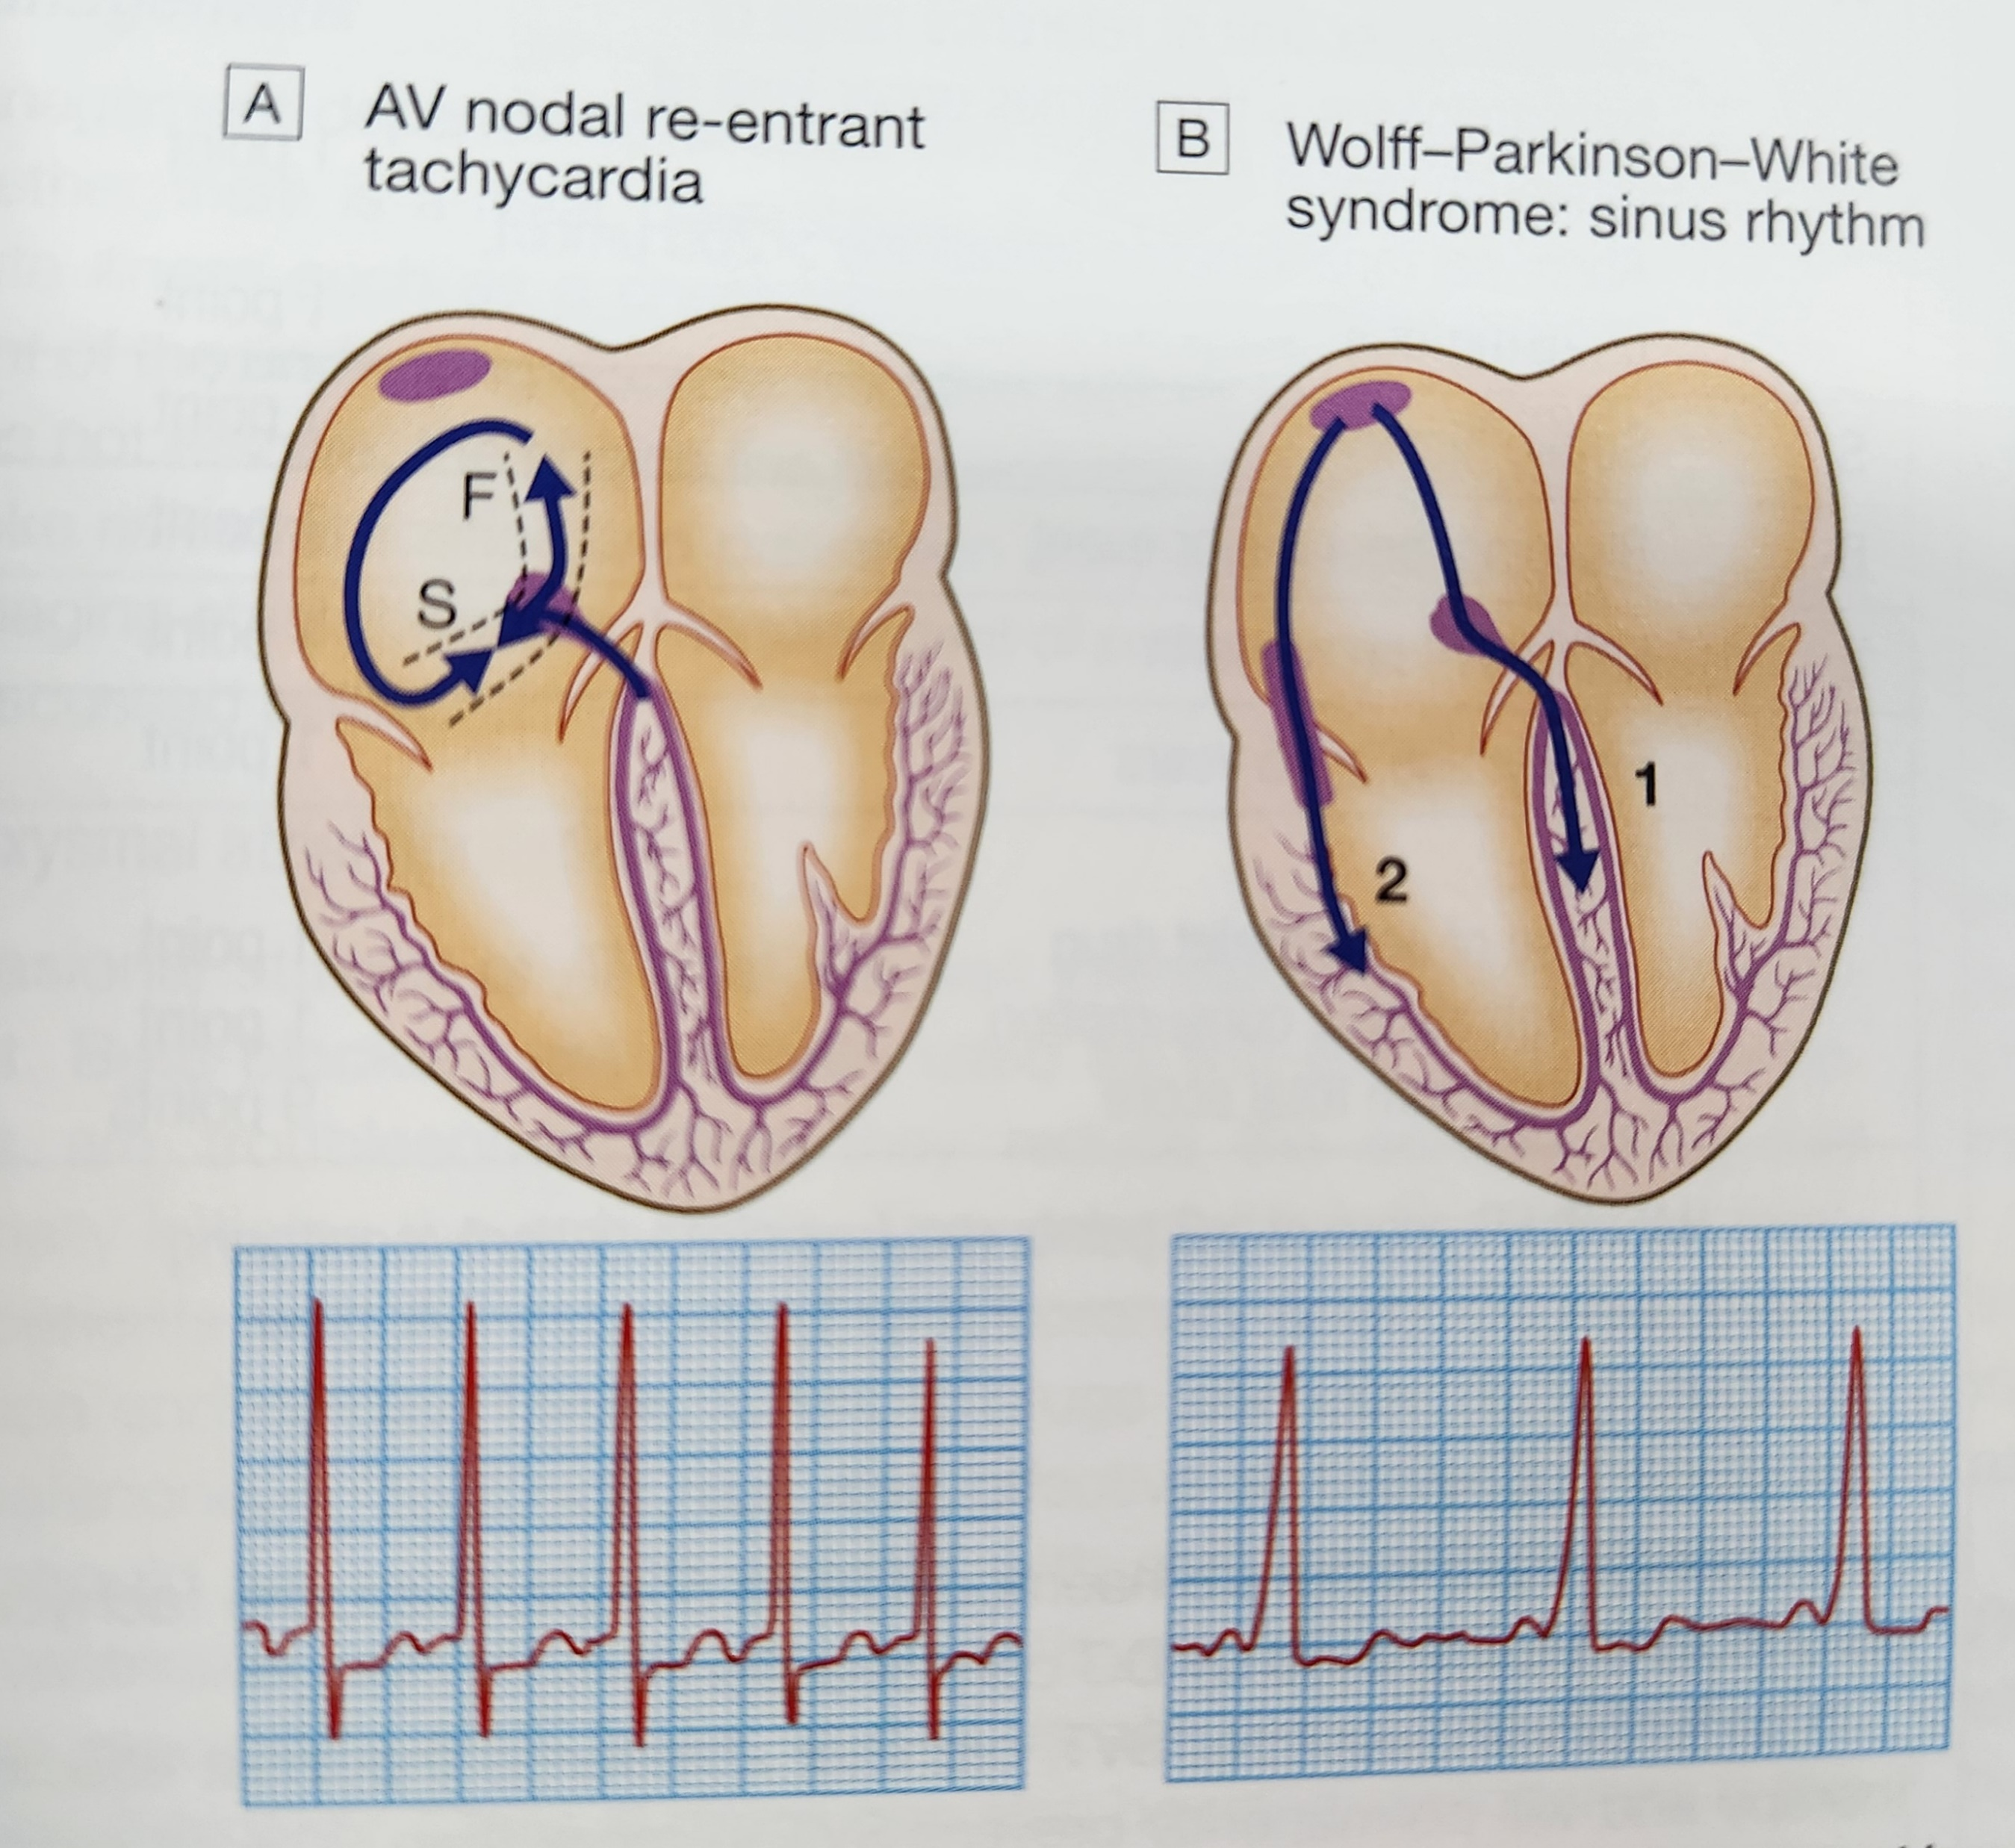
SUPRAVENTRICULAR TACHYCARDIA(SVT)
Rapid heart rhythms that originate above the ventricles- in the atria or the AV node
Abnormal conduction pathway
Symptoms:
Fast heart rate palpitations
Light-headedness
Shortness of breath
TYPES:
Atrioventricular nodal re-entrant
tachycardia-120-240bpm
Atrioventricular re-entrant tachycardia
Atrial tachycardia

Slide 8
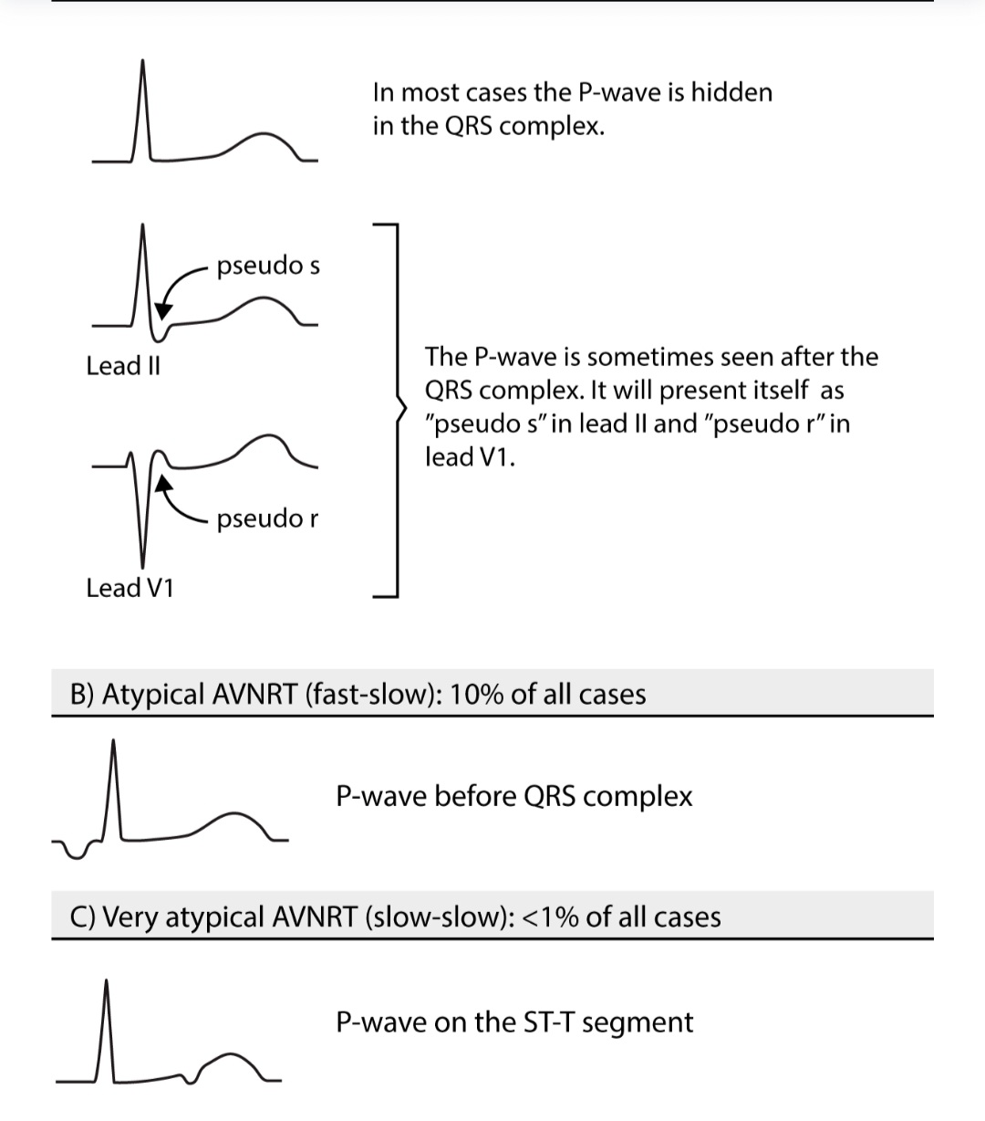
ATRIOVENTRICULAR NODAL RE-ENTRANT TACHYARDIA

Slide 9
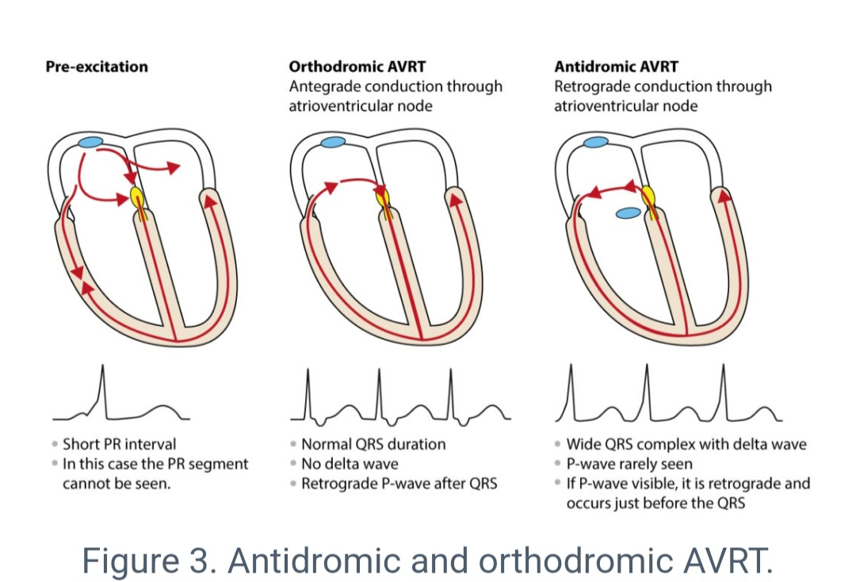
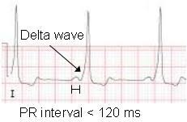
ATRIOVENTRICULAR RE-ENTRANT TACHYCARDIA
WOLFF- PARKINSON -WHITE SYNDROME
BUNDLE OF KENT
QRS>110 ms
HR>300 bpm

Slide 10
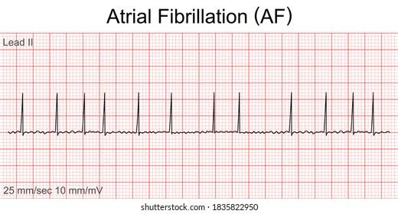
ATRIAL FIBRILLATION
Ectopic sites
Fibrillate rather than contract
Absent P waves
Irregular narrow QRS complexes
Irregulary Irregular rhythm
FEATURES: palpitations, breathlessness
fatigue
CAUSES:
Heart failure, CAD, hypertension , cardiac ischaemia, MI, Mitral valve disease, pneumonia

Slide 11
ATRIAL FLUTTER
Flutter waves: saw tooth waves
Rate:250-350 per min
R-R intervals are regular

Slide 12
VENTRICULAR TACHYCARDIA
A very fast heart rhythm that begins in the ventricles when both the SA node and AV node fail to generate rhythm.
No cardiac output
Rate:100-250 bpm
Rhythm: regularly spaced like tombstones
No p waves
No PR interval
Causes: CAD, electrolyte imbalance, digitalis toxicity, history of MI
DEFIBRILLATION- CARDIOVERSION
MONOMORPHIC

Slide 13
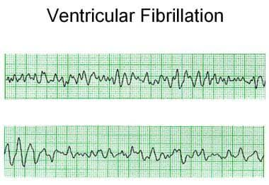
VENTRICULAR FIBRILLATION
Most deadly rhythm
Many foci in ventricle
Rate is indistinguishable
Rhythm is chaotic
No p wave
Cause: CAD, acute MI, valvular heart disease

Slide 14
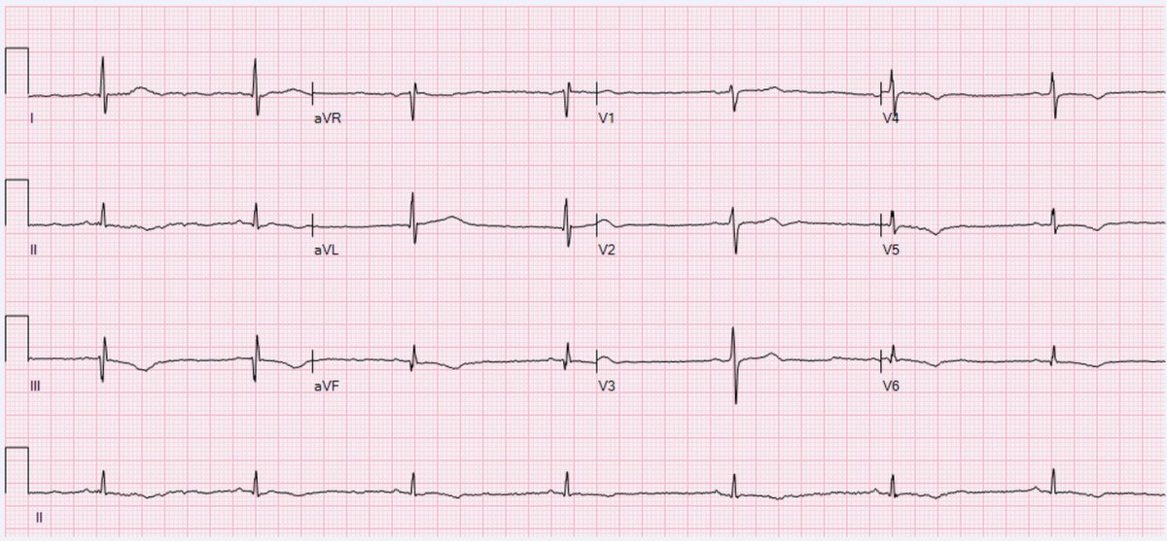
BRADYCARDIAS
Intrinsic depolarization frequency
SA NODE
SINUS BRADYCARDIA

Slide 15
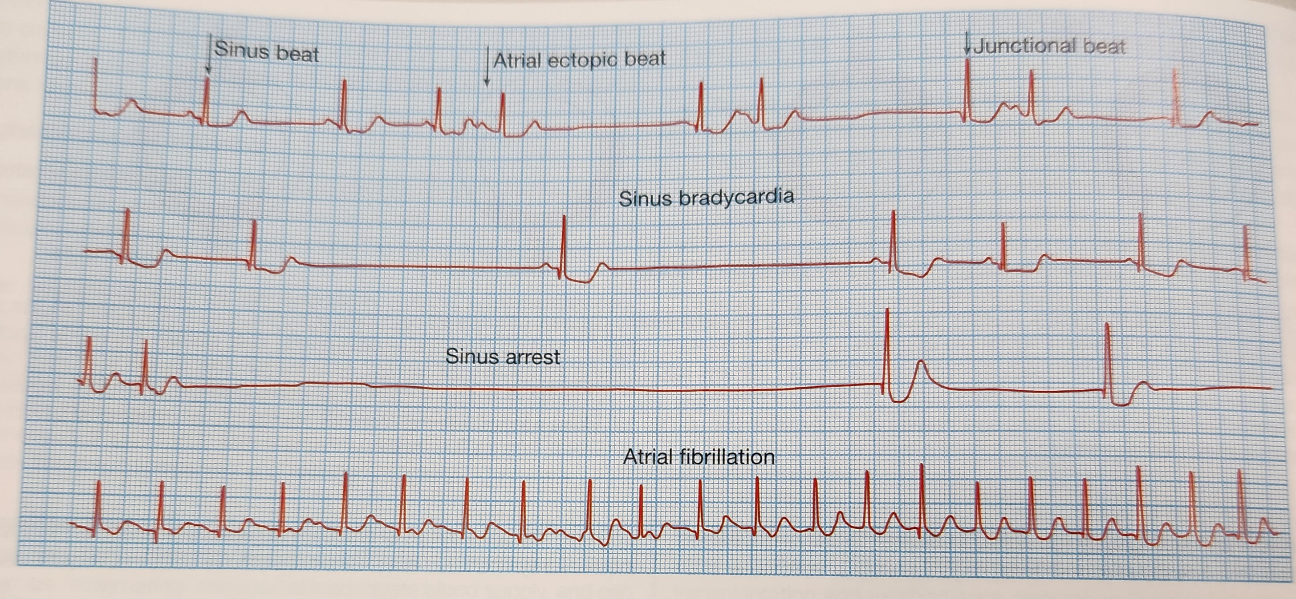
SICK SINUS SYNDROME/SINOATRIAL DISEASE
Degenerative condition of SA node
More common in older age groups
Clinical symptoms:
Palpitations, syncope , intermittent tachycardia or bradycardia, pauses in sinus rhythm.
Features: sinus bradycardia, paroxysmal atrial fibrillation, sinus arrest

Slide 16
ATRIAL ESCAPE

Slide 17
NODAL ESCAPE

Slide 18
VENTRICULAR ESCAPE

Slide 19
Atrioventricular block
1st degree
2nd degree
3rd degree
Mobitz type I
(Wenkebach)
Mobitz type II
TYPES

Slide 20
FIRST DEGREE AV BLOCK
AV conduction is delayed.
PR interval is prolonged(>0.20 sec)
It rarely causes any symptoms

Slide 21
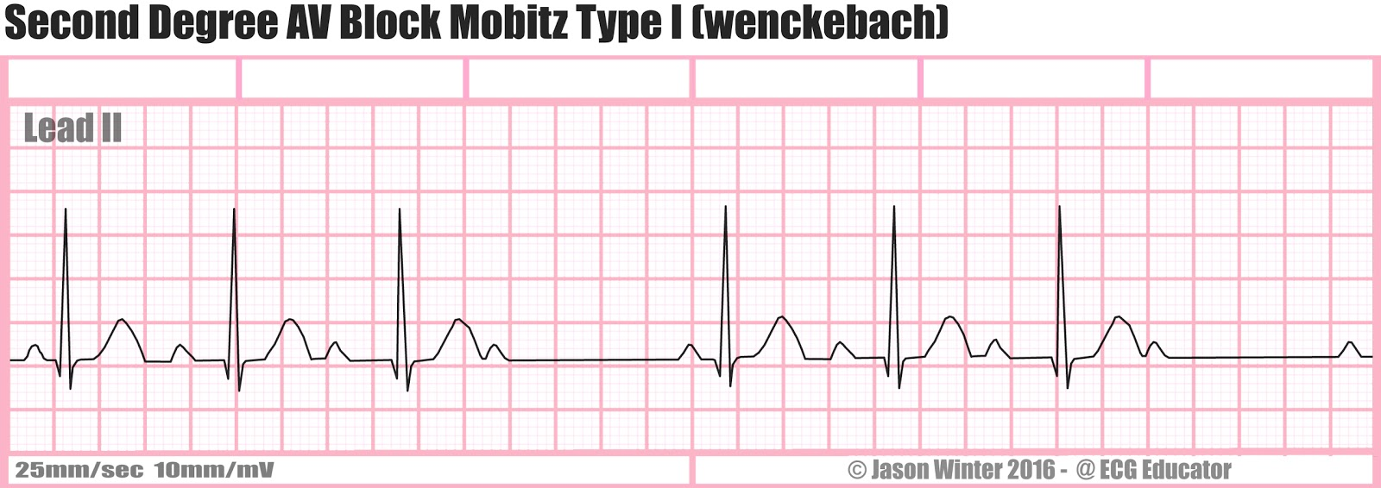
SECOND DEGREE AV BLOCK
Characterised by dropped beats
In Mobitz type I :
Progressive lengthening of PR interval, dropped beat
Seen in athletic young adults

Slide 22
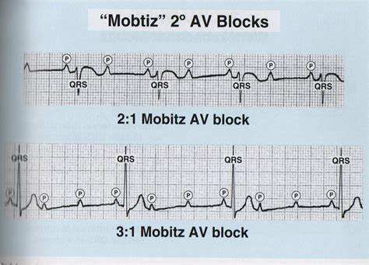
Mobitz type II
PR interval is constant
Some p waves are not conducted

Slide 23
THIRD DEGREE AV BLOCK
AV dissociation
Clinical features:
Recurrent syncope or Stokes –Adams attacks
Brief anoxic seizure, slow regular pulse
CAUSES:
Idiopathic fibrosis, MI,Infective endocarditis,
digoxin

Slide 24
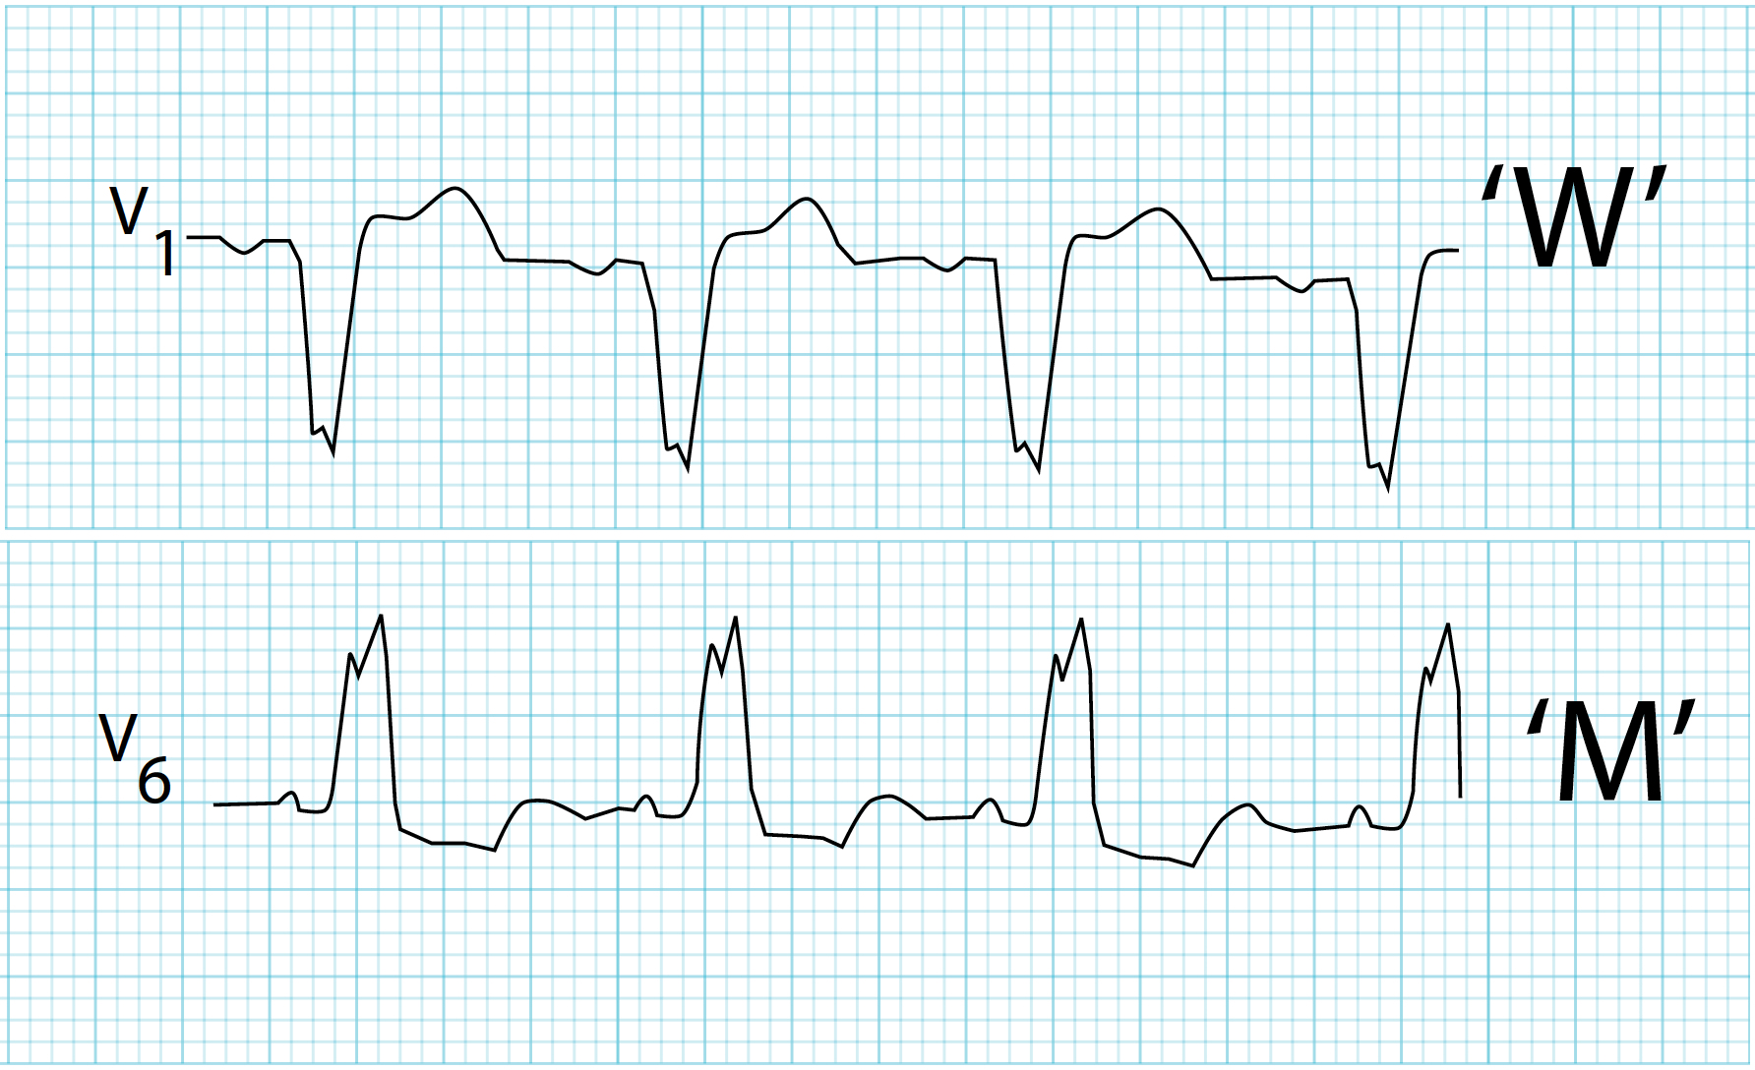
BUNDLE BRANCH BLOCK
RIGHT BUNDLE BRANCH BLOCK
LEFT BUNDLE BRANCH BLOCK
RBBB can occur in normal individuals
LBBB produces changes in QRS complex,
broadens QRS complex
Causes: RBBB: Right ventricular hypertrophy,
atrial septal defect
LBBB: CAD, Aortic valve disease

Slide 25
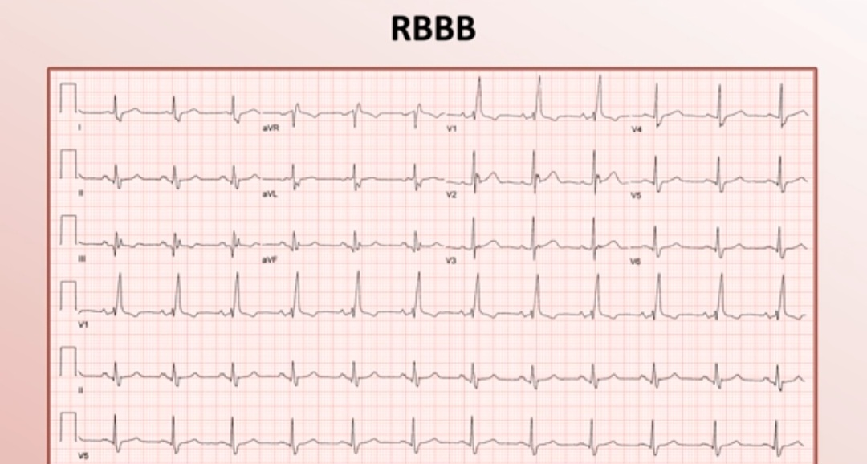

Slide 26
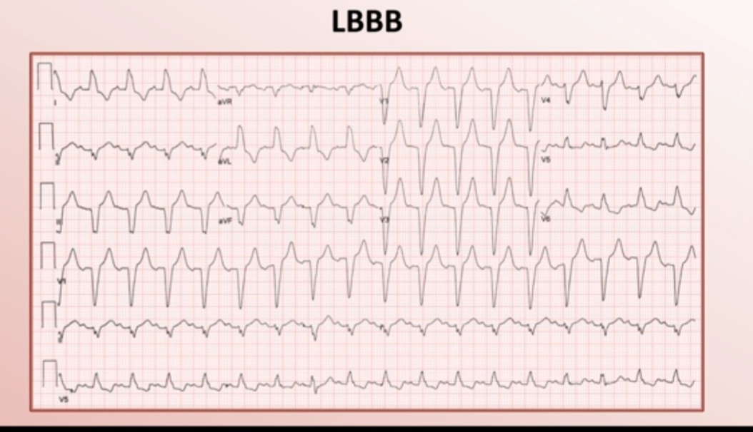

Slide 29
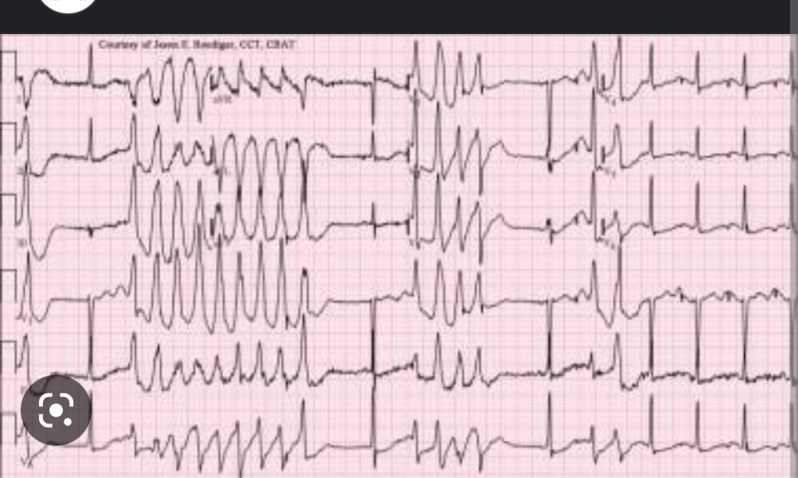
TORSADES DE POINTES

Slide 30
THANKYOU

