Slide 1

Epidemiology of accidents

Slide 2

Definition
An unexpected unplanned occurrence which may involve injury
Represent a major epidemic of non communicable disease

Slide 3
CONTENTS
Definition
Classification
Statistics
References

Slide 4
Classification
Road traffic accidents
Domestic accidents
Drowning
Burns
Falls
Snake bite
Poisoning
Industrial accidents
Railway accidents
Violence
Types

Slide 5
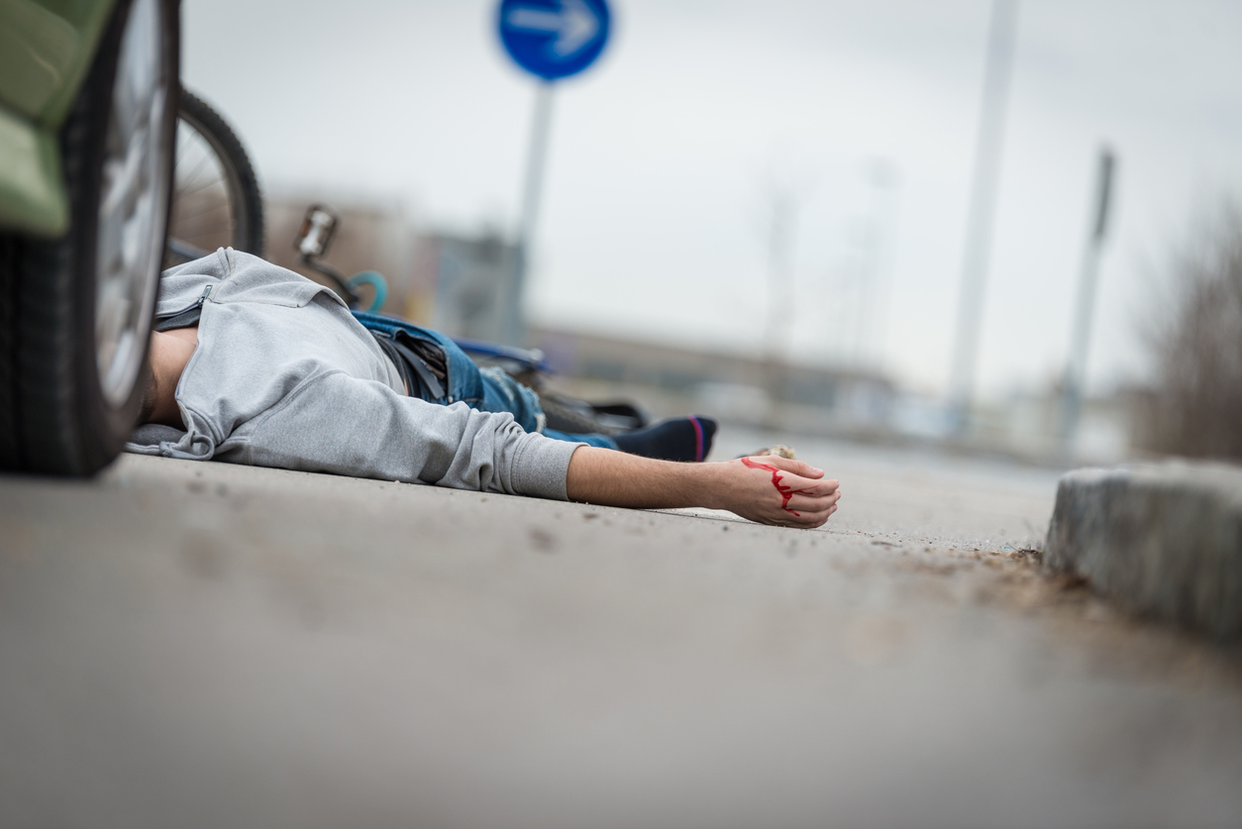
ROAD TRAFFIC ACCIDENTS
Annually 1.25 million people die from road accidents in the world.
Fatalities are common in younger age groups
Two wheeler accidents are more common
More than 90% per cent deaths occur in low and middle income countries
In 2017, 218,876 deaths occurred in India
25.7 deaths per 100,000 in males, 8.5 deaths per 100,000 in females.

Slide 6
RISK FACTORS
At 30 km/h or below pedestrians have a 90% chance of surviving a car crash
Blood alcohol concentration>0.04g/dl Random breath testing can lead to reduction by 20%
Reduces risk of death by almost 40% and risk of severe injury by over 70%
Helmets should meet safety standards
Wearing seat belt reduces the risk of fatality of front seat passengers by 40-50% and of rear seat by 25-75%

Slide 7
HUMAN FACTORS
Increased vulnerability
Age, Sex, Education
Medical conditions
Fatigue
Lack of experience
Impulsiveness
Defective judgements
Lack of body protection
ACCIDENT
Heightened emotional tension
Alcohol and drugs
Defective , narrow roads
Poor lighting
Defective lay out of cross road and speed breakers
Excessive speed, poorly maintained ,overloaded buses
Bad weather
PRECIPITATING FACTORS
ENVIRONMENTAL FACTORS

Slide 8
1.Data collection
2. Safety education
3. Promotion of safety measures
4. Alcohol and other drugs
5. Primary care
6. Elimination of causative factors
7. Enforcement of laws
8. Rehabilitation services
9. Accident research

Slide 9
2. Domestic accidents
Drowning
Burns
Falls
Injuries from sharp objects
Poisoning
Bites and other injuries from animals

Slide 10
Drowning
It is the process of experiencing respiratory impairment from submersion/immersion in liquid
In 2016 , cases of drowning were estimated to be 322,000
3rd leading cause of unintentional death
Found in all economies
China and India account to 43% of world’s drowning mortality rate

Slide 11
Risk factors
Age
Gender: males
Access to water
Unsupervised infants
Medical conditions : epilepsy

Slide 12
Development and maintenance of safe water systems
Building fences
Covering of open wells and cisterns
Safe water zones for recreation

Slide 13
Burns
Injury to the skin and other organic tissues caused by heat, radiation ,electricity ,friction or contact with chemicals
180,000 deaths annually.
Majority occur in middle income countries.
Non-fatal burns are a leading cause of morbidity and hospitalization.
One million people in India are moderately or severely burnt annually

Slide 14
Risk factors
Females
Age:
Children
Socioeconomic status
Occupational hazards
Alcohol abuse and smoking
Use of kerosene as fuel

Slide 15
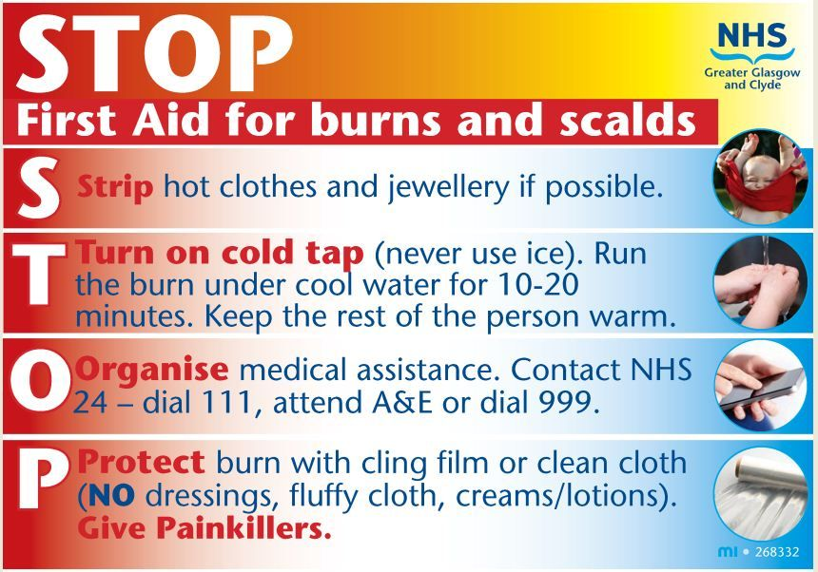
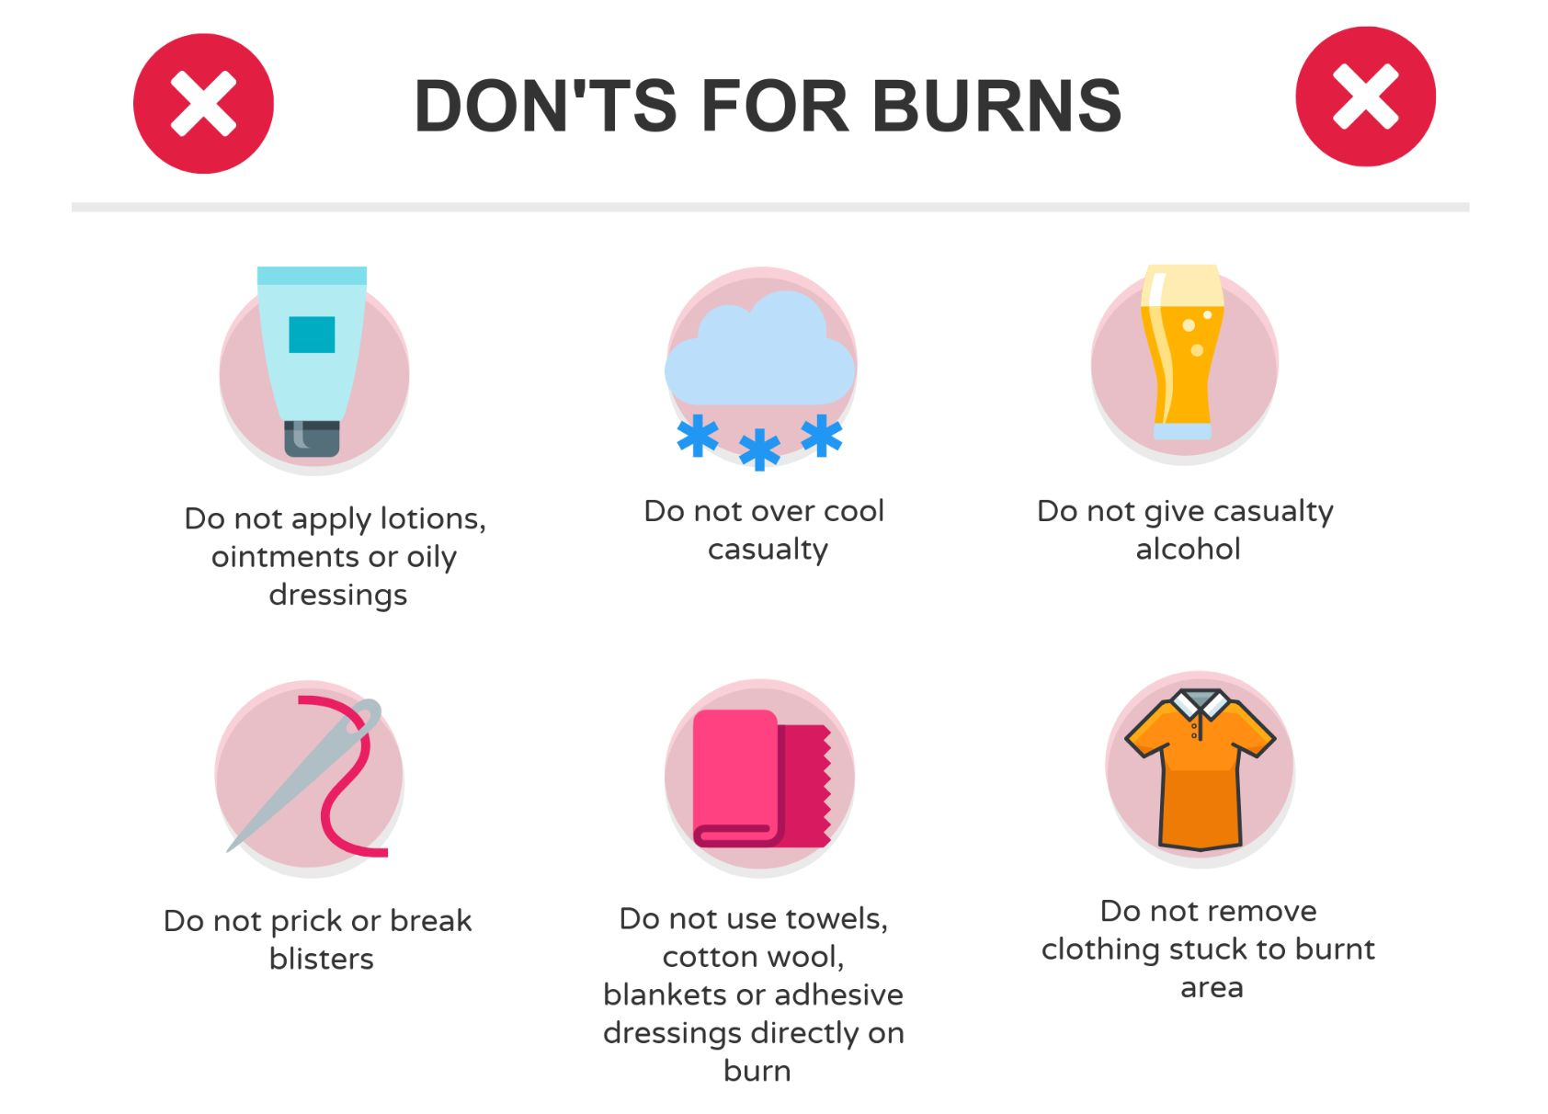
First Aid

Slide 16
Falls
An estimated off 646,000 fatal falls occur each year.
Death rates are highest among adults over the age of 65 years.
Falls from rooftops, balconies, window sears and stairs cases are common.

Slide 17
RISK FACTORS
Occupations at elevated heights
Alcohol or substance use
Neurological and other disabling conditions

Slide 18
PREVENTION
Screening for the risk of falls
Vit D and calcium supplementation
Muscle strengthening
Correction of visual impairment

Slide 19

Poisoning
In India about 28,012 poisoning deaths were reported.
Common agents responsible are pesticides, prescription drugs ,household chemicals and kerosene,
Use of organophosphorus insecticides in suicide events is as high as 20-30 percent.

Slide 20
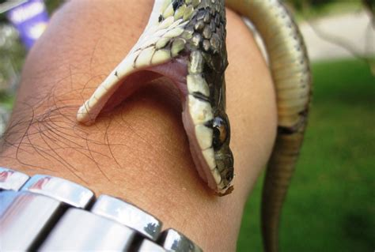
Snake Bites
5 million snake bites annually.
125000 deaths and 400,000 amputations and other permanent disabilities.
Most cases are from countries such as Africa, Asia and Latin America.

Slide 21
Symptoms
Neurotoxic
Cytolytic
Respiratory paralysis
Symptoms:
Ptosis
Dysphagia
Diplopia
Respiratory failure
Haemolysis, Haemorrhage
Symptoms:
Passage of dark black urine
Local pain
Redness
Extravasation of blood

Slide 22

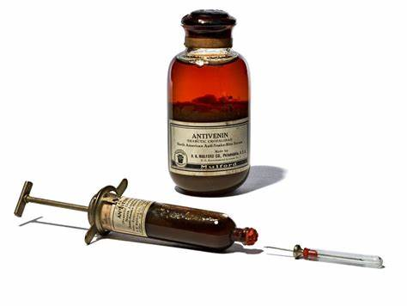
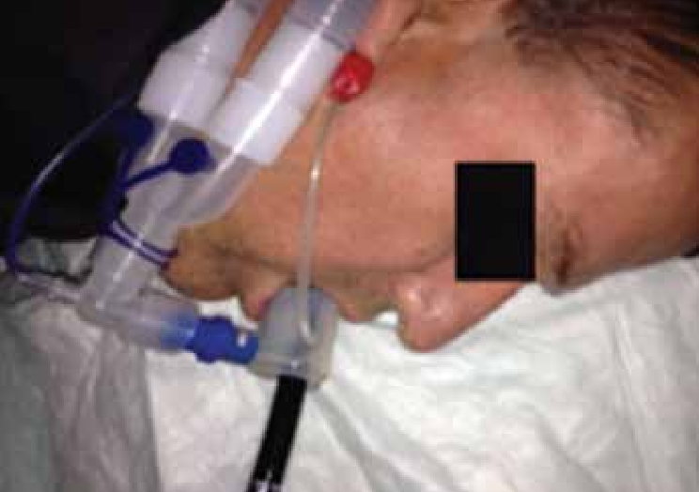
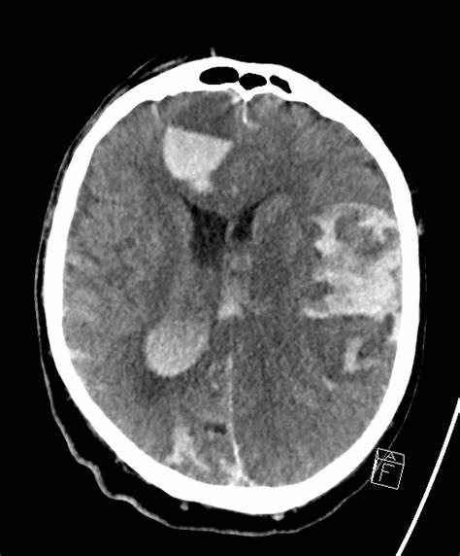
Management
Immobilize the limb
Assess for signs
In case of respiratory paralysis ASSISTED VENTILATION
Do not incise
20 WBCT
Analgesia
Antivenom
CT scans
Split skin grafting
Haemodialysis

Slide 23
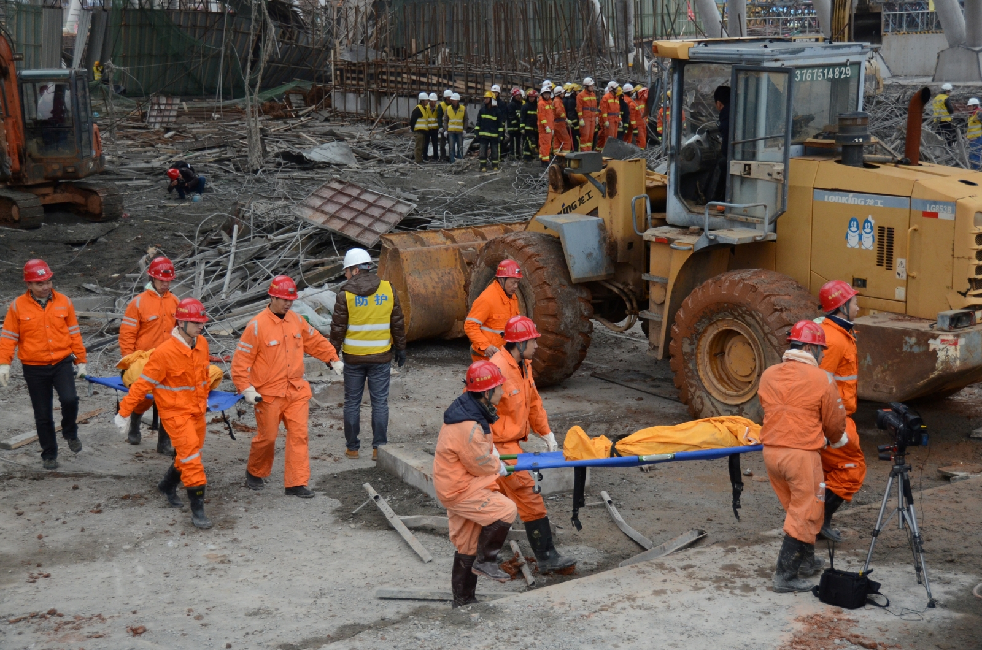
Industrial Accidents
Estimated 120 million injuries.
200,000 deaths per year.
Rapid industrialization.
Incidence among agricultural workers :
22-29 per 1000 workers.

Slide 24
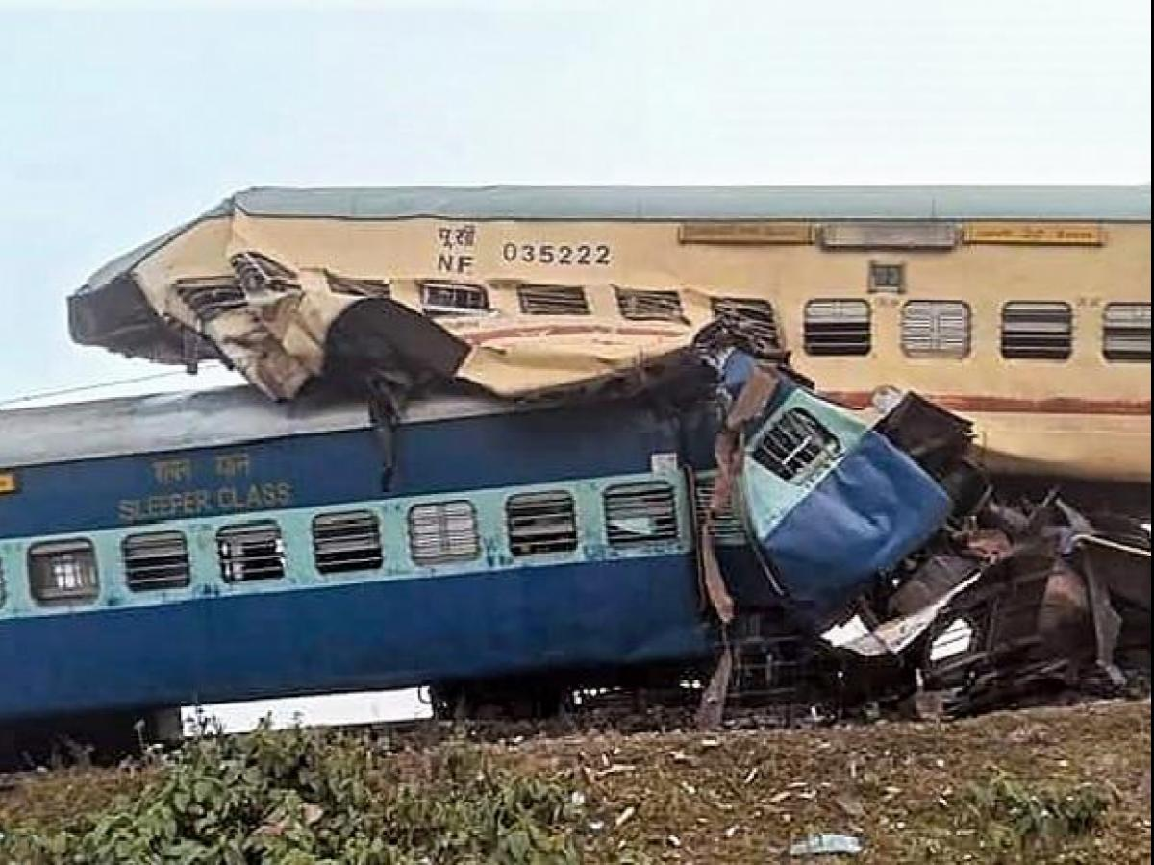
Railway Accidents
Increased number of trains and passengers .
2010, about 300,576 people died of railway accidents in India.
Human Failure.

Slide 25

Violence
In 2016, there were an estimated of 4,77,000 murders.
Risk factors:
Social acceptability of violence as a means to solve problems.
Easily available firearms.
Violence due to war.
suicides : In India an average of
369 suicides take place everyday
248 are committed by males
121 by females

Slide 26
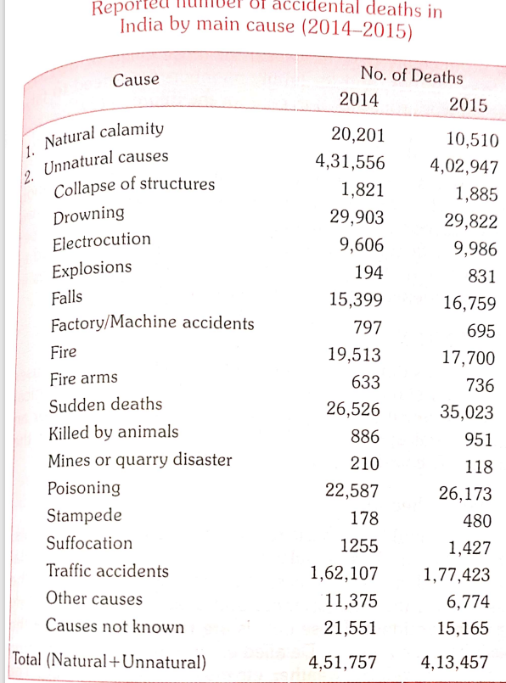
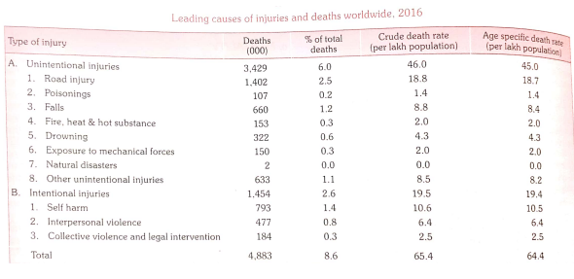
Statistics

Slide 27
References
Park’s textbook of preventive and social medicine

Slide 28
THANK YOU

