Slide 1
Metabolic disorders of Phenylalanine and Tyrosine

Slide 2
METABOLIC DISORDERS
1) PHENYLKETONURIA
2) ALKAPTONURIA
3) ALBINISM
4) HYPERTYROSINEMIA

Slide 3
Case study 1
A six year old boy was referred to the hospital with the problem of aggressive behaviour ,seizures, eczema and developmental delay. . At about one year old, his normal black hair gradually changed to light brown. There was no history of light hair on both parental sides. He could not follow simple instructions and was unable to perform simple arithmetic. Investigations revealed normal blood counts, blood glucose and electrolytes. Blood Phenylalanine levels were more than 30 mg/dl(normal=1-2 mg/dl). Guthrie bacterial inhibition assay and urine ferric chloride test showed blue-green color.
What is the probable diagnosis for the above symptoms?
What are the laboratory tests done for the above diagnosis?
What are its main clinical features?

Slide 4
PHENYLKETONURIA
Phenylketonuria (PKU) is an inborn error of metabolism that results in decreased metabolism of the amino acid phenylalanine. It is due to the deficiency of phenylalanine hydroxylase enzyme.
It is an autosomal recessive disorder.
Thus phenylalanine cannot be converted to tyrosine and accumulates in the body.

Slide 5
Classification of Phenylketonuria
There are five types
Type I is classical type
Phenylalanine hydroxylase
deficiency.
Type I
Type IV
Type V
Type II
Type III

Slide 6
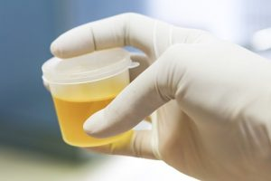
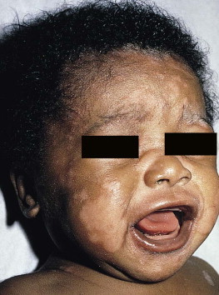
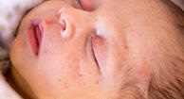
Clinical Manifestations
Mental retardation
Light hair and eyes
Mousy odor
Hypo pigmentation
Eczema

Slide 7
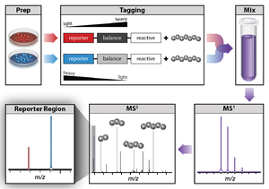
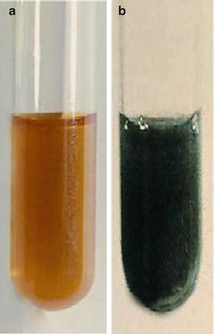
Laboratory diagnosis
Blood phenylalanine: Normal levels=1mg/dl. In PKU levels > 20mg/Dl.
Guthrie test: Rapid screening test
DNA probe test
Tandem mass spectrography: most reliable method.
Ferric chloride test
TMS
DNA probe test
Guthrie test
Ferric chloride test

Slide 8
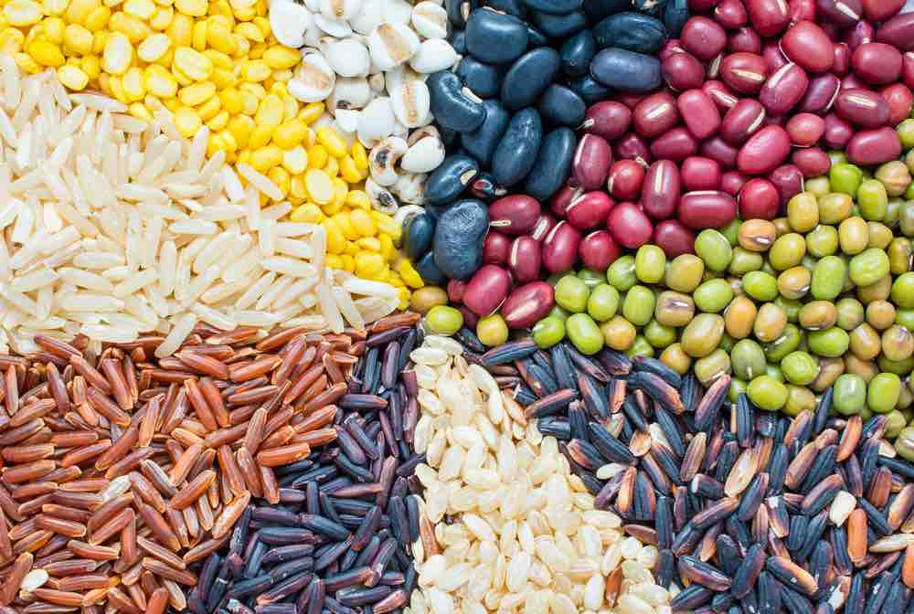
Treatment
First line treatment:
Diet containing low phenylalanine in the first decade of life.
Infant can be given formulas with no phenylalanine
High proteins foods are to be eliminated.
Pharmaceutical treatment(for adults)
Kuvan-co factor for phenylalanine hydroxylase
Palynziq- metabolizes phenylalanine

Slide 9
Case STUDY 2
A 1-year-old infant was referred to outpatient department . His mother complained that the diapers used for the child were stained with dark black urine. On exposure the stains became darker.
On general examination, there was bluish-black discoloration of palms, feet, and cartilage of ear pinna .
Ferric chloride test showed purple-black color. Urine tested positive for Benedict’s test.
What is the probable diagnosis?
What is the enzyme deficient in the above disorder?
Mention the laboratory tests suggested for the above diagnosis.

Slide 10
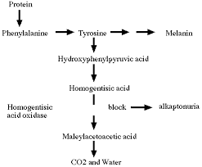
ALKAPTONURIA
It is an inborn error of metabolism due to the deficiency of enzyme homogentisate oxidase.
It is an autosomal recessive condition.
Therefore homogentisic acid cannot be converted to Maleylacetoacetate.
Thus homegentisic acid is excreted in urine.

Slide 11
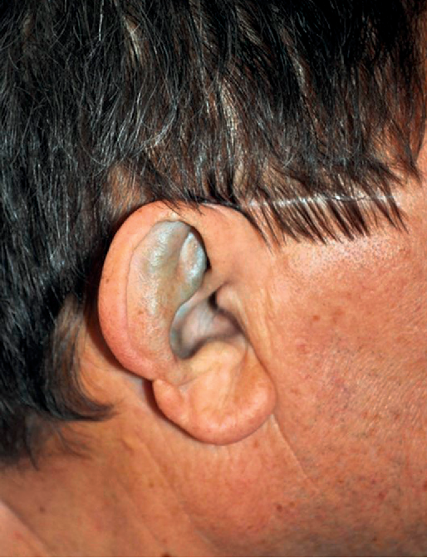
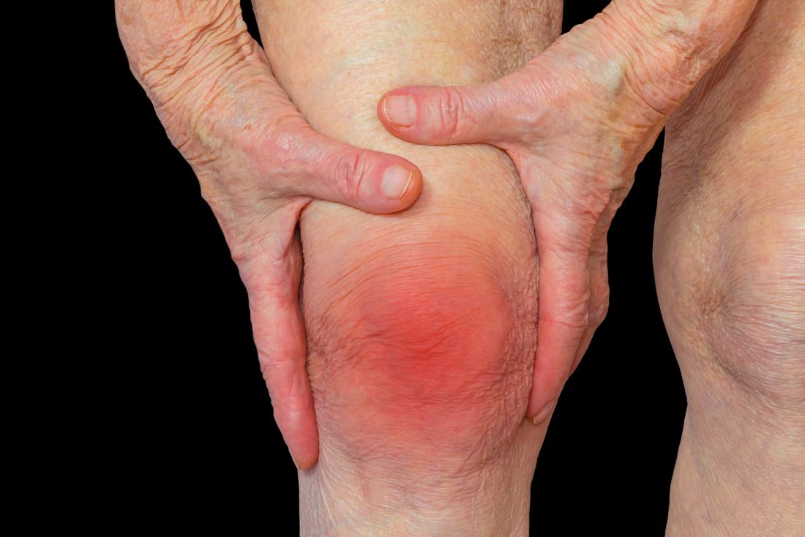
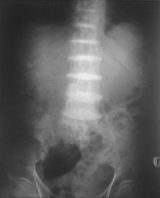
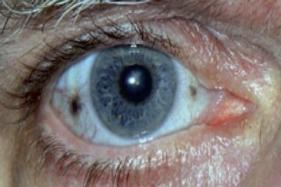
Clinical manifestations
Onchronosis of cartilage of pinna
Arthritis
Onchronosis of vertebral discs
Onchronotic pigment on sclera

Slide 12
Biochemical basis for clinical manifestations

Slide 13
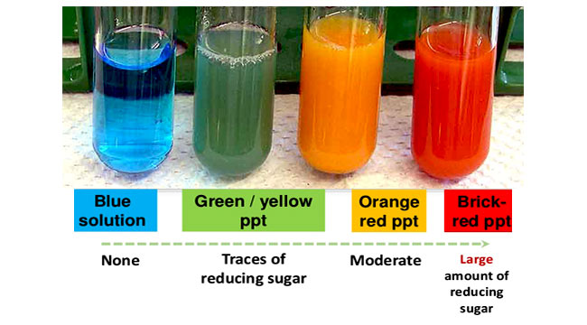
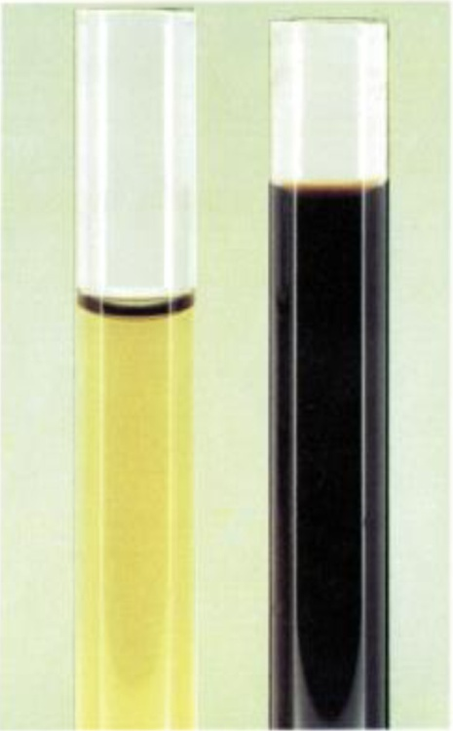
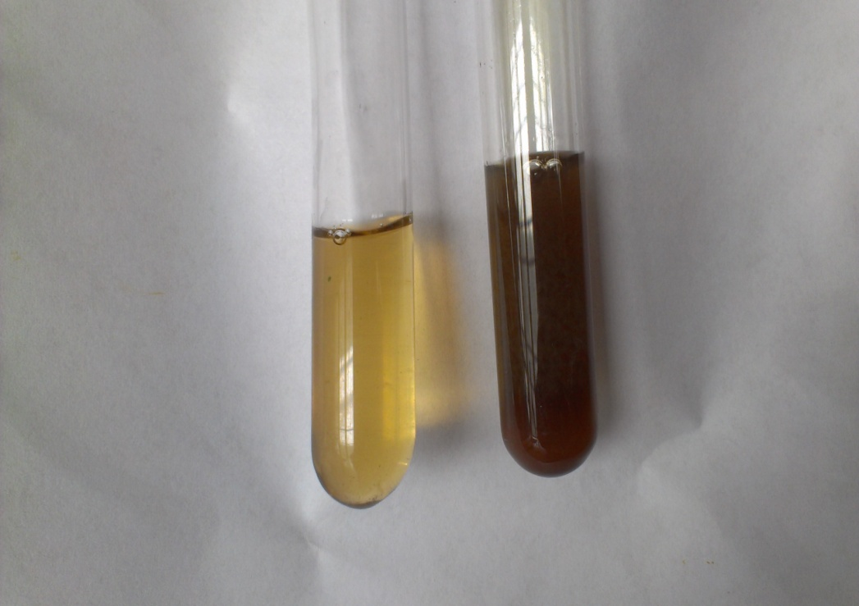
Laboratory investigations
Urine blackens on standing when it becomes alkaline.
Ferric chloride test will be positive for urine.
Benedicts test will be positive
Blackening of urine
On standing
Benedicts positive test
Ferric chloride test: positive

Slide 14
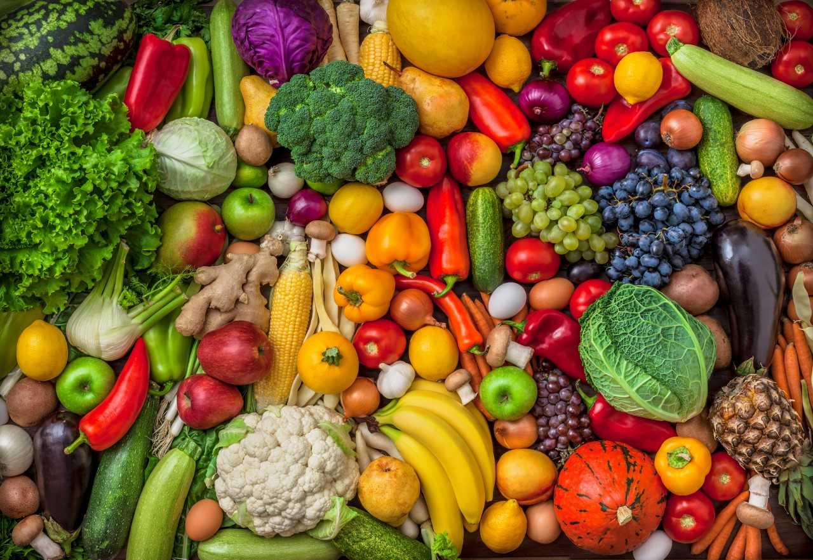
Treatment
Does not include a specific treatment as phenylketonuria.
It is not a dangerous condition.
Diet should be low in phenylalanine.
Ascorbic acid is used to stall the pigment deposition
of collagen

Slide 15
CASE STUDY 3
A newborn baby was found to have marked under pigmentation all over the body. The baby had extremely pale skin, hair and blue eyes. Both parents were quite healthy and normal. But they gave a history of a similar problem in one of the members from the paternal side.
What is the probable diagnosis from the above symptoms?
Mention the biochemical basis for hypopigmentaion.

Slide 16
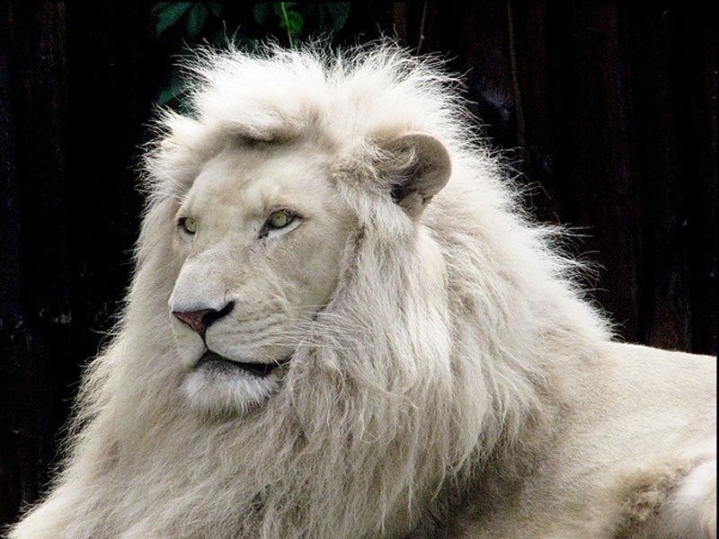
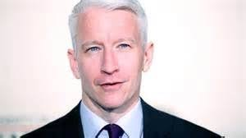
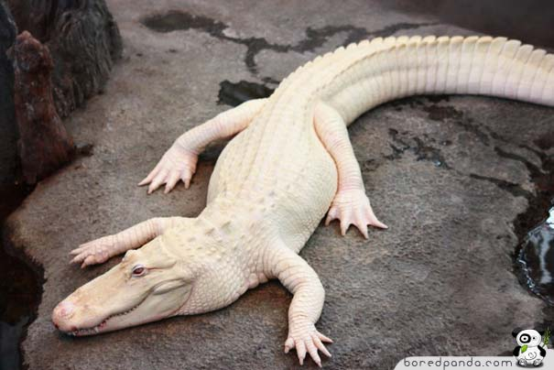
Albinism

Slide 17
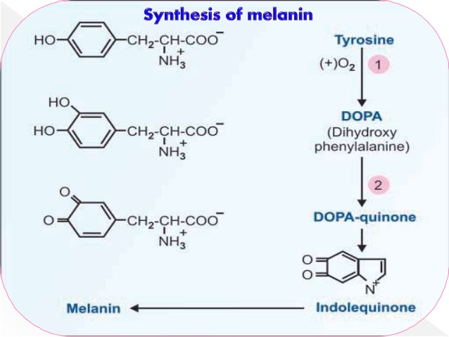
ALBINISM
It is an autosomal recessive disorder
It is usually due to the complete absence of
Tyrosinase enzyme which leads to defective synthesis of melanin.
Thus leading to hypopigmenntation.
Tyrosinase
Oculocutaneous albinism (OCA)
OCA affects the skin, hair, and eyes
It is due to a defect in the tyrosinase enzyme
Ocular albinism is the result of a gene mutation on the X chromosome and occurs almost exclusively in males. This type of albinism only affects the eyes.

Slide 18
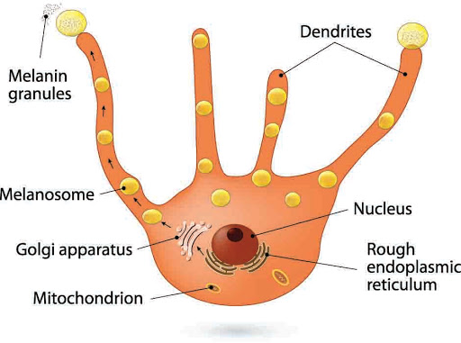
Causes
Tyrosinase deficiency
Failure of melanocytes to form melanosomes.
Failure of melanosomes to store melanin
Excessive destruction of melanosomes

Slide 19
Clinical features
Nystagmus
Melanoma
Photophobia
Low melanin

Slide 20
Treatment
Since it’s a genetic disorder there is no treatment.
Treatment can only relieve symptoms
Sunglasses to protect the eyes from the sun's ultraviolet (UV) rays.

Slide 21
HYPERTYROSINEMIA
Tyrosinemia is a genetic disorder characterized by disruptions in the multistep process that breaks down the amino acid tyrosine, a building block of most proteins. If untreated, tyrosine and its byproducts build up in tissues and organ cause serious health problems

Slide 22
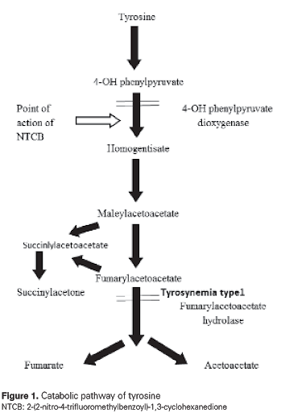
Types of Hypertyrosinemia
Hepatorenal Tyrosinemia (type I):
It is also known as tyrosinosis
It is due to deficiency of fumarylacetoacetate
hydrolase
It is an autosomal recessive disorder
Incidence is 1.5 per 1000 births

Slide 23
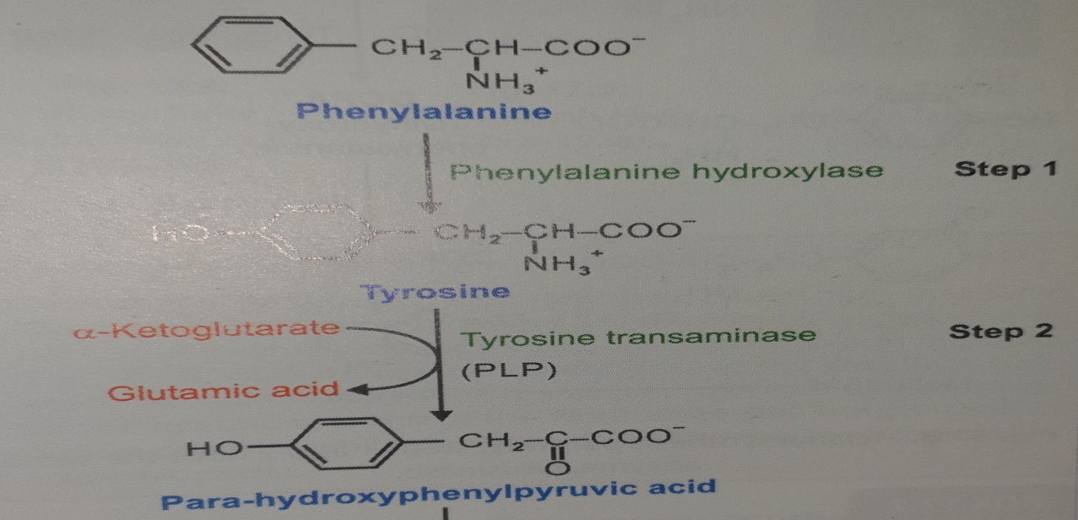
Oculocutaneous Tyrosinemia (Type II)
Also known Richner-Hanhart syndrome.
It is due to deficiency of tyrosine amino transferase.
Neonatal tyrosinemia
It is due to deficiency of para-hydroxy-phenylpyruvate hyroxylase

Slide 24
Clinical features
Acute liver failure
Accumulation of fumaryl and myelylacetatoacetate leads to DNA damage by alkylation.
Symptoms appear by 6 months of life.
Cabbage like odor
Hypoglycemia
Mental retardation
Keratosis of plantar and palmar surface
Painful corneal lesions.
Photophobia
Transient hypertyrosinemia
Developmental delay.
Type I
Type II
Type III

Slide 25
Laboratory findings and treatment
Urine tests positive for tyrosine, para-hydroxyphenylpyruvic acid and hydroxyphenyl lactic acid.
Serum contains high tyrosine levels.
Diet low in tyrosine and phenylalanine is advised
Increased excretion of tyrosine and phenylalanine in urine.
A diet low in protein is advised.
Increased tyrosine plasma levels.
Low protein diet is advised.
Hepatorenal
tyrosinemia
Oculocutaneous
tyrosinemia
Neonatal
tyrosinemia

