Slide 1

NEOPLASIA
CHEMICAL CARCINOGENeSIS

Slide 2
NEOPLASIA
Neoplasia means ‘new growth” and a new growth is called neoplasm
“It is an abnormal mass of tissue, the growth of which exceeds and is uncoordinated with that of normal tissues and persists in the same excessive manner after cessation of the stimuli which evoked the change”
-Willis

Slide 3
PROTO-ONCOGENES AND ONCOGENES
Proto-oncogenes are growth promoting genes
These are:
SIS gene
RAS
JAK2
CDK4
Oncogenes are mutated forms of normal proto-oncogenes. Overactivity of these promotes development of cancer in humans. These are include growth factors, growth factor receptors, cytoplasmic signal transduction proteins, nuclear transcription factors and cell cycle regulatory proteins

Slide 4
Tumour suppressor genes
Normally tumor suppressor genes act by either inducing the dividing cell from the cell cycle to enter into G0 (resting phase),or by acting in a way that the cell lies in the post mitotic pool losing its dividing capability
Major tumour suppressor genes implicated in human cancers are:
RB gene: Located on long arm of chromosome (q). First ever tumour- suppressor gene to be identified. Known as ‘master brake in the cell cycle’
p53 gene(TP53): located on short arm of chromosome(p). It blocks mitotic activity and promotes apoptosis
Transforming growth factor β: It inhibits cell proliferation

Slide 5
CARCINOGENESIS
Carcinogenesis is a multistep process at both the phenotypic and the genetic levels resulting from the accumulation of multiple mutations
There are various types of carcinogenesis:
Chemical carcinogenesis
Radiation carcinogenesis
Microbial carcinogenesis

Slide 6
CHEMICAL CARCINOGENESIS
Chemical carcinogenesis occurs by induction of mutations in the proto-oncogenes and in tumor suppressor genes
More than 200 years ago the London surgeon Sir Percival Pott correctly attributed scrotal skin cancer in chimney sweeps to chronic exposure to soot
Steps involved are:
Initiation
Promotion
Progression

Slide 7
INITIATION
It is the first step in carcinogenesis induced by initiator chemical carcinogen
The change induced is sudden ,irreversible and permanent

Slide 8
Steps involved in transforming ‘the target cell’ into the ‘initiated cell’ are:
METABOLIC ACTIVATION
REACTIVE ELECTROPHILES
TARGET MOLECULES
THE INITIATED CELL

Slide 9
Metabolic activation:
Majority of the carcinogens are indirect acting or pro carcinogens which require metabolic activation. Direct acting do not require any activation.
The indirect acting carcinogens are activated in the liver by the mono-oxygenases of the cytochrome P-450 system in the endoplasmic reticulum

Slide 10
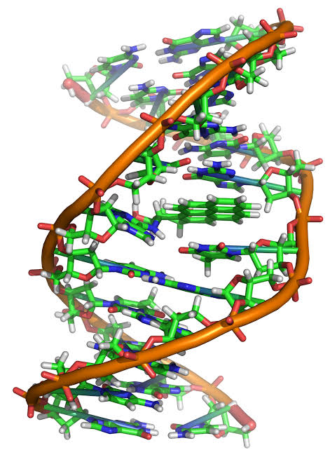
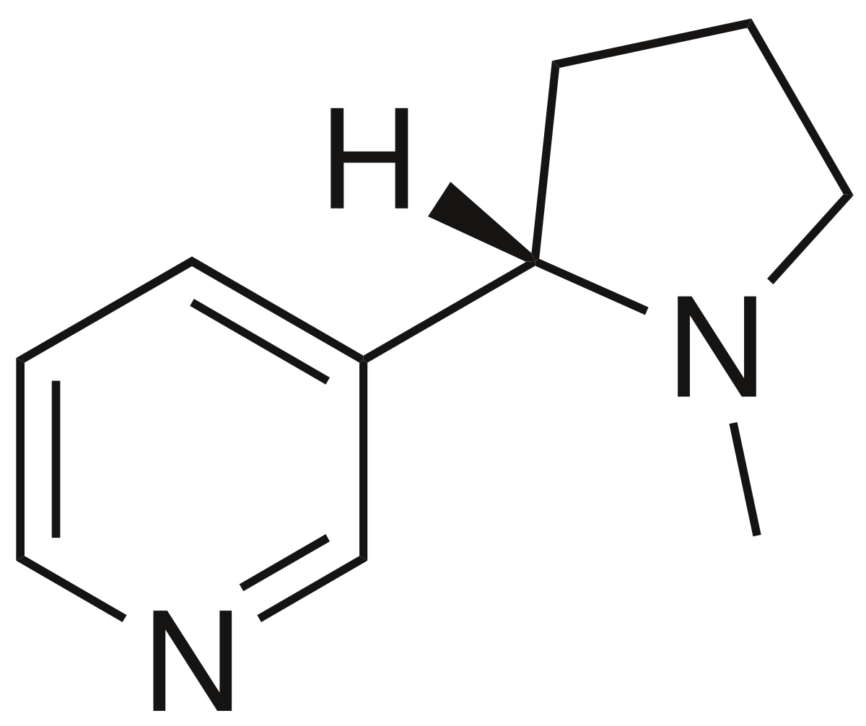
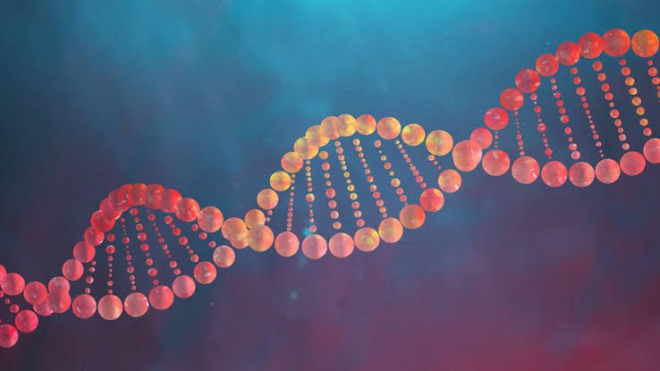
P450
Nicotine DNA ADDUCT
TARGET
ELECTROPHILE
INITIATED CELL

Slide 11
PROMOTION
It is the next sequential change in chemical carcinogenesis.
Promoters of carcinogenesis are substances such as phorbol esters, phenols , hormones , artificial sweetners and drugs like phenobarbital.
They are different from initiators as :
They do not produce sudden change
They require application following initiator exposure for sufficient time and dose.
The induced change might be reversed.
They do not damage the DNA

Slide 12
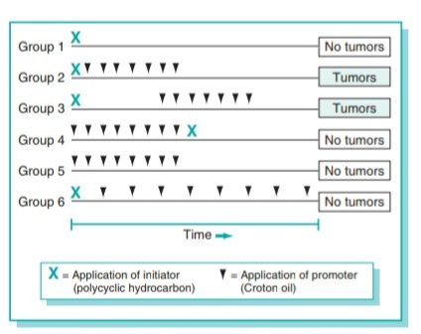

Slide 13
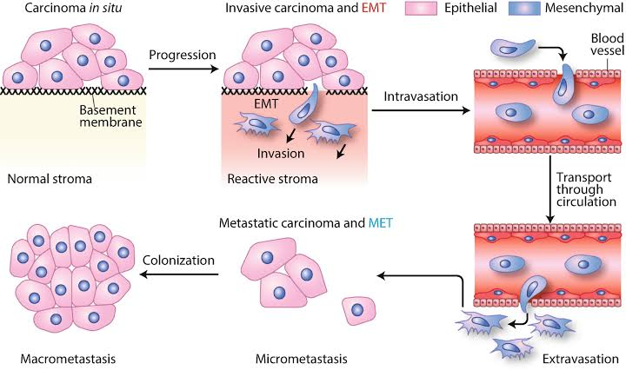
PROGRESSION
This stage occurs when mutated and proliferation cells show phenotypic features of malignancy that includes morphological ,biochemical and molecular characteristics.
These phenotypic features appear only when the initiated cells proliferate rapidly and acquire mutations.
The new progeny of cells acquire genetic and biochemical characteristics of malignancy

Slide 14
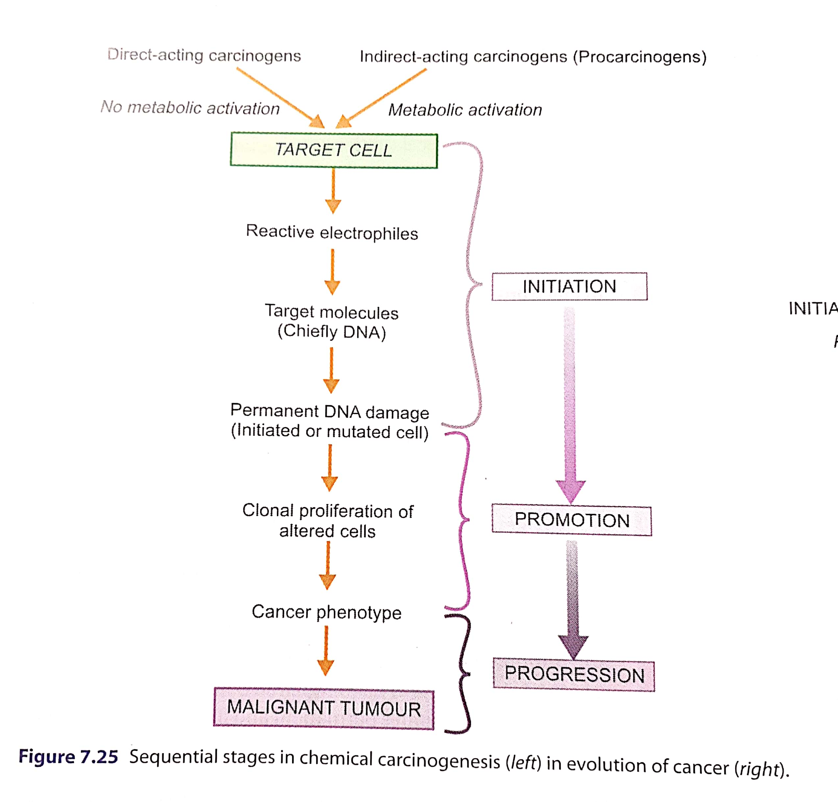
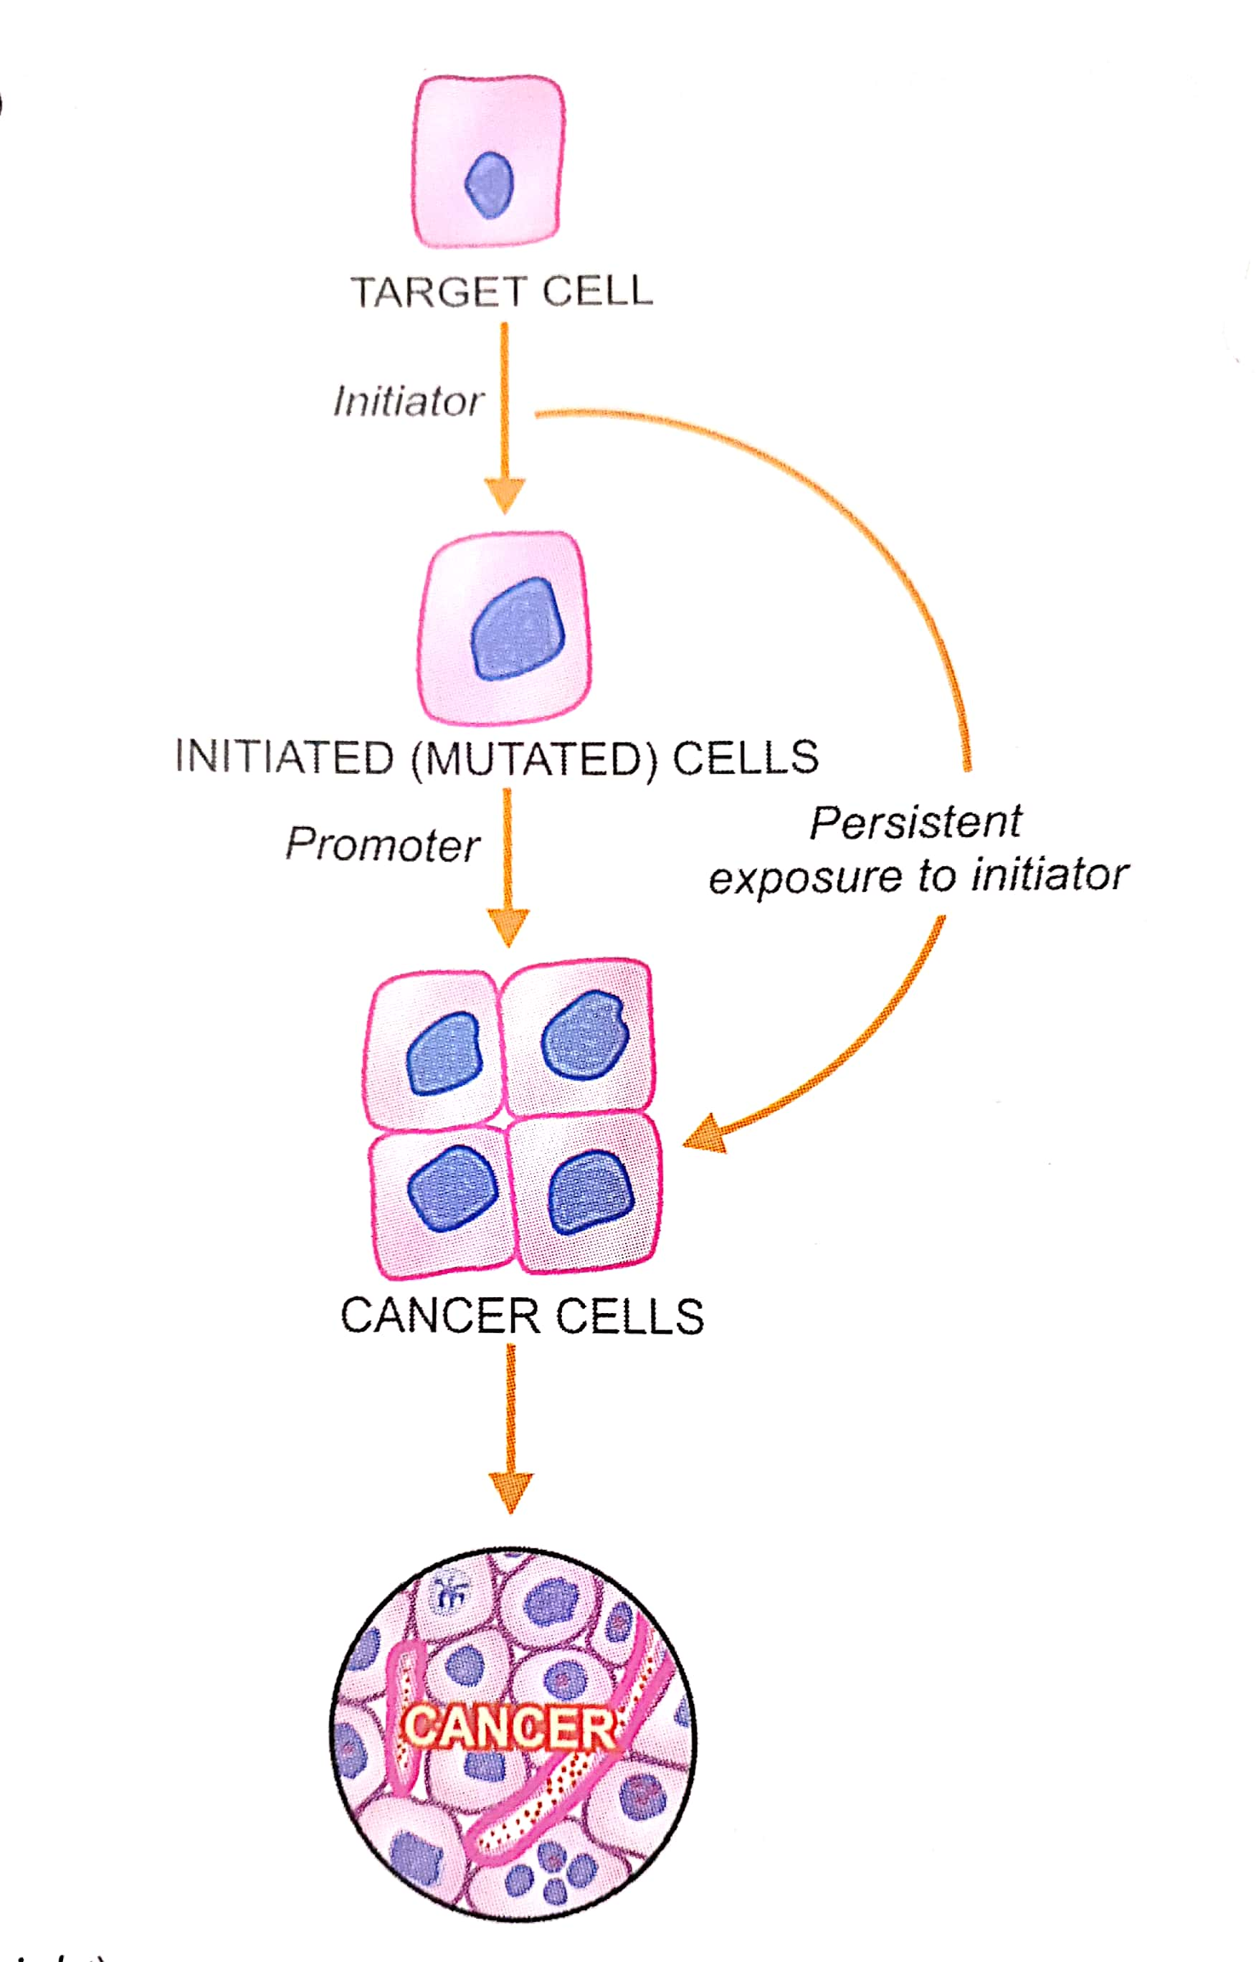

Slide 15
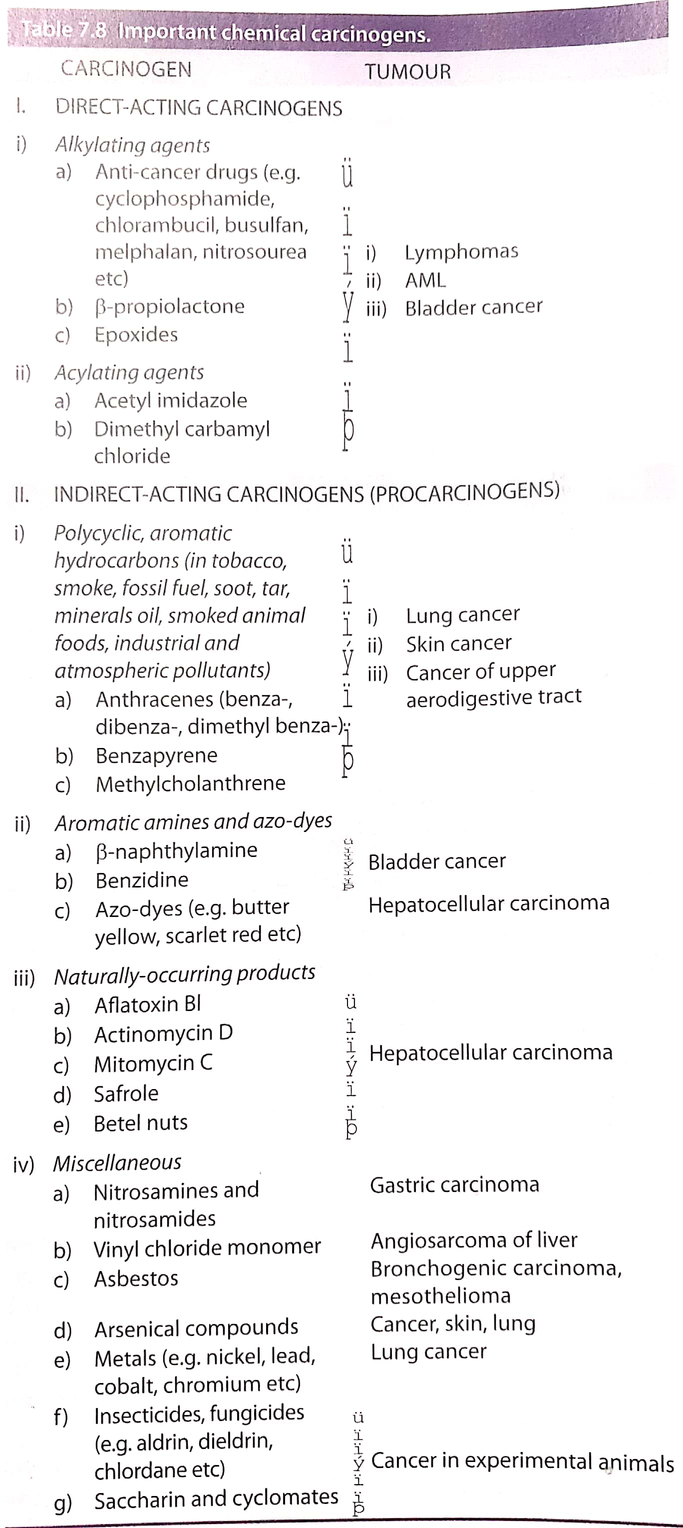

Slide 16
TESTS FOR CHEMICAL CARCINOGENICITY
1. EXPERIMENTAL INDUCTION:
Administration of different chemical compounds to experimental animals and results are obtained. This test is prolonged and expensive.
2. TESTS FOR MUTAGENICITY(AMES’ TEST)
Easy and inexpensive method to evaluate the ability of a chemical to induce mutation in the mutant strain of Salmonella typhimurium that cannot synthesize histidine.

Slide 17
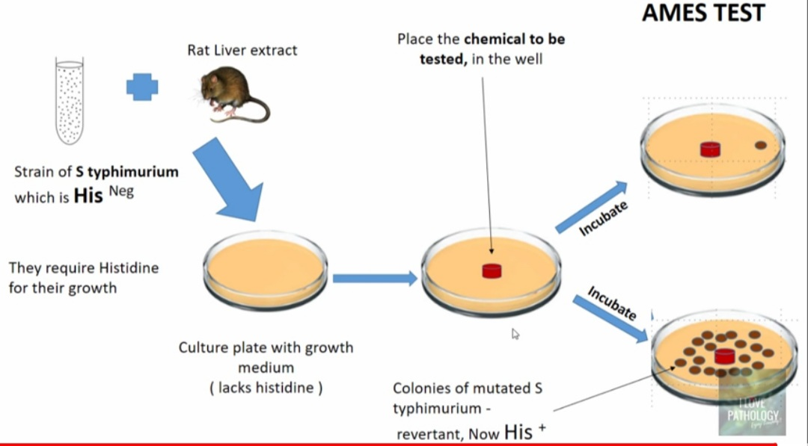

Slide 18
THANK YOU

