Slide 1
Why Understanding 9/11
is
Crucial to Our Future

Slide 2
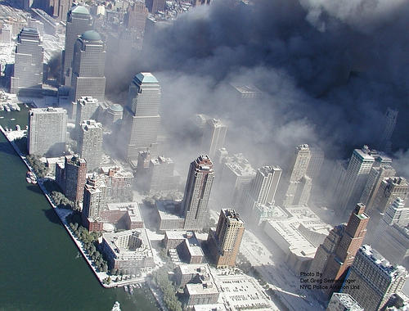
Notes:
The “official story,” or should I say “the official conspiracy theory” would have us believe that … 19 crazed Muslims hijacked 4 planes on the morning of September 11, 2001.

Slide 3
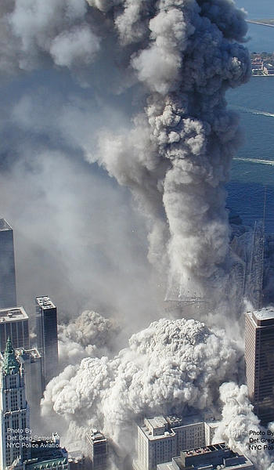
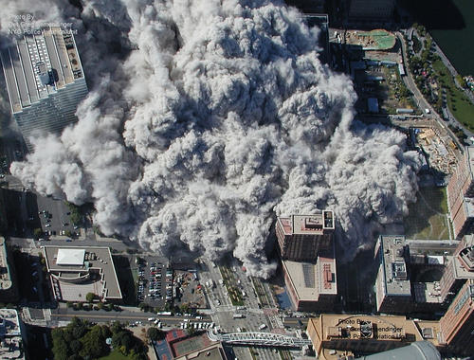
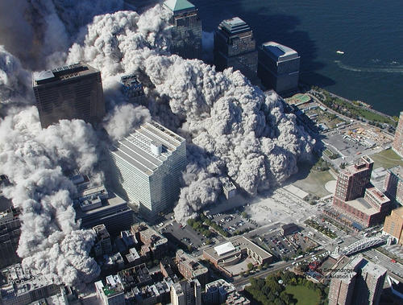
Notes:
The “official story,” or should I say “the official conspiracy theory” would have us believe that … 19 crazed Muslims hijacked 4 planes on the morning of September 11, 2001.

Slide 4
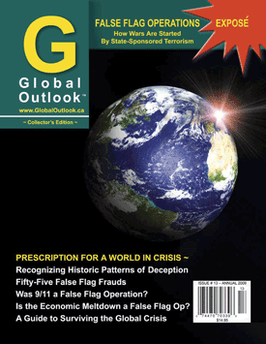
Global Outlook Issue # 13 will be referenced throughout the talk.
It can be purchased at www.GlobalOutlook.ca
Notes:
It is clear that we have been duped into believing the “Official Story”. The mainstream media has covered up the truth!

Slide 5
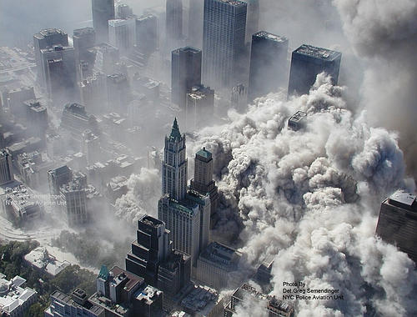
Why Understanding 9/11 is Crucial to Our Future

Slide 6
26 Major 9/11 Anomalies 10 Similar Incidents from History Why Understanding 9/11 is Crucial to Our Future
3 Parts to the Presentation

Slide 7
The Official Story of 9/11
19 Muslim / Arab fanatics
Who were funded and trained by al Qaeda
and directed by Osama bin Laden from cave in Afghanistan
Hijacked four Commercial jets with knives & box cutters on Sept. 11, 2001.
They took the North American Defense Command (NORAD) completely by surprise
Flying two of them into the Twin Towers
As a result, WTC 1&2 collapsed in a “pancake” fashion due to structural failure
The third plane that hit Pentagon disappeared … into the building,
As did the fourth plane that crashed in a field near Shanksville, Pennsylvania
WTC Building 7 collapsed due to structural failure caused by falling debris and fires.
The 9/11 Commission found:
that there were no prior warnings for this “act of terrorism”
and that multiple US government intelligence failures were to blame.
Notes:
The Official Conspiracy Theory of 9/11: 19 Muslin / Arab fanatics, funded and trained by al Qaeda, directed by Osama bin Laden from a cave in Afghanistan, hijacked four commercial jets with knives and boxcutters and took the North American Defense System (NORAD) completely by surprise.
As a result, World Trade Towers 1 and 2 collapsed in a “pancake” fashion due to structural failure caused by the crashing planes and ensuing fires. The plane that hit the Pentagon vaporized upon impact, as did the plane that crashed near a field near Shanksville, Pennsylvania. Later that day, Building 7 collapsed due to structural failure even though it wasn’t hit by a plane.
The 9/11 Commission found that there were no prior warnings for this “Act of terrorism” and that multiple US government intelligence failures were to blame.

Slide 8
26
Major
9/11 Anomalies
Notes:
The “official story,” or should I say “the official conspiracy theory” would have us believe that … 19 crazed Muslims hijacked 4 planes on the morning of September 11, 2001.

Slide 9
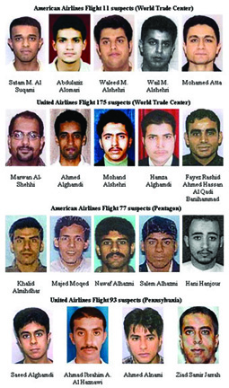
Notes:
The “official story,” or should I say “the official conspiracy theory” would have us believe that … 19 crazed Muslims hijacked 4 planes on the morning of September 11, 2001.

Slide 10
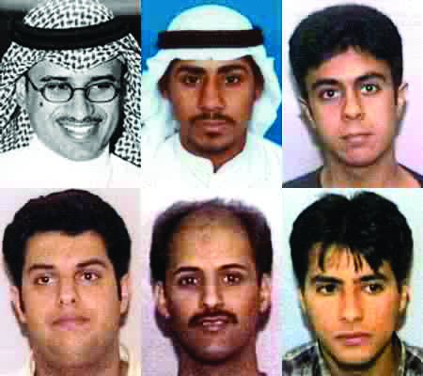
19 Muslim/Arab Fanatics …
Notes:
Half a dozen of the alleged 9/11 “suicide hijackers” were reported still alive after 9/11 by the BBC and The Guardian.
At least five of them may have trained at US military bases, as reported in Newsweek.
Some of the alleged hijackers who were portrayed by the Bush White House as devout Muslims were seen at strip clubs buying lap dances just prior to 9/11.

Slide 11
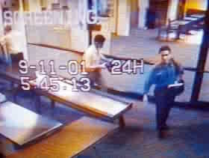
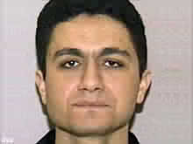
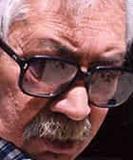
… Funded and trained by al Qaeda?
Airport Security
Video
Mohammed Atta – 9/11 Ringleader
Lt. General Mahmoud Ahmad – the 9/11 Money Man
Notes:
The 9/11 Money Man was visiting members of the Bush administration from September 4th to the 13th, 2001.
It was Lt. General Ahmad (Pakistan’s ISI Director-General) who orchestrated the transfer of money.
$100,000 was transferred to Mohamed Atta just prior to 9/11.

Slide 12
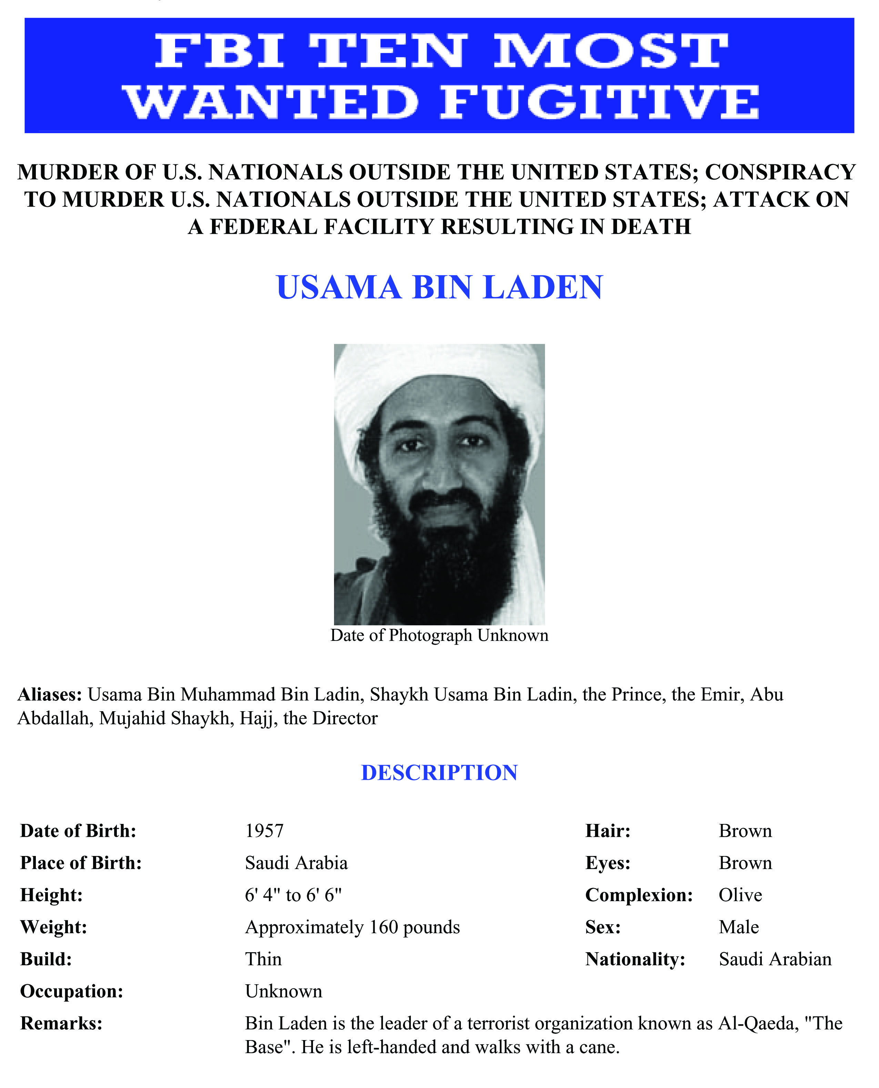
Directed by Osama bin Laden from a cave in Afghanistan.
“USAMA BIN LADEN IS WANTED IN CONNECTION WITH THE AUGUST 7, 1998, BOMBINGS OF THE UNITED STATES EMBASSIES IN DAR ES SALAAM, TANZANIA, AND NAIROBI, KENYA. THESE ATTACKS KILLED OVER 200 PEOPLE. IN ADDITION, BIN LADEN IS A SUSPECT IN OTHER TERRORIST ATTACKS THROUGHOUT THE WORLD.”
Notes:
On the FBI’s 10 Most Wanted Fugitives, you’ll see that even though OBL is listed as one of the 10 Most Wanted, (with ties to the US Embassy bombings in Africa back in 1998) there’s no mention of 9/11. Why?
Because according to FBI spokesman, Rex Tomb, “the FBI has no hard evidence connecting Osama bin Laden to 9/11.”
And yet the White House blames him for orchestrating 9/11. Don’t they believe the FBI?

Slide 13
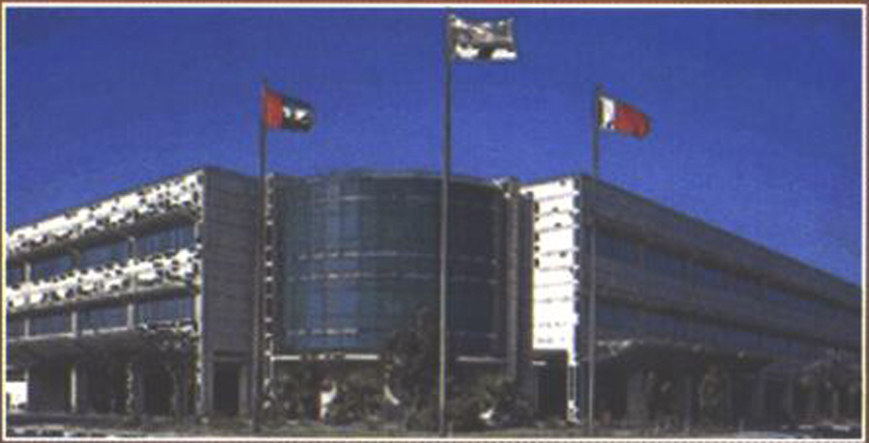
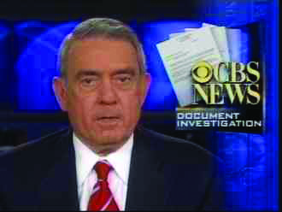
Le Figaro reported that bin Laden was receiving kidney dialysis at the American Hospital in Dubai in July of 2001. And that he was visited by the CIA Station Chief.
Dan Rather reported bin Laden was seen at a military hospital in Rawalpindi in Pakistan on September 10, 2001.
Notes:
OBL was reportedly receiving Kidney Dialysis at the American Hospital in Dubai in July 2001.
And again one day before 9/11 on (September 10) in Rawalpindi at a Pakistani hospital according to Dan Rather of CBS news.

Slide 14
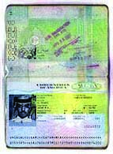
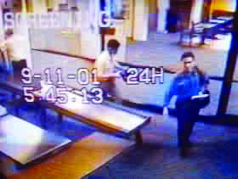
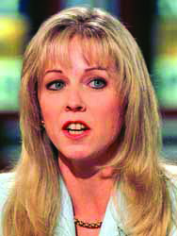
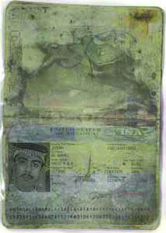
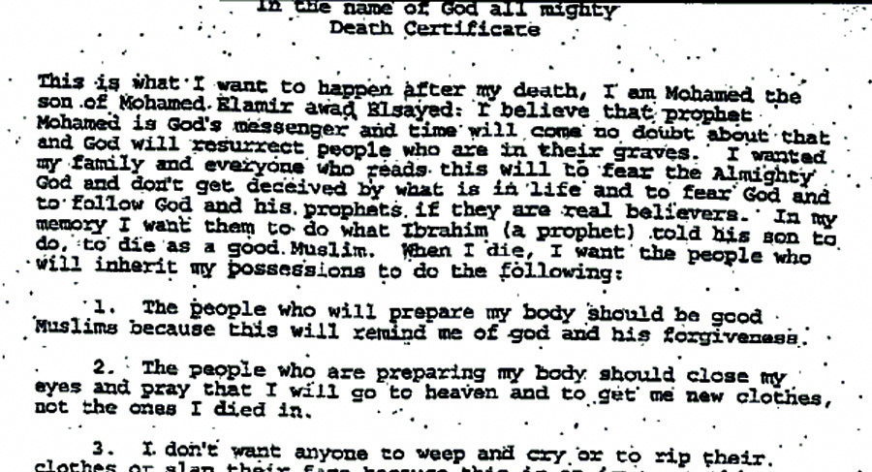
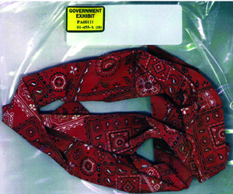
A
B
E
C
D
F
Notes:
What evidence has the US government provided to prove that 19 Arabs hijacked the 4 commercial passenger planes on 9/11?
A Passport found at Ground Zero – A video clip of Mohamed Atta and his buddy at a Portland (Maine) airport terminal – Atta’s will (and other incriminating evidence) found in Atta’s unloaded baggage – A passport and red bandana found at Shanksville’s crash site – Around 40 phone calls from the airliner’s including the famous one from Barbara Olson; and – A series of bin Laden “confession tapes” and “warnings of future attacks” after 9/11.
Dr. David Ray Griffin shows that all of this evidence was most likely fabricated. For example:

Slide 15
Osama Confession Video Tapes
The guy on the right is supposedly Osama bin Laden.
Notes:
OBL has been used as the poster boy for al Qaeda and warnings of future attacks and yet, if you examine the pictures and video messages of him of the so-called “confession tapes” taken after 9/11, it doesn’t even look like him.

Slide 16
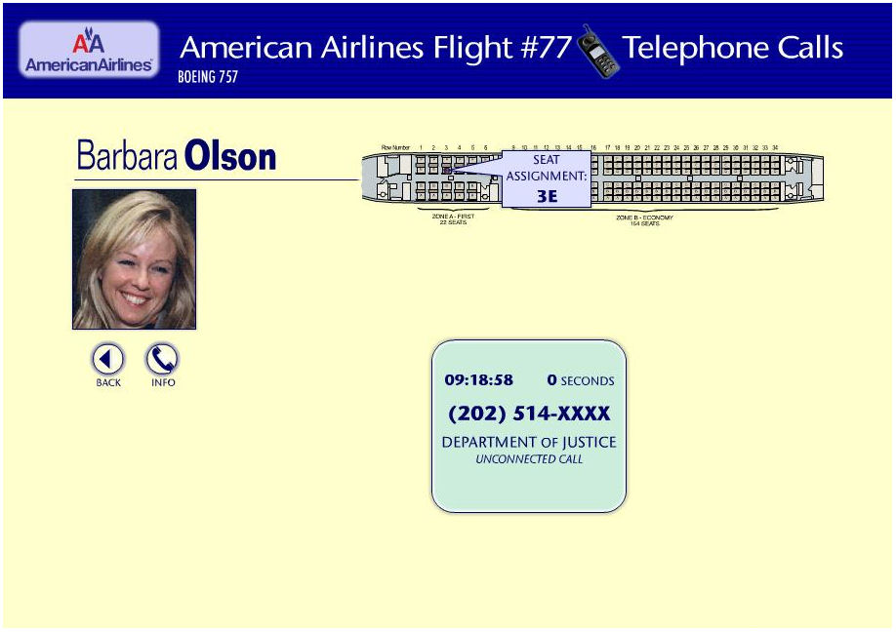
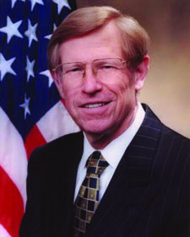
Ted Olsen said he received 2 one-minute phone calls from his wife Barbara. But the FBI say she only made one call
that lasted 0 seconds, i.e. it was disconnected.
.
Notes:
The only evidence that the government has supplied that the alleged hijackers used knives and boxcutters to hijack the planes is a mention of the word “boxcutters” supposedly by Barbara Olson to her husband Solicitor General Ted Olson during two alleged phone calls from Flight 77 as it approached the Pentagon.
However, according to the FBI, during the Zacarias Moussaoui trial, said she made only one phone call and it lasted for 0 seconds.

Slide 17
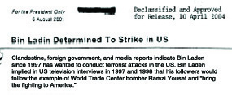
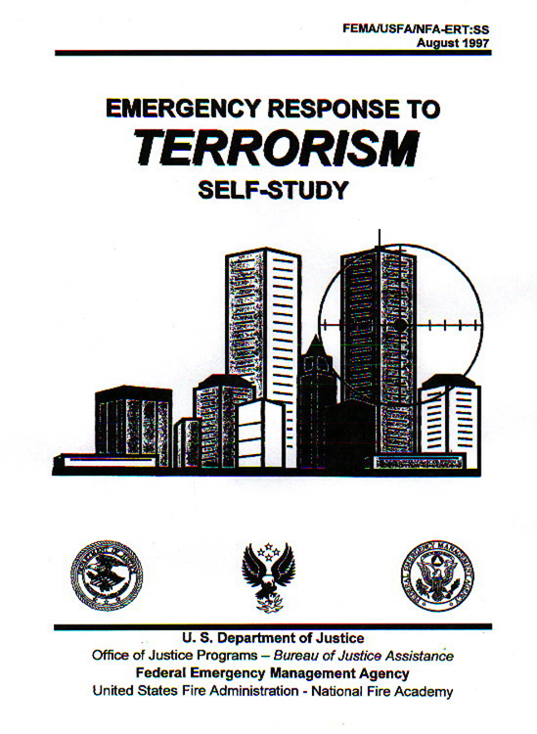
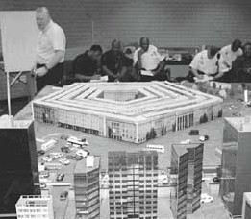
The hijackers took the NORAD completely by surprise,
Bush’s Presidential Daily Briefing – in July 2001
Operation Mascal (Scenario)
at the Pentagon – in Oct. 2000
FEMA Manual - 1997
Notes:
USA Today reported that in the two years before the attacks NORAD conducted exercises using hijacked airliners as weapons, and one target was the World Trade Center.
Here’s the cover of a FEMA Response Manual back in 1997. Operation Mascal simulated a plane crash into the Pentagon eleven months prior to 9/11 in October 2000. One of Bush’s Presidential Daily Briefings in July 2001 was entitiled: “Bin Laden Determined to Strike Inside USA.”

Slide 18
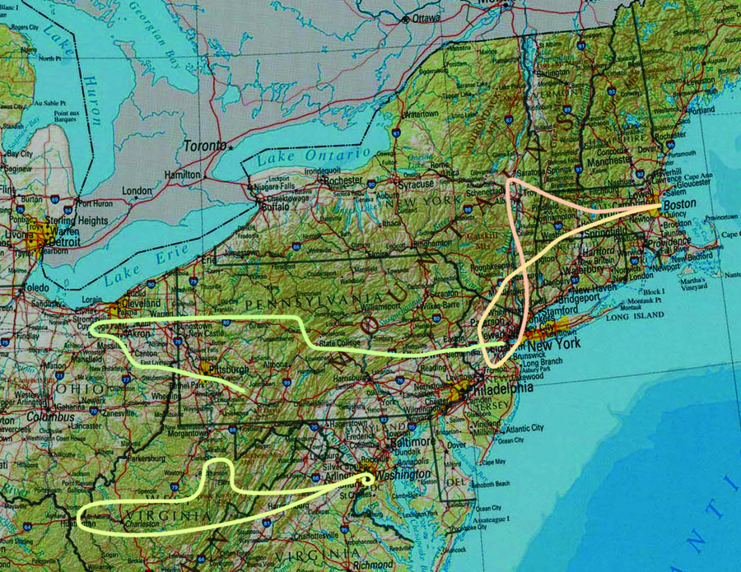
Flight Takeoff From Takeover Reported Crash Site Flt. time
AA11 7:59 Logan 8:20 8:38 8:46 WTC 1 00:47 min
UA175 8:14 Logan 8:42 8:43 9:03 WTC 2 00:49 min
AA77 8:20 Dulles 8:46 9:25 9:38 Pentagon 01:18 min
UA93 8:42 Newark 9:40 -- 10:06 Shanksville 01:24 min
The takeover column gives the times that the planes veered off course.
The reported column gives the times that the FAA notified NORAD.
Total time flights were being simultaneously ‘hijacked’: 1 hour 46 mins.
Source: Washington Post, 9/12/01; NORAD, 9/18/01
Flight 11
Flight 175
Flight 93
Flight 77
Notes:
They flew three of them into symbolic targets in New York and Washington with 100% precision.
The fourth plane which was allegedly hijacked was supposedly prevented from flying into an unknown target by a passenger revolt and as a result, crashed near Shanksville, Pennsylvania.
This was supposedly a result of massive intelligence failure on behalf of the FAA, NORAD, the CIA, the FBI, the NSA and the White House.
Well, that story has more holes in it than Swiss Cheese. Here are 26 major anomalies that undermine the official story.

Slide 19
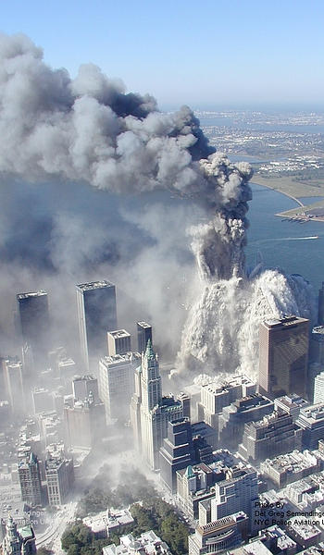
As a result, World Trade Towers 1 & 2 collapsed in a ‘pancake’ fashion due to structural failure caused by the crashing planes and ensuing fires.
Notes:
None of the four airliners transmitted the simple hijack code. (There’s a very, very simple code that you use if your plane is being hijacked. It takes literally just a split-second for you to flip it over.)
And the US government hasn’t shown us any passenger manifests from the four flights with any of the names of the hijackers on them.

Slide 20
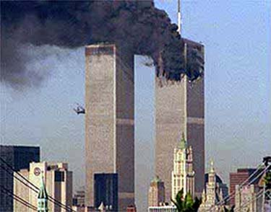
Fire has never before (or after 9/11) caused steel-framed hi-rises to completely collapse from crashing planes and/or extremely hot office fires. (Four examples are mentioned below:)
Notes:
Fire has never – prior to 9/11 – caused any steel framed building to collapse. The sudden vertical, explosive and total collapse of the Twin Towers at near free-fall speed can only be explained by controlled demolition.
There are many examples of highrises that have burned for hours and hours without totally collapsing.

Slide 21
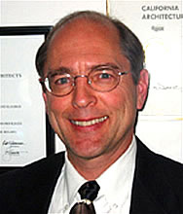
Architect Richard Gage, AIA has now signed up over 1,000 certified Architects and Engineers from around the world who strongly doubt the “official story.”
Their website: www.AE911Truth.org
Notes:
Architect Richard Gage AIA, has found over 1,000 qualified architects and engineers from around the world who agree that the Twin Towers could not have collapsed the way the government said they did.
“What mechanism is required to turn 90,000 tons of concrete into power the width of a human hair?” You can see more damning evidence at: www.AE911Truth.org.

Slide 22
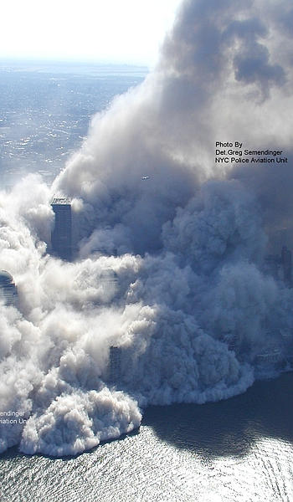
What caused 90,000 tons
of concrete to be transformed into dust the size of the width of a human hair and the consistency of talcum powder? Where were all the large chunks of concrete you would suspect would have resulted from a “pancake collapse”?
Notes:
Physicist Steven Jones has found traces of nano-thermite in dust samples of the WTC which indicate that military grade explosives were used to bring the towers down.
Willie Rodriguez testified to the 9/11 Commission that he hear an explosion go off in the basement just a few seconds before the first plane hit the first tower, but the 9/11 Commission didn’t report is testimony.
Cleanup workers reported molten metal running “like lava” deep below the WTC rubble for six weeks after the attacks.

Slide 23
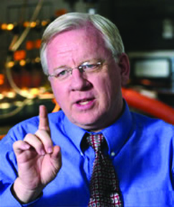
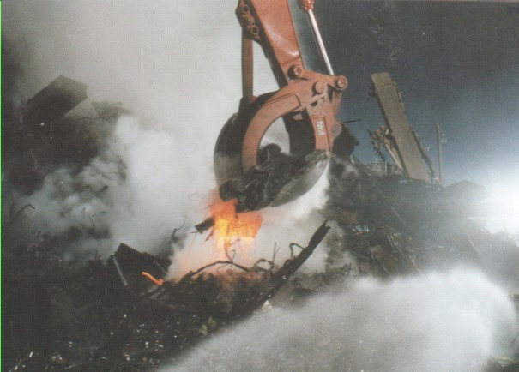
Dr. Steven Jones, Phd.
Molten metal being
pulled from the rubble weeks after the collapses.
Custodian Willie Rodriguez
Notes:
Physicist Steven Jones has found traces of nano-thermite in dust samples of the WTC which indicate that military grade explosives were used to bring the towers down.
Willie Rodriguez testified to the 9/11 Commission that he hear an explosion go off in the basement just a few seconds before the first plane hit the first tower, but the 9/11 Commission didn’t report is testimony.
Cleanup workers reported molten metal running “like lava” deep below the WTC rubble for six weeks after the attacks.

Slide 24
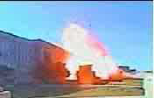
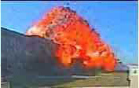
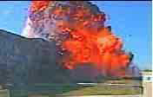
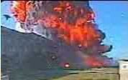
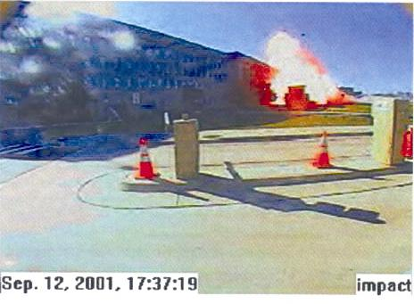
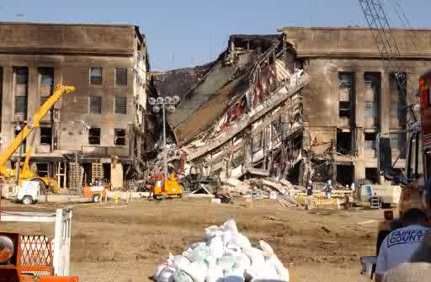
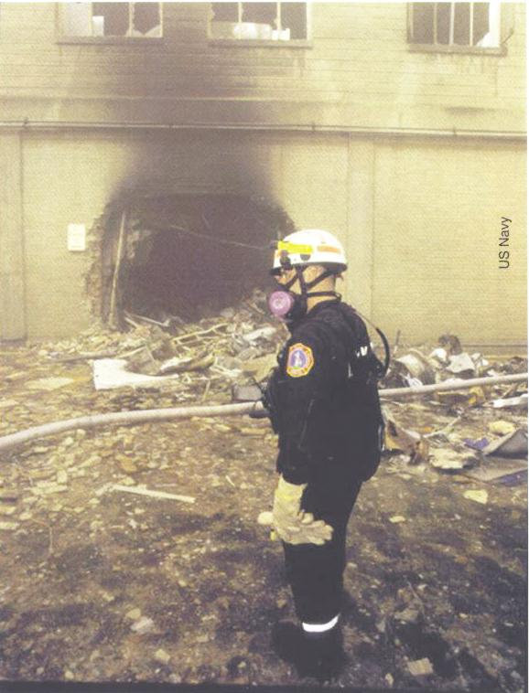
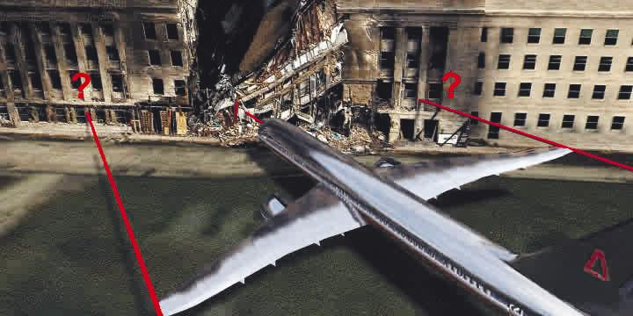
The 3rd Plane that hit the Pentagon, disappeared … into the building.
Notes:
There was incredibly little debris of a giant Boeing 757 aircraft found at the Pentagon crash site. There was no wing damage found on the facade of the building.
They never found the two huge six-ton engines made of virtually indestructible tempered steel and titanium belonging to Flight 77.
Allegedly the soft-nosed aircraft penetrated through 6 load bearing walls leaving a 6 foot diameter hole as evidence.

Slide 25
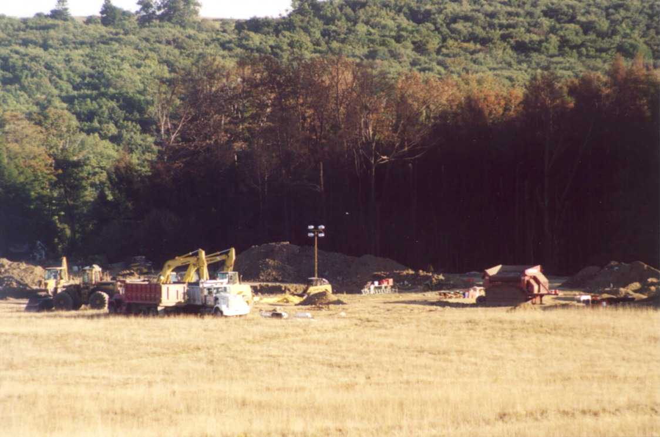
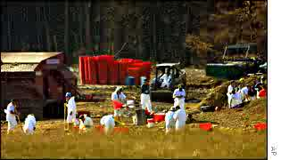
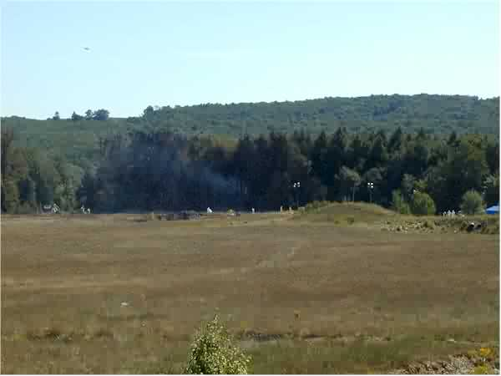
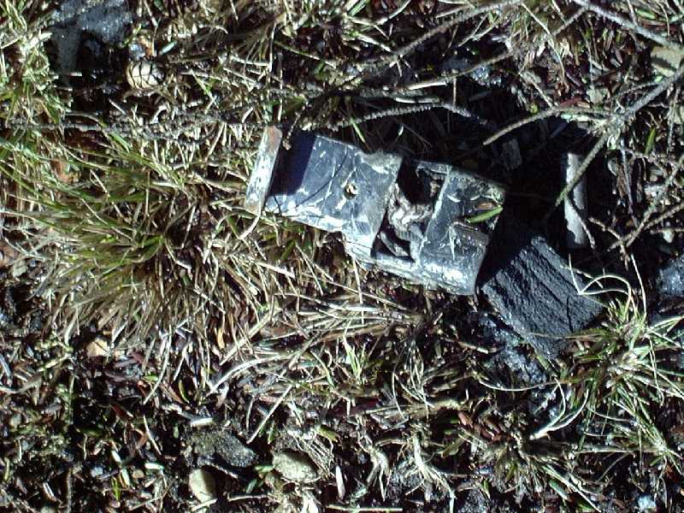
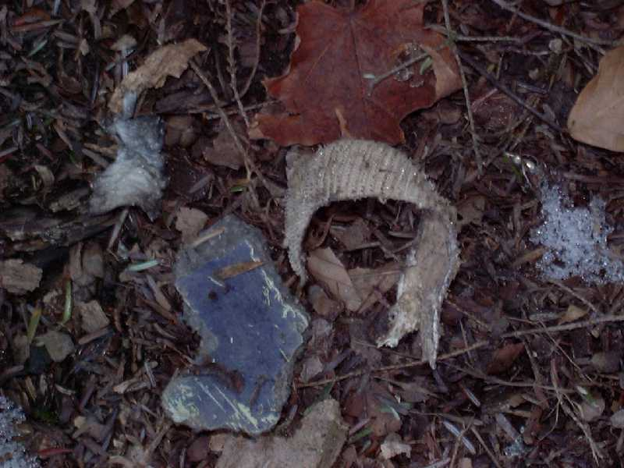
As did the 4th plane that crashed into a field near Shanksville, Pennsylvania, which disappeared into a field.
Small Pieces of Debris
Notes:
Similarly there was very little debris left of Flight 93 which allegedly crashed into a field near Shanksville. Debris however was fond scattered over a 5 to 8 mile swath.
The largest piece of debris found was the size of a telephone book. Residents in the area heard a loud explosion and saw a military jet pass overhead just prior to the crash.

Slide 26
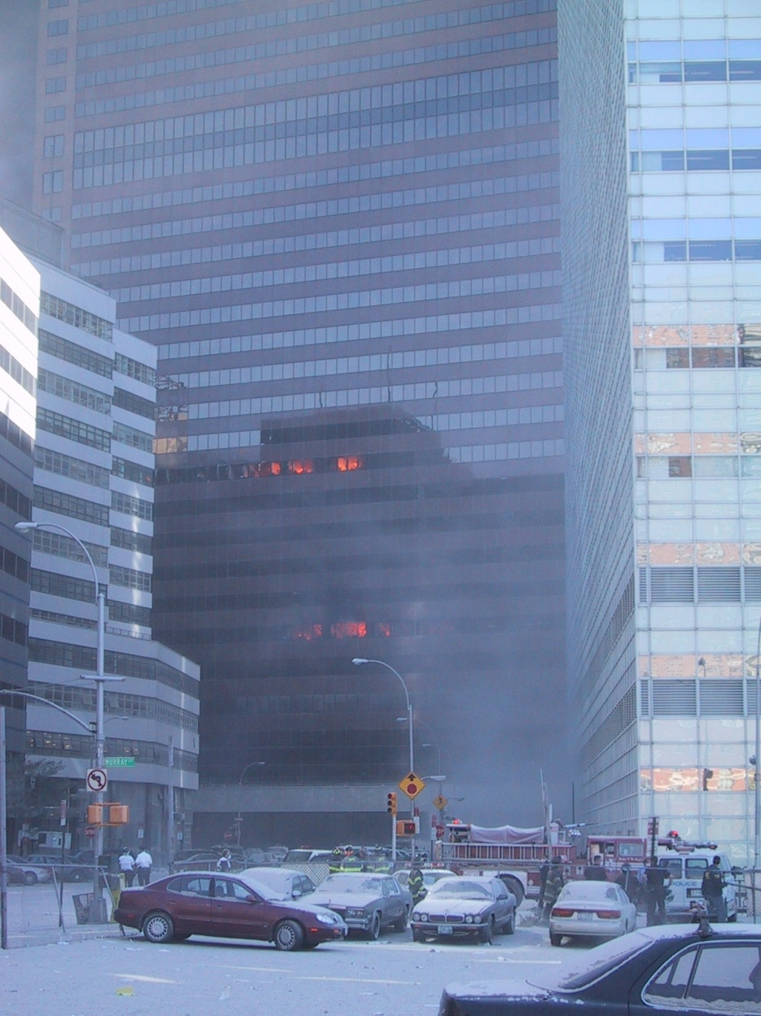
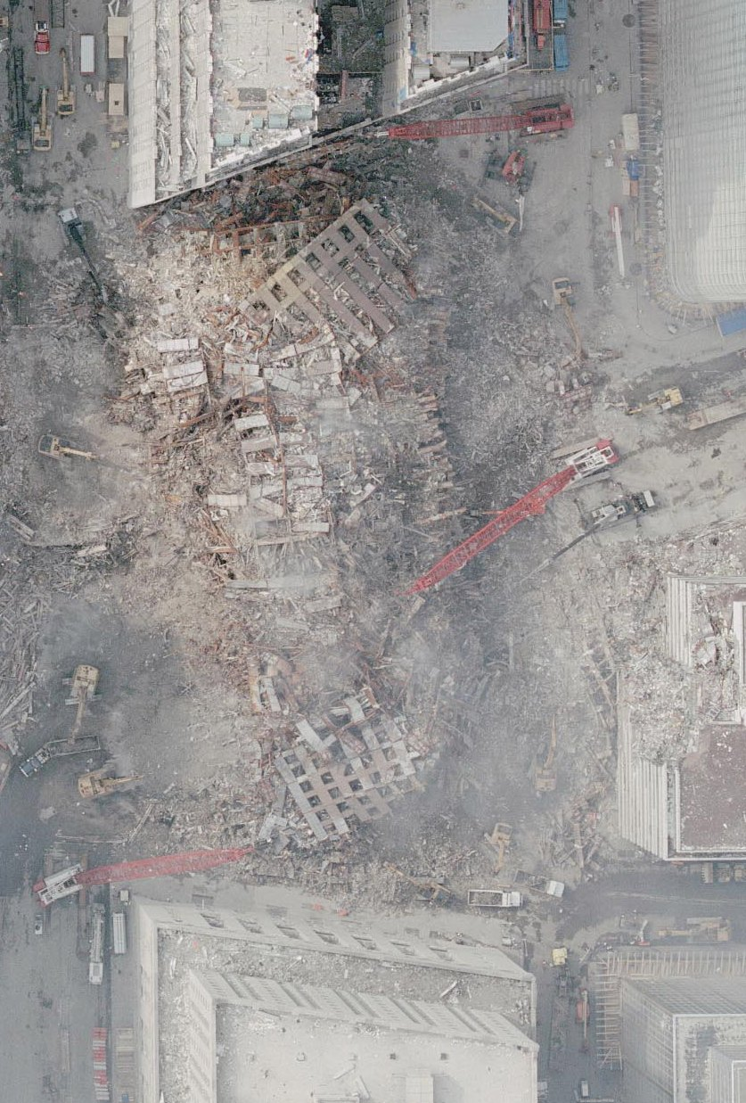
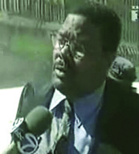
Later that day WTC Building 7 collapsed due to structural failure due to falling debris and ensuing fires.
Eyewitness Barry Jennings heard explosions.
Notes:
WTC Building 7 wasn’t hit by an airplane, and yet the 47-storey steel-framed skyscraper located 300 feet from the Twin Towers collapsed at 5:20 that afternoon.
It imploded at freefall speed into its own footprint just as you would expect a building to do that was brought down using controlled demolition, and yet NIST ‘s final report (which finally came out in Nov. 2008) blamed structural failure due to fires and debris damage from the Twin Towers.
Reports of multiple explosions by witnesses like Barry Jennings wee completely ignored.

Slide 27
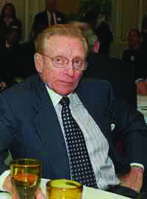
Larry Silverstein, Landlord and Owner of WTC Building 7
“I remember getting a call from the fire department commander, telling me that they were not sure that they were gonna be able to contain the fire, and I said, ‘You know, we’ve had such a terrible loss of life, maybe the smartest thing to do is ... pull it.’
And they made that decision to pull and then we watched the building collapse.”
Notes:
Larry Silverstein, the owner of the building, made an extraordinary statement on PBS TV during a documentary entitled “America Rebuilds” aired in 2004 which stated:
“There had been such a terrible loss of life ...

Slide 28
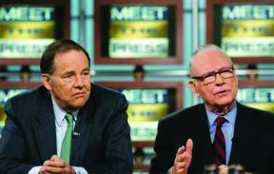
“The 9/11 Commission was set-up to fail.”
… at least according to the two chairmen of the 9/11 Commission: Thomas H. Kean and Lee H. Hamilton.
In their book: Without Precedent: The Inside Story of the 9/11 Commission
Notes:
Our sad history of bogus terrorism and endless wars of hegemony and resource theft will continue until the public demands a full investigation

Slide 29
The Jersey Girls – Four of the Many
Members of the Family Steering Committee
Notes:
The Jersey Girls

Slide 30
The 9/11 Commission found that …
Max Cleland
“It was a whitewash.”
Lee Hamilton
Thomas Kean
Notes:
The 9/11 Commission was “set up to fail” ... at least according to the two chairmen of the commission, Lee Hamilton and Thomas Kean. They admitted they’d been denied access to key witnesses.
Senior Counsel John Farmer admitted that the 9/11 Commission deliberately misled the public about the timeline to hide incompetence. Max Cleland one of the commissioners quit during the hearings saying the commission was a whitewash.
It is now known that NORAD, the FBI and the CIA all lied or obstructed justice at one time or another during the hearings.

Slide 31
There were no prior warnings?
Mayor Willie Brown
was warned not to fly.
John Ashcroft
was warned not to fly.
Notes:
There were warnings

Slide 32
Put options were placed, a
few days prior to the attacks, on United Airlines and American Airlines betting that their shares would drop in value on or after 9/11 … which obviously they did!
SO WHO PROFITED?!
Notes:
Unidentified insiders made millions

Slide 33
Notes:
Good Evening Everyone. Thank you George for your introduction. Thank you all the members of Citizen’s Inquest for putting on this event.
You could say for the last 6 months I’ve been fortunate to hit the trifecta. Since September of last year, I’ve been invited to conferences and meetings of 9/11 Truthers in three of the most famous cities in the world: New York, Paris and now London! The big three! Thanks for inviting me.
Here’s what I’m going to cover this evening:

Slide 34
And that multiple US government intelligence failures were to blame.
Coleen Rowley
Sibel Edmonds
Lt. Col. Anthony Shaffer
.
Michael J. Springmann
A Few 9/11
Whistleblowers
Robert Wright
Notes:
The evidence shows that these were deliberate failures:
Coleen Rowley’s attempt to get a search warrant for Zacharias Mousaoui’s laptop computer was blocked by Dave Frasca at the FBI just prior to 9/11. Had she been able to get that warrant she may have been able to prevent the so-called attacks. SHE WAS BLOCKED.
b. Sibel Edmonds – the most gagged woman in US history tried to testify before the 9/11 Commission about FBI message intercepts which revealed prior knowledge of 9/11 but wasn’t allowed to testify. SHE WAS GAGGED.
c. Michael J. Springmann - Tried to testify in front of the 9/11 Commission about the “Visas for Terrorists Program” which was being run by the CIA in Jeddah, in the years prior to 9/11. Known terrorists from Saudi Arabia and elsewhere were being admitted to the US courtesy of the CIA for some unknown reason. HE WAS IGNORED.
d. Lt. Col. Anthony Shaffer of the Pentagon testified that he and others were told to shut down their operation “Able Danger” which was tracking two of the three 9/11 terror cells (one led by Mohamed Atta) just prior to 9/11 by the Bush White House. Even though Shaffer met with Phillip Zelikow, the Executive Director of the 9/11 Commission three times prior to the release of the Commission’s report, their findings were entirely excluded from it.
e. Robert Wright of the FBI

Slide 35
Porter Goss, CIA
General Richard Meyers
Chairman,
Joint Chiefs of Staff
(Pentagon)
Jane Garvey, FAA
Robert Mueller, FBI
Notes:
Finally, if, as the official story goes, there was a massive intelligence failure on 9/11, then why were the following people promoted shortly afterwards, instead of being reprimanded?
Gen. Richard Myers, acting Joint Chiefs of Staff Chairman on 9/11,was promoted from Vice-Chairman to Chairman three days after 9/11.
ii. Rep. Porter Goss, Chairman of the House Permanent Select Committee on Intelligence, (and his buddy Senator Bob Graham) who met with the 9/11 Money Man, General Mahmoud Ahmad in Washington on 9/11, was appointed to be Director of the CIA by President Bush three years later.
iii. Jane Garvey, head of the FAA at the time of 9/11 was chosen by Presidential nominee John Kerry as an “expert” consultant in charge of security for the 2004 Democratic National Convention, three years later. (In spite of the all the security experts in the United States – which include former or active police chiefs, retired FBI and CIA operatives and private companies that spend 24/7/365 assessing threats.)
The only reprimands (that I know of) were aimed at 9/11 whistle-blowers inside the FBI, CIA and Pentagon such as Colleen Rowley, Sibel Edmonds, Tony Shaffer, Kenneth Williams and Robert Wright, all of whom tried to stop the plot by the 9/11 hijackers (or should I say ‘patsies’) prior to 9/11.

Slide 36
Bush being warned by Andy Card: “America is under attack!” Bush, America’s so-called Commander-in-Chief just sits there for another 7 or 8 minutes.
President Bush at Booker Elementary School in Sarasota Florida – 9:00 am on September 11, 2001.
Notes:
The White House took advantage of this so-called act of terrorism.
Just prior to 9/11 in September of 2000, a group of Neo-con hawks, many of who would become key officials in the Bush administration, wrote that their proposed massive military buildup would proceed slowly “absent some catastrophic and catalyzing event – like a new Pearl Harbor.”
The White House called it an “act of war” and immediately launched a pre-emptive attack on Afghanistan.

Slide 37
Meanwhile people are dying in the Twin Towers.
Notes:
The Taliban, who were ruling Afghanistan at the time, offered to hand over Osama bin Laden to the US after 9/11, provided that the White House provide evidence that he was linked to 9/11, which the US refused to do.
(Prior to invading Afghanistan, Secretary of State Colin Powell promised the UN that he would provide a White Paper with that evidence, but he never did.)

Slide 38
The Official Story of 9/11
19 Muslim / Arab fanatics
Who were funded and trained by al Qaeda
and directed by Osama bin Laden from cave in Afghanistan
Hijacked four Commercial jets with knives & box cutters on Sept. 11, 2001.
They took the North American Defense Command (NORAD) completely by surprise
Flying two of them into the Twin Towers
As a result, WTC 1&2 collapsed in a “pancake” fashion due to structural failure
The third plane that hit Pentagon and disappeared … into the building,
As did the fourth plane that crashed in a field near Shanksville, Pennsylvania
WTC Building 7 collapsed due to structural failure caused by falling debris and fires.
The 9/11 Commission found:
that there were no prior warnings for this “act of terrorism”
and that multiple US government intelligence failures were to blame.
Notes:
The Official Conspiracy Theory of 9/11: 19 Muslin / Arab fanatics, funded and trained by al Qaeda, directed by Osama bin Laden from a cave in Afghanistan, hijacked four commercial jets with knives and boxcutters and took the North American Defense System (NORAD) completely by surprise.
As a result, World Trade Towers 1 and 2 collapsed in a “pancake” fashion due to structural failure caused by the crashing planes and ensuing fires. The plane that hit the Pentagon vaporized upon impact, as did the plane that crashed near a field near Shanksville, Pennsylvania. Later that day, Building 7 collapsed due to structural failure even though it wasn’t hit by a plane.
The 9/11 Commission found that there were no prior warnings for this “Act of terrorism” and that multiple US government intelligence failures were to blame.

Slide 39
Professor David Ray Griffin
Author of 9 books on 9/11
“What is the truth about 9/11?
It is that the official account is false.”
Notes:
Back in 1999 or so ? Some Texan oil men told the Taliban during negotiations to build an oil pipeline through Afghanistan the oilmen are quoted as saying:
“We can either offer you a carpet of gold, or bury you in a carpet of bombs.” (Please CHECK QUOTE and DATE.)

Slide 40
Jesse Ventura
Former Governor of Minnesota,
Wrestler and Navy SEAL
Host of “Conspiracy Theory” a new TV series
on TruTV (available only in the US) did a special episode on 9/11 examined the “official story” and found it lacking.
Notes:
The Taliban, who were ruling Afghanistan at the time, offered to hand over Osama bin Laden to the US after 9/11, provided that the White House provide evidence that he was linked to 9/11, which the US refused to do.
(Prior to invading Afghanistan, Secretary of State Colin Powell promised the UN that he would provide a White Paper with that evidence, but he never did.)

Slide 41
Ten Similar Incidents from History
(Possible Precedents for 9/11)
Notes:
Once you see how easy it is for governments to start wars using false pretexts, you’ll realize how easy it has been for them to fool us into going to war using what is called “state-sponsored terrorism.”
Now back to our original question: Why is Understanding 9/11 Crucial to Our Future?
As George Santayana once said, “Those who cannot remember the past are doomed to repeat it.” And repeat it we are ... with devastating consequences.

Slide 42
What are false flag operations?
“Covert operations which are designed to deceive the public in such a way that the operations appear as though they are being carried out by other entities.”

Slide 43
1. The Mexican-American Border Incident – Leading to War and Expansionism (April 25, 1846)
General
Zachary Taylor
President
James Polk
Over 1,000,000 square miles would be added to the USA

Slide 44
2. The Sinking of the Maine – Precipitating the Spanish-American War (February 15, 1898)
“Remember the Maine! To hell with Spain!”

Slide 45
3. The Sinking of the Lusitania – Brings the US into World War I (May 7, 1915)
The Lusitania – A sitting duck in a sea of German submarines

Slide 46
4. The Reichstag Fire – Vaults Hitler into Power (1933)
German Parliament burns, signaling Hitler’s rise to power

Slide 47
5. The Gleiwitz Attack and the Invasion of Poland – Launching World War II (1939-1945)
A column of arrested Polish police officers, civilian public servants and other “enemies of the people”

Slide 48
6. Pearl Harbor and Japan’s So-Called ‘Sneak Attack’ on America – Resulting in the US Entry into World War II (Dec. 7,1941)
Photograph from a Japanese airplane of Pearl Harbor including Battleship Row at the beginning of the attack

Slide 49
7. Operation Gladio – Terrorism in Post WWII Europe – Conducted by NATO’s Secret Armies to Maintain Cold War Tension (1953-1990)
One of 200 wounded in the 1980 Bologna Train Station bombing
Terrorist Vincenzo Vinciguerra confesses

Slide 50
8. The Korean Border Provocation by the US – To Kick-Start the Korean War (June 1950)

Slide 51
9. ‘Operation Northwoods’ – A Plan by the Pentagon to Murder US Citizens and Justify the Invasion of Cuba (1962)
The ‘Operation Northwoods’ documents were declassified in 2001, much to the surprise of Congress and to the shame of the Pentagon

Slide 52
10. The Gulf of Tonkin Incident – Escalates the Vietnam War (1964)
Map of Vietnam showing the Gulf of Tonkin – where the USS Maddox was allegedly attacked

Slide 53
Why Understanding 9/11 is Crucial to Our Future
“Those who cannot remember the past
are doomed to repeat it.”
~ George Santayana
Notes:
Once you see how easy it is for governments to start wars using false pretexts, you’ll realize how easy it has been for them to fool us into going to war using what is called “state-sponsored terrorism.”
Now back to our original question: Why is Understanding 9/11 Crucial to Our Future?
As George Santayana once said, “Those who cannot remember the past are doomed to repeat it.” And repeat it we are ... with devastating consequences.

Slide 54
The Madrid Commuter Train Bombings – 3/11 Attempt to Re-elect a Right-Wing Government in Spain (March 11, 2004)
Locations of 3 of the 4 Madrid Train Bombings
Notes:
The Madrid Commuter Train Bombings of 3/11 – 2004 – 191 killed, 1,460 wounded – Used as an attempt to re-elect a right-wing (pro-Iraq War) government in Spain on March 14 which didn’t work.
Some of the anomalies included the fact that: two of the bombing suspects were police informants, another one was linked to the Spanish security service, and the bomb damage was inconsistent with backpack bombs which were allegedly used to blow up the trains.
They were most likely hidden under the train carriages. Shortly afterwards, all the suspects were conveniently killed in an apartment building shootout.

Slide 55
The London 7/7 Bombings – To Legitimize British Involvement in the Iraq War (July 7, 2005)
Carnage left by the fourth bomb in a bus in Tavistock Square, downtown London
Bruce Lait said metal floor was “pushed upwards” not downwards
Notes:
The London Public Transit Bombings of 7/7 – 2005 – 56 people killed and 700 injured – Used to legitimize British involvement in the Iraq War, put an end to the anti-globalization protests and terrorize the populace into accepting yet more draconian police state measures to maintain ‘security.’
Some of the anomalies included that fact that: The attack was timed right in the middle of the G8 summit at the Glenn Eagles Hotel in Scotland which was under siege by anti-globalization protestors who had been inspired by the Live 8 concerts to “Make Poverty History.”
The bombings cleared the front pages of the demand by the public for fairer trade rules for poor countries. For some strange reason, the four young Muslim men had bought return tickets and long-term car park tickets.
Two of them had pregnant wives. The damage from the three subway bombs indicated the explosions came from underneath the train carriage floors, not from backpacks placed on the floor. As with 9/11, terrorist attack simulations exercises were taking place at the exact same time, and the exact same locations as the real attacks. What a coincidence!

Slide 56
The Detroit Bound Underwear Bomber of Christmas Day – (2009)
Umar Abdul Mutallah –
The Underwear Bomber
His father
The ‘smartly-dressed’ Indian man
Notes:
Same pattern. Same outcome. And more recently, quite possibly: The Detroit Bound Underwear Bomber of Christmas Day – 2009
Some of the anomalies include the fact that: Umar Abdul Mutallab was able to board the plane in Amsterdam without a passport and without any baggage. According to attorney Kurt Haskell and his wife Lori, a well-dressed East Indian man made all the arrangements with the people at the check-in counter for Northwest Airlines Flight 253.
According to one military analyst, the 80 grams of explosives Mutallab had on him couldn’t have even blown up his own seat. His father, the head of a major bank, warned the CIA station chief in Nigeria just one month before the incident that his son was a risk, but they obviously did nothing to prevent him from flying even though he was on a Terror Watch List.
The same outfit which was in charge of Amsterdam’s Schiphol Airport that day – Verint – was in charge of security cameras at: the three airports allegedly used by the 9/11 hijackers, the London bus system during 7/7 bombings and Charles de Gaulle Airport on Dec. 22, 2001 when ‘shoe bomber’ Richard Reid boarded a plane in Paris.
Two of them had pregnant wives. The damage from the three subway bombs indicated the explosions came from underneath the train carriage floors, not from backpacks placed on the floor. As with 9/11, terrorist attack simulations exercises were taking place at the exact same time, and the exact same locations as the real attacks. What a coincidence!

Slide 57
Taking Mutallab off Flight 253
How did he get on without a passport?
Notes:
We have to learn to recognize the patterns of false flag operations so we can be prepared for the next one, and the next one, and the next one after that, until we know them so well, we, as members of the public at large, don’t get fooled again. Otherwise, it’s the same old drill: Problem, reaction, solution. National security problem: terrorism; public reaction: fear; government solution: more control over the public.
Instead it should be: State-sponsored terrorism: the problem; public reaction: disbelief; public solution: outing the criminal elements within the government who have created the problem in the first place.
False flag operations are a fact of life. They exist. They are a governments’ deadliest deceits. And they are responsible for most of the major wars throughout our history. A false flag fraud could, in fact, be used to spark another world war.
That is why it is imperative for us to be able to recognize the next false flag operation whenever and wherever it happens.

Slide 58
Marc Stinebaugh
Notes:
Now let’s turn our attention to the 2010 Olympics happening right now in B.C. Could that be the next big false flag operation which the power elites will use to manipulate us?
Consider the following facts compiled in an online essay entitled: “Could Vancouver 2010 be the next 9/11?” by Marc Stinebaugh:
In his opinion, the motive for an attack during the Olympics “would be the perfect way to bring in more police state measures and to more fully integrate the US and Canada into a functioning North American Union” or “to expand the ‘war on terror’ into more nations while blaming an attack on their scapegoat for everything, al Qaeda” or even “Iran” to give the US an excuse to “bomb bomb Iran.”

Slide 59
February 22 fits the pattern of double digits
9/11 in New York
3/11 in Madrid
6/6 RFK Assassinated
7/7 London bombings
2/22 is next Monday (Ski-Jumping Day)
3/ 3 is when Parliament resumes
Notes:
So we shouldn’t be surprised if we see something happen at the Olympics any time soon, especially on February 22nd as that is a number that would fit the pattern of doubled numbers that appears so frequently for false flag operations or assassinations: 9/11 in New York, 3/11 in Madrid, JFK was assassinated on 11/ 22, RFK on 6/6 , the London 7/7 Bombings, and coming soon February 22nd (2/22) or possibly March 3rd (3/3) in Vancouver .
If something does happen, how will we react?
Hopefully, by understanding how we have been deceived by our governments and media previously especially on 9/11. Then we’ll be prepared to dismiss the cover story dished out by the mainstream media and the government spokespersons.
As Bob McKeown host of “the fifth estate” program on 9/11 said last December, “The real importance of the fight over 9/11 Truth may have less to do with the past than it does with the future.”

Slide 60
Notes:
When will it ever end? Good question – especially when you begin to think that maybe the same people behind the terror attacks may be the arms dealers, the war profiteers, or power hungry politicians. In short, the military-industrial-complex – which owns the Mainstream Media and the politicians in Congress.
All these nasty outcomes will never end – until we reveal the truth and lies hidden behind the “official story” of 9/11.
Because those who stand to benefit have too much to lose.

Slide 61
Why not pull out of Vietnam?
“I have too many friends
who are profiting from it.”
President
Lyndon B. Johnson
Notes:
President Johnson was once asked by a senior military officer why he didn’t order all of the US troops out of Vietnam when it was clear it was unwinnable. LBJ replied: “Because I have too many friends that are profiting from it.”
So if you want to see an end to all the nasty outcomes of 9/11, you’d better take a serious interest in understanding 9/11 – it’s the biggest deception in modern times
We can't expect different results, if we keep accepting this one big lie. If you don’t think it’s a lie, let me try and prove it to you.

Slide 62
Nasty outcomes of
the “war on terror”
Notes:
It is the casus belli for the “war on terror” and all its consequences:
All the killings and mayhem in Afghanistan and Iraq All the atrocities we’ve heard about at Abu Ghraib and Guantanamo Bay Enemy Combatants who are denied their rights (like Habeus Corpus) Renditioning of innocent people such as Mahar Arar Ongoing use of torture: Waterboarding, Frequent Flyer Programs Secret No-Fly lists, Terror Watch lists, Full body scans Continual Erosion of our civil liberties: the Patriot Act Increased Public surveillance, Homeland Security More and more doublespeak: Colleteral Damage = Civilian Casualties, War = Peace That we will have to give up more of our freedoms for more security More incidents of “terrorism”, More announcements from Osama Endless Wars that “won’t end in our lifetimes.”

Slide 63
Notes:
President Johnson was once asked by a senior military officer why he didn’t order all of the US troops out of Vietnam when it was clear it was unwinnable. LBJ replied: “Because I have too many friends that are profiting from it.”
So if you want to see an end to all the nasty outcomes of 9/11, you’d better take a serious interest in understanding 9/11 – it’s the biggest deception in modern times
We can't expect different results, if we keep accepting this one big lie. If you don’t think it’s a lie, let me try and prove it to you.

Slide 64
There is no peace without justice. There will be no justice without the truth.
Notes:
So I ask you, “How can we expect different results, if we keep accepting the same lies?” We can’t!
But there’s one chink in their armor. A smart peaceful way to pull the curtain back on it all –
For all of us to support a new, completely independent inquiry into 9/11 ... to get at the real truth.
If we get that, then maybe we’ll see some real justice in this world!
Remember there is no peace without justice.
And, there is no justice without truth.

Slide 65
BUSH LIES PEOPLE DIE
The Invasion of Iraq in 2003 was based on a lie: WMDs
Over 4,700 members of coalition forces have been killed so far plus tens of thousands of Iraqis.
Notes:
Example One: the Invasion of Iraq in 2003 was based on a lie: WMDs
As a result, over 4,700 members of coalition forces have been killed so far in the process

Slide 66
EPA’s Christy Todd Whitman told us that the “air was safe to breath.”
BUSH LIES PEOPLE DIE
Many of the 40,000 rescue and clean-up workers are sick, thousands will die as a result.
Notes:
Example Two: the EPA’s Christy Todd Whitman told us that “the air was safe to breath.” in Lower Manhattan just a couple days after 9/11, even though it wasn’t. They were told by the Bush White House so Wall Street could get back to business.
As a result, many of the 40,000 rescue and clean-up workers are sick and several have died as a result.

Slide 67
Examples of historically proven conspiracies
MLK’s Assassination by the US Government
The secret expansion of the war in Vietnam
Watergate
Iran/Contra
Notes:
Just because 9/11 is called a “conspiracy theory” doesn’t mean it’s true. Here are some examples of historically proven conspiracies:
The Plot to Kill Julius Caesar by some Roman Senators in 44 B.C. The Mafia in Italy from 1865 onwards The Dreyfus Affair exposed by Emil Zola in France in 1894 The Business Plot to overthrow FDR in the US in 1933 Operation Paperclip to move top scientists out of Nazi Germany in 1945 MK-ULTRA mind control experiments in Canada and the US from 1953 to the 1960’s The Pentagon Papers leaked the secret US expansion of the war in Vietnam in 1971 The Watergate Burglary and Nixon cover-up in Washington in 1972 Iran-Contra Affair – the sale of arms to Iran to fund Nicaraguan contras in 1986 The Conspiracy by the US government to Assassinate Martin Luther King Jr. in 1999 (See: “An Act of State” by William Pepper. The Enron manipulation of the electricity market in California in 2000 and 2001.
All good examples of conspiracies that turned out to be true.

Slide 68
Notes:
If they lied to us about two fairly significant post 9/11 events, isn’t it possible that the Bush administration may have lied to us about what happened on 9/11 itself?
And with what consequences?

Slide 69
This PowerPoint presentation was brought to you by
Global Outlook™
For more information visit: www.GlobalOutlook.ca
Copyright © 2010
Notes:
As you can see all the evidence points to one truth, as David Ray Griffin says: ... that “the official story is a lie.”
If so, we, as a group of ‘civilized’ nations have accepted this lie which has deceptively launched us all, whether we like it or not, into what they call: “the war on terror” with all its deadly outcomes and nasty consequences.
9/11 was not the first false flag operation used in history to deceptively trigger a war or cause an assassination.

