Slide 1


Indoor Air Quality Control
TARemediation LLC
Mold Remediation
& Consultation
Website

Slide 2
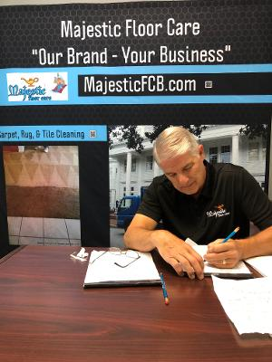
30 years experience in water damage and mold clean-up
Council certified residential mold inspector “CRMI”, Charlotte, NC –May 2006
Certified mold remediation specialist; EM Environ-Mold; 2002 Nevada
Member Indoor Air Quality Association; “IAQA” Rockville, MD
Advanced Upholstery & Drapery course, IICRC/Clean Care, Jeff Bishop; Dothan, AL
Former Board Member American Indoor Air Quality; “CRMI” Board Glendale, AZ
IICRC Certified firm (Institute of Cleaning & Restoration) Vancouver, Washington
Strategies for Conduction Meaningful Microbial IAQ Investigations, American Indoor Air Quality Council
Burt Sappenfield
TARemediation LLC
(706) 910-3198

Slide 3
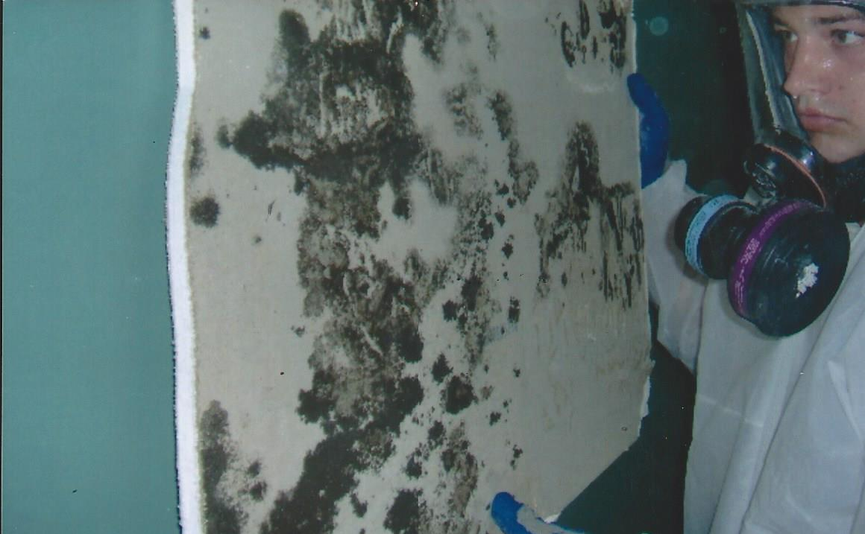
MOLD DAMAGE
The homeowner at this home smelled a foul odor shortly after they purchased this home. Two months after purchasing this home he suffered headaches and sinus issues.
This is the back side of the painted sheetrock after it was removed under containment with the proper safety protocols in place.
There was no visible damage on the outside of the walls. A mold test revealed there were high levels of mold in the home, it was not visible until the sheetrock was removed.
Skidaway Island, GA

Slide 4
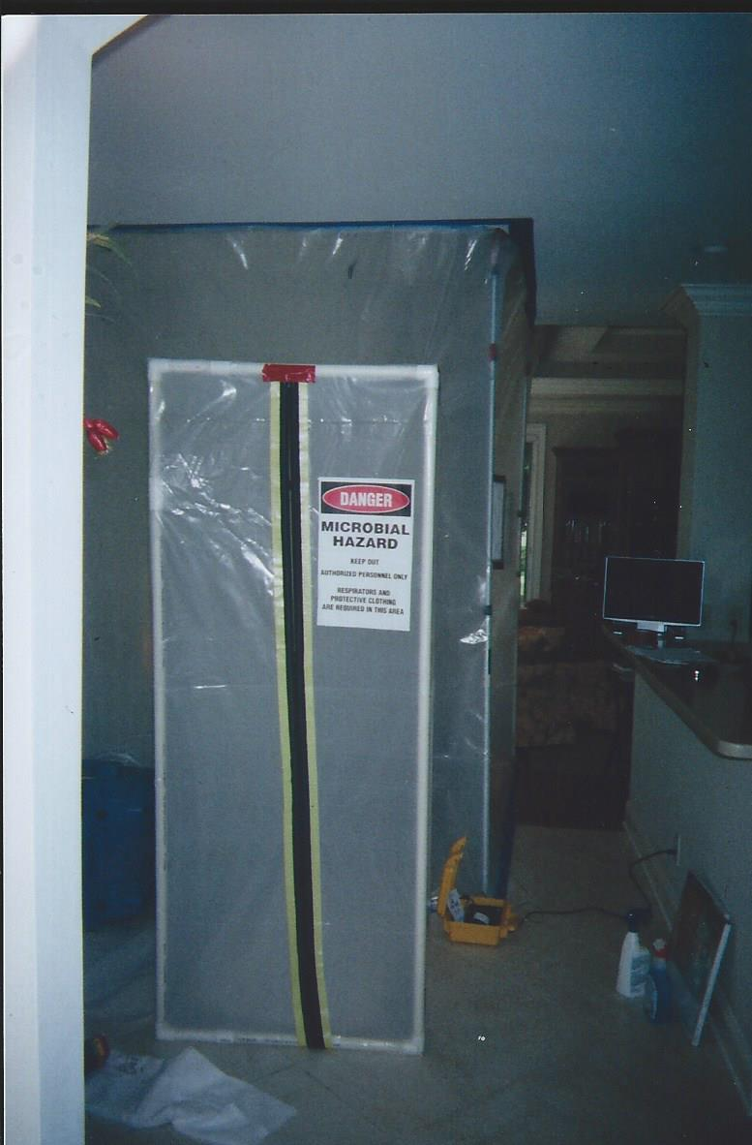
CONTAINMENT
This is an example of a clean room outside of the primary containment room.
Charlotte, NC

Slide 5
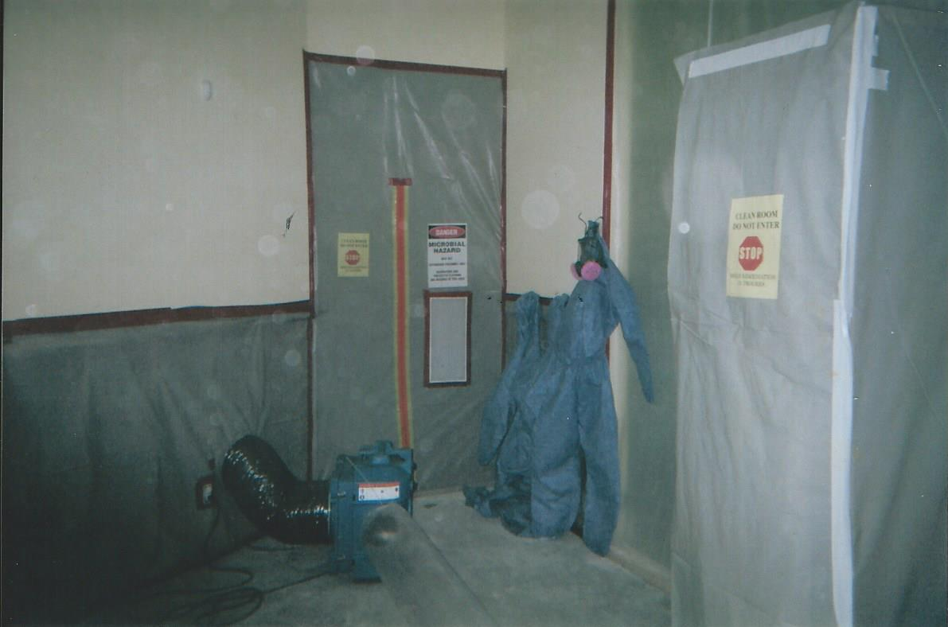
CONTAINMENT
Typical site when entering a proper containment room. This job was set up with a clean/dirty room with the proper safety equipment and documentation.
Hilton Head, SC

Slide 6
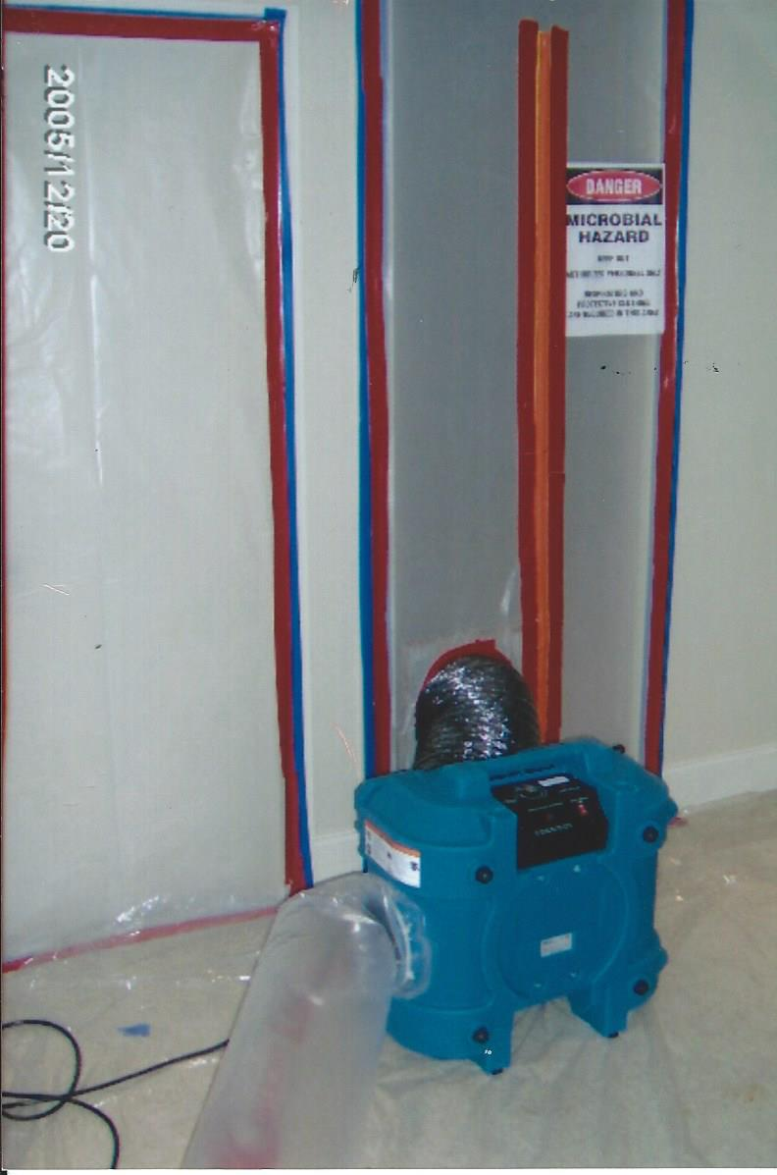
CONTAINMENT AND HEPA AIR SCRUBBRES
This is a Hepa Negative Air Machine that we attached to a containment room to clean the air and remove mold spores.
Louisville, Kentucky

Slide 7
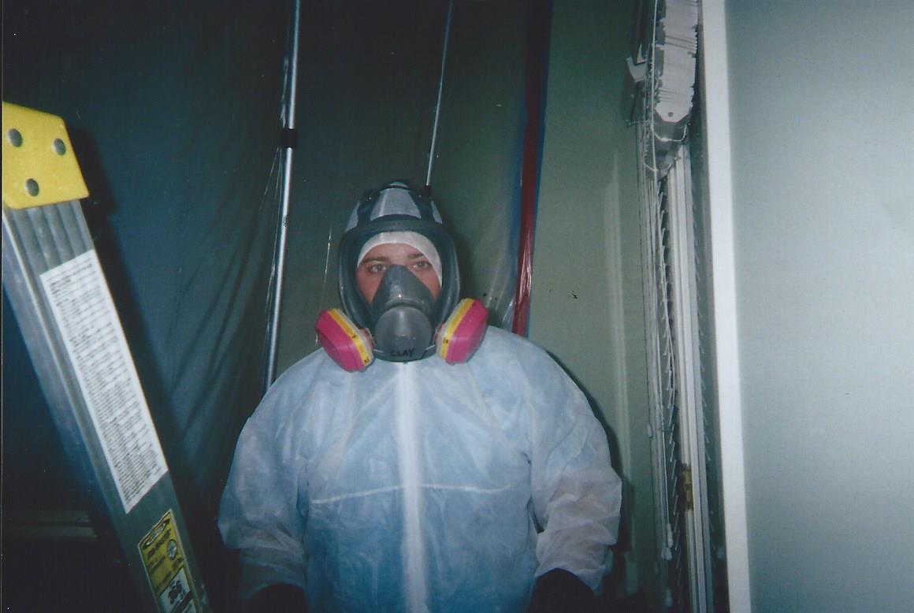
SAFETY EQUIPMENT AND PROTOCOLS
This is a mold remediation worker before going inside our containment room.
Anyone entering our containment rooms must meet all our safety requirements and follow all safety protocols.

Slide 8
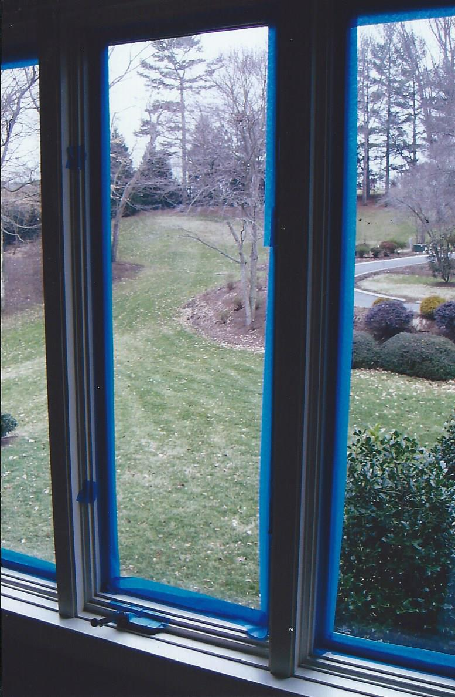
CONTAINMENT
This is inside one of our containment rooms. We taped the windows shut to prevent un-wanted outside air from affecting in inside air mold test.
Hickory, NC

Slide 9
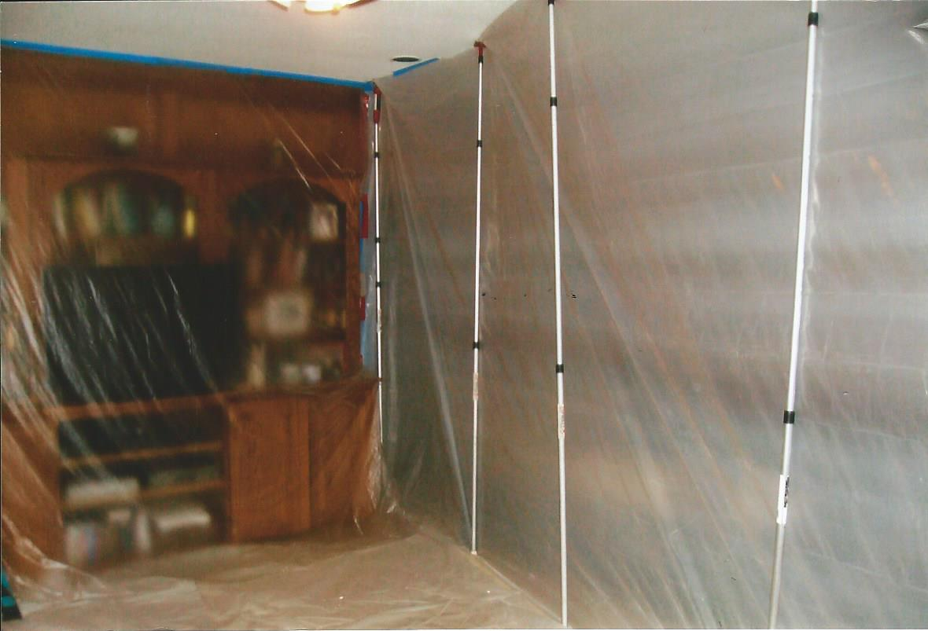
PROTECTION FROM DUST AND SPORES
This is outside one of our containment rooms. We protected the homeowners' personal items and electronics from dust and debris by sealing them off with plastic.
Fayetteville, GA

Slide 10
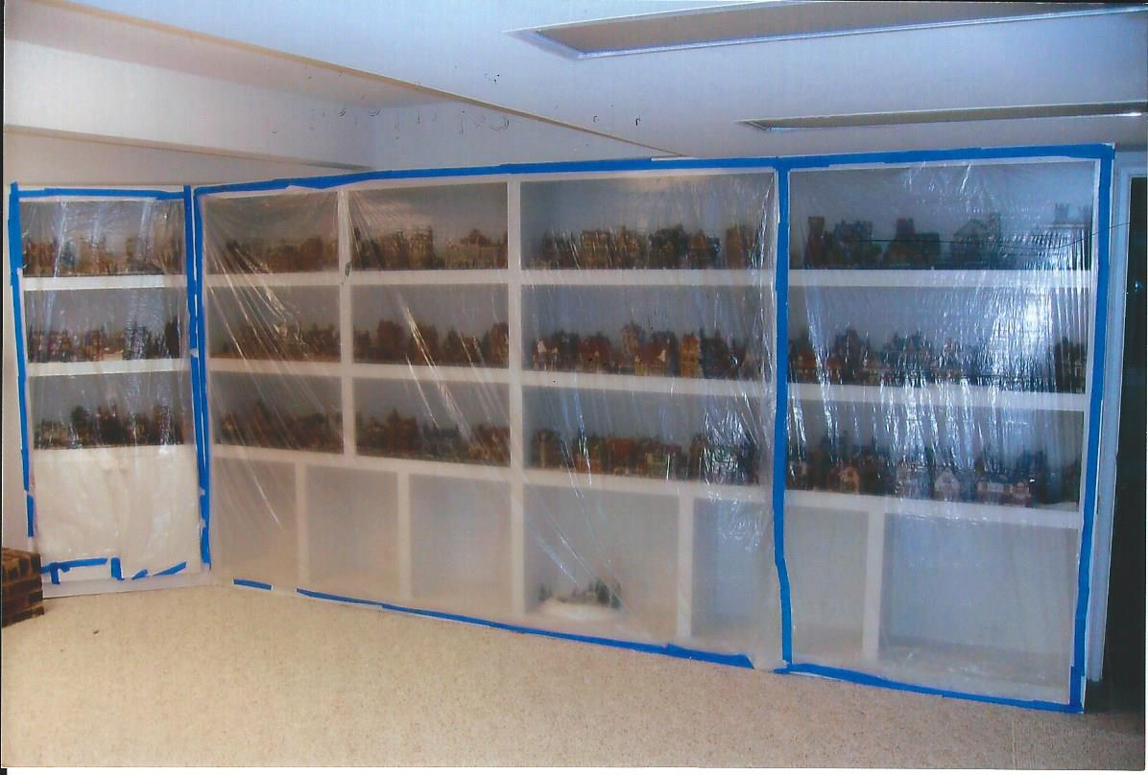
PROTECTION FROM DUST AND SPORES
All personal items on a customer's bookcase was covered to prevent mold spores, dust, and debris contamination.
Atlanta, GA

Slide 11
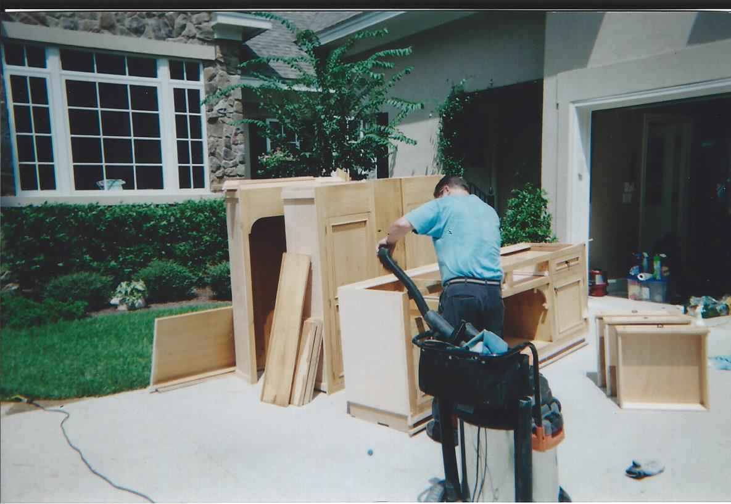
HEPA VACUUMING AND HAND WIPING
We hepa-vacuumed and hand cleaned all the kitchen cabinets after they were removed from the house on a water damage/remediation job.
Hilton Head Island, SC

Slide 12
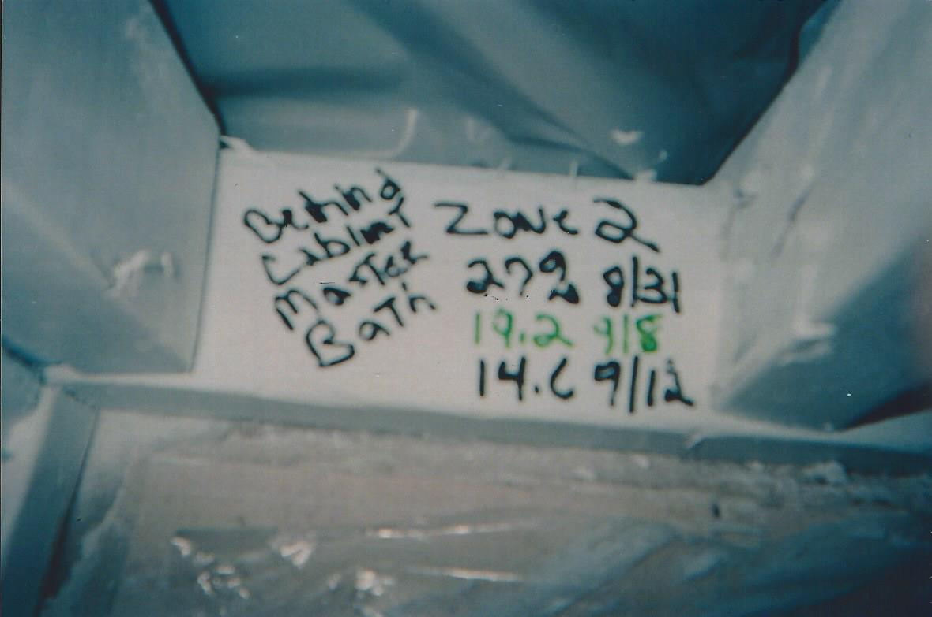
WATER DAMAGE DRYING ZONES
This is a drying zone in one of our water damage jobs. On one of the 2x4 walls behind the bathroom cabinets we recorded each date and the moisture percentage readings in that area.
Each area is marked with its Zone # and the progression of lower moisture which should be mandatory on every water damage job.

Slide 13
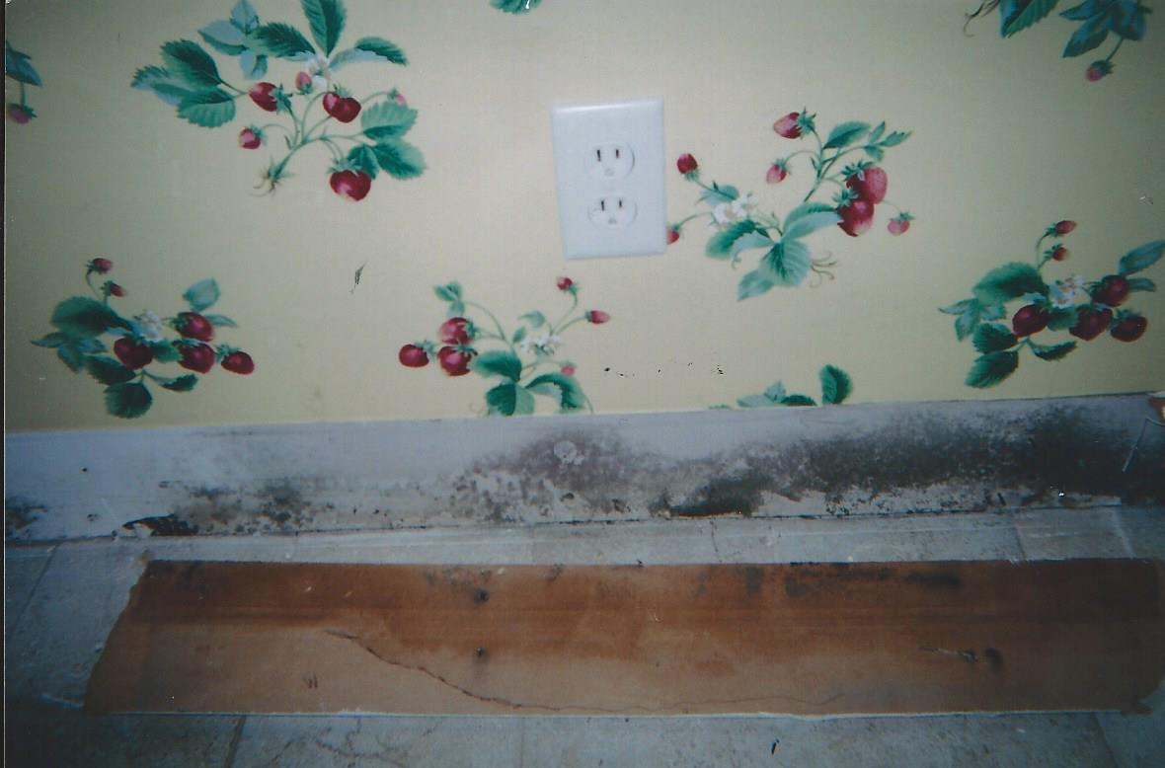
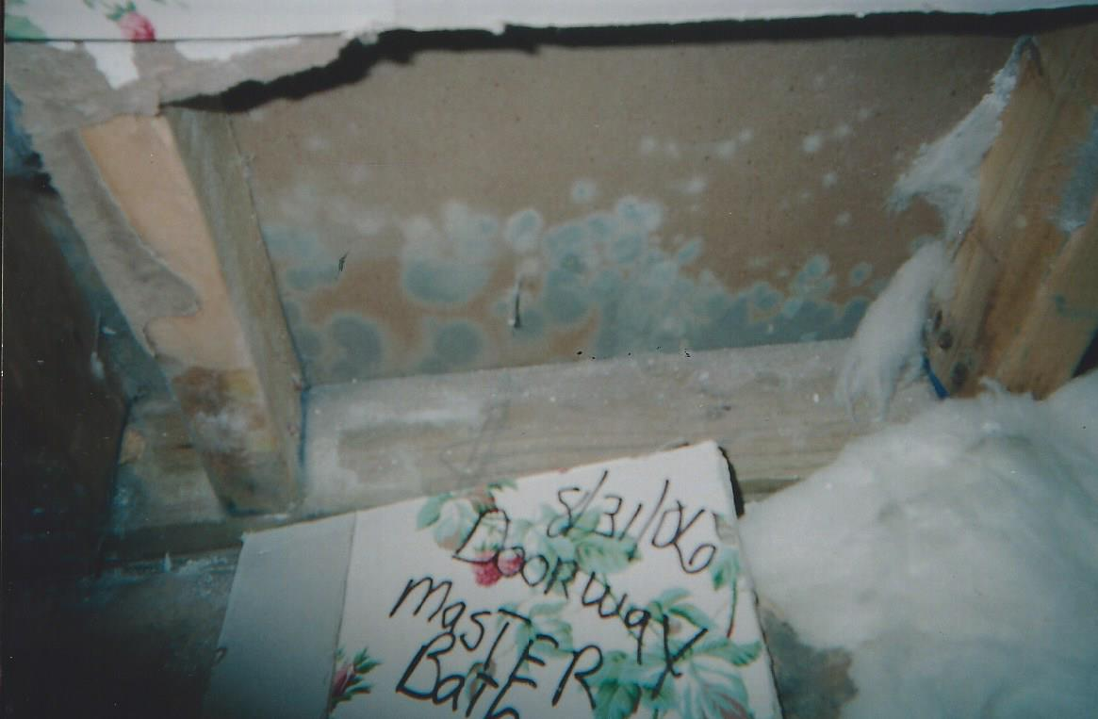
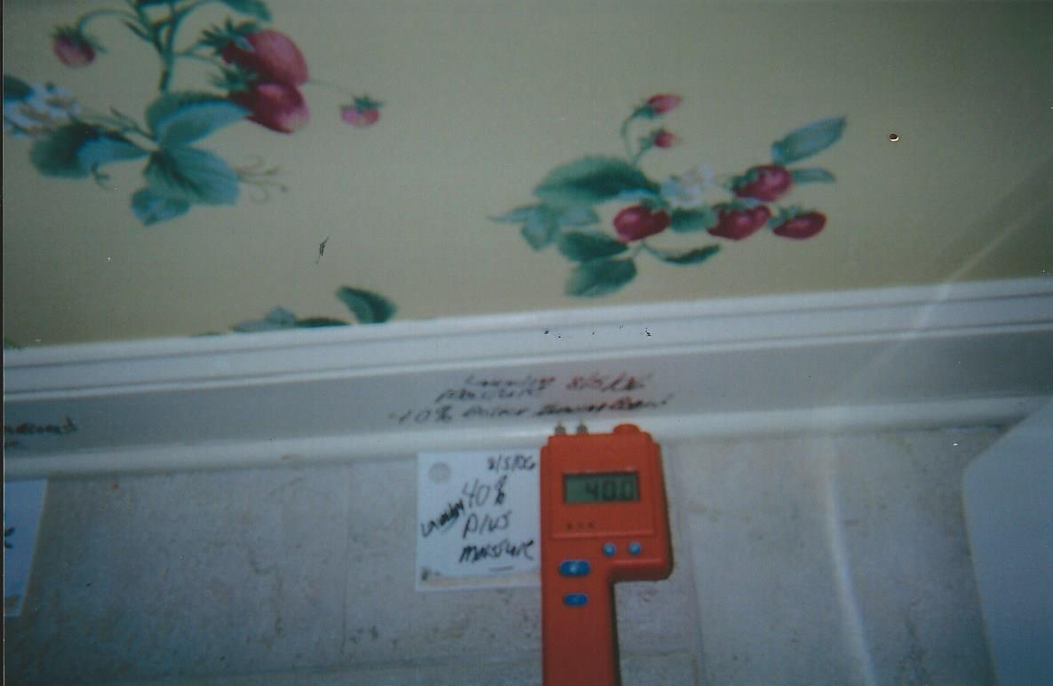
MOLD AND MOISTURE
The wall appeared normal except for the 40% moisture reading in the baseboard. After removal of the baseboard and the sheetrock, the mold was visible.
Hilton Head, SC

Slide 14
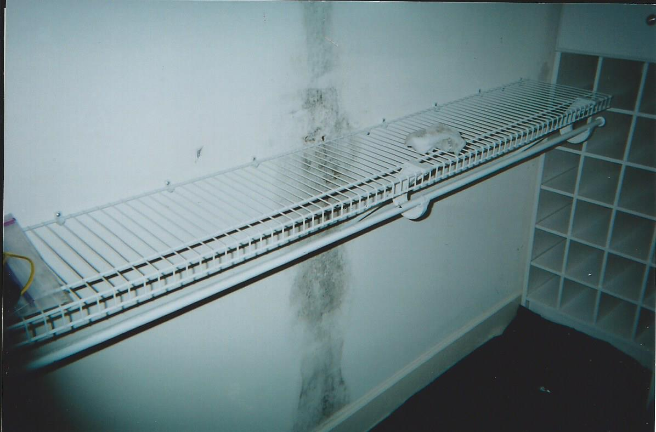
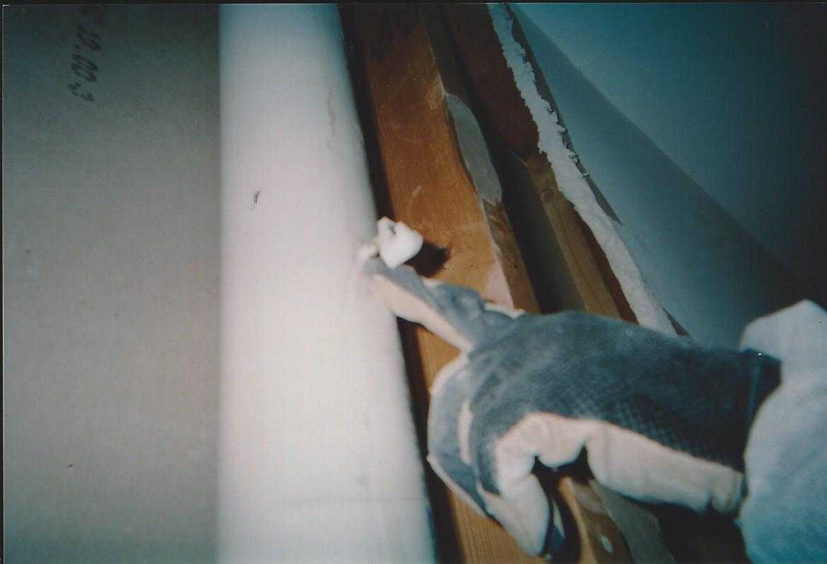
CAUSES OF WATER/MOLD DAMAGE
Mold was found on a sheetrock wall in a closet.
We removed the sheetrock under containment and negative air and found that a screw holding the shelving had gone through the sewer drainpipe.
This small hole caused a water leak from the drain behind the wall, this was the cause of the visible mold.
Skidaway Island, GA

Slide 15
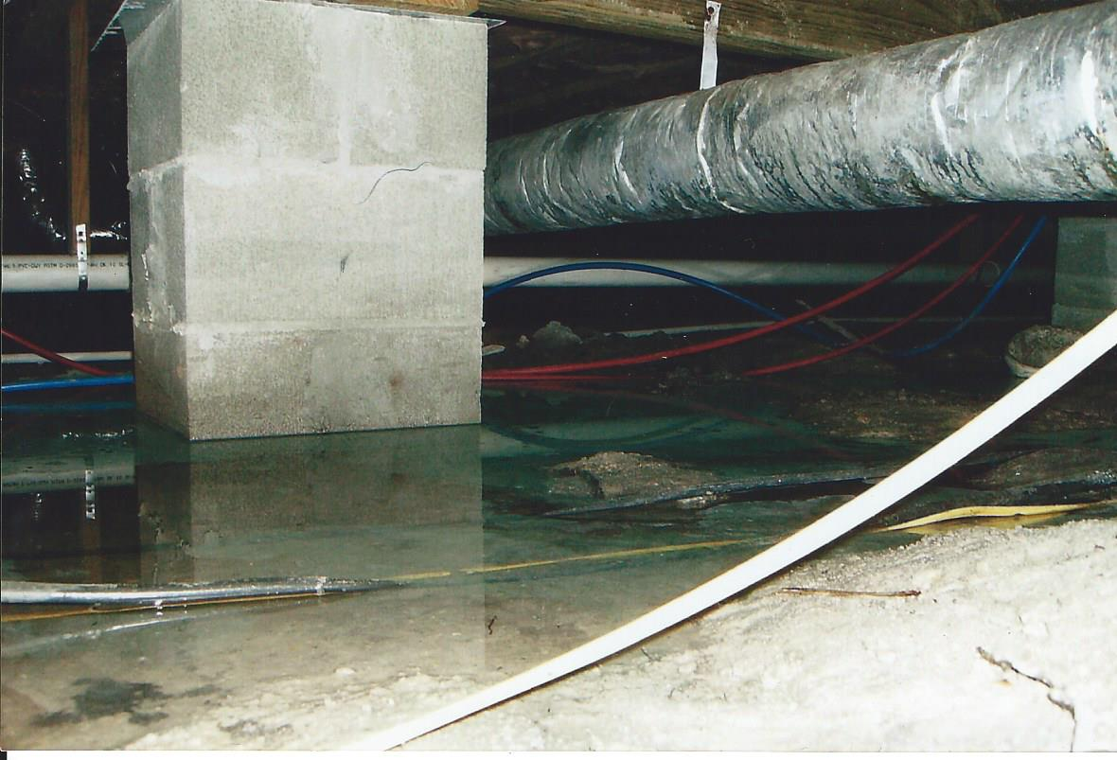
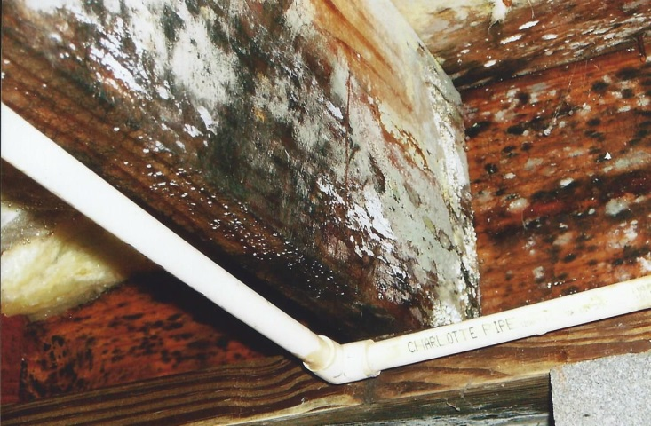
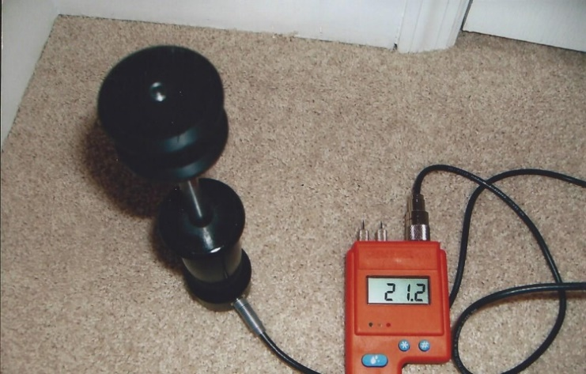
CAUSES OF WATER/MOLD DAMAGE
Initial moisture test under carpet was 21% and should be 6% – 8%.
When we inspected the sub floor in the crawl space we saw that the wood was covered in mold.
The cause of the moisture was improper landscape drainage which caused water to enter the crawl space and create a moist environment for the sub floor wood.
The result of the water in the crawl space was a high moisture reading in the sub floor wood and under the carpet.
Jesup, GA

Slide 16
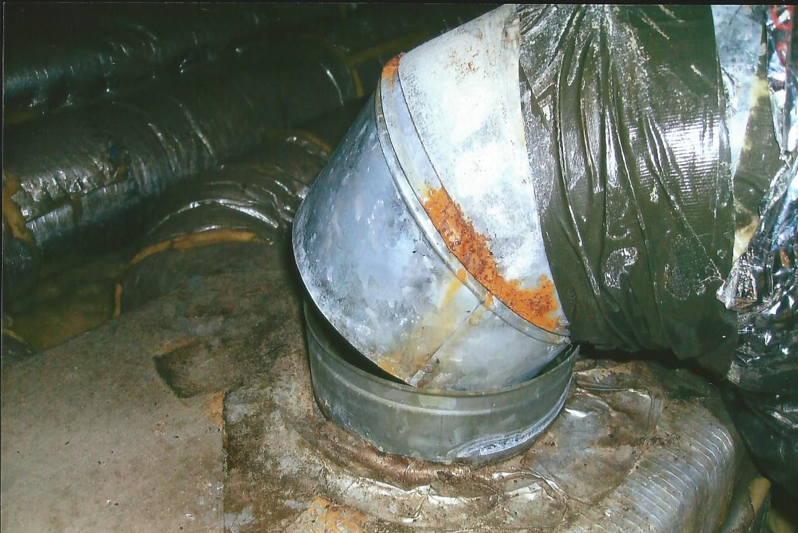
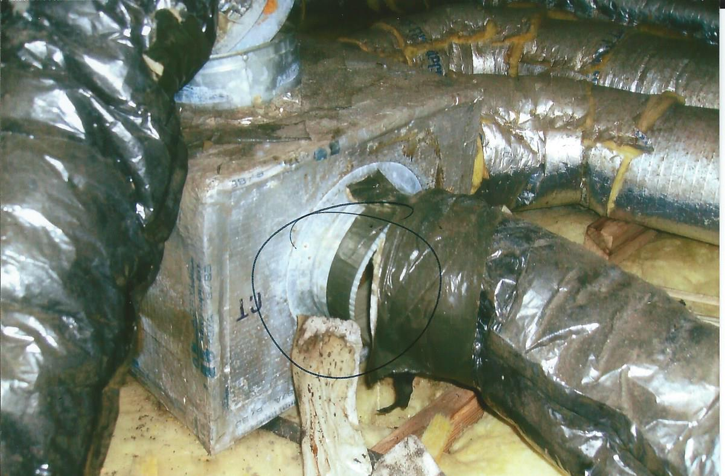
CAUSES OF WATER/MOLD DAMAGE
Some mold jobs are the result of improperly sealed air duct systems.
Cobb County, GA

Slide 17
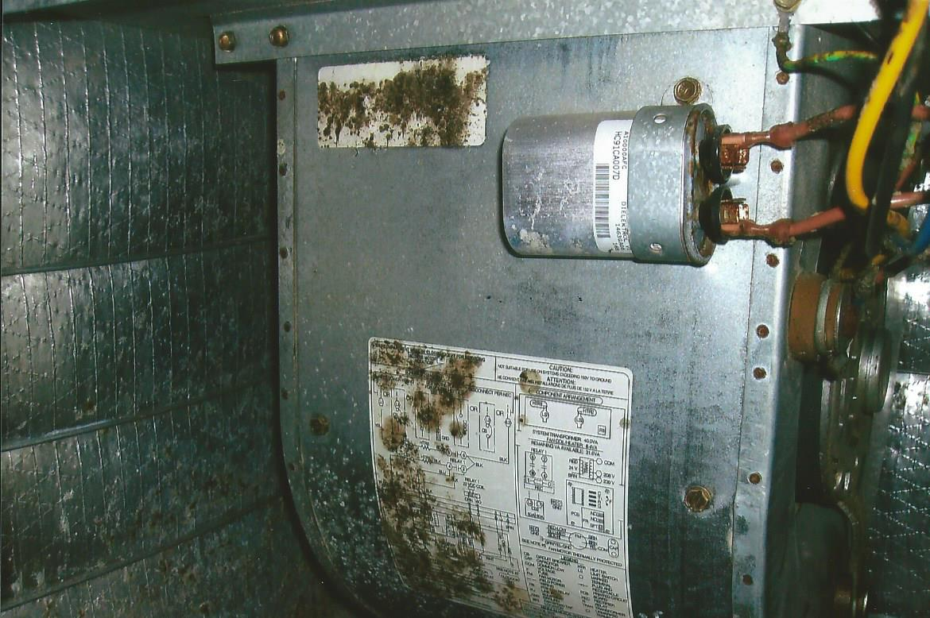
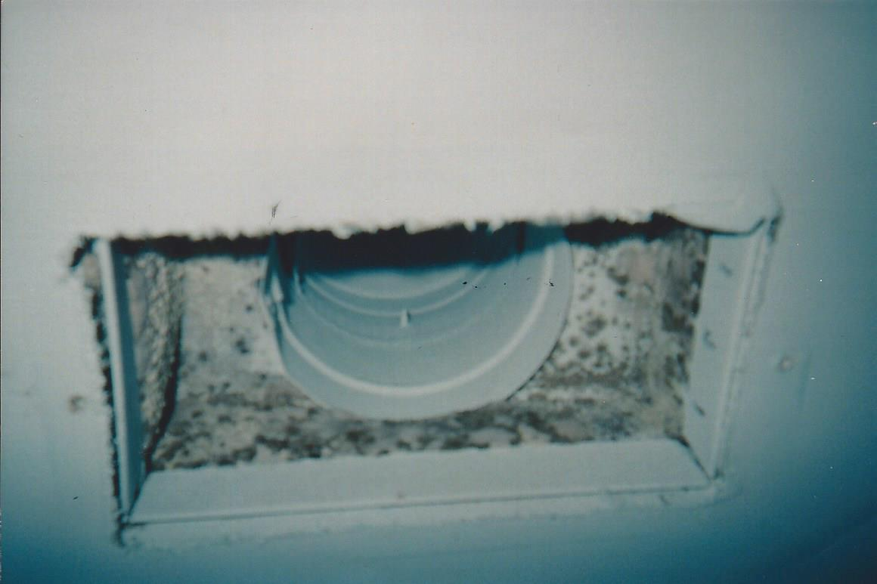
AREAS MOLD ARE FOUND
Mold can be found in A/C units and behind A/C vents in homes due to moisture like is seen in these pictures. We found this mold while remediating a home for mold issues.
Augusta, GA

Slide 18
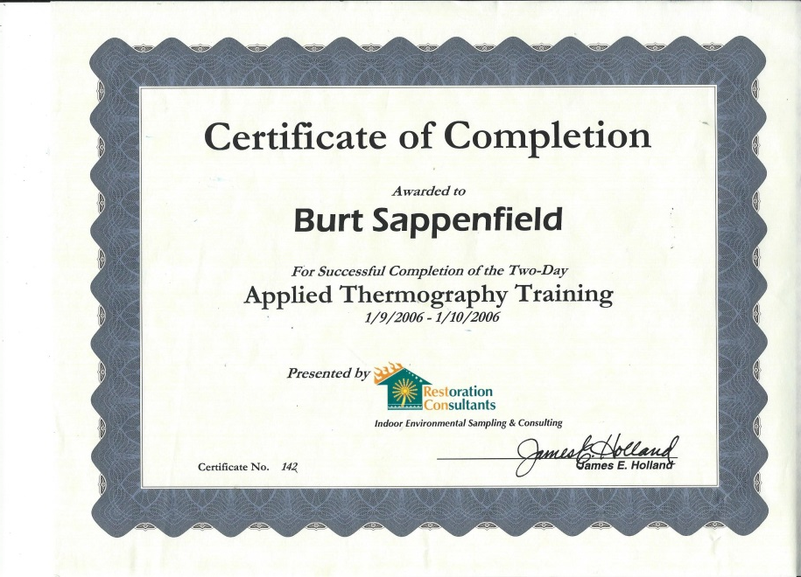
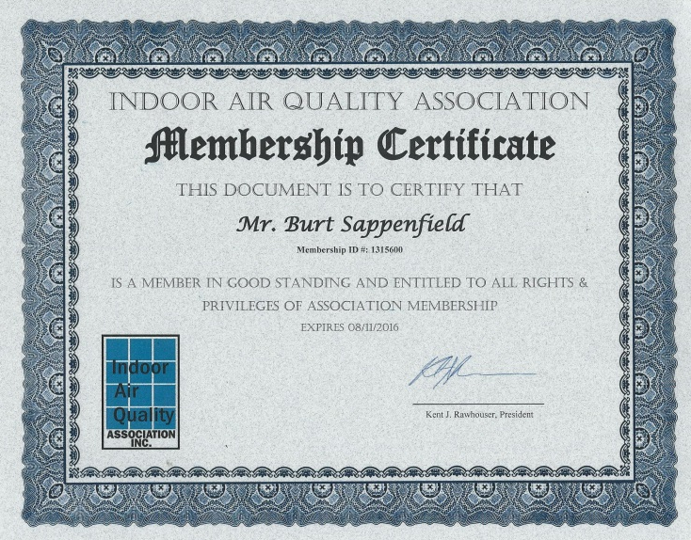
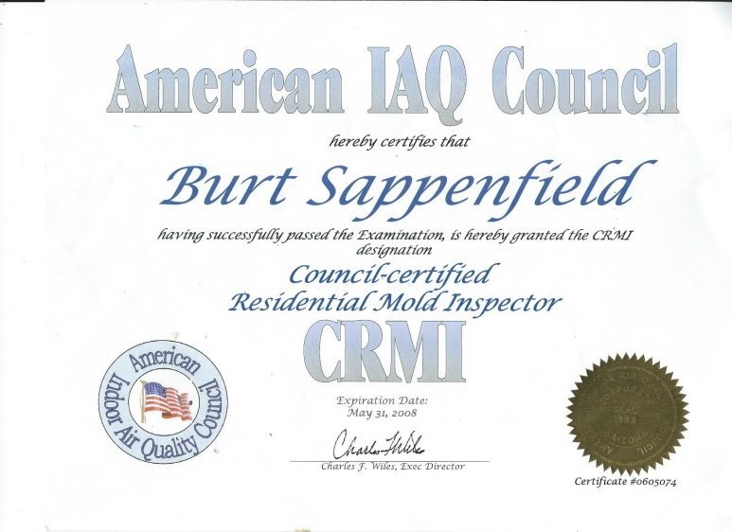
Certifications

Slide 19
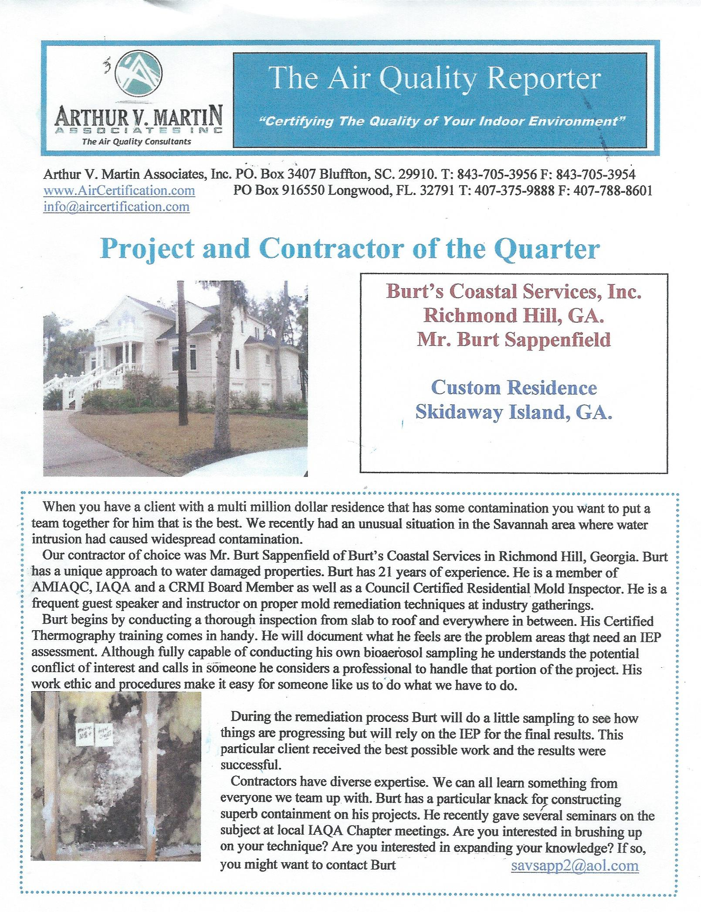

Slide 20
