Slide 1
Trail trauma and first-aid
Presented by: Northwoods Overland Adventures

Slide 2
Who are you learning from?
I am Alexandria Eschen, my husband and I run an Instagram page, and a website/blog called Northwoods Overland Adventures. I have been an ICU nurse for 6 years at a level 2 trauma center. I hold certifications in ACLS, BLS, Stop the Bleed, stroke, and trauma

Slide 3
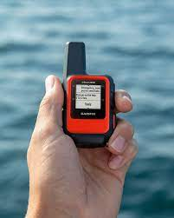
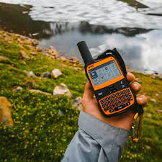
Safety planning should be the first thing you think about after deciding to adventure!
If something goes wrong, how do you contact help is always a good place to start; you cannot rely on cell service with our lifestyles/hobbies
Where is your nearest hospital, and what is their capability? Do you think it would be possible for emergency medical staff to get to you? How long will it take to get to definitive care?
What preparations did you make for your adventure? Did you bring the specific safety gear for the weather? Did you check your kit? Did you familiarize your group with each other’s medical needs?
Consider an SOS device
Notes:
Types on the market:
Garmin in-reach explorer and in-reach mini , Zoleo, Spot X, ACR rescue link
Do your research in the way that is right for you.
You should go through your kit periodically to become accustomed to it and be aware of expiring items. You should have a good core kit that you add things to for specific trips and weather conditions.
Search for trauma centers near your destination before you leave. Learn what the designations of trauma centers mean and what their capabilities are.
https://www.amtrauma.org/page/FindTraumaCenter

Slide 4
Safety:
Always ensure your safety first. You may be the only one who knows how to administer first aid.
If you need to move away from danger, you can try to take the injured with you if safe enough to do so.
If it’s unsafe, wait for emergency services.
Bloodborne pathogens:
Any time you encounter any bodily fluid, you should wear personal protection equipment. Gloves, eye googles, face mask
If you get blood on you wash it off ASAP, let emergency services know that you were exposed and follow their instructions.
Medical awareness:
You should be aware of your own limits and medical needs and make sure you bring your proper medications. About 1 week’s worth is recommended
You should also be aware of your group’s limits and medical needs should you need to help them.
Make sure you know where your group's emergency medications are and that they know where yours are.
Medical info cards should be utilized.
Good Samaritans Law:
This protects any volunteer giving aid to an injured person from being sued by that person.
Keynotes: obtain permission for any care you are giving, if possible, be cognizant of providing care in a non-reckless manner.
Notes:
Good Samaritans law:
Fact: All 50 states and the District of Columbia have some kind of Good Samaritan law, in addition to federal laws for specific circumstances. Though the definitions and coverages vary slightly from state to state.
A bystander is protected under the Good Samaritan laws as long as they have good targets to aid the accident victim to the best of their capability during a medical emergency. Under some Good Samaritan Laws, as long as medical employees, such as doctors, nurses, or medical responders, follow standard procedures, they will also be protected under the Good Samaritan laws.
In most instances, a bystander can’t be held liable for not providing medical assistance. However, there are exceptions. For example, good Samaritan laws in Vermont, Minnesota, and Rhode Island require bystanders to act in some limited capacity. However, that doesn’t mean putting yourself in danger.

Slide 5
The first thing you do is a primary assessment. What could kill your patient in the next 5-10 minutes?
Our goal is to treat that problem before we assess further.
Is this patient a trauma patient or a medical patient?
Trauma think:
Injury
Broken bones
Bleeding cuts/wounds
Etc.
Medical think:
Illness
Heart attacks
Strokes
Anaphylaxis
Asthma
Etc.
QUICKLY assess your scene to help figure out what’s going on.
Notes:
You have to choose the route that leads to the quickest, safest, and best care for that patient.

Slide 6
Assessment tools
M.A.R.C.H.
O.P.Q.R.S.T.
S.A.M.P.L.E
Notes:
If the patient is a significant trauma patient, we are going to assess the scene and go right into MARCH
Otherwise, we have time to start the OPQRST assessment and treatments
SAMPLE is a secondary assessment to make you more aware of your patient and their needs while in your care and provides information to emergency medical personnel.

Slide 7
M: Massive hemorrhage A: Airway R: Respirations C: Circulation H: Hypothermia/Head injury
M.A.R.C.H.
Notes:
See lower slides for details

Slide 8
Massive Hemorrhage
Objective:
Interventions:
Direct pressure
Problem:
Massive Hemorrhage
Stop the bleed
Pressure dressings
Tourniquets
Wound packing

Slide 9
Open wounds:
Control the bleeding, apply direct pressure, and elevate the injury.
If you cannot stop bleeding with direct pressure, assess two things: is it a deep wound that needs to be packed with gauze, or do you need to apply a tourniquet
Pack an extremity wound as tightly as possible and hold direct pressure for 3 minutes, then wrap with pressure dressing and continue to assess
To apply a tourniquet, put it 2-3 inches above the injury; avoid placing it on joints or over bulky clothing. You cannot place tourniquets on the neck or torso
Tighten the strap around the extremity and turn the T bar until the bleeding stops
Write on the tourniquet the time that it was applied
Never remove a tourniquet after application if bleeding does not stop, then apply a second tourniquet higher up than the first one
If you have an injury involving an embedded object, do not remove it; wrap it with gauze to stabilize it from moving.
Notes:
Wounds of the chest, abdomen or pelvis shouldn’t be packed because bleeding from these wounds is generally from a very deep source that can’t be reached from the outside. These patients must be rapidly transported to a surgeon for operative bleeding control. Packing of wounds in these areas should therefore be performed at the discretion of local EMS Medical Directors or the appropriate state agencies where applicable.
Step 1: Stop the bleeding. Now! Immediately apply direct pressure to the wound, using gauze, clean cloth, elbow, knee-whatever it takes to slow or stop the hemorrhage-until you have time to get out your wound packing supplies.
Place your gloved fingers-with or without a dressing-into the wound to apply initial pressure to the target area (with your target being the vein, artery or both) and compress the source of bleeding. Keep in mind that the body’s anatomy presents with major vessels running close to bones. So, whenever possible, utilize a bone to assist with vessel (i.e., bleeding) control. This will also give you an idea of which direction the wound travels and you can insert the gauze accordingly.
Step 2: Pack the wound with gauze. Tightly! Your goal is to completely and tightly pack the wound cavity to stop hemorrhage. Begin packing the gauze into the wound with your finger, while simultaneously maintaining pressure on the wound.
When no more gauze can be packed inside the wound, hold direct pressure on the wound for 3 minutes.
It’s critical that the gauze be packed as deeply into the wound as possible to put the gauze into direct contact with the bleeding vessel. By doing so, you’re simultaneously putting direct pressure onto the bleeding vessel and allowing the hemostatic agent to do work its magic.
Step 3: Keep packing! The key to successful wound packing is that the wound be very tightly packed, applying as much pressure as possible to the bleeding vessel. This pressure against the vessel is the most important component of hemorrhage control. This explains why plain gauze (without an impregnated hemostatic agent), when tightly packed, is also quite effective.
Step 4: Apply very firm pressure to the packed wound for 3 minutes. This step pushes the packing firmly against the bleeding vessel and aids in clotting.
Step 5: Secure a snug pressure dressing and transport. After applying pressure for 3 minutes, place a snug pressure dressing over the wound. You may consider splinting or immobilizing the area, if possible because movement during transport can dislodge the packing and allow hemorrhage to restart.
Continued Hemorrhage
Should the bleeding continue, hemostatic gauze manufacturers recommend removal of the original packing and repacking with fresh gauze. The rationale for this is that they assume it wasn’t packed properly the first time, or perhaps the packing didn’t quite get to the bleeding vessel.
Prior to repacking, another option is to pack more gauze into the wound, if possible. If no further packing is possible, you must decide whether to remove the gauze and start over or simply apply as much direct pressure to the wound as possible and get the patient to a trauma center quickly. This decision should be made during transport; transport shouldn’t be delayed for extensive packing and repacking of the wound.

Slide 10
Airway
Objective:
Interventions:
Listen for breaths.
Problem:
Airway
ensure airway is clear and open
Look for chest rise and fall.
Recovery position-lying on their side
Chin lift or jaw thrust.
Check for obstructions.
Use airway adjunct NPA/OPA

Slide 11
If it is hard to keep the airway open, then you can consider an airway adjunct (ex-Nasopharyngeal (NPA) or Oropharyngeal (OPA).
To measure for correct size of NPA the length should extend from Nare to the tip of their earlobe
DO NOT use nasopharyngeal airway if there is facial trauma
To measure the correct size for an OPA it should extend from the corner of their mouth to the tip of the earlobe
OPAs are shaped like a C, to insert you put it in sideways then turn it downward at the back of their throat Only use oral pharyngeal airway if patient is unconscious (this will activate gag reflux if awake)

Slide 12
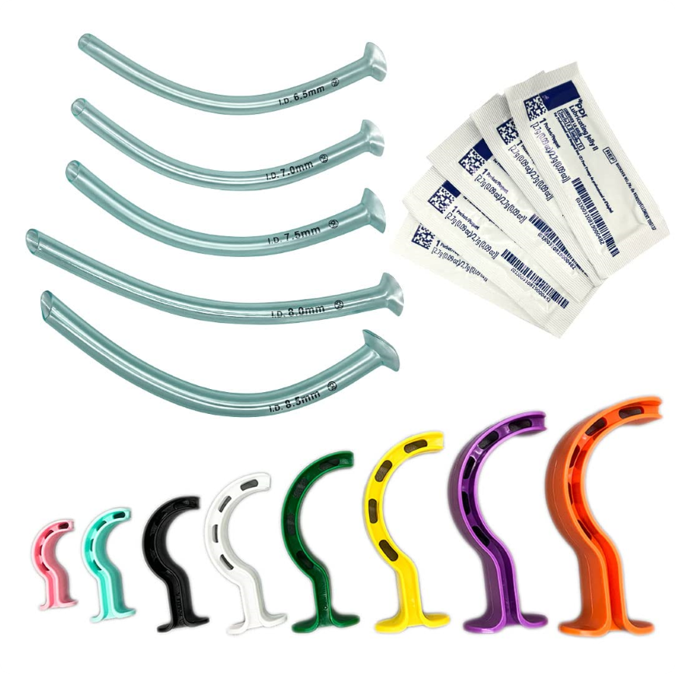
Notes:
NPAs and OPAs come in different sizes for different-sized patients.
You can occlude an airway by using the wrong size.
Top pictured are NPAs or nasal trumpets that slide into one nostril and provide a track for air to flow.
OPAs are the C-shaped pieces pictured.

Slide 13
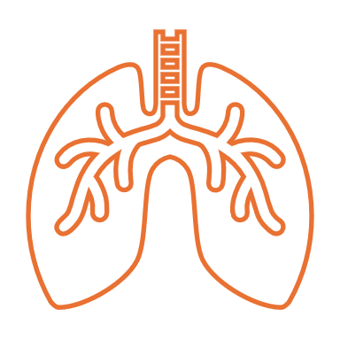
Respirations:
Problem: Breathing
Objective: Functional breathing
Interventions: One-way valve mask rescue breaths
Check the front and back torso for punctures.
Treat with chest seal dressings
Monitor for tension pneumothorax if happening, burp/remove chest seals

Slide 14
How to perform rescue breaths:
Rescue breathing, also known as mouth-to-mouth or mouth-to-nose breathing, can be a first aid technique used to help someone unresponsive and not breathing or has a pulse but isn't breathing:
Open the airway:
Adults and children: Place the person on their back, press your palm against their forehead, and lift their chin away from their spine with your fingers
Babies: Gently tilt their heads back
Check for breathing and a pulse:
If no pulse, start CPR. If they have a pulse, then continue with the rescue breathing technique
Look for their chest to rise
Listen for normal breathing
Give rescue breaths:
Continue:
Give one rescue breath every 5–6 seconds, or about 10–12 breaths per minute, until the person starts breathing or emergency services arrive
If their chest doesn't rise with the first breath, tilt their head back and try again
If their chest still doesn't rise, they might be choking
keep checking back for a pulse, and if it is lost, start CPR

Slide 15
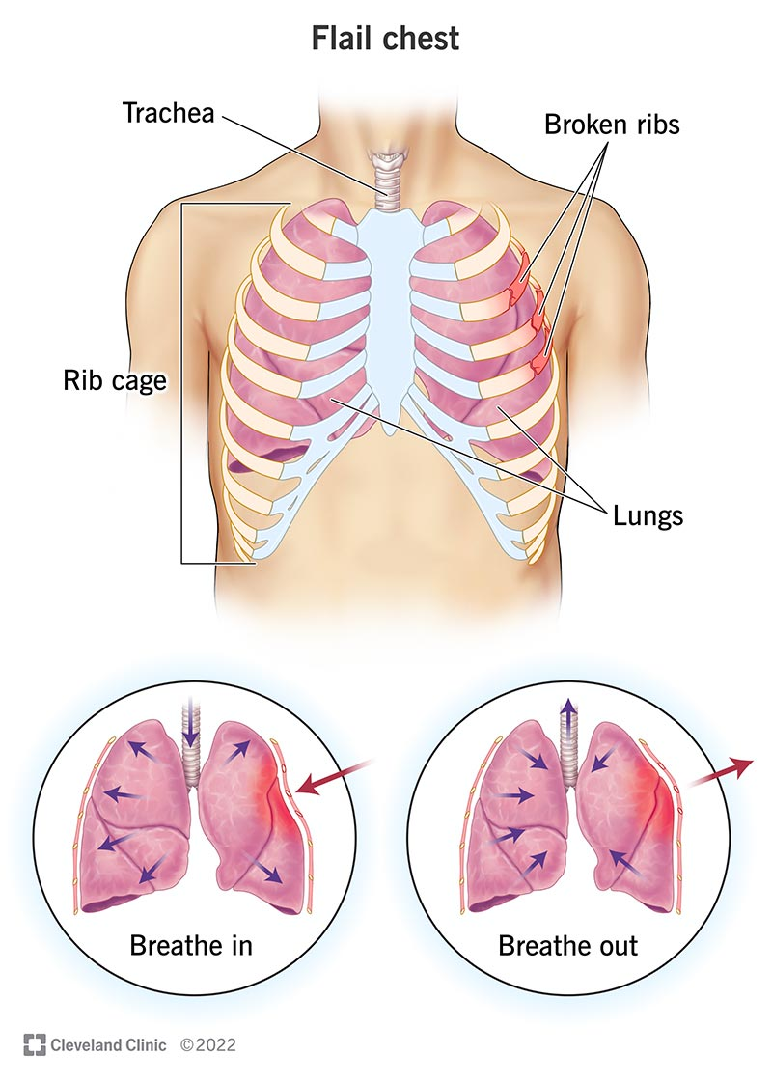
Chest trauma
Rib fracture: treatment is palliative; what makes the patient most comfortable.
Multiple rib fractures: be aware of how much force the injury took and look for other complications; treatment is also palliative care if no other injuries are found.
Flail chest: When 2 or more consecutive ribs are broken in multiple spots, you will note paradoxical chest movement (that section will move opposite to the rest of the chest).
Pneumothorax: Where air has entered the cavity around the lung. The patient may be anxious and have a hard time breathing. Care for this is palliative, and getting the patient to definitive treatment
Tension pneumothorax: This is when so much air has entered the cavity around the lung that the lung is being collapsed. You might see mental status changes, anxiety, and increased work of breathing. Changes in chest rise and trachea deviation are late signs.

Slide 16
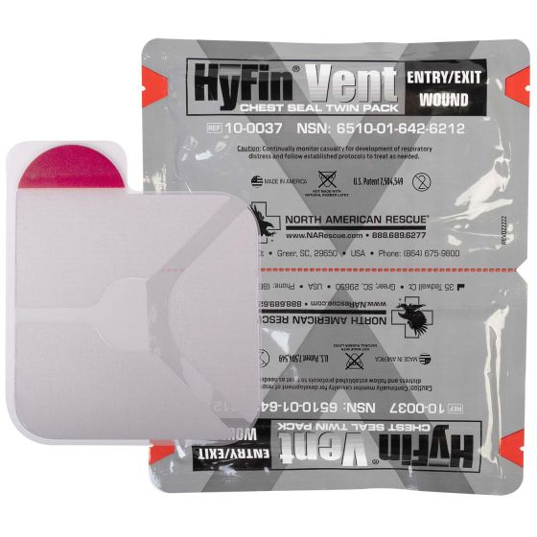
Chest trauma continued
Sucking chest wound: With this, there is a puncture that, with every breath, is sucking air into the chest cavity. The treatment for this is an occlusive dressing that is waterproof and air-tight taped to the skin.
This can be a Ziploc bag taped on 3 sides
Commercial chest seals are recommended for a trauma
first-aid kit. The seals should come in a 2-pack, one that’s
vented and another that is not. There are directions on the package
For use
A vented chest seal allows air out but sucks against the skin
when a breath is taken so it doesn’t let air in.
A regular chest seal can be used if there’s an entrance and exit
wound.
Notes:
When a chest seal is placed, you should monitor breathing and look for signs of a tension pneumothorax developing. If you are seeing signs pull the seal off and let it burp air out then replace the seal.

Slide 17
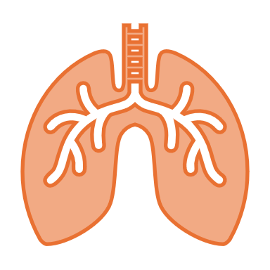
A chest seal is used when a patient has a penetrating chest wound from the neck to the navel, on the front, side, or back of the chest. The chest seal prevents air from entering the chest cavity, making it difficult for the patient to breathe.
You should apply a chest seal if you see or suspect a deep puncture wound to the chest wall. It's better to be cautious and take steps to keep air out of the chest cavity, and applying a chest seal won't hurt the person even if their wound isn't deep enough for air to enter.
To apply a chest seal:
Bare the patient's chest
Wipe away blood and other fluids to identify the wound location
Apply the chest seal over the wound, following the manufacturer's directions
Check the opposite side of the patient's chest, as well as the sides of the chest, for an exit wound
If there is an exit wound, apply another chest seal
First aid kits should contain at least two chest seals.

Slide 18
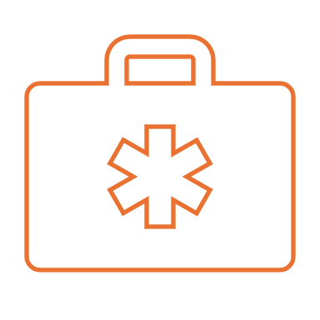
Circulation:
Problem:
Circulation
Objective:
Continue assessment
Interventions:
Reevaluate whether bleeding interventions are still working.
Check for a carotid pulse; if no pulse present start CPR

Slide 19
Adults
Children
Infants

Slide 20
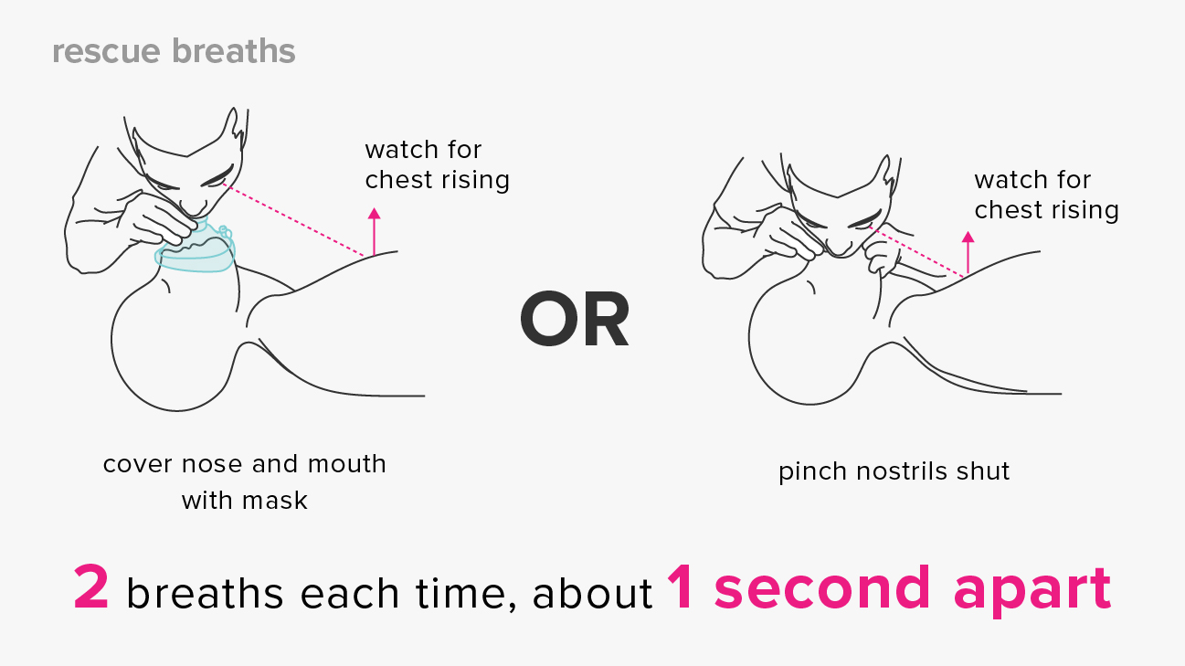
2

Slide 21
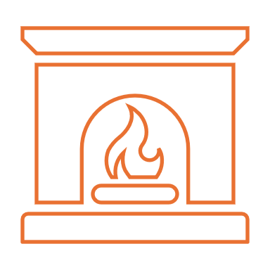
Hypothermia/Head injury
Problem:
Exposure to the elements, heat loss due to blood loss, head injury
Objective:
Prevent heat loss
Assess for head injury
Interventions:
Keep patient as warm as possible, use emergency blankets, take off wet clothes
Assess for head injury
Notes:
To prevent hypothermia in trauma patients, you can try these first-aid steps:
Remove the patient from the cold environment
Insulate the patient from the cold ground with a blanket
Gently remove wet clothing and replace it with warm, dry clothing or blankets
Gradually warm the patient, focusing on the center of their body
Increase the temperature in the room
Cover the patient with multiple warm blankets, especially for children and newborns
Hypothermia can affect how blood clots, increasing bleeding.

Slide 22
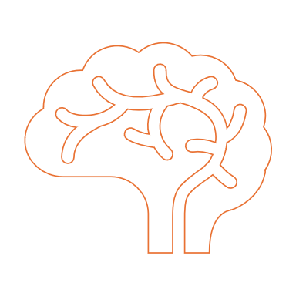
Head injuries:
When diagnosing a head injury, the biggest thing you are looking for is mental status changes
Signs and Symptoms: Headache, lethargy, amnesia, blurred vision, nausea and vomiting, unequal pupils, skull fracture you could see bleeding from ears and nose, and obvious facial trauma
You want to protect their airway (keep it open); remember no NPAs if facial trauma
Think DICC:
Disoriented
Incoherent
Confused Combative
Notes:
When a brain injury is known or suspected, that is call for an immediate evacuation of that patient.
Monitoring for mental status changes as you evacuate. You can think about the mnemonic DICC.
Treatment until evacuation is palliative care (keeping them comfortable). A patient can sleep but needs to be woken up at 1-hour intervals and assessed for mental status changes.
You can have open head trauma like a skull fracture or trauma
Or you can have a closed head trauma in which there’s not a clear place of injury from the outside.
Don't press on a head wound if you suspect a skull fracture
Once you see breathing changes or pupil changes a brain injury is for progressed and severe

Slide 23
Spinal Column Injuries
Assess the mechanism of spine injury. If a positive or uncertain mechanism exists, protect the spine by whatever method is available. This could include, but is not limited to, hand stabilizing in the in-line position.
Do a thorough evaluation, including a history and physical examination. To rule out a spine injury, the patient must meet all of the following criteria:
The patient must be reliable, cooperative, sober, and alert, and free of other distracting injuries significant enough to mask the pain and tenderness of the spine injury.
The patient must be free of significant spine pain and tenderness consistent with a spinal injury.
The patient must have normal motor/sensory function in all four extremities:
• Finger, hand, or wrist motion (check both hands).
• Ankle or great toe motion (check both feet).
• Normal sensation to pain and light touch in all four extremities.
• If reduced function in one extremity can be attributed with certainty to a condition unrelated to a potential spine injury (wrist fracture, for example), that deficit alone will not preclude ruling out a spine injury, because the motor/sensory assessment contain built-in redundancy.
If the spine cannot be cleared, spine injury remains on the problem list and must be appropriately managed and followed up as part of patient care and evacuation. This may include stabilization and carry, assisted self-extrication, or other means of reducing the risk of further injury pending medical evaluation and treatment.
If the patient with the suspected spinal column injury is reliable (alert & oriented, sober, not distracted), there is no stated pain/tenderness on the spine, and normal CSMs in all four extremities, a decision to discontinue spinal immobilization can be made. This also means the patient has good distal pulses, no numbness, tingling or unusual (psychological) sensations, and has a normal range of motion.
Notes:
In a wilderness context, clearing a potential spine injury when there is a positive mechanism for such an injury requires a careful evaluation focusing on patient reliability, nervous system function, and spinal column stability. Adequate time must be allowed for the evaluation.
Neutral alignment should be restored and maintained using non-rigid tools during extrication unless such a maneuver is met with resistance, increased pain, or a new or worsening neurologic deficit.
Injuries to the cervical spine (neck) may result in trouble breathing, which may be life-threatening. Above C4, they Breathe No More…
Positive Significant Mechanisms of Injury: • Fall w/ Loss of Consciousness • Fall from Greater than 3 Feet • Evidence of trauma from High-Velocity Impact • Landing Head-First (compression) • Landing on the Buttocks/heels (axial loading) • A Fall onto Rock or another Hard Surface
Over the past 15 to 20 years, research has been conducted on rescue best practices, and it shows the following:
Rigid spine boards and cervical collars are ineffective at “immobilizing” the spine.
Rigid boards and cervical collars do cause harm. They also delay and complicate the extrication process.
First responders do a terrible job of not moving a patient’s spine when transferring them from one location to another.
Patients who are awake and alert do the best job of holding their own spine still when moving from one place to another.
Spinal protection is the new objective. Essentially, this means being reasonably careful when moving a patient to keep their head/spine in a neutral alignment.
Conscious and alert patients should be allowed to move themselves when able.
In remote wilderness and backcountry settings, evacuation can be dangerous, delayed, and complicated. First responders need to consider the cost/benefit of letting a patient “walk out” versus waiting for help. Depending on the injuries and other factors, delays in getting that patient to a hospital or urgent care facility can be fatal.

Slide 24
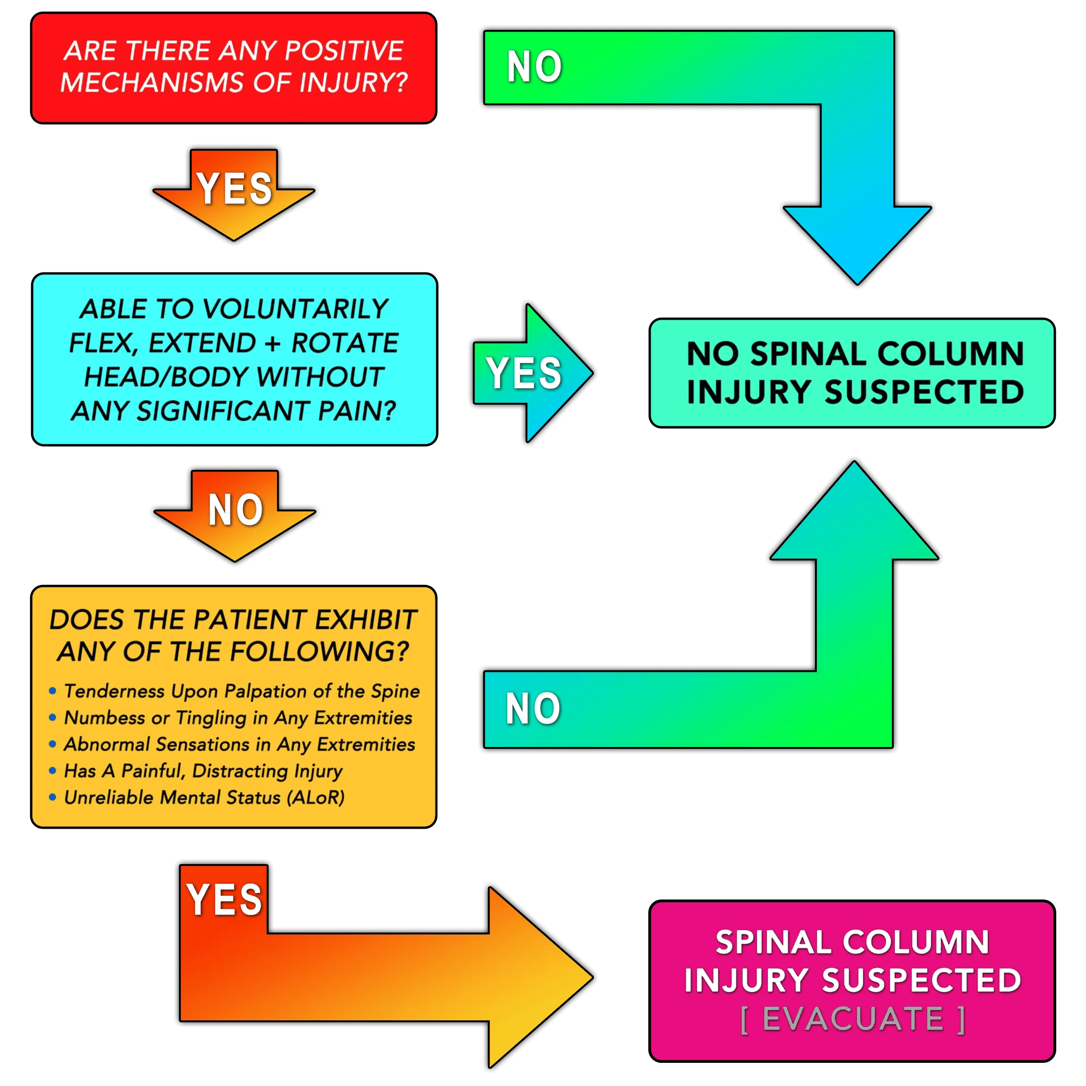

Slide 25
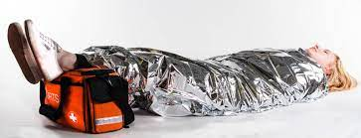
Shock
Signs and symptoms:
• anxious
• restless
• confused
• increased heart rate
• increased respiratory rate
• cool clammy skin
• nausea and vomiting
• thirsty
• dizzy.
Care:
Treat the cause!!!
Maintain an open airway.
Keep patient calm, and warm, if possible
Keep the patient lying prone with legs elevated.
Monitor vital signs.
Notes:
Shock occurs when the blood can no longer supply vital organs oxygen. There are several types of shock:
Hypovolemic Shock: Decreasing blood volume due to blood loss or dehydration.
Cardiogenic Shock: Decreasing blood flow when heart stops working as in the case of a heart attack (lightening causes this).
Neurogenic Shock: Loss of vascular tone resulting in increased vascular space/expanding arteries (i.e., a head/spinal injury or severe infection).
Decompensatory shock is evidenced by falling BP.]

Slide 26
O.P.Q.R.S.T.
Onset: When did it start/ what were they doing?
Palliate/Provoke: what makes it better/ what makes it worse
Quality: Describe the pain/ stabbing, burning, aching, sore, etc.
Radiate: Does the pain go anywhere else? Did it start off somewhere then move?
Severity: Pain scale 1-10; is it getting worse or better over time?
Time: change over time, what has changed since onset, what made you seek help now?

Slide 27
S.A.M.P.L.E
Signs & Symptoms: what can you see or measure? Signs. What are they complaining of? Symptoms
Allergies: do they have any allergies? Medications, foods, or environmental?
Medications: do they take any medications/ what for/ what dose
Past pertinent medical history: What relates to the problem at hand
Last in/ last out: when did they last have food and water? When was the last time they went to the bathroom? What was it? How much?
Event: review the events to this point with the patient, recap the storyline.
Notes:
Allergies: When asking about allergies, ask twice! Make sure you’re asking, and they understand ANY allergies. Ask about medications, foods, or environmental allergies.
Differentiate something that could kill them versus something that just makes them uncomfortable.
Always ask about a medication allergy before giving a medication.
Medications: When asking about medications, you should also ask twice. Ask about prescriptions, over-the-counter, or herbal supplements.
You won’t know every medication; that’s fine. Ask them what it’s for. Ask what dose they take.
Past pertinent medical history:
For example, do they have a known heart issue and are having chest pain?
You can ask them to compare what they are feeling to past experiences. Have they broken a bone before? Does this feel like that?
Last in/ Last out: We don’t really care about bowels unless there seems to be a problem with them, such as diarrhea, constipation, nausea, vomiting, and/or abdominal pain.
You can help emergency personnel by recording this information. You can write this on your patient with a permanent marker (this ensures that the information stays with the patient and isn’t lost in communication.

Slide 28
Vital signs: Heart rate
We are looking for 3 things:
Rate: how many beats per minute?
Normal range is 60-100
Rhythm: is it a steady regular beat or irregular?
Quality: describe it, is the pulse weak, strong, hard to find?
To obtain a heart rate,
use a pulse point; radial pulse is the most common.
Use your fingers, not your thumbs
Count how many beats in 15 seconds and multiply by 4 this gives you how many beats per minute.
Notes:
Take heart rate into the context of the situation; 60-100 are just averages.
Someone just resting may be lower than that, and someone who was just trail running may be much higher.
A heart rate out of range doesn’t necessarily mean the person is distressed.
That’s why we also look at rhythm and quality!

Slide 29
Vital signs: Respirations
We are looking for 4 things:
Rate: how many breaths a minute?
Normal range is between 12-20
Rhythm: is it regular or irregular
Quality: is it shallow, deep
Work of breathing: how hard is their work of breathing? How difficult is it for them to get air in and out?
To assess respiratory rate:
How many breaths per minute
Can be very difficult to see
May have to lay your hand on their chest to feel it
Don’t tell them you're looking for breaths. People will adjust their breathing patterns

Slide 30
Vital signs: skin color, temperature, and moisture
To assess this, you’re looking at :
Color: are the gums or inside of the eyelids pink
Temperature: Is the patient warm
Moisture: Is the patient dry
Simply take note and realize anything but pink, warm, and dry is different and must be assessed further.

Slide 31
Vital Signs: Pupils
When looking at pupils, they should be:
Round
equal size on both sides
they should react to light
When using a flashlight to look at pupils both pupils should constrict at the same time
To assess pupils, we use the acronym PERRL
Pupils
Equal
Round
Reactive
Light
Notes:
Pupil changes are a late sign and a bad sign of injury. See mental status for more depth.

Slide 32
Vital signs: Blood pressure
Radial pulse means that systolic blood pressure is over 90
Femoral pulse means that the systolic blood pressure is between 80-90
Carotid pulse means that systolic blood pressure is 60-80
No carotid means start CPR
In most cases, we will not have a blood pressure cuff or a stethoscope available, so we do what's called blood pressure by estimation.
We are using pulse points to estimate a systolic blood pressure.
Notes:
You assess the radial first; if you cannot feel it, move on to the femoral and finally, the carotid.
This is not taking place in this order if you suspect cardiac arrest if suspected. Check carotid first and start CPR if not present.
You are using this mostly as a trend over time: are the pulses improving or worsening?

Slide 33
Mental status :
Pay attention to the little details!
Your brain is very sensitive to changes.
The scale used to assess mental status is AVPU

Slide 34
Orthopedic injuries: Sprains, Strains, Fractures, and Dislocations
Sprains: Involve ligaments Bone-to-bone connections Provide stability Generalized pain | Strains: Involve tendons Muscle-to-bone connections Provide mobility Between joints Generalized pain
Fractures: Involve bone Provides structure Between joints Pinpoint pain Floppy feel during exam | Dislocations: Involve joints Looks weird or unsymmetrical Pinpoint and/or generalized pain Rigid feel during exam
Notes:
Different types of pain: generalized versus pinpoint
Generalized= all around
pinpoint= one specific place usually, the person can point that spot out easily
Work from the bottom up on the exam:
Example: the area feels floppy, there is pinpoint pain, and it's between a joint that points toward a fracture.

Slide 35
Treatment of orthopedic injuries:
Think about CSMs
Circulation: assess distal (further past) the injury for pulses, Skin color/temp, and capillary refill.
Sensation: assess nerve function distal; can you feel this?
Motion: assess movement
Splints: what are you stabilizing?
Bone= joints above and below
Joint= bones above and below
The less movement, the better
Padding is your friend
Think about accessibility: make your splint in a way you can take it apart and put it back together again
Long-term monitoring ability: Keep assessing CSMs

Slide 36
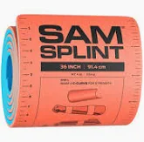
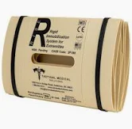
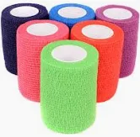
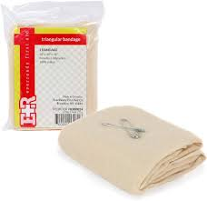
Splinting supplies
Sam splint/ rise splint
Roller gauze
Ace wraps/ Coban wraps
Medical tape
Triangular bandage

Slide 37
Internal anatomy

Slide 38
Chest trauma
Rib fracture: treatment is palliative; what makes the patient most comfortable.
Multiple rib fractures: be aware of how much force the injury took and look for other complications; treatment is also palliative care if no other injuries are found.
Flail chest: When 2 or more consecutive ribs are broken in multiple spots, you will note paradoxical chest movement (that section will move opposite to the rest of the chest).
Pneumothorax: Where air has entered the cavity around the lung. The patient may be anxious and have a hard time breathing. Care for this is palliative, and getting the patient to definitive treatment
Tension pneumothorax: This is when so much air has entered the cavity around the lung that the lung is being collapsed. You might see mental status changes, anxiety, and increased work of breathing. Changes in chest rise and trachea deviation are late signs.

Slide 39
Chest trauma continued
Sucking chest wound: With this, there is a puncture that, with every breath, is sucking air into the chest cavity. The treatment for this is an occlusive dressing that is waterproof and air-tight taped to the skin.
This can be a Ziploc bag taped on 3 sides
Commercial chest seals are recommended for a trauma
first-aid kit. The seals should come in a 2-pack, one that’s
vented and another that is not. There are directions on the package
For use
A vented chest seal allows air out but sucks against the skin
when a breath is taken so it doesn’t let air in.
A regular chest seal can be used if there’s an entrance and exit
wound.
Notes:
When a chest seal is placed, you should monitor breathing and look for signs of a tension pneumothorax developing. If you are seeing signs pull the seal off and let it burp air out then replace the seal.

Slide 40
Traumatic abdominal injuries
There’s not much we can do for these in the field. We need to get to definitive care if we recognize signs of anything more than a surface bruise.
Solid organs = highly vascular, with lots of blood flow. Think liver, spleen, kidneys, and pancreas. Injury to these will result in internal bleeding
Look for bruising to the abdomen, flanks, and back. Distention or rigidity of the abdomen.
Hollow organs = hold waste. Think stomach, gallbladder, bladder, and intestines
These will leak waste into the body, causing infection. Monitor for fever.
Notes:
Because there isn’t anything we can do for these types of injuries evacuation is indicated.
There could be internal bleeding that we cant diagnose.
You can bleed out from internal bleeding alone.
Crazy fact: The human body has 5-7 liters of blood in it. The pelvis can hold 4-6 liters in it and the femoral areas can hold 2-4 liters each.

Slide 41
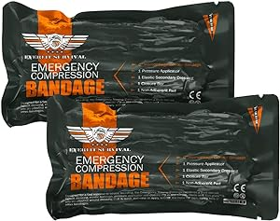
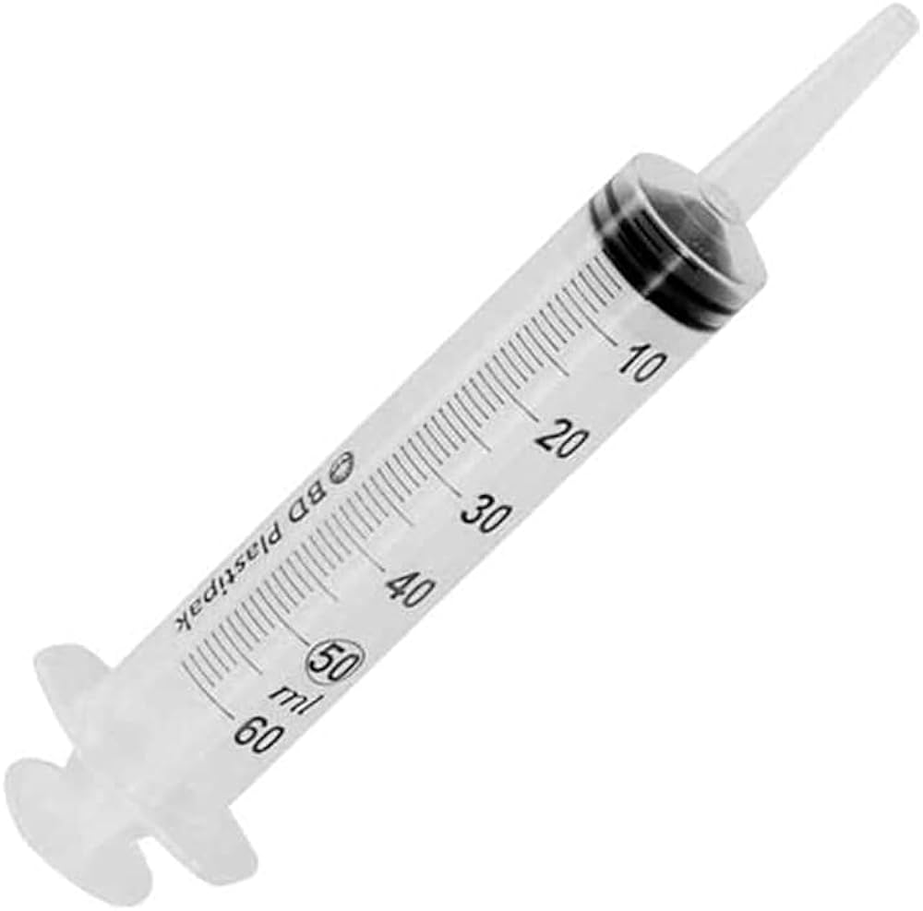
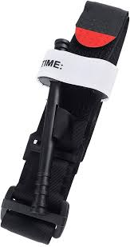
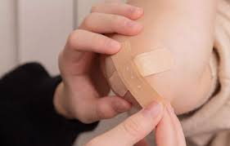
Soft tissue injuries
Treatments:
Stop the bleed
Clean the wound
Dress and bandage
Monitor for infection
Notes:
Stop the bleeding:
Direct pressure will stop most bleeding; if a dressing is soaked through, change it out for another one. If indicated, you can use hemostatic gauze, which helps clot blood.
Pressure dressings can be applied.
If there is life-threatening bleeding, you need to act quickly. You will recognize life-threatening bleeding when you see it. You may need to apply a tourniquet if it is on an extremity. (see open wounds slide in MARCH)
Clean the wound:
Using only water, nothing else. You can use a syringe to get pressure to clean better.
Antibiotic ointment is only for surface scrapes and abrasions. You should still clean and change dressings if you are using this ointment.
Dress and Bandage:
A dressing is the protective layer that covers a wound, while a bandage is the material that secures the dressing in place.
You want to change these twice daily or whenever they become dirty, soaked, bled through, etc.
Monitor for infection:
Local infection will be reddened, hot, and have and increase in pain. Sometimes swelling and pus as well. If scabbed over sometimes it is indicated to open wound back up to let infection drain away its ok if it bleeds a little bit. Clean the wound thoroughly again and continue to monitor.
Never close a wound fully in the field it needs to breathe so it doesn’t breed bacteria, especially when it comes to bites these should be cleaned frequently and left open to drain you can still place a dressing and change when needed.
Systemic infections mean the whole body is now involved; that infection is in the bloodstream. You may see red streaks emanating from the wound towards the body and/or fever. You may only notice one of the other, indicating the infection’s spread. This is a call for evacuation.

Slide 42
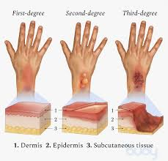
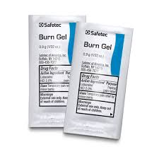
Burns
We are assessing the type of burn, the degree of burn, and the extent of the burn.
Type:
Usually, thermal burns are most common but can be chemical or electrical.
Degree:
Superficial: sunburn type, hot red, painful, no blistering
Partial thickness: blisters forming, hot red, pain
Full thickness: extends deep through tissues and can be with or without pain depending on the extent and burn areas around it
Extent:
1 palm is 1%. This dictates the care course.
Anything partial thickness that’s 15% or more, anything full thickness, or any burn involving the airways, a burn that goes all the way around an area, or burns to the hands, feet, face, or genitalia is called for evacuation.
Notes:
Sun poisoning is essentially a very severe sunburn. It occurs when you have been exposed to the sun’s ultraviolet (UV) rays without protection for an extended period. In addition to sunburn, symptoms may include fever, chills, and nausea. People with fair skin and hair are at a higher risk, as well as those who have a family history of skin cancer. The difference between a burn and poisoning lies in the symptoms and treatment.
The symptoms of sun poisoning
People with sun poisoning usually don’t know it because for the first six to twelve hours, it presents the same symptoms as a sunburn. In addition to mild sunburn symptoms, people with sun poisoning often experience:
blistering or peeling skin
severe redness and pain
fever and chills
dehydration
joint or muscle pain
nausea and vomiting
headaches
dizziness or fainting
Most sun poisoning cases can be treated with at-home remedies. To treat sun poisoning at home, try:
soaking or showering in cool (not cold) water to ease discomfort
applying aloe vera or a thick moisturizer to the area to conserve moisture
drinking lots of water to retain hydration
taking an anti-inflammatory like ibuprofen or acetaminophen to help with pain
Burns:
The best thing to cool the burn down does not have to be ice water, but a 20–30-minute soak is recommended.
Remove jewelry, watches, or anything that could become restrictive when swelling occurs.
Biggest considerations with burns are fluid imbalances and infection risk:
Skin is what keeps your body from losing water, so you quickly lose water with extensive burns
Try to keep all blisters intact
Do not scrub a burn cool it off then dress it you may choose to use burn gel or a burn dressing on a burn
Burns to hands, feet, face, and genitals may not be life-threatening, but those body parts are necessary to everyday activities, and delaying care could cause permanent damage.
Circumferential burns cause inward swelling and can cause compartment syndrome.
Airways: you may see soot or dusky appearance at the nose or throat this is a true medical emergency the airways can swell shut.

Slide 43
Carbon monoxide poisoning
Carbon monoxide poisoning:
Signs and symptoms: headache, dizziness, stomach upset, vomiting, chest pain, confusion, mental status changed.
Be aware of anything that burns fuel: engines, stoves, heater, lanterns, grills
Move person away from area, airway support, oxygen therapy.
Notes:
Be aware of proper air movement in vehicles and that tailpipes are clear and not submerged.
Be aware of where fumes from diesel heaters will rise and vent to.
Don’t run gas heating methods in enclosed spaces

Slide 44
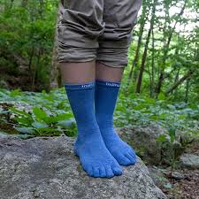
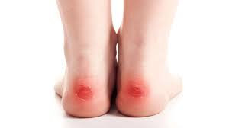
Friction blisters
The first thing you want to do is not get a blister!
This means wearing liner socks, keeping feet dry, taking breaks from your boots, making sure your shoes fit properly, wearing gloves if you're at risk of hand blisters, be aware of friction areas.
You want to control these, pop with a pinhole, drain, clean, and dress them. Then apply your friction prevention method. Moleskin, blister band-aids, Tegaderm, and or liner socks
Notes:
If a blister isn't too painful, try to keep it from breaking open. Unbroken skin over a blister may provide a natural barrier to bacteria, and it decreases the risk of infection. Cover the blister with a bandage or moleskin. Moleskin is a durable fabric that can help protect blisters in high-friction areas.
Cut a piece of moleskin about 1 inch (2.5 centimeters) larger than your blister. Fold the nonsticky sides together and cut a half-circle that's about the size of your blister. When you unfold the moleskin, you have a hole in the middle that's about the size of your blister. Apply the moleskin over the blister, aligning your blister with the hole you made. Then cover the blister and moleskin with gauze.
To relieve blister-related pain, drain the fluid while leaving the skin above the blister in place. If you have diabetes or poor circulation, or tend to get infections, take extra care to prevent infection.
How to drain a blister and help prevent infection:
Wash your hands and the blister with soap and water.
Apply an antiseptic to the blister.
Clean a sharp needle with an antiseptic wipe or rubbing alcohol.
Use the needle to prick the blister in several spots near the edge. Let the fluid drain but leave the skin above the blister in place.
Apply an antibiotic ointment or petroleum jelly to the blister and cover it with a nonstick bandage or gauze pad.
After several days, cut away the dead skin. Use tweezers and scissors that you sterilize with an antiseptic wipe or rubbing alcohol. Apply more ointment and a bandage.
Check the area every day for infection.

Slide 45
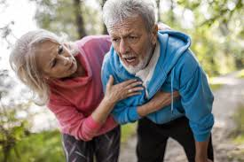
Heart Attack
Signs and Symptoms: chest, jaw, arm, back, and neck pain. Shortness of breath, feeling of impending doom, sweating, dizziness, lightheadedness
Treatment: If the patient has no allergy to the medication, have them chew four 81 mg of chewable baby aspirin and note the time given. Nitroglycerin may be given if the patient has a prescription and is carrying it.
Call emergency services ASAP
If you must transport the patient somewhere, medical personnel can get to them, try to limit their exertion
Notes:
Nitroglycerin is a potent vasodilator, meaning it expands the blood vessels; this can lower blood pressure. You want to check for a strong radial pulse before giving this medication, so you don’t reduce the patient’s blood pressure dangerously.
You can give one 0.4 mg tablet of nitroglycerin under the tongue every 15 minutes if symptoms persist for up to three doses.
Patients should understand how to use this medication if they are prescribed it.
You and the patient must decide on evacuation. The quickest way to evacuate is to walk out, but that causes increased stress on the heart.
While waiting, someone can take much longer to get to you.
Any chest pain, even ones that go away after the strenuous activity has stopped, should still be treated like a heart attack because we can’t diagnose the severity in the field.

Slide 46
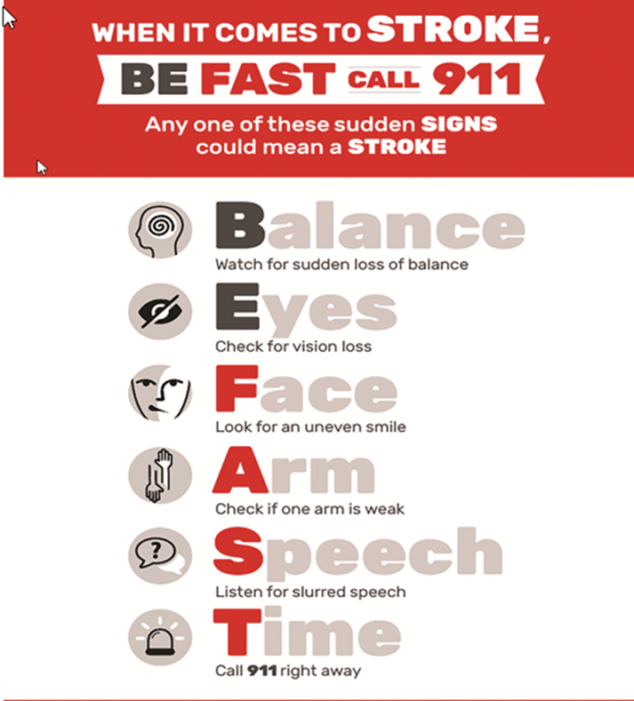
Stroke
Signs and Symptoms: Difficulty walking, coordination changes, vision changes, slurred speech, vertigo, balance issues, swallowing issues, mental confusion, facial drooping, inability to talk, difficulty finding words, words not making sense.
Note last time they were well (normal self). Need to get help ASAP call 911

Slide 47
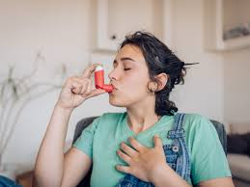
Shortness of breath
Asthma: shortness of breath, tripod breathing, wheezing.
They need their inhaler. Read the label. The medication should be albuterol or ipratropium bromide; if anything, else, it’s not a rescue inhaler. They can use this as often as needed until the asthma attack is gone.
Hyperventilation: Rapid shallow breathing, stress or anxiety induced.
Prolonged hyperventilation causes face and hand tingling and carpopedal spams (t-rex hands)
Have them slow their breathing down calm them down. Have them breathe in through their nose out through their mouth
Notes:
When you come upon a patient, they will usually be able to tell you they are having an asthma attack.
If they don’t have a diagnosis of asthma, you’re assuming it is something else.
You can also try a bear hug with someone having issues with asthma as they exhale give their chest a big hug to help them push more air out of their lungs.

Slide 48
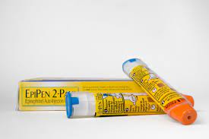
Anaphylaxis
You can have anaphylactic reactions to:
Particular foods
Medications
Latex
Insect stings
To help confirm the diagnosis:
You might be tested for allergies with skin or blood tests to help determine your trigger.
Treatment:
During an anaphylactic attack, you might receive cardiopulmonary resuscitation (CPR) if you stop breathing or your heart stops beating. You might also be given medications, including:
Epinephrine (adrenaline) to reduce the body's allergic response
Oxygen to help you breathe
Intravenous (IV) antihistamines and cortisone to reduce inflammation of the air passages and improve breathing
A beta-agonist (such as albuterol) to relieve breathing symptoms
Notes:
What to do in an emergency:
If you're with someone who's having an allergic reaction and shows signs of shock, act fast. Look for pale, cool and clammy skin; a weak, rapid pulse; trouble breathing; confusion; and loss of consciousness. Do the following immediately:
• Call 911 or emergency medical help.
• Use an epinephrine autoinjector, if available, by pressing it into the person's thigh. ONLY IF THERE’S DIFFICULTY BREATHING
Give them 50 mg of diphenhydramine (Benadryl)
• Make sure the person is lying down and elevate the legs.
• Check the person's pulse and breathing and, if necessary, administer cardiopulmonary resuscitation (CPR) or other first-aid measures.
Using an autoinjector
Many people at risk of anaphylaxis carry an autoinjector. This device is a combined syringe and concealed needle that injects a single dose of medication when pressed against the thigh. Using an autoinjector immediately can keep anaphylaxis from worsening and could save your life. Be sure you know how to use the autoinjector. Also, ensure the people closest to you know how to use it.
• Try to stay away from your allergy triggers.
• Carry self-administered epinephrine x2. During an anaphylactic attack, you can give yourself the drug using an autoinjector.
Epinephrine lasts 10-15 minutes and then wears off. This buys time for treatment with an antihistamine like diphenhydramine to kick in. Diphenhydramine will take 30 minutes to kick in, so you may have to use two epinephrine injections. That is why they always come in a two-pack

Slide 49
Seizures
DO
Do move objects and/or furniture away from the person having a seizure so that they don’t injure themselves.
Do time the seizure and call for emergency help if the seizure lasts more than 5 minutes, if there are repeated seizures, or if the person is injured or has difficulty breathing.
Do make the individual comfortable when the seizure stops.
Do consider turning the person on their side after the seizure during the period of recovery.
Do expect to find that the person who has had the seizure will be confused and tired afterwards
DO NOT
Do NOT try to hold someone down when they’re having a seizure.
Do NOT (and I mean NEVER) try to put anything in the mouth of someone having a seizure. (Some think you should put an object like a ruler in the mouth to stop the person having a seizure from biting their tongue, but it’s more likely that you’ll get bitten or they’ll bite a piece off the object and choke on it.)
Notes:
Seizures without any change of awareness
In some forms of seizure, the person is at least partially aware of the seizure – these are called Focal Aware Seizures and result from altered electrical activity in a “focal” region of the brain.
Usually you don’t need to do anything.
Stay calm and reassure the person they are safe.
If the person is frightened or anxious, encourage them to take slow deep breaths or do something that is calming or relaxing.
Stay with the person until the seizure is over. Make sure that they are fully aware of what is going on before they are left alone.
Seizures with altered awareness
In Focal Impaired Awareness Seizures the focal electrical activity prevents the person being aware of their surroundings and they will not be able to respond fully.
If the person has a warning before they lose awareness, help them to a safe place.
Stay with the person and don’t let them wander away into an unsafe situation.
Do not assume that they can talk or that they can hear you and follow instructions. Assure them they are safe and repeat instructions on what they should do next.
Time the seizure.
Make sure that they are alert, oriented and safe after the event before they are left alone

Slide 50
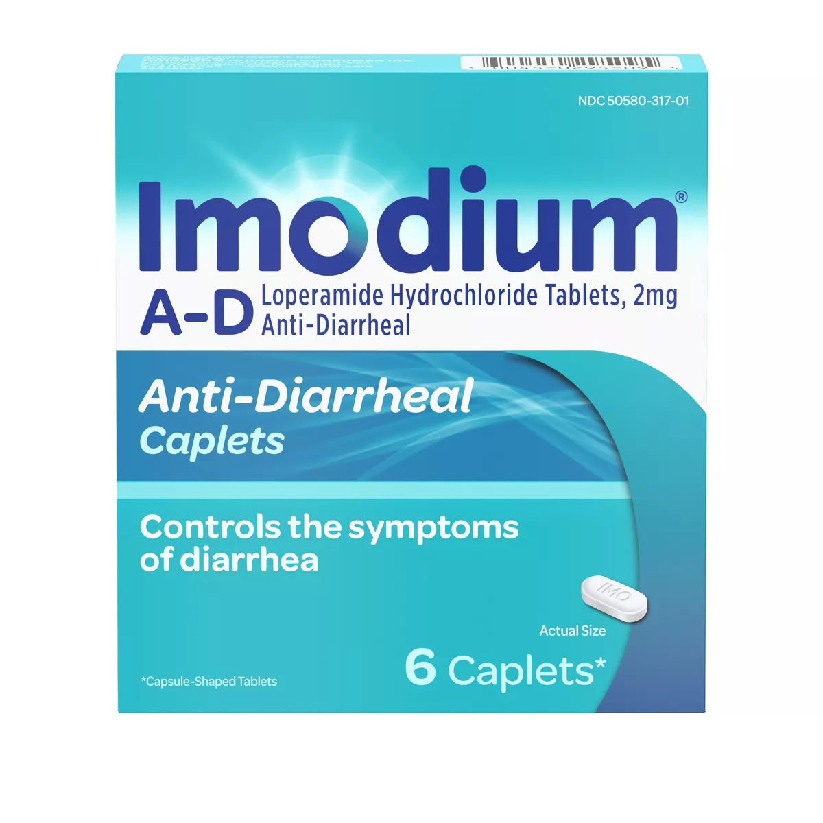
Acute abdomen
Acute means something that happening right now.
Nausea, vomiting, diarrhea, constipation
Appendicitis
Ectopic pregnancy
Stay hydrated, eat, and do the best that you can
Notes:
Vomiting is the body’s way of ridding itself of a foreign contaminant the best treatment is to let it run its course, keep as hydrated as possible. If it persists for longer than 36 hours, consider evacuation. Medications are the last course as you are keeping anything the body was trying to get rid of in.
Diarrhea can be like vomiting in that the body is trying to rid itself of a contaminant. Only use something like Pepto Bismol or Imodium if you have to.
Constipation can be treated with increased fluids and fiber foods.
Appendicitis will start as belly button pain and then move to the right lower quadrant of the patient's abdomen.
They will experience rebound tenderness = when you push down the pain goes away and when you let off quickly there's a sharp pain.
If a woman is having vague abdominal pain and there is a change that they may be pregnant, then we could suspect an ectopic pregnancy, which is a medical emergency, and we should evacuate

Slide 51
Dehydration
Dehydration occurs when your body loses more fluid than you take in. When the normal water content of your body is reduced, it upsets the balance of minerals (salts and sugar) in your body, which affects the way it functions.
Some of the early warning signs of dehydration include:
• feeling thirsty and lightheaded
• a dry mouth
• tiredness
• having dark colored, strong-smelling urine
• passing urine less often than usual
A baby may be dehydrated if they:
• have a sunken soft spot (fontanelle) on their head
• have few or no tears when they cry
• have fewer wet diapers
• are drowsy
The best prevention is to drink when you are thirsty and don’t overuse electrolyte drinks
The fastest way to cure dehydration is to drink fluids, particularly those that contain electrolytes, such as sports drinks or oral rehydration solutions. People unable to drink properly due to medical conditions may require IV hydration for faster results.

Slide 52
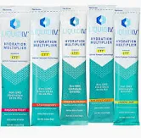
Electrolyte products

Slide 53
Heat Stroke:
Be aware of weather forecasts
Signs of heat exhaustion: Hot dry skin, Profuse sweating, increased heart rate, nausea and vomiting, thirst, weakness, dizziness
Signs of heat stroke: Confusion, slurred speech, hot dry skin of cold clammy skin, fainting, temp above 104 degrees is severe
Try to cool down, get in water, shade, or air conditioning, drink lots or water, electrolyte drinks or packets, use the ice packs in your first aid kit
Call emergency services in severe cases most people will need IV fluids to recover.

Slide 54
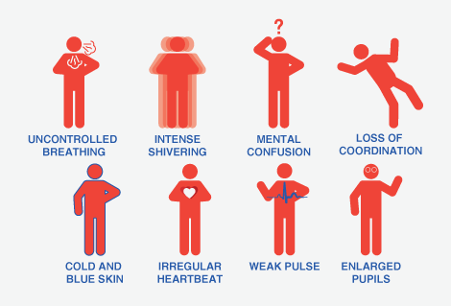
Hypothermia
Signs and Symptoms: Shivering, exhaustion, confusion, fumbling hands, memory loss, slurred speech.
Hypothermia comes with mental status changes that are subtle.
Be aware of weather forecasts
Treatment: Change out of wet clothes, if possible, try to get warm use the emergency blanket, hot hands in your first aid kit
Notes:
You want to increase activity to warm up the core body temperature, insulate the patient, and let them shiver.
Shivering is the body's way of producing body heat.
When a patient stops shivering, you should add heat like hot hands to their core areas like under the armpits or in the groin area.

Slide 55
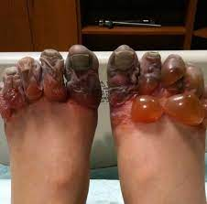
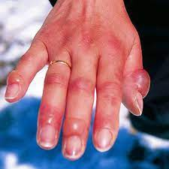
Frost bite
Be aware of the weather forecasts
Signs and symptoms: Cold skin, prickling feeling, numbness, Skin color changes, hard waxy looking skin, clumsiness, joints or muscle stiffness, blistering after rewarming
Try and cover exposed areas rewarm (hot hands), emergency blanket, shelter, remove wet clothing, pain reliever.
Frostnip/mild frost bite:
Not permanent damage, rewarm and be aware of exposed skin
Superficial frostbite:
Skin is affected; may notice changes in skin color, may feel warm or burning sensation, swelling, and blisters 12-36 hours after rewarming.
Severe Frostbite:
All layers and tissues affected, blue or white coloring to skin, all loss of sensation including cold, pain, discomfort in the area, joints or muscles may stop working, 24-48 hours large blisters will appear, tissue turns hard and black as tissue dies.
Notes:
Treatment for all of these is to gently rewarm, place hands in your armpits, on your stomach, in your groin, use hot hands through a layer, and rewarm
DO NOT RUB; this will move ice crystals within the skin, which will cause more damage.
Rewarming is extremely painful; if you cannot guarantee that things will stay thawed, leave them frozen and evacuate
If toes are frozen, it is sometimes best to leave them until after you evacuate, as they will be extremely painful once thawed out.
If the patient is not allergic to aspirin, you could give them a dose. This has a blood thinning effect that may allow blood to flow into the frozen areas.
You don’t know the extent of the damage until after rewarming. You should get medical help for anything more than mild frostbite.

Slide 56
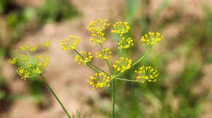
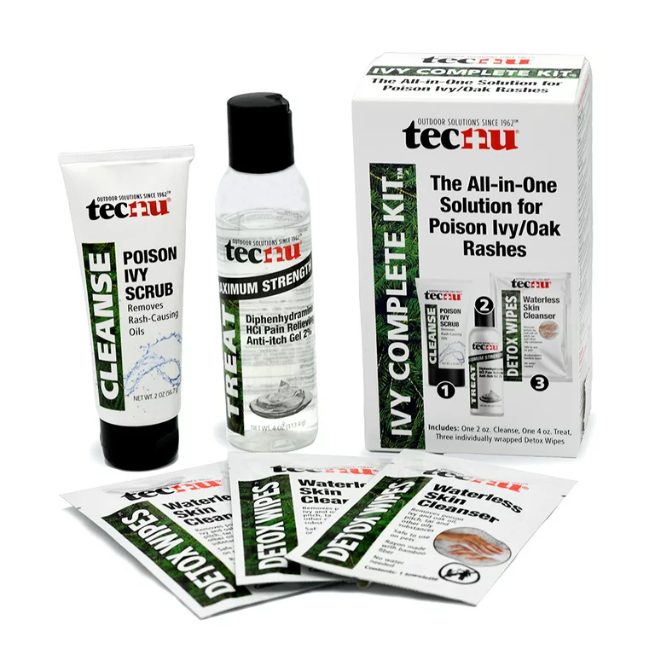
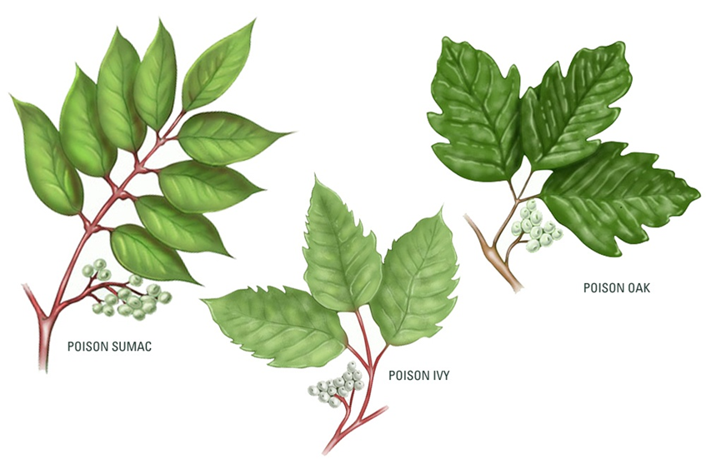
Plant toxins:
You may have heard the popular saying, "Leaves of three, let them be." When you encounter the oil from any part of these plants, you'll likely develop small bumps, itchy skin, redness, hives, or fluid-filled blisters. That can happen from five hours to 15 days after contact, but most commonly it occurs eight to 48 hours after.
Treating poison ivy, oak, sumac, and wild parsnip contact: If you've been exposed, wash the affected skin with rubbing alcohol and then with water. Wait to use soap until you've done this because it will move the oils around your body. Finally, take a shower with soap and water.

Slide 57
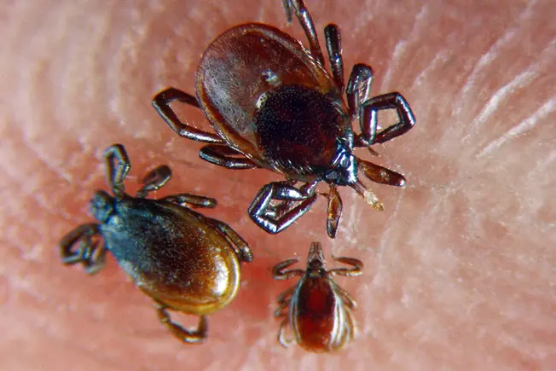
Ticks
Ticks can attach as you brush past grass and plants. Ticks don't always carry diseases, and most bites are not serious. But they can carry diseases including Lyme disease and Rocky Mountain spotted fever.
Once a tick latches onto skin, it often moves to the warm, moist armpits and groin, feeding on blood and passing on any disease it carries. A tick bite can also trigger an allergic reaction. If you have a tick, it is important to remove it properly.
To prevent tick bites, keep your arms, legs, and head covered when outdoors. Use tick repellant with DEET on skin or clothing, or products with permethrin on clothing. Check for ticks after spending time in grassy or wooded areas.
Little know fact: It usually takes 24-48 hours for a tick to transmit disease
Notes:
In the U.S., the Western black–legged tick and the deer tick can carry Lyme disease bacteria. Infected ticks usually don't spread the disease until they've been attached for at least 36 hours. The first sign of infection is often a circular skin rash. Early symptoms may also include fever, headache, and fatigue. Untreated Lyme disease may spread to other parts of the body, including the muscles, joints, heart, and nervous system.
To remove a tick grasp it with tweezers at the bast and slowly pull straight up, to pull out the entire tick.

Slide 58
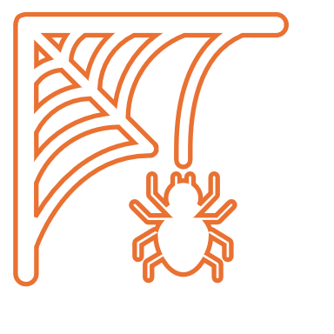
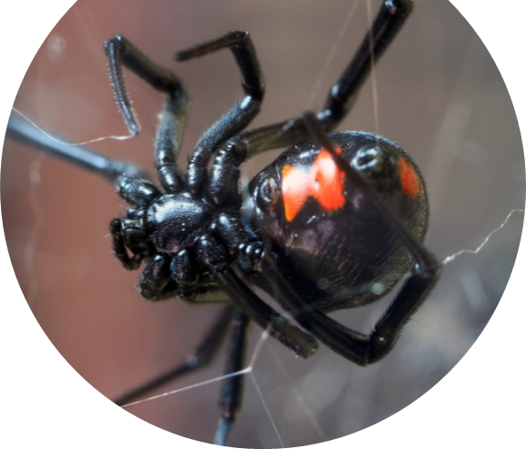
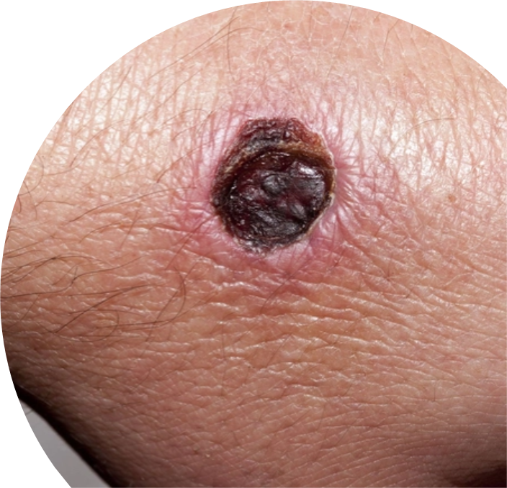
Black widow spiders
Wood piles and tree stumps are common places to find them. They are long-legged and glossy black, with a distinctive orange, red, or yellow "hourglass" shape on their underside. These spiders are roughly 1/3 inch wide and 1 1/2 inches long, counting their long legs.
Black widow spider bites may cause stabbing pain in the bite area, but they can also be painless. Look for one or two red fang marks, redness, tenderness, and a nodule at the bite site. Severe muscle cramps, difficulty breathing, nausea, vomiting, seizure, and a rise in blood pressure may follow soon after. Care for this is palliative and working towards evacuation, these bites aren’t usually fatal.

Slide 59
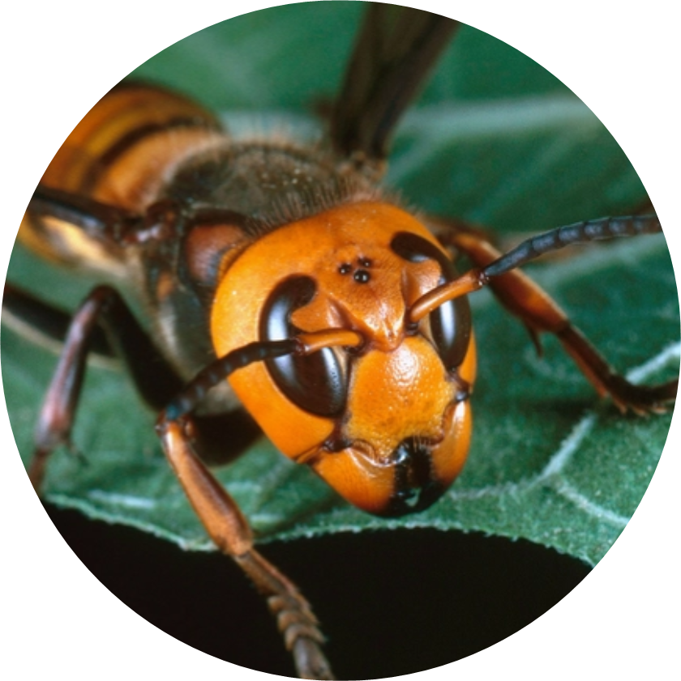
Asian giant hornet
The largest and most dangerous species of hornet in the world. It’s nicknamed “murder hornet”. This black and yellow-orange striped hornet doesn’t usually bother people or pets. But it can sting dozens of times if threatened.
Its stinger is a quarter-inch long and tough enough to pierce protective beekeeper wear. Venom from an Asian giant hornet is more toxic than from a domestic bee or wasp. A sting may feel like a hot nail. The venom can be serious or even deadly if you’re allergic. Walk away calmly if you spot the hornets. Put ice on the area right away if you’re stung. Get medical care if you’re stung multiple times

Slide 60
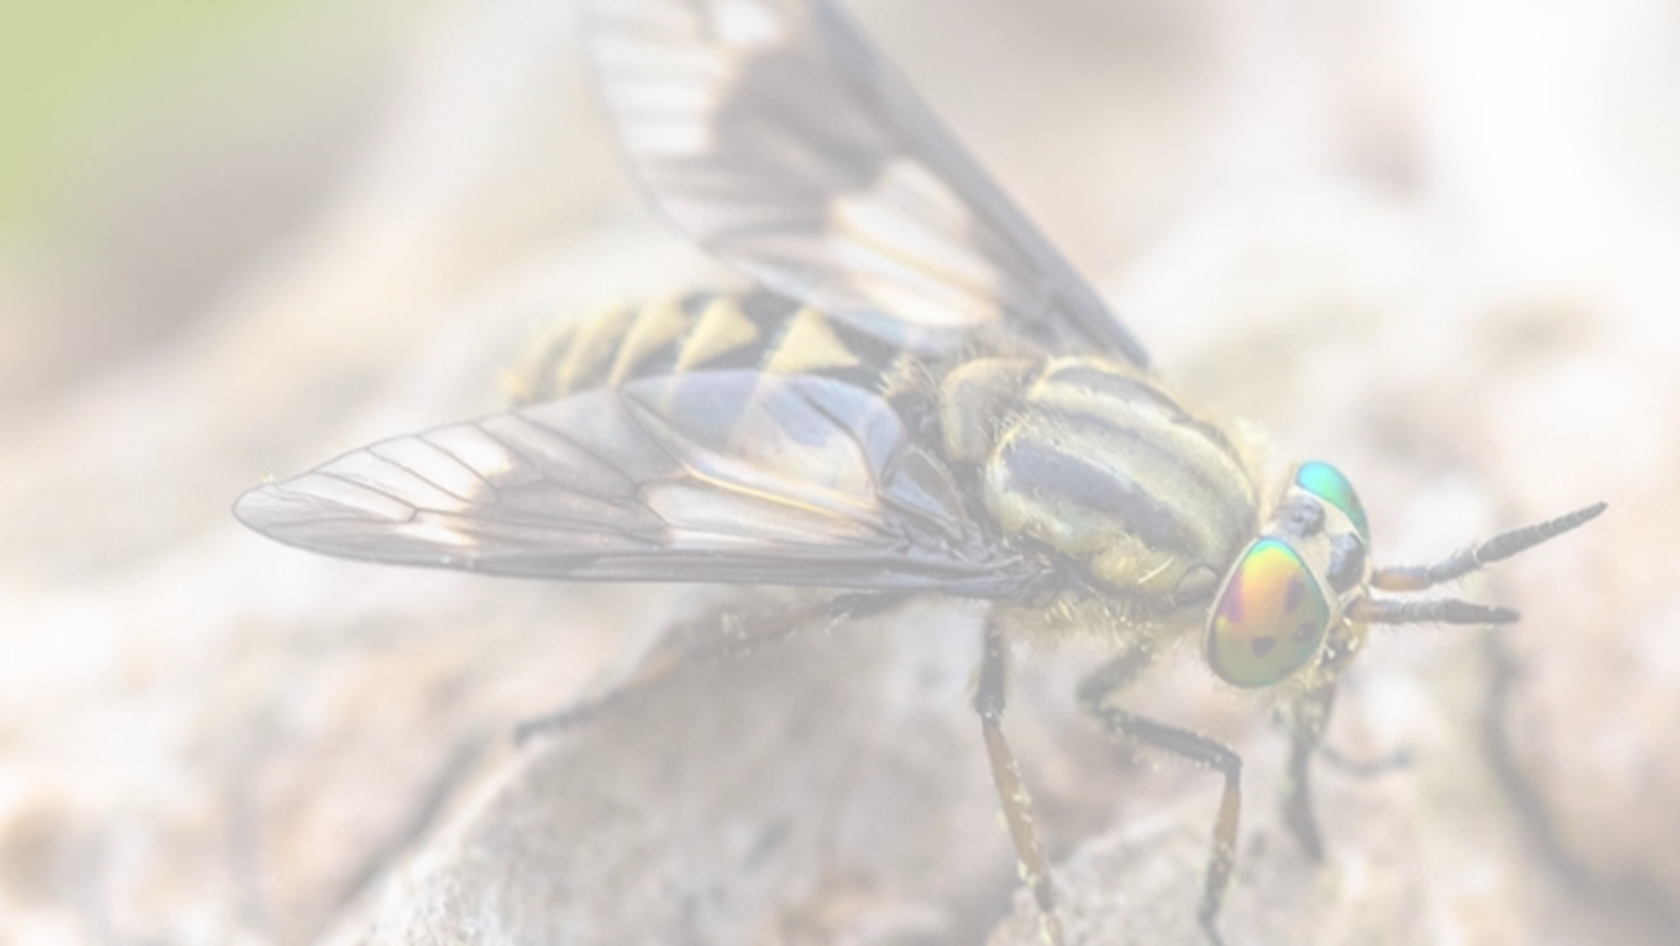
Deer Flies
These biting flies live in wetlands, forests, and other damp environs. Keep these painful bites clean and avoid scratching to help prevent infection. Some types of deerflies spread Tularemia, an infectious bacterial disease that requires medical attention. Insect repellant and protective clothing help prevent deerfly bites

Slide 61
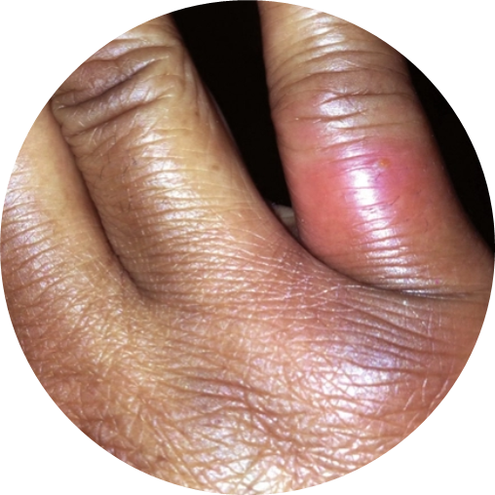
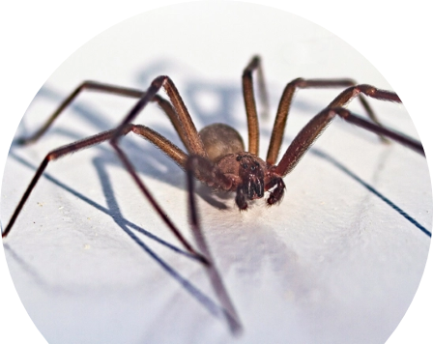
Brown recluse spiders
The spider's range in color from yellowish-tan to dark brown, with darker legs. Their venom is extremely toxic, and their bite can cause serious wounds and infection. Yet you may not feel their bite.
When the brown recluse bites, it is often painless; skin reddens, turns white, develops a red "bull's eye," blisters, and becomes painful. These bites are rarely fatal but can cause tissue necrosis and complications.

Slide 62
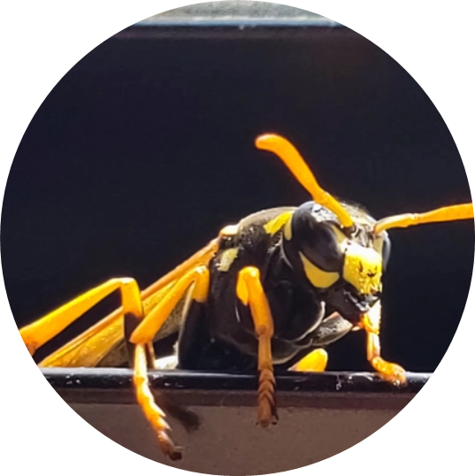
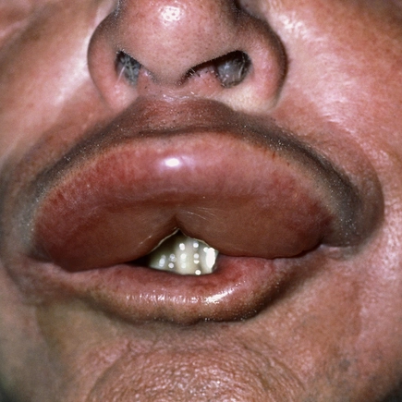
Bees, hornets, and wasps
When certain types of bees sting, they lose their stinger and die. But a wasp, hornet, or yellow jacket can inflict multiple stings because it does not lose the stinger. These stings can cause serious reactions in people who are allergic to them.
If you don't have an allergic reaction, simply remove the stinger, clean the sting site, apply ice, take oral antihistamine for itching, and take ibuprofen or acetaminophen for pain relief. If you have a severe anaphylactic reaction, use an epinephrine auto-injector if you have one. Call for emergency care. Lie down and carefully remove the stinger without squeezing the venom sac.

Slide 63
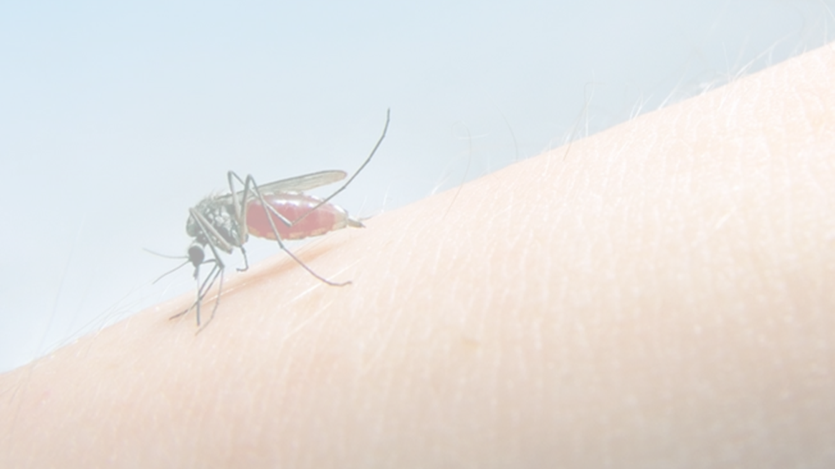
Mosquitoes
Mosquitoes aren't just annoying, they rank among the world's deadliest animals. Scratching a bite can cause a skin infection. Also, mosquitoes can carry West Nile virus, dengue fever virus, and other diseases including malaria. To protect yourself from mosquitoes, apply insect repellent and cover up when you go outdoors.

Slide 64
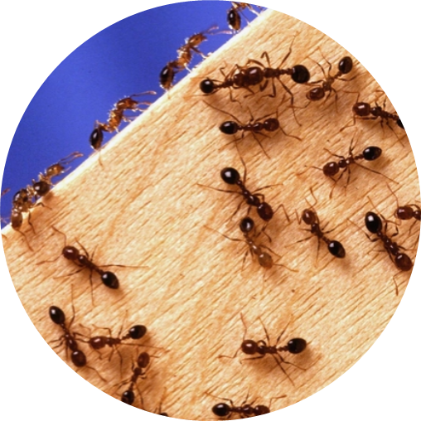
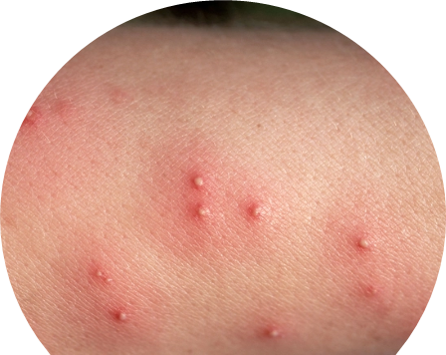
Fire ants
Fire ants look much like ordinary ants are found in most of the Southern states. They produce large mounds in open areas and are aggressive when disturbed. During an attack, the fire ant latches onto the skin with its jaw, then stings from its abdomen. It may inject venom many times
The fire ant sting typically causes red lesions that burn and itch. Painful pus-filled lesions can also occur. Cold packs, pain relievers, and antihistamines can help relieve the discomfort. A large number of stings may trigger a toxic or severe life-threatening allergic reaction. Get emergency care.

Slide 65
Chiggers
Chiggers are the juvenile (or larval) form of a type of mite. They only dine on humans in their juvenile form. Their bites are painless, but lesions are very itchy. Itching usually peaks a day or two after you're bitten.
After a few days of being attached to the skin, chiggers fall off, leaving itchy red welts. Over-the-counter products can help relieve itching. See your doctor if the skin appears infected or the welts appear to be spreading.

Slide 66
Animal bites
General bite care:
Pain, bleeding, numbness, and tingling may occur with any animal bite.
The site may also result in:
• Breaks or major cuts in the skin, with or without bleeding
• Bruising (discoloration of the skin)
• Crushing injuries that can cause severe tissue tears and scarring
• Puncture wounds
• Tendon or joint injury resulting in decreased motion and function of the injured tissue

Slide 67
Wound Care:
Because of the risk for infection, you should see a health care provider within 24 hours for any bite that breaks the skin. If you are caring for someone who was bitten:
• Calm and reassure the person.
• Wash your hands thoroughly with soap and water before treating the wound.
• If the wound is bleeding, put on latex gloves if you have them.
• Wash your hands again afterward.
To care for the wound:
• Stop the wound from bleeding by applying direct pressure with a clean, dry cloth.
• Wash the wound. Use mild soap and warm, running water. Rinse the bite for 3 to 5 minutes.
• Apply an antibacterial ointment to the wound. This may help reduce the risk for infection.
• Put on a dry, sterile bandage.
• If the bite is on the neck, head, face, hand, fingers, or feet, call your provider right away.
• For deeper wounds, you may need stitches. The provider may give you a tetanus shot if you have not had one in the last 5 years. You may also need to take antibiotics. If there is an infection that has spread, you may receive antibiotics through a vein (IV). For a bad bite, you may need surgery to repair the damage.

Slide 69
Snake Bites
In North America, venomous snakes include the rattlesnake, water moccasin, and the coral snake, also called cottonmouth and copperhead. Their bites can cause serious injuries and sometimes death.
If a venomous snake bites you, call 911 or your local emergency number right away, especially if the bitten area changes color, swells or is painful. Many emergency rooms have antivenom drugs, which may help you.
If possible, take these steps while waiting for medical help:
• Move far away from the snake.
• Stay still and calm.
• Remove any jewelry, watches or tight clothing before swelling starts.
• Sit or lie down so that the bite is in a neutral, comfortable position.
• Clean the bite with soap and water. Cover or wrap it loosely with a clean, dry bandage.
Notes:
Caution
Don't use a tourniquet or apply ice.
• Don't cut the bite or try to remove the venom.
Don't drink caffeine or alcohol.
• Don't take pain-relieving medicine, such as aspirin, ibuprofen (Advil, Motrin IB, others) or naproxen sodium (Aleve). Doing so can increase your risk of bleeding.
Don't try to catch or trap the snake. Try to remember its color and shape so that you can describe it. If possible, take a picture of the snake from a safe distance. Knowing what kind of snake bit you can help with treatment.

Slide 70
Bat encounters and bat bites:
Most people who have been bitten by a bat report a stinging or needle prick sensation. However, bat bites may not be noticed, especially if someone is asleep, and bat bites may leave little or no evidence of a wound or puncture.
Therefore, if there is any chance that there was physical contact with a bat, the bat should be tested for rabies. If the bat is not available for testing, then rabies post-exposure prophylaxis (PEP) should be administered.

Slide 71
Anxiety attacks can be a major concern when facing an emergency so its helpful to be able to distinguish these from a medical emergency
Anxiety attacks:
Some of the signs of anxiety include the following:
• Restlessness
• Difficulty concentrating
• Muscle tension
• Sleep difficulties
• Sudden periods of intense fear
• Pounding heart
• Sweating
• Trembling
• Shortness of breath
• Choking
• Feeling of impending doom
• Panic Attacks
The symptoms of a panic attack are not dangerous, but can be very frightening. They can make you feel as though you're having a heart attack, or that you're going to collapse or even die. Most panic attacks last somewhere from 5 minutes to half an hour.

Slide 72
The 333 rule is a common and informal technique for coping with anxiety. Its purpose is to help you ground yourself and calm down in a moment where you are feeling particularly anxious or overwhelmed.
The 333 rule involves looking around your current environment and:
naming 3 things you see
identifying 3 sounds you hear
moving or touching 3 things, such as your limbs or external objects
You should start to feel better in a few minutes. You may feel tired afterwards.

Slide 73
Staying Calm in Emergencies:
Some people undergo amazing transformations in emergencies: They can make a solid plan and tell everyone what to do in a calm voice. The rest of us freak out, yell, and drop things. The good news is, the rest of us can learn the ability to stay calm in an emergency. Here are some tips from survival and medical experts:
Get educated. The number one thing you can do to stay calm is to be relatively confident that you know what to do. Learn basic first aid, be prepared with (at least) basic supplies, learn survival skills, and download a few apps. The more you know, the less likely you are to panic.
Focus on a goal. The magnitude of things going on during an emergency can overwhelm many people. Practice tuning everything out except the one thing you’re doing and learn to focus on one task at a time. If the house is on fire, focus on getting the people out. If you’re performing CPR, do that one thing. If you’re the one calling 911, focus on the conversation with the operator and nothing else.
Breathe. In emergencies, the body naturally kicks into “fight or flight” mode. It’s common to start breathing rapidly and shallowly in the top of the chest – almost as if you have been running away from danger. You can override it by consciously taking long, deep breaths that feel like they’re filling the belly instead of the lungs. Tell the body you’re calm, and the mind will follow.
Learn to adapt. Almost every day we find ourselves facing a situation that didn’t go as planned. Experts say that the people who practice adapting instead of resisting unplanned outcomes are calmer in general. The next time something small goes wrong in your day, view it as an opportunity to practice a critical survival skill.
Be bold. We are so attuned to following the rules that it can be difficult to break social rules when we need to. In emergencies it’s perfectly okay to take emergency measures like disturbing the peace, bossing around total strangers, ripping expensive clothing or taking charge of someone else’s property as needed to save lives.
Take care of yourself. For a healthy portion of the population, panic and worry don’t just dissipate when an emergency is over. Emergency situations, or the threat of an emergency, can cause prolonged panic, anxiety and worry that can keep you from being clear-headed in daily life. If you find yourself panicking or worrying instead of taking charge, learn a few tricks to manage anxiety.

Slide 74
American Heart Association: Basic Life Support, Standard first aid
Stop the bleed/ FAST (First Aid for Severe Trauma)
American outdoor school wilderness first aid
Notes:
AOS (free class if you don’t take the certification) Certification $99

