Slide 1


PART-TIME FLEXIBLES
Region 6
NBA David Mudd
Instructors
RAA Ronnie Roush
Pete Palmer – Branch 1
Guidance for Union Representatives as
PTFs Re-emerge onto Workroom Floors

Slide 2
PTF = PART-TIME FLEXIBLE
Career employees with flexible schedules, start-times and no set non-scheduled days.
What is a PTF?

Slide 3
MEMORANDUM OF UNDERSTANDING BETWEEN THE UNITED STATES POSTAL SERVICE AND THE NATIONAL ASSOCIATION OF LETTER CARRIERS, AFL-CIO
Re: City Carrier Assistants – Conversion to Career Status
The U.S. Postal Service and the National Association of Letter Carriers, AFL-CIO agree that City Carrier Assistants (CCAs) who reach 24 months of relative standing will be converted to part-time flexible career status in their installation.
*Page 160 of 2019-2023 National Agreement
Why are PTFs more common (again)?

Slide 4
• Conversions to career status will be effective as soon as practicable, but no later than 60 days from the ratification date of the 2019 National Agreement or the first day of the third full pay period that follows the date a CCA achieved 24 months of relative standing, whichever is later;
Some Specifics of this MOU…

Slide 5
• Conversions made under this MOU are in addition to conversions to FTR opportunities pursuant to the MOU, Re: Full-time Regular Opportunities – City Letter Carrier Craft;
Some Specifics of this MOU…

Slide 6
• CCAs may decline the opportunity to be converted to career status under this MOU. A CCA who does not accept the career opportunity will no longer be eligible for conversion to career status under this MOU but will retain his or her relative standing and will remain eligible for conversion to career status under the Memorandum of Understanding, Re: Full-time Regular Opportunities – City Letter Carrier Craft (pp 161-165 NA).
Some Specifics of this MOU…

Slide 7
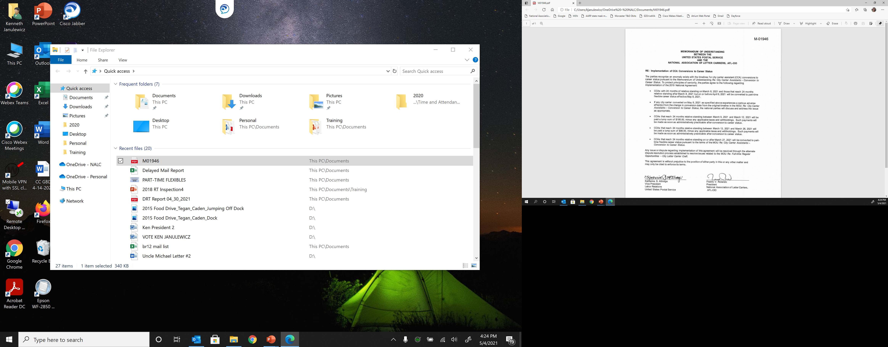
Which Led to MOU 01946…

Slide 8
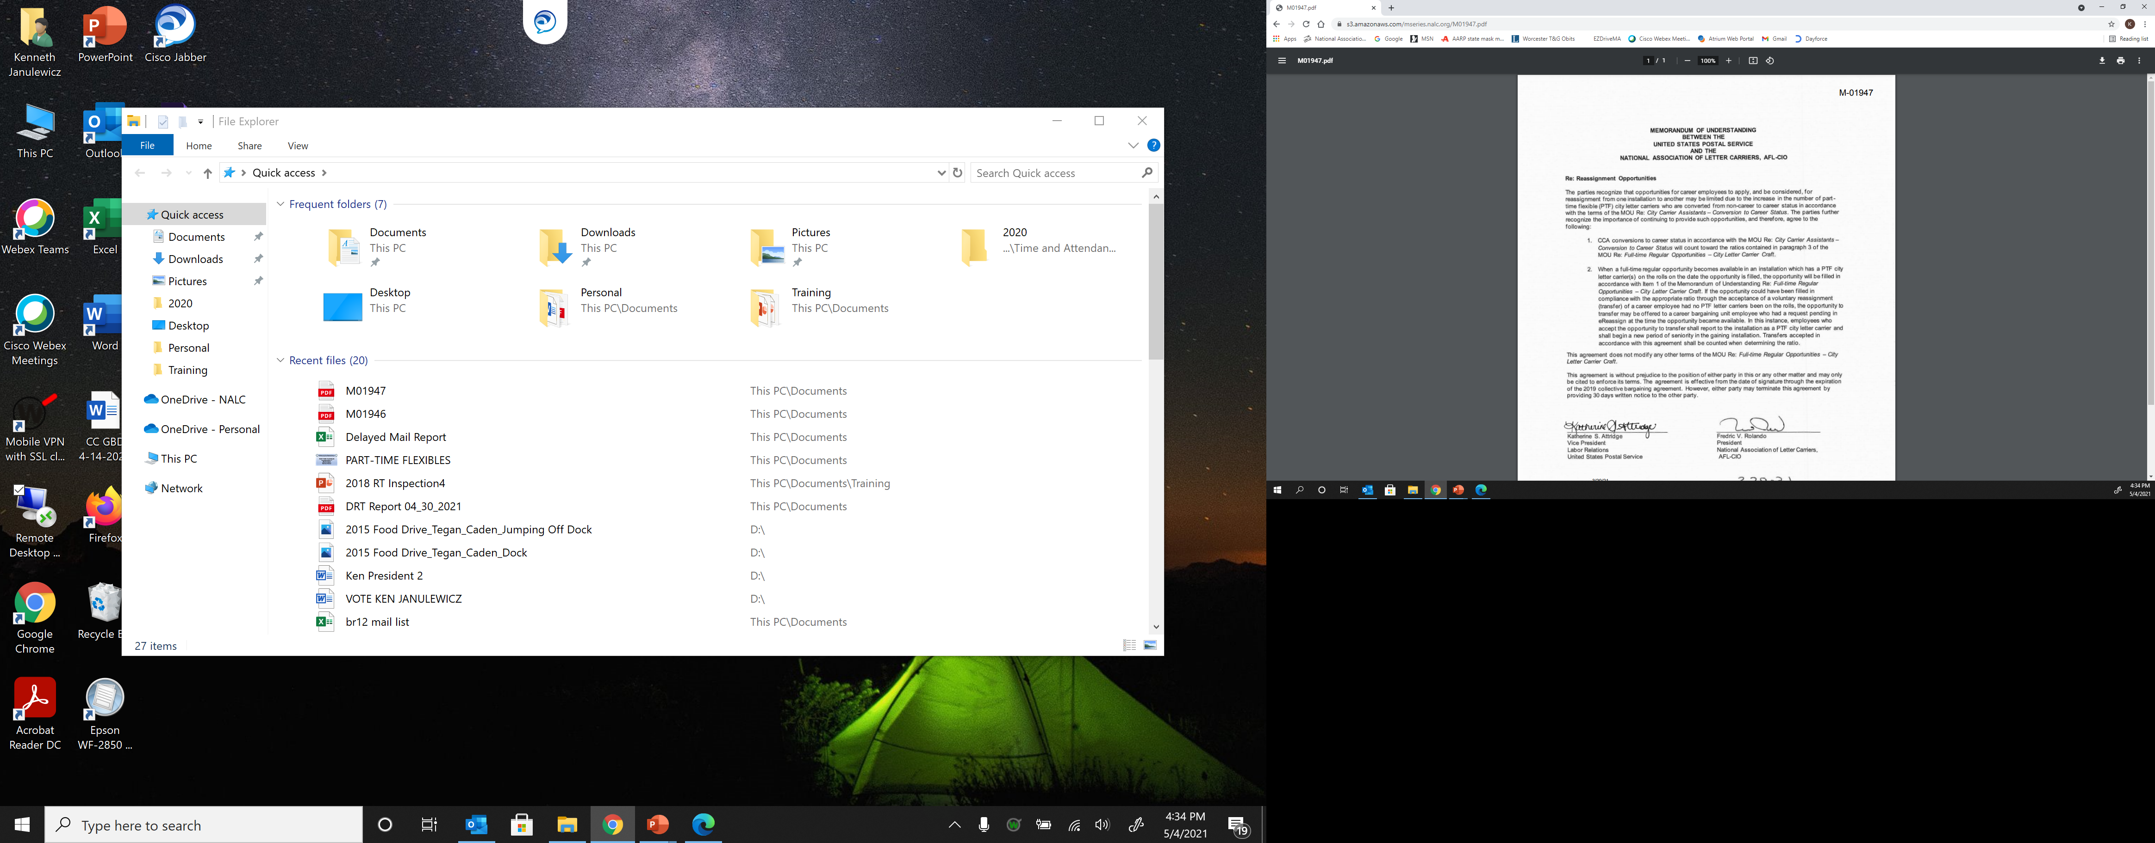
And of Course, MOU 01947…

Slide 9
M-01947 Impact
  Residual vacancy occurs and, due to the 1:4 or 1:6 ratio, a Transfer from eReassign would be taken:
  PTF IN OFFICE
  The PTF is converted to FTR and assumes the residual vacancy. The Transfer comes to your office as the junior PTF
  NO PTF IN OFFICE
  The Transfer comes to your office as a FTR and assumes the residual vacancy

Slide 10
PTF Gains Versus CCA
    More $$
    Paid Sick Leave
    A/L Carryover (normally up to 440 hours)
          No more Terminal Leave Payout!
    USPS Contributions Towards Retirement

Slide 11
PTF Gains Versus CCA (cont.)
    Can Participate in the TSP
    Full Uniform Allowance on Citibank Card
    USPS Contributes more to Health Ins.
    Relative Standing SENIORITY!
          A/L selections, Opting, Conversion to FTR
          Relative Standing only used for tie-breaker

Slide 12
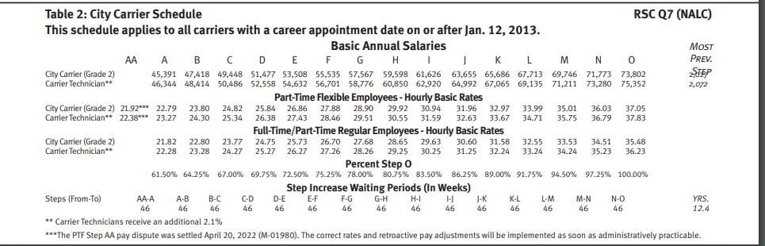




8/27/22 Pay Chart Table 2

Slide 13
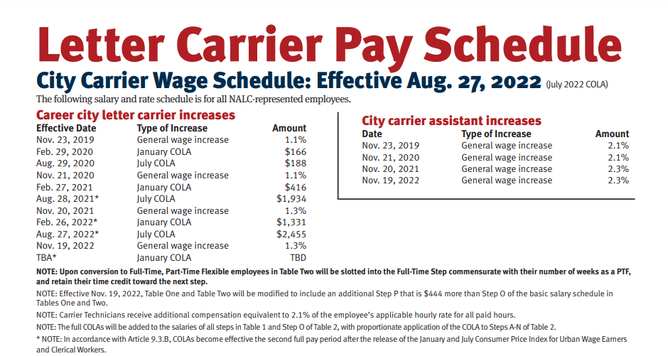
8/27/22 Raises & COLAs

Slide 14
PTF Pay Rates
  PTFs begin in new Step AA ($21.92/$22.38)
    Equal to FTR Step A
    Receives proportional COLAs
    46 week waiting period to PTF Step A
    46 week waiting period for A-B, B-C, C-D, etc.

Slide 15
PTF Pay Rates (cont.)
  Upon conversion to FTR
    PTF slotted into Step commensurate with their number of weeks as PTF

Slide 16
PTF Pay Rates (cont.)
    PTFs receive the following rates of pay based on the number of hours worked:

Slide 17
PTF Pay Rates (cont.)
    Up to 8 hours in 1 day…Straight-time
    From 8-10 hours worked in 1 day…Overtime
    Over 10 hours worked in 1 day…$Penalty Overtime$*
    Over 56 hours in a service week…$Penalty Overtime$*
    *Excluding December (Article 8.4.E)

Slide 18
PTF Pay Rates (cont.)
    PTFs are limited to 11.5 hours of work per day (ELM 432.32)

Slide 19
PTF Schedules
PTFs are part of the regular workforce (Art 7.1.A.2)
      Flexible hours and days;
      No weekly workhour guarantees
        Daily work-hour guarantees apply, same for CCAs
          4 hours work or pay with 200 or more workyears
          2 hours for all other facilities;

Slide 20
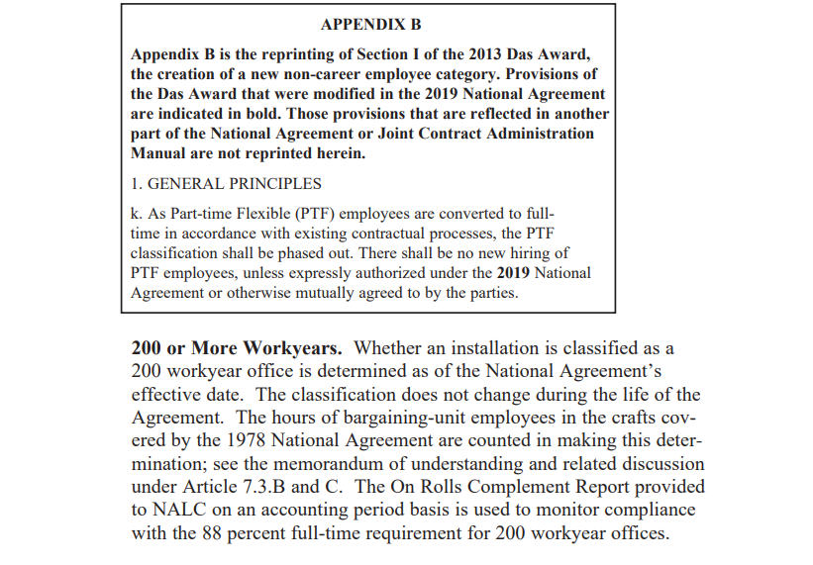
PTF Schedules (cont.)

Slide 21
PTF Schedules (cont.)
      Can still work Sundays with or without CCAs
        Sunday Premium Pay now applies (Article 8.6)
          Extra 25% of base hourly straight-time rate
          After 8 hours, normal OT rules apply

Slide 22
PTF Schedules (cont.)
PTFs can do Split Shifts or be Called Back
  Notified prior to clocking out to return with-in 2 hours:
    Considered a Split Shift, no new guarantee applies

Slide 23
PTF Schedules (cont.)
PTFs can do Split Shifts or be Called Back (cont.)
  Notified prior to clocking out to return after 2 hours:
    Must receive 2 or 4 hour guarantee for 1st shift
    AND
    Must be given another minimum guarantee for 2nd shift
    >>Applicable to any size office<<

Slide 24
PTF Schedules (cont.)
PTFs can do Split Shifts or be Called Back (cont.)
  If assignment is completed, PTF has clocked out, and has left the premises regardless of intervals between shifts:
    Guarantee of 4 hours pay if called back
    >>Applicable to any size office<<

Slide 25
PTF Schedules (cont.)
Article 7.1.C.4
Over the course of a service week, the Employer will make every effort to ensure that qualified and available part-time flexible employees are utilized at the straight-time rate prior to assigning such work to CCAs working in the same work location and on the same tour, provided that the reporting guarantee for CCA employees is met.

Slide 26
PTF Schedules (cont.)
2022 JCAM (Page 8-3)
Stand-by. PTFs and CCAs may not be required to remain on stand by or remain at home for a call-in on days they are not scheduled to work.

Slide 27
PTF Schedules (cont.)
2022 JCAM (Page 8-3)
Breaks: PTFs and CCAs receive the same rest breaks as full-time letter carriers when they work eight hours or more in a service day. When PTFs and CCAs work only a portion of a day (less than eight hours) they receive one rest break if the employee works less than six hours and two rest breaks if the employee works six hours or more.

Slide 28
PTF Schedules (cont.)
2022 JCAM (Page 12-17)
Full-time and part-time flexible employees involuntarily detailed or reassigned from one installation to another who do not qualify for relocation benefits shall be given not less than thirty days advance notice, if possible. Note that this provision applies not only to those employees who are involuntarily reassigned or excessed from one installation to another, but also to employees, including part-time flexibles, who are temporarily detailed on an involuntary basis.

Slide 29
Leave Entitlements
Article 10 and ELM Section 510 Outlines Leave Program
Annual Leave
  less than 3 years = 1 hour/20 hours in pay status (13 days)
  3 years < 15 years = 1 hour/13 hours in pay status (20 days)
  15 years or more = 1 hour/10 hours in pay status (26 days)
  Military Veterans, with DD Form 214, receive credit towards their years of service for earning annual leave

Slide 30
Leave Entitlements (cont.)
Sick Leave
  1 hour/20 hours in pay status (up to 104 = 13 days)
Court Leave
  Eligible if completed 90-day probationary period
  Paid if otherwise in work status or scheduled for leave
  Leave shall not exceed 8 hours/40 hours

Slide 31
Leave Entitlements (cont.)
Military Leave
  For PTFs who are members of National Guard or Reserves
  Paid for hours PTF would have worked during regular schedule
  1 hour military leave for each 26 hours in pay status
  Must have minimum of 1,040 in preceding fiscal year (Oct-Sept)
  Paid Military Leave can’t exceed 80 hours annually

Slide 32
Article 11: Holidays
  Per Article 11.7
  A part-time flexible schedule employee shall not receive holiday pay as such. Part-Time Flexible employees other than those in Step AA shall be compensated for the eleven (11) holidays by basing the employee’s regular straight time hourly rate on the employee’s annual rate divided by 1,992 hours.

Slide 33
Article 11: Holidays (cont.)
  For work performed on December 25, a part-time flexible employee shall be paid an additional 50% for each hour worked up to eight (8) hours.
Note – Holiday portion of PTF hourly straight-time rate not used when calculating overtime or Sunday Premium (May 2021 PR Pg. 16)

Slide 34
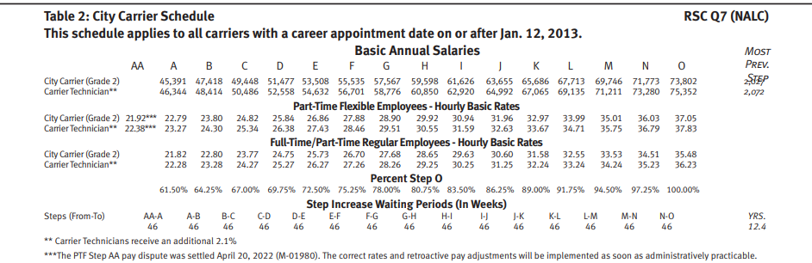


Article 11: Holidays (cont.)
1992 vs 2080

Slide 35
Article 16
JCAM page 16-13
"Discipline issued to a CCA may not be considered or cited in determining whether to issue discipline to the CCA employee after his or her conversion to career status".
CCA conversion to PTF is “conversion to career status”

Slide 36
Health Benefits
PTFs can participate in the FEHB Program
  Have 60 days to join once converted
    Package info sent via US mail – lists plans & costs
    Self Only, Self Plus One, Self and Family
    Union is entitled to time on the clock to discuss Health Benefits (pg. 17-9 JCAM)

Slide 37
Health Benefits (cont.)
PTFs can participate in the FEHB Program (cont.)
  Non-Career HB Plan terminates…
    Last day of the month that is 28 days after CCA is converted to career
    OR once enrolled in a FEHB Plan
    Whichever is EARLIER

Slide 38
Health Benefits (cont.)
PTFs can participate in the FEHB Program (cont.)
  Article 21.1.B of National Agreement
    73% for 2020 & 2021
    72% for 2022 & 2023

Slide 39
Health Benefits (cont.)
Online FEHB information:
WWW.OPM.GOV

Slide 40
Health Benefits (cont.)
FEDVIP – Federal Employees Dental & Vision Insurance Program
  Voluntary Program
  Provides Supplemental Dental & Vision Benefits
  Enrollee-pay-all basis (no USPS contributions)
  www.benefeds.com

Slide 41
Health Benefits (cont.)
  FSA – Flexible Spending Account
    Pre-tax dollars
    Can use for out-of-pocket health care expenses
    www.fsafeds.com

Slide 42
Health Benefits (cont.)
    FEGLI – Federal Employee Group Life Insurance
      Automatic enrollment for basic coverage
      Coverage can be waived
      USPS pays entire cost for basic coverage
      Coverage is Annual Rate of Base Pay rounded up to the next $1,000 plus $2,000

Slide 43
Health Benefits (cont.)
    FEGLI – Federal Employee Group Life Insurance (cont.)
      Additional options and coverage available (up to 5X annual salary)
      Optional coverage for spouse and eligible dependent children
      60 days to enroll using form SF 2817
      Open seasons are rare

Slide 44
Health Benefits (cont.)
Online FEGLI information:
      WWW.OPM.GOV

Slide 45
Retirement
      **IT IS NEVER TOO EARLY TO START CONTRIBUTING**
      FERS – Federal Employee Retirement System
        Three Components
          FERS Basic Benefit Plan (defined)
          Social Security (defined)
          Thrift Savings Plan (401k-ish)

Slide 46
Retirement (cont.)
      **IT IS NEVER TOO EARLY TO START CONTRIBUTING**
      USPS automatically contributes 1% of base pay
      USPS will match up to 5% of base pay
      TSP participation is voluntary
        Automatically enrolled for 5% of base pay
        Can elect to change or stop contributions

Slide 47
Opting/Temp Bids
      Article 41 of the National Agreement
      PTFs can Opt on vacant assignments of 5 days or more
      Awarded on basis of seniority
        Full-time Reserve, UARs, & PTFs have preference (41.2.B.3 & 4)

Slide 48
Opting/Temp Bids (cont.)
      Article 41 of the National Agreement (cont.)
        Works assignment until Regular returns/new Regular is assigned (Duration Clause)
        Entitled to work regular schedule/hours
        *Management cannot unilaterally change the N/S day

Slide 49
Opting/Temp Bids (cont.)
      Article 41 of the National Agreement (cont.)
        Can only be removed to provide FTR 8-hours
        When converted to full-time can voluntarily end hold-down (Art. 41.1.A.7)
        Can request assignment to Carrier Technician temporary vacancies Article 25 now applies!

Slide 50
Layoff Protection
  Article 6 – No Layoffs or Reduction in Force
  Provides security to career employees
    Original Arbitration Award from Arbitrator James J Healy
        September 15, 1978
    PTFs are CAREER employees
    Once 6 years of continuous service is reached

Slide 51
Layoff Protection (cont.)
  Article 6 – No Layoffs or Reduction in Force
    Must work at least 1 hour in at least 20 of 26 PP
    Absences from duty considered work:
        Paid Leave, Military Leave, LWOP for Union Business, OWCP

Slide 52
Voluntary Transfers
  Must serve a lock-in period in their current installation
  Local Transfers (within current or adjacent District)
      18 months
    All Other Transfers
      12 months

Slide 53
Voluntary Transfers (cont.)
  Fair Consideration When Evaluating Requests
      “Normal Considerations”
        Attendance
        Work & Safety Record

Slide 54
Article 13 – Light Duty
  PTFs who are unable to perform their normal duties as a result of non-work related illness or injury qualify to submit requests for Light Duty work.
  (Article 13.2.A)

Slide 55
Article 13 – Light Duty (cont.)
  Requests Must Be In Writing
  Medical Statement From Licensed MD
  Goes to Installation Head/Postmaster
  LMOU Items 15, 16, 17
  *Keep copies of all documentation

Slide 56
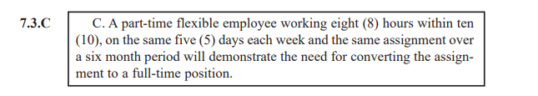
Maximization
Article 7.3.C applies to all installations regardless of size M-01032

Slide 57

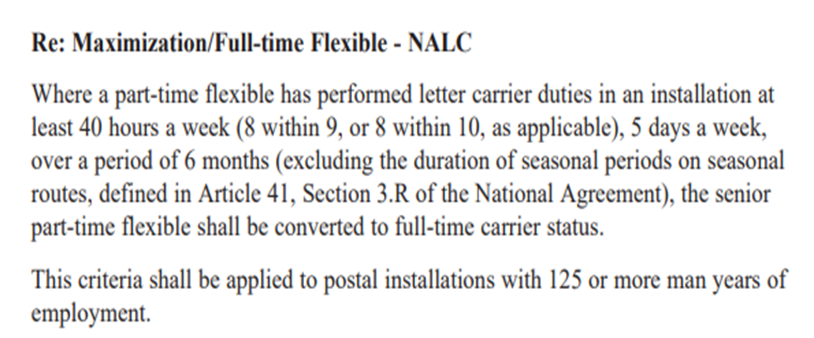

Slide 58

Questions?

Slide 59
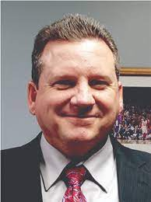

Questions?
Any questions call “The David Mudd”.
586-997-9917 Office

