Slide 1
ajhd aidan james hurren design
ibiza
the renovation and extension of an old finca in the countryside

Slide 2
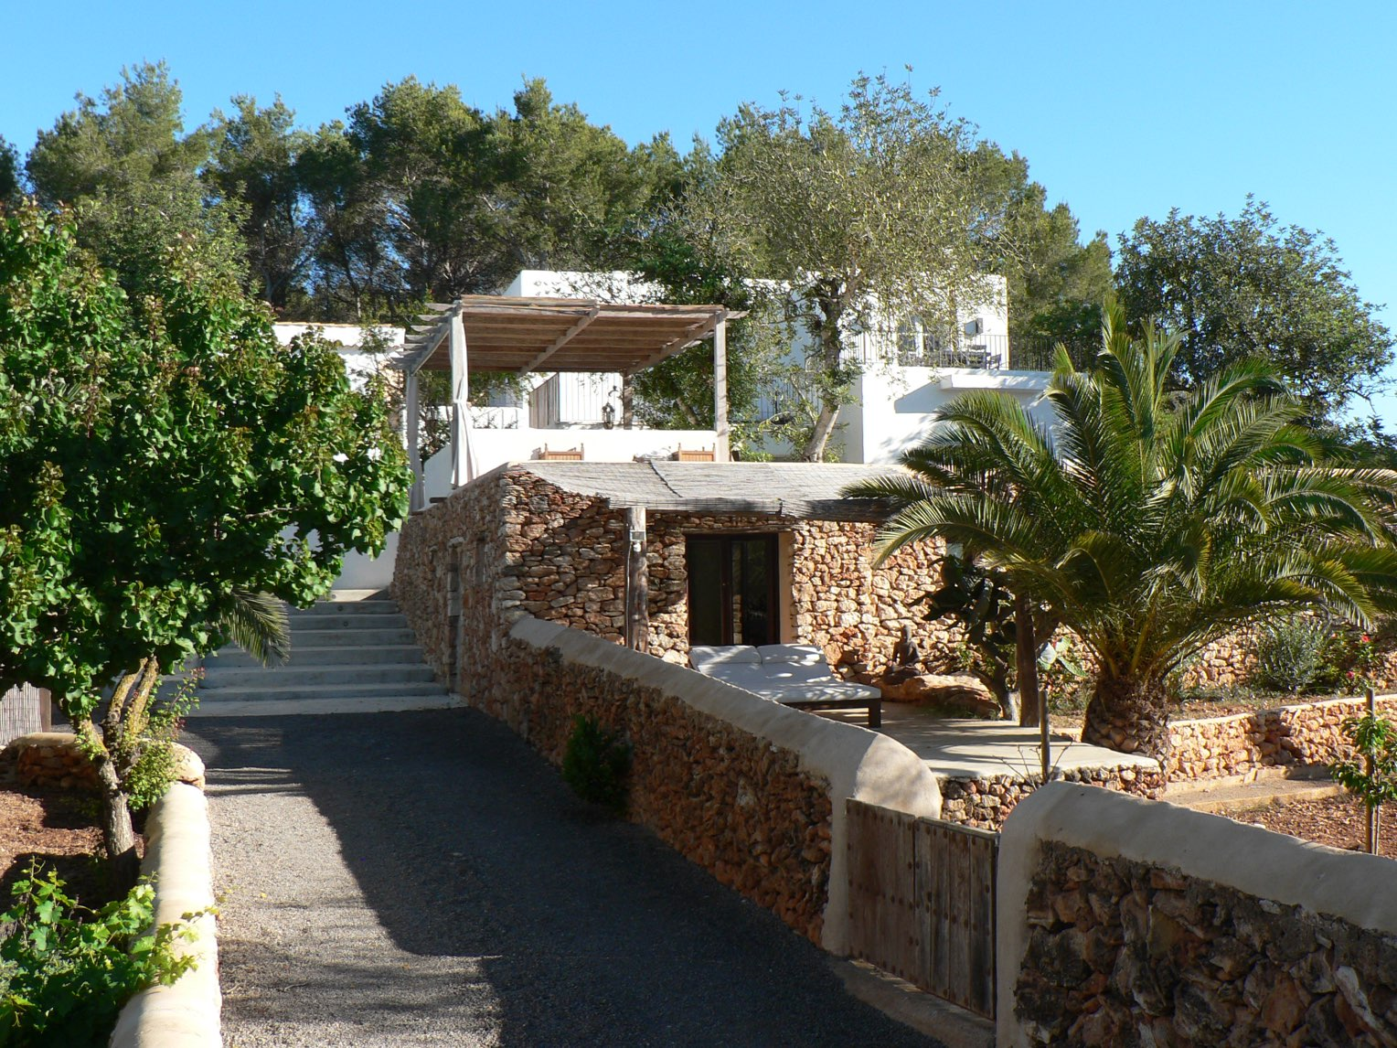
ajhd aidan james hurren design
an old Ibicencan finca,
which had only two bedrooms in the main building to start with, but by the time we had finished renovating and extending the house, converting the old animal pens and making new buildings where ruins had been, the property had 8 bedrooms and 7 bathrooms!
The existing pool was revamped, and a new plunge pool created.
A pool-house and a games room were also created, and with such a varied arrangement of different buildings it feels almost like a small hamlet rather than one single house, with numerous hidden-away corners for relaxing privately, but also many glorious terraces where the numerous guests can gather.
Given it’s position deep in the Ibiza countryside, the architecture of all the works were kept in a traditional style using traditional materials, so the finished property looks as if it has always been there.

Slide 3
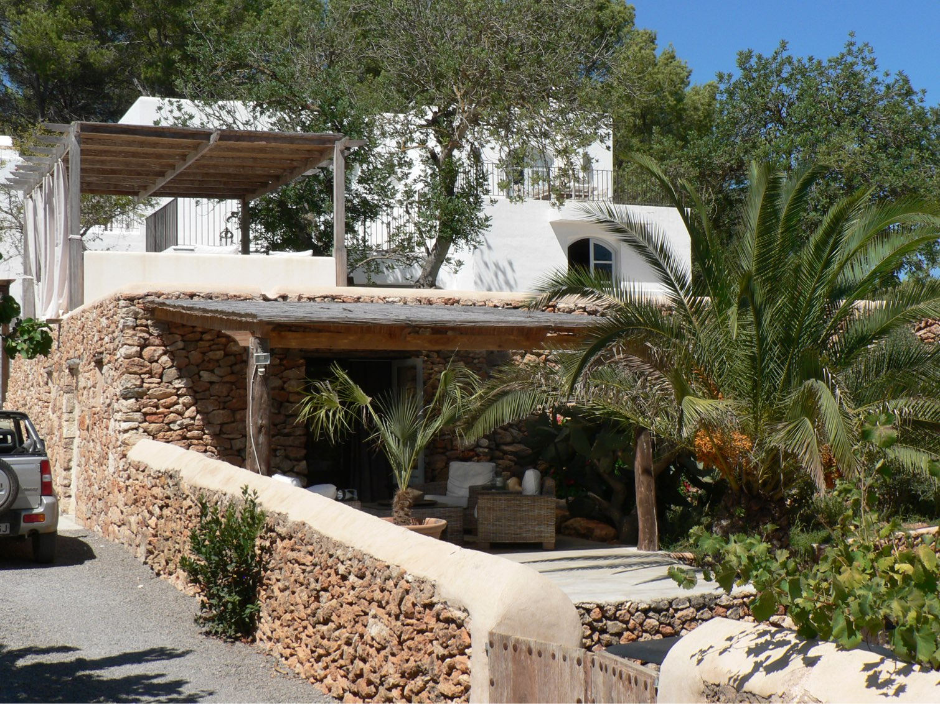
ajhd aidan james hurren design
The drystone walls of the old animal corrals were completely rebuilt to create a new bedroom suite.
The white-painted house remains the most noticeable part of the whole property, surrounded by many large and established trees and the newer planting.

Slide 4
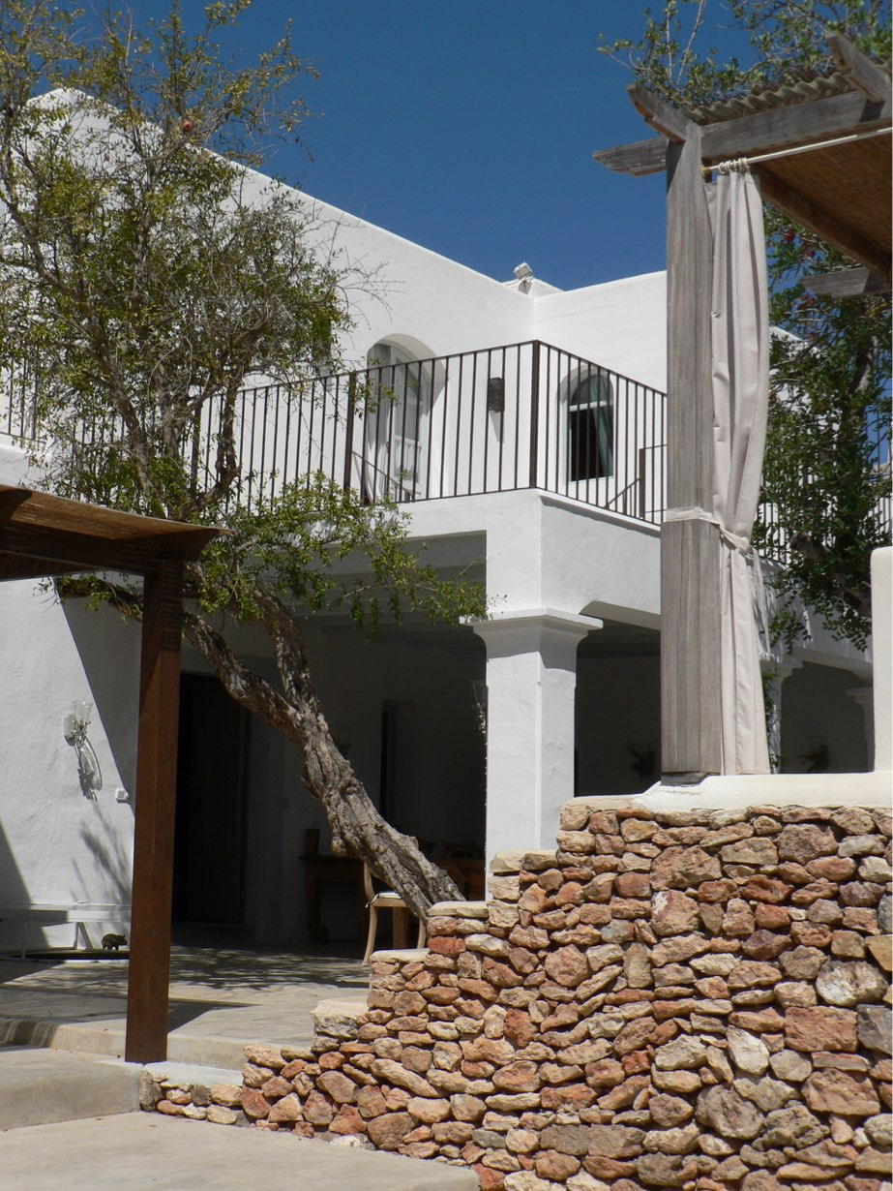
ajhd aidan james hurren design
The entrance to the main house.
The large porche was built anew, making a large terrace outside the new bedroom, created on the flat roof of the original house.
This covered area makes the perfect al fresco dining terrace.
The stepped drystone wall in the foreground of the photo is the side of the steps leading to the elevated seating area, shaded by the Balinese pergola

Slide 5
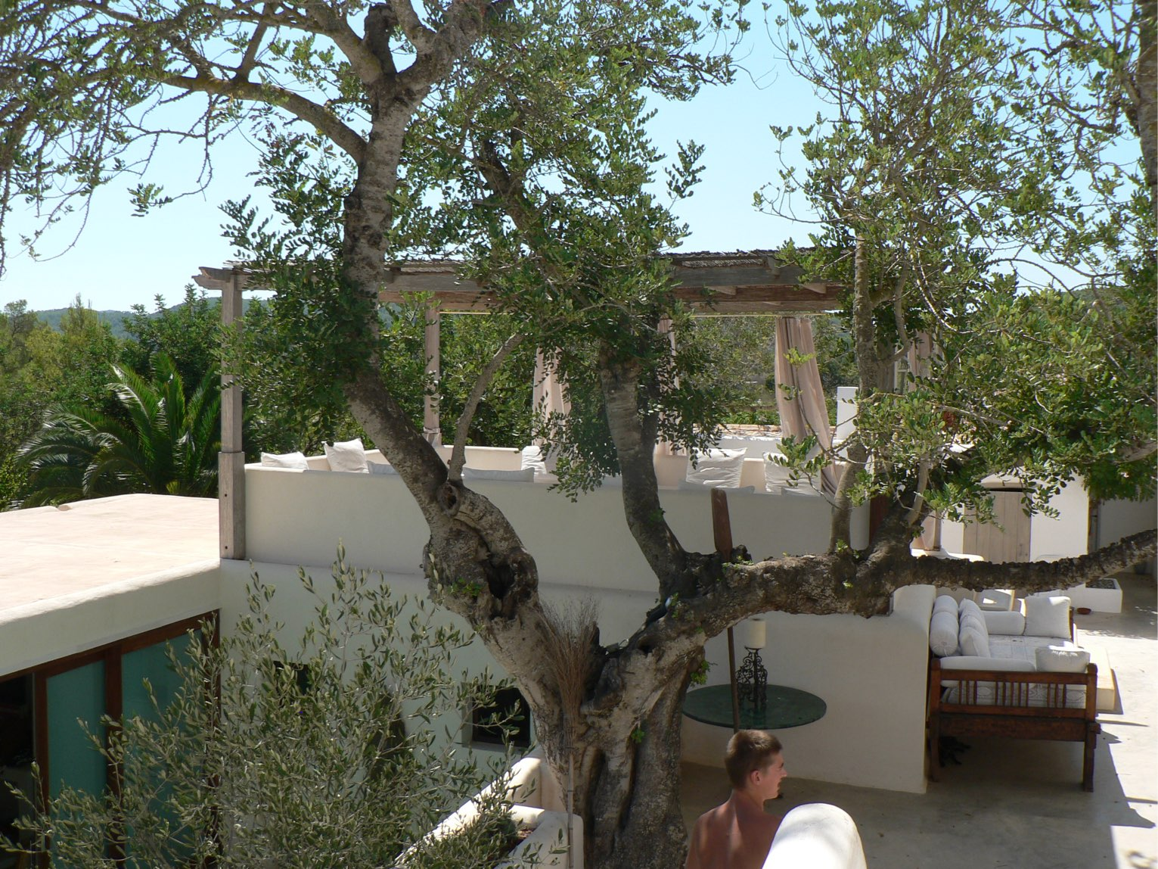
ajhd aidan james hurren design
a Balinese Pergola
stands on the roof of the converted animal corrals, and makes a spacious seating area.
On the left of the picture the sliding doors to the Pool room can just be seen, opening on to
the Plunge Pool below,
shaded by the ancient carob tree

Slide 6
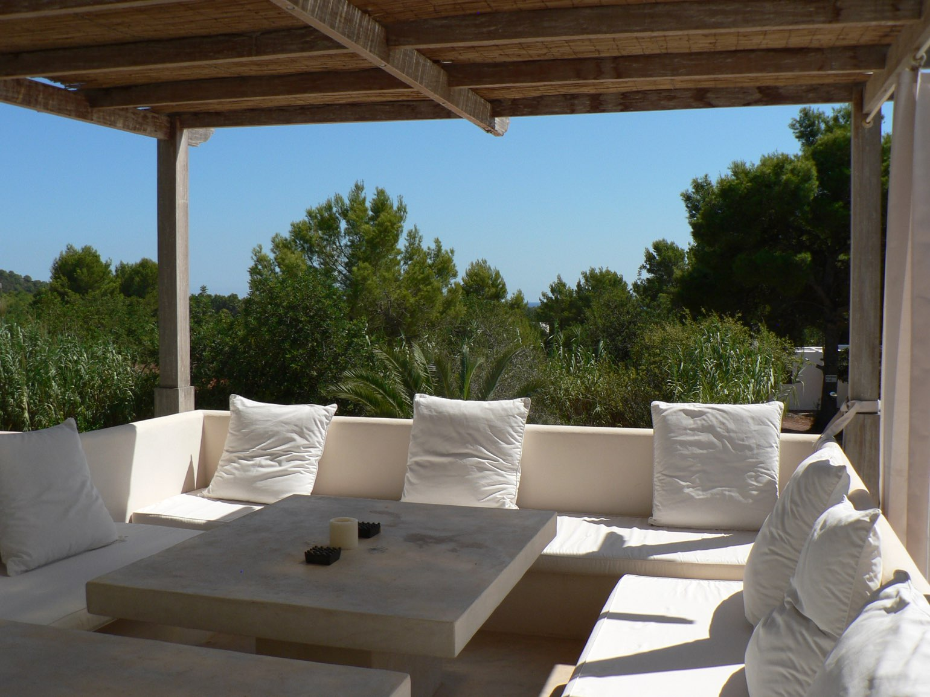
ajhd aidan james hurren design
The Balinese Pergola
has bench seating and centre tables, all in a polished, white cement finish, with white canvas cushions

Slide 7
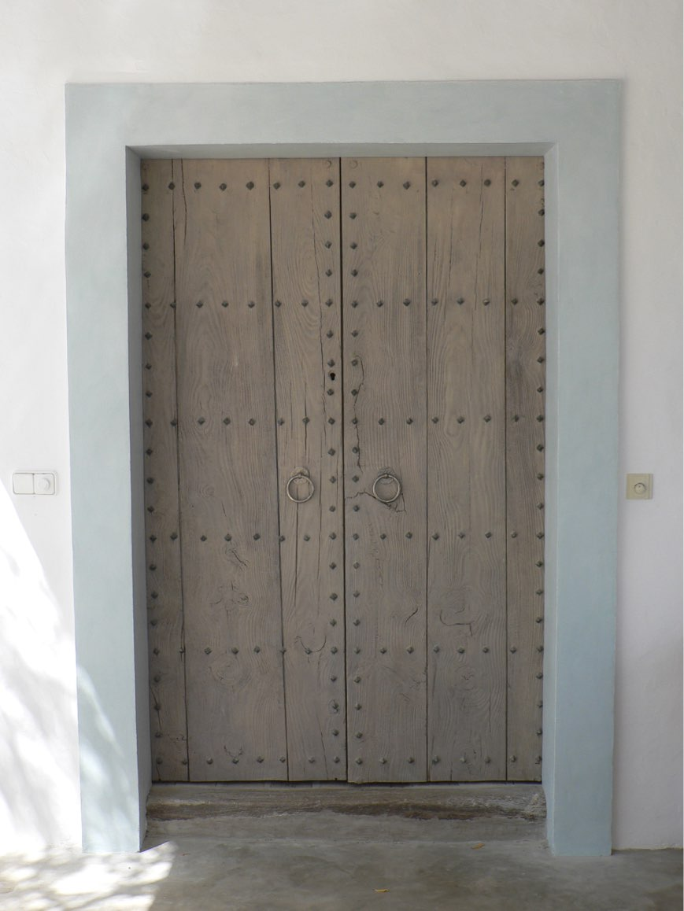
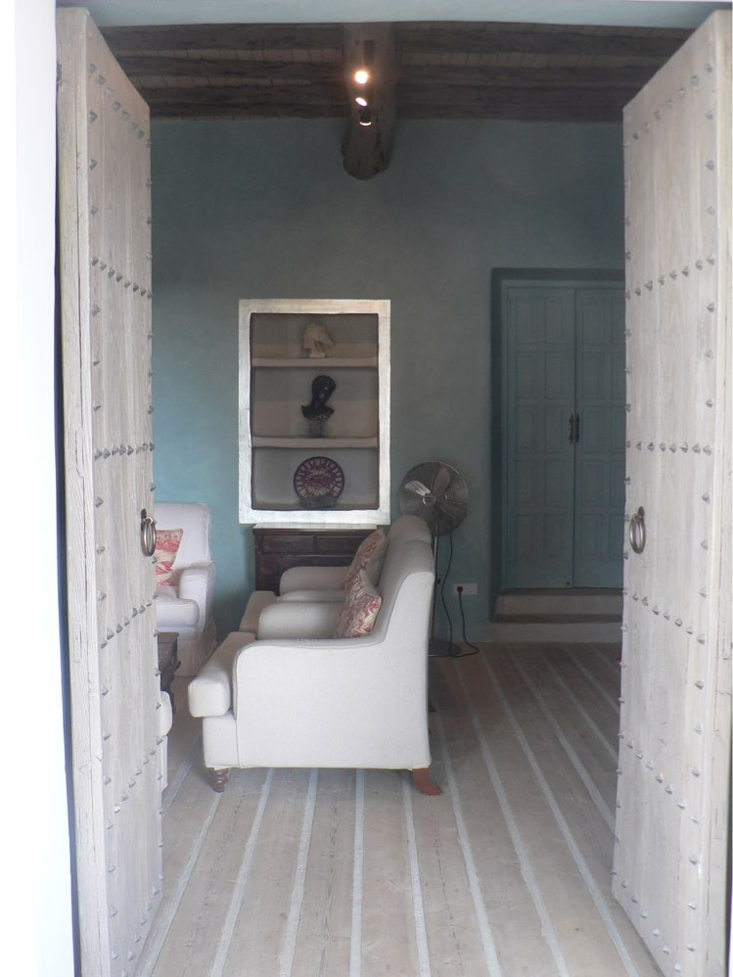
ajhd aidan james hurren design
The very old, dark and heavy timber doors to the house were revived
with a specialist effect to give the the look of sun-bleached wood

Slide 8
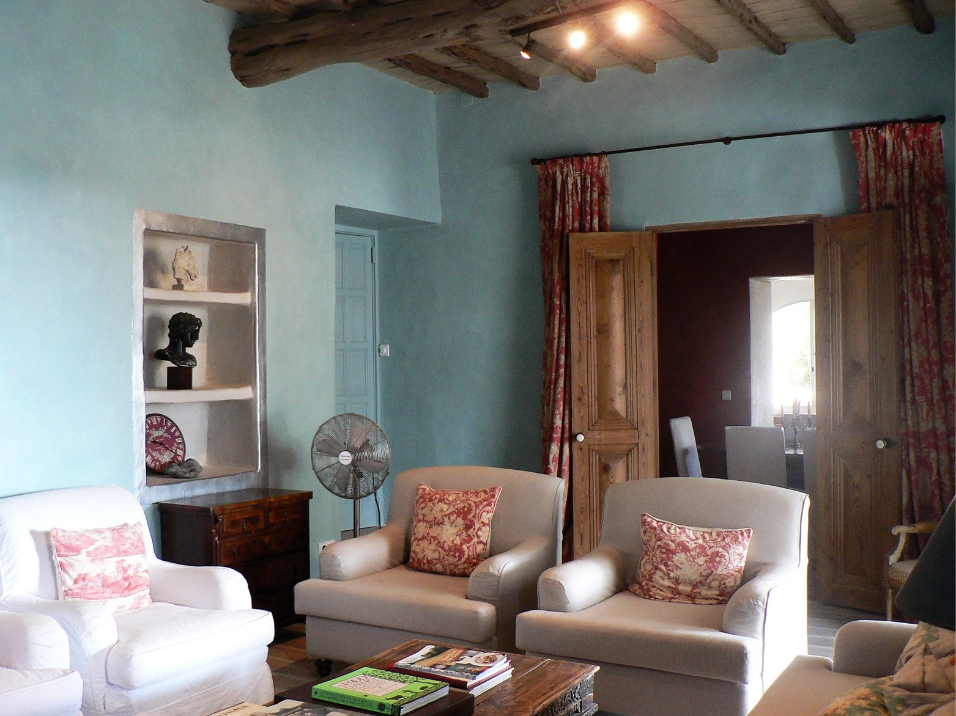
ajhd aidan james hurren design
The Snug

Slide 9
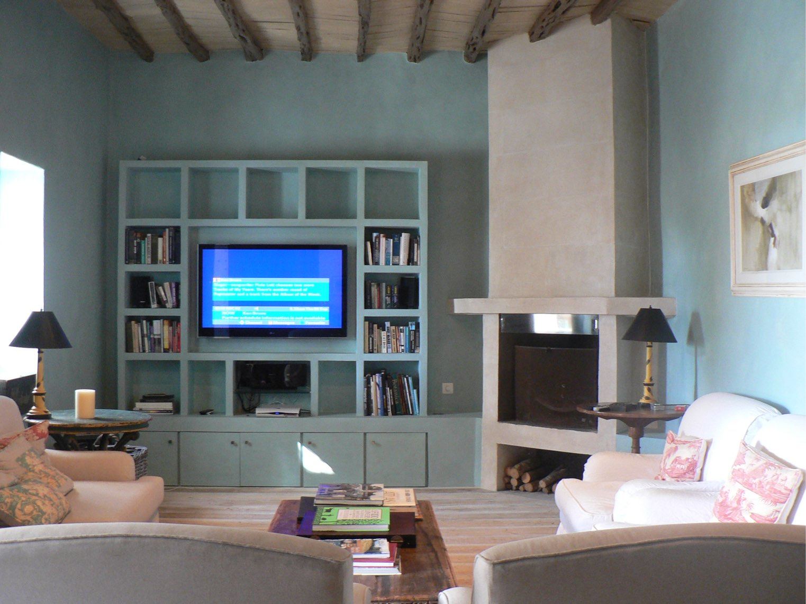
ajhd aidan james hurren design
The Snug
The walls and the new masonry shelving were plastered smooth, and specialist painted in many fine translucent layers of a colour very specific to the client.
The ceiling of ancient smoke-blackened savina beams and bamboo was painted to look like sun-bleached driftwood
Old battered and bleached scaffolding boards were laid as the simple floor covering
The practical (and much-used) fireplace is housed in a stone-effect chimney breast

Slide 10
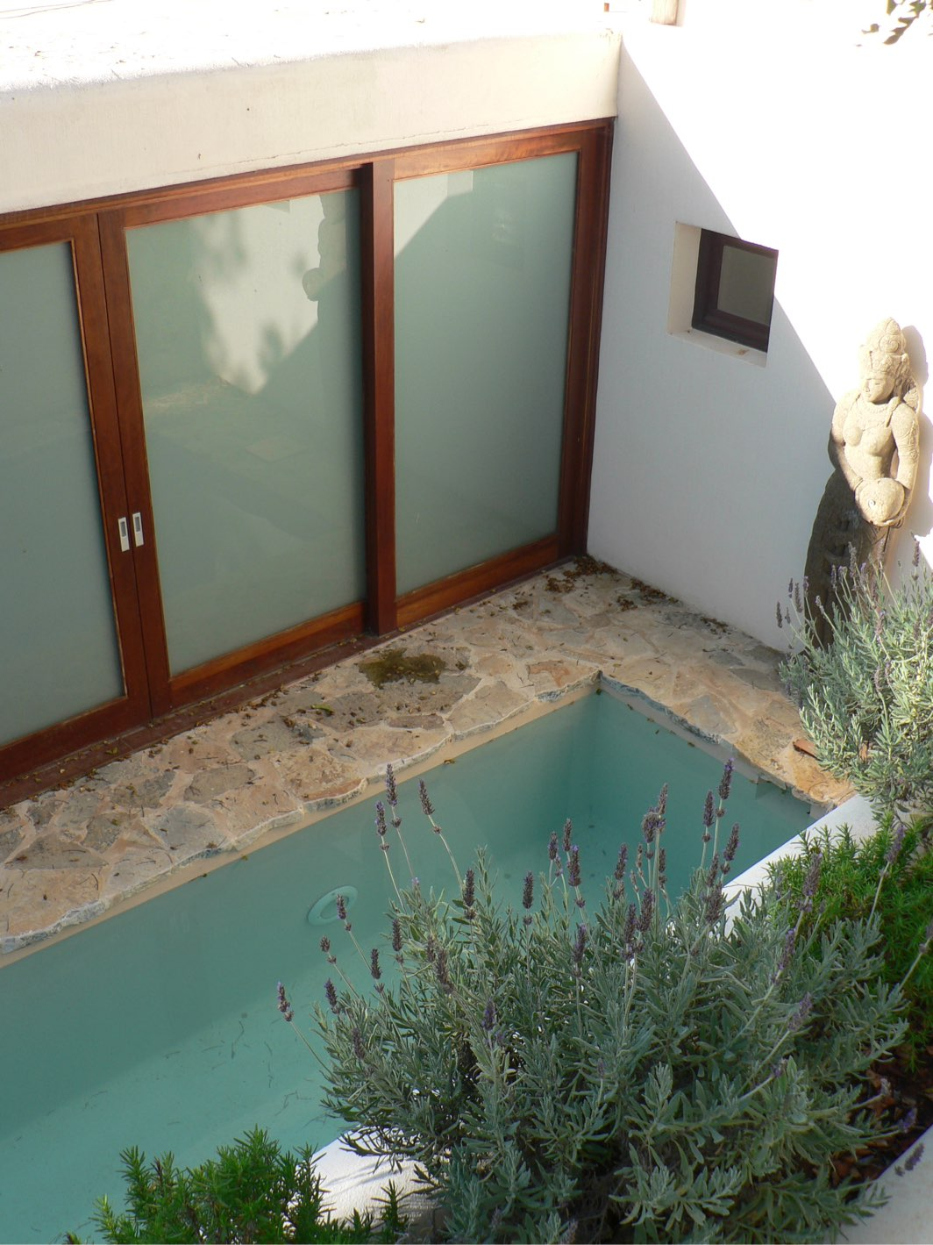
ajhd aidan james hurren design
The Plunge Pool
excavated - with much noise and effort - out of the solid rock,
in an area that was previously just a hen run!
The Pool House was built to replace the old corrals and animal sheds.
Now a beautiful stone Buddha stands with a water-jar fountain,
to bring even deeper peace and harmony to the cooling aquamarine water, under the shade of the ancient carob tree,
with fragrant lavender and rosemary in the planter

Slide 11
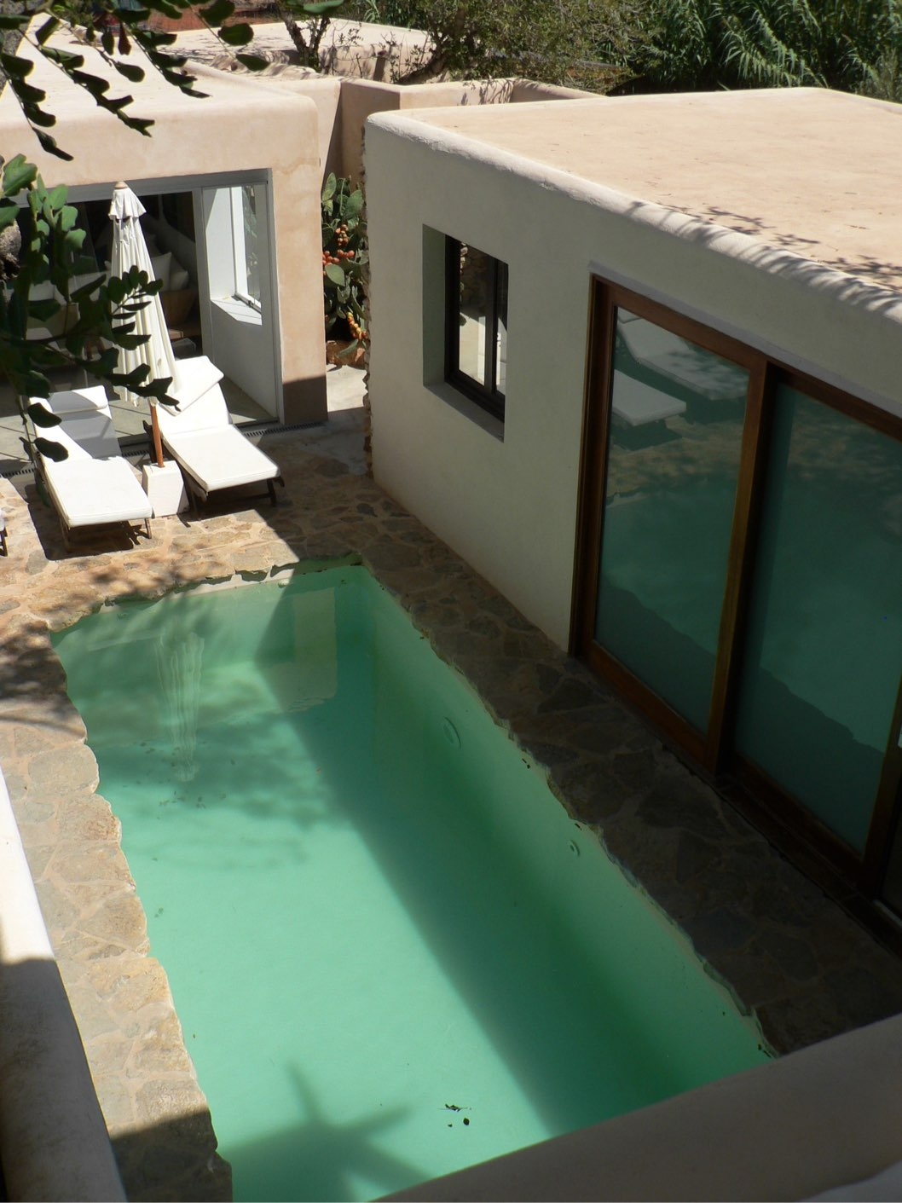
ajhd aidan james hurren design
The Plunge Pool
with the Pool House to the right hand side,
and the Games Room at the far end

Slide 12
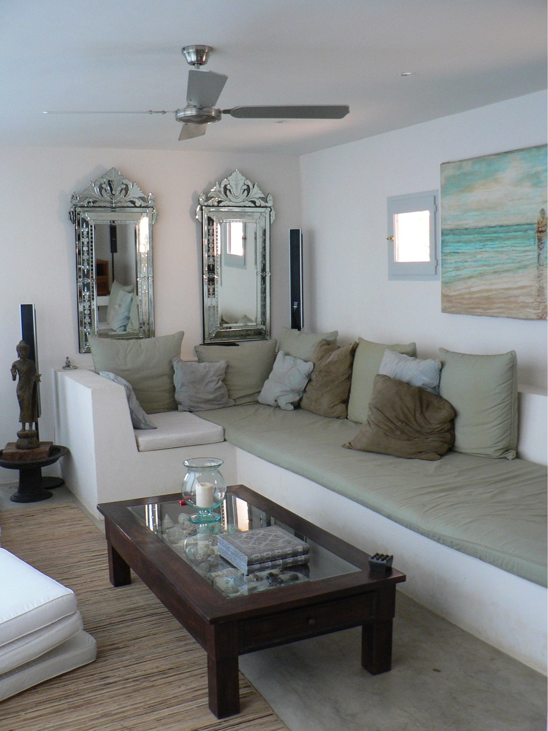
ajhd aidan james hurren design
The interior of the pool house is cool and simple,
with built-in bench seating and lots of cushions.
The full-wall-width sliding doors open directly on to the surround of the Plunge Pool, so one can simply flop into the water…

Slide 13
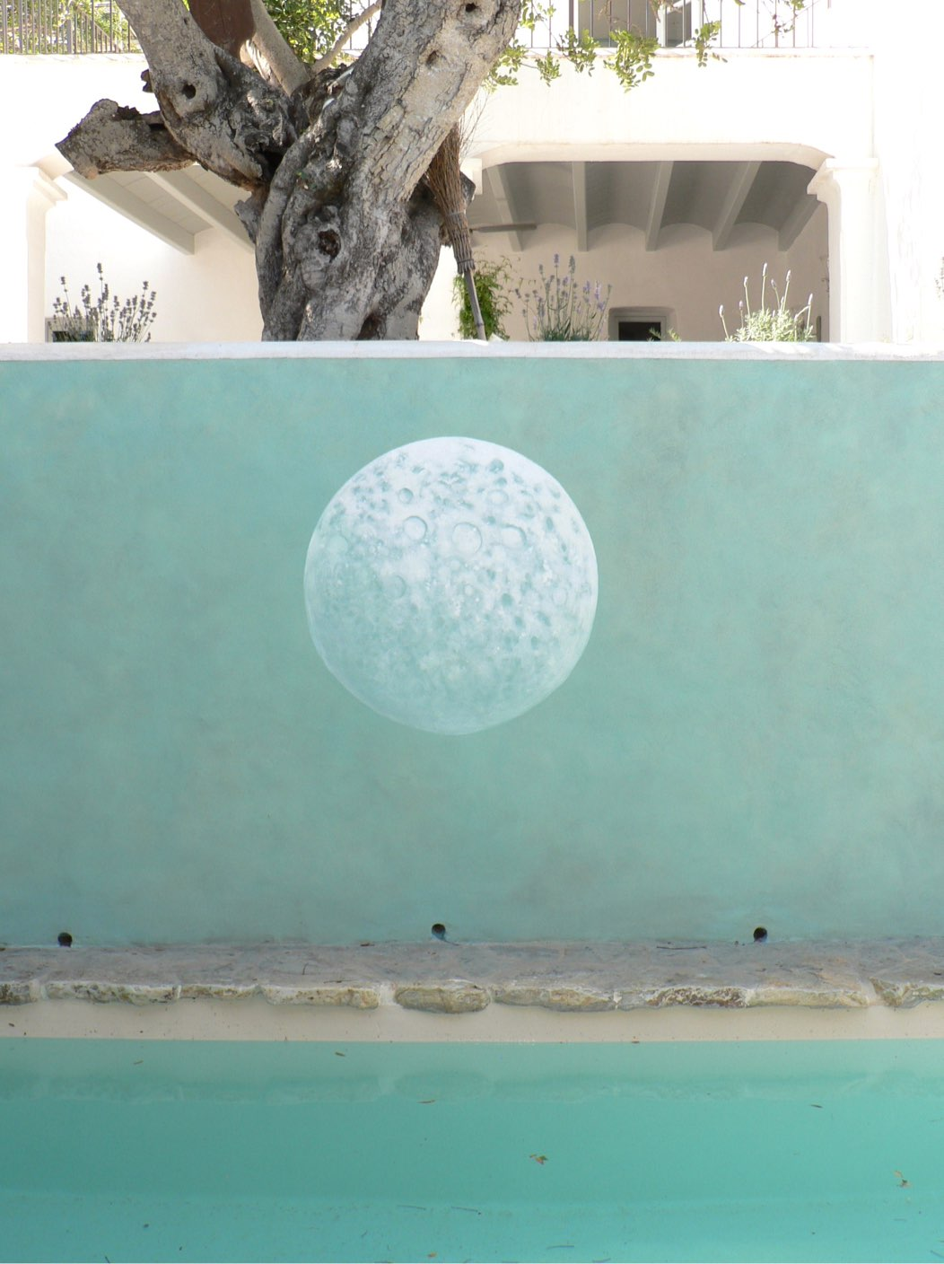
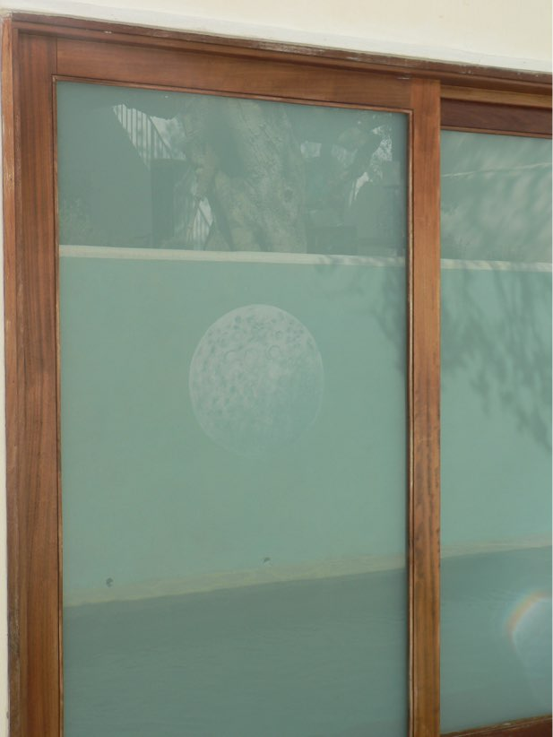
ajhd aidan james hurren design
The inside of the plunge pool is simply painted white,
the water itself provides the aquamarine colour.
The wall facing the pool house has a hand-painted Moon motif,
on a painted background, the colour mixed to match the subtle green of etched glass
This is reflected in the actual etched glass doors opposite.
The ancient carob tree above casts dappled shade on the pool

Slide 14
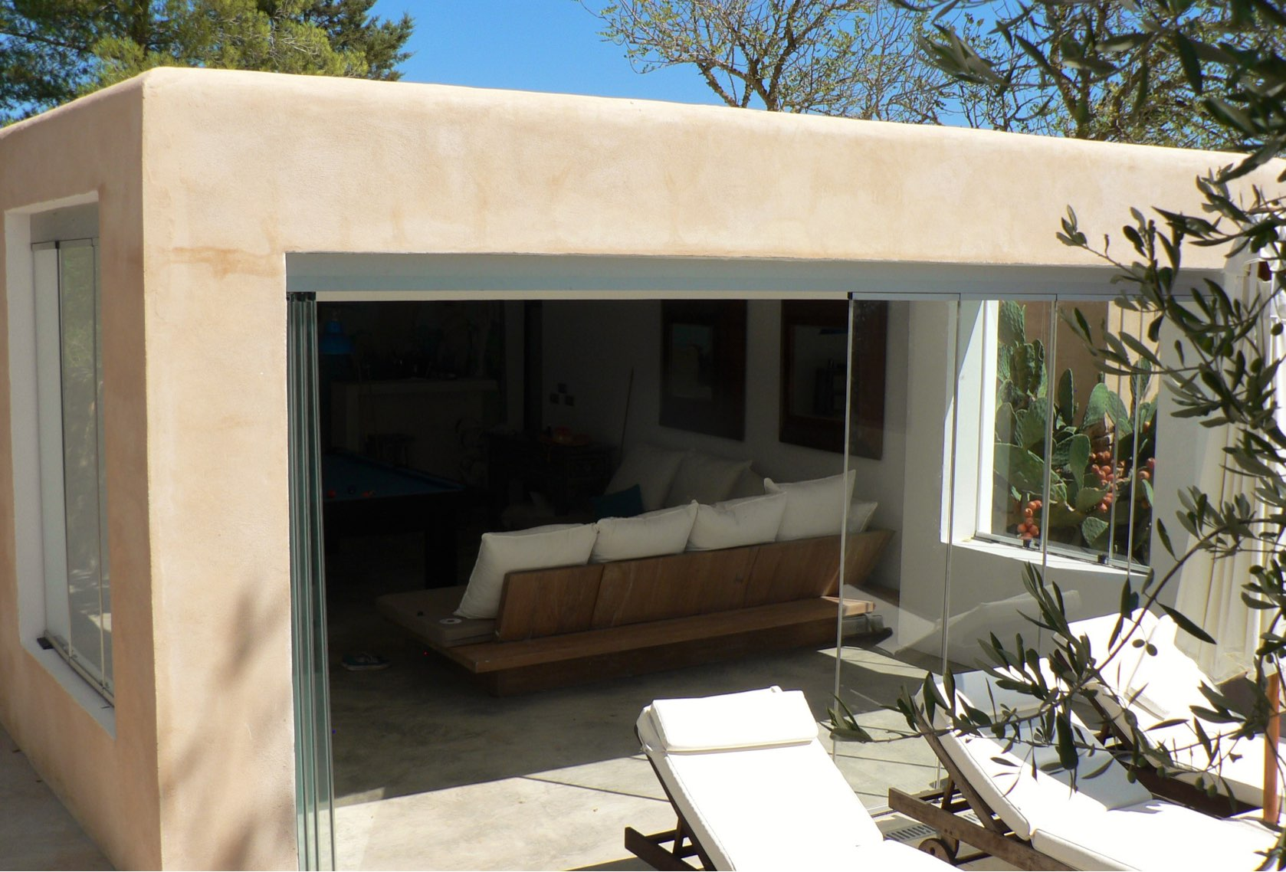
ajhd aidan james hurren design
This new building replaced the former pig-sties, and was designed as a Games Room, but also includes another bedroom and
an en-suite bathroom.
It has a large billiard table, dart board, bar area and some generous seating.
The bi-fold glass doors open on to the small plunge pool terrace

Slide 15
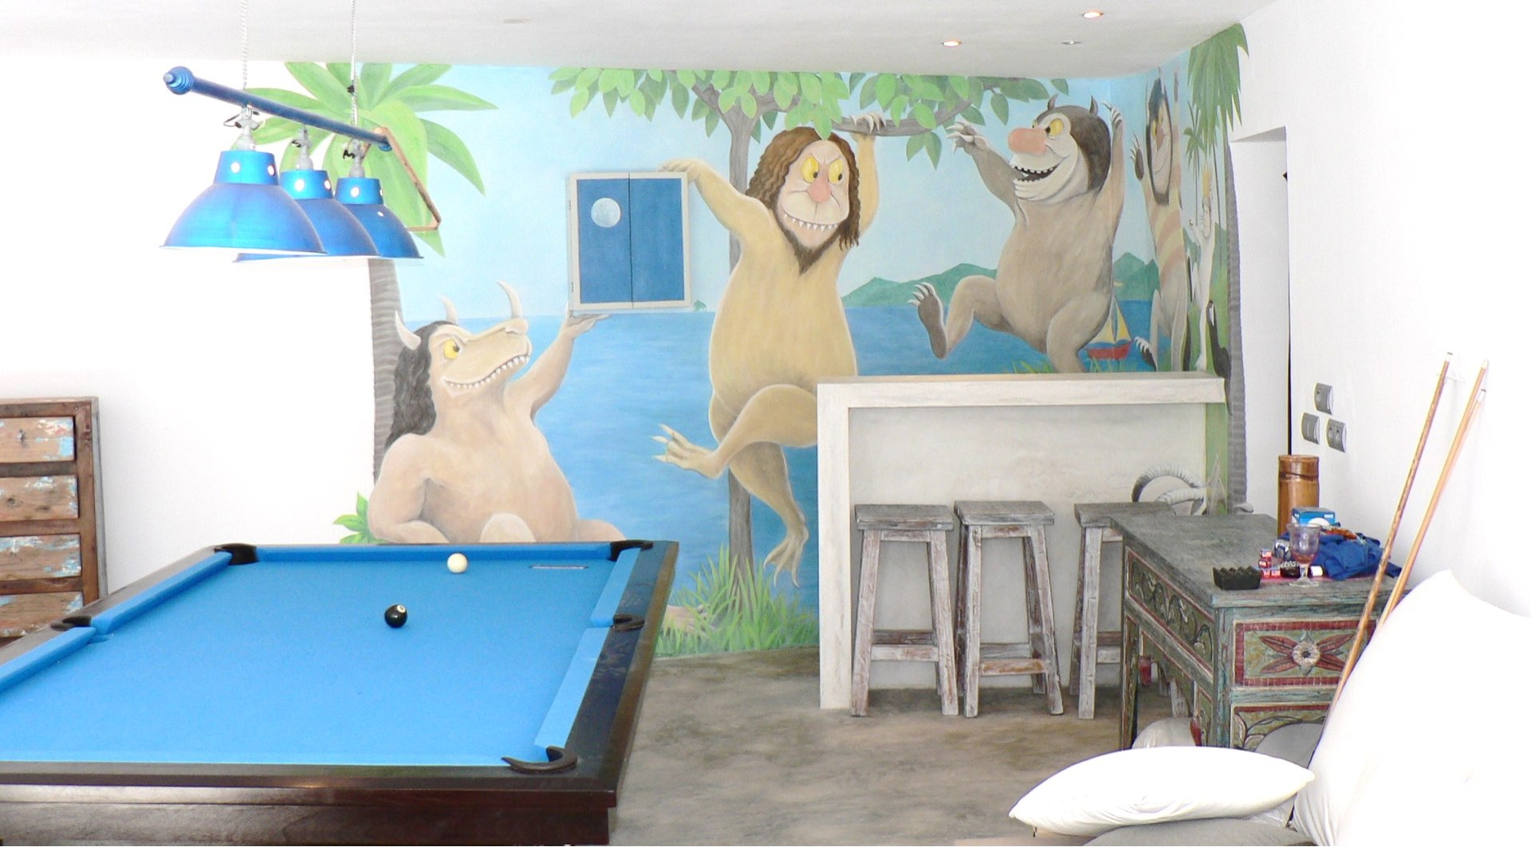
ajhd aidan james hurren design
The Games Room
features a fun mural of “Where the Wild Things Are”
still a favourite book of the now-grown-up children of the family

Slide 16
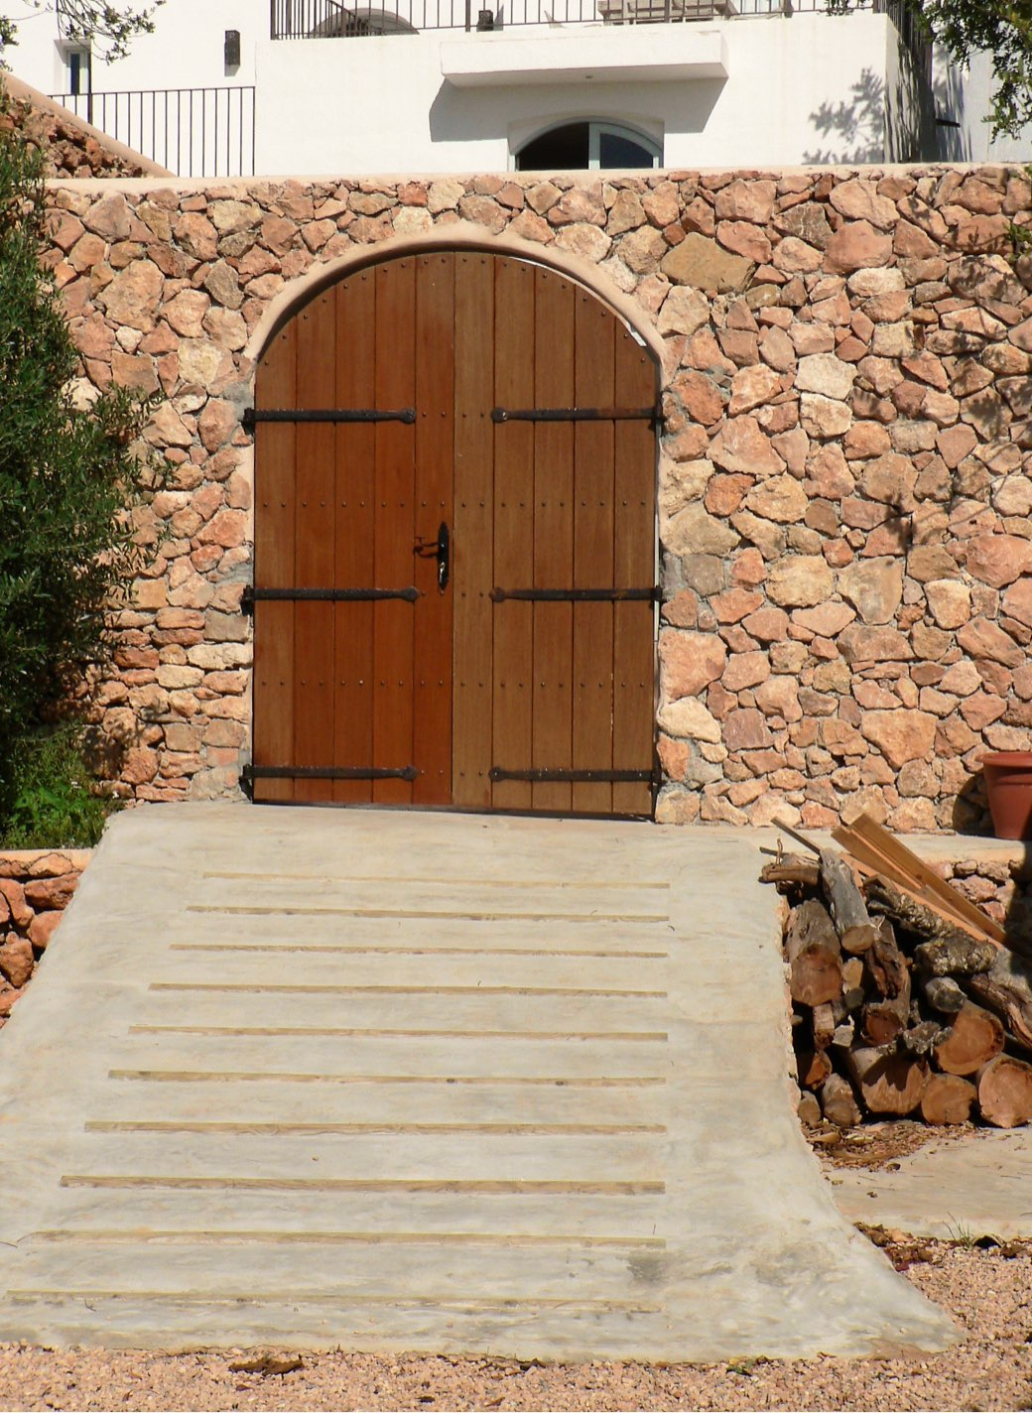
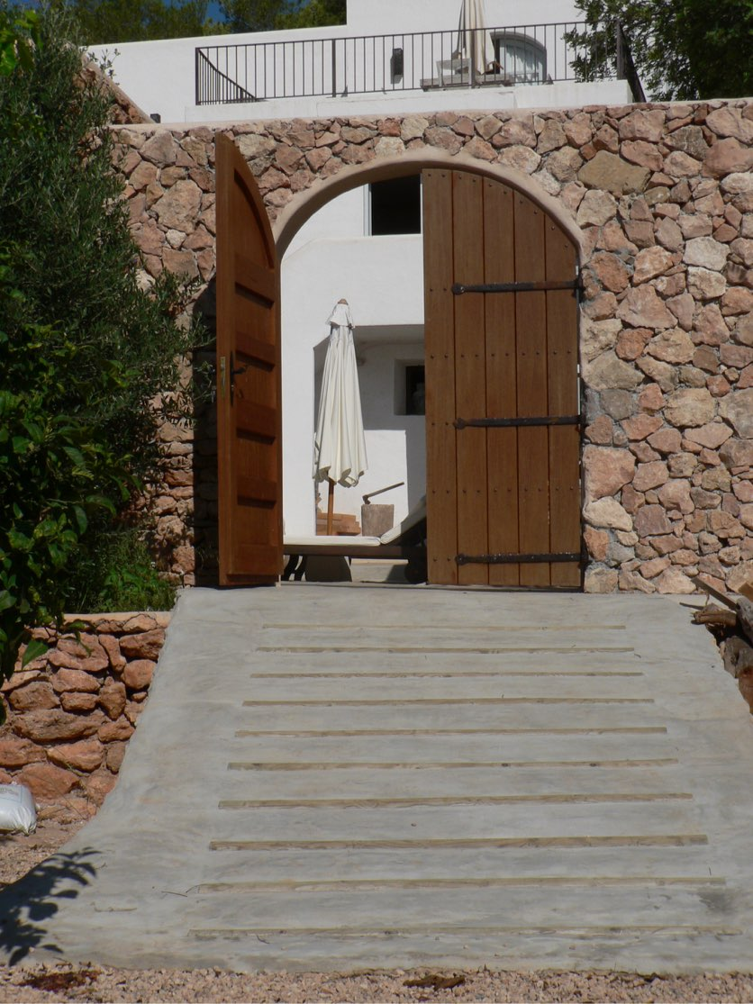
ajhd aidan james hurren design
The solid teak Farm Gates
between the Plunge Pool courtyard and the lower garden.
The ramp (finished in smoothed concrete) with inset timber palos is a traditional sight in Ibicencan farms, a simple but clever way to avoid slipping on a smooth slope.

Slide 17
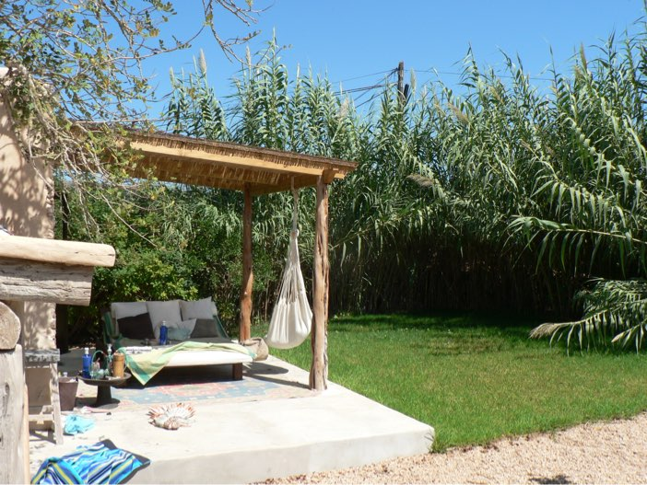
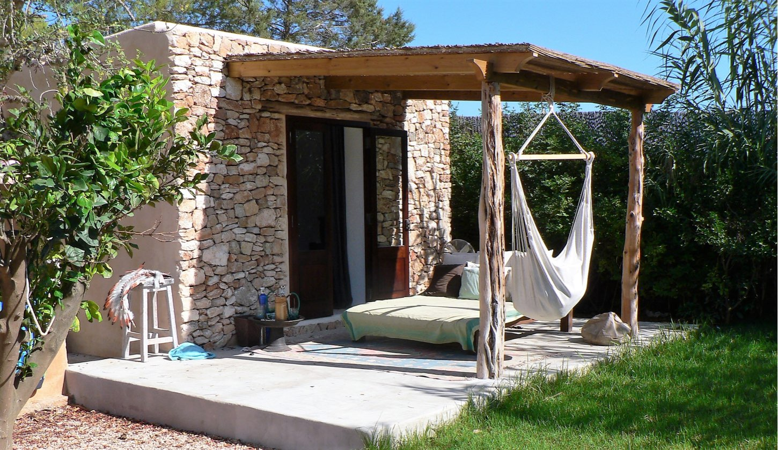
ajhd aidan james hurren design
The terrace outside the bedroom
in the Playroom building.
As elsewhere in the renovated and new-build structures, traditional drystone walls continue the local vernacular.
The surface finish on most of the terraces is smooth polished white cement.
The porch is made from ancient posts of savina timbers, recycled pine beams and bamboo.

Slide 18
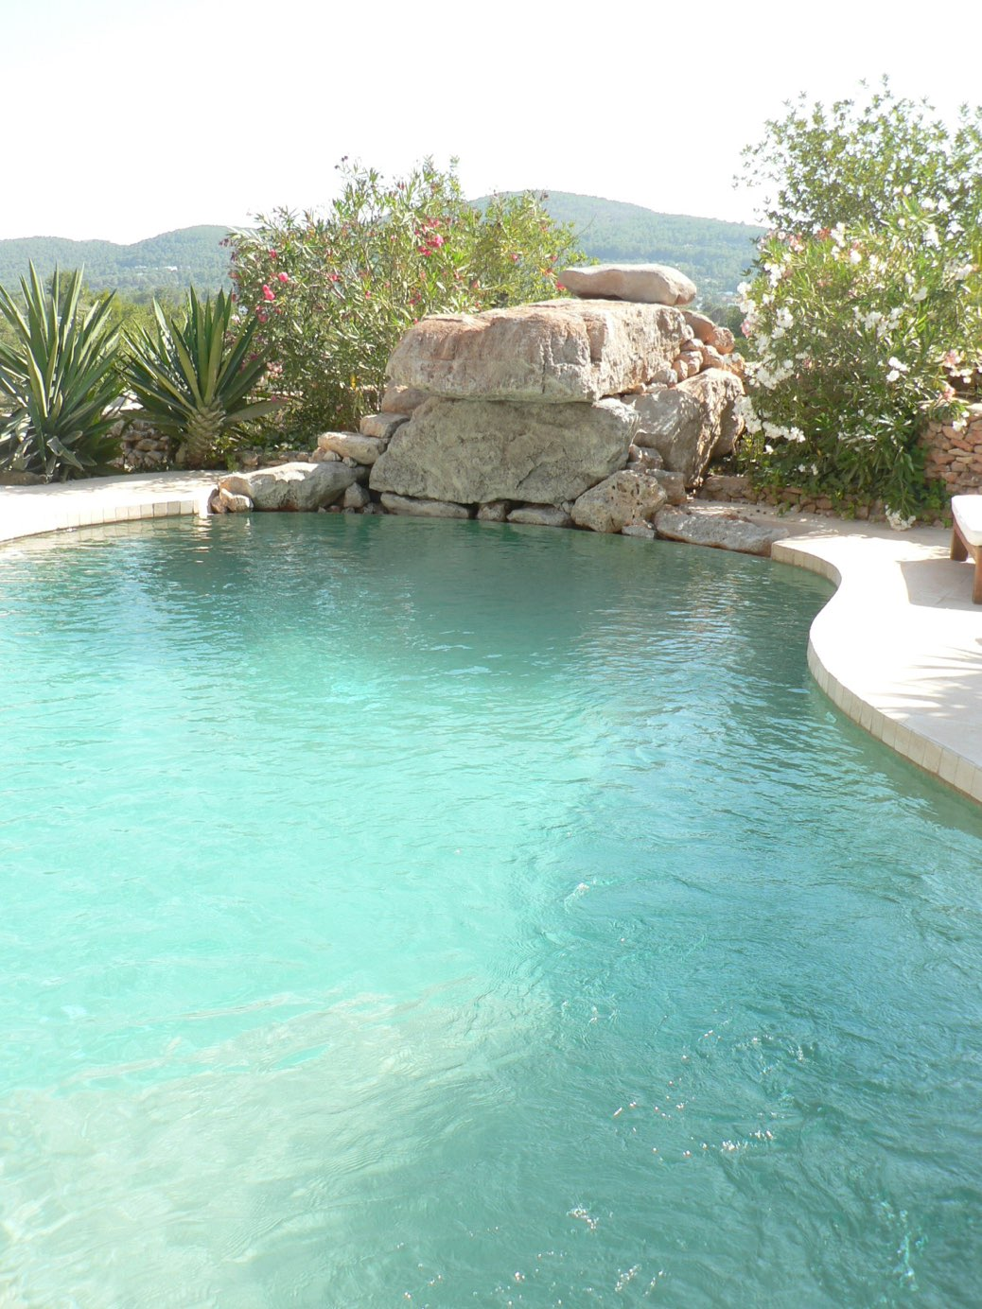
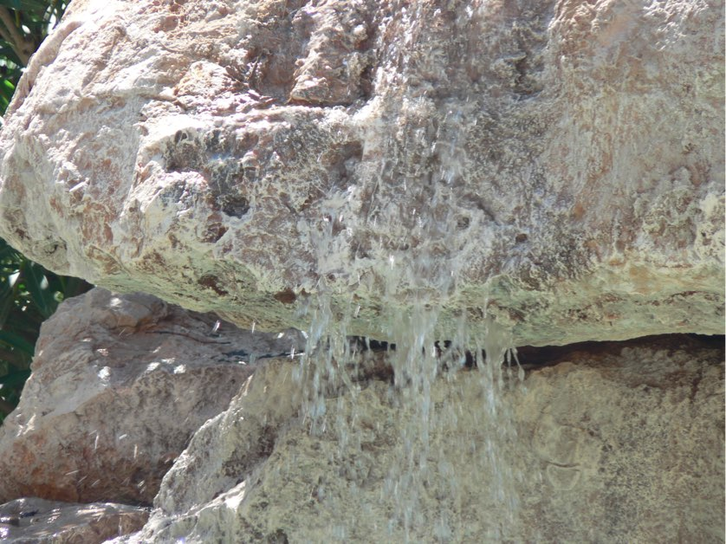
ajhd aidan james hurren design
The swimming pool was re-tiled with sand-colored mosaics
and the terrace paved in natural stone.
The huge boulders were selected from a local quarry and positioned to make a cascade and a jumping platform at the very deep end (nearly 3 metres)
The crystal clear water comes from the property’s own spring.

