Slide 1
ajhd aidan james hurren design
paros, greece
the total renovation of a large villa and it’s gardens

Slide 2
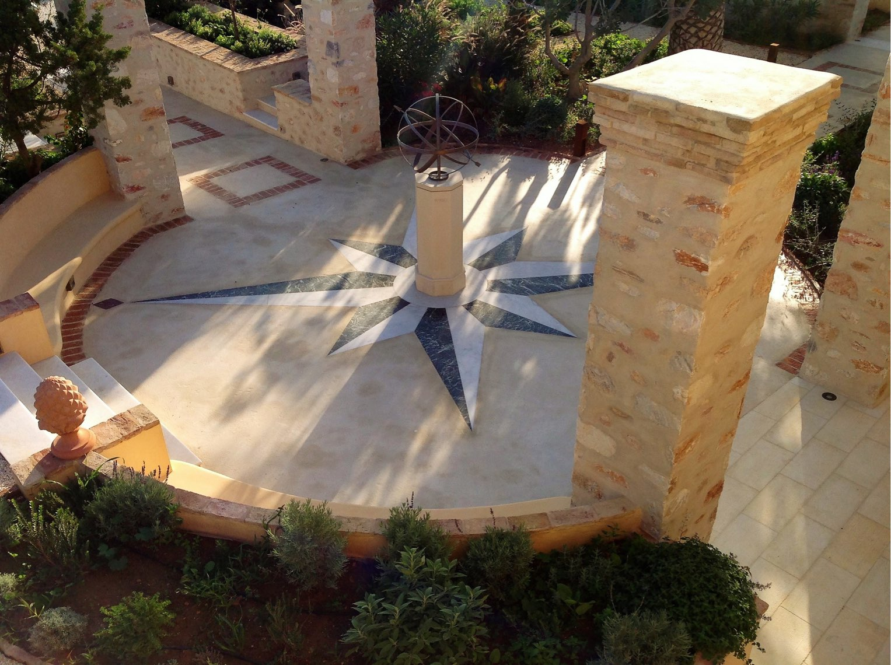
ajhd aidan james hurren design
An old house in the Venetian style, on the island of Paros
Rather charmingly dilapidated, and very picturesquely overgrown, once work began to clear the house and grounds it became apparent that it was going to have to be a rip-it-out-and-start-from-scratch project.
The whole house was stripped, inside and out: re-wired, re-plumbed re-plastered, re-floored, re-tiled, re-painted,
re-everythinged !!
The long-gone-wild gardens were tamed again; and the former vegetable garden with the Aloni, the old grain-threshing circle, all bounded by massive stone walls, was re-imagined and
re-configured as a ‘formal’ garden.

Slide 3
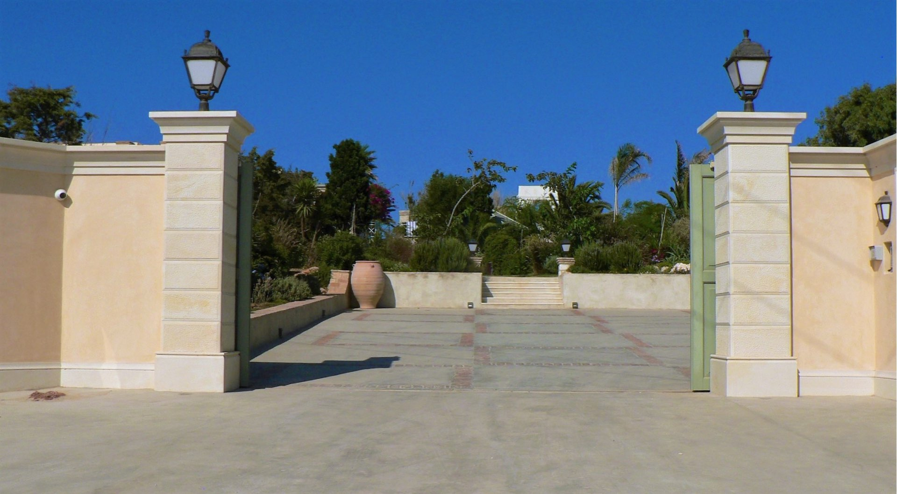
ajhd aidan james hurren design
The Main Entrance to the property, where previously nothing had defined the boundary

Slide 4
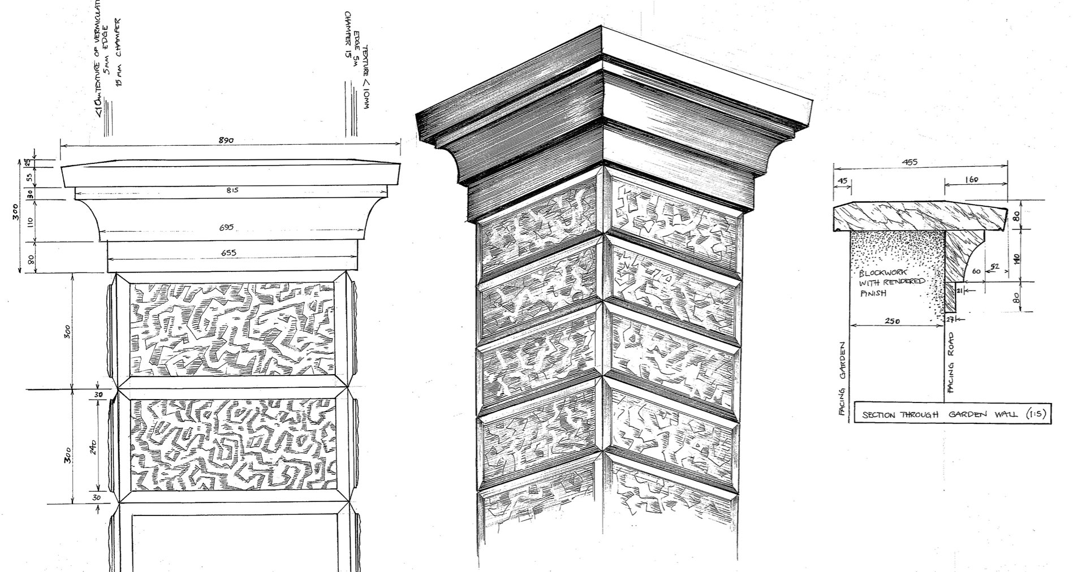
ajhd aidan james hurren design
Design drawings for the gate columns

Slide 5
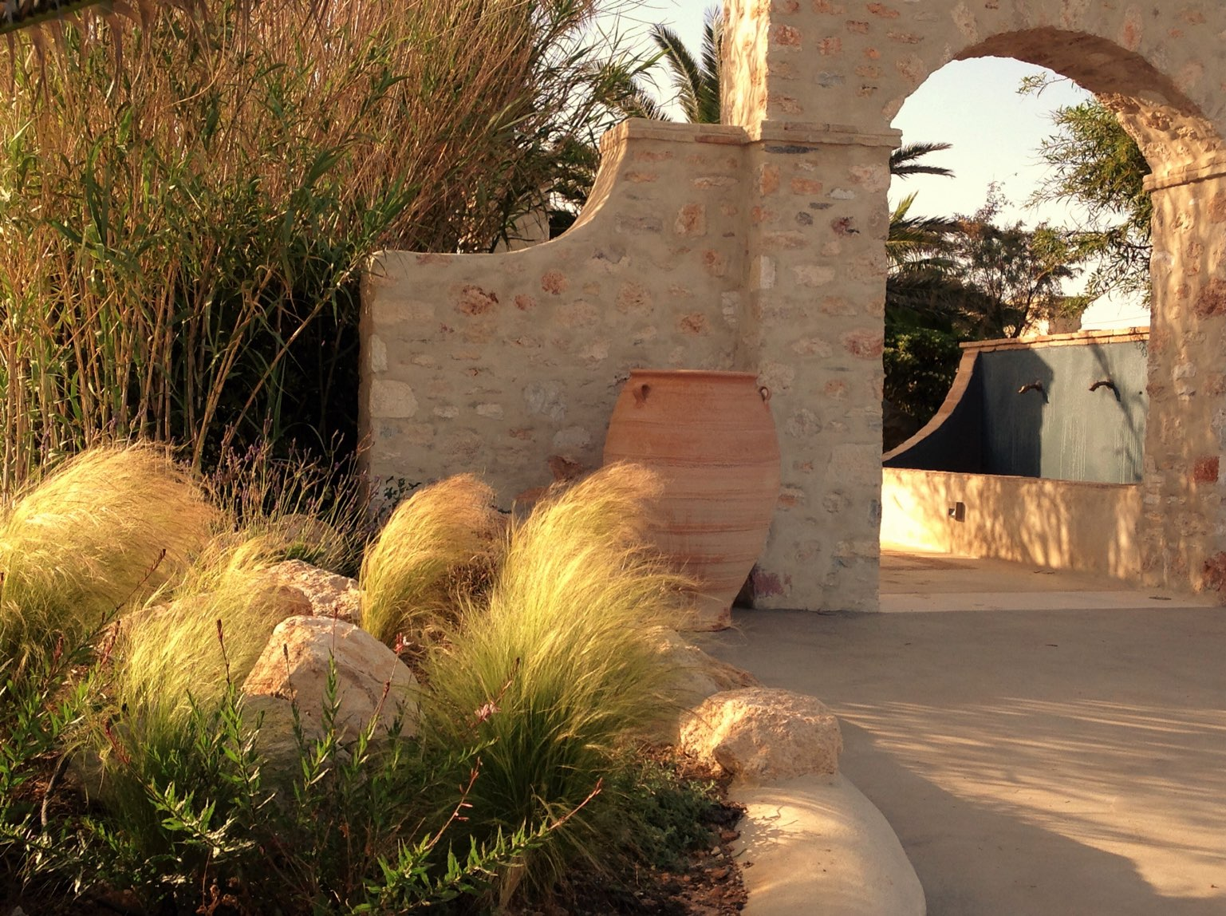
ajhd aidan james hurren design
The Arrival Area
This newly constructed
stone archway frames the entrance to the garden,
Two pools flank the way through to the Formal Garden

Slide 6
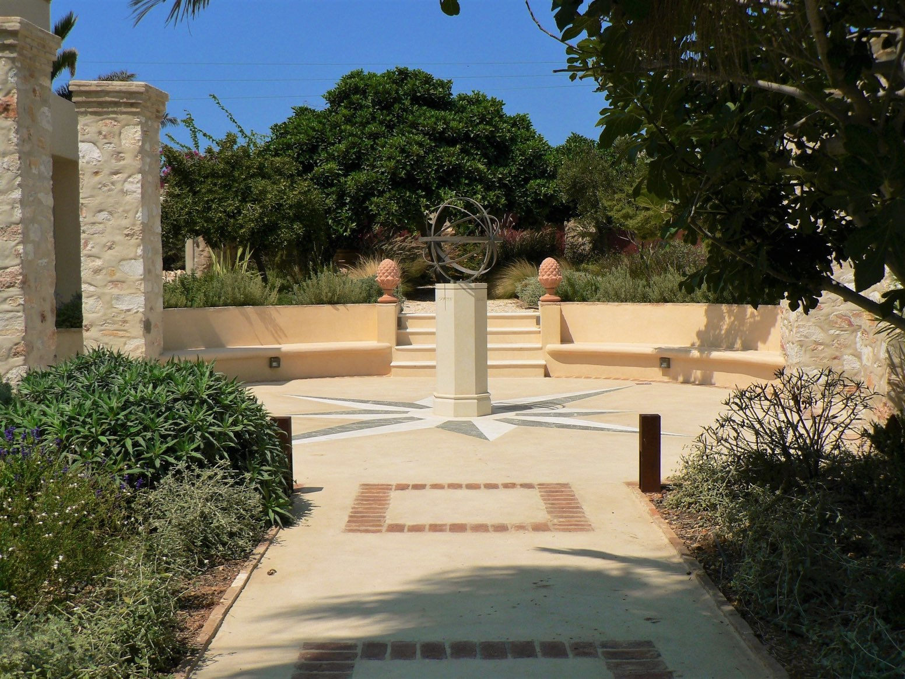
ajhd aidan james hurren design
The Aloni
where grain was once threshed,
now completely transformed
with polished concrete
and an inlaid marble design
in the form of a compass

Slide 7
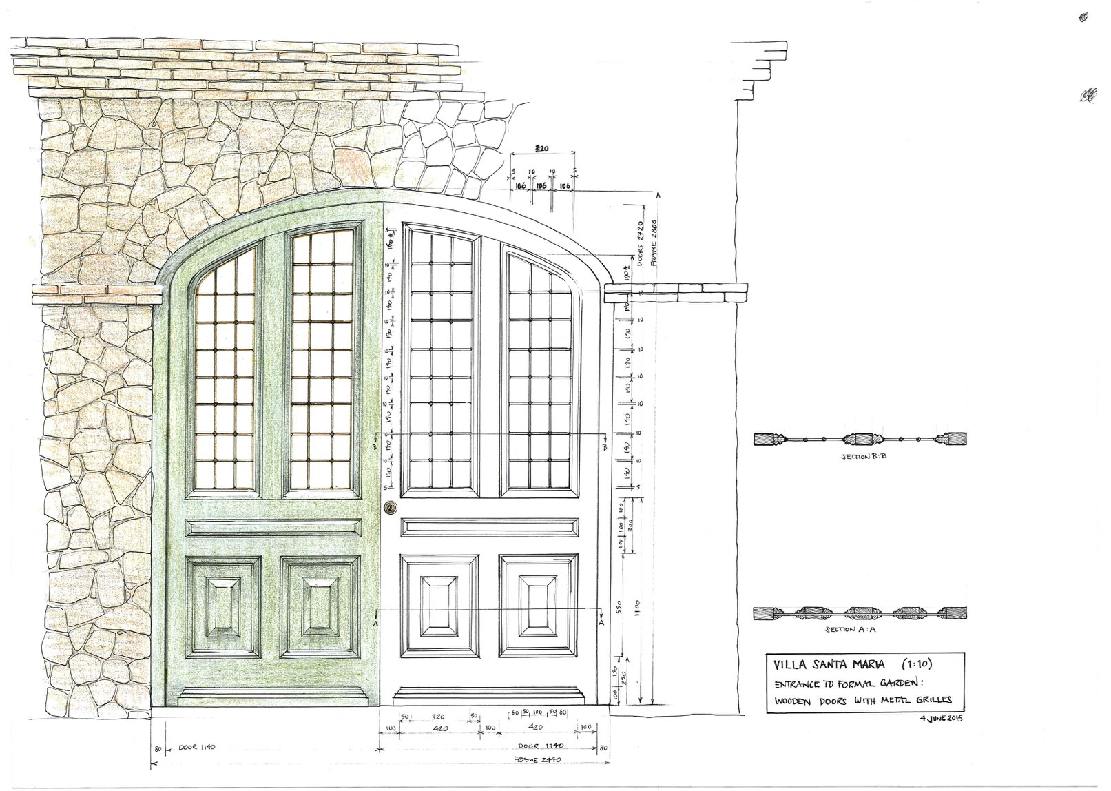
ajhd aidan james hurren design
Design drawing for the new stone archway
with huge timber and iron gates

Slide 8
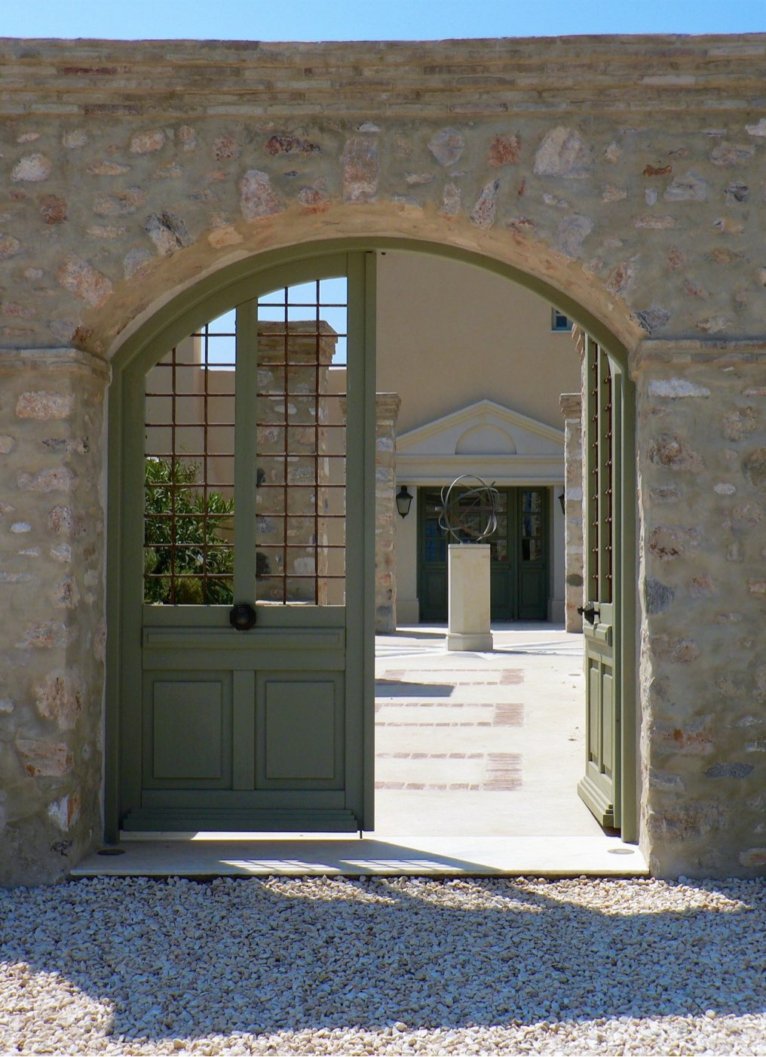
ajhd aidan james hurren design
The completed gated archway entrance from the car parking area,
and, beyond, the Armillary Sphere in the centre of the Compass,
and the Main Entrance to the house

Slide 9
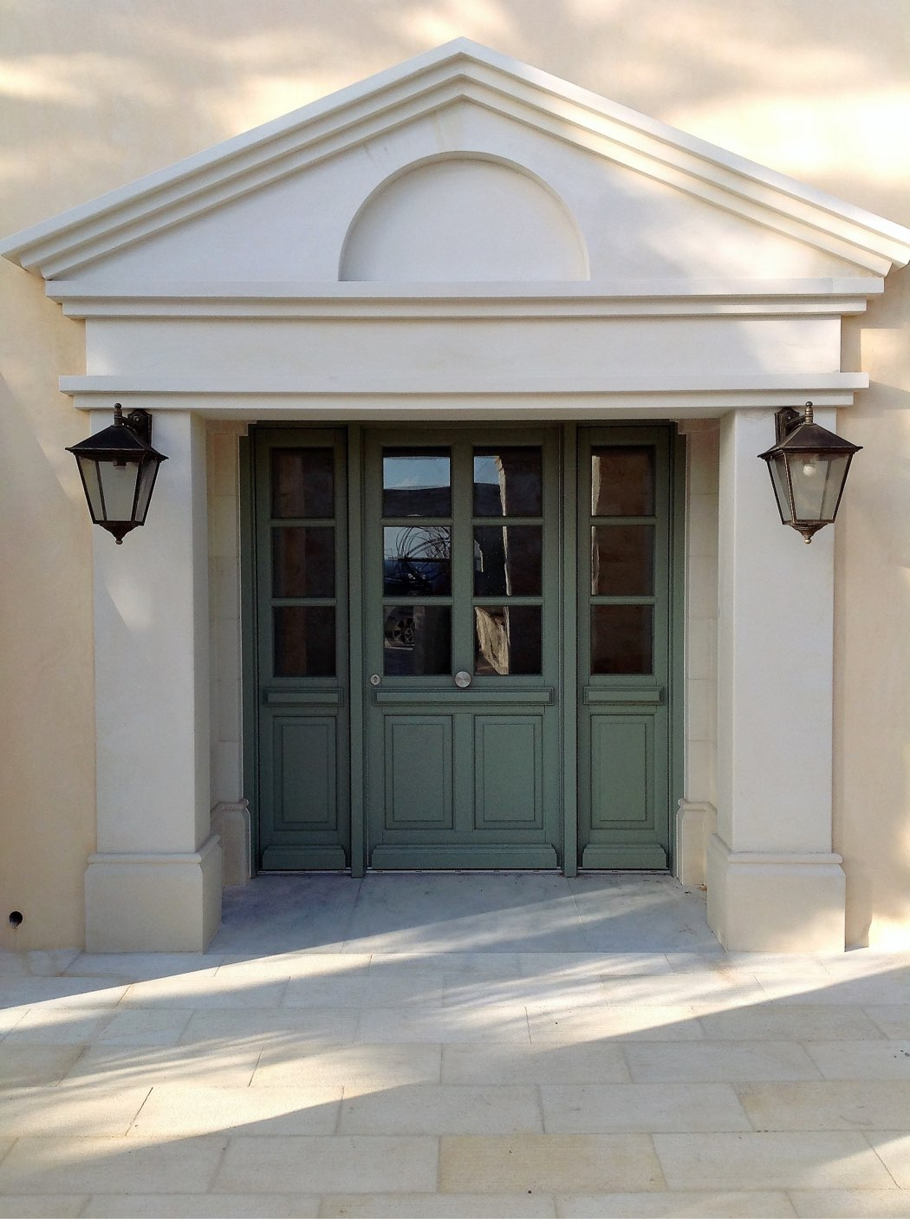
ajhd aidan james hurren design
the new Front Door to the house.
Previously there was a very low and narrow door.
The creamy stone surround and pediment is actually local marble.

Slide 10
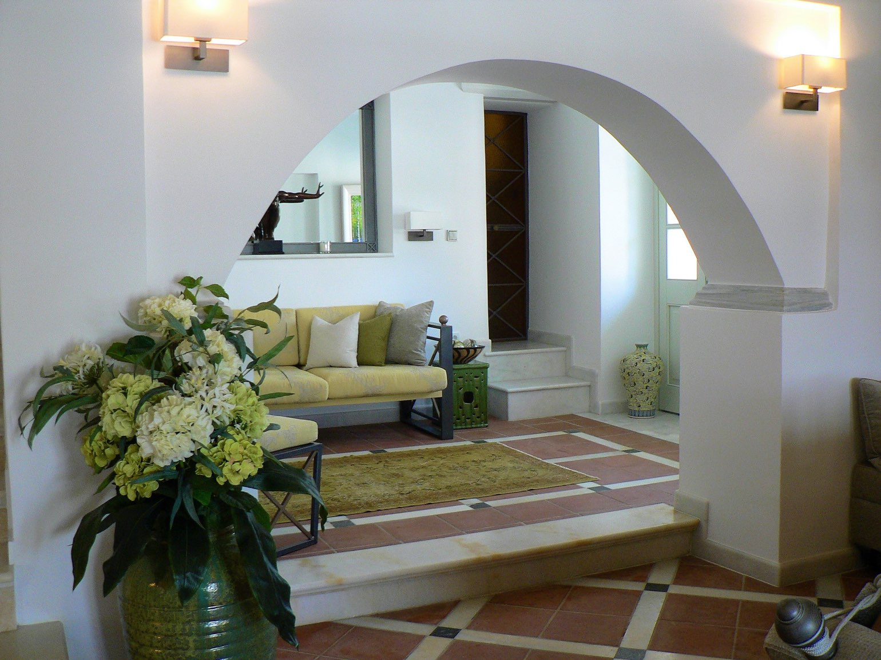
ajhd aidan james hurren design
The Entrance Hall,
viewed from the Sitting Room.
The marble and terracotta floors were the original floors in this part of the house, one of the few parts that only needed to be restored and deep cleaned !

Slide 11
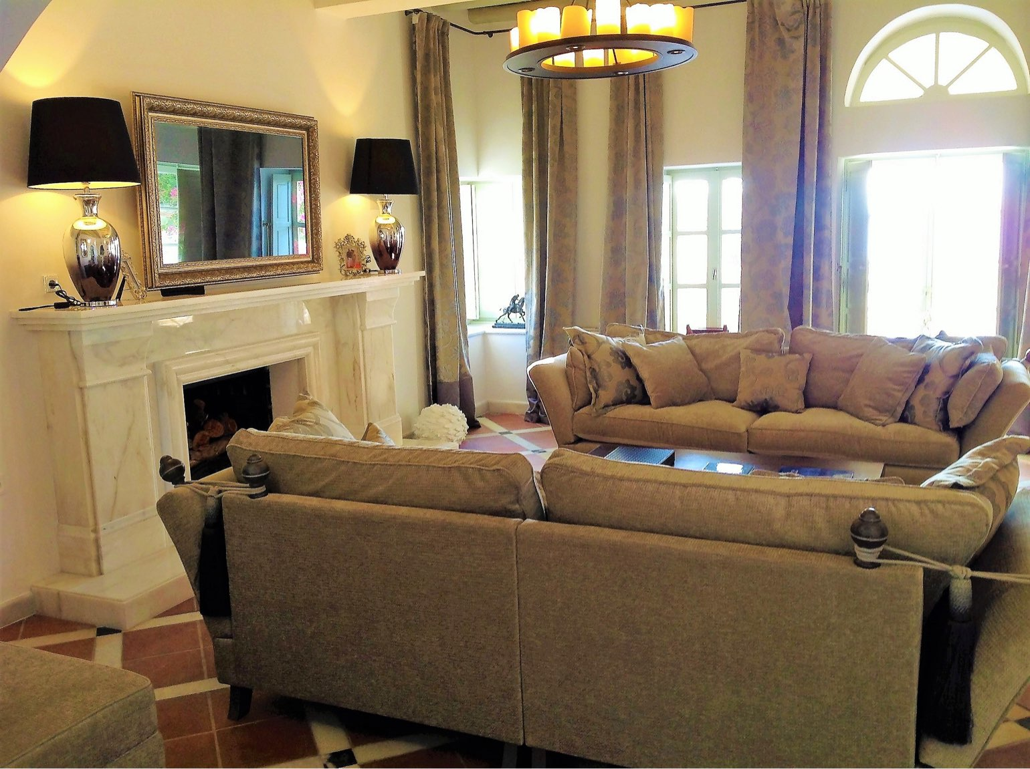
ajhd aidan james hurren design
The Drawing Room,
with the new, locally-quarried
marble fireplace.
The overmantel mirror hides a television.

Slide 12
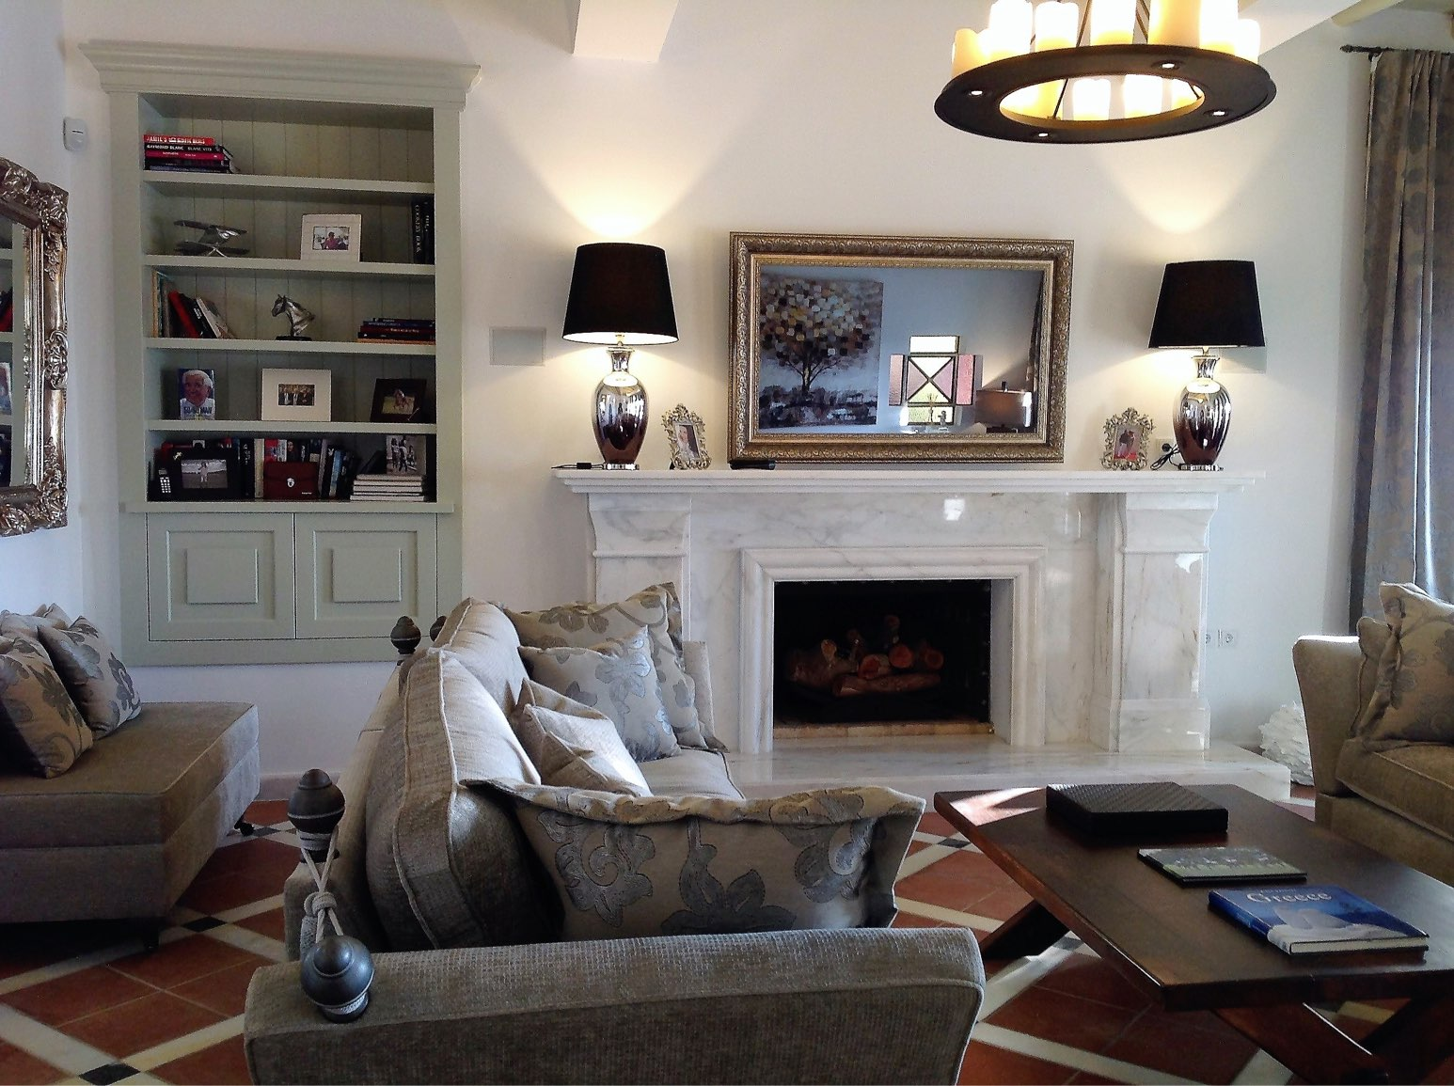
ajhd aidan james hurren design
The Drawing Room
with a wonderful marble fireplace, a television disguised as a mirror, hand-made cabinets and sumptuous Knowle sofas

Slide 13
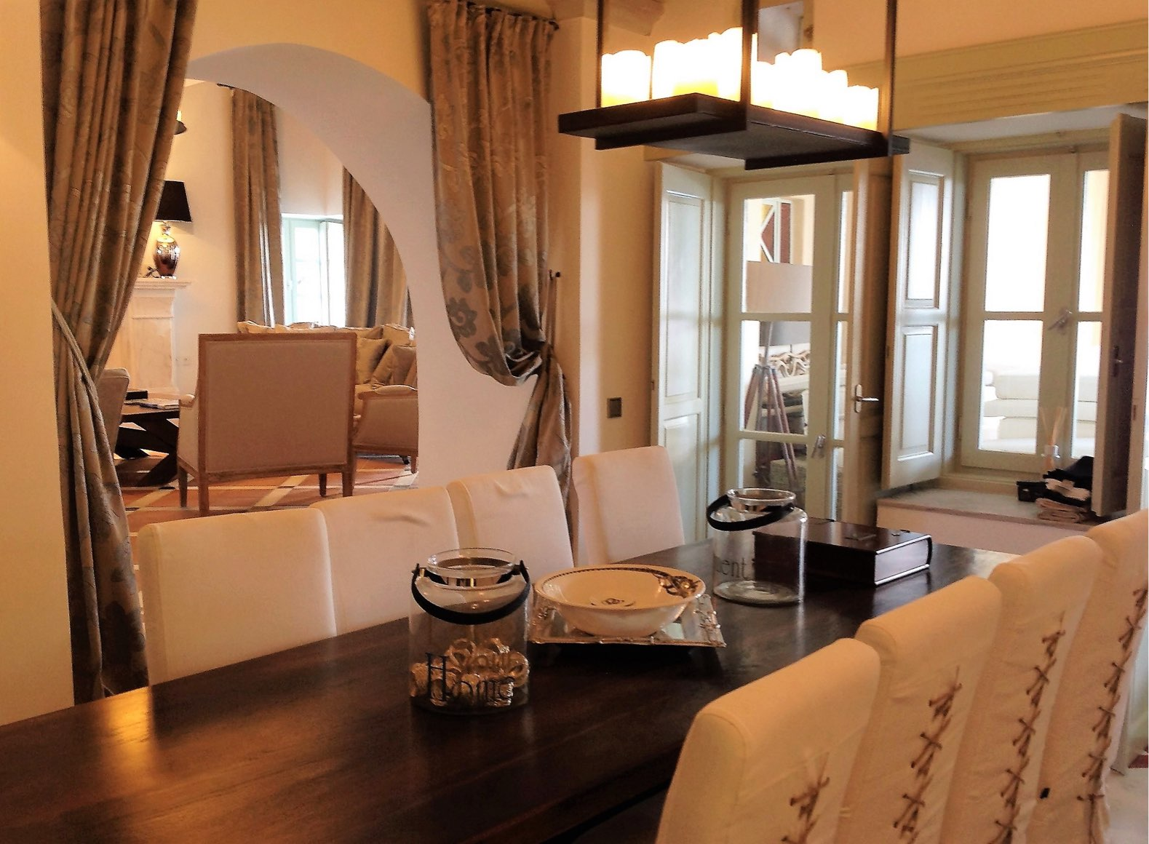
ajhd aidan james hurren design
the Dining Room,
adjacent to the Drawing Room

Slide 14
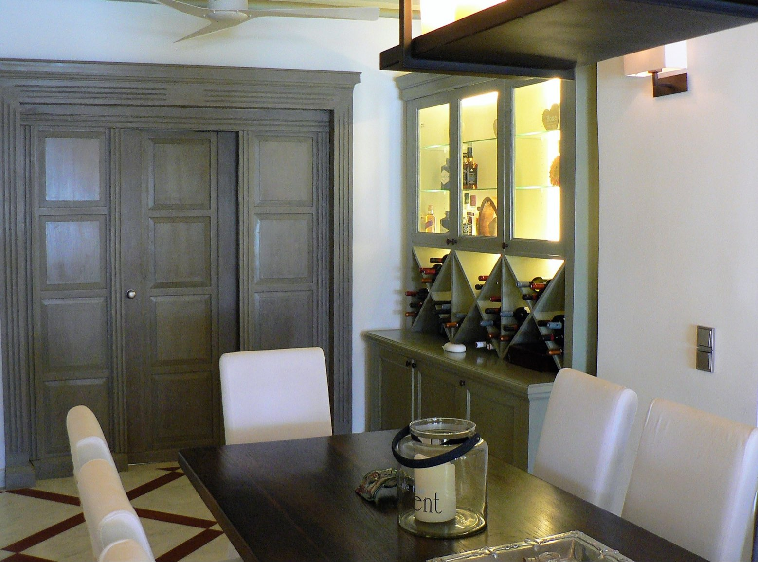
ajhd aidan james hurren design
The Dining Room
The design of the new marble floor with inset polished concrete detail is a reverse version of the original floor in the Drawing Room.
The refurbished old paneled doors form the entrance to the principal guest suite

Slide 15
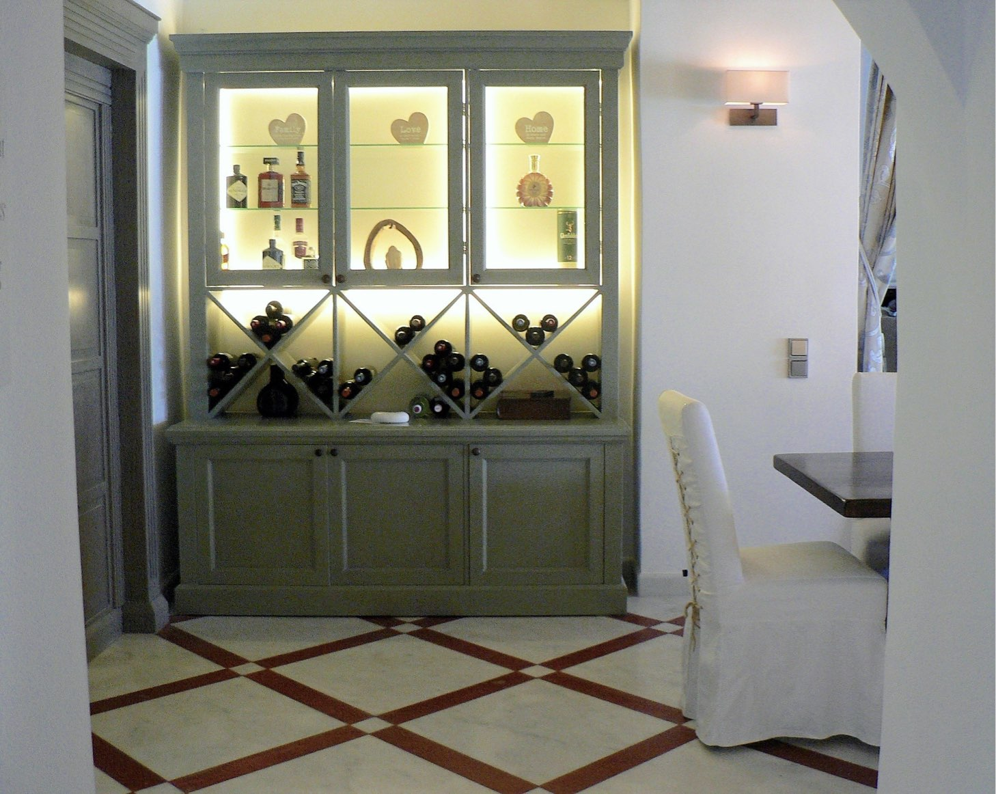
ajhd aidan james hurren design
The Dining Room
showing the floor made of
locally-quarried Parian marble,
with inserts of polished concrete.
Aidan-designed cabinets, made by local craftsmen

Slide 16
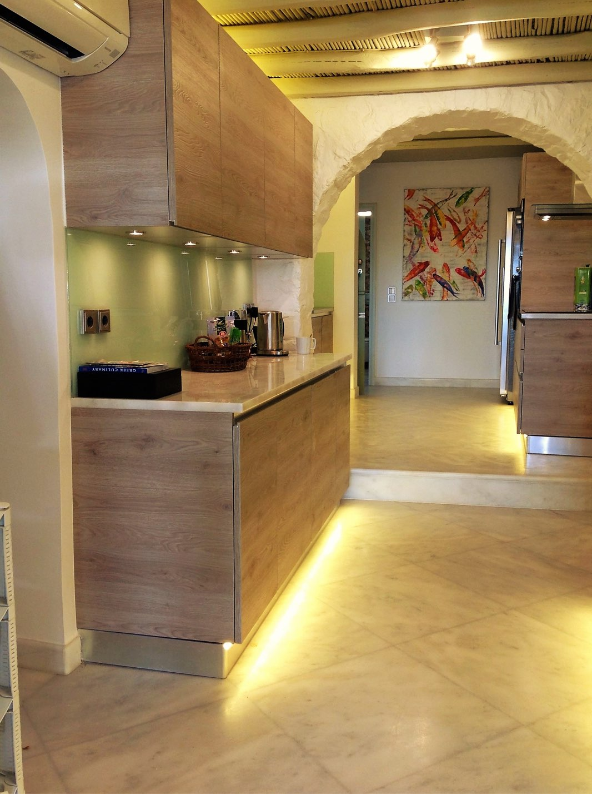
ajhd aidan james hurren design
The sleek modern Kitchen
set in the rustic architecture of white-painted, rough fieldstone walls:
driftwood-look cabinets, marble and stainless steel worktops,
etched-glass splash-backs, smooth marble floor

Slide 17
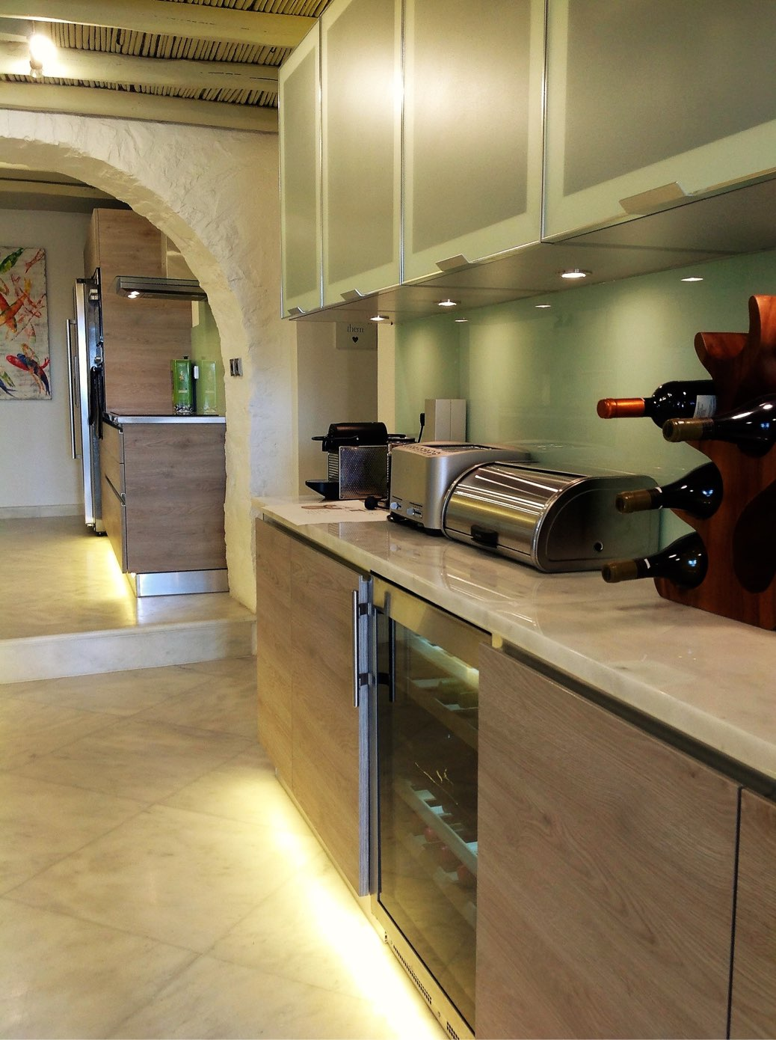
ajhd aidan james hurren design
The Kitchen

Slide 18
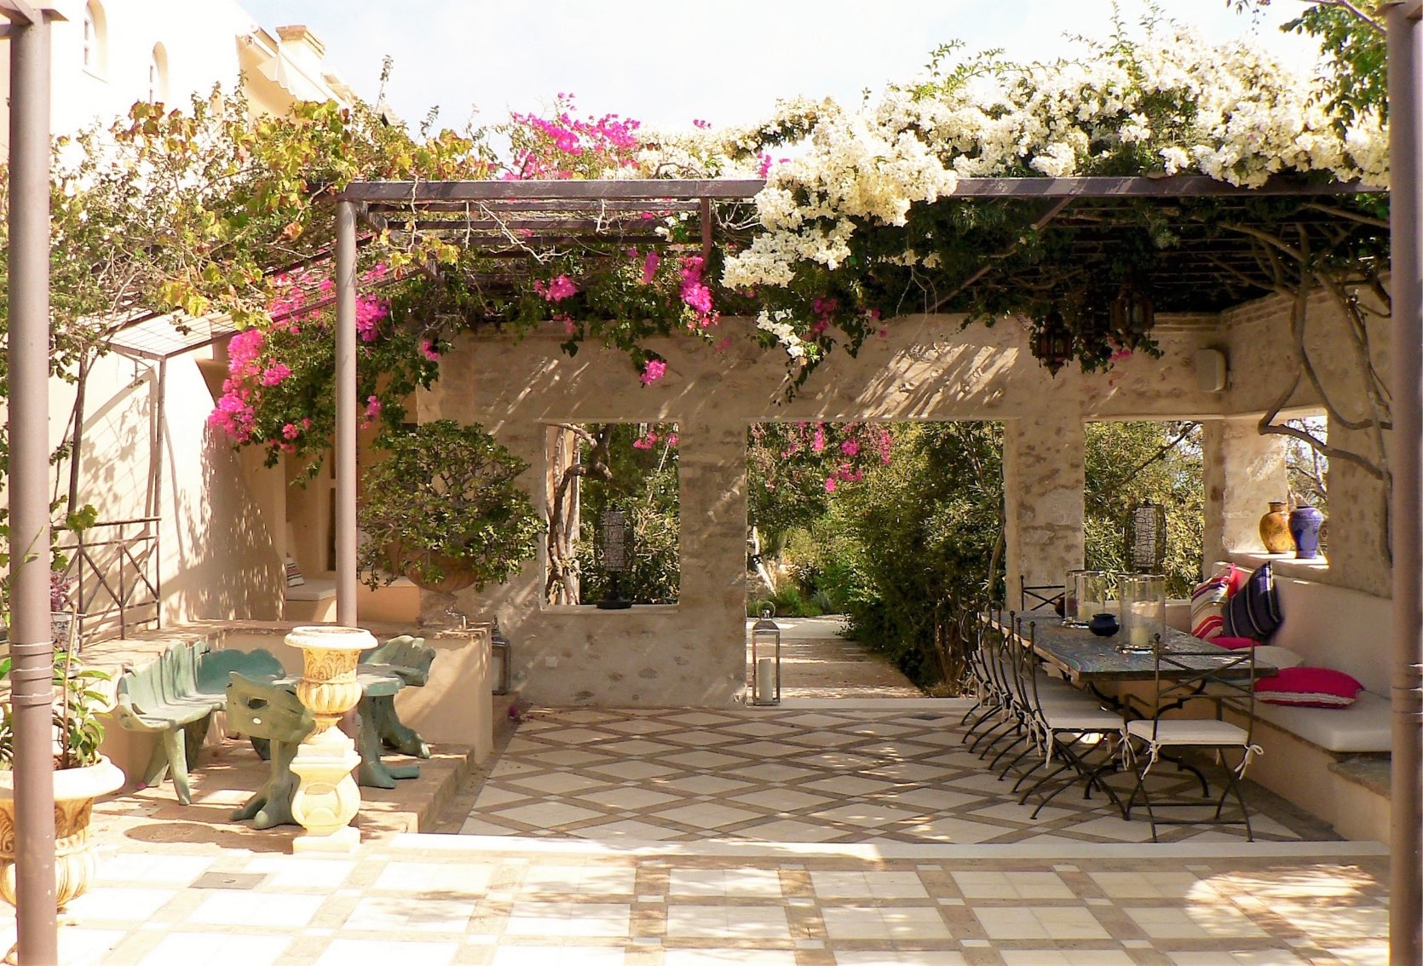
ajhd aidan james hurren design
The Dining Courtyard

Slide 19
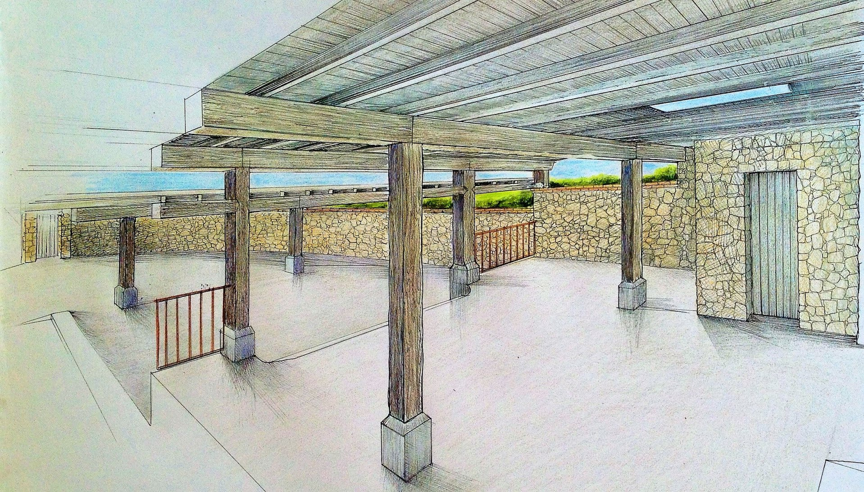
ajhd aidan james hurren design
Aidan’s design concept drawing for the Playroom,
to be created on the site of the former animal pens and stalls

Slide 20
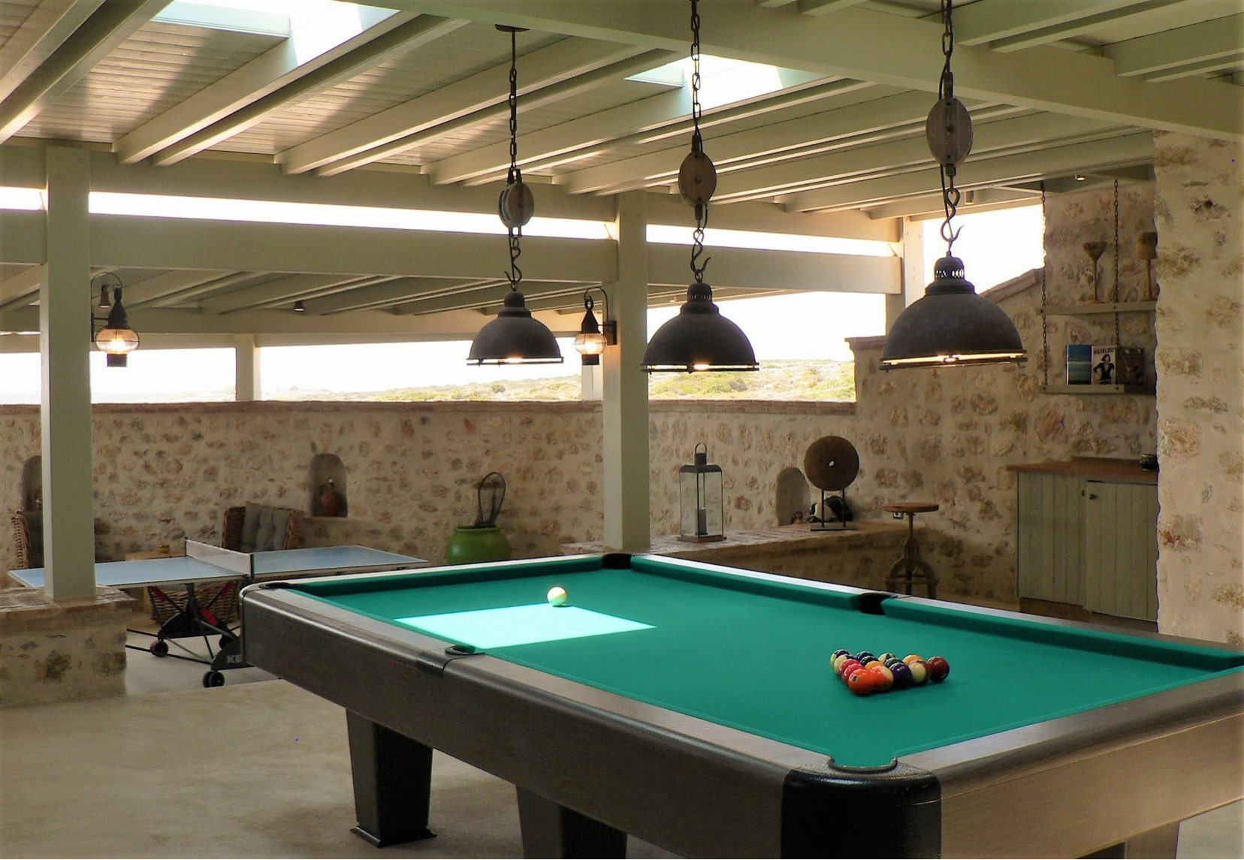
ajhd aidan james hurren design
The finished Playroom:
the Billiards - Darts - Table Tennis - Music -Party Zone!

Slide 21
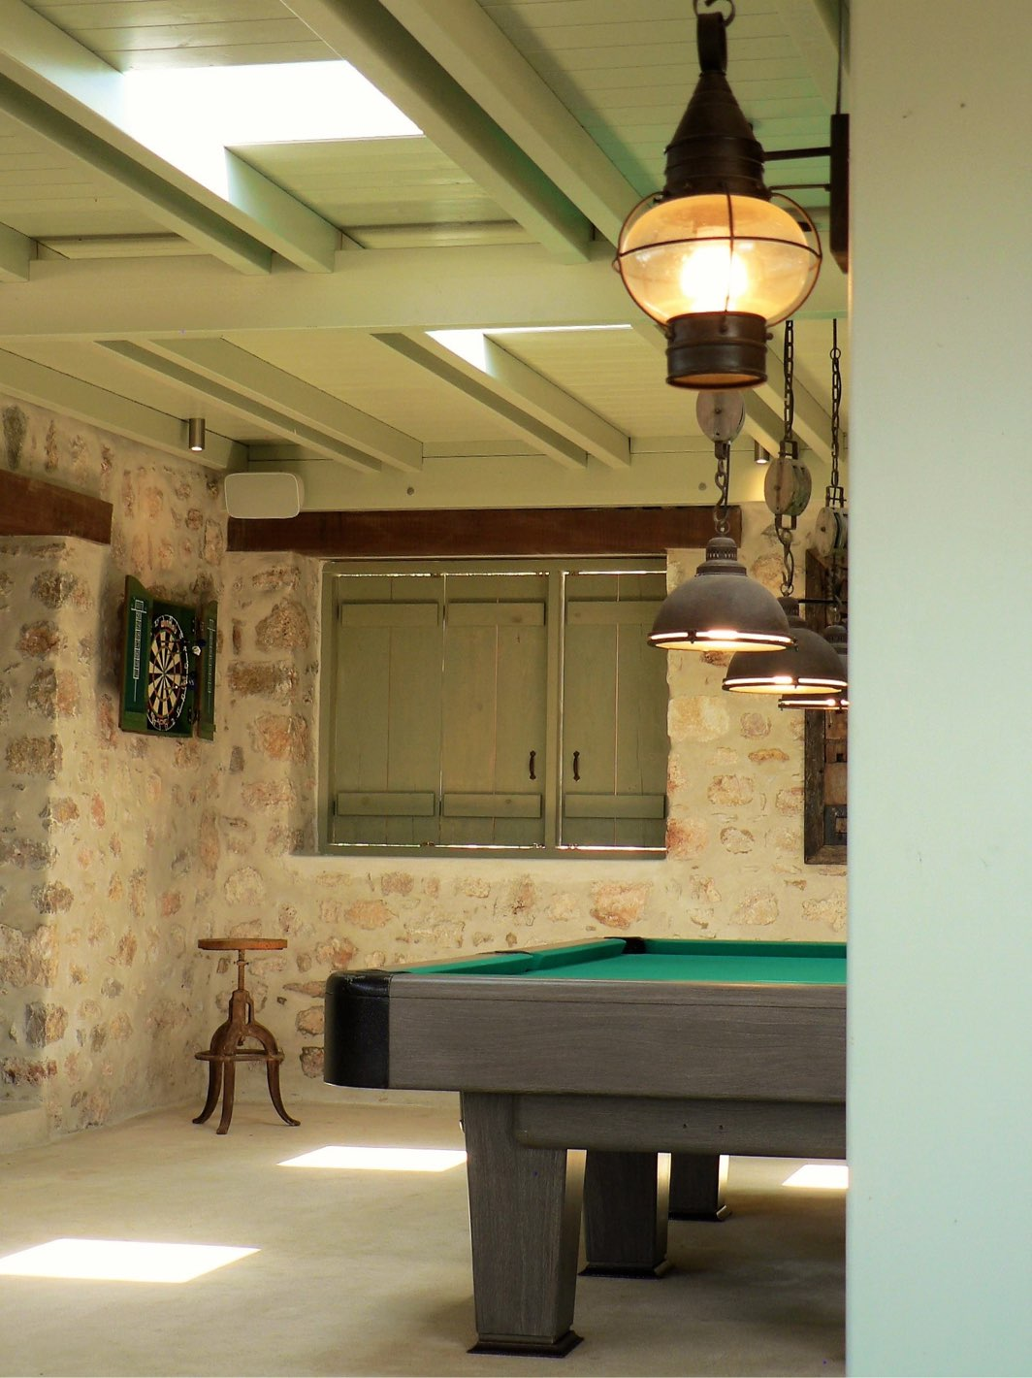
ajhd aidan james hurren design
The Playroom

Slide 22
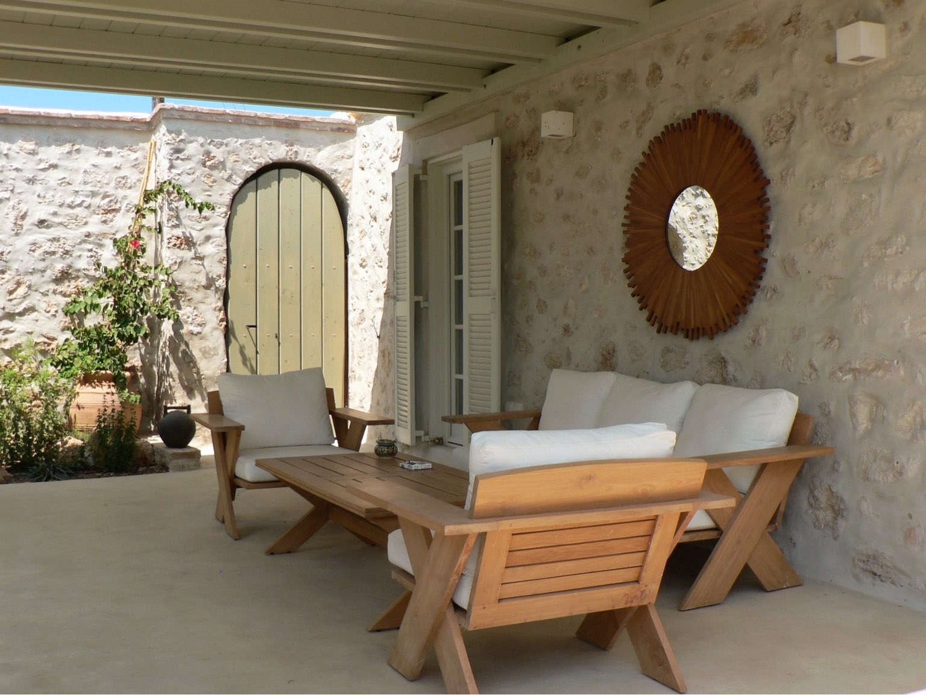
ajhd aidan james hurren design
The Guest House Terrace

Slide 23
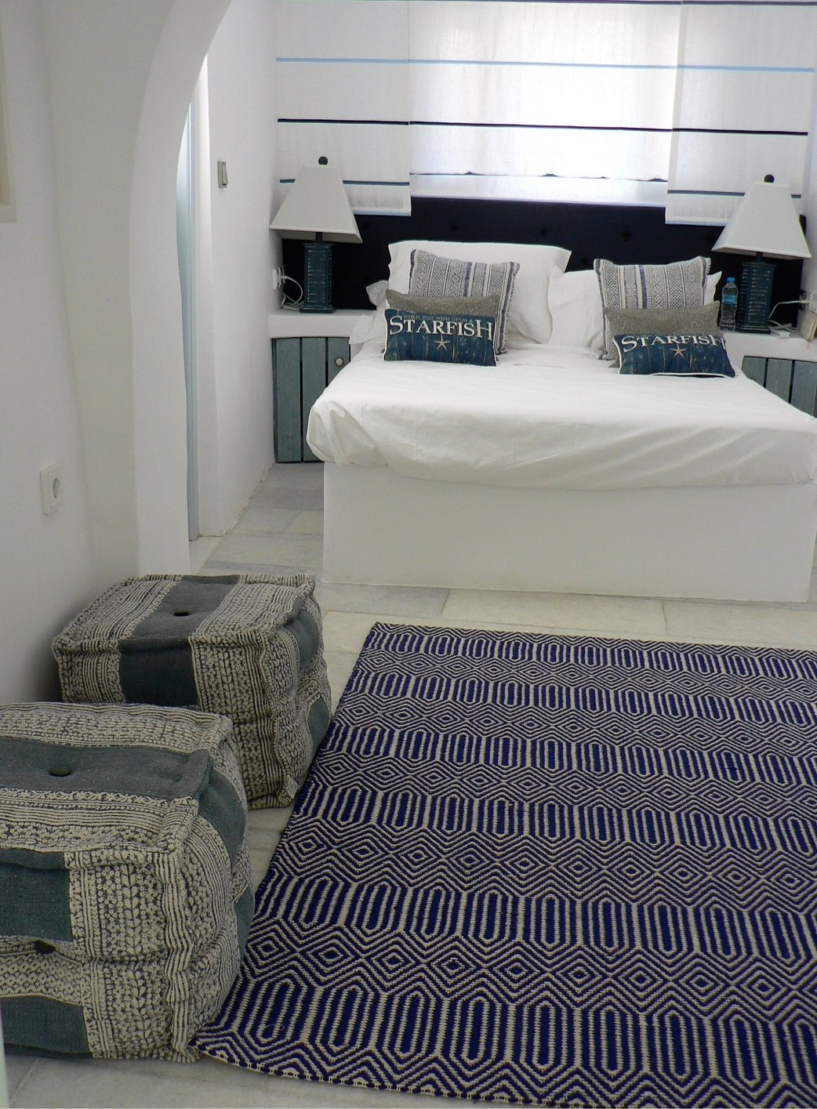
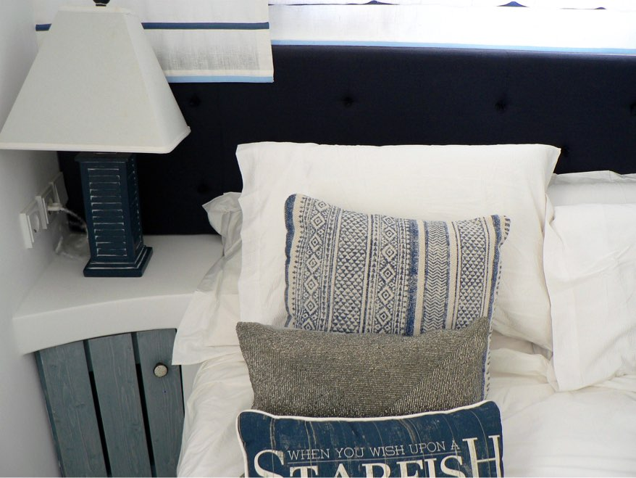
ajhd aidan james hurren design
the Blue Room, in the Guest House

Slide 24
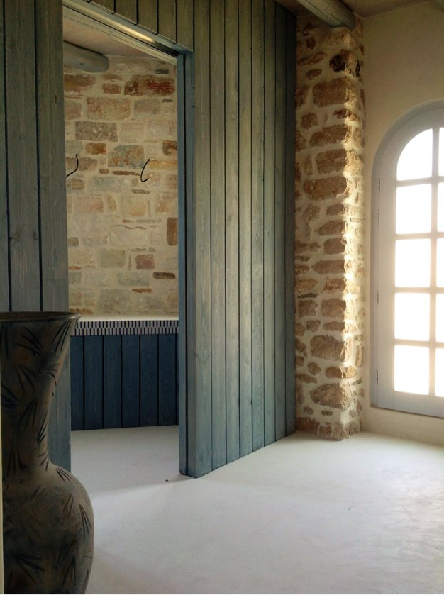
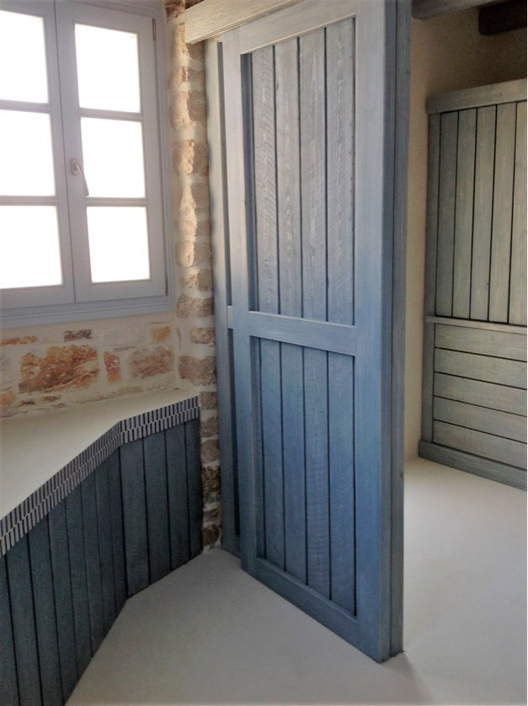
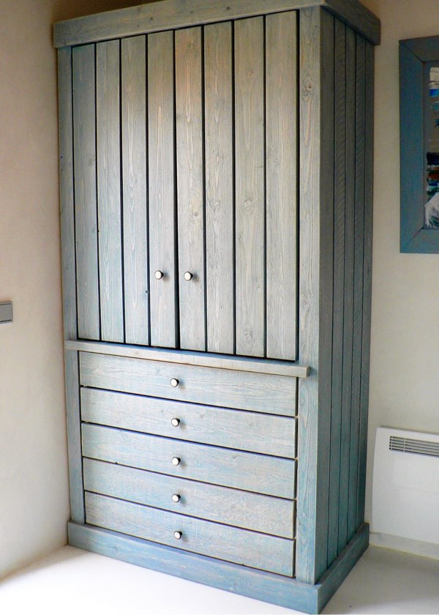
ajhd aidan james hurren design
The en-suite bathroom and dressing area of the Blue Room
in a newly-constructed annexe, to replace an old tin-roofed lean-to; with a room-dividing partition and built-in furniture, all made from simple sawn timber, painted and distressed

Slide 25
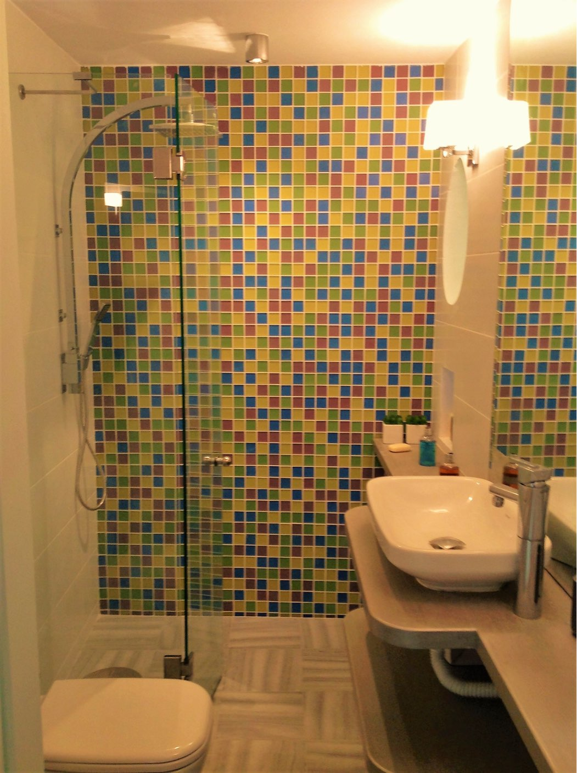
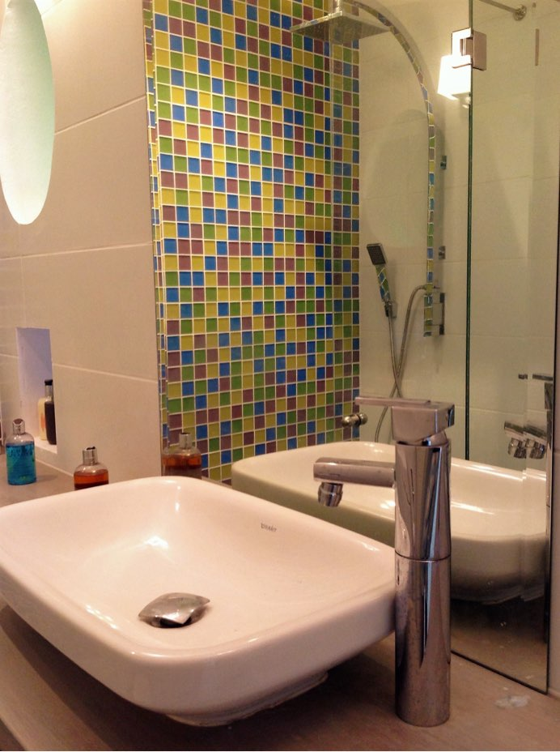
ajhd aidan james hurren design
the Guest House Bathroom
coloured glass mosaic tiles, the local marble,
and silvery wooden counter tops

Slide 26
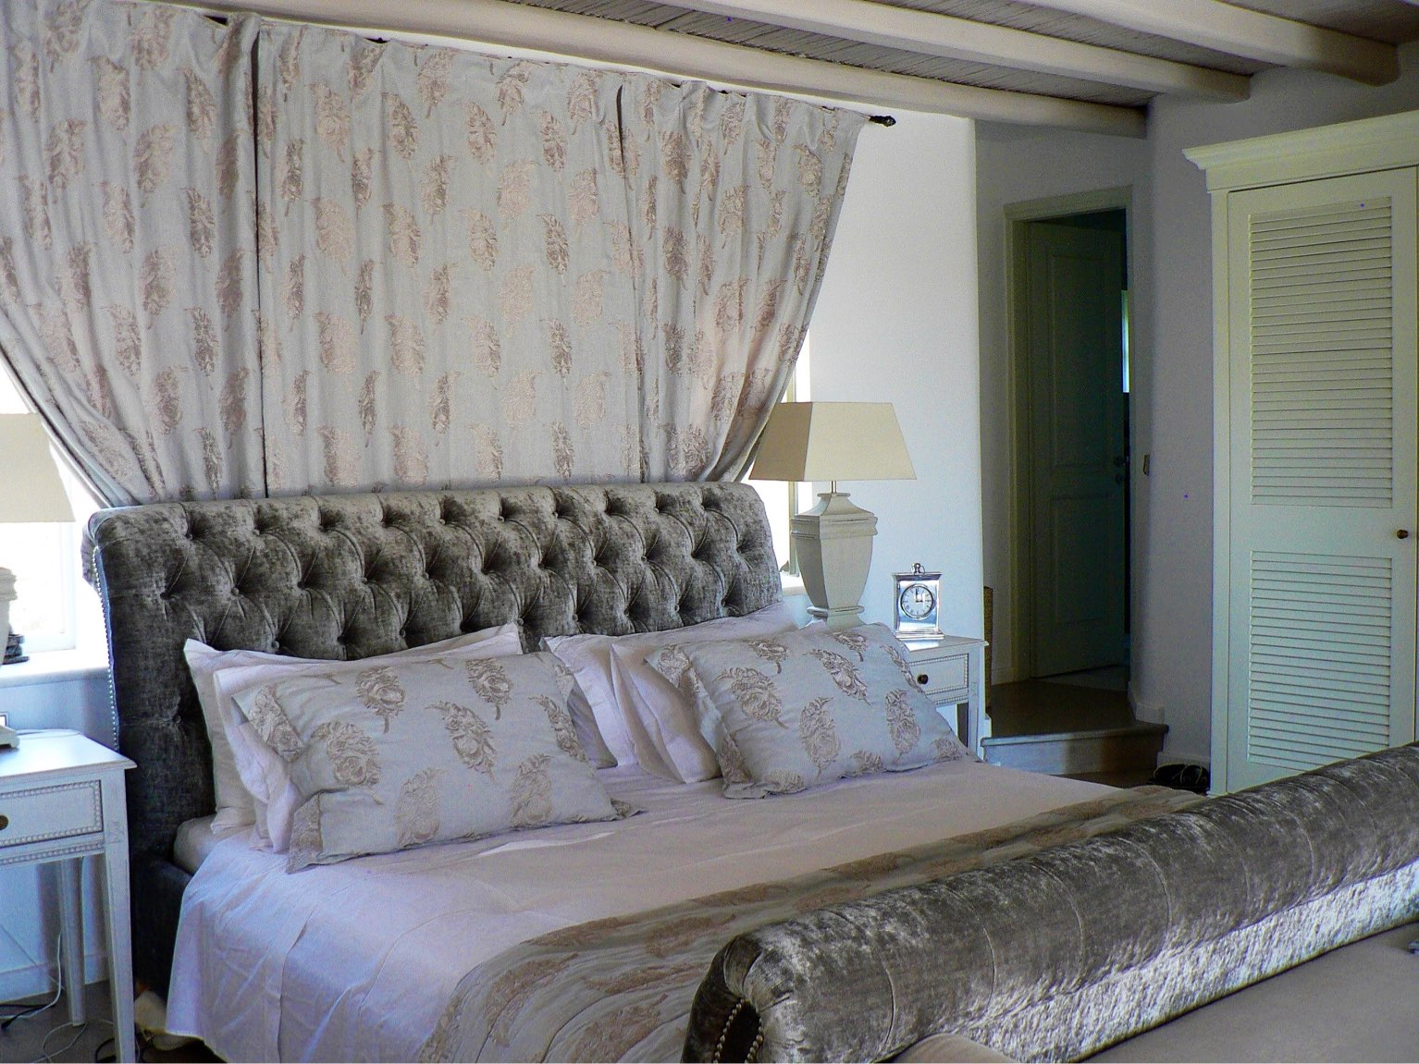
ajhd aidan james hurren design
The Master Bedroom
beautiful embroidered linen fabric for the curtains, a large sleigh bed upholstered in sumptuous graphite-grey crushed velvet
and fresh louvred doors on the wardrobes give the Master Bedroom a rather opulent simplicity

Slide 27
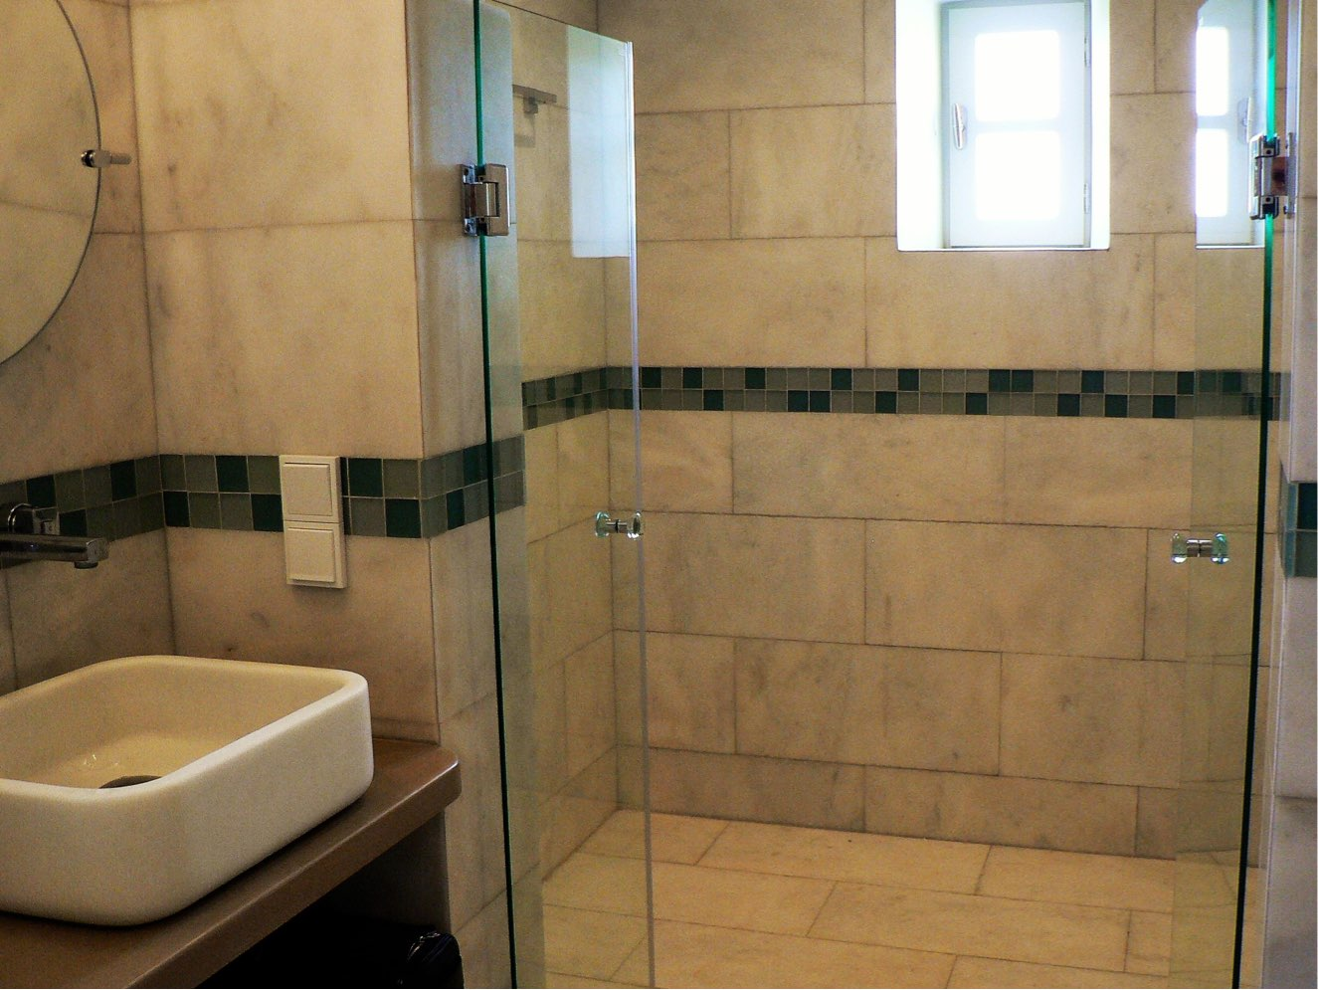
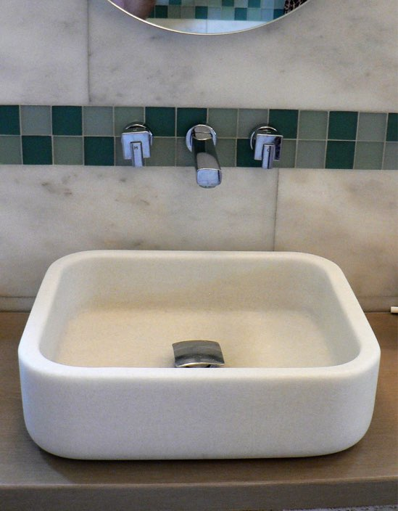
ajhd aidan james hurren design
The Master en-suite bathroom
Local Parian marble on all the walls and floors, with a coloured glass mosaic trim, and bespoke hand-carved marble basins

Slide 28
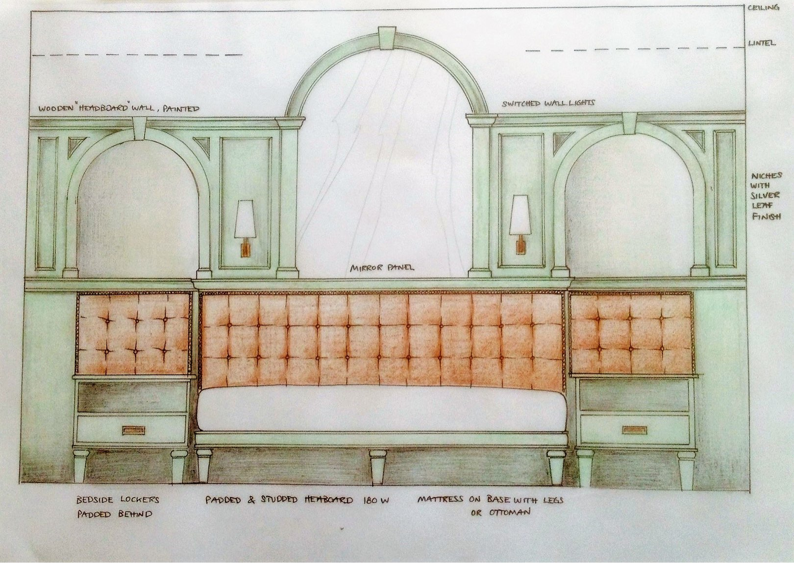
ajhd aidan james hurren design
Design drawing for
the principal Guest Room
The two smaller arches were existing niches in the thick stone walls

Slide 29
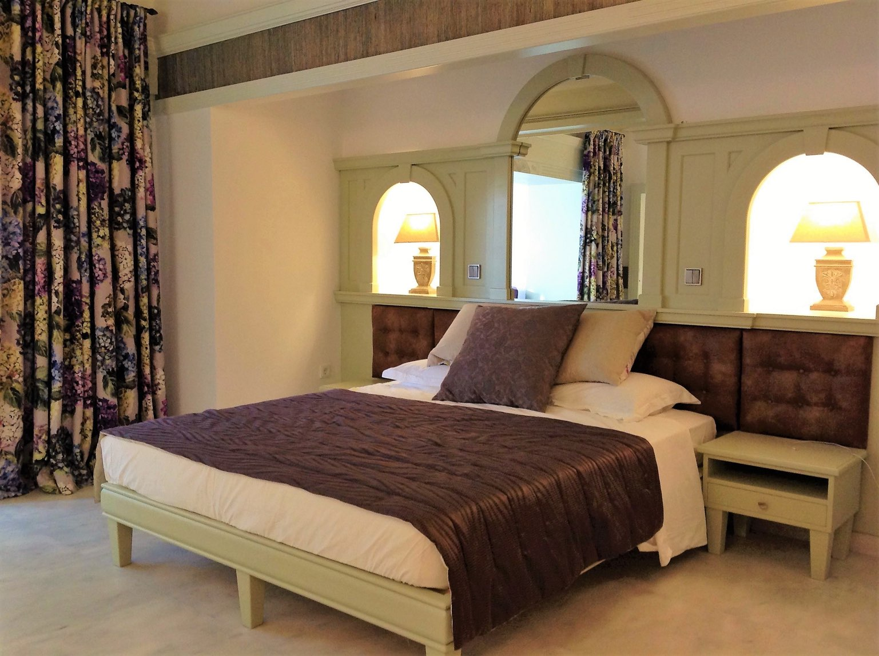
ajhd aidan james hurren design
the principal Guest Room.
Previously this room was very sombre, with dark terra-cotta tiled floors, and a pitch-dark bamboo ceiling.
Totally revamped with a painted bamboo ceiling and exquisite Parian statuary marble on the floor,
it is now a light and cool room,
with a vibrant Hydrangea design fabric at the window, to echo with what is outside - the shady courtyard, full of foliage and blooms.
The bed, and it’s paneled headboard, (designed around the existing niches in the phenomenally thick stone walls), the bench seat and the dressing table, were all made by local craftsmen

Slide 30
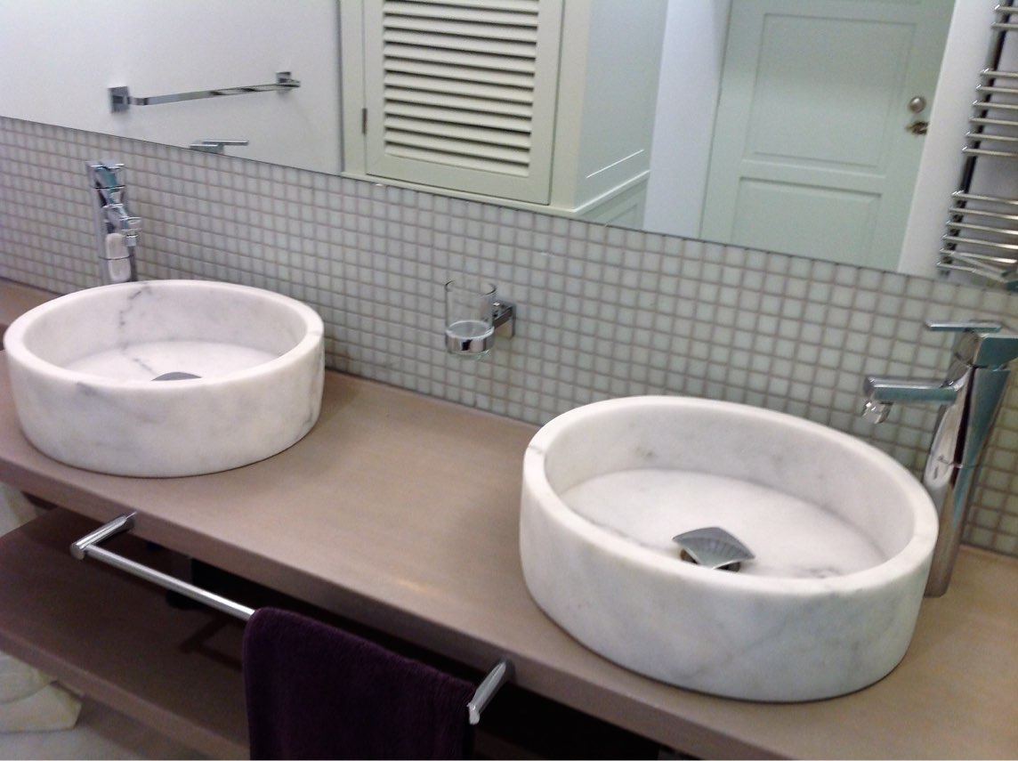
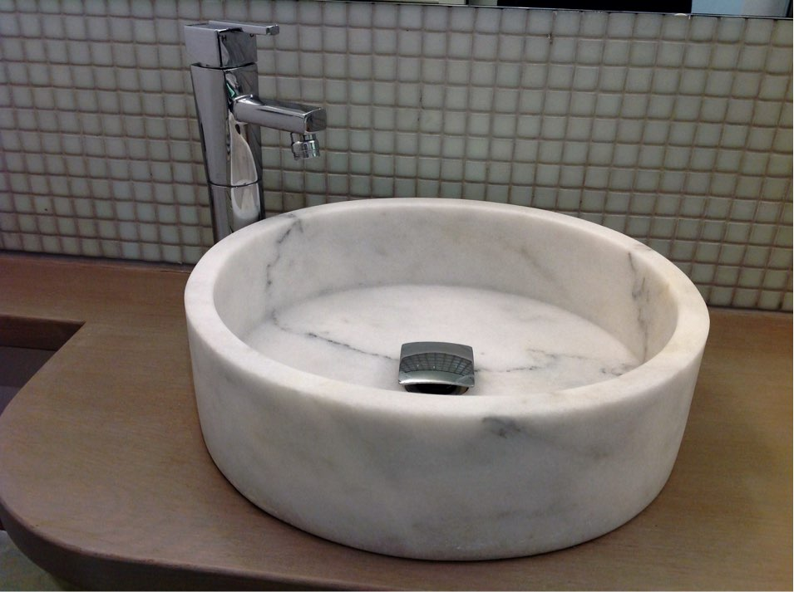
ajhd aidan james hurren design
beautiful hand-carved marble basins in the principal Guests’ Bathroom

Slide 31
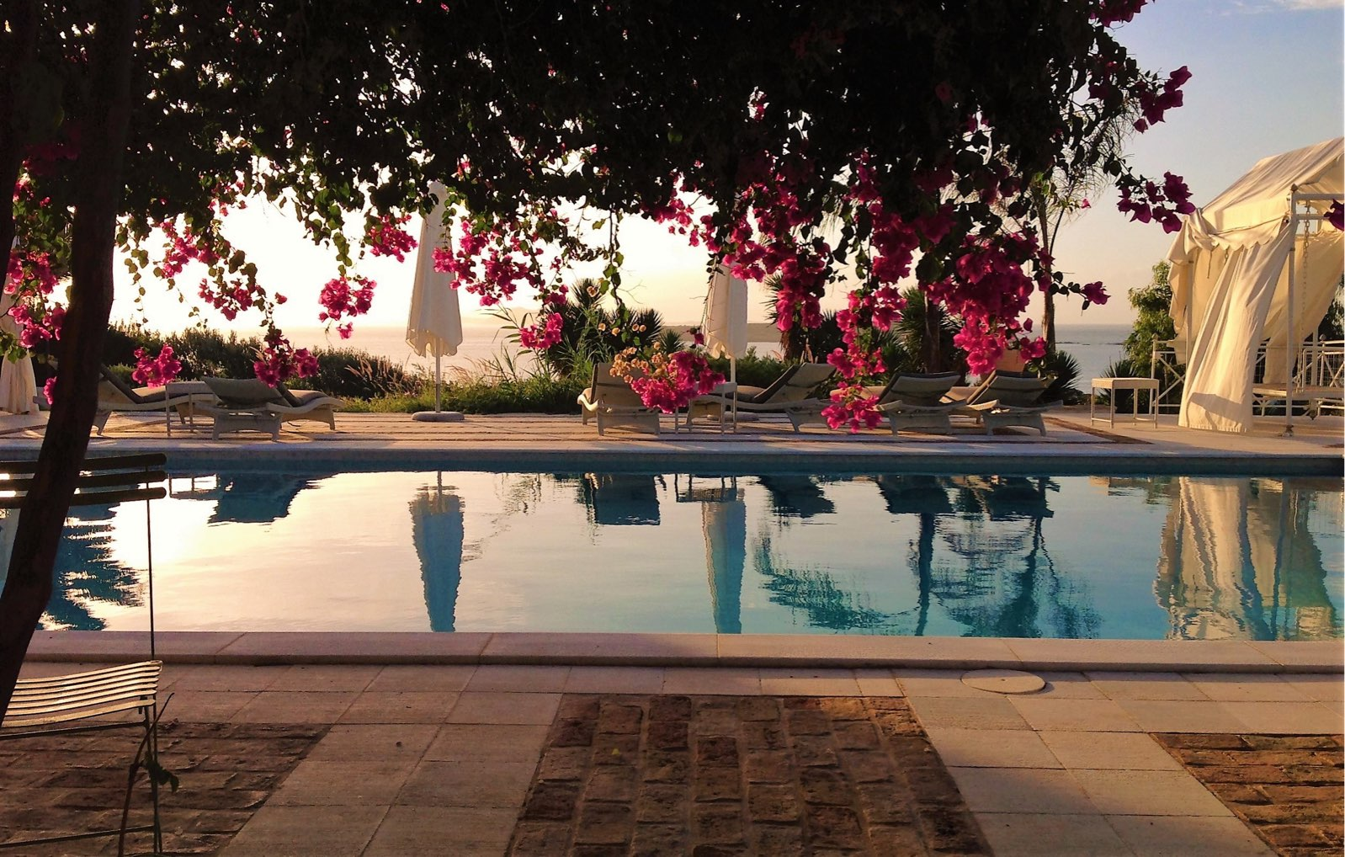
ajhd aidan james hurren design
The large and very deep pool was made shallower (safer), and tiled with pale green etched-glass mosaics.
The cement tiles around the pool edge were replaced with reeded Parian marble.
The original terraces around the house were finished in honed white Parian marble, inset with panels or designs of handmade brick, which all needed to be deep-cleaned, repaired, and revived.
Two curtained, metal gazebos frame the lovely view across the landscape to the turquoise sea below.
One gazebo provides seating around a dining table, the other a comfy swing-sofa

Slide 32
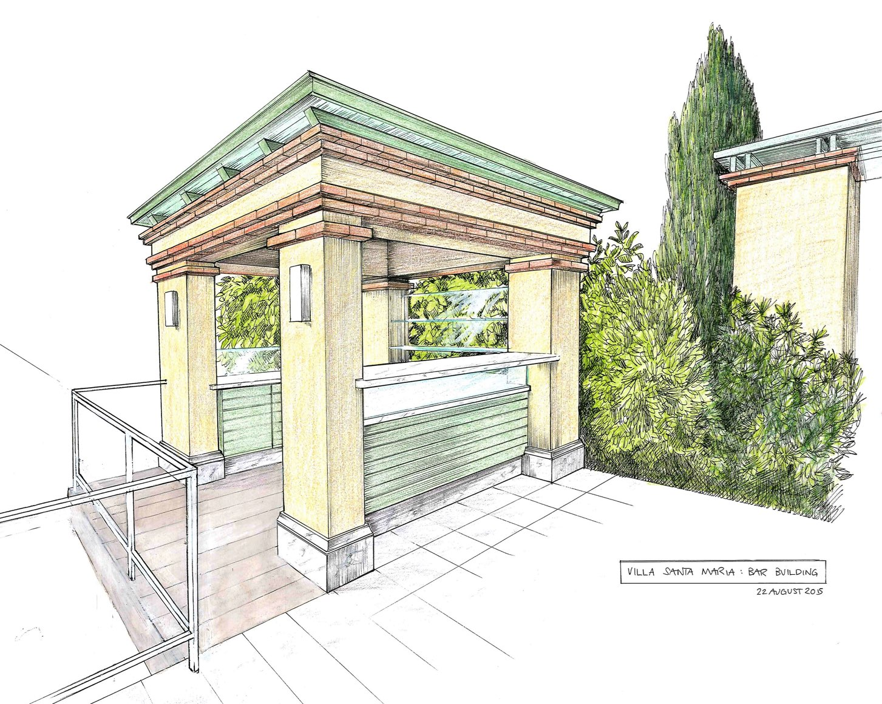
ajhd aidan james hurren design
Design for a
Pool-side Bar
Design drawing
for the Poolside Bar

Slide 33
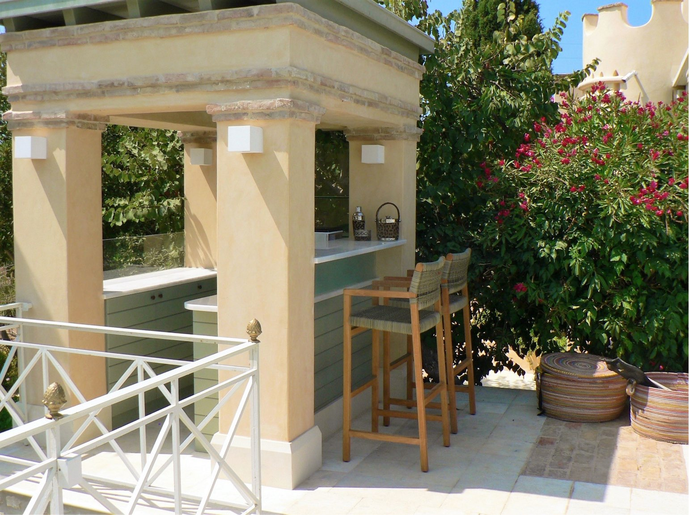
ajhd aidan james hurren design
The finished Poolside Bar

Slide 34
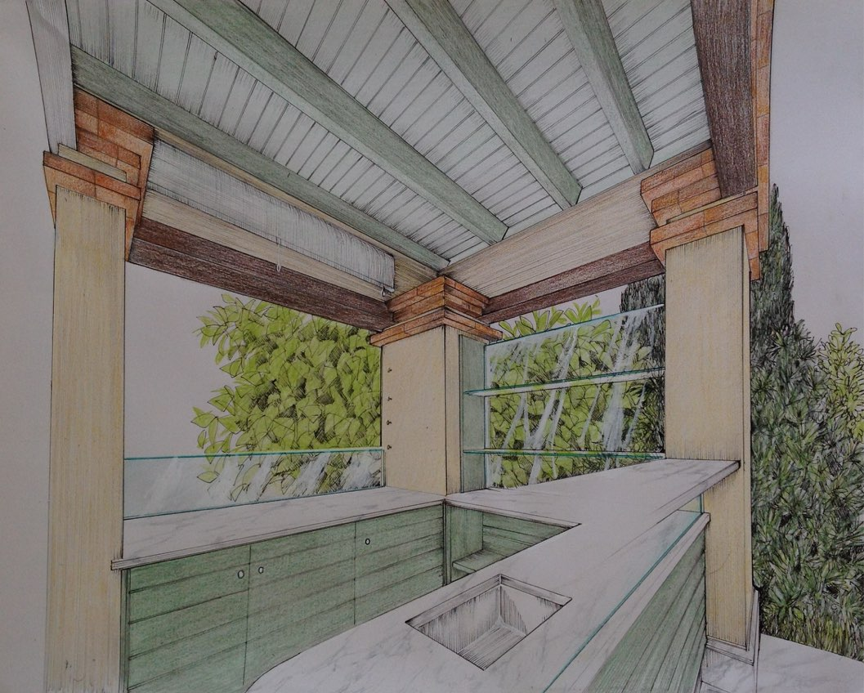
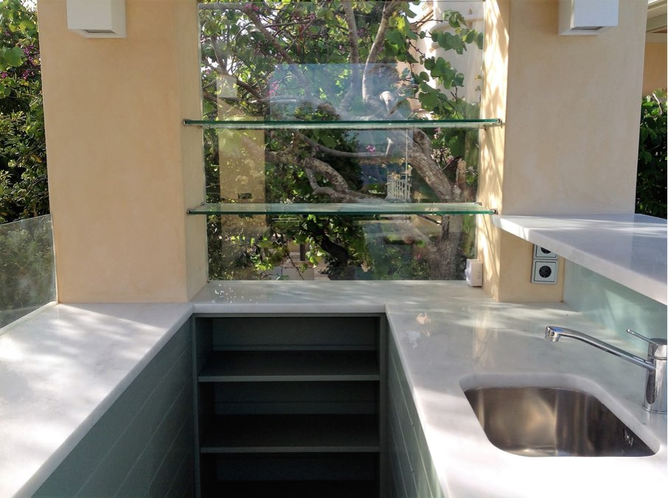
ajhd aidan james hurren design
Design drawing for the Poolside Bar

Slide 35
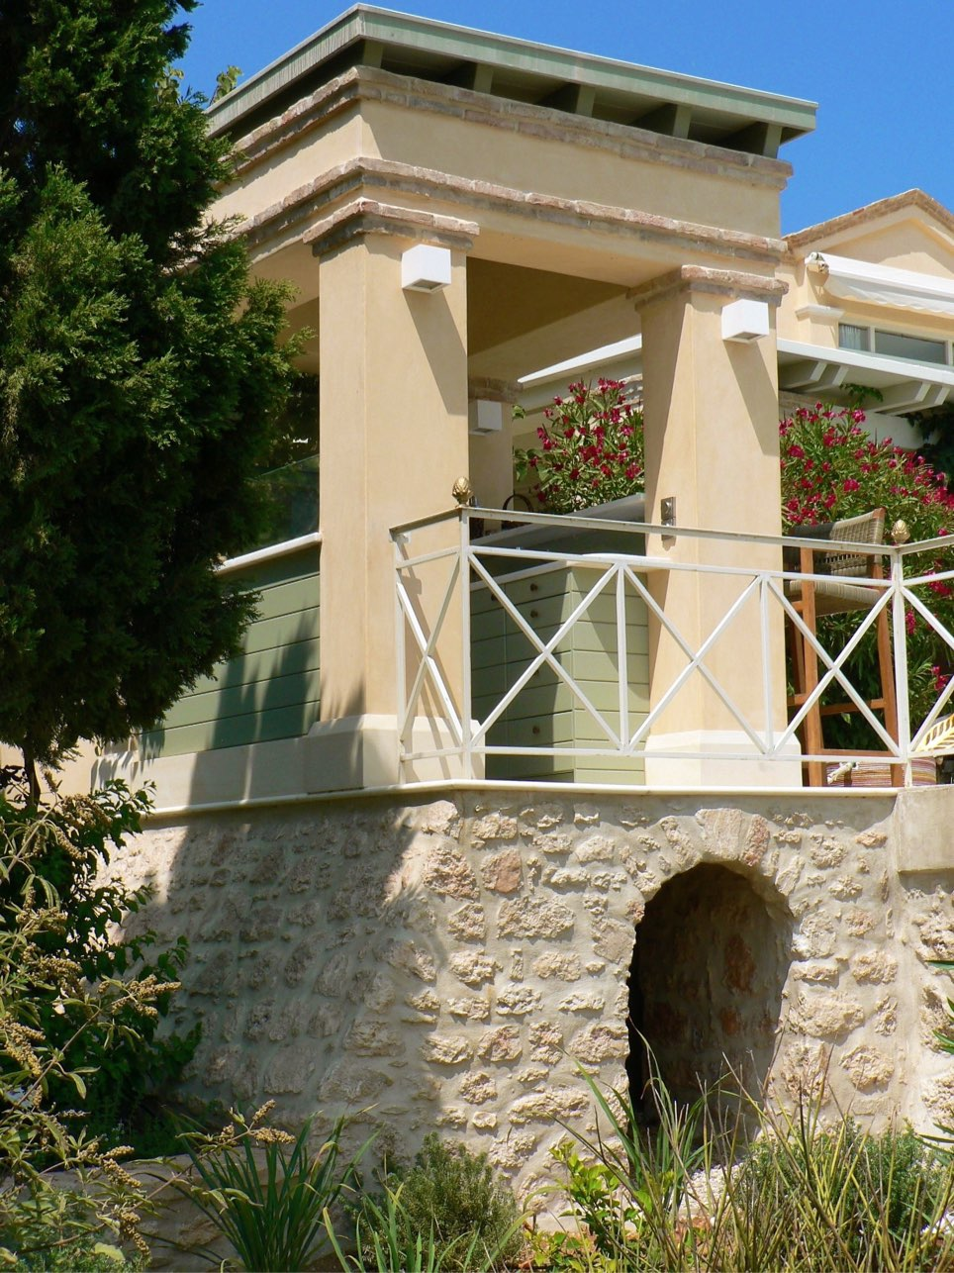
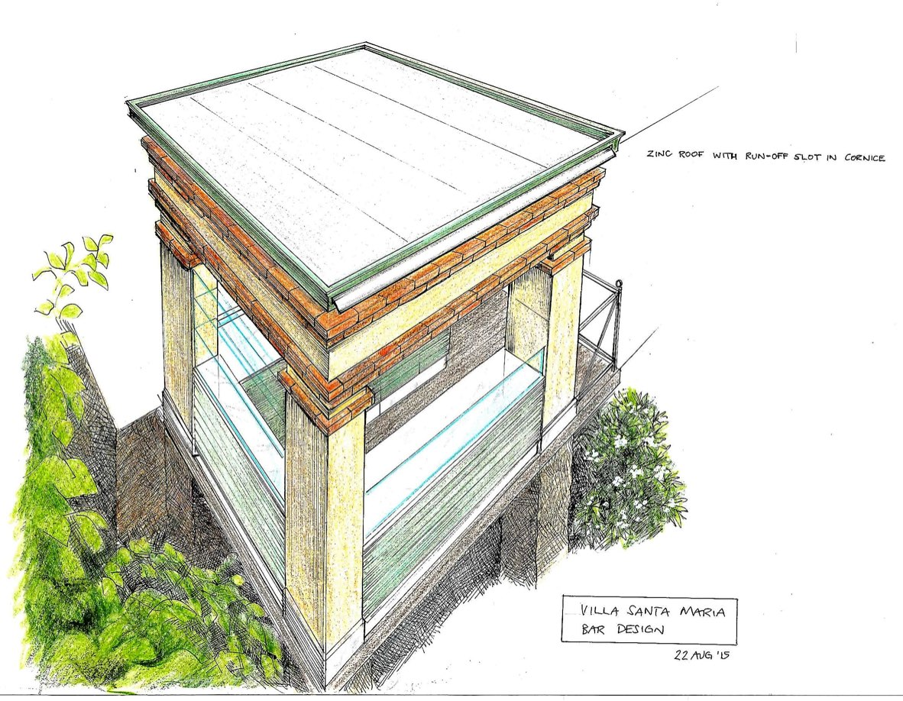
ajhd aidan james hurren design
Pool-side Bar,
rear view
Poolside Bar, Design drawing and the finished structure

