Slide 1
ajhd aidan james hurren design
essex, uk
the renovation of an unusual ‘hybrid’ house in Epping Forest
- Victorian Lodge meets Modernist Villa

Slide 2
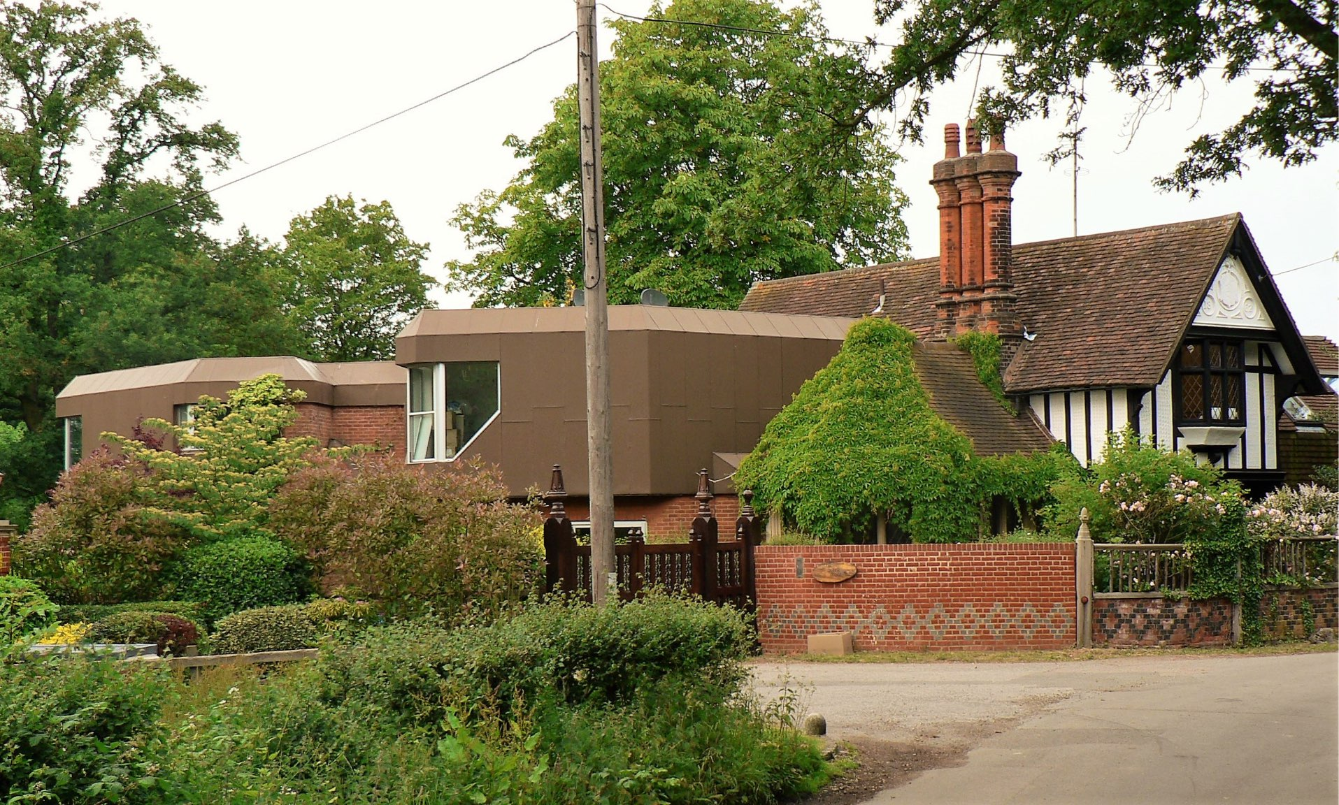
ajhd aidan james hurren design
The unusual combination of Victorian Lodge building and 1970’s modernist Architect’s Own villa was looking drab and tired, despite the bucolic location.
With the drab copper cladding, locals said it looked like an abandoned space-ship…

Slide 3
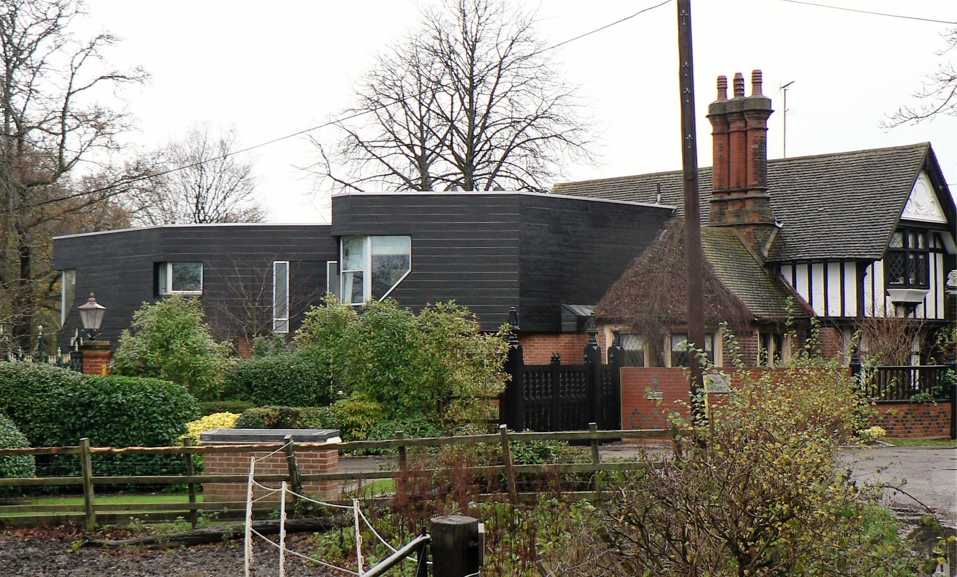
ajhd aidan james hurren design
the 1970’s ‘space-ship’ with it’s tired copper cladding was completely hidden and re-shaped with the new black weatherboarding, typical of the local Essex vernacular architecture, and harmonizing much more comfortably with the black-and-white Victorian Lodge.

Slide 4
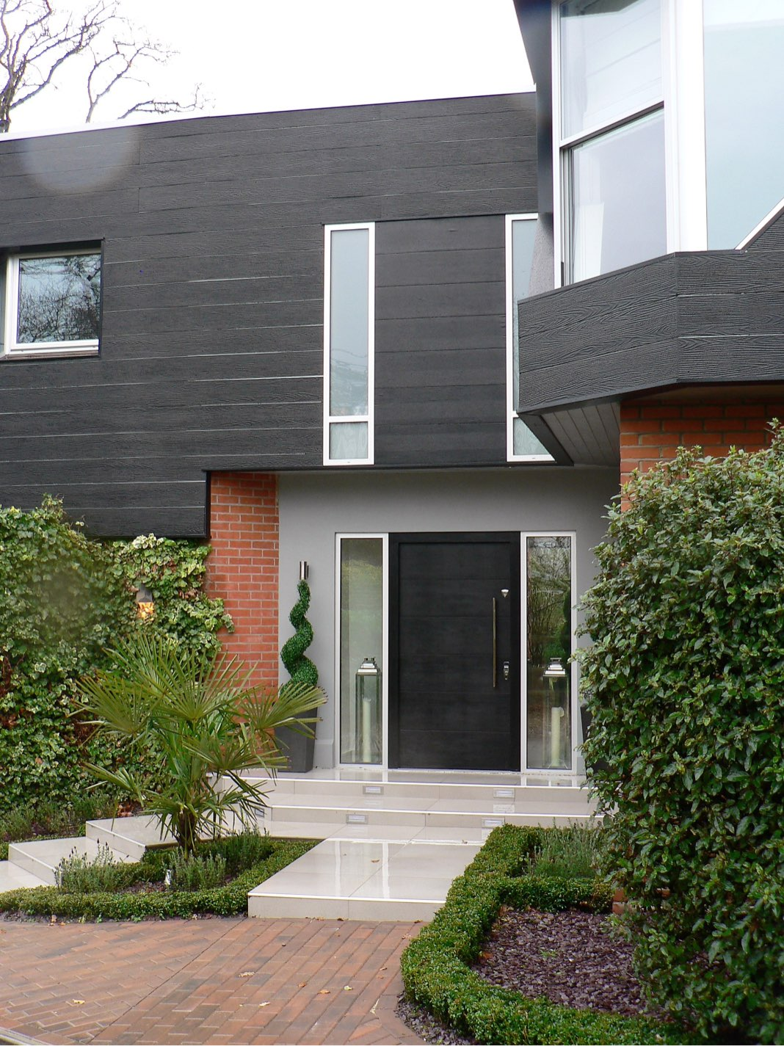
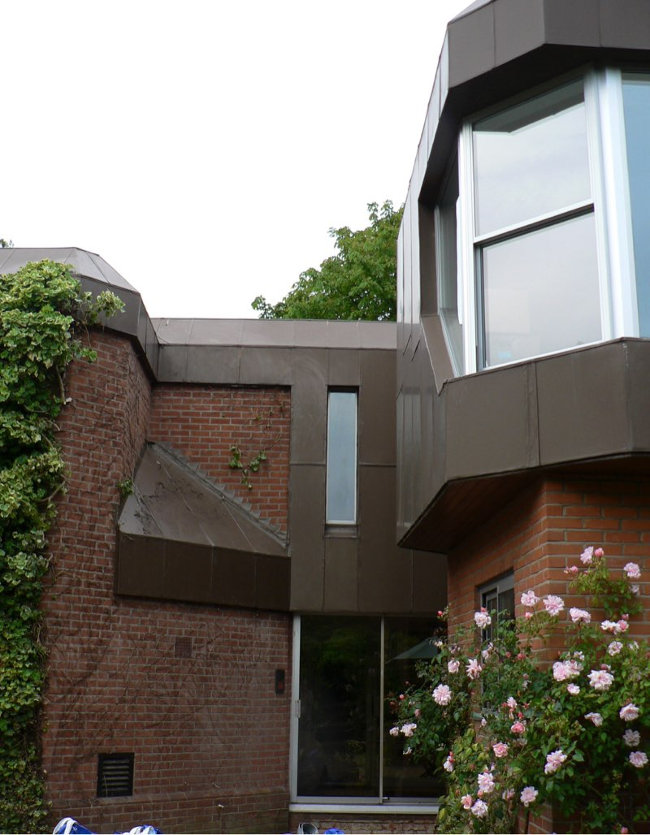
ajhd aidan james hurren design
the ungainly facade and awkward, dark main entrance to the house were reconfigured by moving the doorway forward, making new steps and adding new planting. The black weatherboarding, smooth rendered panels , and smooth ceramic tiled paving make for a sleek exterior, which works with the modern red-brick ,and with the old black-and-white Victorian Lodge.
(Above the door an extra room was created which became a walk-in closet for the Master Bedroom suite)

Slide 5
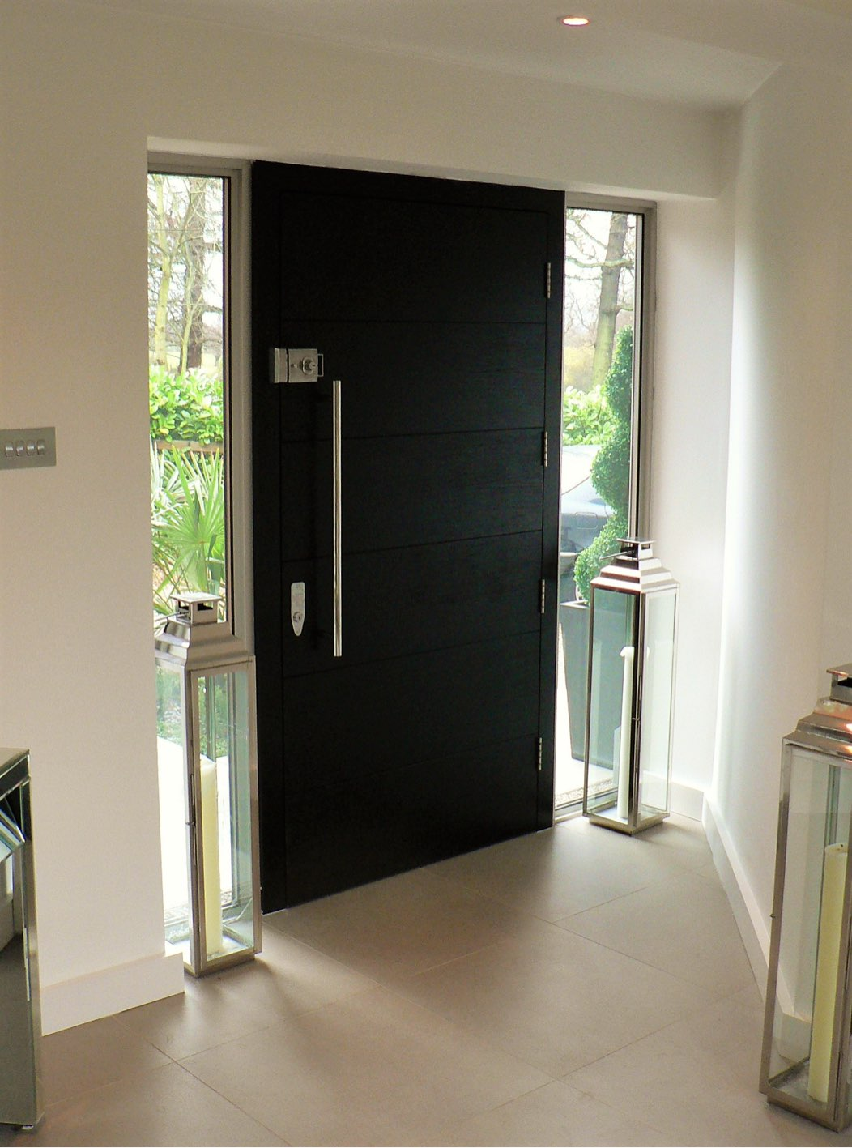
ajhd aidan james hurren design
The inside of the impressive 100cm wide front door
in the extended Entrance Hall

Slide 6
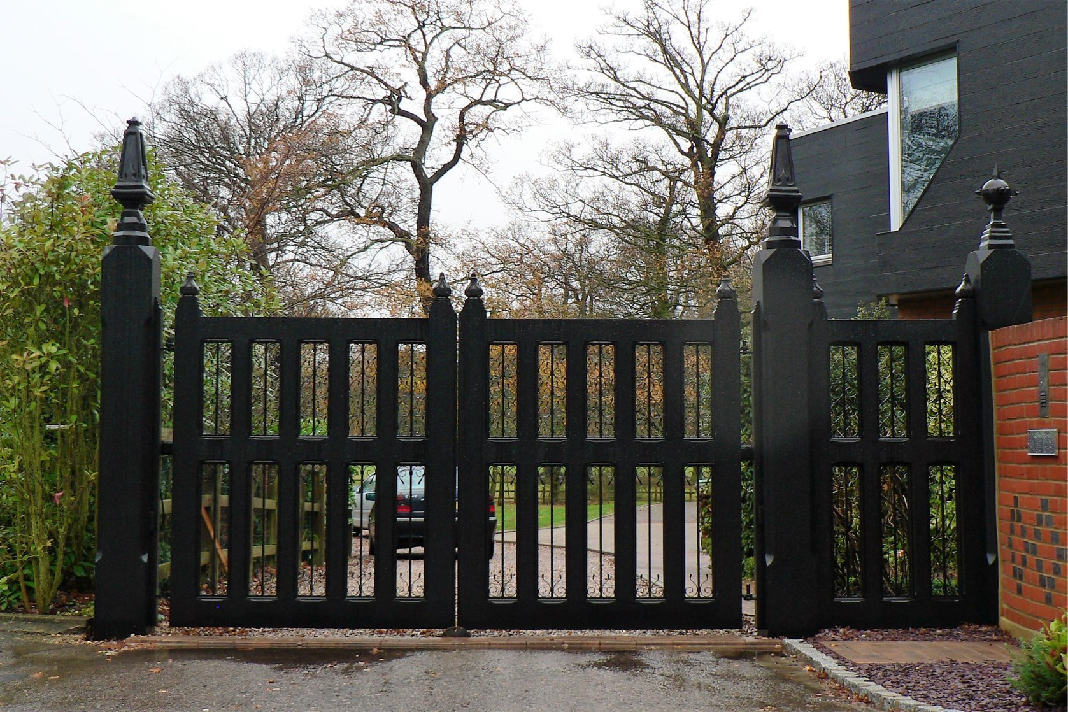
ajhd aidan james hurren design
Of the original Victorian gates to the earlier grand estate, only the gateposts remained, mostly rotten and very decayed.
Copies were made (with a box steel core) recreating the striking carved oak finials.
New gates of solid oak and wrought iron were designed to complete the ensemble.
The black stain ties in with the black weatherboarding of the ‘new’ house &
the black-and-white
Victorian-era Lodge

Slide 7
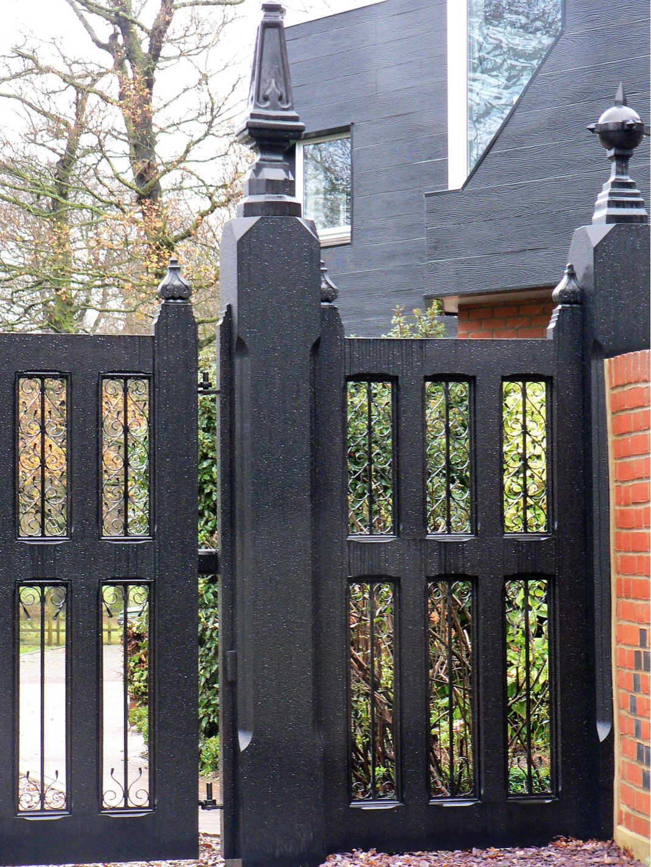
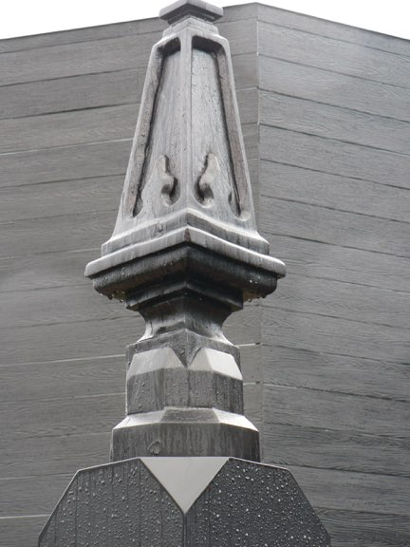
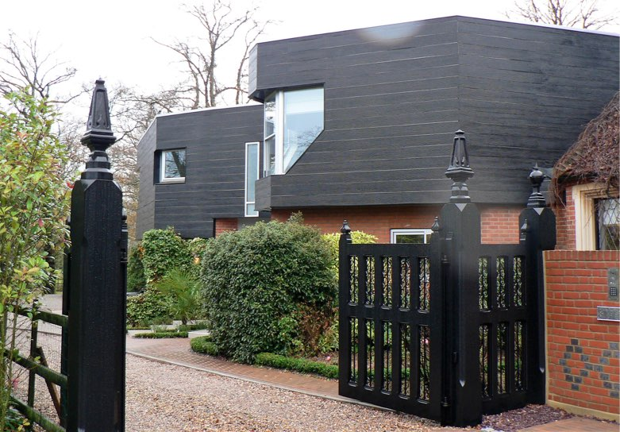
ajhd aidan james hurren design

Slide 8
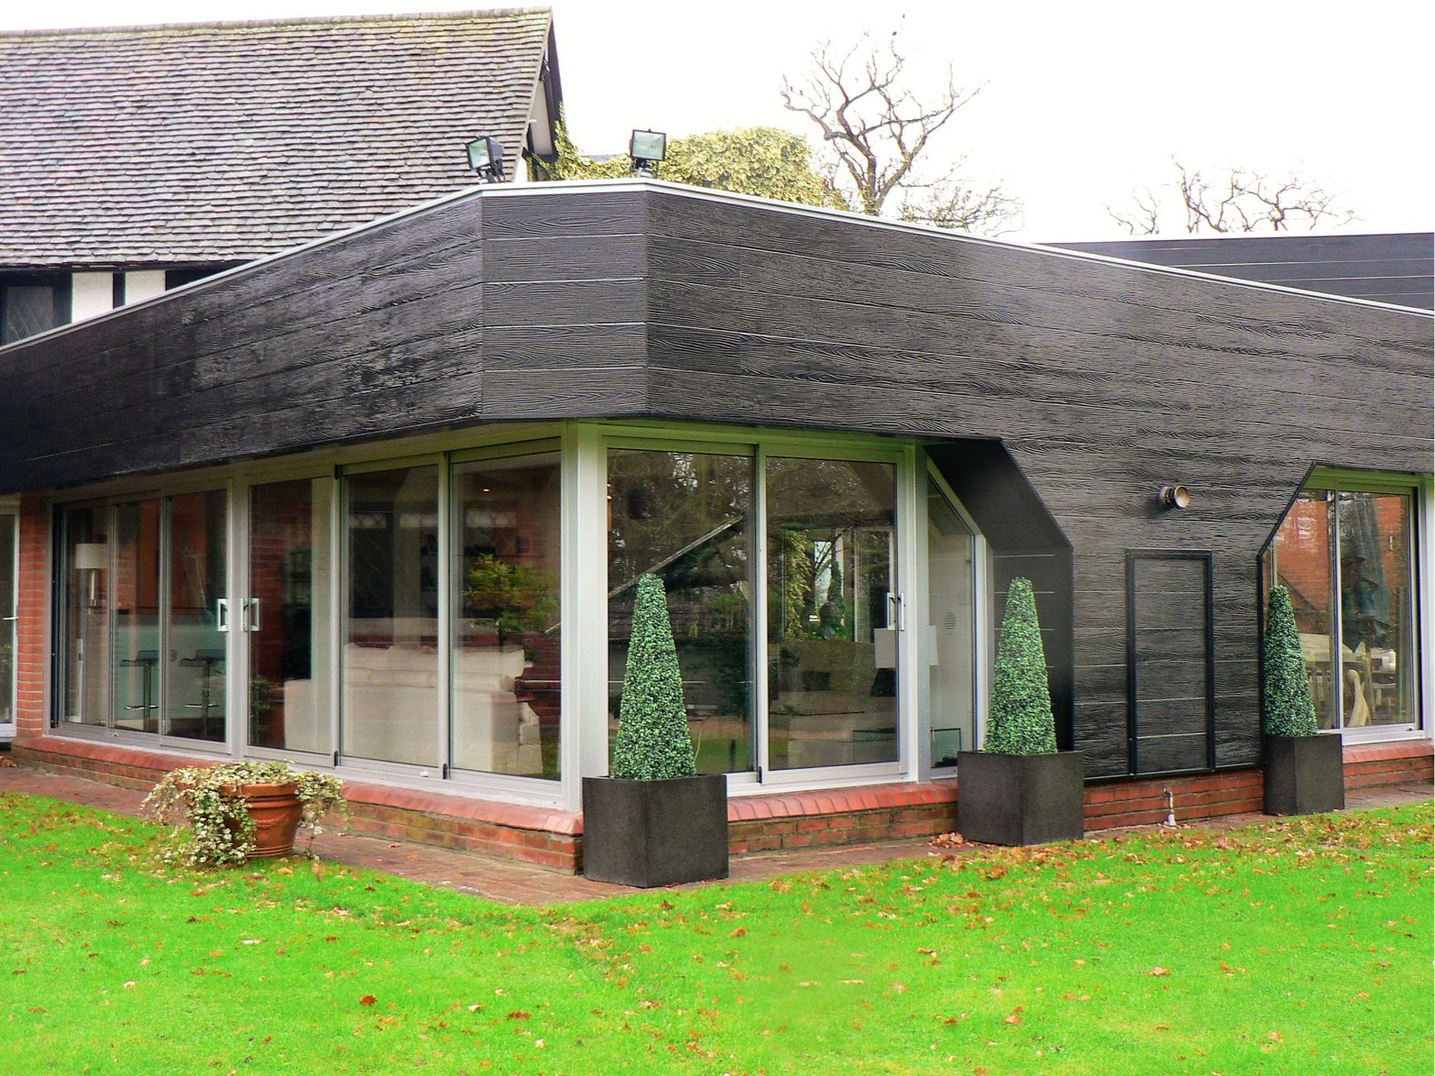
ajhd aidan james hurren design
the Garden Room,
after the re-cladding with weatherboard.
More than 8 x 8m, the room has virtually all-glazed walls to the garden

Slide 9
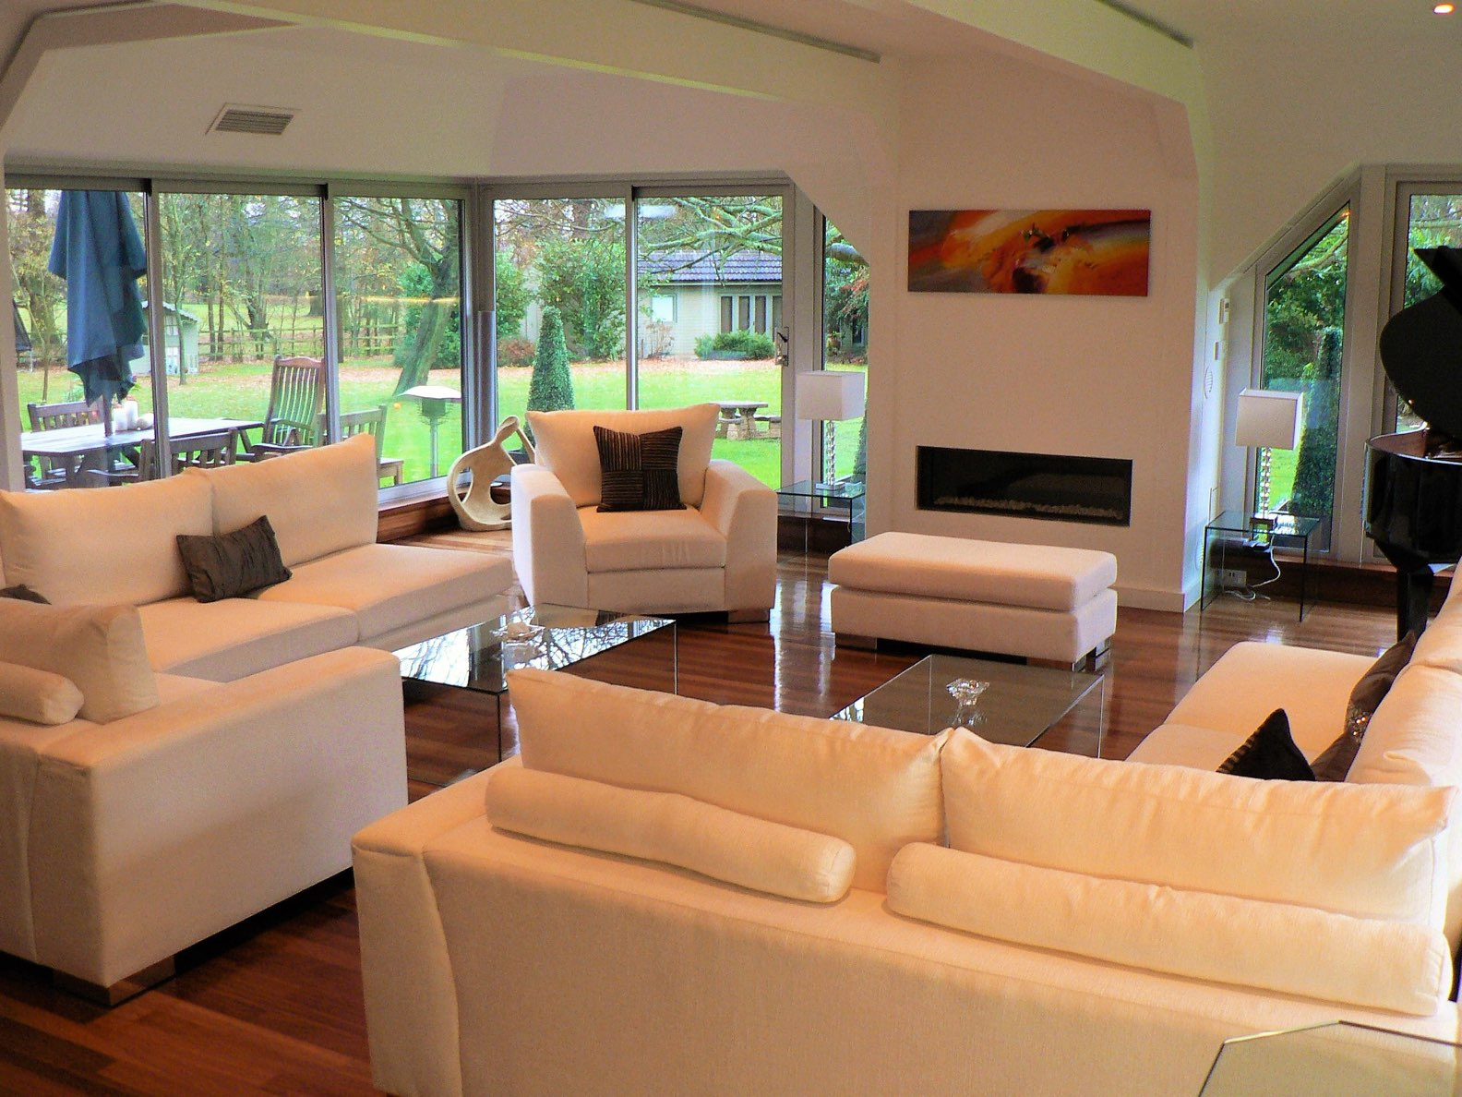
ajhd aidan james hurren design
The Garden Room
is inevitably dominated by the garden outside the windows, so the modern interior is kept simple

Slide 10
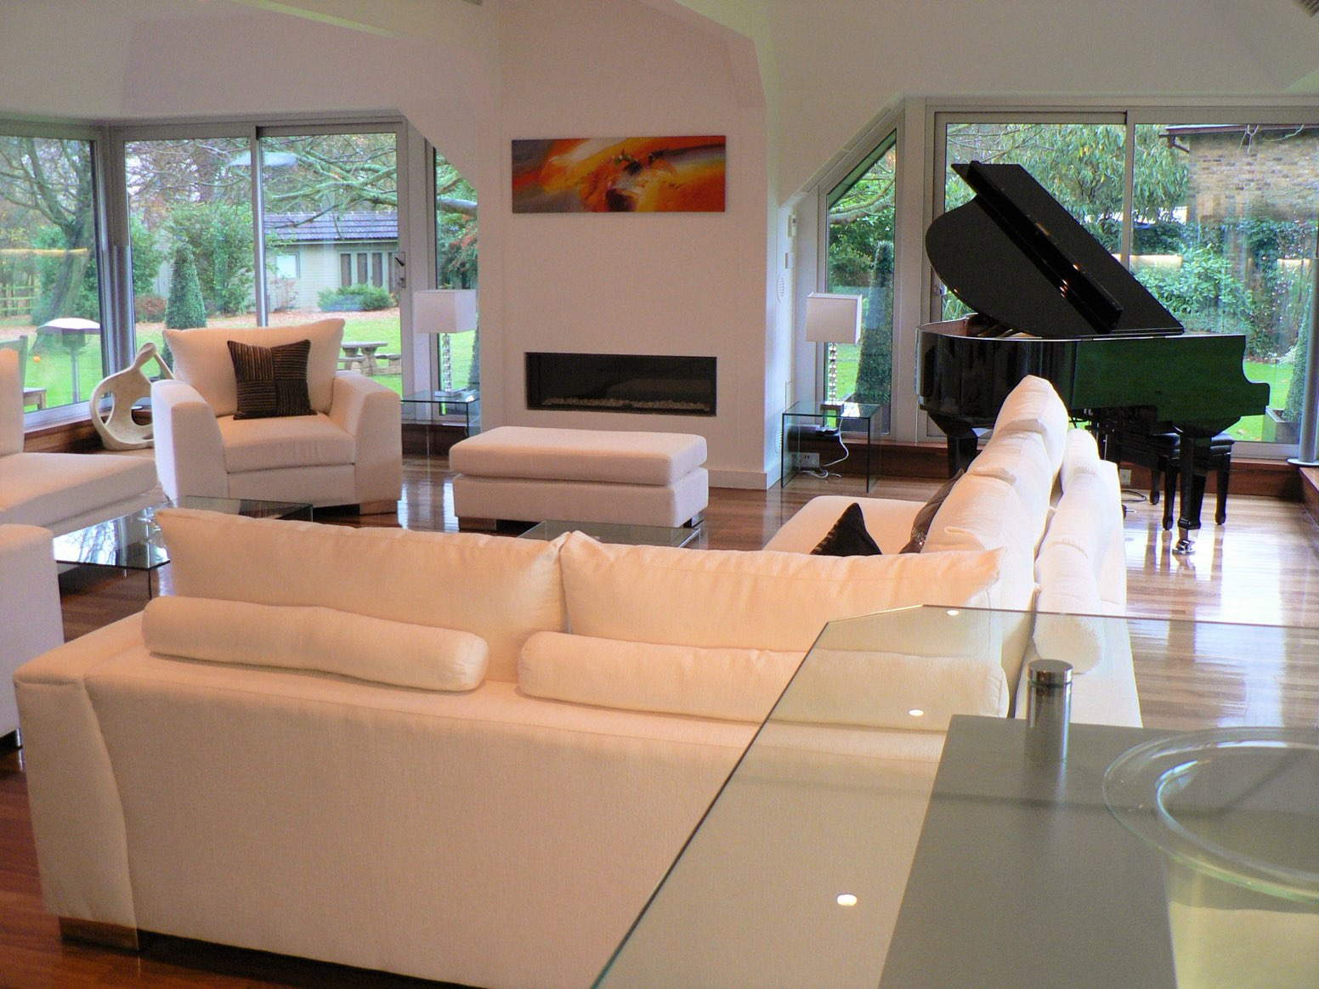
ajhd aidan james hurren design
The Baby Grand Piano is a striking sculptural piece in this spacious room

Slide 11
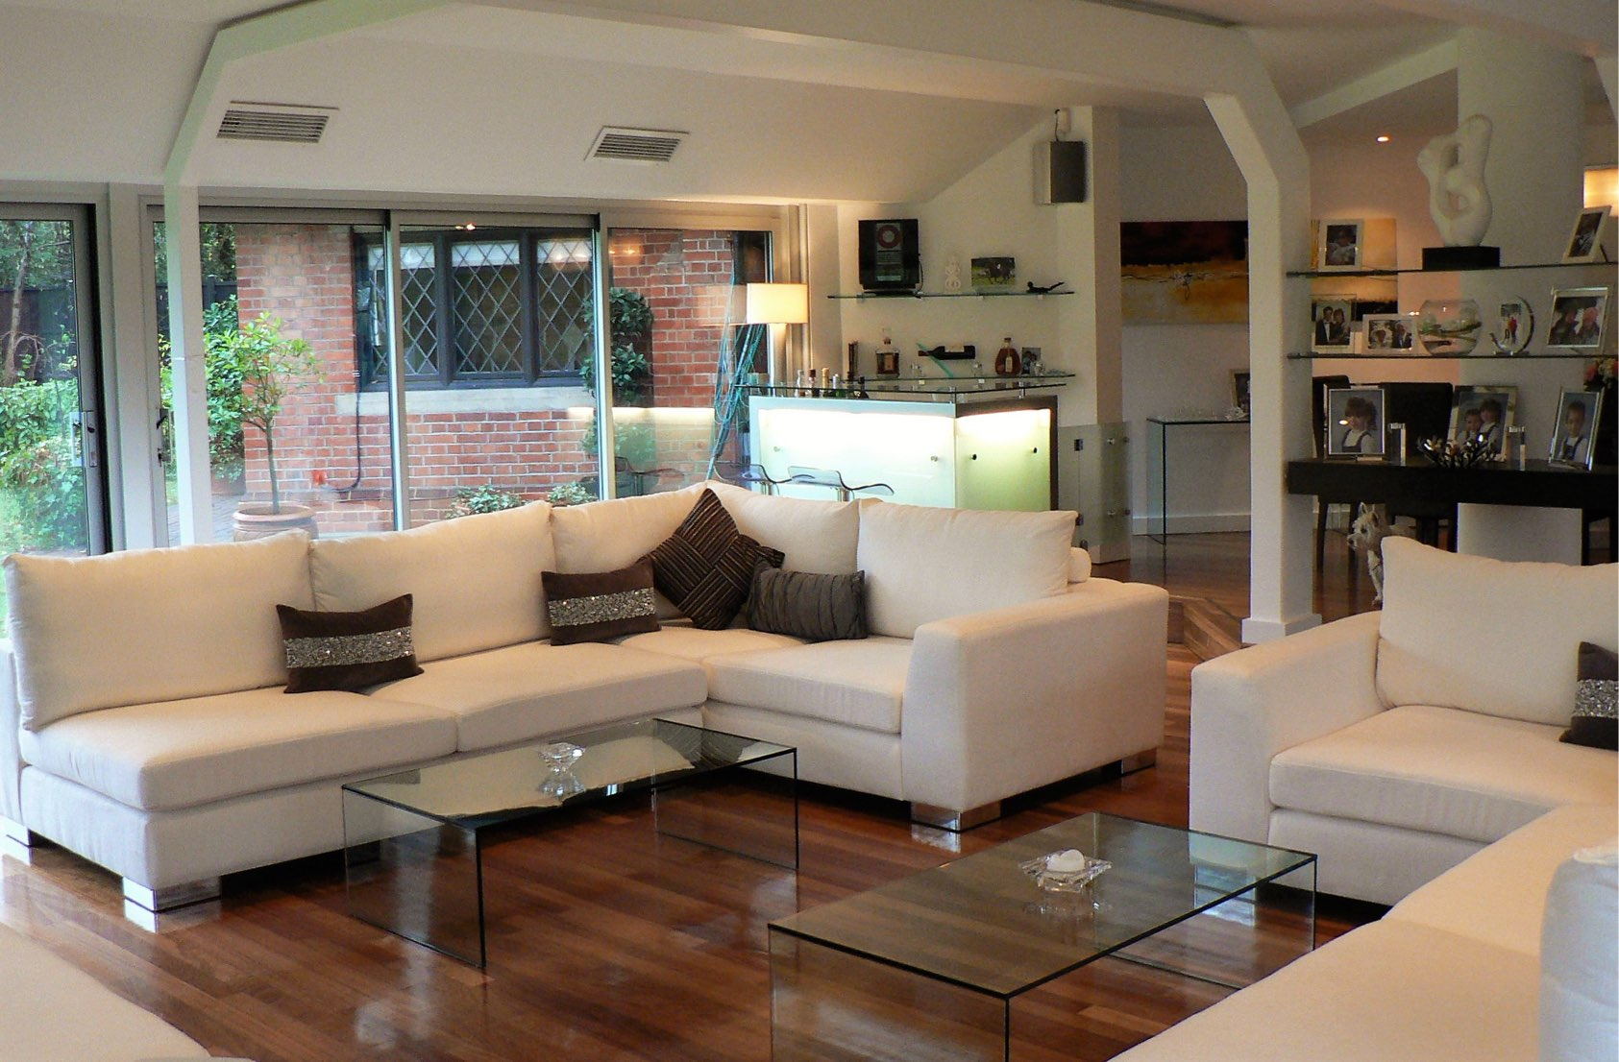
ajhd aidan james hurren design
The Garden Room clearly shows off it’s architectural form with the steel structure on display, undisguised except by paint.
The shapes created by 45-degree angles, seen here in the columns and girders, were also a determining factor in the overall floor-plan of the whole modernist extension to the original building.
This angled shape became a principal design motif, repeated in the design of the Bar counter (visible in the corner of the room)

Slide 12
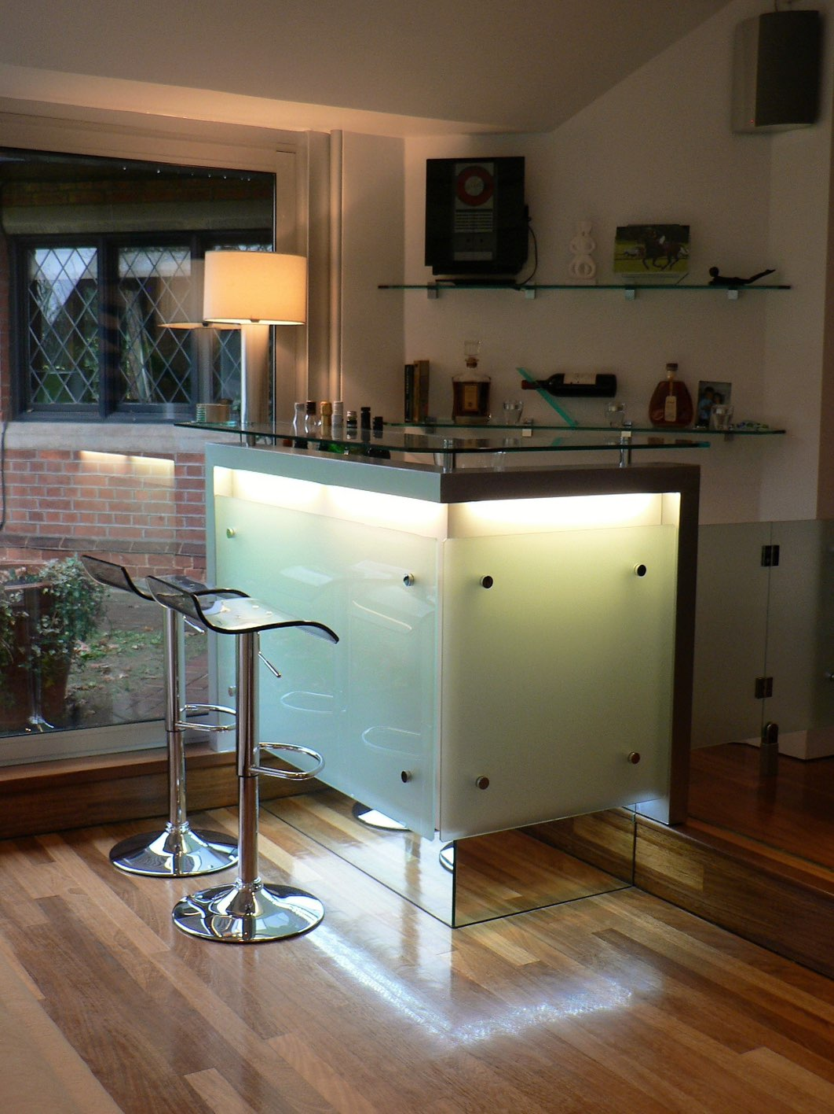
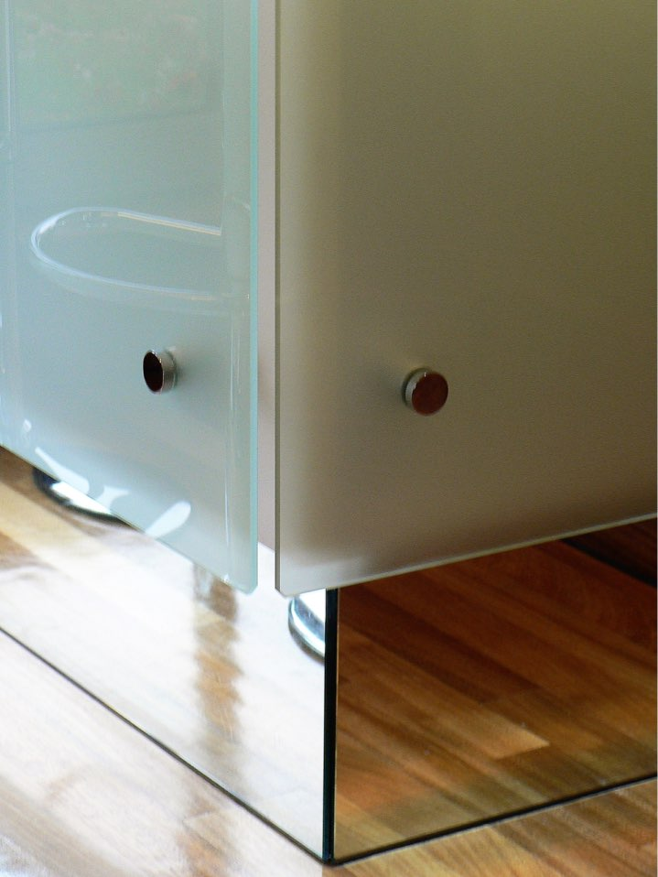
ajhd aidan james hurren design
the Bar in the corner of the Garden Room.
Constructed by hand, with illuminated glass panels and mirrored plinths, it almost appears to float

Slide 13
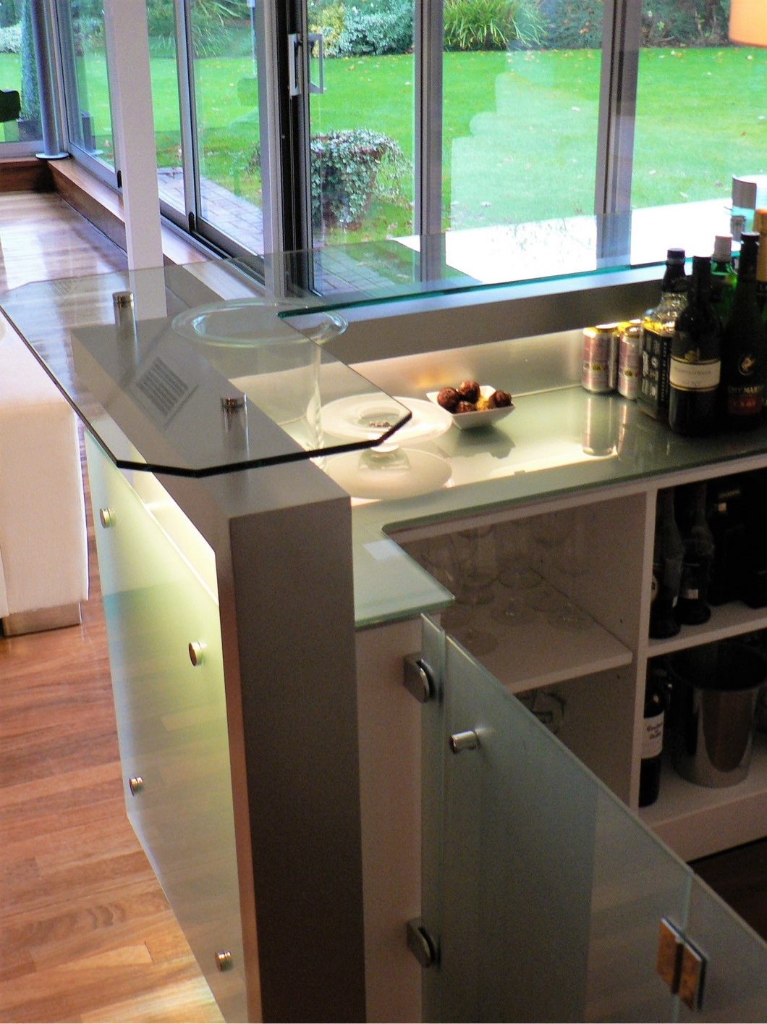
ajhd aidan james hurren design

Slide 14
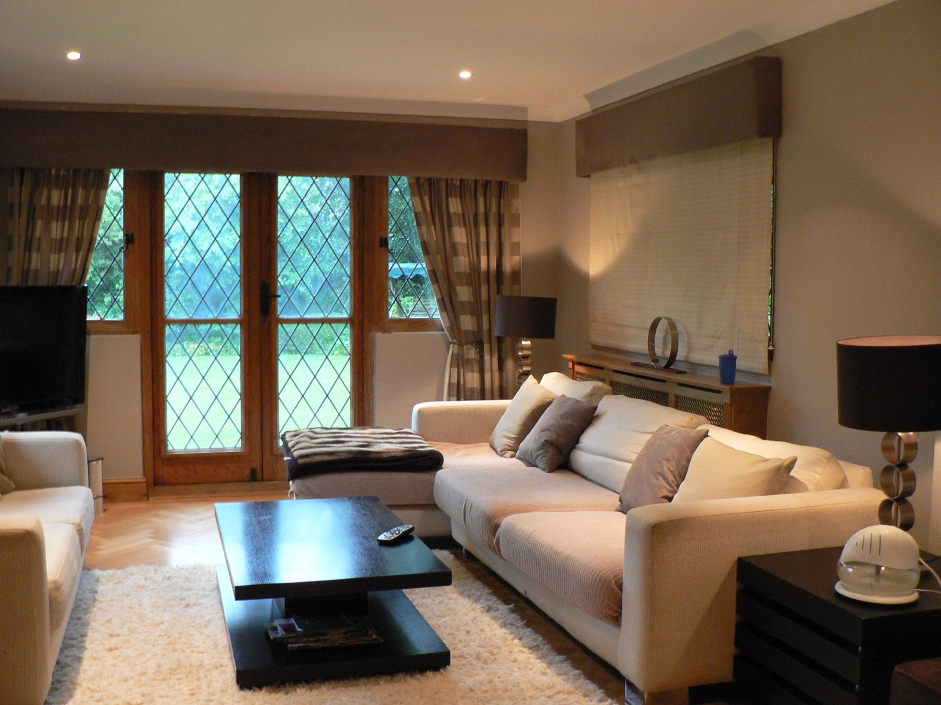
ajhd aidan james hurren design
The Television Room
in the original Victorian Lodge building

Slide 15
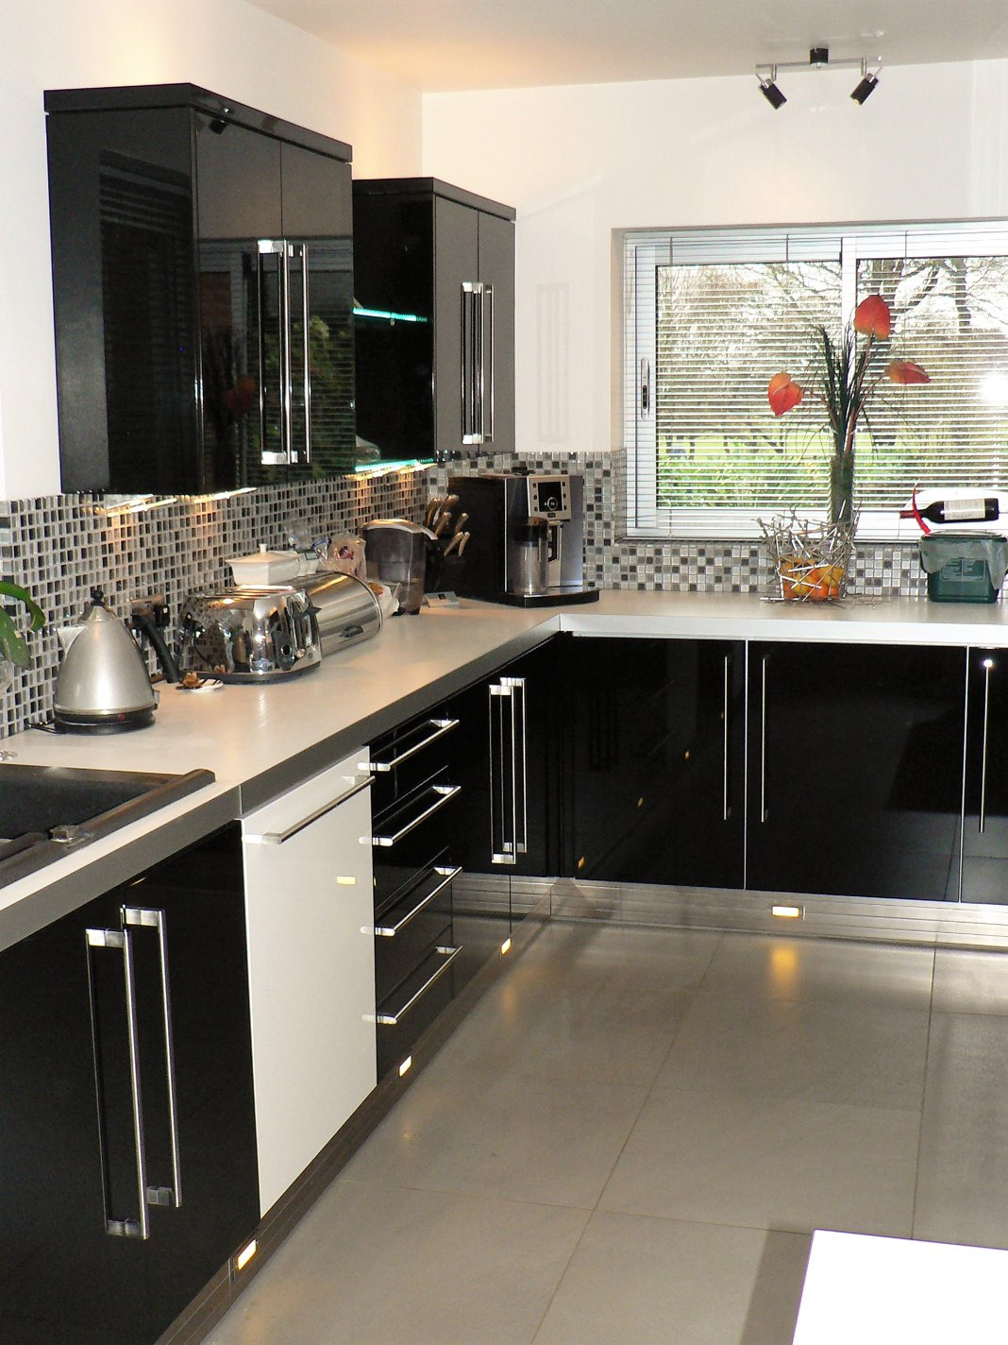
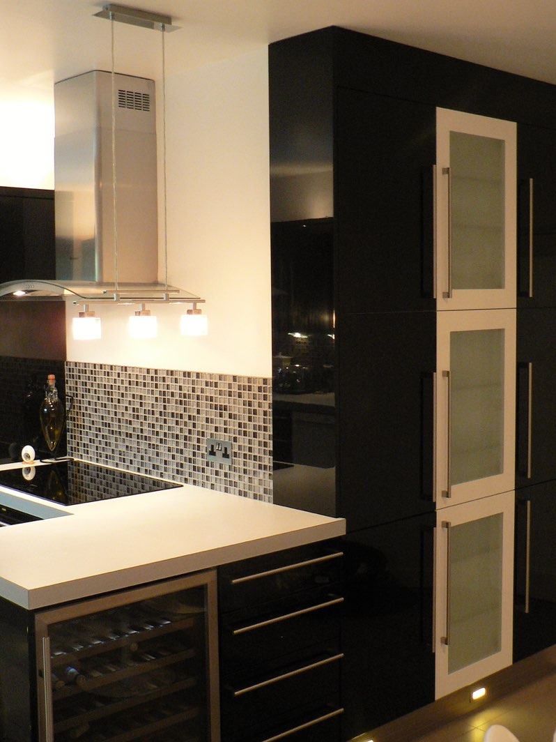
ajhd aidan james hurren design
The black-and-white Victorian Lodge inspired the colour scheme for the modern, high gloss, black-and-white kitchen

Slide 16
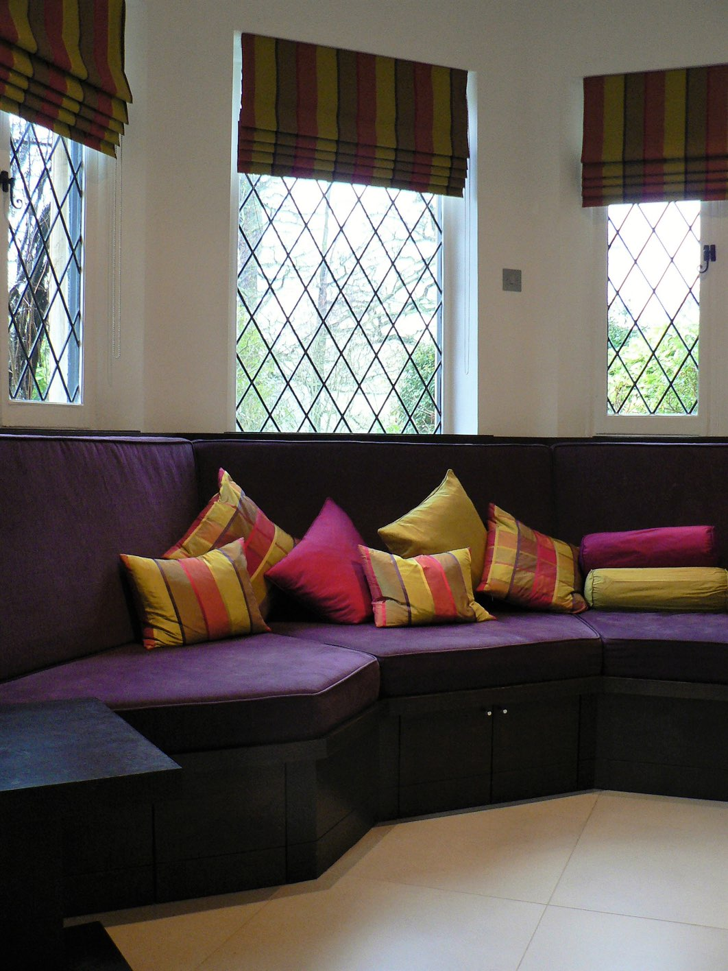
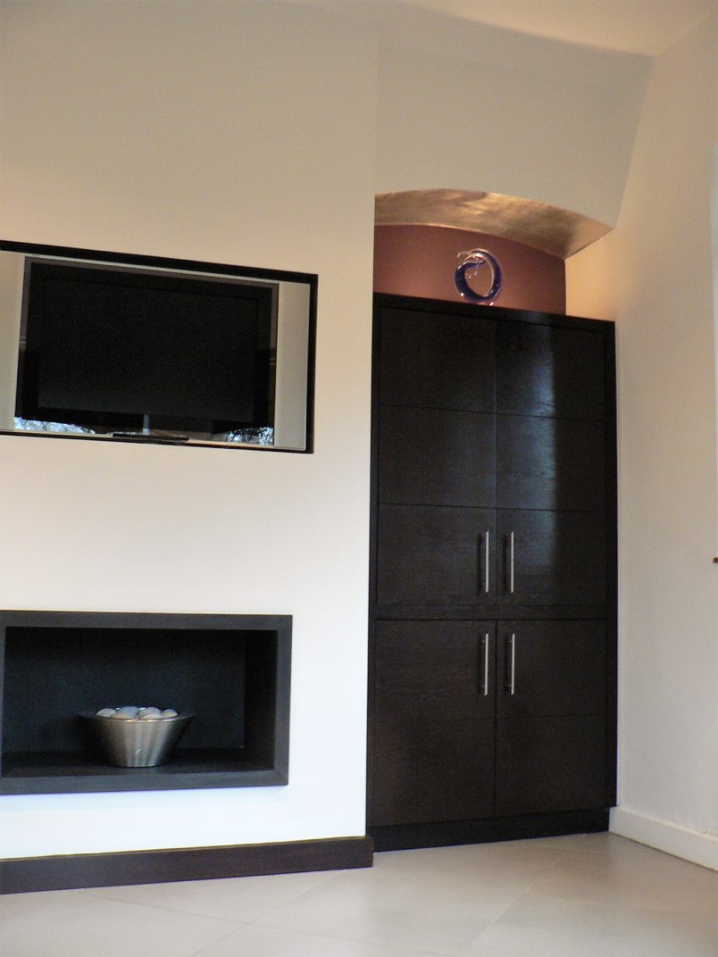
ajhd aidan james hurren design
leading off from the modern kitchen, in the Octagonal room of the original Lodge building, we created a smart ‘day room’ with comfortable bench seating and a gel-fireplace - but also designed for the children to watch television and play games

Slide 17
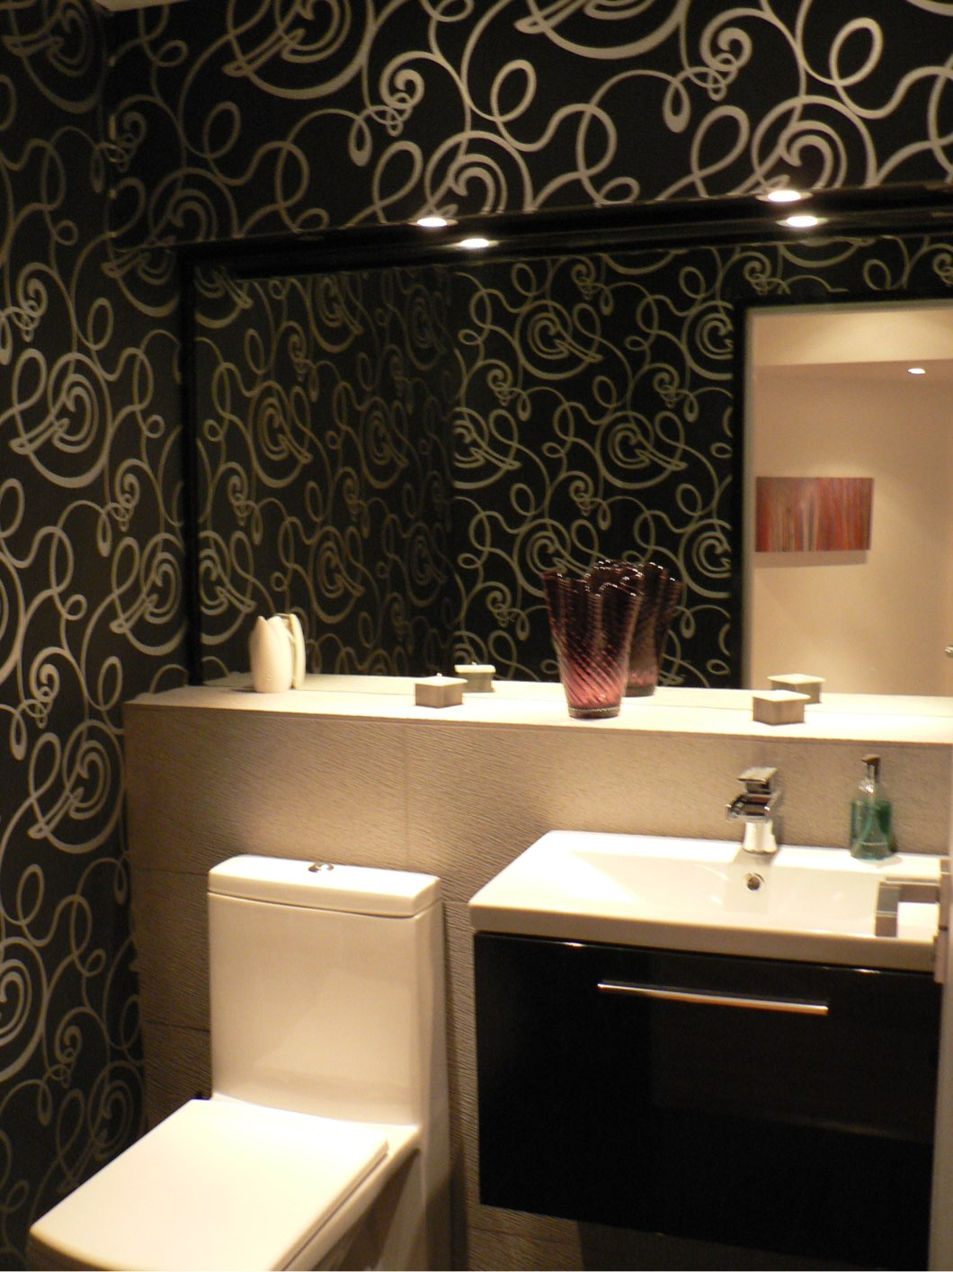
ajhd aidan james hurren design
the Guest Loo
in former scullery of the Victorian part of the house,
the black-and-white decorative theme continues.
Without a window it was totally dark, so we decided to make it like a Night Club - with dramatic lighting, high-gloss black ceramic floor, black vanity unit, black towels, even black toilet paper - and a rather wacky black and silver wallpaper.
Not the expected, in a country house!

Slide 18
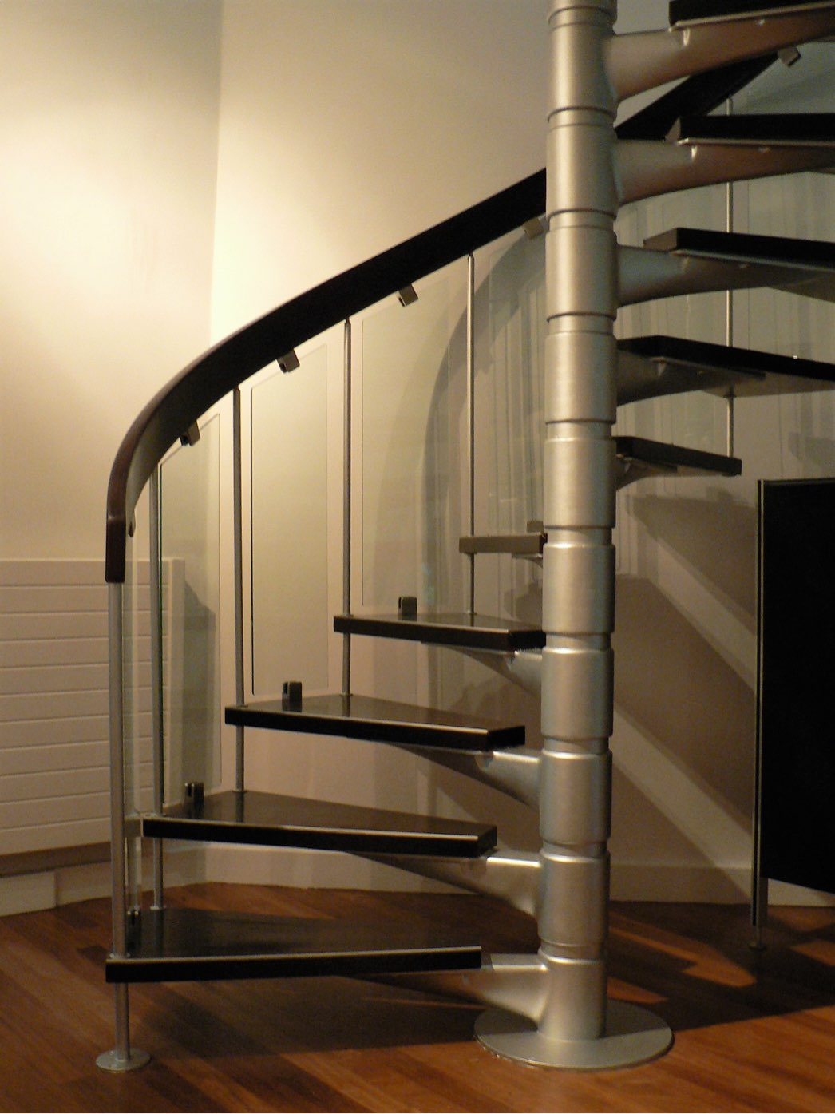
ajhd aidan james hurren design
The Spiral Staircase in the modern part of the house
(a traditional wooden staircase serves the older part)
was re-vamped with plate glass panels, silver paint and dark wengue stain

Slide 19
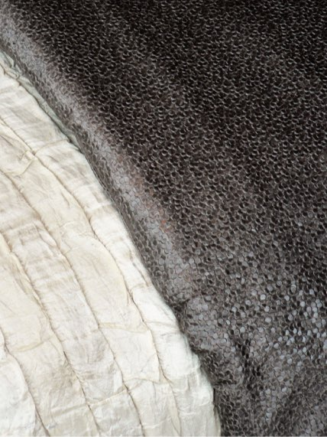
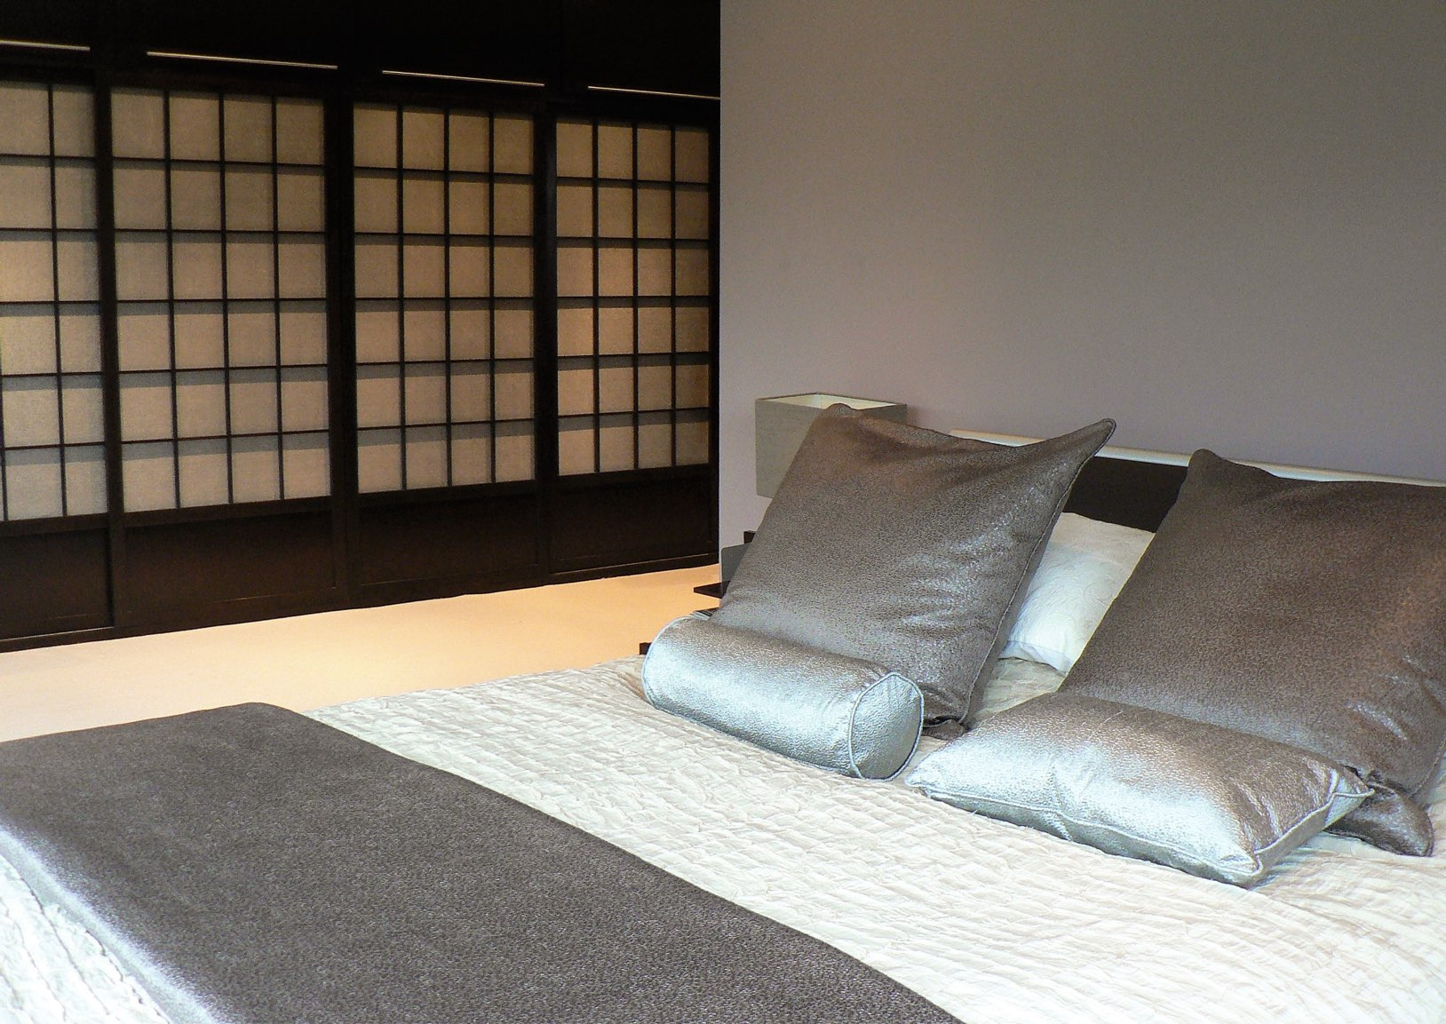
ajhd aidan james hurren design
The Master Bedroom
Japanese-influenced sliding wardrobe doors, have a fabric in the panels that resemble fish-scales, used again for the cushions and bed runner
The colour scheme of dark-wengue coloured wood-stain, silvery-hues and a lilac-tinged mushroom-grey lend an understated and sophisticated atmosphere

Slide 20
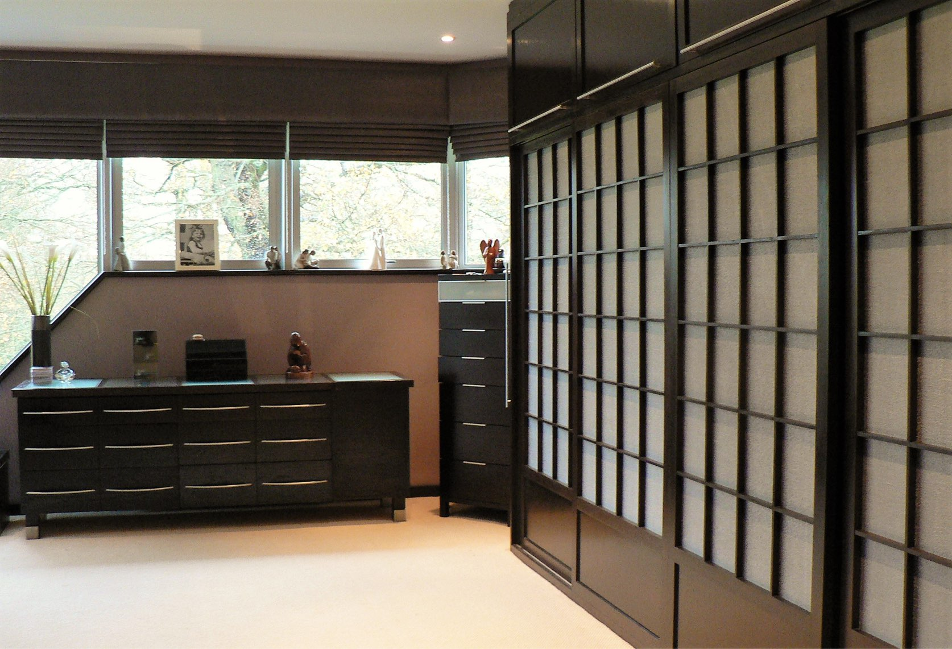
ajhd aidan james hurren design
The Master Bedroom
looking into the garden, with it’s magnificent listed trees,
the decorative scheme was kept deliberately muted

Slide 21
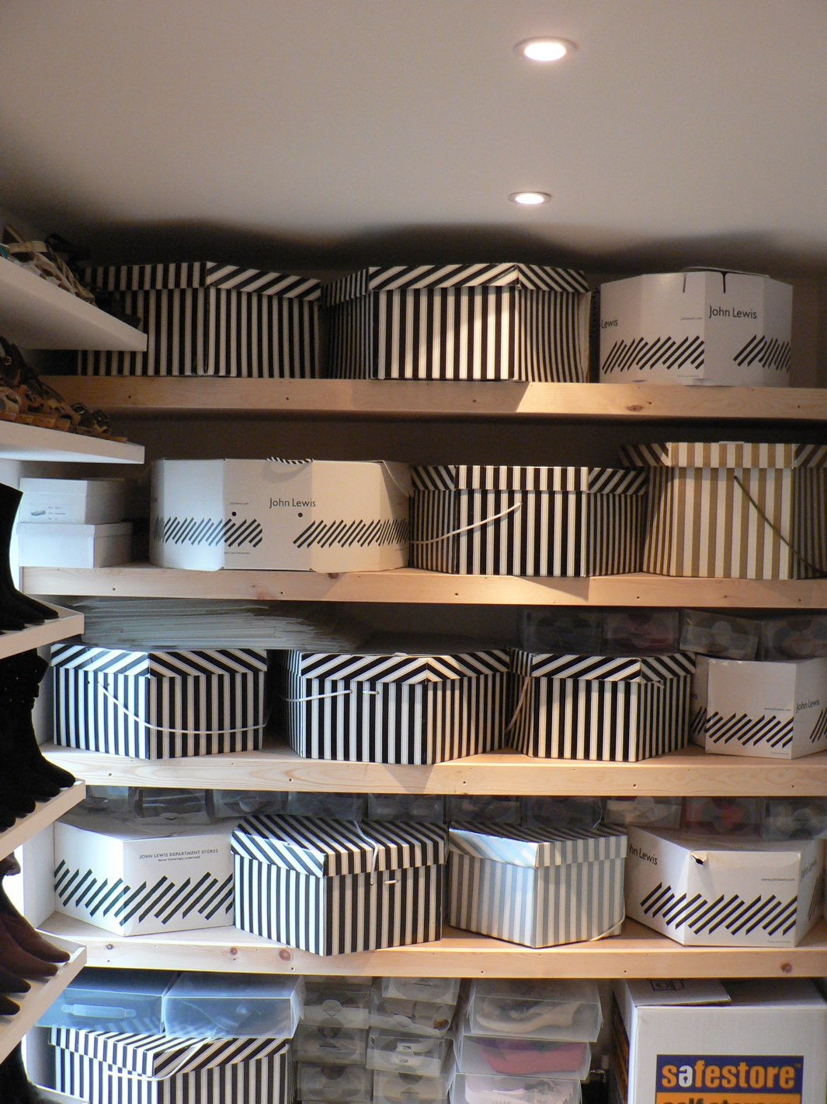
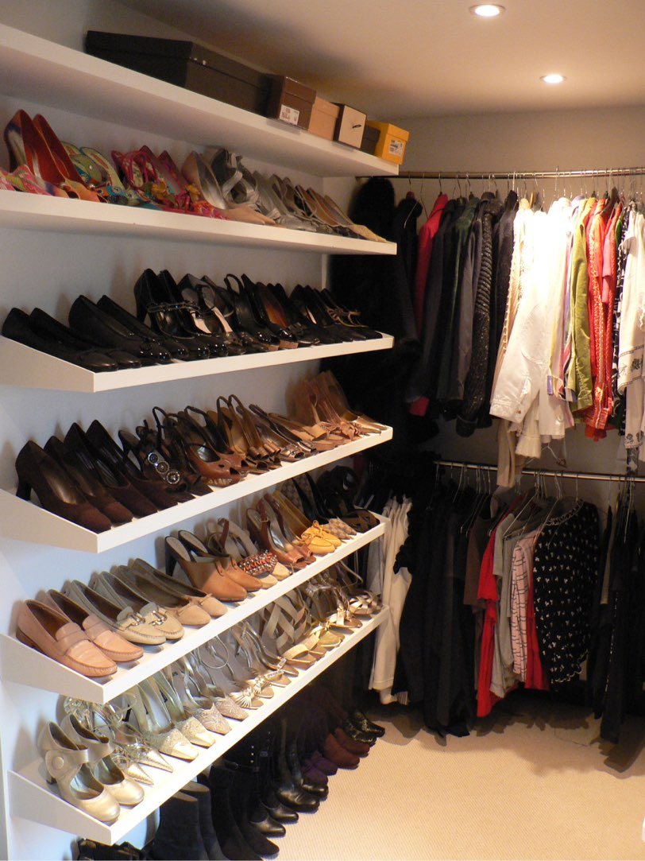
The walk-in closet of the Master Suite, in the new room created above the re-modeled Front Door. Shoes and Hats to die for!!
ajhd aidan james hurren design

Slide 22
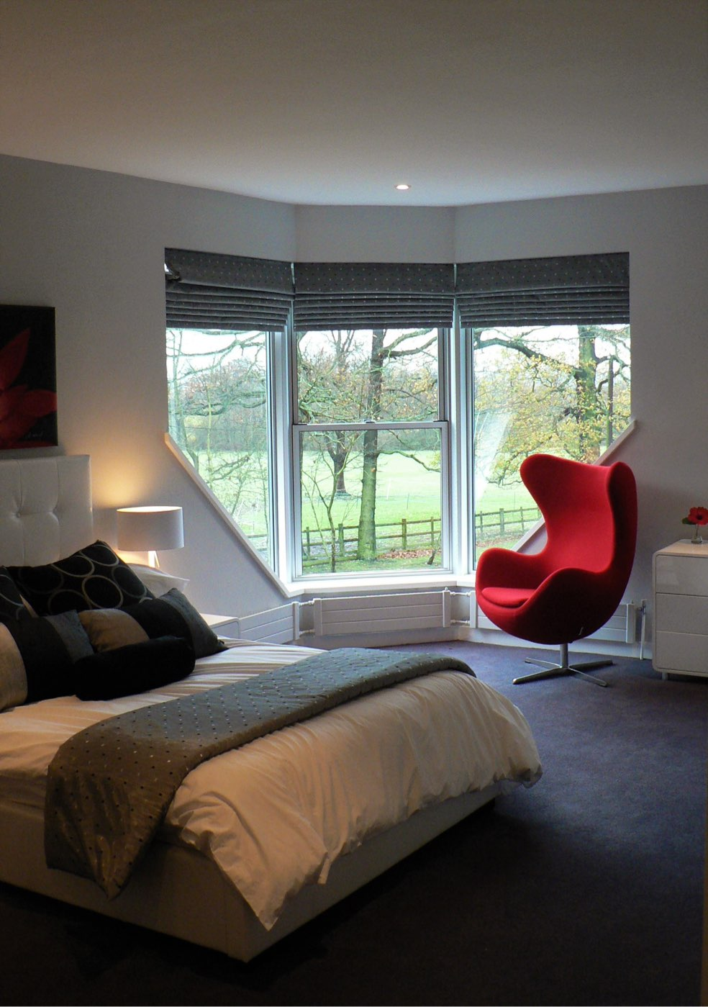
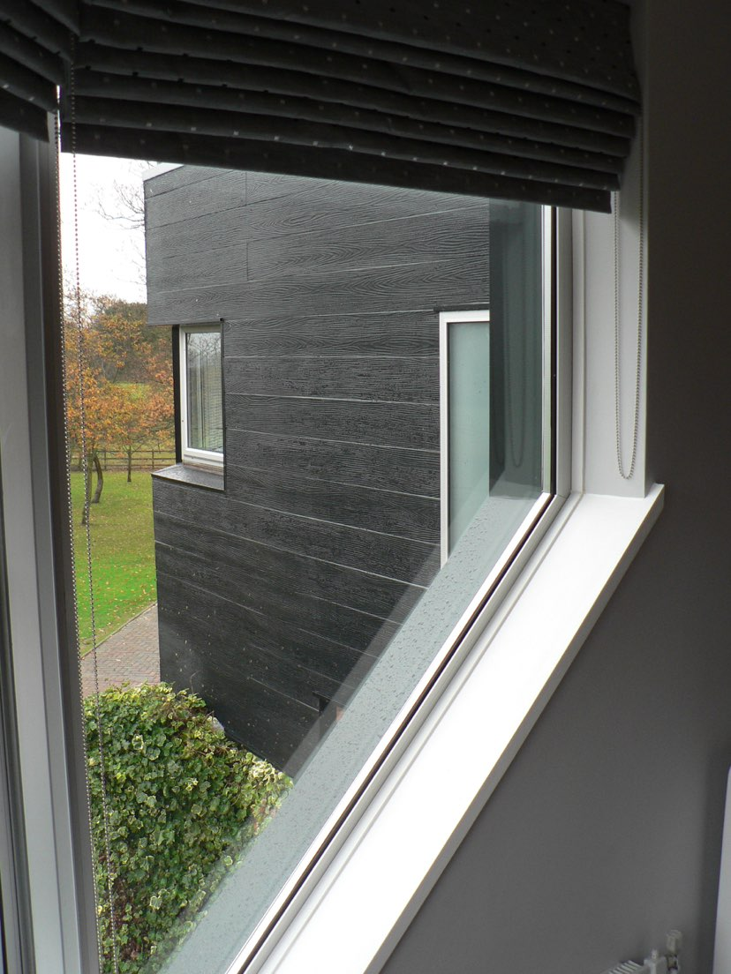
ajhd aidan james hurren design
the Principal Guest Room, looking out to the park landscape beyond.
The silver, grey, white and black tones of the textiles maintain a continuity of decor through the house, with drama from the strong red accent chair
The form of the windows is another example of the 45-degree-angle which so influenced the layout and design of the house, both inside and out

