Slide 1
ajhd aidan james hurren design
essex, uk
a swimming pool and a pool house,
to complete an unusual house in Epping Forest

Slide 2
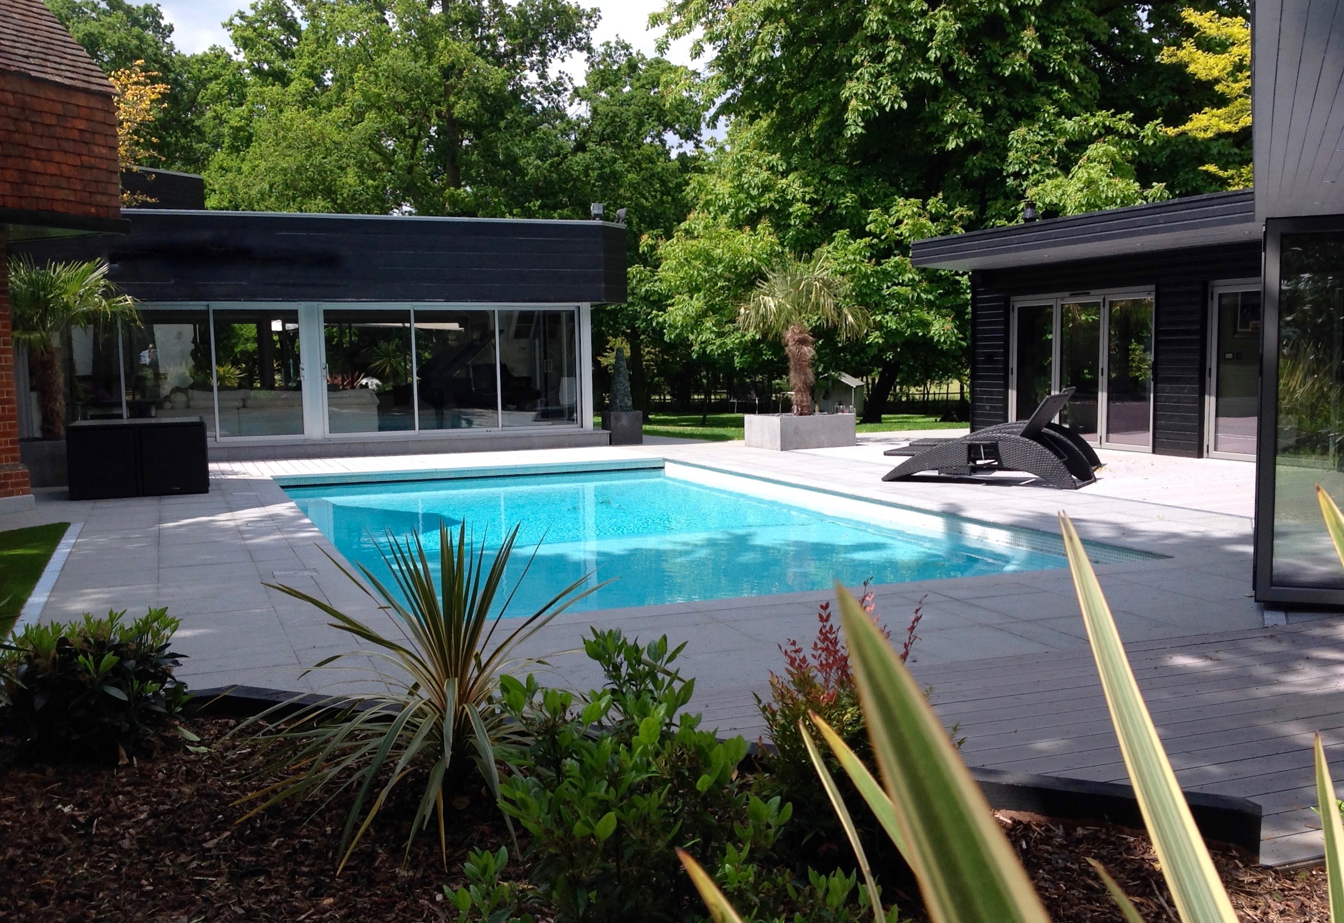
ajhd aidan james hurren design
A new-build Swimming Pool and Pool House, to complement an existing house in Essex.
The house, an unexpected hybrid of Victorian lodge and Modernist villa, has a complicated footprint within the large plot, set on the edge of Epping Forest and boasting a garden full of ancient listed trees.
This made for a design challenge - how to fit a pool in at all without disturbing the trees, AND somehow squeeze in a building that would provide a changing room, a gym, and some social space - a bar and a lounge area?
AND of course to make the whole thing sit comfortably with the unusual main house…
The geometry of the house and plot dominated the conceptualizing, but revealed a framework of lines and angles, which made for a very happy confluence of shapes, and thus the perfectly balanced design became clear.
The Pool House was styled in the local vernacular of black weatherboarding, but with modern bi-fold doors to open the whole building to the Swimming Pool terrace.

Slide 3
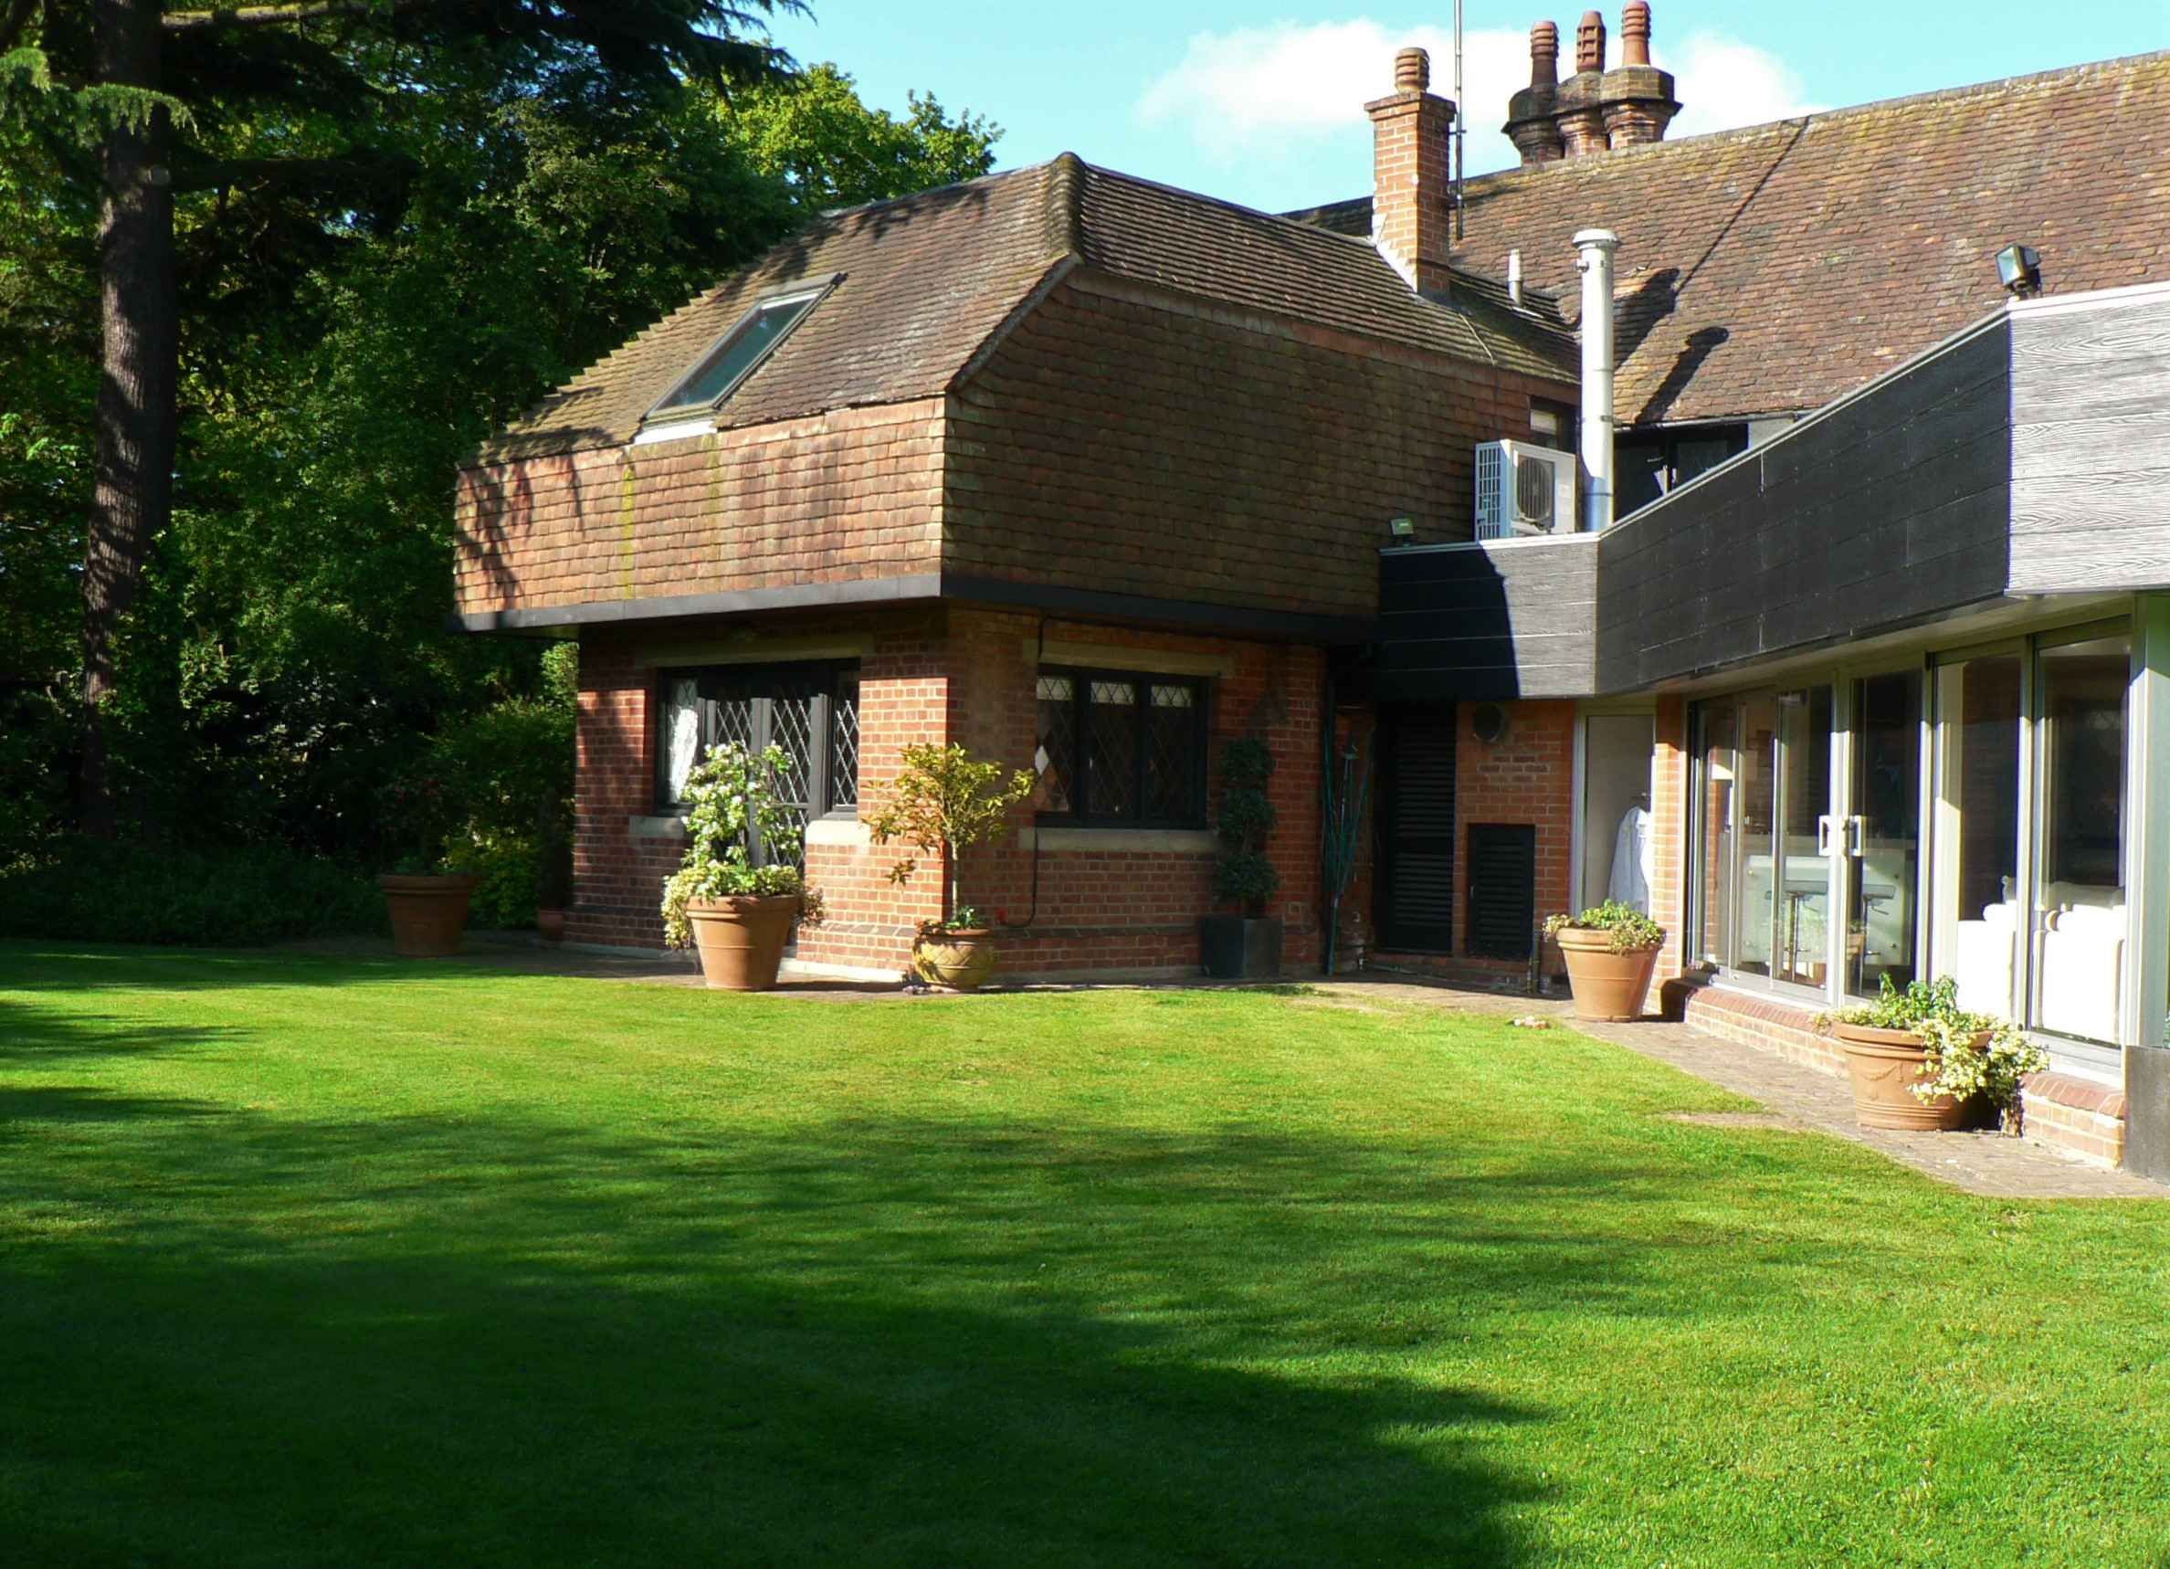
ajhd aidan james hurren design
The lawned area outside the Garden Room was the only suitable area in the garden where a swimming pool would fit

Slide 4
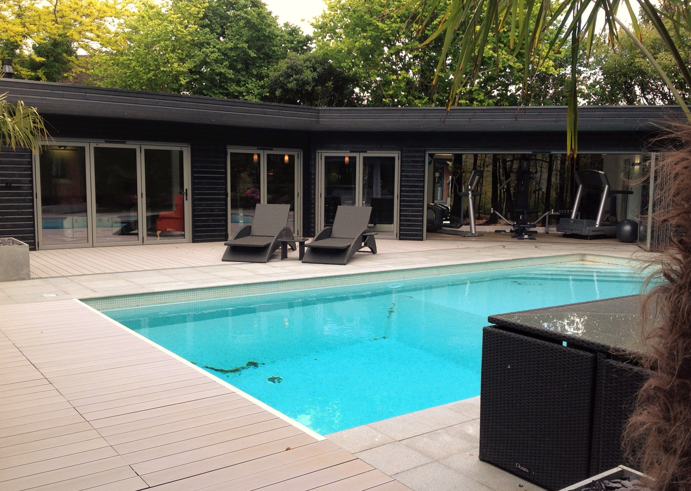
ajhd aidan james hurren design
The Pool House
styled in the local Essex vernacular of black weatherboarding, in keeping with the exterior of the previously-renovated (in 2010) Modernist part of the main house
The choice of material, the shape and the scale of the building almost gives it the look of a converted stable building, but with modern bi-fold doors to open the whole building to the Swimming Pool terrace.
The terrace is finished in a combination of honed grey granite slabs and synthetic timber decking.
The pool (10m x 5m) was tiled in pale glass mosaics

Slide 5
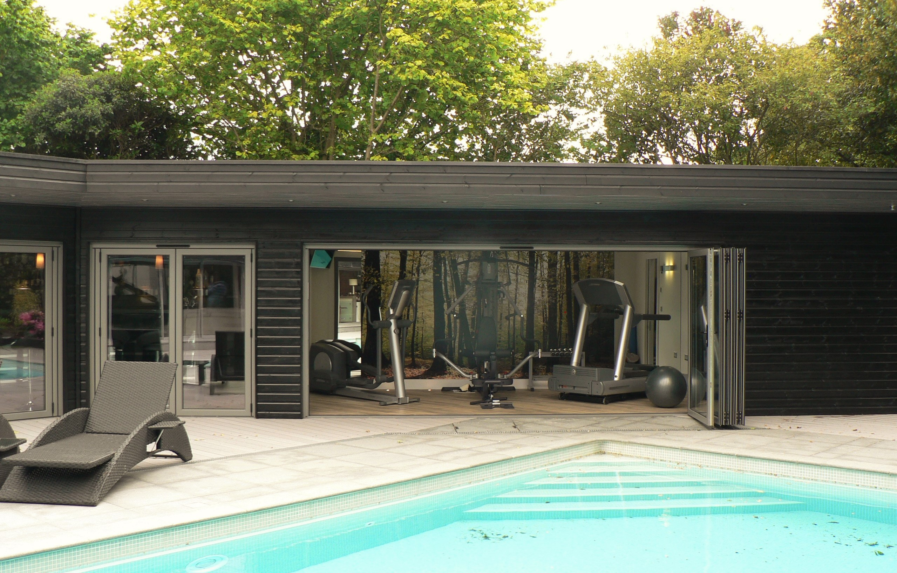
ajhd aidan james hurren design
The open bi-fold doors reveal the well-equipped gymnasium.
The woodland mural on the rear wall gives the illusion that one is looking right through the building. to the forest behind.

Slide 6
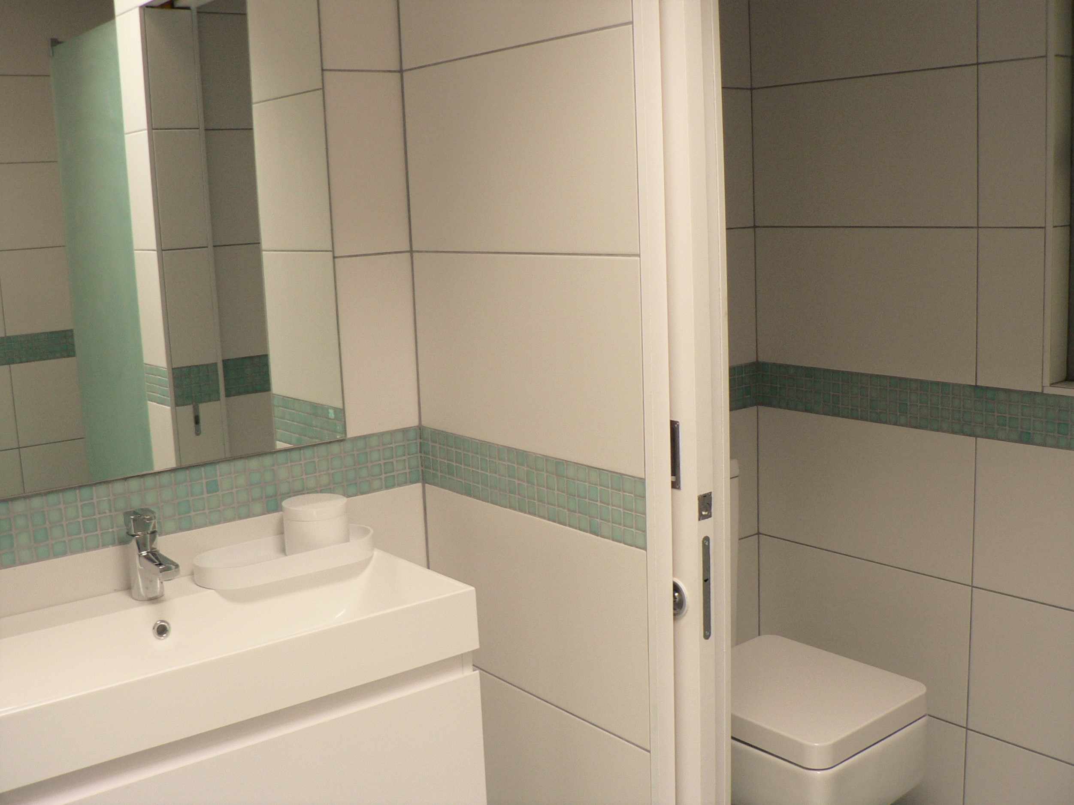
ajhd aidan james hurren design
The Changing Room
The Changing room and shower are next to the gymnasium, at the end of the building, set behind the black weatherboarding wall.
White tiles throughout are complemented by the same etched-glass glass-mosaics used in the swimming pool, used here both as the floor covering, and as a decorative trim.

Slide 7
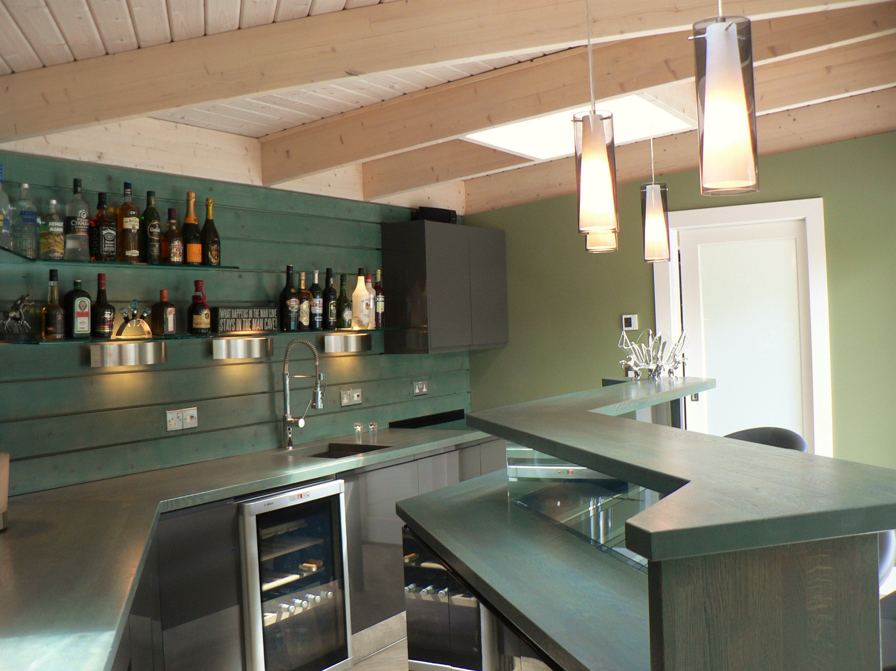
ajhd aidan james hurren design
The Pool House is shaped rather like a boomerang (a wide shallow V), the Pool-house Bar is set in the angle of the building.
The shape of the room is accentuated and enhanced by the striking custom-made wood-glass-mirror-and-perspex bar.
Glass shelving and ample work surfaces make this a very practical place from which to serve a pool party (or any kind of party!)
The rear wall is clad in green-stained weatherboard, the cabinets are grey gloss.
.

Slide 8
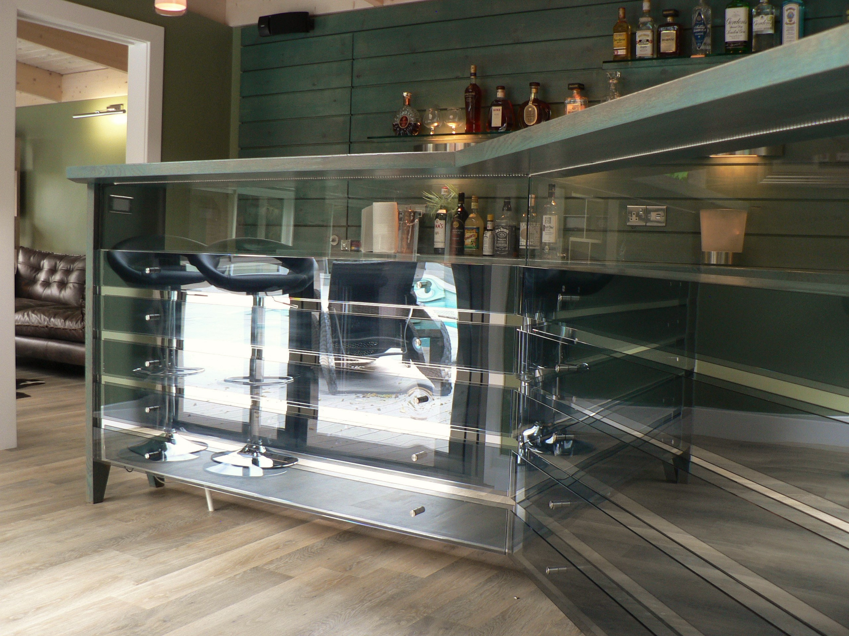
ajhd aidan james hurren design
The Bar
The complicated but streamlined design , combining solid oak, glass, mirror and smoked perspex
makes a bold statement

Slide 9
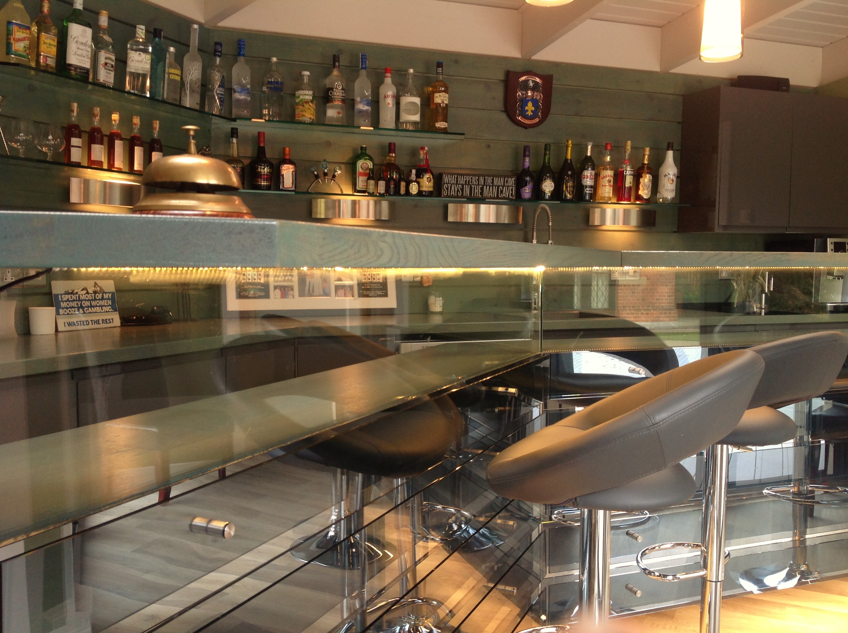
ajhd aidan james hurren design
Comfortable bar stools,
and great lighting, ensure that
This is Where the Party Starts!

Slide 10
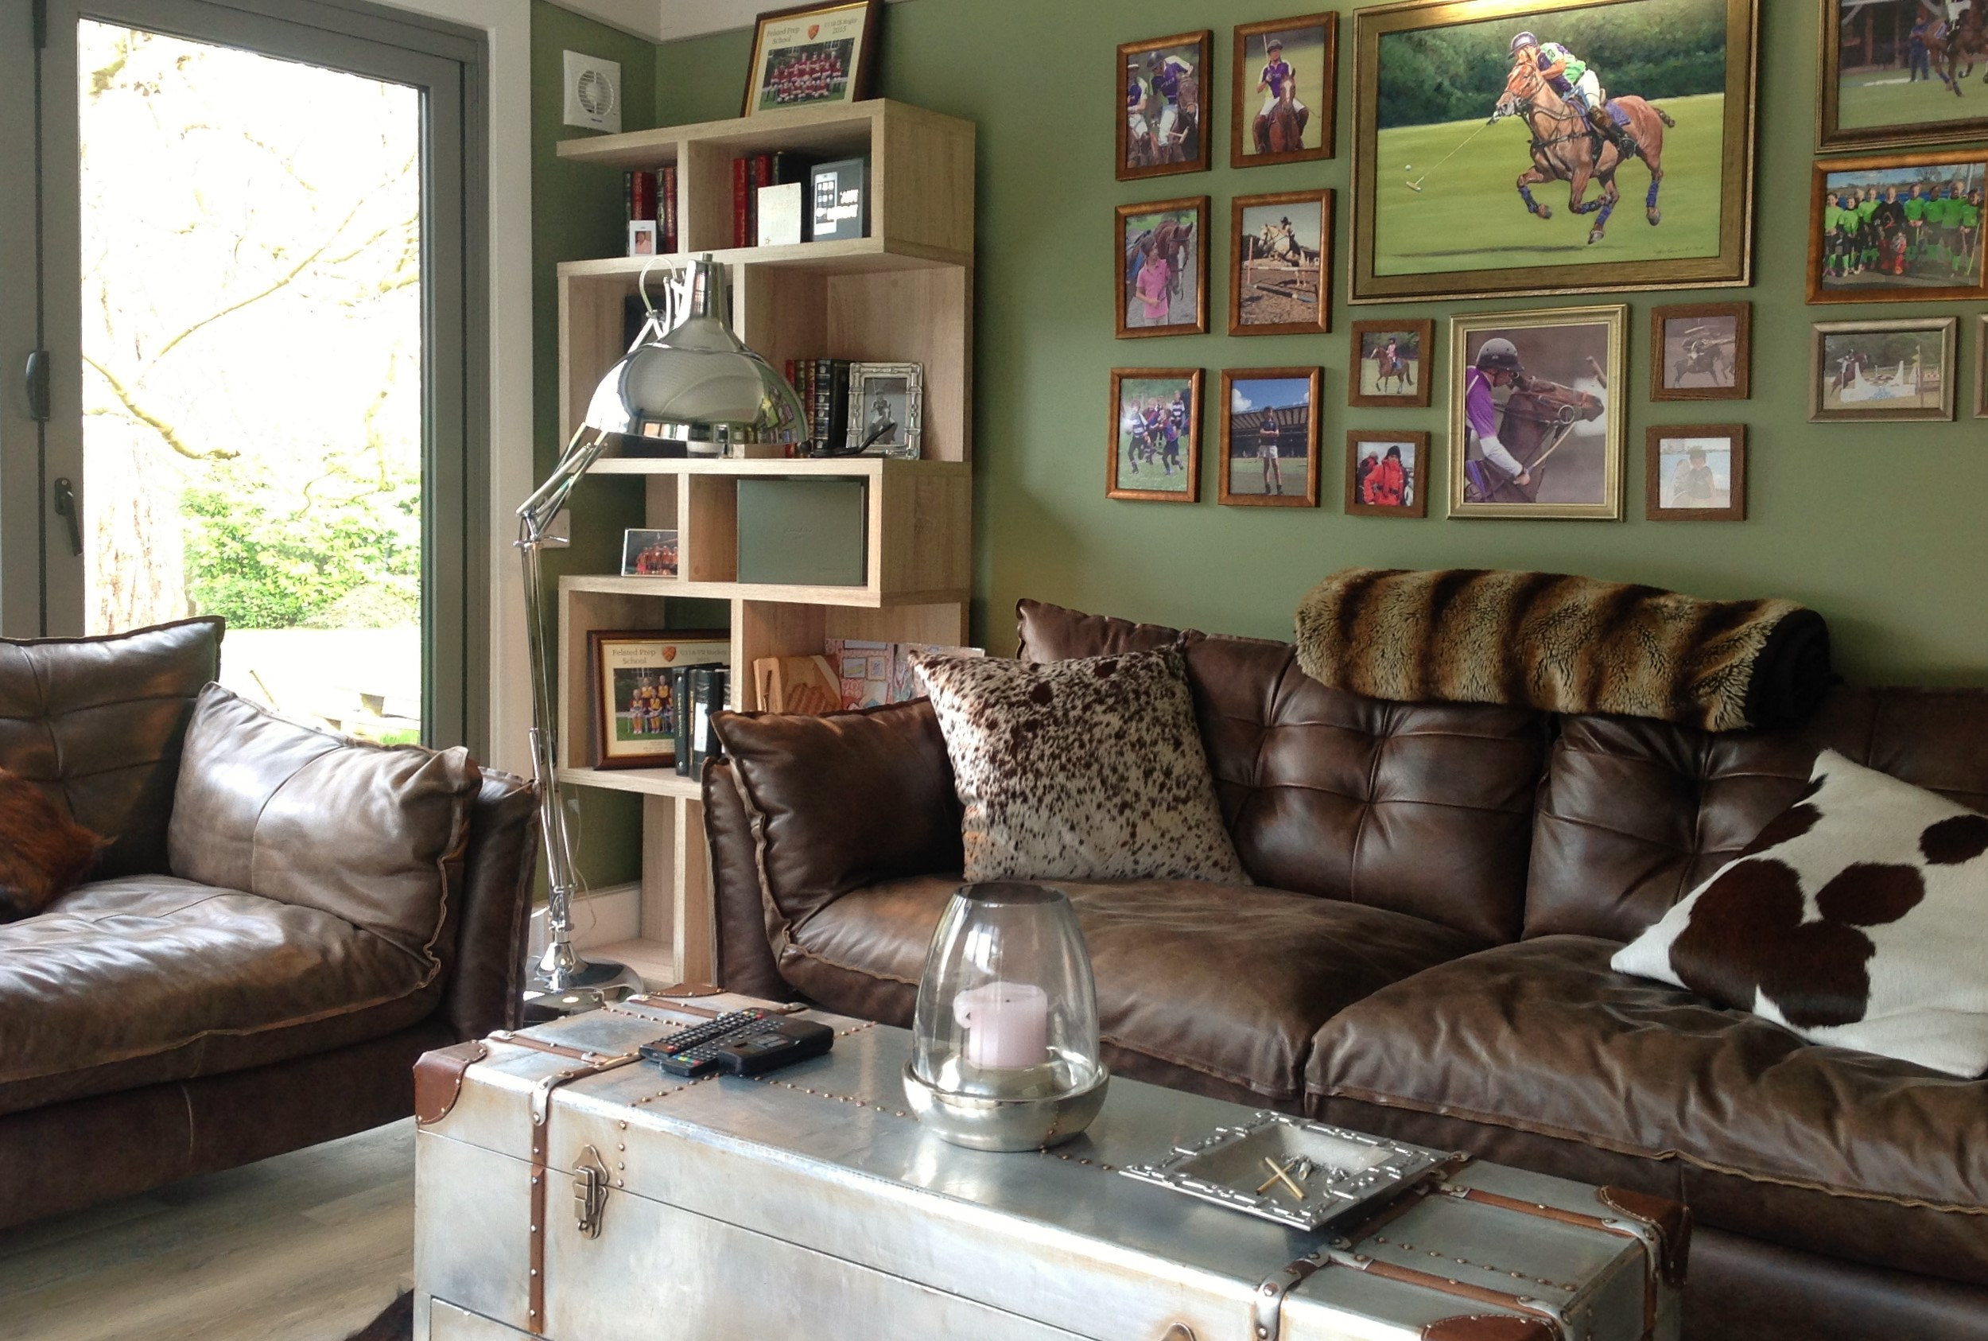
ajhd aidan james hurren design
The Den
Designed for my polo-playing client, is next door to the Bar, and has become the favourite go-to room in the whole house, where everyone loves to congregate.
Extremely generous and comfortable leather seating, a wood burning stove, a large screen TV (for the sports), and a great vibe have made it the centre of family social time.

Slide 11
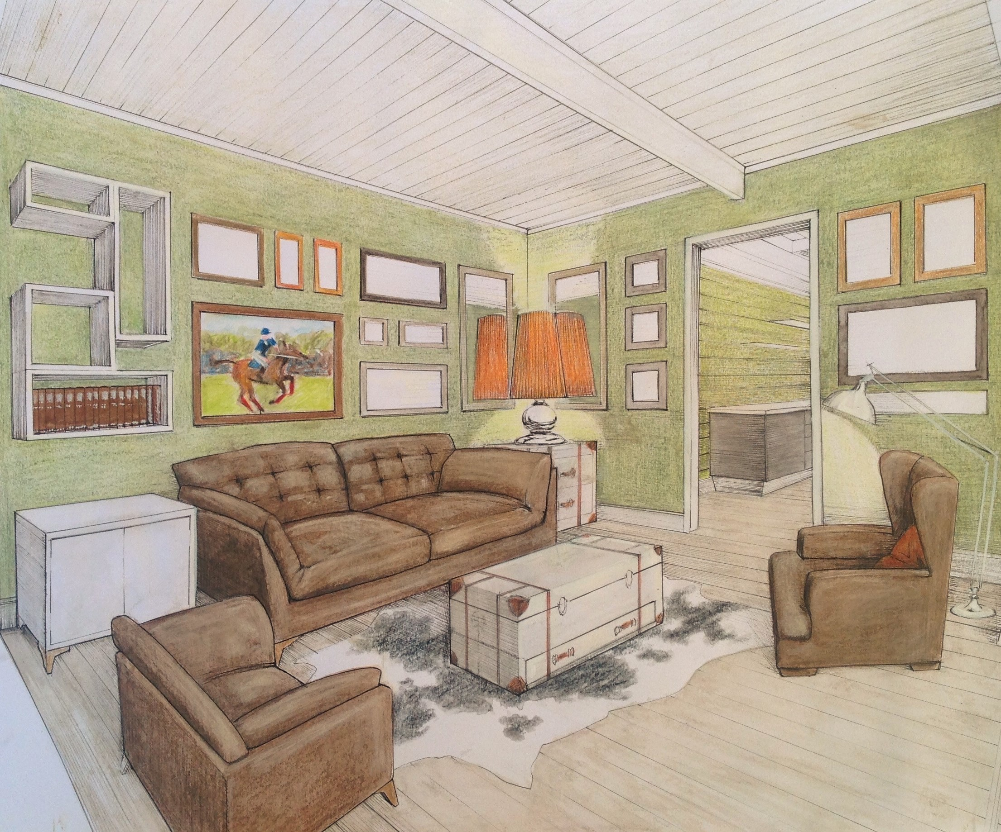
ajhd aidan james hurren design
original concept drawing for The Den

Slide 12
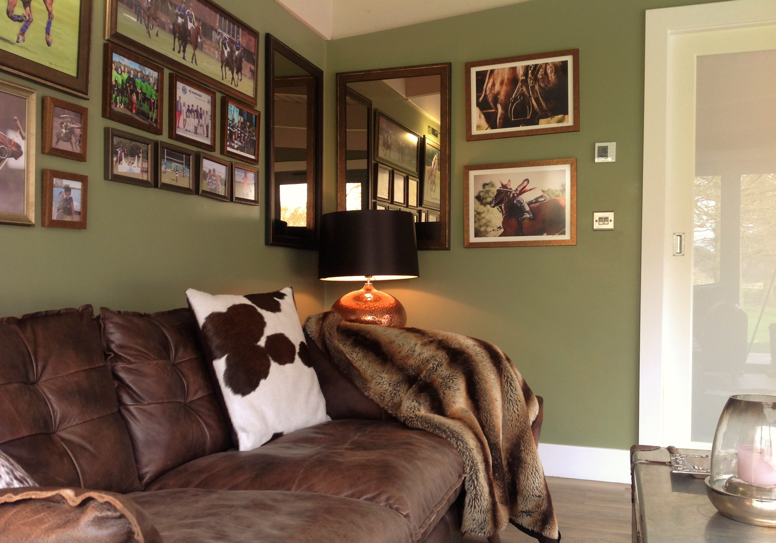
ajhd aidan james hurren design
Deep and soft leather seating,
fur throws, cowhide accessories, polo souvenirs and gentle lighting make a very masculine but welcoming room

Slide 13
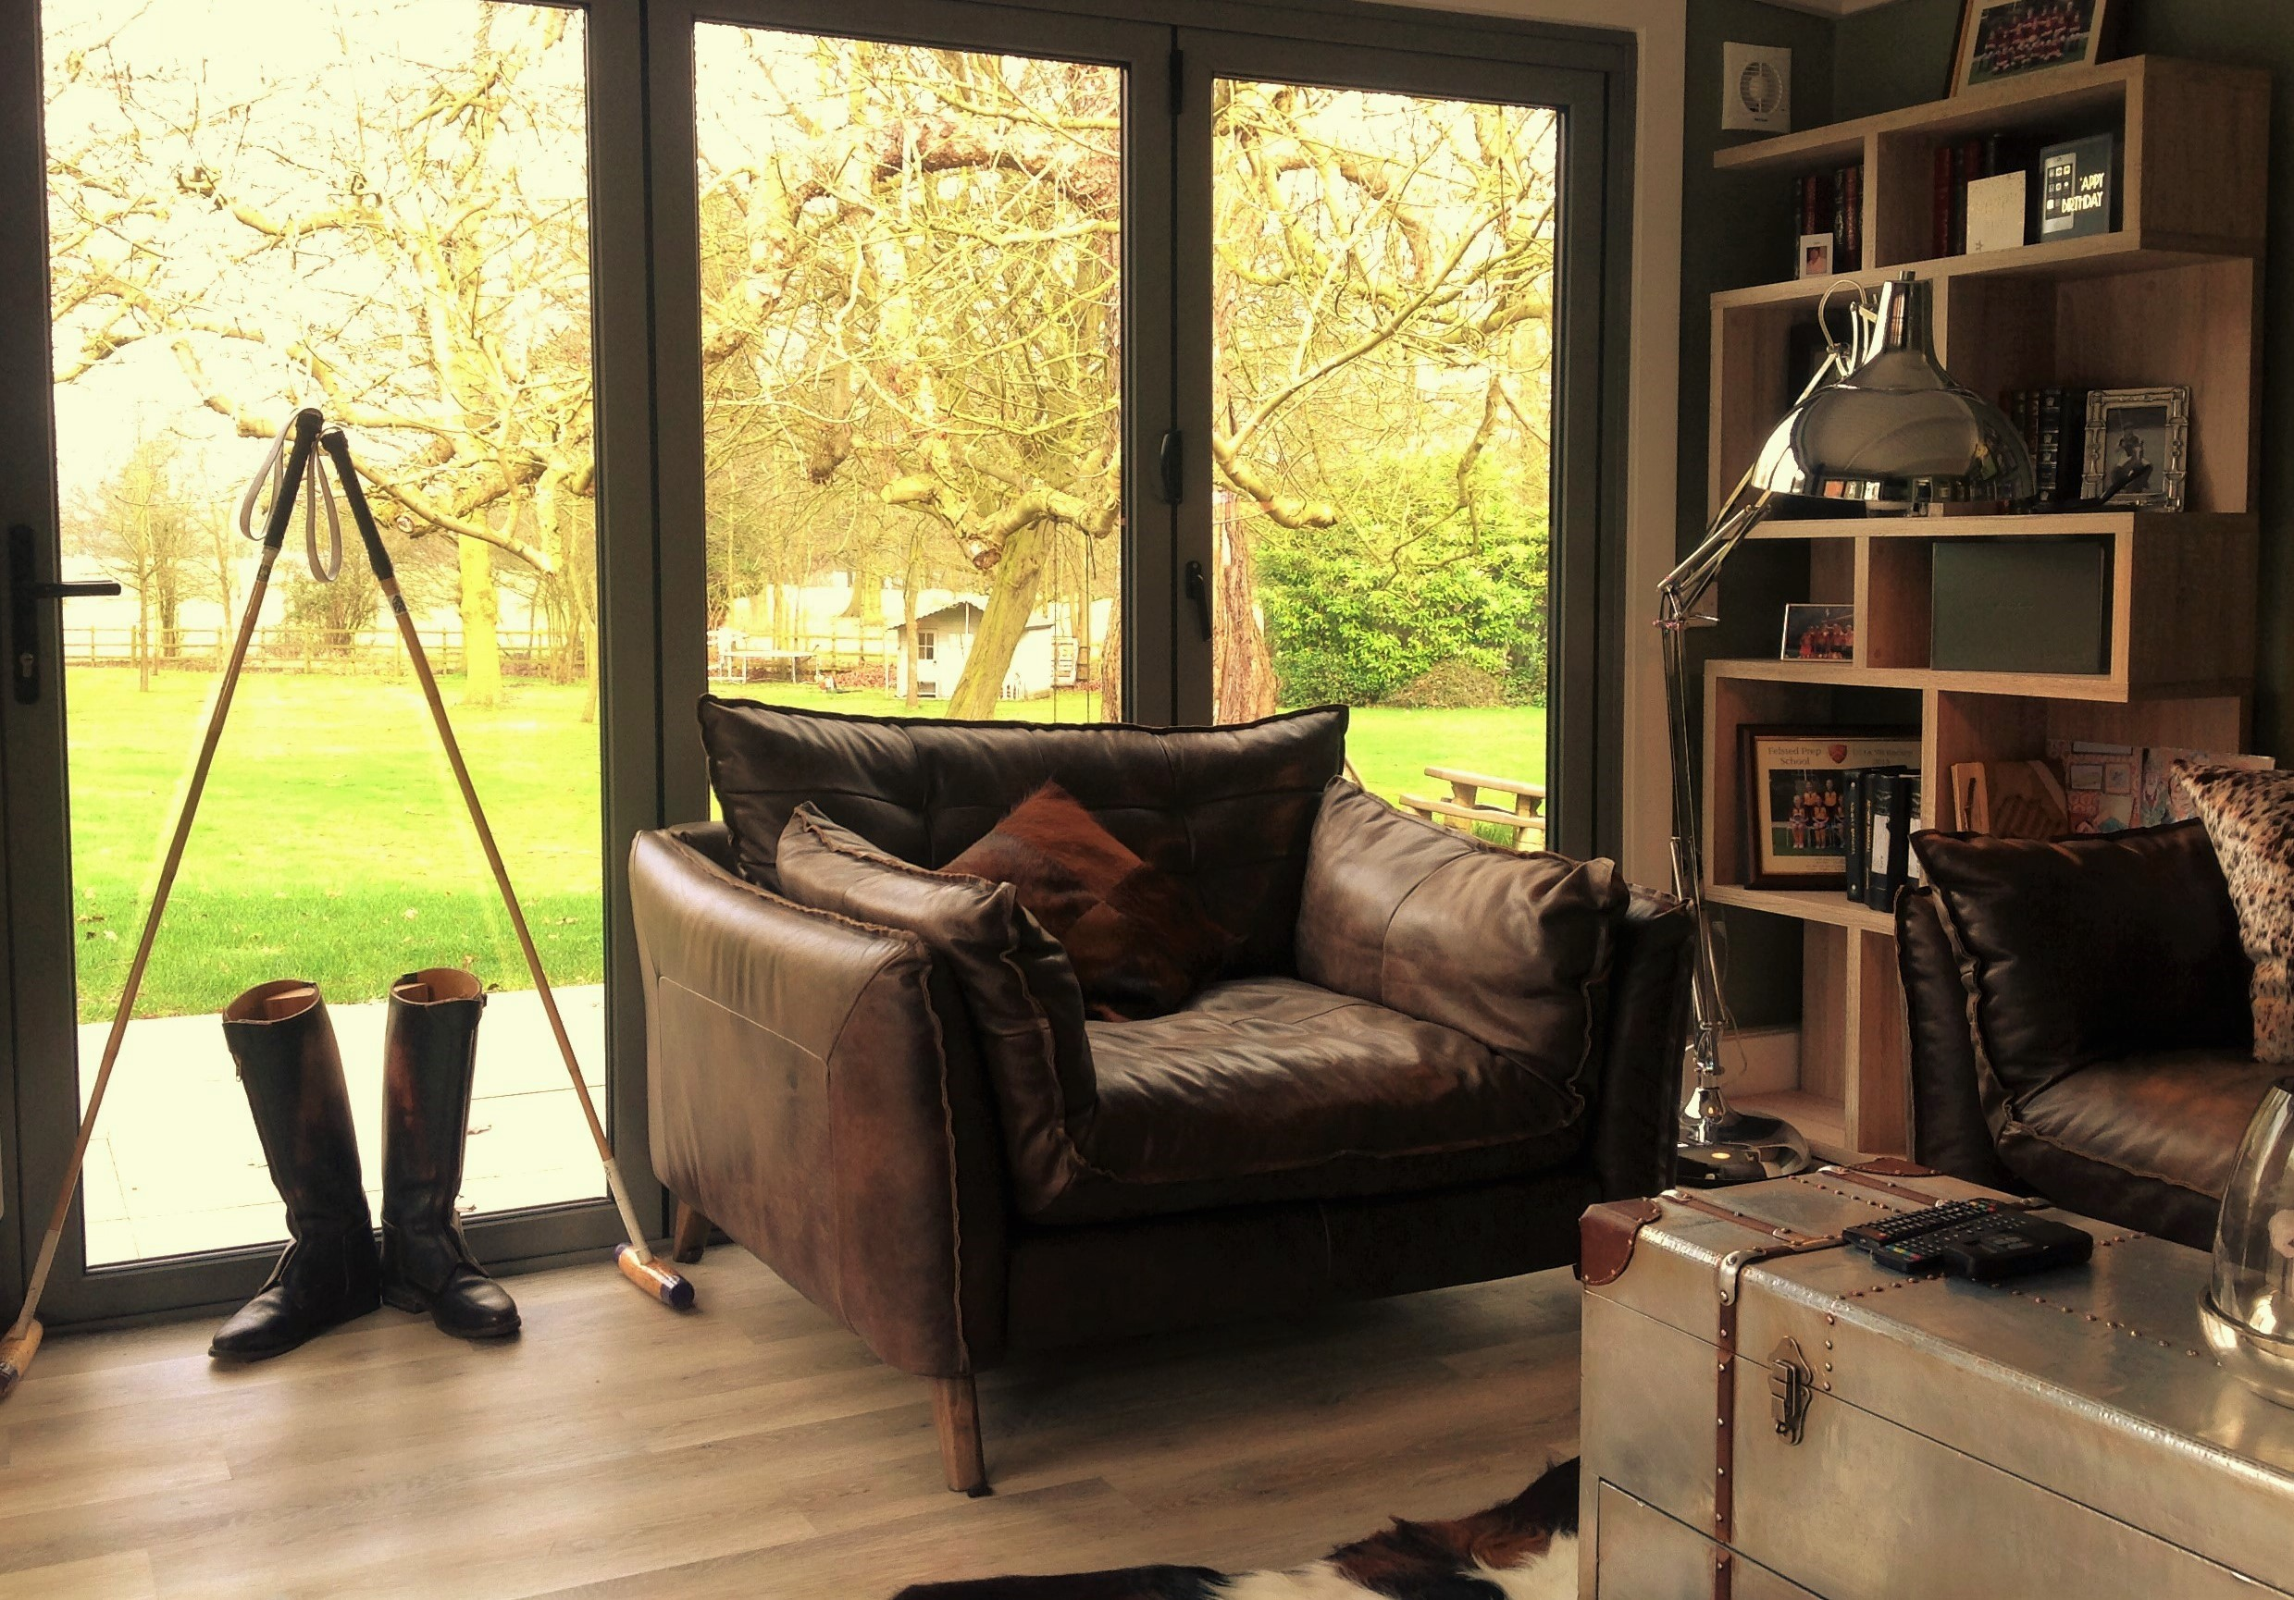
ajhd aidan james hurren design
Polo accessories and souvenirs feature strongly.
The room has dual aspect, with bi-fold doors opening to both the pool terrace and to the main garden

