Slide 1
ajhd aidan james hurren design
a major project in mallorca
involving every aspect of my work -
interior and exterior design, new build and renovation work

Slide 2
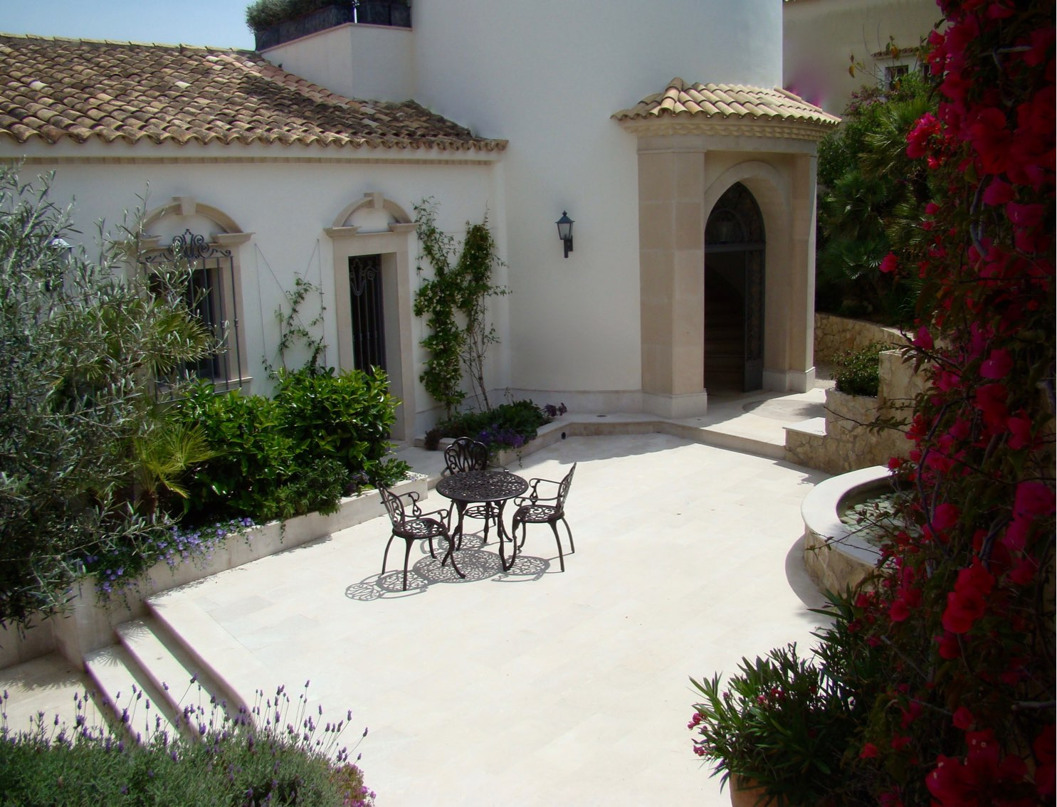
ajhd aidan james hurren design
A very grand and spacious villa, set over several levels on a steep slope and overlooking the beauty of Cala Marmassen, in fashionable Puerto Andratx.
I worked with the architect to determine the best architectural alterations, including the conversion of the the former underground water tanks into a whole new floor of living space, opening up onto the reconfigured Swimming Pool Terrace
All interior and exteriors were designed by AJHD. The complex project of combined renovations and new-build works was executed by large team of craftsmen of many nationalities, and it included much bespoke carpentry and many unique items of fine cabinetmaking.
The decorative schemes were conceived for an aristocratic Englishman’s “Castle in Spain”

Slide 3
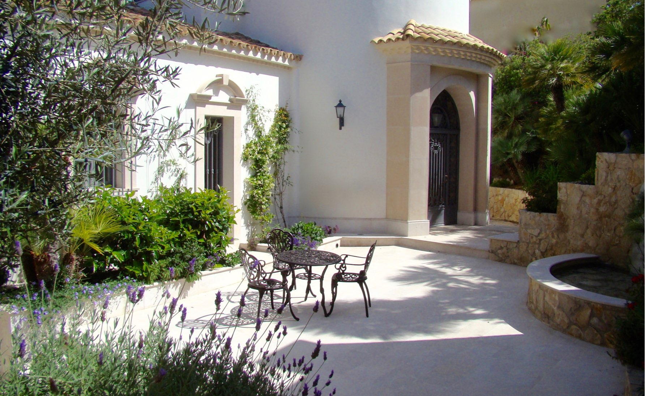
ajhd aidan james hurren design
The Courtyard Entrance

Slide 4
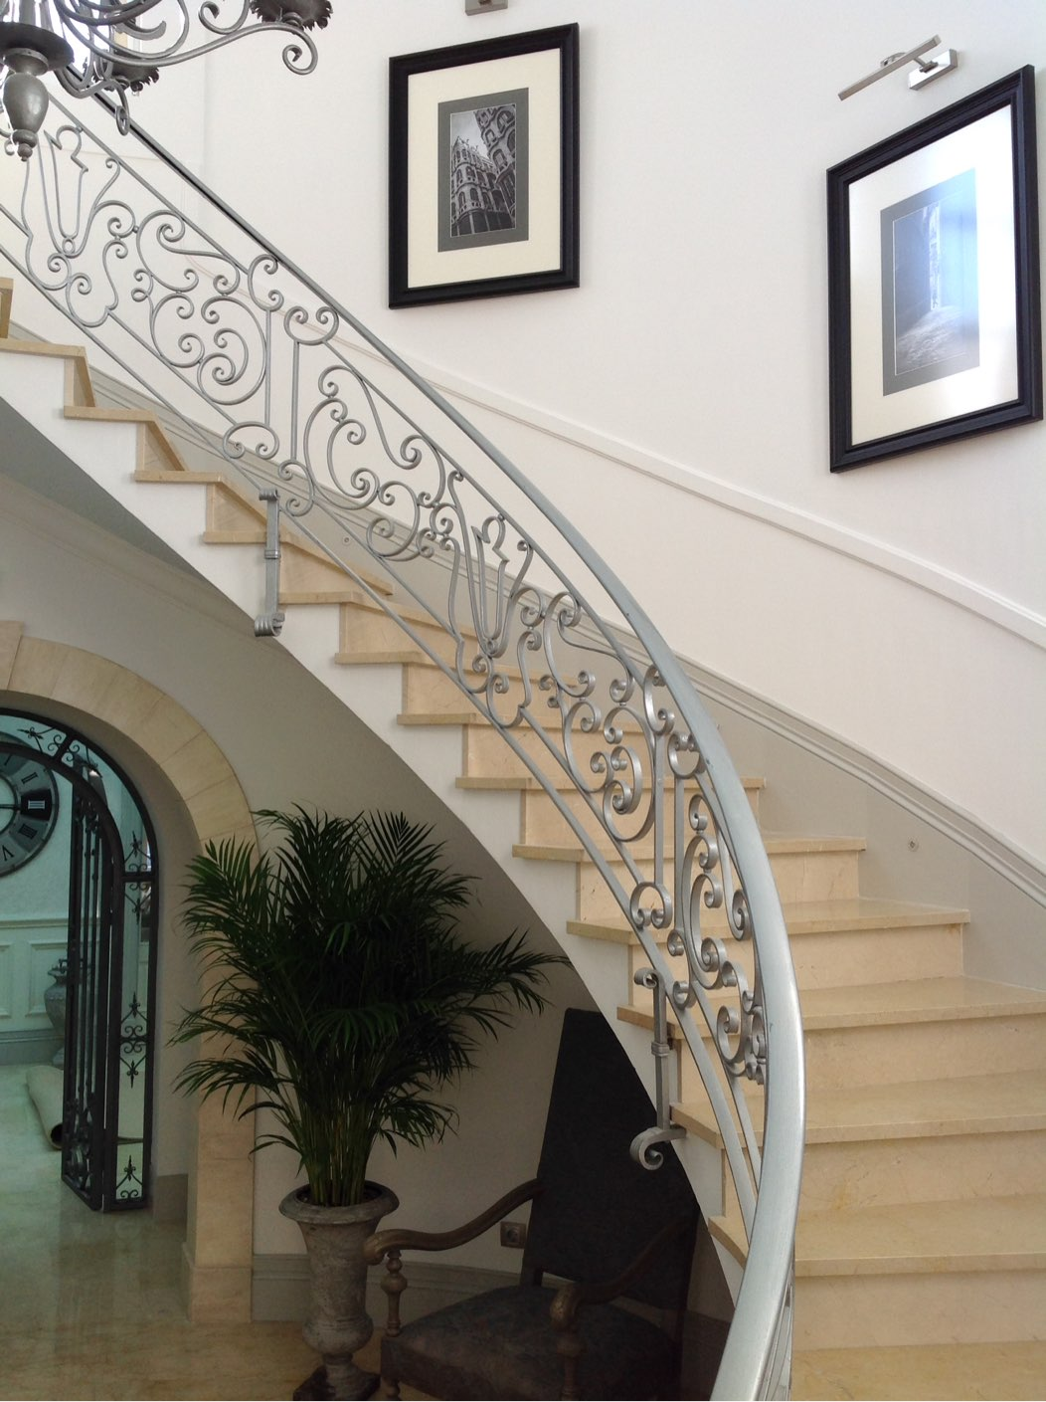
ajhd aidan james hurren design
the gracious curving staircase in the Entrance Hall, leading to the Tower Terrace and the Tower Room above, a circular Belvedere with 360-degree views

Slide 5
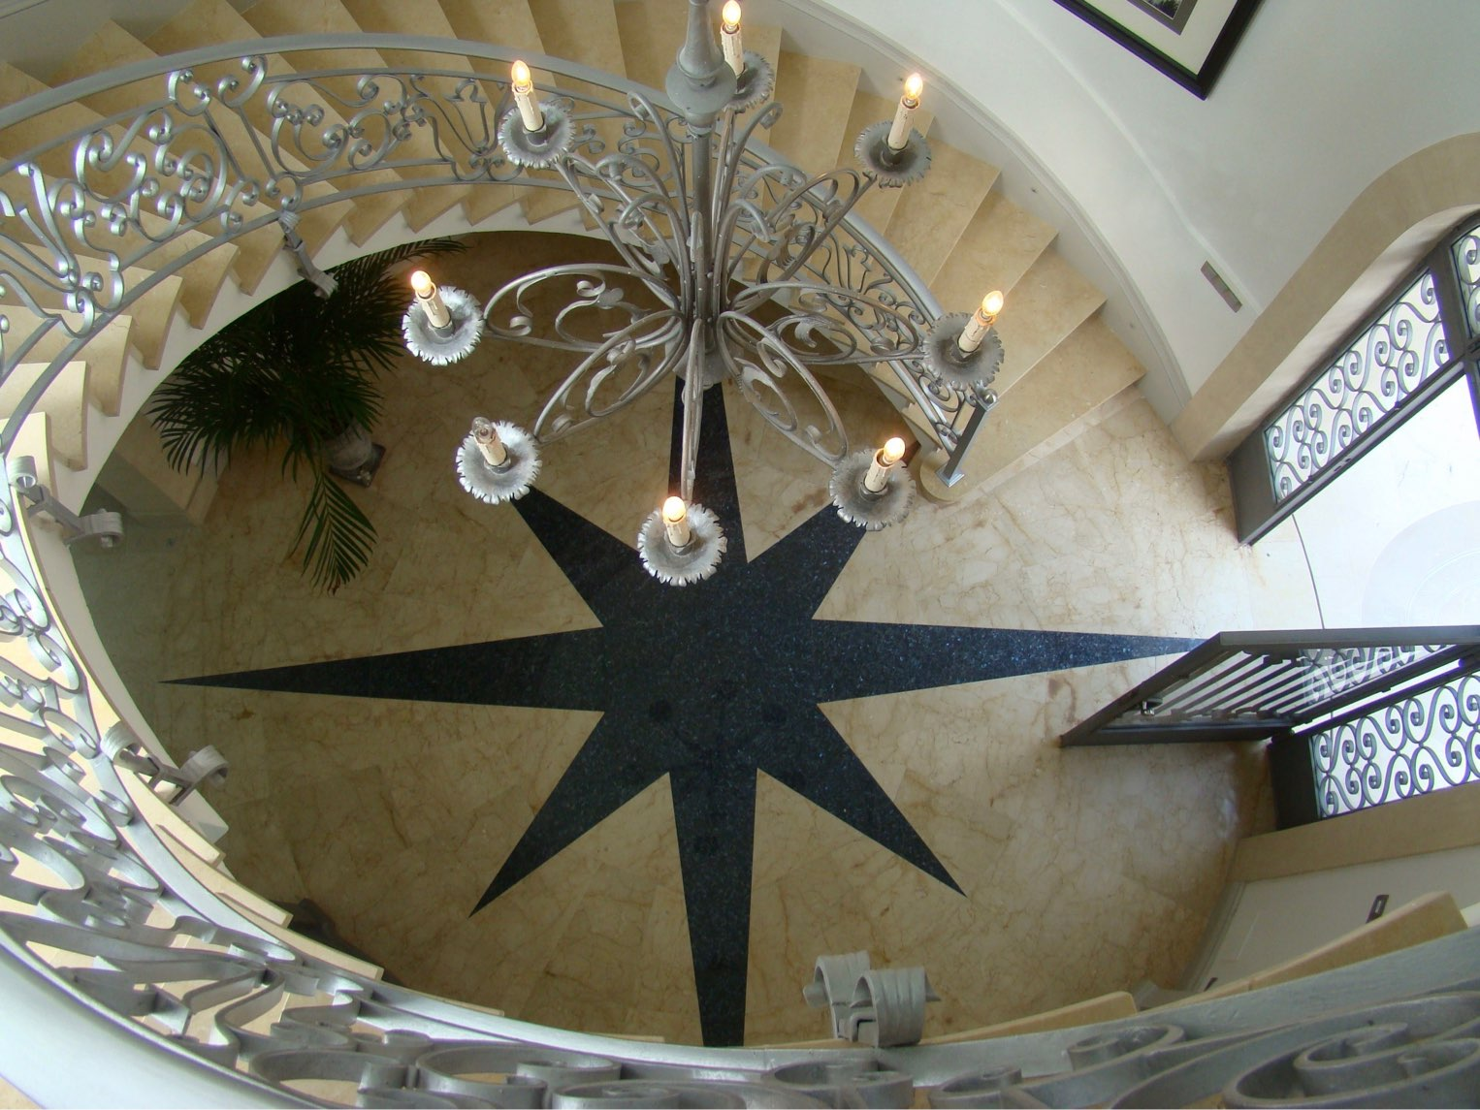
ajhd aidan james hurren design

Slide 6
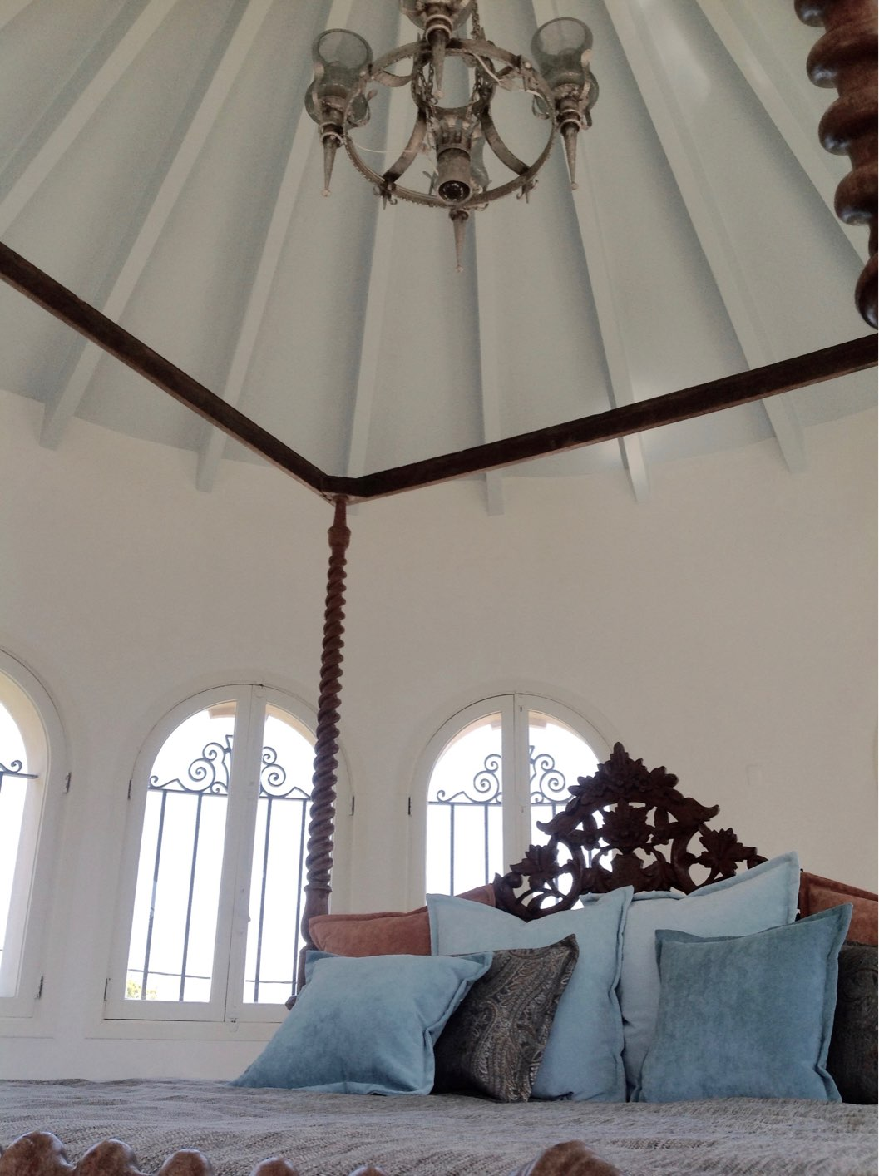
ajhd aidan james hurren design
in the circular Tower Room,
a carved Indian bed with luscious cushions makes a chill out area

Slide 7
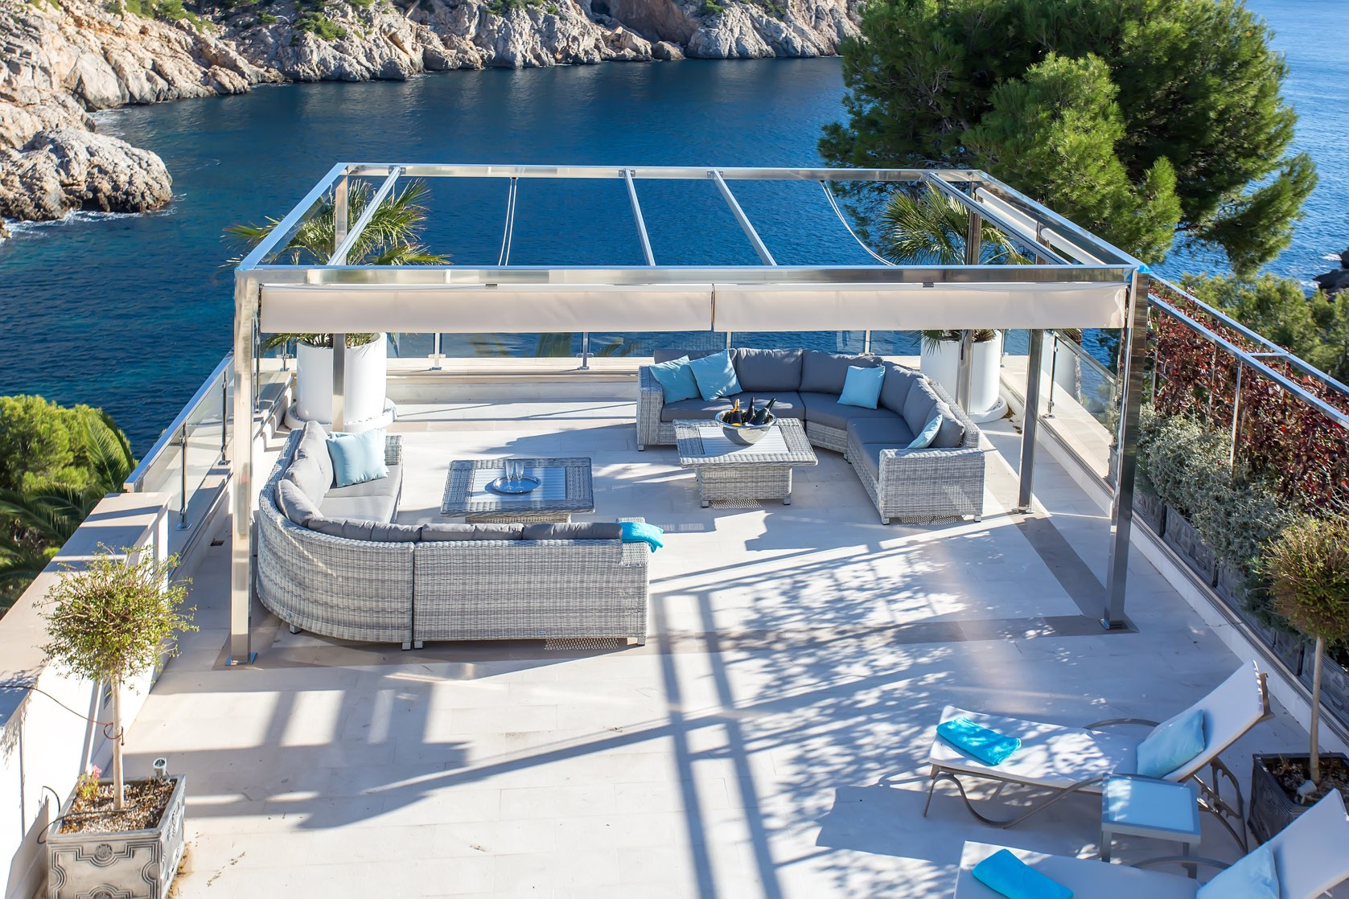
ajhd aidan james hurren design
The Tower Terrace has a stainless steel frame for the retractible awnings, and lots of seating to allow enjoyment of the stunning views

Slide 8
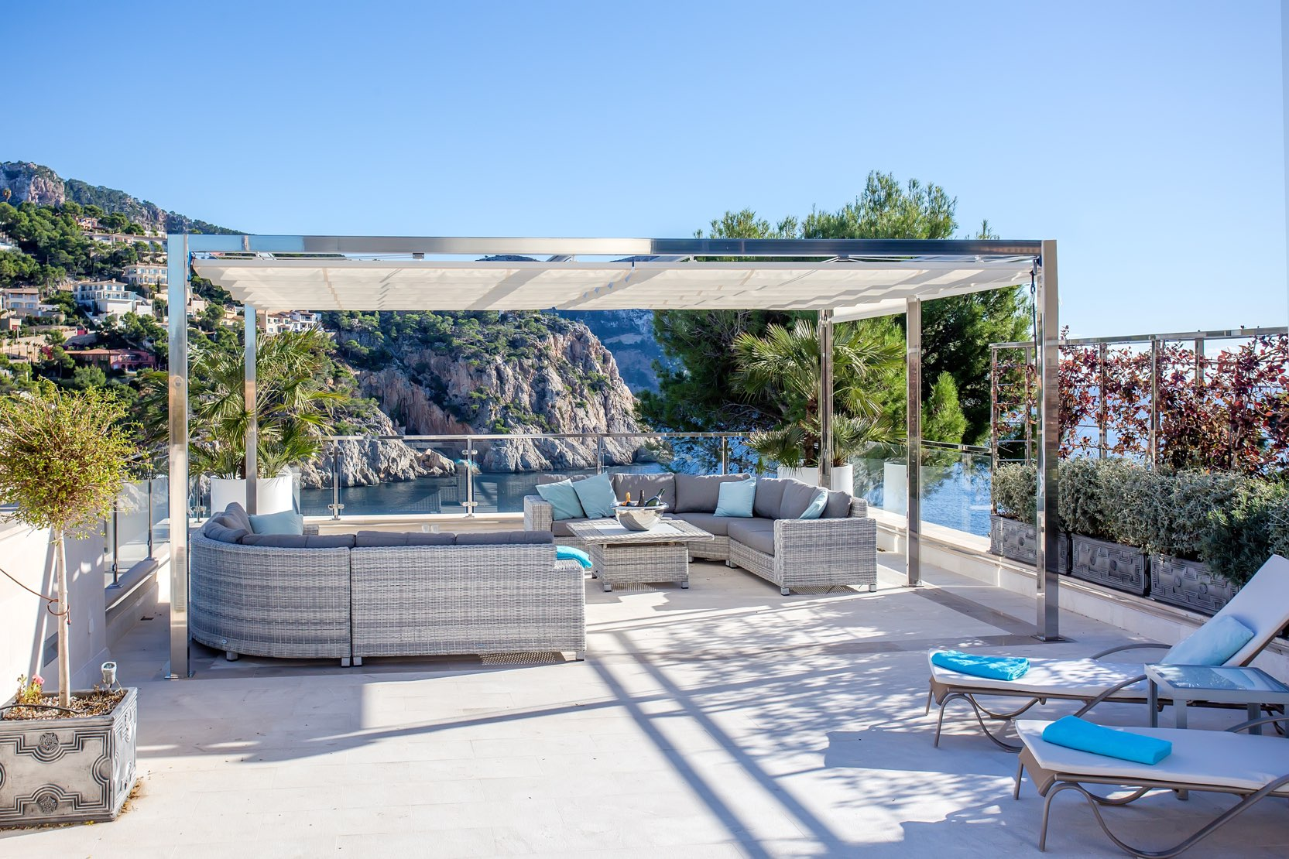
ajhd aidan james hurren design

Slide 9
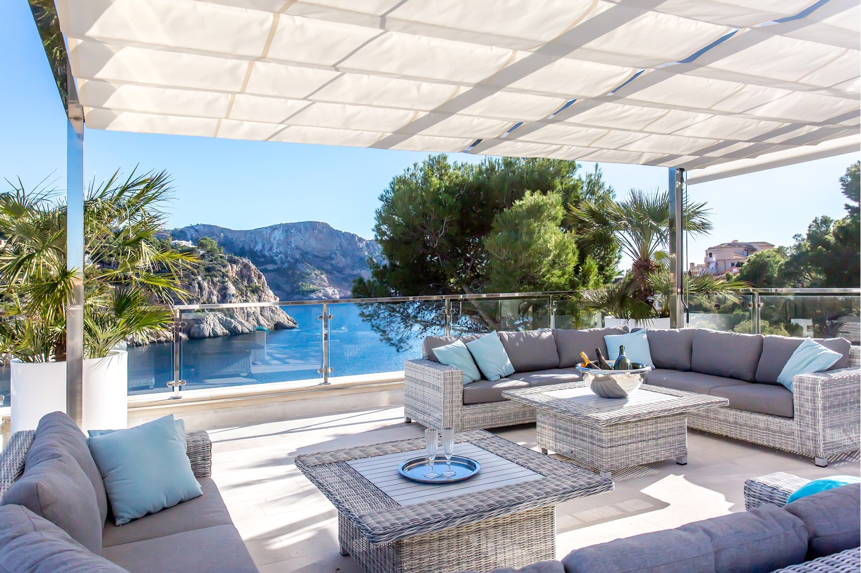
ajhd aidan james hurren design

Slide 10
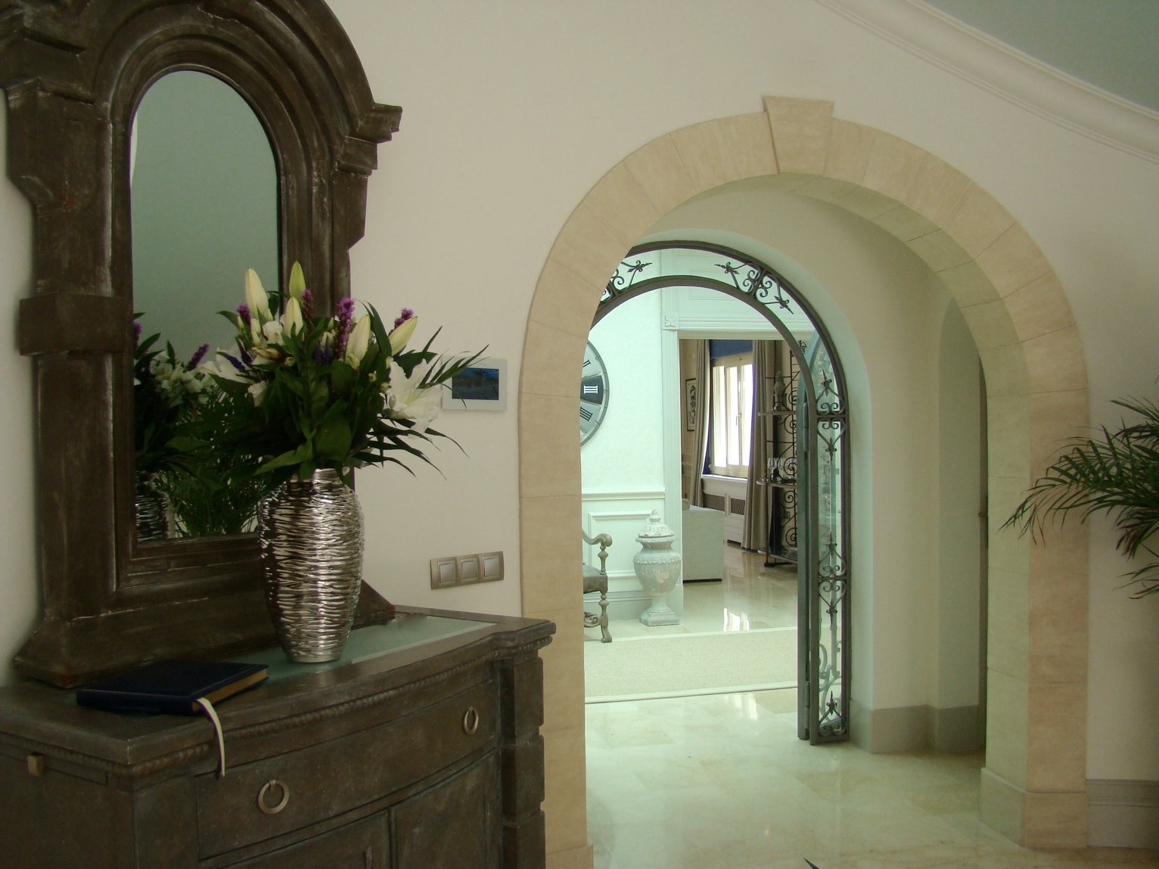
ajhd aidan james hurren design
The Entrance Hall

Slide 11
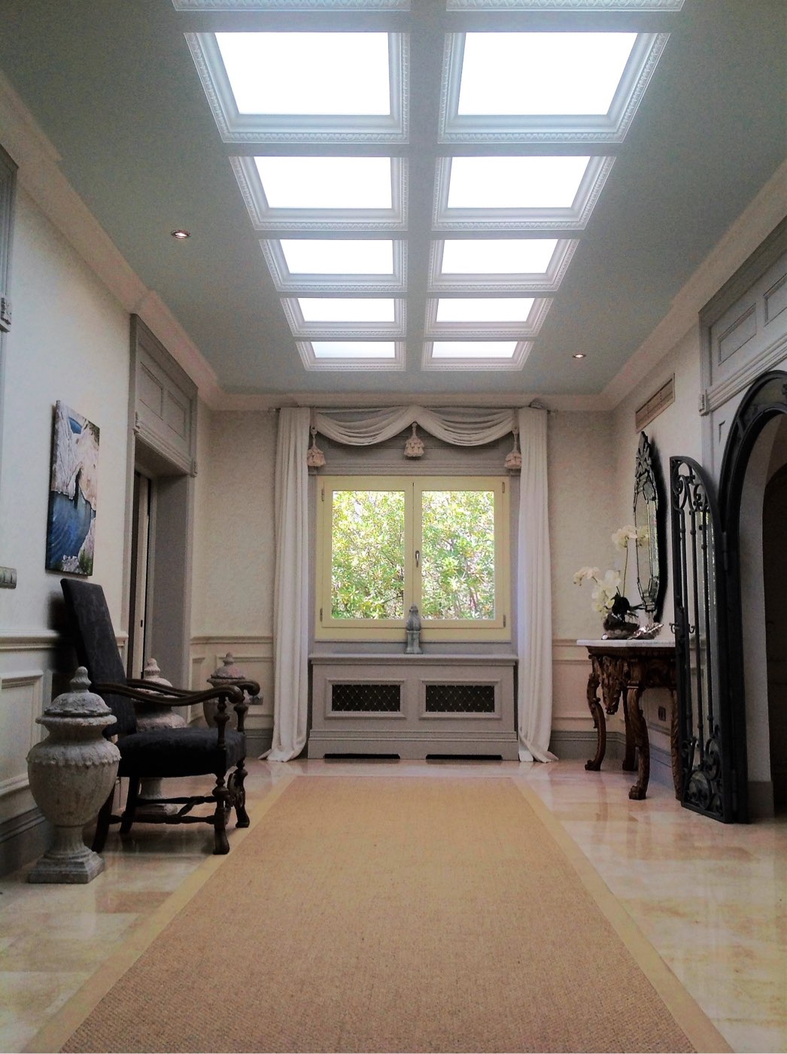
ajhd aidan james hurren design
The Skylight Hallway
The expanse of skylights was created by punching through from the Tower Terrace above to this previously rather dark internal Hallway.
Designed with detailed plaster mouldings around the etched glass panels and with cornice; plaster columns and painted wooden dado panels.
The etched-glass skylight panels are set below thick plate glass panels - which form part of the floor of the Tower Terrace, and can be walked on.
Thus the bright Mallorca sunlight passes through the thick glass and becomes aqueous and cool.
The walls are papered in a subtle almost white-on-white,
a modern take on a traditional Damask design wallpaper,
bringing a real touch of ‘the Englishman’s home is his Castle”

Slide 12
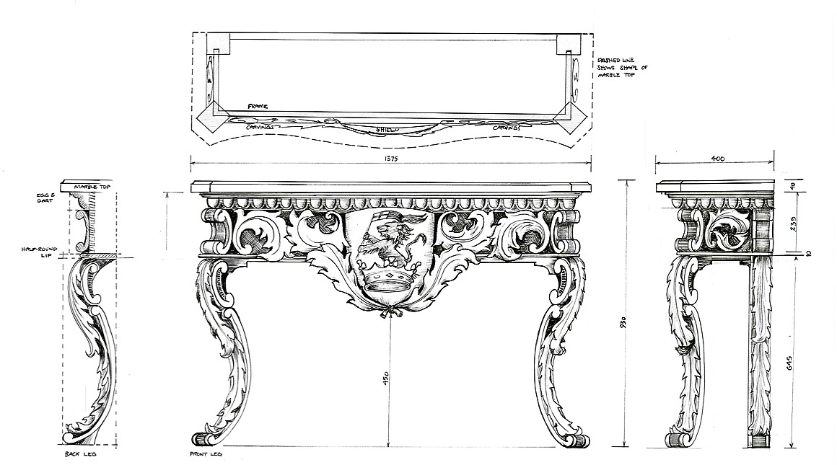
ajhd aidan james hurren design
Especially designed for the Skylight Hall, a pair of hand-carved oak,
marble-topped Console Tables, featuring the aristocratic family’s Coat-of-Arms

Slide 13
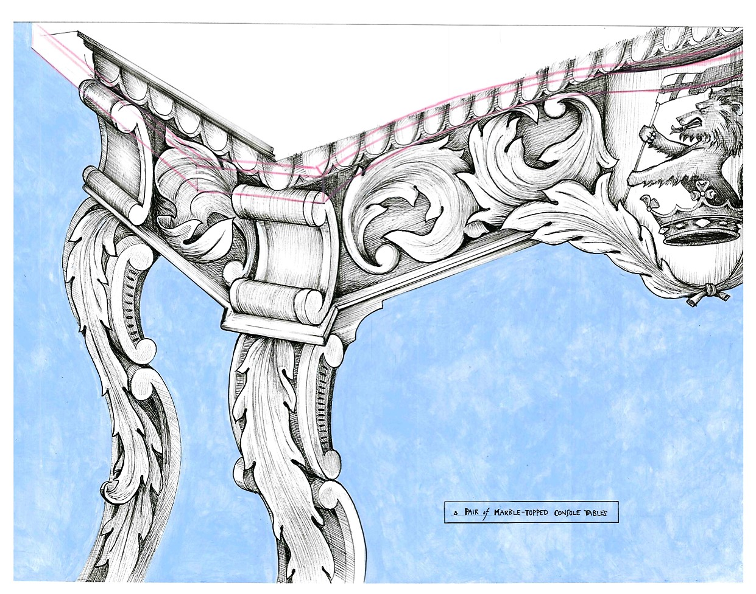
ajhd aidan james hurren design
detail drawing of the design for the carved Console Tables

Slide 14
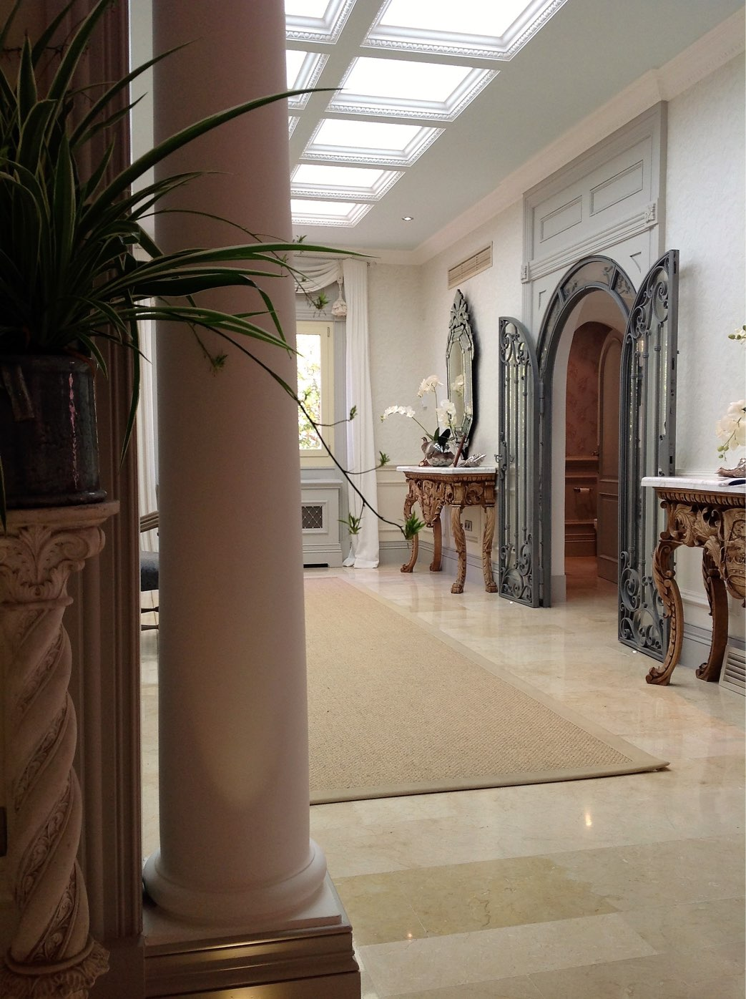
ajhd aidan james hurren design
the Skylight Hall, showing the carved Console Tables

Slide 15
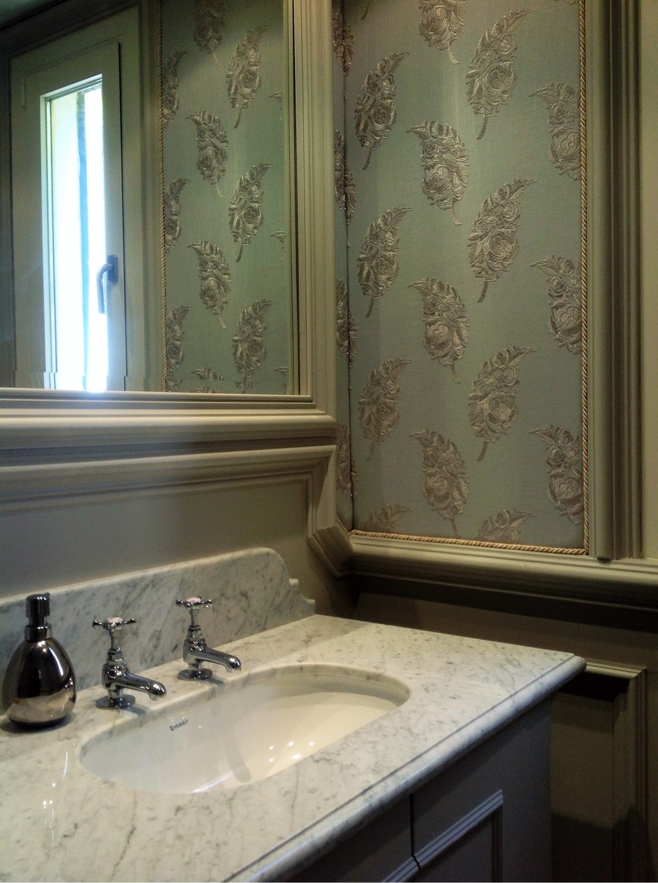
ajhd aidan james hurren design
one of the three Guest loos in the house,
with padded, embroidered linen walls,
and a bespoke marble-topped vanity unit

Slide 16
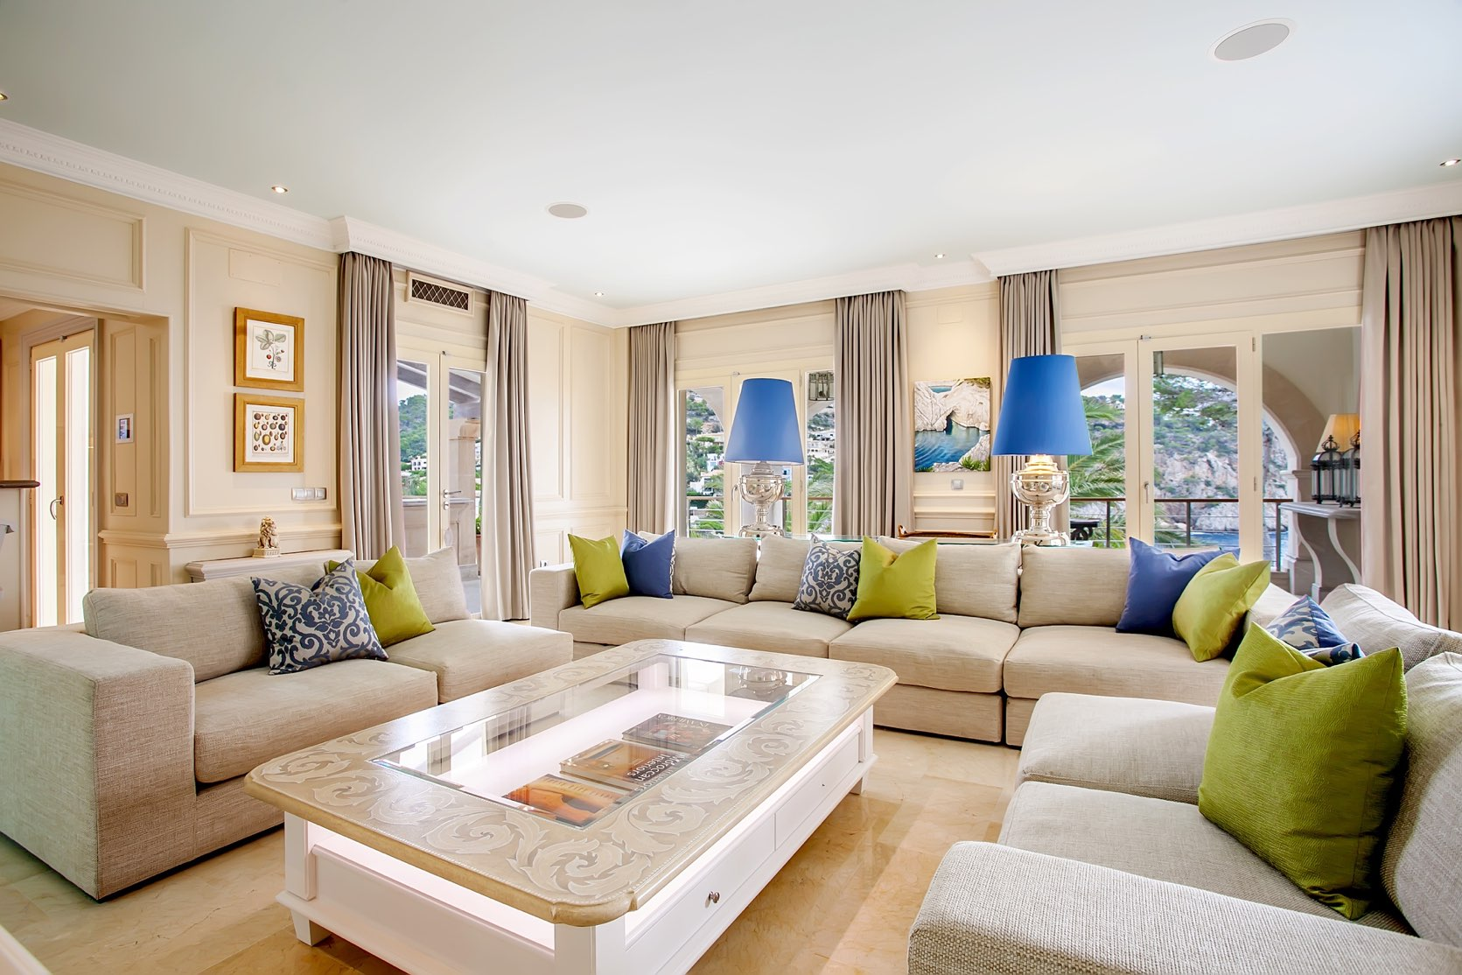
ajhd aidan james hurren design
The Television Room

Slide 17
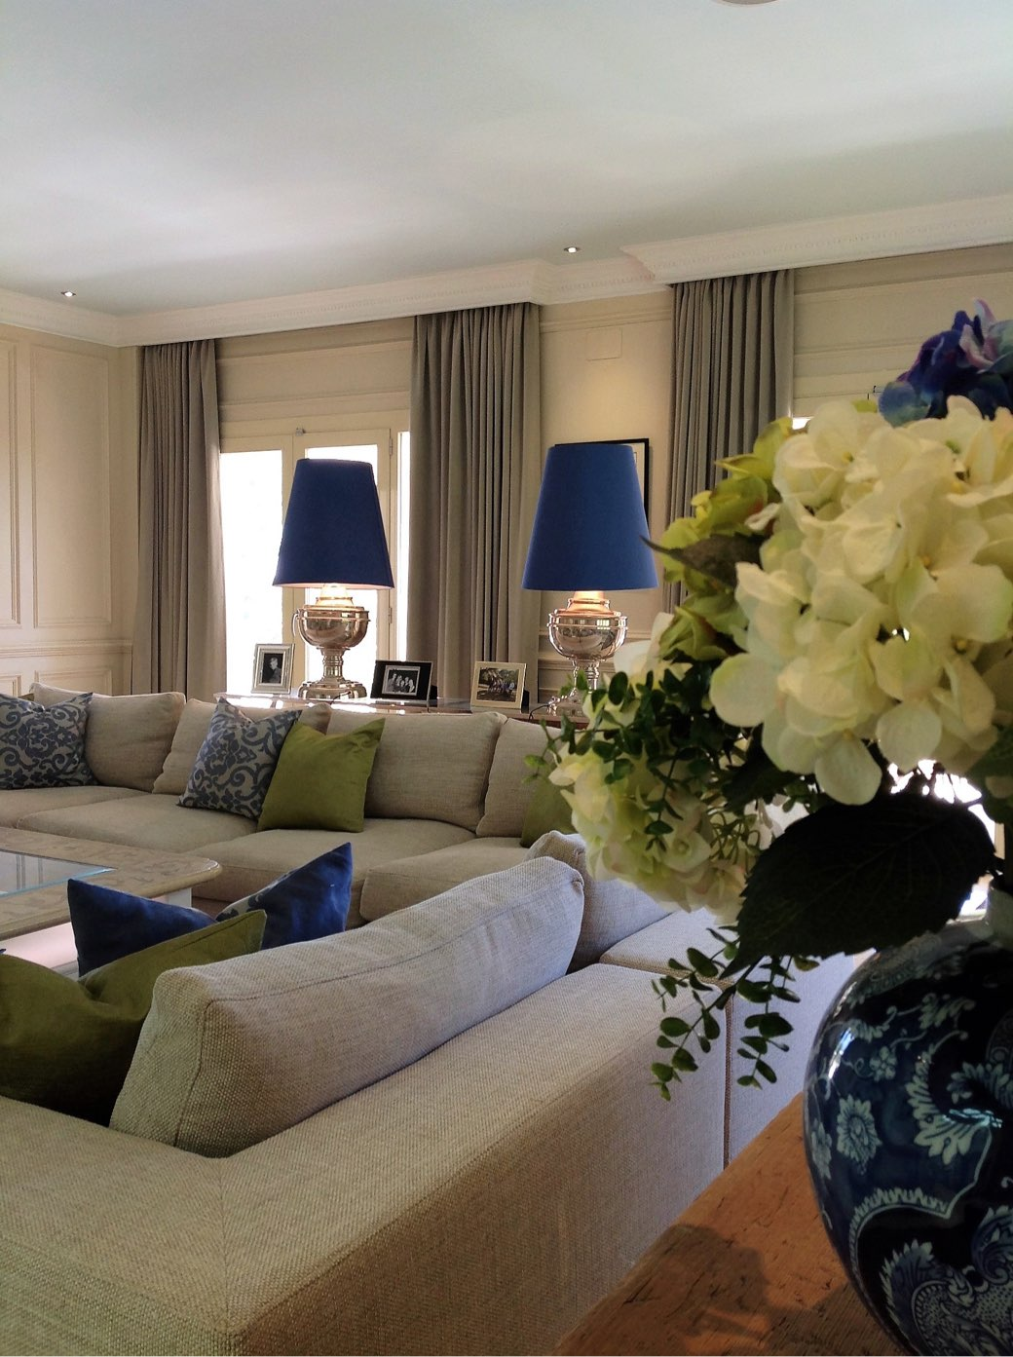
ajhd aidan james hurren design

Slide 18
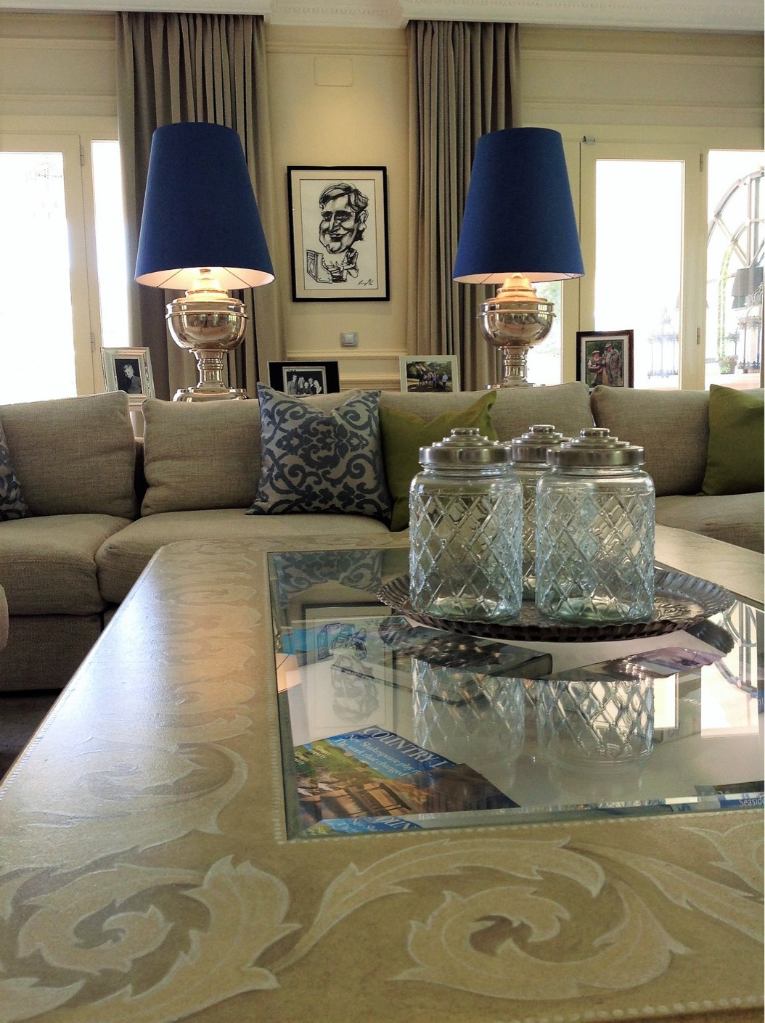
ajhd aidan james hurren design
custom made, hand-painted, illuminated Coffee Table

Slide 19
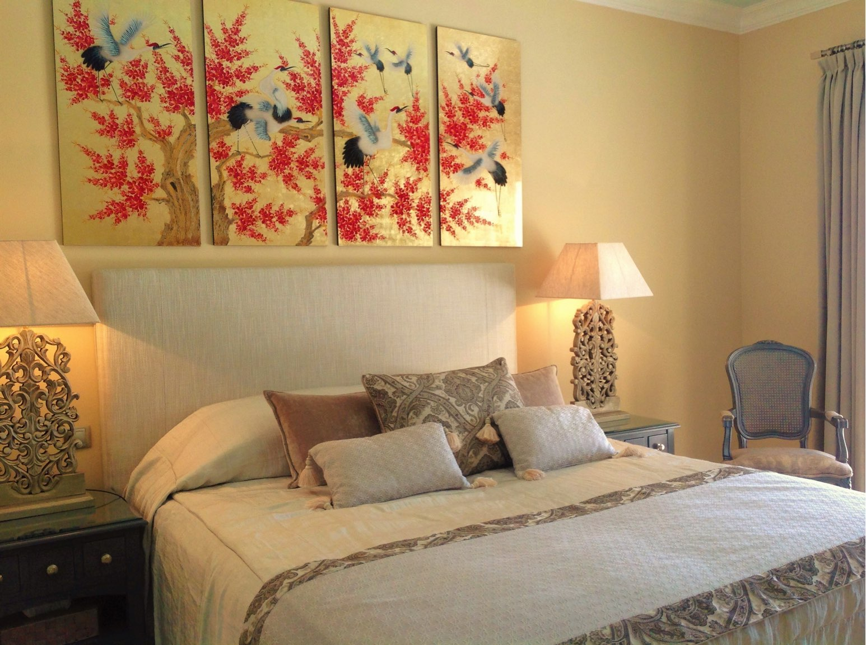
ajhd aidan james hurren design
Guest Room

Slide 20
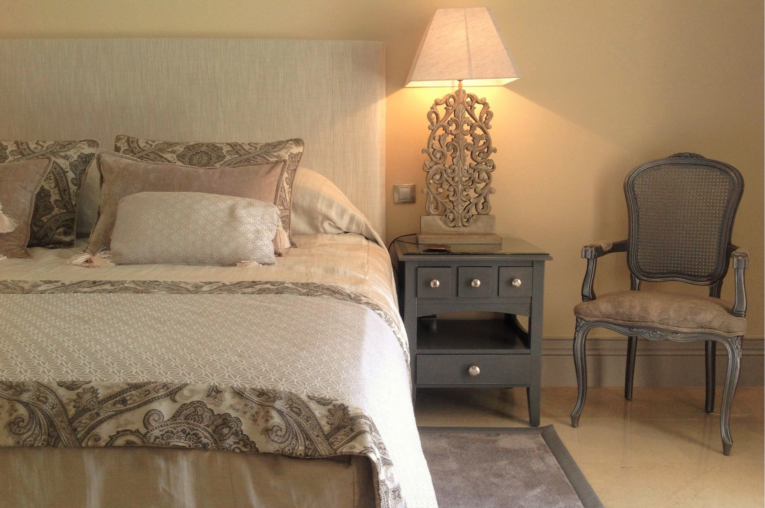
ajhd aidan james hurren design
Guest room

Slide 21
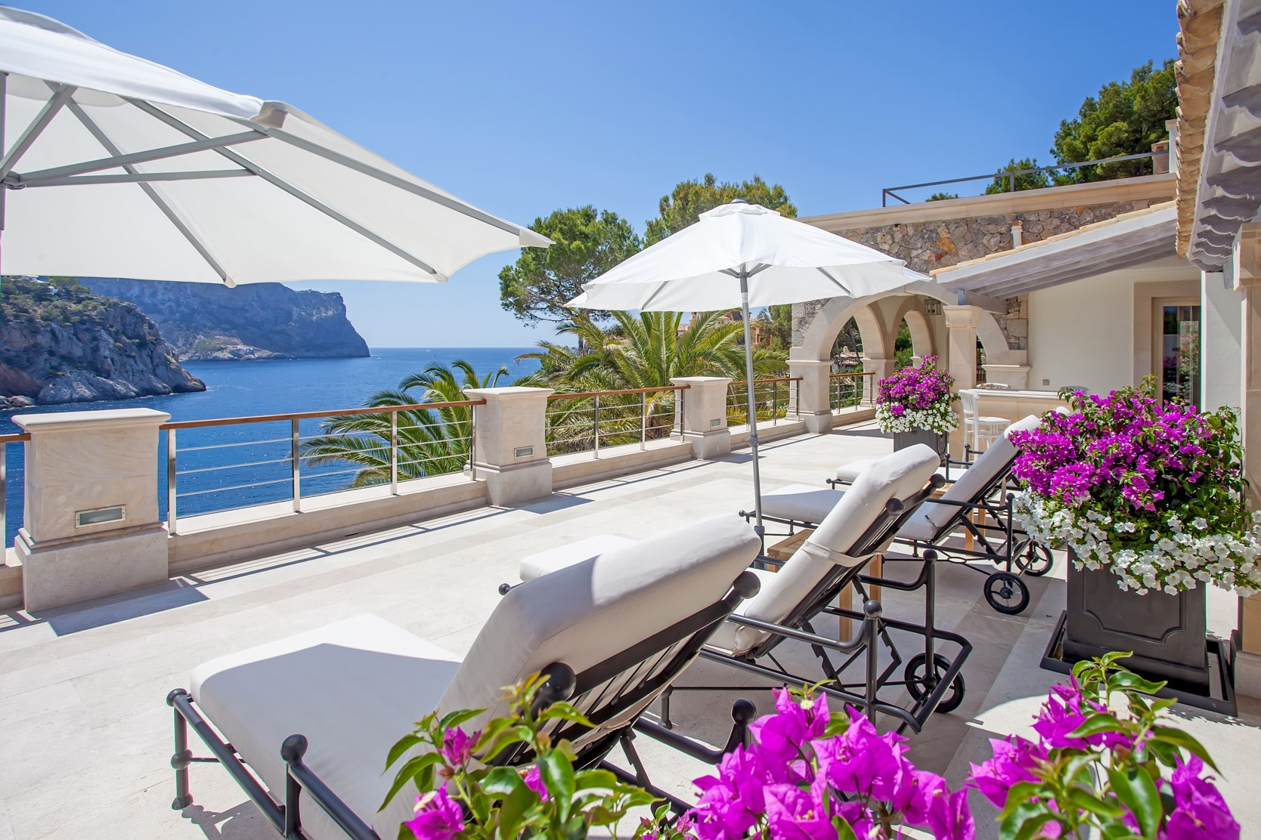
ajhd aidan james hurren design
The upper Solarium

Slide 22
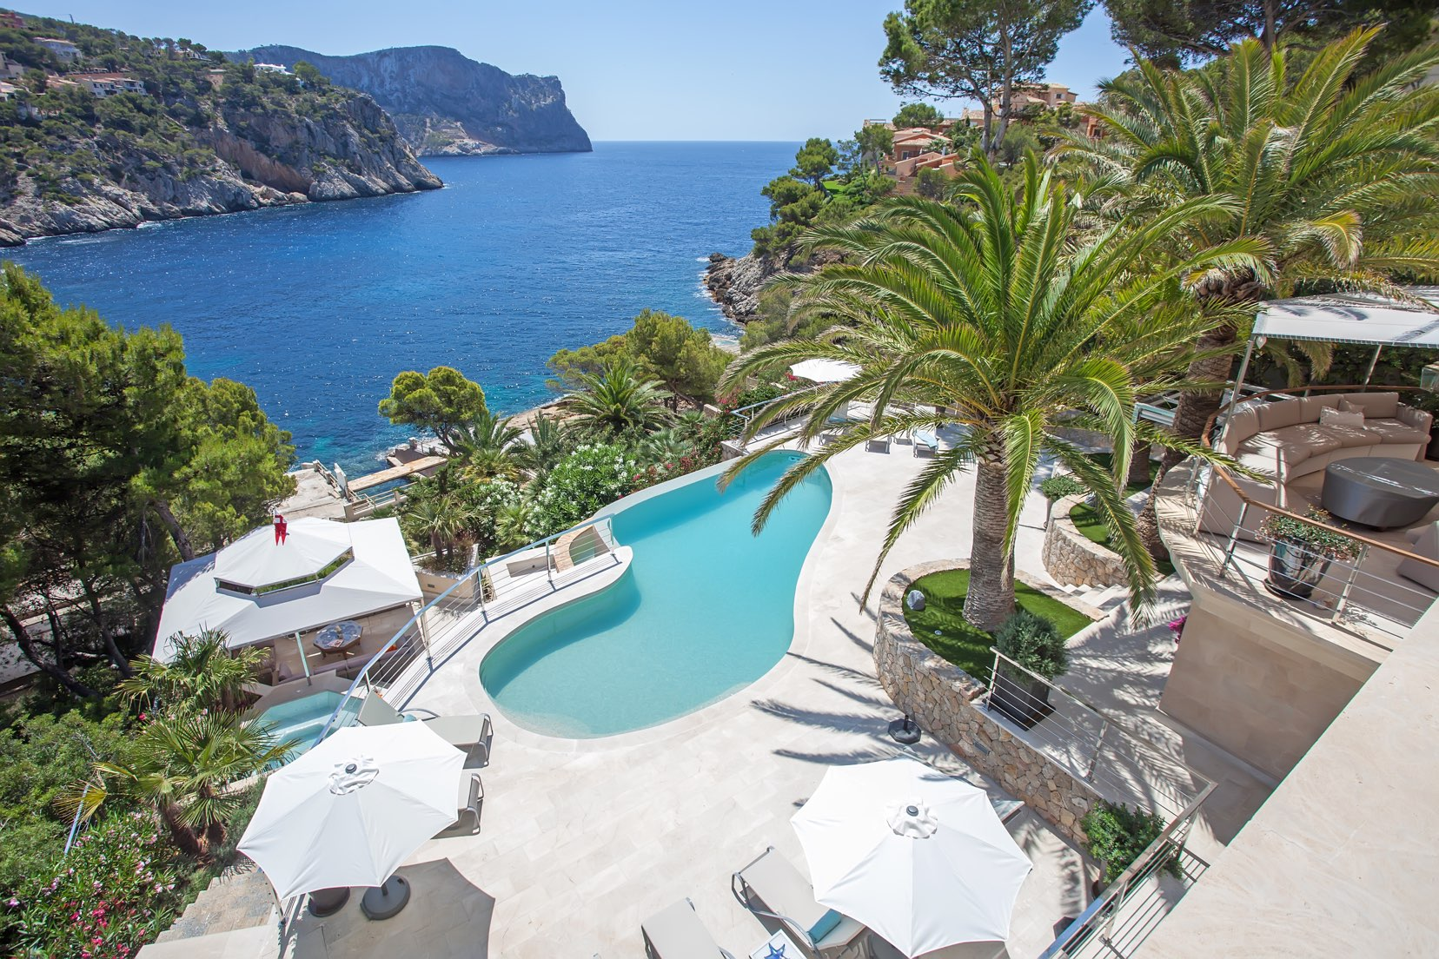
ajhd aidan james hurren design
The view over the property, from the upper solarium

Slide 23
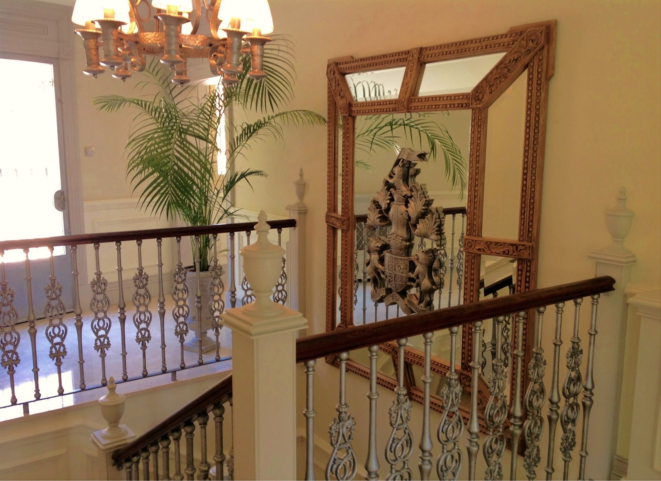
ajhd aidan james hurren design
The Landing
with cast-metal balustrade. above the remodeled Middle Staircase.
Bespoke hand-carved Cushion Mirror,
made to display the carved Family Crest

Slide 24
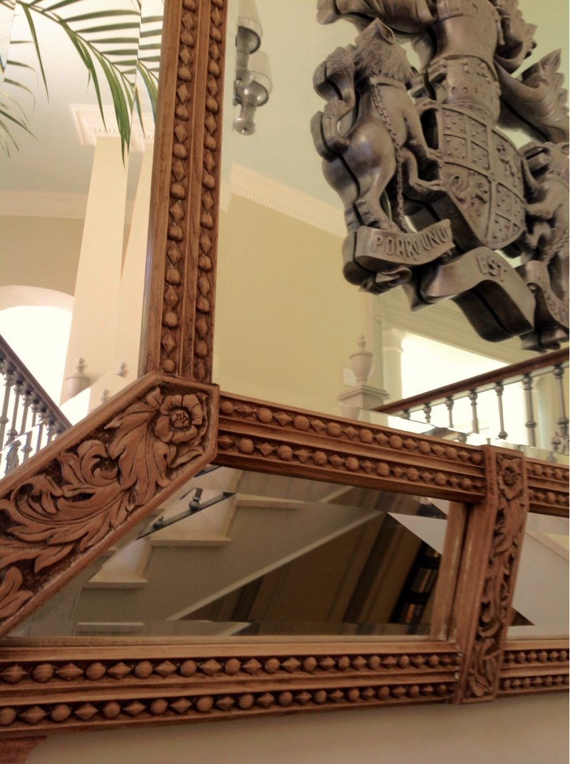
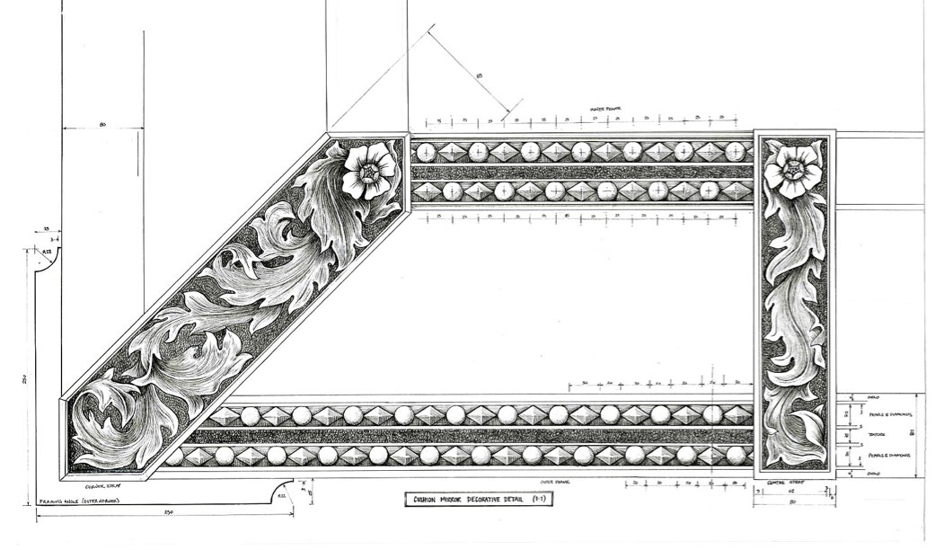
ajhd aidan james hurren design
Left, detail of the Design drawing,
and Above, the finished hand carved Cushion Mirror,
featuring the carved Family Crest

Slide 25
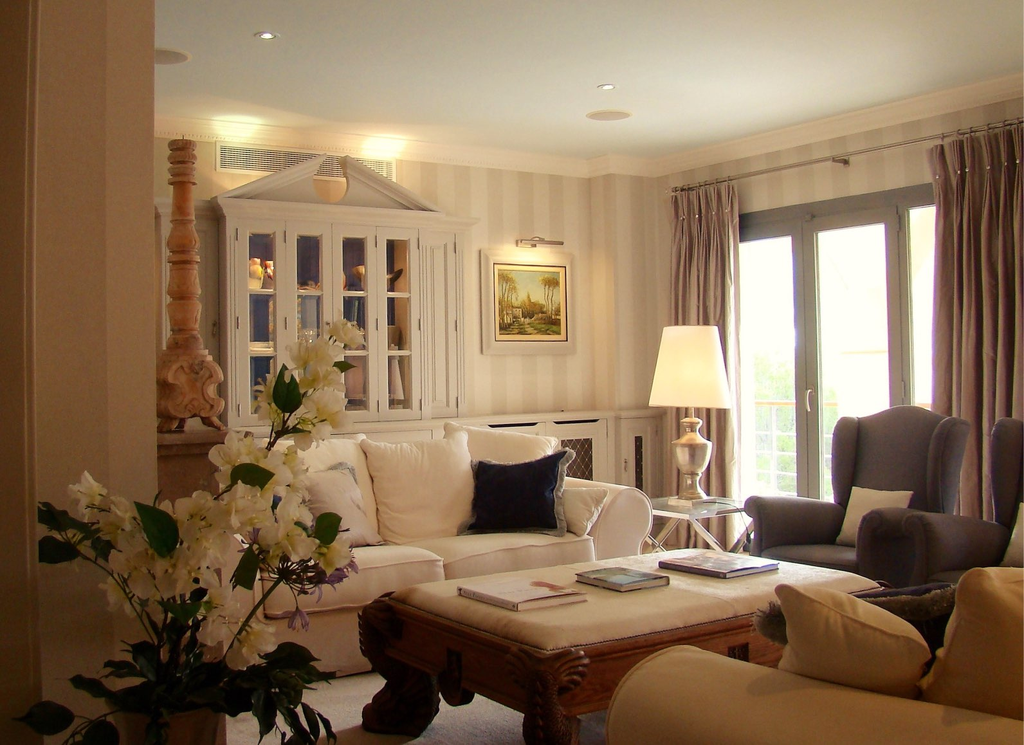
ajhd aidan james hurren design
The Drawing Room,
with bespoke cabinet work

Slide 26
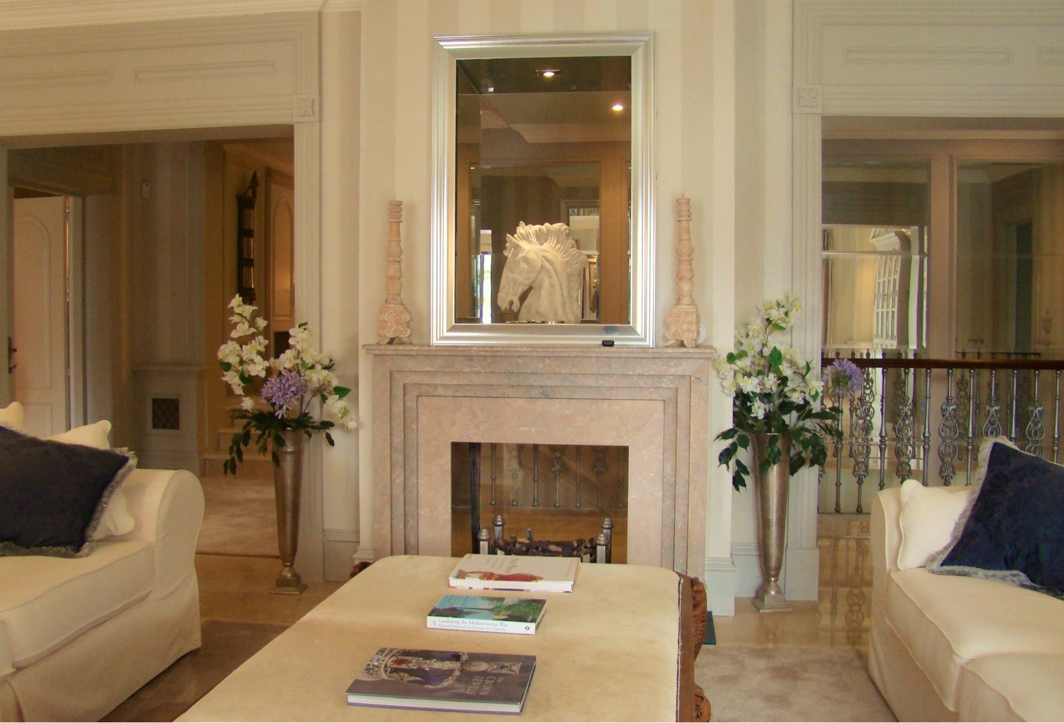
ajhd aidan james hurren design
The Drawing Room
with a nod to the architectural genius of Sir John Soane,
the double-aspect Fireplace, and the mirrored opening above it reveal the
Mirrored Staircase behind.

Slide 27
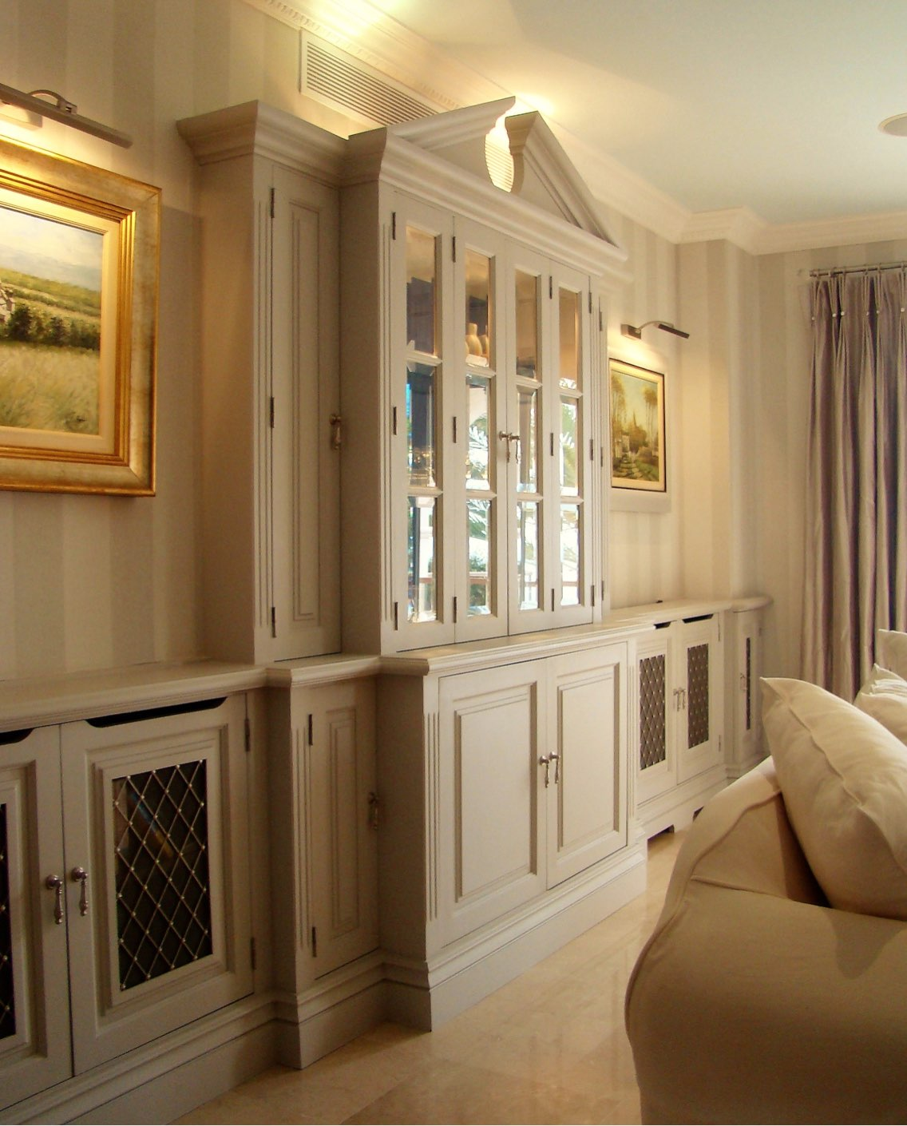
ajhd aidan james hurren design
The Drawing Room
the bespoke cabinets, made by local Mallorquin craftsmen, feature bevelled glass panels, hand-made nickel mesh from the UK, and exquisite hand-made nickel drop handles from India.
The central unit was designed to be used as a drinks cabinet, and includes a refrigerator and ice-maker in the lower cabinets

Slide 28
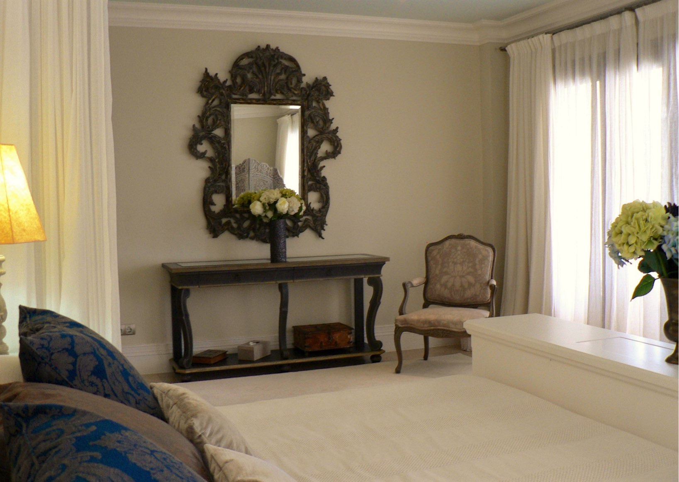
ajhd aidan james hurren design
The Master Bedroom

Slide 29
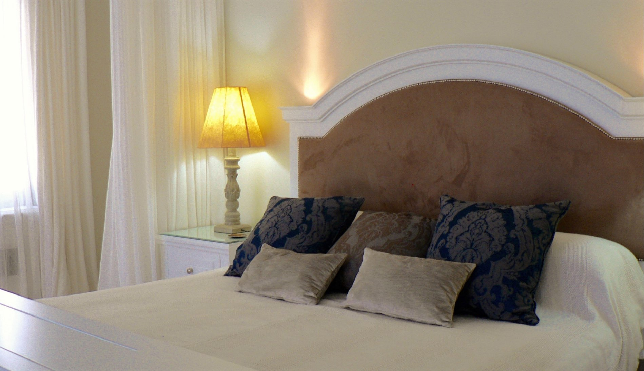
ajhd aidan james hurren design
the bespoke Master Bed features a deeply padded and studded faux-suede headboard,
and a foot-board cabinet which houses a built-in television, on a hydraulic lift mechanism
the bespoke Master Bed features a deeply padded and studded faux-suede headboard,
and a foot-board cabinet which houses a built-in television, on a hydraulic lift mechanism

Slide 30
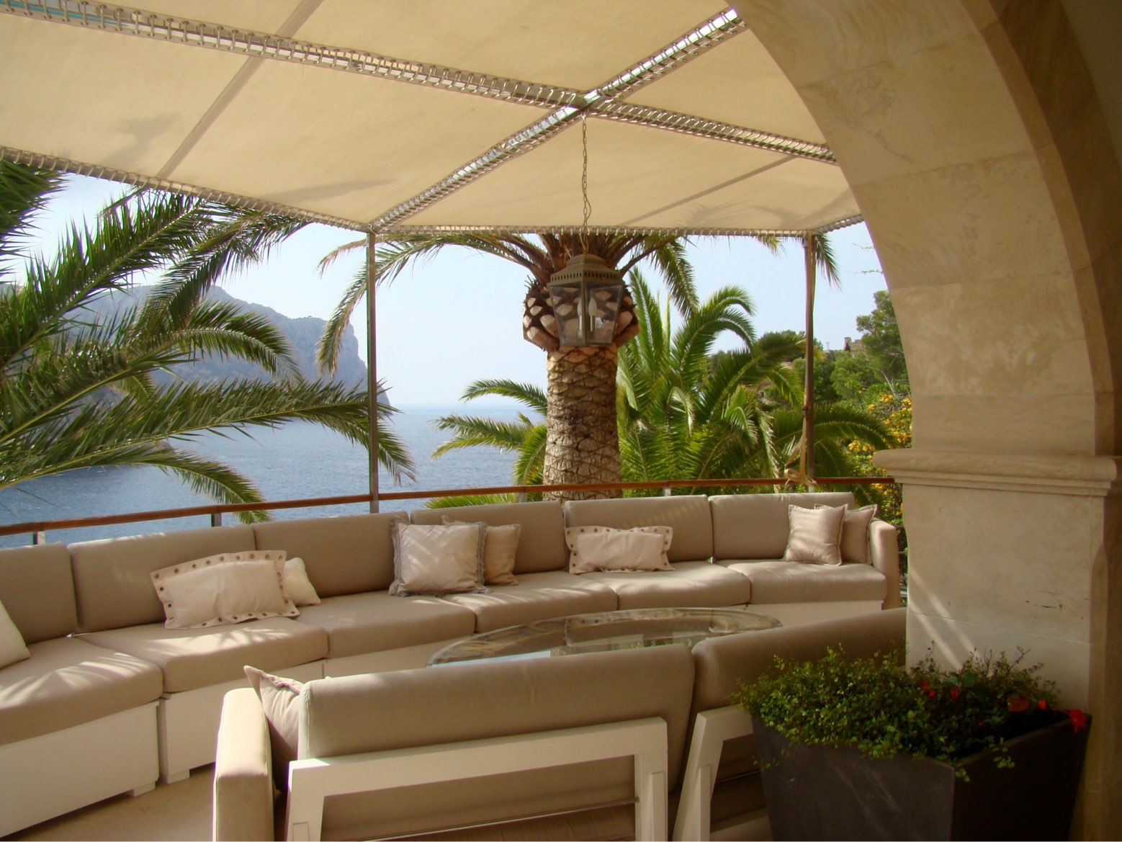
ajhd aidan james hurren design
the Chill-out Terrace

Slide 31
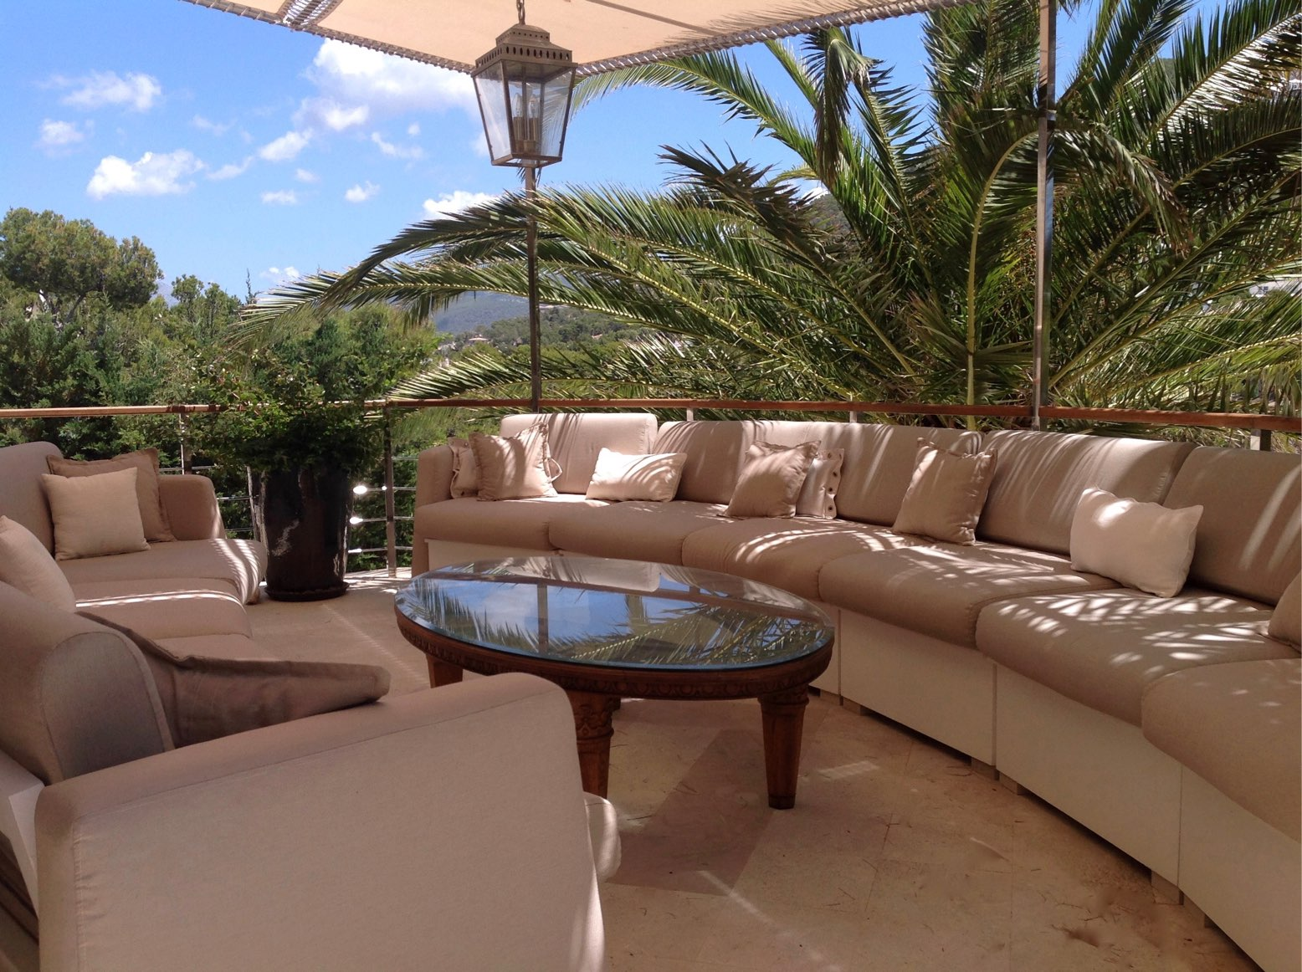
ajhd aidan james hurren design
The Chill-out Terrace

Slide 32
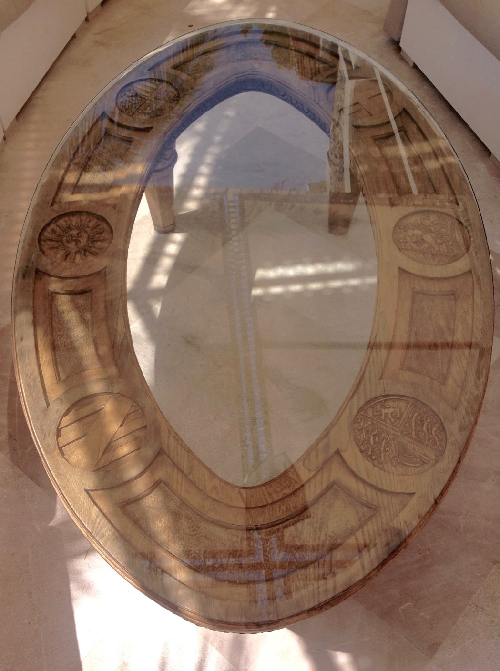
ajhd aidan james hurren design
the carved Coat-of-Arms centre table for the master Chill-out area
featuring the heraldic devices of the United Kingdom, the City of London, and the client’s august family;
along with those of Spain, Mallorca and Andratx

Slide 33
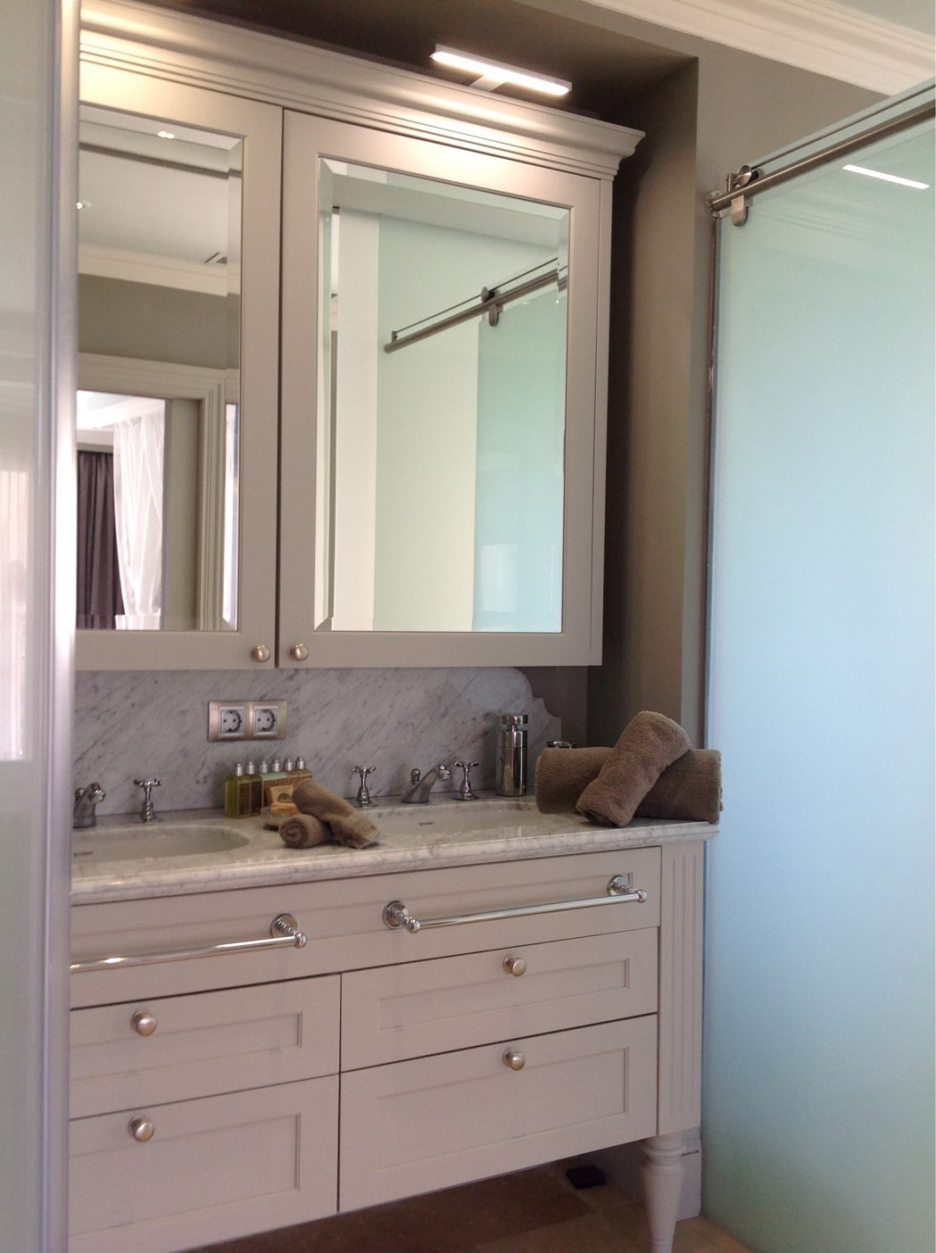
ajhd aidan james hurren design
modern sliding etched glass doors lead into the en-suite of the principal guest room, and to the shower and WC enclosures, paired with the elegance of traditional styling in the marble-topped bespoke vanity unit

Slide 34
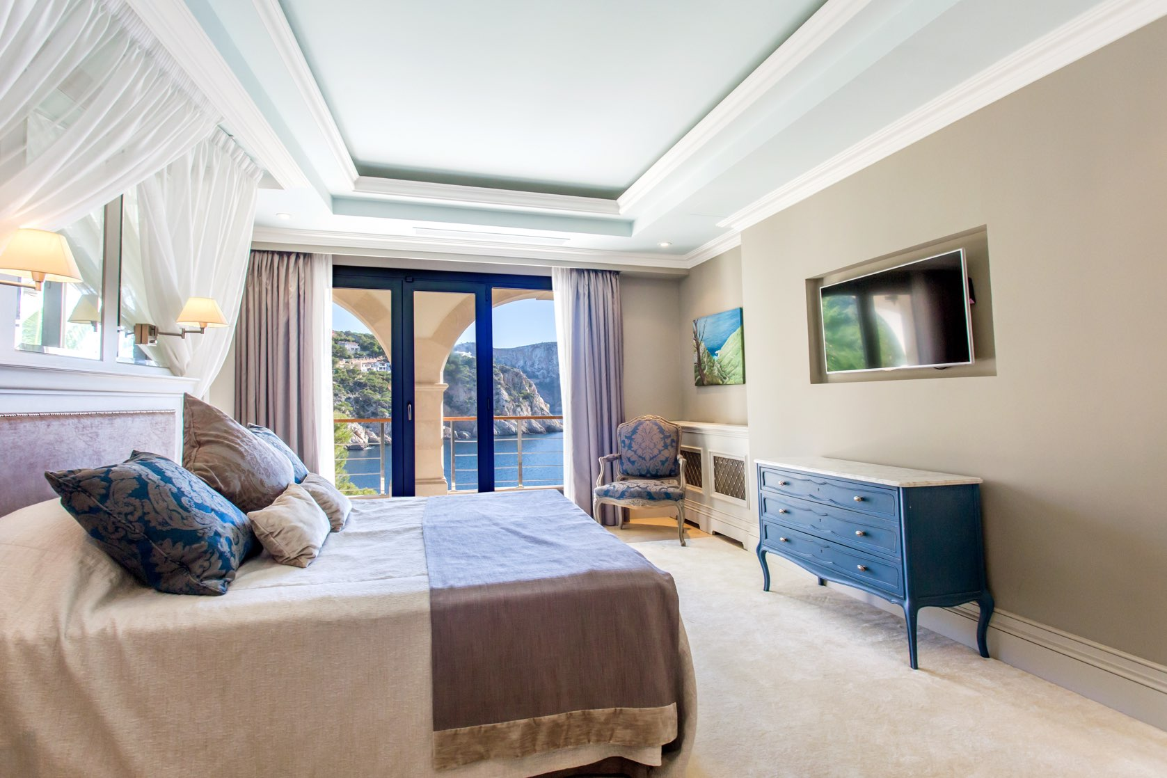
ajhd aidan james hurren design
the Principal
Guest Room
has a very wide ‘half tester’ bed,
with mirrored panels
and indirect lighting around the paneled ceiling

Slide 35
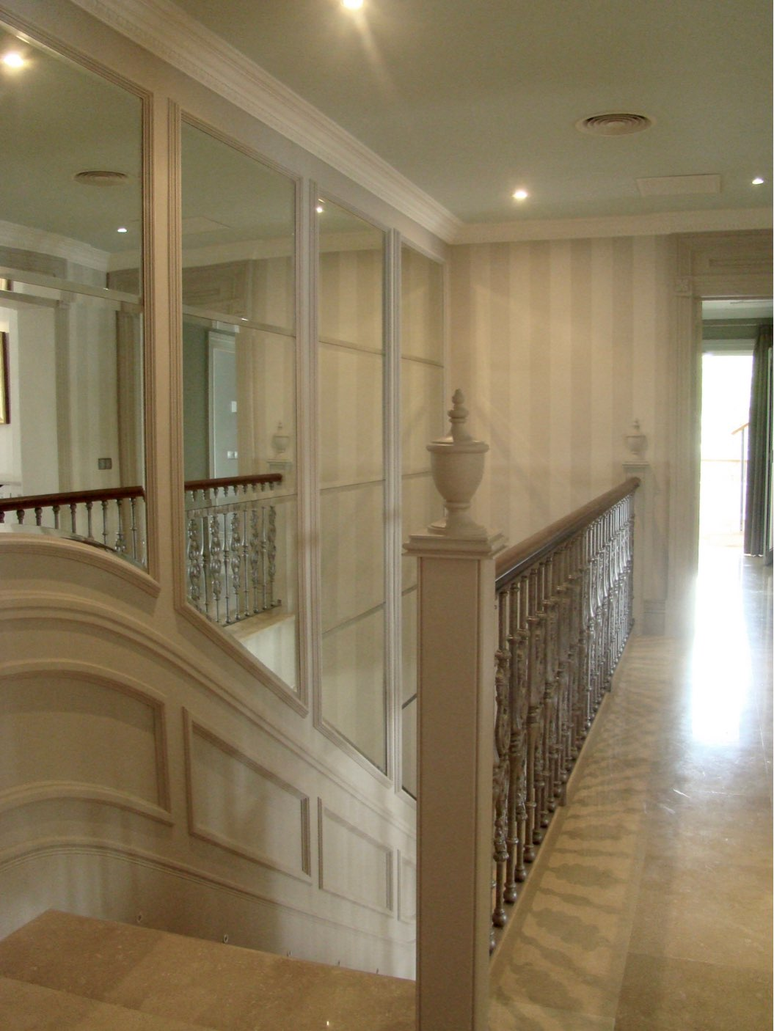
ajhd aidan james hurren design
The Mirrored Staircase
to bring light into the centre of the building, and exaggerate the height of the stairwell, Aidan designed a timber-paneled wall with shaped and bevelled mirrors.
It was created by local firms of yacht carpenters and glaziers

Slide 36
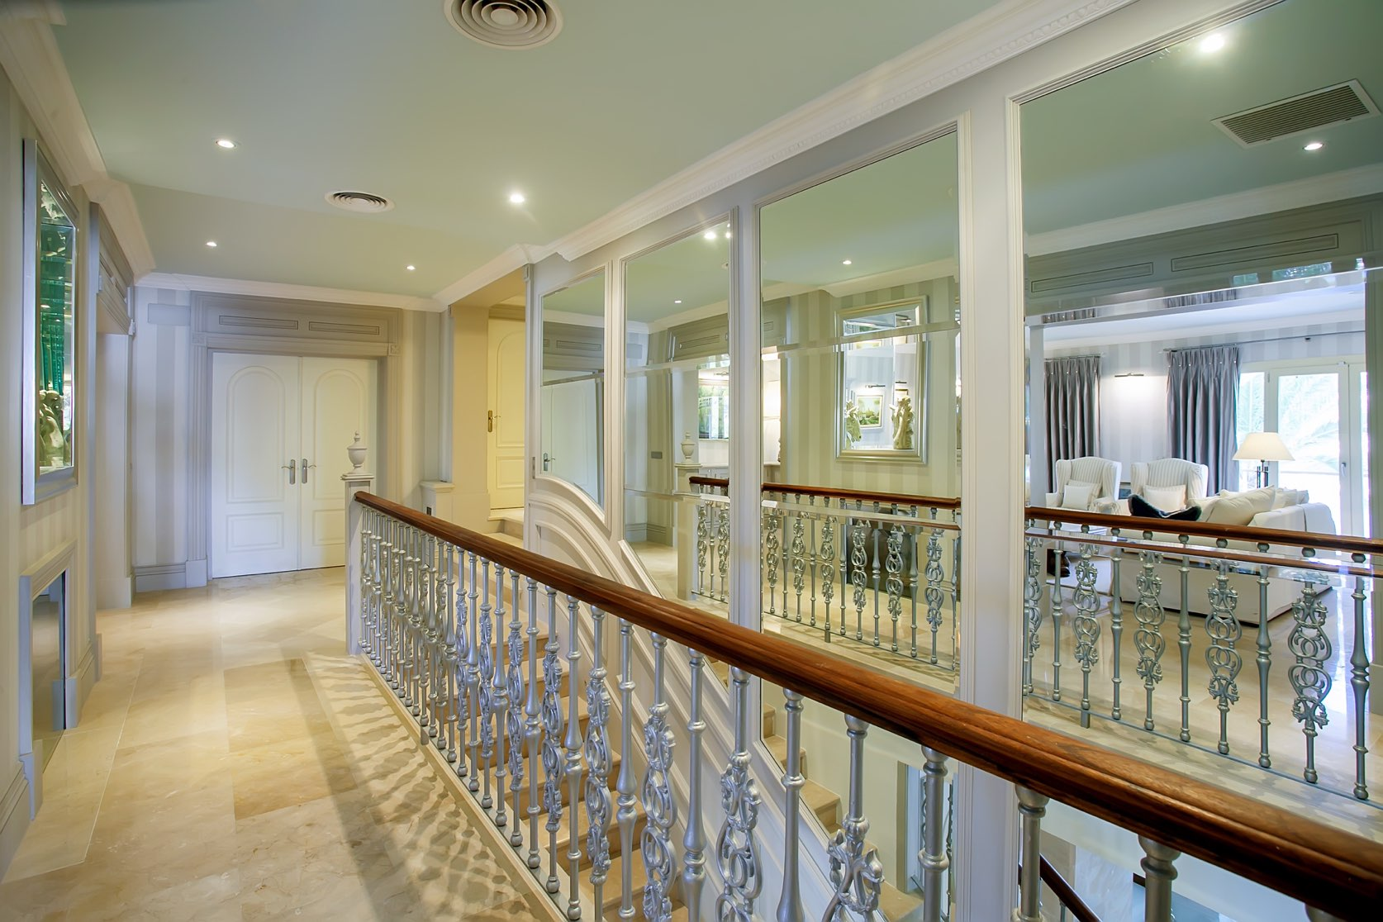
ajhd aidan james hurren design

Slide 37
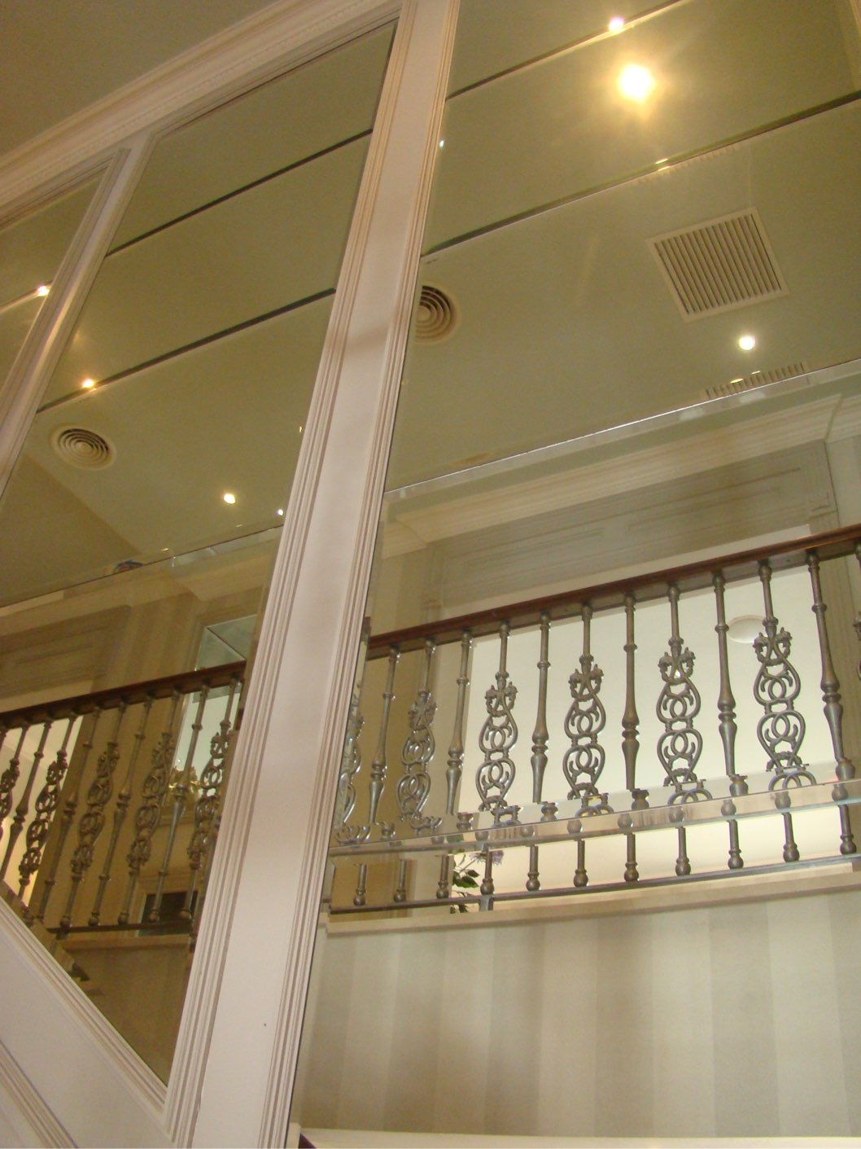
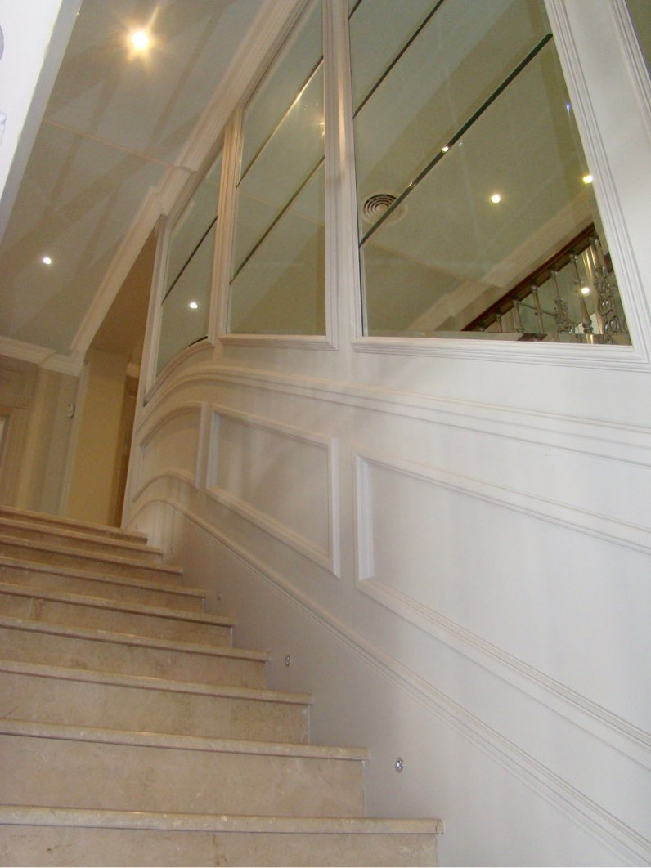
ajhd aidan james hurren design

Slide 38
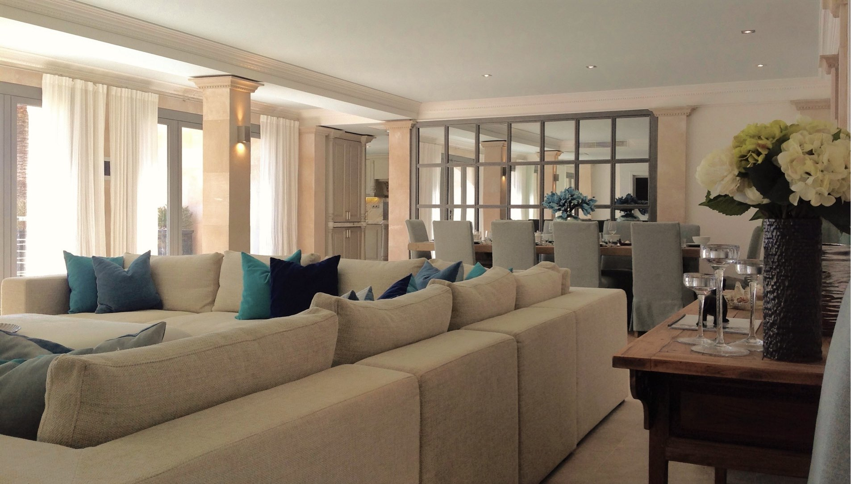
ajhd aidan james hurren design
The Family Room and the main Kitchen occupy the whole of the newly-excavated lower floor of the villa

Slide 39
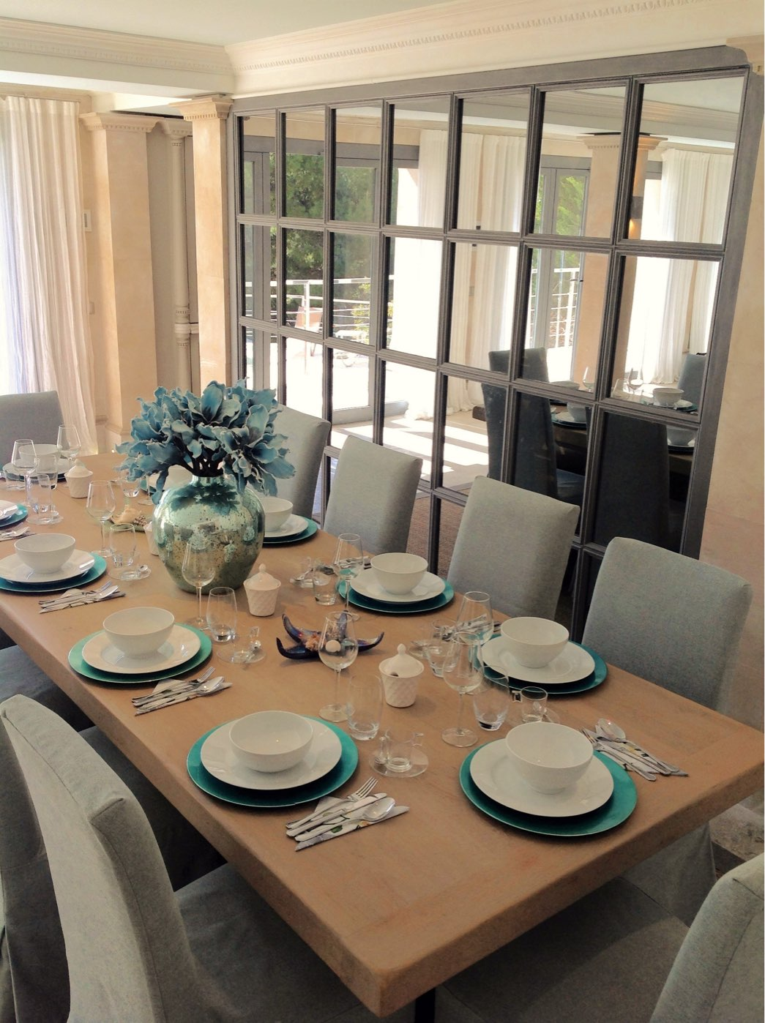
ajhd aidan james hurren design
The Family Room with Bodega
the Bodega (wine cellar) is concealed behind
the wall of two-way-mirror panels

Slide 40
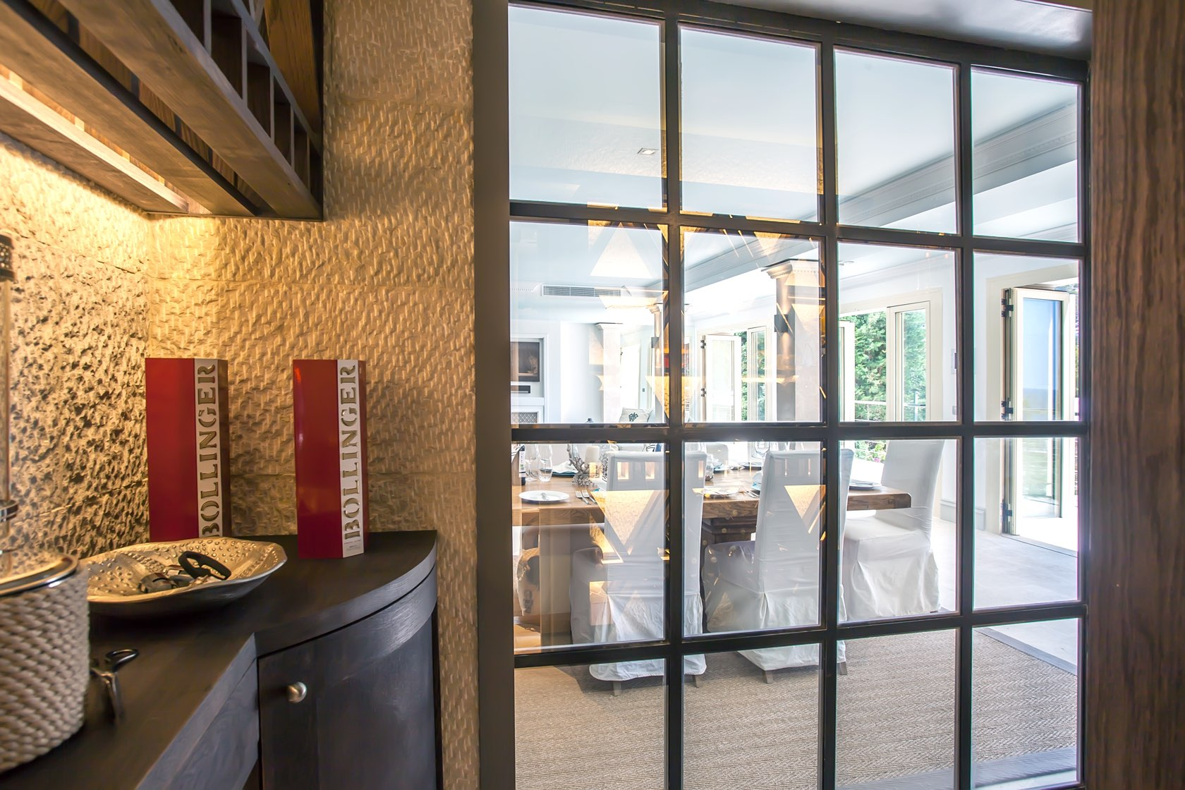
ajhd aidan james hurren design
the interior of the Bodega (wine store) is lined with chiseled stone.
The ‘spy’ mirror wall allows a view through to the living area, and at night when the bodega is illuminated, the interior can be seen from the other side

Slide 41
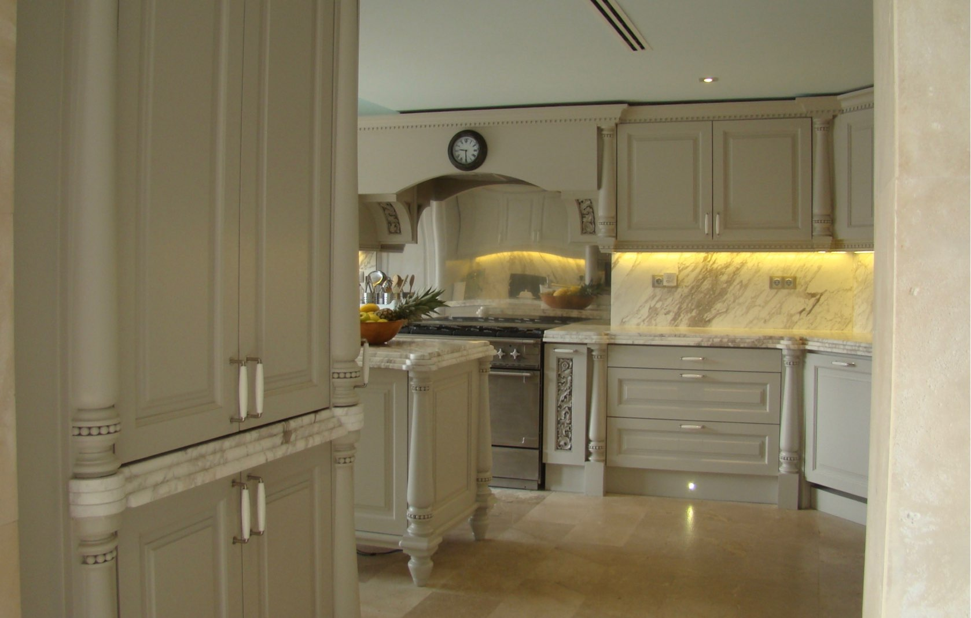
ajhd aidan james hurren design
The Main Kitchen

Slide 42
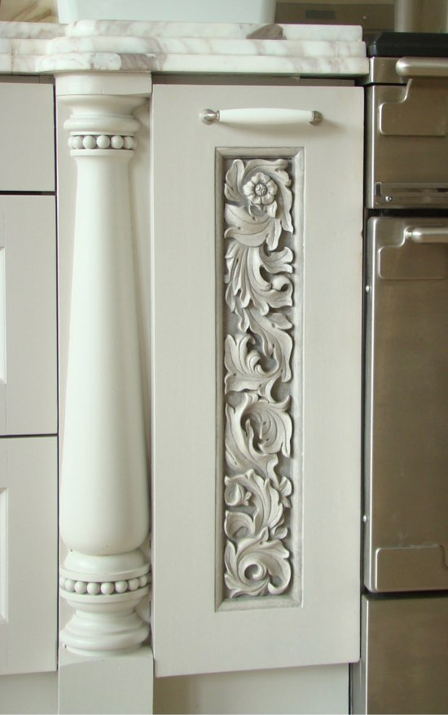
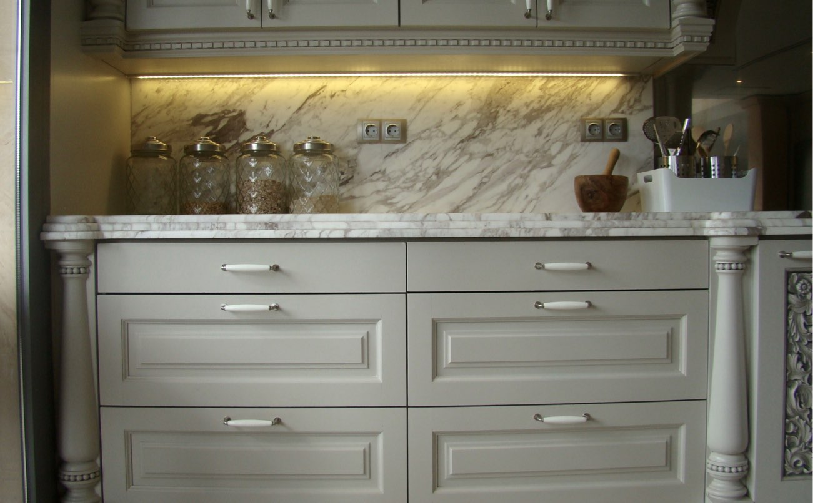
ajhd aidan james hurren design
The hand-made kitchen includes turned pilaster details and a hand-carved design of Acanthus leaves.
The 60mm thick work surfaces and splash-backs are Greek marble.
Behind the large range cooker is a stainless steel splash-back panel

Slide 43
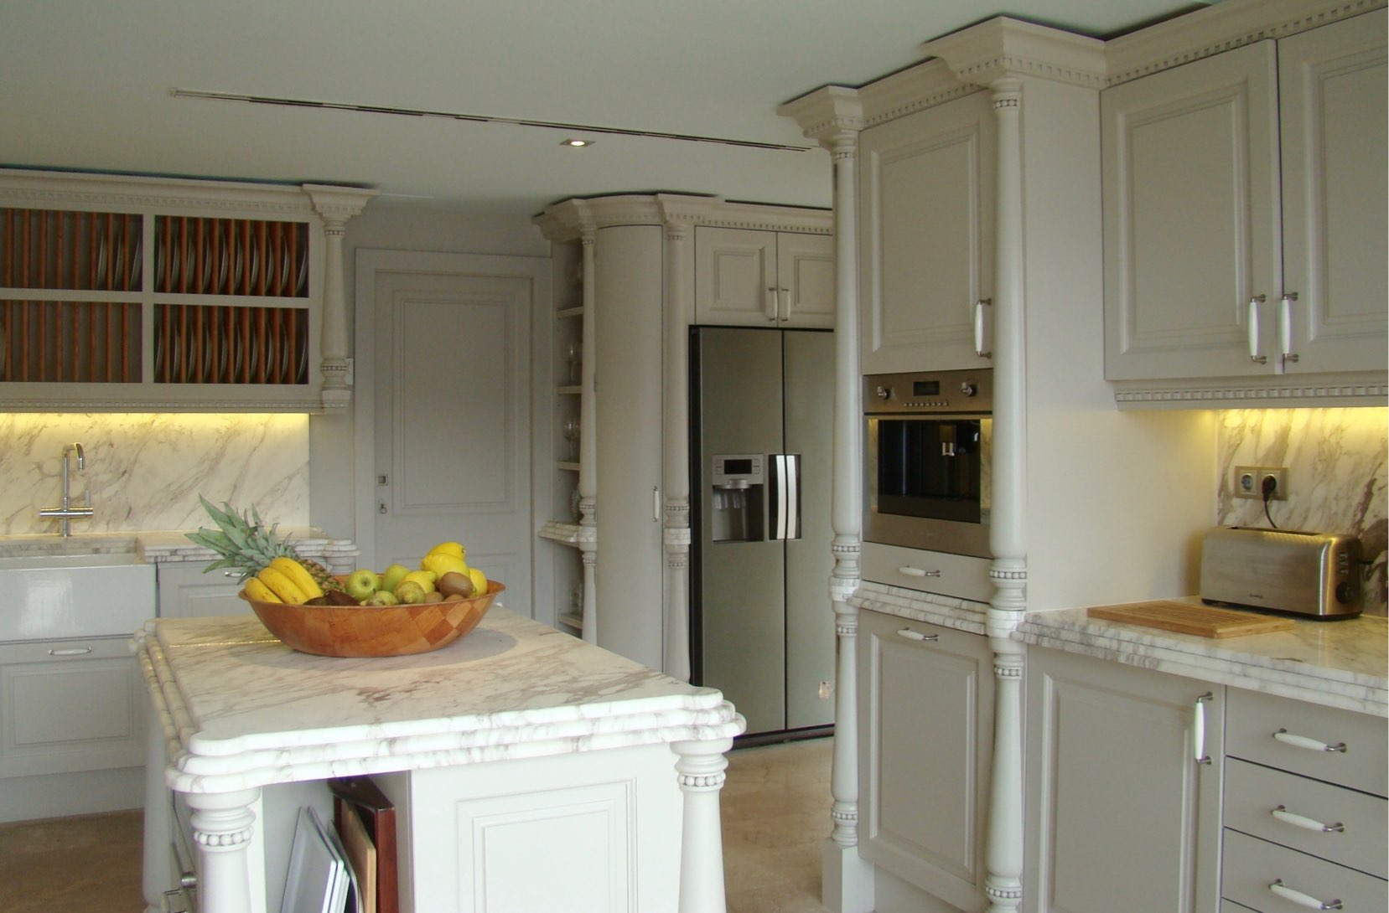
ajhd aidan james hurren design

Slide 44
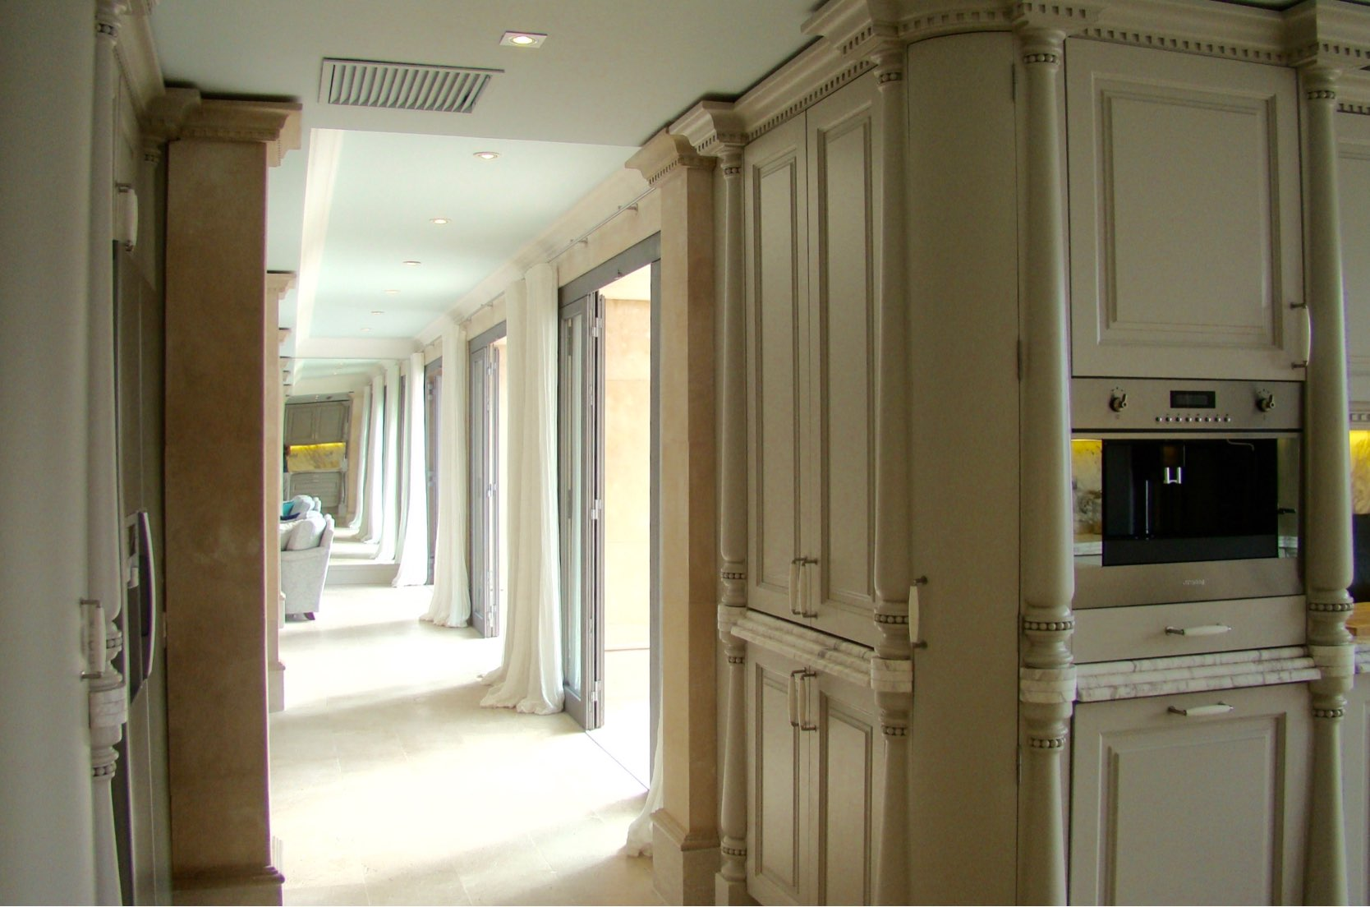
ajhd aidan james hurren design
Looking back from the Main Kitchen
towards the family room.
The mirrored wall at the far end extends the perspective and creates the illusion of a colonnade

Slide 45
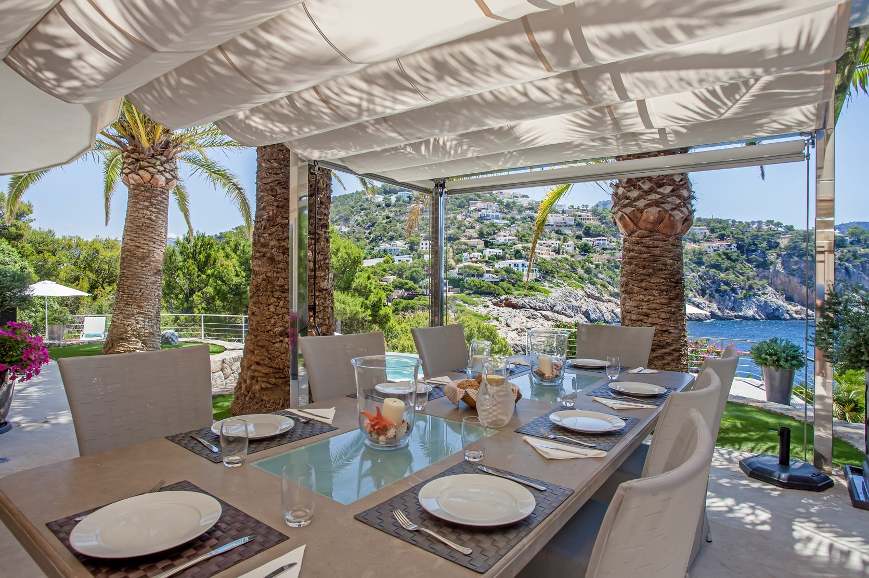
ajhd aidan james hurren design
the main outdoor dining area is outside the kitchen, under a canvas awning beneath the palm trees

Slide 46
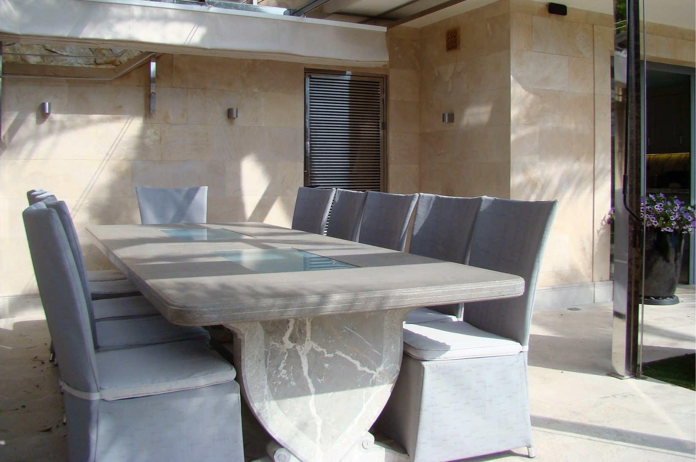
ajhd aidan james hurren design
The large (3m x 1m) bespoke solid stone dining table
has inset glass panels which are lit after dusk for a soft illumination from below

Slide 47
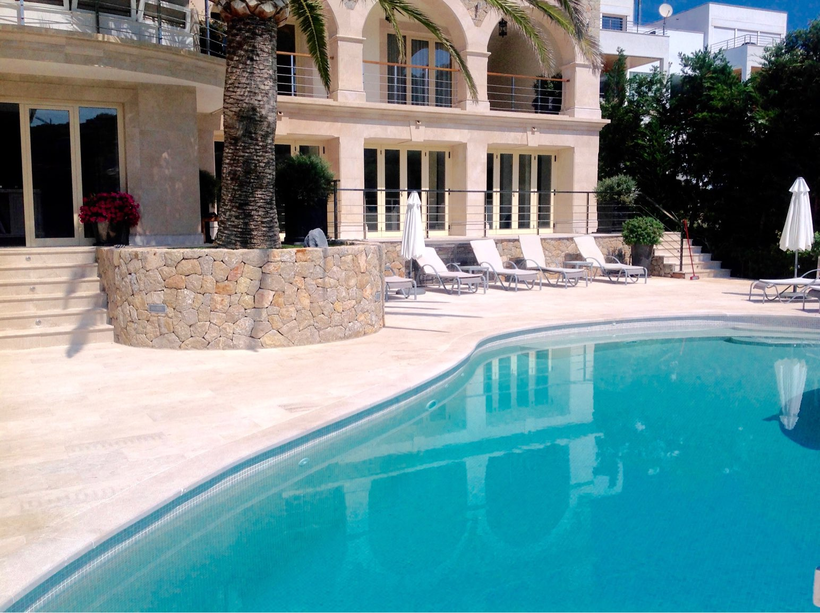
ajhd aidan james hurren design
The rear facade of the villa.
The lower floor was created from the former underground water tanks of the house

Slide 48
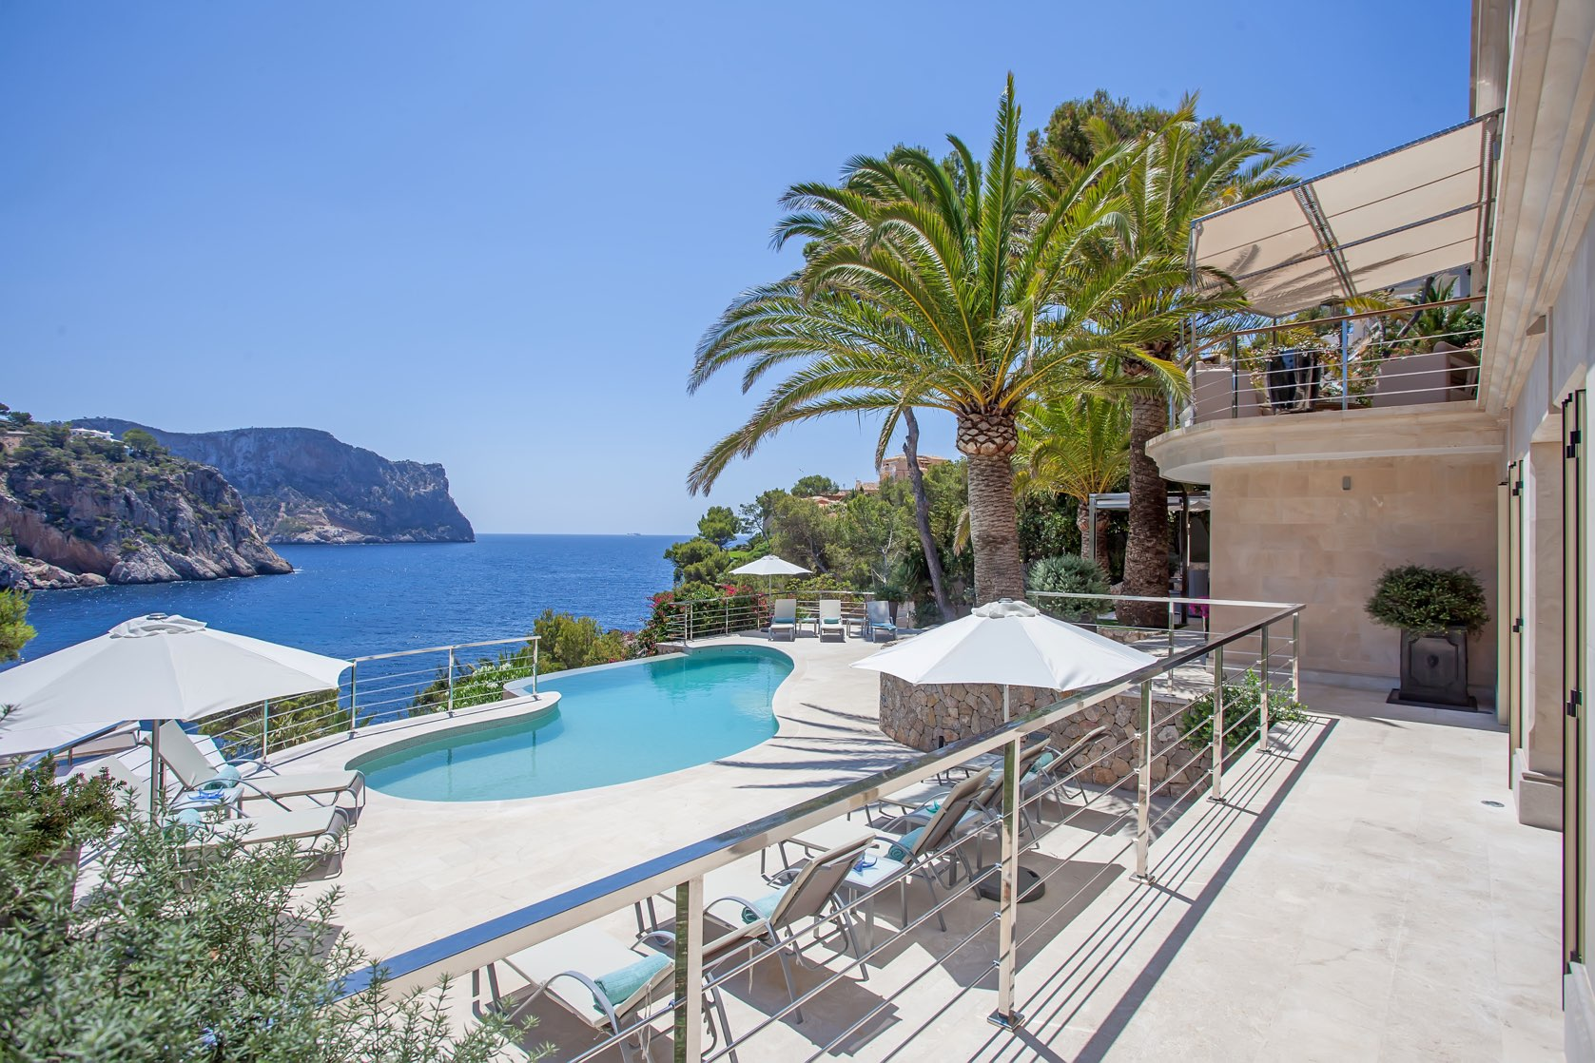
ajhd aidan james hurren design

Slide 49
ajhd aidan james hurren design
the Terrace around the Swimming Pool

Slide 50
ajhd aidan james hurren design
The Swimming Pool
was refinished with subtle sand-coloured mosaics,
to give the same colour to the water as in the sandy bay below.
A jet-stream contra-flow and jacuzzi jets were also added

Slide 51
ajhd aidan james hurren design
The View from the edge of
the Pool Terrace,
looking across the canopy of
the Jacuzzi Pavilion

Slide 52
ajhd aidan james hurren design
The Jacuzzi Pool, the Pavilion, and the Ducal Corwn table all make use of an octagonal form, repeated again in the design of the some of cushion fabrics

Slide 53
ajhd aidan james hurren design
The Jacuzzi Pavilion seating
with the Ducal Crown table

Slide 54
ajhd aidan james hurren design
Original design for the ‘Ducal Crown’ centre table

Slide 55
ajhd aidan james hurren design
the heavily-carved oak
‘Ducal Crown’ table,
with cast glass ‘jewel’ inserts

Slide 56
ajhd aidan james hurren design
1 the inlet & private mooring
2 sunbathing terraces
3 Boat house
4 mezzanine level, ideal for gymnasium
5 private entrances, with secure gates
6 main sun terrace, with barbecue
7 funicular station
8 funicular middle station
9 funicular upper station
1O garden archway
11 statuary on column
12 jacuzzi, pavilion, outdoor kitchenette
Lower Terraces, the Boathouse & Outer Terraces
Aidan’s Concept for the Landscape Design of the gardens, terraces and private mooring

Slide 57
ajhd aidan james hurren design
The
Garden Archway
Aidan’s Concept visual
for the proposed
Garden Archway

Slide 58
ajhd aidan james hurren design
New Entrance
from the
Outer Terrace
Aidan’s Concept visual for the proposed
New Entrance from the Outer Terraces

