Slide 1

AI
© 2019 Reece Pye
Notes:
Although many of us haven’t met before, I think we all have something in common, the recognition that AI is on the boardroom table of just about every major business in the developed world, automation and robotics (bots) are taking over more and more of the menial manual and technical roles and humans are being left to deal with more important roles, predominantly the critical roles of dealing with other human beings where AI will never be the ultimate answer in maximising opportunities through human relationship management, e.g. managers and employees, colleague to colleague, and employee to key customers in particular that will never be replaced well by machines.
With this in mind, I think we need to embrace our own form of AI, Attitude Intelligence… with help from The Neuroscience of Mind Hacking.

Slide 2
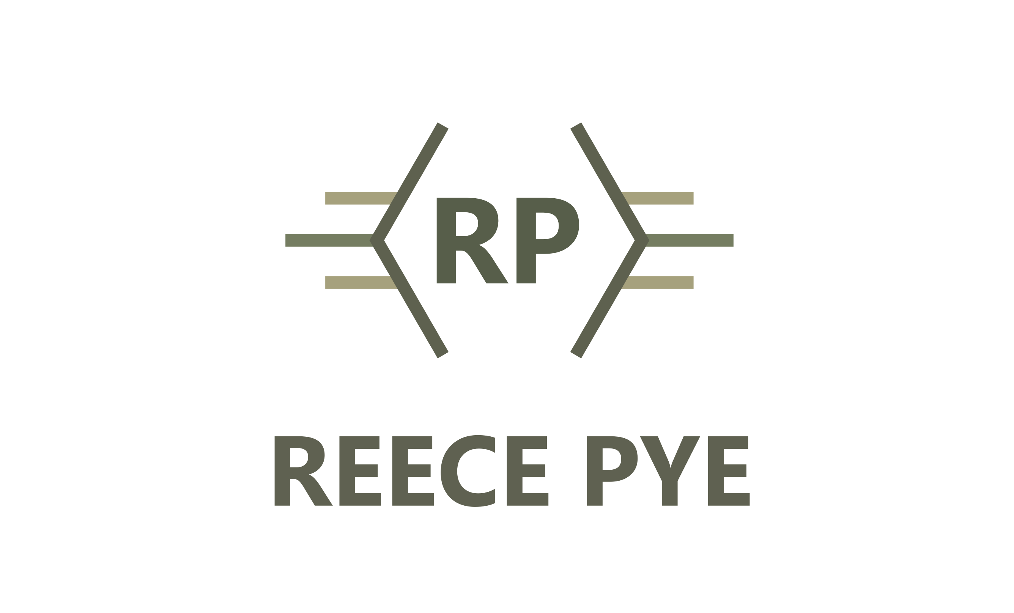
The Mind And The Brain Are Not The Same!
© 2019 Reece Pye
Notes:
The 1st MH I’d like to share with you is that The mind and the brain are not the same - Your mind and your brain are not the same!
By the end of this session, you’ll not only understand why I say this but how to use your mind to operate your brain far more effectively to reduce stress levels and open the mind to new ways to achieve success.

Slide 3
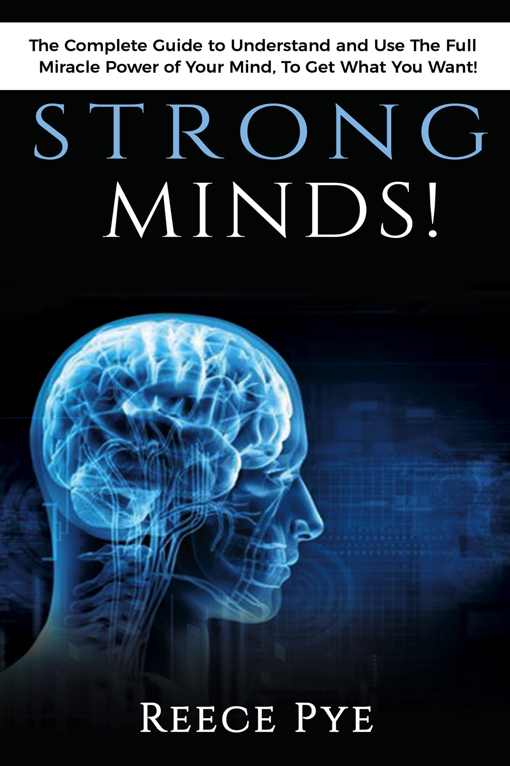
The Neuroscience (New Science) of Mind Hacking
Speaker: Reece Pye
Author of Strong Minds
Book & Online Courses
reecepye@reecepye.com
+44 (0) 7701 090245
© 2019 Reece Pye
Notes:
Let me introduce myself properly, I’m Reece Pye, Author of the Strong Minds book, of which I have a few to give away on 1st come 1st served basis at the end of the session and 2 interactive online programs, PLM 8 Module – 30 Lesson course and the rather unique Instant Mindshift Formula.
All my products and services are about one single thing – INFLUENCE, how to influence our own thinking, emotions and behaviours and how to influence those of others.

Slide 4
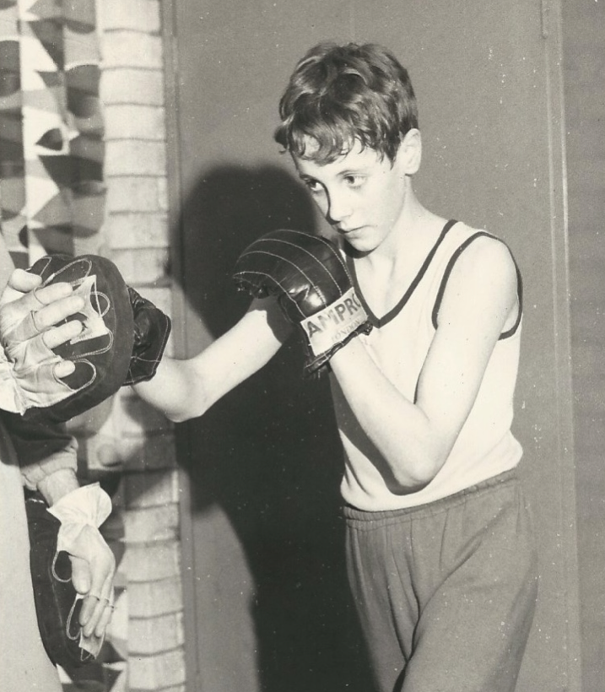
A Brief Background.
‘From’ There
‘To’ Here
© 2019 Reece Pye
Notes:
This was me aged 11 yrs, cute right :) at least cuter than I am now ;) but behind the cute look was an angry kid, shy, insecure, low self-esteem and no self-worth, but also with a fierce temper and short fuse.
Not surprising as my early childhood was one of physical and emotional abuse thanks to having an alcoholic father, who fortunately for us was often in prison, until he died in his early 40’s from a drink & drugs overdose, although not known if intentional.
So the reason I show this boxing picture is because this was a turning point where I learned valuable character building traits including patience, persistence, paying attention, self-discipline, work ethic and moral behavior from boxing coaches, god bless their souls, these were giving people and I’ll forever be grateful for the foundation they gave me to build on.
Fast forward to today and I’ve enjoyed a career with many more successes than failures, including closing a deal for the first ever AI solution of its kind in UK credit card fraud market (2001) and here I am now, speaking in front of a group of very highly paid IT professionals (hee hee) talking to you about a subject that has made all the difference to my success levels and my stress levels, and those I’ve taught it to!
Namely: Mind Hacking

Slide 5

The Mind And The Brain Are Not The Same!
The Brain is… Tangible!
The Mind is… Invisible!
The Brain is inner computer
The Mind is the operator
The brain is the most sophisticated piece of technology know to humans.
There is a way to manage the brain better to unlock potential, self-directed neuroplasticity or Mind Hacking!
© 2019 Reece Pye
Notes:
Let’s get into the presentation, why do I say the mind and the brain are not the same?
“Your brain is part of the physical, visible, tangible part of the body. It’s the organ (not a muscle) that weighs in at 1.33kg for men and 1.19kg for women or 2% of body weight, mentioned to wife and she said “yeah but we use all of their don’t they’ …. ha ha ☺
Your mind is part of the invisible, transcendent world of thought, feeling, attitude, belief and imagination. The mind is therefore closely associated with but not confined to the brain because the intelligence of your mind has the potential to affect every cell of your body and all bodily functions, including the nervous system and the heart.. Heart send more signals to brain but mind interprets
The brain is without doubt, the most sophisticated piece of technology known to humankind and we could be the most intelligent beings in the whole universe so how come some people still manage to act so dumb ha ha ☺
Now, thanks to the advances in brain scanning technology and subsequent findings around Neuroplasticity, I believe that Neuroscience & Neuropsychology are on the cusp of a Mind Hacking Revolution. One whereby many more normal human beings will be able to consciously and deliberately change the way they think for the better, neuroscientist call this Self-Directed Neuroplasticity – I call it MH!

Slide 6
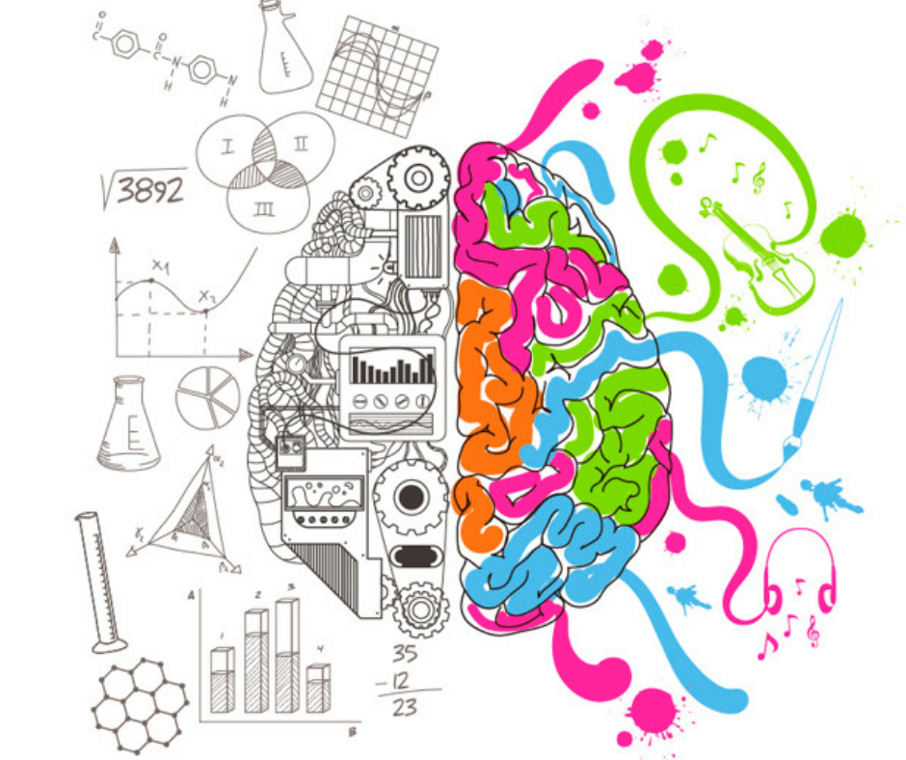
What Is Mind Hacking?
© 2019 Reece Pye
Notes:
Lets first say what it’s not, The term MH may sound a little sinister to some of you but it isn’t a technique, gimmick, mind trick, brain-washing or mental manipulation but a disciplined way of being, a method that makes you much more conscious (awake, alert and aware) of what’s going on in and around you so that you can manage your brain more creatively and effectively.
In the same way that computer hacking geniuses are being employed by major corporates and govt orgs to infiltrate systems to test vulnerabilities, find, fix or remove bugs, improve software and applications to ensure the system runs at optimum levels, we can do the same with our brain.
Understanding that the brain is our computer and our mind is the operator, we can begin to take more conscious control rather than allowing the brain to run our lives and careers in autopilot.
Mind hacking is the most modern and effective form of mindfulness I’ve come across and a key tool in developing MH is the use of Mind hacks (insights, stories, anecdotes or questions) to interrupt our current mode of thinking and open our minds to new ideas… let me give you a simple example using the following illustration

Slide 7
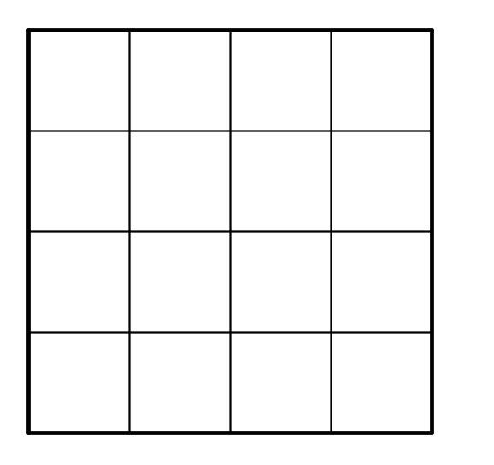
Do You Think Outside The Box?
Thinking Inside The Box May Surprise You!
© 2019 Reece Pye
Notes:
Show of hands – how many here think outside the box?
Thinks Outside The Box - Businesses, bosses, managers spend inordinate amounts of time…. Conditioned, programed, conventional ways that achieve conventional (average ) results
Explain 16-30 and IT Director of Global Hospitality Group example, i.e. said this turned his lights on and made him and his team refocus and build on strengths rather than diluting their power by looking externally for solutions (thinking outside the box all the time)

Slide 8
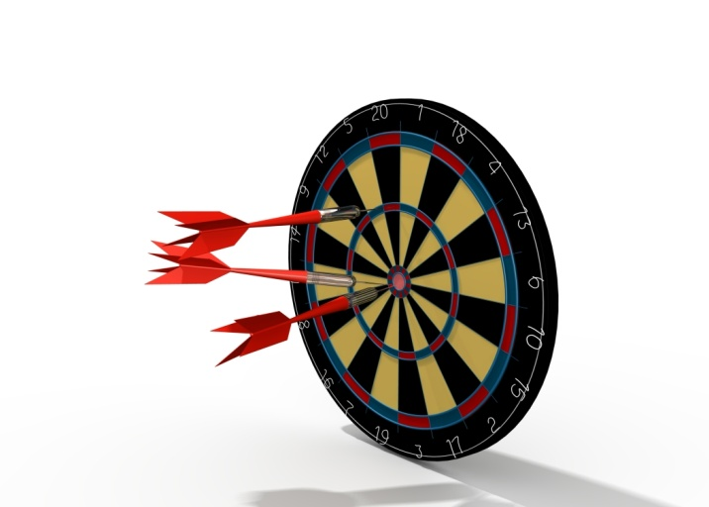
Slow Down To Speed Up & The Rule of 60!
TBM’s x 26 & FSE x 160
12% Adrift of £47m Revenue Target
Assumptions of SMT v Diagnostics
3 month management development program
Interactive - workshops, classroom, online, reading, coaching
9% Improvement = £4.2m impact!
Reduction in Stress – Increased Success!
Rule of 60 applied to Key Customers –
£10m V £11m Stretch Target
© 2019 Reece Pye
Notes:
Explanation of change program using 2 mind hacks compared to usual focus on Pareto’s 80-20 Rule

Slide 9
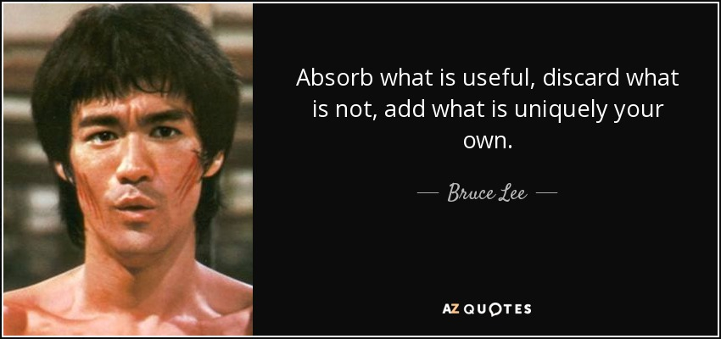
How To Think Differently – Four Core Ways!
Education (Neuroscience)
Pattern Interrupt (MH”s)
3. Repetition
4. Impact
© 2019 Reece Pye
Notes:
So if we want to change our thinking habits we have to recognise there are 4 Key Ways to re-program our brains…
RP preferred route – Boxing 19 yrs, 4 Finals, females and money in business - so studied Management greats, how and why of benefit re: stimulation. Crucially, educating yourself in the key areas of the brain responsible for your conditioning and how to reprogram your brain, will open your mind to how to realise more of your own potential and also that of your teams!!!
The right kind of education not only stimulates new ideas but also new ways of looking at existing ideas, e.g. Steve Jobs was famously quoted as saying “We’ve always been shameless about stealing great ideas” and adapting them to become something more brilliant and useful and Bruce Lee summed it up well in his approach to mastering martial arts!
Use education to stimulate PI & MH and then repeat to re-program. Any manager not investing in themselves will never realise their potential or that of their teams or in fact, business!!!

Slide 10
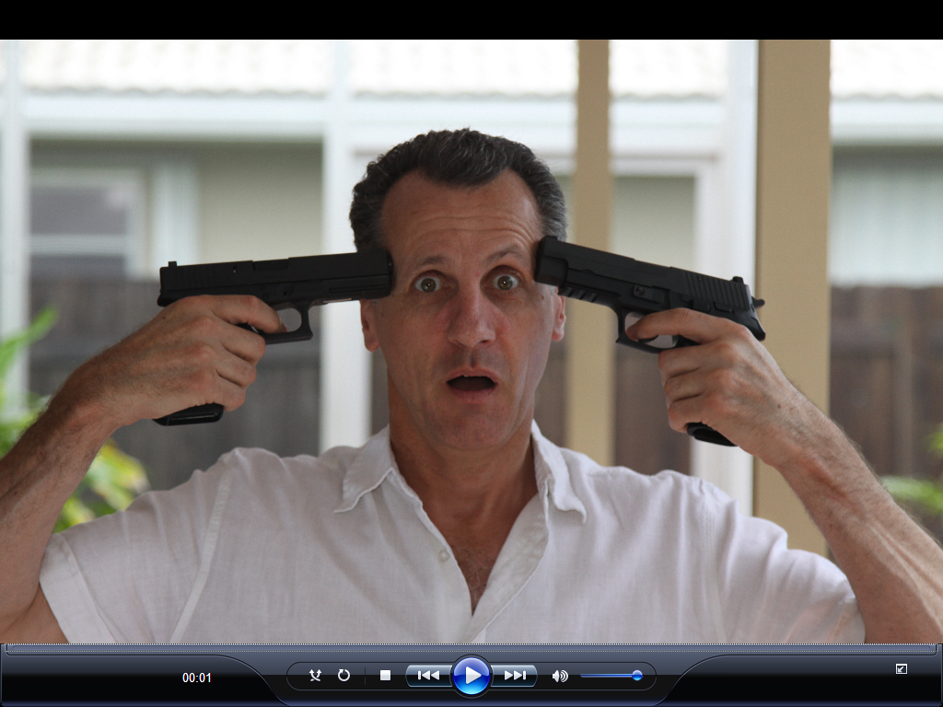
One Of The Biggest Obstacles In Our Way?
10
© 2019 Reece Pye
Notes:
10

Slide 11

Emotions Get In Our Way – The Raging River!
11
© 2019 Reece Pye
Notes:
Although we’ve covered some MH examples to improve results and diffuse stress, there will be times when we get in our own way, or more accurately we get hijacked by our emotions, i.e. when we’re not fully conscious or mindful (awake, aware alert) … Emotions can be likened a Raging River… standing on rocks at top and fall in, bang head, go under, gasp for breath, suffocating!
But it doesn't’t have to be this way, you can step outside the raging river and look in, it’s called meta-thinking or meta-cognition.
And this is how the the special From-To formula came about, it offers a coping mechanism (Cognitive Behavioural Intervention) that enables you to stand back and observe your emotions and state of mind versus being in the raging river.
11

Slide 12
‘From – To’ Impact!
"I went from a mixed up state, full of self-doubt after all the knock-backs to one of clarity, belief and optimism, all thanks to Reece’s special ‘FROM-TO’ method and not long after using it, I closed a Multi-Year 6 figure contract, the single biggest contract win of my entire life. Had I known in advance the difference it would make to my mindset, my negotiations and subsequently the client win, I would willingly have paid thousands for it”. SP, Palm Beech, Florida
© 2019 Reece Pye

Slide 13
FROM-TO Mind Hack for Instant Mindshift
Take a sheet of paper, journal or create a word doc or PowerPoint slide.
On the left hand side write FROM at the top and on the right hand side, write TO at the top.
Then write the negative emotions in the left column and counter these with the opposite, desired emotions in the right column.
Whenever you feel one or a combination of the emotions in the left hand column, refer to the FROM-TO sheet, read, recognise and accept the emotion on the left but then read the counter-emotion in the right hand column so you focus on the desired emotional habit or outcome you want to create.
Add power to this by closing your eyes for a few seconds to picture in your mind through conscious imagination, a situation where you’re applying and behaving in the desired way based on the right hand emotion.
Notes:
A major resistance to changing our emotions and improving our states of mind is that we try to do this in our head.
A word of warning… At first glance, this formula may look so simple that you dismiss it but don’t because it works wonders when you use it, if you need it of course… S Jobs and simplicity versus any idiot statement re: genius is in simplicity as any fool can make things complicated
Run through what to do and mention the full formula and mini-course with lots more templates available on my website.
I could cover a whole new session on the use of ‘conscious creative imagination’ but we don’t have time, refer to book and course!

Slide 14
FROM ‘OLD’ TO ‘NEW’
Hesitancy & Doubt | Conviction & Belief
Inertia | Action
Fear | Courage & Confidence
Easily Distracted | Focused & Disciplined
Restless & On Edge | Calm & Relaxed
Lethargic | Motivated & Active
Unfulfilled | Fulfilled
Discontent | Happy
Tomorrow | Today
Going Nowhere / Being No-One | Going Places / Being Special
© 2019 Reece Pye
Notes:
Example tamplate

Slide 15
‘From – To’ Impact!
“I've been trapped in my own nonsense lately and need this physical aspect to bring me back to who I really am! Sincerest gratitude to you!” CJ, Texas, USA
“Reece Pye, love, love, love this! So simple and yet so effective. Have my FROM-TO message set as my lock screen message on my phone” KC, Southampton, UK
“It’s quite a complex situation and one where I am struggling to understand how I should be feeling and what is most positive for me long term… have had to revert to the ‘From – To’ pages quite a bit I will be honest. It’s proving a huge help day to day!” DC, Glasgow, Scotland
© 2019 Reece Pye
Notes:
Example: DC day to day help with focus, Use of smartphone as reference and subliminal penetration, take in unconsciously, powerful! Repetition, re-program neural networks and focus attention on +’s and not –’s.

Slide 16

Use Technology – 110 Mind Hack!
© 2019 Reece Pye
Notes:
110 x per day is average number of times we unlock our mobiles – use tech to help you and not rule your life with distractions that draw your attention away from what’s productive for you or drains your mental energy!!!

Slide 17
In Summary – The 3 Key Takeaways
Understand the difference between the mind and the brain for better personal & professional influence.
Methods for diffusing your own stress and helping your team or colleagues do the same.
Learn a simple Mind Hack to transform negative thoughts or emotions into positive ones.
© 2019 Reece Pye
Notes:
I promised organisers to give you 3 key takeaways and I hope I’ve lived up to my promise… but this is just the tip of an iceberg, taken me thousands of hours and investment over many years to create the PLM condensed course so you don’t need the same time and investment... that said, next slide “what happens next?’

Slide 18

So What Happens Now?
I need to THANK YOU!
Questions or More Info: Speak, Email, Call or Connect.
PLM Course – Open Access FOC to Enrol until midnight tomorrow. (Click on the BANNER at the top of each page on my website)
Get in touch about ‘White Label – Bespoke Pricing’ on PLM course, including facilitating change if required.
Use my website www.reecepye.com for contact details, plus free resources, blogs, mind hacks, to purchase the Strong Minds book or enrol in either course.
Slide presentation, leave your business card or email .
Half a Dozen Strong Minds Books FOC.
© 2019 Reece Pye
Notes:
Almost finally… All stand and put hands together - Standing Ovation ☺

Slide 19

Thank You All For Your Attention & Interest!
© 2011 British Telecommunications plc

