Slide 1
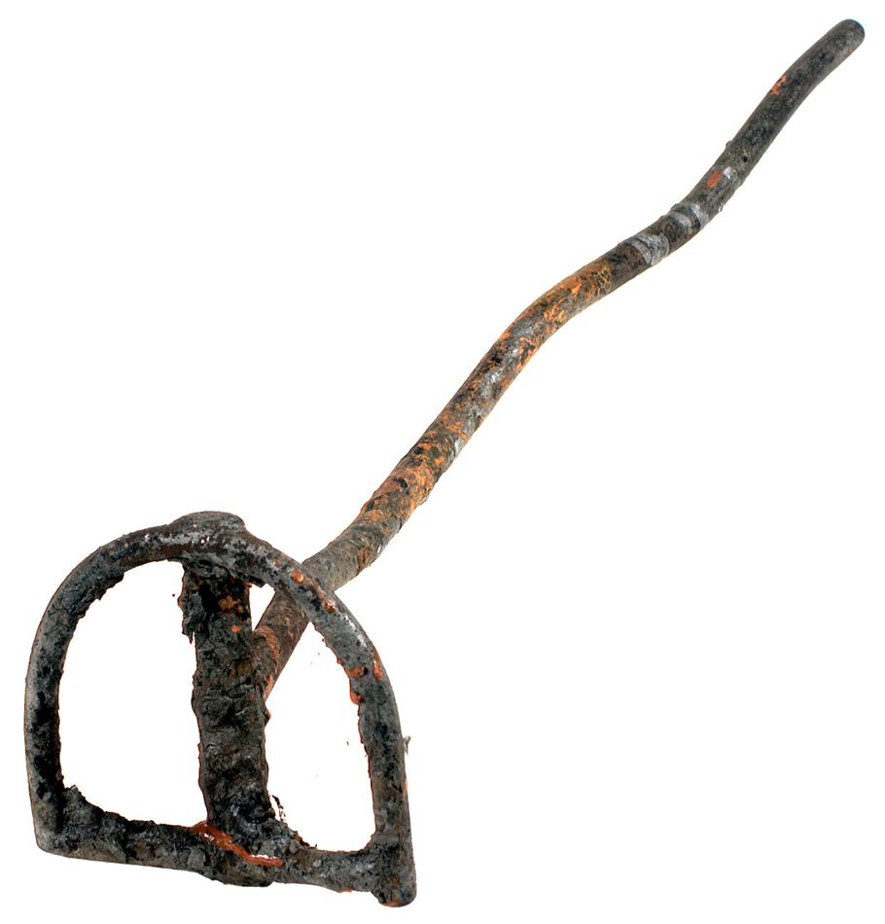
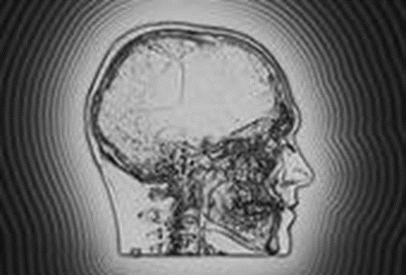
The Branded-Mind
Mount Carmel Missionary Baptist Church
Bible Study
Pastor Leroy Hines Anthony, M.Div.
April 13, 2022

Slide 2
1 TIMOTHY 4:1-2
Now the Spirit speaketh expressly, that in the latter times some shall depart from the faith, giving heed to seducing spirits, and doctrines of devils;
² Speaking lies in hypocrisy; having their conscience seared with a hot iron;

Slide 3
The Conscience
The "conscience" is a person's painful reaction to a past act which does not meet the standard.

Slide 4
Two Conclusions of mind:
Condemnation
Conviction
To express strong disapproval
A judgement of guilt
Continuous Condemnation leads to REJECTION.
Continuous Conviction leads to CORRECTION.
The absence of Conviction (guilt-feeling),leads to Total Rejection
Condemnation is controlled by YOU!
LET'S READ: Romans 8:1-2

Slide 5
Steps to a “seared” conscience
Receiving Spiritual Lies- (1 Timothy 4:2)
Speaking out of an evil heart- (Matthew 15:18-20)
Sexual Interference (Genesis 34:2,5)
Illicit Sex &Lustful Desires (Ezekiel 23:17)
Abominations to God (Jeremiah 32:34)

Slide 6
Steps to a “seared” conscience
6. Unforgiven Sin that leads to bitterness- (Hebrews 12:15)
7. Ungodly words, attitudes, and actions- (2 Peter 2:7-8)
Lack of the Knowledge of Truth (1 Corinthians 8:7)
Acknowledging and Worshipping Idols-(Ezekiel 23:30)

