Slide 1
Foundational scripture &
Lesson Objective
FOUNDATIONAL SCRIPTURE
HEBREWS 11:6
But without faith it is impossible to please him: for he that cometh to God must believe that he is, and that he is a rewarder of them that diligently seek him.
CONFESSION STATEMENT
WE CONFESS THAT IT IS OUR DESIRE TO GAIN A GREATER UNDERSTANDING OF THE SUBJECT MATTER OF FAITH, THAT WE MAY BECOME MORE ADEPT AT LIVING BY FAITH, SO THAT WE MIGHT BE MORE PLEASING TO GOD IN EVERY ENDEAVOR.

Slide 2
Exploring What Faith Means
1. Faith is believing what is impossible to believe.
2. Faith is deliberate confidence in the character of God whose ways you may not understand at the time.
3. Faith is trust without reservation.
4. Faith declares what the senses cannot speak, sees what the eyes cannot see, hears what no one else can hear, and leans on what seems so foolish. Faith just believes God!

Slide 3
Exploring What Faith Means
5. Remember, faith itself cannot accomplish anything… only GOD does! Faith is simply trusting that GOD will accomplish what He has already promised!
6. Faith means not worrying
7. God isn't looking for people of great faith, but for individuals ready to follow Him
8. Sometimes God doesn't tell us His plan because we wouldn't believe it anyway.

Slide 4
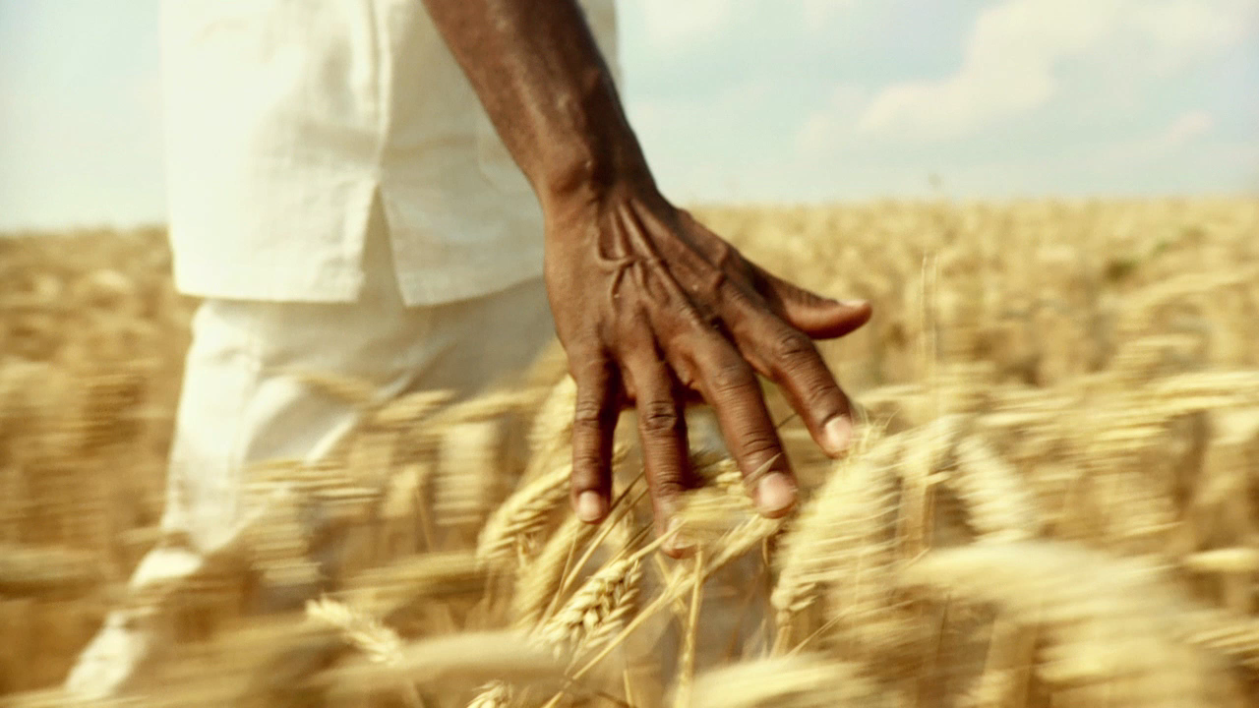
The Depth’s of Faith
Pastor L. H. Anthony, M. Div.
Mount Carmel Missionary Baptist Church
Bible Study 1/26/2022

Slide 5
ROMANS 1:17
¹⁷ For therein is the righteousness of God revealed from faith to faith: as it is written, The just shall live by faith.

Slide 6
The “BY FAITH” Factor
When reading the words “BY FAITH”, in scripture one should translate these words to mean “By Confident Obedience to God’s Word, despite circumstances or consequences; and as evidence of things not before or ever seen, but expected of the willingness and capabilities of God!

Slide 7
Hebrews 11:4
By faith Abel offered unto God a more excellent sacrifice than Cain, by which he obtained witness that he was righteous, God testifying of his gifts: and by it he being dead yet speaketh.
Notes:
We do not know the details of Abel faith. o We do not just how much had been revealed to Abel about how he was to worship. ▪ But his father Adam had walked with God. ▪ We do know that his faith caused him to worship God. ▪ This verse tells us, “Abel offered to God a more excellent sacrifice.” ▪ He chose the choicest lamb as an offering and he brought it to the place of sacrifice. o I am no one’s final judge, but I find it extremely hard to believe that a person whose faith never compels them to come into the Lord’s house to worship is truly saved. o True faith looks for an opportunity to worship!

Slide 8
Hebrews 11:5
By faith Enoch was translated that he should not see death; and was not found, because God had translated him: for before his translation he had this testimony, that he pleased God.
Notes:
Enoch is a fascinating biblical character.
▪ Enoch lived in one of the darkest period of the history of the world. ▪ Enoch lived just before God had to destroy the earth because of man’s evil, yet Enoch managed to keep himself pure. ▪ Enoch walked with God. o Yet the Genesis record indicates that this was not always the case in Enoch’s life (Gen 5:21-24). o For the first 65 years of his life, Enoch did not walk with God. ▪ Presumably he was a man of his times.
▪ But from the birth of his son, Methuselah, throughout the remaining 300 years of his life he “walked with God.” ▪ The Hebrew form of the verb means he walked closely and continually with God.
o The walk that Enoch experienced was one of deepening intimacy with God. ▪ He lived every day in the presence of the Lord and in constant communion with Him. ▪ His faith and his obedience, as well as his worship, were outstanding. o The hallmark of Enoch’s life was that “he pleased God.” o What a wonderful description of a believer’s life. ▪ Can that be said of your life? ▪ Is God pleased with how you use your time? ▪ Is God pleased with what you read? ▪ Is God pleased with the words you speak? ▪ Is God pleased with your plans for the future? ▪ Have you even bothered to consult God with your plans? o Enoch walk of faith delivered him from the consequence of death. ▪ Will yours? o This verse does not say that faith is simply one way to please God: it is the only way.

Slide 9
Hebrews 11:6
But without faith it is impossible to please him: for he that cometh to God must believe that he is, and that he is a rewarder of them that diligently seek him.
Notes:
This verse does not say that faith is simply one way to please God: it is the only way.

Slide 10
Hebrews 11:7
By faith Noah, being warned of God of things not seen as yet, moved with fear, prepared an ark to the saving of his house; by the which he condemned the world, and became heir of the righteousness which is by faith.
Notes:
By faith Noah, being warned of God of things not seen as yet, moved with fear, prepared an ark to the saving of his house; by the which he condemned the world, and became heir of the righteousness which is by faith. Noah employed “SAVING FAITH”.

Slide 11
EMPLOYING SAVING FAITH PROVIDES A BENCHMARK WHEN FAITH ADJUSTMENTS ARE NEEDED
Saving Faith should be employed when “NO FAITH” prevails.
(Mark 4:40)
Saving Faith should be employed when “LITTLE FAITH” prevails (Matthew 8:26)
Saving Faith should be employed to stabilize “WAIVERING FAITH” (Hebrews 10:23)
Saving Faith should be employed to regulate “STAGGERING FAITH” (Romans 4:20)
Saving Faith should be employed to stimulate “HINDERED FAITH”
(1 Timothy 1:5)
SAVING FAITH LEADS TO STRONG FAITH: (Matthew 8:10)

Slide 12

FAITH PROGRESSIONS
Steps to Walk Walk to Work Work to Worship
WORSHIP IS THE LIIFESTYLE OF THE FAITH-FILLED (Faithful) TO GOD
FAITH TO WORSHIP
SAVING FAITH
SAVING FAITH
FAITH WALK & FAITH WORK
SAVING FAITH
FAITH TO WALK
SAVING FAITH
SAVING FAITH
SAVING FAITH

