Slide 1
Maintaining The Joy of The Lord
The Ultimate Position of The Unoffended.
Notes:
In our lesson last week,
We identified “Forgiveness and Repentance” as the “Self-engaging” practices that we as believers must employ at moments, or during occurrences that offer us the opportunity to “take offense”.
Engaging these will help us both recovery from an “offense-taken” disposition,
But when employed helps us to remain in “right-standing with God”.
We ended are session last week considering what I call today “THE ULTIMATE POSITION OF THE UNOFFENDED”.
THAT IS “IN THE JOY OF THE LORD”.

Slide 2
Establish a Lifestyle of peace, based on the Joy of The Lord (James 1:2)
My brethren, count it all joy when ye fall into divers temptations;
Notes:
I said to us that it was essential that we “ESTABLISH A LIFESTYLE OF PEACE, and that it should be based on The Joy of The Lord.
James 1:2 states that we are to “count” is all Joy.
The word “count” means to “evaluate”,
To consider for greater understanding or purpose.
Therefore, avoiding the pity party of offense, for the greater objective of purpose.
We need to “Process Situations”

Slide 3
WHAT IS THE JOY OF THE LORD?

Slide 4
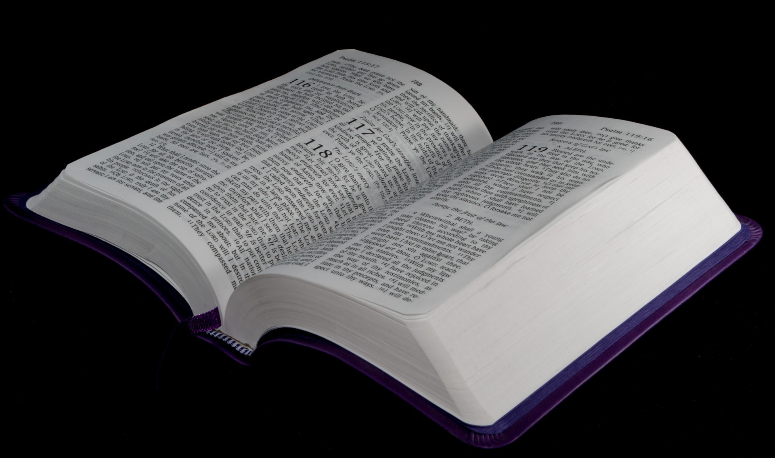
THE JOY OF THE LORD IS THE BY-PRODUCT OF ABIDING IN THE LORD
TURN IN YOUR BIBLE TO JOHN 15:1-11

Slide 5
THE JOY OF THE LORD IS OUR STRENGTH
TURN IN YOUR BIBLE TO:
Nehemiah 8:1-10

Slide 6
THE JOY OF THE LORD SUSTAINS US JUST AS IT DID JESUS CHRIST
TURN IN YOUR BIBLE TO HEBREWS 12:1-2

Slide 7
THE JOY OF THE LORD IS THE BEDROCK OF OUR BELIEF.
TURN IN YOUR BIBLE TO ROMANS 15:1-13

Slide 8
WHAT THOSE WHO HAVE THE JOY OF THE LORD BELIEVE.
A. Isaiah 54:17 “No weapon formed against me shall prosper”
B. Romans 12:17-19 God will recompense the transgression.
C. Psalm 138:8 The Lord will perfect all that concerns me.
D. Psalm 23:5 That God will vindicate me by his visible manifested goodness.

