Slide 1
Presentation By Mr. Y. Srinivas +91 98490 39200 ecomixsoftware@ecomixonline.com www.ecomixonline.com
ECO-MIX
( LEAST COST FEED FORMULATION SOFTWARE ) for any kind of LIVESTOCK FEEDS

Slide 2
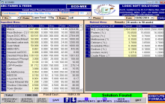
ECO-MIX
LEAST COST FEED FORMULATION SOFTWARE DETAILS
It is my pleasure to share some of my views on Least cost rations:
As you are well aware, the cost of feed represents more than 70-75 % of total
Poultry, Dairy, Aqua, Swine, Sheep, Goat and any kind of Livestock production.
The quality and cost of the feed are the main pivotal things, which determine
the profit margin of livestock farming. So any attempt to minimize the cost of
the feed, while balancing the nutrients to the optimum levels will certainly increase
the profit margins.
Using this software, feed formulas can be prepared for various kinds of Livestock like Pre-Broiler Starter, Broiler Starter, Broiler Finisher, Layer Chick, Grower, Layer diets, Cattle, Aqua, Swine, Sheep and Goat feed etc.,

Slide 3
ECO-MIX
LEAST COST FEED FORMULATION SOFTWARE DETAILS
This Software is compatible to include and modify any number of Ingredients
and Nutrient values and it is very much user friendly. This software also display the available substitute feed Ingredients.
Already we have provided our software to some of the Poultry Farmers, Feed Manufacturer (Poultry, Cattle, Aqua , Swine, Sheep, Goat & Livestock), Hatcheries, Consultants, Doctors, Pharmaceutical Companies throughout India who are enjoying the fruits of this software.

Slide 4
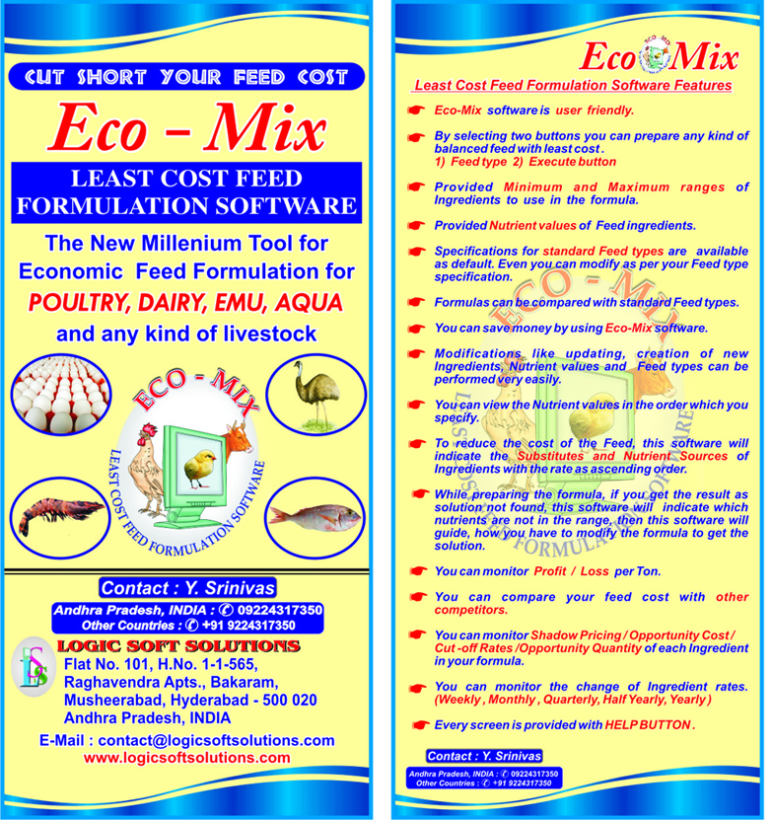
English & Hindi Brochures

Slide 5
ECO-MIX FEATURES
Eco-Mix software is user friendly and provided Help Manual
By selecting two buttons you can prepare any kind of balanced feed
with least cost.
a) Feed type b) Execute button
Provided Nutrient Values and minimum and maximum ranges of Ingredients to use in formula
Specifications for Standard Feed types are available as default. Even you
can modify as per your feed type specification.
You can save money by using Eco-Mix Software

Slide 6
ECO-MIX FEATURES
You can ADD / Copy / Modify / Delete any items & Get Customised Balanced Formulations & Reports as per your exact requirements for any kind of Livestock Feeds
To reduce the cost of the feed, this software will indicate the Substitutes and Nutrient Sources of Ingredients with the rate as ascending order.
You can monitor Shadow Pricing / Opportunity Cost / Cut-off price / Future Costing / Shadow Quantity of each Ingredient in the formula
You can monitor other Competitor feed Cost/bag in the Market with Profit / Loss per Ton

Slide 7
Create New Formula

Slide 8
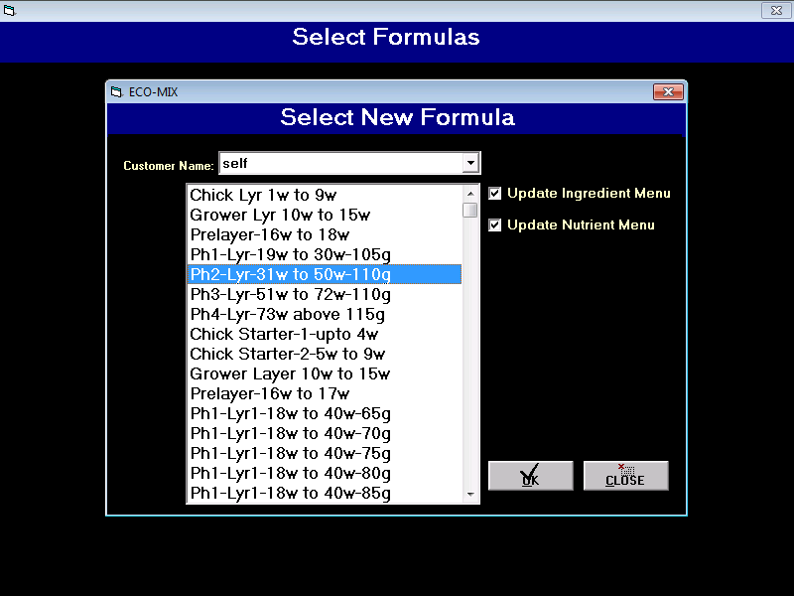
Select New Formula

Slide 9
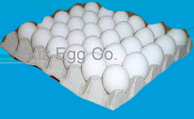
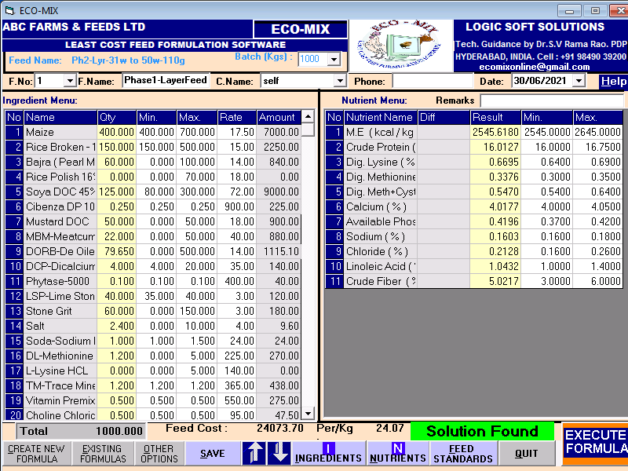
Layer Feed Formula

Slide 10
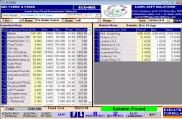
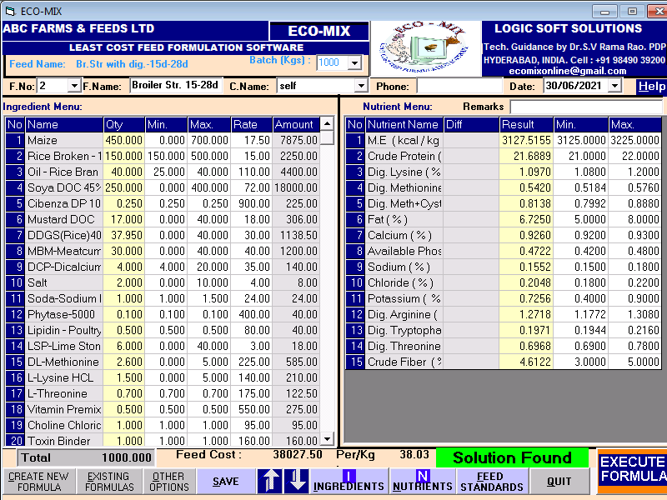
Broiler Feed Formula

Slide 11
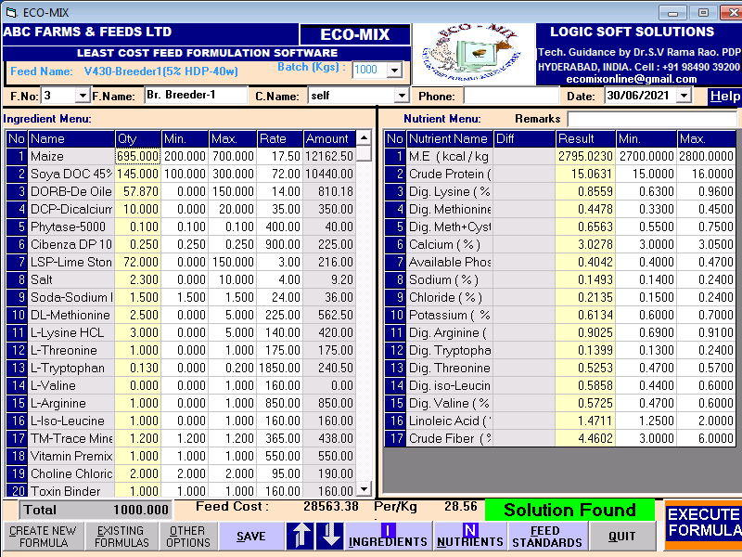
Br. Breeder Feed Formula

Slide 12
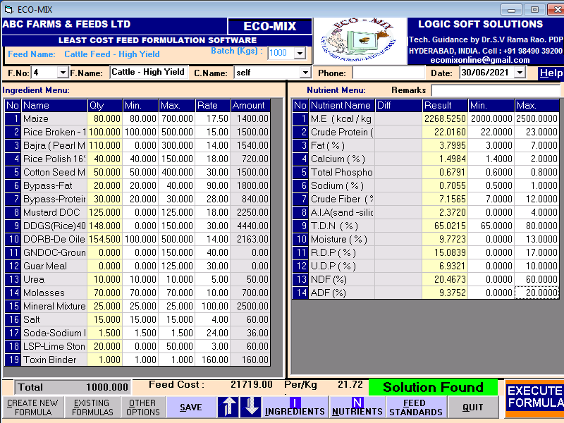
Cattle Feed Formula

Slide 13
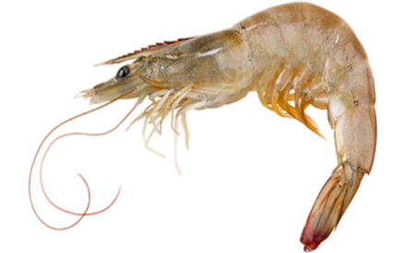
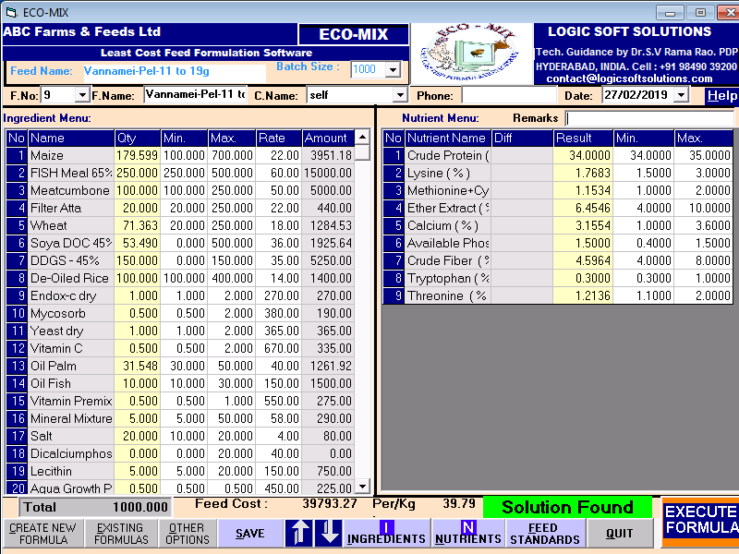
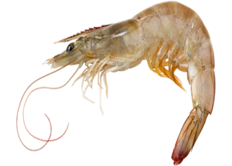
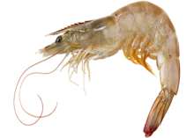
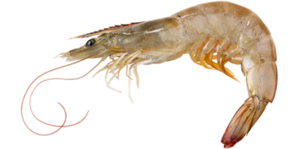
Vannamei Pel. 11g-19g Feed Formula

Slide 14
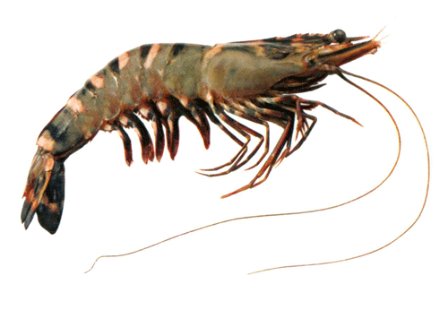
Tiger Shr-Pe 11g-19g Feed Formula

Slide 15
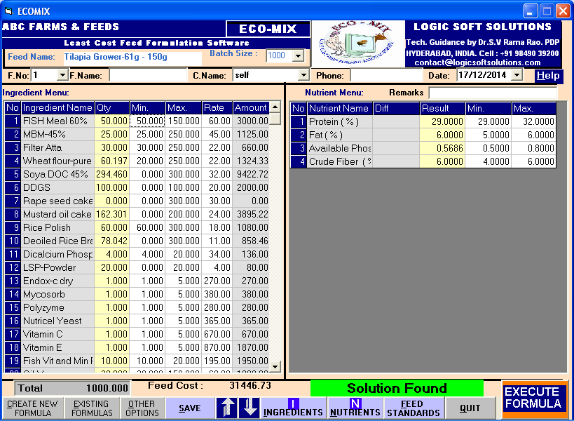
Tilapia Grower 61g to 150g Feed Formula

Slide 16
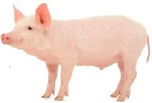
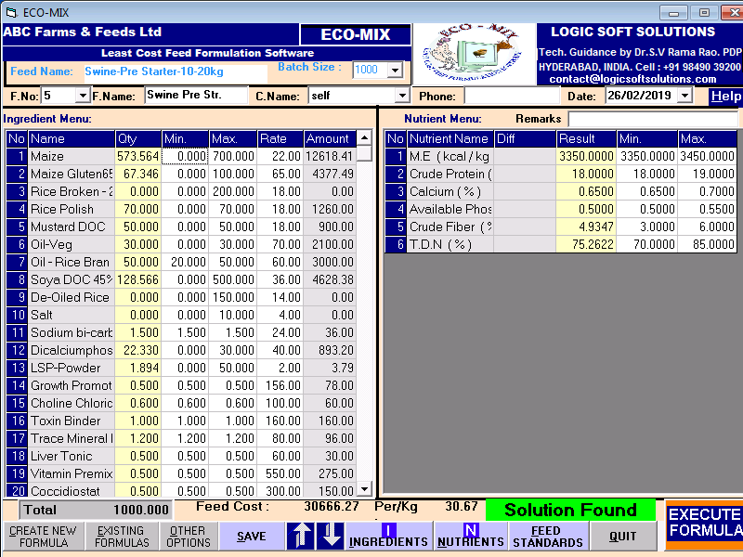
Swine Feed Formula

Slide 17
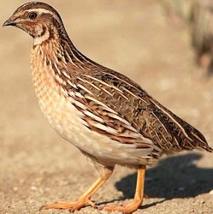
Quail Strtr. Feed Formula

Slide 18
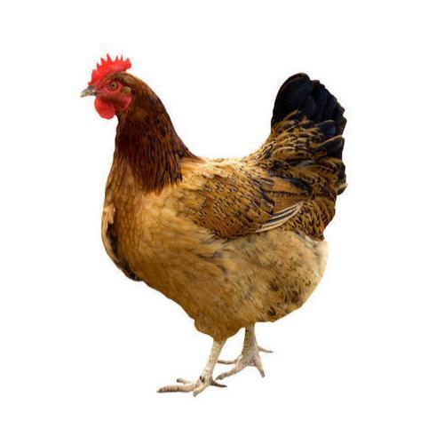
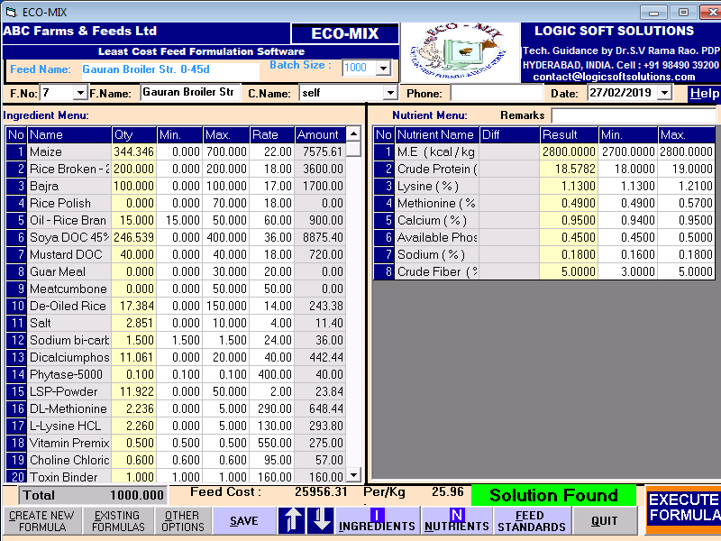
Gauran Broiler Feed Formula

Slide 19
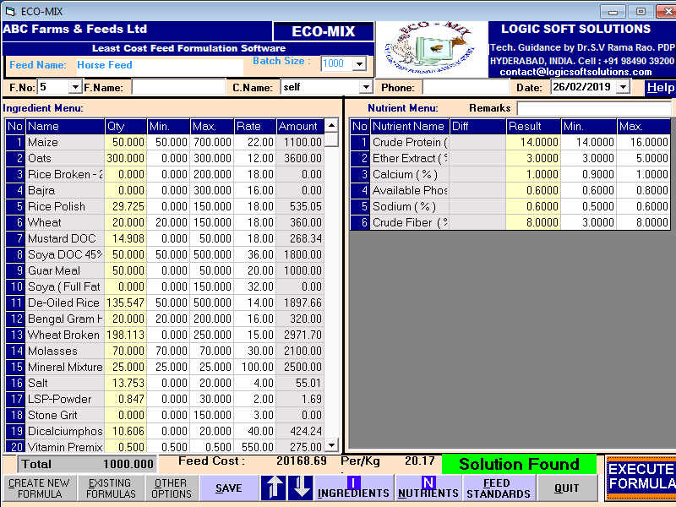
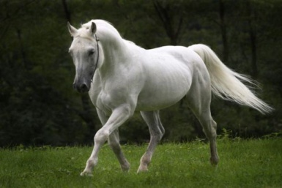
Horse Feed Formula

Slide 20
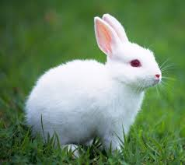
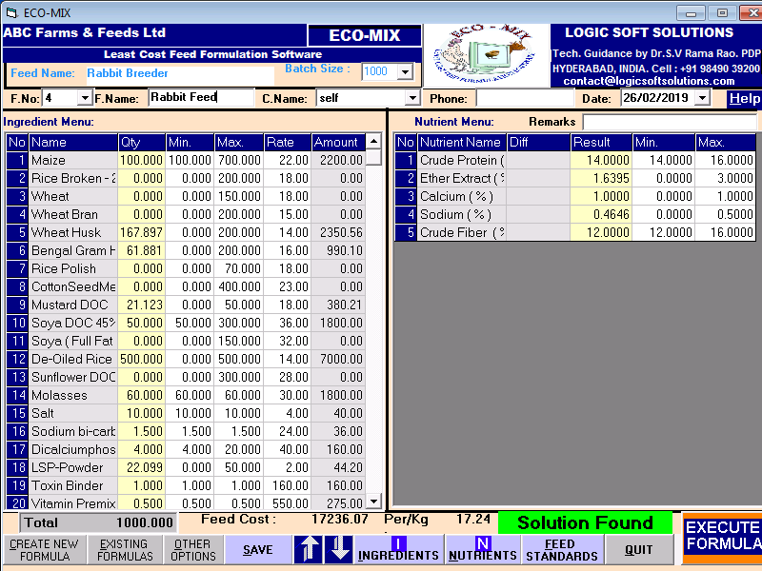
Rabbit Feed Formula

Slide 21
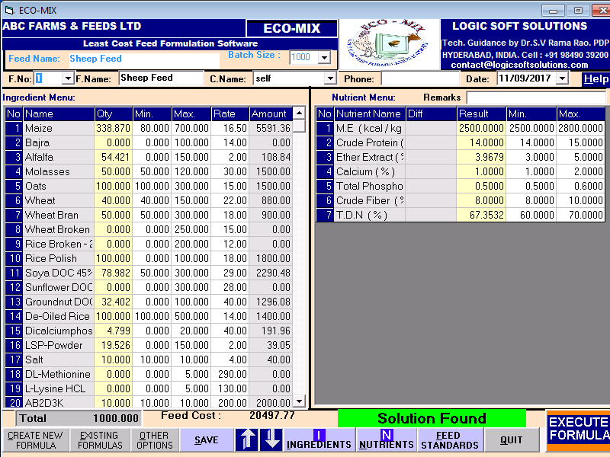
Sheep Feed Formula

Slide 22
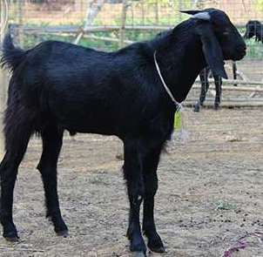
Goat Feed Formula

Slide 23
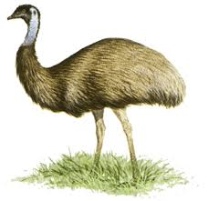
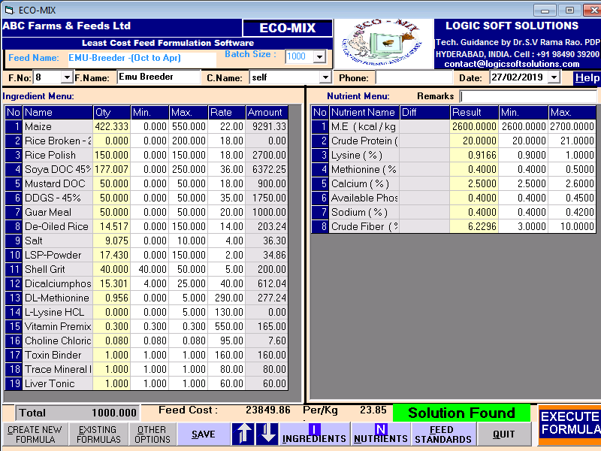
Emu Breeder Feed Formula

Slide 24
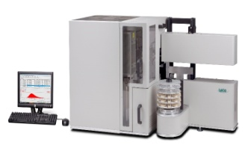
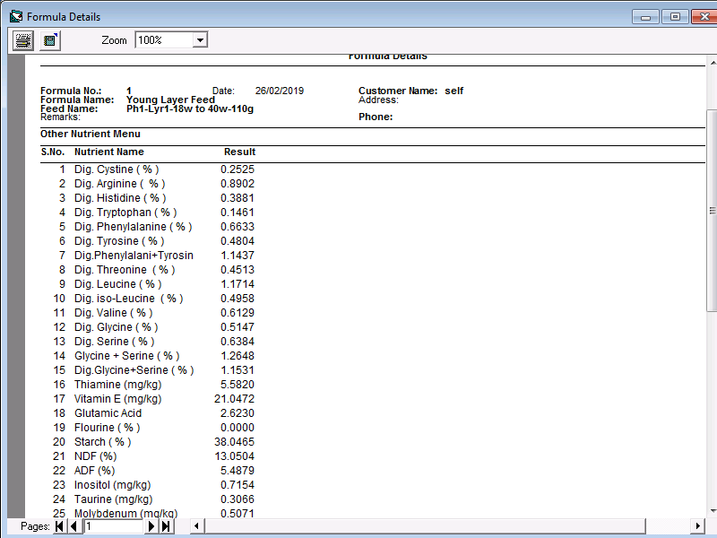
Other Nutrient Results in the Layer Feed Formula

Slide 25
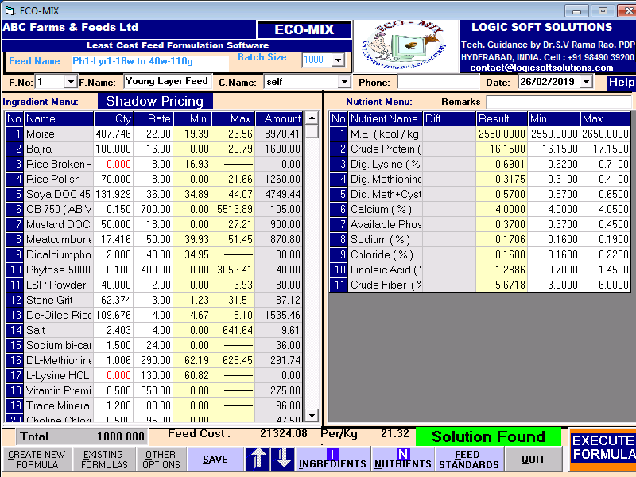
Cut-off / Future price of Ingredients in the formula

Slide 26
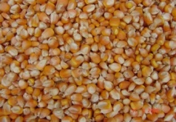
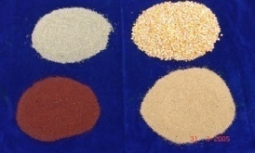
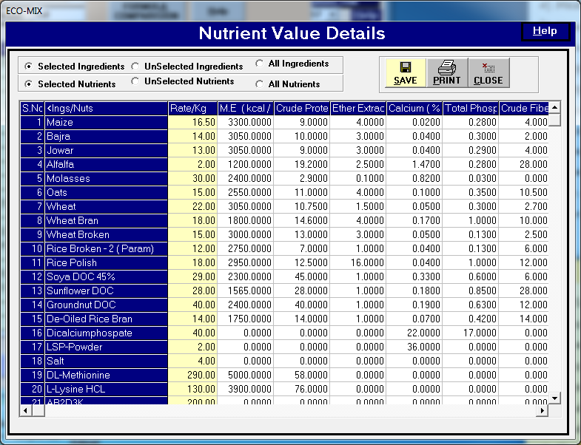
Nutrient Value Details

Slide 27
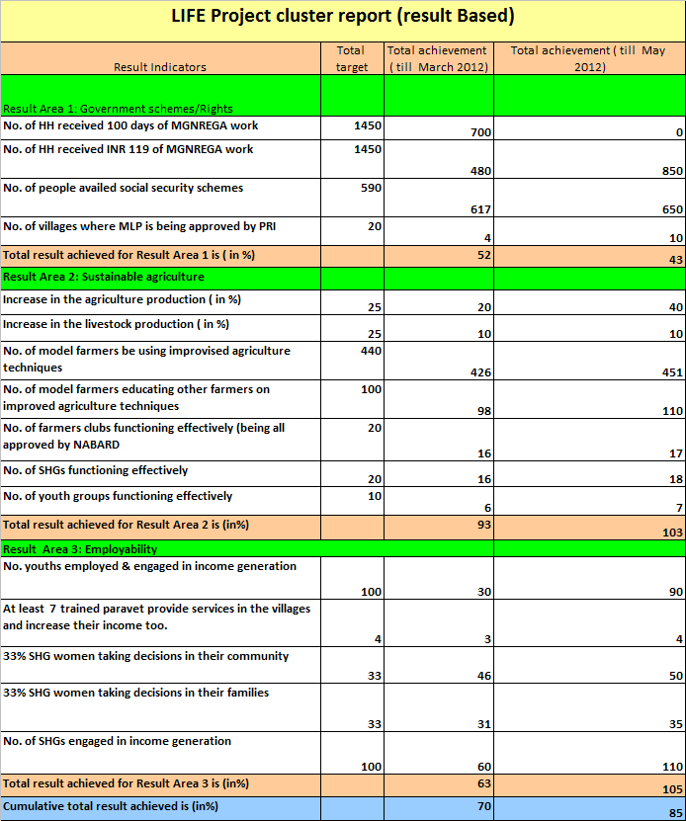
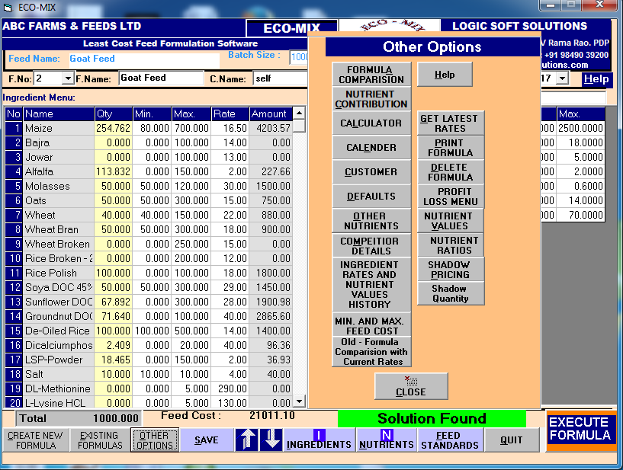
Other Options

Slide 28
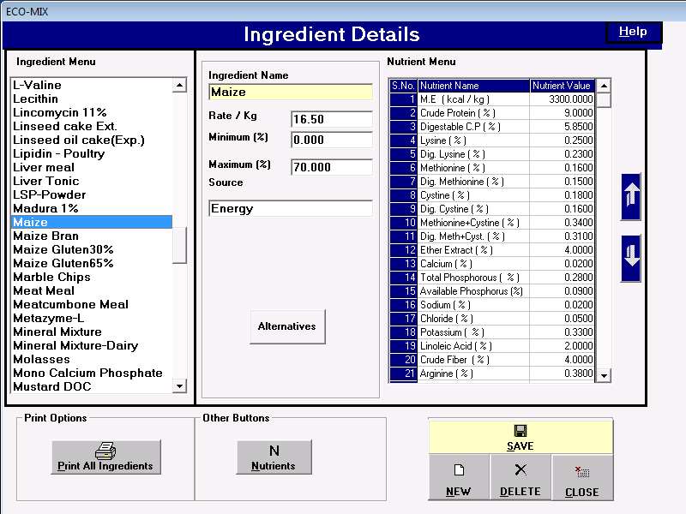
Maize Nutrient Values

Slide 29
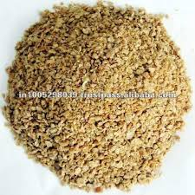
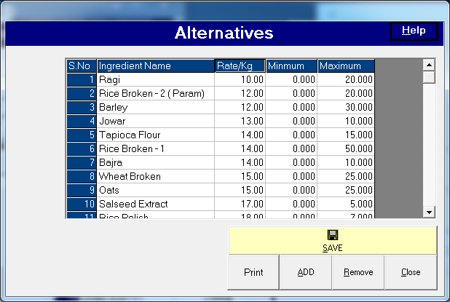
Alternatives for Maize

Slide 30
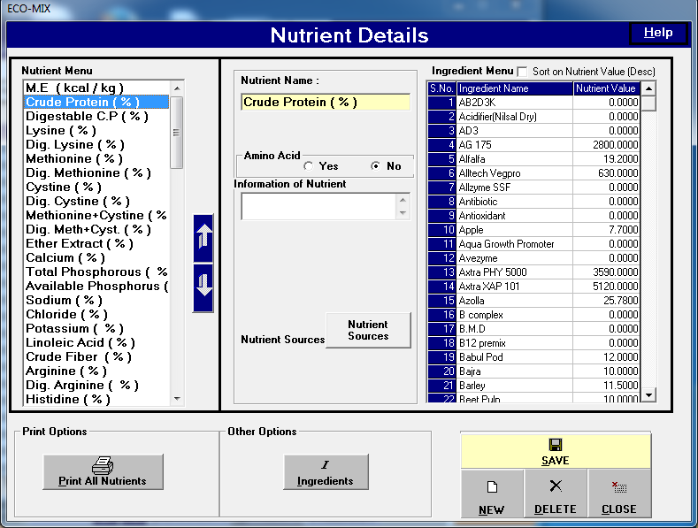
Protein Values in all Ingredients

Slide 31
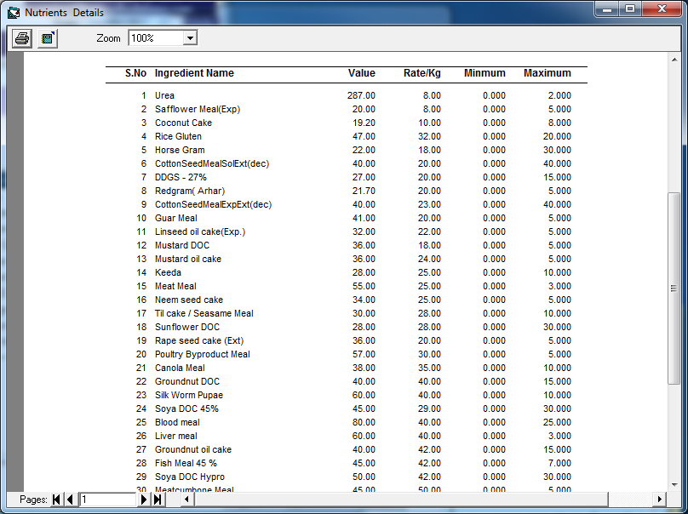
Protein sources of Ingredients

Slide 32
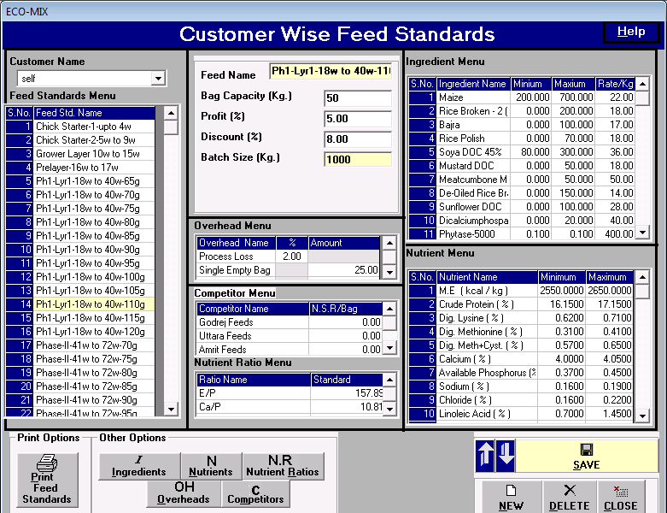
Feed Standards for all the Feeds

Slide 33
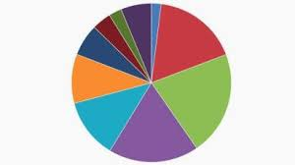
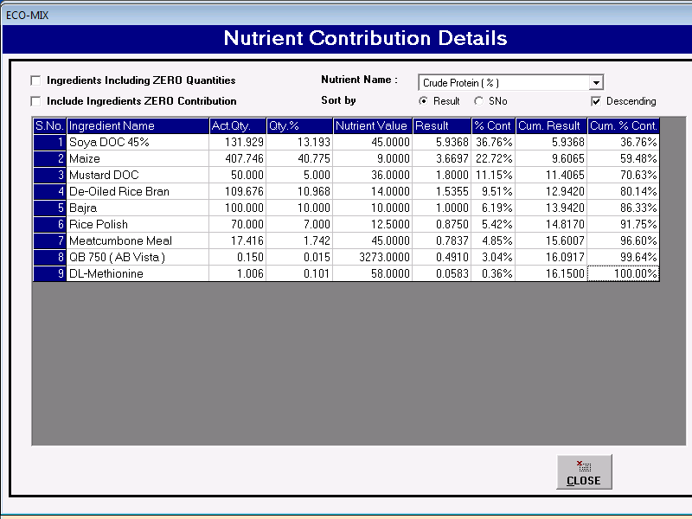
Protein Contribution details in the Layer Feed Formula

Slide 34
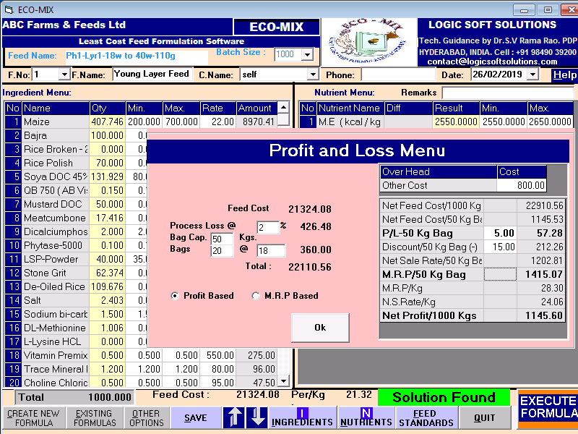
Profit and Loss bag / ton

Slide 35
Competitor Feed Comparison / bag

Slide 36
www.ecomixonline.com

Slide 37
Thank you
Please contact
Mr. Y. SRINIVAS
+91 98490 39200

