Slide 1
Tips and Tricks for FLL Coaches - Robot
Aditya Jain and Rohan Suri:
Co-Presidents of LCSRC
(Ladue Community STEM and Robotics Club)

Slide 2
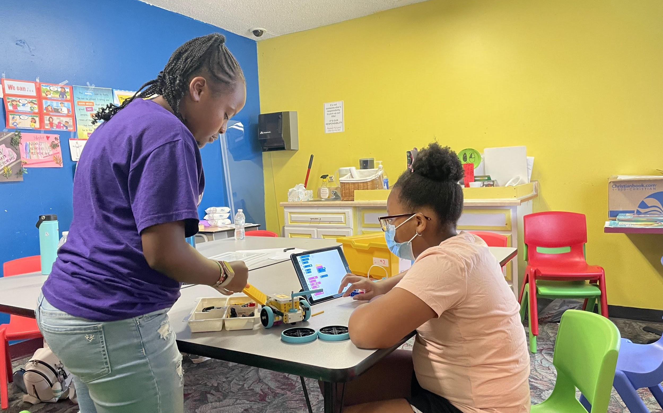
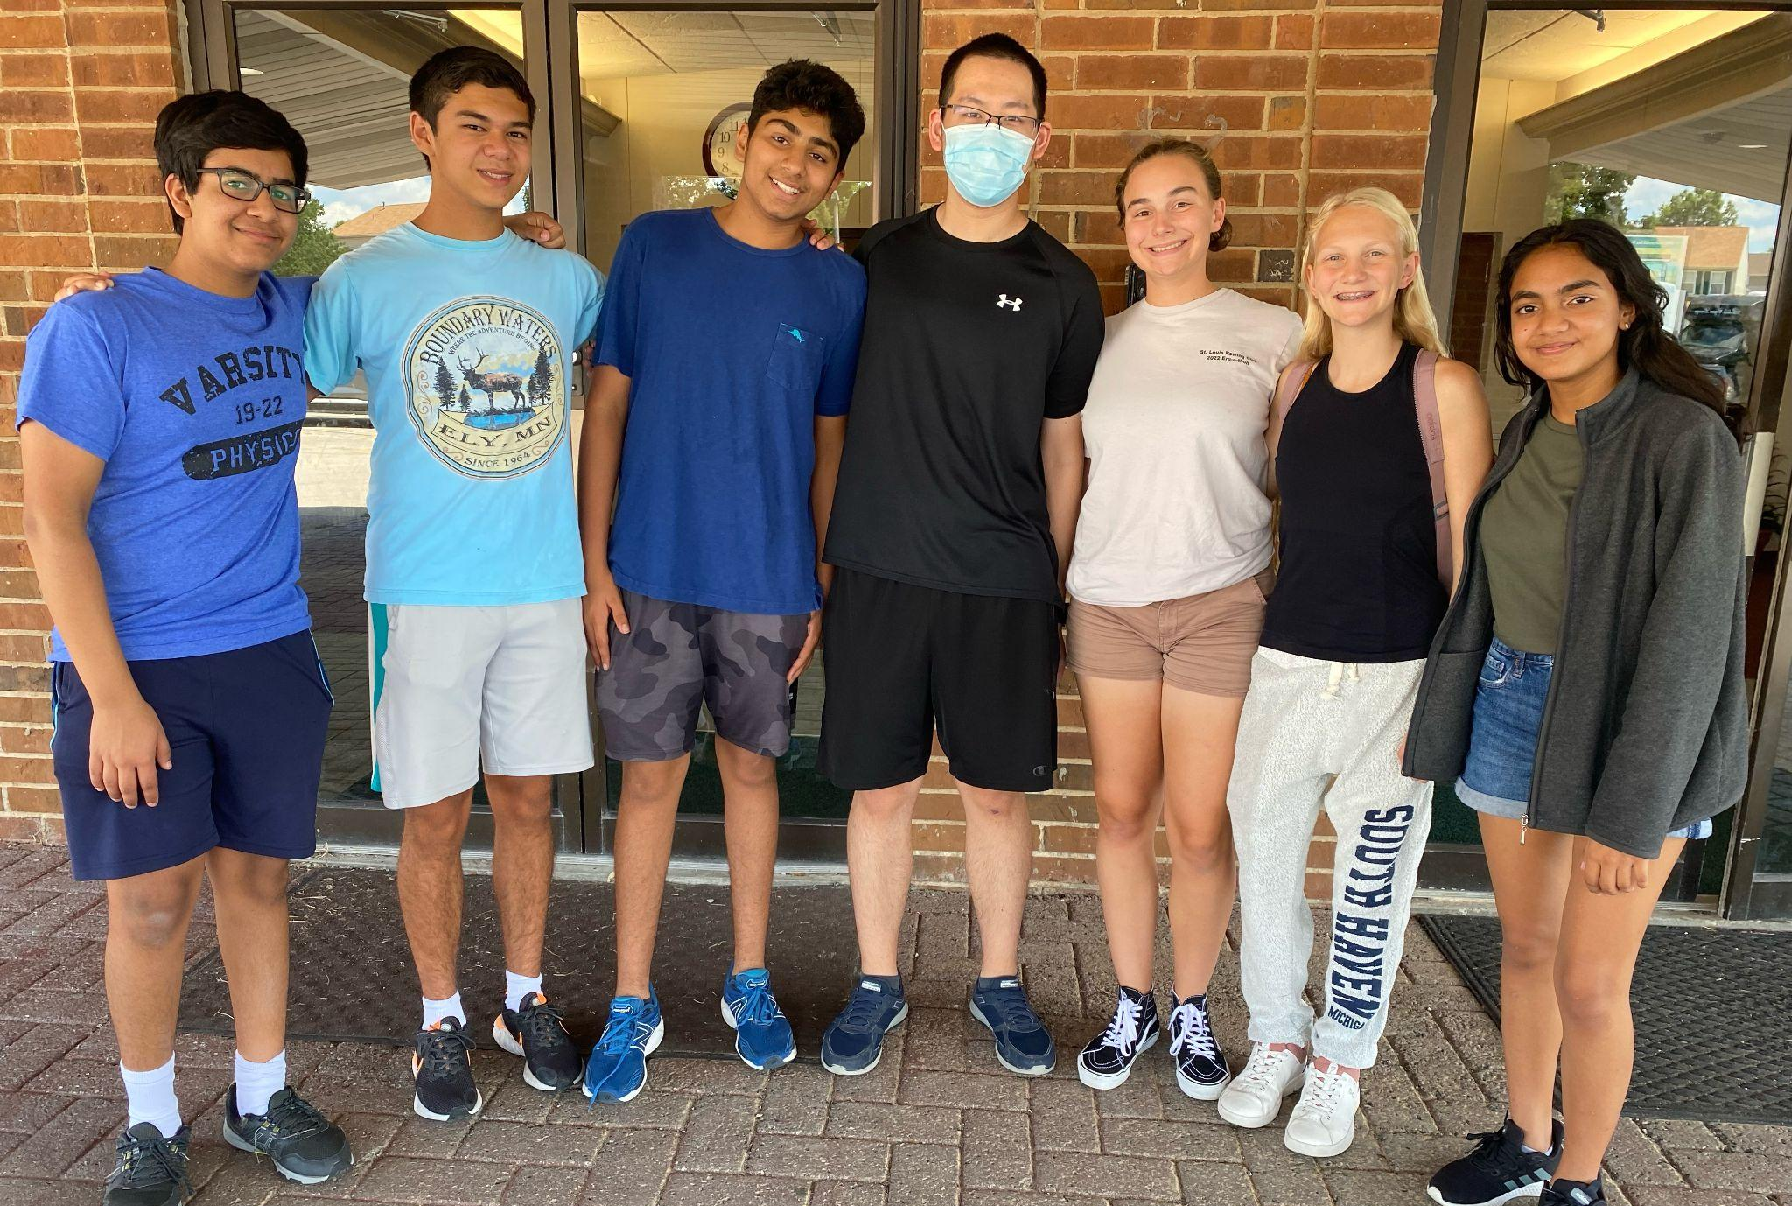
Who are we?
Involved with FIRST for 10+ years
JFLL to FLL to FRC
We run robotics events and programs throughout the year
Mentor and Coach several FLL Challenge Teams
Entirely run by students in high school

Slide 3
The SUPERPOWERED Board

Slide 4
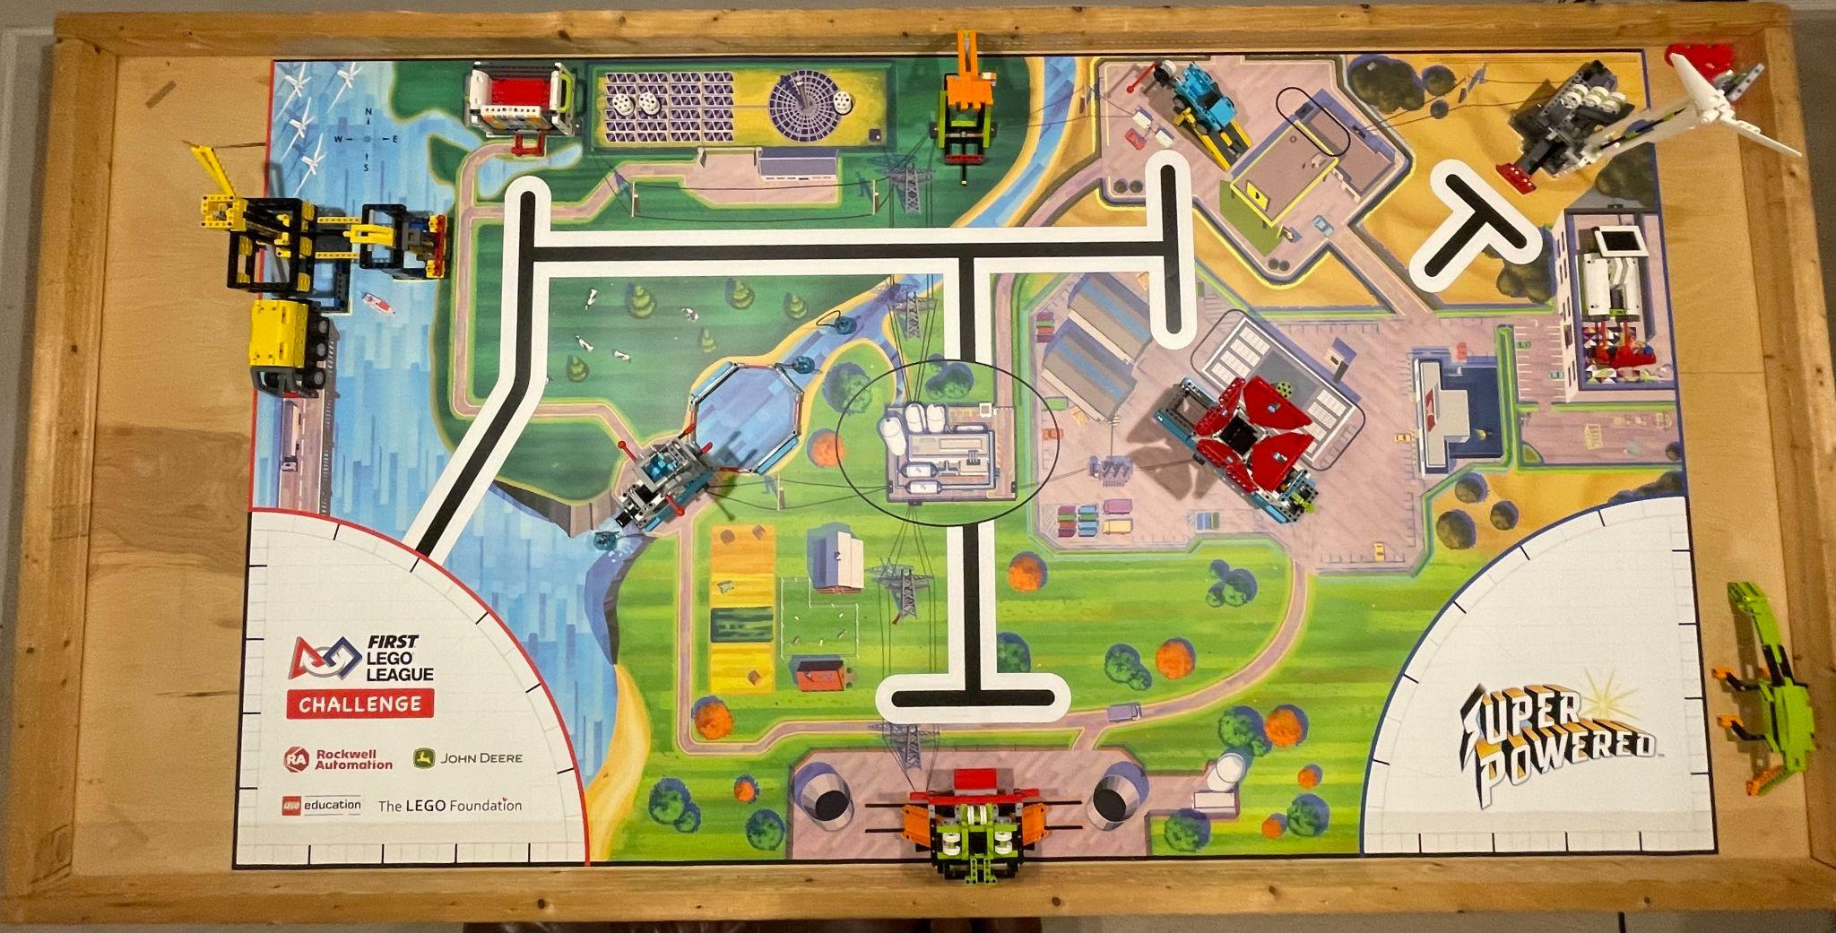

Slide 7
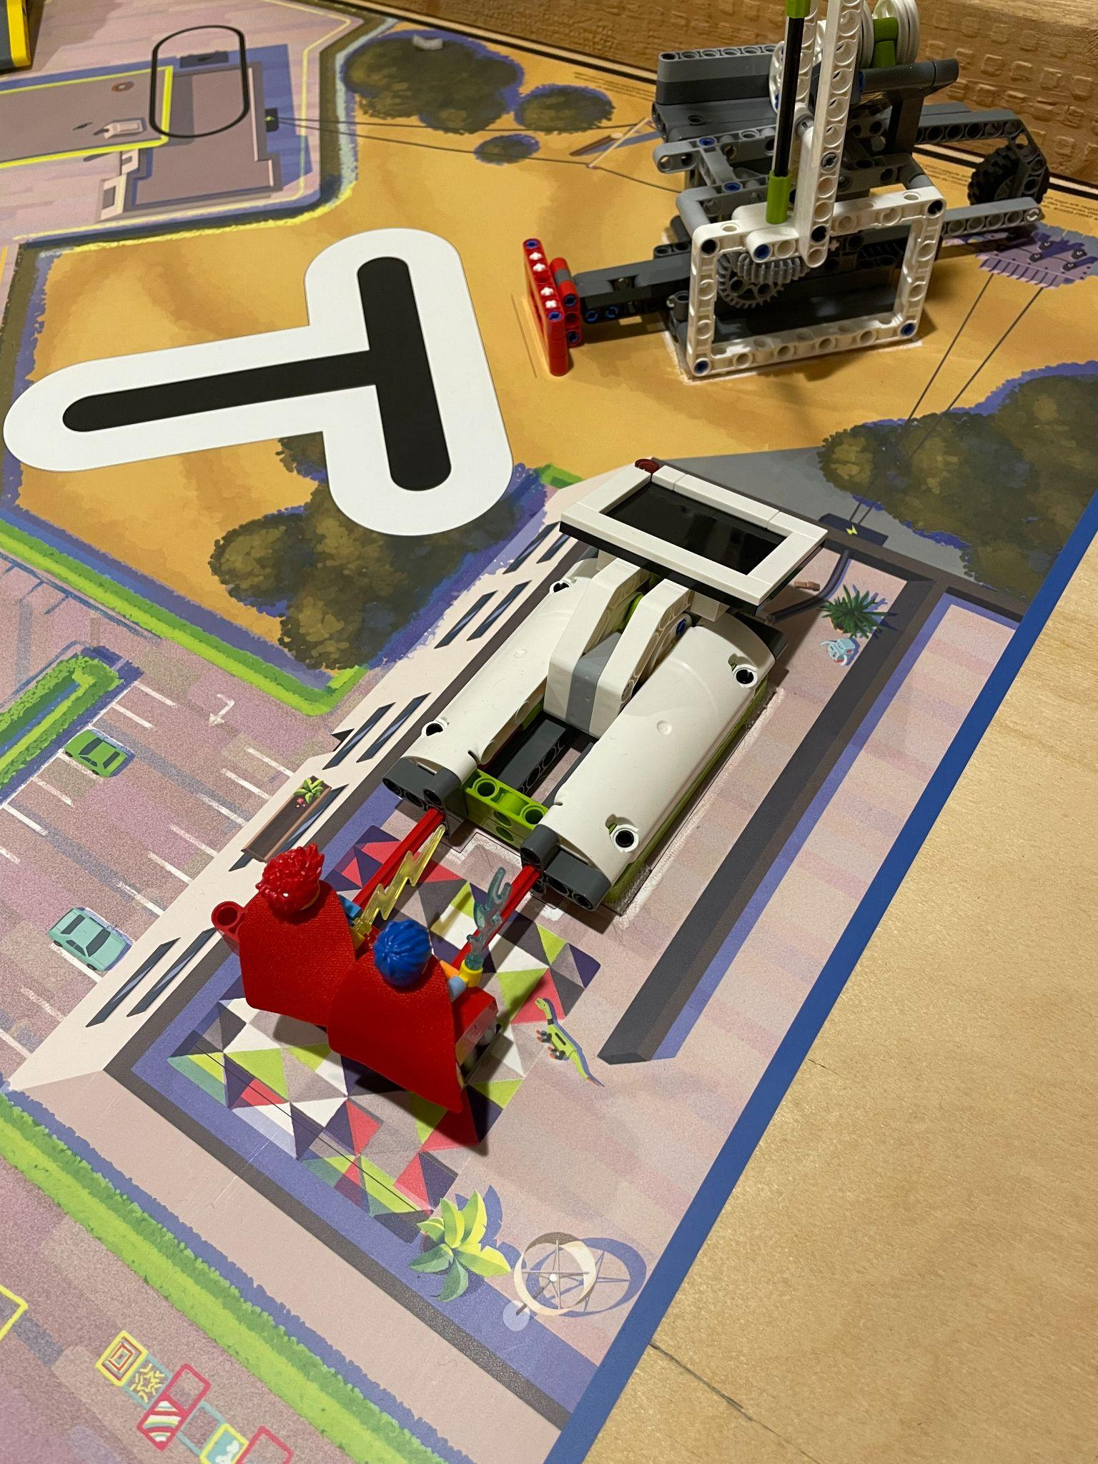
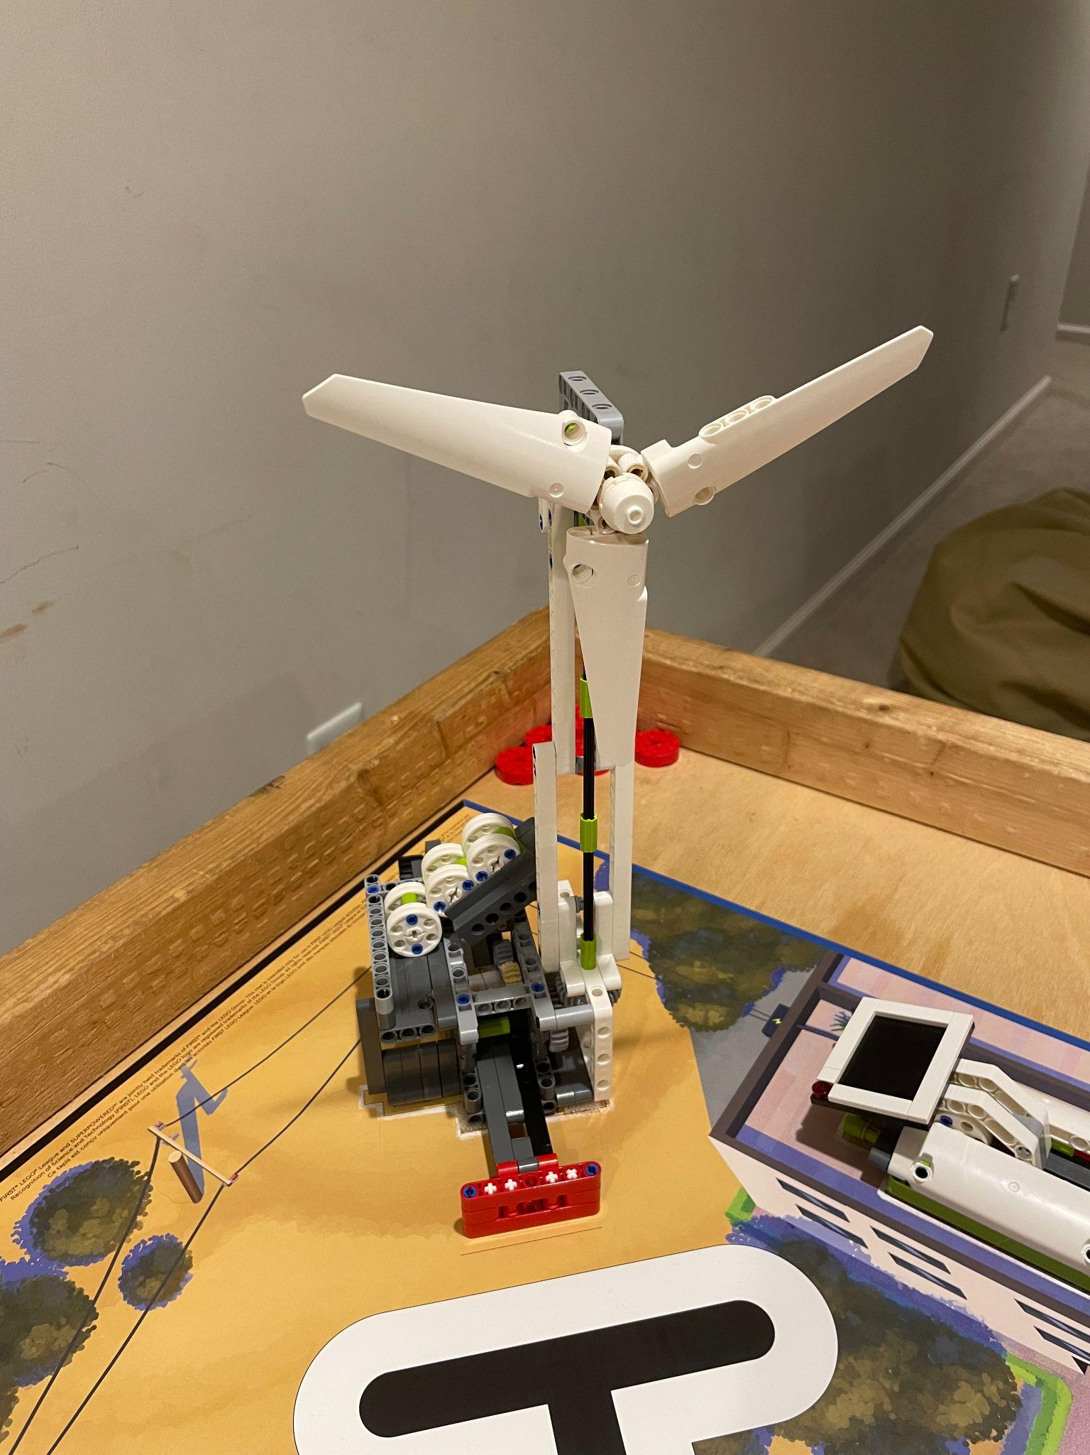
M08: Watch Television
10 + 10
M07: Wind Turbine
10 + 10 + 10

Slide 8
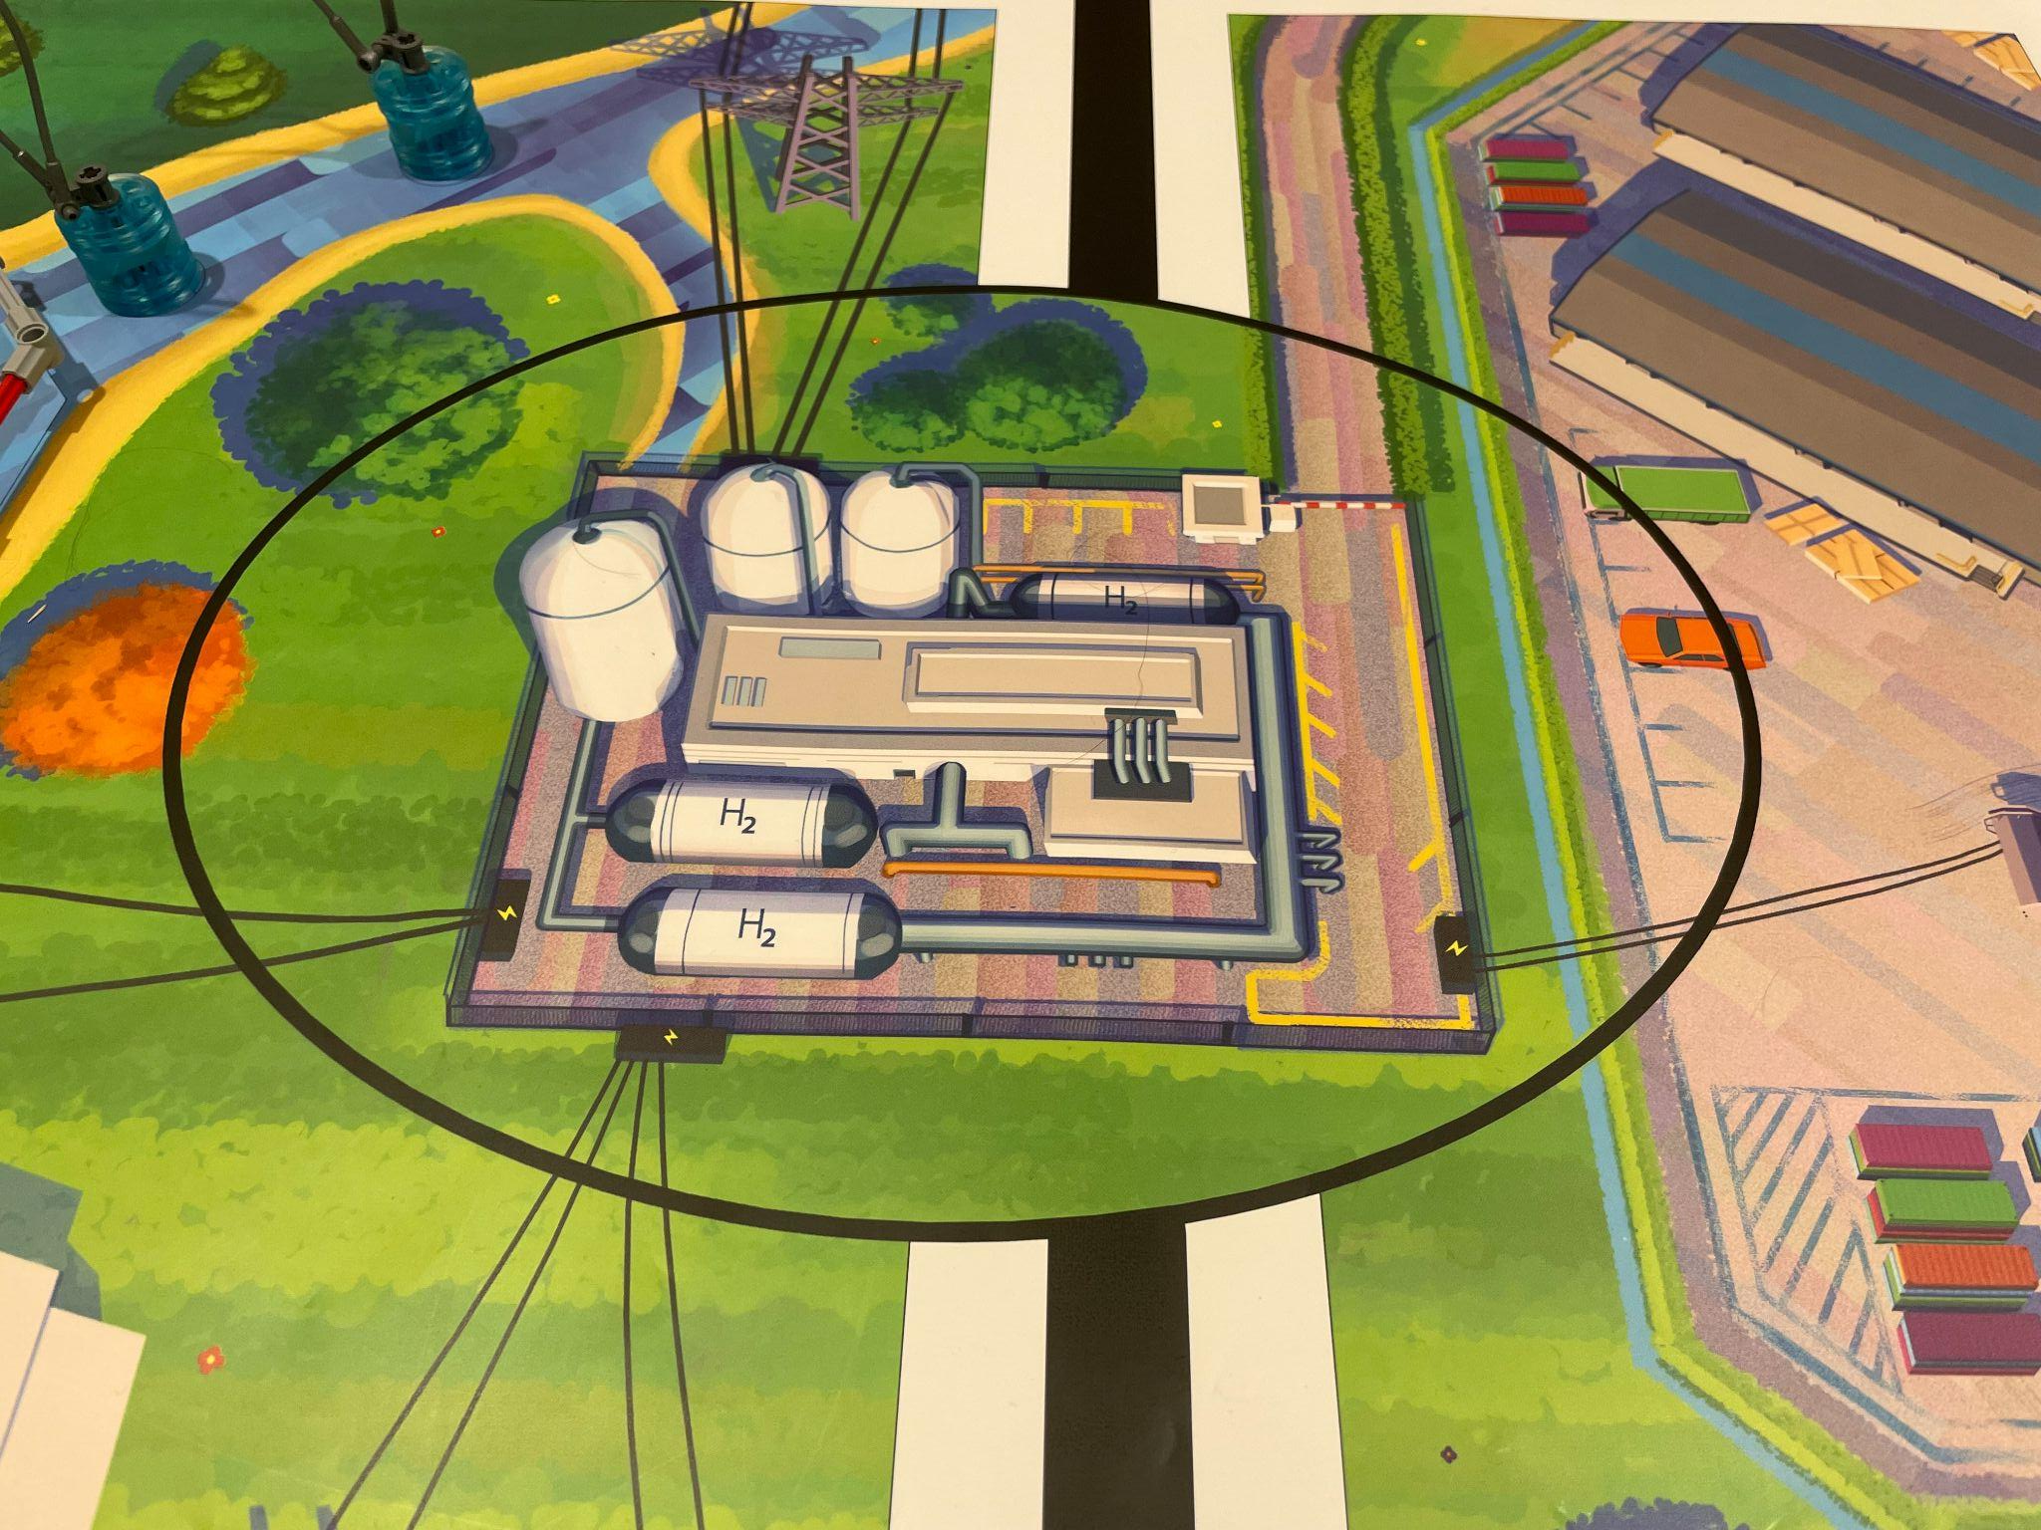
M01: Innovation Project Model
10

Slide 15
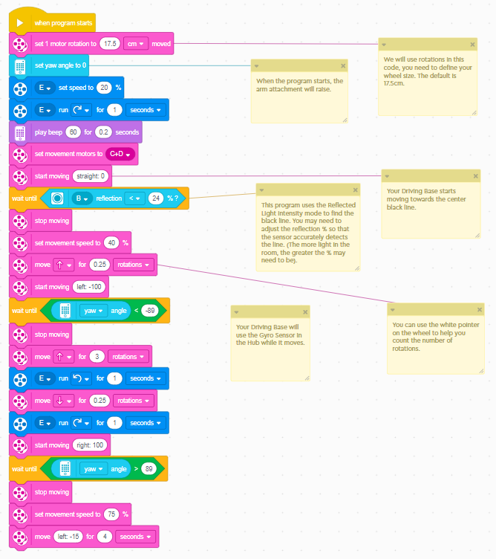
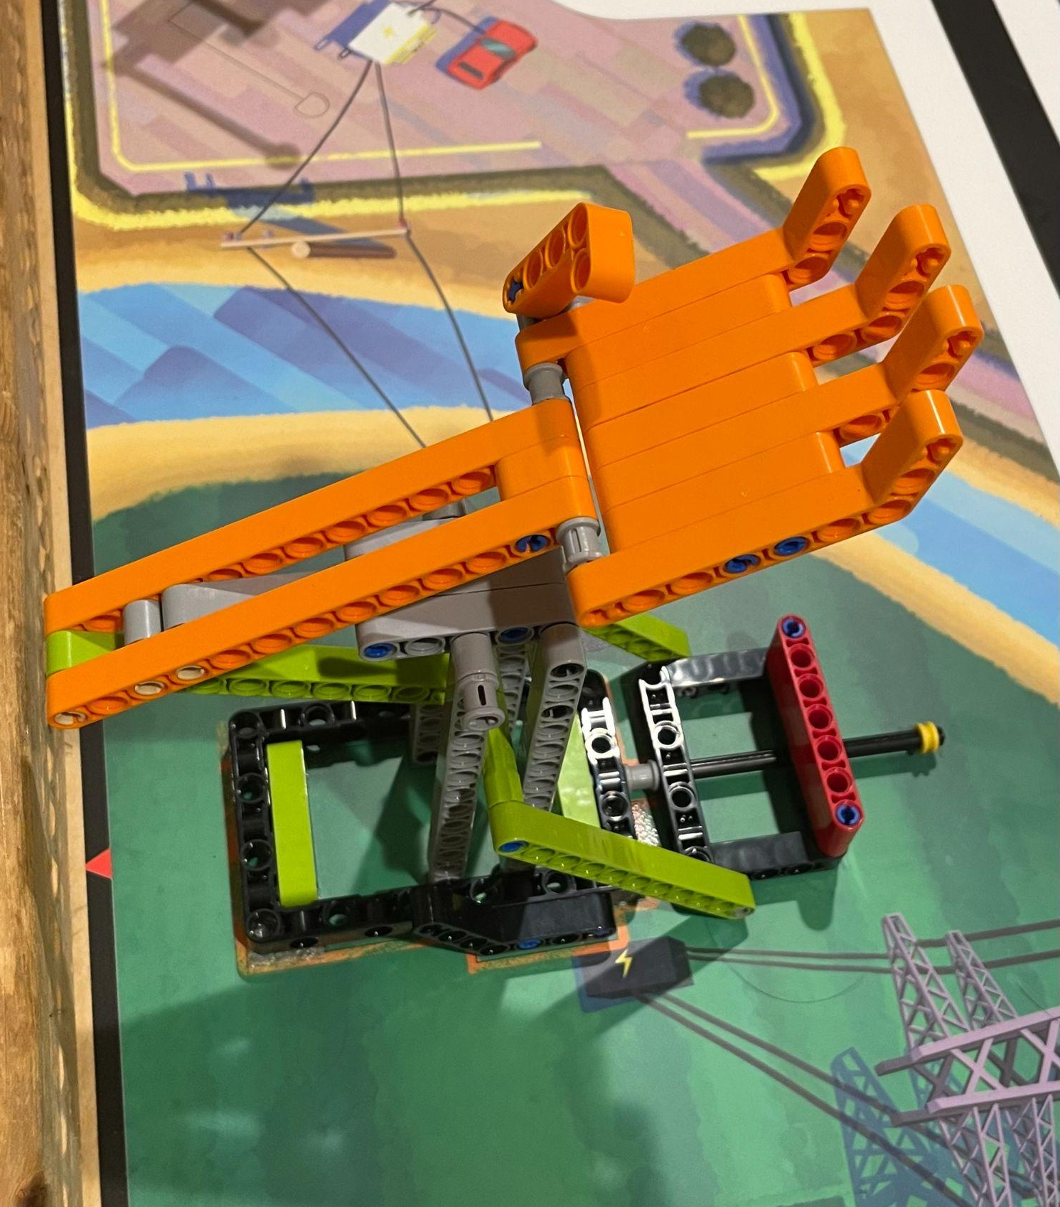
M08: Smart Grid
20 (+10)

Slide 16
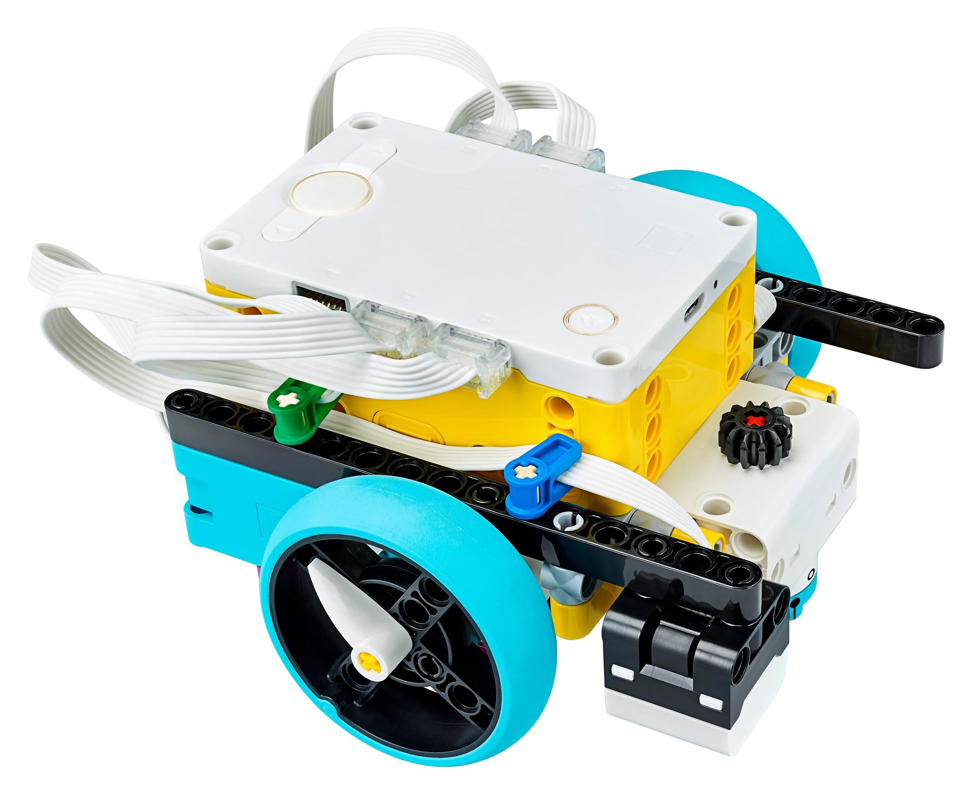
Lego SPIKE Prime
How’s does it compare to Mindstorms?
New Brick
Battery Life
Startup time
Consistency
Units on SPIKE Prime App
“Competition Ready” - great for new teams
Motors/Sensors
Embedded gyro sensor
Programming interface
Word blocks or python

Slide 17
Sensors
Types of Sensors
Ultrasonic Sensor
Track Distance
Color Sensor
1 vs 2 Color Sensors
Force Sensor
Tracks force instead of only touch
Embedded Gyro Sensor
Driving perfectly straight
Perfect turns

Slide 18
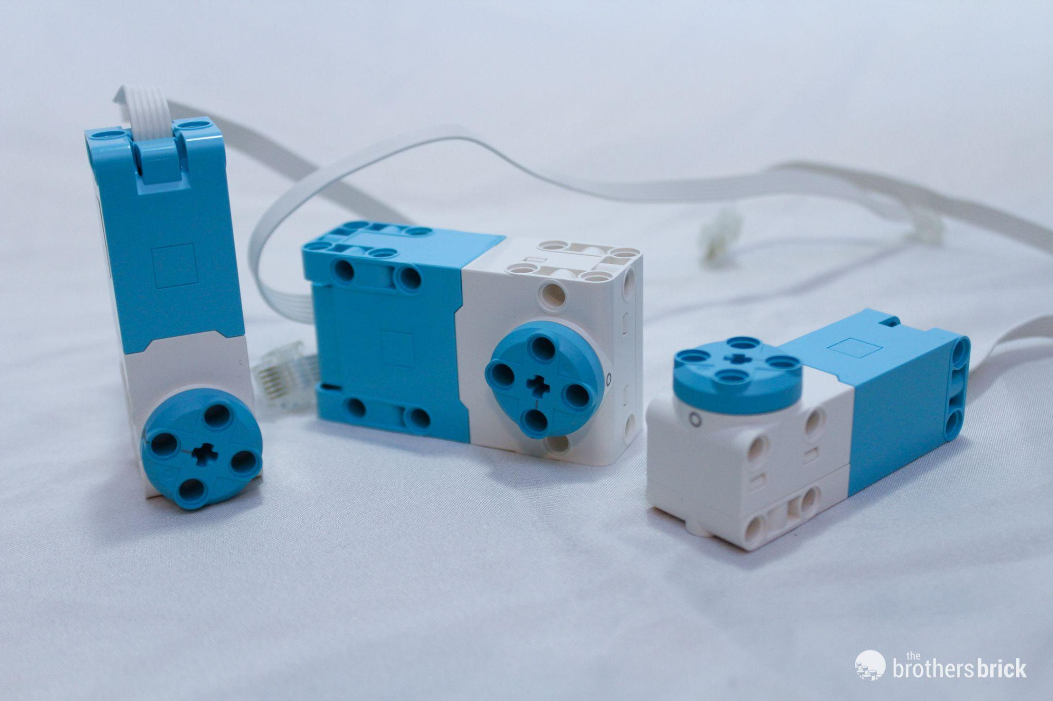
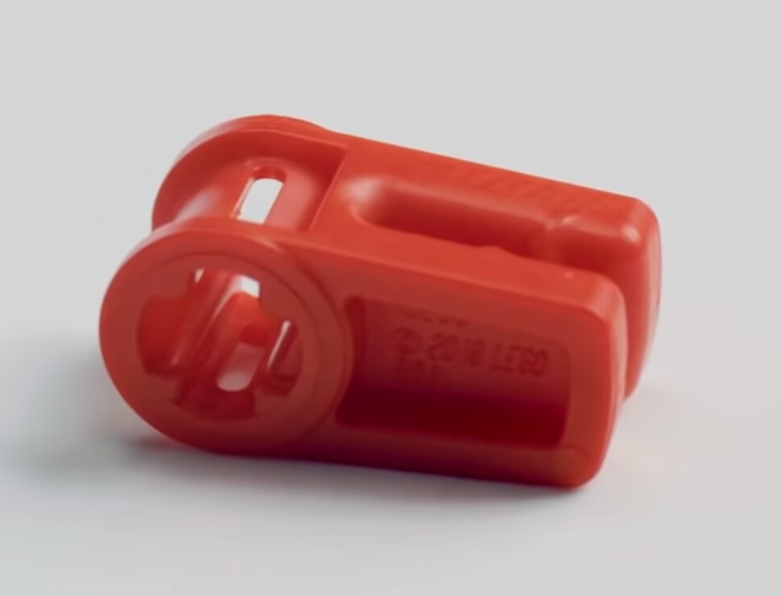
Motors/Wiring
Two Types of Motors:
Large Motors
Great for Attachments
New Shape
Medium Motors
Great for Driving Base
Wiring Changes
Wire Clips!

Slide 19
SPIKE Demonstration!
Notes:
Driving Base 1
How to operate spike, motors, sensors
Advanced Base robot design
Base attachment drop on design
Simple axle → motor attachment, how it can complete missions

Slide 20
Building Tips
Advanced Building Tips
Base Robot
Driving Base 1
Flat Edges
Driving Base
What type of motors?
Typical Types
Easy to attach attachments
Attaching straight to the motor
Drop On Attachments
Dog Gears

Slide 25
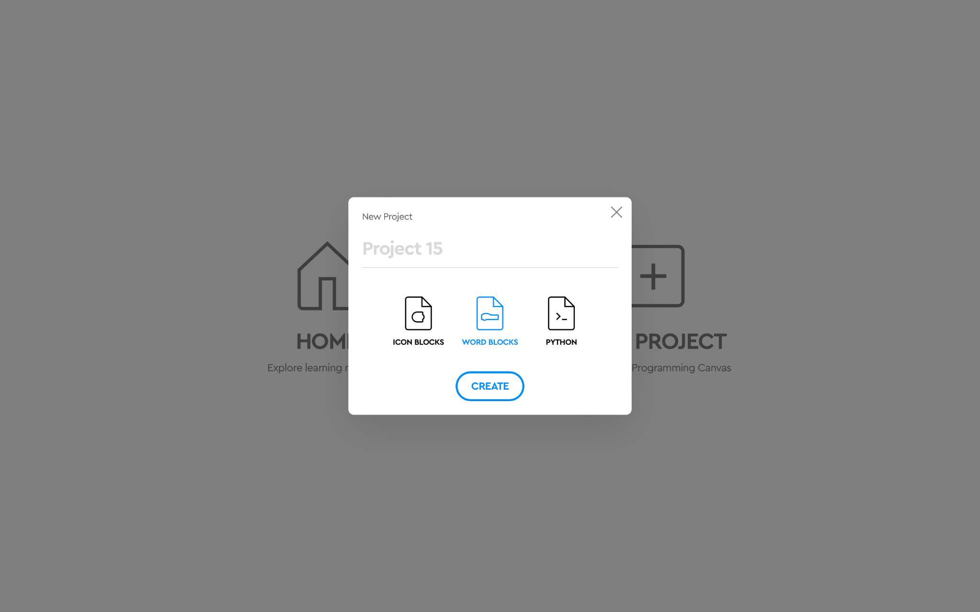

Slide 27
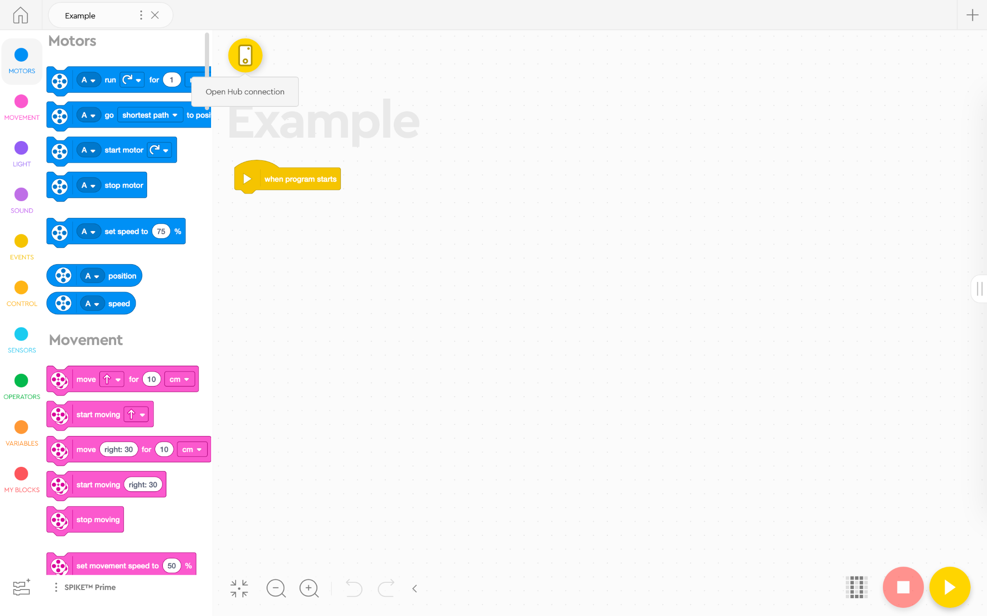

Slide 29
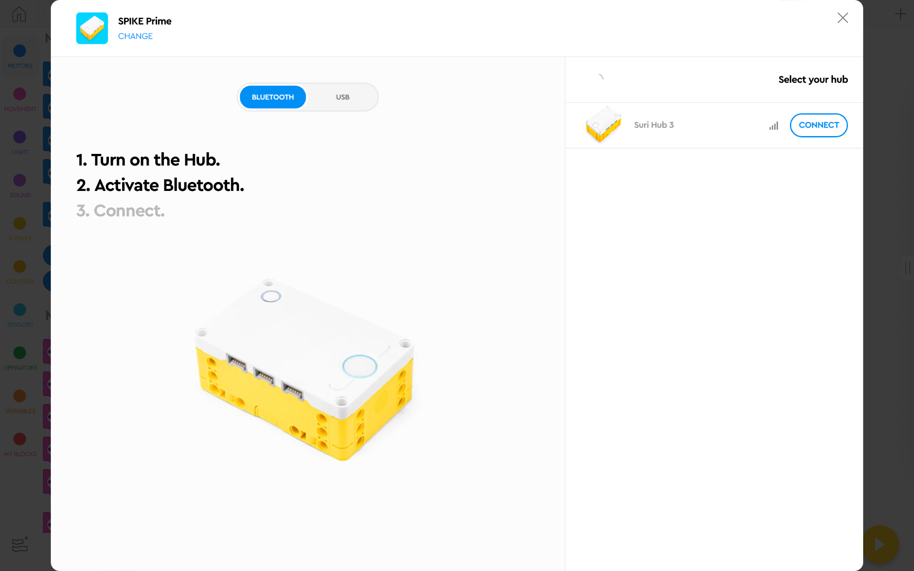

Slide 34
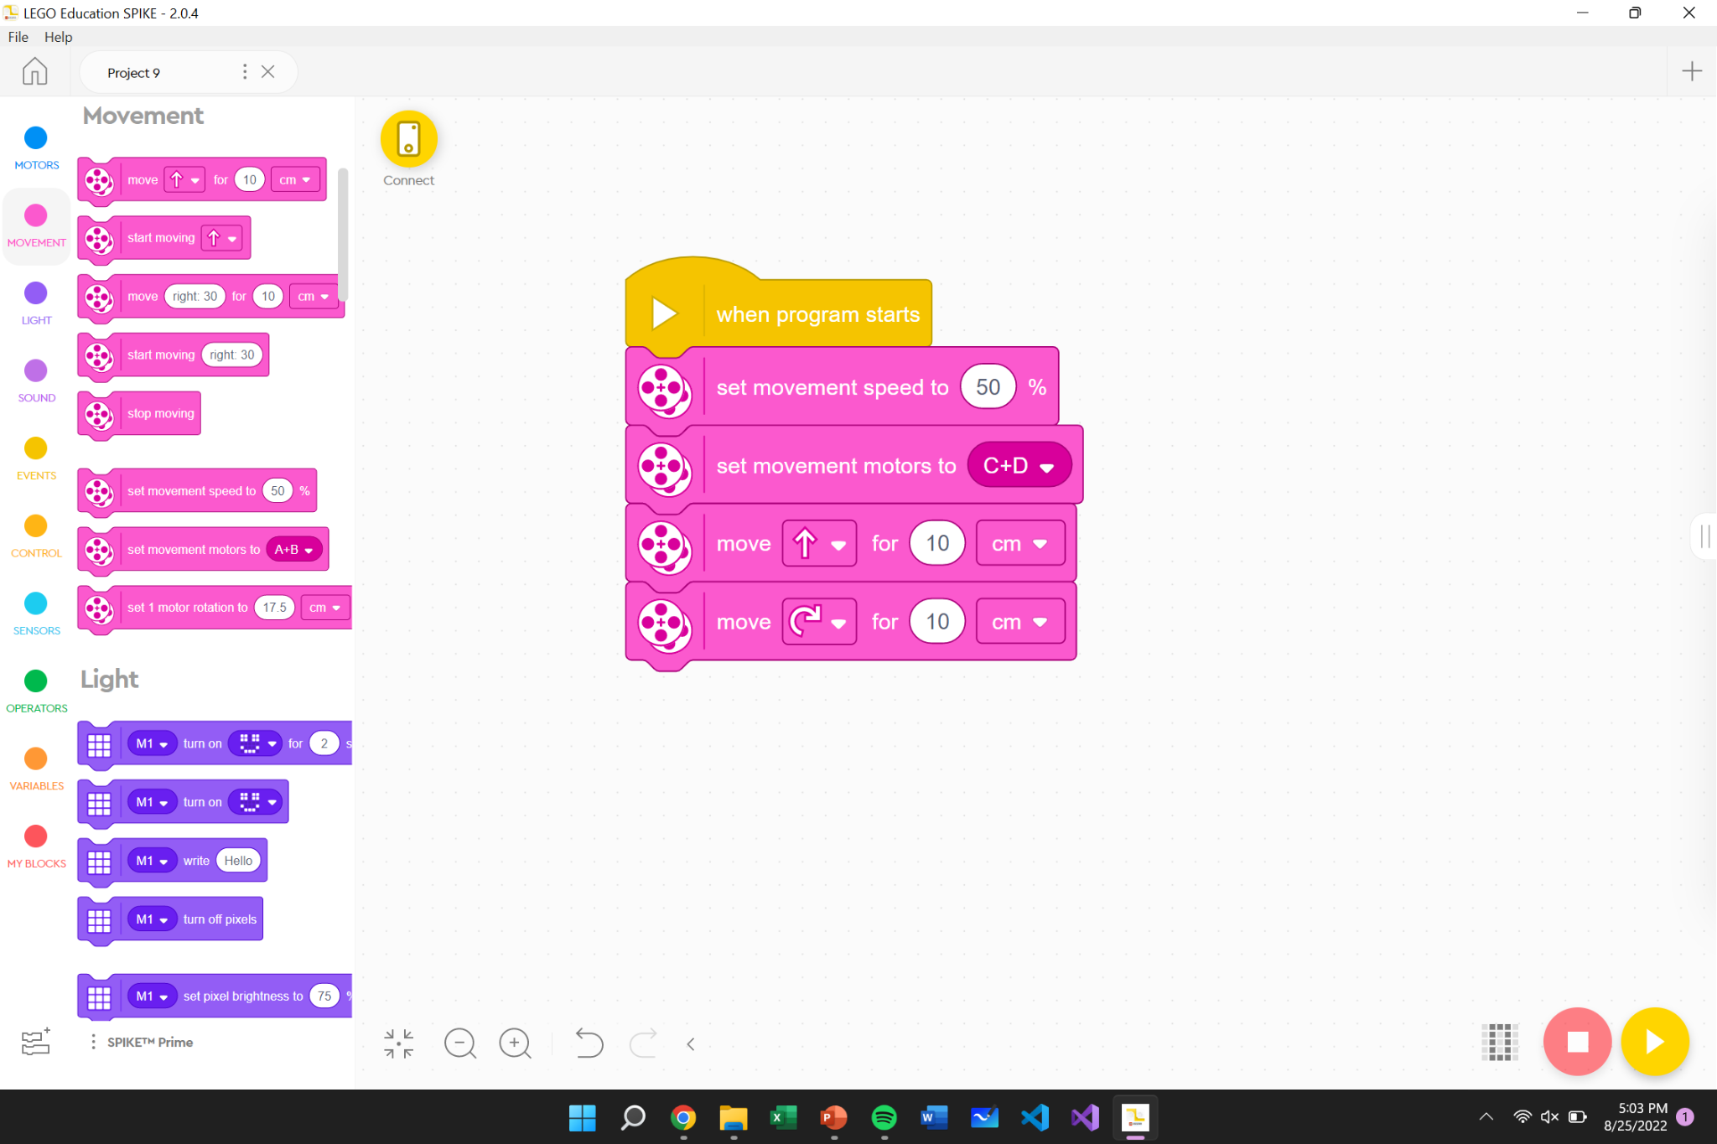
Basic Driving

Slide 35
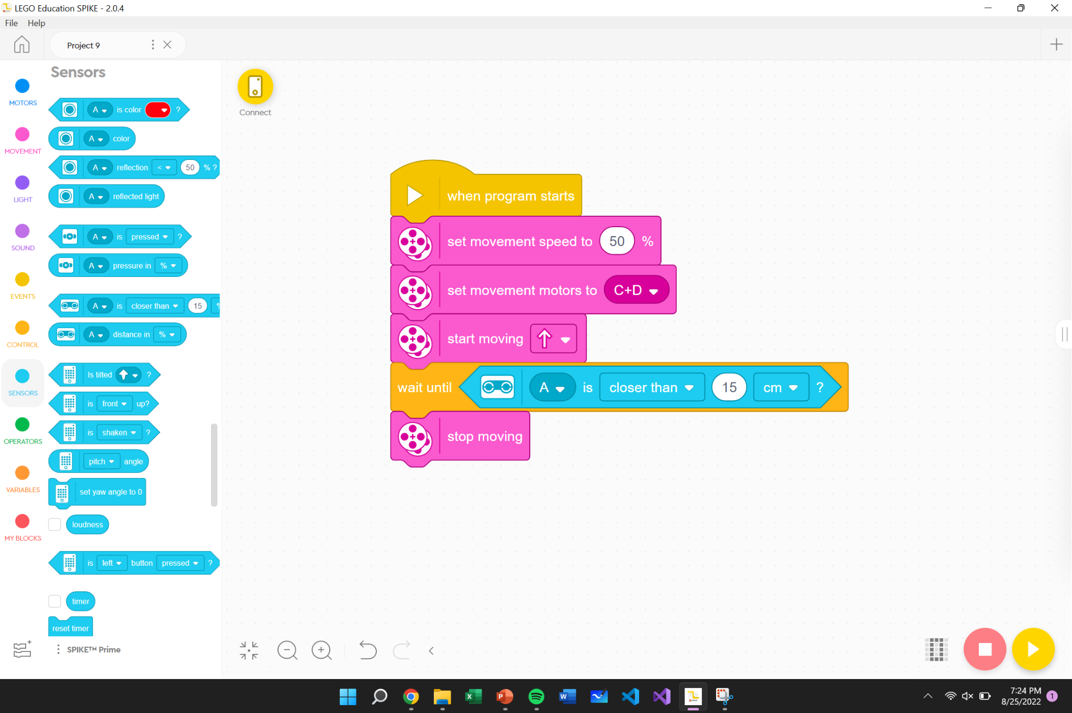
Distance Sensor: Stop

Slide 36
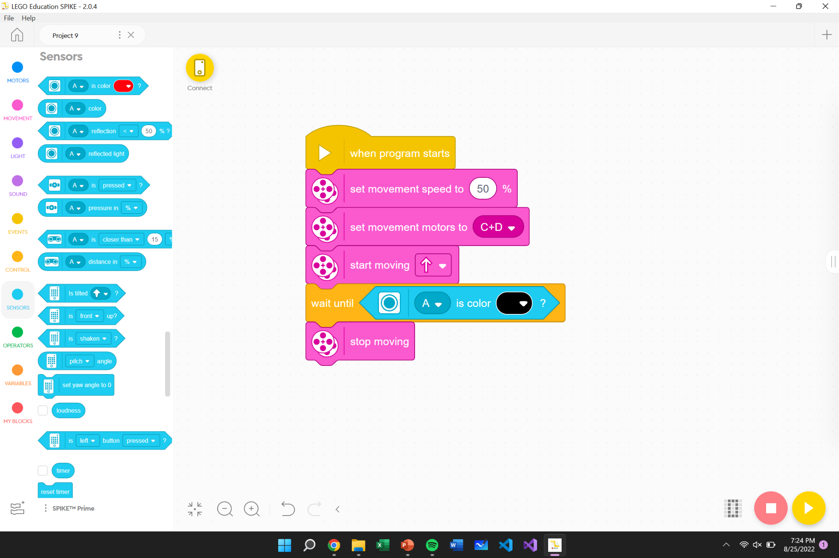
Color Sensor: Stop at Black Line

Slide 37
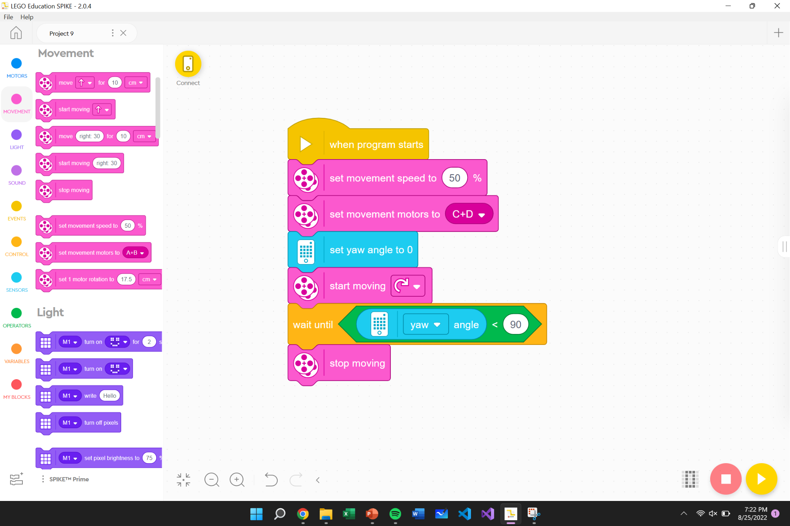
Embedded Gyro Sensor: Turn

Slide 38
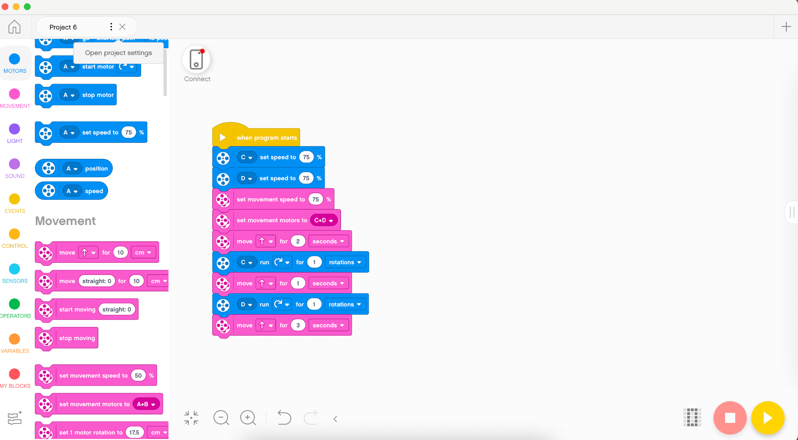
Coding Tips
Coding Tips
Don’t Overcomplicate!
Make sure the kids can explain each step of their code
Print out code
The judges love to see a printout of the code
Word Blocks vs Python
SPIKE offers both this year
Kids do the work!

Slide 39
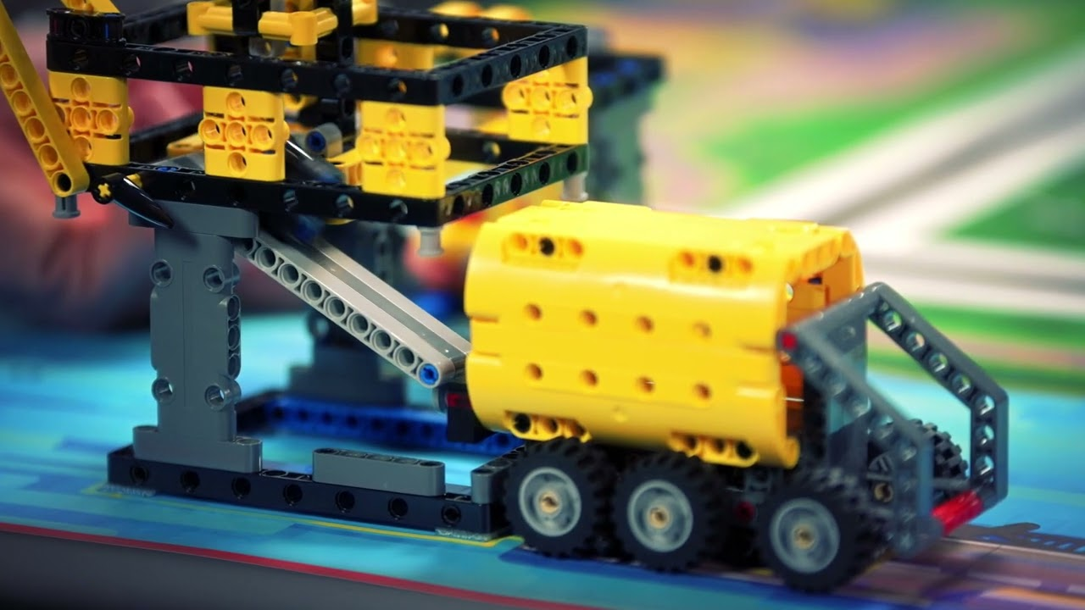
Competition Day!
What to do on Competition day
Have a clear plan of who is bringing what
Make sure to have a backup of the code
Have the kids hold EVERYTHING
If you can, bring spare parts
Things will go wrong, and that is ok!
It’s a stressful day, don’t forget to have fun!

Slide 40
Any questions?
Website: laduestem.org
Email: laduestem@gmail.com
Phone: (314) 325-4017
Twitter: @lcsrc3
Facebook: Ladue Community STEM and Robotics Club

