Slide 1
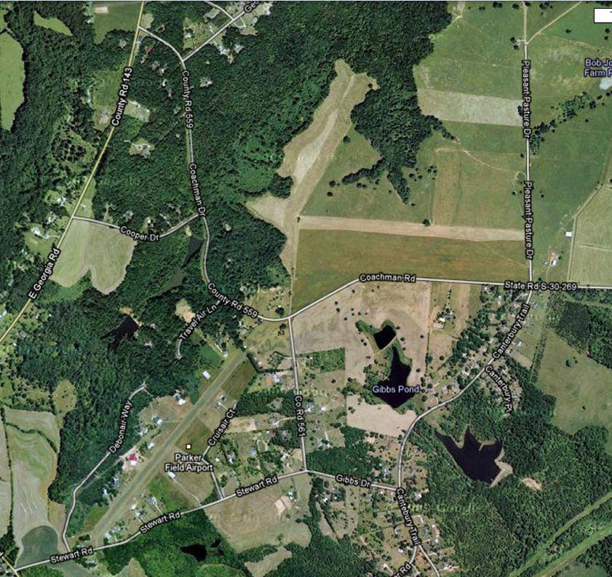
Groves Pond
Directions
East on Woodruff from 5 forks Right on E Georgia
Left on Coachman Right on Stewart Rd Left on Gibbs
Left on Cantebury Trail Right into Groves Pond
GPS Coordinates:
34°45'44.1"N 82°09'02.9"W
Notes:
Good morning everyone. The location for the swim tests are Grove's Pond. Grove's Pond is a wooded private property that has a ~5 acre pond. The owner of the land is a member of Advent UMC and very generously allows us to use the property for our scouting activities. The directions to the property are:
Head east on Woodruff Road from 5 Forks
Take a right on East Georgia Road
Take a left on Coachman
Take a right on Stewart Rd
Take a left on Gibbs Road
Take a left on Canterbury Trail
The entrance to Groves Pond is very unassuming. It is a gravel road with a cattle gate. The gate will be open. I will have a small sign at the entrance to let you know you've made it. Take the gravel road back to the campground parking area.
For those who like to use GPS coordinates (First Class requirement 4b) here are the longitude and latitude for the entrance to Grove's Pond:
34°45'44.1"N 82°09'02.9"W

Slide 2
