Slide 1

You may not think you have much of an influence on the future yet you do. Every action you take creates the future that will be. You can create something of worth that will stand the test of time.

Slide 2
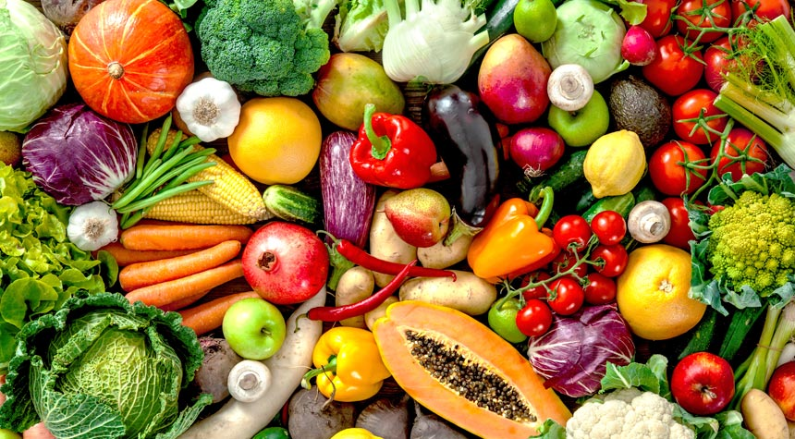

Food Rx
Nourishing People & Cultivating Community

Slide 3


In Partnership With

Slide 4
Food Rx Program
A produce prescription to individuals, and families who struggle to get enough fruits and vegetables weekly.
Goals:
Increase consumption of fruits and vegetables
Increase familiarity and comfort in using fruits and vegetables in cooking
Contribute to positive health outcomes for the whole family.

Slide 5
The Prescription:
Participants receive a pre-made produce box every other week, all year long. During the farmers market season, participants may shop for their own choice of produce at their local market or continue to receive a premade share.
Produce shares also include recipes and storage tips to help participants utilize fresh, local ingredients. Gardening programs are also offered throughout the year.
Produce shares are delivered by Logan Health, and Land to Hand staff to convenient locations throughout the Flathead, and Lincoln Counties.

Slide 6
Who’s Your Farmer?
Land to Hand
By utilizing a local produce broker, we make sure that the food purchased for produce boxes is from local and regional farmers. This ensures patients the freshest, most nutrient fruits and vegetables available.
Additionally, we support local farmers and our local economy by keeping the funds for this program within the Flathead Valley.
Farmers Market Locations
Kalispell Market - Flathead Valley Community College Saturdays
Whitefish Market – Depot Park Tuesdays
Columbia Falls Community Market – The Coop - Thursday

Slide 7
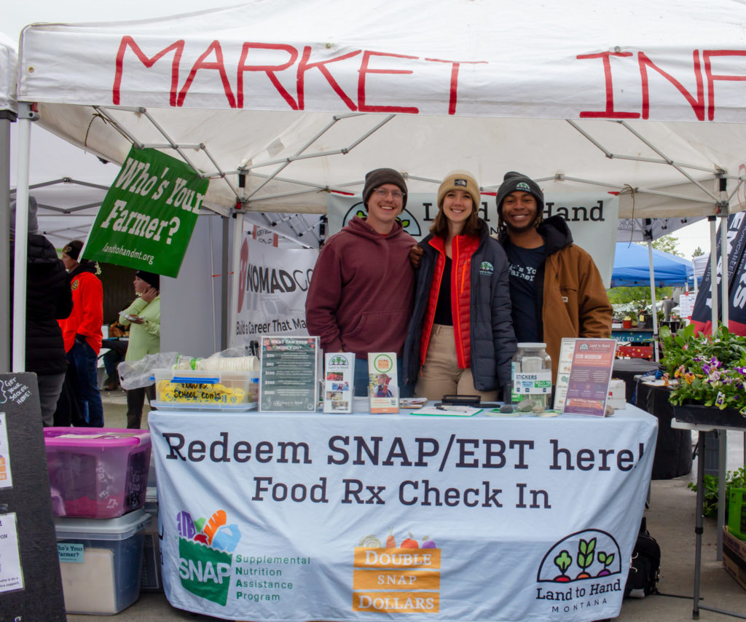
Impact
Double SNAP Impacts:
Farmers:
Nearly 50% of farms in Montana are small less than 180 acres. Double SNAP dollars help these farms reach more consumers. Directly benefiting Montana farmers.
Families:
In a survey of Double SNAP participants, 86% reported consuming a greater amount of fresh fruits and vegetables as a result of the program.
Improved Access to nutrition means:
Children are better learners
Seniors and people with disabilities have better health outcomes
Reduced healthcare spending in Montana
The Economy:
SNAP is an effective economic stimulus, with each dollar generating $1.50 to $1.80 in economic activity.
Throughout the state the Community Food and Agriculture Coalition has administered the Double Supplemental Nutrition Assistance Program Dollars program, allowing Montanans who receive SNAP benefits to double their benefit dollars at participating farmers markets, farm stands increasing their access to fresh local food.

Slide 8
Outcomes
Logan Health providers, we are able to track pertinent health metrics for participants in the program.
Within 2021 patient cohort at the Logan Health Diabetes Education and Prevention Center , 100%of the Food Rx participants dropped in their A1c.

Slide 9
Program Materials
User Friendly Registration. Coding to ensure patients privacy.

Slide 10
Education
Introduction to Culinary Skills
Recipes specific to food basket contents

Slide 11
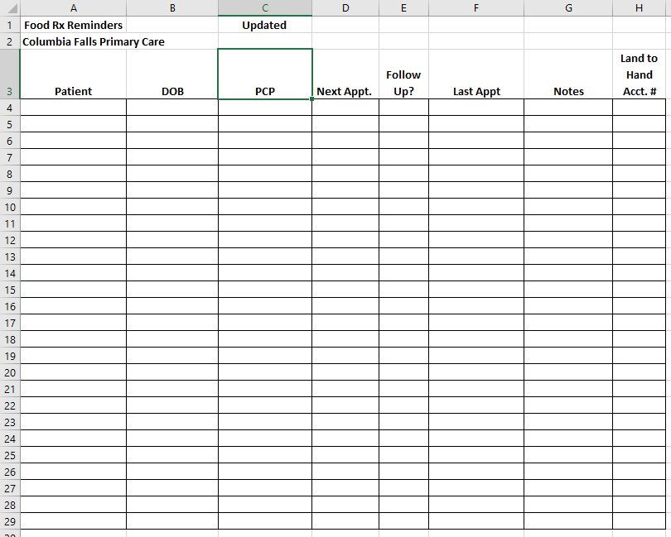
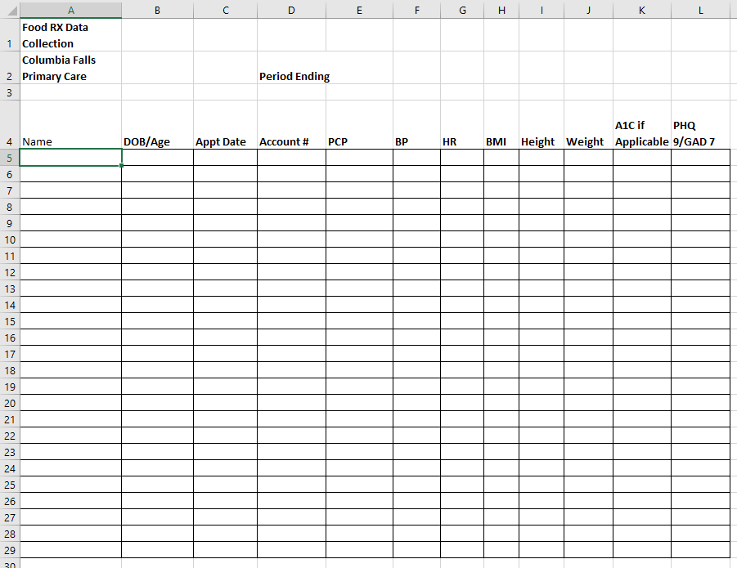
Patient
Data
Tracking
Health Metrics Tracking
Primary Care Physician Appointment Tracking

Slide 12
THANK YOU!
Mark Logsdon
Community Healthcare Worker
Logan Health
Whitefish
Email
mlogsdon@logan.org

Slide 13

Look at your life. What legacy are you leaving for your children? Seek to leave a legacy you would be proud of.

